Slide 1
Preservation Best Practices
Session 3:
Collections Care: handling, Access, Storage, and Exhibition
The California Preservation Program Presents
Laura Hortz Stanton
Thursday, December 12, 2013

Slide 2
Today
Handling
Access
Storage
Exhibition

Slide 3
Handling and Access

Slide 4
Poll
Notes:
Poll 1:
How confident are you that you are appropriately handling the items in your collections:
I’m an expert!
I’m pretty sure I’m doing an OK job.
I know I haven’t damaged anything….yet.
I have no idea what I’m doing.

Slide 5
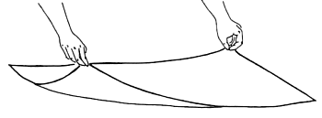
Handling and Access: Getting Started
  There are written handling guidelines for both staff and researchers

Slide 6
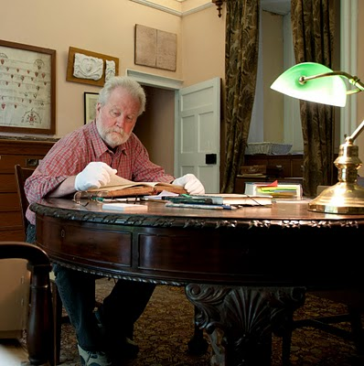
Handling Procedures
Staff
  Handling
  Moving
  Carts
  Transportation
Researchers
  pencils
  limit # items
  gloves with photographs
  lockers
  monitor
sherwords.blogspot.com

Slide 7
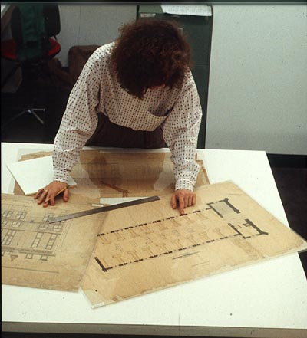
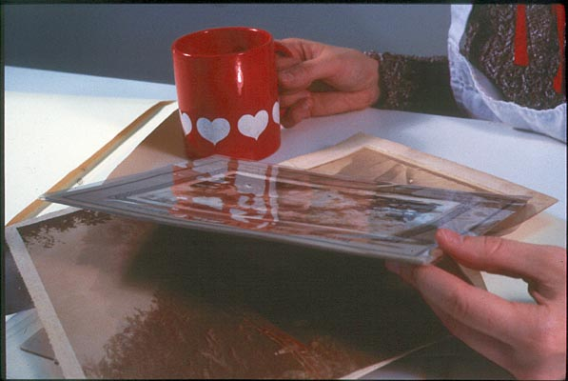
Mishandling

Slide 8
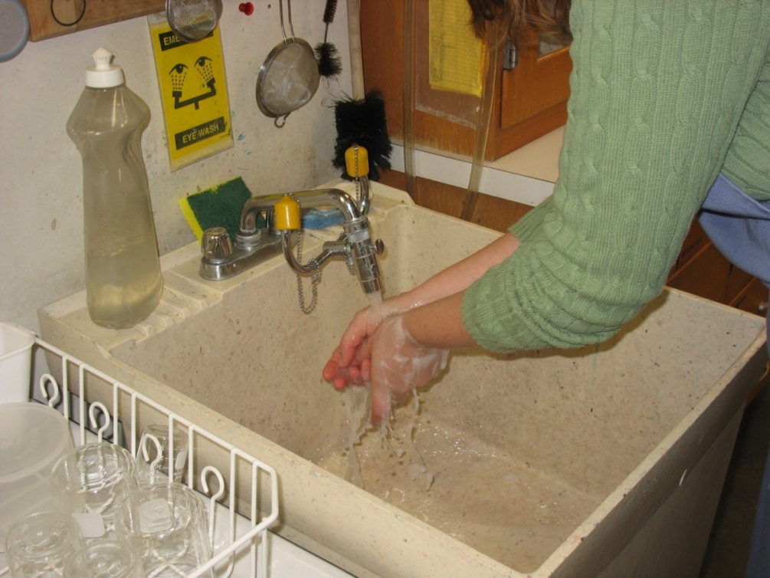
Handling and Access: Getting Started
Preparation for Handling Objects
Wash hands and dry thoroughly
Remove jewelry (bracelets, rings, large belt buckles, etc.) and name badges.
Remove items from top pockets

Slide 9
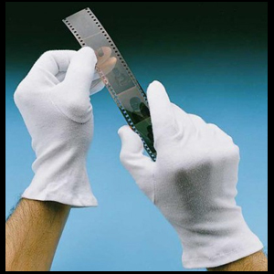
Handling and Access: Getting Started
  Gloves are available for use as necessary
http://www.sharifphotographic.co.uk
Notes:
Cotton gloves should only be used for handling photographs, gilded frames, metal objects, or moisture sensitive organic objects such as bone or ivory.

Slide 10
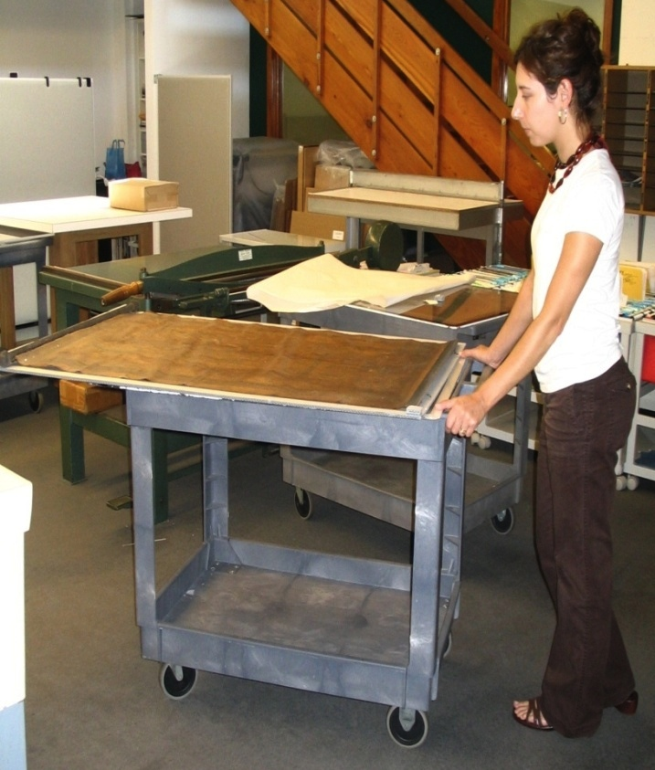
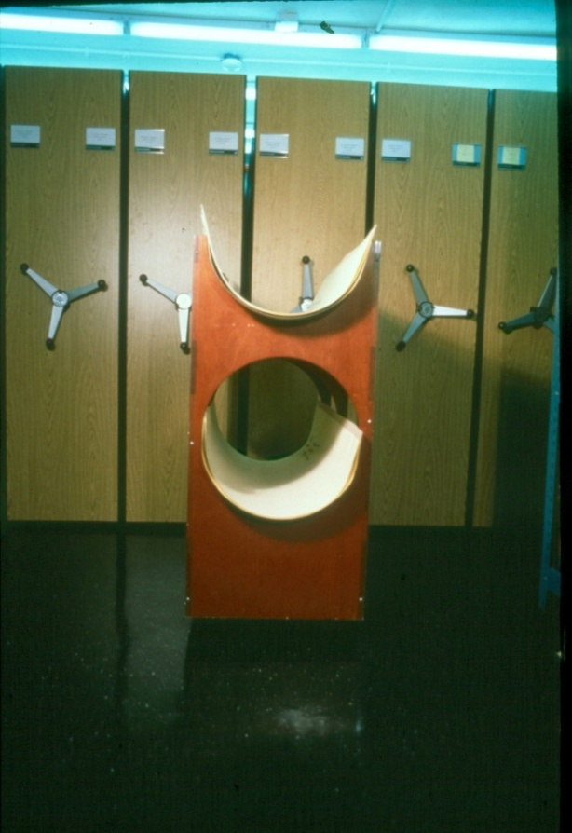
Handling and Access: Getting Started
  Carts are available to move collections throughout the building
Courtesy Athenaeum of Philadelphia

Slide 11
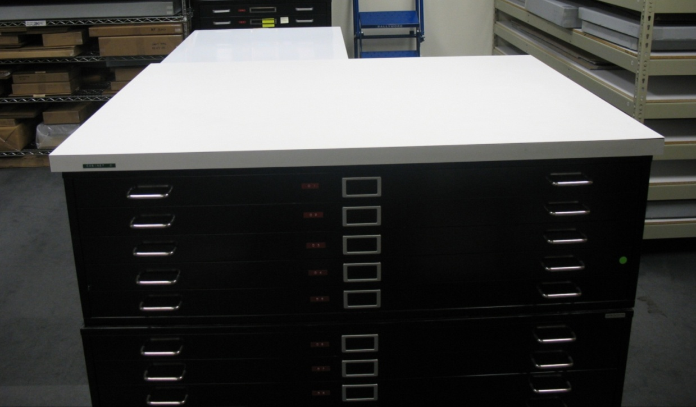
Handling and Access: Getting Started
  Landing spaces are available in collections storage spaces to aid in retrieval and return to storage

Slide 12
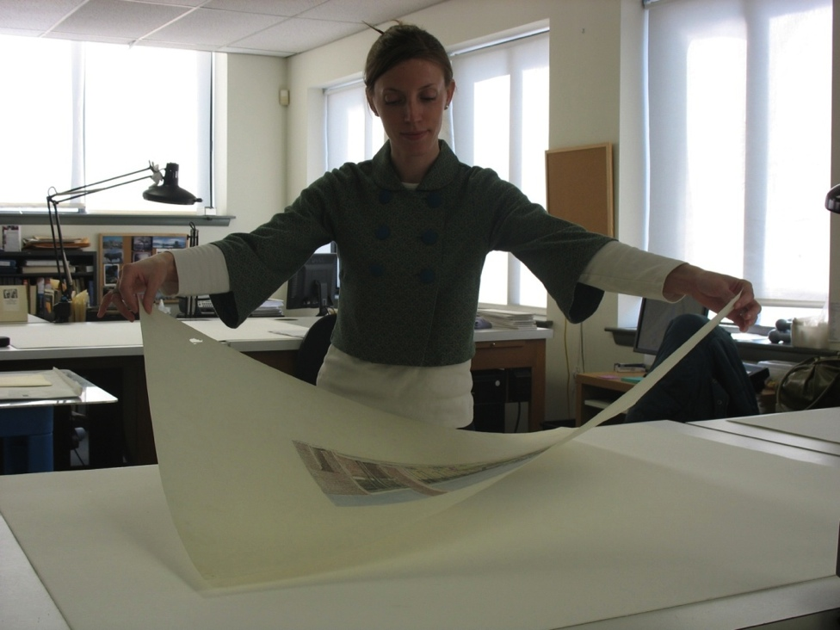
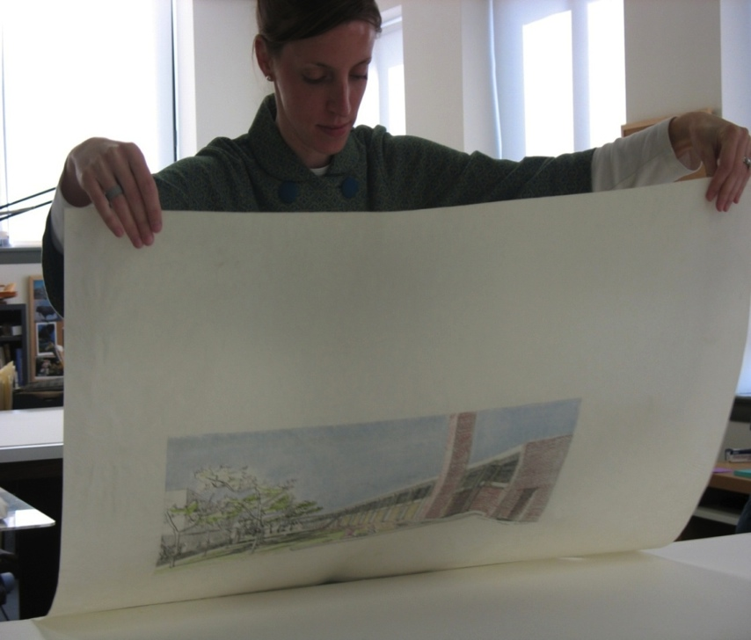
Handling and Access: Getting Started
  Staff members are trained in appropriate handling techniques
Notes:
For moving an object from one clean landing space to the next, lift the object at opposite corners using a light grasp between two fingers and a slight bow at the center.
When flipping an object, grasp at adjacent corners, lift off and clear the table to turn over while avoiding slack. Alternatively, use two boards to flip an object.

Slide 13
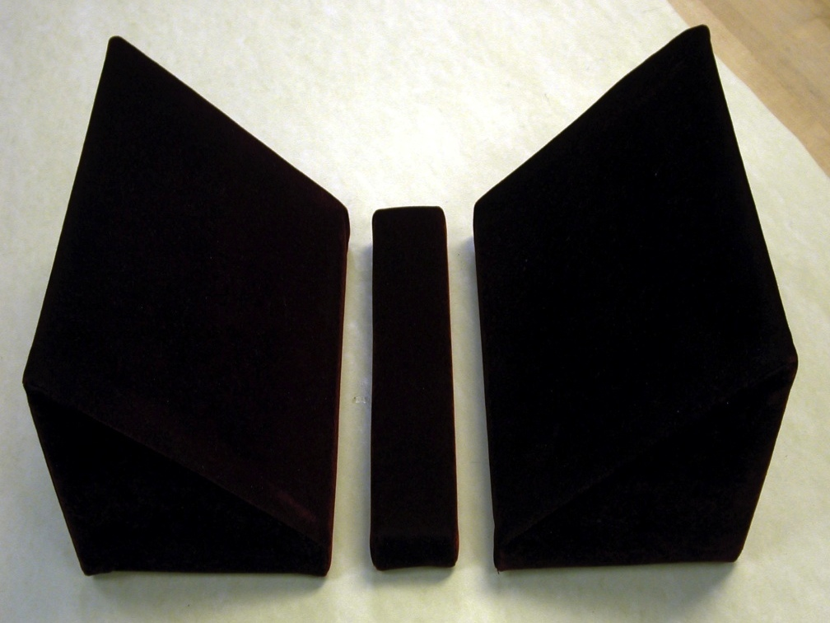
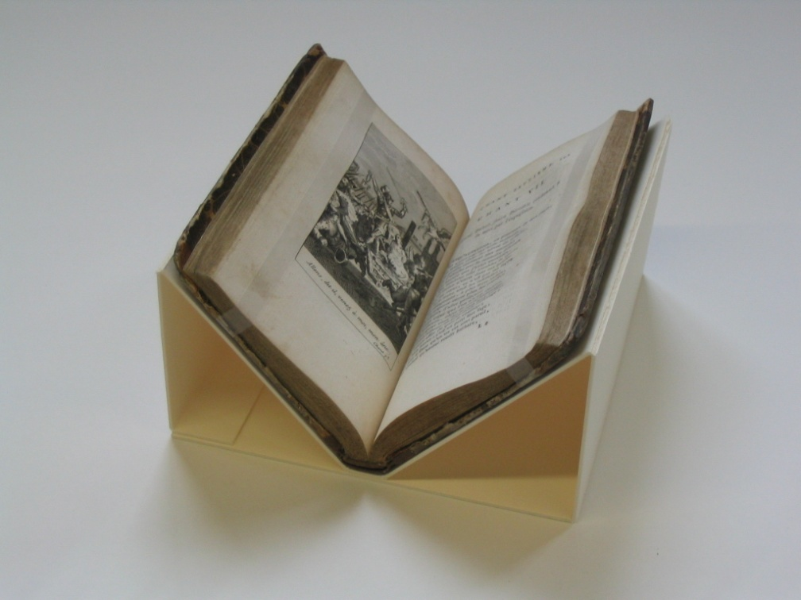
Handling and Access: Good
  Mounts and supports are available to staff and researchers using the collections

Slide 14
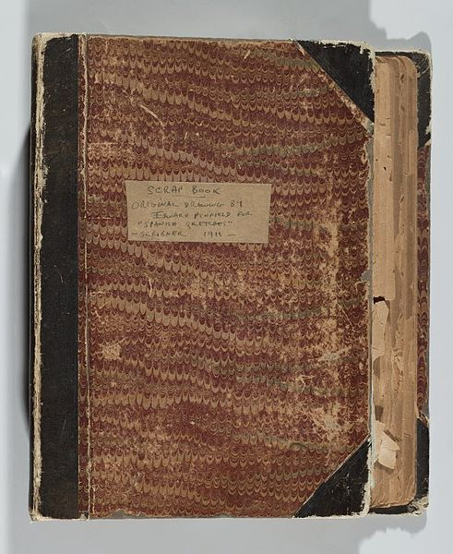
Handling and Access: Good
  A system is in place for reporting and recording damage to collections materials
  Enclosures are marked for collections that are fragile and/or require special handling instructions
  Only specially trained staff move collections materials
  Access to fragile materials is limited until rehousing or conservation treatment can be completed
Image via the Brooklyn Museum

Slide 15
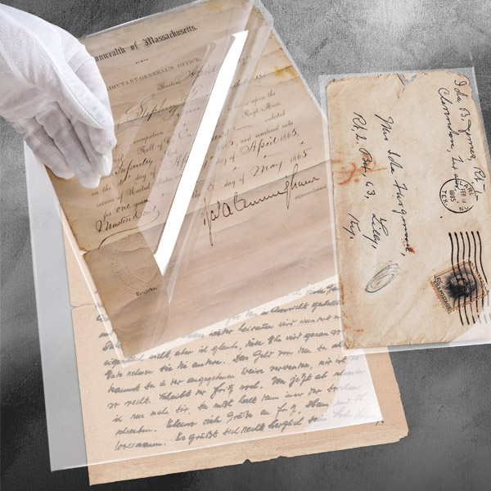
Handling and Access: Better
  Collections materials are in protective enclosures for transportation, handling, and research
  Conservators and art handlers are consulted and retained for moving large, awkward, or particularly fragile materials
Archival Polyester L-Velopes,
http://www.universityproducts.com

Slide 16
Collections Storage

Slide 17
Poll
Notes:
Poll 2:
How are your collections stored?
I’m happy with how my collections are stored.
Things are ok, but there are improvements to be made.
My collections storage is abysmal. Help

Slide 18
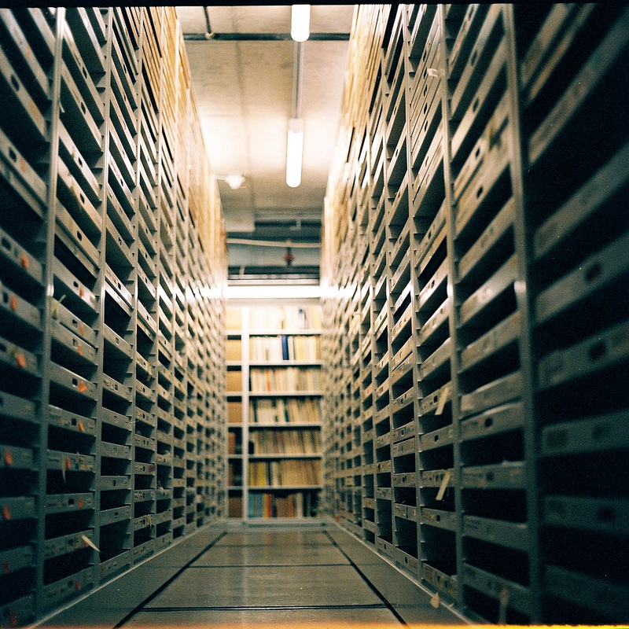
Collections Storage: Getting Started
  There is sufficient space to store all collections materials according to established standards
Image by keightdee, www.flickr.com

Slide 19
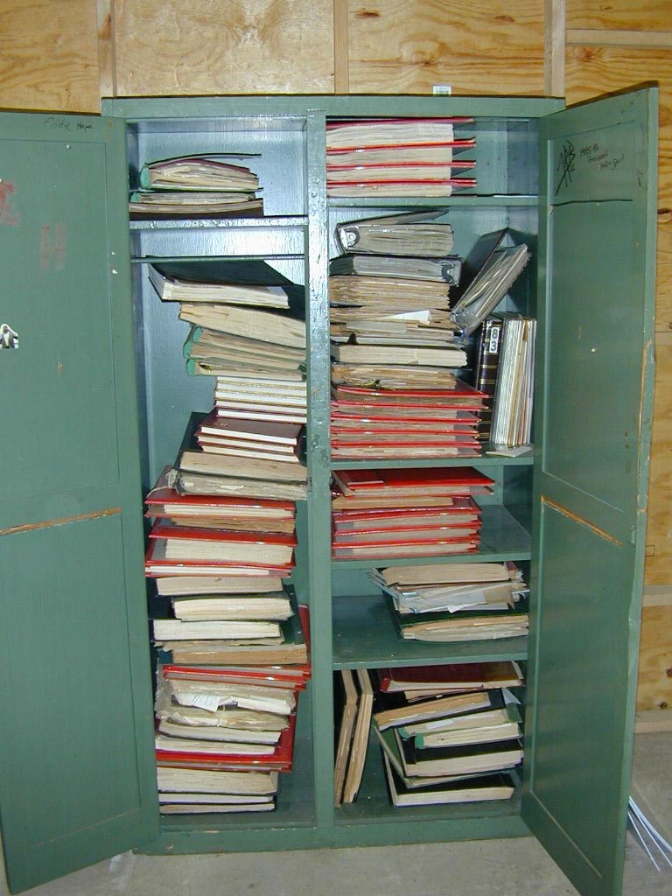
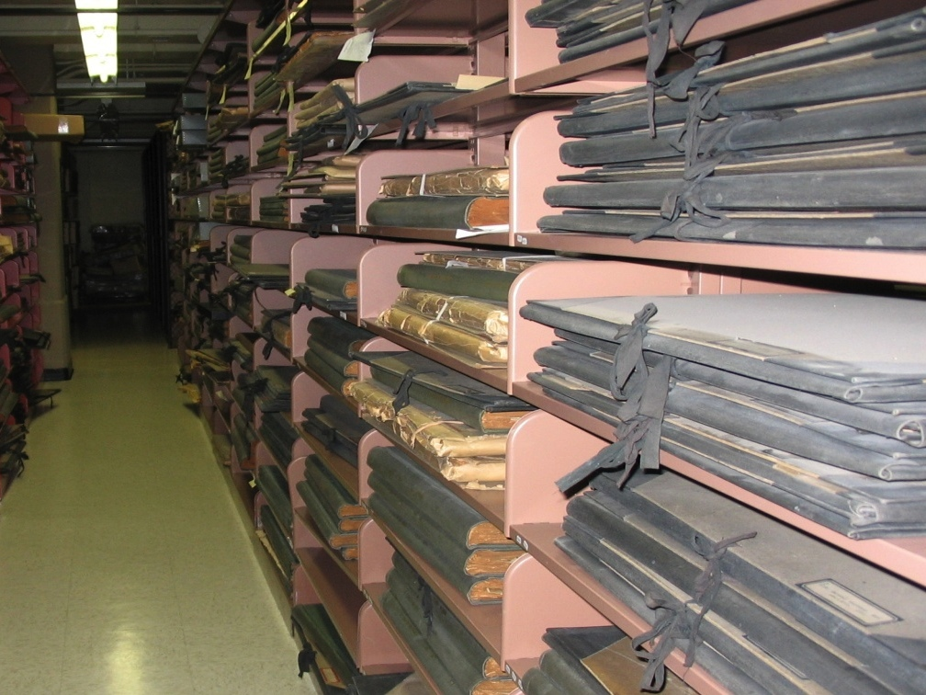

Slide 20
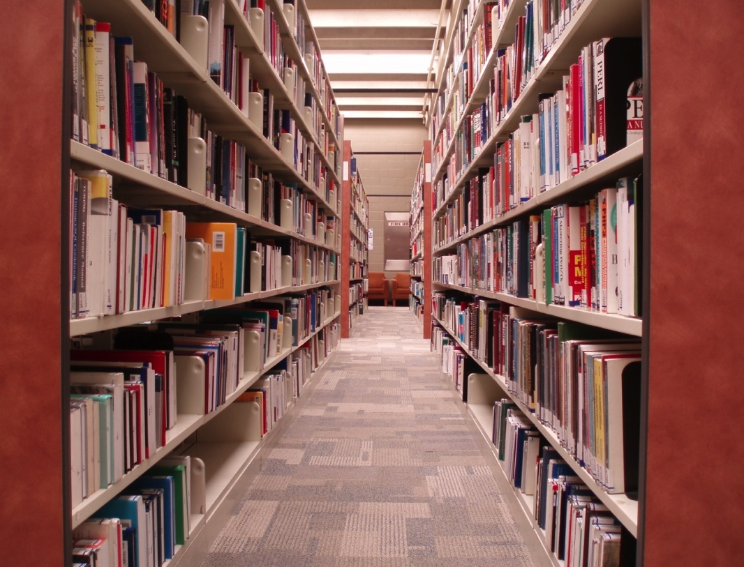
Collections Storage: Getting Started
  Shelving is in place and all collections are stored at least 3 inches off the floor
  Non-collections materials are not stored with collections materials
Notes:
Almost everyone needs to take a close look at their collections- make hard decisions about scope
In appropriate enclosures, fasteners, and adhesives can cause greater deterioration of collections

Slide 21
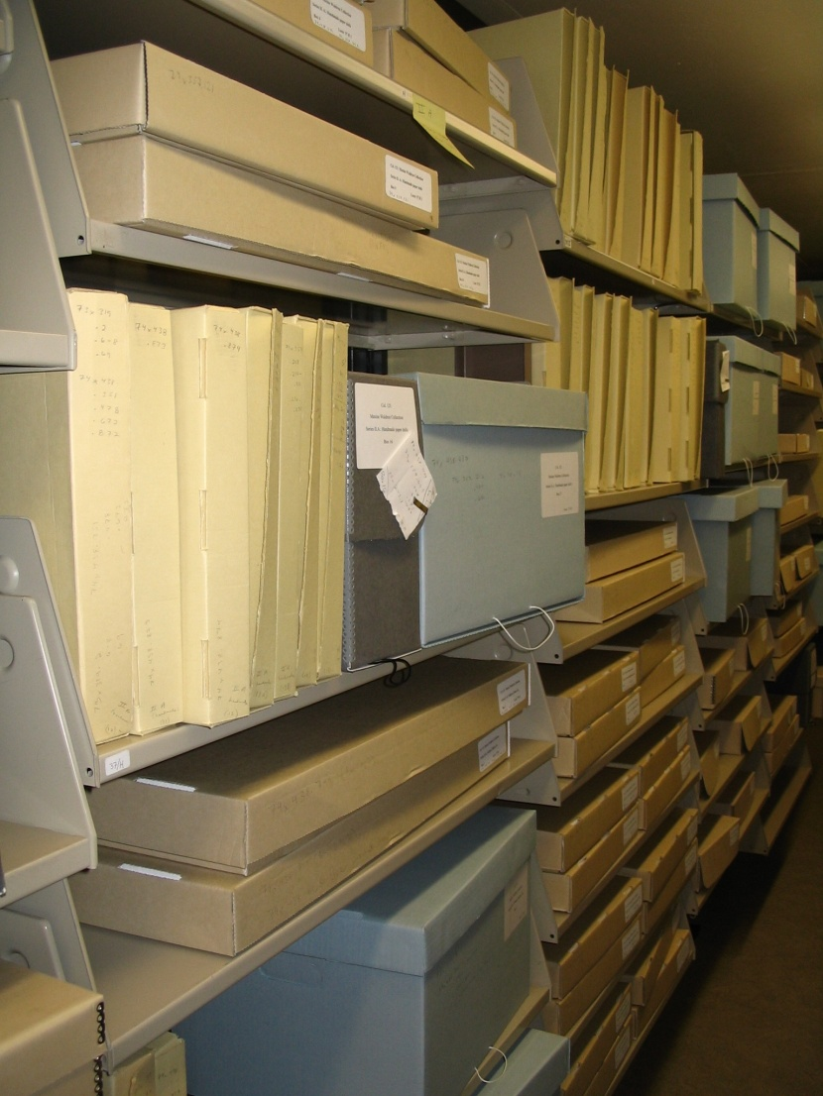
Collections Storage: Getting Started
  Collections are housed using conservation-grade materials
  What does “archival” really mean?
Buzz words to look for:
Acid-free
Lignin-fee
Buffered
Photograph courtesy of Joan Irving, Winterthur
Notes:
Just because an item is in an “archival” catalog does not mean that it is appropriate to use – “Archival” has gained such a broad definition that the term is nearly meaningless. Instead, look for products labeled “acid-free,” “lignin-free,” and “buffered.”
Buffered means calcium carbonate reserve. PH- Alkiline.

Slide 22
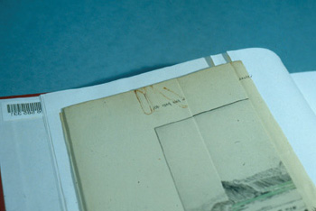
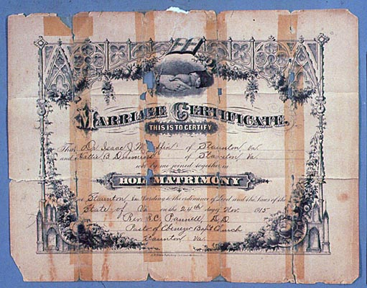
Collections Storage: Getting Started
Avoid inappropriate fasteners and adhesives

Slide 23
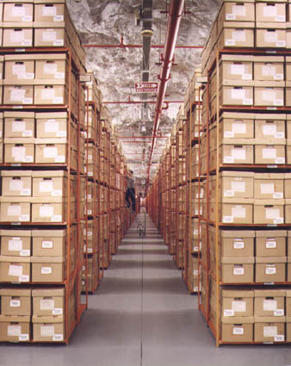
Collections Storage: Getting Started
  Aisles are of sufficient width and are clear of collections materials
  Materials can easily be retrieved from shelving and necessary step stools and ladders are available
http://www.archives.gov/preservation/storage/underground-facilities.html
Notes:
Almost everyone needs to take a close look at their collections- make hard decisions about scope

Slide 24
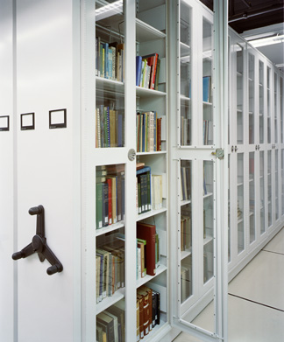
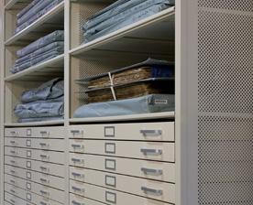
Collections Storage: Good
  Storage furniture is made from powder coated steel and accommodates collections of various sizes and shapes (rolled, oversized)
  There is room for collections growth
www.museum.spacesaver.com
  Subject specialists and conservators are consulted regarding optimal storage for collections materials

Slide 25
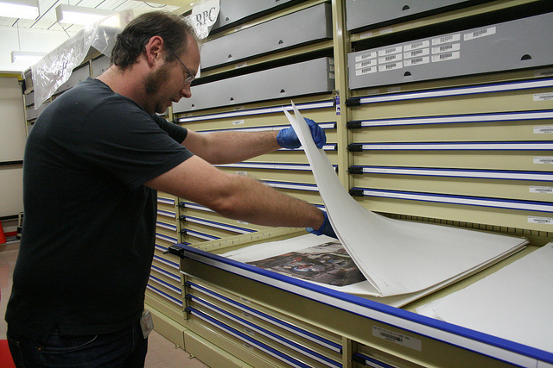
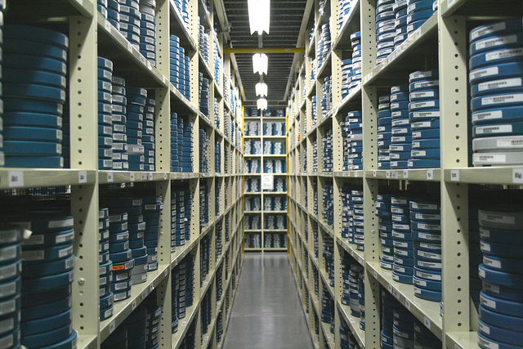
Collections Storage: Good
  Collections materials are stored by format
Images from the National Film and Sound Archive, Australia
Notes:
Collections materials are stored by format

Slide 26
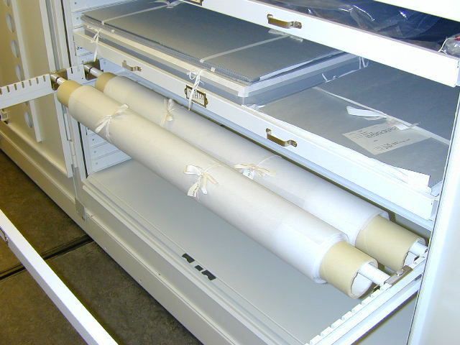
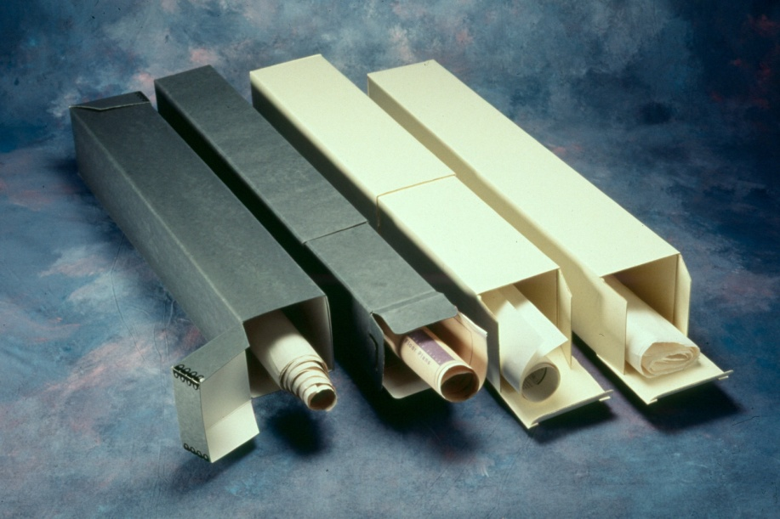
Collections Storage: Good
  Collections housing is refined and all materials are secure within boxes/enclosures
University Museum of
Archeology and Anthropology
Single Roll Storage Boxes, www.hollingermetaledge.com

Slide 27
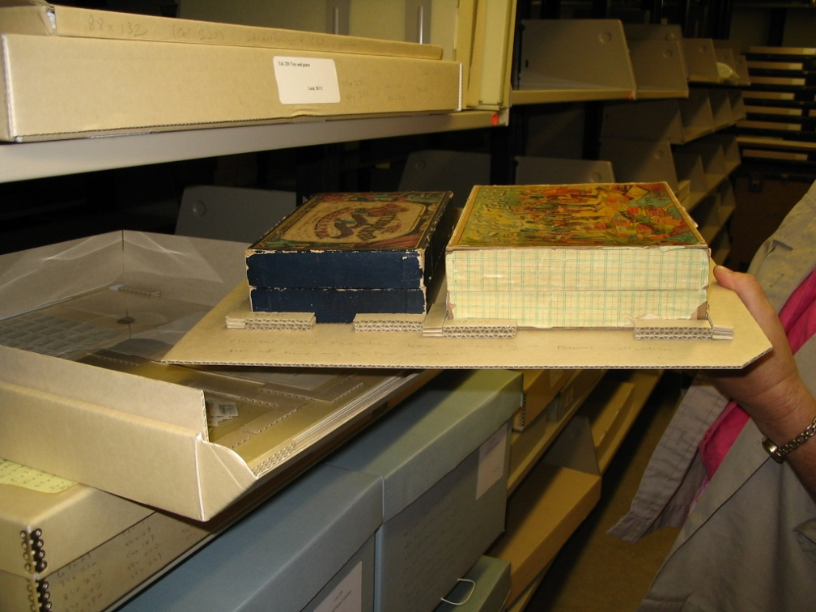
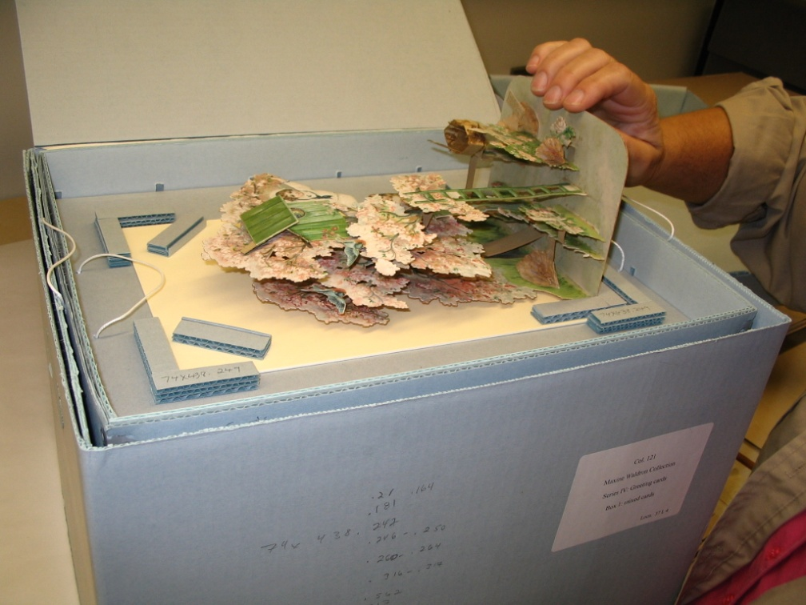
Photographs courtesy of Joan Irving, Winterthur

Slide 28
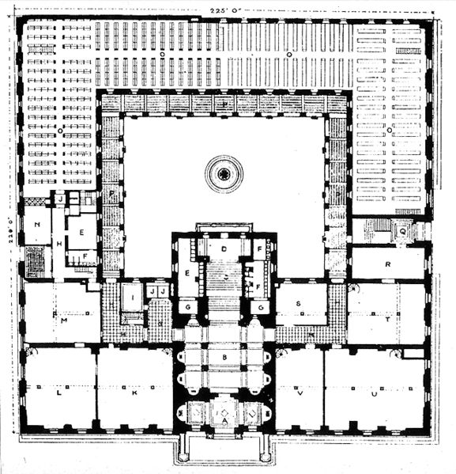
Collections Storage: Better
  Collections pieces are stored on or with specialized mounts that can be used for access and/or exhibition
  A space plan has been conducted to ensure that the space is being used at its maximum capacity
Notes:
Floor Plan BPL

Slide 29
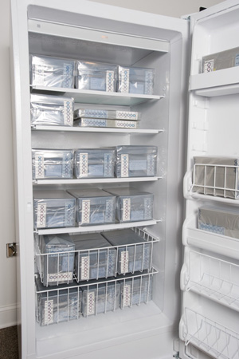
Collections Storage: Better
  Specialized storage environments are in place for collections materials with specialized needs
  Storage enclosures are regularly inspected to ensure they are still meeting the needs of the collections
Image via the National Park Service
Notes:
Specialized environments: Zones areas. Cold Storage

Slide 30
Exhibition

Slide 31
Poll
Notes:
How often does your institution exhibit its collections?
Never
On rotation
We’ve kept the same exhibit for the past decade

Slide 32
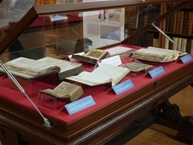
Exhibition: Getting Started
  Materials that are fragile or in poor condition are not placed on exhibition
  Only conservation-grade materials are used for exhibit mounts and mounts fully support the object on exhibit
rowanwilliams.archbishopofcanterbury.org

Slide 33
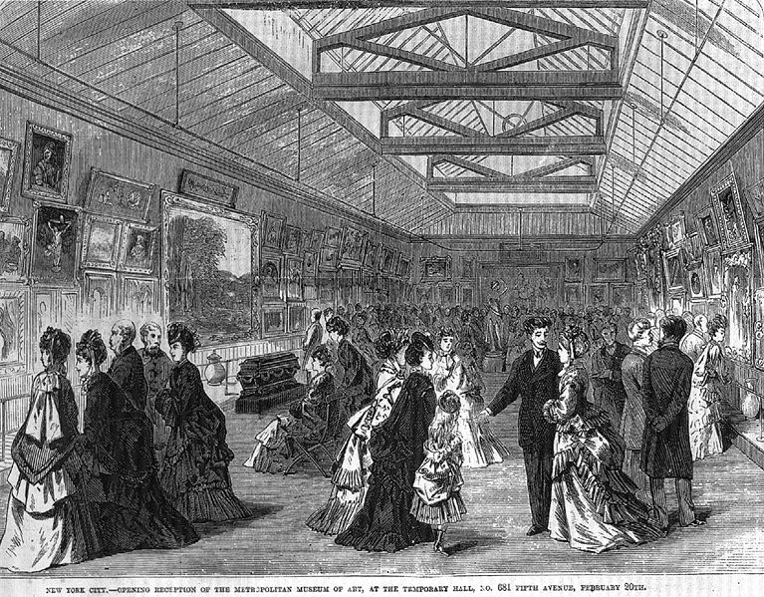
Exhibition: Getting Started
  Food and drink are not permitted in exhibition areas and galleries are not used as special events spaces
  Exhibit cases are secure and are not harmful to collections materials
  Sensitive materials on exhibition are regularly rotated
Notes:
Opening gala at the Met 1872

Slide 34
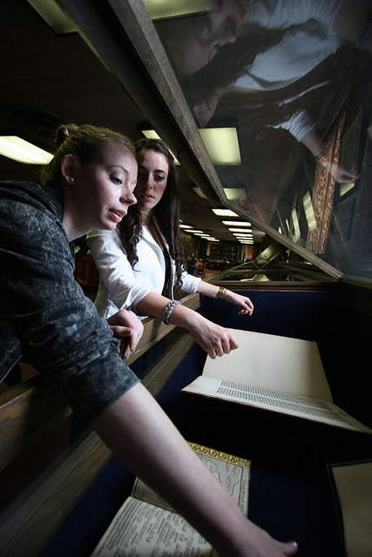
Exhibition: Good
  Materials on exhibit are regularly checked for condition during the exhibition period
  Advice regarding mounts and appropriate exhibition methods is sought from qualified specialists
  Lighting levels can be, and are, adjusted to meet the needs of specific materials
Gleeson Library at USF, www.flickr.com

Slide 35
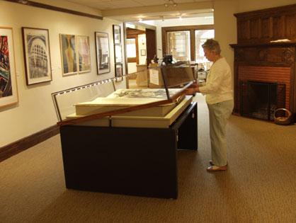
Exhibition: Good
  Cases are designed to maintain specific environments for the collections
  Condition reports are completed for materials before and after exhibition
L Style Standard Case with Rolling Deck
www.smallcorp.com

Slide 36
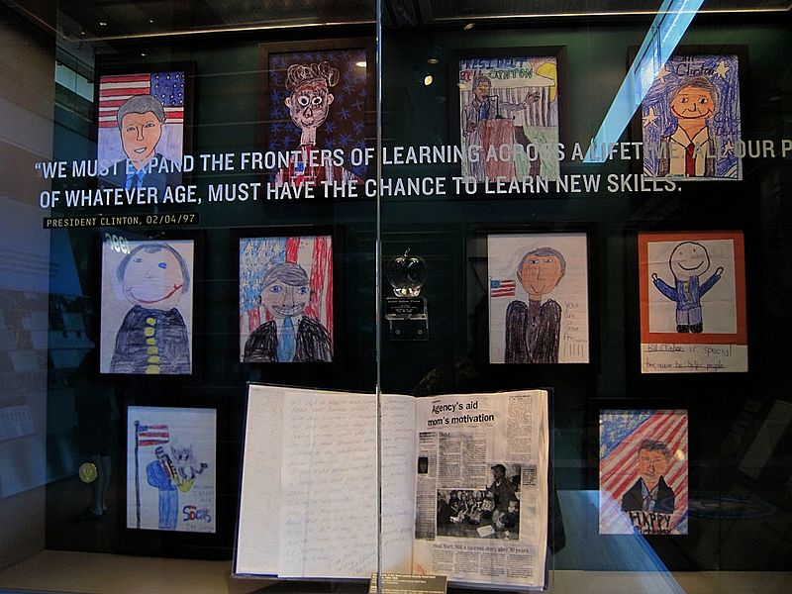
Exhibition: Better
  An exhibition policy is
  in place that outlines
  guidelines for length of
  exhibition, lighting, and
  mounts
Notes:
Image Clinton Presidential Library- no I’m not making any political statement.

Slide 37
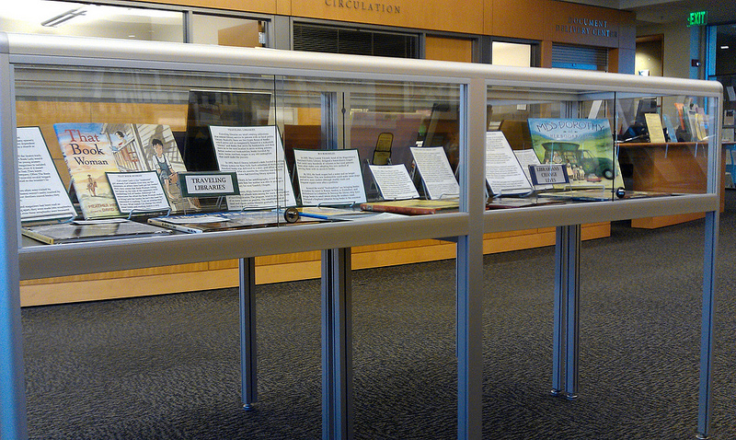
Exhibition Policy
Selection
Length of time on display
Light
Support
Security
Housekeeping
Seattle University Law Library

Slide 38
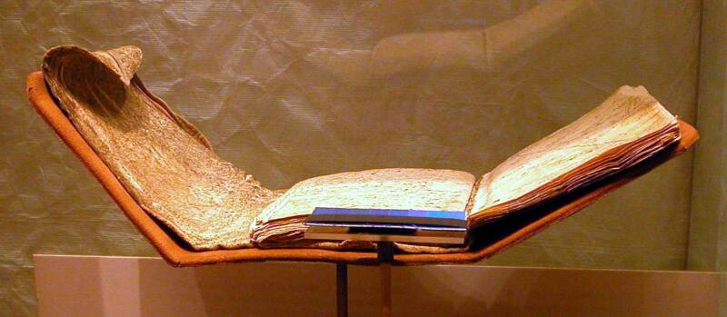
Exhibition: Better
  Records are kept for length of time and light levels for each collections piece placed on exhibition
  All collections materials to be exhibited are examined, treated (if needed) and mounted by a conservator who is part of the exhibition team
  Plans for what materials will be exhibited are made at least one year in advance so mounts and conservation treatment can be planned
Image via Artifact Advocate

Slide 39
Thank you and Questions
Questions about collections care?
Contact the California Preservation Program info@calpreservation.org

Slide 40
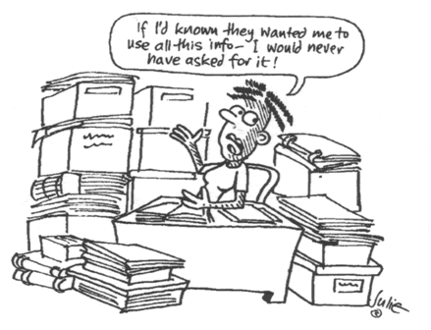
Next Session
Session 4: Planning and Prioritizing
December 19, 2013
http://www.semwisdom.com/blog/wp-content/uploads/data-analysis-cartoon-1.gif

Slide 41
California Preservation Program
This series is sponsored by the California Preservation Program, a project of the California State Library, supported in part by the U.S. Institute of Museum and Library Services under the provisions of the Library Services and Technology Act, administered in California by the State Librarian.
CalPreservation.org
Helping preserve heritage collections

