Slide 1
Preservation Best Practices
Session 4:
Planning and Prioritizing: Tools for Success
The California Preservation Program Presents
Laura Hortz Stanton
Thursday, December 19, 2013

Slide 2
Today
Policies
Planning

Slide 3
Policies and Intellectual Control

Slide 4
Poll
Notes:
Which best describes your institution:
We have a complete set of fully updated policies
We have policies, but they haven’t been updated since 1989
We don’t have policies, we prefer to wing it

Slide 5
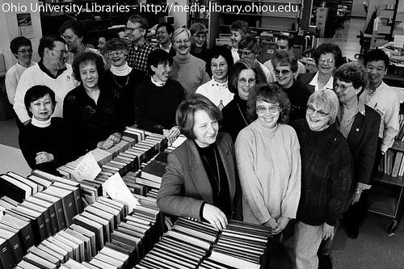
Policies and Intellectual Control: Getting Started
  The board and staff and the institution understand the purpose and importance of the collections management policies and are committed to having the necessary documents in place

Slide 6
Policies and Intellectual Control: Getting Started
Policies
  Mission Statement
  Collections Management Policy
  Collections Development Policy
  Collections Procedures Manual
  Preservation Plan
  Emergency Preparedness and Response Plan
  Security Policy
  Loan Policy
  Exhibition Policy Handling Policy
  Use Policy
  Rights and Reproduction Policy
  Housekeeping Policy and Procedures

Slide 7
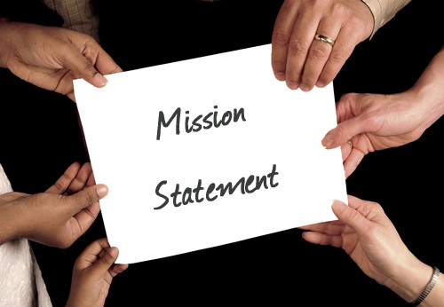
Policies and Intellectual Control: Getting Started
  A mission statement is in place that is a true reflection of the institutional direction
Notes:
In just a few sentences a mission statement needs to communicate the essence of your organization to your stakeholders and to the public – From Alliance for Nonprofit Mgmt.
If you don’t have a good mission
organization members can waste time "barking up the wrong tree"
the organization may not think broadly enough about different possibilities if its mission statement is unclear or overly narrow
􀂋 A mission statement describes the purpose of a museum—its reason for
existence. It defines the museum’s unique identity and purpose, and provides a
distinct focus for the institution.
􀂋 A mission statement articulates the museum’s understanding of its role and
responsibility to the public and its collections, and reflects the environment in
which it exists.
􀂋 Activities of the museum should support, directly or indirectly, the mission.

Slide 8
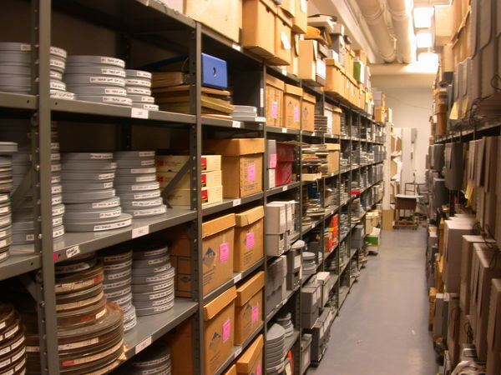
Policies and Intellectual Control: Getting Started
  The institutional strategic plan includes goals and objectives that relate to preservation
  A Collections Development policy is in place
  A basic inventory of the collections has been completed
http://www.nyu.edu/tisch/preservation/media/images/2005_02_dc/summary_smithsonian.shtml

Slide 9
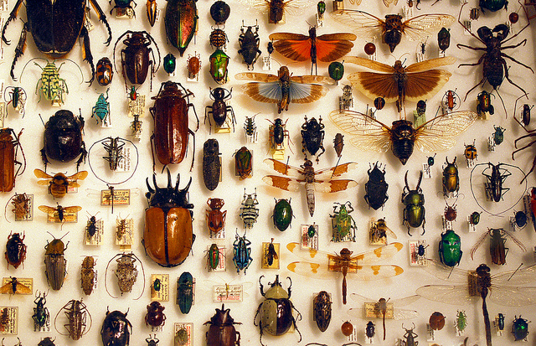
Policies and Intellectual Control: Good
  A collections management policy is in place
Barta IV, www.flickr.com

Slide 10
Policies and Intellectual Control: Good
Collections Management Policy
  a document that establishes policy regarding:
    accessioning
    deaccessioning
    collections authority
    collections access
    staffing
    materials placed in institutional custody
    the level of necessary care
    record keeping and documentation
    insurance coverage

Slide 11
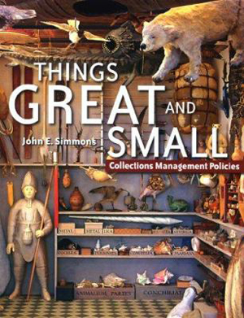
Resource
Things Great and Small by John Simmons
American Association of Museums, 2006

Slide 12
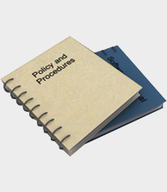
Policies and Intellectual Control: Good
  A loan policy is in place
  Access policy are in place for staff and outside researchers
  A procedures manual is in place for the collections
  A rights and reproductions policy in in place for researchers

Slide 13
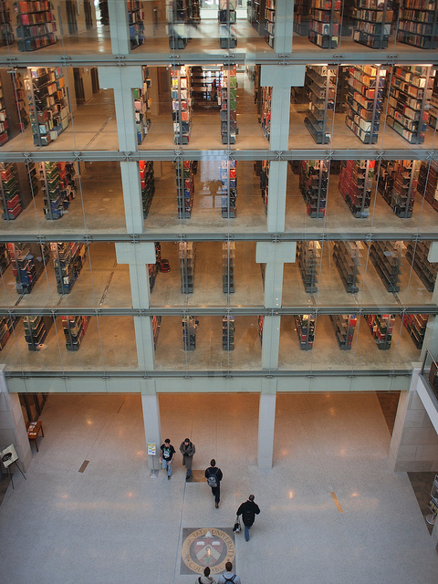
Policies and Intellectual Control: Better
  Policies are understood and approved by the board and/or collections committee
  Policies and guiding documents are reviewed and updated on an annual basis
  An institutional records management program is in place
OSU Main Library Stacks, yobgorf, www.flickr.com

Slide 14
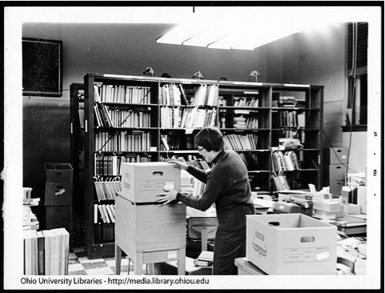
Policies and Intellectual Control: Better
  The entire collection is cataloged to established standards
  A system is established for the regular inventory of collections

Slide 15
Planning & Prioritizing
Notes:
Talking about big ideas here and smaller ideas too.

Slide 16
Poll
Notes:
Which best describes how you feel about tackling preservation of your collections:
I’ve got this!
I kind of know what I need to do first
There’s so much to do and I have no idea where to start

Slide 17
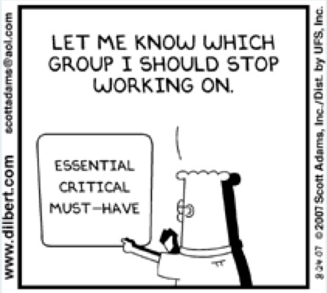
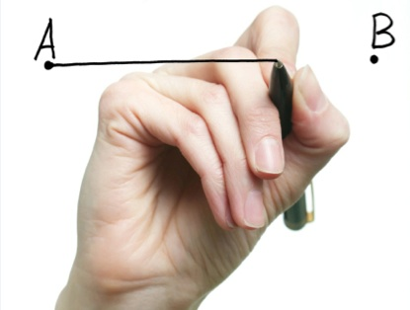
Planning & Prioritization
Notes:
You have to be an advocate for your collections and have a list of priorities and a plan.
Do you know how you want to get from point A to point B. If you don’t know, how can you explain it to others? I make no assertions that this is an easy task, it’s much like this Dilbert cartoon.
.

Slide 18
Get Preservation in the Plan
Strategic Planning:
Helps people define the institution over the next 10-20 years
Creates a directional document, to guide while not limiting future opportunities
Enables the institution to align strategic objectives with financial and human resources
Provides a mechanism to continually review and ensure excellence
* Source: University of Illinois
Notes:
Preservation needs to be in your strategic plan. I can tell you how many plans that I read that talk about exhibitions, education programming, increased accessibility, and digitization (all laudable goals) but in those plans I rarely see preservation listed as a priority. But none of those other things can happen without a collection in good condition.
Who looks at strategic plans anyway, you might be asking? And what I want to tell you is that the people that hold the purse strings look at strategic plans – Boards, foundations, funders.
What I have here in this slide is information on strategic planning from the University of Illinois. The first point and the last point are important, but what I want you to look at here are the two middle points that discuss future opportunities and financial/human resources. If you don’t have preservation in this document, it’s not going to be part of your institution's director and you aren’t going to get your fair share of the financial and human resources.
But my colleague Lee Price, CCAHA’s Director of Development, and I have put together a little diagram that gives you a preservation roadmap to help guide you. This roadmap was developed based on 2 things. 1)We’ve seen institutions that use the path I’m about to tell you about and be successful and 2) It’s the path that funders want to see you following and what they expect.
If you remember nothing else from my talk today – remember this next slide

Slide 19
The Preservation Roadmap
Inventory
Risk Assessment
Preservation Needs
Assessment
Emergency Preparedness
and Response Plan
Preservation Plan
Collections Management
Activities
Improvements to Stabilize
Environmental Conditions
Collection-Level
Assessment
Conservation and
Accessibility
Item-Level
Survey
Notes:
This is the roadmap and I’m going to talk you through it now. (Go through the list)

Slide 20
The Preservation Roadmap
Inventory
Risk Assessment
Preservation Needs
Assessment
Emergency Preparedness
and Response Plan
Preservation Plan
Collections Management
Activities
Improvements to Stabilize
Environmental Conditions
Collection-Level
Assessment
Conservation and
Accessibility
Item-Level
Survey

Slide 21
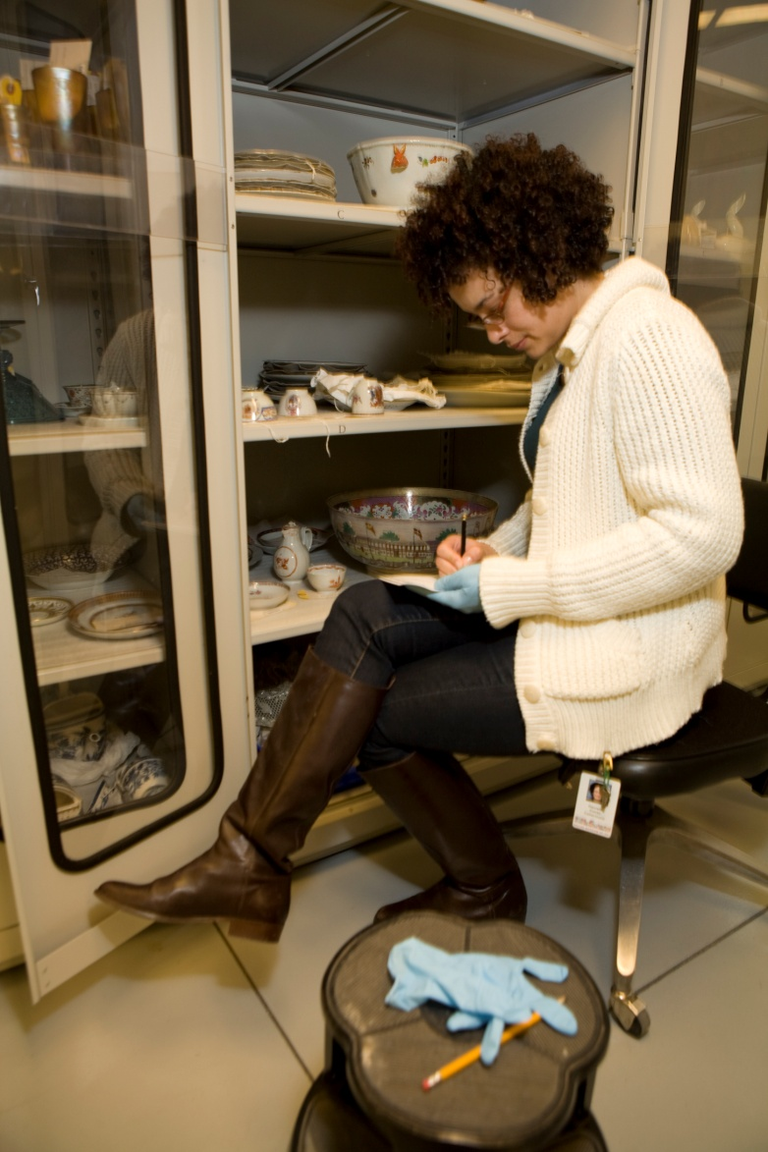
Inventory
Know what you have
Quantify
Basics of condition
Location
http://uncrated.wordpress.com/2010/08/31/smallobjects/

Slide 22
The Preservation Roadmap
Inventory
Risk Assessment
Preservation Needs
Assessment
Emergency Preparedness
and Response Plan
Preservation Plan
Collections Management
Activities
Improvements to Stabilize
Environmental Conditions
Collection-Level
Assessment
Conservation and
Accessibility
Item-Level
Survey
Notes:
This is the roadmap and I’m going to talk you through it now. (Go through the list)

Slide 23
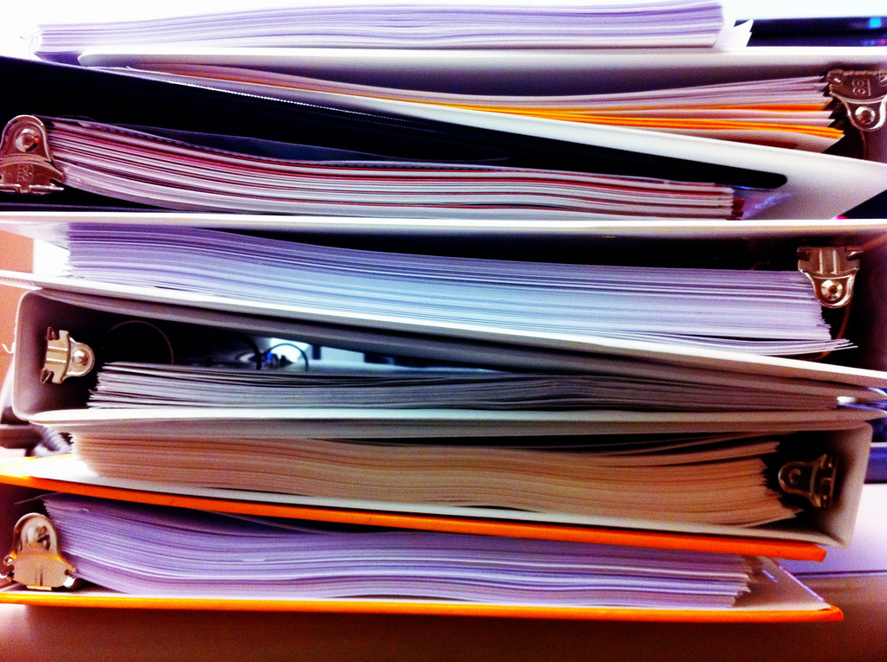
Preservation Needs Assessment
An evaluation of:
Policies
Procedures
Building
Collections management
Collections care
David Lee King, www.flickr.com

Slide 24
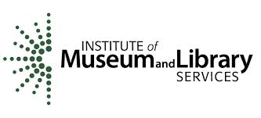


Preservation Needs Assessment
IMLS Conservation Assessment Program
NEH Preservation Assistance Grants for Smaller Institutions
California Preservation Program

Slide 25
The Preservation Roadmap
Inventory
Risk Assessment
Preservation Needs
Assessment
Emergency Preparedness
and Response Plan
Preservation Plan
Collections Management
Activities
Improvements to Stabilize
Environmental Conditions
Collection-Level
Assessment
Conservation and
Accessibility
Item-Level
Survey
Notes:
We’re going to come back to this one in a moment

Slide 26
The Preservation Roadmap
Inventory
Risk Assessment
Preservation Needs
Assessment
Emergency Preparedness
and Response Plan
Preservation Plan
Collections Management
Activities
Improvements to Stabilize
Environmental Conditions
Collection-Level
Assessment
Conservation and
Accessibility
Item-Level
Survey

Slide 27
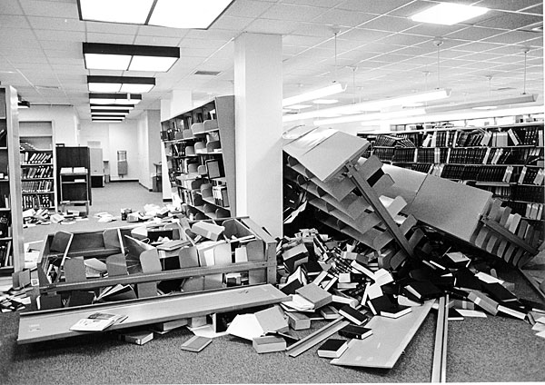
Emergency Planning
Risk Assessment
Emergency Planning
Resources for more info:
California Preservation Program
WESTPAS
http://news.stanford.edu/news/2006/february1/planning-020106.html
Notes:
Emergency planning and risk assessment are essential to a good preservation program. I didn’t cover them because there are already a ton of great web resources.

Slide 28
The Preservation Roadmap
Inventory
Risk Assessment
Preservation Needs
Assessment
Emergency Preparedness
and Response Plan
Preservation Plan
Collections Management
Activities
Improvements to Stabilize
Environmental Conditions
Collection-Level
Assessment
Conservation and
Accessibility
Item-Level
Survey
Notes:
This includes cataloging, photography, rehousing

Slide 29
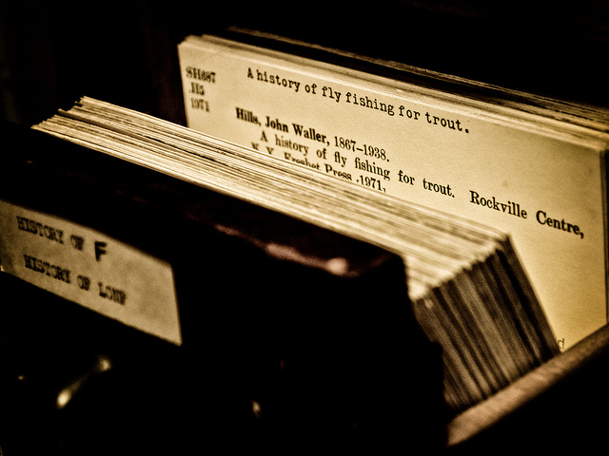
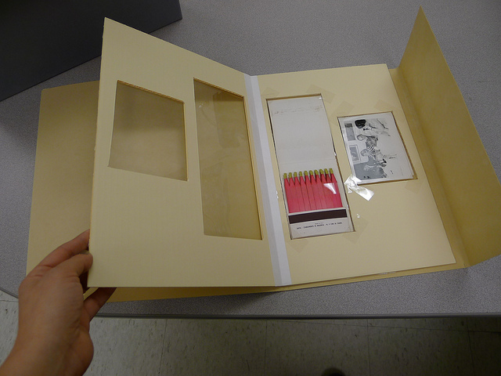
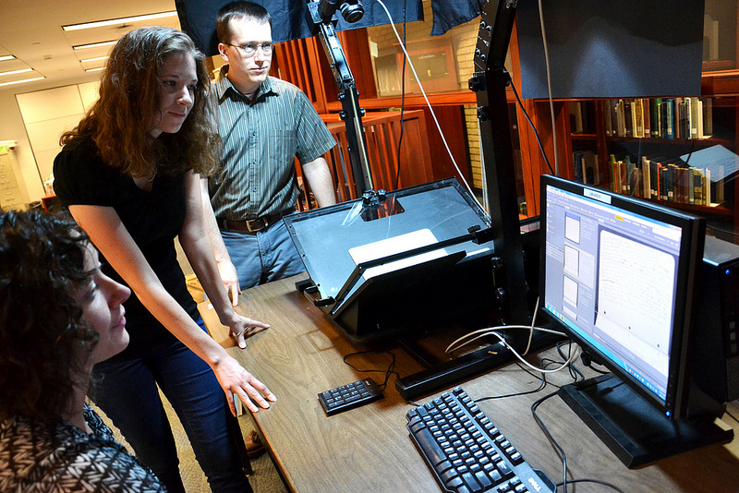
Collections Management Activities
Cataloging
Photography
Rehousing
Clockwise from Top: Dawn M. Armfield, Washington University Libraries, and Smithsonian Institutional Archives. All from www.flickr.com

Slide 30
The Preservation Roadmap
Inventory
Risk Assessment
Preservation Needs
Assessment
Emergency Preparedness
and Response Plan
Preservation Plan
Collections Management
Activities
Improvements to Stabilize
Environmental Conditions
Collection-Level
Assessment
Conservation and
Accessibility
Item-Level
Survey
Notes:
This is the roadmap and I’m going to talk you through it now. (Go through the list)

Slide 31
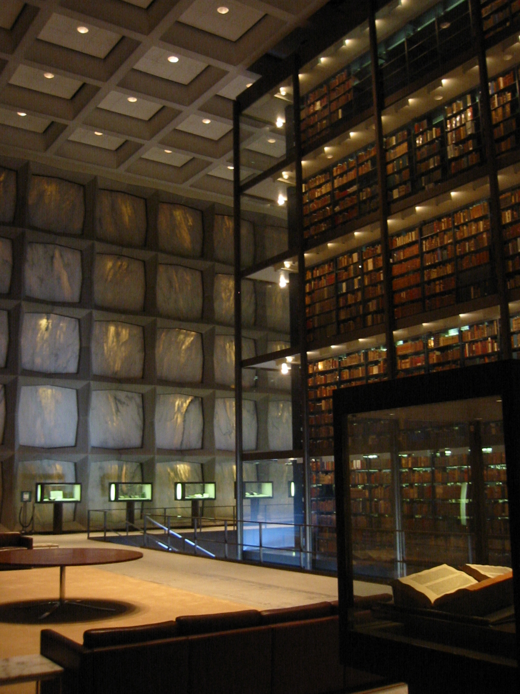
Environmental Conditions
Climate control
Environmental monitoring
Lighting
Security
Fire Prevention
Storage furniture

Slide 32
The Preservation Roadmap
Inventory
Risk Assessment
Preservation Needs
Assessment
Emergency Preparedness
and Response Plan
Preservation Plan
Collections Management
Activities
Improvements to Stabilize
Environmental Conditions
Collection-Level
Assessment
Conservation and
Accessibility
Item-Level
Survey

Slide 33
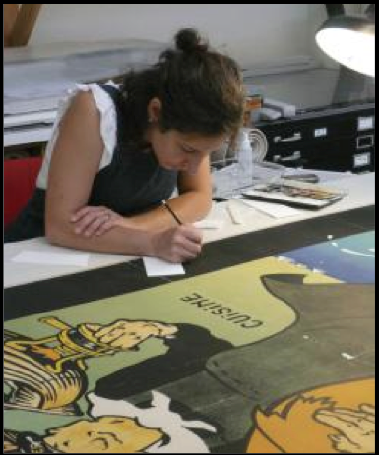
Conservation
Appropriate conservator
References
Treatment proposal
Documentation
Safety
Code of Ethics

Slide 34
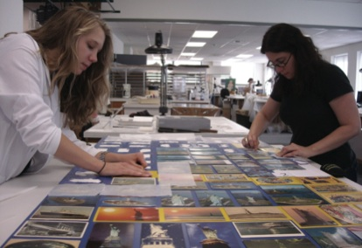
Preservation Plan
Outlines strategic goals specifically for preservation
Aligns with institutional strategic plan
Establishes timelines and benchmarks
Holistic
Systematic
Creates cohesion
Allows for continuity
Notes:
To help you with your advocacy, develop a preservation plan. A preservation plan is basically a strategic plan for preservation and conservation. It needs to align with your larger institutional goals and should have specific timelines and benchmarks. It should also be (not last 4 bullets)

Slide 35
Parts of a Preservation Plan
Policies
Facilities
Environment
Lighting
Emergency Preparedness
Security
Housekeeping
Pest Management
Handling and Access
Collections Storage
Exhibition
Preservation Planning
Conservation
Additional Considerations
Notes:
Your preservation plan should touch on all of these areas. Does this look familiar? You saw this slide earlier too!

Slide 36
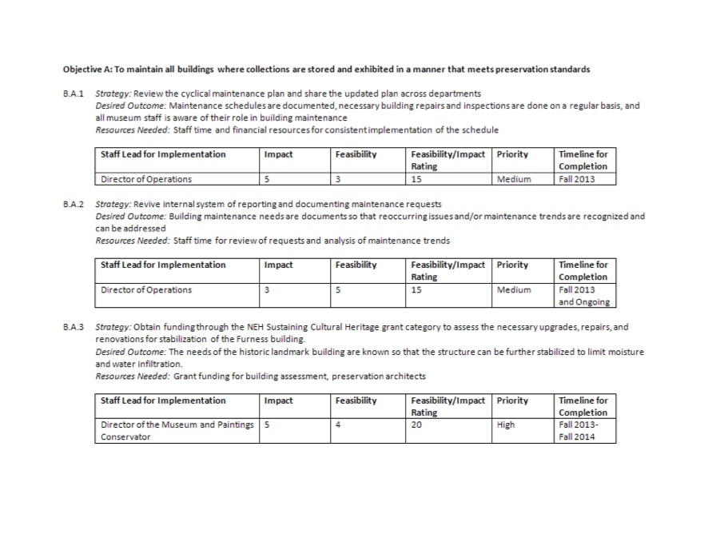
Notes:
Here’s a sample page from a preservation plan that CCAHA worked on for an organization. (Point out how it’s structured and explain)

Slide 37

Develop a Funding Plan
Match projects & $$$
Identify grants
Plan necessary matching funds
Court donors
Notes:
To go with your preservation plan, create a funding plan. Figure out how you’re going to pay for all the great ideas you outlined in the plan.

Slide 38
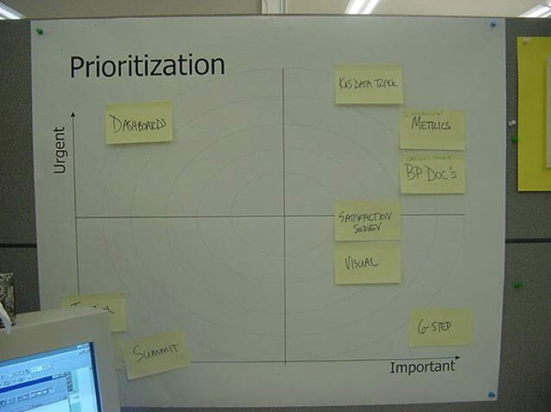
Still Overwhelmed?
Notes:
If you’re still overwhelmed, you can use a simple matrix to help you make decisions and prioritize

Slide 39
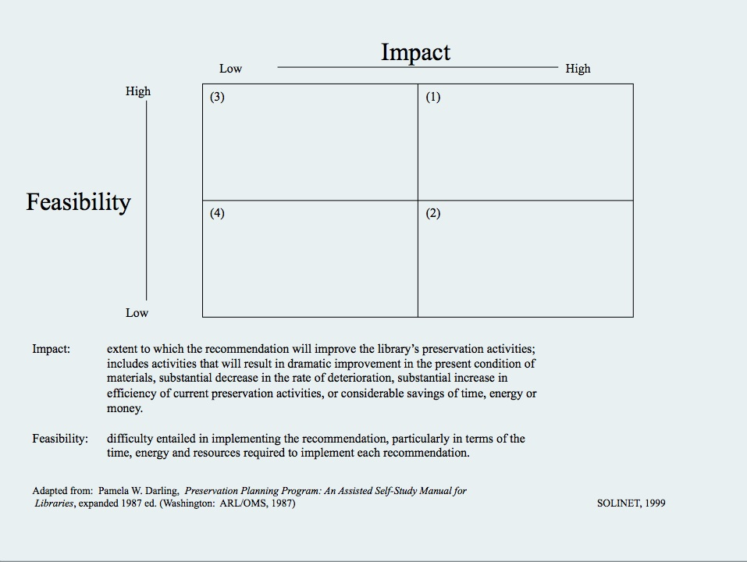
Notes:
Here’s a sample matrix that measuring feasibility and impact of a project. (explain how matrix works and give a few concrete examples)
This puts some good solid numbers next to things to help with decision making.

Slide 40
Resources
California Preservation Program
calpreservation.org
Regional Alliance for Preservation
preservecollections.org
Conservation Online
cool.conservation-us.org
National Park Service Conserve O Grams
www.nps.gov/history/museum/publications
Connecting to Collections Online Community
www.connectingtocollections.org
Image Permanence Institute
www.imagepermanenceinstitute.org

Slide 41
Thank you and Questions
Questions about collections care?
Contact the California Preservation Program info@calpreservation.org

Slide 42
Infopeople webinars are supported in part by the U.S. Institute of Museum and Library Services under the provisions of the Library Services and Technology Act, administered in California by the State Librarian. This material is licensed under a Creative Commons 3.0 Share & Share-Alike license. Use of this material should credit the author and funding source.

