Slide 1

Transmedia and Young Adult Literature:
When Stories Are More Than Paper
Rachel McDonald & Jackie Parker
An Infopeople Webinar
Tuesday, January 7, 2014

Slide 2

Today’s Objectives
Understand what transmedia is and its impact on the future of reading
Learn six ways to evaluate transmedia
Discover three tools to use transmedia with teens, especially reluctant readers

Slide 3

What is Transmedia?
“A process where integral elements of a fiction get dispersed systematically across multiple delivery channels for the purpose of creating a unified and coordinated entertainment experience. Ideally, each makes it own unique contribution to the story.”
Dr. Henry Jenkins, Profession of Communication
“Transmedia Storytelling 101”
http://henryjenkins.org/2007/03/transmedia_storytelling_101.html

Slide 4
Definition of Transmedia
Multiple Media
A Single Unified Story
Avoidance of Redundancy Between Media
- Andrea Phillips, A Creator's Guide
to Transmedia Storytelling

Slide 5

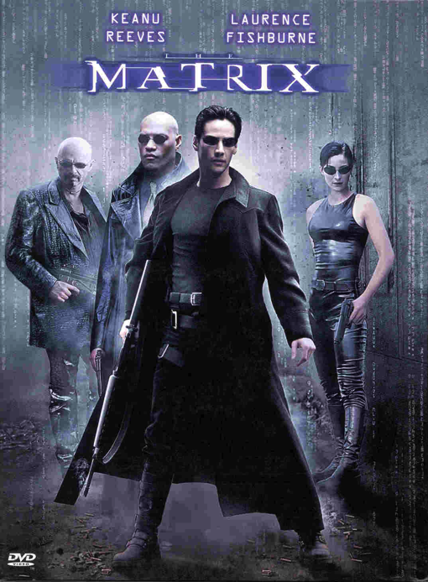
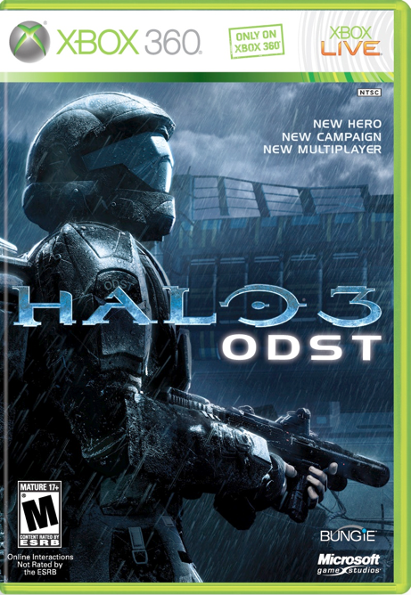




Examples of Transmedia

Slide 6
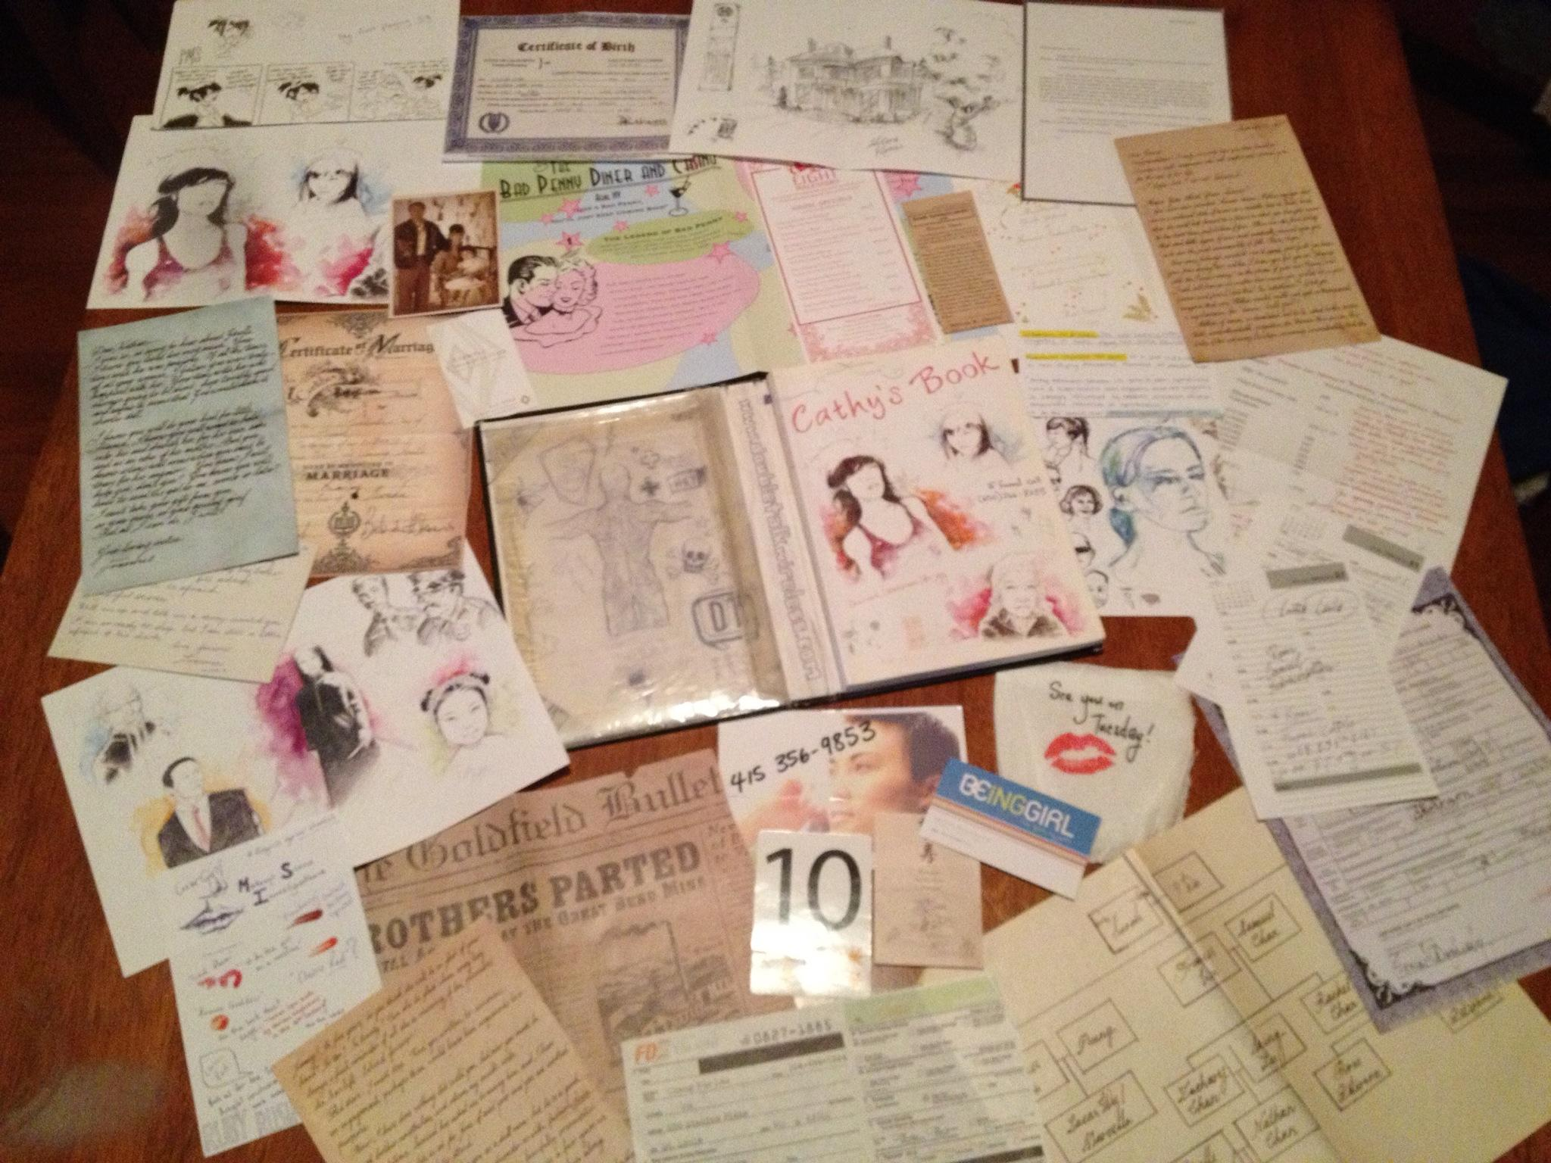
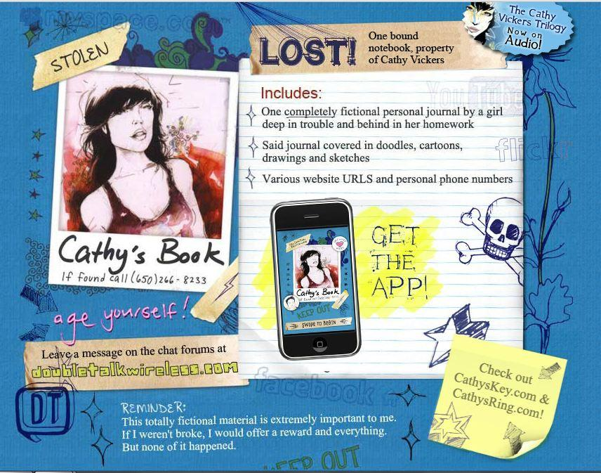
Cathy’s Book
Storytelling Elements: Book, Phone Number, Ephemera, Website, App

Slide 7
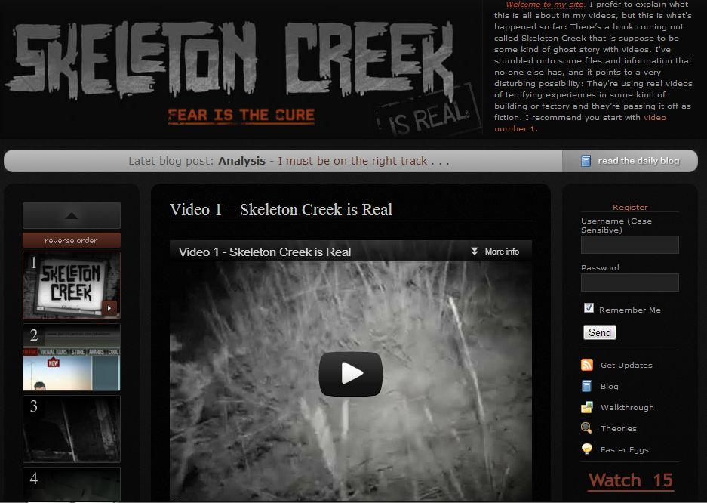
Skeleton Creek by Patrick Carman
Storytelling Elements: Book, Website, Videos

Slide 8

Chopsticks by Anthony & Corral
Storytelling Elements: Book, Enhanced Ebook, Videos, Songs, Shuffle

Slide 9
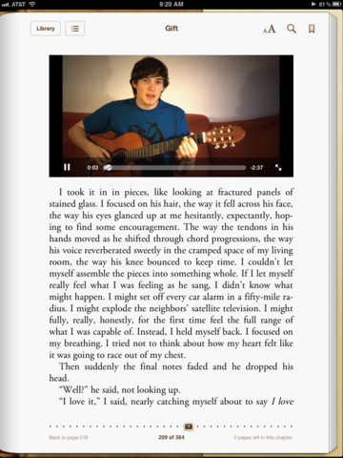
Gift by Andrea J. Buchanan
Storytelling Elements: Book, Enhanced Ebook, Graphic Novel, Journal, Videos, Songs and Lyrics

Slide 10
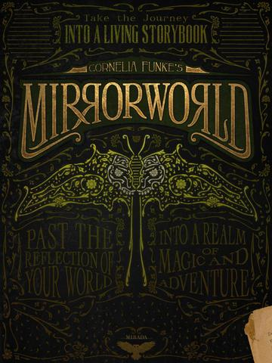
MirrorWorld by Cornelia Funke
Storytelling Elements: Novels, app-based short stories, audio, animation, illustration, music

Slide 11
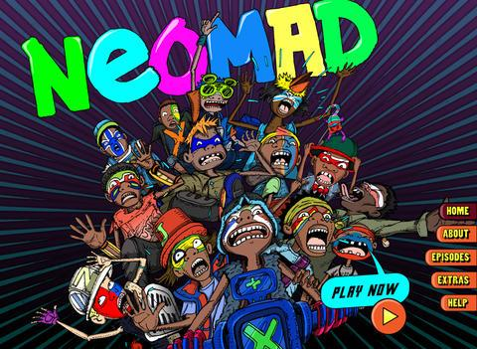
Neomad by Big hART
Storytelling Elements: Interactive comics, sound effects, audio, animation, music, live-action video

Slide 12
Evaluation
Accessibility
  What’s necessary to participate?
Cost
  Money is a barrier. Libraries don’t lend.
Functionality
  Does it work? Is it too slow?
Relevancy
  Is it current? Is it a gimmick?
Entertainment
  Does it go beyond novelty?
Readability
  Treatment of text; decoding.

Slide 13



Reviews of Apps & Enhanced Ebooks
SLJ's Touch and Go
Kirkus' iPad Book Apps
YALSA's App of the Week

Slide 14
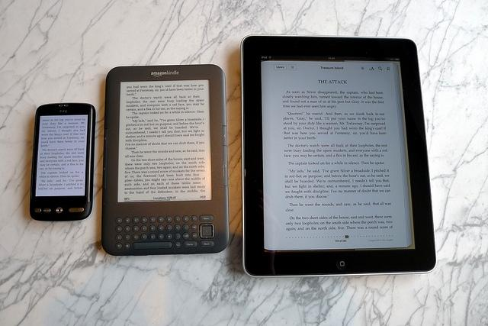
Digital Divide
eReader Comparison by Edwc
Attribution Non-Commercial License

Slide 15

Dickens’ Dark London
Storytelling Elements: Graphic Novels, audio, maps

Slide 16
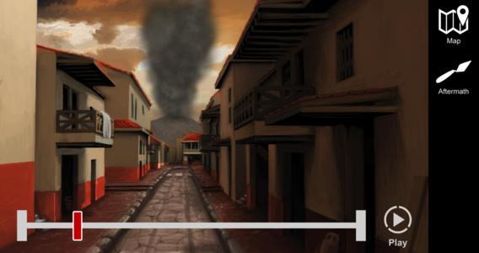
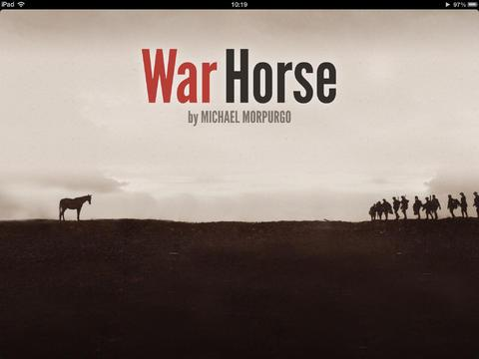
Life and Death in Pompeii & Herculaneum
War Horse Interactive
Storytelling Elements: Animation, maps, audio, artifacts (photos of)
Storytelling Elements: Illustration, video, audio, artifacts (photos of)

Slide 17

Ereader & Tablet Ownership
24% of Americans ages 16 and older own an ereader
35% own a tablet
43% own either or both devices
Pew Internet & American Life Project: Tablet and E-reader Ownership Update
Lee Rainie & Aaron Smith, October 13, 2013

Slide 18
Teens’ Access to Technology
78% of American teens (ages 12 to 17) own a cell phone
37% of teens have smartphones
23% of teens own tablets
95% of teens use the internet
93% of teens have access to a computer at home
Pew Internet & American Life Project: Teens and Technology 2013
Mary Madden, Amanda Lenhart, Maeve Duggan, Sandra Cortesi, Urs Gasser; March 13, 2013.

Slide 19
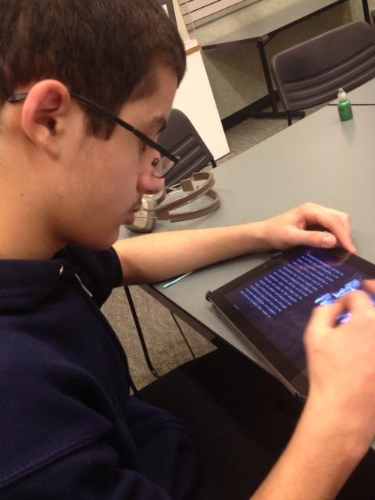
Teens and Ebooks
More adults than teens purchase ebooks
Teens are more likely
to read ebooks on a
smart phone or laptop
than an ereader or tablet
92% of teens think ebooks cost too much
Most teens are not happy with restrictions on ebooks

Slide 20
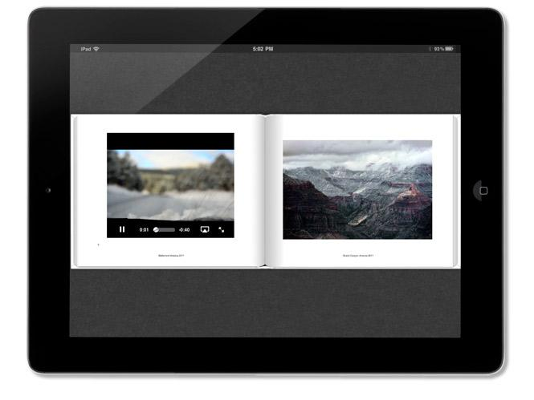
Library Lending of Enhanced Ebooks

Slide 21
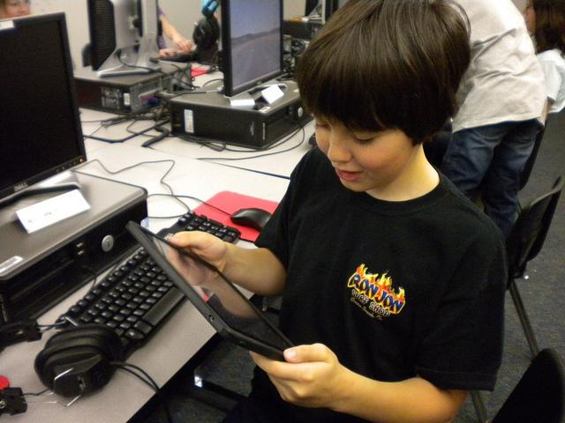
Ebooks and Tablets in Schools
Student iPad 001by Brad Flickinger
Attribution Non-Commercial License

Slide 22
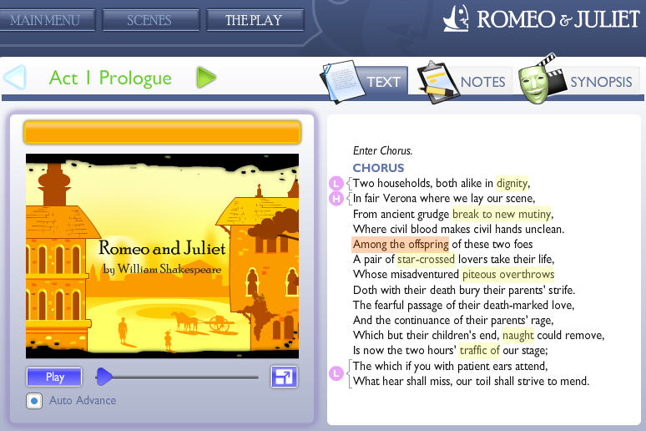
Shakespeare in Bits

Slide 23
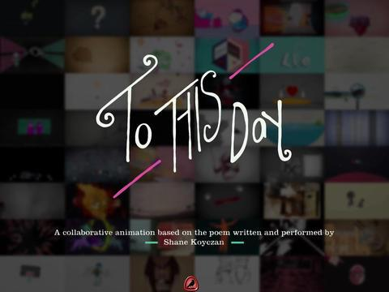
To This Day
Storytelling Elements: Animation, audio

Slide 24
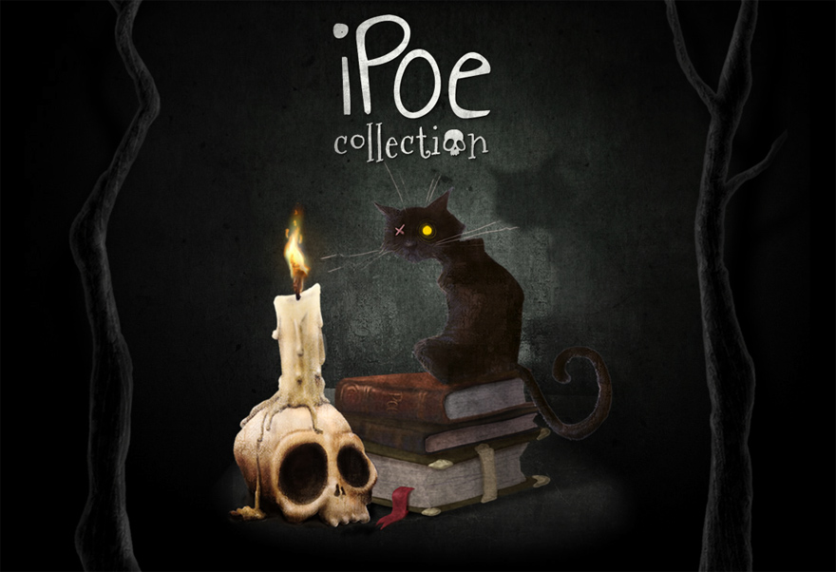
Apps from Classic Texts

Slide 25

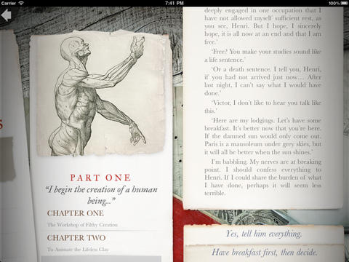
Apps from Classic Texts

Slide 26
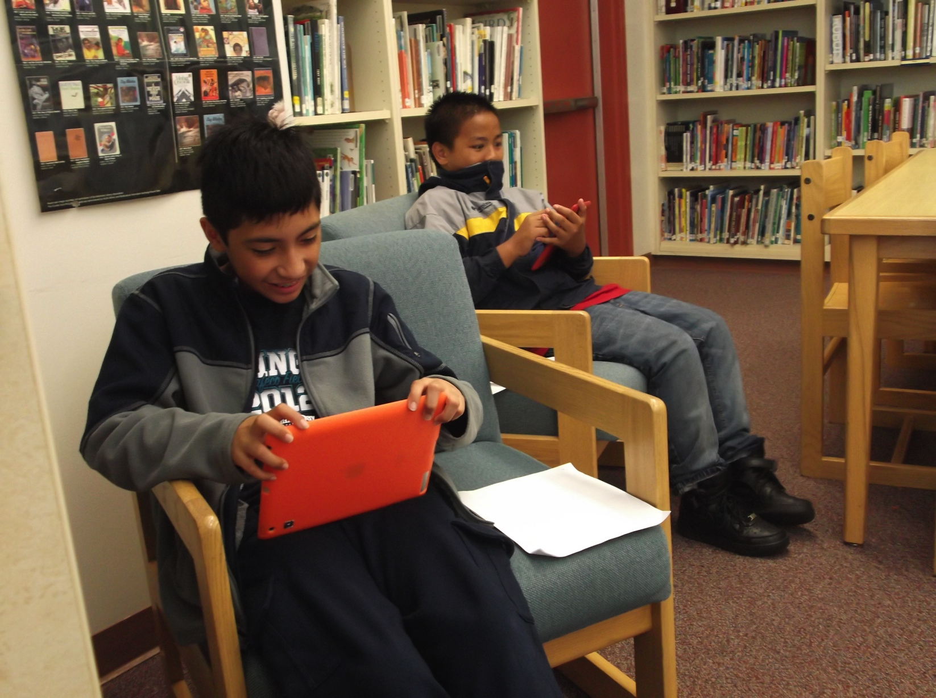
Using Transmedia with Teens

Slide 27
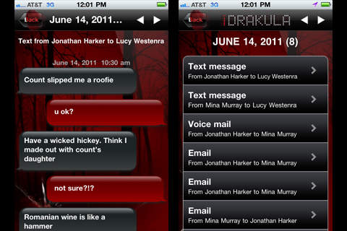
Reluctant Readers and Transmedia

Slide 28
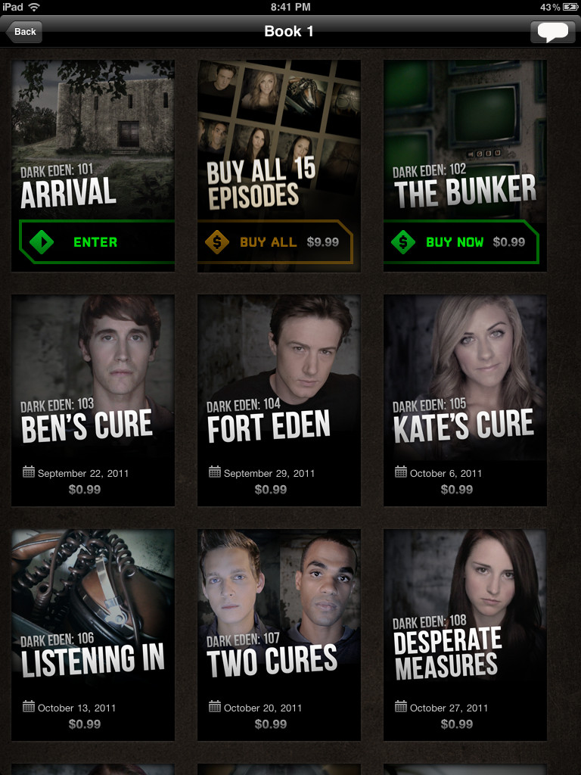
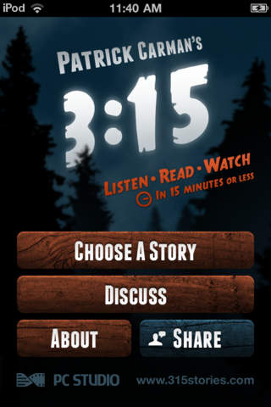
Reluctant Readers and Transmedia

Slide 29





Teens as Transmedia Creators

Slide 30
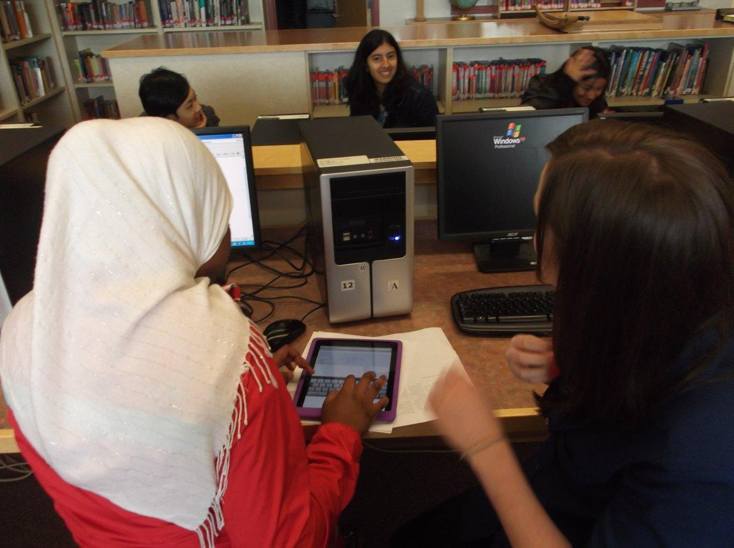
Teens as Transmedia Creators

Slide 31
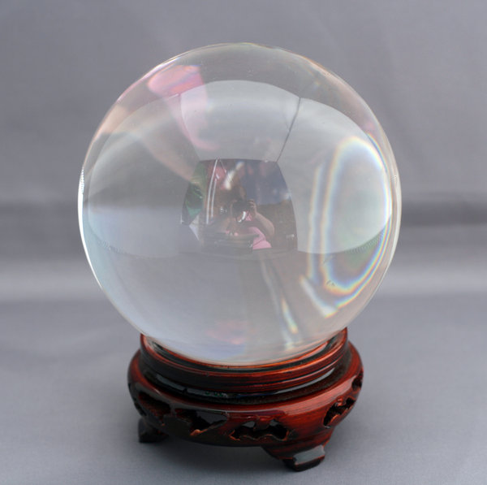
Forecasting the Future

Slide 32

Ebooks and Social Media

Slide 33
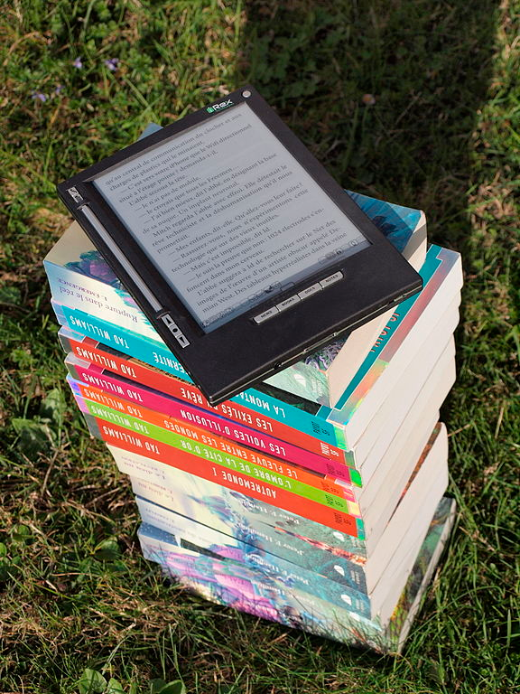
Creating Transmedia for Teens
Lacking a consistent platform and format, publishers may be reluctant to create transmedia titles.
IRex iLiad ebook reader outdoors in sunlight by Martouf
Attribution Noncommercial License

Slide 34
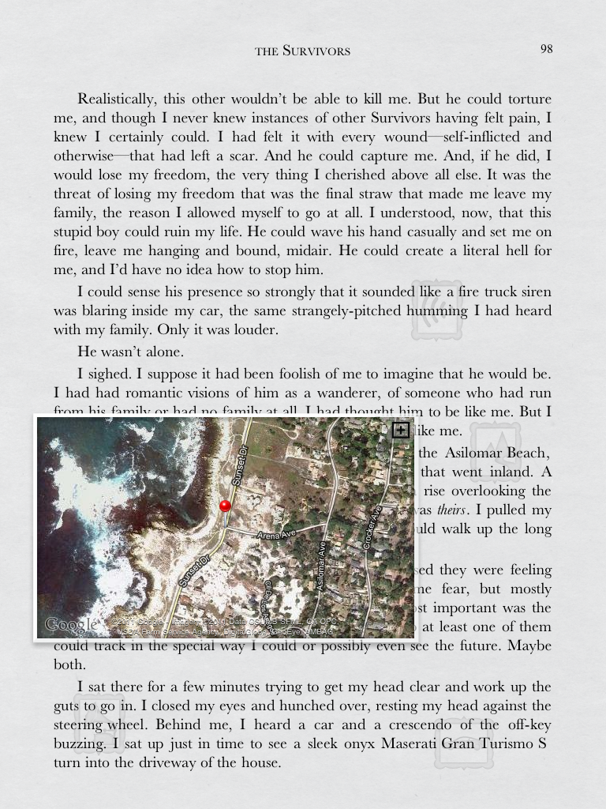
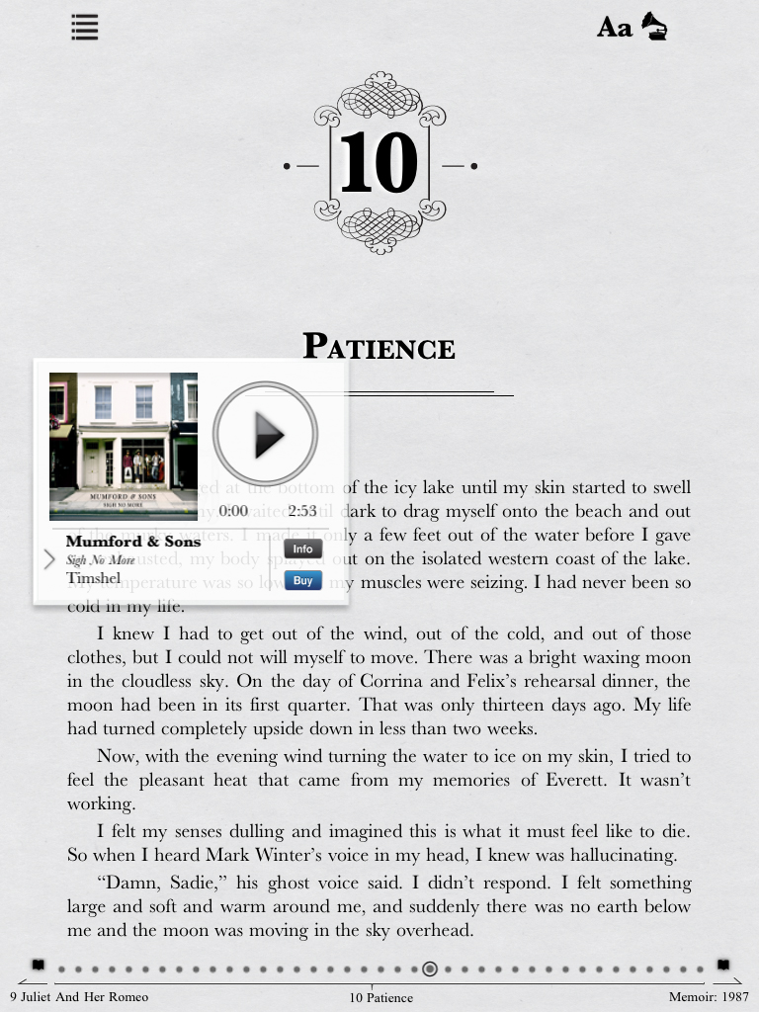
The Survivors

Slide 35
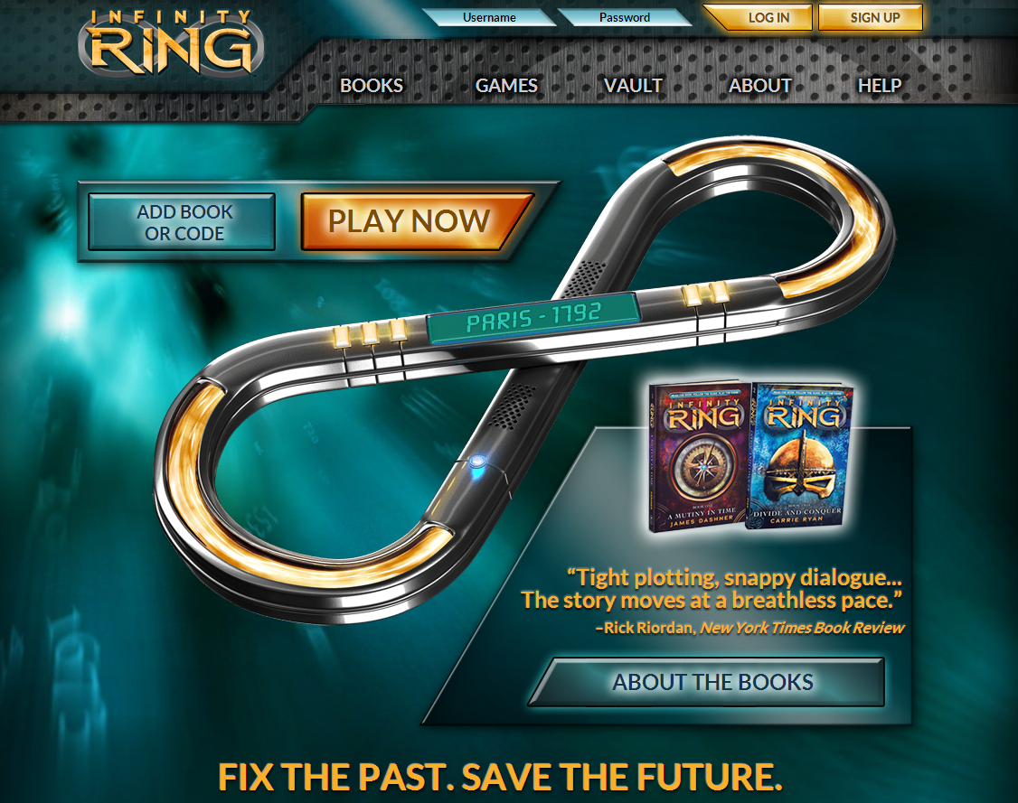

39 Clues and Infinity Ring

Slide 36
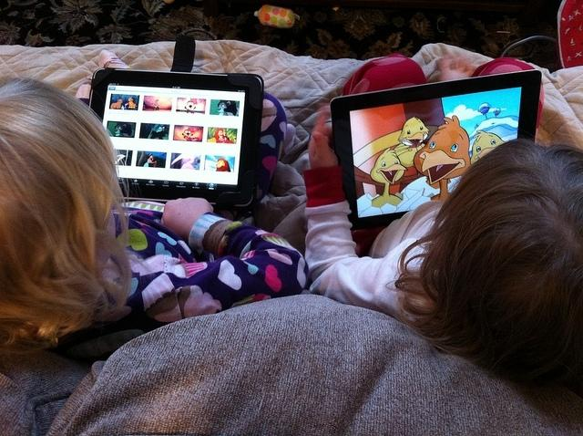
Brave New World
The Modern Toddler iPad Experience by Wayan Vota
Attribution Noncommercial License

Slide 37

Questions?
Thank you.
Rachel McDonald - rmmcdonald@kcls.org
Jackie Parker - jacparker@gmail.com

Slide 38
Infopeople webinars are supported in part by the U.S. Institute of Museum and Library Services under the provisions of the Library Services and Technology Act, administered in California by the State Librarian. This material is licensed under a Creative Commons 3.0 Share & Share-Alike license. Use of this material should credit the author and funding source.

