Slide 1

Optimizing Materials Handling on the Cheap
How to Lean Your Workflow
Lori Bowen Ayre
January 30, 2014
Infopeople Webinar

Slide 2
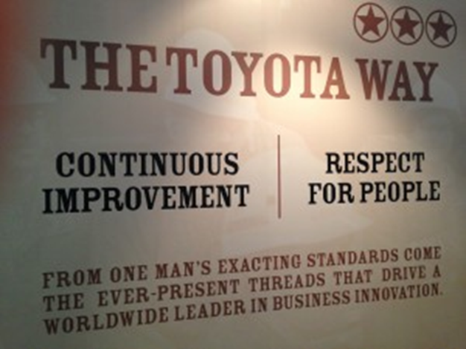
Defining Lean
Lean is a set of concepts, principles, and tools used to create and deliver the most value from the customer’s perspective while consuming the fewest resources.
Notes:
Workflow improvement methodology
Six Sigma
TQM (Total Quality Management)
BPR (Business Process Reengineering)
What I like about it:
Practical
Customer focused
Empowers staff

Slide 3

Value and Value-Add
Lean focuses on effectively delivering value to your customer
Value-add activities
  Are activities the customer is willing to pay for
  Transform the product or service
  Must be done correctly the first time
Notes:
Idea is to look at steps in a workflow based on their value to customer
So, any activity that adds value to the customer is a “value add” activity
Per Lean, three criteria define “value add”
Are activities the customer is willing to “pay” for – “would” pay for?
Transform the product or service – make a difference to the end product
Must be done correctly the first time – are not defective or missing something or the wrong thing

Slide 4
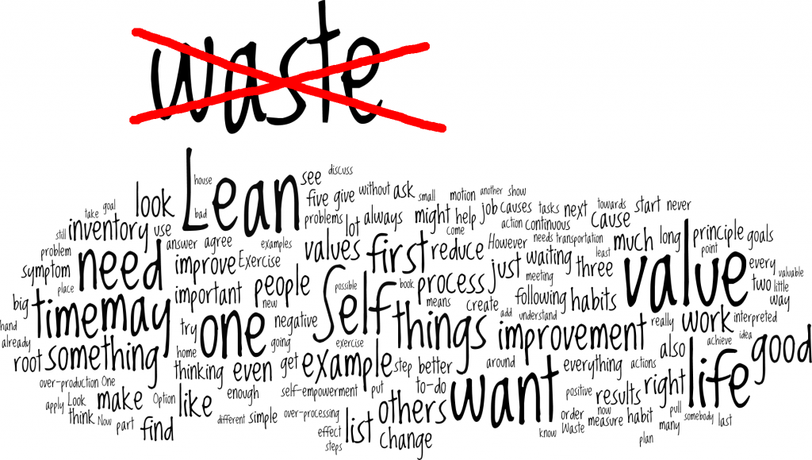
Lean focuses on the elimination of “waste”
(C) 2013 Jens R. Woinowski, leanself.org; Created with Wordle and GIMP
Notes:
If not value added activity it is either waste or “incidental”
Incidental work – requirements that don’t necessarily contribute to the end product
Waste is the arch enemy of Lean.
Waste is anything other than the minimum amount of equipment, materials, technology, space, and worker’s time that are essential to add value to the product, service or information required by the customer.
Waste is a symptom of underlying problems with the system which need to be corrected.

Slide 5
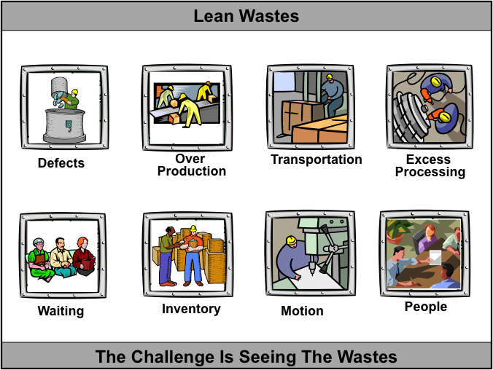
How Waste Happens
Defects
Inventory
Transportation
Extra Processing
Waiting
Motion
Bureaucracy
Notes:
Categories of Waste
Defects – things that have to be fixed or redone
Excessive Inventory – having more than you need or not the right inventory
Transportation – moving things from place to place unnecessarily
Processing – adding processing steps that don’t do anything for customers
Waiting – staging and staging material
Motion – unnecessary handling, hand-offs, and touches
Bureaucracy

Slide 6
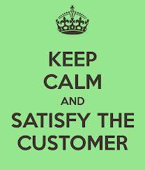
Value Stream
All the activities, materials, people, and information that must flow and come together to provide your customer the value they want, when they want it and how they want it
Notes:
Value Stream – all the linked activities, information, and people that go into delivering the product or service to the customer

Slide 7
PDCA Improvement Cycle
Process of “leaning your workflow”
Plan: determine goals and needed changes to achieve them
Do: implement the changes
Check: evaluate the results
Act: standardize and stabilize the change or begin the cycle again

Slide 8
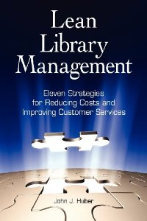
Lean Library Management by John J. Huber
Excellent resource for applying Lean ideas to library workflows
Provides step-by-step instructions

Slide 9
Huber Steps to Leaning Your Workflows
Form Team
Select Value Stream to tackle and set goals
Document the process (value stream)
Analyze the process to find waste
Design new workflow
Implement new workflow and analyze results (measure)
Continue to make adjustments (continuous improvement)
Notes:
These are the basic steps recommended by Huber.
Good about walking you through each of these steps
I don’t want to give you the reader’s digest version of his book
But I do want to highlight a couple of things….

Slide 10
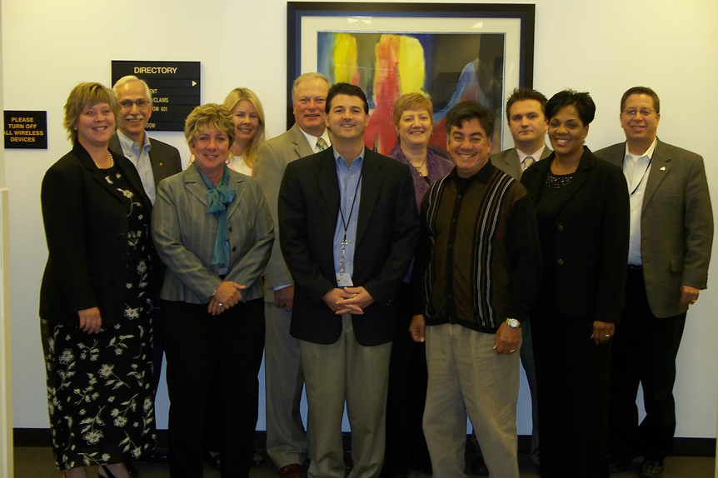
Lean is an Organizational Effort
The people who do the work are the experts – they must be involved
Management support critical
Top Down and Bottom Up
Notes:
The people who do the work are the experts – they must be involved
People who really know the workflow and why certain things are done
Point is to empower and engage everyone at every level
Management support critical too
Process takes time and Lean Team needs to be released to do the work
Process results in change – Management needs to support those changes

Slide 11
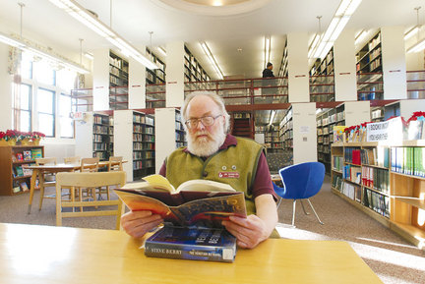
Define Value Stream in Customer Terms
Not a Value Stream: processing bookdrop
Value Stream: shorten return to shelf time (RTS) for bookdrop returns

Slide 12
Use Value Stream and Process Maps
Value Stream Map – high level view
Designed for leadership (people who can authorize changes)
Process Maps – micro view of each step
Created by people doing the work
Includes:
  Each step of process
  Person doing the work
  Equipment used
  Handoffs
  All “wait times”

Slide 13
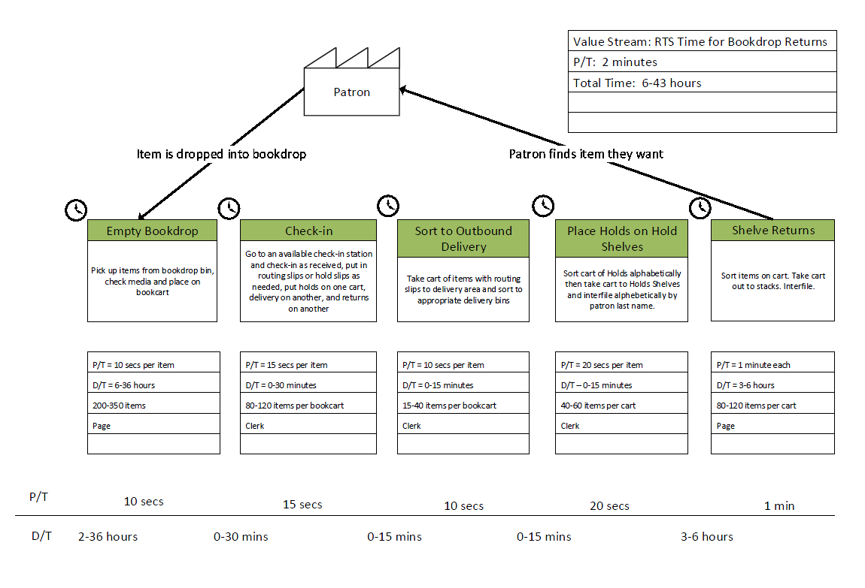

Slide 14
Process Map

Slide 15
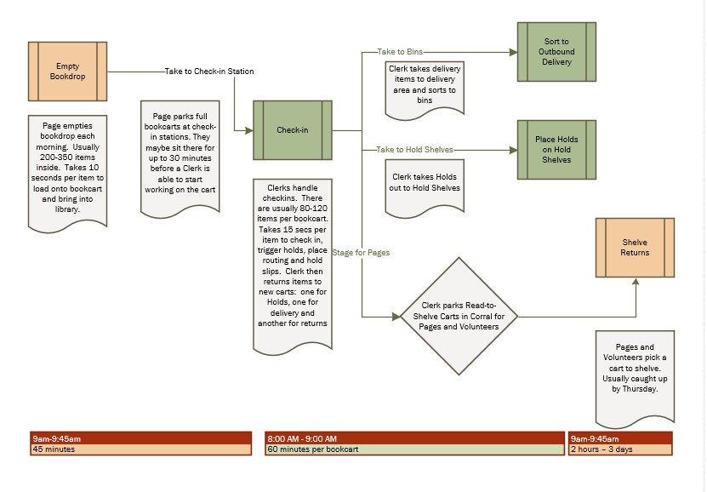
Bookdrop Returns Workflow

Slide 16

Analyze the Process and Find the Waste
Notes:
With the Team…..

Slide 17

Critical Questions for the Team
Do we really need all these steps?
How can we eliminate all delays and make this process flow?
  adjust work assignments
  plan around “peak” volumes
  simplify!
What equipment changes would make a difference?
Notes:
Find steps
That can be eliminated or combined
That can be divided into smaller steps
That can be changed in sequence
That can be moved
That can be aided with tools or equipment
Requiring a special skill that can be simplified
That can be automated

Slide 18
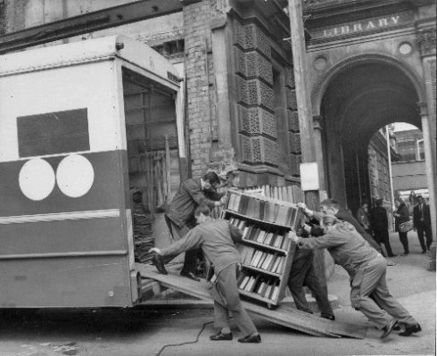
Find Ways to Eliminate…
Excessive walking, reaching, or bending
Wait times and delays
Errors and defects
Handoffs between people
Transfers of material

Slide 19
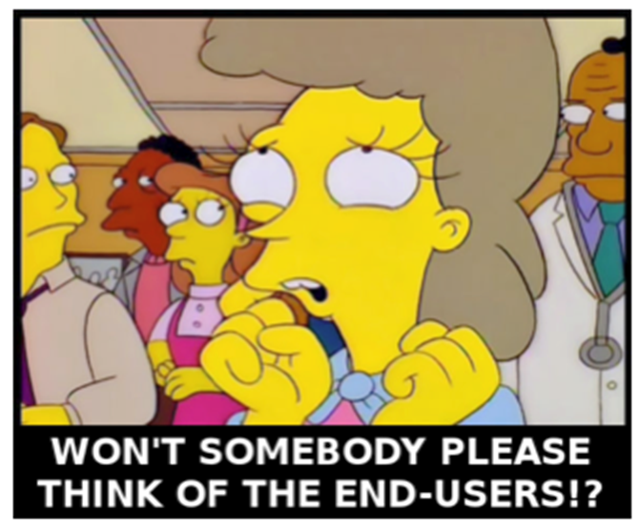
Implement New Workflow and Begin Monitoring Results
Not as easy as it sounds
  may require new equipment
  may require training
  will undoubtedly require workspace changes
Make sure you are doing the measurements that will tell you how you are doing – in terms of value to the customer
Notes:
Make sure measurements measure the right thing - RTS Holds 1 business hour from notices going out
RTS Returns before opening
Transit Returns/Holds in Bookdrop – out same day a.m. delivery

Slide 20
Focus on labor efficiency and productivity AFTER the process has been streamlined, batch sizes reduced and lead times reduced.
(Huber)

Slide 21
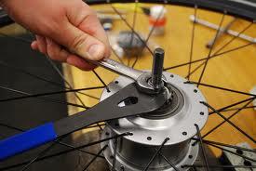
Continue to Make Adjustments
Notes:
Don’t get discouraged if you don’t hit the mark the first time, this is an iterative process

Slide 22
Continuous Improvement
An important Lean principle because…
  Conditions change
  Always room for improvement
Everyone should be looking for those improvements every day
Many Lean tools to support continuous improvement
Notes:
David Mann, author of Creating a Lean Culture

Slide 23
Visual Management
Goal: status of system can be understood at a glance for everyone

Slide 24
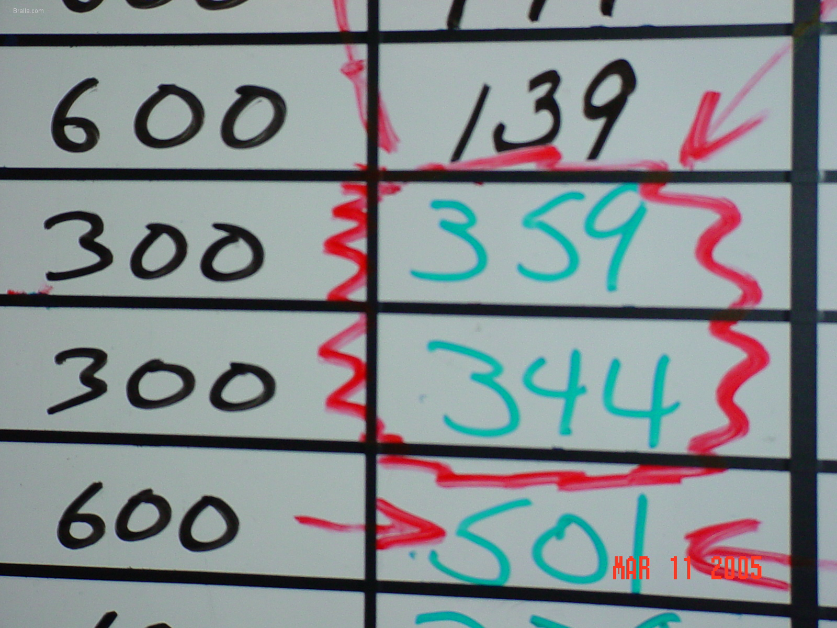
  Display Boards Showing Goals and Key Metrics
Notes:
Lean environments convey critical information with a glimpse of an eye.
A Lean environment should enable everyone — even an outsider — to understand the status and state of affairs. How are you doing? All at a glance
Use simple techniques like floor tape and labels to show when something is out of place or has spilled over.
performance trend charts for key metrics
everyday so you start to see the patterns and how well you are handling peaks
e.g. to see if you are hitting your metric for getting bookdrop returns shelved – track each bookcart (capture when it was loaded, number books, number media, time shelved)
Visual Management
Communications Board
Why U shaped work areas matter
Importance of FIFO to “flow”
Examples of posters to document performance
How to defining and arrange work areas

Slide 25
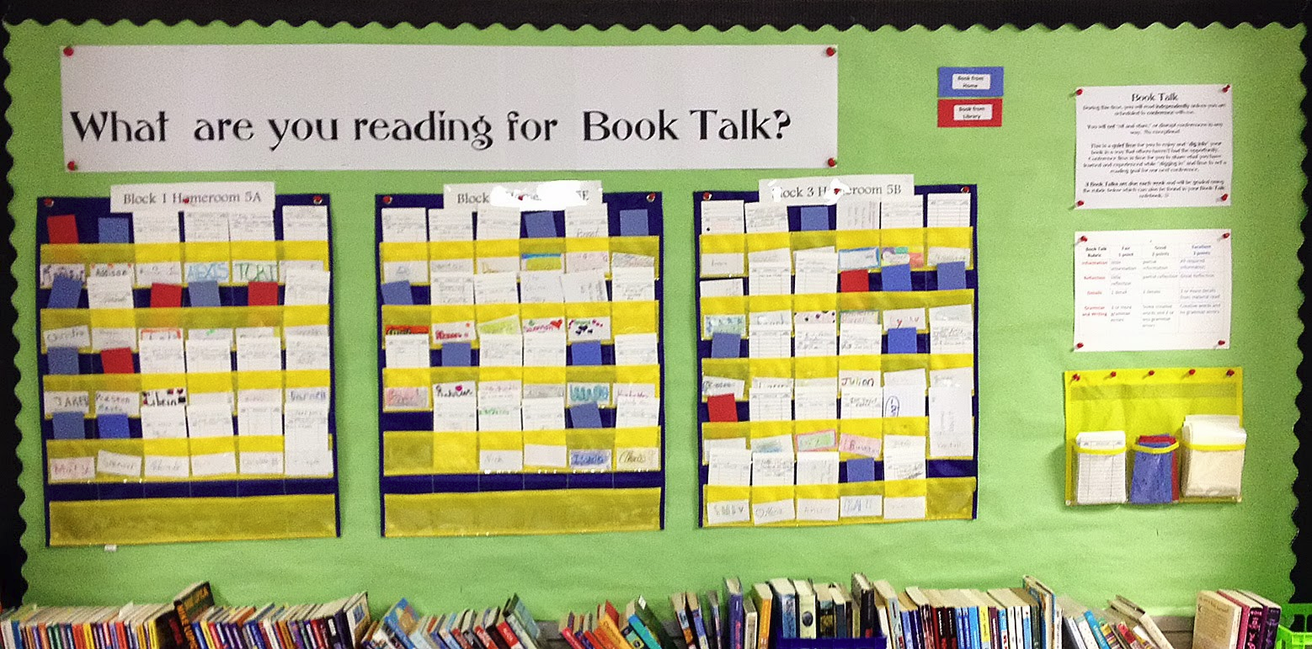
Teachers are Naturals at Visual Management!
Notes:
Blue card – reading a book from home
Red card – reading a library book
White card – reading book owned by teacher

Slide 26
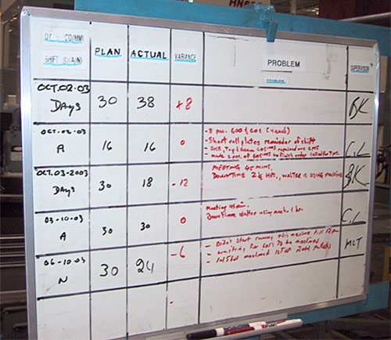
Display Board Reveal Problems to Address

Slide 27

Labeling Work-in-Progress

Slide 28
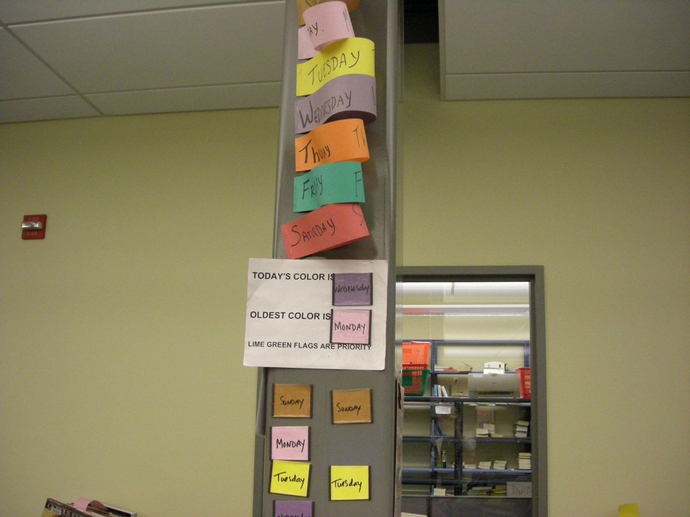

Slide 29
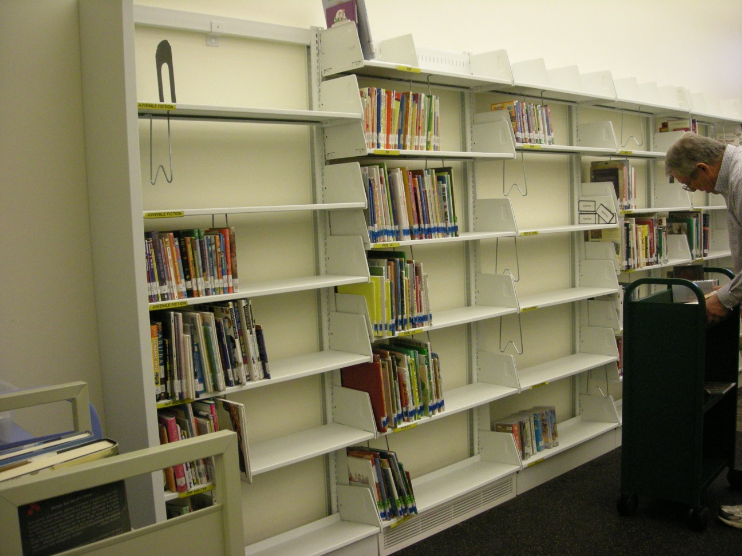
“Sorting” Shelves are NOT Visual Management
Don’t know how bad backlog is
Wasted steps of shelving and unshelving

Slide 30

Lean Tool: Five Ss of Efficiency
Notes:
Sort: RETAIN items essential to work area, RETURN items belonging elsewhere, get RID of everything else
“Only what is needed, in its proper place, clean and ready to use
2. Straighten: find a place for every essential item and put everything in its place and delineate and label it
3.

Slide 31
#1 Sort
Retain, Return, Rid
Only what is needed, in its proper place, clean and ready to use
When in doubt, move it out

Slide 32
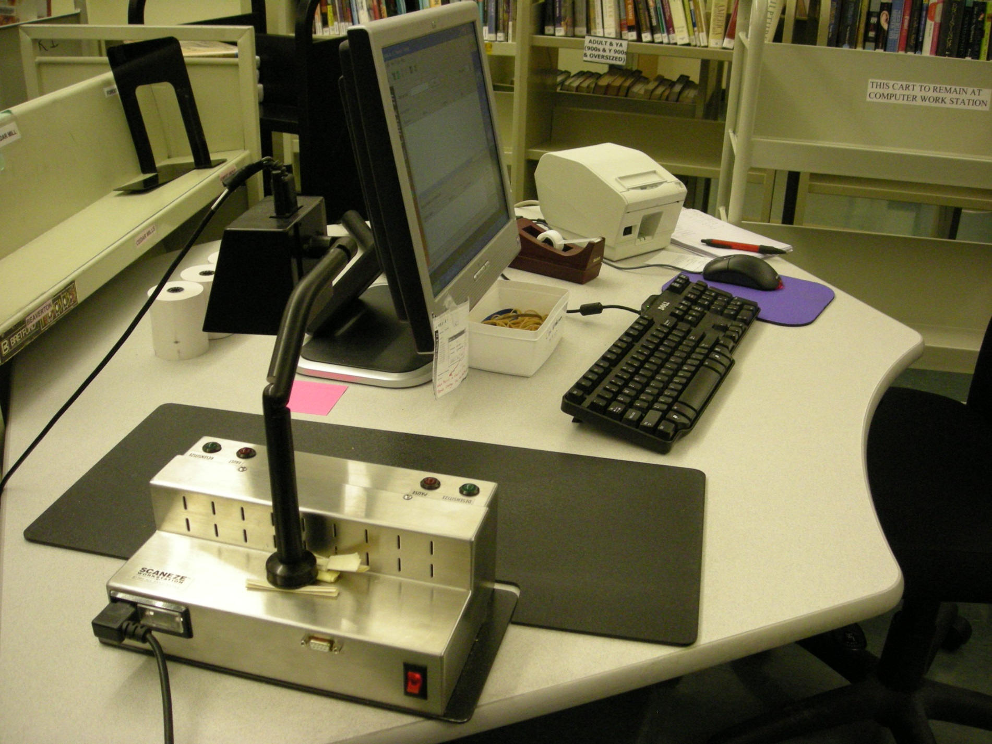
Tidy Work Space

Slide 33
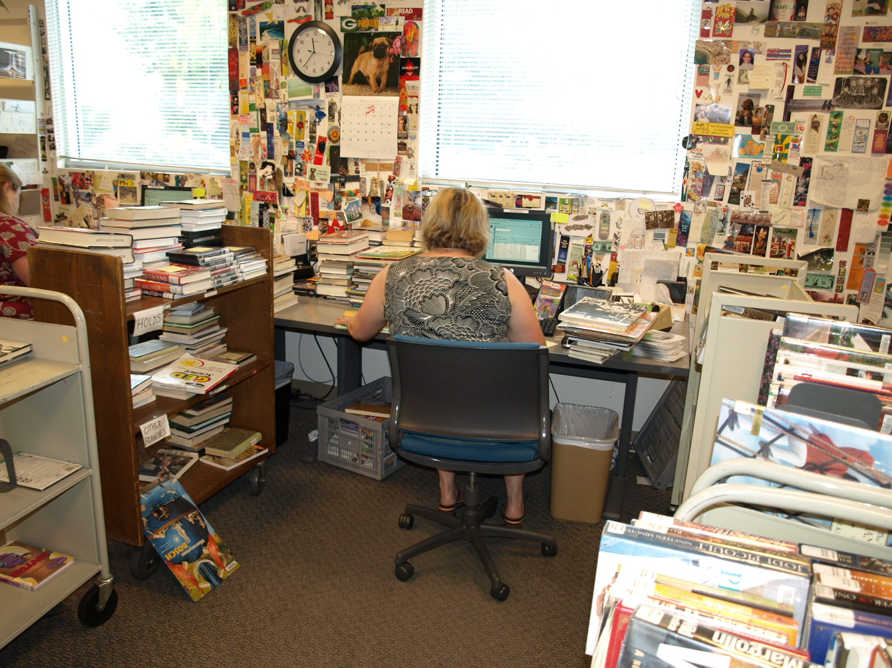

Slide 34
#2 Straighten
Find a place for every essential item, delineate it and label it
A place for everything and everything in its place

Slide 35
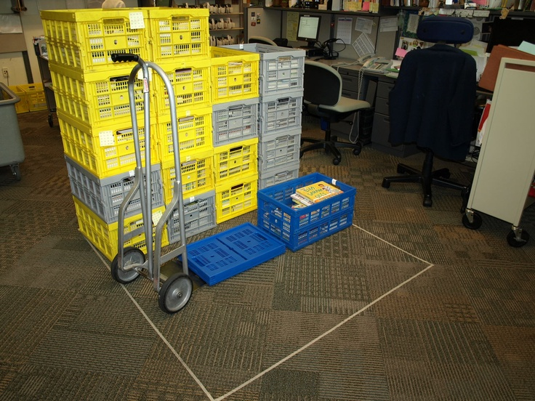

Slide 36
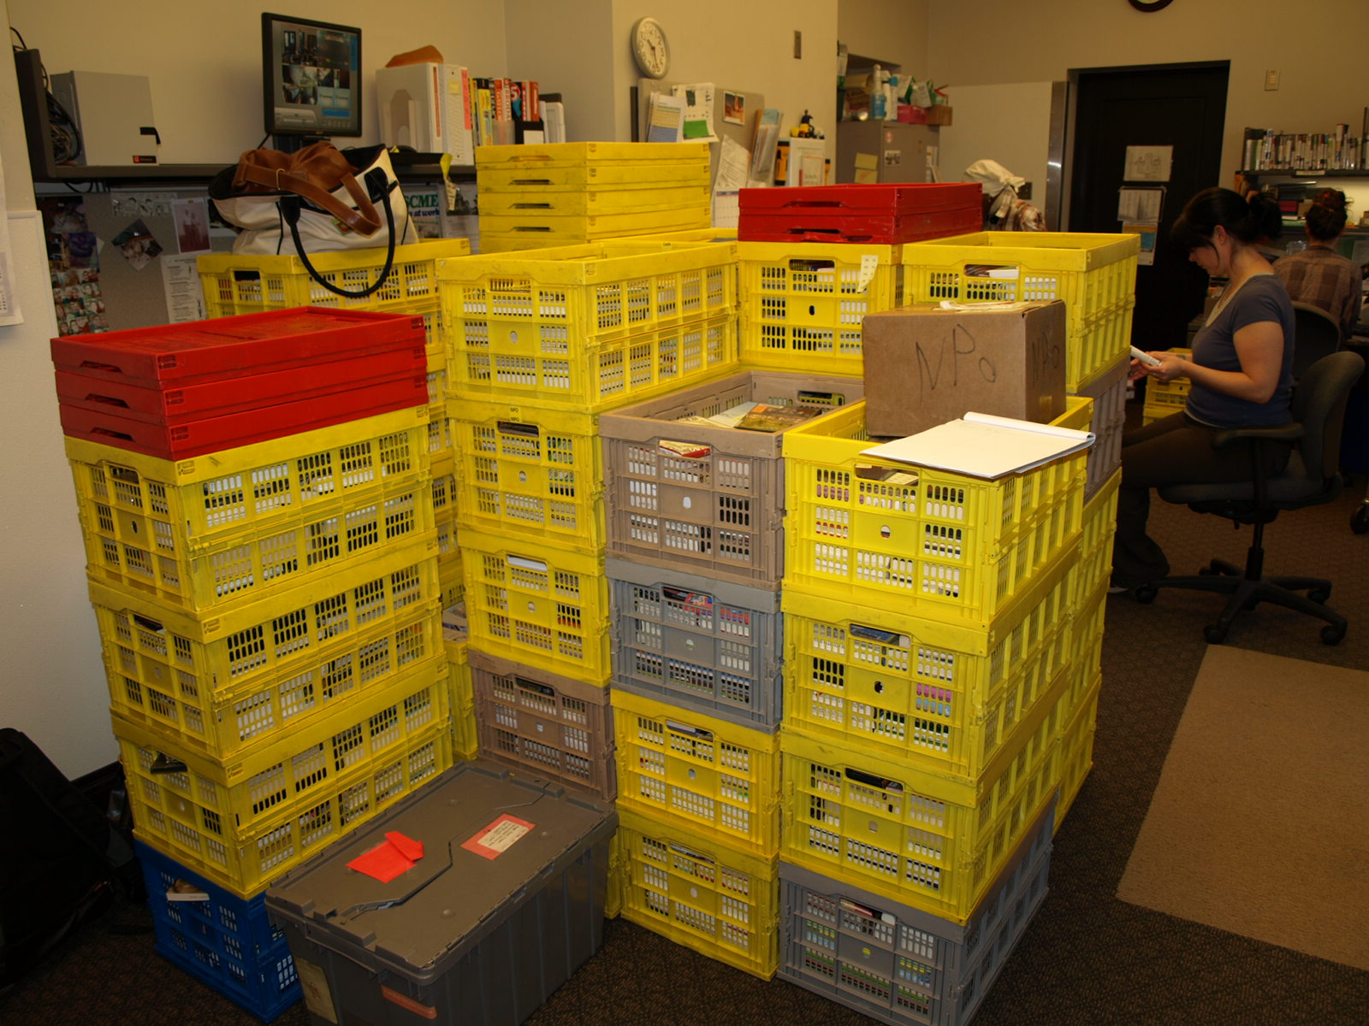

Slide 37
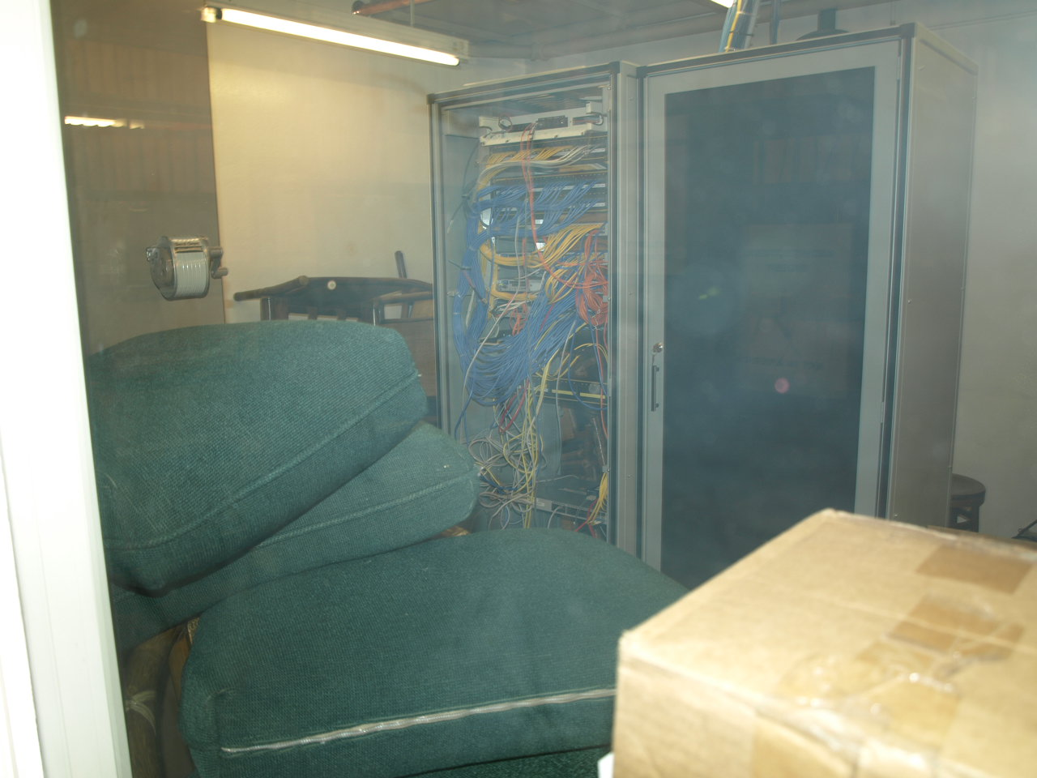
#3 Scrub
Clean work areas make everyone feel better, are safer, and reveal problems

Slide 38
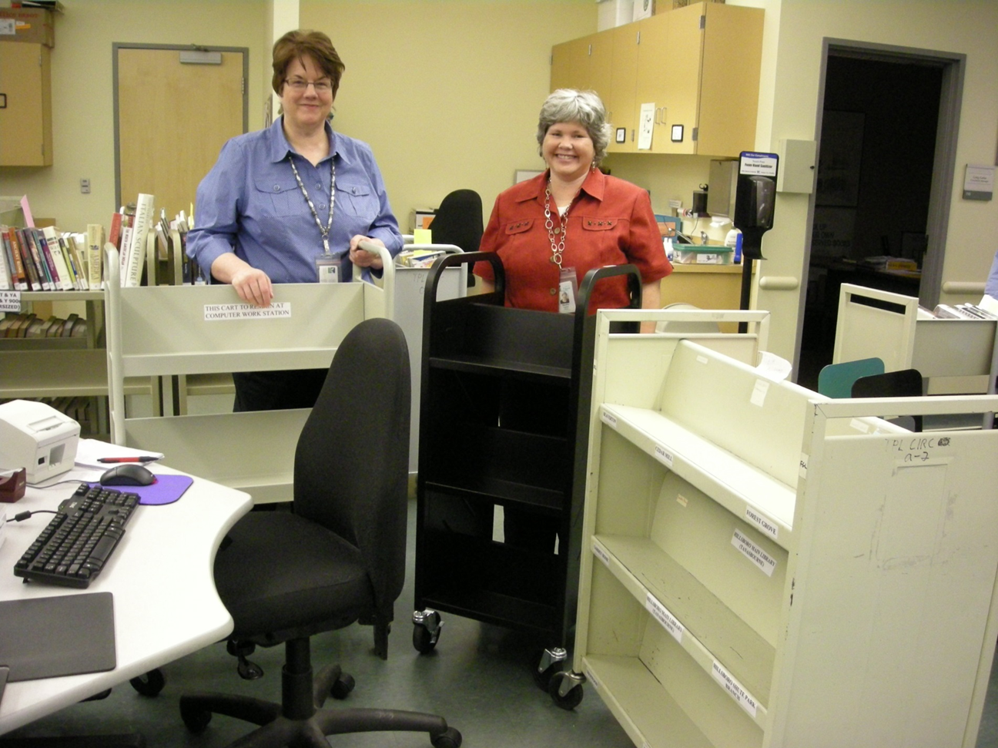
#4 Systematize
Keep area
organized
orderly
clean

Slide 39
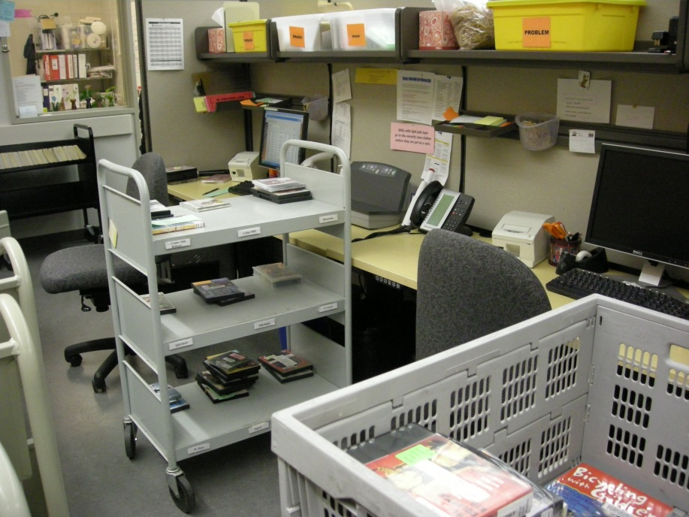
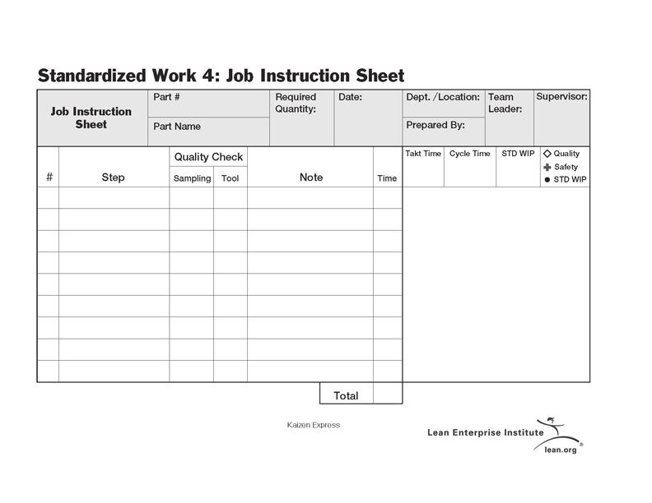
# 5 Standardize
Make this the new status quo
“Standardized Work”

Slide 40

Where libraries often go wrong

Slide 41
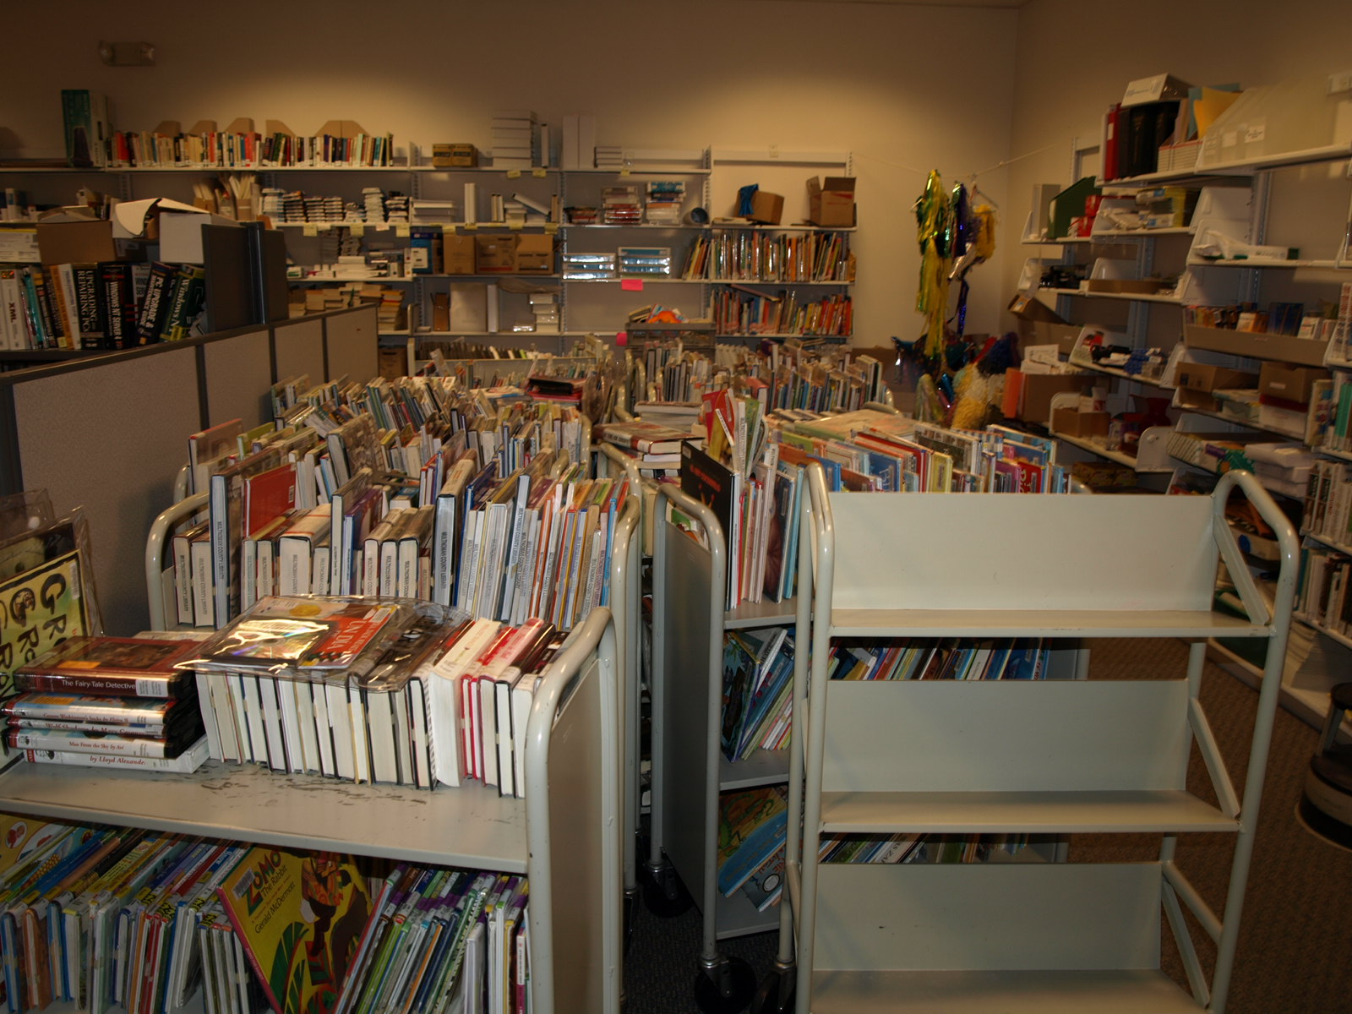
Bookcart Defines the Batch Size
"Large batches are the result of placing too much emphasis on labor efficiency and not enough on delivery lead times or the performance of the service chain as a whole." (Huber)

Slide 42

Think Differently About Bookcarts
Okay NOT to fill a bookcart
Better ergonomically
Limiting items on bookcart to smaller batch can reduce need to presort
Notes:
Bookcarts are just staging areas on wheels

Slide 43


Slide 44
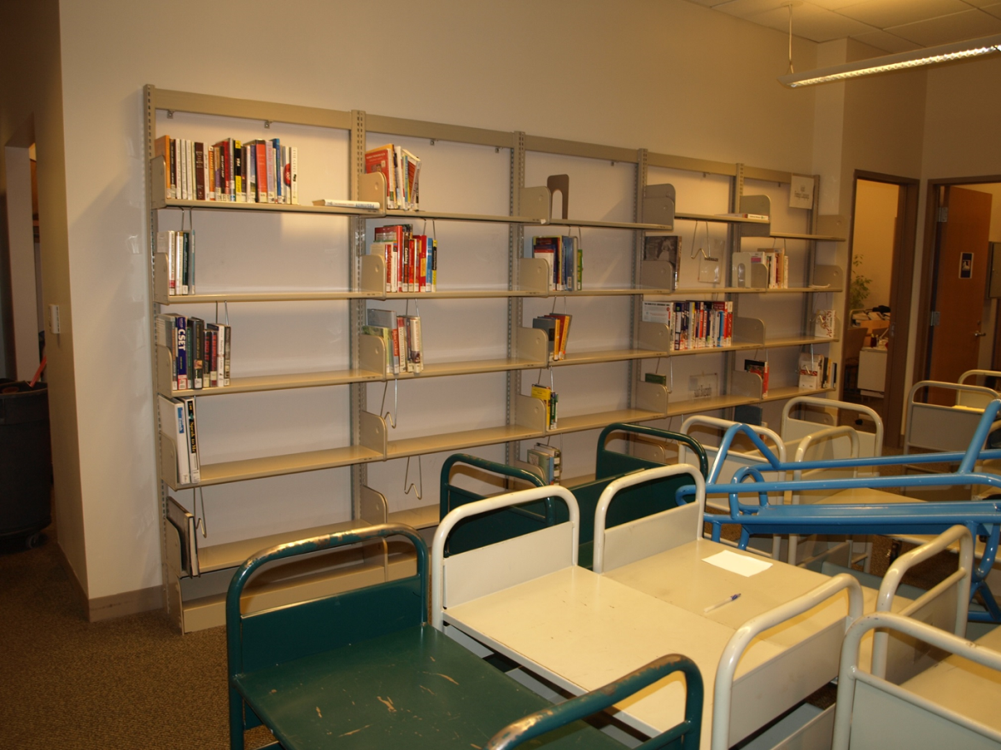
Reliance on Staging Areas
Libraries use lots of different things for staging:
Sorting carts
Ready to shelve carts
Sorting shelves
Stacks
All of the above!

Slide 45
"Staging areas hide inefficiencies and imbalances between workstations and staff, and they are an open admission by management that they have designed into the service flow imbalances and delays“ (Huber)

Slide 46
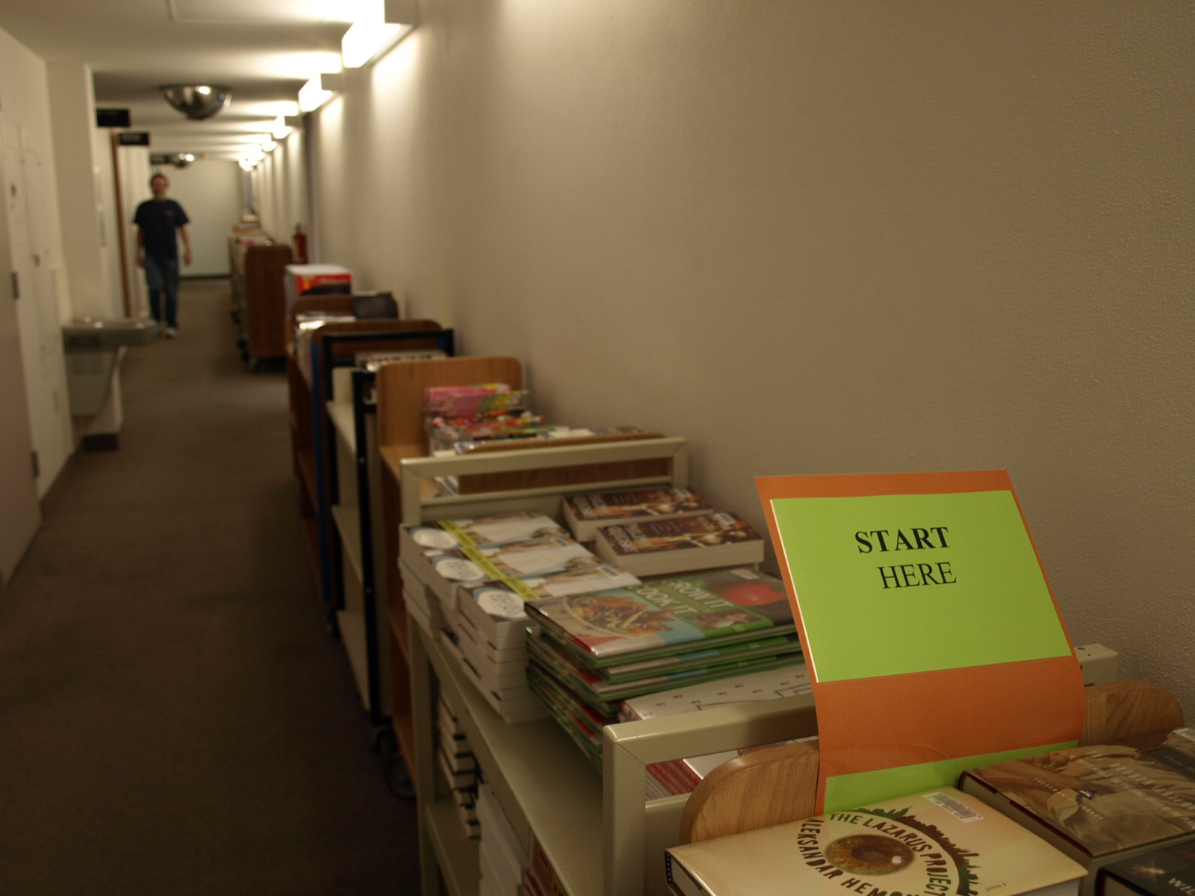
Lack of Acquisitions Master Schedule

Slide 47
Exceptions and Expedited Workflows
Expedited Workflows (holds, media)
Volunteers who choose material they want to shelve instead of what needs to be shelved
Staff unwilling to pitch in to help when needed
Very difficult to design a workflow with lots of exceptions

Slide 48
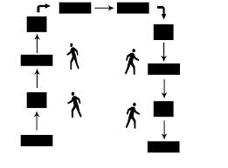
Make a Single Workflow
You should be able to stand in the middle of a process and see where everything is and how everything is doing (U-shape)
Notes:
Exceptions make spaghetti
Think about whether you really need to set something down that’s in your hands right now to do something else or can we make the process work without doing that?

Slide 49
Rigid Staff Roles
Surges are a way of life (delivery, holidays, new acquisitions)
Implement flexible job descriptions
Cross train staff so they can be more flexible about handling surges
Seeing the bottlenecks and clogs in the flow isn’t useful if you can’t put resources to the task of unclogging

Slide 50
“If the current organizational structure cannot change, then the processes behind this organizational structure cannot change either” (Huber)

Slide 51

San Jose Lessons Learned
Don’t need staging areas for sorting
Sort only to top shelves of book carts
Two return slots are better than four

Slide 52
San Jose’s Lean Project
Time for returned materials back to shelf went from 23 hours to 15 hours
20% reduction in labor costs
Improved employee productivity and morale
Improved space utilization
Staff re-assigned to relational work

Slide 53
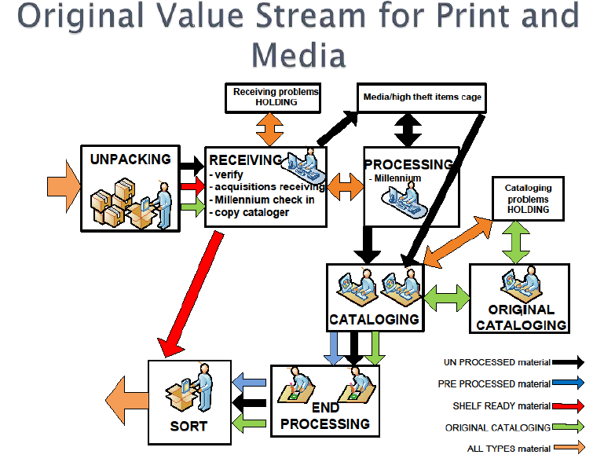
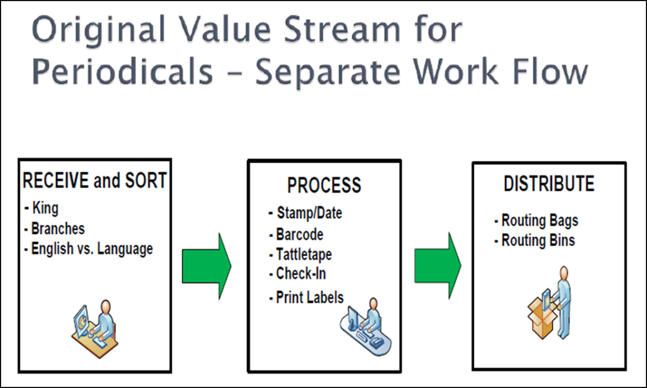
San Jose’s 2nd Lean Project

Slide 54
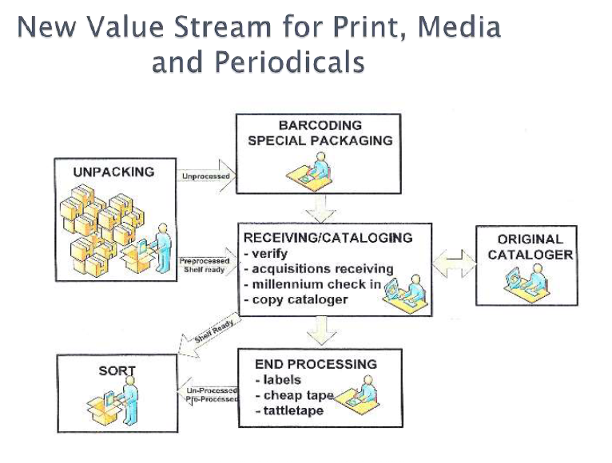
New Value Stream for Print, Media and Periodicals

Slide 55
Getting Started with Lean
Huber, John J. (2011) Lean Library Management: Eleven Strategies for Reducing Costs and Improving Customer Services, Neal-Schuman Publishers, New York.
Review SJPL Presentation (CLA 2012)
Free webinars from Lean office consultant Karen Martin: http://www.ksmartin.com/webinars/

Slide 56
Questions?
Thank you.
Lori Bowen Ayre
lori.ayre@galecia.com

Slide 57
Infopeople webinars are supported in part by the U.S. Institute of Museum and Library Services under the provisions of the Library Services and Technology Act, administered in California by the State Librarian. This material is licensed under a Creative Commons 3.0 Share & Share-Alike license. Use of this material should credit the author and funding source.

