Slide 1
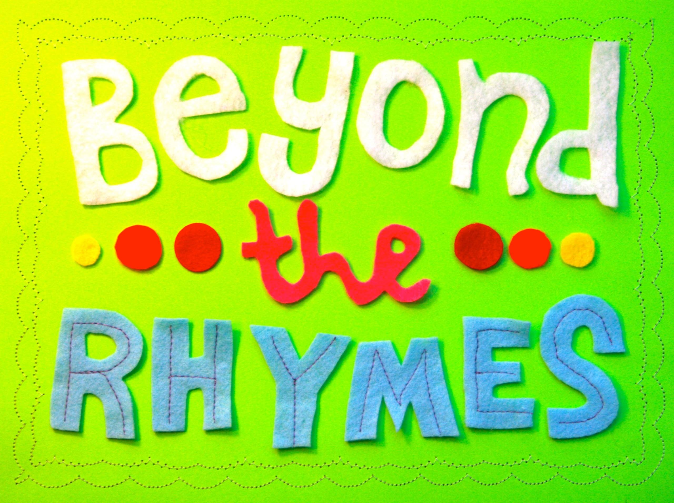
The Early Learning with Families @ Your Library (ELF) 2.0 presents
Thursday, February 6, 2014

Slide 2
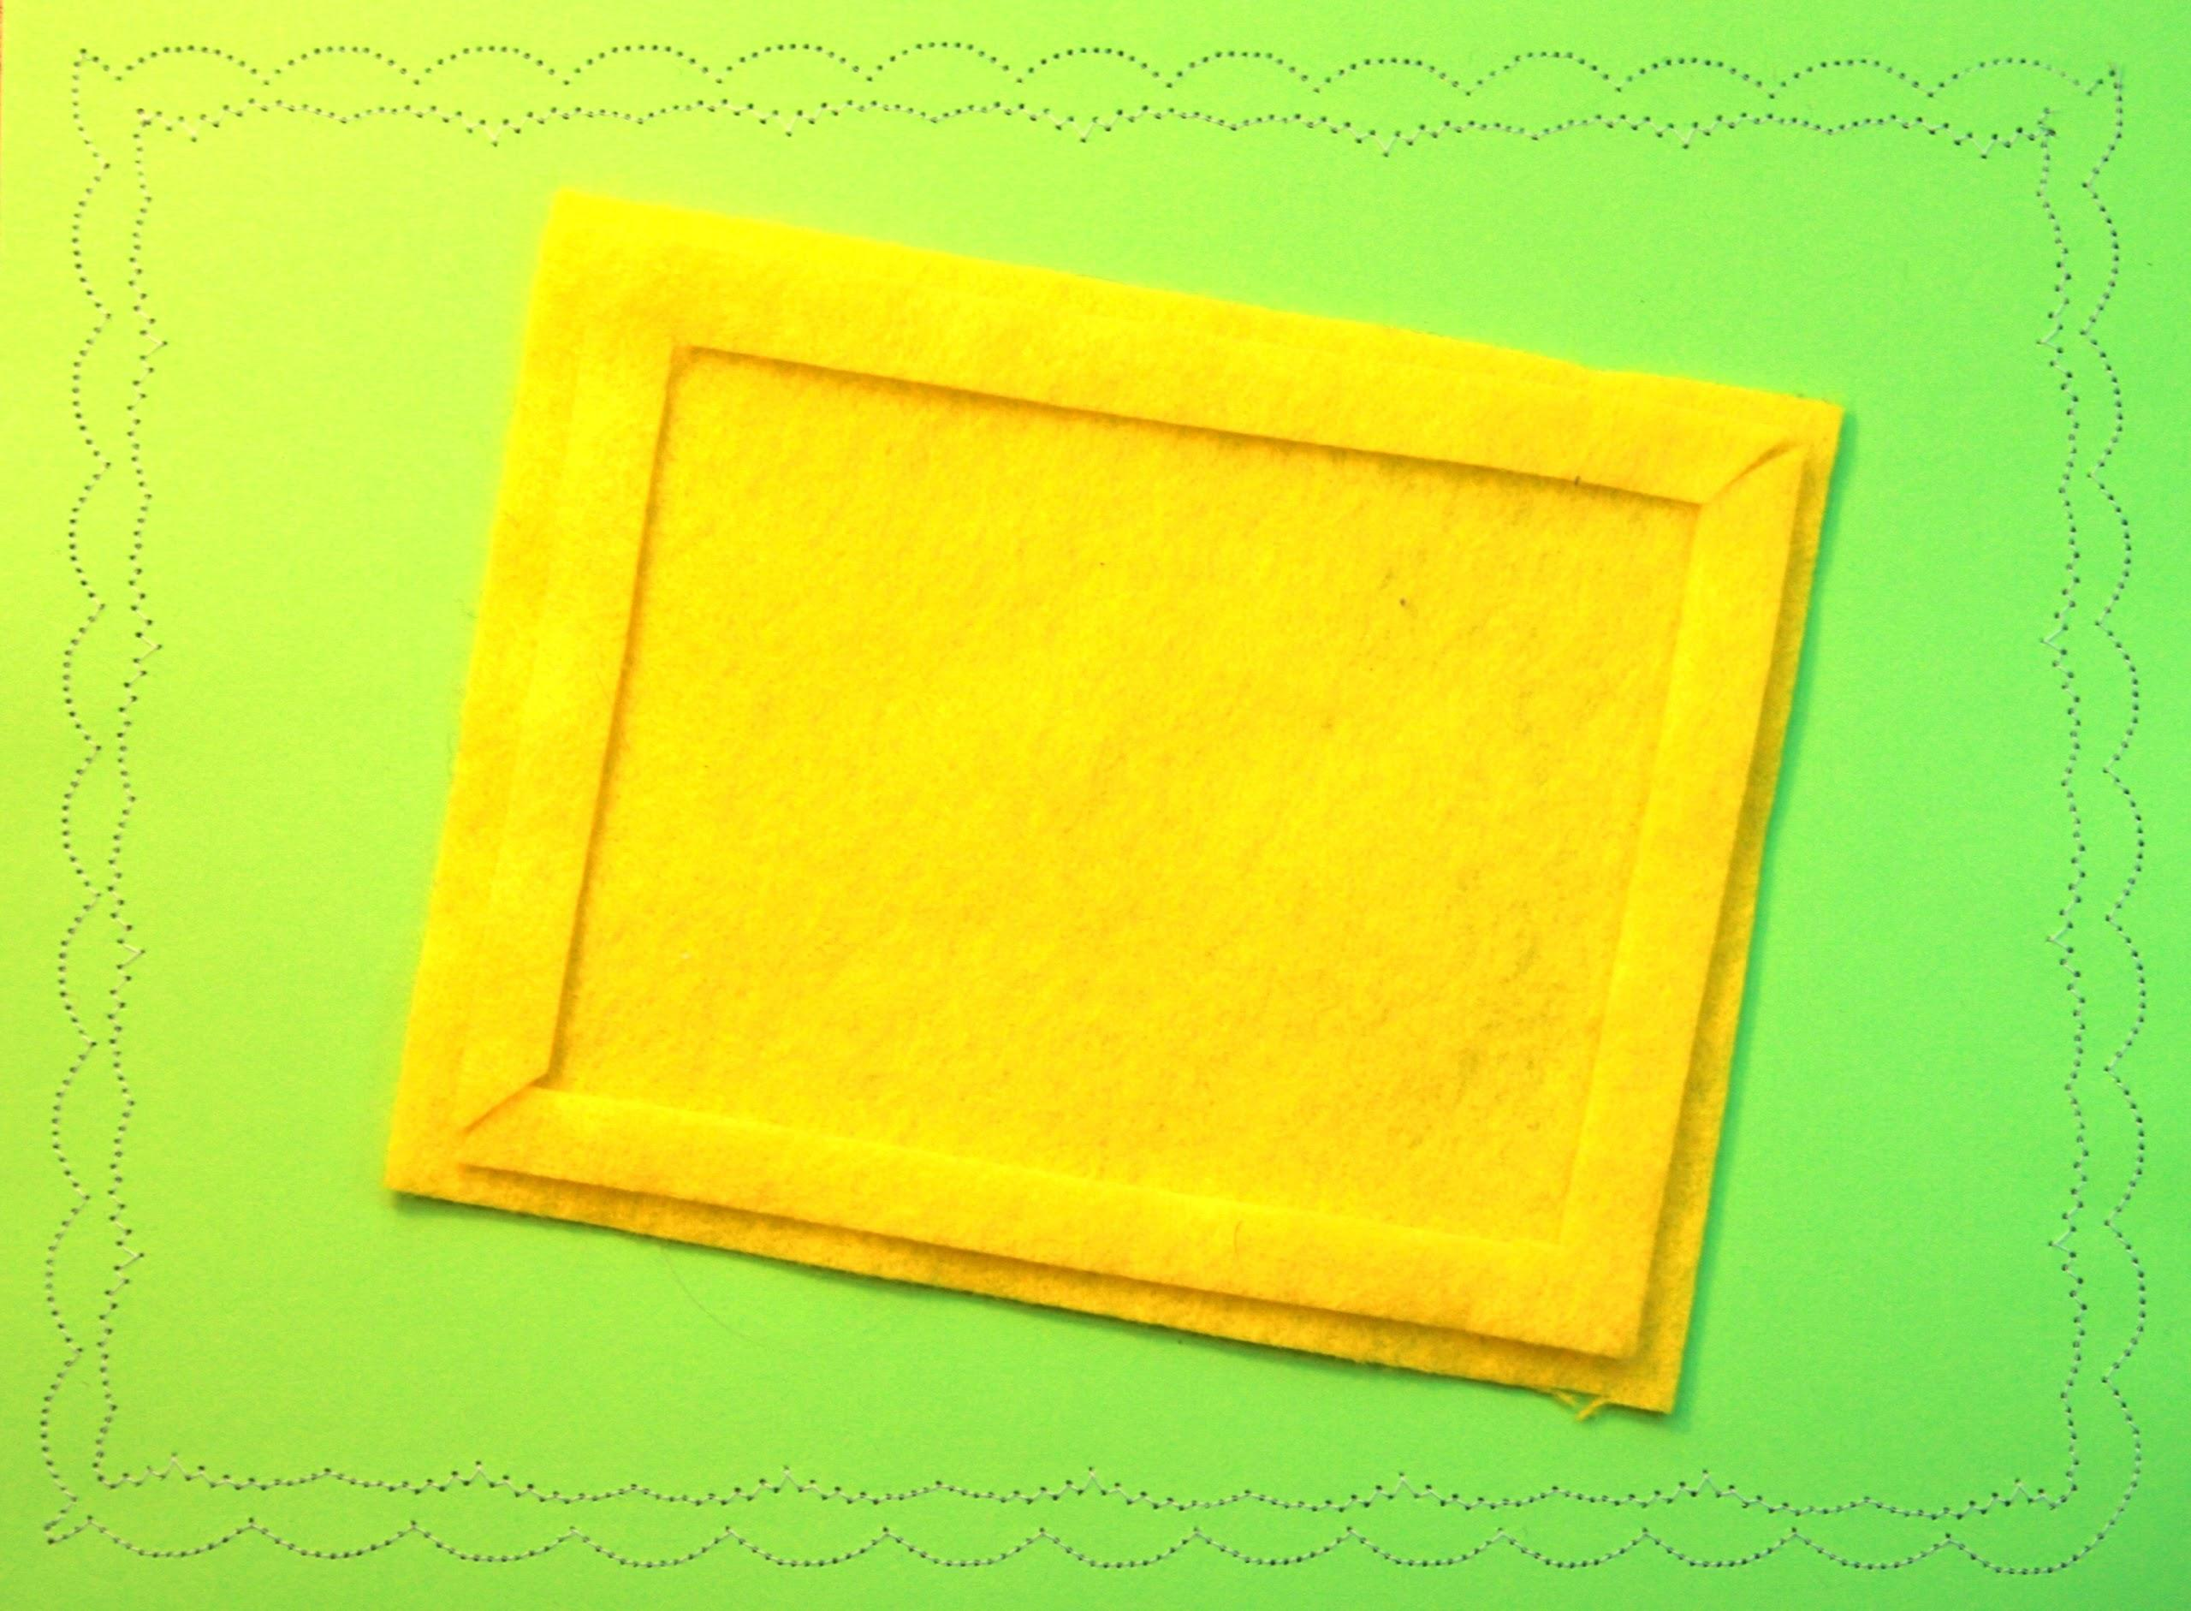
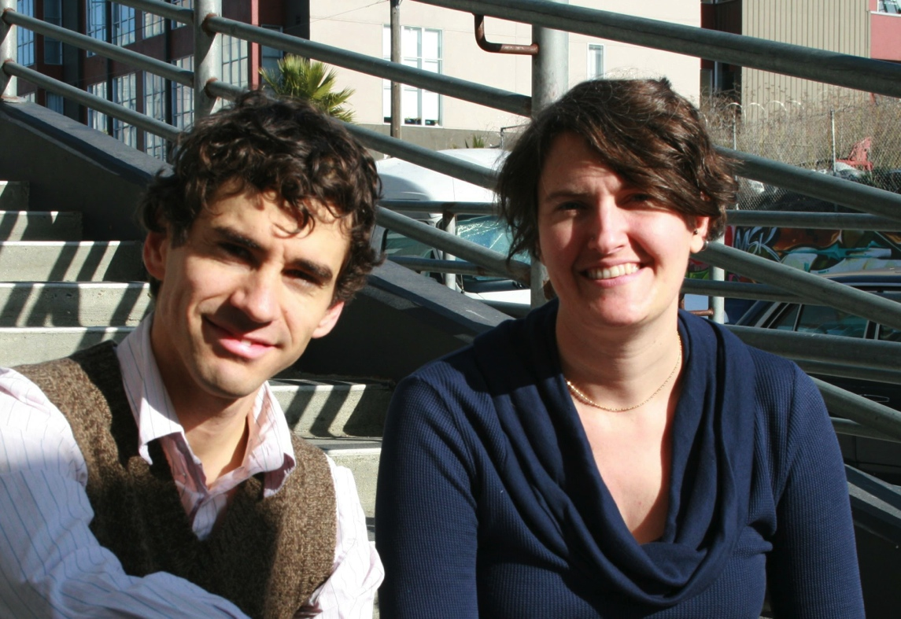
heidi dolamore
patrick remer

Slide 3
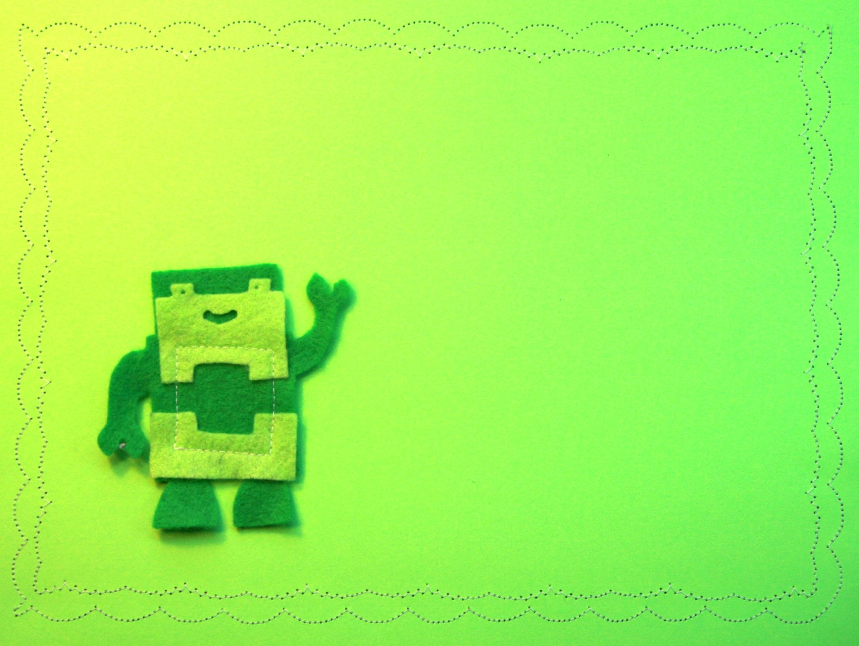
1
the PEOPLE
-
2
the place
-
3
the package

Slide 4
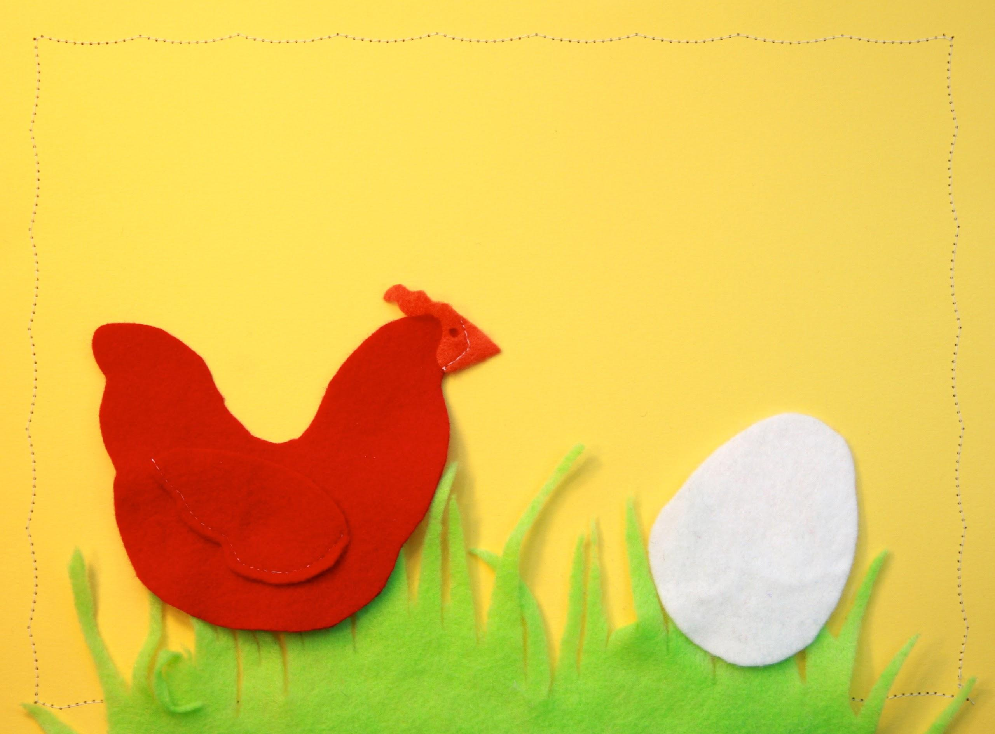
chicken and the egg LEADERSHIP

Slide 5
share the love
get others into it

Slide 6
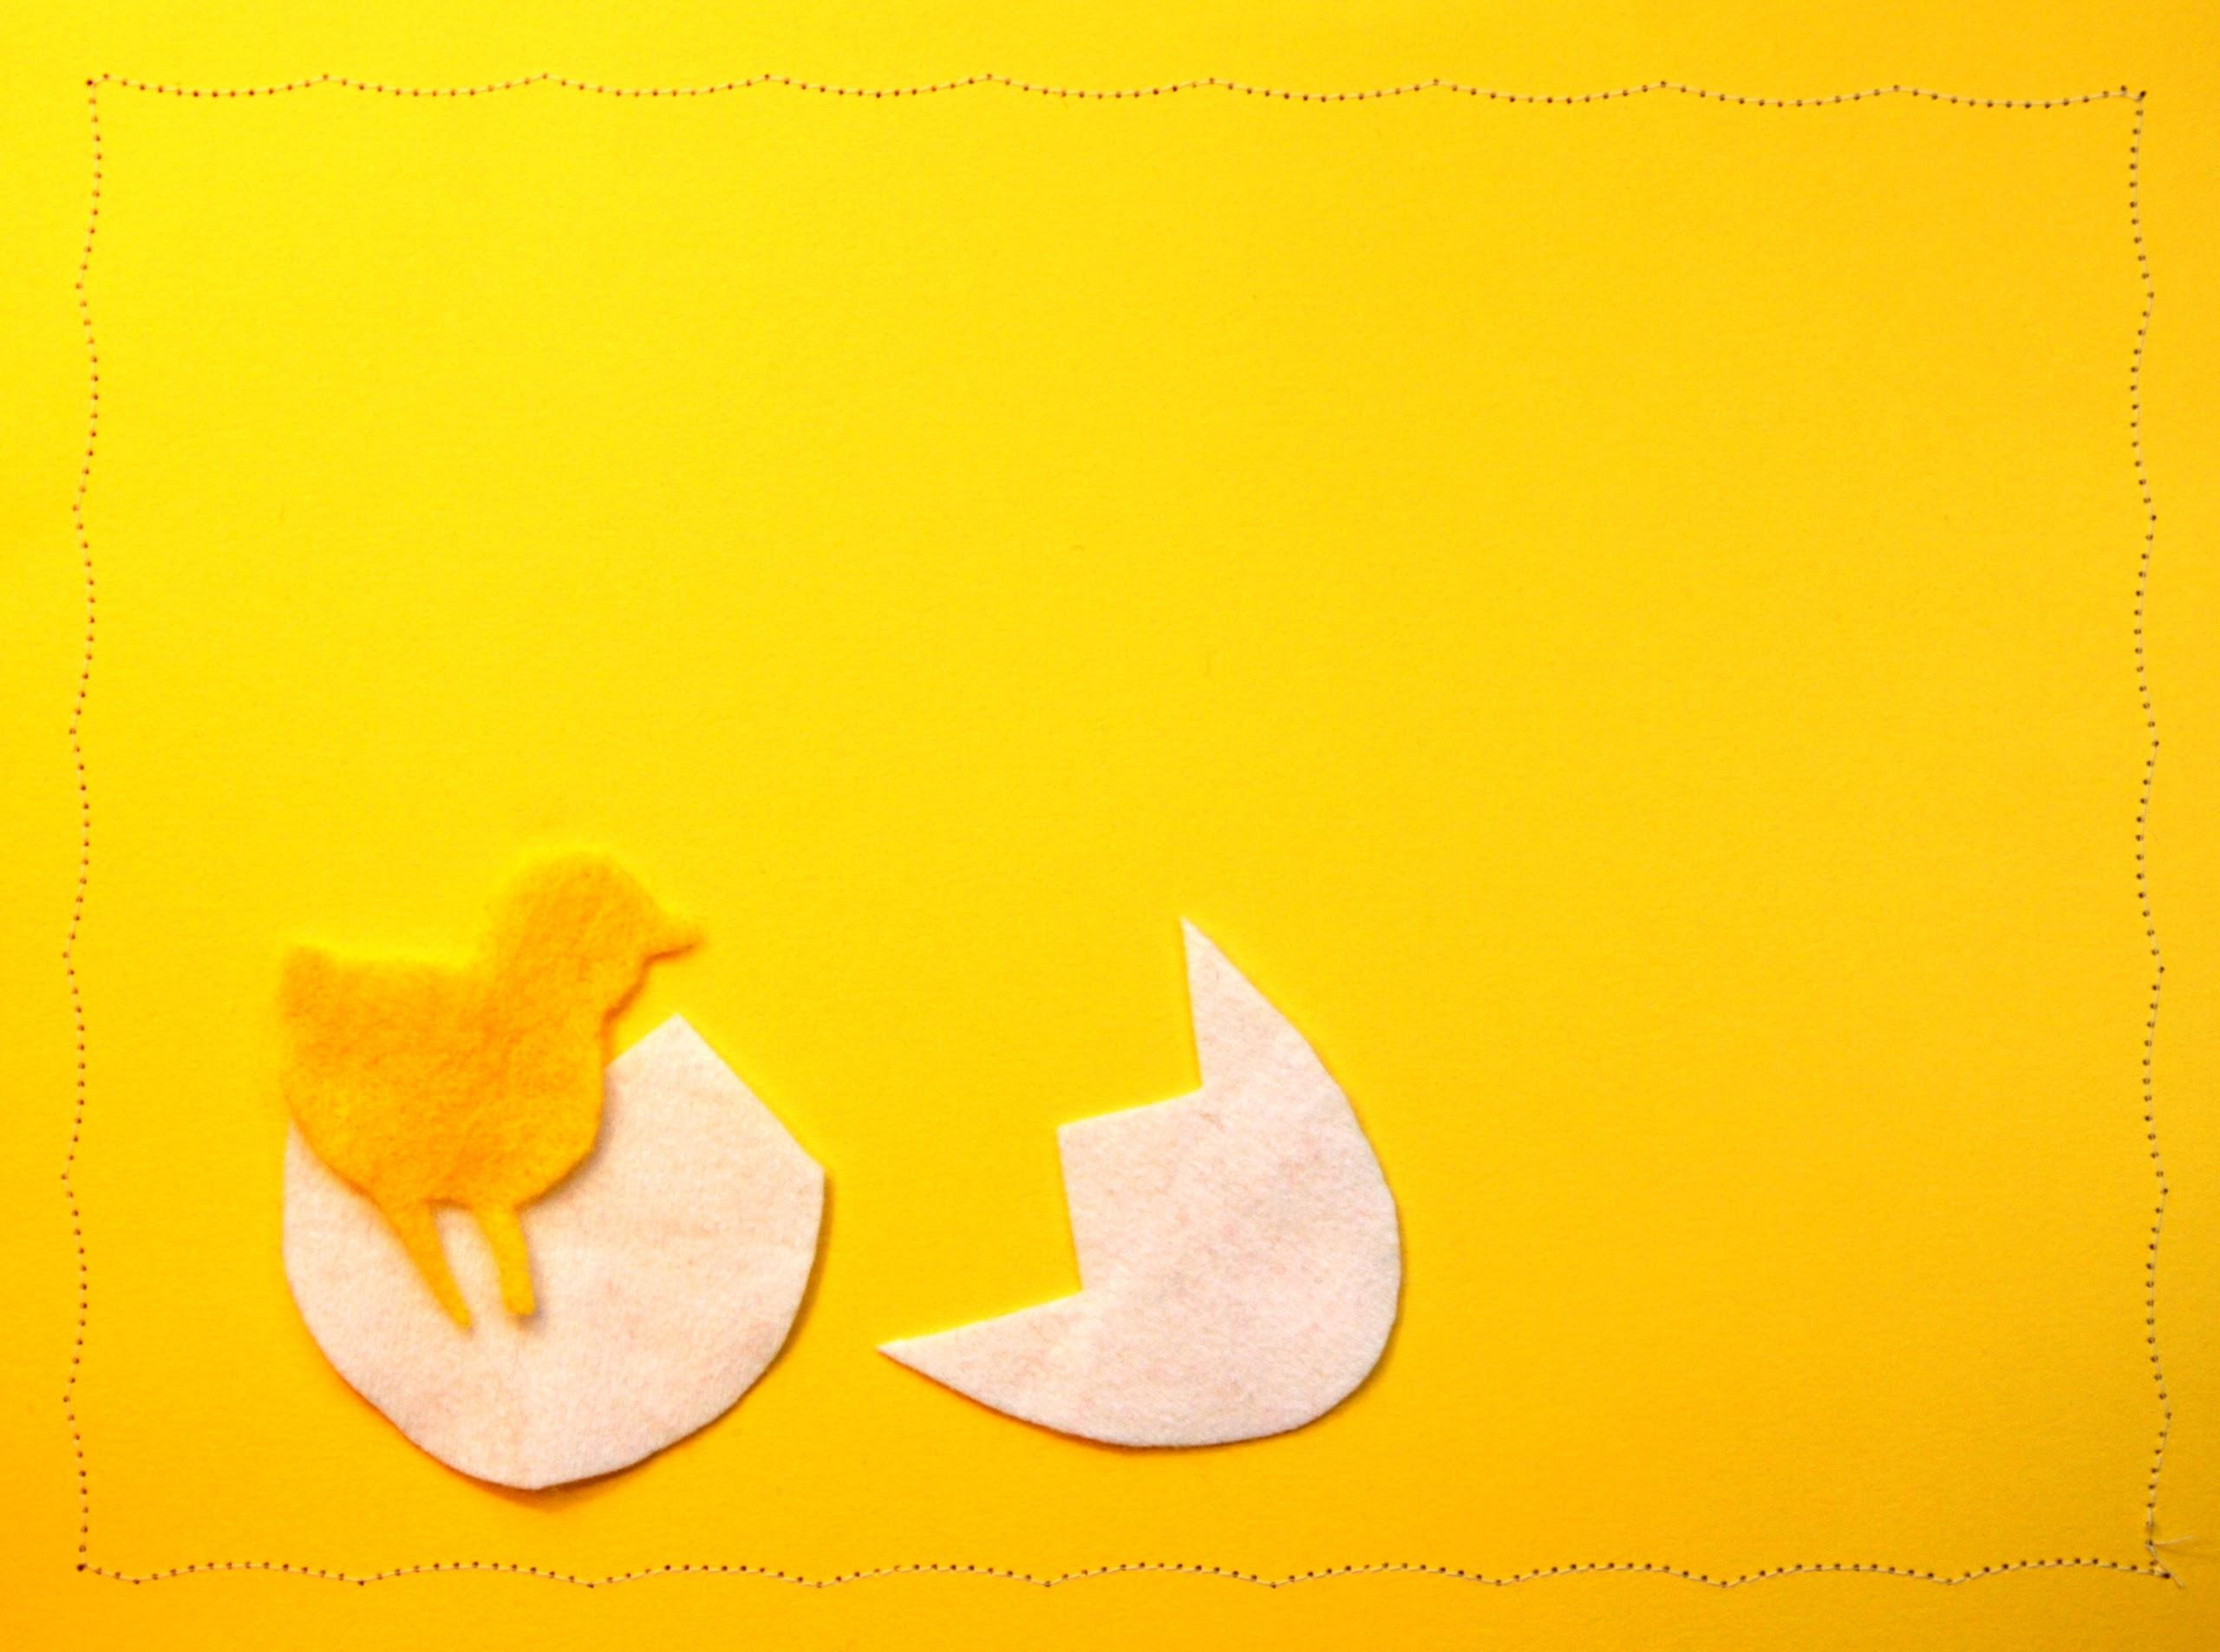
study, plan,
and get involved

Slide 7
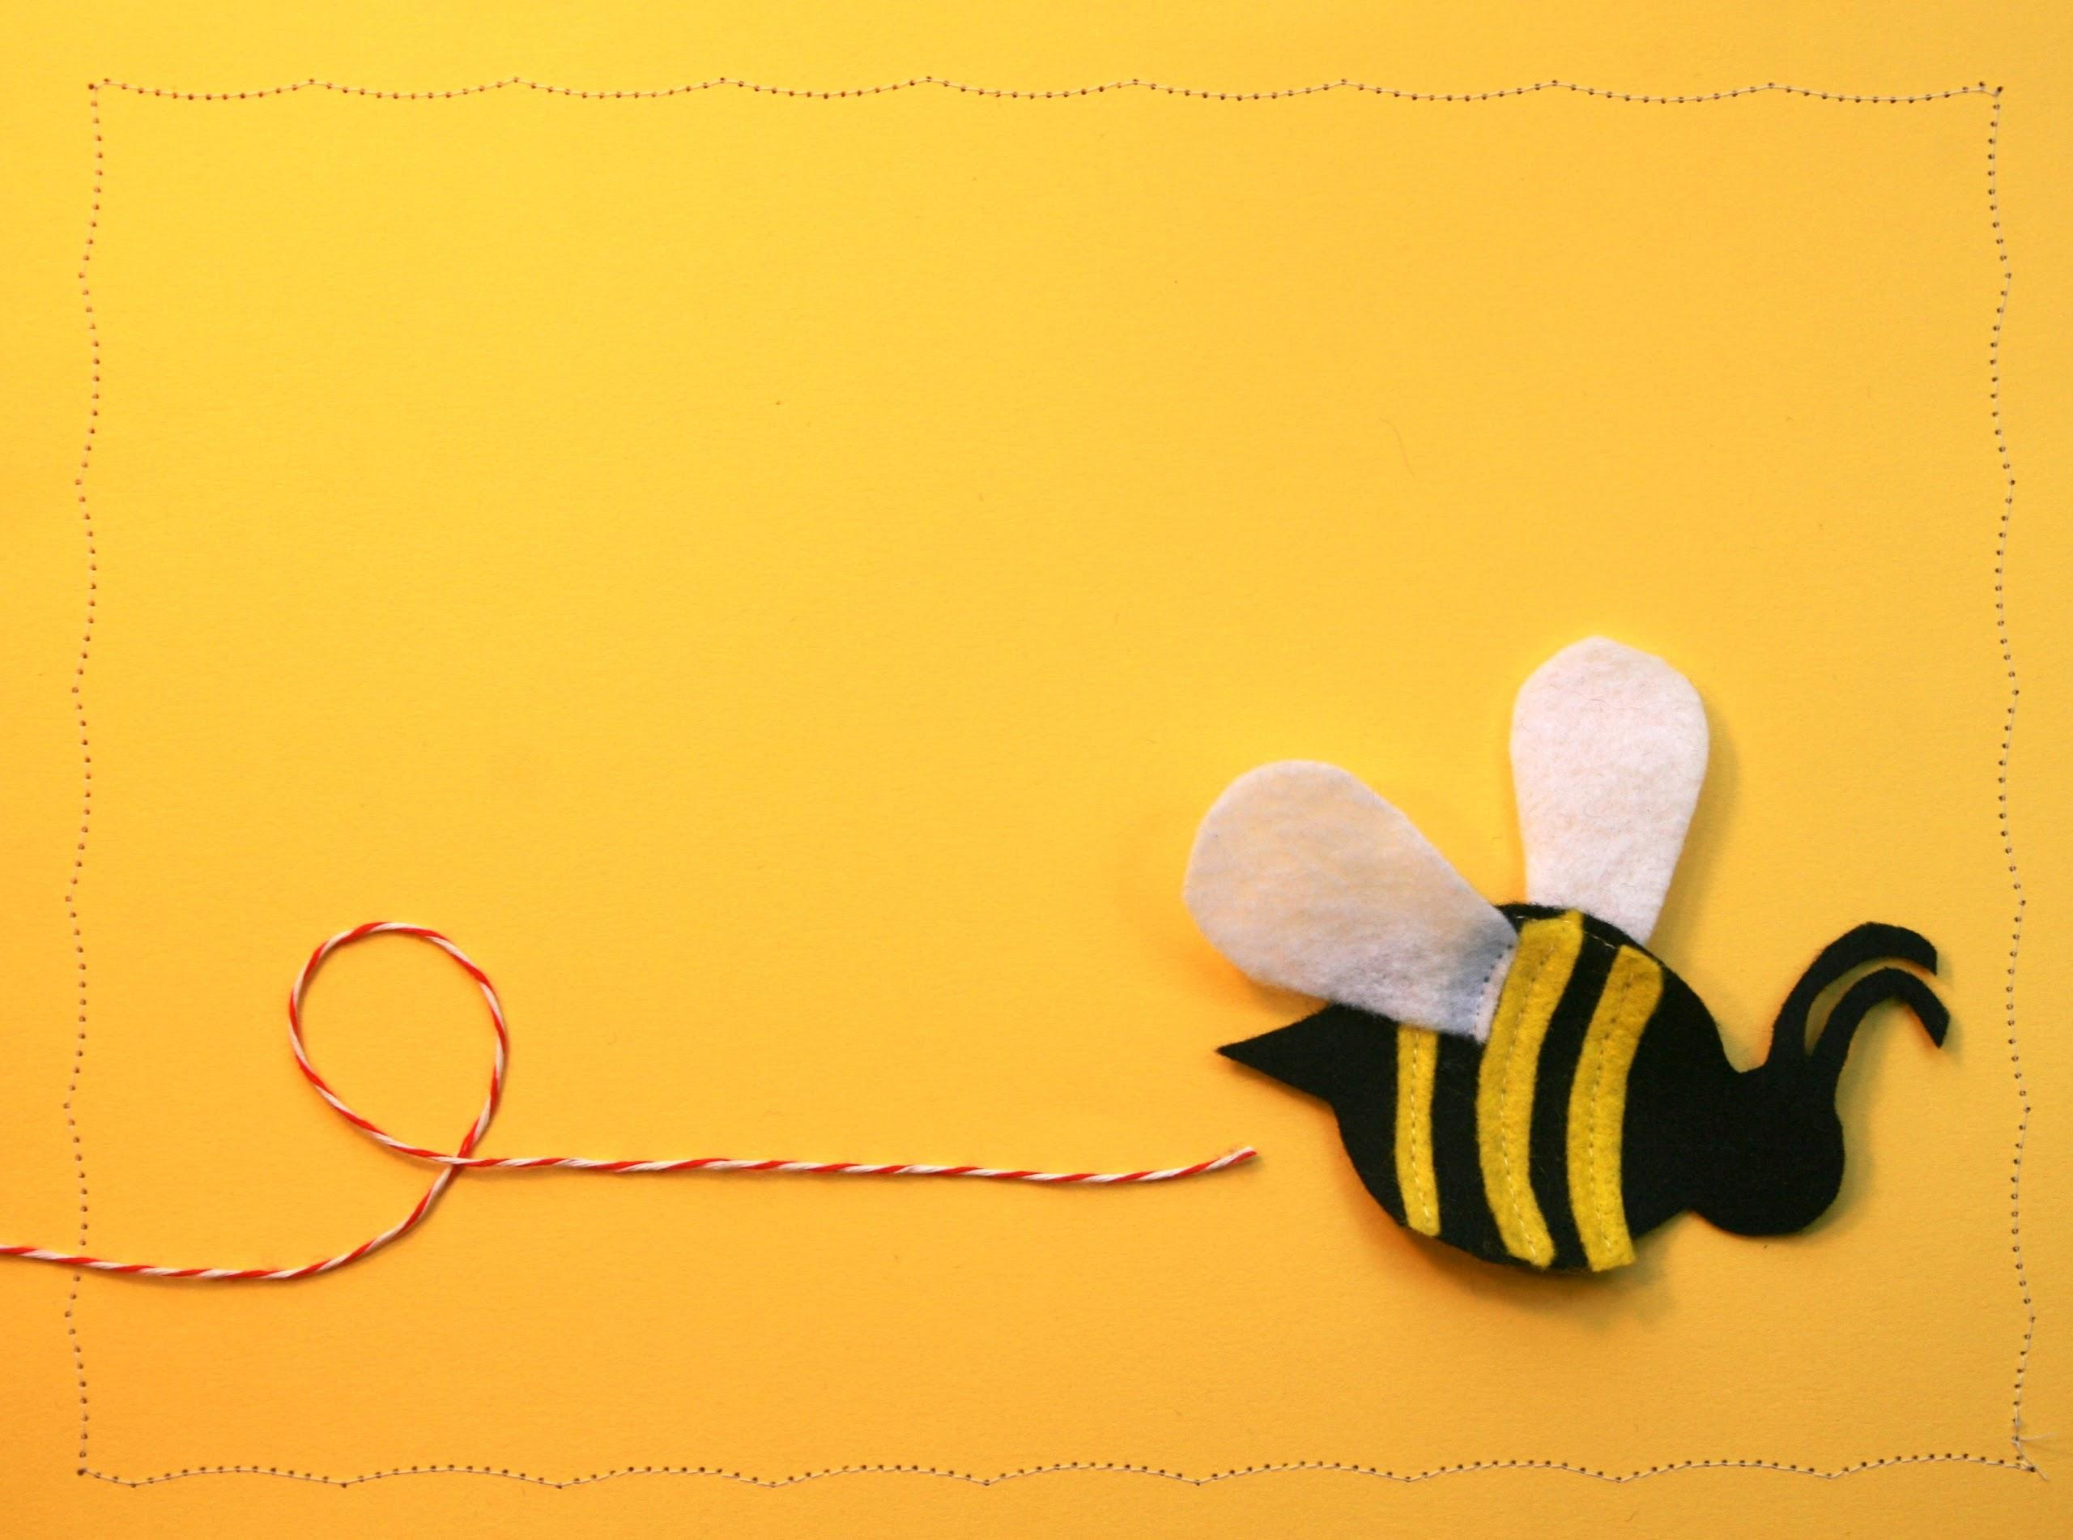
takeaway for supervisors
Have everyone on your staff read a similar article related to early childhood literacy and discuss.

Slide 8
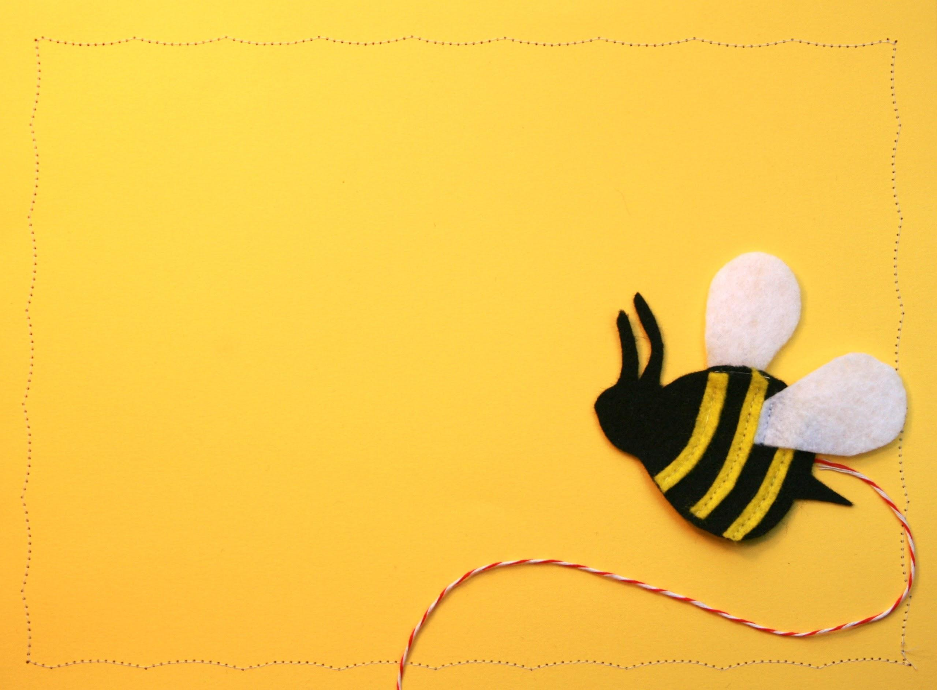
takeaway for librarians
Invite your supervisor to observe your storytime and schedule a time to talk about it.

Slide 9
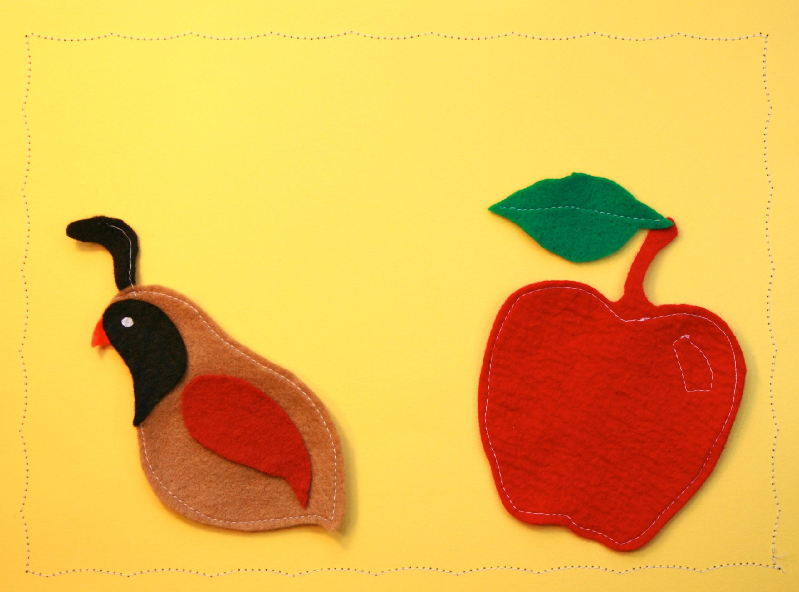
Q & A

Slide 10
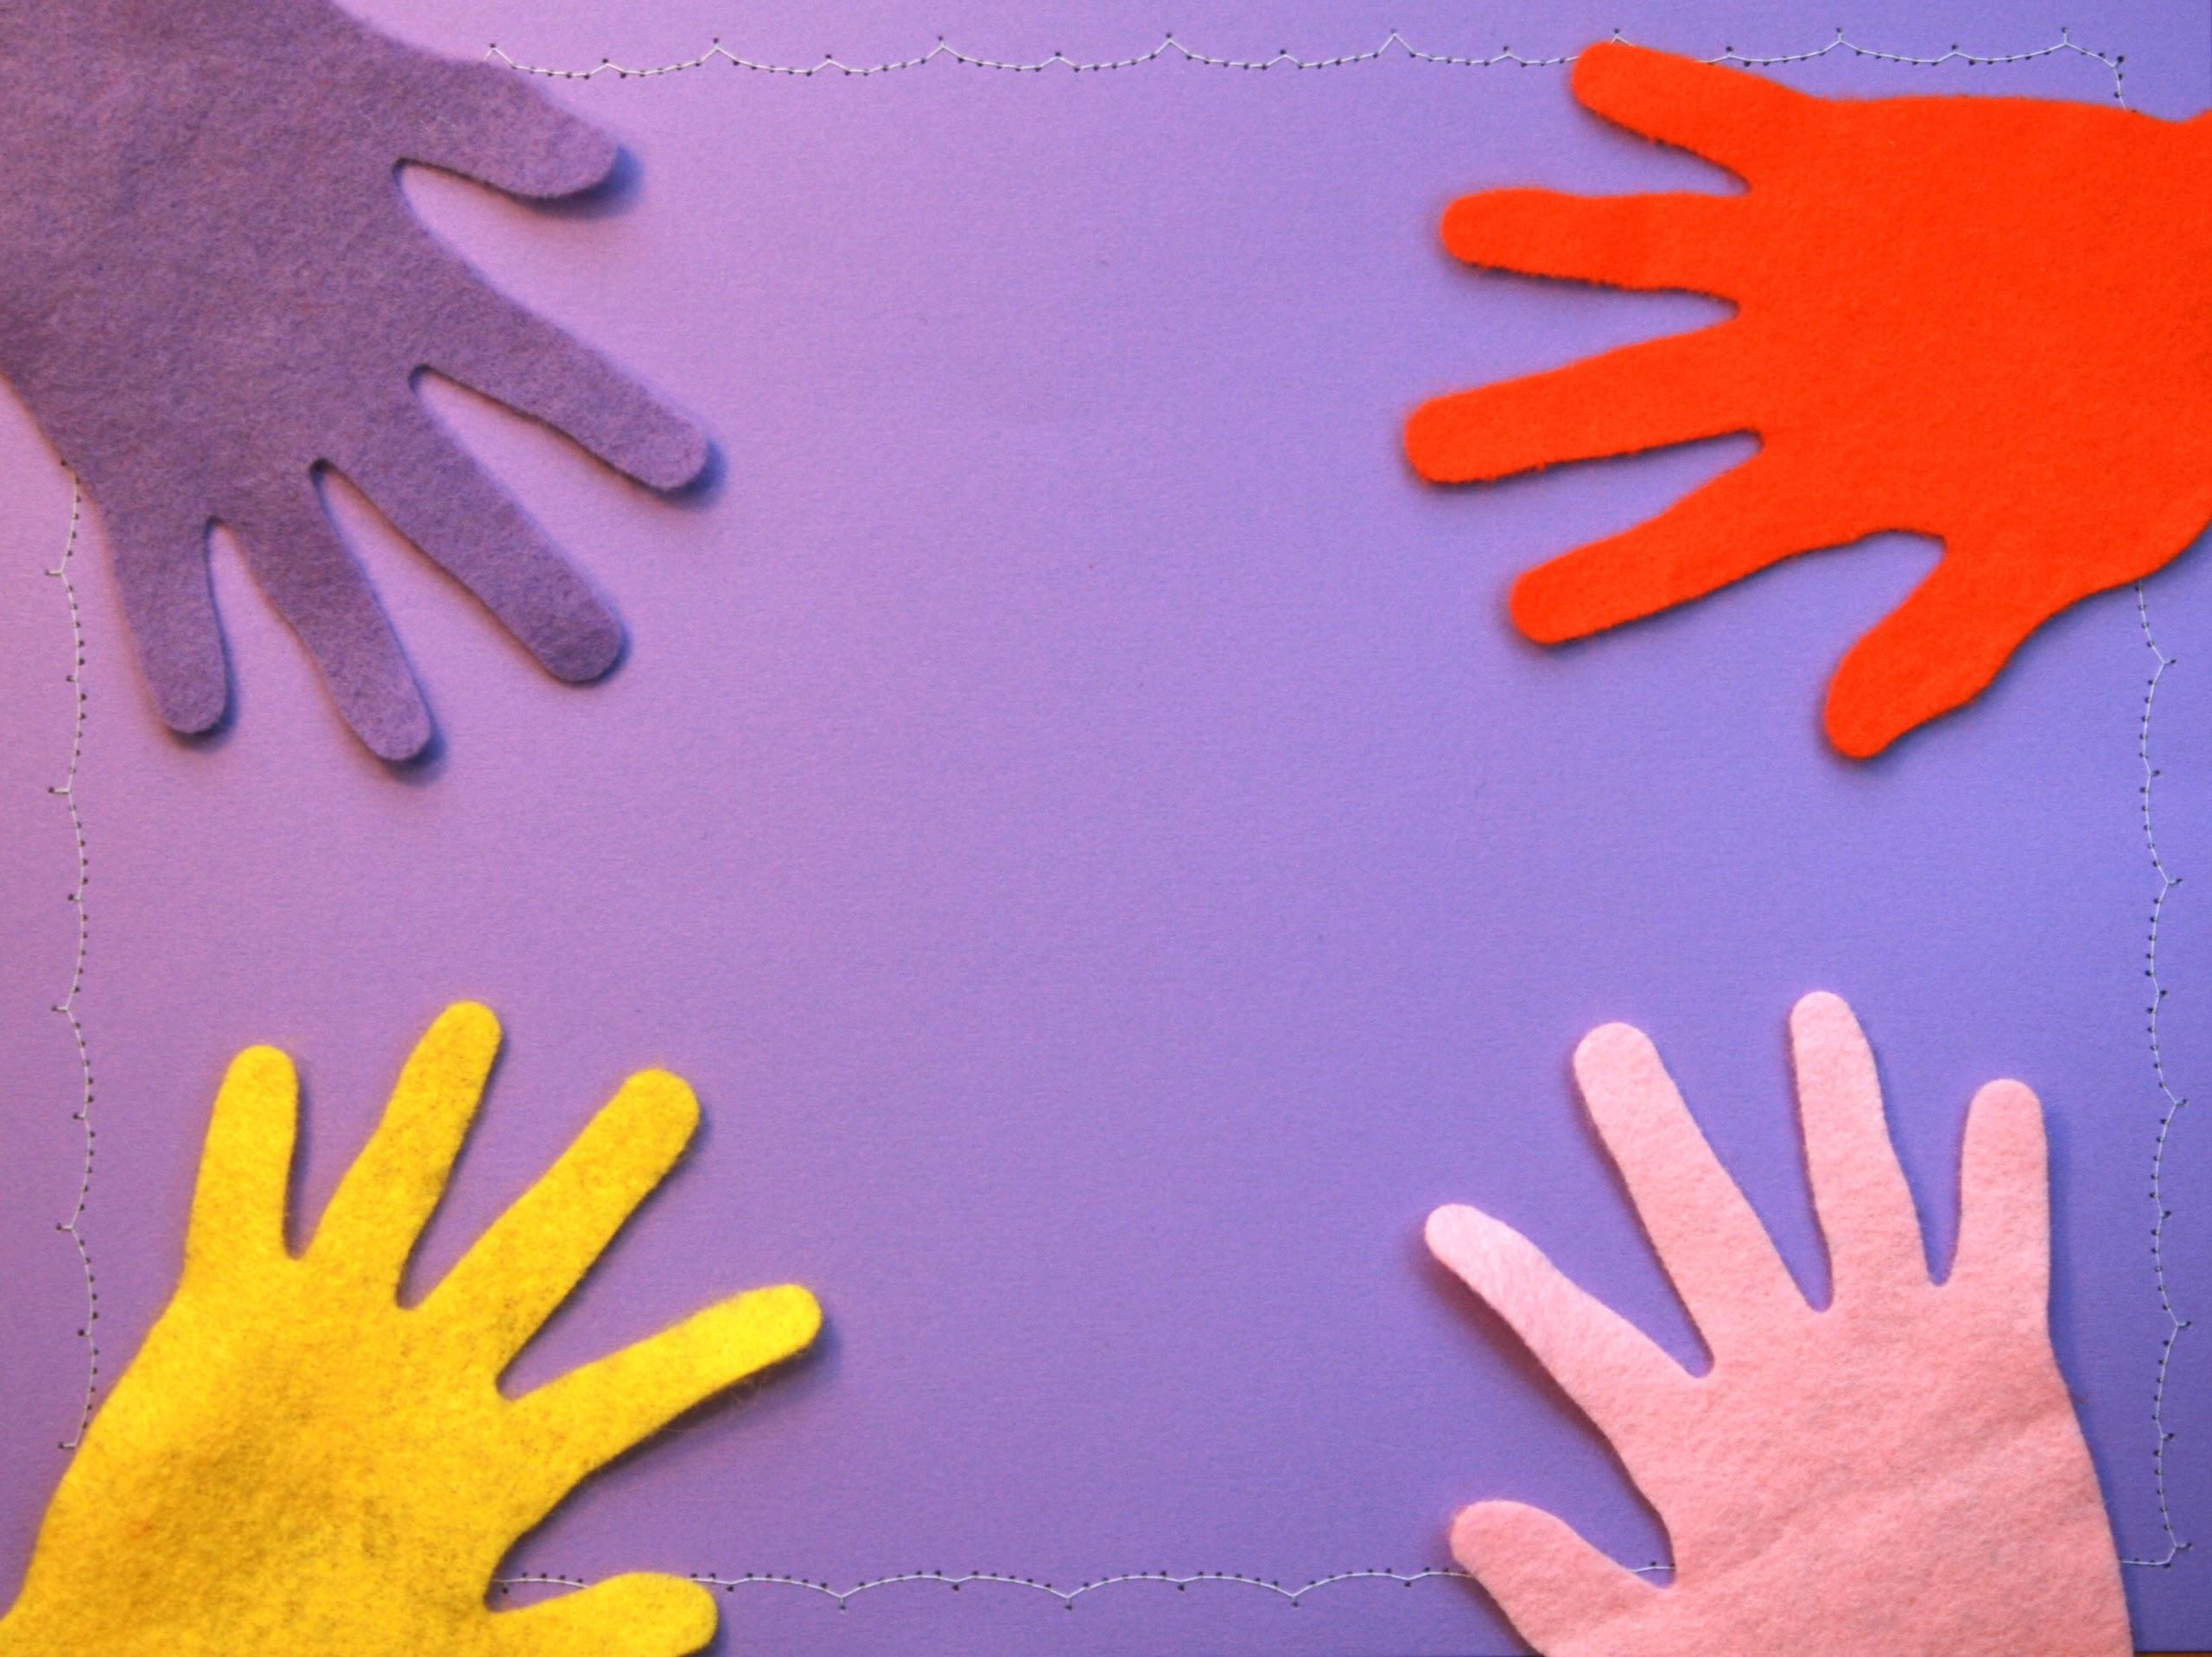
flexible
TEAMS

Slide 11
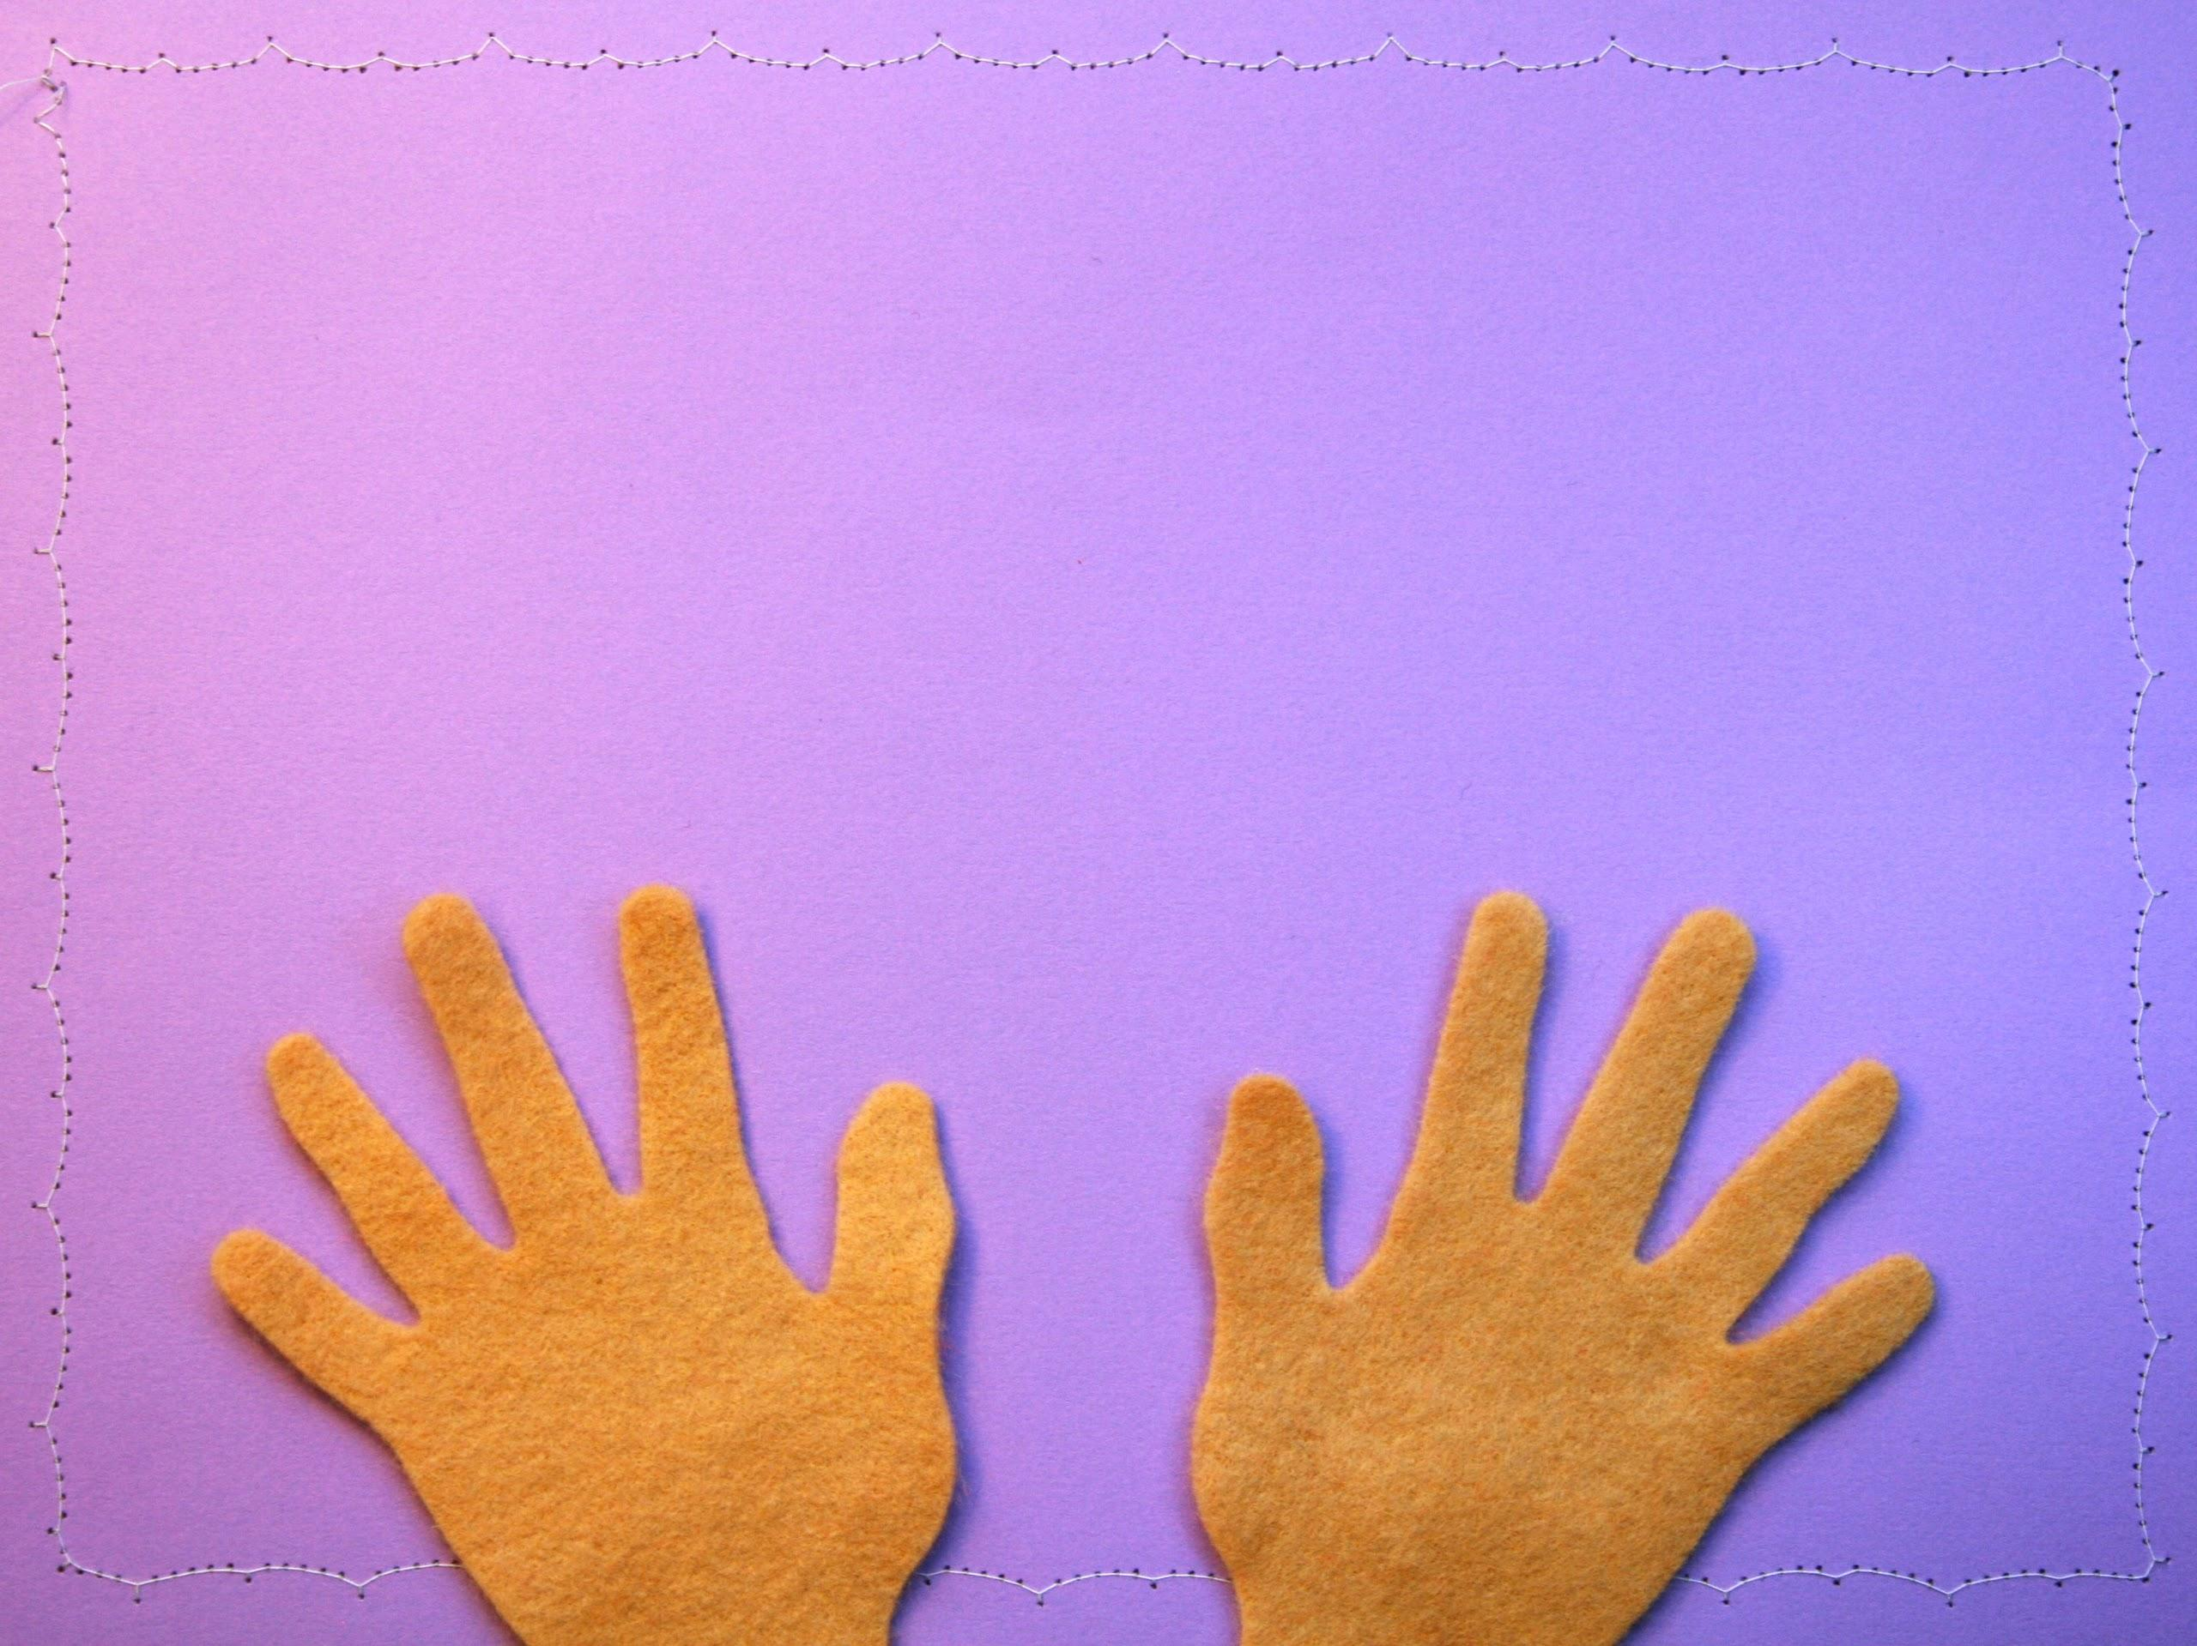
expand your capacity

Slide 12
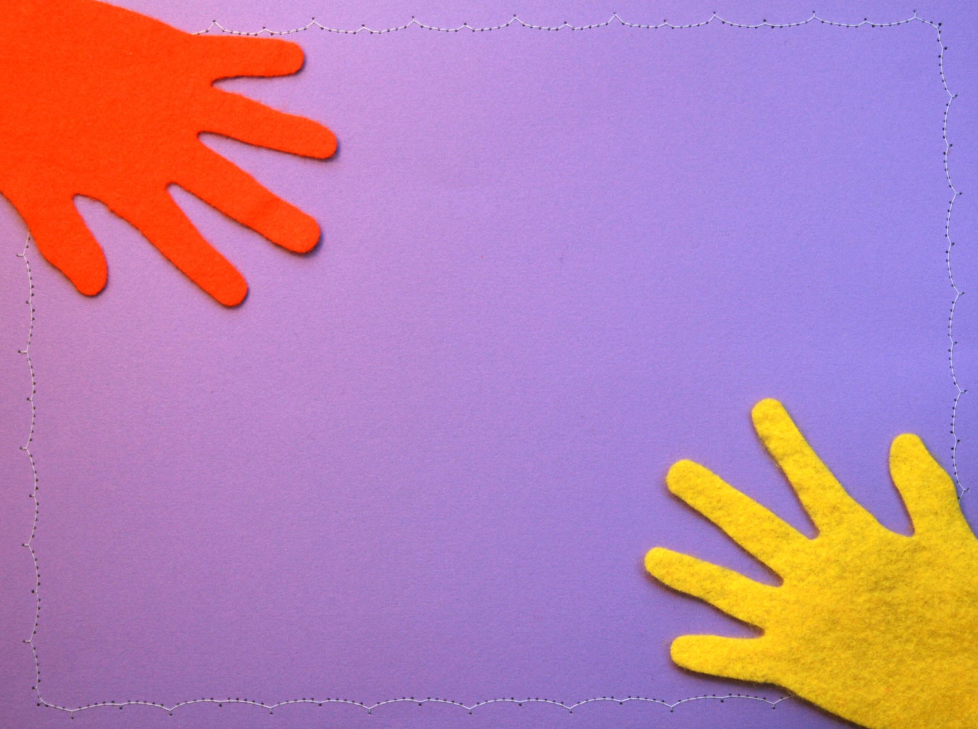
uninterrupted
year-round

Slide 13
8 in 10 adults support free early literacy programs to prepare kids for school.
Library Services in the Digital Age
Pew Report, 2013

Slide 14
big teams = big advantages

Slide 15
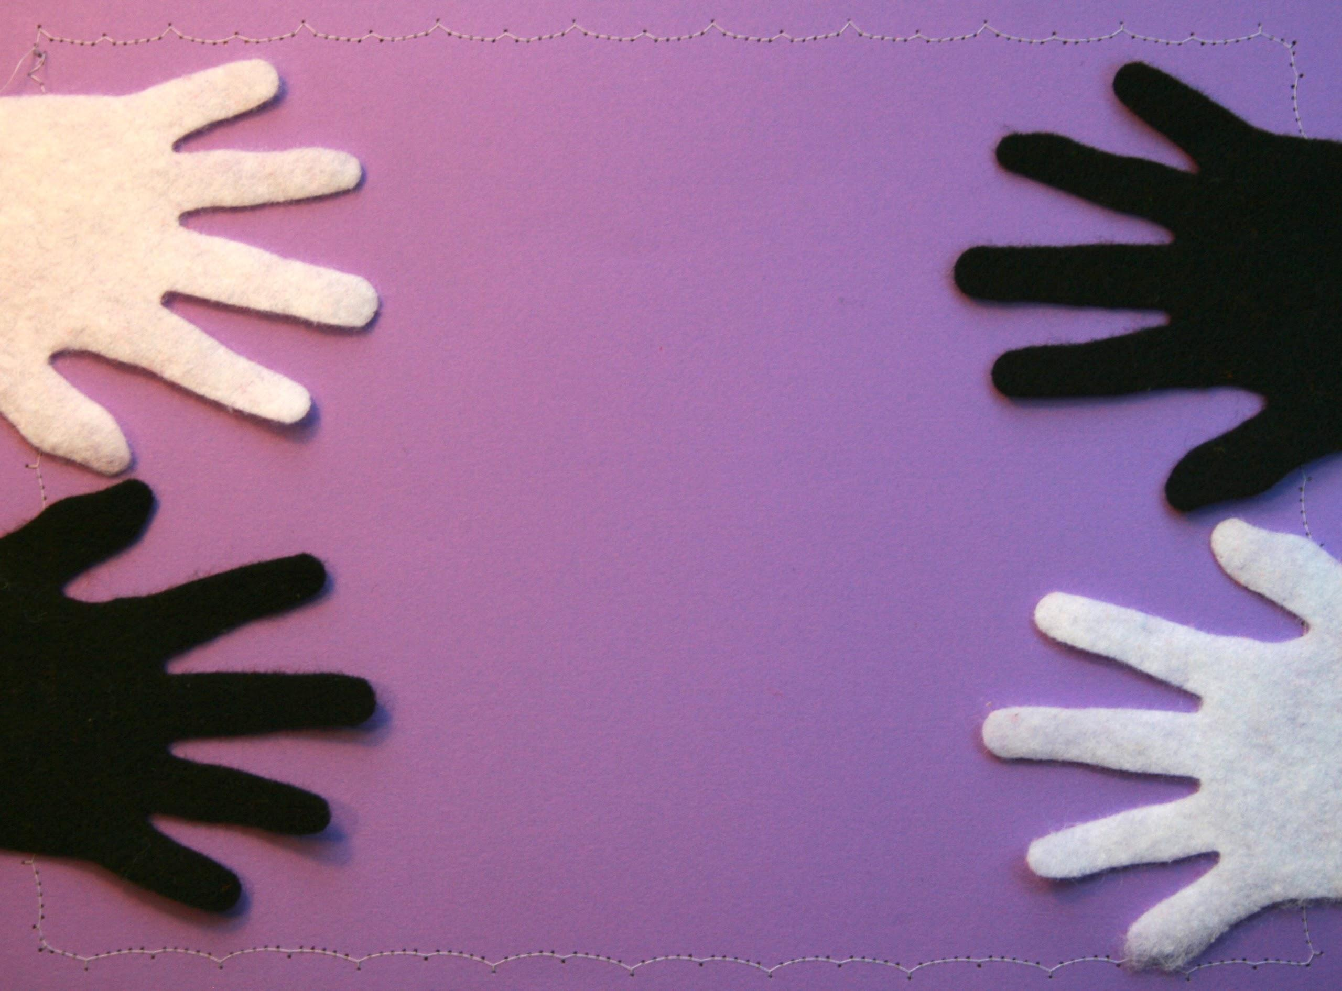
rethink
roles

Slide 16
takeaway for supervisors
Discuss storytime at your next staff meeting and talk about how it connects to the larger goals of the branch and the library system.

Slide 17
takeaway for librarians
At this staff meeting, acknowledge the great things other staff members do to make storytime a success.

Slide 18
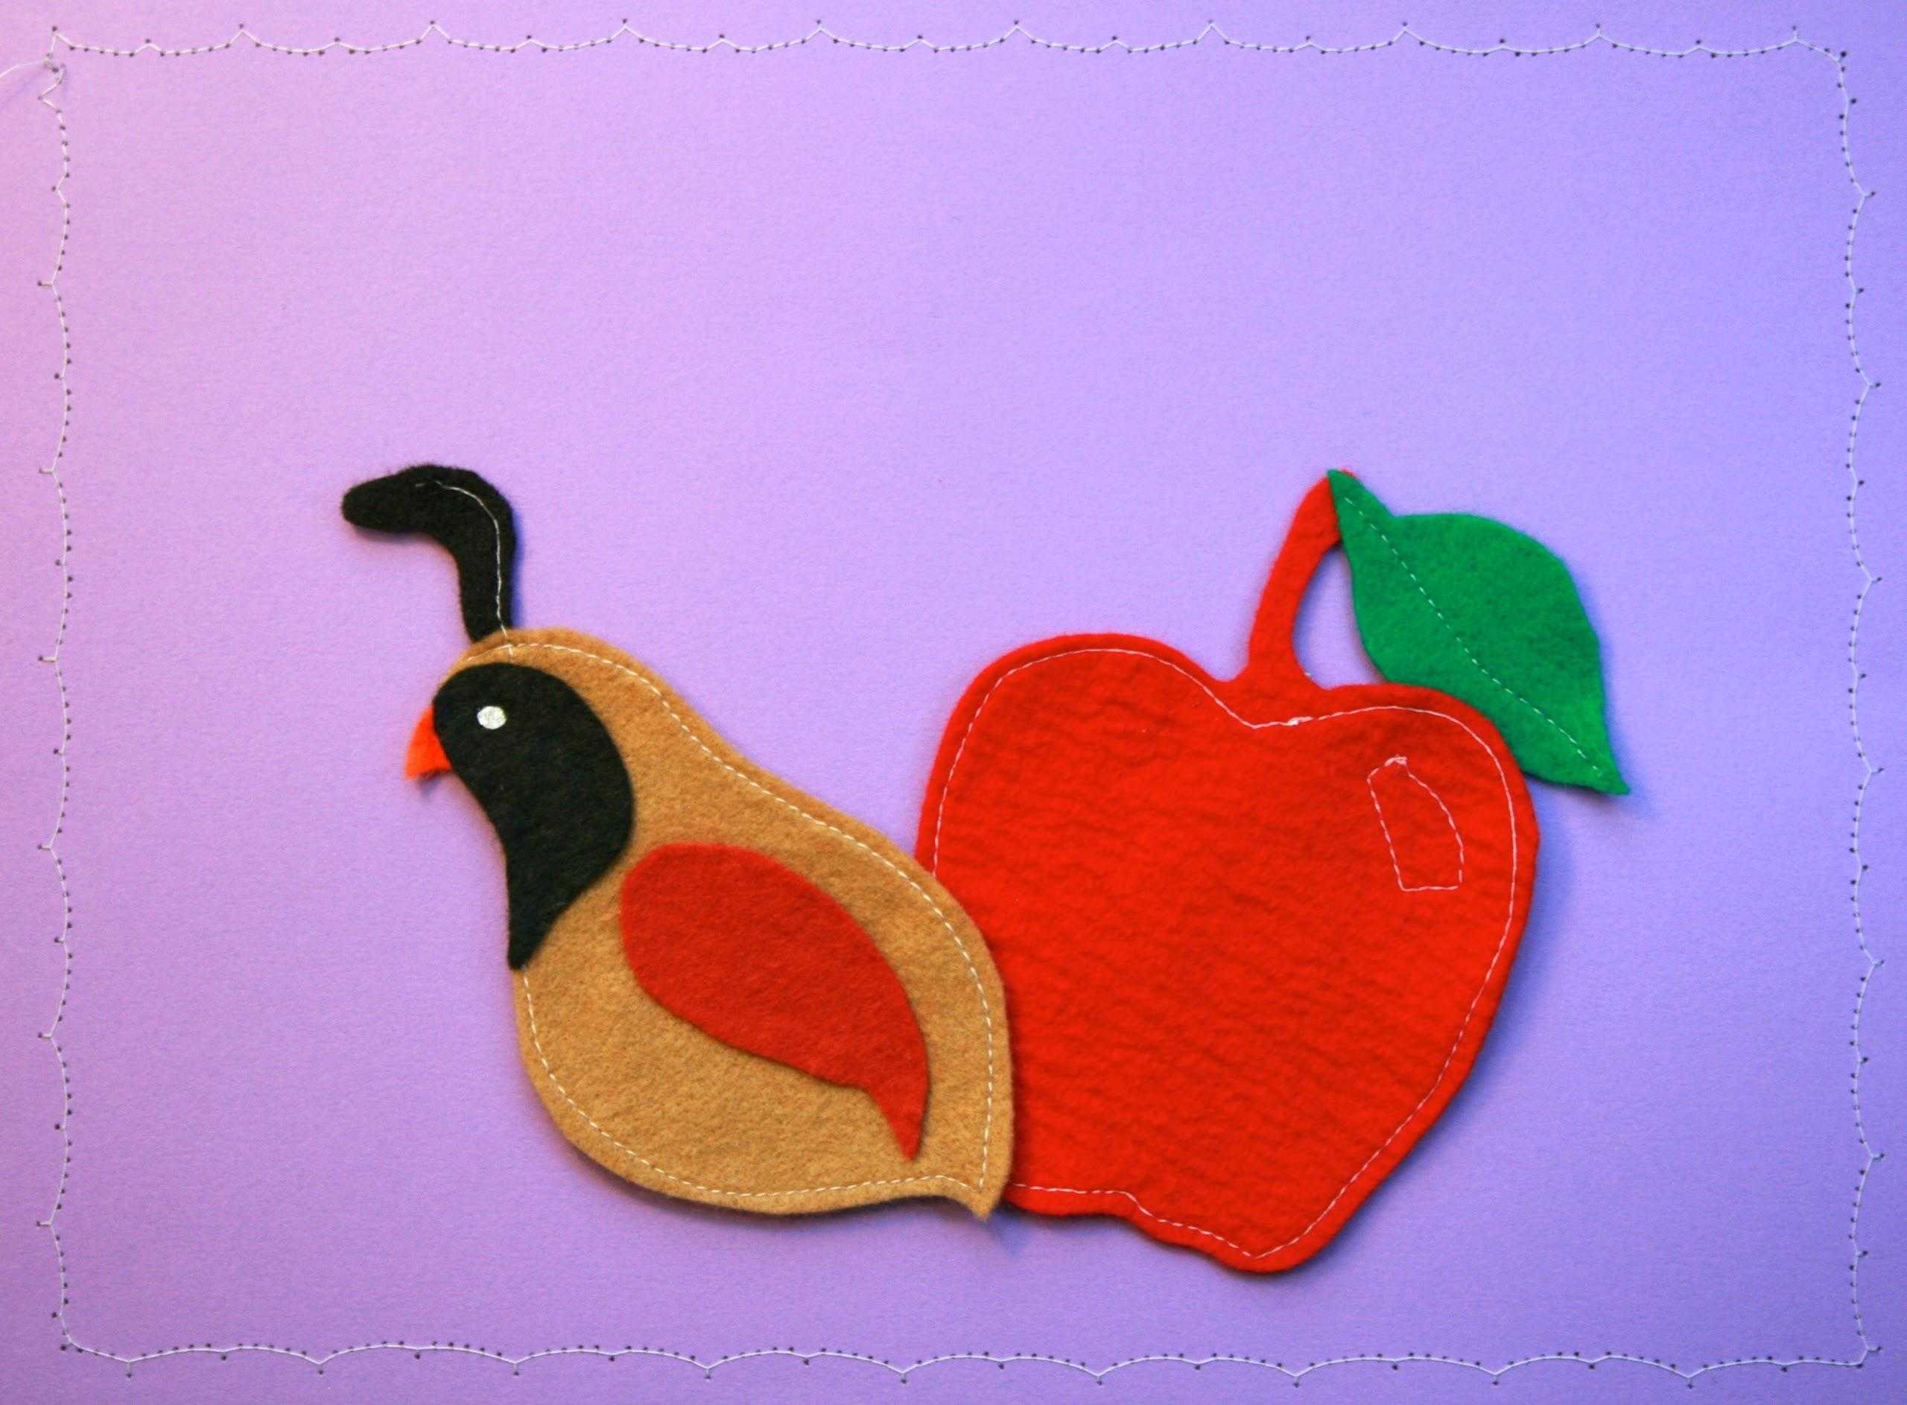
Q & A

Slide 19
GROWING
confident storytellers

Slide 20
create opportunities to learn

Slide 21
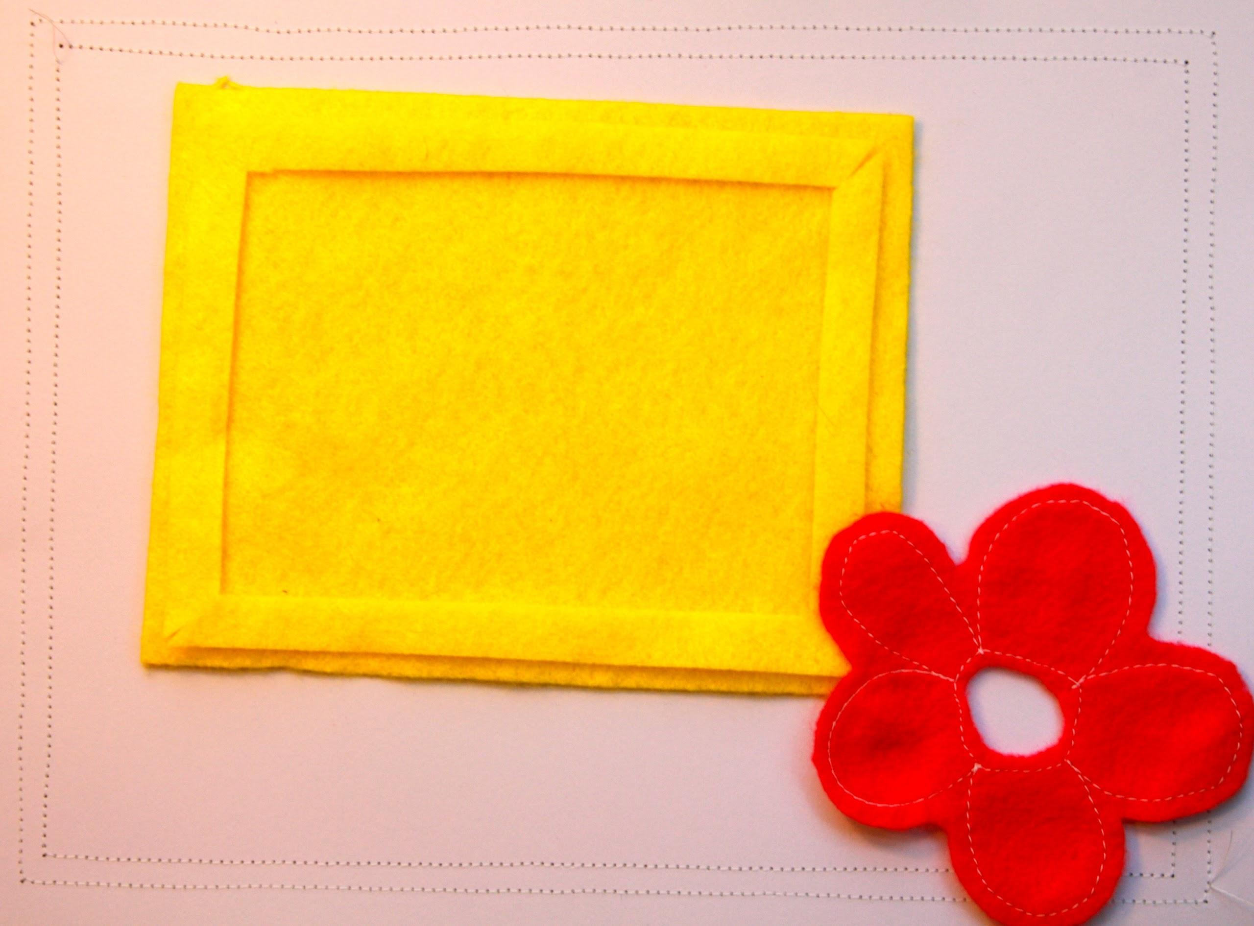
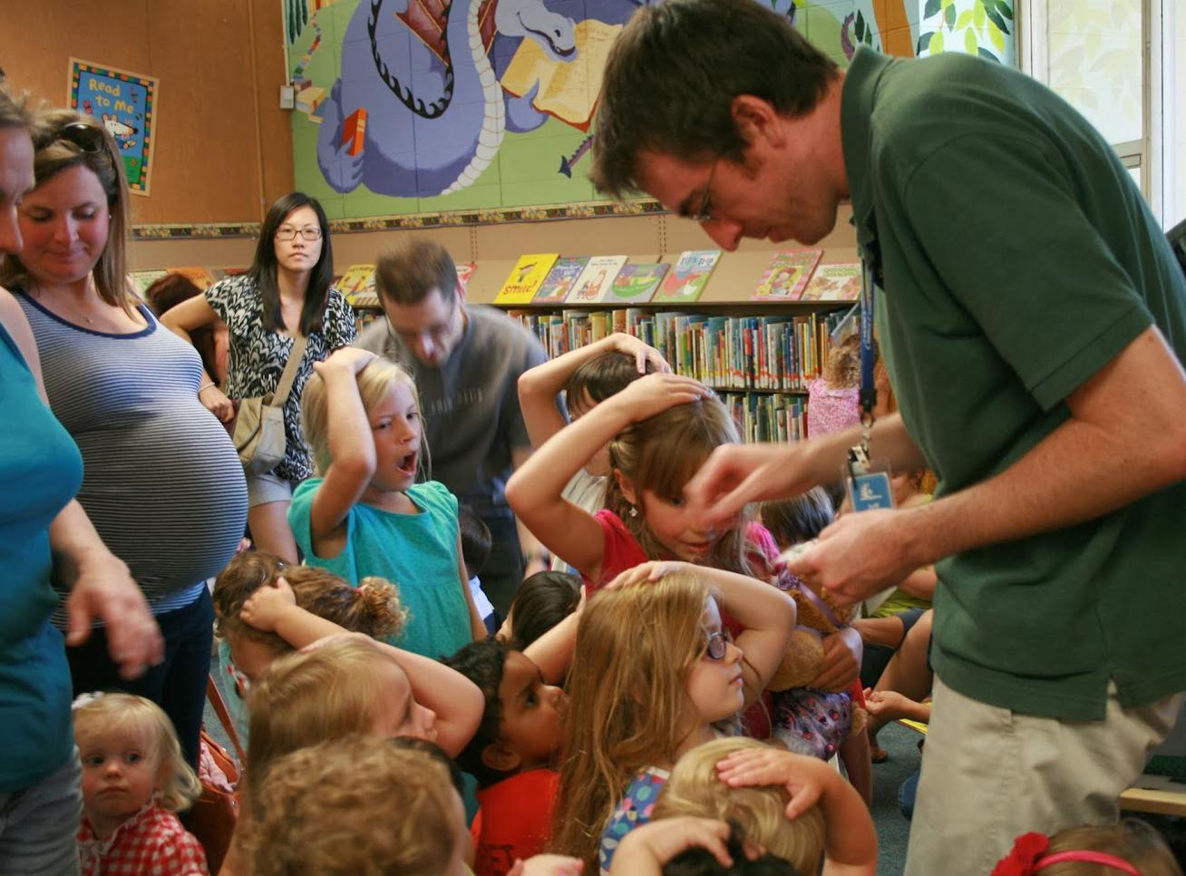

Slide 22
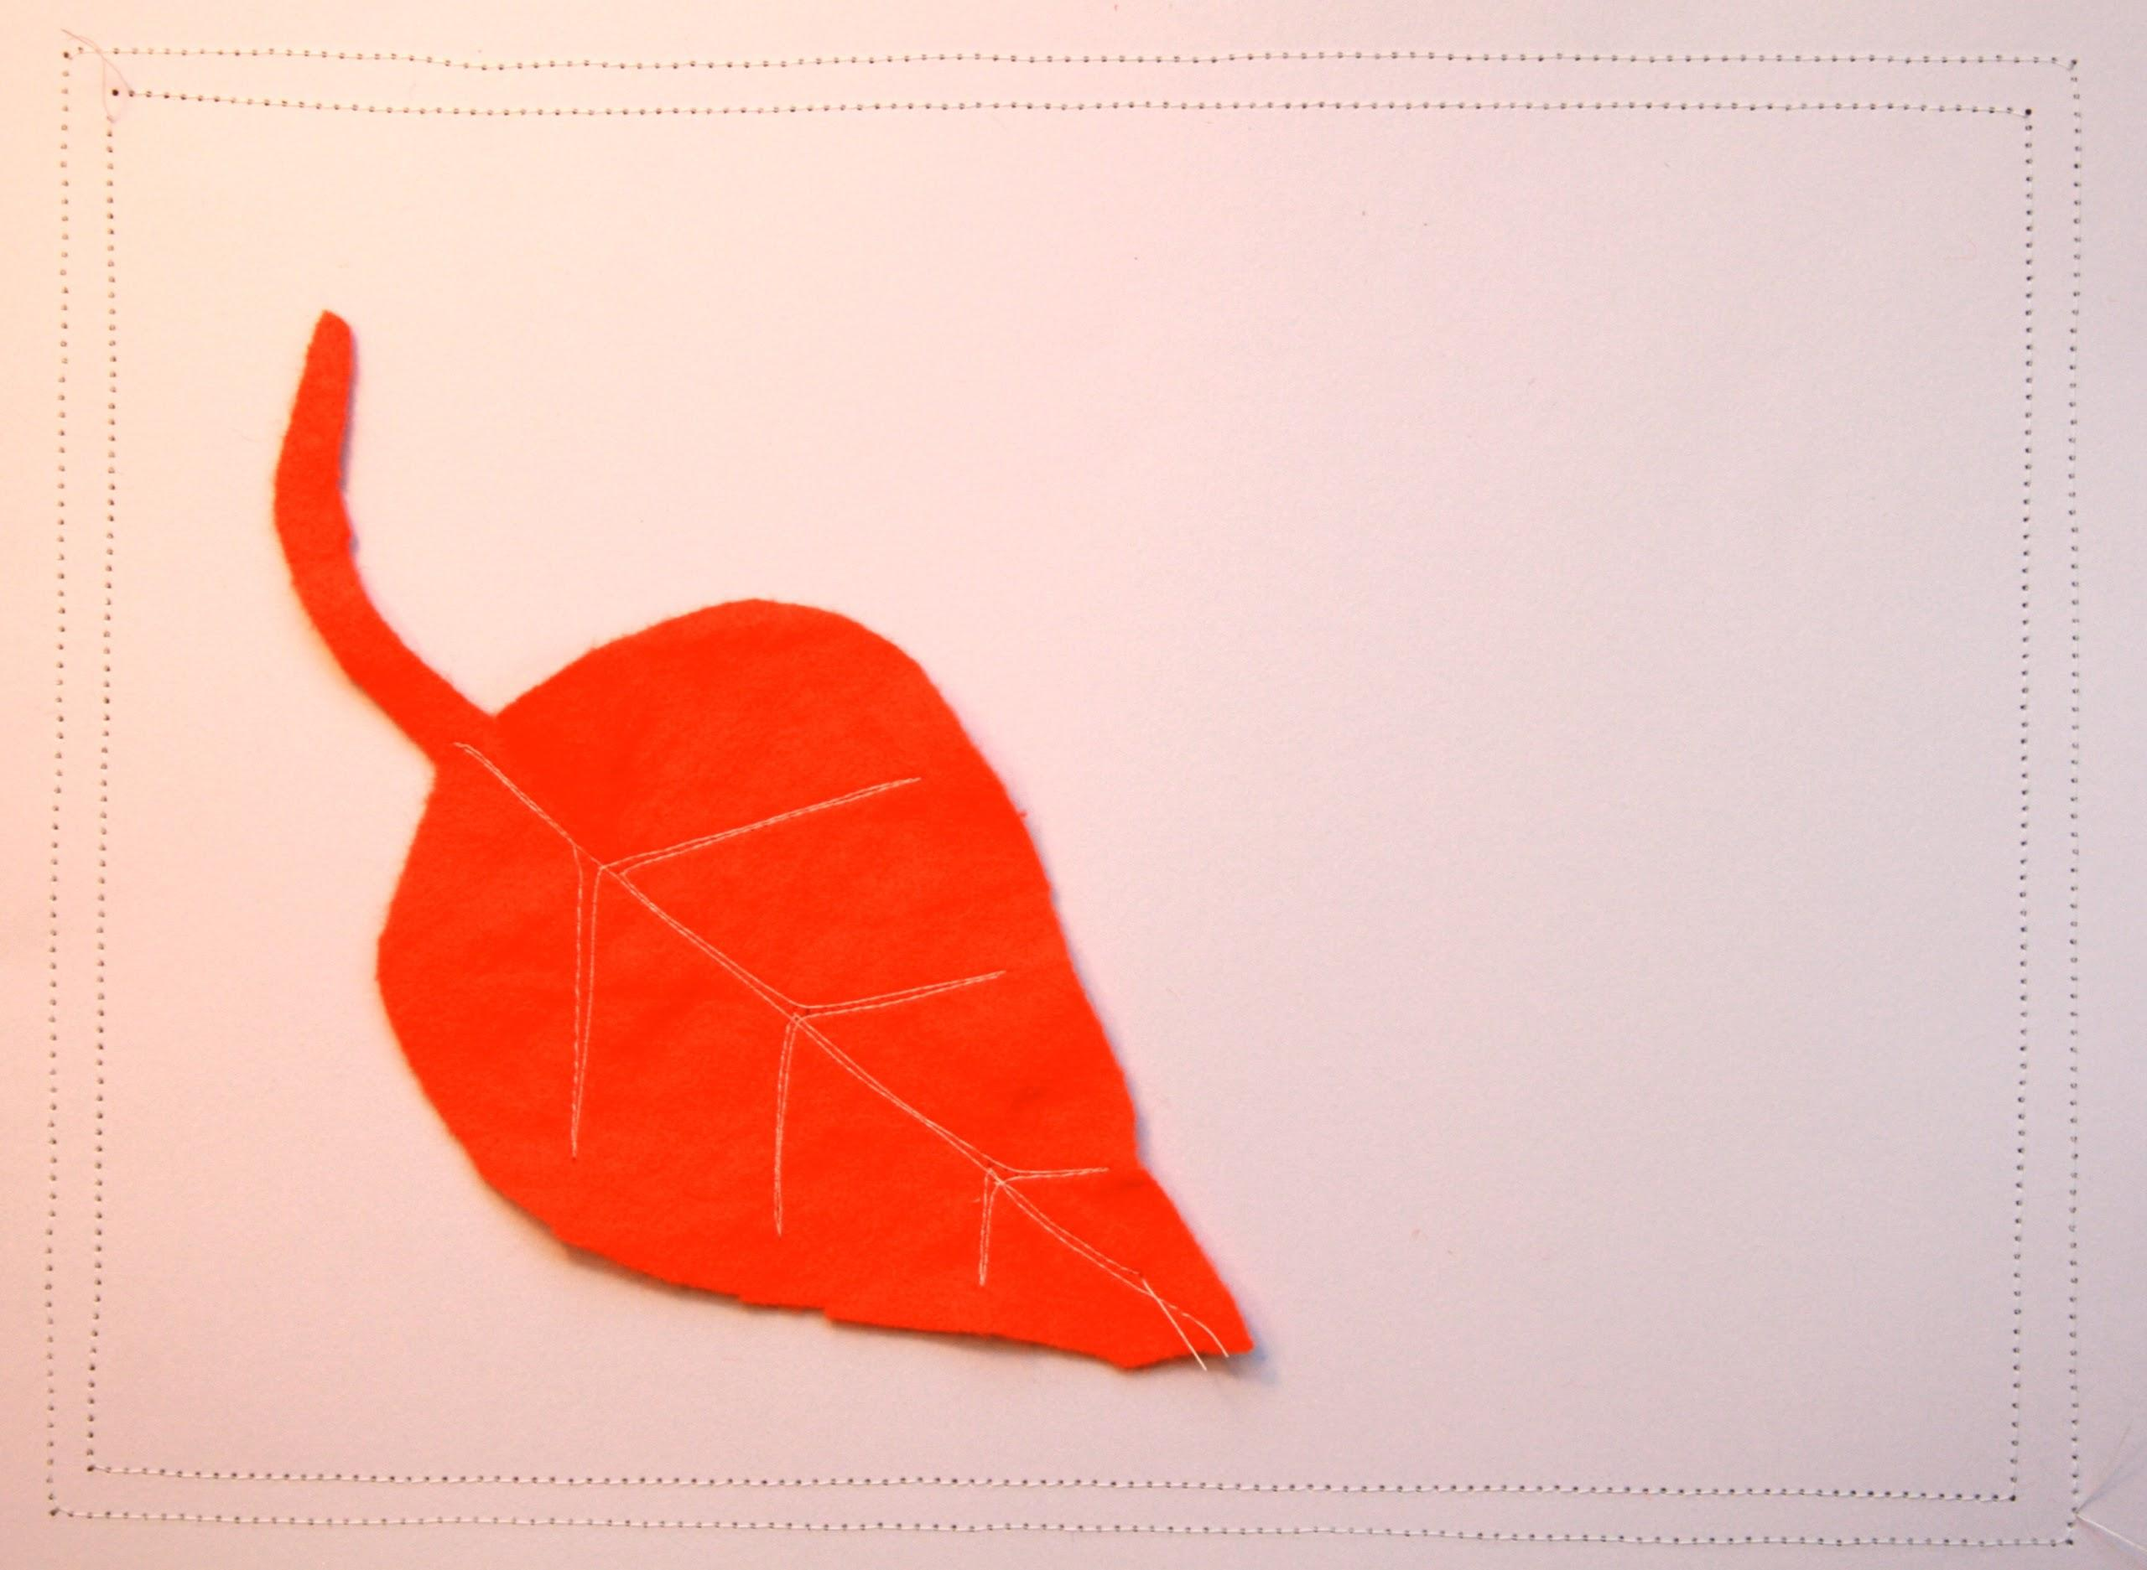
mentoring & goal-setting

Slide 23
a community of practice

Slide 24
peers as mentors

Slide 25
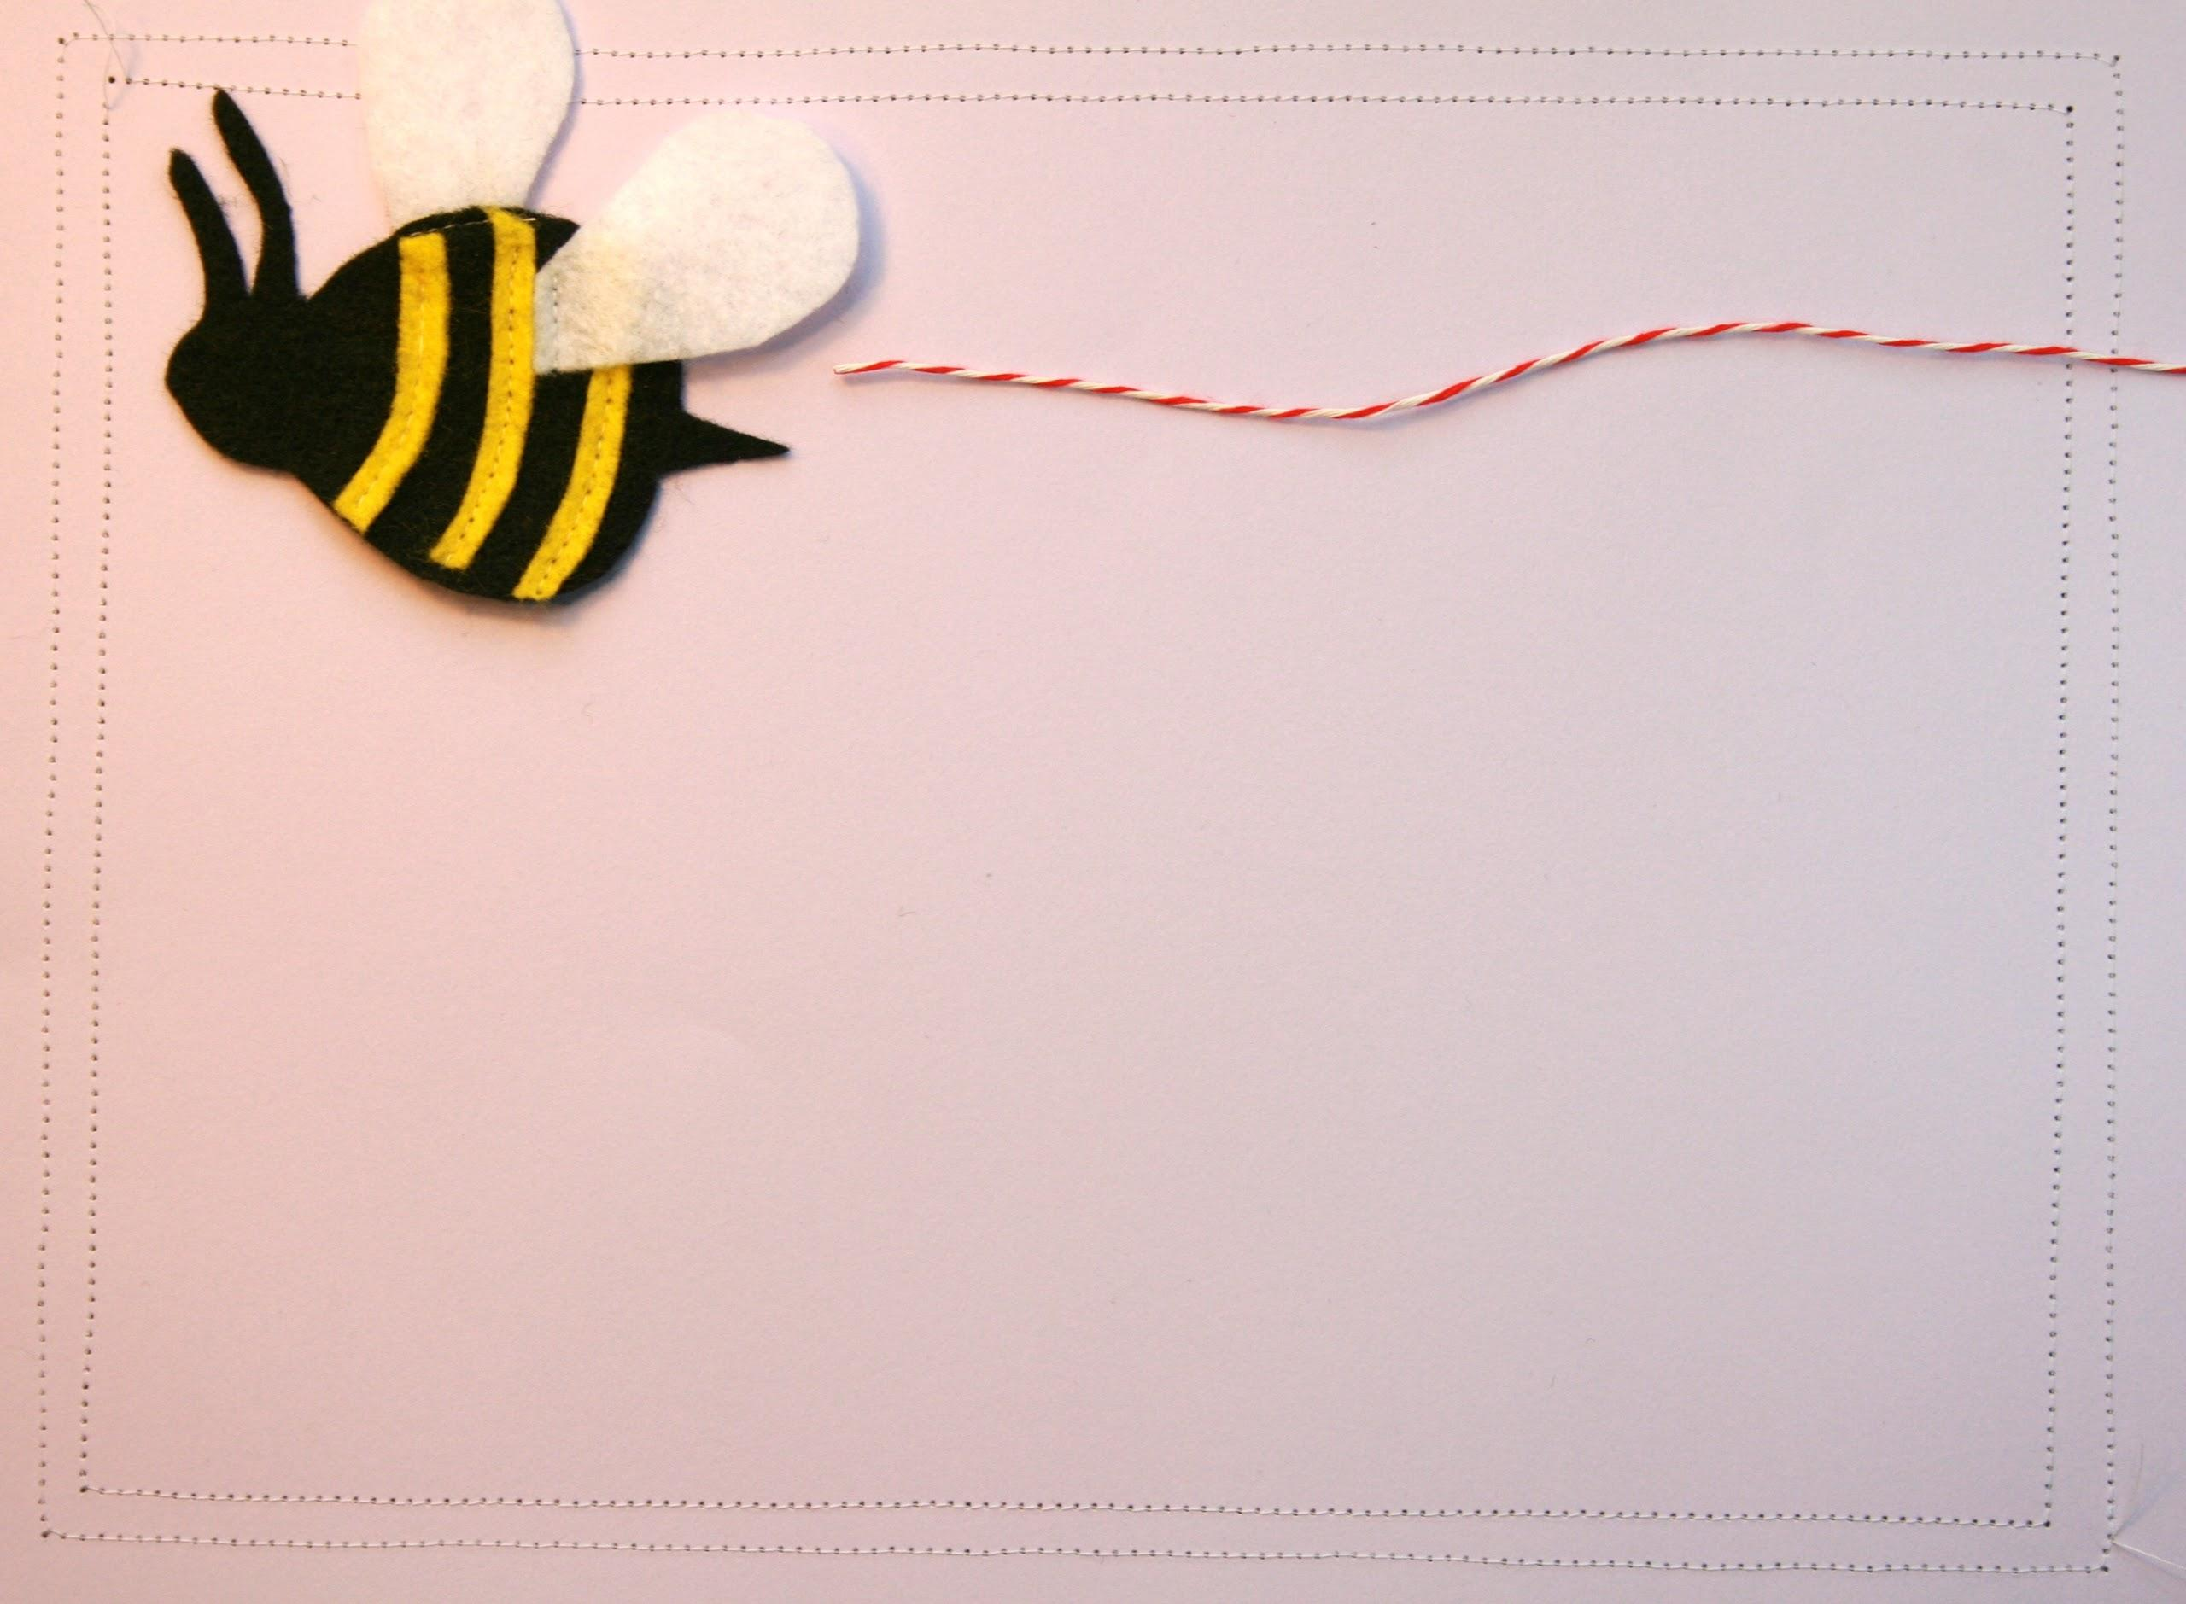
takeaway for supervisors
Read the article on Peer Coaching from
Public Libraries with your staff and discuss
how you can incorporate peer coaching
into your storytime practice.

Slide 26
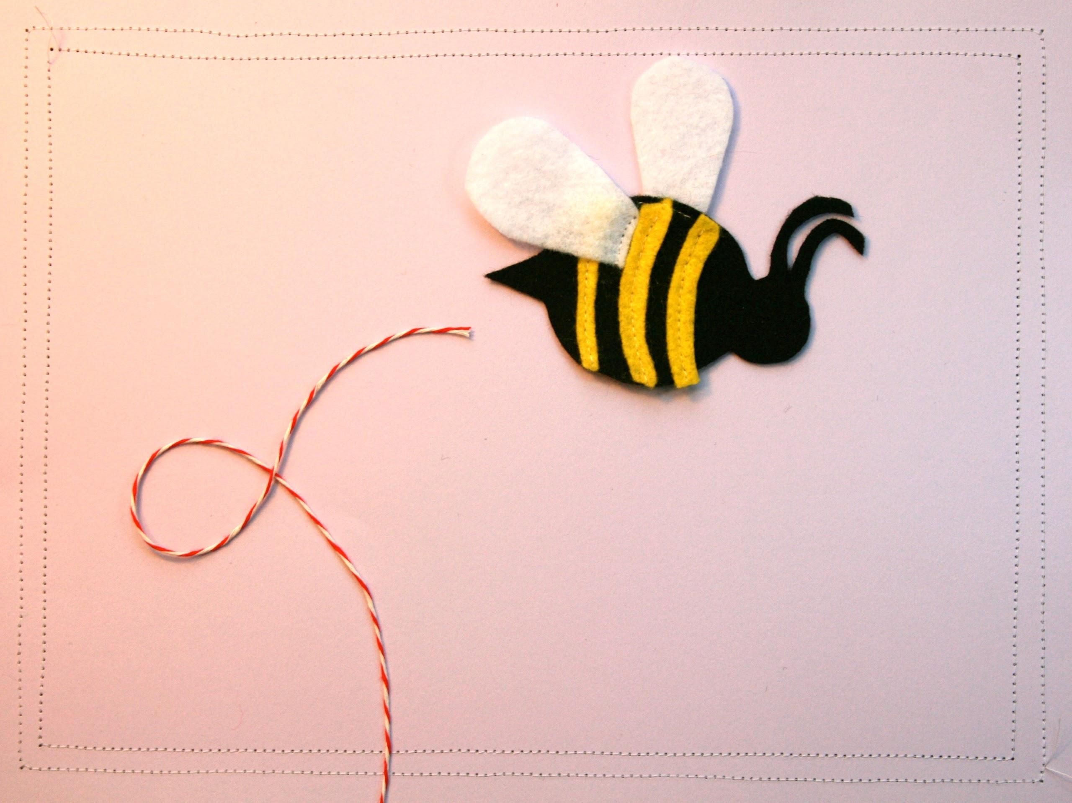
takeaway for librarians
Share this same article with your peers at the next Youth Services meeting.

Slide 27
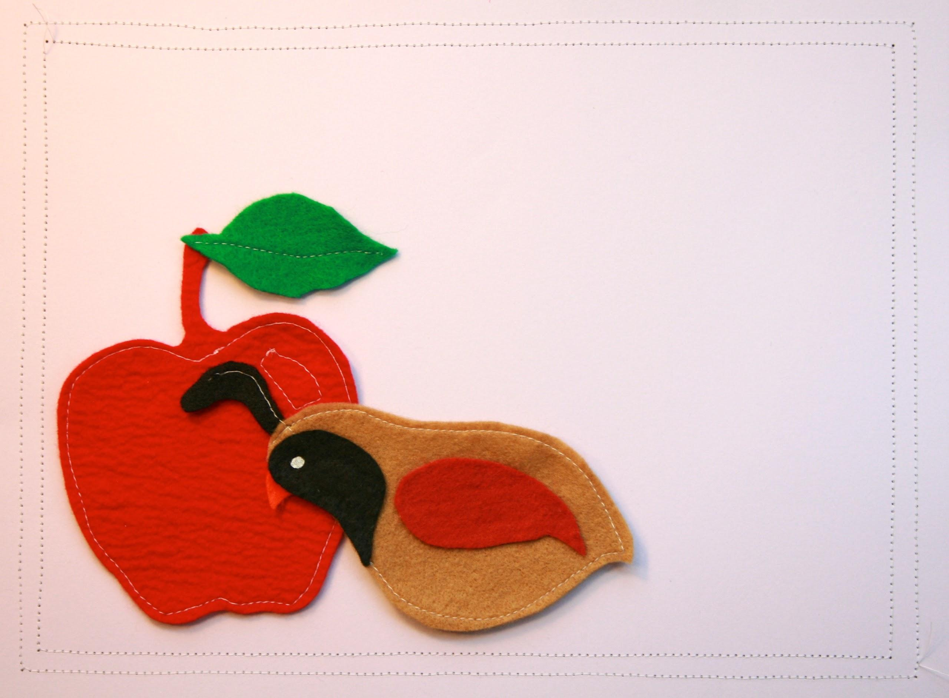
Q & A

Slide 28
wrap
up
Tuesday, February 11 - The Place
Thursday, February 20 - The Package
hwdolamore@solanocounty.com premer@ccclib.org

Slide 29
The Early Learning with Families @ Your Library (ELF) 2.0 is supported by the U.S. Institute of Museum and Library Services under the provisions of the Library Services and Technology Act, administered in California by the State Librarian. This material is licensed under a Creative Commons 3.0 Share & Share-Alike license. Use of this material should credit the author and funding source.

