Slide 1

The Early Learning with Families @ Your Library (ELF) 2.0 presents
Tuesday, February 11, 2014

Slide 2
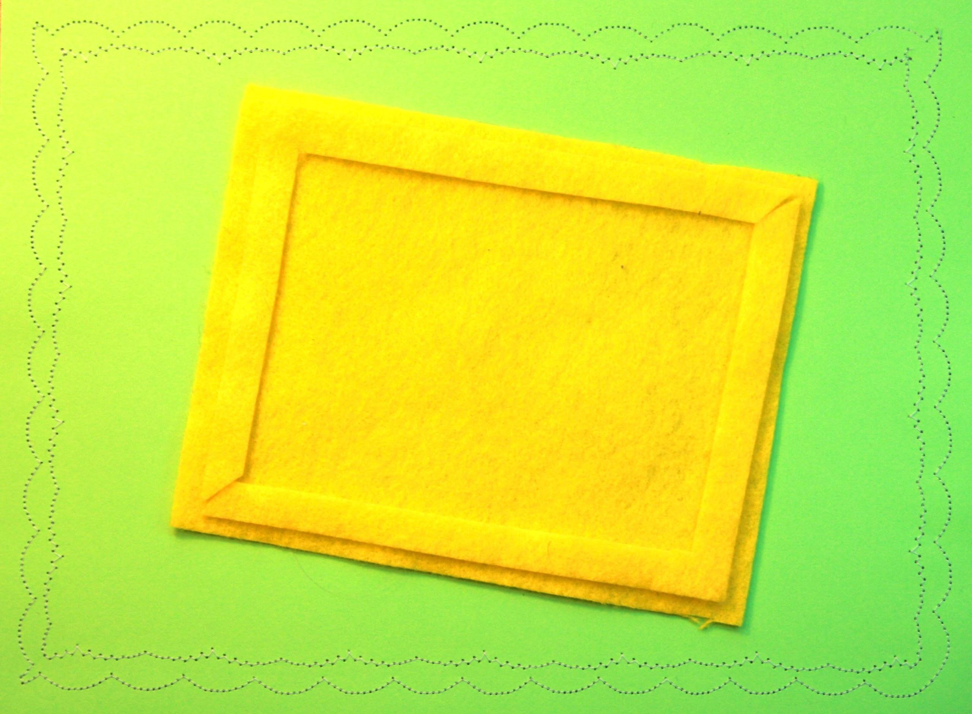
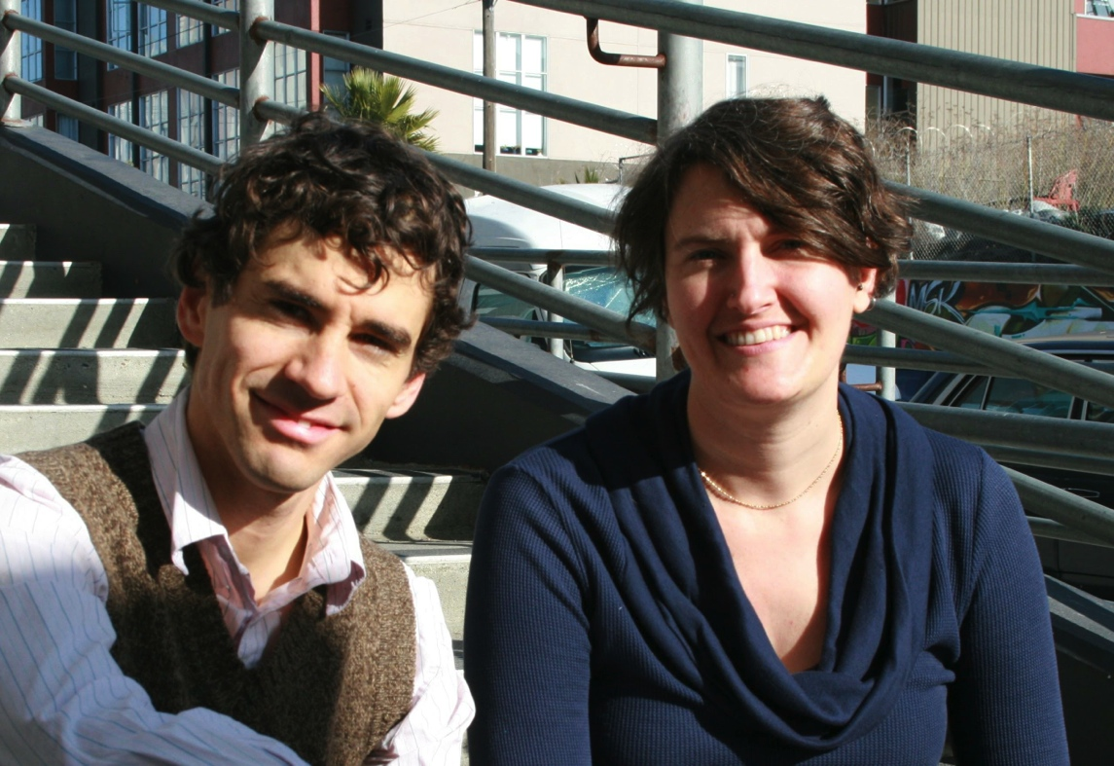

heidi dolamore
patrick remer

Slide 3
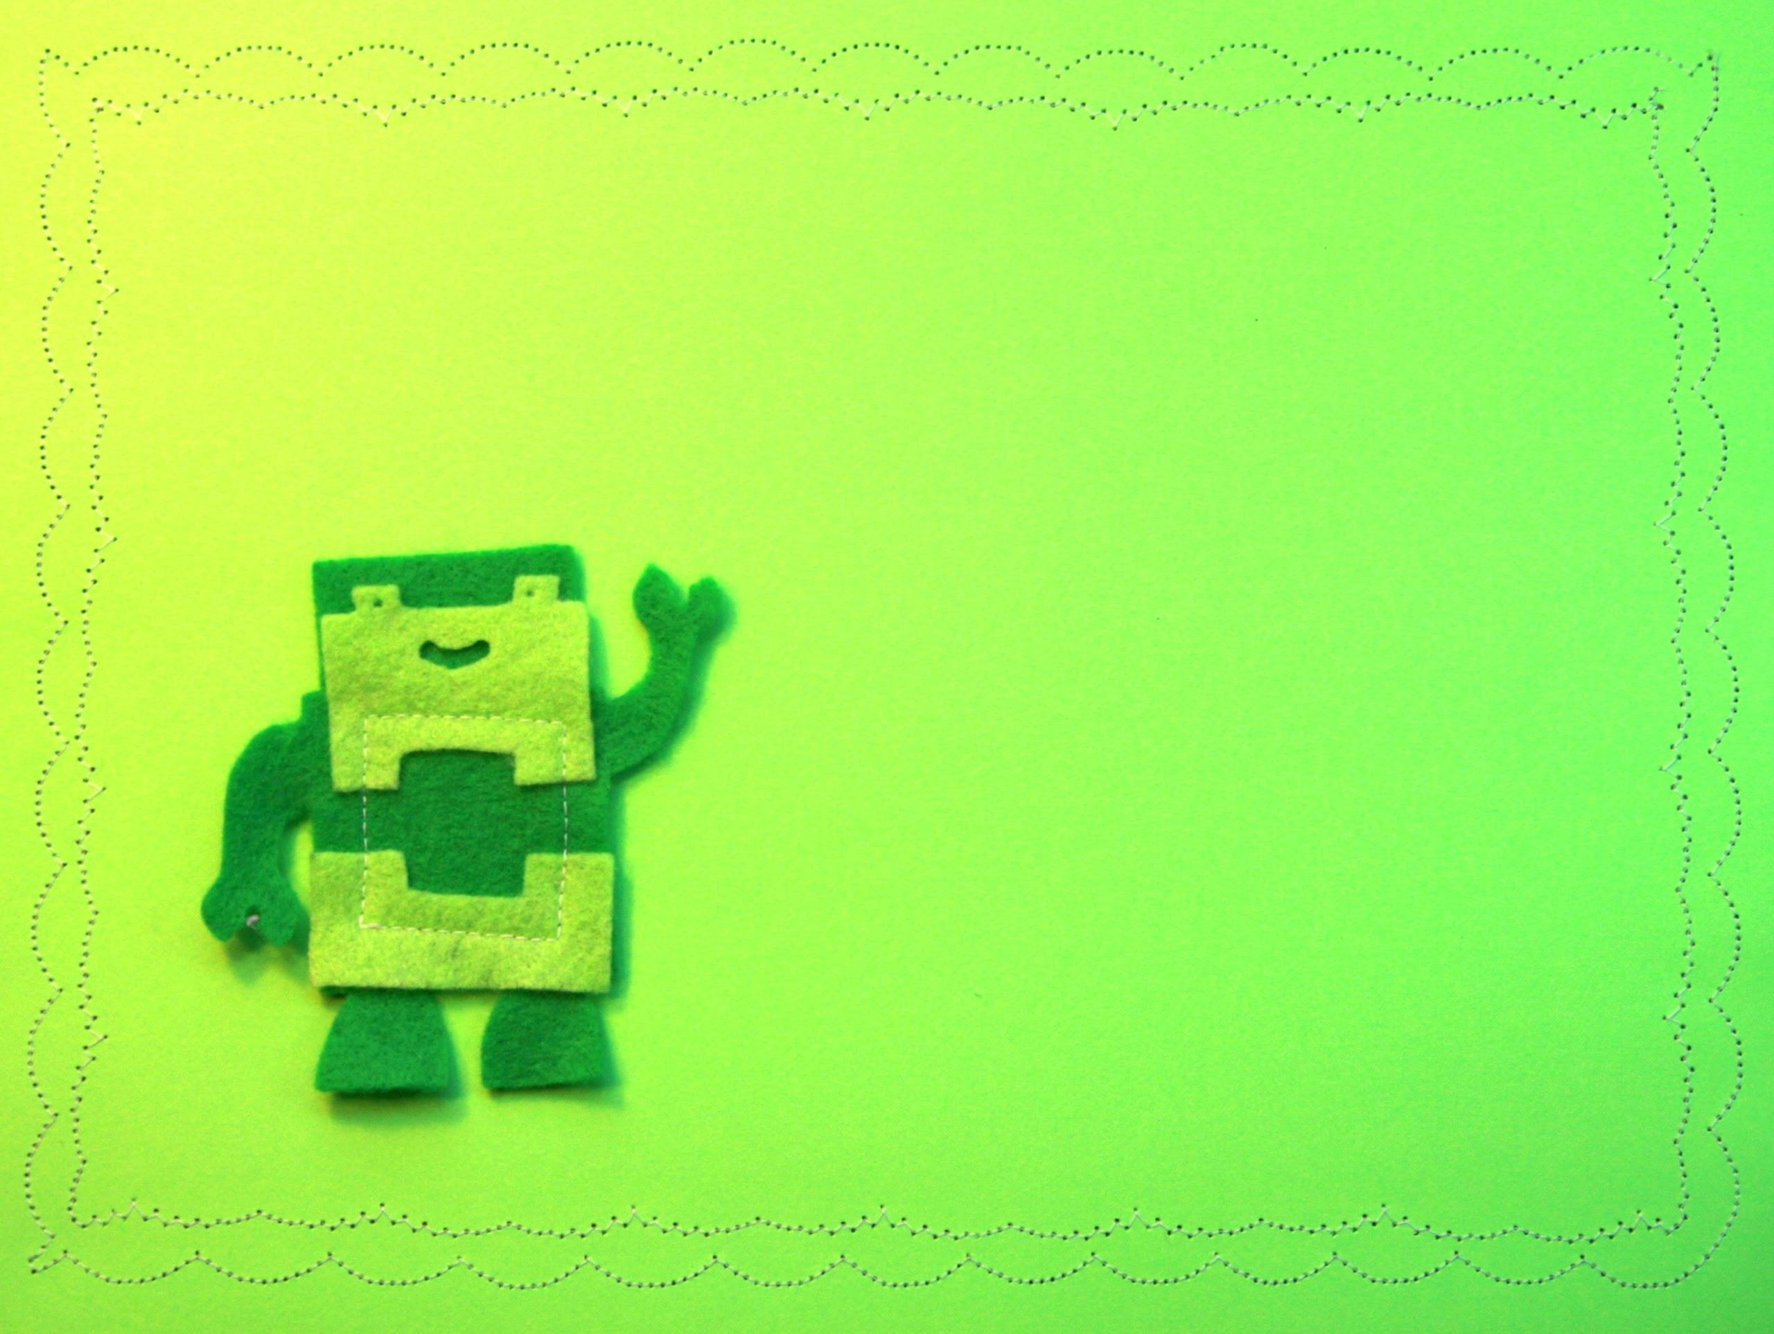
1
the people
-
2
the PLACE
-
3
the package

Slide 4
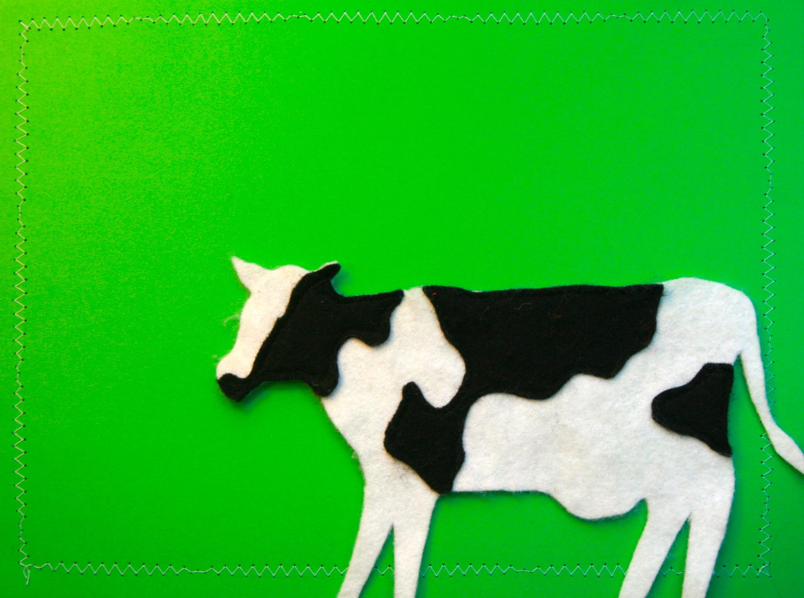
get out in the OPEN

Slide 5
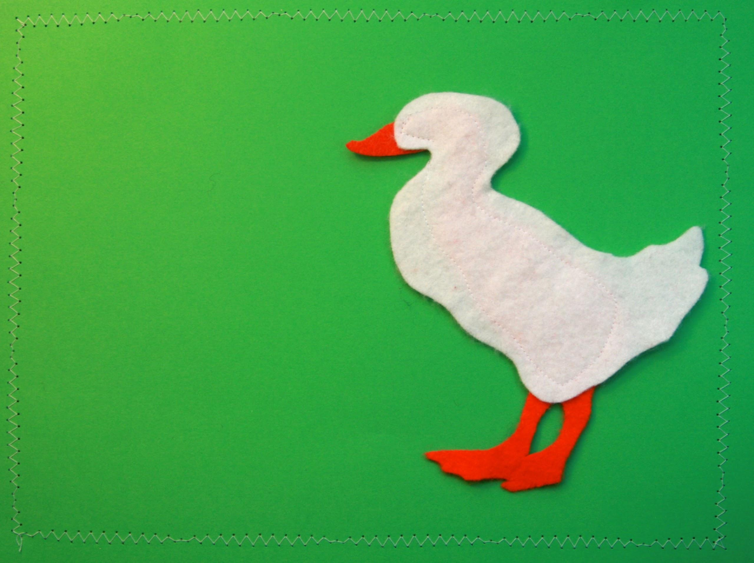
see and be seen

Slide 6
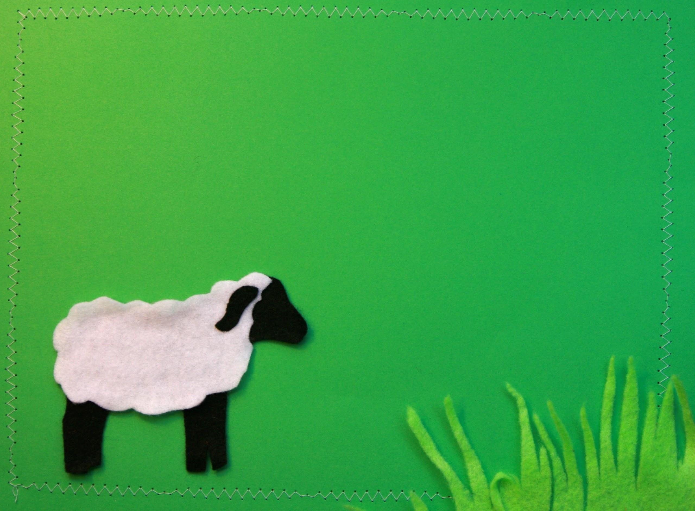
an invitation
to join in

Slide 7
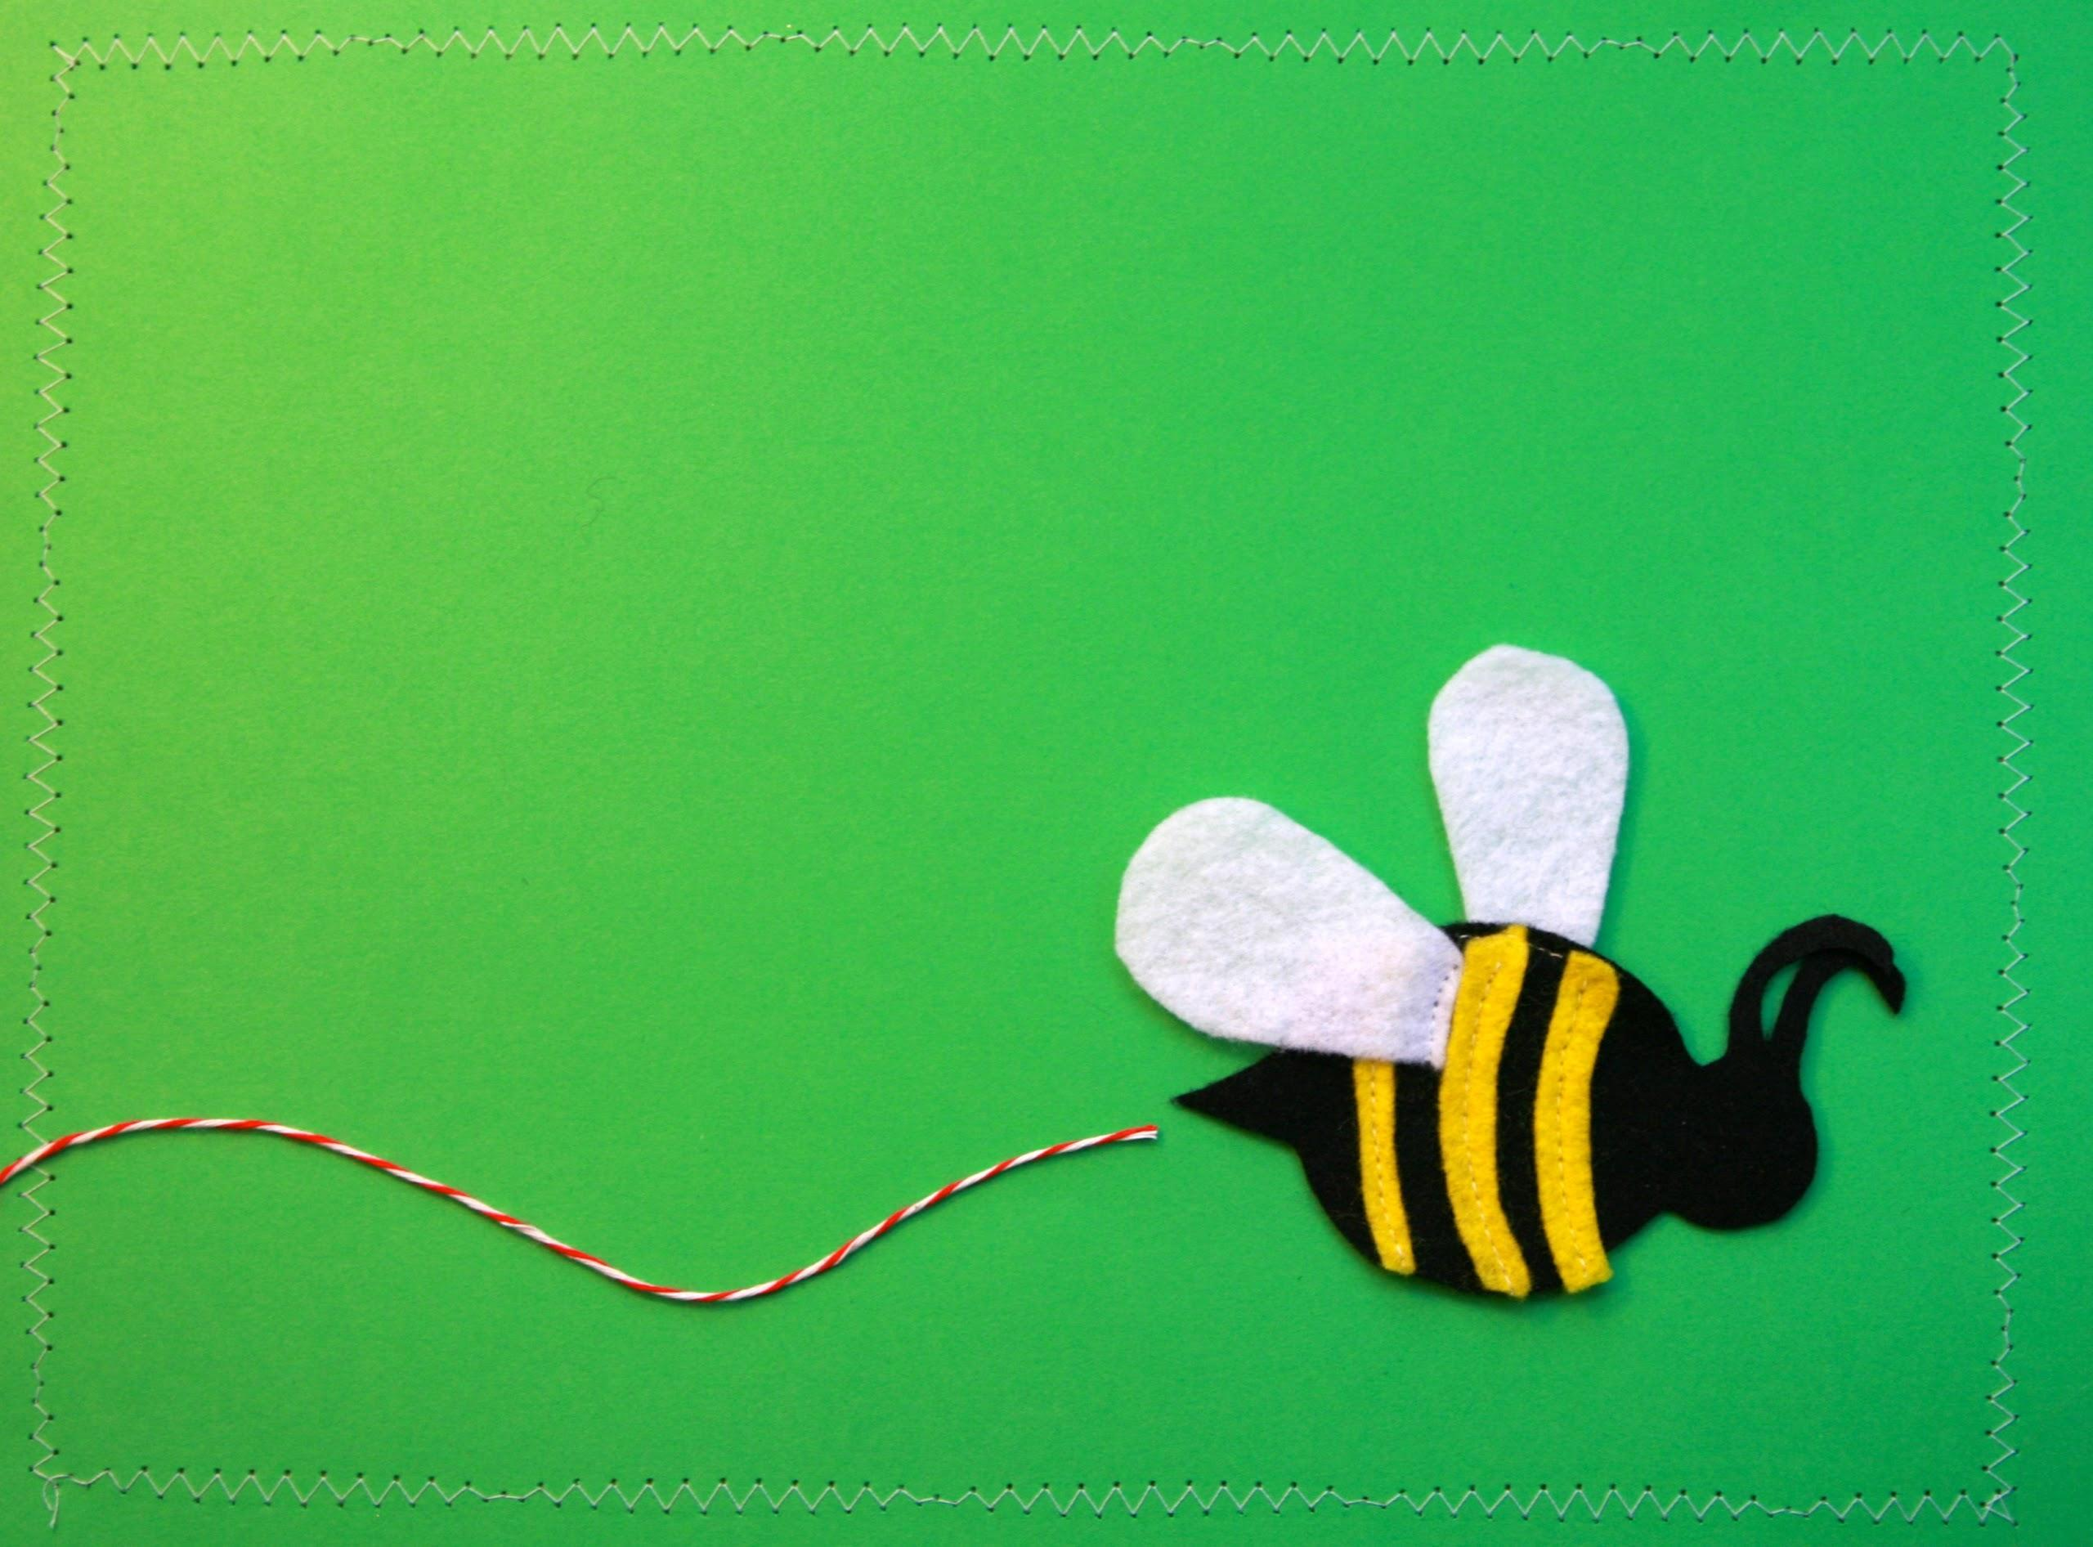
takeaway for supervisors
Conduct an audit of the physical layout
of your children’s area:
What can/can’t be moved?
Where do people gather?
What visual or spatial cues
tell you that you are
entering the children’s area?

Slide 8
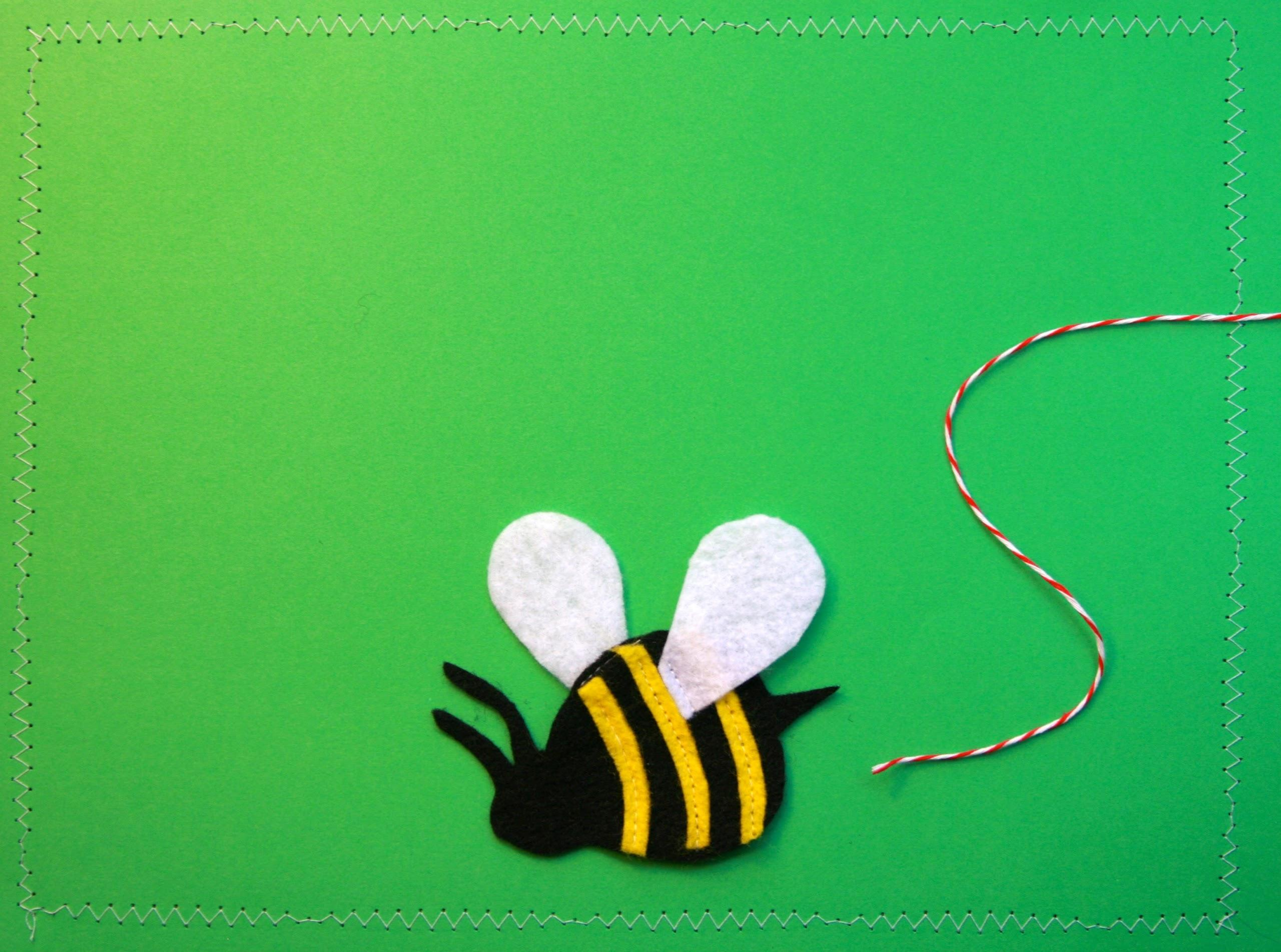
takeaway for librarians
Do the same audit separately
and compare notes
with your supervisor.

Slide 9
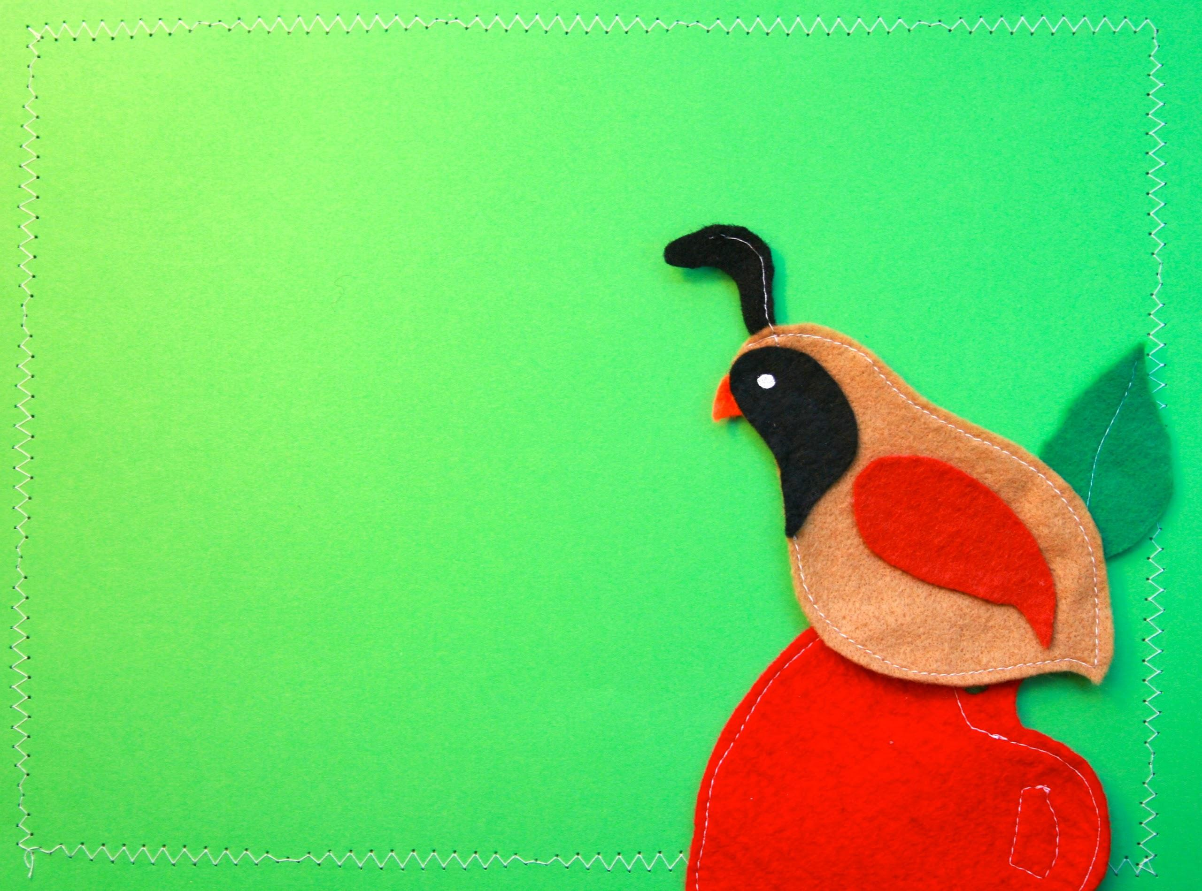
Q & A

Slide 10

GOALS
& successes

Slide 11

a goal for every program

Slide 12
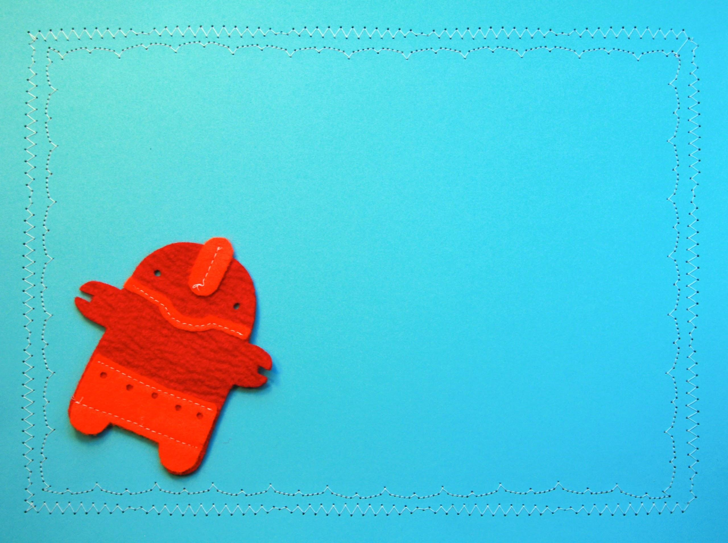
there are over 3 million children 0-5 in California.
U.S. Census
2012 estimate

Slide 13

what does success
look like?

Slide 14

making space for outreach

Slide 15

embracing success

Slide 16

experiment

Slide 17
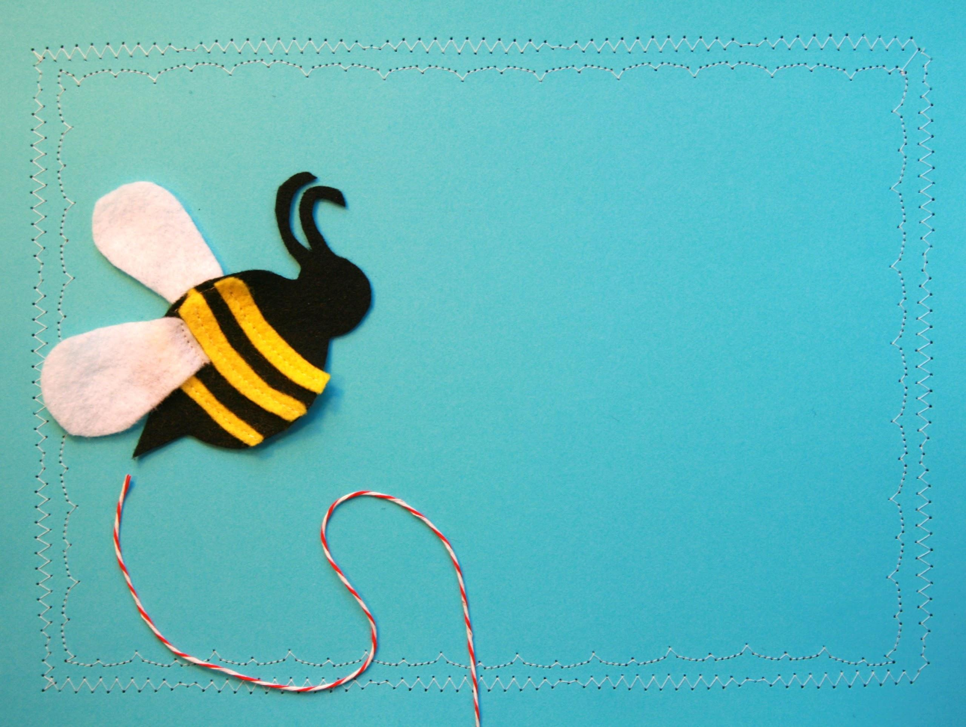
takeaway for supervisors
Use the American FactFinder
on census.gov to research demographics for your
service population.

Slide 18
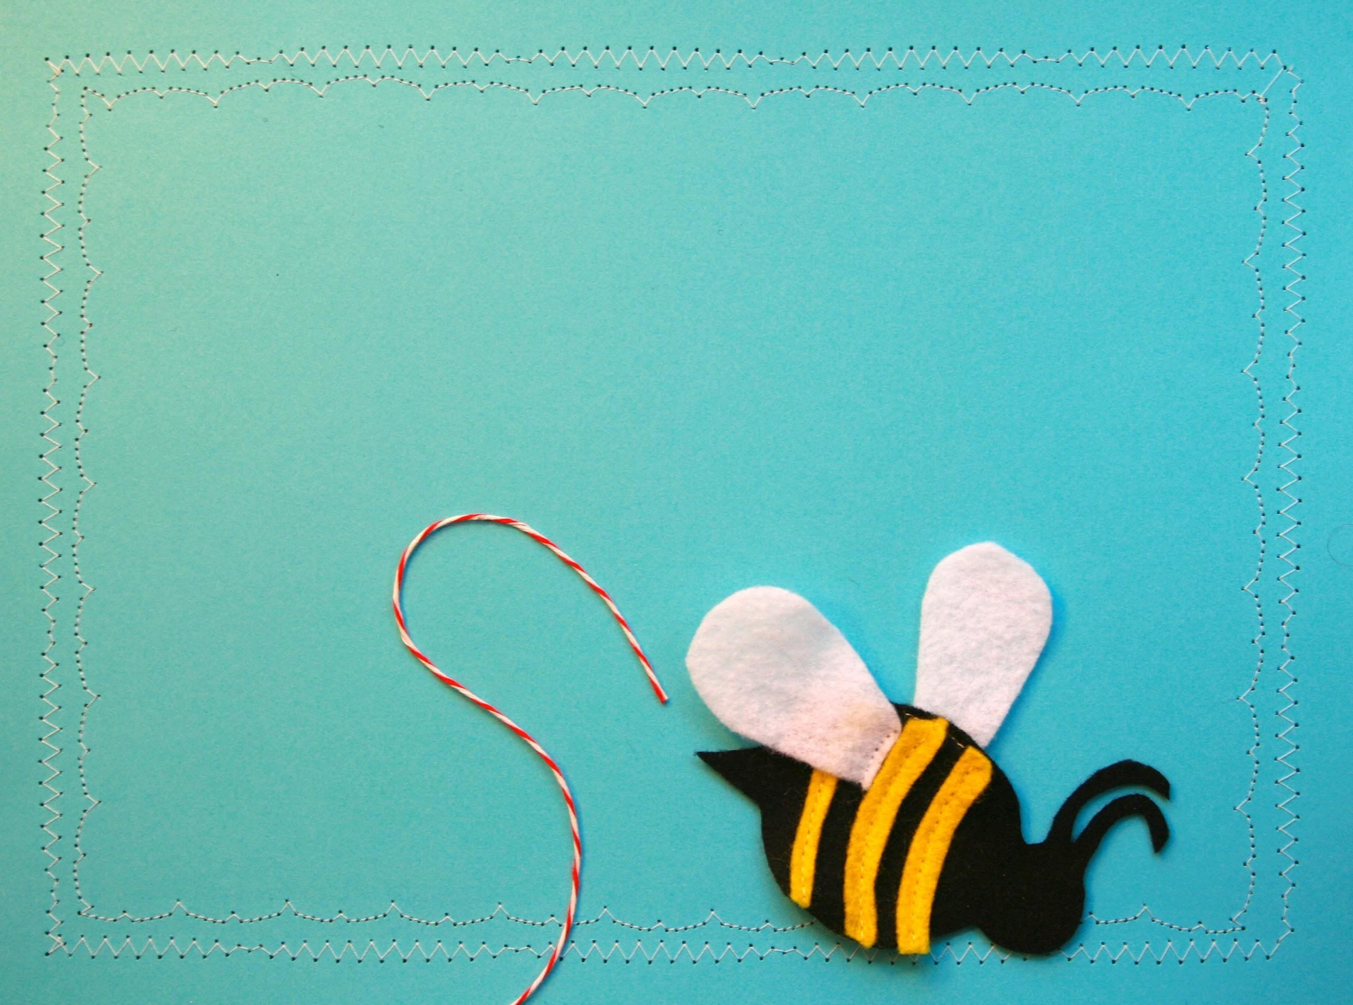
takeaway for librarians
Identify a new venue outside of the library where you can bring storytime.

Slide 19
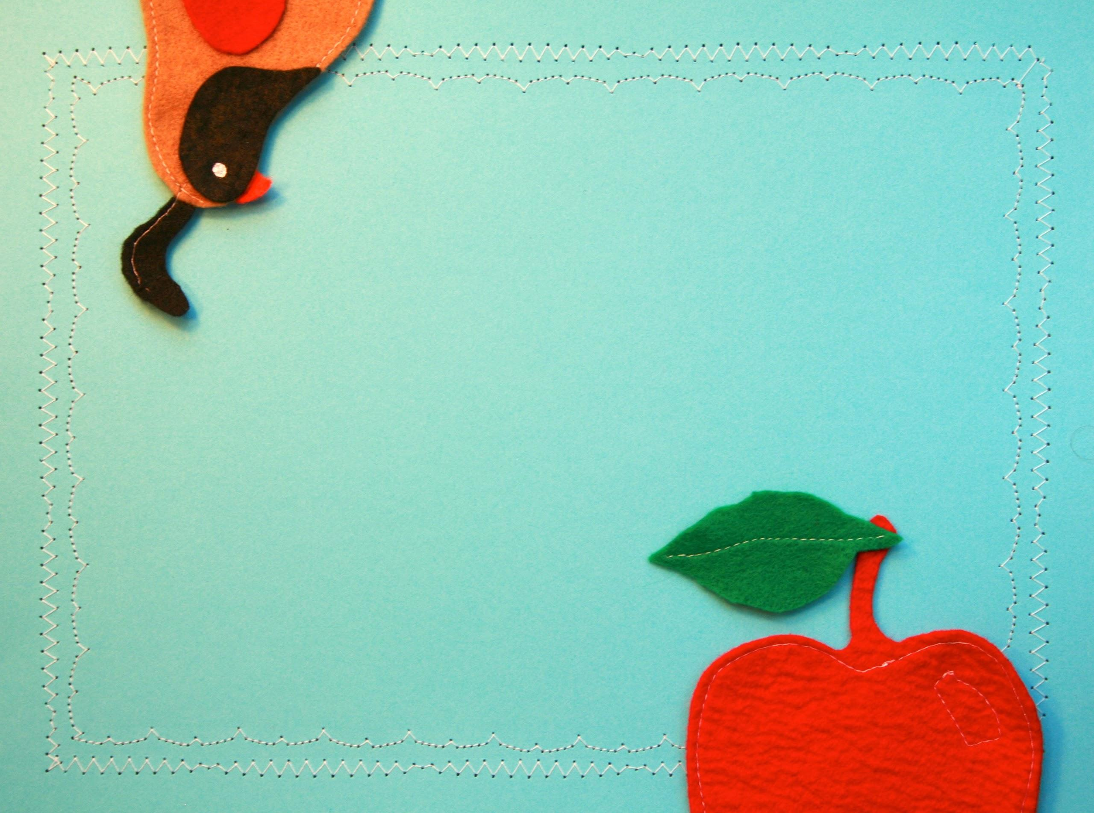
Q & A

Slide 20
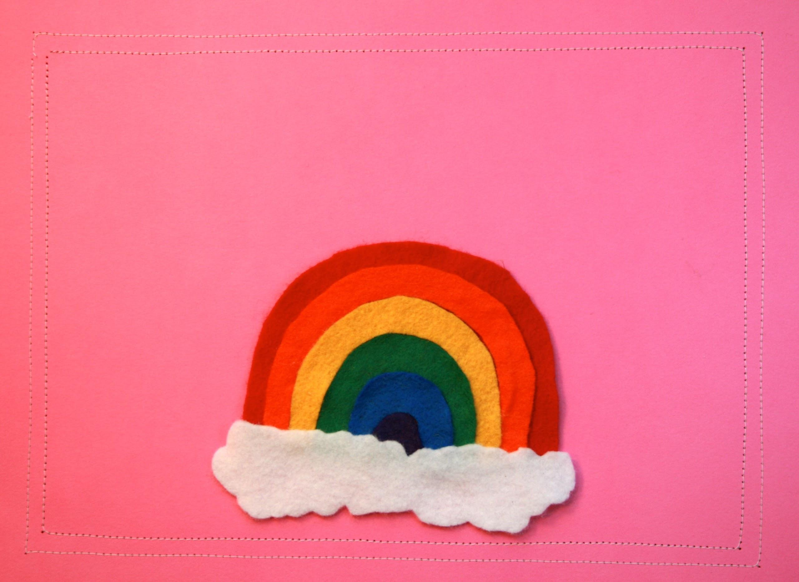
PLAYFUL spaces

Slide 21
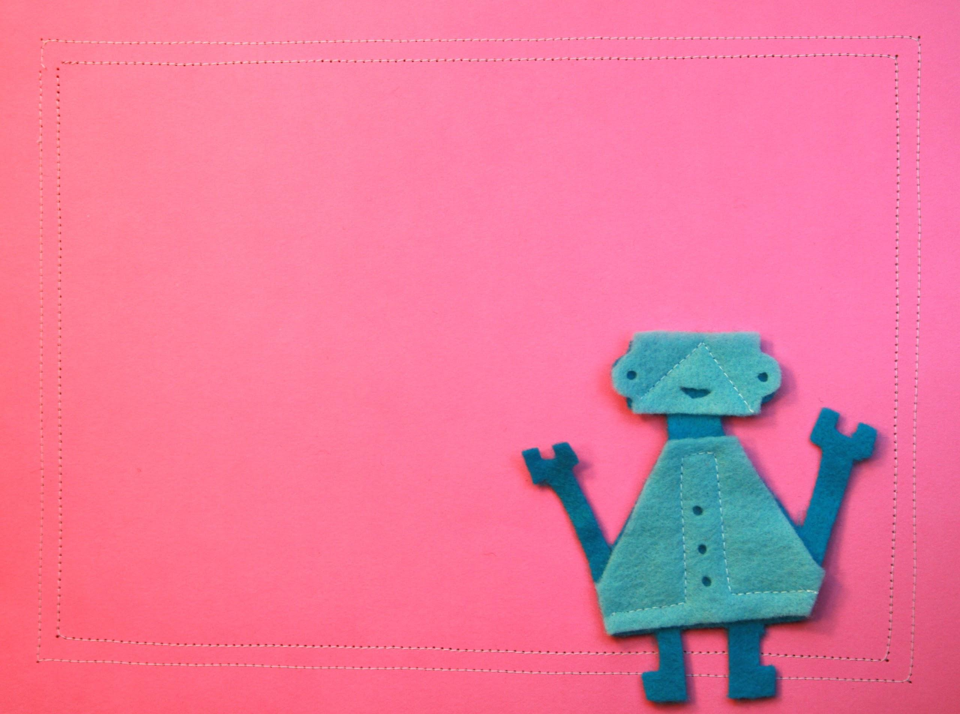
“Play is puposeful activity for a child.”
Lev Vygotsky,
“Play and Its Role in the Mental Development of the Child” (1933)

Slide 22
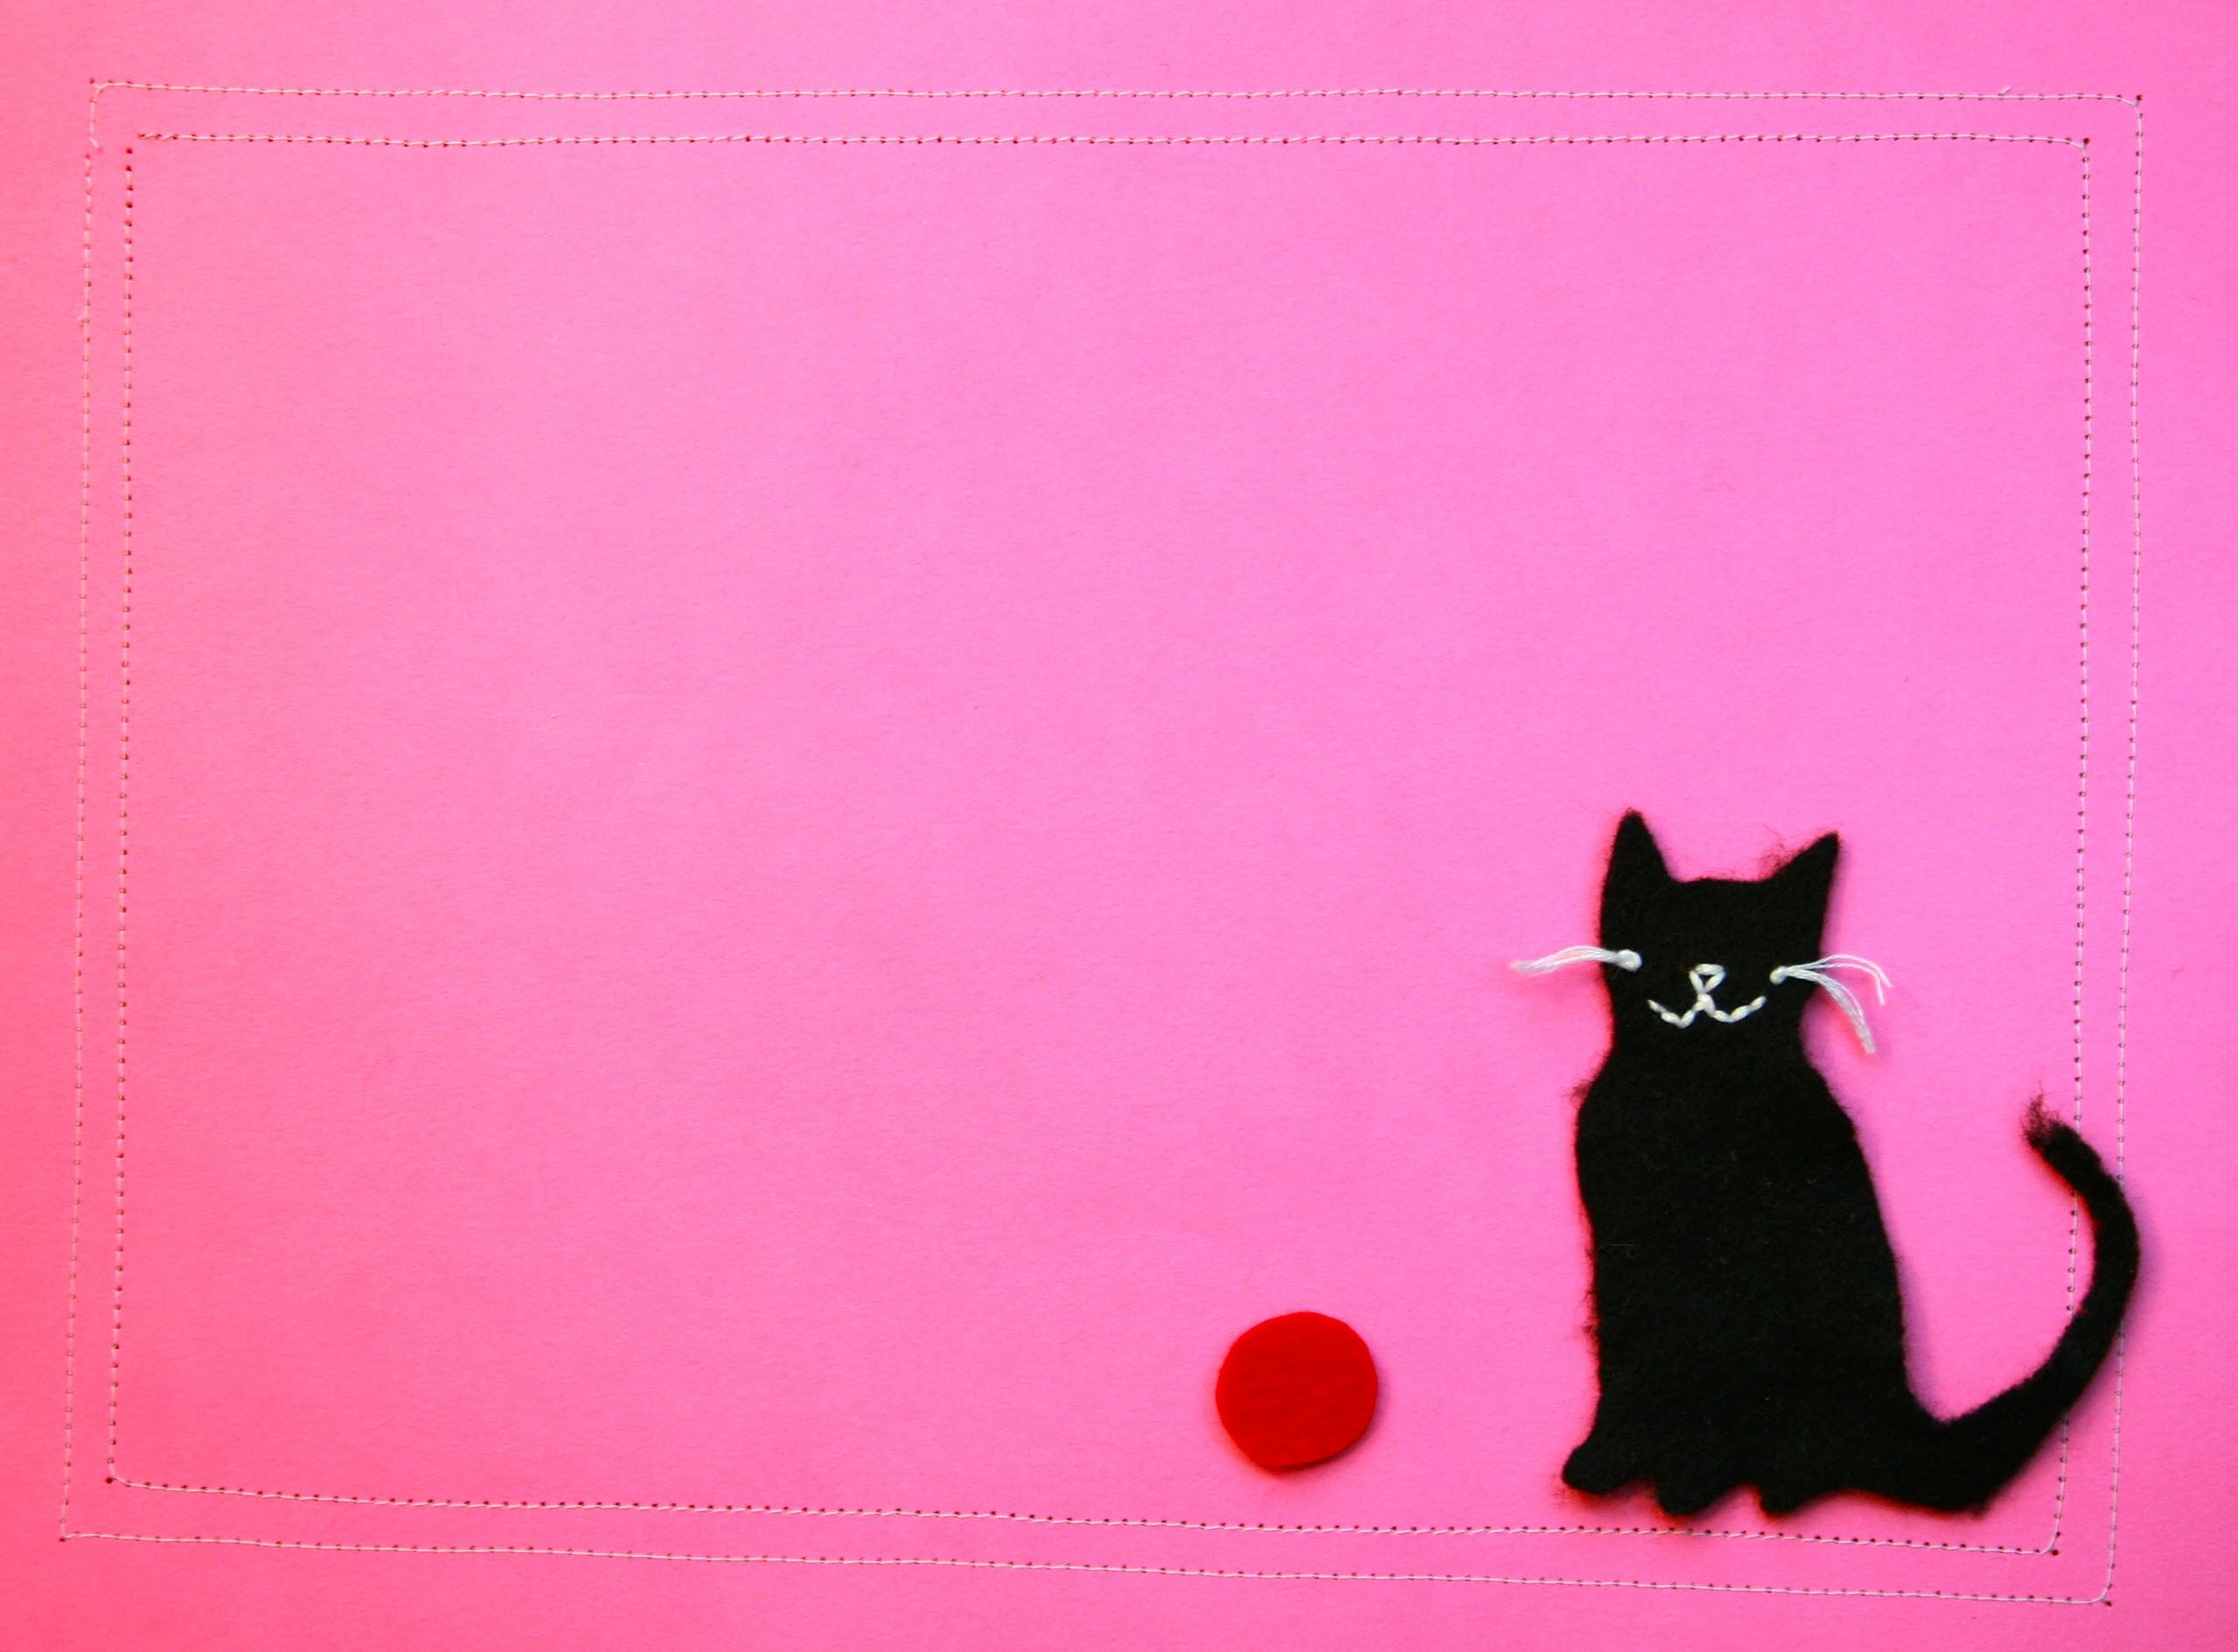
learning through play

Slide 23
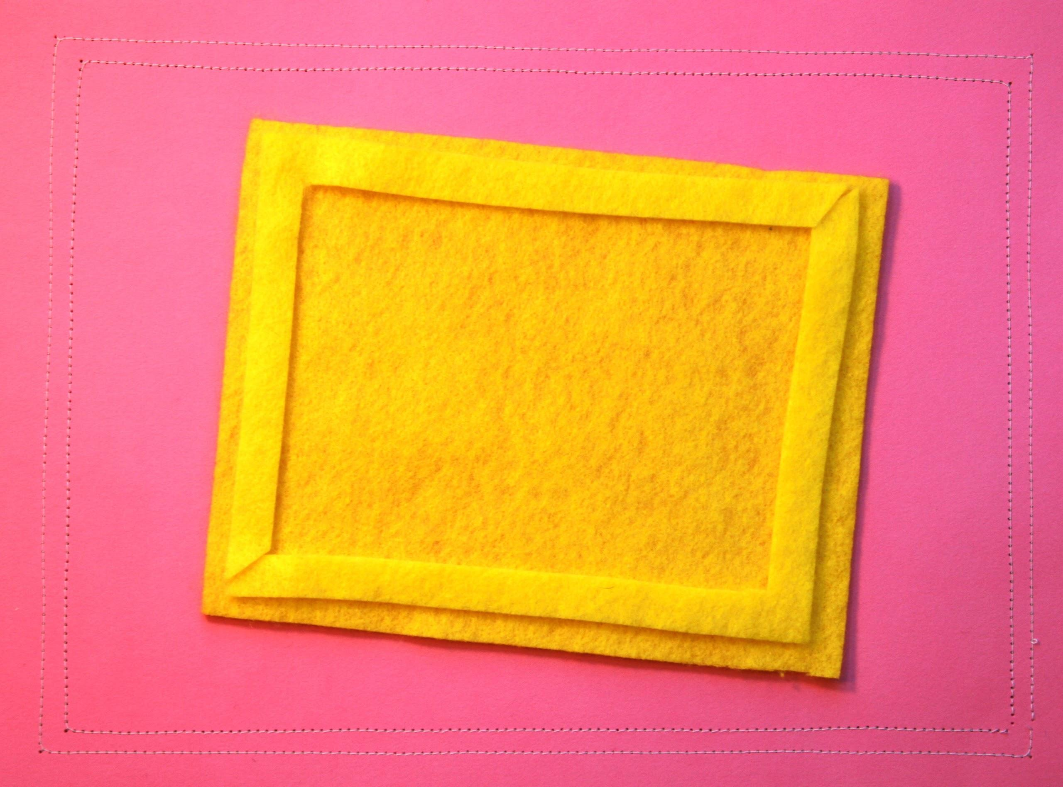
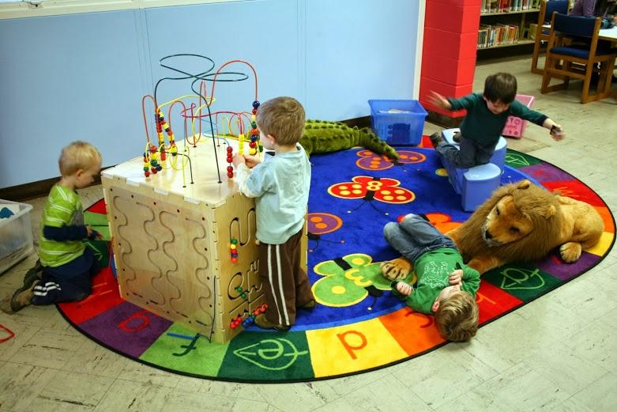

Slide 24
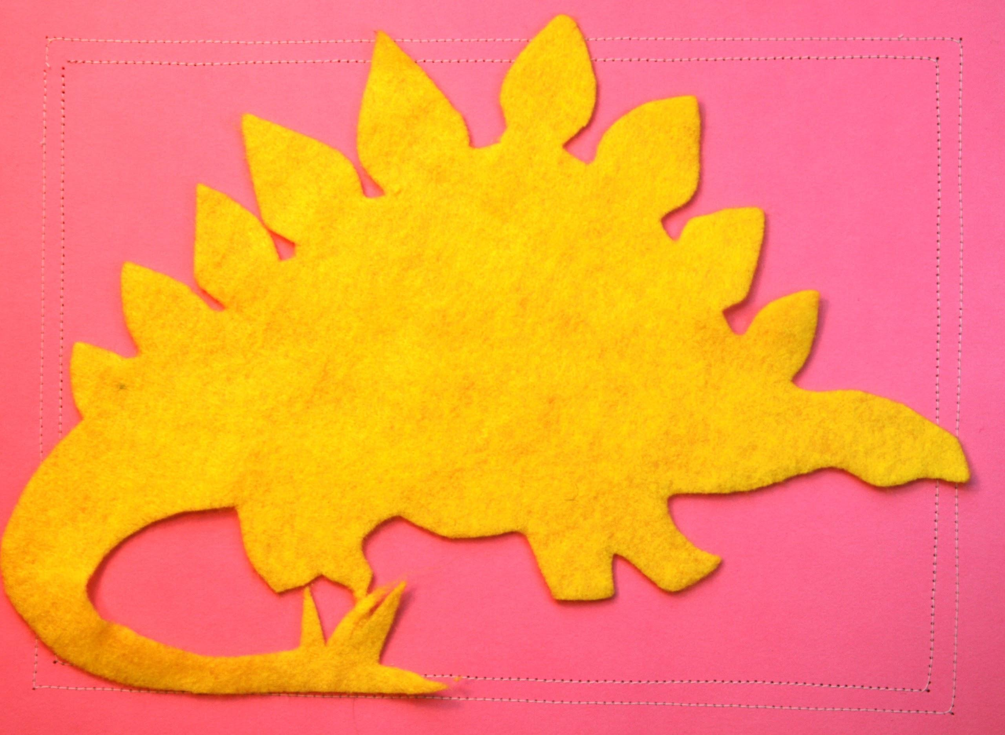
noise

Slide 25
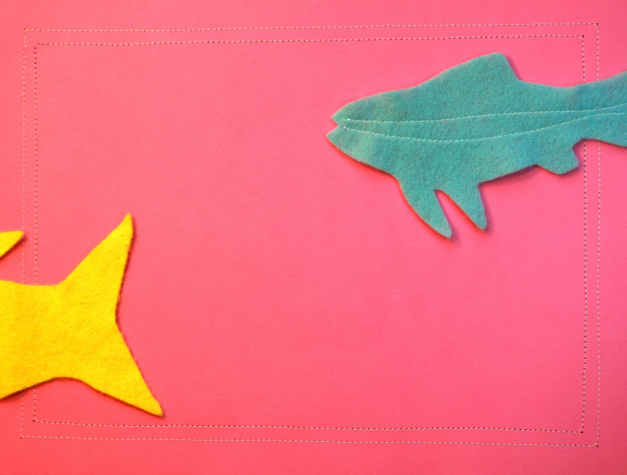
social objects

Slide 26
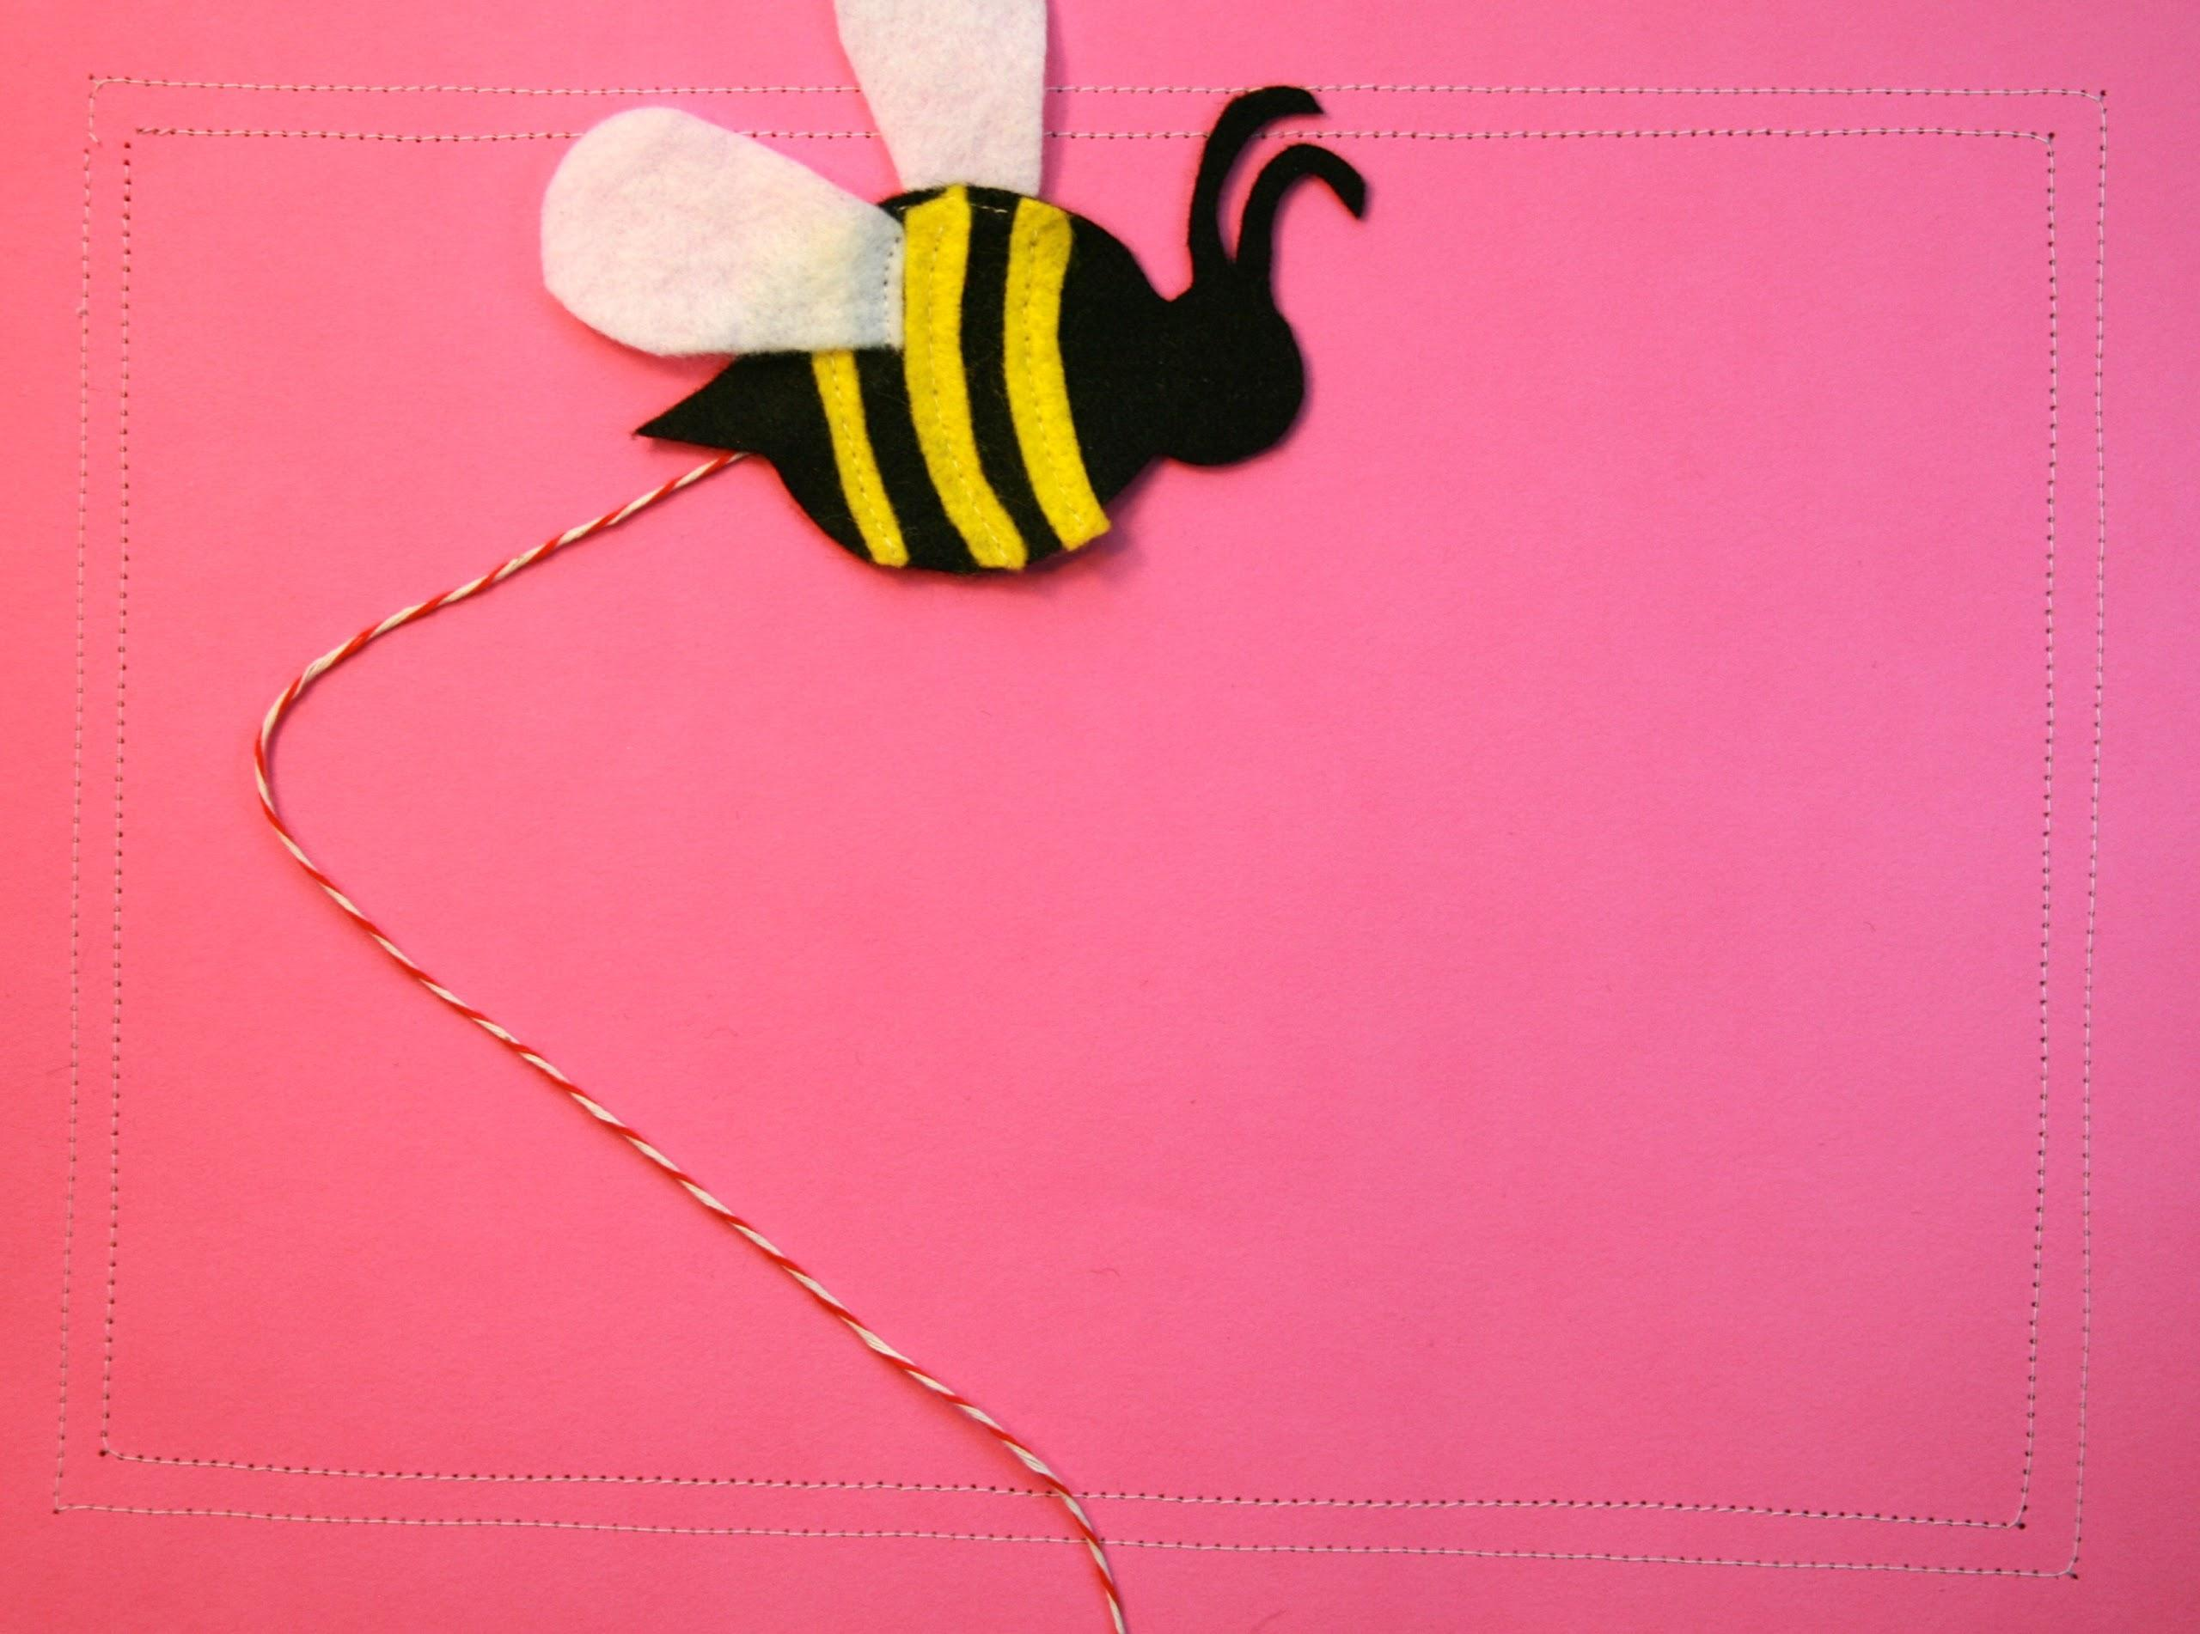
takeaway for supervisors
Talk about noise
at a staff meeting.

Slide 27
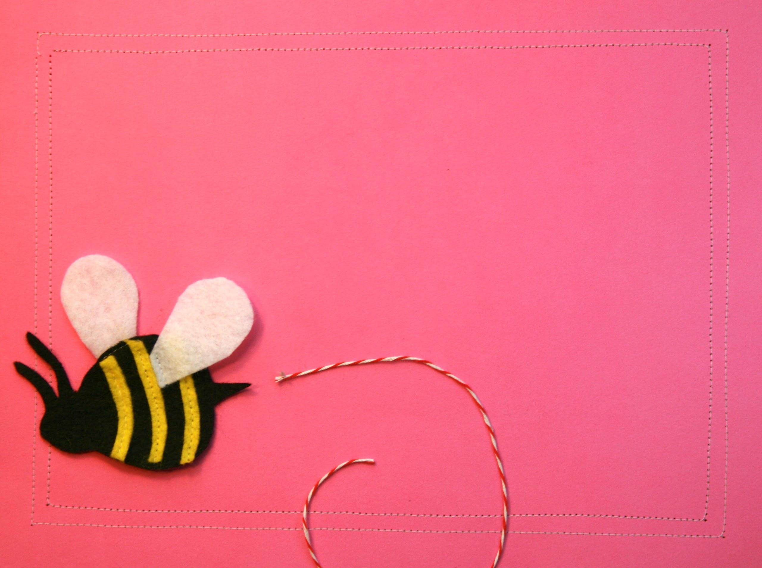
takeaway for librarians
Find two improvements - one under $100 and one under $500 - to make your space more playful and discuss them with your supervisor.

Slide 28
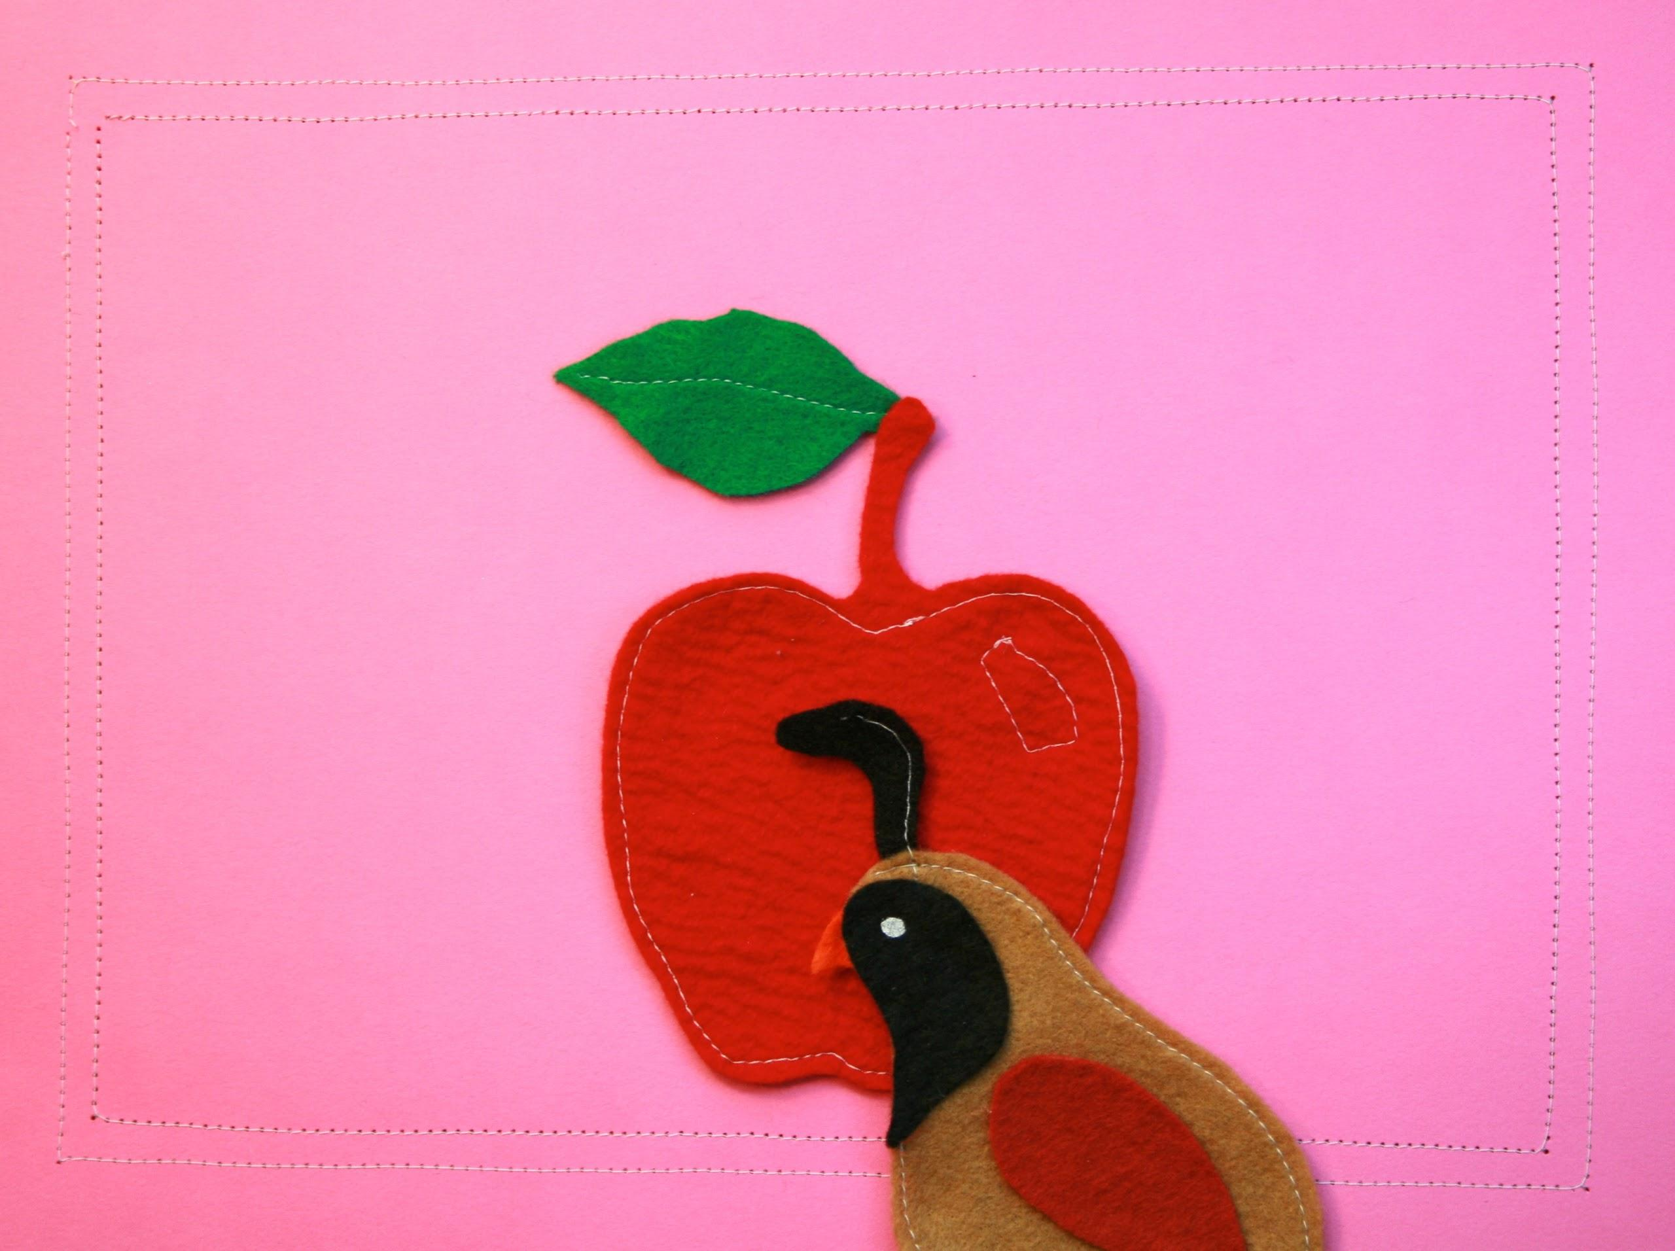
Q
&
A

Slide 29

wrap
up
Thursday, February20 - The Package
hwdolamore@solanocounty.com premer@ccclib.org

Slide 30
The Early Learning with Families @ Your Library (ELF) 2.0 is supported by the U.S. Institute of Museum and Library Services under the provisions of the Library Services and Technology Act, administered in California by the State Librarian. This material is licensed under a Creative Commons 3.0 Share & Share-Alike license. Use of this material should credit the author and funding source.

