Slide 1
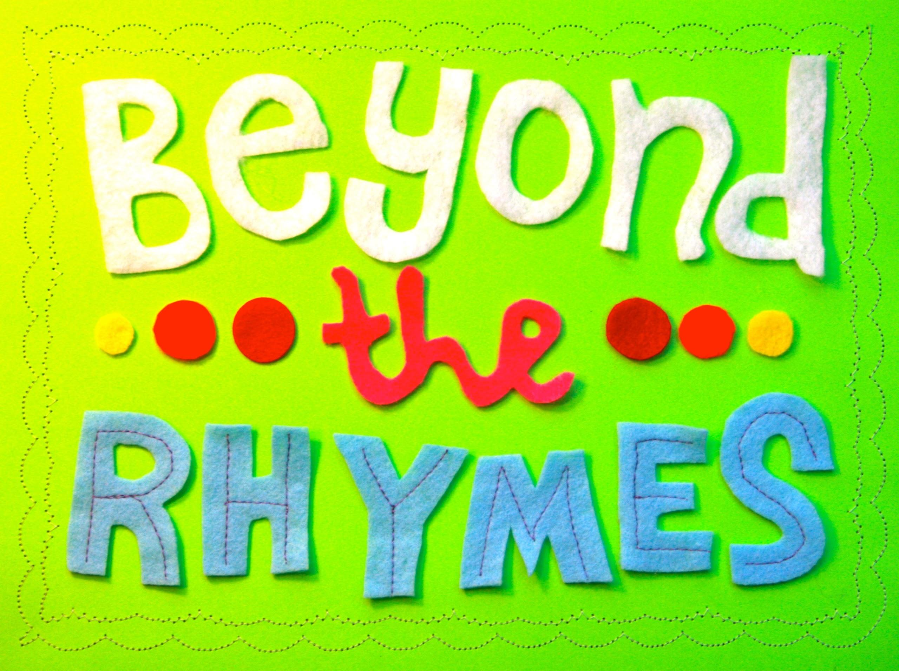
The Early Learning with Families @ Your Library (ELF) 2.0 presents
Thursday, February 20, 2014

Slide 2
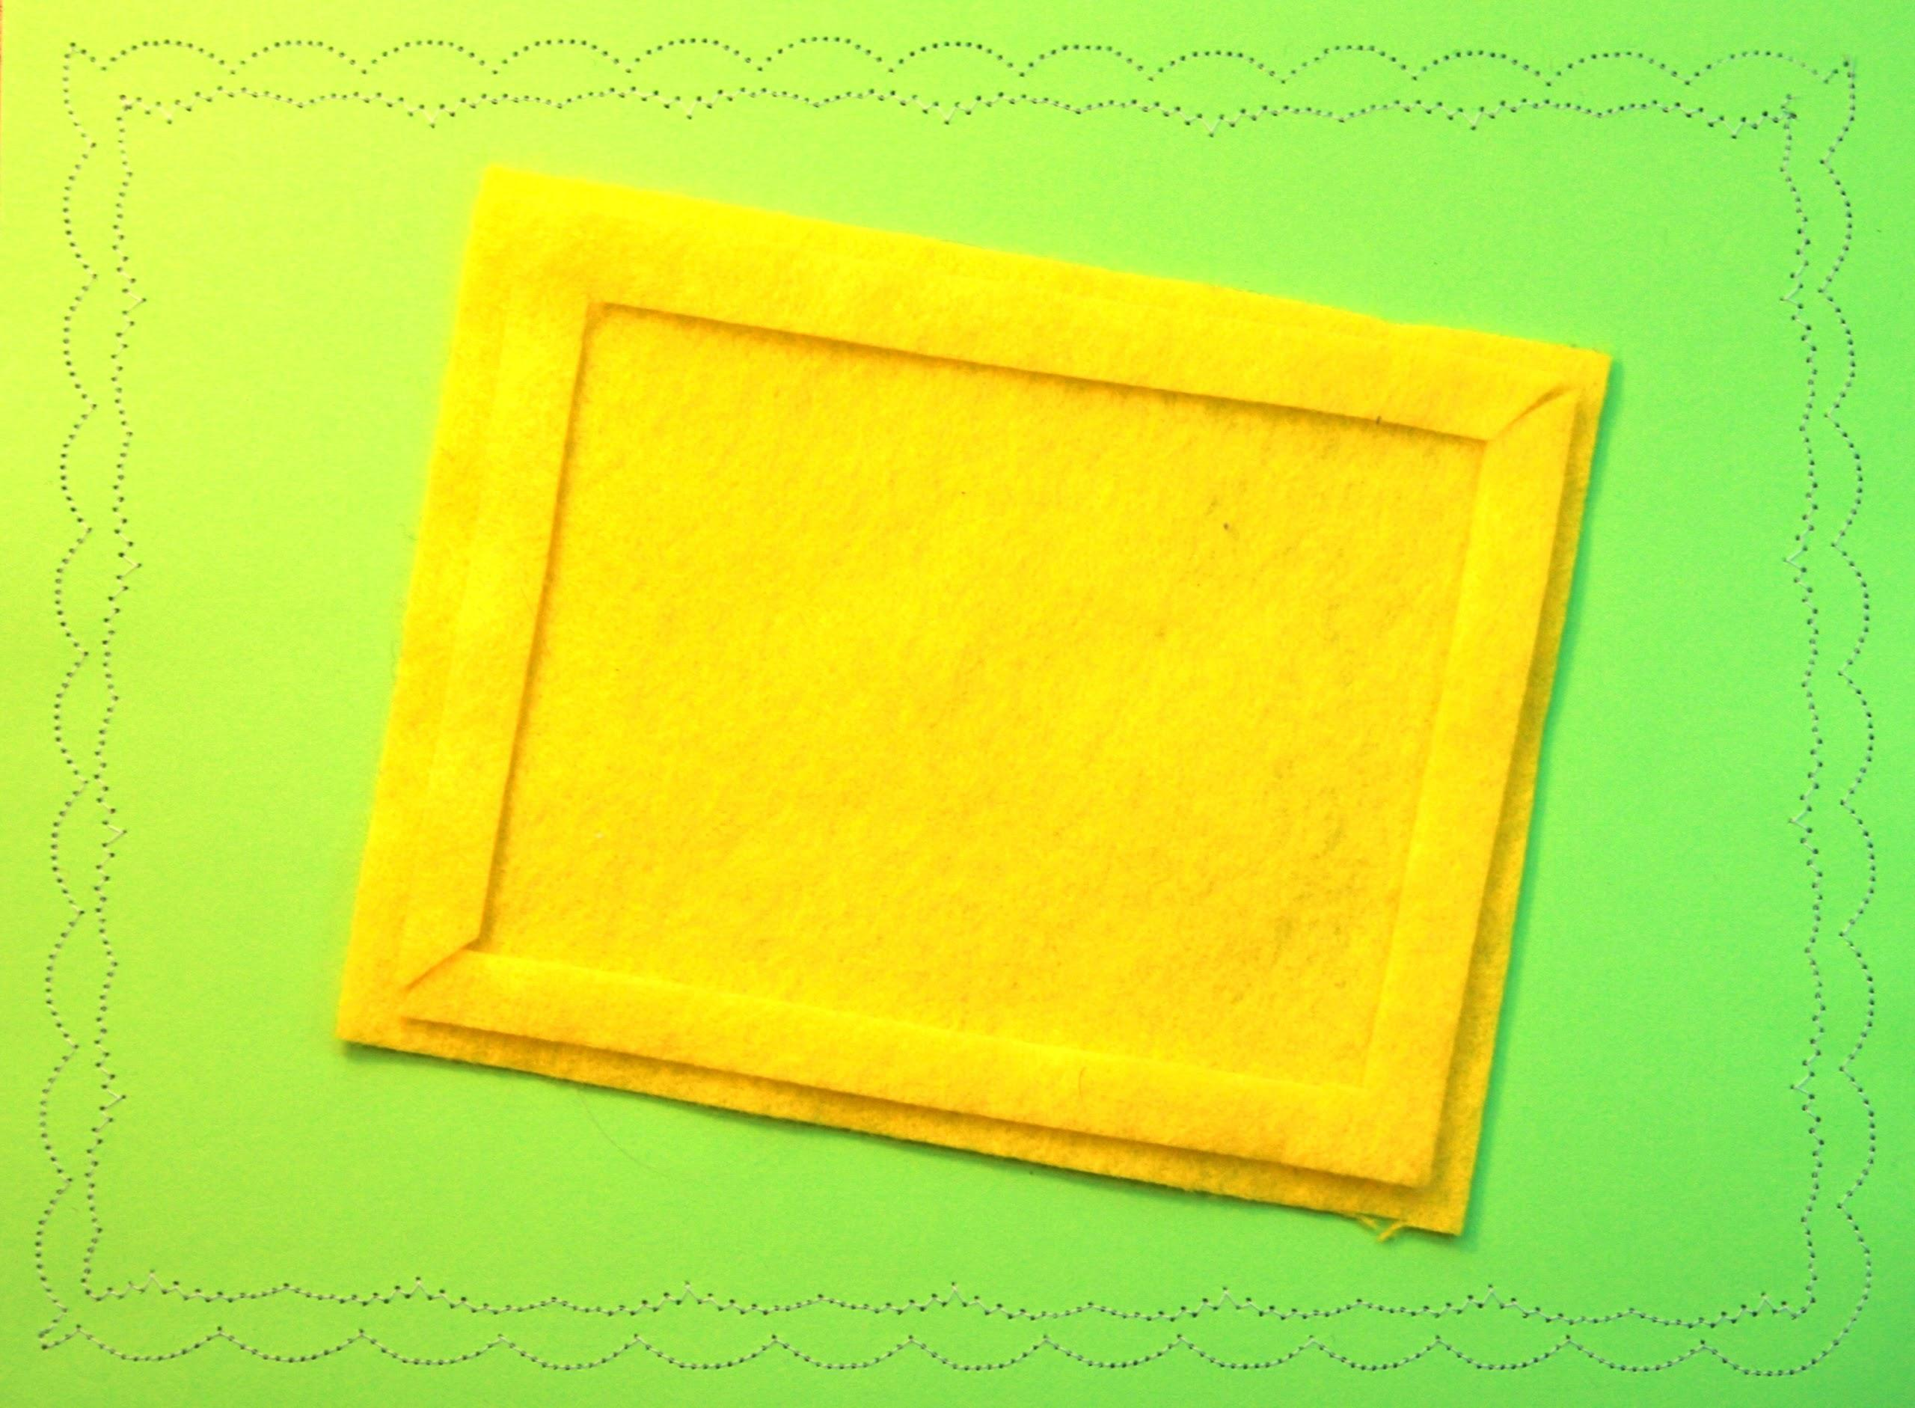
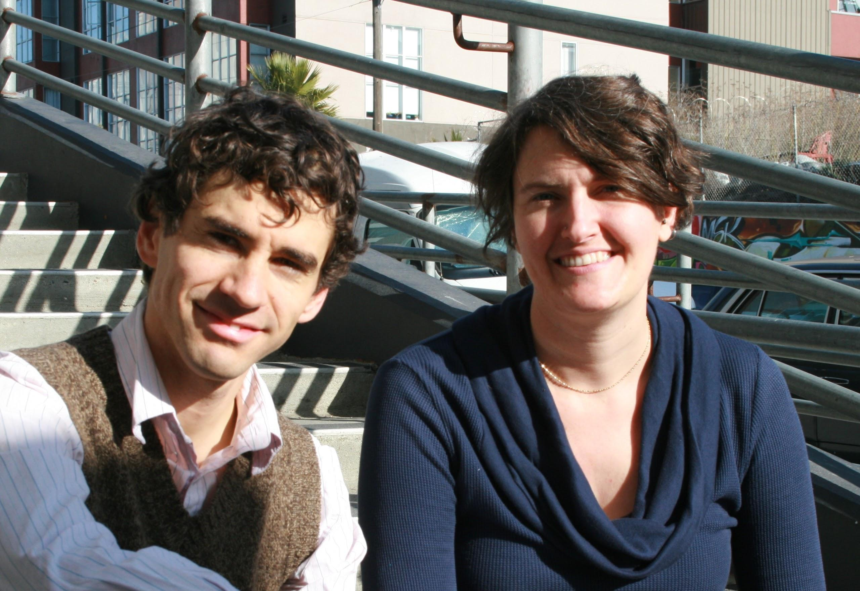
heidi dolamore
patrick remer

Slide 3
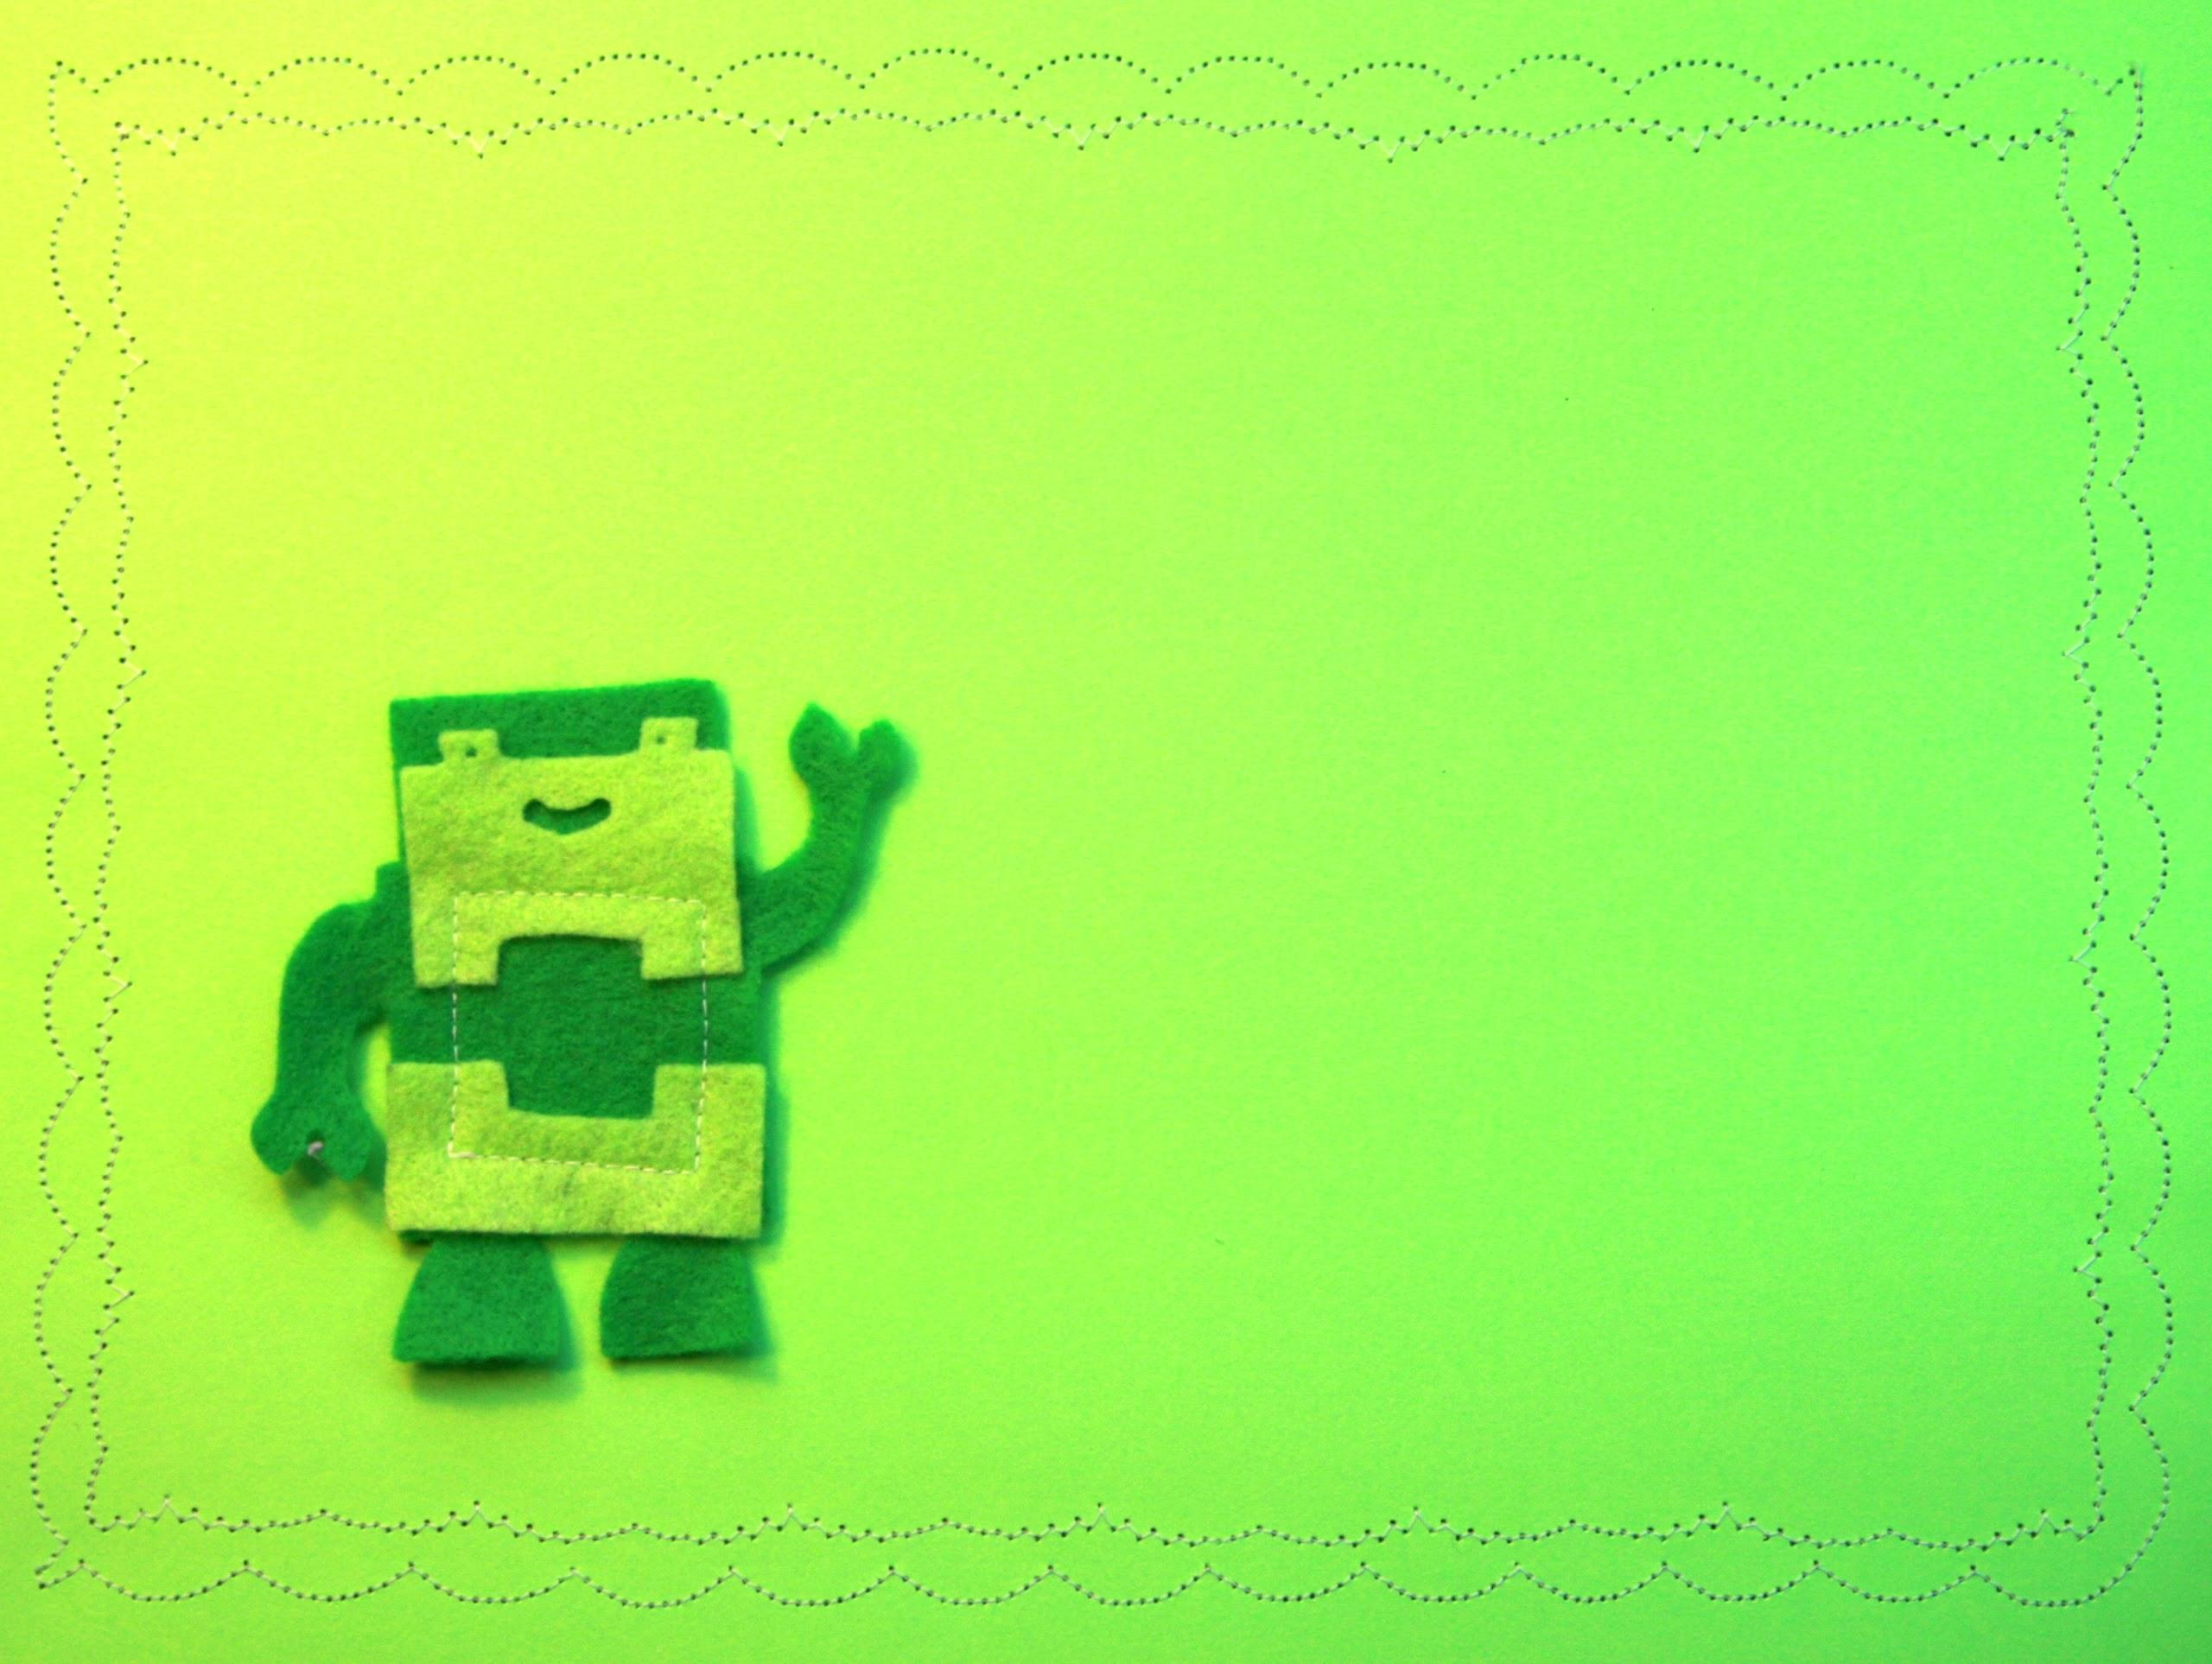
1
the people
-
2
the place
-
3
the PACKAGE

Slide 4
SIMPLE & easy

Slide 5
what makes sense
for families?

Slide 6
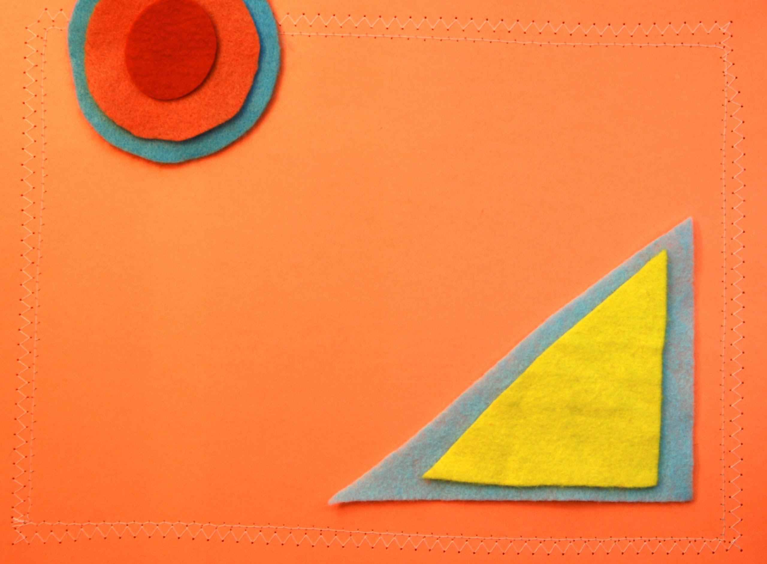
mixed ages

Slide 7
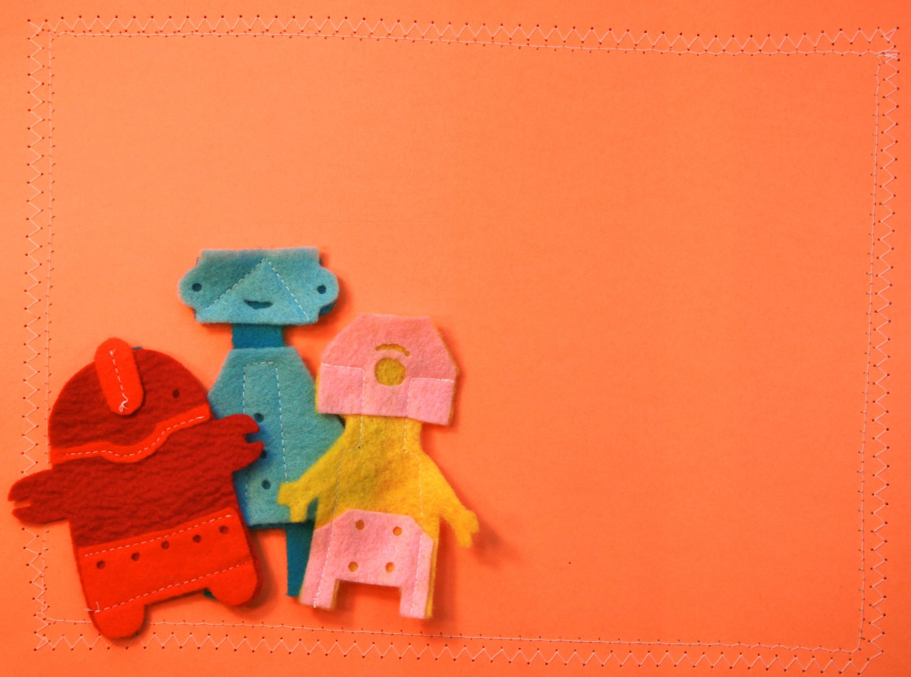
Young children develop cognitive, linguistic, and motor skills more rapidly when playing in mixed age groups.
See Peter Gray, “The Special Value of Children’s Age-Mixed Play”
(2011)

Slide 8
consistency

Slide 9
breaking the rhythm

Slide 10
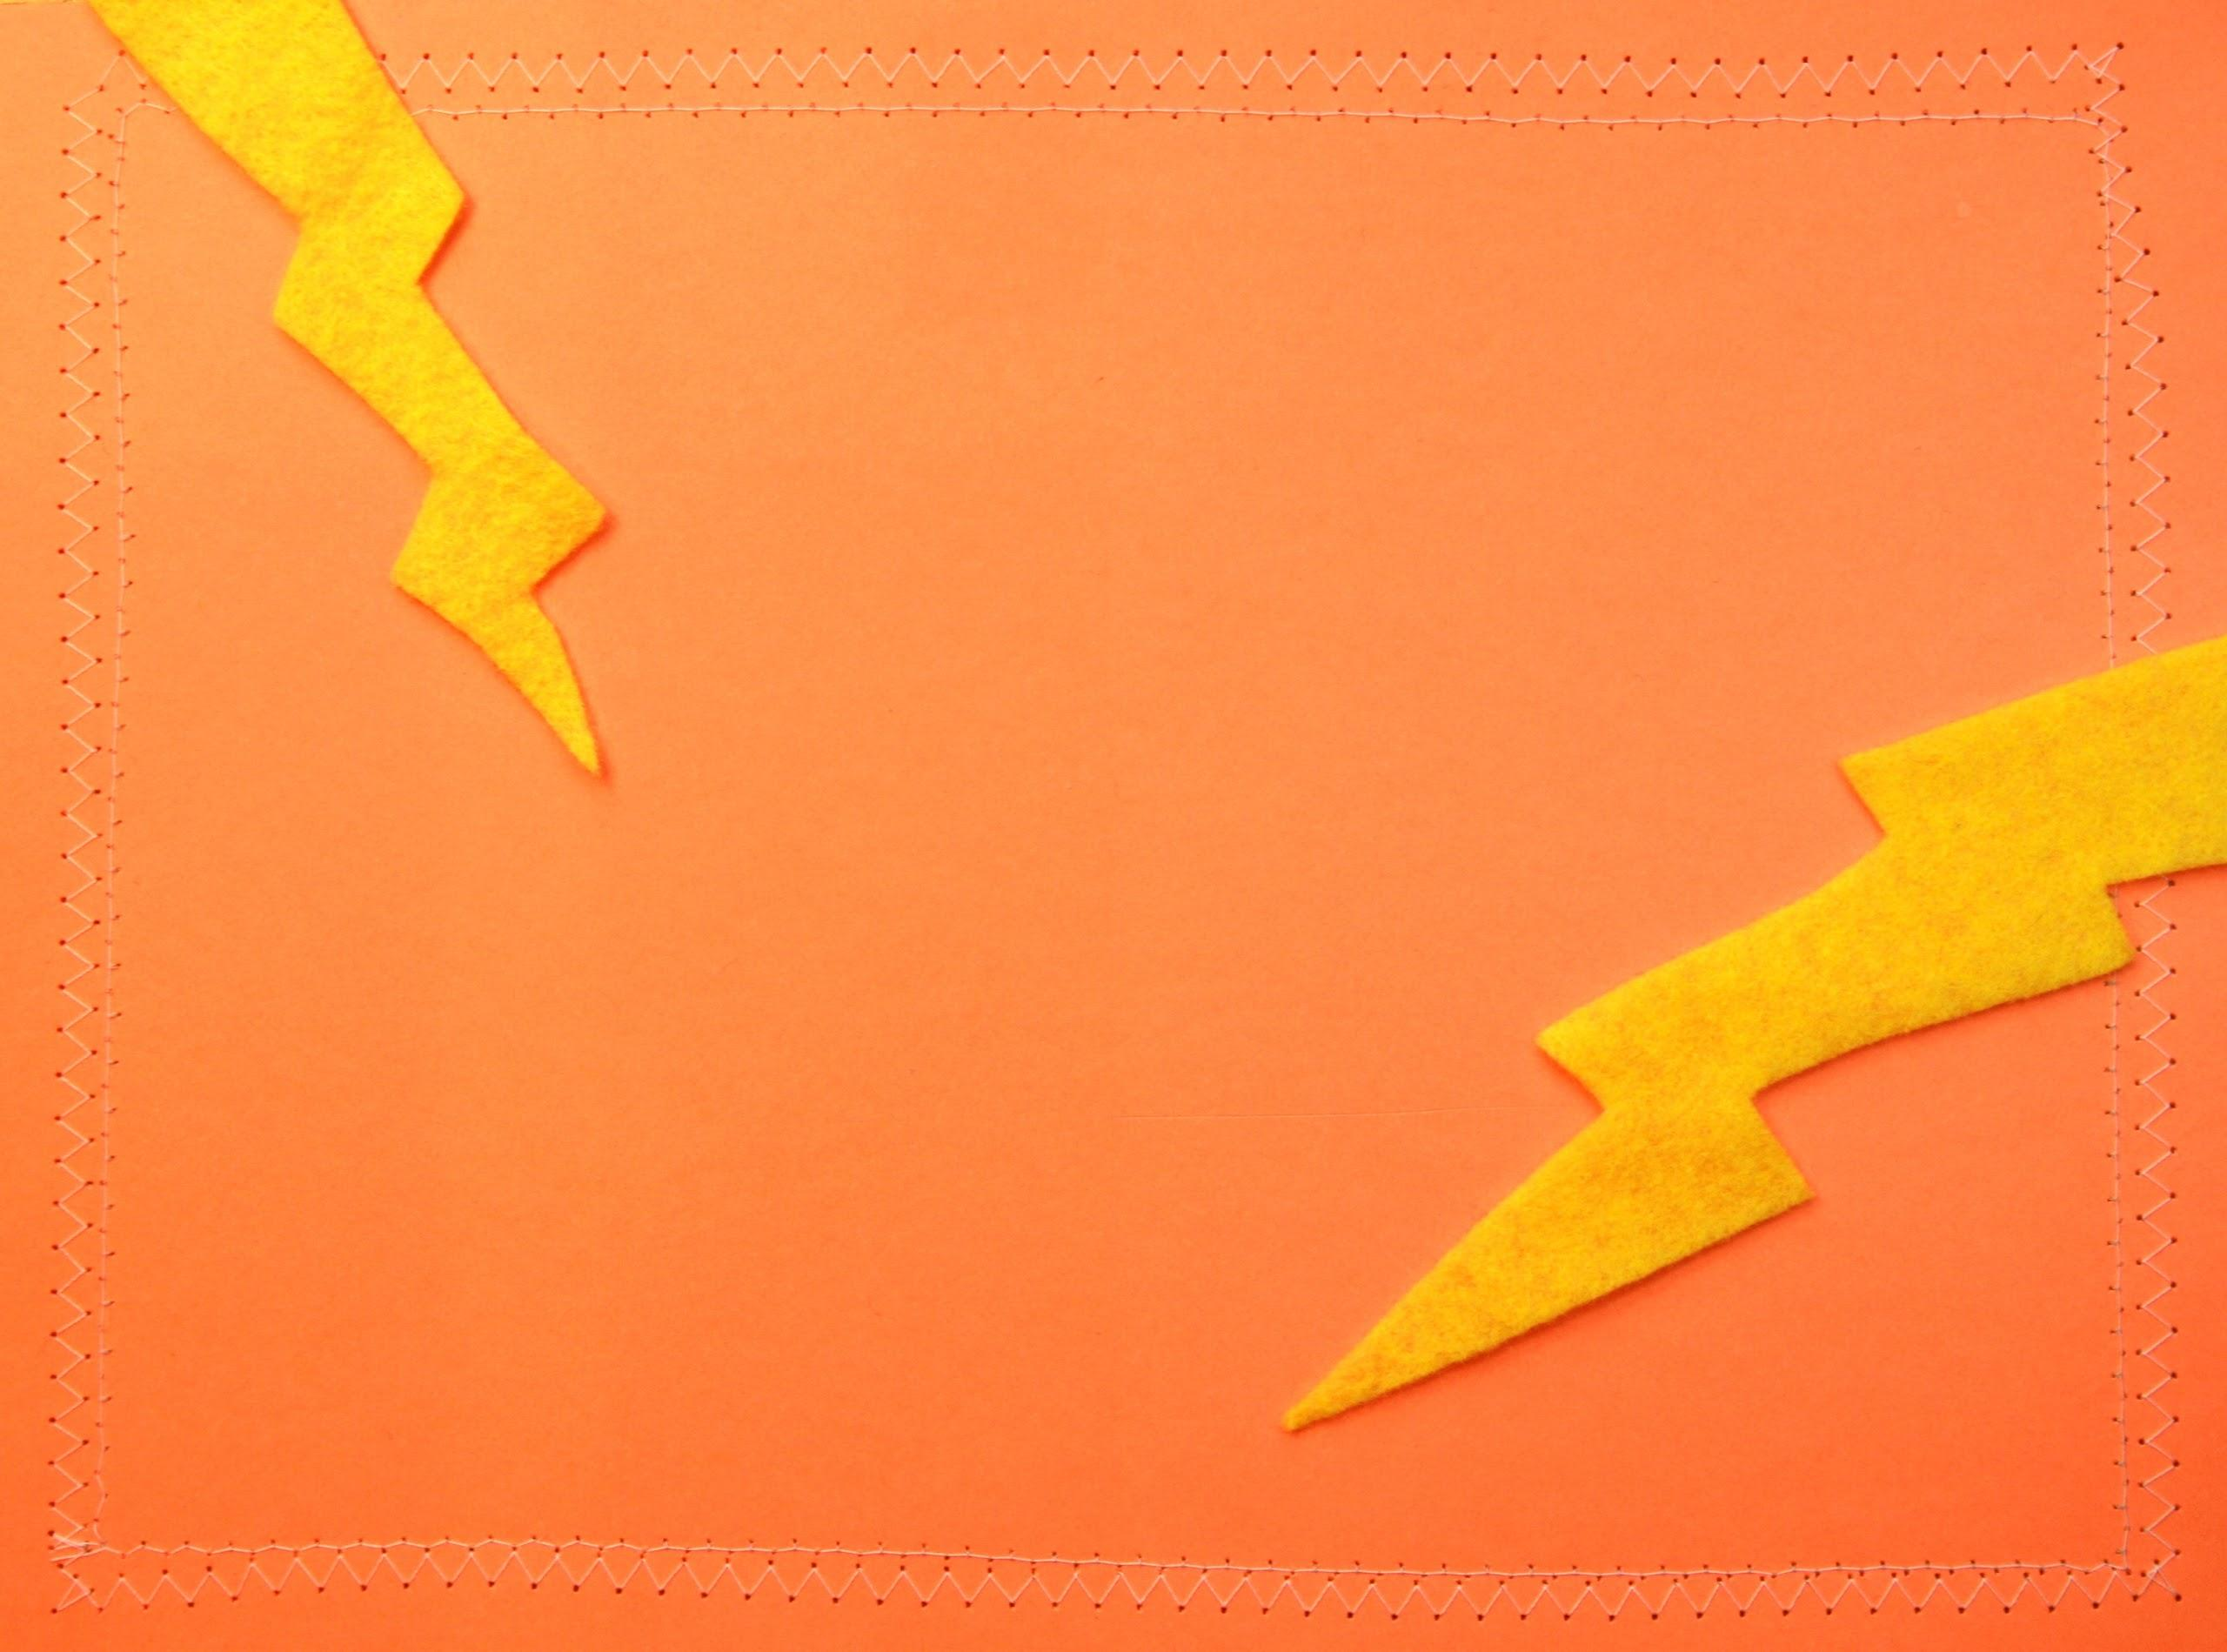
predict the unpredictable

Slide 11
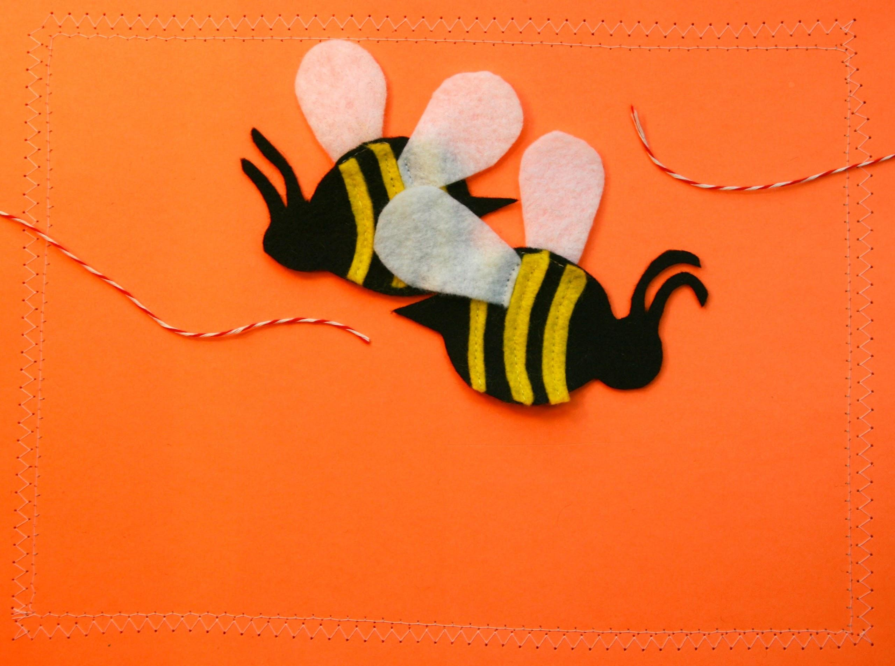
takeaway for supervisors
Chat with families after storytime.

Slide 12
takeaway for librarians
Think about one of your favorite storytime songs. How could you use it for babies? Toddlers? Preschoolers?

Slide 13
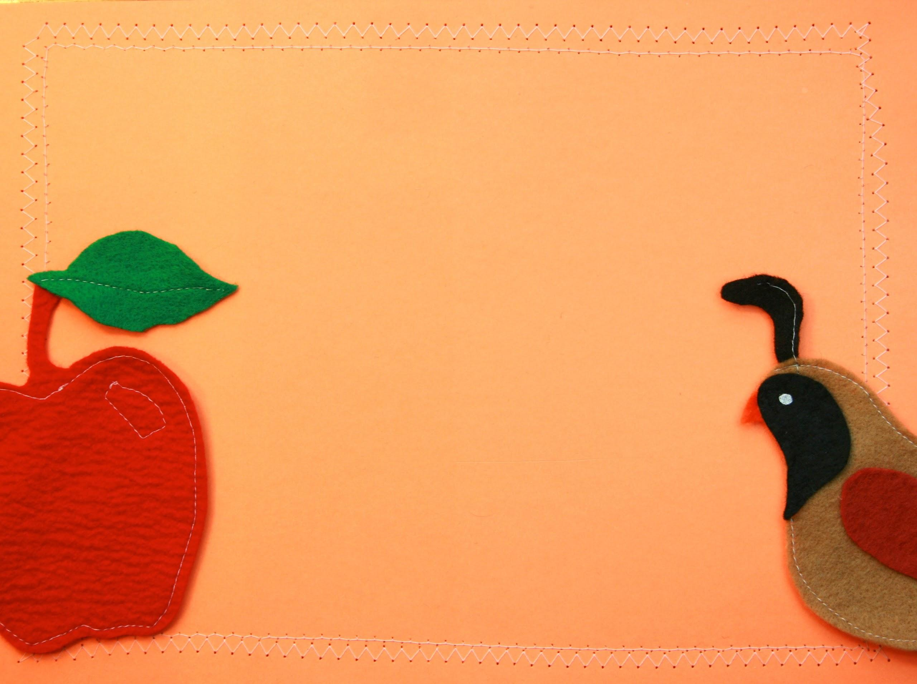
Q & A

Slide 14
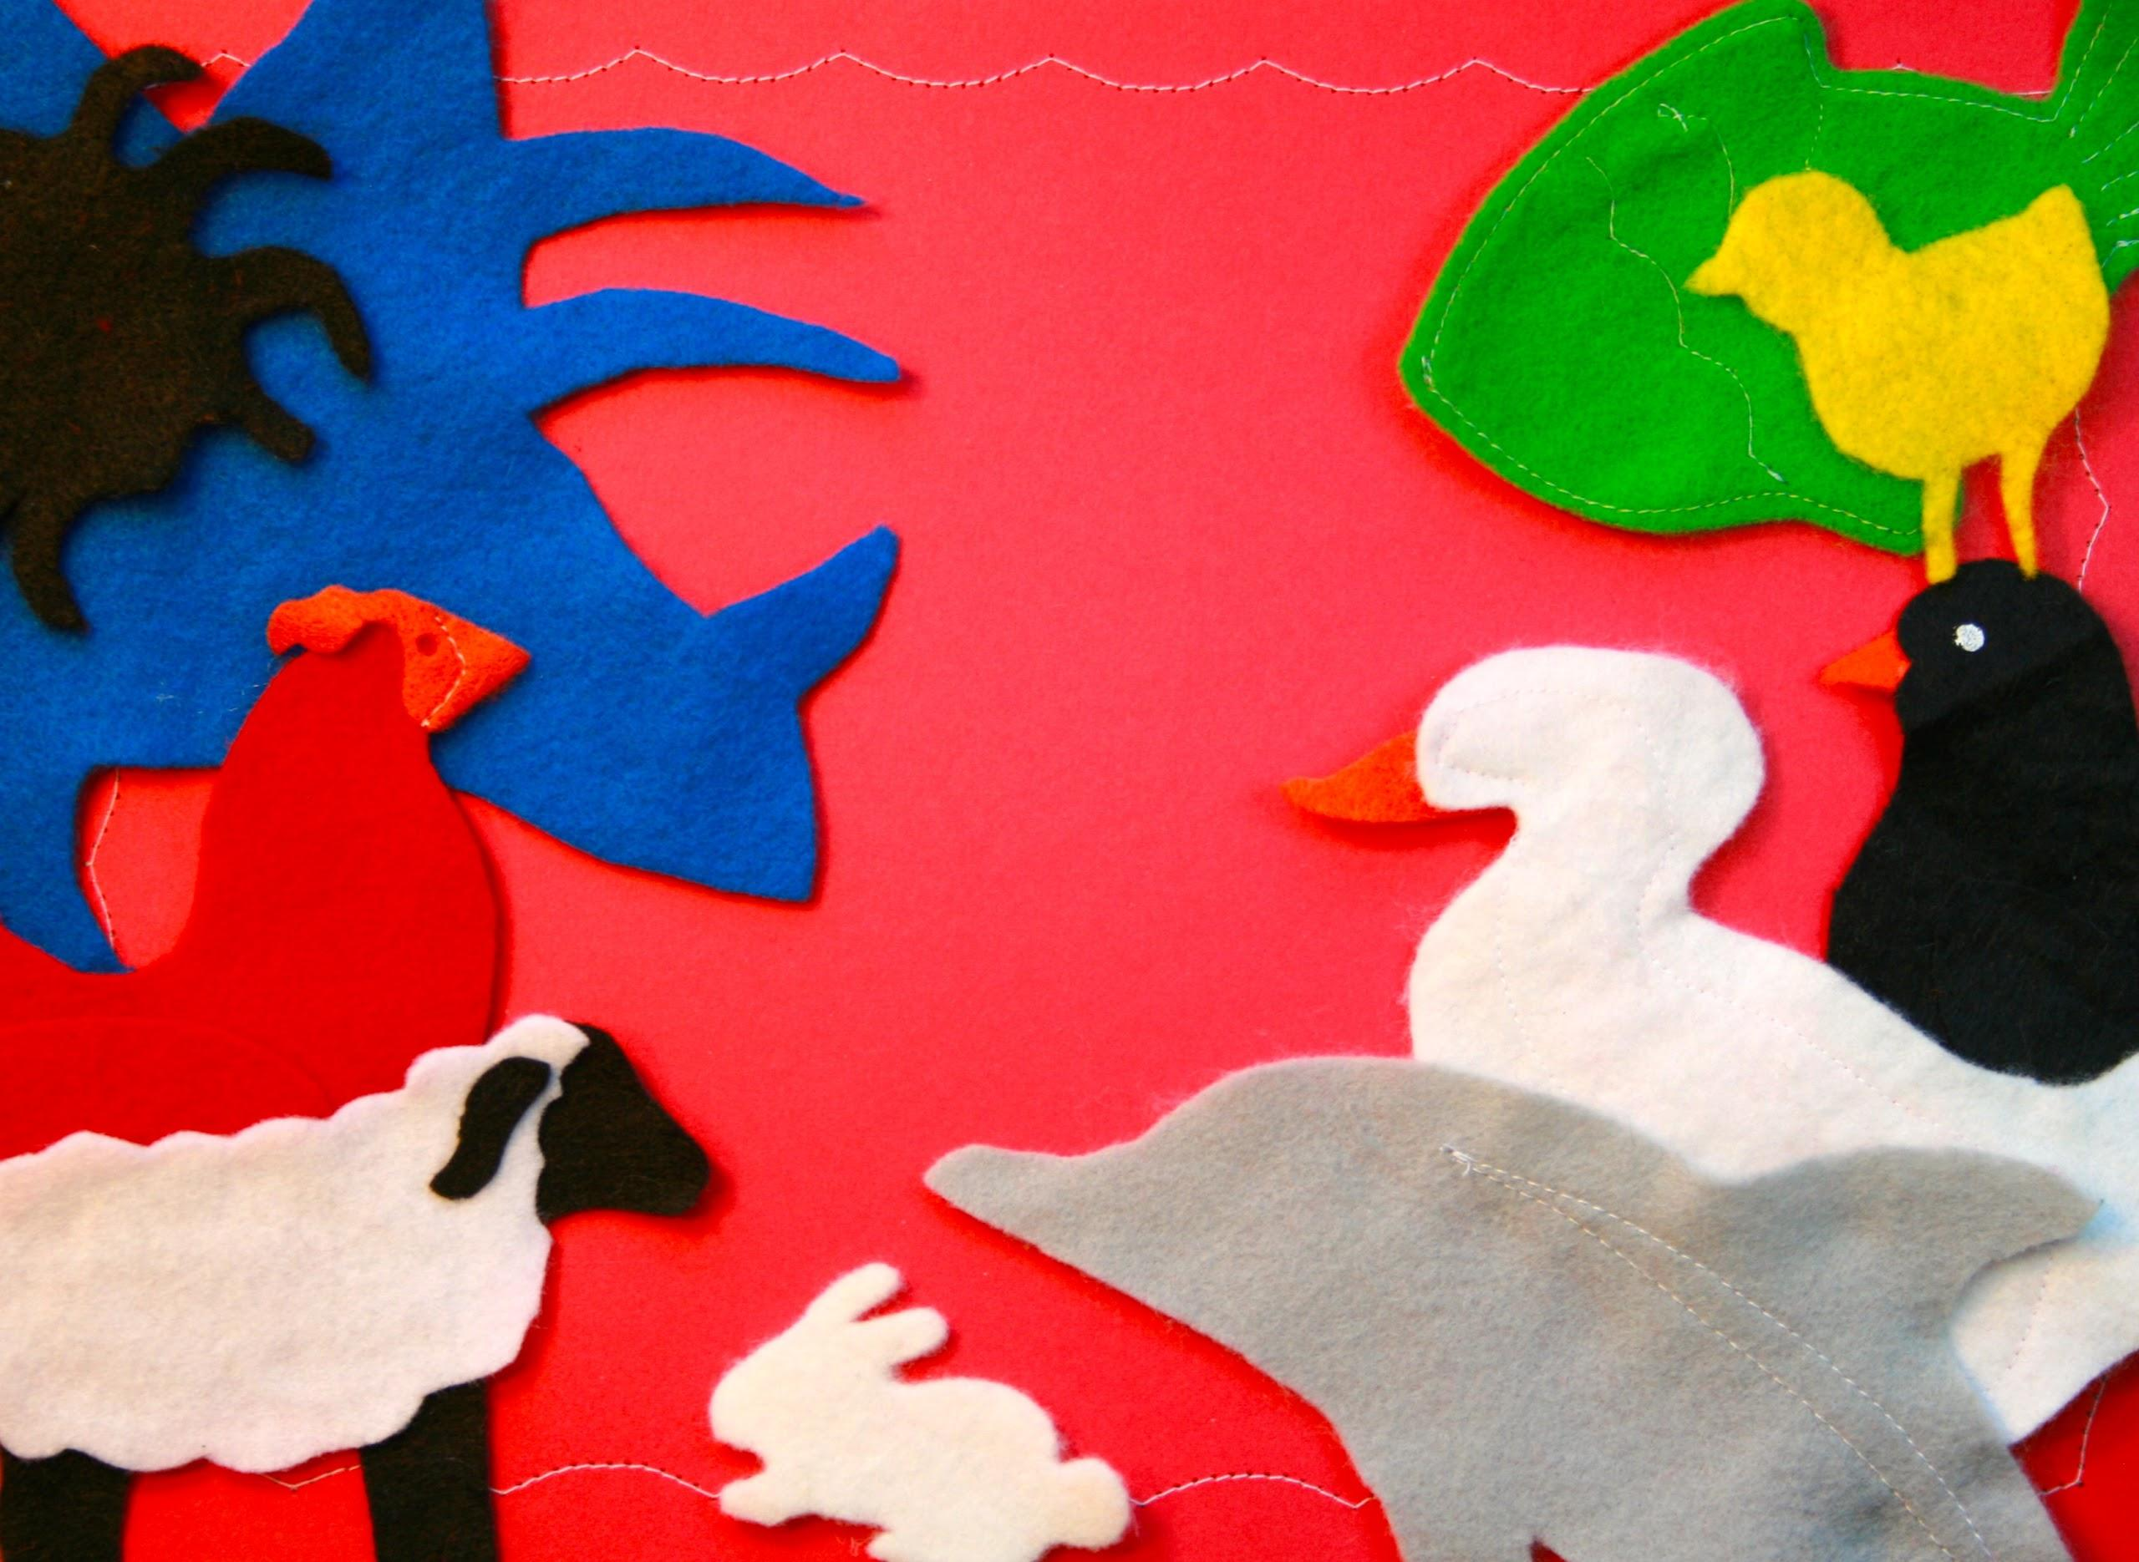
catering to a CROWD
catering to a CROWD

Slide 15
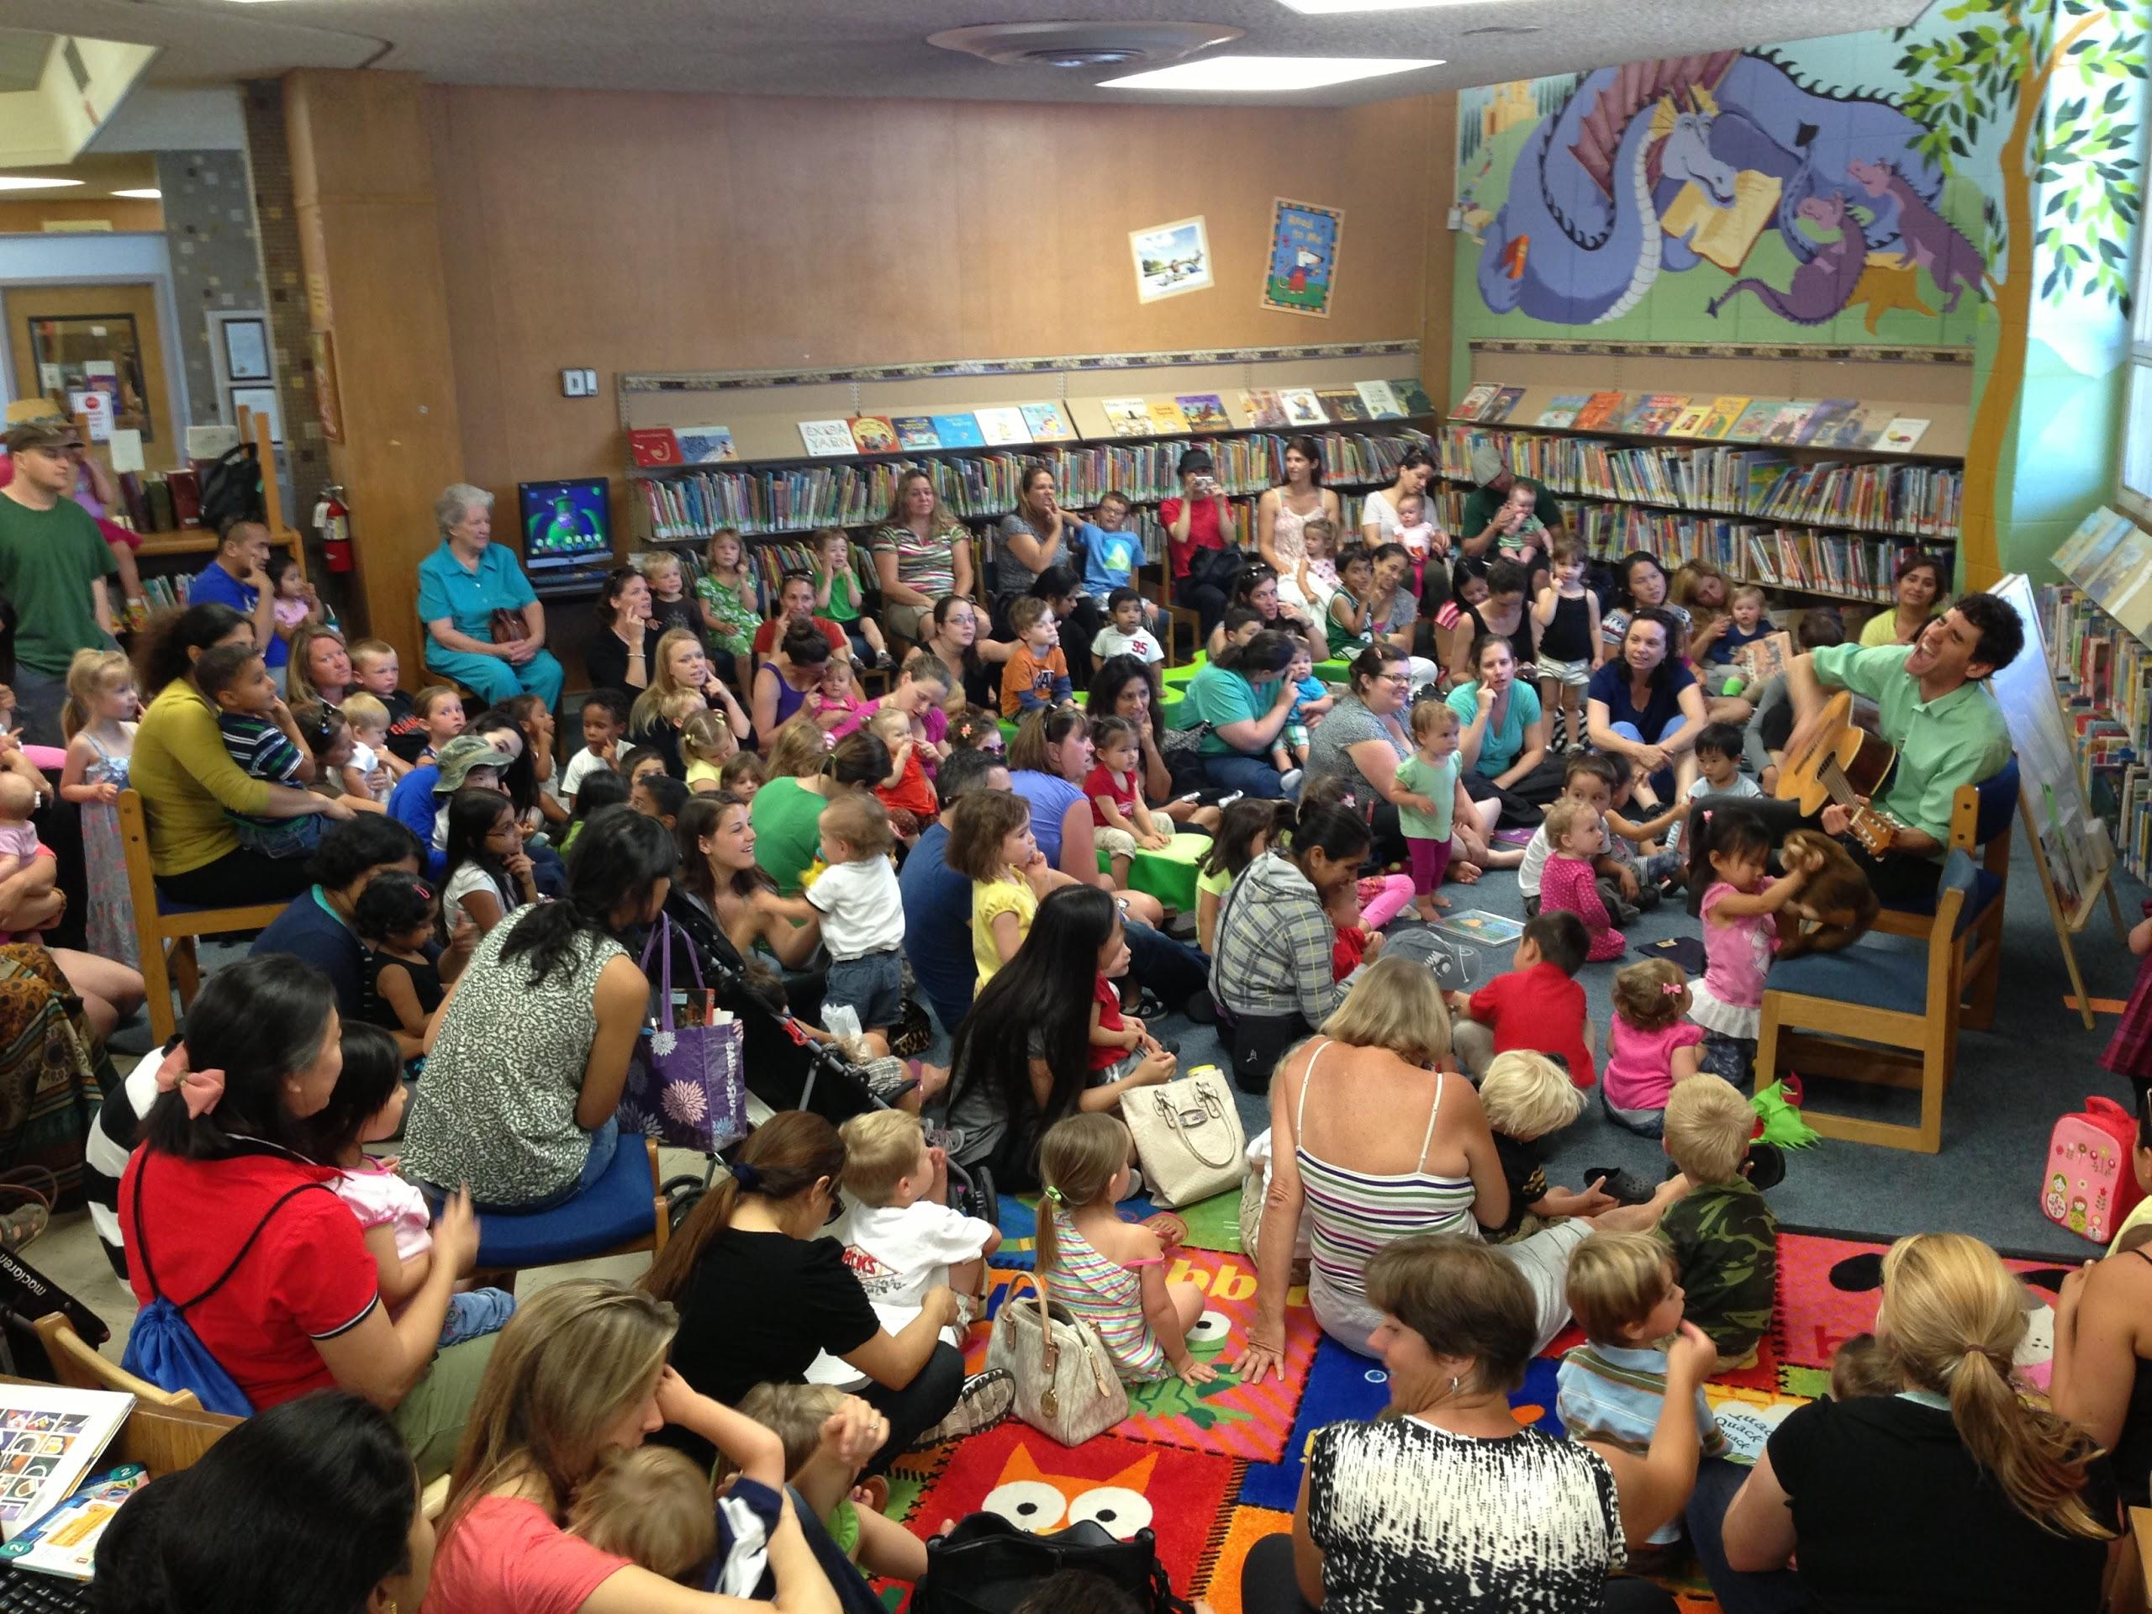

Slide 16
big & bright

Slide 17
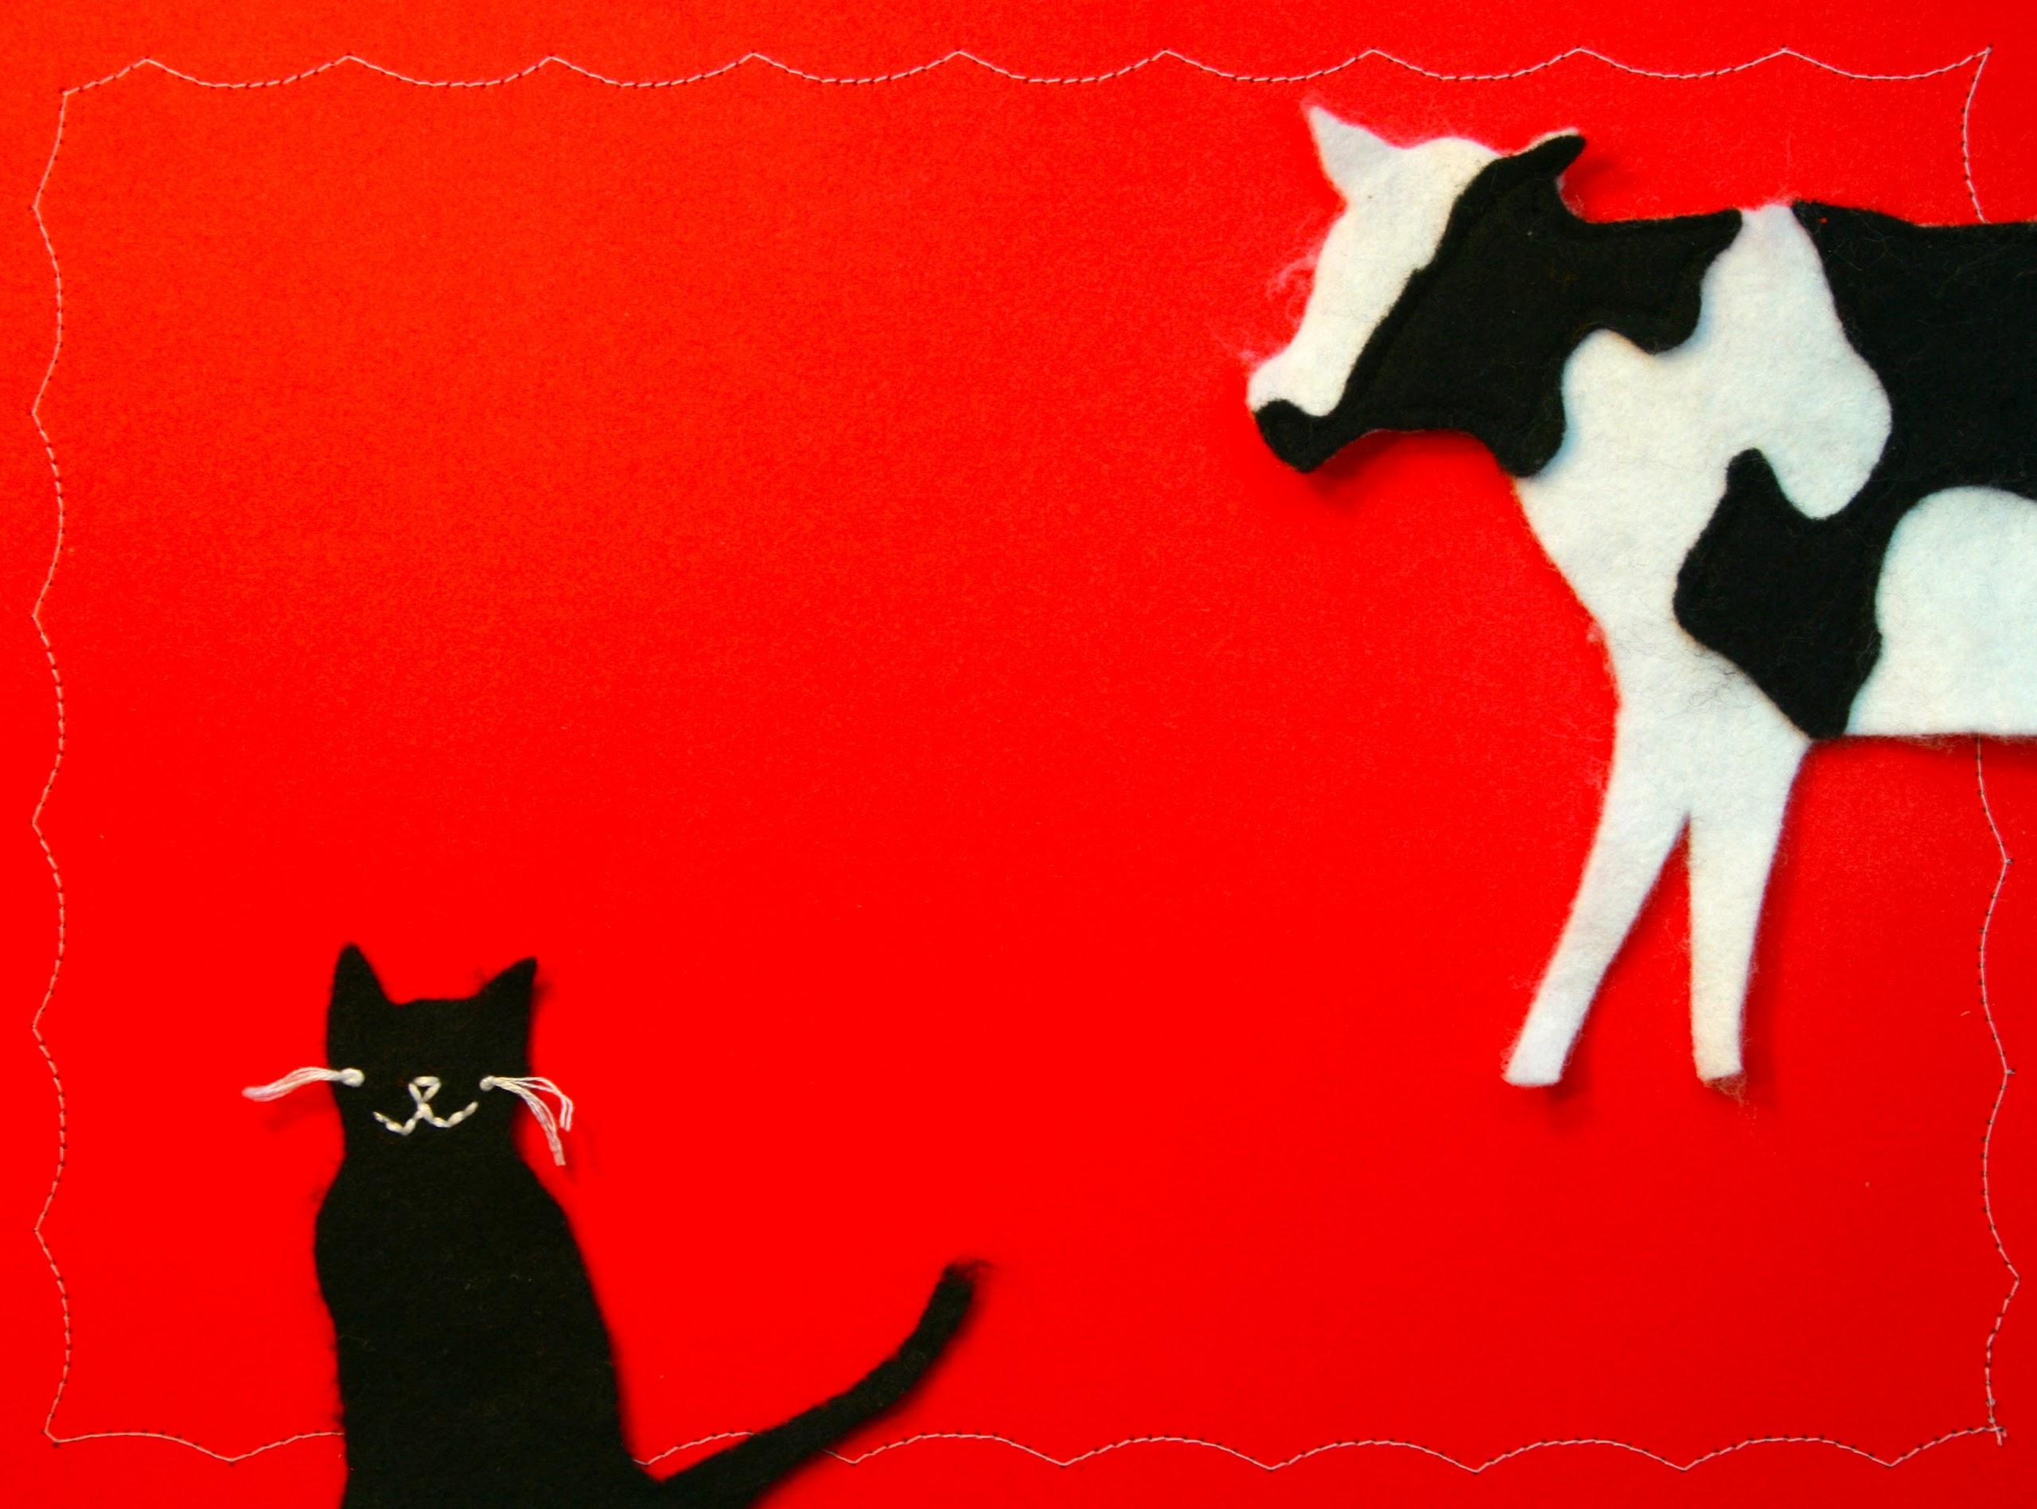
follow the leader

Slide 18
pre-registration

Slide 19
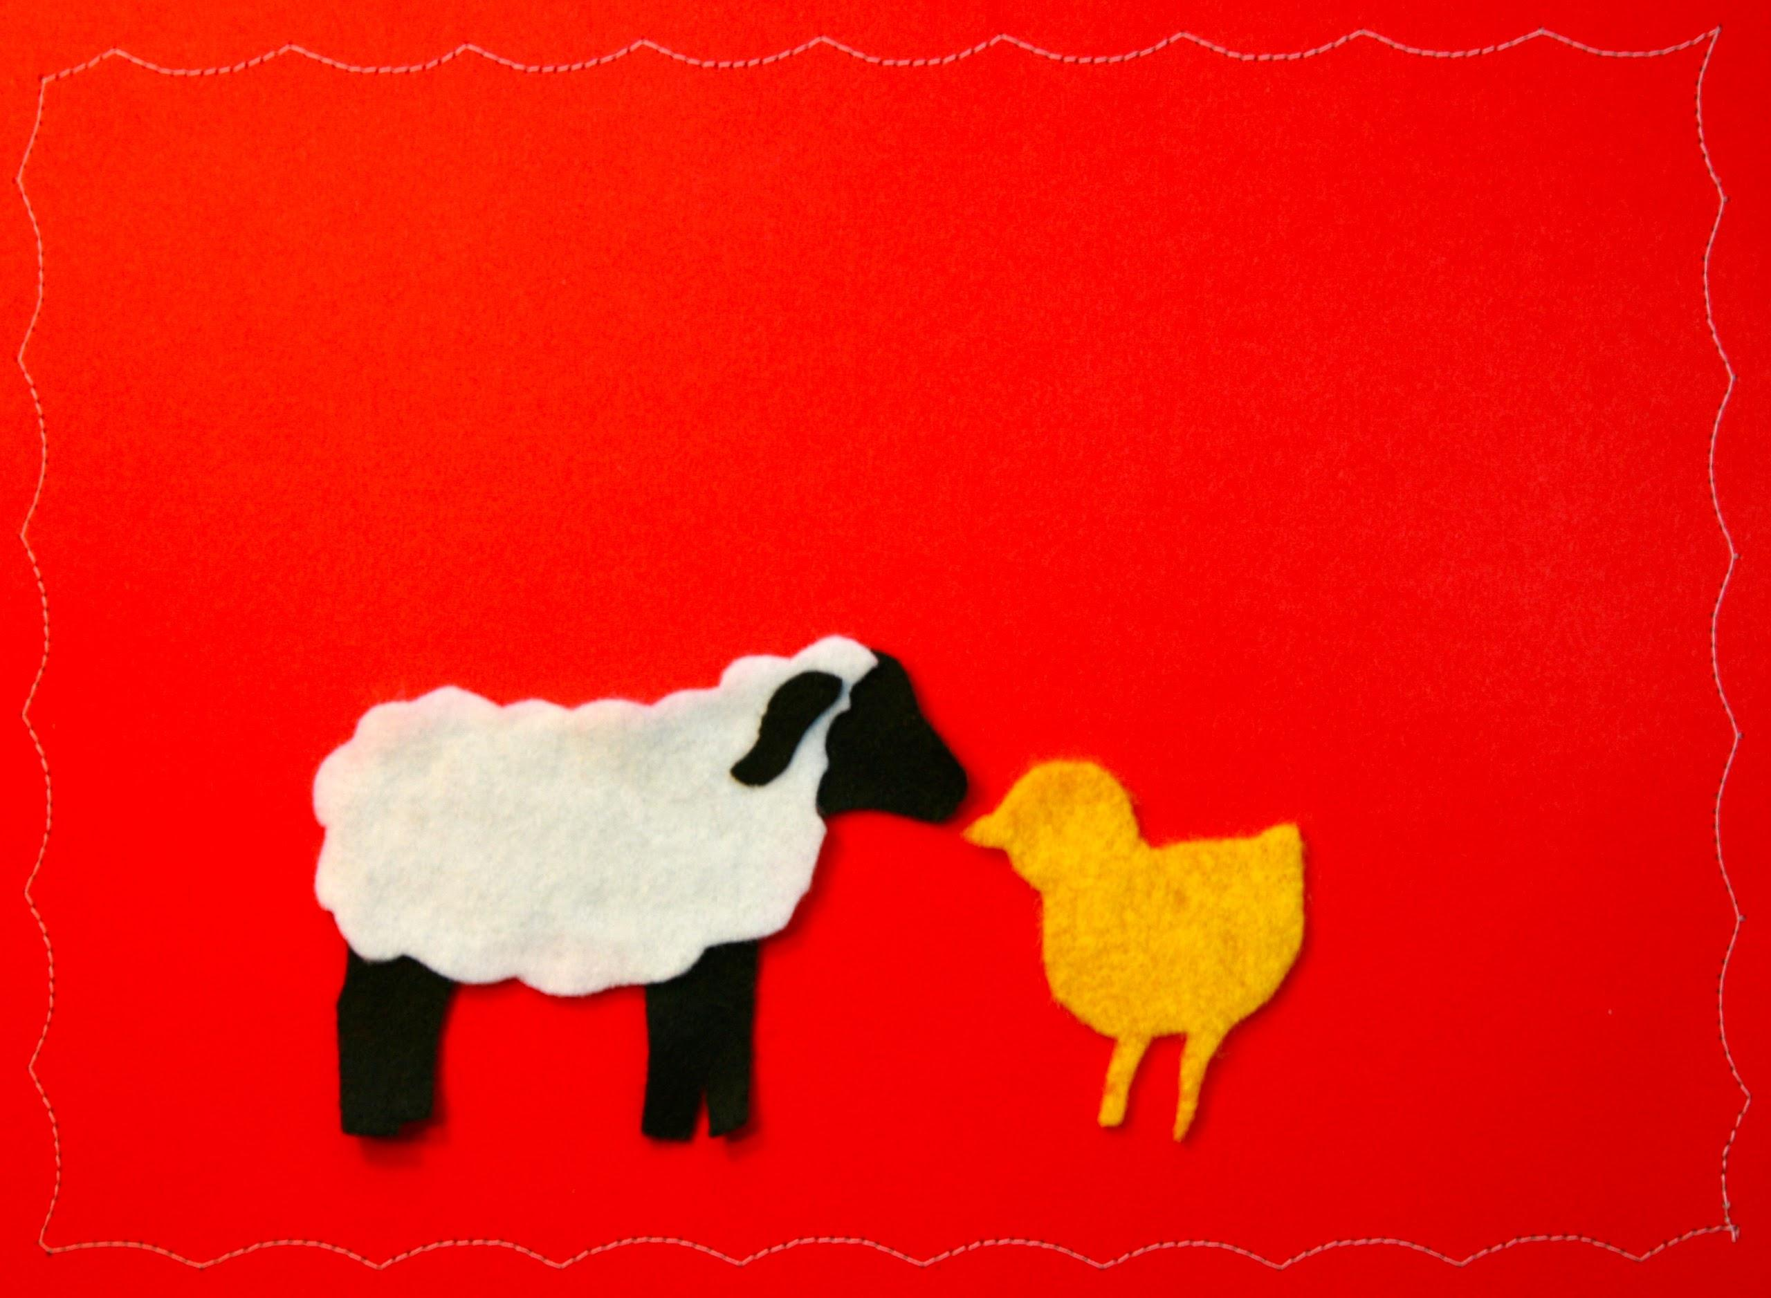
creating connections

Slide 20
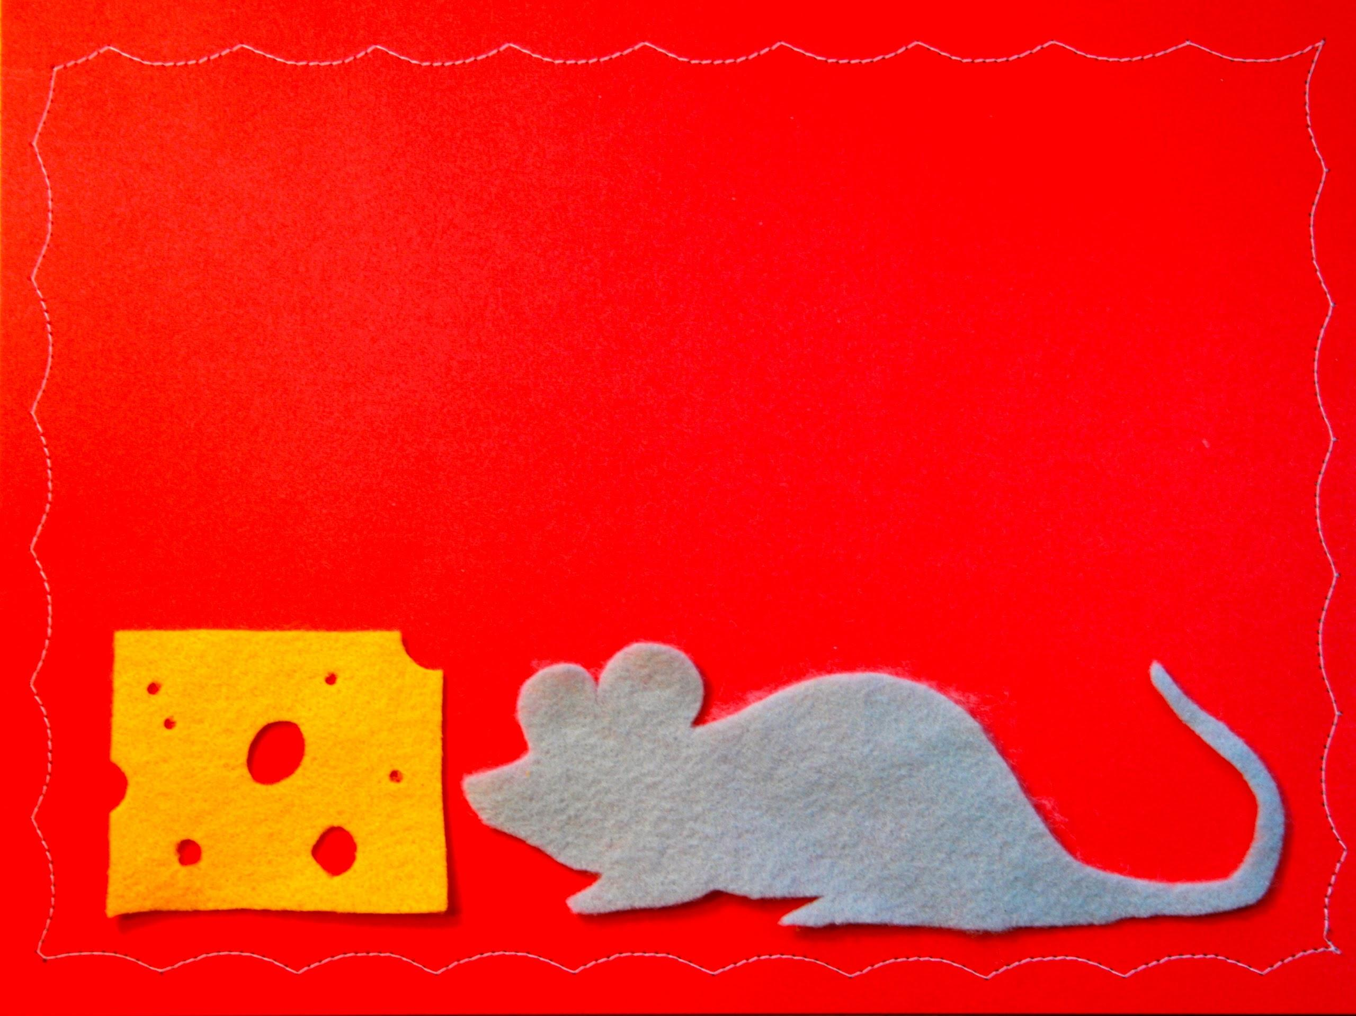
the small stuff

Slide 21
takeaway for supervisors
Assign someone other than the storyteller to direct traffic as families arrive.

Slide 22
takeaway for librarians
Ask other librarians to share their secrets for dealing with the unexpected.

Slide 23
Q & A

Slide 24
wrap
up
hwdolamore@solanocounty.com premer@ccclib.org

Slide 25
The Early Learning with Families @ Your Library (ELF) 2.0 is supported by the U.S. Institute of Museum and Library Services under the provisions of the Library Services and Technology Act, administered in California by the State Librarian. This material is licensed under a Creative Commons 3.0 Share & Share-Alike license. Use of this material should credit the author and funding source.

