Slide 1

Measurements that Matter:
Analyzing Patron Behavior
Presented by
Joan Frye Williams
Tuesday, March 4, 2014

Slide 2
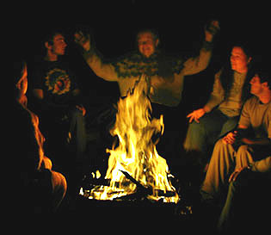
Beyond vivid anecdotes

Slide 3
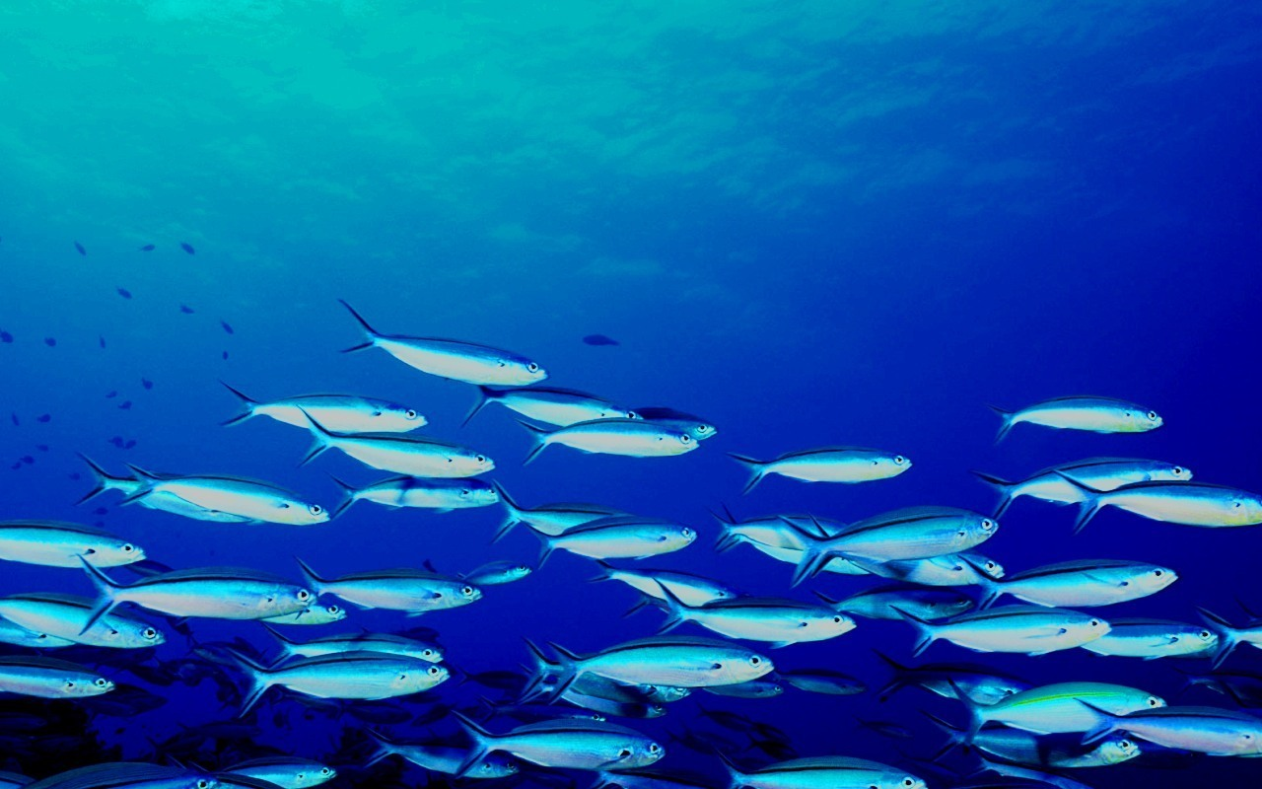
Your mission:
Understand your community better so you can respond and prepare

Slide 4

Bonus: Counteract common misconceptions

Slide 5

Look for relationships between patron groups and use of specific services

Slide 6
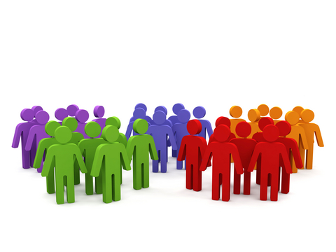
As long as you’re looking at groups, you’re not breaching confidentiality

Slide 7
Set up patron groups for known behavioral indicators
Age range
  Examples: 0-5, 40-49, under 30
  Include birthdate or birth year in patron record
Tenure as a cardholder
  Examples: 0-6 months, first year, 10+ years
  Include date of first registration in patron record
Membership in a specific constituency
  Examples: friends, donors, volunteers
  Include flags for these affiliations in patron record

Slide 8

Encourage patrons to opt into other pre-defined interest groups
Subject or genre
Service or program type
Format or medium
Preferred communications channel

Slide 9

Create ad hoc patron groups based on specific behaviors
Example:
Create a group of patrons who checked out graphic novels this month. Then see how often that group downloads e-books.

Slide 10

1. Who uses each service?
Total transactions
Number and % breakdown of transactions by patron group
Total unique users
Number and % breakdown of unique users by patron group

Slide 11

Knowing who’s using each service can tell you
“Niche” vs. broad appeal
How many people/which groups will be affected by change or discontinuation
Which groups to target with outreach or advertising
Which services are starting to “age out”

Slide 12
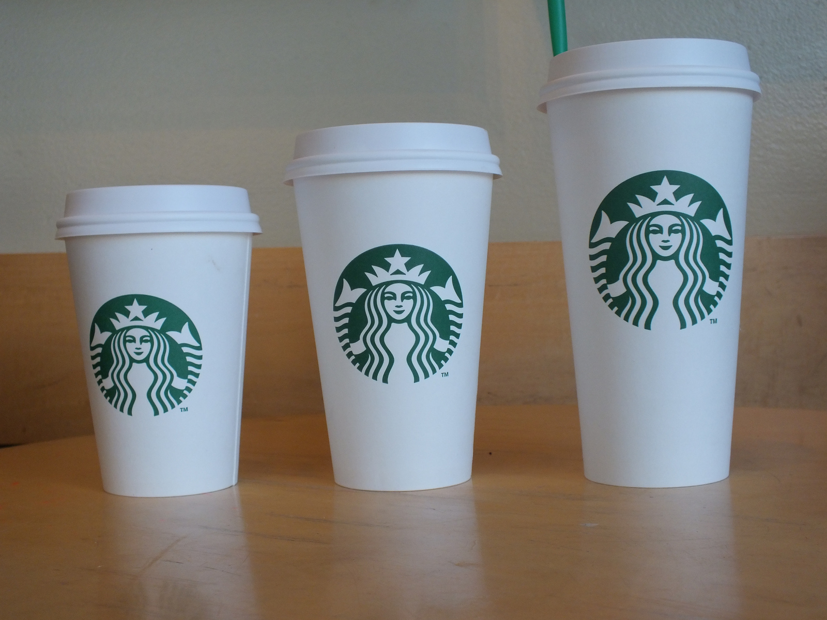
2. What is a “typical” transaction for patrons in different groups?

Slide 13

You don’t have to be a math wiz to know what’s going on, but…

Slide 14

One simple math concept can help you get a better picture of typical use for any library service

Slide 15
Most libraries calculate average (mean) usage
100 patrons borrowed 2 items each
20 patrons borrowed 10 items each
4 patrons borrowed 50 items each
Total items borrowed = 600
Divided by total patrons = 124
Average (mean) number of items checked out = 4.8

Slide 16
Try calculating the mode instead
The mode is the number that occurs most often
http://www.mathsisfun.com/mode.html
100 patrons borrowed 2 items each
20 patrons borrowed 10 items each
4 patrons borrowed 50 items each
Typical number of items checked out (mode) = 2
i.e. the most frequently occurring situation

Slide 17

Knowing how patrons typically use a service can tell you
Where to draw the line for policies and limits
Whether one size fits all or to tailor for different groups
How to estimate minimum resources required to provide a specific service to a specific population

Slide 18

3. Where is the service being used?
Total transactions
Number and % breakdown of transactions at each location – facility, floor, service desk, workstation ID, IP address
Number and % breakdown of transactions by each patron group for each location

Slide 19
Knowing where a service is used can tell you
How to allocate space to match demand
How to co-locate services for a target group
How different groups move through your buildings
Which virtual transactions are done by patrons and which by staff on behalf of patrons

Slide 20
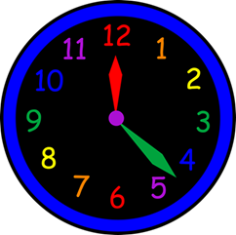
4. When is the service being used?
Total transactions
Number and % breakdown of transactions by month, day of the week, hour of the day
For virtual transactions, number and % breakdown of transactions during library building open hours and during closed hours
Number and % breakdown of transactions by each patron group for each day, hour

Slide 21
Knowing when a service is used can tell you
How to avoid scheduling incompatible groups
Which services might be corralled into specific “drop in” hours
Whether a specific event correlates with increased library usage by target patron groups
How virtual services affect in-building workload

Slide 22
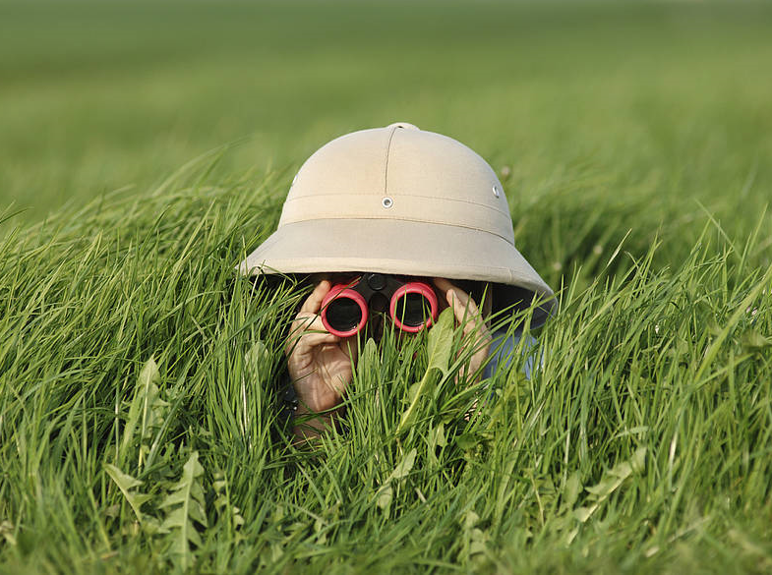
The analysis part: What to look for

Slide 23
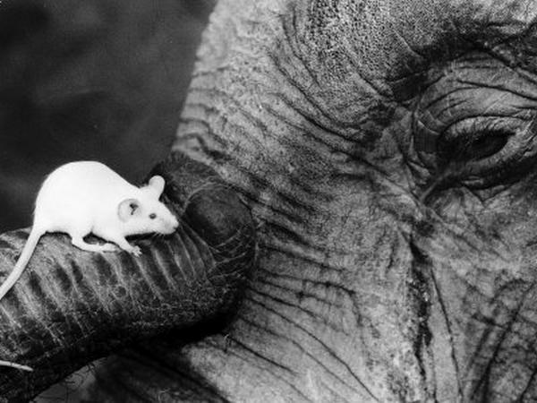
Disparities in size

Slide 24
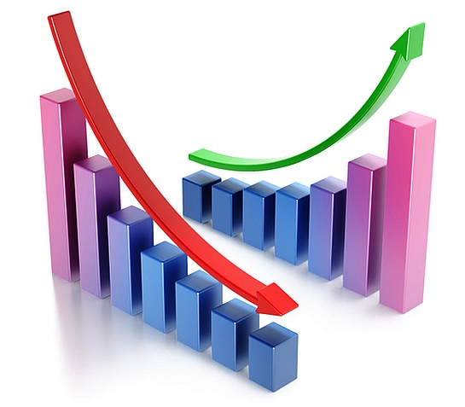
Trends over time: up, down, or steady?

Slide 25
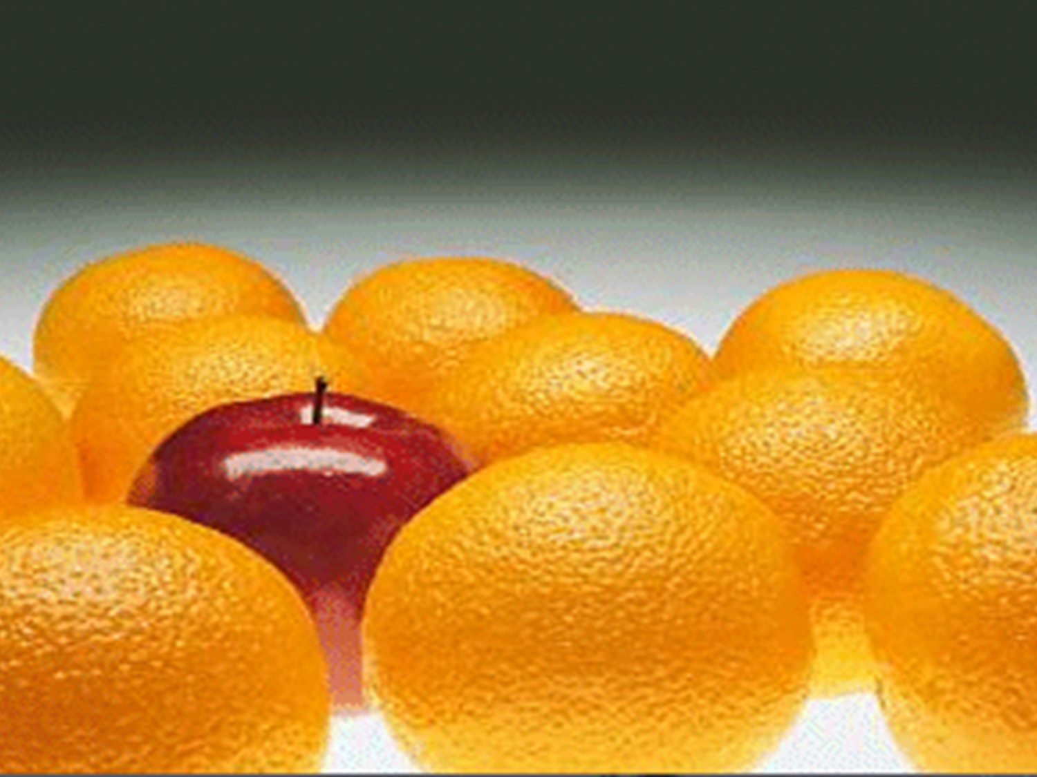
Outliers and exceptions

Slide 26

What isn’t there

Slide 27

Enjoy the thrill of the chase!

Slide 28
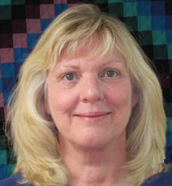
joan@jfwilliams.com
Let’s continue the conversation…
Photo by Martin Helmke

Slide 29

Infopeople webinars are supported in part by the U.S. Institute of Museum and Library Services under the provisions of the Library Services and Technology Act, administered in California by the State Librarian. This material is licensed under a Creative Commons 3.0 Share & Share-Alike license. Use of this material should credit the author and funding source.

