Slide 1
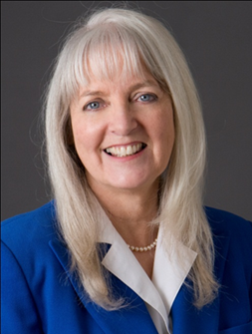

How to Get Media Coverage for Your Event
Presented by
Barbara Lewis
Centurion Consulting Group
Thursday, March 13, 2014
Hosted by Infopeople

Slide 2
Barbara Lewis
Over two decades in Marketing
MBA from UCLA Anderson & Lecturer
Started career as journalist – WSJ
On-camera television reporter
Literacy organization volunteer
Book author
Get a Black Belt in Marketing: The Marketing Success Book

Slide 3
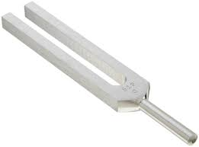


What We’ll Cover Today
Survey results
Types of articles and interviews
Perfect pitch
Press releases
Do’s and Don’ts of dealing with reporters
Ideas for attracting the media
Case studies
Questions
Use Literacy as Example

Slide 4
Survey
January 15th Carla Lehn emailed survey
12 questions
Distributed to >100 people
36 responses; ~35%.

Slide 5
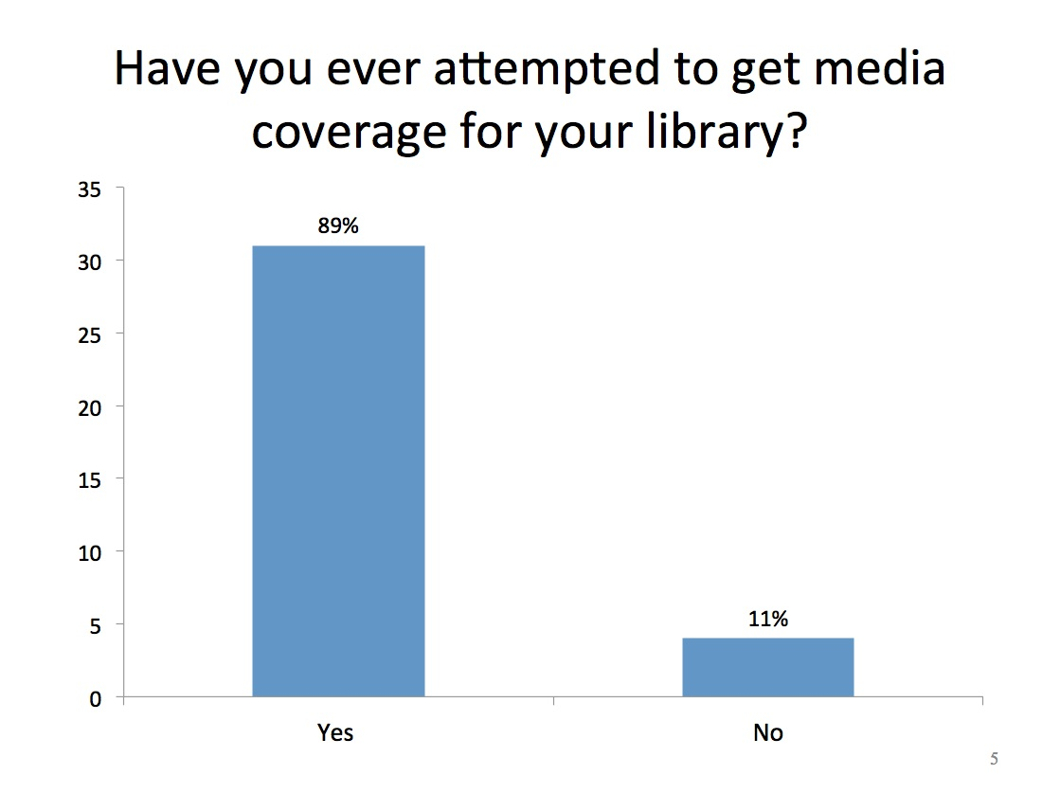

Slide 6
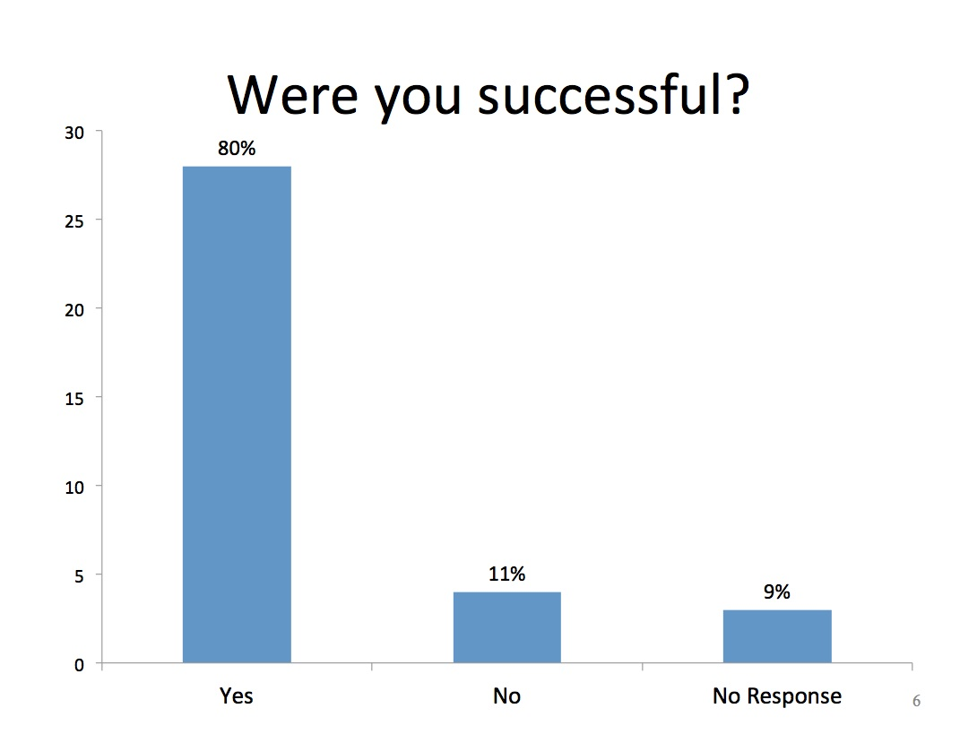
Were you successful?

Slide 7
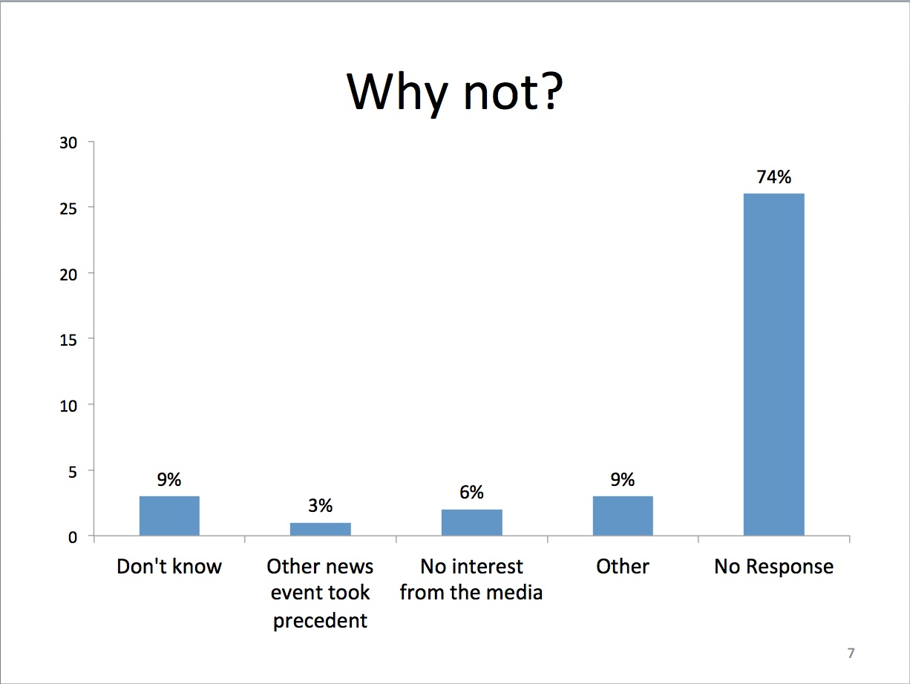
Masterplanner Calendar:
Consult Events
Submit Events
Start a Masterplanner

Slide 8
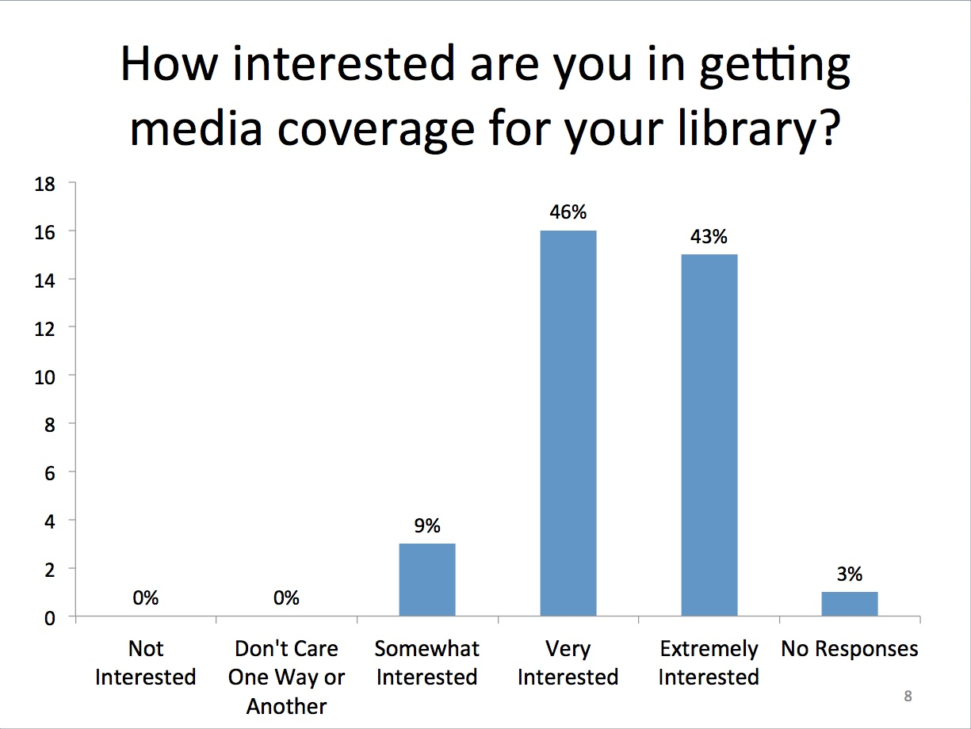
Degree of Difficulty:
Small Towns vs. Large Cities

Slide 9
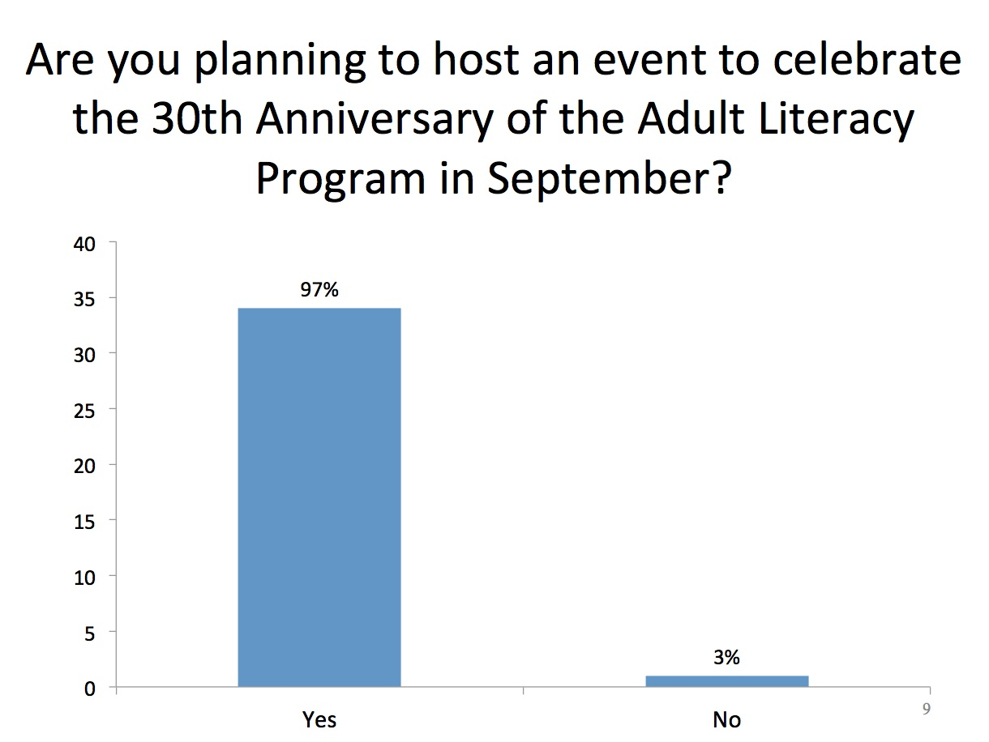

Slide 10
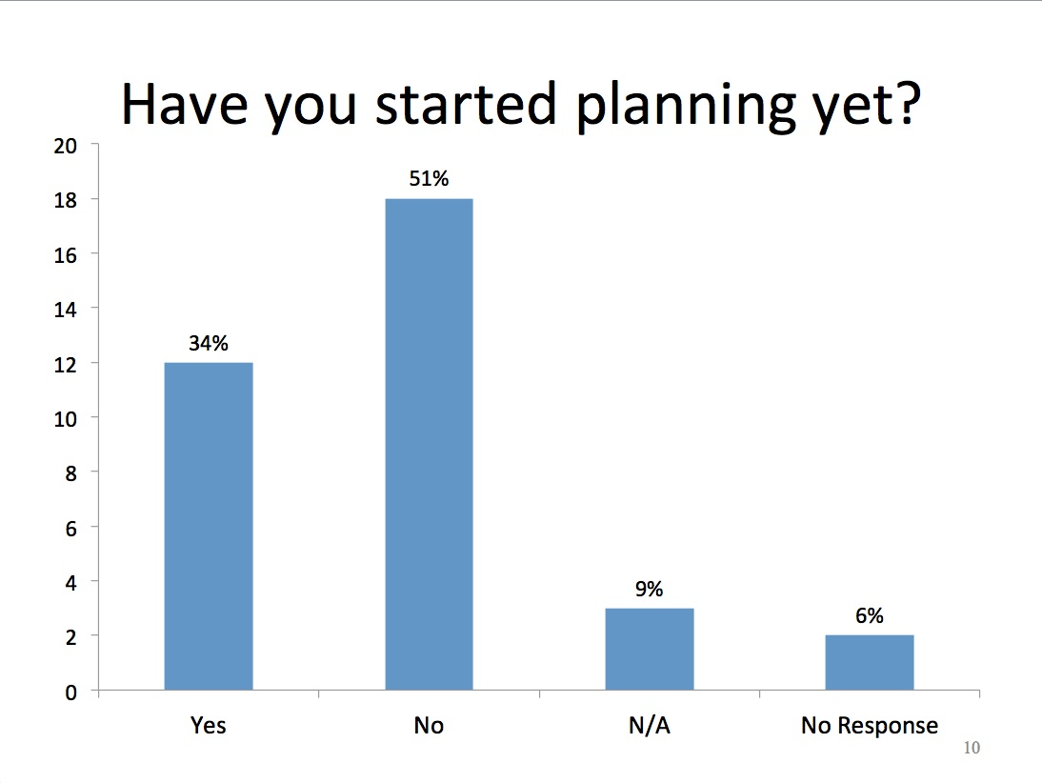

Slide 11
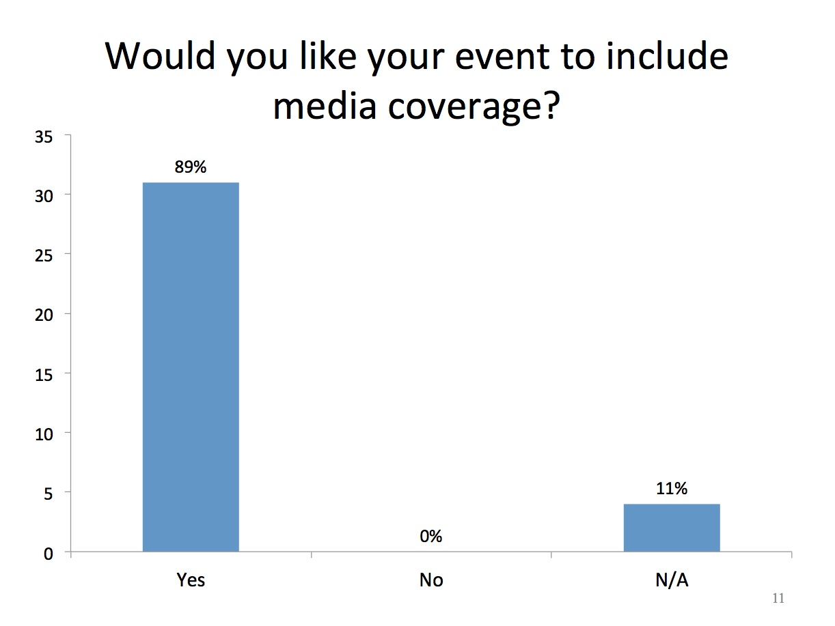

Slide 12
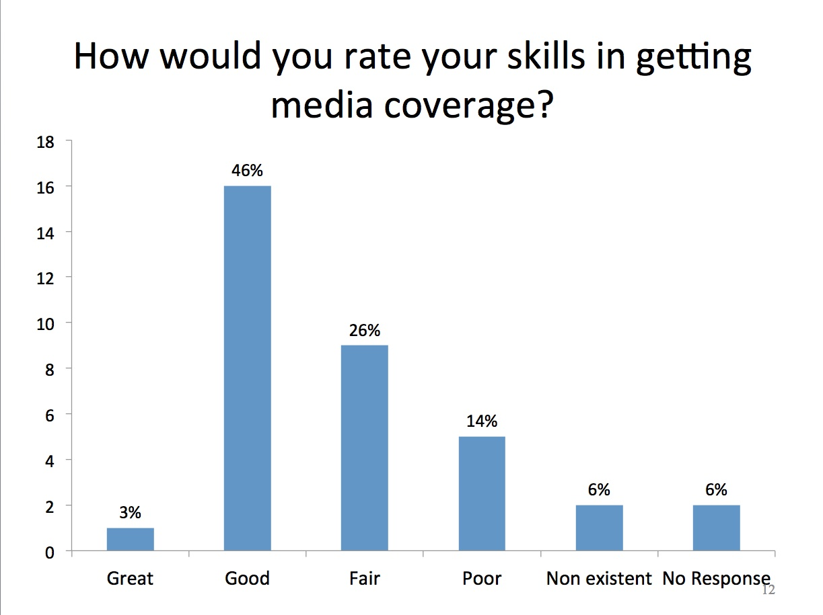

Slide 13
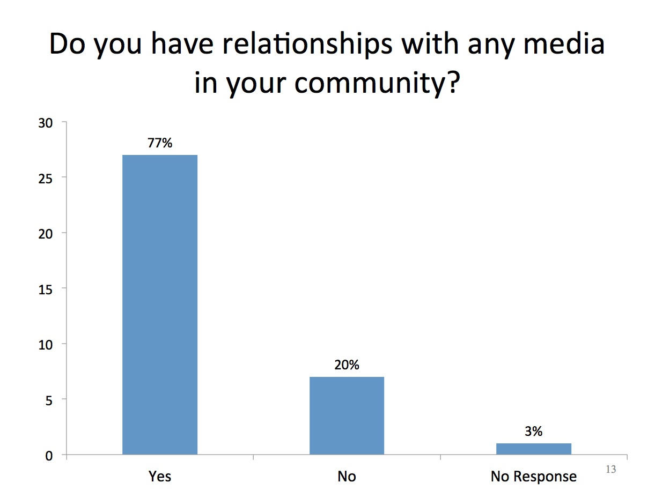

Slide 14

What is your biggest barrier, fear or concern with dealing with the media?
Time
Getting responses to emails or voicemails
Inexperience with creating YouTube videos
The difference between what you want and what media prints
Making mistakes in presenting the program in the best light
Differences between coverage pre-, during-, and post- event for each media outlet (radio, television, print, Patches, etc.)

Slide 15
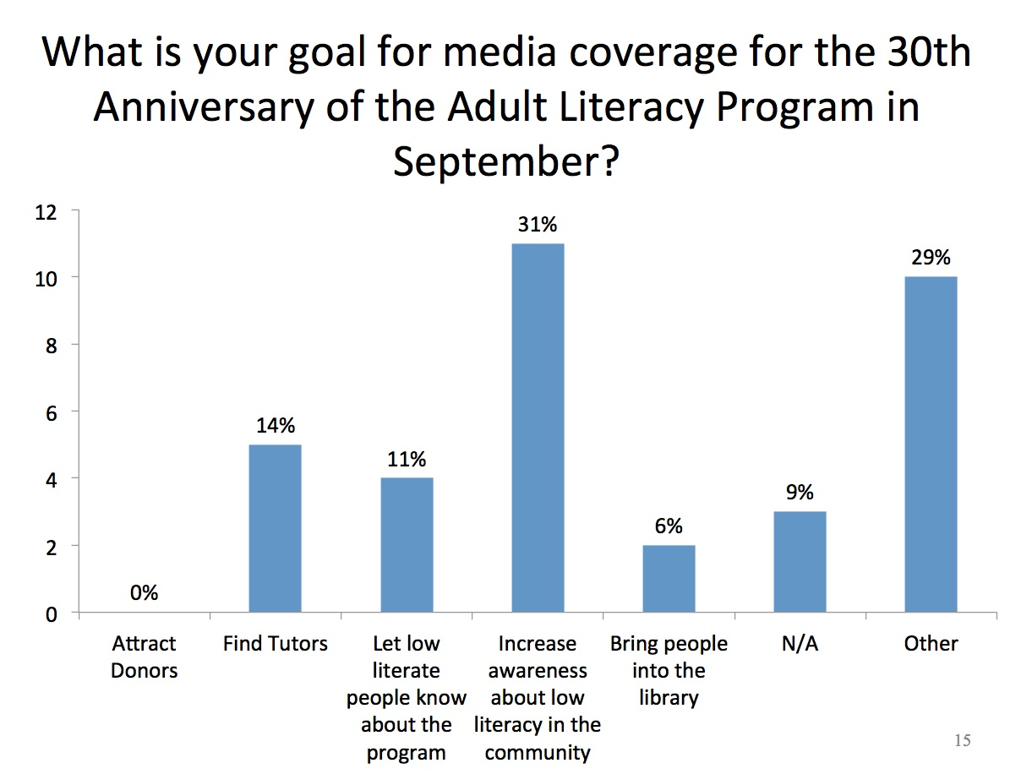
Other = All of the above
Not sure

Slide 16
Media Coverage: What is the Goal?
Increase awareness about low literacy in the community
Let low literate people know about the program
Bring people into the library
Attract donors
Find tutors
Lend books
Your Primary Goal Drives the Media Plan

Slide 17
Your Primary Goal Drives the Media Plan
Increase awareness about low literacy in the community
All - Print, electronic, Internet, PSAs
Let low literate people know about the program
TV & Radio
Bring people into the library
All
Attract Donors
Business Media
Find Tutors
Business Media
Lend Books
All Media

Slide 18
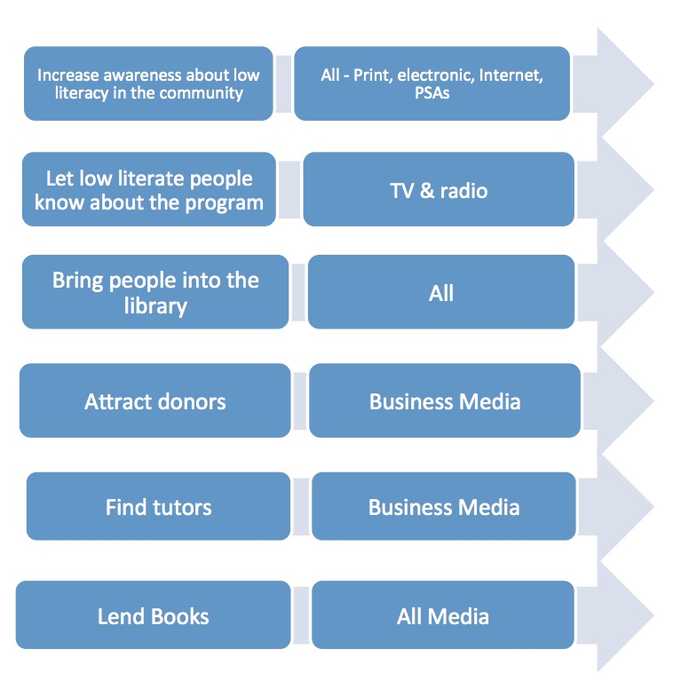
How Do You Measure Your Success?
Increase awareness about low literacy in the community
All - Print, electronic, Internet, PSAs
# Media Mentions
Eyeballs
Pre/Post Survey
Let low literate people know about the program
TV & radio
Signups
Bring people into the library
All
# of People
Attract donors
Business Media
Amount of $
Find tutors
Business Media
# of Tutors
Lend Books
All Media
# of Books

Slide 19


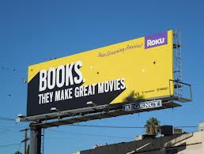
Economics of the Media
Advertising
Print
Electronic
Viewers
Content Driven
PSAs
Free + Cost
of Production

Slide 20
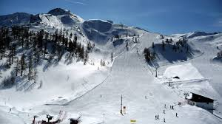


Degree of Difficulty in Getting Coverage

Slide 21
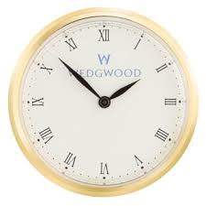
Return You Get for Your Time Spent:
Degree of Difficulty/Return
High
PSA
Electronic
Degree of Difficulty
Print
Internet
Low
Return
High

Slide 22


Musical Chairs may be the
Reporter’s Career
Begin at small media
Work up to prestigious media
Your Job: Make friends with all of the reporters
Reporter’s Job: Pursue the Pulitzer Prize, win recognition.

Slide 23
Why Deal with Reporters?
Enhance profile
Squash bad publicity
Accomplish goals
Leverage press.

Slide 24
Two Types of Articles
Interview
  You are use as source in an article
By-lined
  Written by you
    Article
    Letter to the editor
    Op ed piece
    Column
  Not as effective.

Slide 25

News vs. Feature
Most important details first
Editing is from bottom up
Important details are throughout
Editing is throughout
If you are quoted at the bottom of a news article, you may be cut

Slide 26
Why Reporters Call
Premise needs a source
  Interrogatories - Who, What, Where, When, Why & How
Accessible
Timely return of call or request for information
Quotable quotes.

Slide 27
How Do You Get Media Coverage?
Unsolicited Interview
  Reporter is looking for a quote
  Interviewee is a good source & credible
  Interviewee is on the contact list
Pitch Interview
  Call is made to the reporter suggesting a story idea
  Reporter goes to editor and looks good
  Quotes pitch source.

Slide 28
How to Pitch Successfully
Develop your media goal
Target audience
Research “media kits”
Decide on media
Develop good idea with a good angle
  e.g. trends, surveys
  Personal story
Create Problem, Solution, Benefit.

Slide 29

Research Publication thru a Media Kit
Rate card for advertisements
Demographic information
Sample publication
Circulation/viewer information
Editorial calendar.

Slide 30
Selecting the Topic
Identify a problem, trend or an issue where public is confused or ask questions
Analyze topic for capability to accomplish your goals
Research if topic has already been written on extensively
Format as “Problem/Solution/Benefit.”

Slide 31
Problem/Solution/Benefit
Editors favor style
Organizes article
Each section is 2 to 3 sentences.

Slide 32
Problem/Solution/Benefit Example
Problem
  Begin with a story – the “hook”
  Persuade editor
  Capture reader
Solution
  Explain how problem was solved
Benefit
  Describe advantage for story individual.
Personalized & Relatable
School Bus Accidents
747 Crashes
Notes:
CBPs

Slide 33
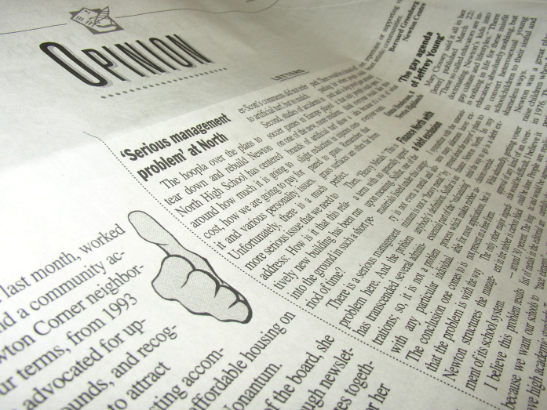
Contact:
Editor or Reporter?
Can assign article to any reporter
May not know which reporters are available or interested
May ask you to write the article
Champions article ideas
May have an interest
May be too busy to handle.
Research the reporters:
Who writes what?
Recruit volunteer to help

Slide 34
Contact Editor or Reporter
Pitch the idea
Offer to send background information
Agree to write the article if requested
Inquire about number of words and deadline
Ask for writer’s guidelines
Read publication for style, etc.
Write the article after the go ahead.

Slide 35
The Perfect Pitch (Part 1)
1. Include the time, date, where the event is or how much it costs and the name of the section where it might go.
2. Don't use Facebook or Twitter or some other form of social media as a way to let the media know about something.
3. Find out the best editor/reporter to send the information to. It's OK to send to more than one person if the event might be of interest to different people, but don't blanket the entire newsroom with emails. And once an editor/reporter is working with you, don't work with another editor/reporter from the same publication.
4. READ the publication you are pitching to. Does it cover events? Does it preview events? Those are two different kinds of stories. What section does this coverage go in? If you show that you know the publication, that really impresses editors.
5. Pitch as far ahead of time as you can. Even daily newspapers plan far ahead. Magazines plan months ahead.
6. Most editors/reporters prefer email pitches.

Slide 36
The Perfect Pitch (Part 2)
7. Make people available to talk to - and not just a spokesperson or executive: speakers, celebrities, experts, directors, people affected by the event.
8. Allow photography. Most publications now are very visually oriented because most stories get published online or on a mobile device. Photos are very important.
9. In the pitch, focus on why a preview or coverage of the event fits that publication's particular audience.
10. Make the pitch as timely as possible: Find a news story peg for the event; mention a recent study or report; relate it to a current issue; relate it to a current popular book or movie.
11. Include information in the body of the email; don't send attachments. Companies worry about viruses, which often come from downloaded attachments.

Slide 37
Article Content
Adhere to editor’s requests
  It’s harder to write a short article than a long one
Write strong opening and closing
Use examples
Answer who, what, where, when, why and how
Write for the readers
Don’t use sophisticated terminology.

Slide 38
Sentence Structure
Order as subject, verb, object
Write in active voice not passive
  The library was a participant in the adult literacy program for 30 year. (passive)
  The library participated in the adult literacy program for 30 years. (active)
Use phrases sparingly (short sentences)
Use spell check and grammar check
Use readability statistics.

Slide 39

Readability Statistics
Determines grade level of article
  Most newspapers are 8 to 10
Based on:
  Number of syllables in a word
  Number of words in a sentence
  Number of sentences in a paragraph
Enhances ease of reading
Flesch or Flesch-Kincaid
MS 2010 File > Options > Proofing > Check Grammar w Spelling >
Check Show Readability Statistics (check spelling to get to readability)

Slide 40
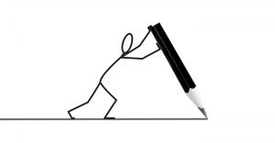
Most Common Pitfalls in Writing
Word length
Technical jargon
Passive sentences
Phrases, phrases, phrases.

Slide 41
Do’s and Don’ts of Dealing with a Reporter (Part 1)
Alert anyone who answers the phone, etc.
Take the call immediately
Prepare yourself by verbalizing
Get name, publication, phone number, etc.
Allow a reporter to tape record
Answer question beginning with question
Give more than yes/no answer
Don’t use technical jargon.

Slide 42
Do’s and Don’ts of Dealing with a Reporter (Part 2)
Never talk “Off the record”
Never say, “As I said before…”
Use humor with caution
Suggest reporter call with further questions
Ask when article is to be published
Offer to send additional information
Never call a reporter and inquire about status.

Slide 43
Leverage Media Coverage
Put on your website
Publish in e-newsletter
Turn into speech for local organization
Place on bulletin board
Include in materials given to prospective partners.

Slide 44
Case Study
Issue – low reading scores in elementary schools
Goal – raise money from businesses to buy more books
Target – business people reading the business journal
Problem – our future work force has low reading skills
Solution – businesses should team with local elementary schools to supply books and tutors
Benefit – businesses will have literate work force.

Slide 45
Ideas to Attract Media for Literacy Month
What Worked in the Past?
Increase awareness about low literacy in the community
  City Proclamation/Keys to the City
  Celebrity spokesperson
Let low literate people know about the program
  Success story on electronic media
Bring people into the library
  Article in print media on success story and tutor
  In-library events, such as career counseling, resume creation, movie book afternoon, story days
Find tutors
  Profile of literacy tutor
  Op ed in the business journal
30th Anniversary Toolkit – libraryliteracy.org

Slide 46

Questions or Comments or Ideas?

Slide 47
Centurion Consulting Group
Barbara Lewis, MBA
Centurion Services
Strategic & Marketing Plans
Surveys & Focus Groups
Articles & White Papers
Market Research
Public Relations
Business Plans
Data Analysis
Social Media
2934 Beverly Glen Circle, Suite 240
Los Angeles, CA 90077
Tel: (818) 784-9888
BarbaraLewis@CenturionConsulting.com
www.CenturionConsulting.com
Blog: www.CenturionConsultingCMO.com

Slide 48
Infopeople hosted webinars are supported in part by the U.S. Institute of Museum and Library Services under the provisions of the Library Services and Technology Act, administered in California by the State Librarian. This material is licensed under a Creative Commons 3.0 Share & Share-Alike license. Use of this material should credit the author and funding source.

