Slide 1
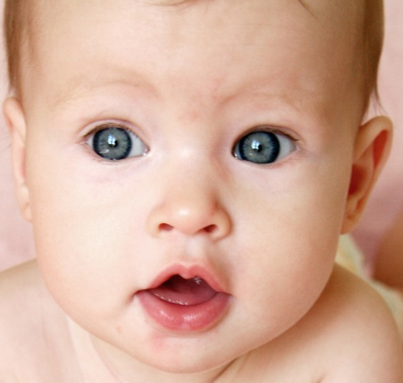
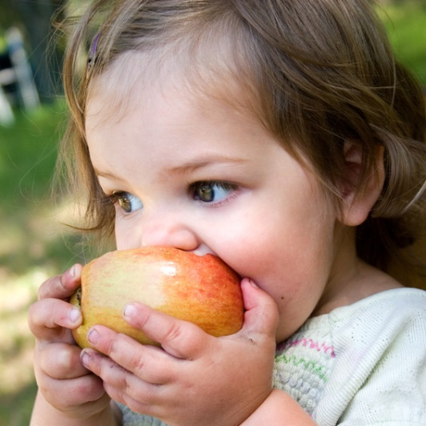

From Baby to Preschooler: Early Childhood Health Resources
From Baby to Preschooler:
Early Childhood Health Resources
Kelli Ham, MLIS
Consumer Health and Technology Coordinator
NN/LM Pacific Southwest Region
An Infopeople Webinar Presented April 16, 2014

Slide 2
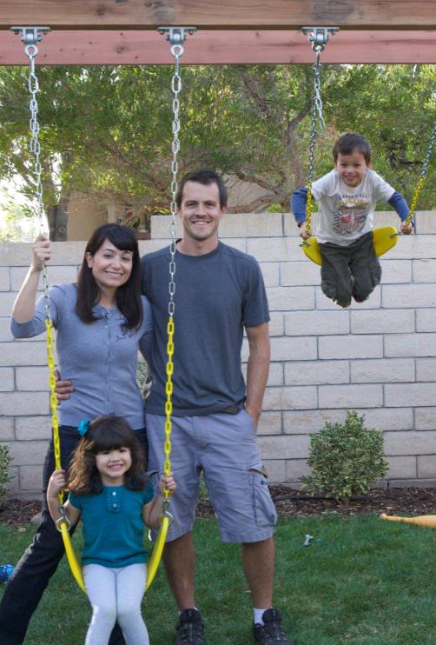
Objectives
Participants will be able to:
Understand the topics that concern parents of young children
Match users with appropriate, high quality resources, based on needs and circumstances
Envision engaging programs for kids, parents and caregivers

Slide 3
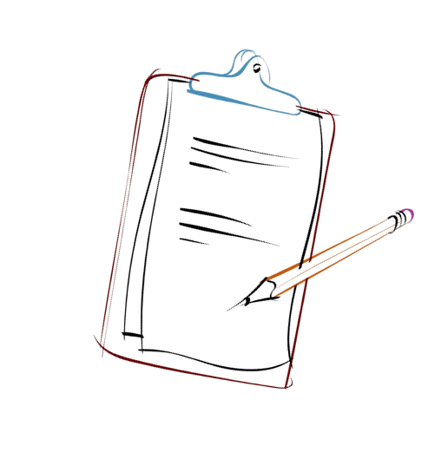
Agenda
Your community snapshot
Types of information needs
  Health topics
  Special circumstances or populations
Resources
Program Ideas
Final thoughts and take-aways

Slide 4



Your Community Snapshot

Slide 5

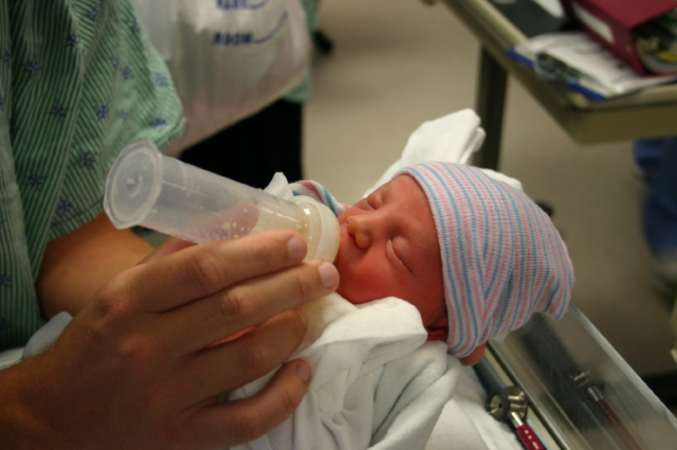

Health Indicators
  Certain measures help indicate the health of the community

Slide 6
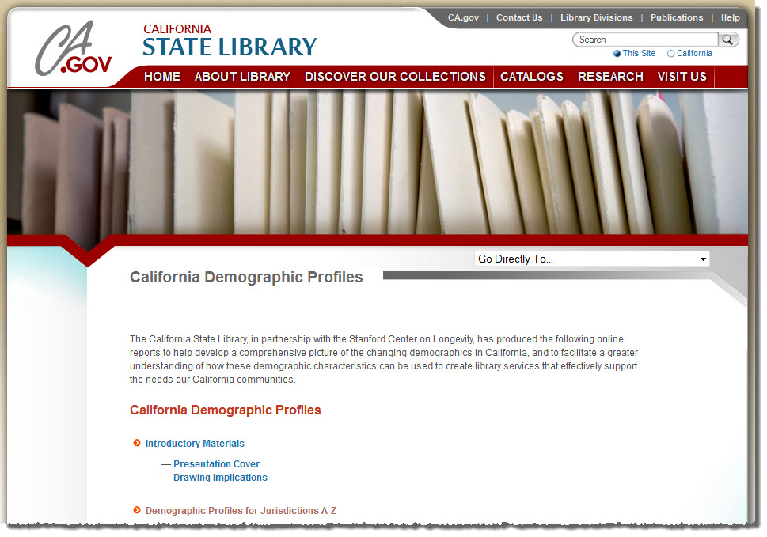
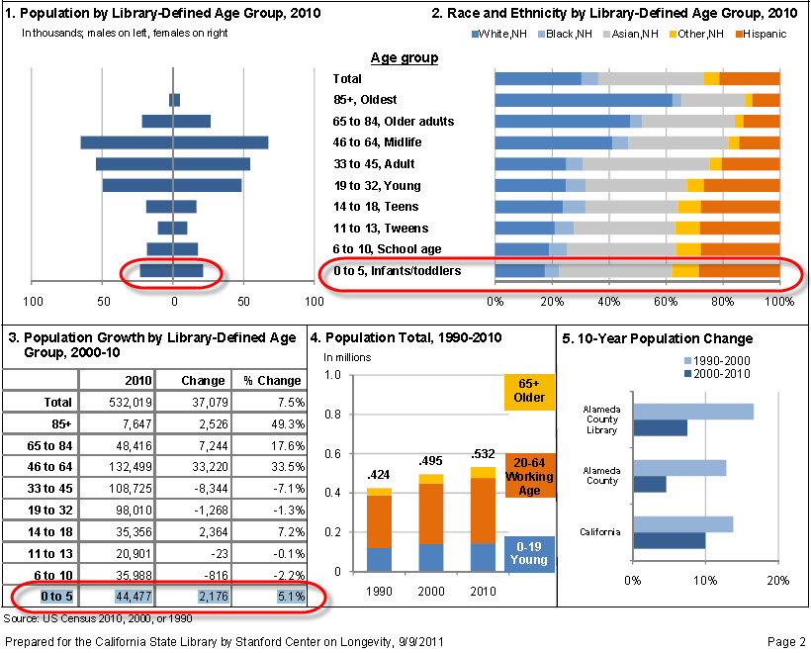
California Demographic Profiles
http://www.library.ca.gov/lds/demographicprofiles/

Slide 7
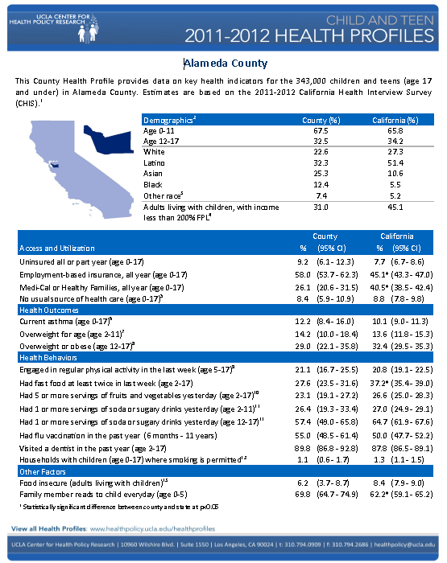
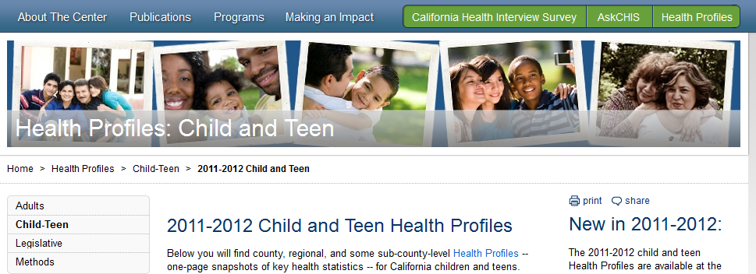
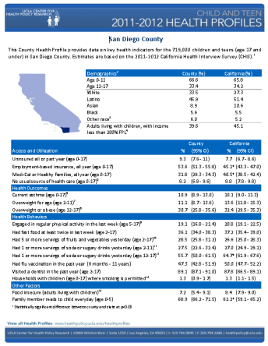
UCLA Health Profiles
2011-2012 Child and Teen Health Profiles
One page snapshots of key health statistics for California children Created from the California Health Interview Survey (CHIS)
http://healthpolicy.ucla.edu/health-profiles/Child_Teen/Pages/2011-2012-Child-and-Teen.aspx

Slide 8
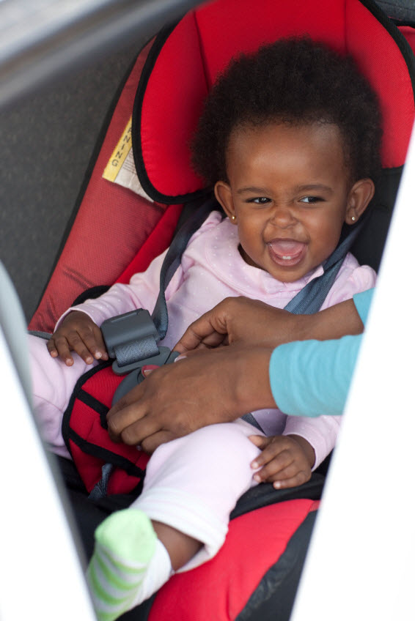
Community Health Needs Assessments
Non-profit hospitals required to provide reports
Wealth of information
Community demographics
Identify health issues not readily apparent
Findings lead to change
Try this with your county name:

Slide 9
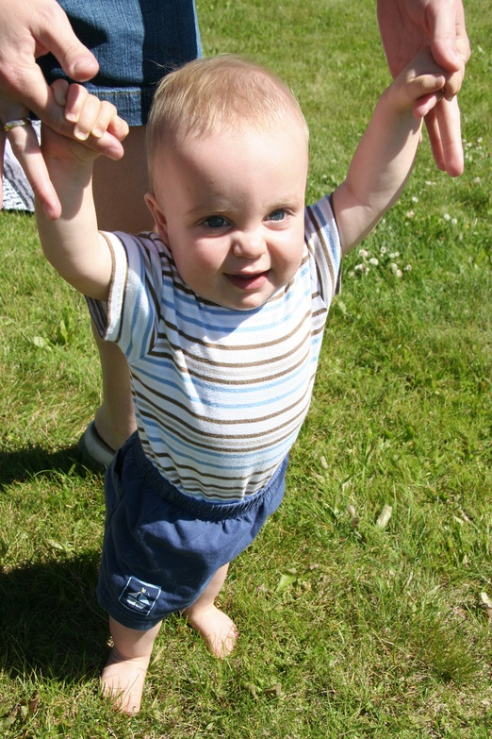
The Parent Perspective
Babies and toddlers don’t come with an owner’s manual
What information will parents need?

Slide 10

Types of Information Needs
Basic Care (breastfeeding, nutrition, sleeping)
Child development and behavior
Childhood illnesses
Prevention (injuries, illness, vaccinations)
Choosing childcare
Special populations

Slide 11
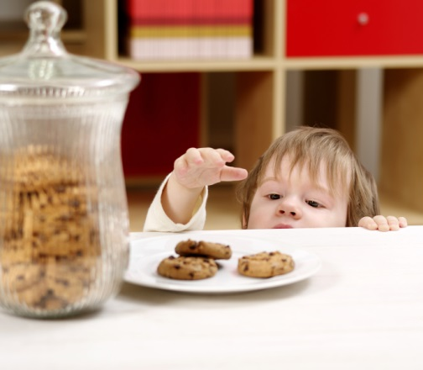
The Kid Perspective
Are there materials for young kids related to health?

Slide 12

Know Your Own Collection
The library’s collection – knowing what you have and knowing when to use it
Subscription databases
Circulating materials
Print reference
Multimedia

Slide 13
What Works in Your Library?
Parenting Collection?
  books or media focusing on healthy development, concerns, and topics of interest
  picture books with health theme to share with young kids
Playaways or other media?
  A few Playaway titles for Age 3-5: Happy Healthy Monsters and More; Healthy Elmo, Justin Time: New Friends, New Foods; Sid the Science Kid: Health and the Body

Slide 14
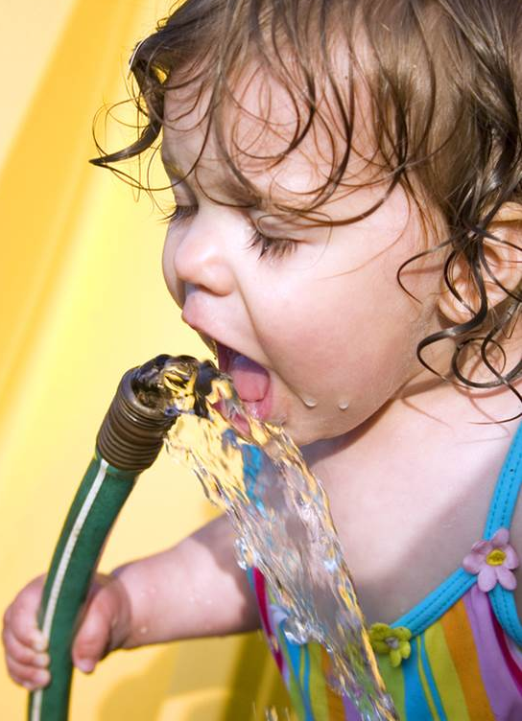
Recommended Online Resources
A handful of good online resources will save you time and provide the information the user needs to provide the best care for their kids.

Slide 15
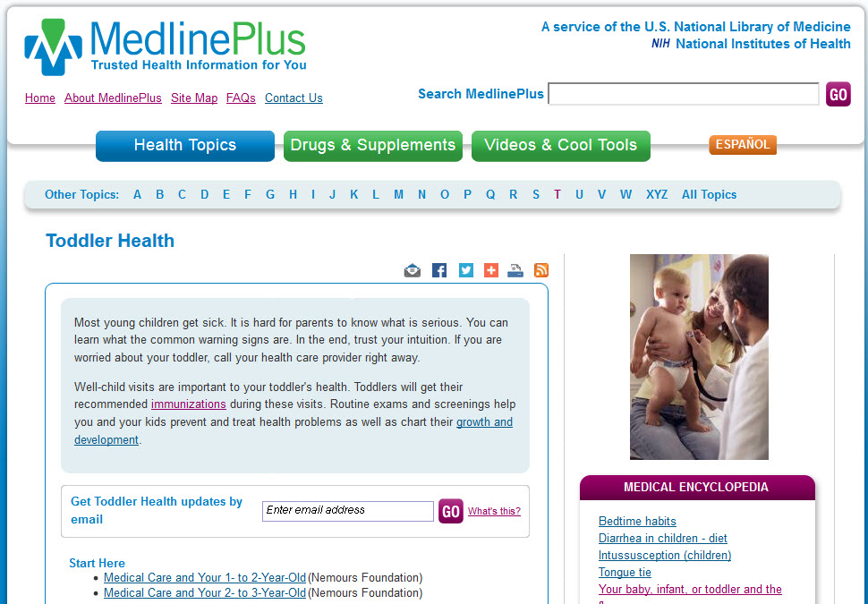
MedlinePlus
http://medlineplus.gov

Slide 16
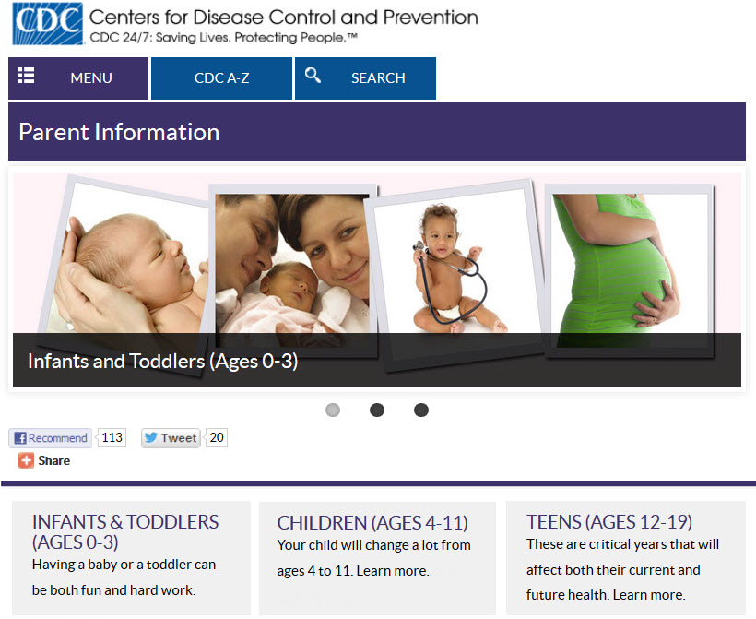
Centers for Disease Control and Prevention
http://www.cdc.gov/parents/

Slide 17
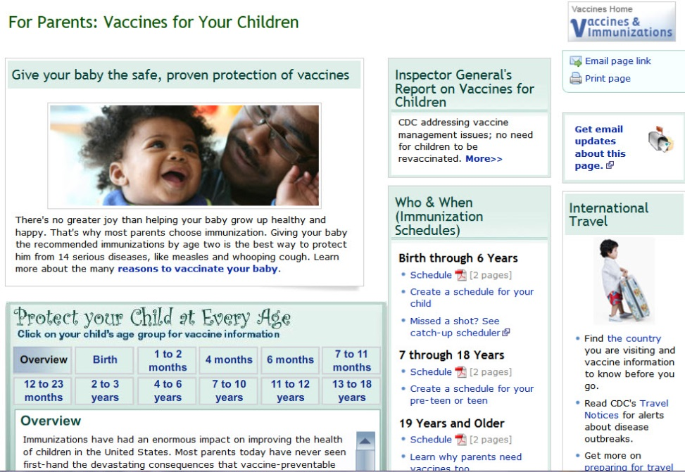
About Vaccines
http://www.cdc.gov/vaccines/parents/

Slide 18
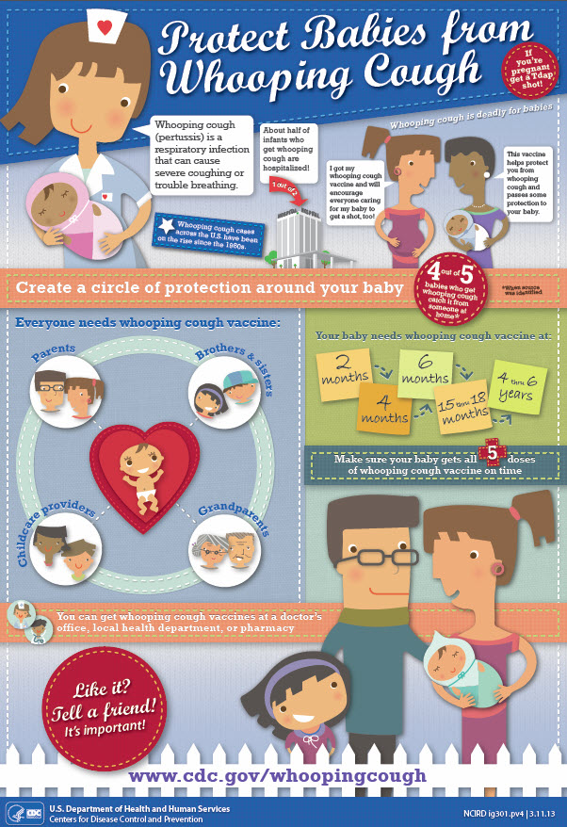
Great Free Stuff!
CDC and other .gov sites offer posters, brochures, and other materials
Perfect for library displays, handouts, and programs!
Try these Google searches:
- posters flu cdc.gov
- bulletin board nutrition usda.gov

Slide 19
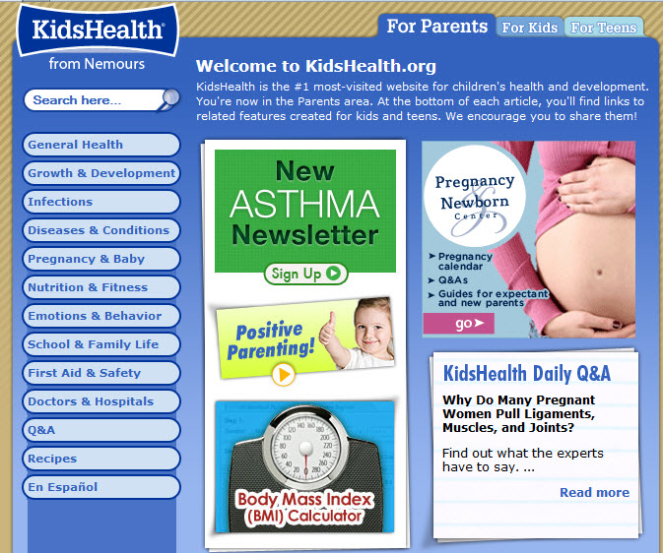
KidsHealth for Parents
http://kidshealth.org/parent/

Slide 20
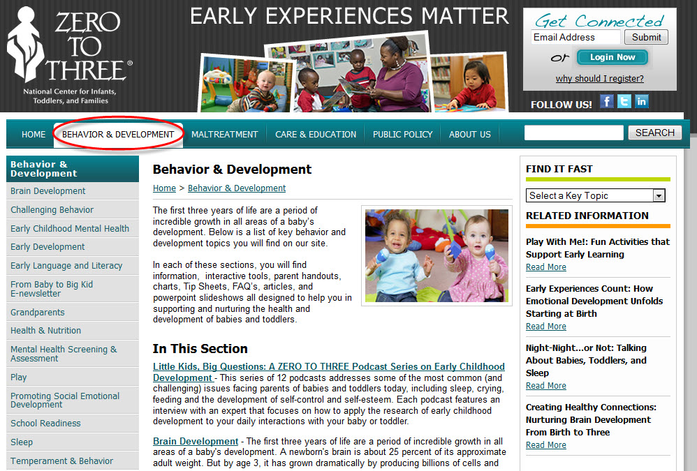
Zero to Three
http://www.zerotothree.org/child-development/

Slide 21
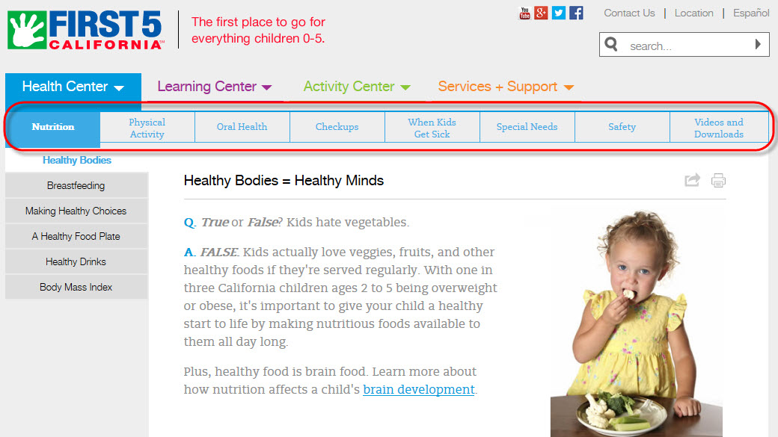
First Five California
http://www.first5california.com/

Slide 22
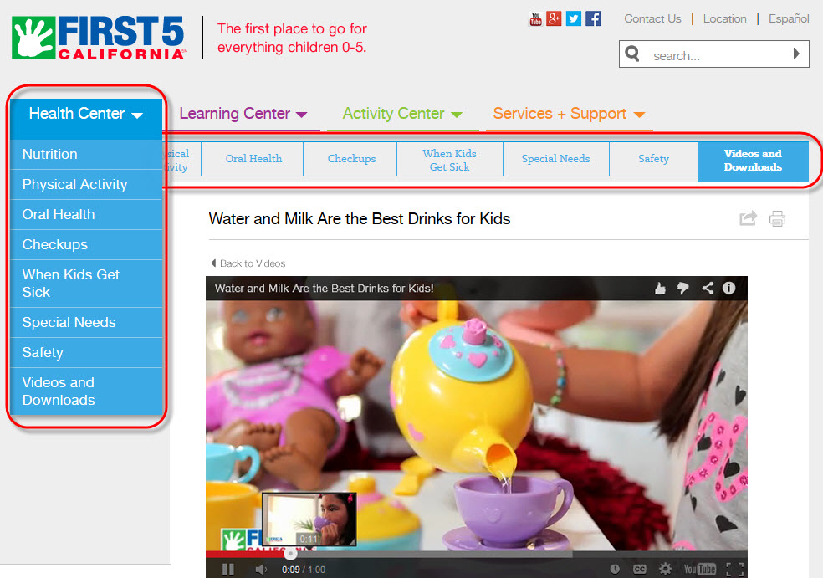
First Five Videos
Water and Milk Are the Best Drinks for Kids

Slide 23
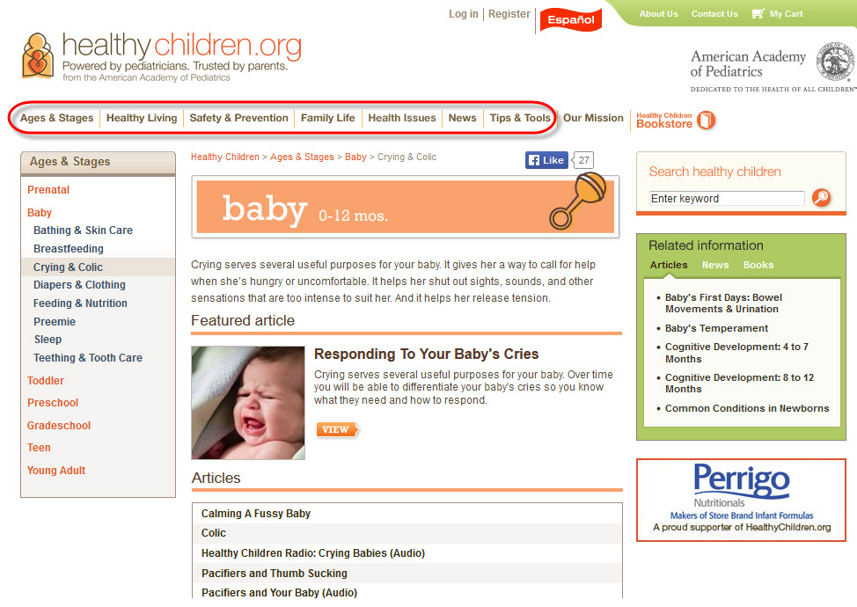
HealthyChildren.org
http://healthychildren.org

Slide 24
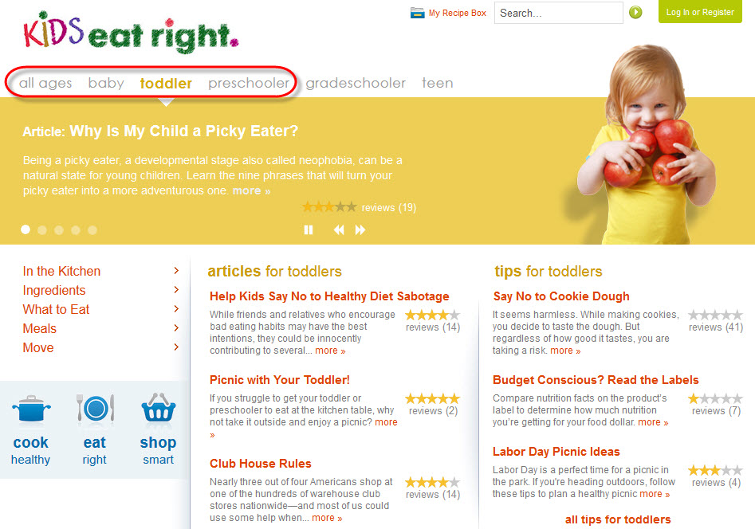
Kids Eat Right
http://www.eatright.org/kids/

Slide 25
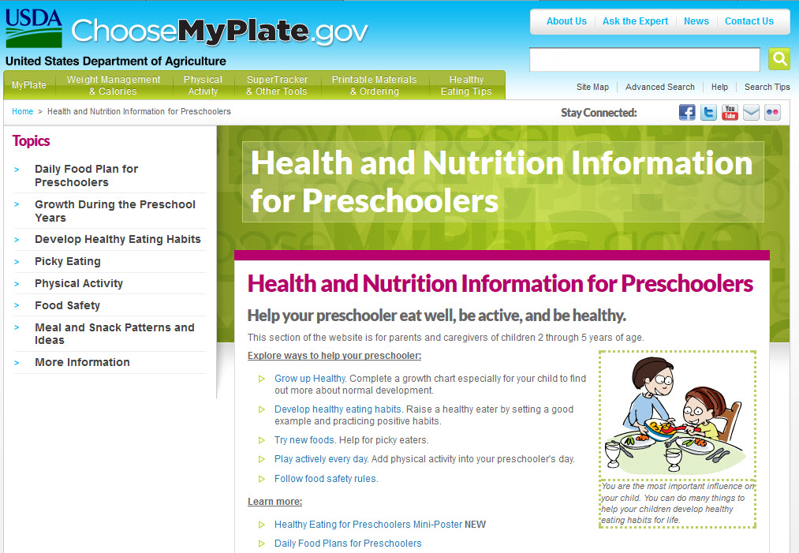
Choose My Plate
http://choosemyplate.gov/preschoolers.html

Slide 26

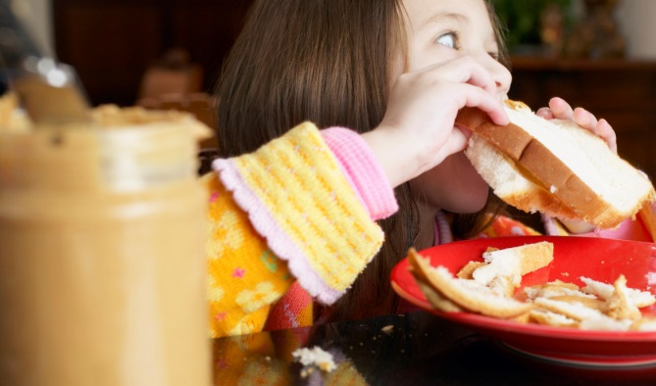
Mommy Blogs: The New Reference?
Blogs and social sites
  Sense of community
  Common concerns and topics
  Social support
  Non-authoritative
  Heavily supported by targeted advertising
  Not-for-everyone topics

Slide 27
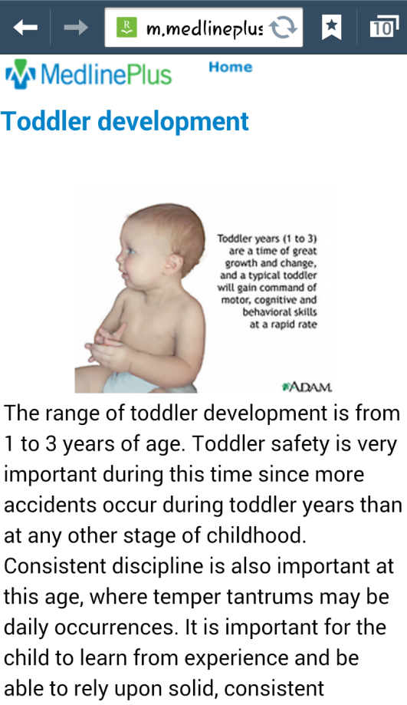
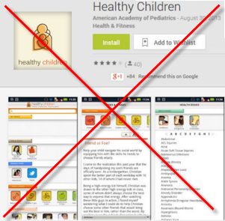
Mobile Apps and Sites
  Some are excellent, some are not ready for prime time
  Evaluate like a website (plus some)

Slide 28
Special Circumstances:
Traumatic Experiences
In the news:
Recent school violence
Shooting at Fort Hood
Landslide
Personal experiences:
Earthquakes, tornadoes
Other traumatic events

Slide 29
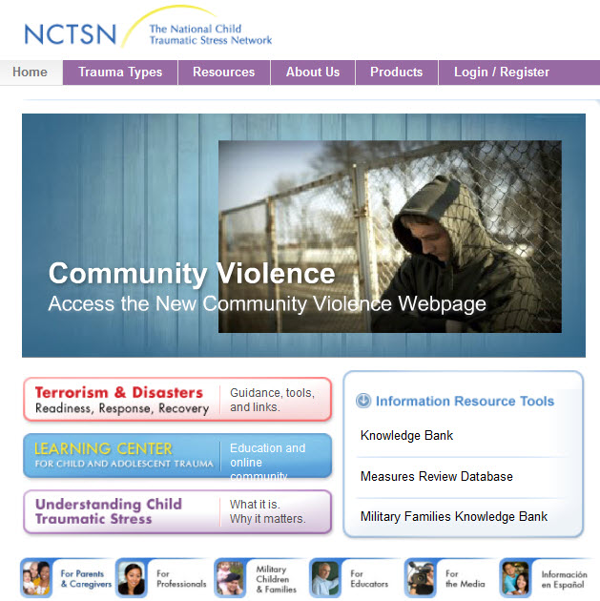
National Child Traumatic Stress Network (NCTSN)
http://www.nctsn.org/

Slide 30
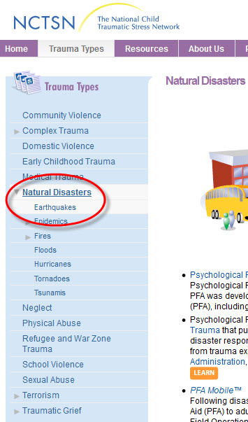
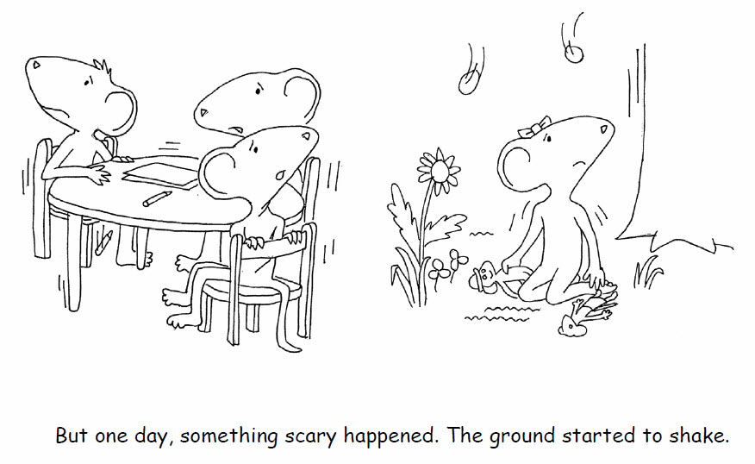
Natural Disasters
Trinka and Sam: The Day the Earth Shook

Slide 31
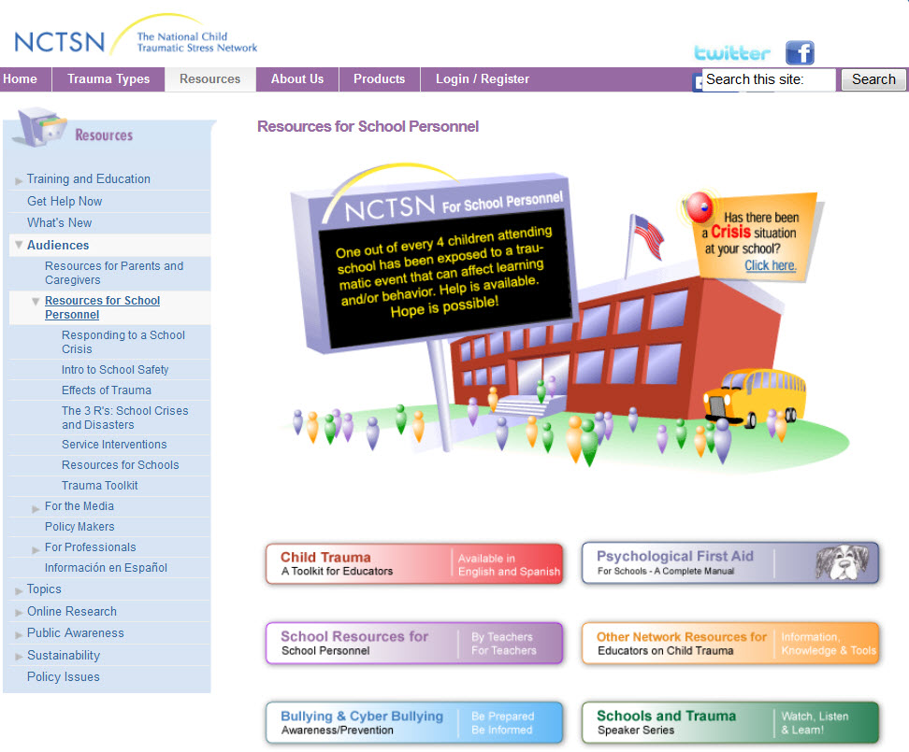
Resources for Schools
http://www.nctsn.org/resources/audiences/school-personnel

Slide 32

Handling Hot Button Issues
Affordable Care Act
Childhood vaccines
Latest advice on child raising
HPV vaccination

Slide 33
Finding Local Services
Do you maintain a list of local service providers at the reference desk? If so, post in chat!
Common request, but difficult to answer
Library’s role is to provide information, but not to recommend a provider or service
Time-consuming to create and maintain
What are some solutions?

Slide 34

Healthy Programming Ideas
Storytimes are a perfect fit
Invite a dietician to demonstrate kid-friendly healthy snacks
Look at community health issues, then bring in a health professional to speak
Get ideas from titles and build on a theme

Slide 35
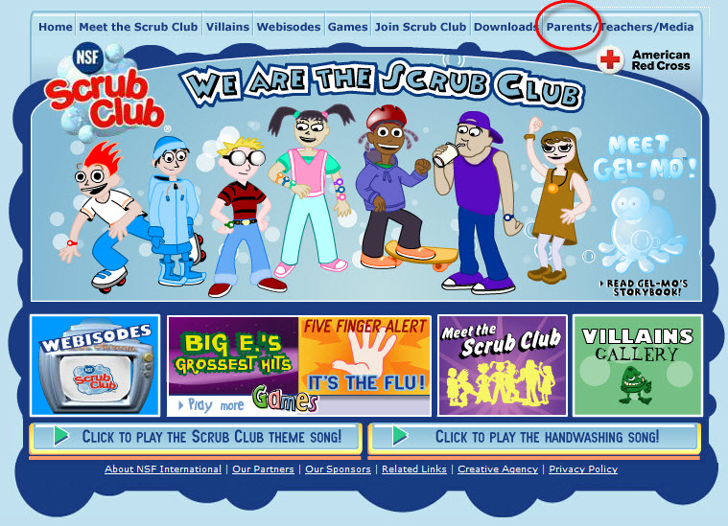
Scrub Club
http://www.scrubclub.org/

Slide 36
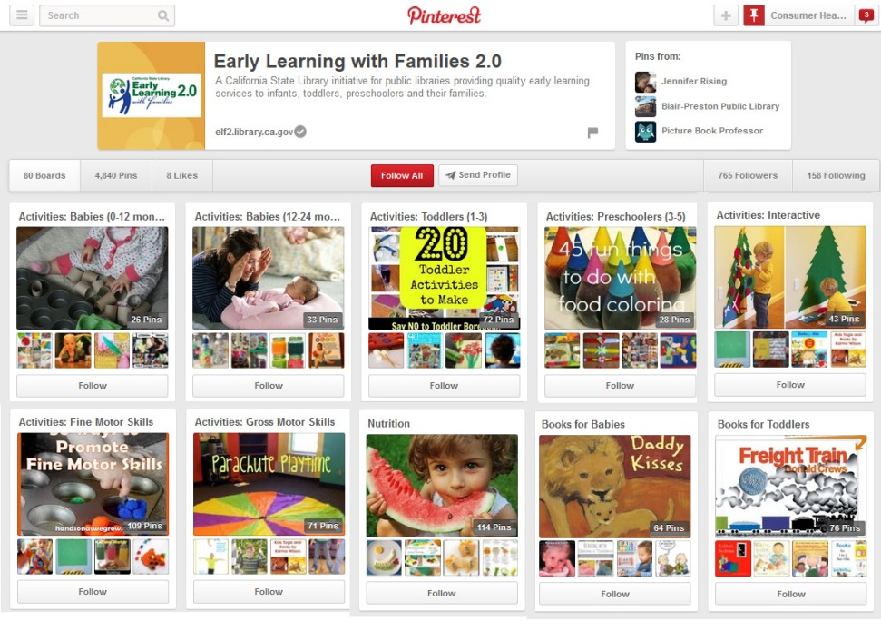
Early Learning with Families
http://pinterest.com/ELF2Libraries

Slide 37
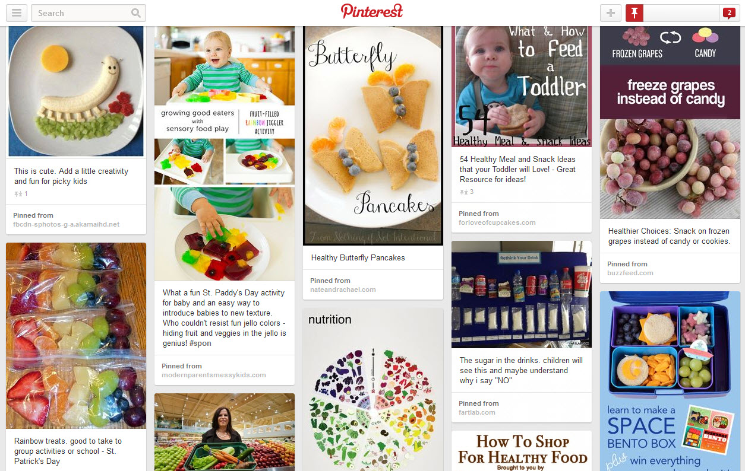
ELF2Libraries Nutrition Board

Slide 38
Health Reference in Brief
Provide quality information, not advice
Offer factual, vetted information, not personal experience or perspective
Avoid judgment
Respect the patron’s point of view
Provide current, authoritative, unbiased resources
Help patron evaluate resources
Be wary of health sites that lead users to targeted advertising

Slide 39

MedlinePlus: One Stop Shop
MedlinePlus points to the best resources
Results are manageable
In English and Spanish; some materials in over 45 other languages
Results are vetted for quality
Powerful search tools
Try out some sample searches!

Slide 40
Over 20 Health Child Health Topic Pages; Thousands of Articles
Baby Health Checkup
Infant and Newborn Care
Infant and Newborn Development
Infant and Newborn Nutrition
Medicines and Children
Common Infant and Newborn Problems
Premature Babies
Rh Incompatibility
Sudden Infant Death Syndrome
Uncommon Infant and Newborn Problems
Child Behavior Disorders
Child Care
Child Dental Health
Child Development
Child Mental Health
Child Nutrition
Child Safety
Asthma in Children
Childhood Brain Tumors
Cancer in Children
Childhood Immunization
Childhood Leukemia
Obesity in Children
Diabetes in Children and Teens

Slide 41

Take-away Points
Provide information users can trust to make good decisions
MedlinePlus saves time for busy library staff and users
Your users are listening – use teachable moments
Healthy babies and healthy kids equals a healthy community!

Slide 42


Thank You!
        Kelli Ham, Consumer Health Coordinator
        National Network of Libraries of Medicine
        Pacific Southwest Region
        UCLA Louise M. Darling Biomedical Library
        kkham@library.ucla.edu
        http://nlm.gov/psr

Slide 43
Infopeople webinars are supported in part by the U.S. Institute of Museum and Library Services under the provisions of the Library Services and Technology Act, administered in California by the State Librarian. This material is licensed under a Creative Commons 3.0 Share & Share-Alike license. Use of this material should credit the author and funding source.

