Slide 1
Embrace the Evolution:
Adapting Reference Service to New Technology
Wednesday, April 23, 2014
R. Toby Greenwalt
toby@theanalogdivide.com
#RefEvolved

Slide 2
everything is changing
Bring-Your-Own-Device
New Learning Models
Ubiquitous Access
Digital Literacy

Slide 3
everything is changing
Bring-Your-Own-Device
New Learning Models
Ubiquitous Access
Digital Literacy
What else have you observed?

Slide 4
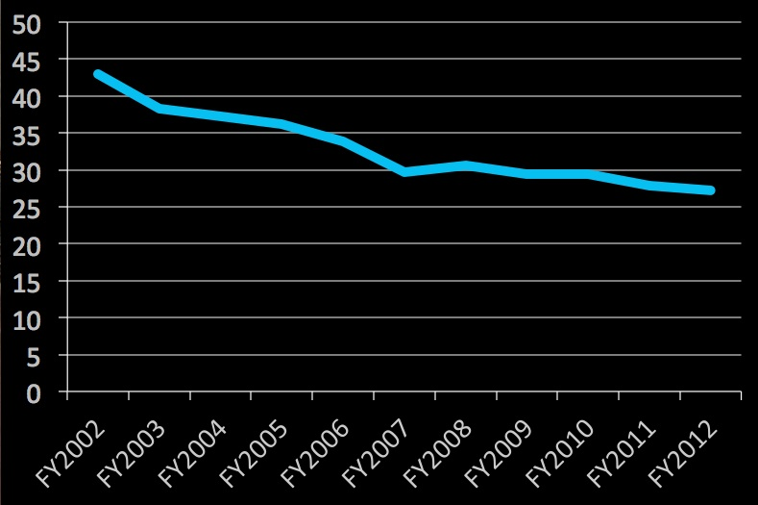
everything is changing
Reference transactions per $1000 spent, according to Public Library Data Service trend report

Slide 5
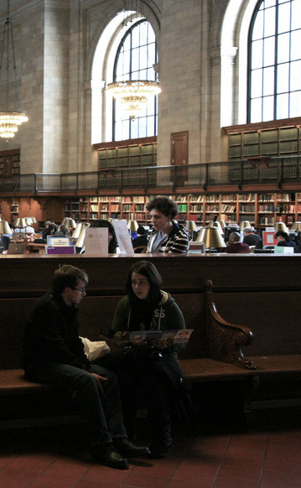
Agenda
Escaping the Desk
Virtual/Online Reference
Personalized Services and Flipped Learning
Speculation on the Future
Questions? Use the chat or tweet with #RefEvolved

Slide 6
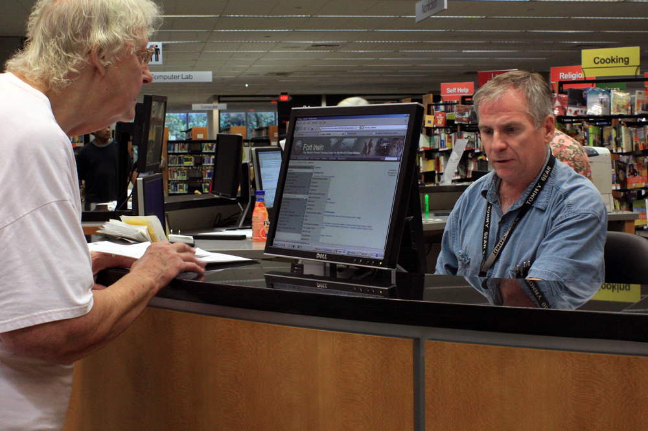
technology should enhance skills,
not replace them

Slide 7
Escaping the Desk

Slide 8
Why hasn’t roving happened?

Slide 9
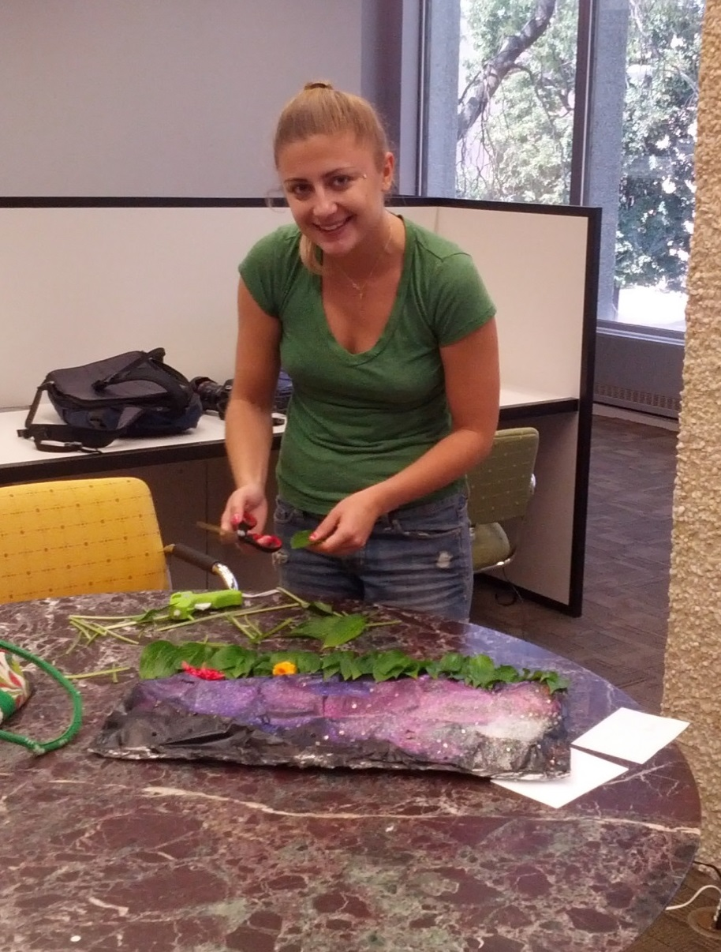
Strategies for Effective Roving
Making regular rounds
Posture, Body Language, and Eye Contact
Prompts
Engaging the Campers

Slide 10
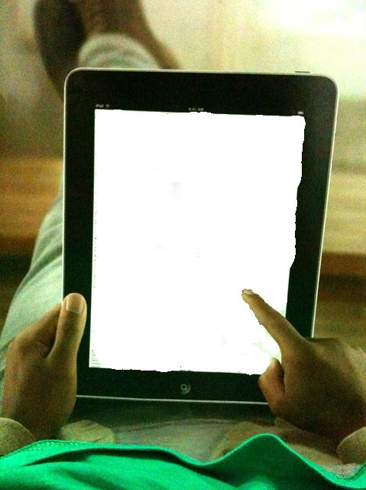
What’s still missing?
ILS Support
Database compatibility
Granular Statistics
Circulation and other functions
?

Slide 11
Roving Beyond the Library
To consider:
Location
Equipment
Time
TechSoup’s Mobile Beacon program

Slide 12
Virtual Reference Services

Slide 13
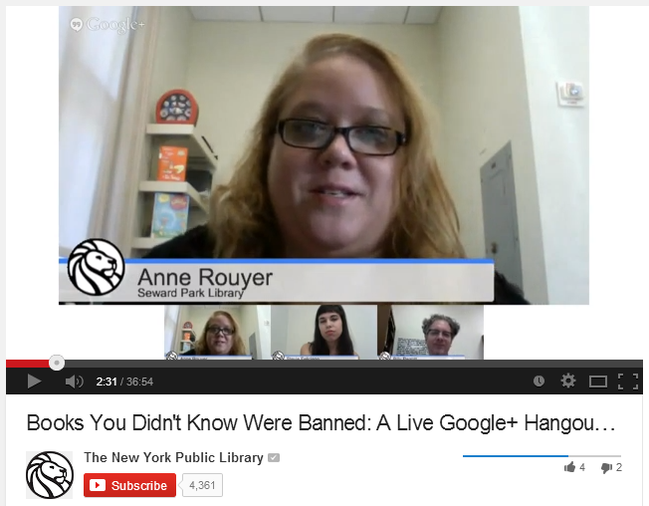
Google Hangouts
Quick way to put discussions online
Can be archived on YouTube
Remote Desktop (Google+, Chrome)
Helpouts

Slide 14
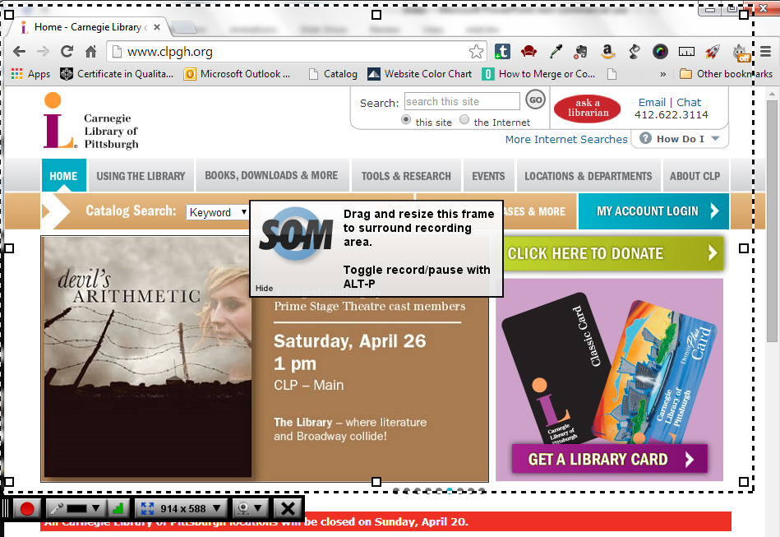
Screencasting
Just-in-time, not just-in-case
Simplicity is key
Screenr.com and Screencastcast-o-matic.com
Consider the update cycle
Don’t reinvent the wheel

Slide 15
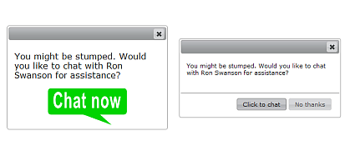
Effective VR
Widgets where people get stuck
Timing and pop-ups (libraryh3lp, Olark)
Setting proper limits
Card numbers
Length of session
Transfer from VR

Slide 16
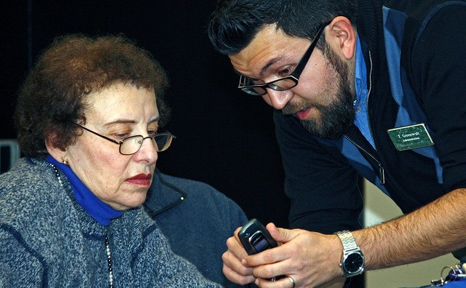
Personalized Reference Services

Slide 17
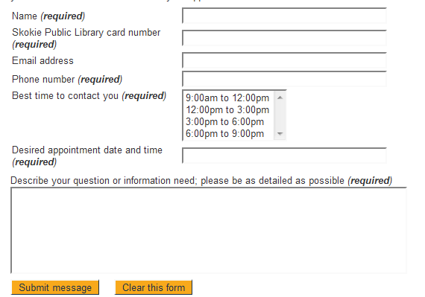
1-on-1 Instruction
Begin with a skills audit
Identify weekly “office hours” for staff (also helps with room reserve)
See past Infopeople webinar on customized library services

Slide 18
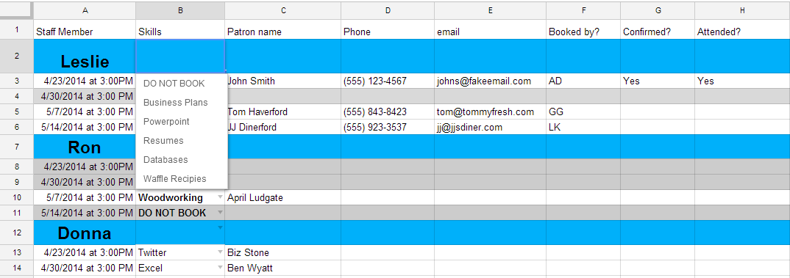
1-on-1 instruction
View template at bit.ly/RefEvolvedSheet

Slide 19
The library as a shared learning platform
Good for 101-level classes
Teaching through show-and-tell
Students learn from one another
Unlocking “hidden” tech competencies

Slide 20
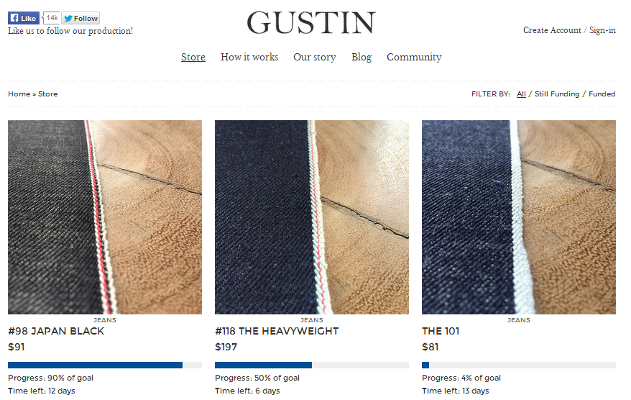
Teaching as a learning activity
Can we crowdfund our MOOCs and classes?

Slide 21
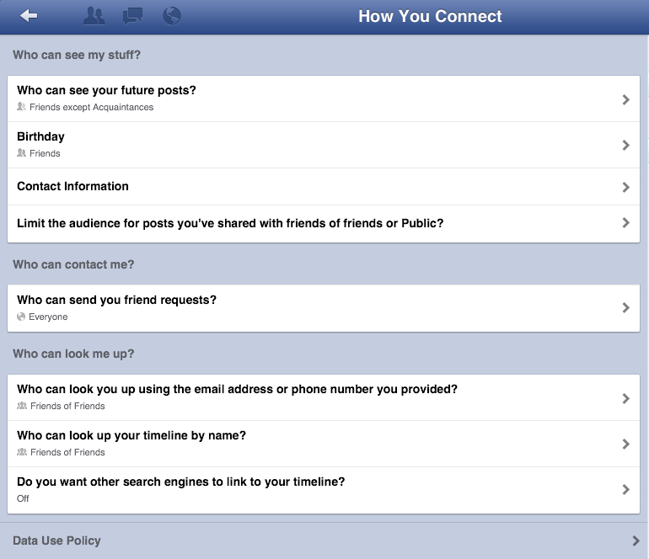
Risks and opportunities of personalization
Opt-in concierge service
Data aggregation and trend analysis
Balancing convenience with privacy
Empowering users to take control of their data

Slide 22
Where do we go from here?

Slide 23
INSPIRATION
INTERACTION
TRANSACTION
Notes:
In doing so, we can move the library from a place of transactions - a venue where you go, check out some stuff, leave, and that’s it - to a place of participatory experiences.
Right now, most interactions can be summed up like this.
Once the transaction is finished, there’s no way for the library to pick up where the previous interaction left off. If the patron comes back in, there’s nothing to guarantee that a staff member will remember their preferences – if that staff member handles the transaction at all. It’s something of a forced amnesia – where library workers and patrons alike are forced to start from scratch every time they come back to the library.

Slide 24
INSPIRATION
INTERACTION
REFLECTION
TRANSACTION
Notes:
But digital tools are making it easier to introduce a better sense of collective memory. Having constant access to portable technology and pervasive, powerful makes it easier for all of us to document and share our lives with one another. (examples: anyone have a fitbit?) Regardless of how you feel about this phenomenon, it presents an opportunity for us to make reflection another component of the transaction.
If this is happening publicly, then our users become just as much a part of the inspiration cycle. This probably happening already in every one of our libraries. We’ve got to make this process more visible, so we can lay better claim to those things our users accomplish using our services. By doing so, we’re reinforcing the point that the library functions as the hub of a community. We’ll create additional touchpoints for better engaging with the public. And it’ll give us ready pile of evidence to point to when dealing with our stakeholders.
If we can do this internally – and with our user’s permission – we can do a better job of providing customized services, and make the library experience more of a fluid, ongoing relationship. This will not only buff out the seams from transaction to transaction, but over time it will make for a comprehensive library experience that runs from cradle to grave.
Let’s talk about some examples in which libraries are already doing this.

Slide 25
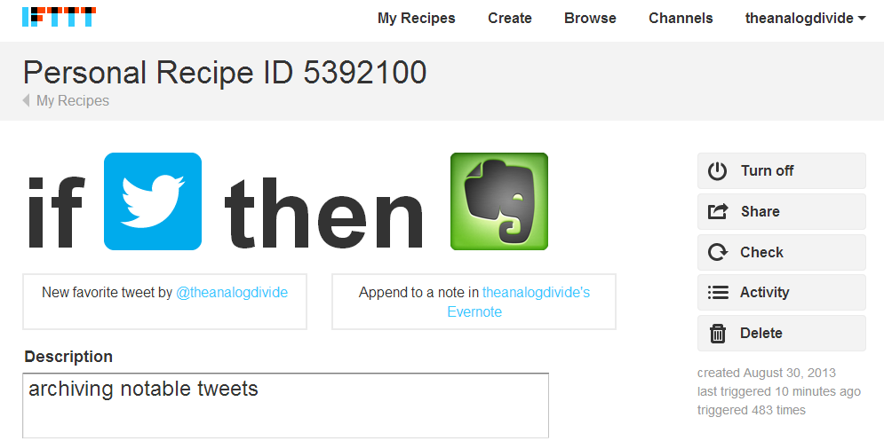
Archiving successes

Slide 26
Telling our story

Slide 27
Long Live Reference

Slide 28
Thank You
Questions? Let’s talk.
Toby Greenwalt
toby@theanalogdivide.com
@theanalogdivide

Slide 29
Photo Credits
Title Slide: Vincent Desjardins, https://flic.kr/p/9h3fso
Dual Monitors: Skokie Public Library, https://flic.kr/p/6YrKWT
Reference Desk: Manchester City Library/Yvonne Loomis, https://flic.kr/p/51rzTe
Roving Reference: Kimberly Vardeman, http://flic.kr/p/8HdbkH
iPad: Cheon Fong, https://flic.kr/p/82LS7x
Virtual Reference Map: http://www.forbes.com/sites/markfidelman/2013/07/11/look-out-klout-these-twitter-influencer-maps-are-amazing/
Mobile class: https://flic.kr/p/7idL6i
iPad classroom: courtesy Richard Kong
Facebook photo: http://on.fb.me/1r2B2e0

Slide 30
Infopeople webinars are supported in part by the U.S. Institute of Museum and Library Services under the provisions of the Library Services and Technology Act, administered in California by the State Librarian.
This material is licensed under a Creative Commons 3.0 Share & Share-Alike license. Use of this material should credit the author and funding source.

