Slide 1
STEAM in the Public Library:
Programs & Services for Children
Amy Koester | St. Charles City-County Library District
Wednesday, May 7, 2014

Slide 2

Hello!
Amy Koester
Children’s Librarian with St. Charles City-County Library District, Missouri
The Show Me Librarian
Youth programs, services, and outreach

Slide 3
In today’s webinar…
What is STEAM, and why does it belong in my public library’s youth services?
Programs for preschoolers
Programs for school-age children
STEAM services
What you need to do STEAM, and where to find it

Slide 4
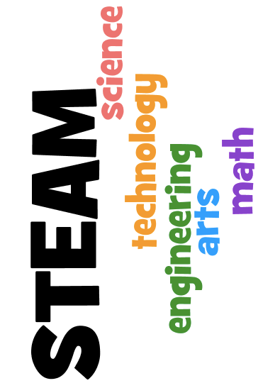
What is STEAM?

Slide 5
Why STEAM instead of STEM?
Arts in STEAM is NOT crafts
Arts in STEAM means creativity
Makes STEAM more accessible, more meaningful

Slide 6
Why STEAM Matters
American children are lagging
School & life success isn’t just about reading
Creativity is a top work skill

Slide 7

STEAM at the Library
What’s your mission?
Literacy
School success
Lifelong learning

Slide 8
Anyone can STEAM
You don’t need to be a content expert to use STEAM with library kids.

Slide 9
Programs for Preschoolers

Slide 10
Why STEAM with preschoolers?
Natural curiosity
Introduce concepts
Reinforce concept knowledge
Vocabulary
Hands-on learning

Slide 11
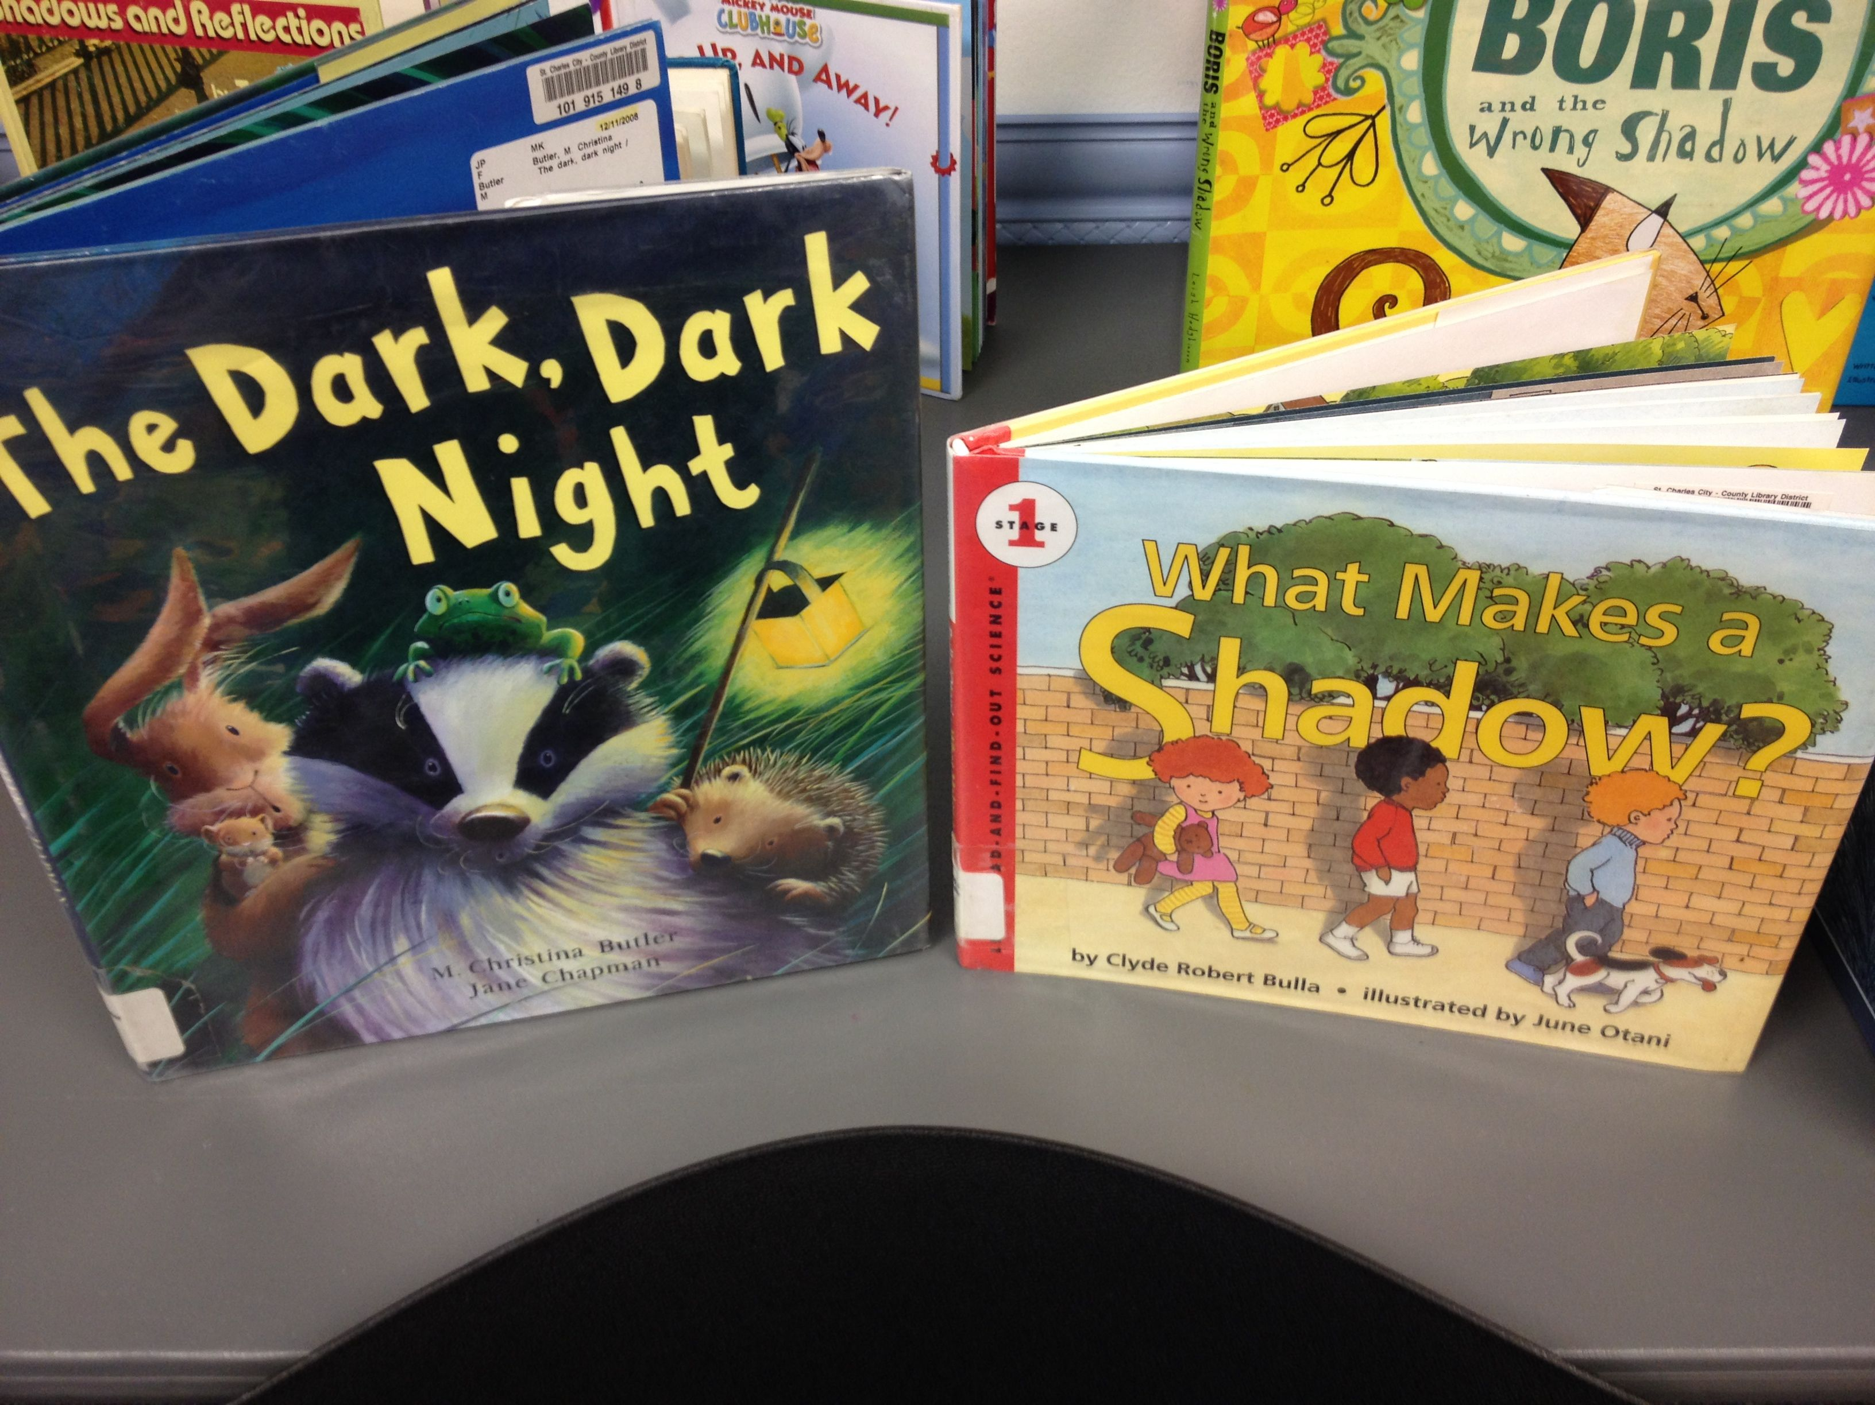
STEAM Stories
Be intentional about your books
Include non-fiction
Tap the STEAM concepts in fiction
Talk!

Slide 12
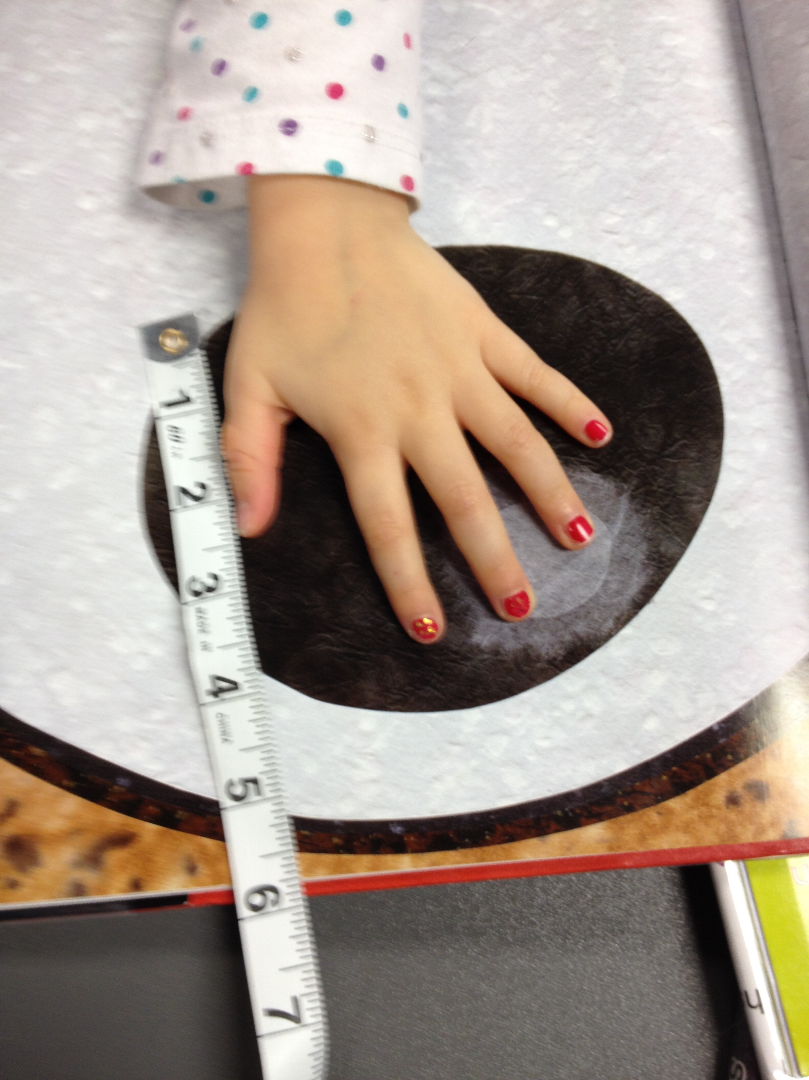
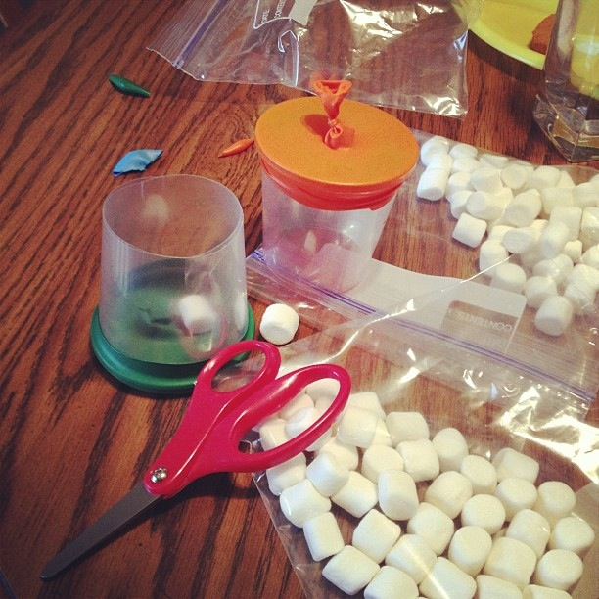
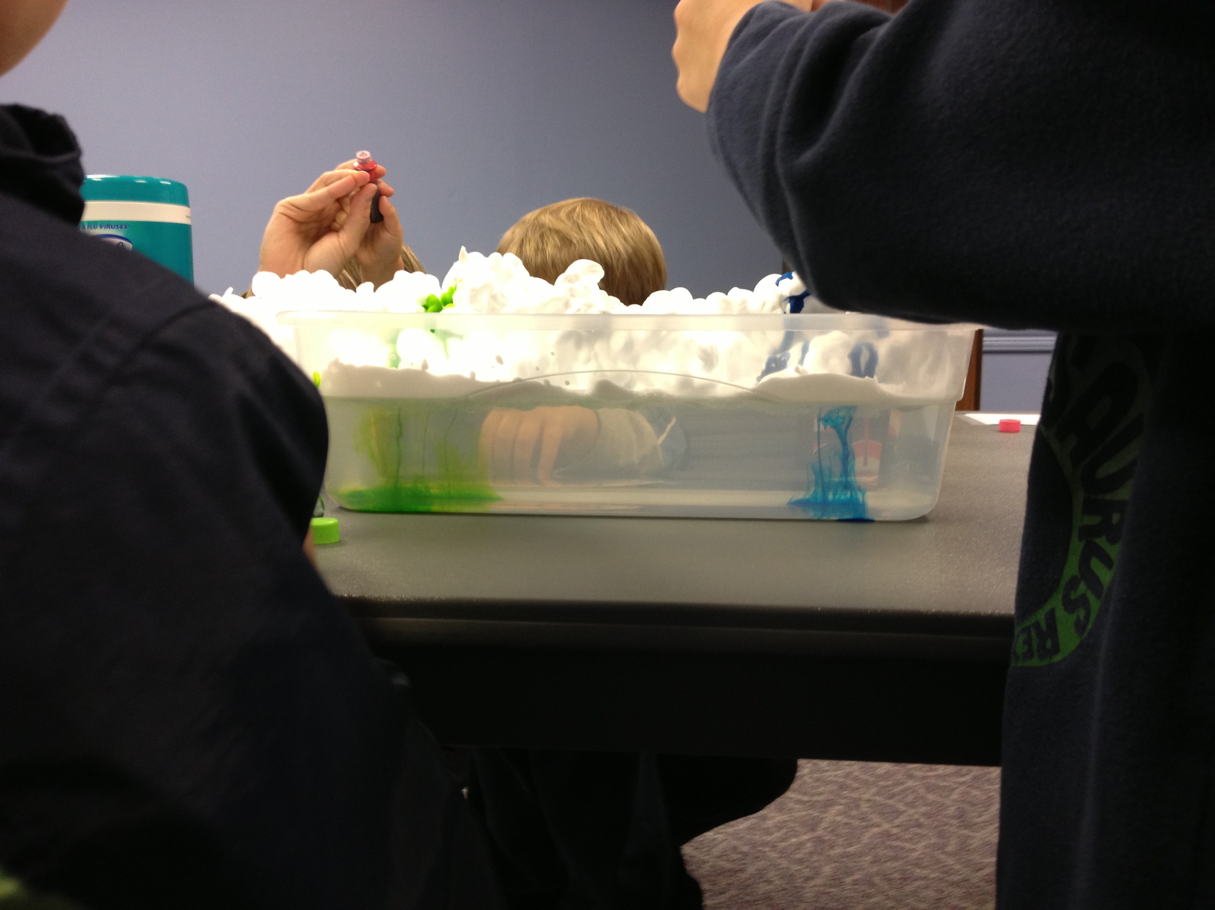
STEAM Activities
Hands-on is integral
Add an experiment
Use tools
Make something
Provide options

Slide 13
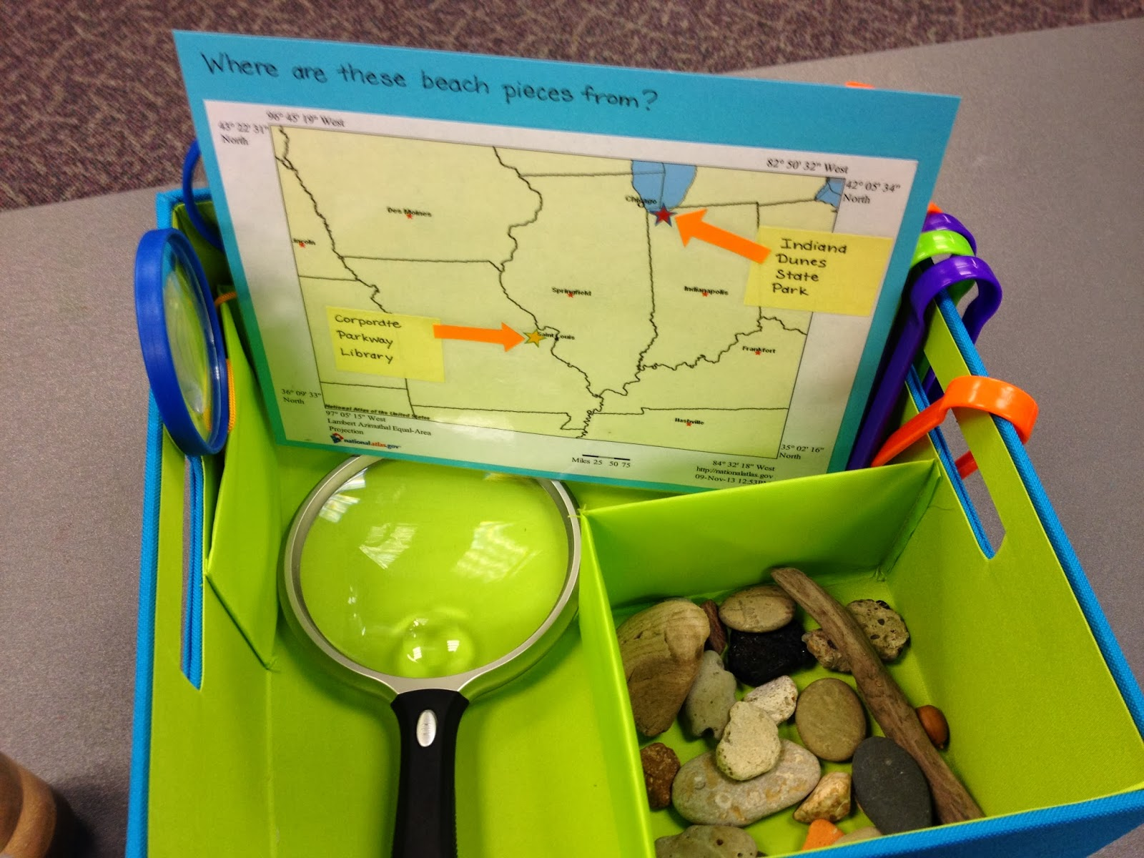
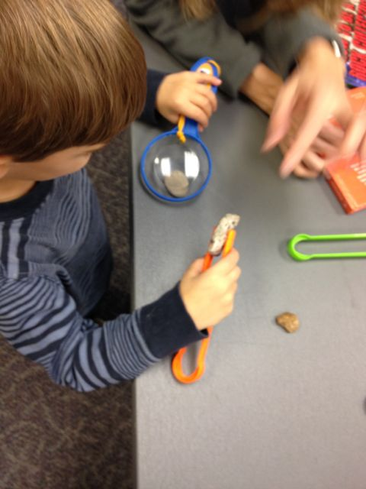
Observation Stations
Exploring things close-up
Sensory experiences
Things that grow & change
Tie to books

Slide 14
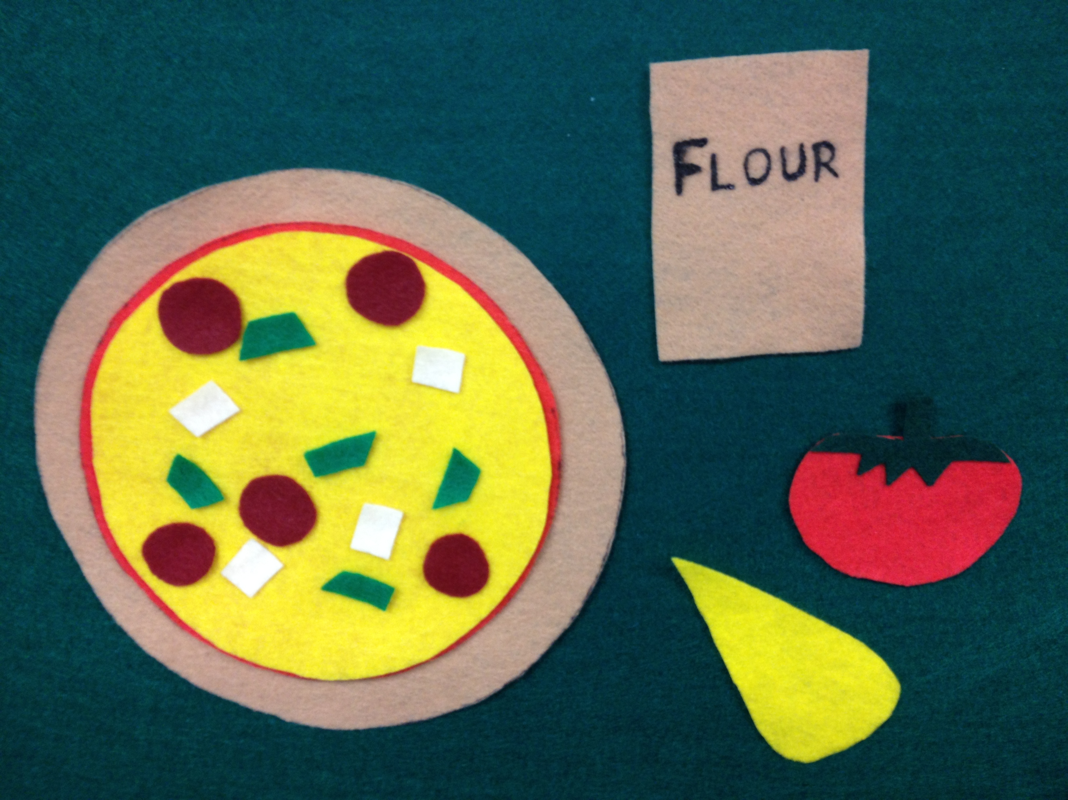
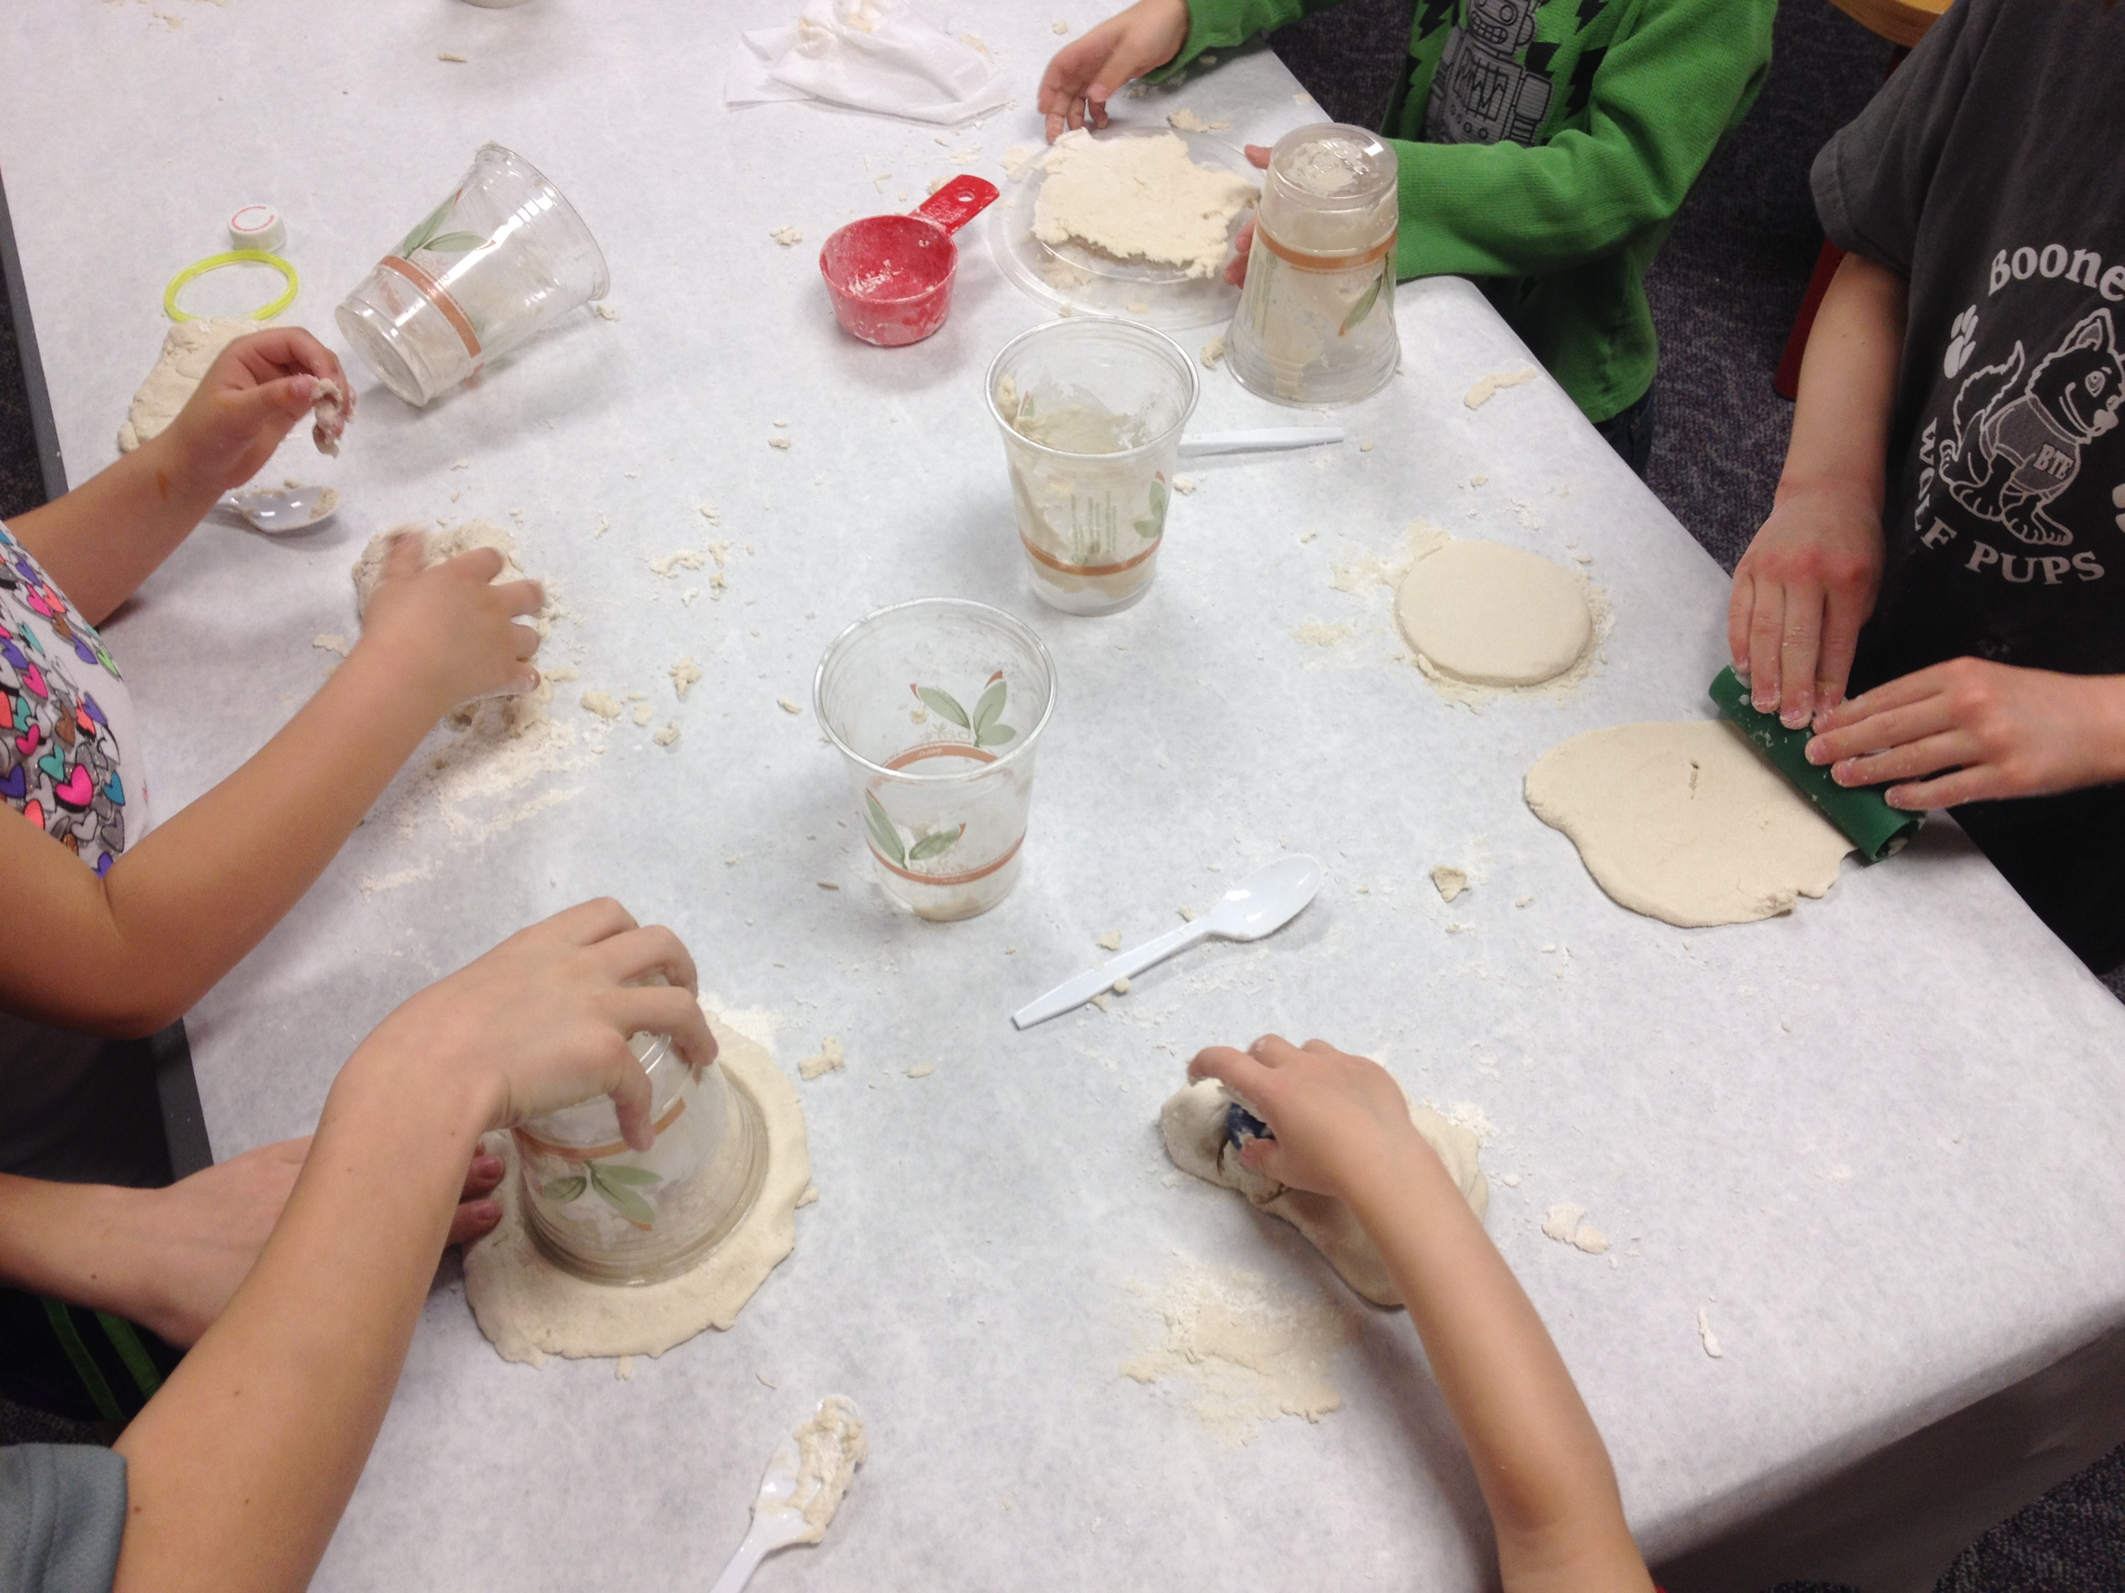
STEAM Programs
STEAM Preschool Storytime
Start with a book
Talk about the STEAM concepts
Ask (and answer) questions
Hands-on activities
Supply at-home options

Slide 15
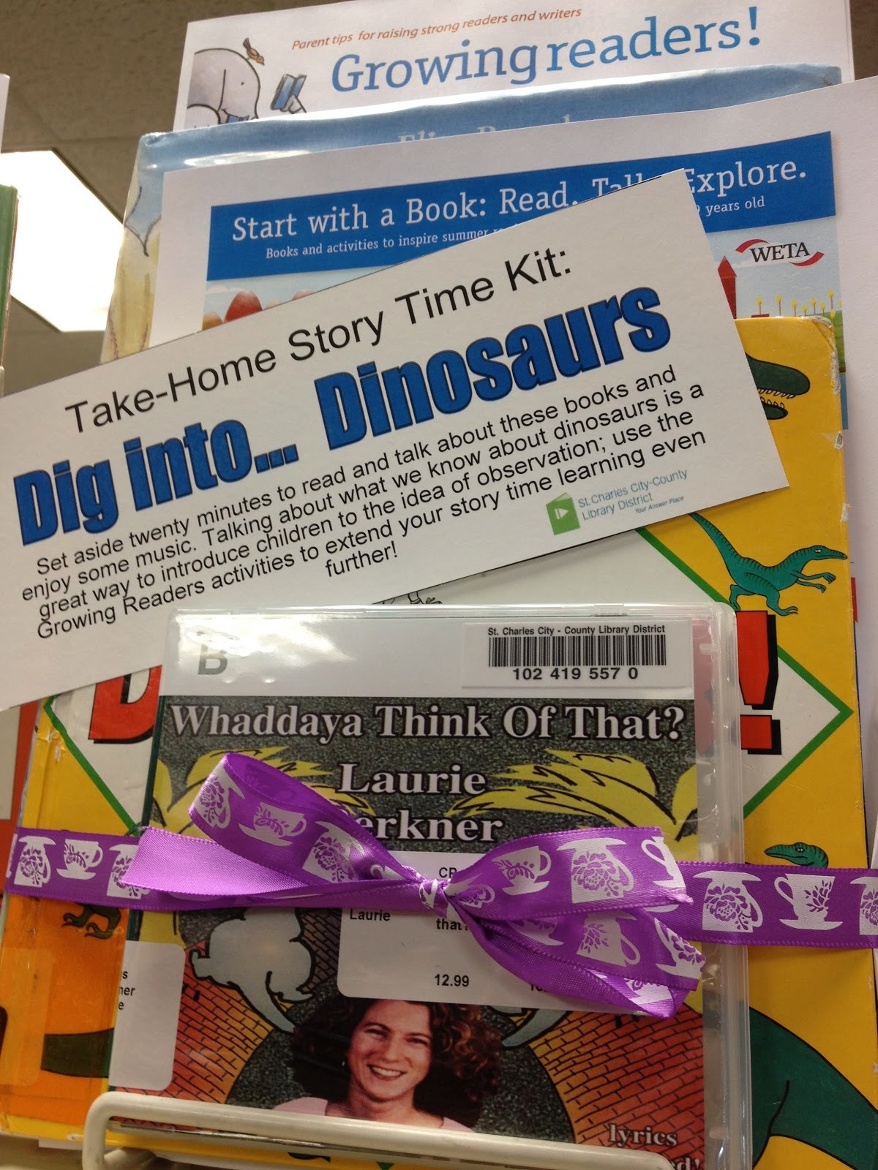
Take-Home Kits
Build around a topic
Pack a few books
Add some songs
Include activity instructions

Slide 16
POLL
Can you think of one of your existing preschool programs that you could modify to include a STEAM element?
Please type your answers into the Chat Box.

Slide 17
Programs for School-Age Children

Slide 18
Why STEAM with school-age children?
Curiosity
Reinforce basic concepts
Multiple literacies
Creative problem-solving
Developing personal interests

Slide 19
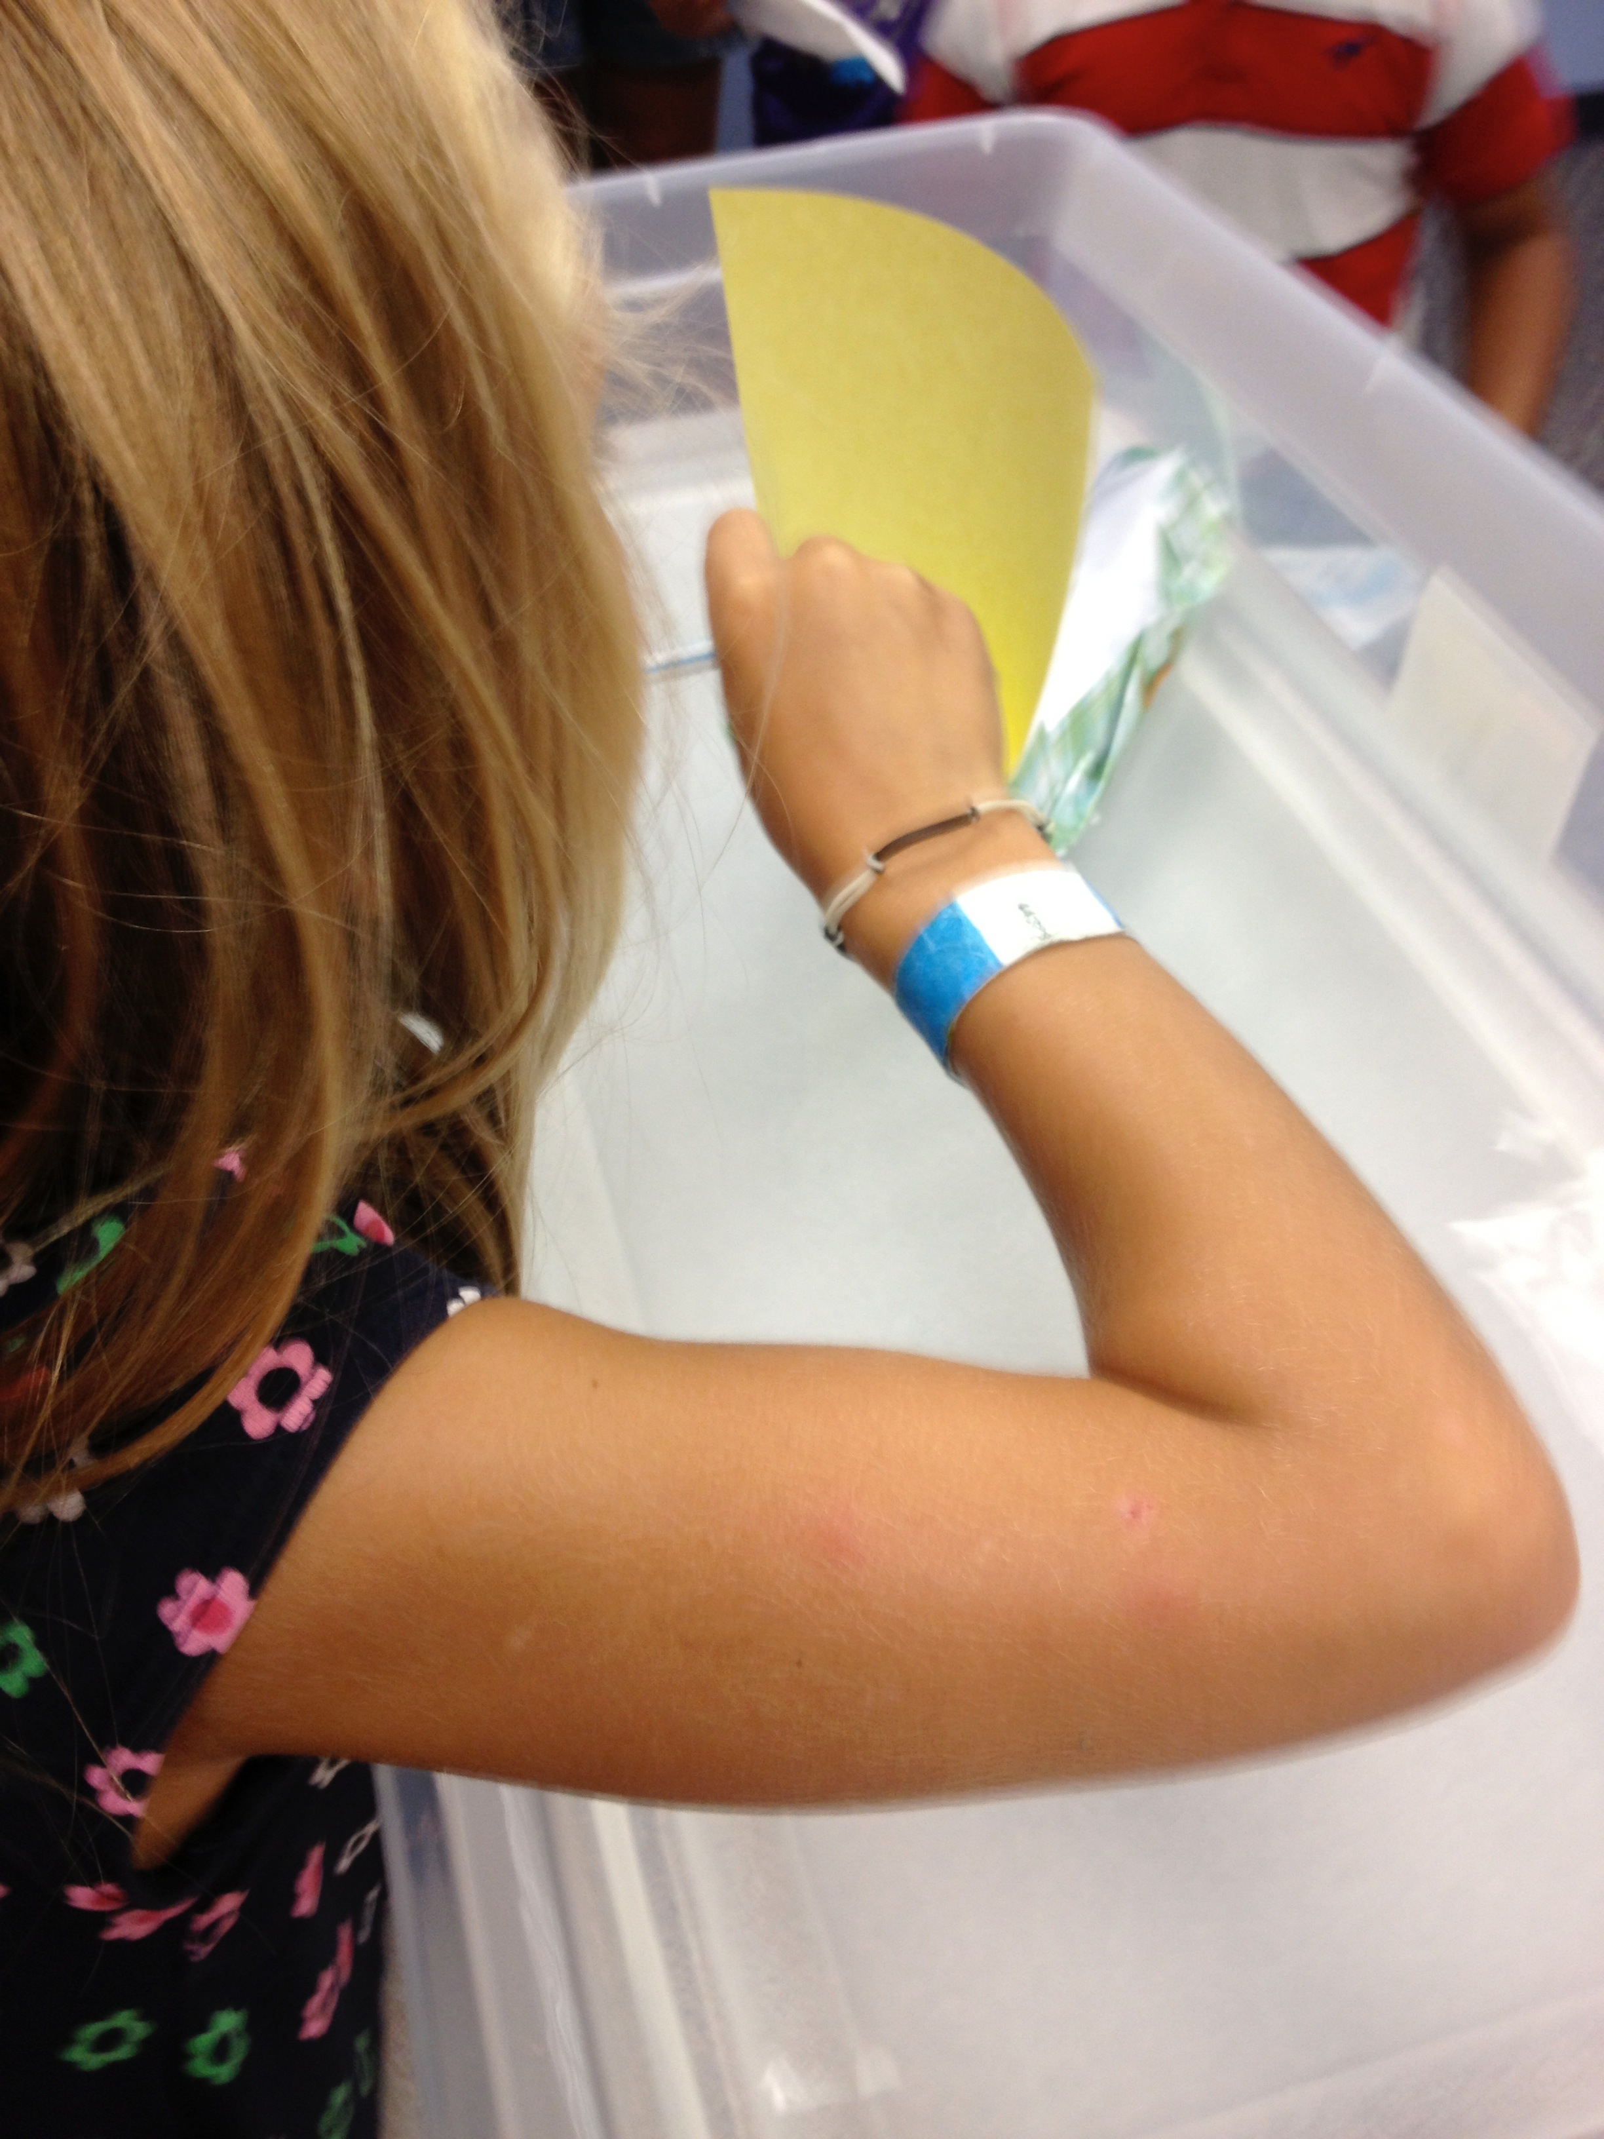
Science Programs
Introduce your concept
    Books!
    Images & videos!
Take questions
Pose a challenge
Time to build
Test & observe

Slide 20
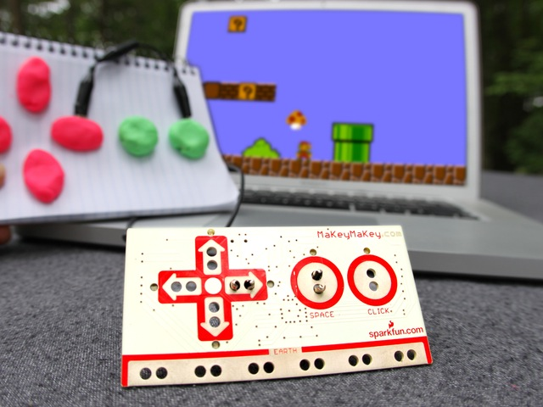
Technology Programs
Meet kids where they are
Introduce new tech
Tablets & media creation
Circuits & electricity
Programming & gaming
photo from MaKey MaKey: An Invention Kit for Everyone

Slide 21
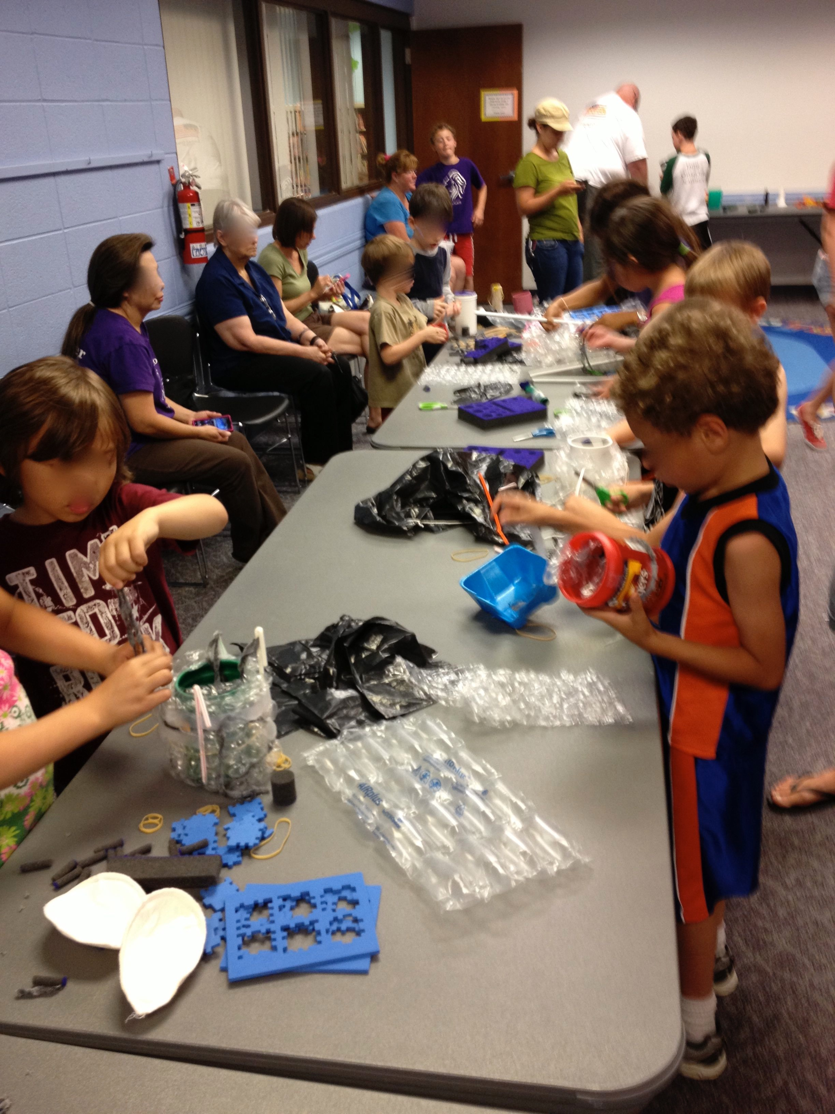
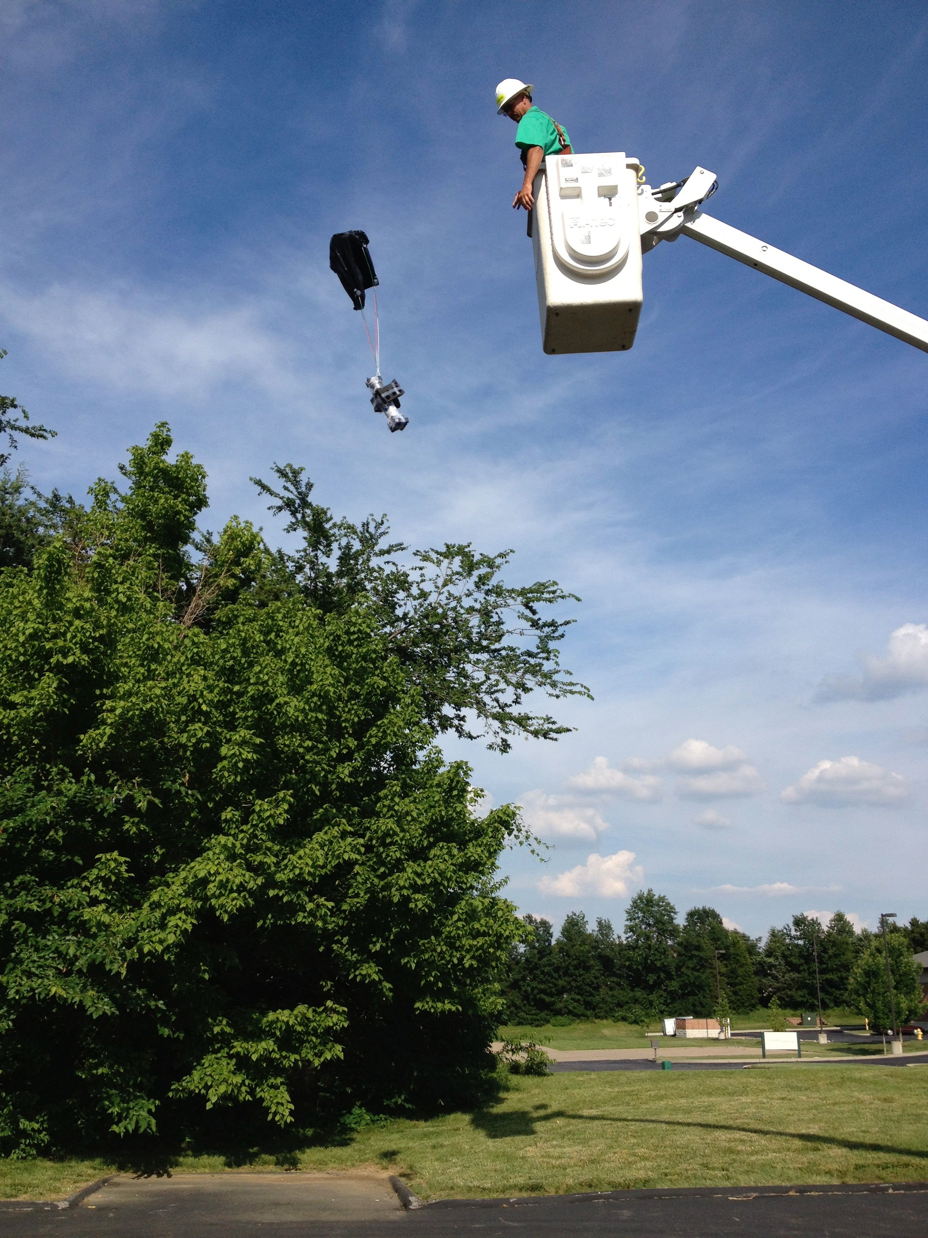
Engineering Programs
Build something
Give direction, but leave room for creativity
Variety of materials
Share examples
Test & compare structures

Slide 22
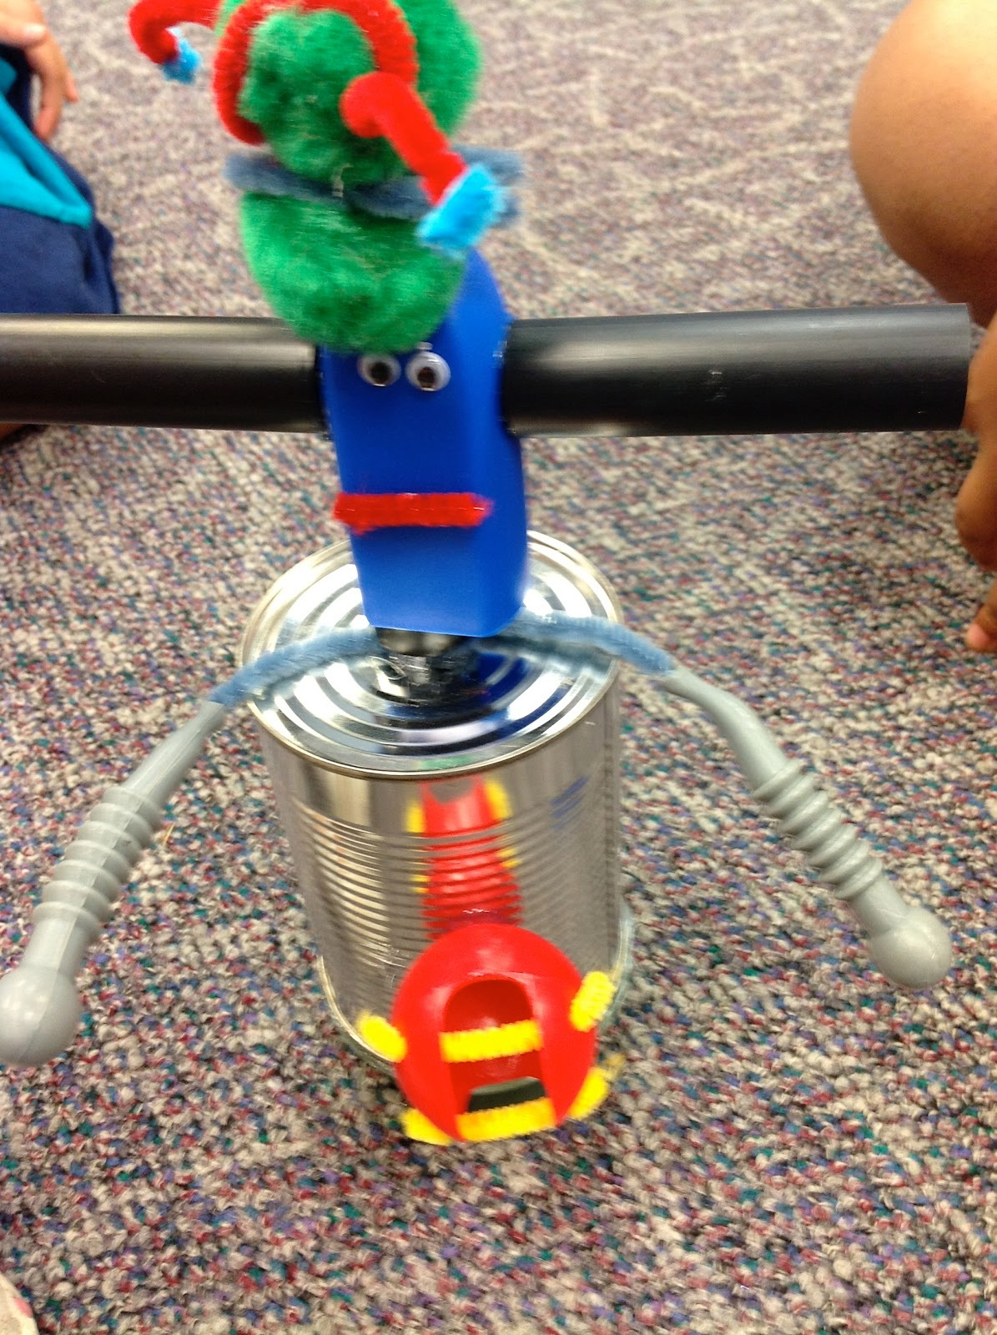
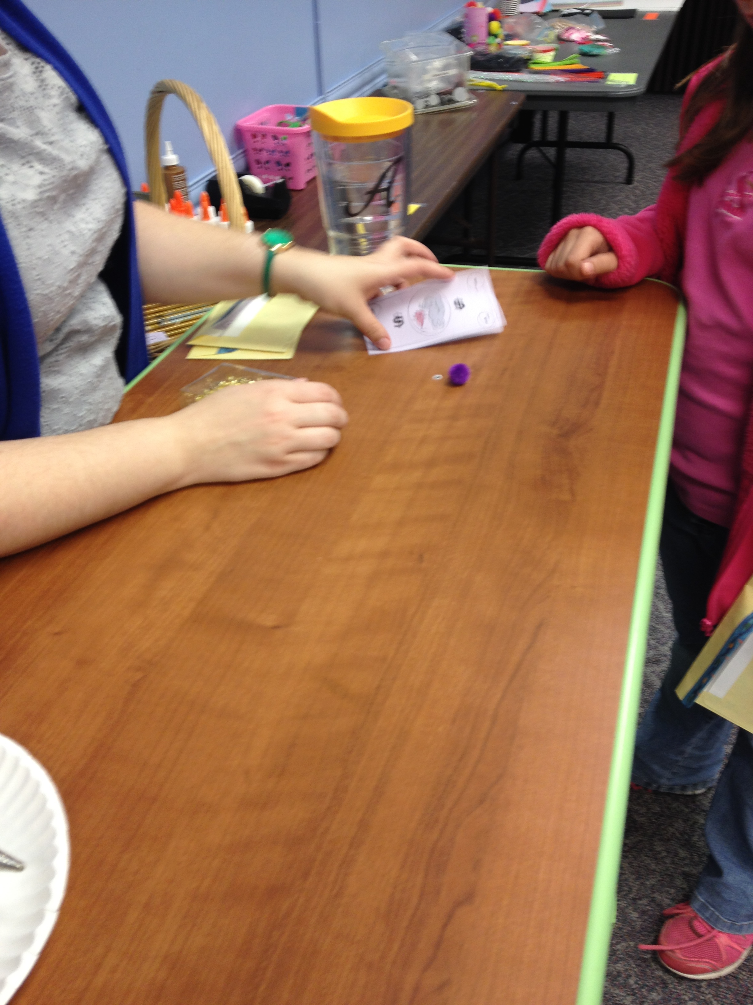
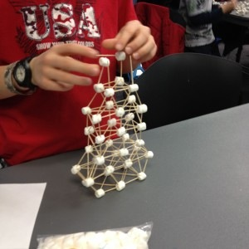
STEAM Programs
Find the STEM potential in arts & crafts
Create with atypical materials
Provide context for activities

Slide 23
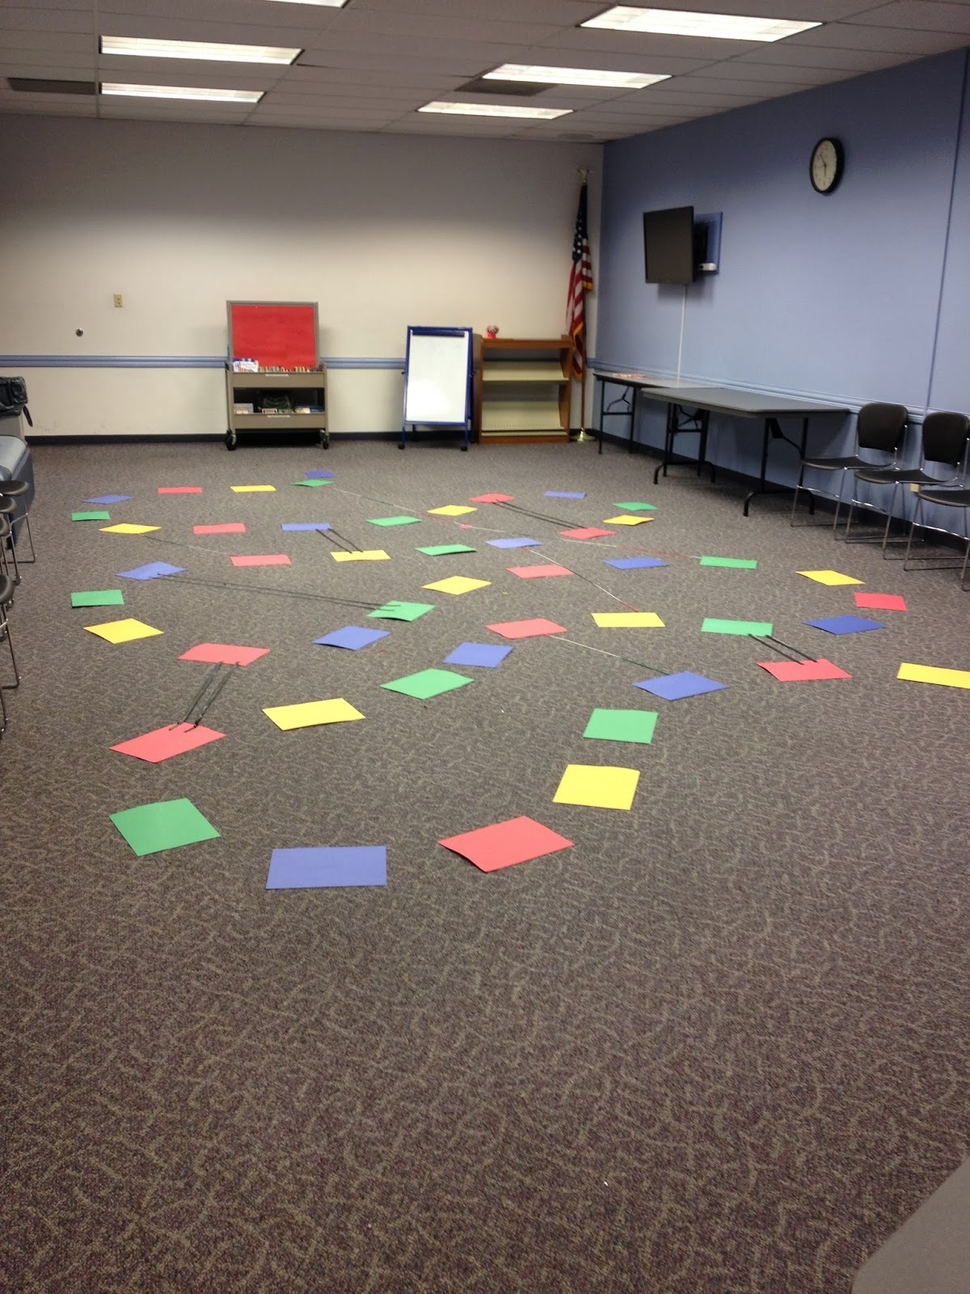
Math Programs
Don’t call it a “math program”
Find the math in games
    Puzzles!
    Board games!
Spatial thinking
    Origami
    Simple weaving

Slide 24
POLL
Can you think of one of your existing school-age craft programs that you could turn into a STEAM program?
Please type your answers into the Chat Box.

Slide 25
STEAM Services

Slide 26
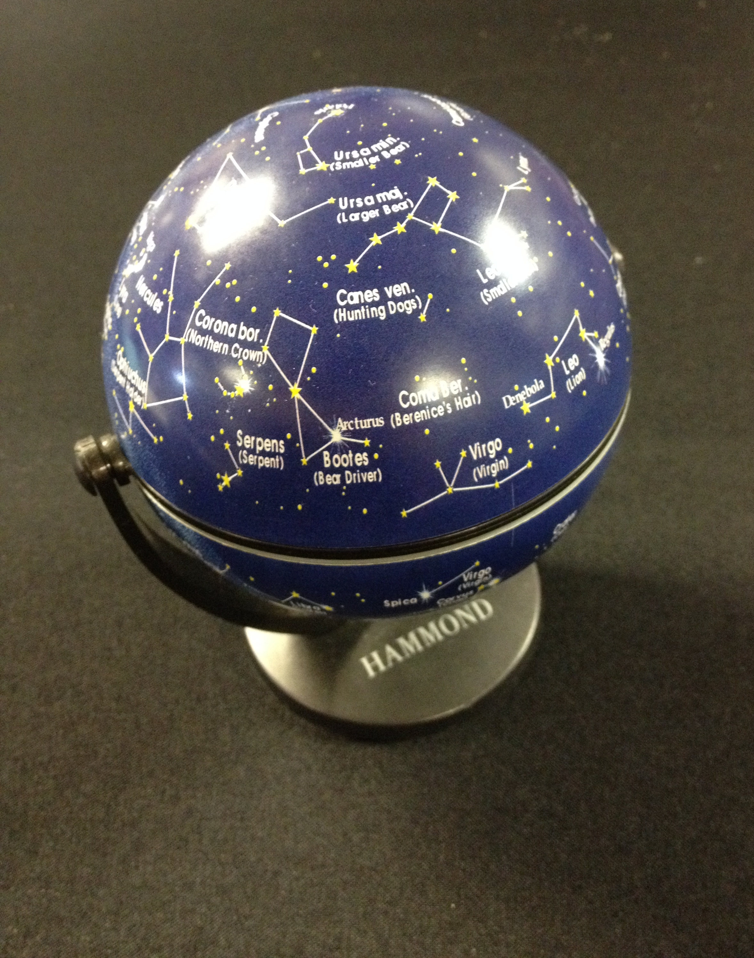
Displays
Make them attention-grabbing!
Fiction and non-fiction
Range of reading levels
Visual interest
Realia

Slide 27
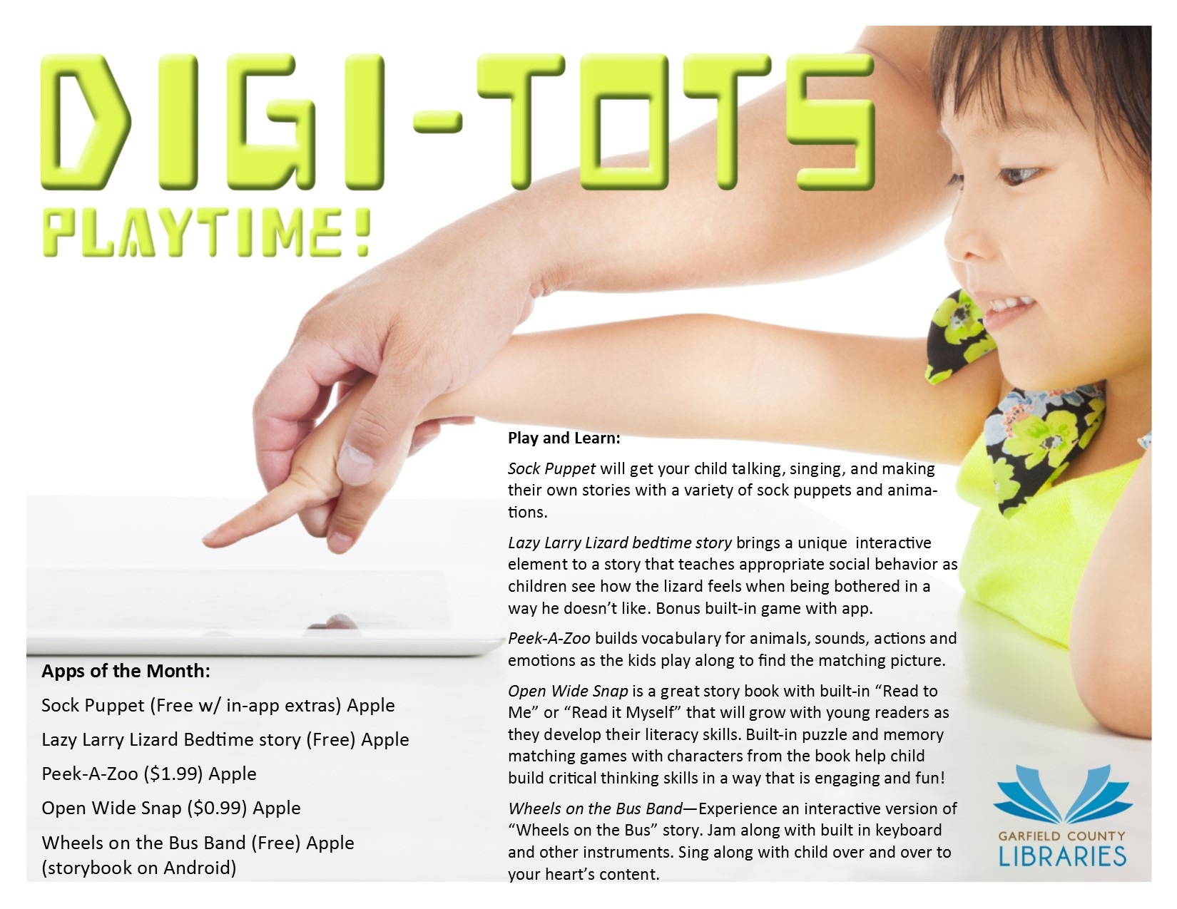
Databases & Apps
Highlight what you’ve got!
Shelf talkers
Tablet time
Handouts
Demo in programs
photo from Digi-tots Playtime, by Stephen Tafoya

Slide 28
STEAM Readers’ Advisory
Things to keep in mind:
Non-fiction isn’t just for homework
Different ways of reading
Stories with STEAM themes
Pairing materials

Slide 29
POLL
Do you venture into the non-fiction stacks when doing readers’ advisory with children?
Please type your answers into the Chat Box.

Slide 30
What you need,
and where to find it.

Slide 31
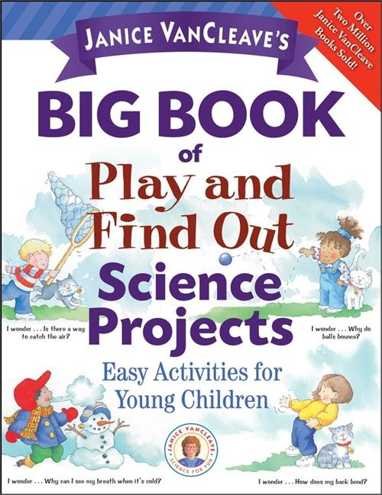
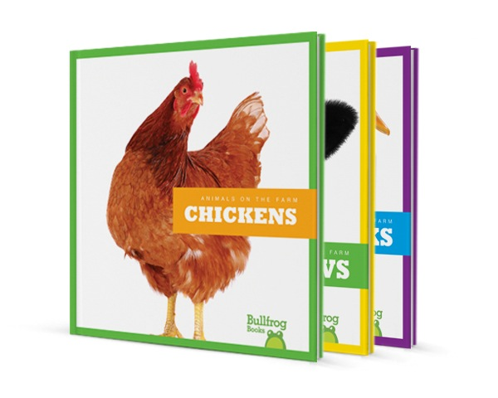
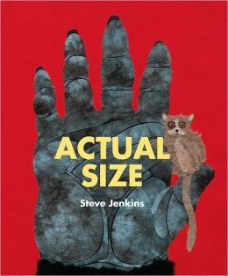
Resources: Books
Activity Ideas
  Janice Van Cleave
  Kids Can Press
Great Publishers
  Pebble Plus
  Jump! from Bullfrog Books
Authors/Illustrators
  Gail Gibbons
  Steve Jenkins

Slide 32
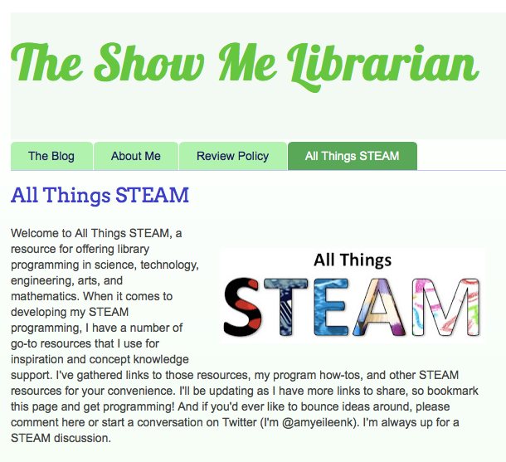
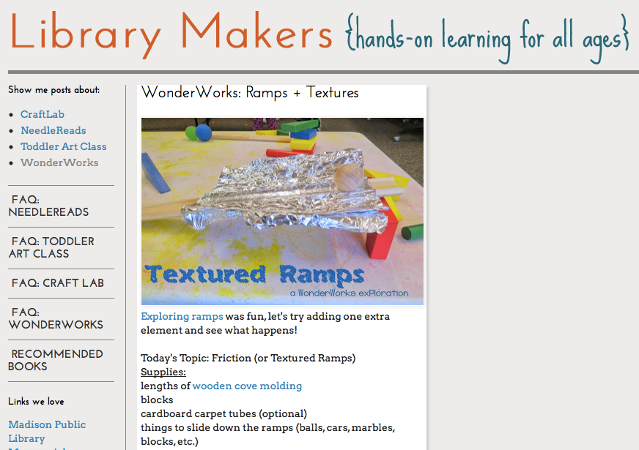
Resources: Blogs
Library Blogs
  The Show Me Librarian
  Library Makers
  Little eLit
  Abby the Librarian
Other Blogs
  Teach Preschool
  PreKinders

Slide 33
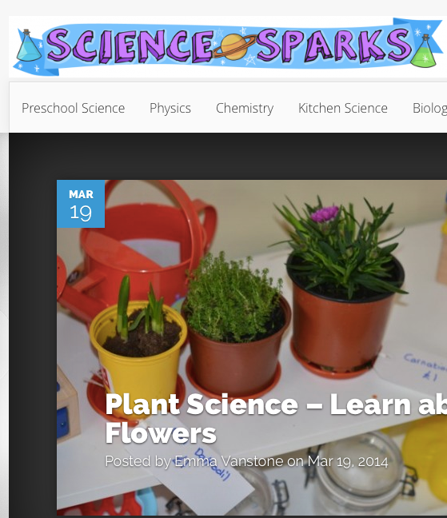
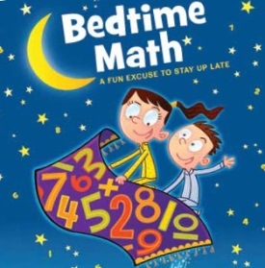
Resources: Websites
Science Sparks
Fun Science from National Geographic Kids
Bedtime Math
Mixing in Math
Wonderopolis
Pinterest (lots of STEAM boards!)

Slide 34
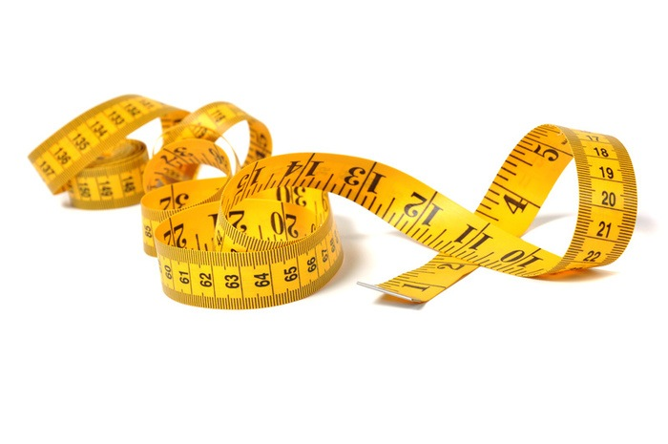
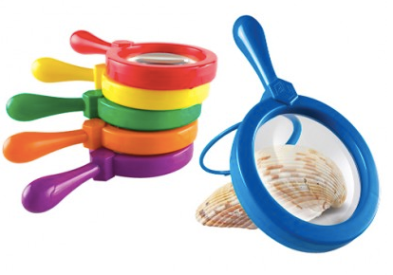
Supplies to Start
Consider your STEAM service goals
Gather recyclables
Procure the basics

Slide 35



Funding, Grants, & Partnerships
Budget
    No amount is too small
    Don’t be too modest
Grants
    LSTA Grants
    Friends of the Library
    Private Grants
Partnerships
    Local Businesses
    Local Schools

Slide 36
Wrapping Up
STEAM has a place in public library youth services
Existing programs can be modified with STEAM aspects
STEAM services means more than just programs
Lots of resources are available to help

Slide 37
Questions?
Amy Koester
@amyeileenk
amy.e.koester@gmail.com
http://showmelibrarian.blogspot.com

Slide 38
Infopeople webinars are supported in part by the U.S. Institute of Museum and Library Services under the provisions of the Library Services and Technology Act, administered in California by the State Librarian. This material is licensed under a Creative Commons 3.0 Share & Share-Alike license. Use of this material should credit the author and funding source.

