Slide 1
Innovative & engaging teen programs
Presented by dolly goyal and jack baur
Tuesday, May 13, 2014
12 noon

Slide 2

why do we need teen programming?
Notes:
Why are they important?
Who are teens in the library?
Why must we care?

Slide 3
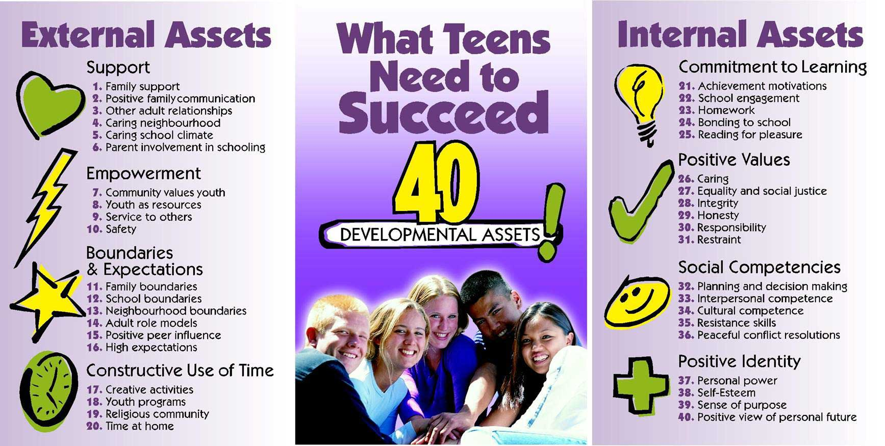
why do we need teen programming?
http://www.search-institute.org/content/40-developmental-assets-adolescents-ages-12-18
Notes:
Teens Need YOU!
http://www.teenlibrariantoolbox.com/2012/11/a-night-of-firsts.html
We provide:
Support as another positive adult role model.
Safety
Boundaries & set expectations (different from school)
An outlet for creativity
RESPECT!

Slide 4
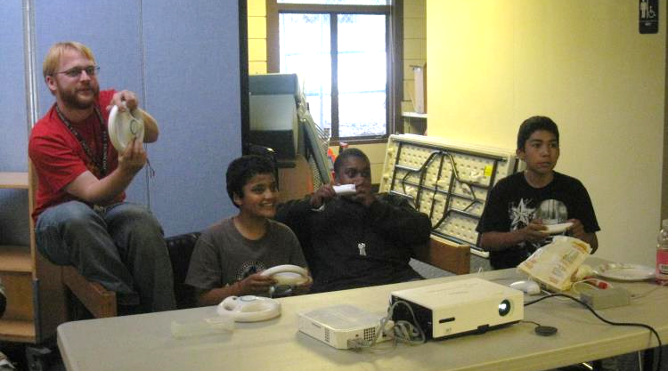
why do we need teen programming?
Notes:
Anecdote about teen gamers and how changed staff! - JB

Slide 5
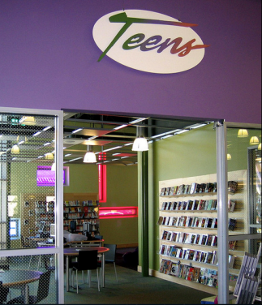
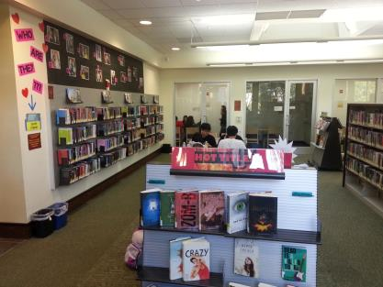
Teens & teen spaces
San Mateo County Library - Belmont
San Jose Public Library – Alum Rock
http://www.ala.org/yalsa/guidelines/teenspaces
Notes:
Why is it important that we have a space carved out for them? – Jack’s story about his space
How do we create a “space” when there isn’t any?

Slide 6
Establishing a Teen Audience

Slide 7

Find out what they’re into!

Slide 8
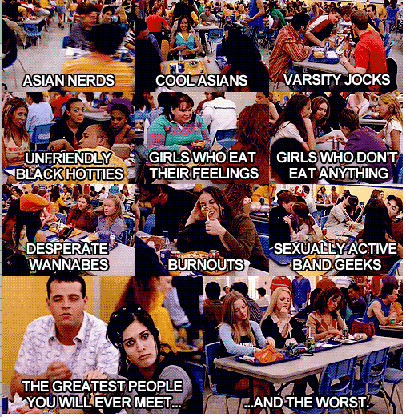
Identifying teen groups

Slide 9
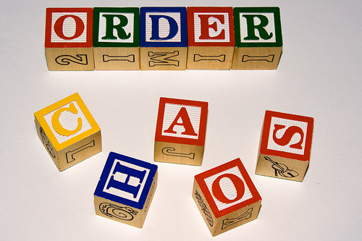
Managing “bad” teens
Notes:
Set expectations and balance those expectations. (Jack)

Slide 10
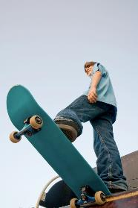
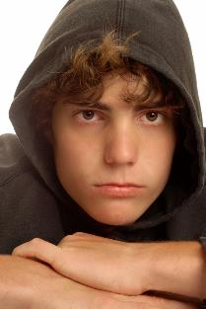
Managing “bad” teens
Make sure you are the one directly dealing with them and communicate what you’re doing with staff.
Talk to them. Use language that asks more of the “why” of what they’re doing.
Invite them to programs.
Make jokes.
Remember their names.

Slide 11
Engaging teens with fun programs

Slide 12
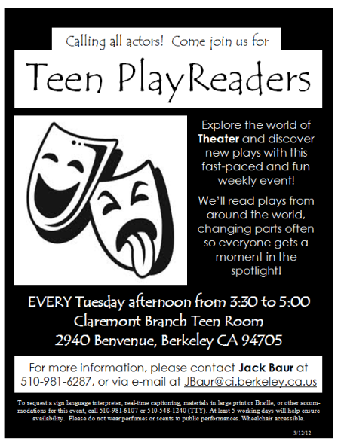
Play readers
Easy to run – just photocopy plays!
Easy to market – find the drama nerds!
Once you’ve got your group reading, see what other performance opportunities exist!

Slide 13

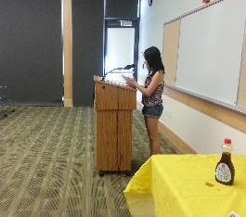
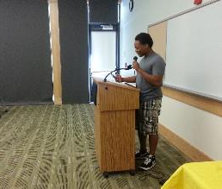
Pancake poetry
Read a poem, get a pancake!
E-mailed English teachers about event.
Teens could either help make pancakes or read poetry.
Turnout included teens who just wanted pancakes – what to do?

Slide 14
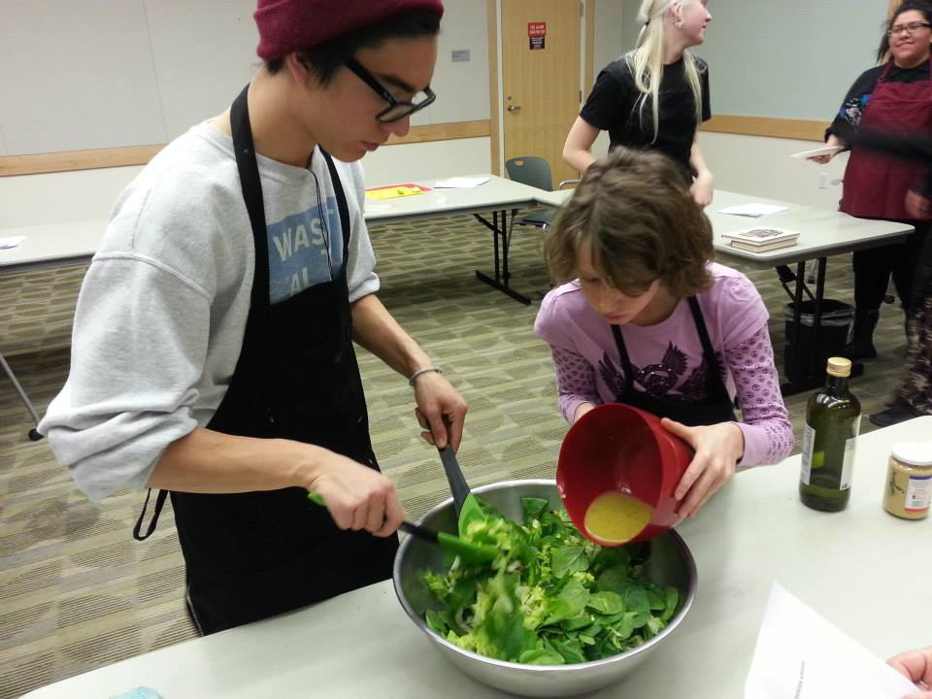
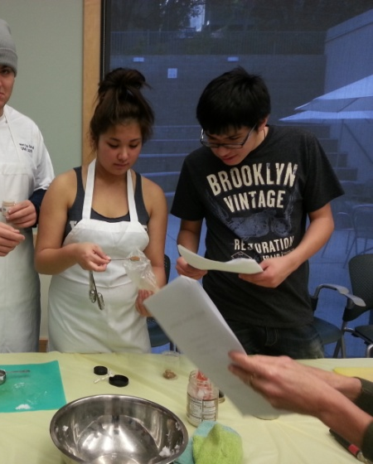
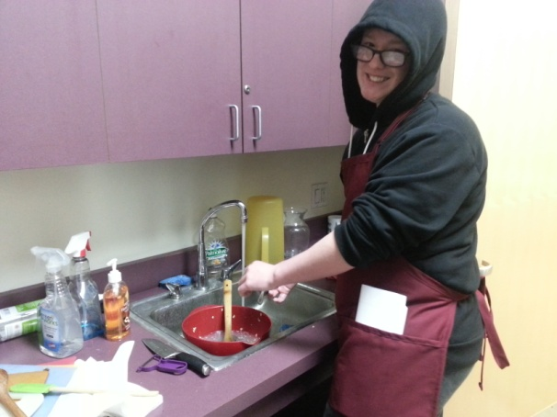
Cooking programs
Can be taught be outside cooking instructor or lead by YOU!
Food attracts teens. If teens didn’t cook, they had to clean.
Take pictures!
E-mailed English teachers, school librarians, counselors and PTA about events.

Slide 15
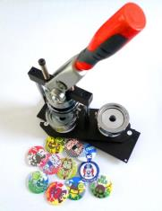
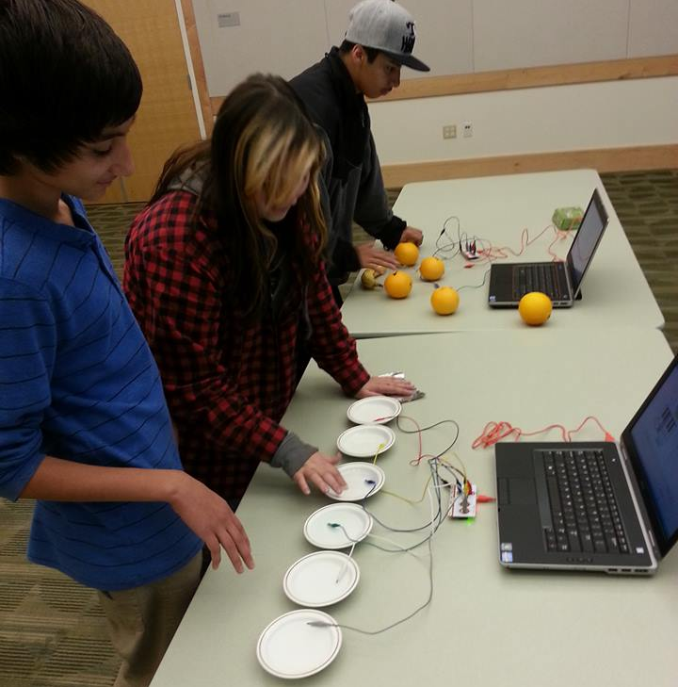
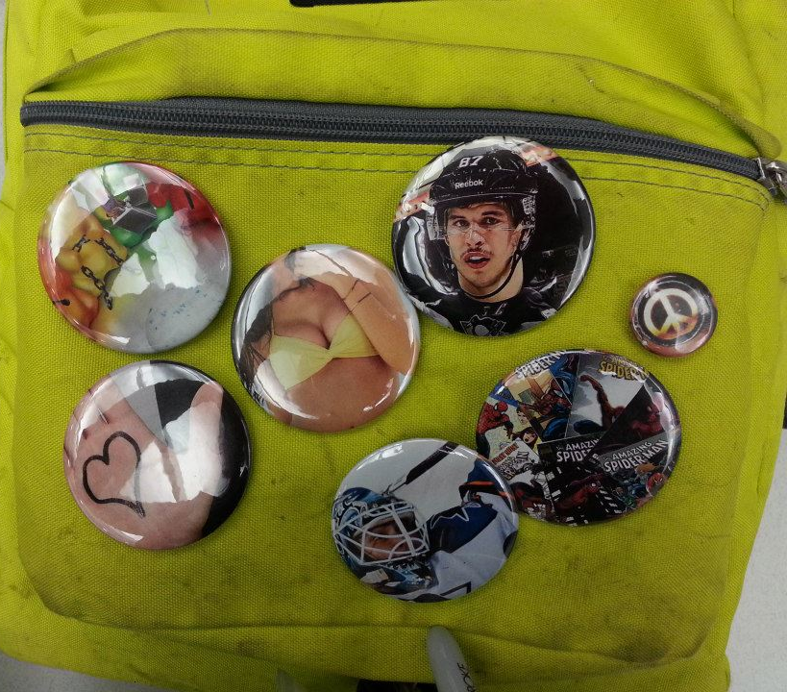
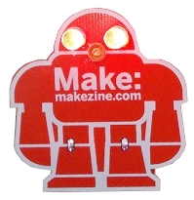
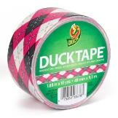
Teens creating
Notes:
(Programs where teens can make/create/design)
button making, duct tape, soldering – MAKE buttons empowering

Slide 16
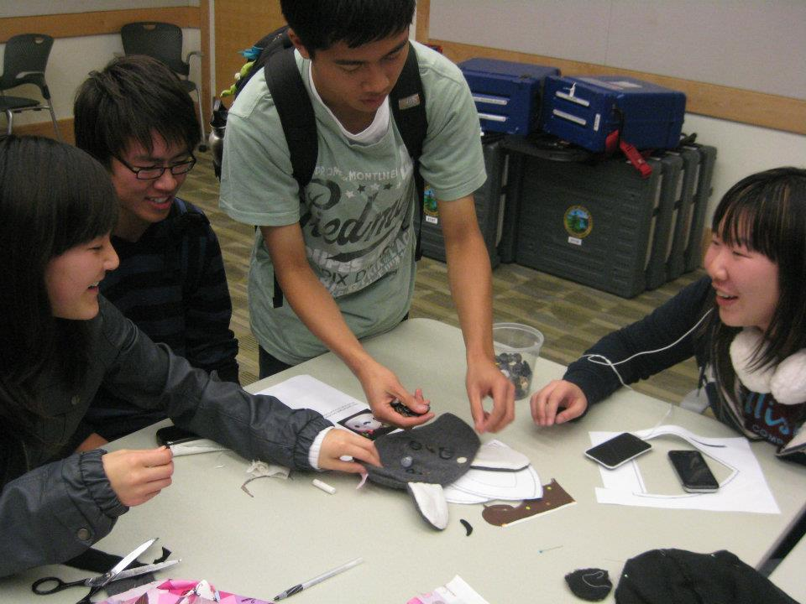
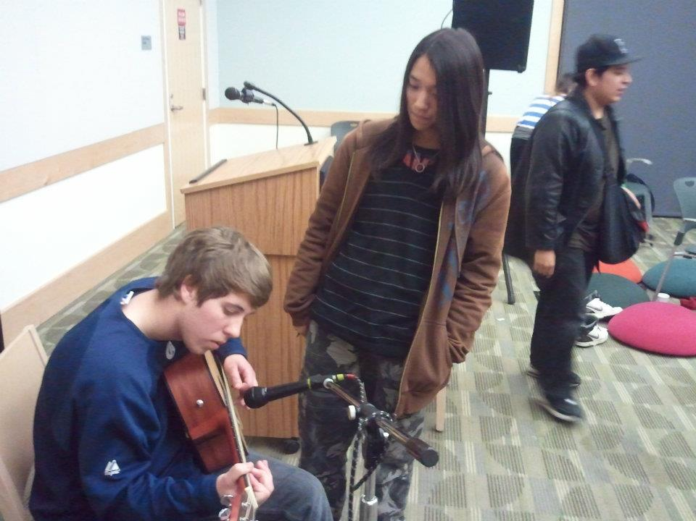
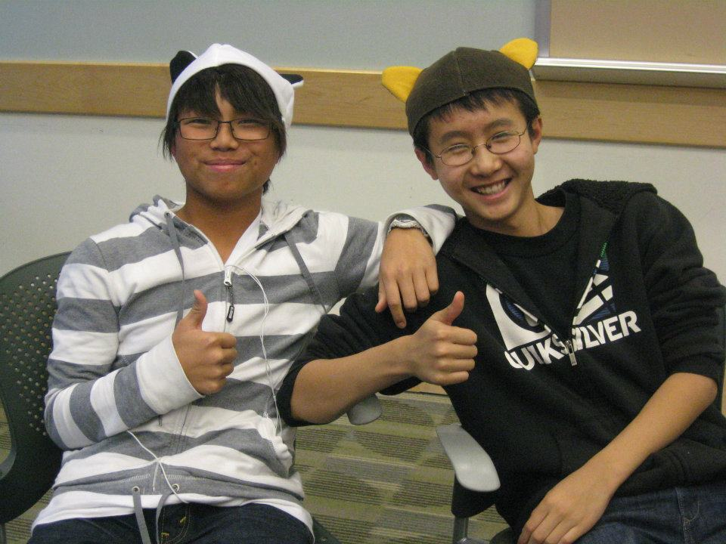
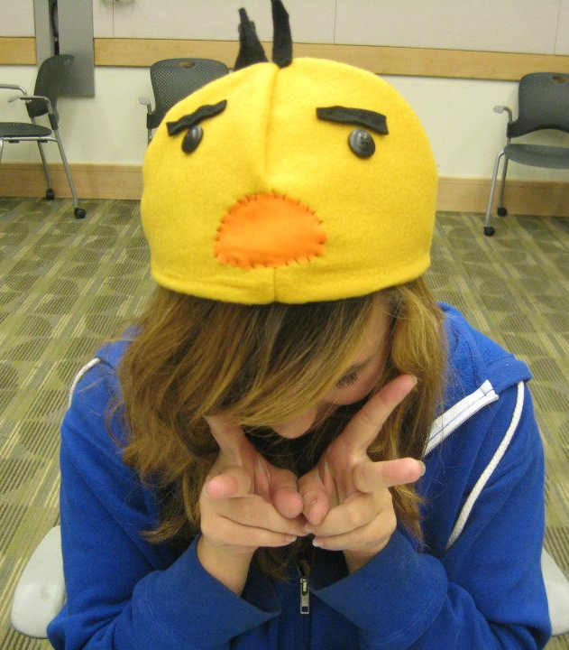
Teens teach teens
Notes:
Sewing, knitting, video games, needle-felting

Slide 17

Teens teach teens
Notes:
General principle: Motivate! (Jack separate slides)
Talk to teens about what they might want to learn, find kids who know something and think about ways to encourage them to share with friends

Slide 18
Promoting teen programs
Tips & tricks

Slide 19



Social media
Teens and their friends can see what’s going on without having to be there.
Convenient.
Makes it easy to communicate with groups such as your TAG, anime club, etc.
Great for feedback!
Notes:
Facebook/Tumblr/Twitter works wonders
Great way to promote events and allow teen’s friends to see events at the library.
Easy to maintain! Convenient for teens since they can check it from their phones
Not really a page about you.
A good way to get feedback on events and ideas for new ones.

Slide 20



Social media
Notes:
Facebook has been annoyingly and aggressively changing their policies about how they display content to your fans. If you don’t pay Facebook to promote your post, probably only 5% of your fans will see it. Basically, if you have a Facebook account and want to promote your library using it, expect to spend money on it. No free lunch any more…

Slide 21
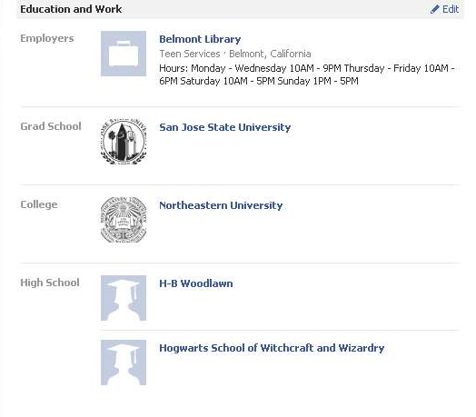
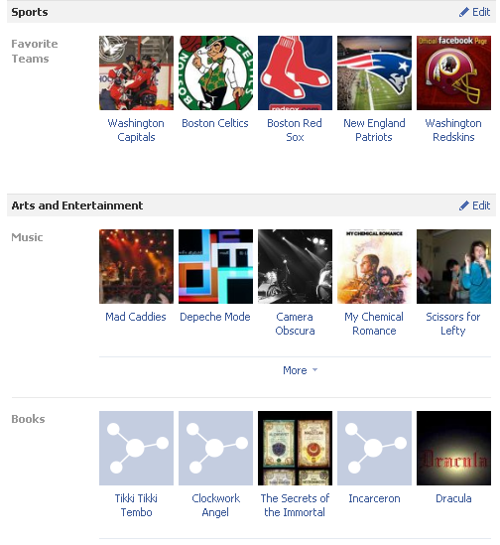
“dollythelibrarian”
Notes:
Have a laptop available at a programs.
Lost & Found items
Create business-like Facebook cards.
Hand them out in person.
Leave them by computers during peak teen user hours.

Slide 22
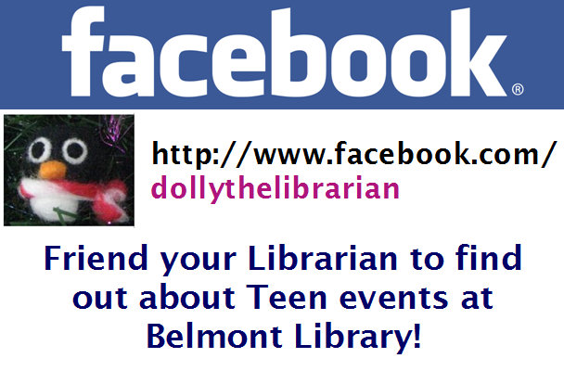
Notes:
When creating events, keep the event private, but enable guests to invite their own friends.
When asking someone to be friends, be upfront.
Purpose of the page
You will eventually get your own “friend requests.” ☺

Slide 23
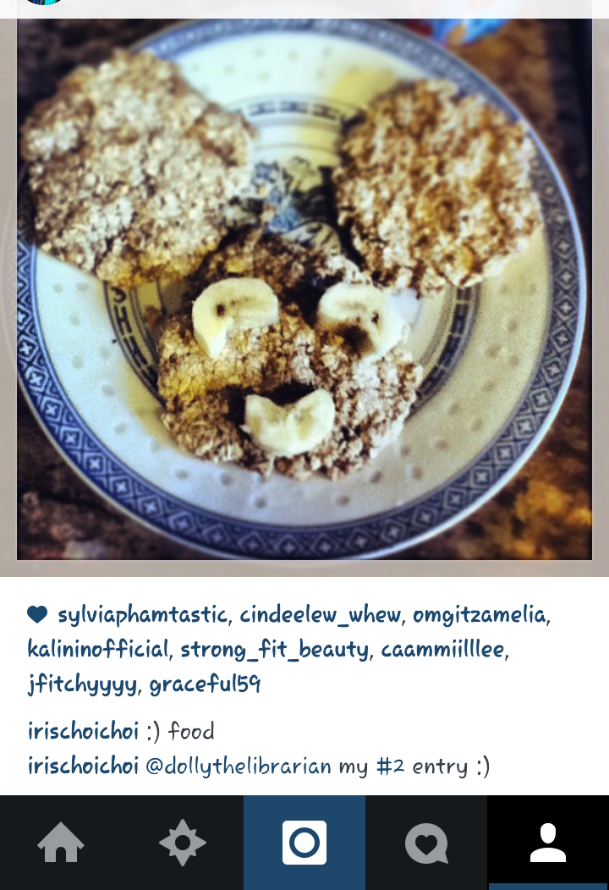
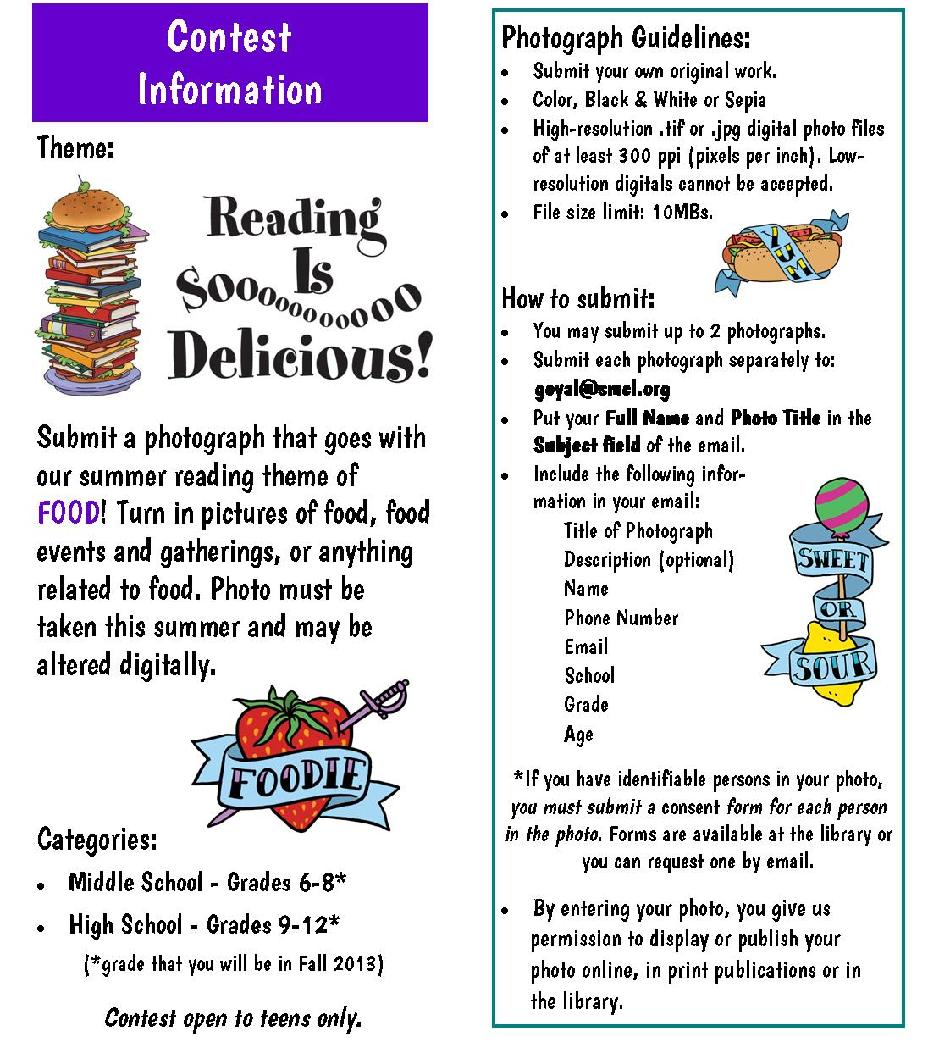
Contests!
Notes:
Instagram - DG

Slide 24
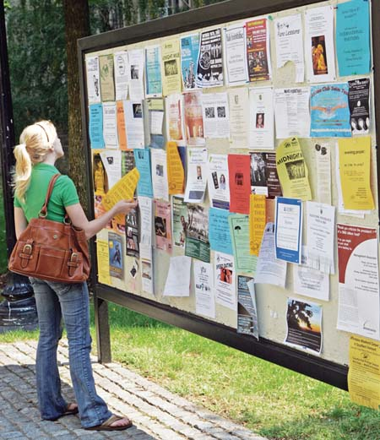
Traditional ways that work!
Flyers!
Work with Parks & Recreation.
E-mail teachers or school librarians.
Create a Teen Advisory Group (TAG).
Talk to teens in person!
Notes:
Flyers:
Appeal to teens
Post flyers in local stores where teens or parents may frequent.
Work with Parks & Recreation.
E-mail teachers or school librarians
Create a Teen Advisory Group (TAG).
Promote within school
Talk to teens in person.
Include smaller takeaway versions

Slide 25

Beware of clipart!
Notes:
Jack - Flyers should not be Word doc with clipart and here’s why – U-G-L-Y (you ain’t got no alibi!) No flyer is better than an ugly flyer! Never Comic Sans!

Slide 26

Get teens involved!
Notes:
Talk to and work with your teens about designing flyers. - JB
Open Mic Night before and after images – DG

Slide 27

Questions?

Slide 28
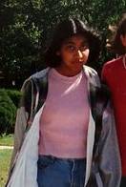
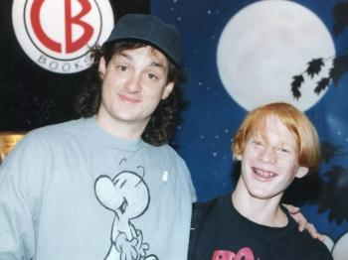
Thank you!
Dolly Goyal
San Mateo County Library
goyal@smcl.org
Jack Baur
Berkeley Public Library
jbaur@ci.berkeley.ca.us
1993
1995

Slide 29
Infopeople webinars are supported in part by the U.S. Institute of Museum and Library Services under the provisions of the Library Services and Technology Act, administered in California by the State Librarian. This material is licensed under a Creative Commons 3.0 Share & Share-Alike license. Use of this material should credit the author and funding source.

