Slide 1


Using Twitter for Professional Development
An Infopeople Webinar
Wednesday, 14 May 2014
Noon – 1 PM
Francisca Goldsmith, Presenter

Slide 2
Agenda
Setting up your professional development Twitter account
Twitter best practices
Curating your professional Twitter environment
Guiding others
Participating responsibly
Comments, questions

Slide 3

Repeat an opinion you’ve heard about Twitter with which you agree.

Slide 4
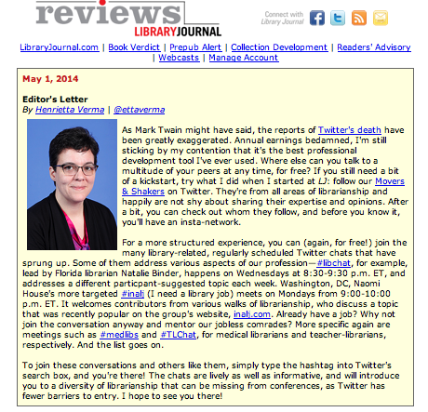

Slide 5
Tenet VIII.
We strive for excellence in the profession by maintaining and enhancing our own knowledge and skills, by encouraging the professional development of coworkers, and by fostering the aspirations of potential members of the profession.
--Code of Ethics of the American Library Association

Slide 6


Getting Started:
FAQs and the Basics
Colleagues and mentors
Community connections
Access to experts
Professional resources just hitting publication
Targeted events

Slide 7
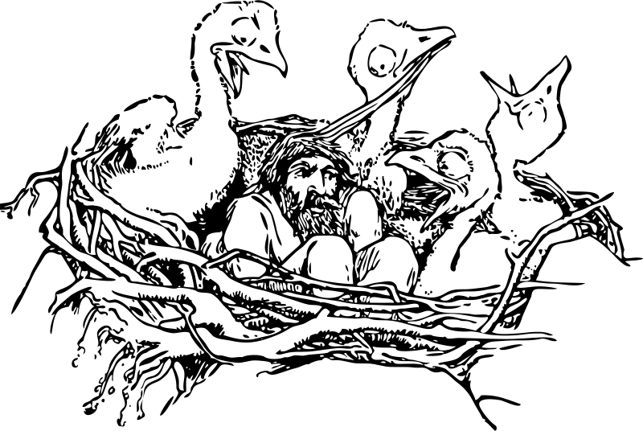
You can’t break it!
Of course, it’s a good idea to learn and
use best practices….
Notes:
Tweeting and retweeting
Replying and posting content from others
Hashtagging
Social conventions, such as Follow Fridays

Slide 8
Conventions support best use
Learn about @, .@, and related direct identification
Give credit where credit is due
Take a moment to find and use hashtags that aid discoverability
Make allowances for retweeting by limiting original message to 120 characters
Remember you are in a public place and behave accordingly

Slide 9

Get your ducks in a row…
Recognize what you need
Discover who tweets that
Budget your Twitter time
Follow up
Follow up
Follow up

Slide 10
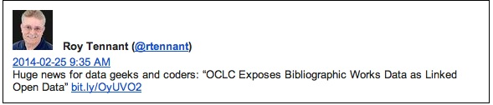
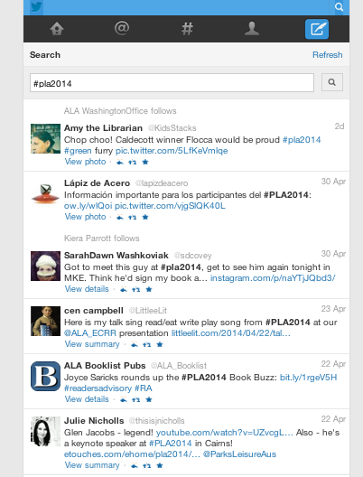
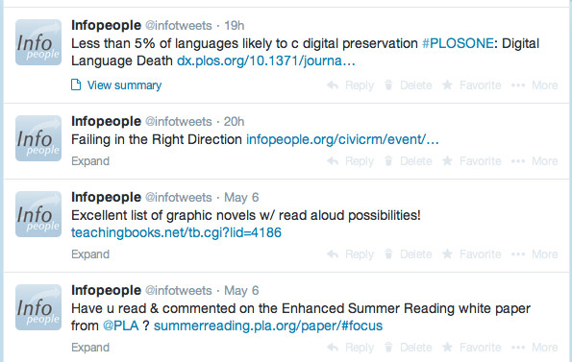
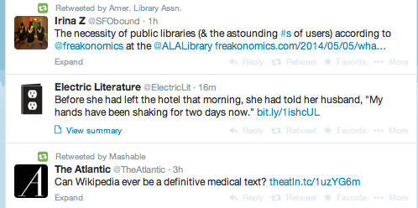

Slide 11
Good to know in general
@TechSoup
@FactTank
@oclc
@brainpicker
@mashable
@INFOdocket
@infotweets
@USGS
#policy
#libraries
#google
#NLM
#socialstrategy
#libresearch

Slide 12
Better to get specific
Your state library
Your local health and emergency services departments
ALA division aligning with your job portfolio
Library movers and shakers whose reputations you trust
International agencies pursuing the goals you share for your workplace
Notes:
@CAStateLibrary
@yalsa
@laurasolomon

Slide 13
Type into the text chat an example of a local organization or agency you think would be professionally helpful to follow on Twitter.

Slide 14
Poll 1

Slide 15
Balancing and Budgeting
Time
Travel costs
Diversified skill set needs
24/7
Global access and ubiquity
Moving from silos to open range

Slide 16
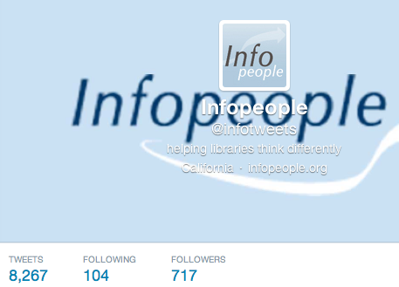
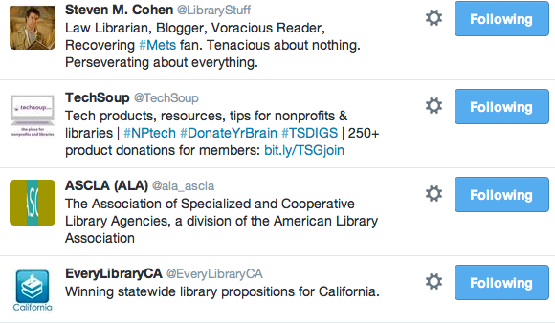
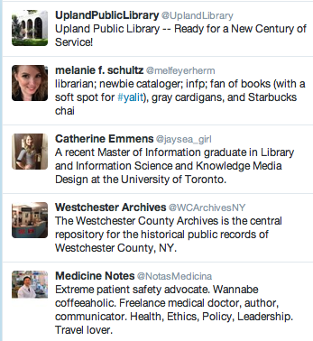
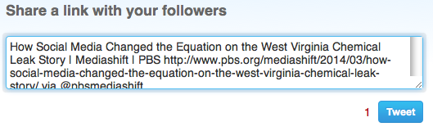

Slide 17
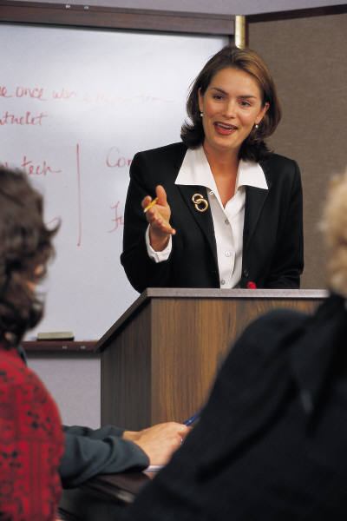
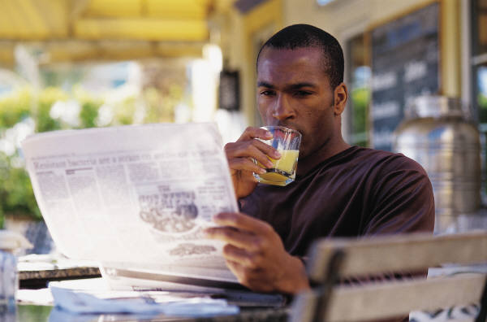
Twitter is communication
Be concise
Be specific and clear
Provide next step/place to go
Think when you read
Evaluate what you see
Use what you learn to learn more

Slide 18
Poll 2

Slide 19
Share your own Twitter handle, or that of a professional you recommend others here follow.

Slide 20
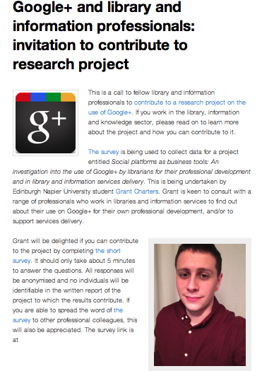
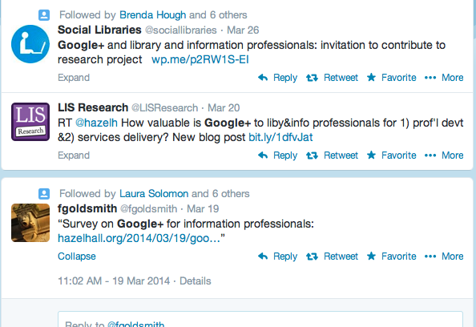
Spreading professional development through Twitter

Slide 21

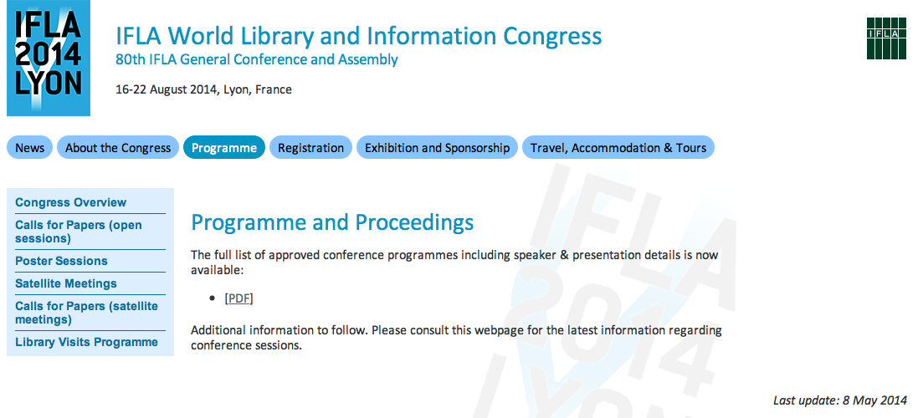

Slide 22
It’s your professional development
What do you need? Who are the experts? What’s your best learning style option?

Slide 23
Comments, Questions?

Slide 24
Infopeople webinars are supported in part by the U.S. Institute of Museum and Library Services under the provisions of the Library Services and Technology Act, administered in California by the State Librarian. This material is licensed under a Creative Commons 3.0 Share & Share-Alike license. Use of this material should credit the author and funding source.

