Slide 1
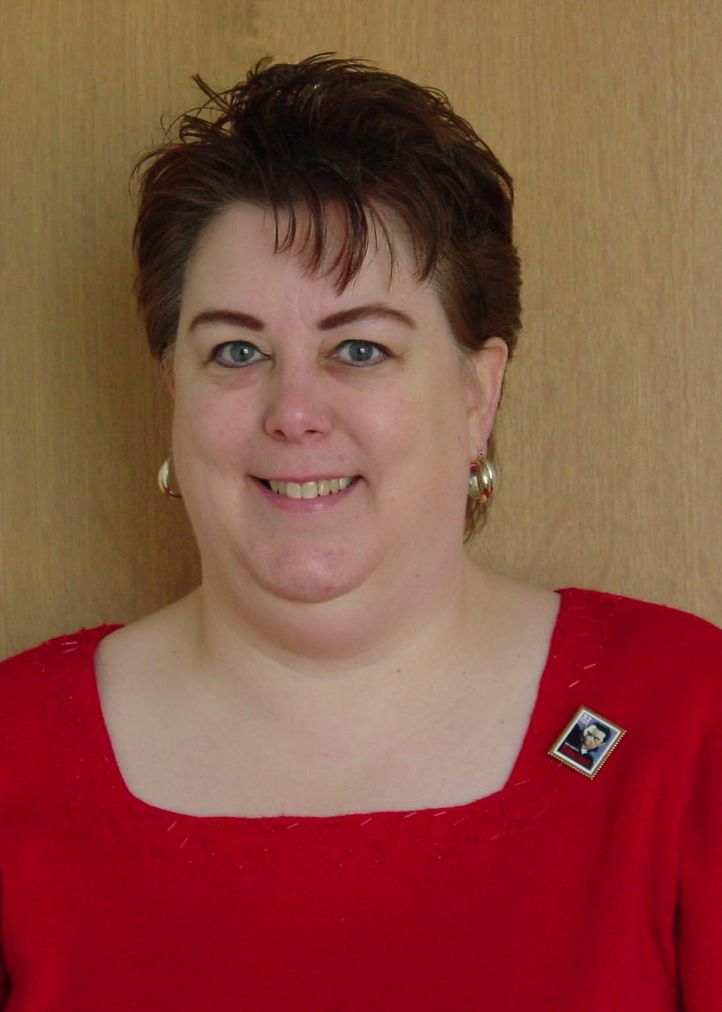
What’s New in Children’s Literature 2014
An Infopeople Webinar
Wednesday, May 21, 2014
12:00 noon to 1:00 p.m.
Presented by Penny Peck
PIKLY@AOL.COM
Infopeople webinars are supported by the U.S. Institute of Museum and Library Services under the provisions of the Library Services and Technology Act, administered in California by the State Librarian.

Slide 2
Agenda
New Board and Picture Books, and Easy Readers
New Transitional Fiction, Poetry, Graphic Novels, Pop Culture
Nonfiction and Common Core
Tween Genre Fiction
Multicultural Fiction
Useful Websites

Slide 3
Handouts
Books covered in the webinar
Short informational picture books for primary grades
Read-alikes for popular middle grade series
Short novels for children and tweens
Websites listing children’s books, including new books, awards, graphic novels, and read-alikes

Slide 4
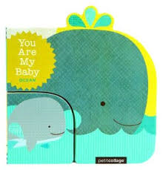
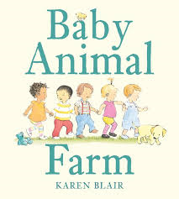
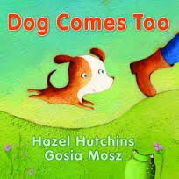
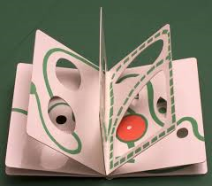
New Board Books

Slide 5
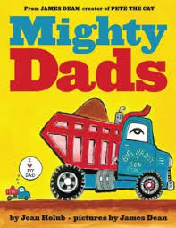
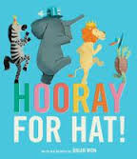
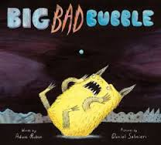
New Picture Books

Slide 6

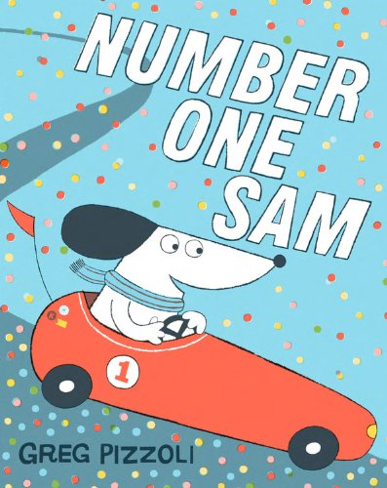
New Picture Books

Slide 7
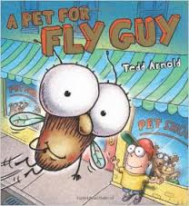
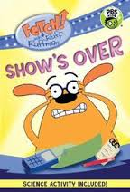
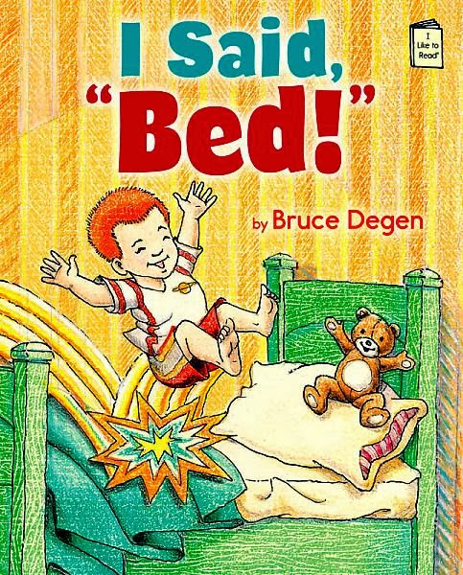
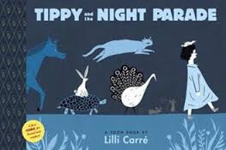
New Easy Readers

Slide 8
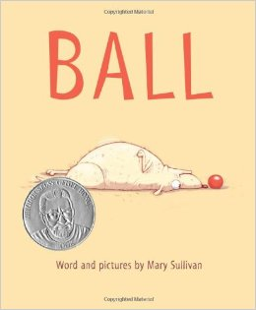
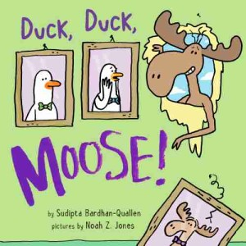
Very Easy to Read, One or Two Words

Slide 9
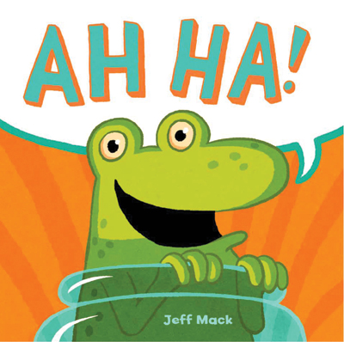
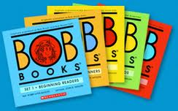
Other Suggestions for Very Easy Readers?

Slide 10
Transitional Fiction
Easy Chapter Books
Bridge or Moving Up Books
2nd and 3rd grades
Series fiction
Sometimes with ink drawings once or twice in each chapter

Slide 11
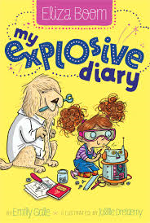
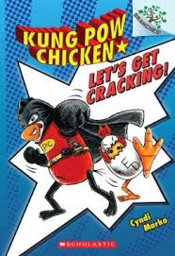
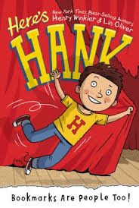
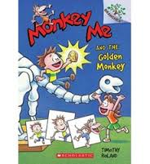
New Transitional Fiction

Slide 12
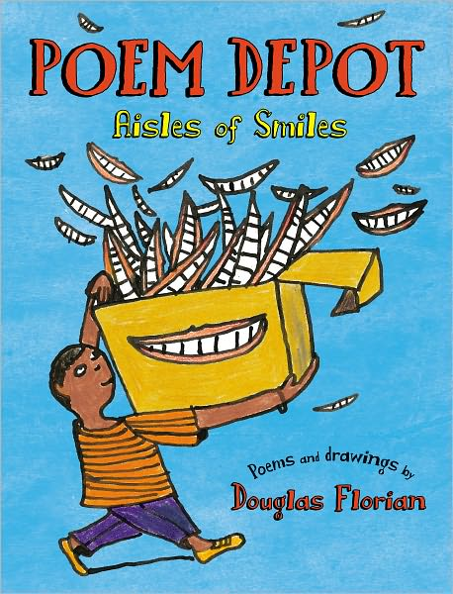
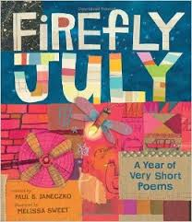
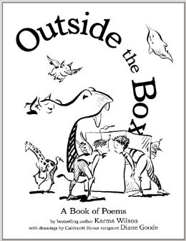
New Poetry for Children

Slide 13
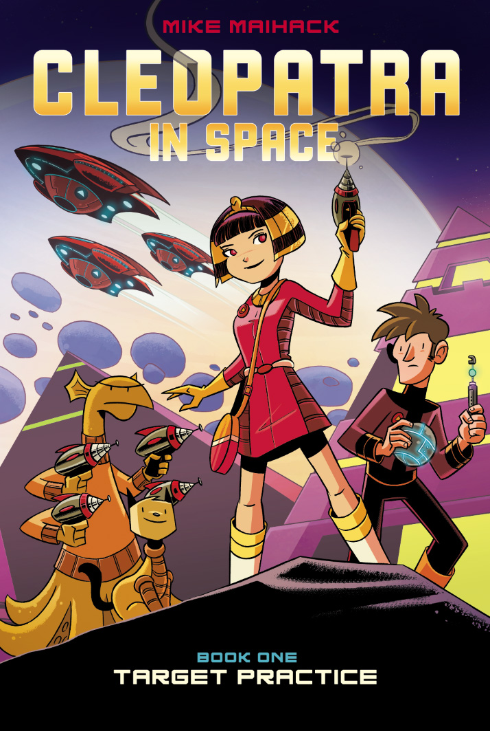
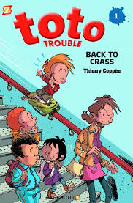
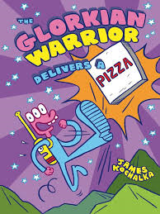
New Graphic Novels for Kids

Slide 14
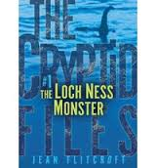
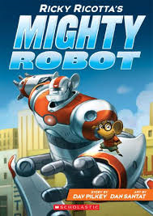
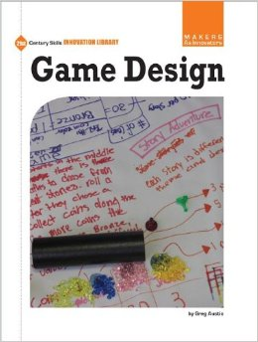
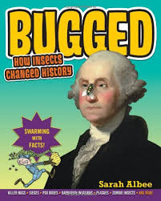
Pop Culture-related Books

Slide 15
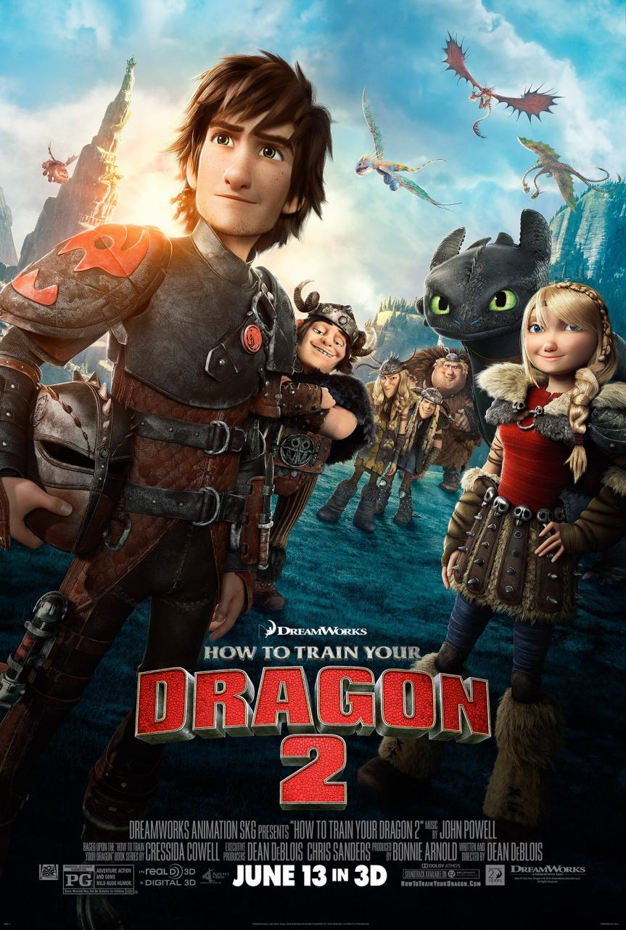
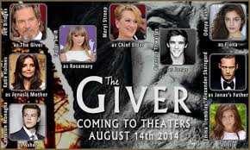
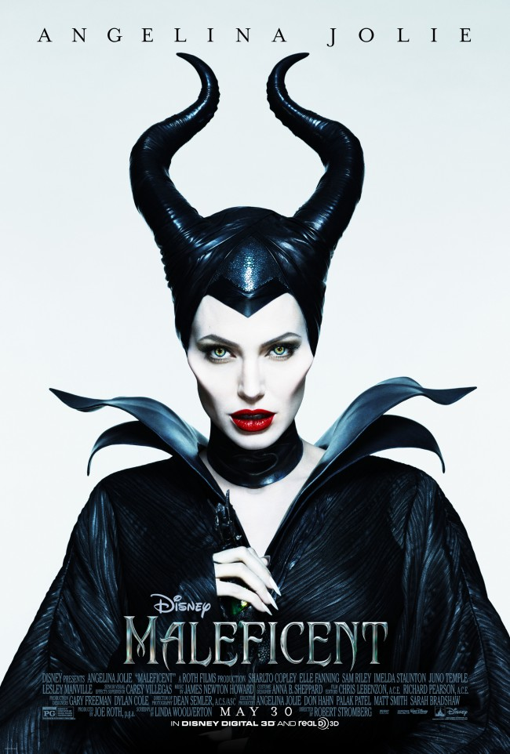
Movies Based on Books

Slide 16
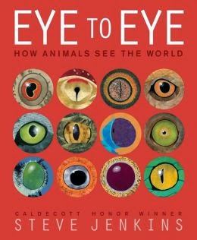
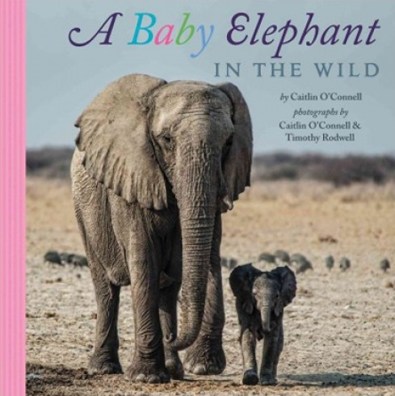
New Nonfiction

Slide 17

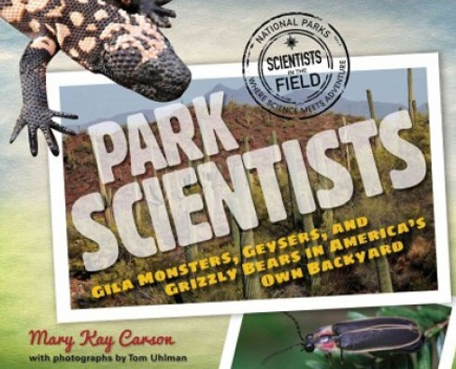
More New Nonfiction

Slide 18

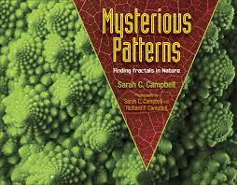
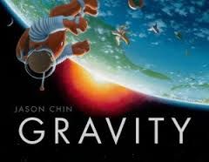
More New Nonfiction

Slide 19
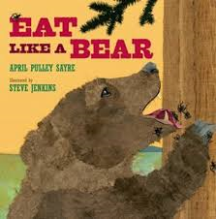
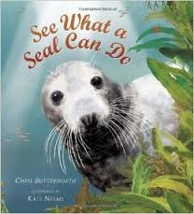
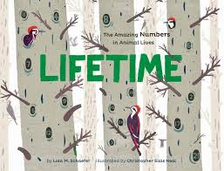
Informational Picture Books

Slide 20

Any favorites I missed you would like to mention?

Slide 21
Assisting Teachers with Common Core
www.corestandards.org
www.slj.com/category/standards/common-core
www.readcommoncore.com
Other suggestions?

Slide 22
Tween Genre Fiction
Genres include:
Fantasy
Historical Fiction
Sports novel
Humorous novel
Science Fiction
Mystery
Adventure
For grades 4 – 8
Ages 9-12
Independent, confident readers

Slide 23
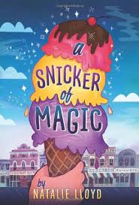
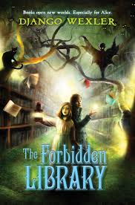
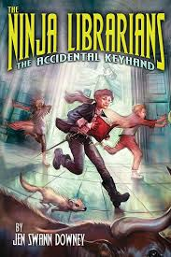
Fantasy

Slide 24
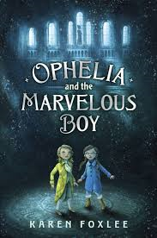
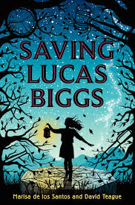
More Fantasy

Slide 25
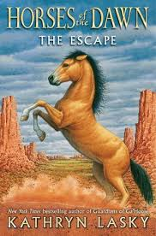
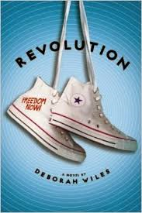
Historical Fiction

Slide 26

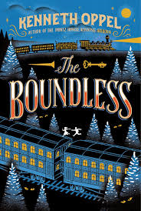
More Historical Fiction

Slide 27


Humor

Slide 28



Adventure

Slide 29



Sports

Slide 30


Mystery

Slide 31


More Tween Mysteries

Slide 32



Science Fiction

Slide 33



Realistic/Contemporary

Slide 34



Short Novels with Tween Appeal

Slide 35


More Short Tween Novels

Slide 36
Any new favorites I missed?

Slide 37




Multicultural Books for Younger Children

Slide 38



Multicultural Books for Older Children

Slide 39



More Multicultural Tween Novels

Slide 40
Websites on Multicultural Children’s Books
ALA White Paper
Entertainment Weekly
Lee and Low Books
CCBC’s List of Multicultural Resources

Slide 41
Finding What’s New for Children
No Flying, No Tights for graphic novels
Best-seller’s lists: Publishers’ Weekly
ALA/ALSC Book Awards (Newbery, etc.)
Free webinars from Infopeople, and from Booklist magazine

Slide 42
Finding Read-Alikes
“What book did you read recently that you liked?” – then find something similar
A book in the same genre
A book by that author or from that series
Try the websites for Read-alikes listed on handout
Check out the handout with Read-alikes for Holly Black’s The Doll Bones, and the series “Five Kingdoms” by Brandon Mull

Slide 43
Read-alike Resources
ACL Bayviews Read-alikes
www.bayviews.org/readalikes.html
Novelist K-8 – a paid database
Children’s Series Books
www.mymcpl.org/books-movies-music/juvenile-series

Slide 44
Time for questions?

Slide 45

Thank You!
Penny Peck
Pikly@aol.com

Slide 46
Infopeople webinars are supported in part by the U.S. Institute of Museum and Library Services under the provisions of the Library Services and Technology Act, administered in California by the State Librarian. This material is licensed under a Creative Commons 3.0 Share & Share-Alike license. Use of this material should credit the author and funding source.

