Slide 1

What’s New in Young Adult Literature 2014
Michael Cart
Wednesday, June 11, 2014

Slide 2
Current Trends
Profusion of First Novels
William C. Morris Award
Renaissance of Realistic Fiction
Decline in Paranormal Fiction
Decline in Dystopian Fiction
Genre Bending
The New Adult
Lack of Multicultural Titles

Slide 3
Realistic Fiction

Slide 4




Slide 5




Slide 6




Slide 7




Slide 8




Slide 9
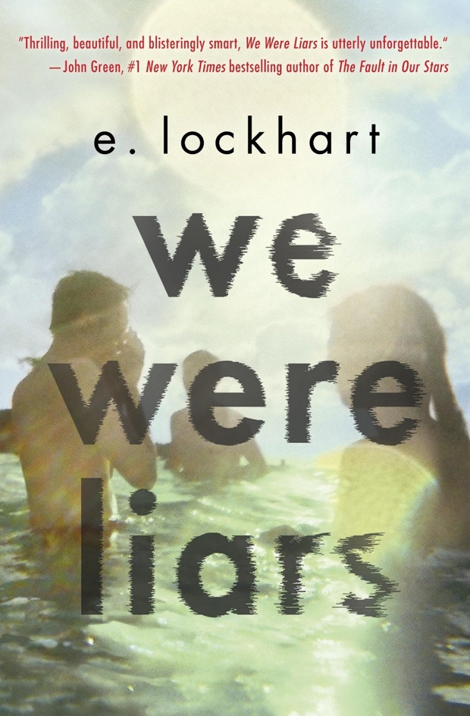



Slide 10



Slide 11



Slide 12
Genre Fiction

Slide 13




Slide 14




Slide 15




Slide 16




Slide 17




Slide 18


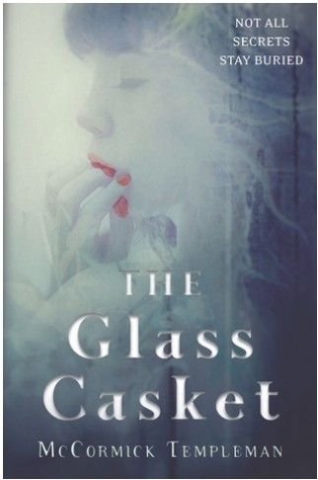

Slide 19



Slide 20



Slide 21
Nonfiction and Graphic Novels

Slide 22


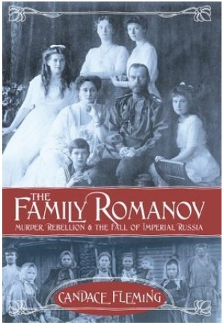
,
,.,.,,. |  | ,
.... ..
.'
S.U SA
N
^{I}.,

Slide 23


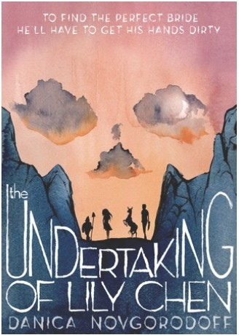

Slide 24
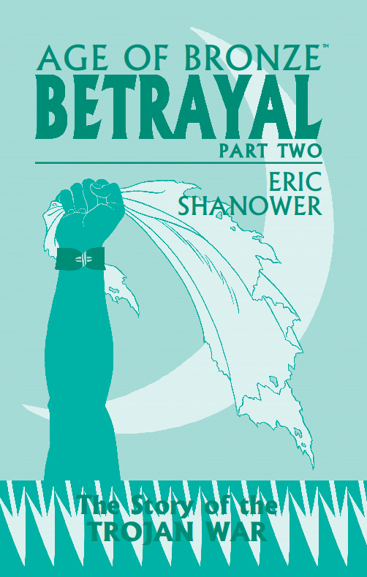
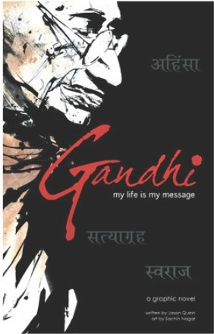


Slide 25
Adult Fiction

Slide 26


Slide 27
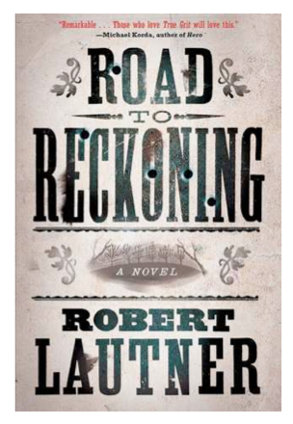
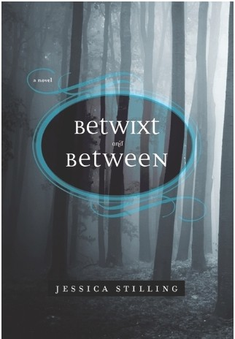

Slide 28
Want more from Michael?
Check out his twice-monthly podcasts
for Infopeople:
www.infoblog.infopeople.org/tag/podcasts/

Slide 29
Questions & Answers

Slide 30
THANK YOU

Slide 31
Infopeople webinars are supported in part by the U.S. Institute of Museum and Library Services under the provisions of the Library Services and Technology Act, administered in California by the State Librarian. This material is licensed under a Creative Commons 3.0 Share & Share-Alike license. Use of this material should credit the author and funding source.

