Slide 1
Creative Spaces and Family Engagement in Libraries
Bridget Alexander, Executive Director of Waking the Village

Slide 2
The Art Beast Manifesto

Slide 3
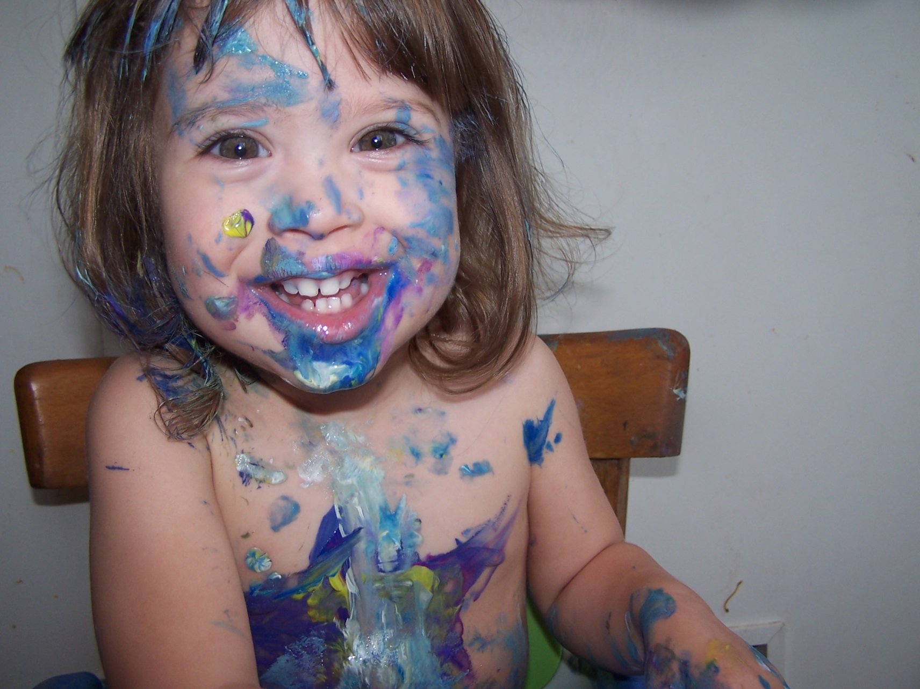
We believe discovering who you are is usually messy and loud.

Slide 4
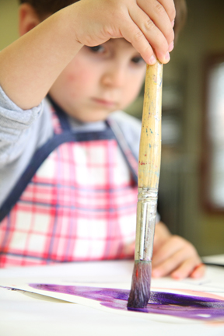
But quiet and methodical are just fine too.

Slide 5
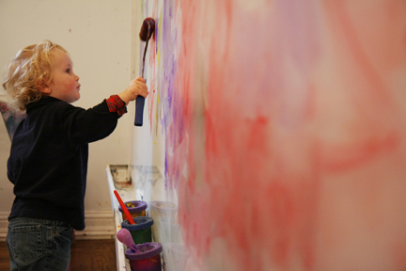
We believe that every child needs space and materials and the quieting of adult voices to make their own sense and define their own place in the world.

Slide 6
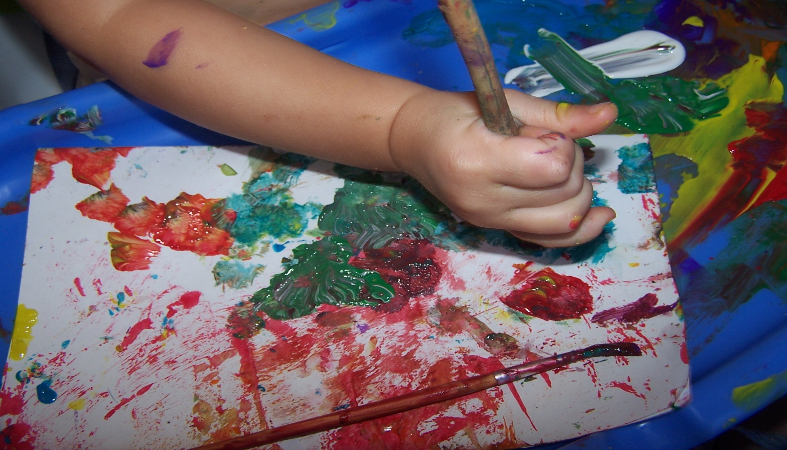
We believe that art can never come from precut circles and step by step directions.

Slide 7
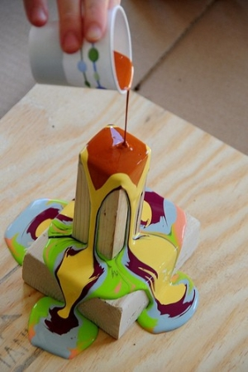
We believe that children need to make green and blue and orange art and not be bothered with learning all the names of every color.

Slide 8
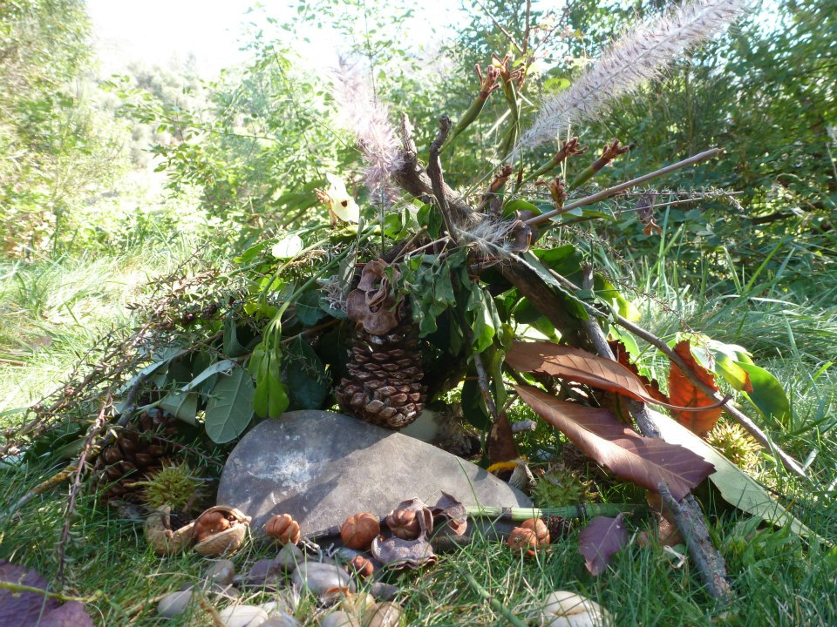
We believe children can create so much more than a painted handprint.

Slide 9
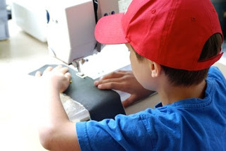
We believe that the best way to keep a child safe is to keep a close eye AND give them the world with all its tiny bits and sharp edges.

Slide 10
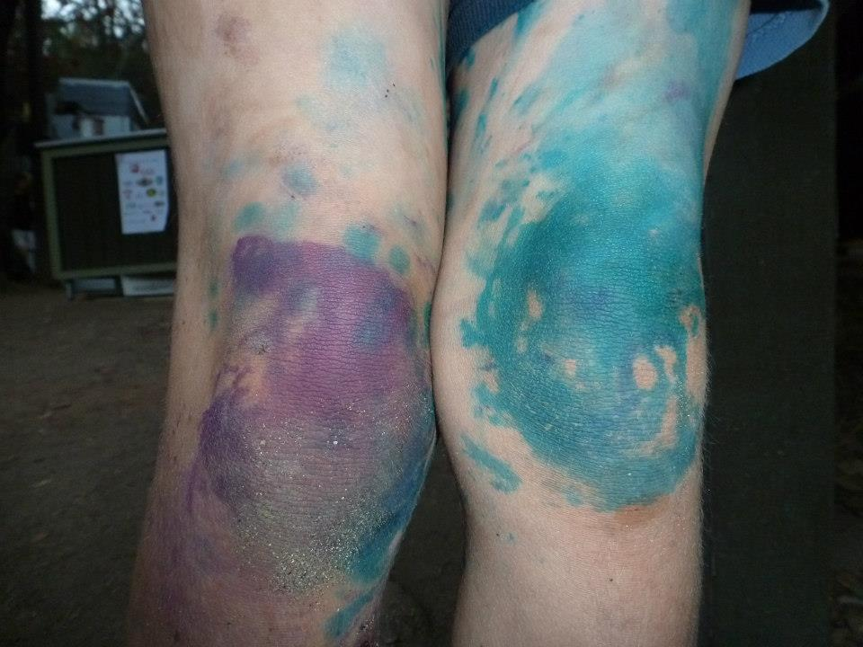
We believe children deserve space to explore every art before choosing one to master.

Slide 11
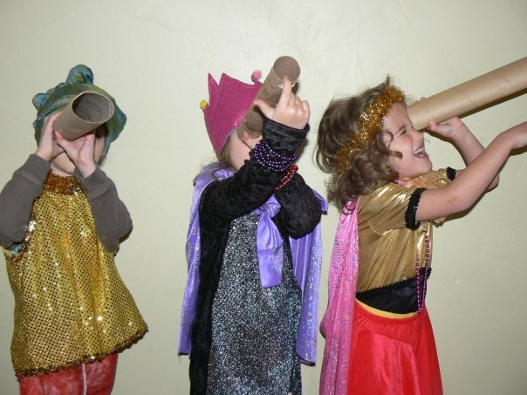
We believe that if you fill a child’s life with stories and opportunities to build and play and discovery, you will not be able to hold them back from reading and science and learning.

Slide 12
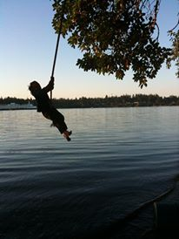
We believe children will take the risks they are ready for.

Slide 13
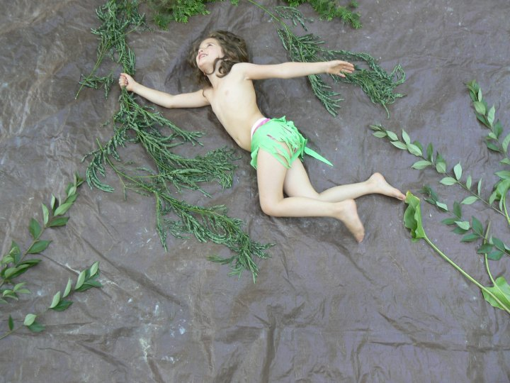
We believe the act of creating is more important than the art piece created.

Slide 14
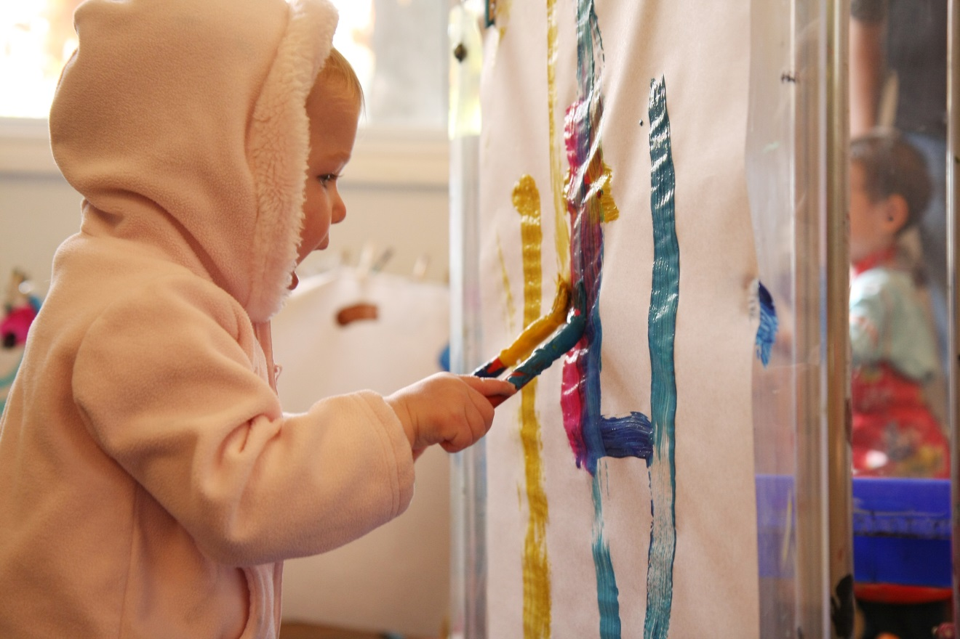
We believe children have an aesthetic.

Slide 15
We believe the look on a child’s face when they are concentrated on creation is sacred.

Slide 16
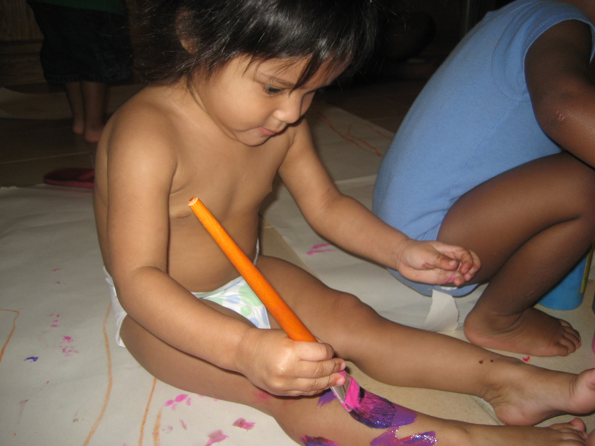

Slide 17
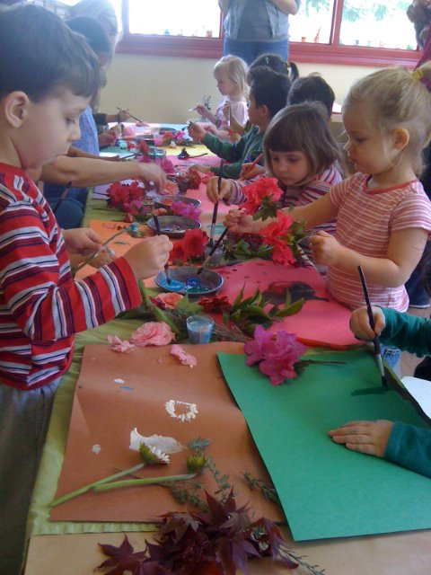

Slide 18
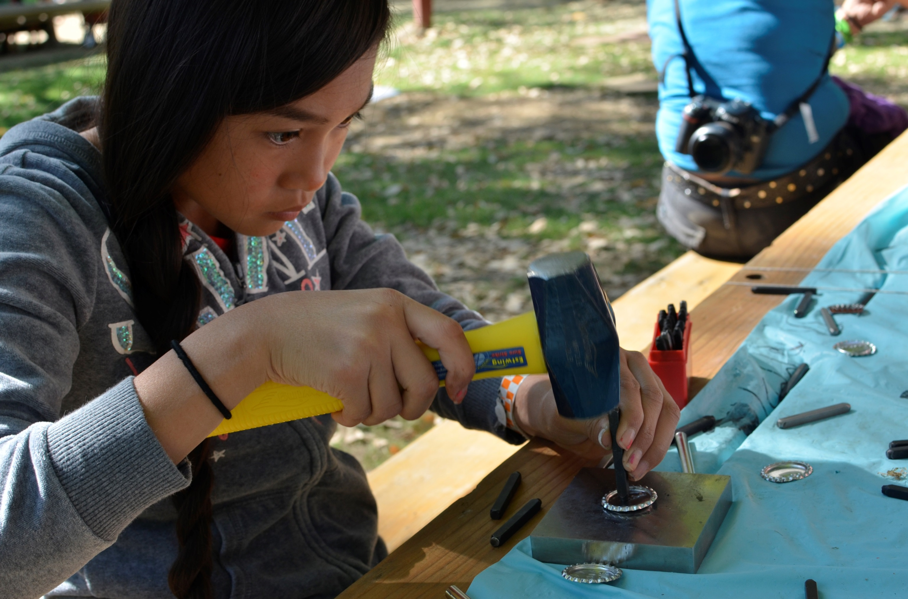

Slide 19
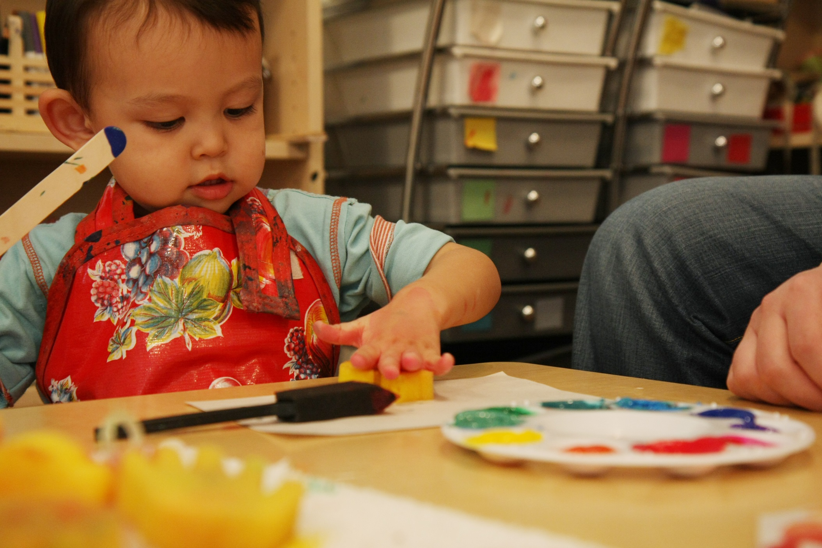

Slide 20
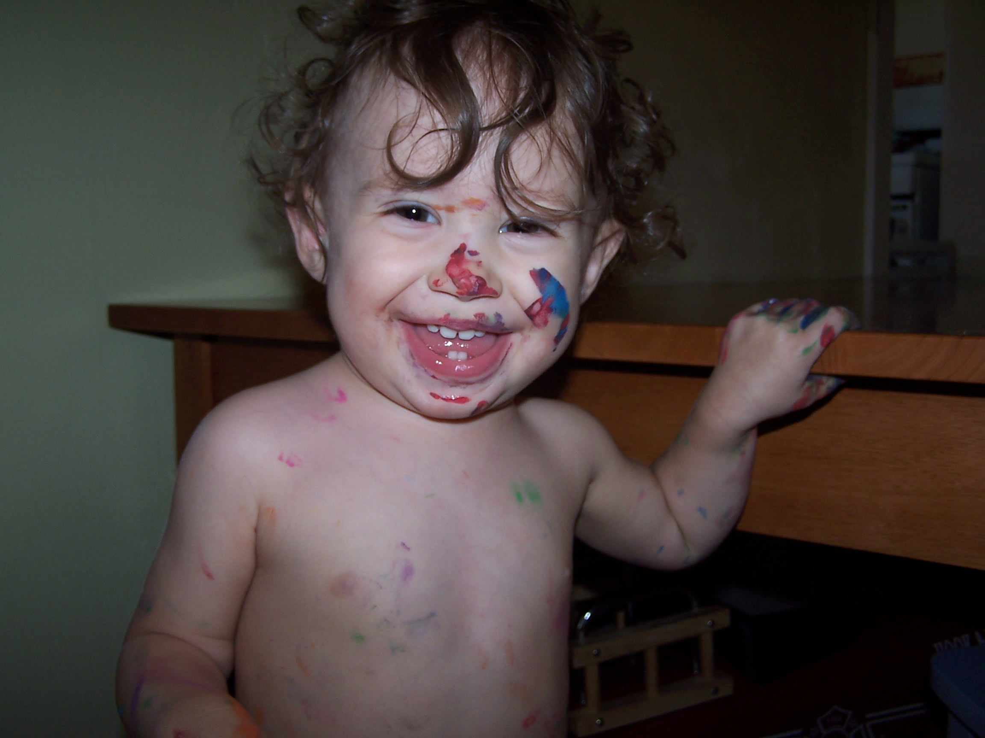

Slide 21
Poll: Challenges of Offering Arts Experiences in Libraries
The Challenges of Offering These Environments in a Library Setting
The Critical Importance of Doing So Anyway: As an institution,
library has the power to reinforce or challenge the notion
of what art and creativity can be.
Library also may be some families sole access point to the arts

Slide 22
It took me 4 years to paint like Raphael, but a life time to paint like a child. -Pablo Picasso

Slide 23
The arts are not just expressive and affective. They are deeply cognitive.
The arts develop essential thinking tools:
Pattern recognition and development
Mental representations of the observed/imagined
Symbolic and metaphorical representations
Abstraction from complexity
Cross wiring of brain areas

Slide 24
Arts integration improves learning
Studies consistently show :
Greater emotional investment in classes
Work more diligently and learn from each other
Parents become more involved
Teachers collaborate more
Increased cross curricular learning
Curriculum becomes more authentic, hands-on and project-based

Slide 25
Engagement with an art trains the brain to FOCUS, improving learning
Interest in an art form leads to sustained attention when practicing that art form.
Engaging in art involves resolving conflicts among competing possible responses.
The ability to resolve conflict among competing responses is also a crucial aspect of attention training.

Slide 26
Literature Contains These Same Elements
Stories Carry the Listener into a Highly Complex Cognitive Space
Arts are a Perfect Medium to Express a Response Provided We Offer Quality Arts Experiences (and not cookie cutter crafts)

Slide 27
USA is experiencing a creativity crisis.
We need:
Learning that crosses subjects
Learning that teaches us to pull information from varied brain regions to form new ideas
Opportunity to practice creative activities that teach us to recruit the brains’ creative networks quicker and better

Slide 28
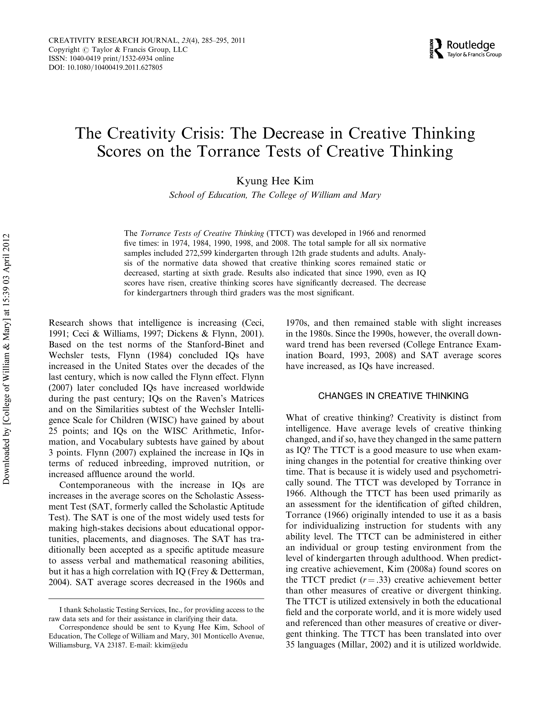

Slide 29
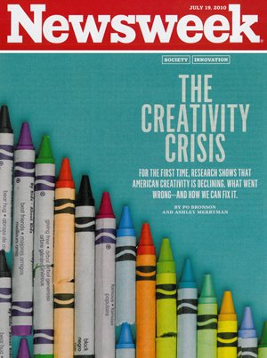
“Kyung Hee Kim at the College of William & Mary discovered this after analyzing almost 300,000 Torrance scores of children and adults. Kim found creativity scores had been steadily rising, just like IQ scores, until 1990. Since then, creativity scores have consistently inched downward. “It’s very clear, and the decrease is very significant,” Kim says. It is the scores of younger children in America—from kindergarten through sixth grade—for whom the decline is “most serious.”
The potential consequences are sweeping. The necessity of human ingenuity is undisputed. A recent IBM poll of 1,500 CEOs identified creativity as the No. 1 leadership competency of the future. “

Slide 30
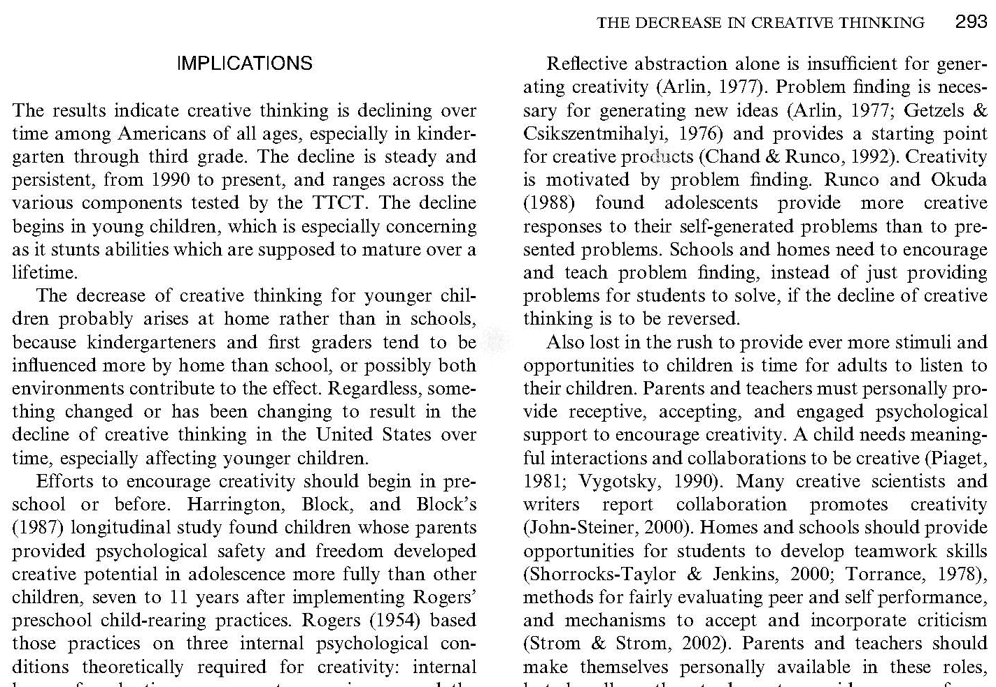

Slide 31
“Instructions for living a life. Pay attention. Be astonished. Tell about it.”
- Mary Oliver

Slide 32
Think of setting up an art experience in the same way you would think of setting up a science experiment.
Encourage tinkering.
Invite inventiveness.

Slide 33
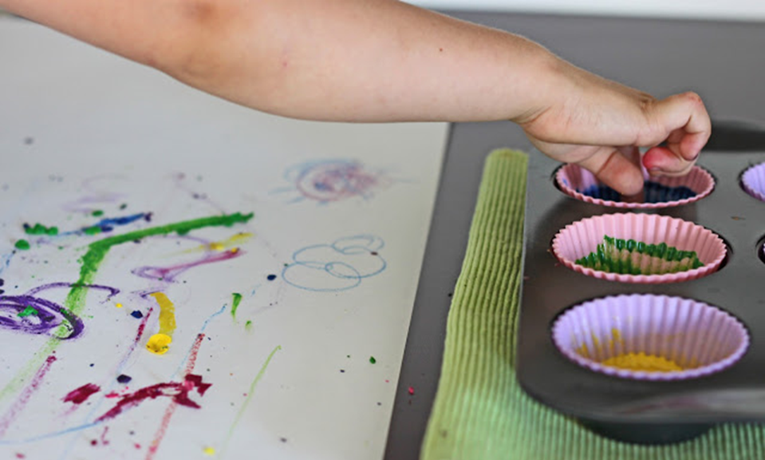
Use Familiar Mediums in a New Way: Melted Crayon Exploration

Slide 34
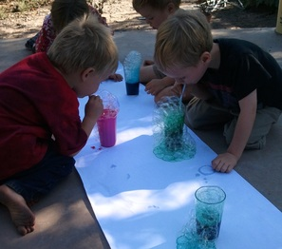
Spend lots of time in the space where science meets art- and resist the urge to explain everything!

Slide 35
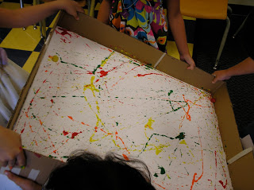
Introduce new ways of manipulating mediums.

Slide 36
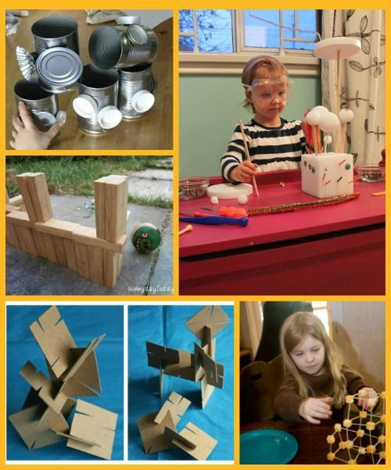
Embrace the broadest definition of art and creativity.

Slide 37
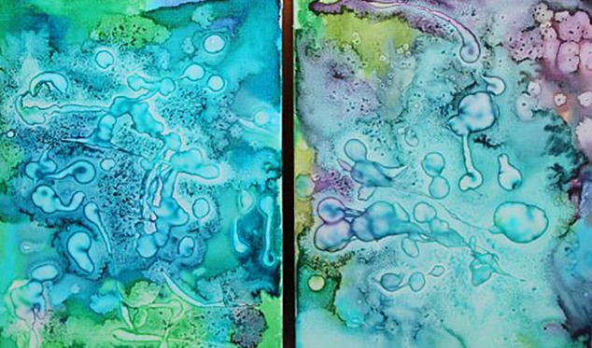
Embrace Abstraction: Watercolors with Lemon Juice

Slide 38
Present art constantly as a form of exploration and playfulness- not replication.
Oobleck and food dye bouncing on plastic wrap stretch over a speaker.

Slide 39
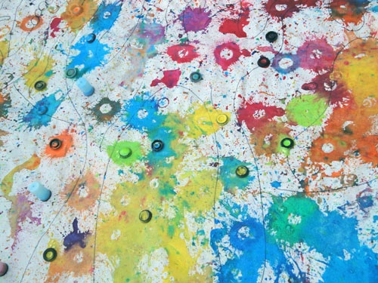
Sometimes art answers: “What if?”
Alka seltzer tablet, vinegar and paint trapped in a film canister

Slide 40
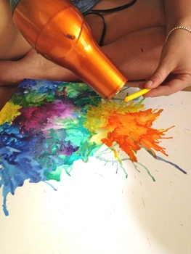
Offer art processes that are completely irresistible.
If the grown ups want to play too, you know you are on the right track.

Slide 41
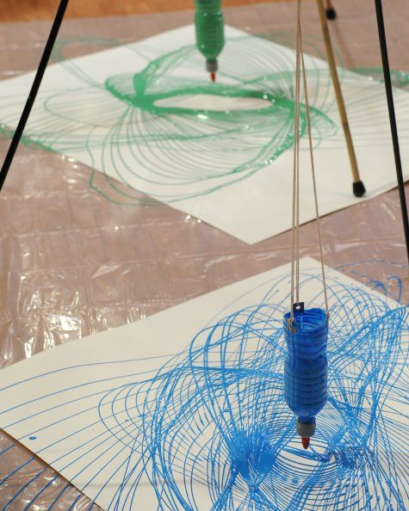
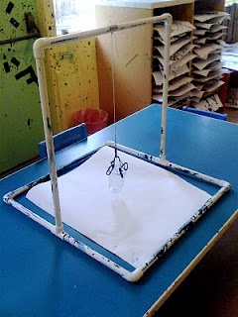
It’s all about the invitation. The space and supplies can be simple.

Slide 42
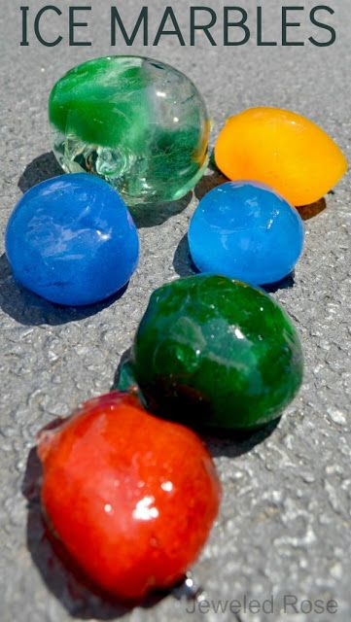
Don’t overthink what the kids need to do.
Present the offering and step back.
Paint squeezed into a balloon. Balloon filled with water and frozen overnight.

Slide 43
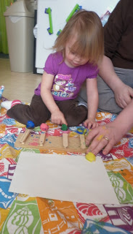
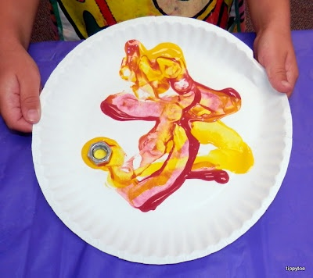
With a great process art, the adults will naturally engage, but still allow the children to lead and extend the possibilities.
Left: Popsicle stick catapults shooting clay/paint.
Top: Painting with magnets.

Slide 44
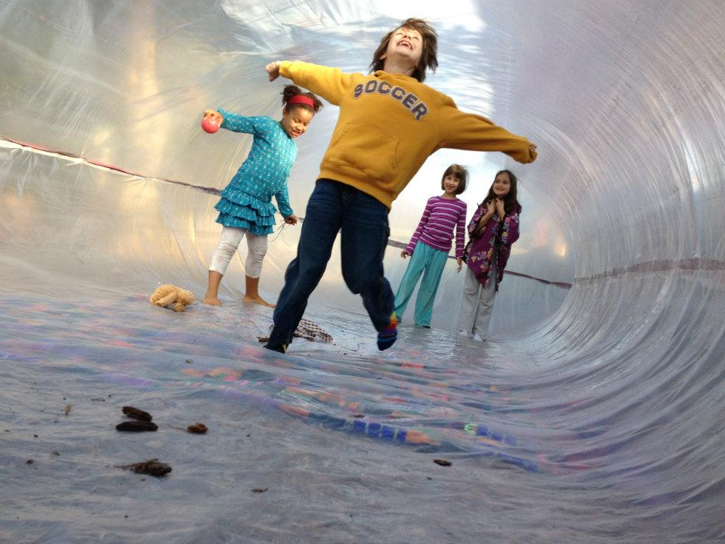
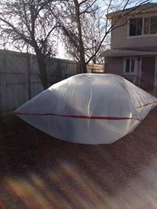
Look new places for your art supplies.
Paint tarps taped together and inflated with a fan.

Slide 45
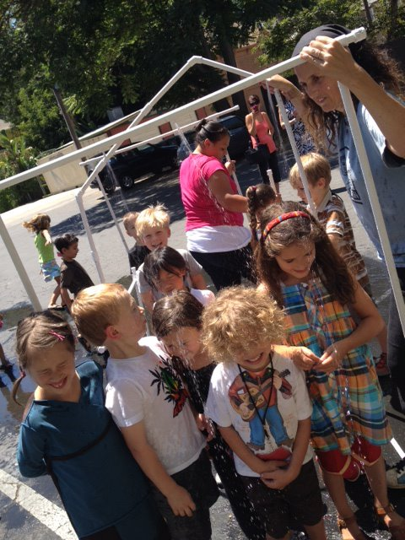
Collaborative creation can be done if you find the right project.
PVC pipe connected to build a sprinkler house invented by the children.

Slide 46
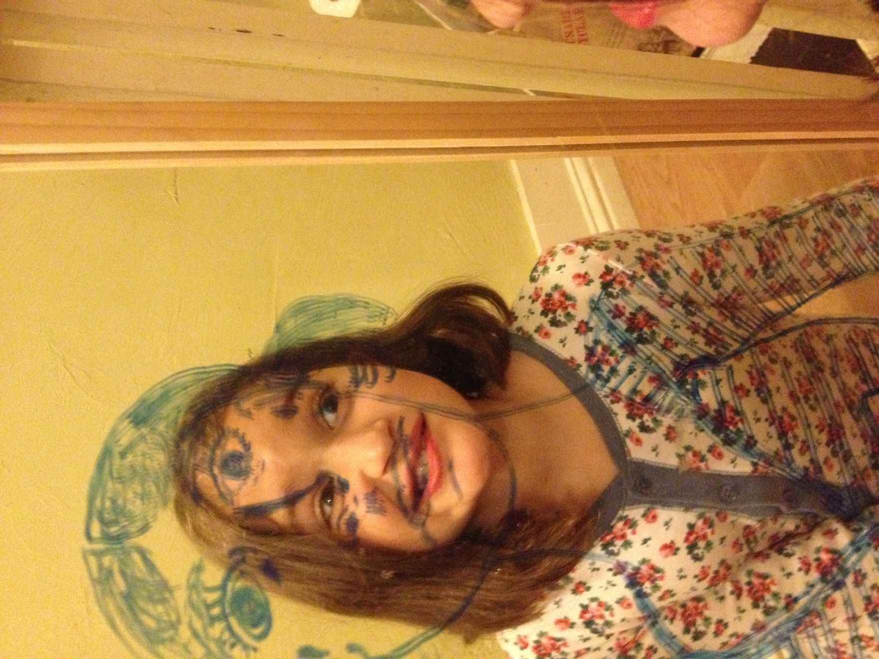
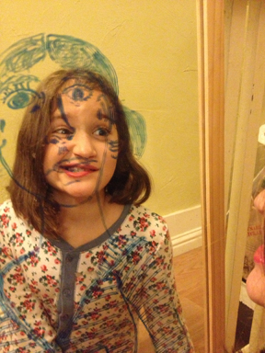
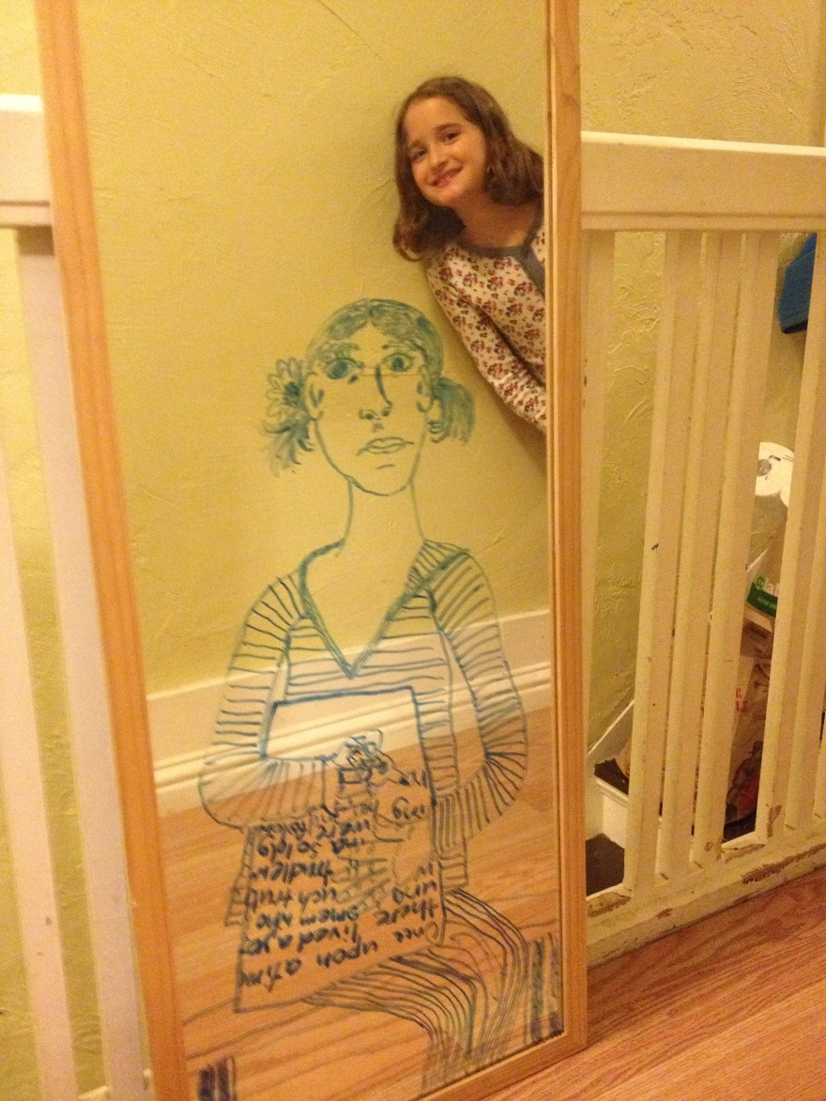

Slide 48
Art is a form of self expression.
Art experiences should not invite sameness.
Art should not require an instruction sheet.
Art should not have a deadline.
Art should encourage creativity not conformity.

Slide 49
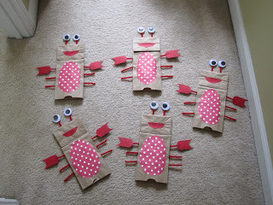
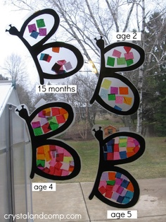
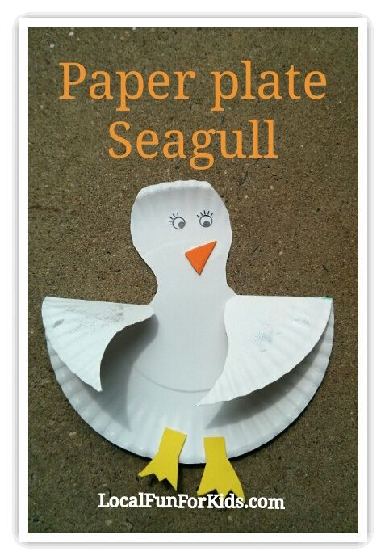
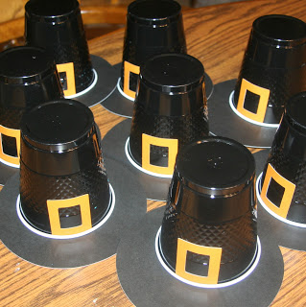
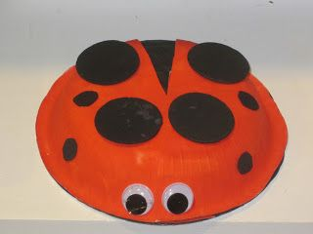
Warning Sign One: Paper plates, cups, lunch sacks or Costco bulk items are involved.

Slide 50
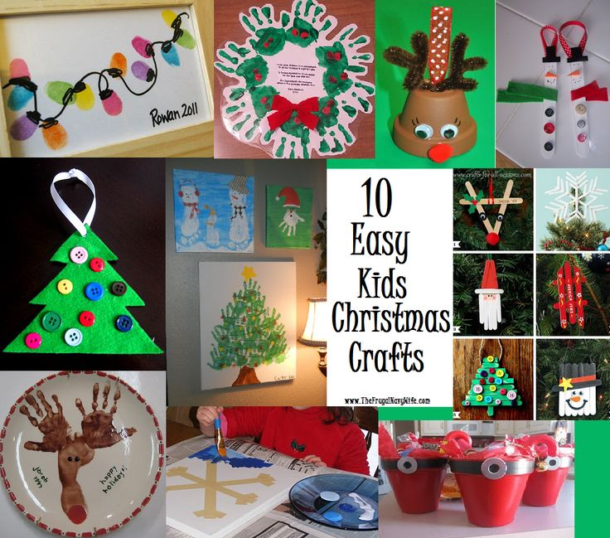
Warning Sign Two: The primary act of creating is gluing stuff onto things.

Slide 51
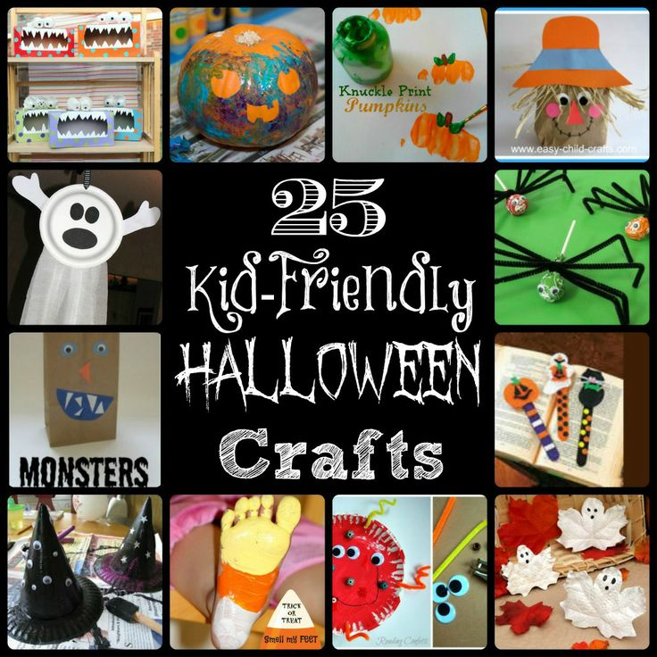
Warning Sign Three: The primary motivation to create is to decorate for the holiday.

Slide 52
And now for a brief rant about HANDPRINTS

Slide 54
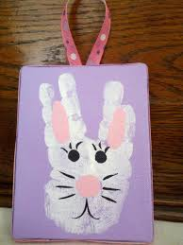

Slide 56
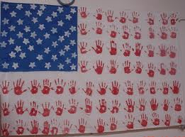
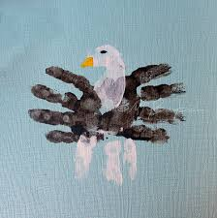

Slide 57
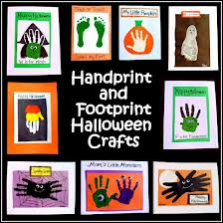

Slide 58
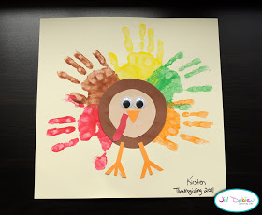

Slide 62
This is art.

Slide 67
It has bothered me all my life that I do not paint like everybody else. -Henri Matisse

Slide 68
Art is not a team sport.
Most often, artistic creation is solitary.
Group art WILL leave some kids feeling rushed and compared.

Slide 69
The most popular space at Art Beast is the empty canvas.

Slide 70
Artists claiming their own space.

Slide 74
The best collaborative art processes allow children to add elements over time or add an individually created element to a group art piece.

Slide 76
Poll: Who Gets to Make the Decisions About Arts Programming in Your Library?
The administrators for the library system in our area
The administrators of our individual library
Contract artists and teachers
The library staff that work with most directly and most often with the children
Others not listed here

Slide 77
Challenges for Integrating the Arts into Your Library:
Finding a Space for Creativity and Art

Slide 78
If you want to bring people into your branch, creating a space to DO art is probably more meaningful than a place to display art.
Hang art on your walls, but fill your rooms and floor space with a space for community interaction and creativity.

Slide 79
The Learn and Play Space in the Children's Department at the Monroe County Public Library
YES. This would be awesome.

Slide 80
But absolutely not mandatory.
In fact, the $50,000+ to build that could buy a LOT of cool art supplies.
A room, a few tables and a stash of tarps will get you VERY far.
Don’t have a room? A 12 by 12 foot square of open floor with a tarp on it and a few card tables can become a magical space.

Slide 81
Challenges for Integrating the Arts into Your Library:
Finding a Time/Attracting Families

Slide 82
Lessons Learned:
Kids and caregivers want to build a relationship with a teacher, librarian or artist.

Slide 83
Lessons Learned:
Kids and caregivers want to build a relationship with a teacher, librarian or artist.
Kids and caregivers want to build a relationship with one another.

Slide 84
Lessons Learned:
Kids and caregivers want to build a relationship with a teacher, librarian or artist.
Kids and caregivers want to build a relationship with one another.
A series offered in a consistent time for a long duration (6 months at least) will do much better than a short term series or one time event.

Slide 85
Lessons Learned:
Kids and caregivers want to build a relationship with a teacher, librarian or artist.
Kids and caregivers want to build a relationship with one another.
A series offered in a consistent time for a long duration (6 months at least) will do much better than a short term series or one time event.
Caregivers are more concerned with age range than topic. A class titled “Baby and Me” or “Toddler Time” will do better than a class titled “Storybook Art (0 to 3)”

Slide 86
Challenges for Integrating the Arts into Your Library:
Themes

Slide 87
The Problem with Themes:
Forces library staff to put theme before art experiences.
Inspires a bunch of one time events/workshops that don’t build a library community .
They tend to be driven by a short term grant. This leads to a burst of funding that results in short term planning of Summer events and Big Reads instead of the long term planning that makes a library a community hub.
Results in high pay for contract artists instead of developing your existing and invested library staff.

Slide 88
Creating a Meaningful Art Space in Any Library

Slide 89
“Why do you try to understand art? Do you try to understand the song of a bird?” Pablo Picasso

Slide 90
Offer a range of supplies.
Include “adult” art supplies.
Offer supplies that artists work with.

Slide 92
Artists don’t use these supplies so why do we give them to children?
Foam Sheets
Glitter
Art Kits
Precut felt
Paper Plates
Stickers
Rubber Stamps
Precut Paper Shapes
Construction Paper

Slide 93
Great Art Supplies for Kids
Paint: Watercolor, Acrylic, Tempera
Good Crayons: Stick and Block
Good Chalk
Clay
Fabric
Wool Roving
Yarn
Wire
Wood
Mud
IKEA Tidbits
Mosaic Elements
Doughs
PVC Pipe and Fittings
Wood
ANYTHING from Nature

Slide 94
An environment that invites creativity does not need to be well-stocked or organized. It needs to be inviting.
It needs to tempt.
It needs to beckon.

Slide 95
This space did not look like this once it went into use.

Slide 108
Keep it simple. Put stuff out on a small table. Step back.
Mortar and pestle and chalk
White paper and two jars of watercolor
A block of clay
Sticks and yarn
A box top, marbles and two colors of paint
Tray of baking soda, a jar of dyed vinegar, a dropper
Paint Lab: qtips, combs, sponge, scrubs…
Burlap and yarn with plastic needles

Slide 109
Center instruction on mediums not look-alike crafts.

Slide 133
Expand your definition of what art is.

Slide 137
The constant arranging that children do is ART.
Creating order from chaos.
Giving meaning to a jumble of supplies.
Using something in a new way.

Slide 138
Let the children lead.
Let them have weird ideas.
Let them follow inspirations.
Let them chase crazy notions.

Slide 143
Let it get loud, messy and wild.
Art can get gross motor.

Slide 151
Survey: What changes to your space or routines would be an affordable and simple way to integrate more arts programming?
Dedicate a space to art
Dedicate budget to weekly sessions rather than one time event
Set up an arts supply cabinet that story time leaders can access
Start a pinterest board for library staff to gather ideas
Dedicate an hour a week to arts programming for one age group
Uplift quality of arts and crafts that children engage in at library events or workshops

Slide 152
When my daughter was about seven years old, she asked me one day what I did at work. I told her I worked at the college- that my job was to teach people how to draw. She stared back at me, incredulous, and said, "You mean they forget?" -Howard Ikemoto

Slide 153
5 Children’s Books and Connected Arts:
Dave the Potter + Clay Work
Hungry Caterpillar + Balloon Art
Chicken Sunday + Hats
When Sophie Gets Angry + Calm Down Jars or Anger Art
Tom Sawyer + Fence Board Art

Slide 155
NO
YES!

Slide 157
Calm Down Jars * Anger Release Art*
Angry Breath Art * Abstract Anger *
Metaphor Art * Volcano Making *
Anger Release Games * Yoga Circle

Slide 159
Profile of a Great Library Arts Space:
Crete Library Art Studio

Slide 160
Crete library offers youth art exploration
October 14, 2013 12:00 am • For The Times
CRETE | The Crete Public Library's Art Studio explores different art mediums and lets participants make unique works of art to take home.
Recently the group's project was to paint patterns on small tree branches and a second project was painting patterns on canvas.
Each participant chose his tree branch, colors and patterns to make an exclusive art piece to take home. The canvas paintings will be completed this month and displayed on the second floor for the community to view.

Slide 161
Process oriented art projects @ Lisle Library
The Youth Services Department at Lisle Library District (in Lisle, IL) focuses on process oriented art in our programs. It's about the process, not the product! Great art projects for toddlers and preschoolers.
http://www.pinterest.com/lislelibrary/process-oriented-art-projects-lisle-library/

Slide 162
Profile of Powerful Arts Programs
Centered in Libraries:
NY Library Partnership

Slide 163
Uptown
'Project Art' program turns New York Public Libaries into studios for young students uptown
Adarsh Alphons seeks to remedy gap in art education in schools, shortage of youth programming in libraries. Program offers classes at Hamilton Grange branch with plans for large-scale expansion.
BY Laignee Barron
NEW YORK DAILY NEWS
Friday, July 19, 2013, 9:24 PM
Read more: http://www.nydailynews.com/new-york/uptown/artist-bold-stroke-inspiration-article-1.1404105#ixzz33WbcvvaG

Slide 164
One enterprising artist is painting over two public funding crises in one stroke.
Adarsh Alphons wants to remedy the gap in art classes and public education, while simultaneously helping to restore youth programming to libraries, where budget cuts have eliminated thousands of hours of programming.
Alphons’ organization, Project Art, is turning the library into a studio where low-income uptowners ages 5 to 18 learn to prime a canvas, mix a color palette and sculpt a masterpiece.
Project Art temporarily moved to the Hamilton Grange Library last fall when its former studios became a liability with leaking bathrooms and faulty sinks.
“We urgently needed space, and libraries are unable to provide as much programming as they used to,” Alphons said.
A libary spokeswoman called the partnership a "win-win situation" that works to the benefit of Harlem residents.
"The New York Public Library has experienced budget cuts over the past five years, which has made it difficult for the staff to offer the same types of programs they have offered in the past," said Amy Geduldig, the organization's public relations manager. "Programs like ProjectArt help provide us with programs and resources that are important to the people we serve."
Alphons, 30, plans to expand the program to other branches in Harlem, including Countee Cullen.
Read more: http://www.nydailynews.com/new-york/uptown/artist-bold-stroke-inspiration-article-1.1404105#ixzz33WbvmWAU

Slide 165
The Problem: The Void
The arts opportunity gap is widest for children in high-poverty schools. This is absolutely an equity issue and a civil rights issue-just as is access to AP courses and other educational opportunities. Nearly four million elementary school students do not get any visual arts instruction at school during their formative learning years.
The Solution:
Public Libraries Partnership
ProjectArt collaborates with public institutions (libraries) that are strategically located to bring access to arts directly to underserved communities. This is particularly effective for communities on the lower socioeconomic scale.

Slide 166
Chat: What are some great activities
or programs you have seen?

Slide 167
Excellent Internet Resources for Art Inspiration: Pinterest: Search Process Art Teacher Tom Red Ted Art Play at Home Mom Magic Onions Artful Parent Tinkerlab Make Zine and the Makers Movement Child’s Play Music Bev Bos Project Art (New York Library Project)

Slide 168
Contact Information:
Bridget Alexander
Executive Director of Waking the Village
bridget@wakingthevillage.org
www.artbeaststudio.com
www.littlehousesfestival.com
www.wakingthevillage.org

Slide 169
The Early Learning with Families @ Your Library (ELF) 2.0 is supported by the U.S. Institute of Museum and Library Services under the provisions of the Library Services and Technology Act, administered in California by the State Librarian. This material is licensed under a Creative Commons 3.0 Share & Share-Alike license. Use of this material should credit the author and funding source.

