Slide 1

Veterans Connect @ the Library
Wednesday, July 16, 2014
Hosted by Infopeople

Slide 2
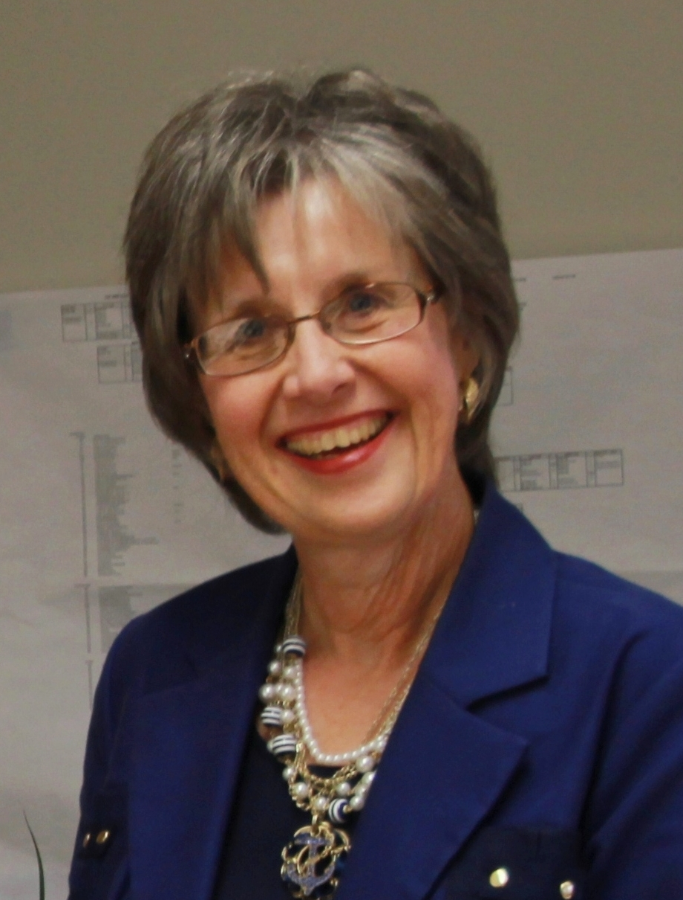
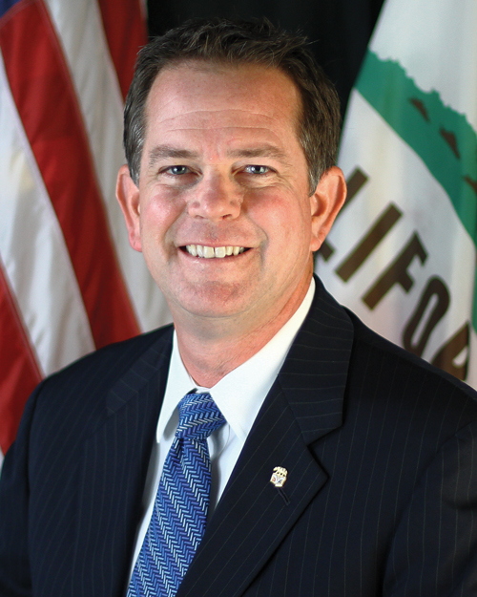
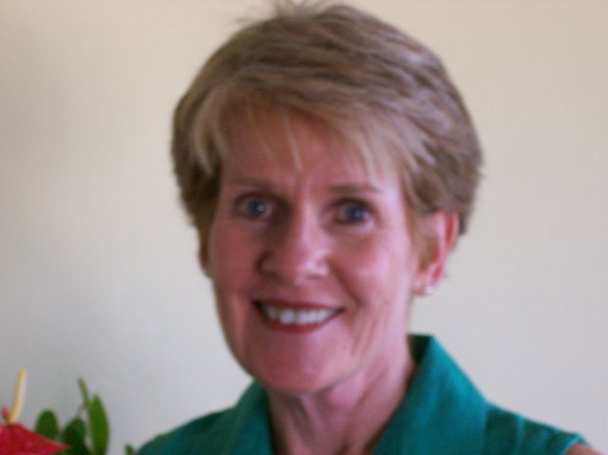
Introductions
Jacquie Brinkley
Karen Bosch Cobb
John “Buzz” Kraft
Notes:
This is Jacquie Brinkley
For nearly two years public libraries in California have been designing services to reach out to veterans through our libraries.
Delighted you have joined us because it means you want to improve services to veterans in your community.
Three presenters: Jacquie, Karen and Buzz (Karen and Buzz say “hello”). We will take turns during the presentation.
Take questions at the end.

Slide 3

Why California public libraries are helping veterans
The California State Library has a Statewide LSTA grant Veterans Connect @ the Library to provide services to help veterans and their families.
The goals for this grant are to:
  Provide veterans benefits and local service information to veterans and family members, links to other local organizations serving veterans especially local County Service Offices, CalVet and the Federal VA
  Increase registered veterans in the CalVet Reintegration system through use of myCalVet
  Increase California veteran benefit claims
  Increase use of libraries by veterans and their families
Notes:
Jacquie, I mentioned that we have had a grant for two years. The goals of that grant are outlined on this slide. (Go over briefly)

Slide 4
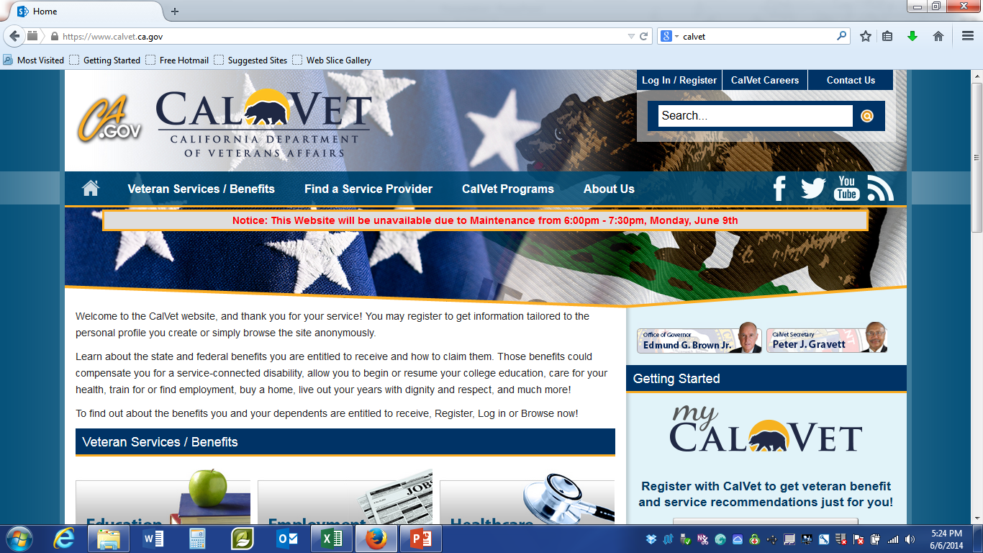
Our Partner: CalVet
Notes:
Jacquie, Services to Veterans are provided at the federal level by the U.S. Department of Veterans Affairs. In California there are two levels of service: CalVet also called the California Department of Veterans Affairs and County Veterans Service Officers (CVS0) in nearly every county. These two levels of agencies authorize benefits in a variety of areas.
Through the USA and California there are also many Veterans Services Organizations who also assist veterans though many are not able to authorize benefits.

Slide 5
Why libraries when there are so many other agencies serving veterans?
“The skill sets, resources and dedication …can play a crucial role in positively changing the way that veterans return to their communities -- without …isolation, fear, pain and shame.
Libraries…safe places where people care and want to help, and where core professional values of respect and confidentiality are upheld.”
-Jason Deitch, veteran and partner with Contra Costa Library
Notes:
Jacquie: so why add another agency?
Reasons above
Not wanting to enter a building with a flag (meaning a military building)
Services already providing in libraries: jobs search, internet access, needed by veterans applying for benefits or services

Slide 6
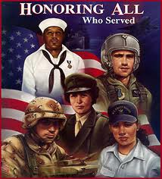
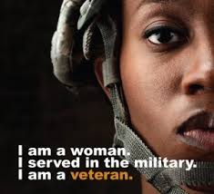
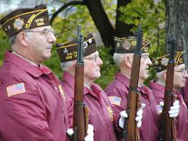
The facts about California Veterans
“Did you ever serve in the military” You are a veteran!
Notes:
Jacquie, just like all of us veterans have different service needs at different times in their lives.
Also veterans, like all human beings do, seek information in many different ways; sometimes they don’t seek it when they should
Furthermore many veterans do not even think of themselves as veterans. Their mental image of a veteran might be a World War II image in a Veterans Day parade or someone going on an Honor Flight to Washington D.C.
So the first question to ask is, Did you ever serve in the military?
Now we are going to ask our CalVet partner, John “Buzz” Kraft, himself a veteran to tell us more about veterans in California.

Slide 7
The facts about California Veterans
1.7 million veterans in CA, highest in the US
300,000 veterans will leave the military in each of the next 4 years
40,000 of these veterans will be returning or moving to California
½ of all veterans in California live in five (5) Southern California Counties
Notes:
Buzz covers these points and adds a little text to make the facts come alive.

Slide 8

The facts about California Veterans
Notes:
Buzz, talks about the 5 branches. Also if you have a good graphic of give branches, please let me know and I will replace one of these.
Stanley, I know we are supposed to have interactive elements. (This would be a good one—to ask people ahead of time to name the five branches of service.) We will need advice on how to do this interactive element.

Slide 9






Top Benefit Needs
Notes:
Buzz

Slide 10
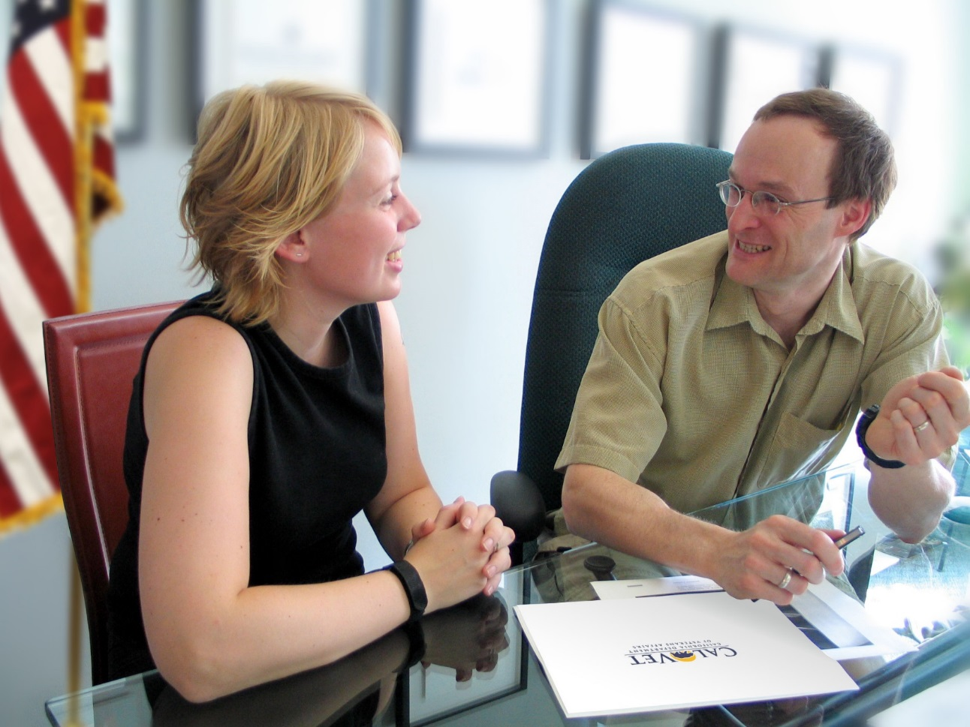
Utilization of services by Veterans in California
  Compensation and pension benefits:
  CA 15.7% - National 16.5%.
  Healthcare benefits
  CA 21.8% - National 24.6%
  Women veterans will constitute 15% of the California veteran population in 20 years.
Notes:
Buzz
Flesh out script below.
Younger veterans now leaving the service are less likely to contact the Veterans Administration for their healthcare and less likely to join veteran organizations where they may get information regarding the benefits and/or services for which they are eligible.
Now go back to Karen Bosch Cobb and Jacquie Brinkley who will outline six steps which have been tested during the past two years in California Public Libraries for serving veterans

Slide 11
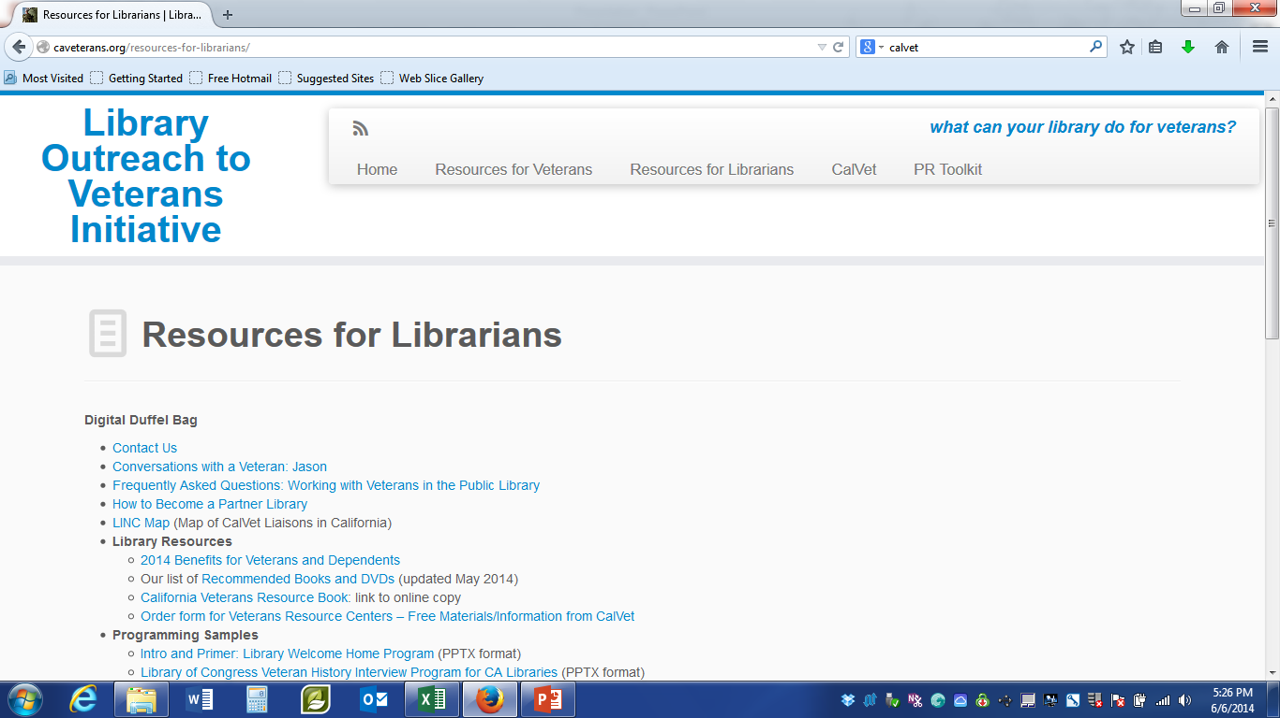
6 Steps to services to veterans
During past two years 16 libraries have launched services based on our model.
Model is “service in a box” or what we call a “digital duffel bag: http://caveterans.org/resources-for-librarians/
Step by Step approach
Notes:
KAREN STARTS:
As you know libraries have a long history of establishing and sharing models of practice. This allows us to set up services quickly and utilize best practices. So we have set up service to veterans “in a box”

Slide 12

Step 1
Research, meet, and get to know your County Veterans Service Officer (CVS0) and other agencies serving veterans in your community.
http://www.cacvso.org/
http://caveterans.org/resources-for-veterans/
Notes:
As we mentioned earlier, there are County Veterans Service Offices in Each county and many Veterans Service Agencies. At first it might seem confusing to figure out where to start: You must start with your CVSO: they are they key.

Slide 13
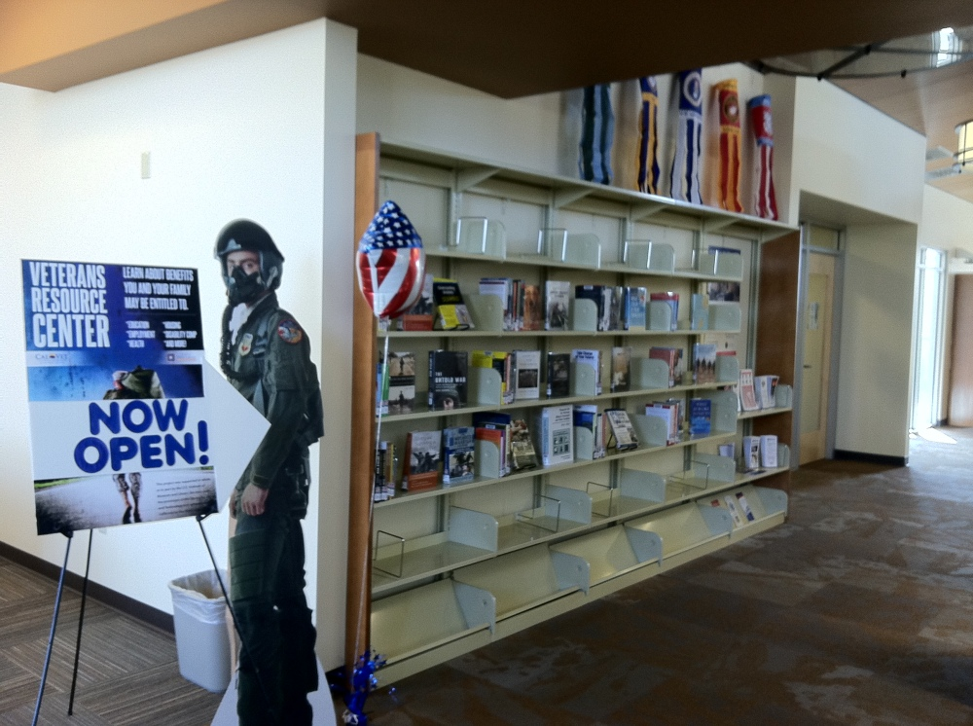
Step 2
Establish a collection of books and CD for your library 60+ recommended books and DVDs for veterans
Notes:
Karen: We have created a list of books and DVDs for serving veterans: fiction and non fiction. List is up to date and available to anyone to use. Collection at one of our libraries.

Slide 14
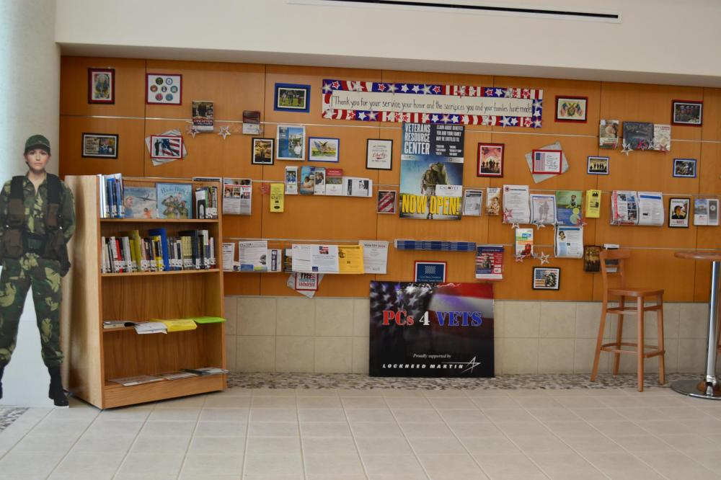
Step 2 -continued
Setup up a display area: order posters and pamphlets Order Form for Free Materials from CalVet
Notes:
Karen: this is another of our libraries: they combined their books with pamphlet materials which they acquired from CalVet and their local Veterans Services Organizations.

Slide 15
Step 2 - continued
Develop an online list of your local resources for veterans and post on your webpage.
  The four most important websites for libraries serving veterans
http://caveterans.org/resources-for-librarians/
https://www.calvet.ca.gov/
http://www.va.gov/
Your list of local resources for Veterans
Notes:
Karen: as you are contacting your local organizations, keep track of them so that you can develop a list of Veterans Service Organizations for your service area. Your work here will help veterans learn about and receive the benefits they have earned.

Slide 16
Step 3
Train Staff
This Webinar
Veterans and Public Libraries: What Every Public Library Should Know: Infopeople Webinar
Complete the CalVet online training module for staff and volunteers. Click here for a link
Notes:
Is an overview
Diversity and need training
Specifics of service
Karen ends

Slide 17
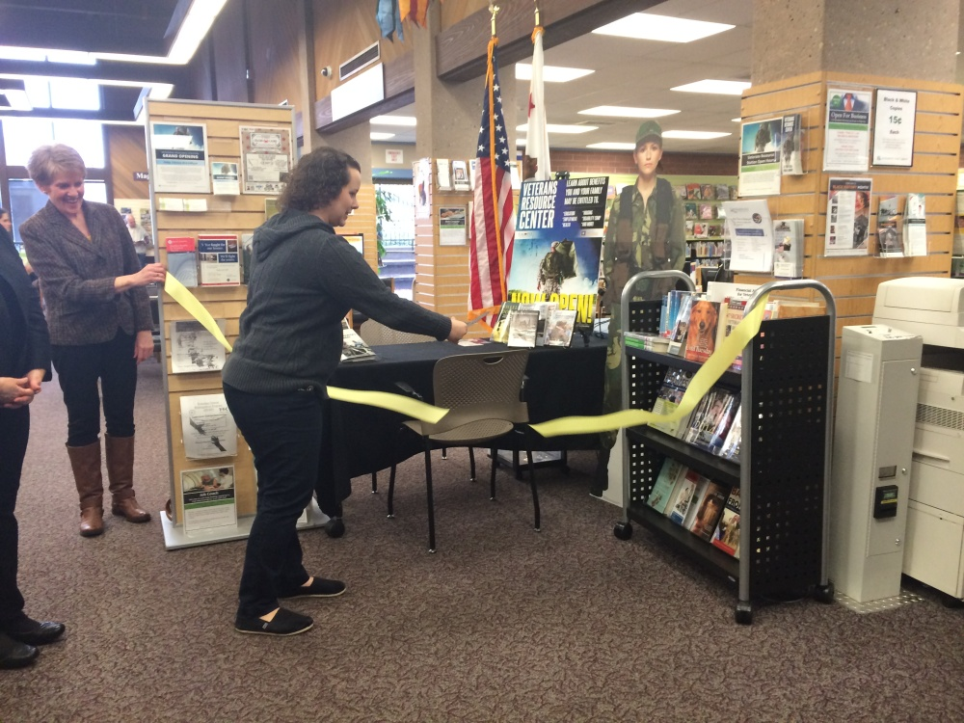
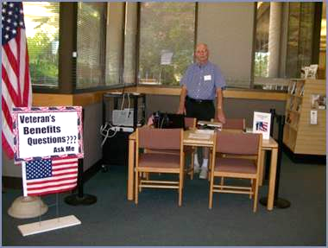
Step 4
Set up a Veterans Resource Center staffed by trained volunteers
Notes:
Jacquie starts with 4
After your staff and volunteers have completed the online training program, you are ready to open up a Veterans Resource Center:
This is a spot in the library staff by volunteers who have the time to spend 30 minutes or more to assist veterans. VRC are open set days of the week at set times or by appointment. Of our 16 libraries 10, have opened VRC’s

Slide 18
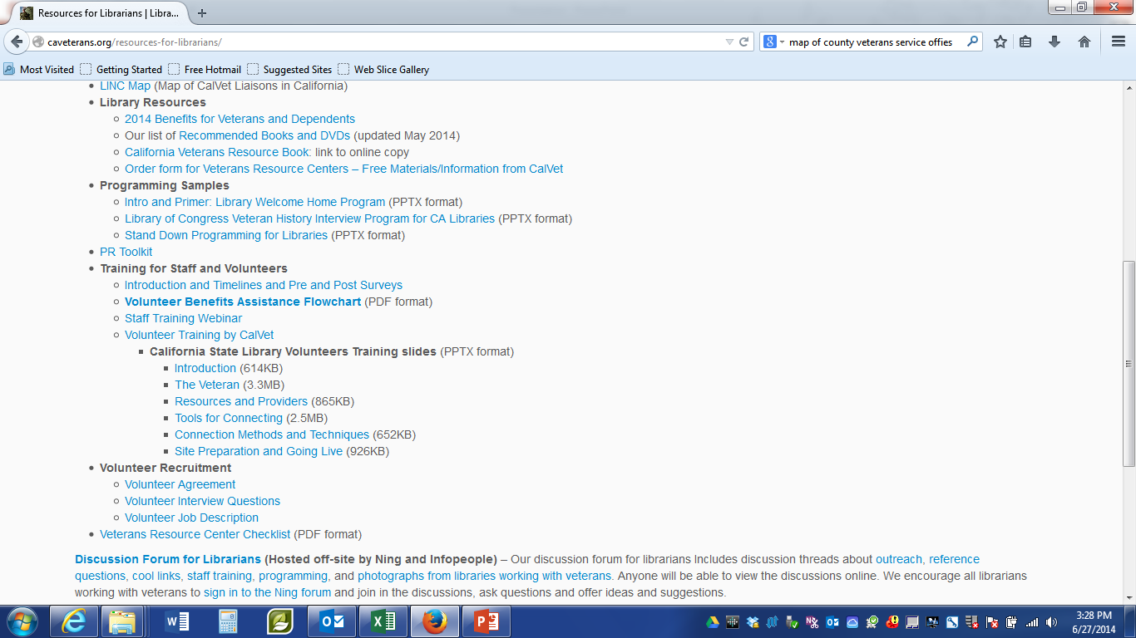
Step 4 - continued
Get your volunteers on board. Everything you need is found here
    Recruit
    Interview
    Train volunteers
Notes:
Setting up a Veterans Resource Center might seem like a daunting task, but again, we have already mapped it all out. Everything you need to recruit, interview and train your volunteers is on our web page.
(need to add a red arrow to point to the section on volunteer recruitment)

Slide 19
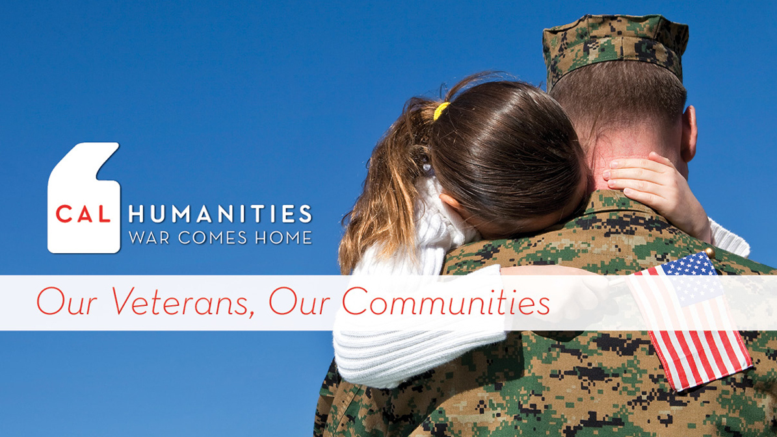
Step 5
Present programs in libraries to attract more veterans
  Invite veterans to general audience programs
  3 programs available on our website
  Book groups, author talks, etc.
  Samples from other libraries in PR toolkit on our website
  War Ink an online exhibit of stories told through tattoos of California Veterans is launching 11-11-2014
  Some libraries are already participating
  in Cal Humanities: War Comes Home
Notes:
Make your library “vet friendly” by issuing special invitations to programs. Your programs can be just for vets or for general audience and you issue a special invitation through the veteran contacts you have developed by meeting with your County Veterans Services Officer and other Veterans Services Groups
For example, if you give a program on family finance or resume writing or job searching or a family program, include your veterans.
We have developed three programs for veterans
Intro and Primer: Library Welcome Home Program (PPTX format)
Library of Congress Veteran History Interview Program for CA Libraries (PPTX format)
Stand Down Programming for Libraries (PPTX format)
We are also creating a community of practice by publishing PR samples in our PR toolkit and NING photos.
Contra Costa County is coordinating a project to create an online exhibit of stories told through tattoos of California Veterans. It launches on Veterans Day and has follow-up up activities on Memorial Day.
Mention Cal Humanities

Slide 20
Step 6
Participate in evaluation of outputs and outcomes
Usage counts monthly
Postcard Surveys to measure the impact of services.
Notes:
So you get a lot for free! What’s the catch? Simple, we want you to sign up formally with us and participate in our usage counts and postcard surveys to measure the impact we are having on veterans

Slide 21
We invite you to participate
The California State Library is looking for more libraries to join this effort. LSTA funding is available.
Libraries which are selected will receive funding for collections, equipment, programming, staff support, supplies, and coaching from grant monitors.
  Interested: Contact Karen Bosch Cobb at karenboschcobb@infopeople.org
  Your library will be asked to complete a Letter of Commitment signed by your director and submit by July 31, 2014.
Notes:
Jacquie ends here

Slide 22
?
Notes:
Add contact info for Jacquie, Buzz, and Karen

Slide 23
Thanks
Contact us at:
Jacquie Brinkley - jacquiebrinkley@infopeople.org
Karen Bosch Cobb - karenboschcobb@infopeople.org
John “Buzz” Kraft - John.Kraft@calvet.ca.gov

Slide 24
Infopeople webinars are supported in part by the U.S. Institute of Museum and Library Services under the provisions of the Library Services and Technology Act, administered in California by the State Librarian. This material is licensed under a Creative Commons 3.0 Share & Share-Alike license. Use of this material should credit the author and funding source.

