Slide 1



MedlinePlus: Power Searching for Hidden Treasures
An Infopeople Webinar
Presented by Kelli Ham, MLIS
August 21, 2014

Slide 2

Today’s Objectives
Participants will:
See a spectrum of questions that can be answered with MedlinePlus
Discover new ways of advanced searching
Utilize MedlinePlus as a springboard to other sources

Slide 3
Agenda
Overview
Scenarios and techniques
  Basic and advanced key word searching
  Choosing the right resource
  Search and refine techniques
  News alerts and RSS feeds
  New ways to find current research results
  Performing PubMed searches within MedlinePlus

Slide 4
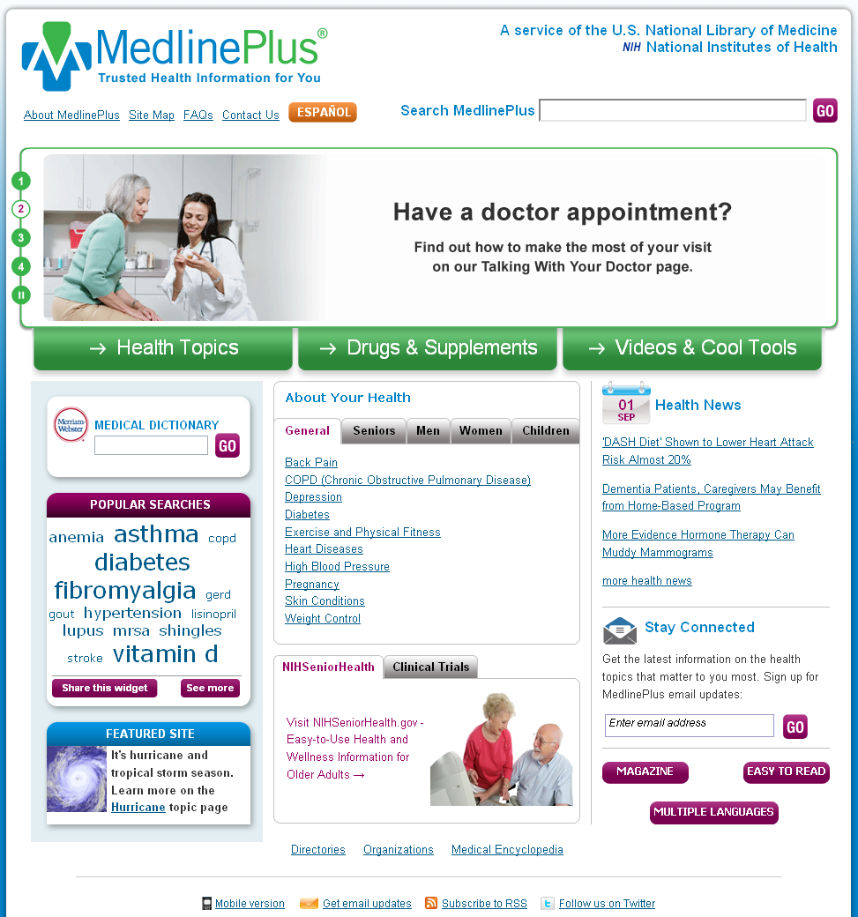
MedlinePlus = Quality Health Info
Over 950 health topics
Drug and herbals
Extensive Spanish materials
Multiple languages
Easy-to-read collection
Videos and tutorials
Health Check tools
Medical Encyclopedia
Dictionary
Health News
Special populations
Clinical trials
Preformulated searches in PubMed.gov
And much more!
Notes:
Reliable
Up to Date
No Advertisements or Endorsements
Designed to be Easy to Use
Great info and links to reliable sources
Includes a collection of easy-to-read materials
Easy-to-understand tutorials and anatomy videos
Substantial Spanish language materials
Multilingual section includes over 45 other languages
Health Check Tools, games and quizzes

Slide 5


The Spectrum of Questions
Basic reference tools – (encyclopedia, dictionary, anatomy)
Conditions and Diseases – Symptoms, Diagnosis, Prognosis
Treatments and therapies
Drug information
Patient instructions, care, coping
Health, wellness and prevention
Caregiver, aging, and end-of-life issues
Health statistics
Health insurance, navigating healthcare systems

Slide 6
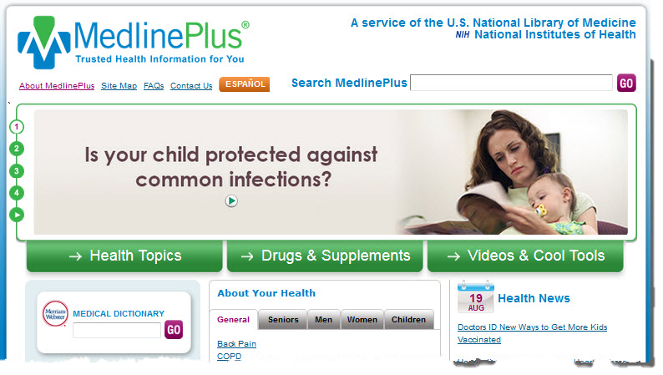
Common Search Techniques
Key word search
Navigating to specific content areas and topics
Browsing and discovery

Slide 7

Reference Resources
Dictionary, encyclopedia, directory…
  Who, what, why?
  What you learn will dictate resources and search strategy
Notes:
Understanding how MedlinePlus is structured allows you to search most effectively and efficiently. For instance, if you know that the medical encyclopedia has good images, you can go directly there. Or, you can do a proper keyword search and limit by encyclopedia entries. There are usually several methods of getting to the same answer, so that no matter how someone searches they can find what they need.

Slide 8

Scenario – Reference Resource
Patron has lab test results for a lipid panel and would like help interpreting the numbers.
Technique: key word search; limit to Medical Encyclopedia or browse results list
Notes:
MedlinePlus has an excellent encyclopedia which will have easy to understand information about many lab tests, but also links to other non-commercial resources.

Slide 9
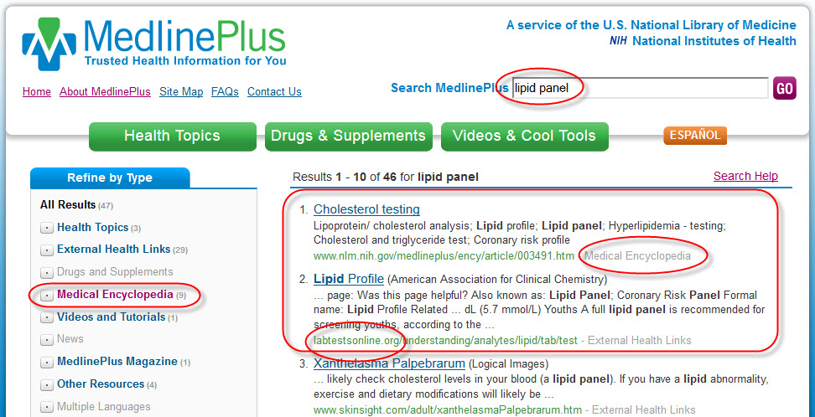
Search and Refine by Content Type

Slide 10
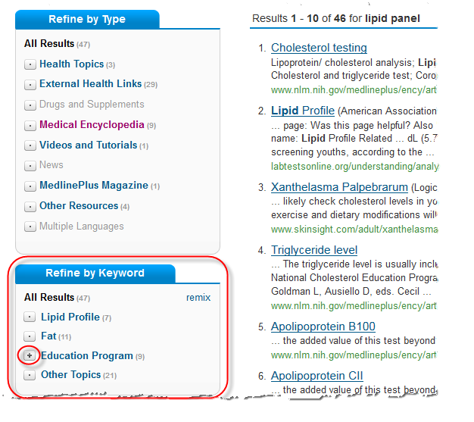
Refine by Concept

Slide 11

Student Research Paper
High school student doing a paper on ethics of patient who wants to stop dialysis treatment for kidney failure
Technique: Key word search
Main concepts: dialysis, choice/decision, ethics
Kidney failure deciding choosing to stop dialysis ethics = 0
Deciding stop dialysis ethics = 3
Deciding stop dialysis = 22
Choosing stop dialysis = 33
Advanced search techniques:
Stop dialysis ethic* = 6
"stop* dialysis“ = 7
(choosing OR stopping OR choose OR stop) dialysis = 231
Search Help: http://www.nlm.nih.gov/medlineplus/searchtips.html
Notes:
NOTE: Less May be More when doing key word searching
Choos* stop* dialysis (Not a good choice, in this case!)
Different search strategies:
Health topic Kidney Failure → Treatment, Coping, Specific Conditions, Related Issues

Slide 12
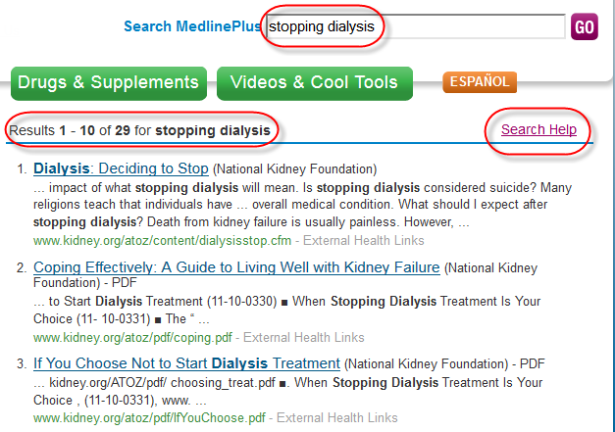
Simple May Suffice
Notes:
Different search strategies:
Health topic Kidney Failure → Treatment, Coping, Specific Conditions, Related Issues

Slide 13

Staying Informed
Patron: “I know a lot about macular degeneration, because both of my parents have been diagnosed with it. How can I get updates on new treatments?”
Technique: Sign up for updates
on Health Topic page
  RSS Feeds
  Email updates

Slide 14
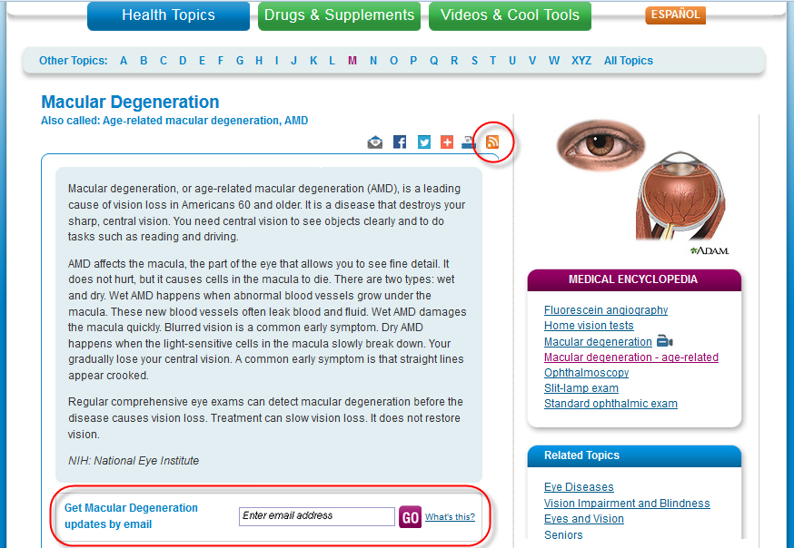
Email Updates and RSS Feeds

Slide 15
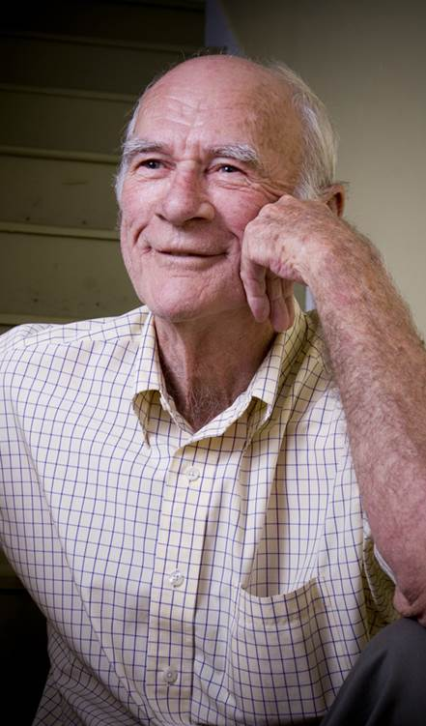
Same User, New Question
My father’s macular degeneration (AMD) has progressed, and the doctor is recommending injections of a drug called Avastin because it’s a lot cheaper and just as effective as another drug. What is meant by off-label use? Is there any research that says it’s effective and safe?
Technique: Determine concepts
off label, AMD + avastin + safety,efficacy
Clinical trials results

Slide 16
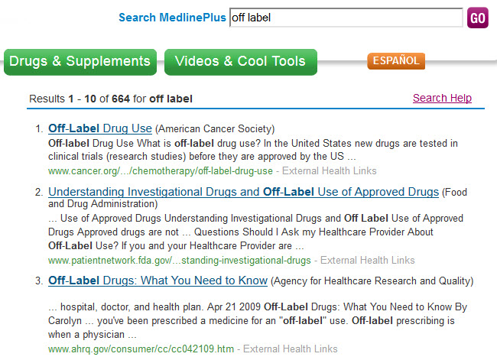
Search Results – off label

Slide 17
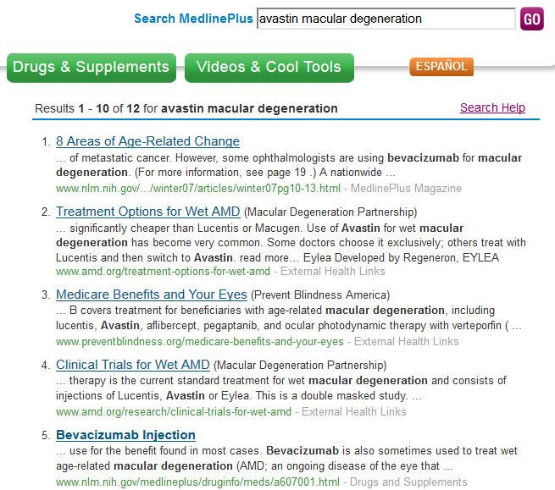
Search Results – Avastin for AMD

Slide 18
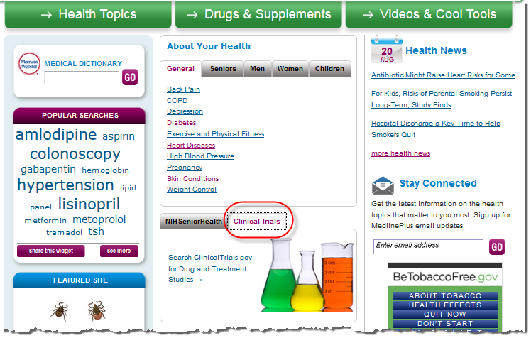
ClinicalTrials.gov
Technique: Go to site directly or from home page tab.

Slide 19
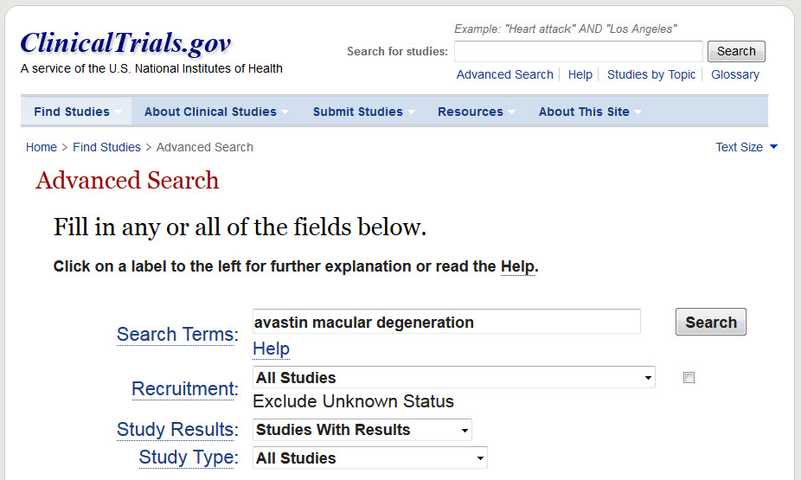
ClinicalTrials.gov
Technique: Use Advanced Search form; type in key words; use Help link for more tips.

Slide 20
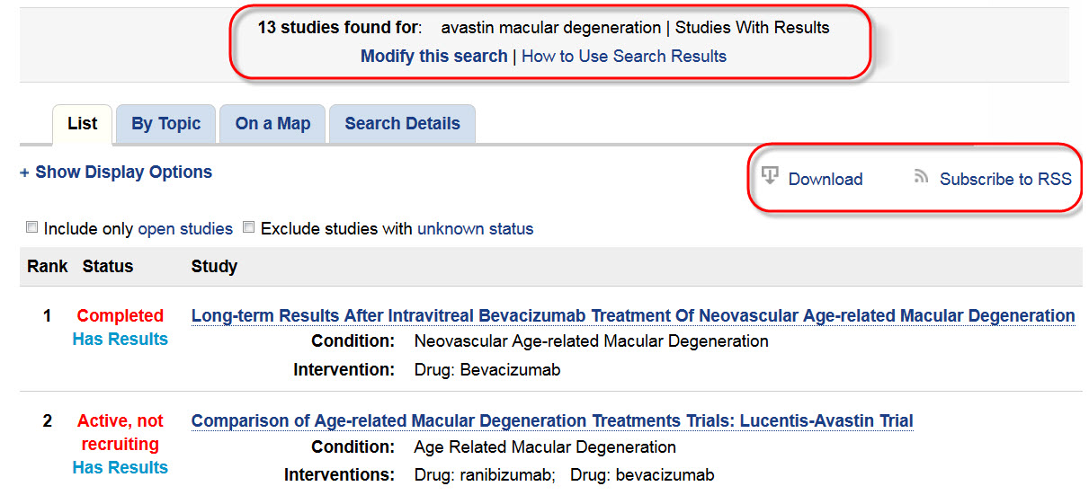
Clinical Studies with Results

Slide 21

In the News
Library user hears about a new study reported in the news, and would like to read the journal article. “Red Meat may Raise Breast Cancer Risk, Study Suggests,” June 11, 2014
Technique:
Glean info from news item – investigator’s last name, journal, topic. Do search in PubMed.gov.

Slide 22
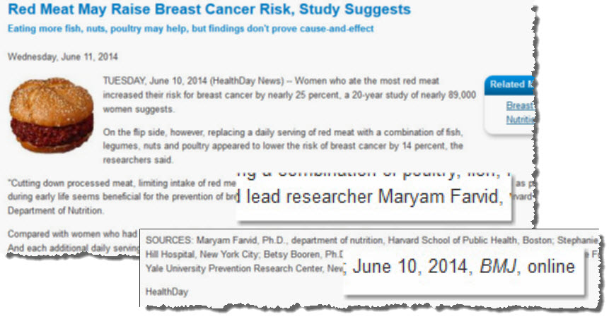
Clues from the Content

Slide 23
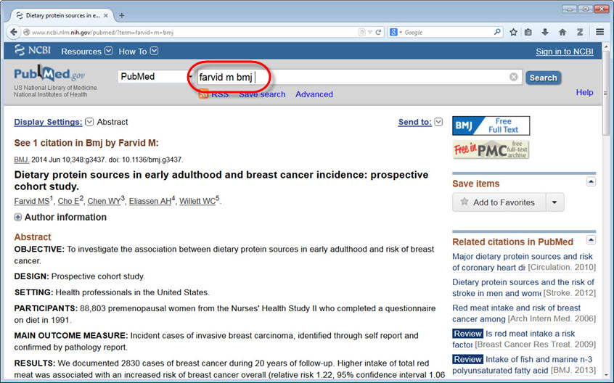
PubMed.gov Search
Tip: Learn how to search PubMed with short tutorials :
http://www.nlm.nih.gov/bsd/disted/pubmed.html

Slide 24
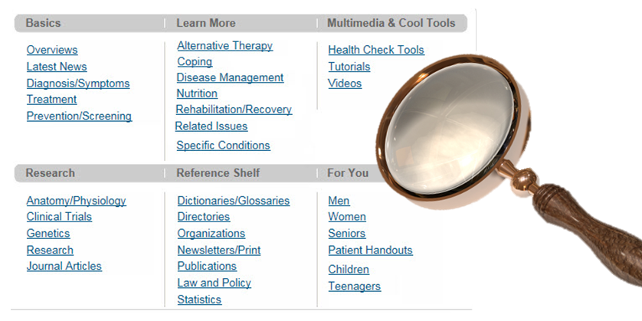
Go Exploring!
Every Health Topics Table of Contents has six sections
Not every category will be on every page
Also Spanish and other languages

Slide 25
Questions?

Slide 26
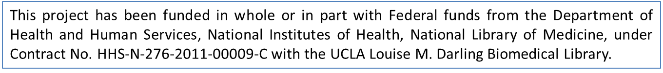
Thank You!
        Kelli Ham
        National Network of Libraries of Medicine
        Pacific Southwest Region
        UCLA Louise M. Darling Biomedical Library
        kkham@library.ucla.edu
        http://nlm.gov/psr

Slide 27
Infopeople webinars are supported in part by the U.S. Institute of Museum and Library Services under the provisions of the Library Services and Technology Act, administered in California by the State Librarian. This material is licensed under a Creative Commons 3.0 Share & Share-Alike license. Use of this material should credit the author and funding source.

