Slide 1

You Can Do I.T. On Your Own!
Ahren Sievers
Technology Librarian @ Elmwood Park Public Library
An Infopeople Webinar
Thursday, September 18, 2014

Slide 2
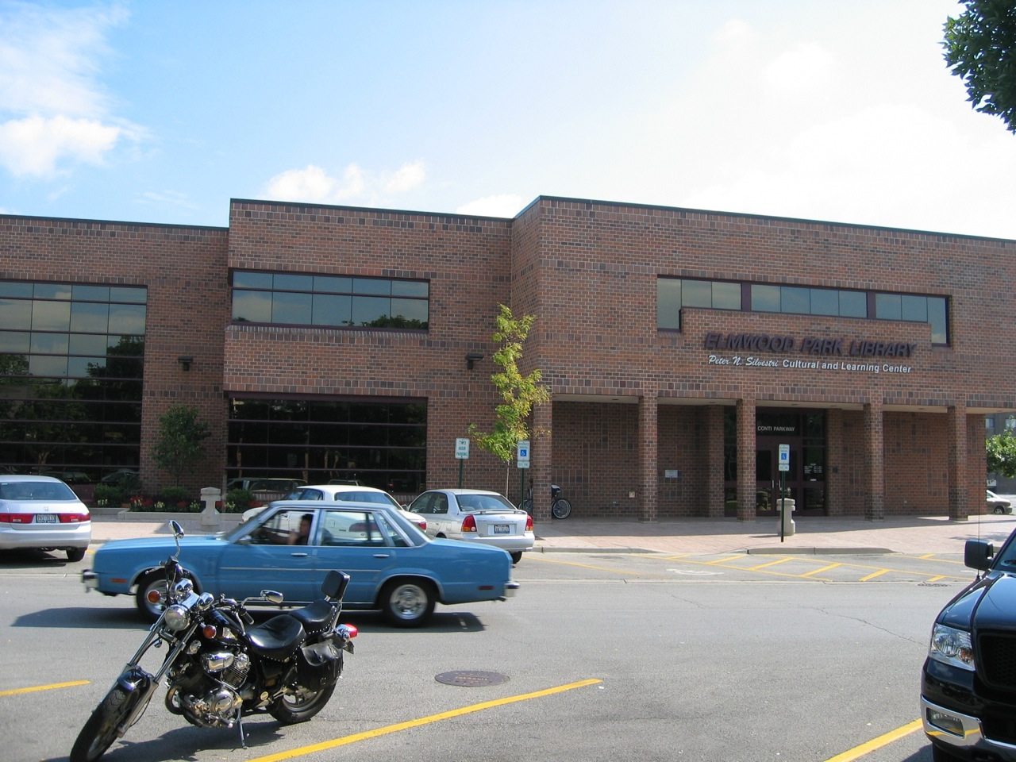
Elmwood Park Public Library
Medium-size Library (225K annual circ)
Staff of 30
100 computers
$18K annual computer equipment budget

Slide 3
Librarians are Natural Troubleshooters
We are inquisitive.
We’ve been trained to quickly find and assess the value of information.
We can use our talents as librarians to fix complex problems.

Slide 4
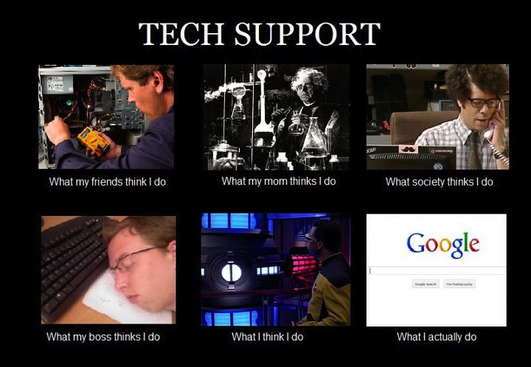

Slide 5

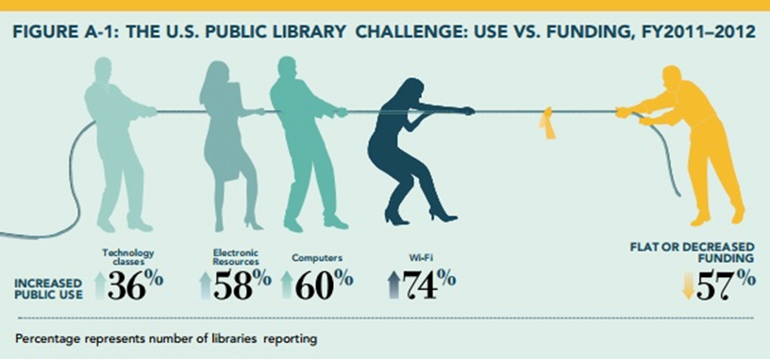
Now More Than Ever
ALA Technology Study
  http://goo.gl/gWSSJG

Slide 6

Meanwhile…
2014 Pew Study finds “technophiles” make up one of the biggest groups of library users.
http://pewrsr.ch/1kmz2fE

Slide 7
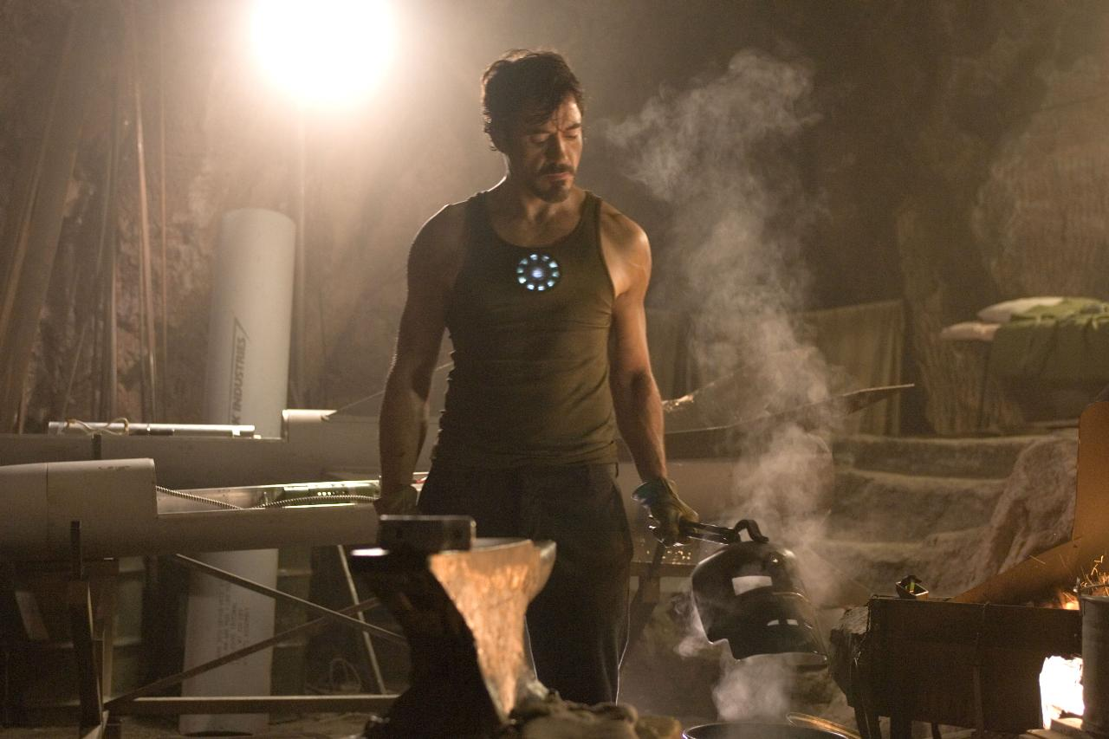
When life gives you lemons…

Slide 8
Time Savers
Money Savers
Sanity Savers

Slide 9
Sanity Savers
Get your digital house in order
Take Notes / Write Things Down
  Remember Solutions
  To-Do Lists
  Show your worth

Slide 10
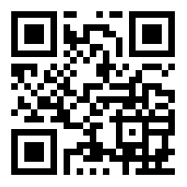
Doesn’t Matter Which:
Evernote
Google Keep
Apple Notes
Any.Do
Dropbox
Google Drive
OneDrive
Cubby
http://goo.gl/jxDMPX
All that matters:
Automatic Sync
Multi-Platform
Searchable

Slide 11

MS OneNote
Syncs across devices
Recognizes and searches handwriting
Converts handwriting to text
Free app available on all platforms and the web
MS Office integration

Slide 12
Email
Clean up your Inbox
Use IMAP folders/labels
Learn to power search your email
Learn and follow email etiquette.

Slide 13
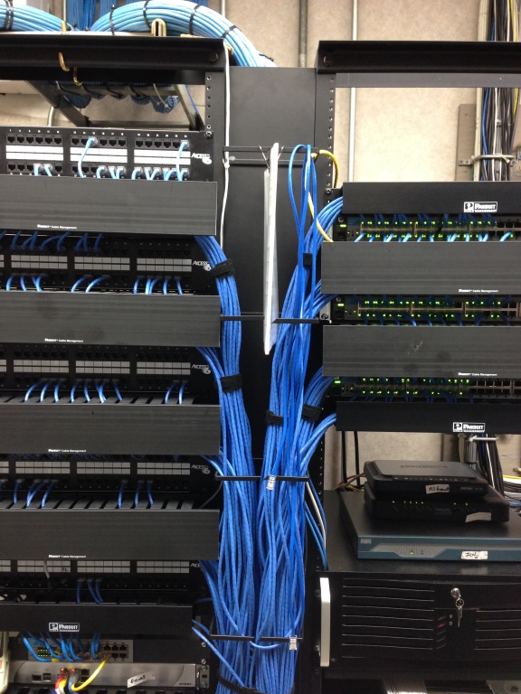
Inventory
Equipment Inventory
  Create a spreadsheet and just go department by department
    Pro Tip! – Use your smartphone as a barcode scanner!
Network Inventory
  Where are all those wires going?
Budgeting
  Whether you’re in charge or not,
  keep track of everything you spend.

Slide 14

Find an IT service
Establish contact before an emergency

Slide 15

Other Help
Subscribe to Listservs
  California Library Information eXchange (CALIX)
    calix@lists.gseis.ucla.edu
  California Library Association Technology Interest Group
    it@listserv.cla-net.org
  Security for Libraries
    SEC4LIB@listserv.nd.edu
  ALA Listservs - http://lists.ala.org/sympa

Slide 16
Forums
Whatever problem you face, there is a message board for it.
TechSoup
Spiceworks
Microsoft TechNet
LibraryThing

Slide 17


Pre-Emptive Help
RSS Feeds
  Pick your reader of choice
    Subscribe to library and tech blogs
    Don’t overload it – stay current
  Reader Rundown - http://goo.gl/lJwlY

Slide 18
“Back that thang up!”
Make sure you have a viable Backup
Test it (Friday the 13th)
Do an off-site backup

Slide 19
Time Savers
Backup Tools – TO THE CLOUD!
  Offsite by very definition
  Requires no special hardware
  No physical tapes to change out
  Amazon Glacier Carbonite
  Crashplan BackupChain

Slide 20
Remote Desktop
Built-in to Windows – RDC/RDP
Remote Desktop Client, Remote Desktop Protocol
Outside the library? Forget about VPNs
LogMeIn
GoToMyPC
TeamViewer
Chrome Remote Desktop

Slide 21
Windows AIK
Windows Automated Install Kit
  Install Windows over a network
    Capture & Deploy images
    Requires some expertise but it’s invaluable.
AKA:
Windows Desktop Deployment
Business Desktop Deployment

Slide 22


AutoIT
Very simple but powerful scripting for Windows GUI
Used to customize the look, feel and behavior of Windows
  Automate software installs
  Automatically dismiss pop-up dialog boxes
  http://goo.gl/B5ge6

Slide 23
Ninite.com
Install 3rd party software with one click
  No toolbars or add-ons
NinitePro - $20/month, unlimited use
  Scans for updates
  Runs silently
Works from the Command Line

Slide 24
Demo

Slide 25
Alternatively…
Patch My PC
  $1 per PC
Secunia PSI
Allmyapps
OUTDATEfighter
Zero Install (0install)

Slide 26
Faronics Core
Faronics is the company that makes Deepfreeze
Powerful options to view and control the PCs on your network
Similar to products like N-Central by N-Able

Slide 27
Demo

Slide 28

Money Savers
Buy computers without Windows (FreeDOS) and save ~$100
  Great if you already have a Windows site license
Buy your software from Techsoup

Slide 29
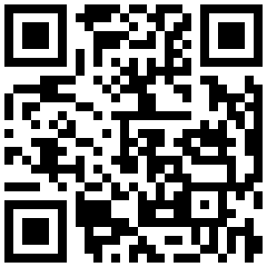
AVAST
Free for Education
Free Anti-Virus for schools & public libraries
  Apply online: www.avast.com/en-us/education

Slide 30
iPads & Tablets
As functional as a PC –half the price.
Buy them used: Glyde.com
What to do with them?
  Give them to staff (Roving Reference)
  Kiosks

Slide 31

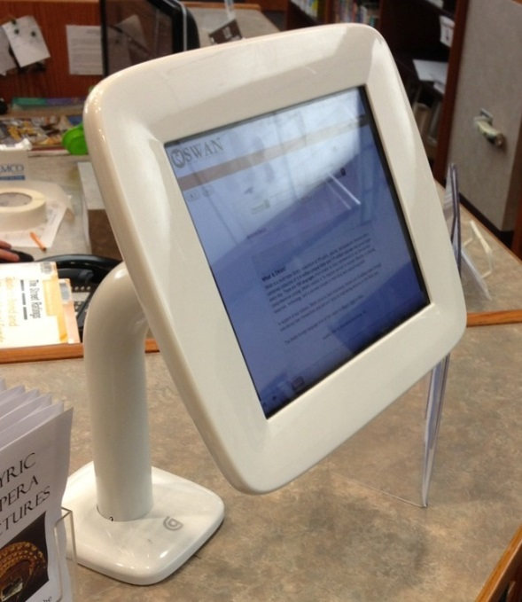
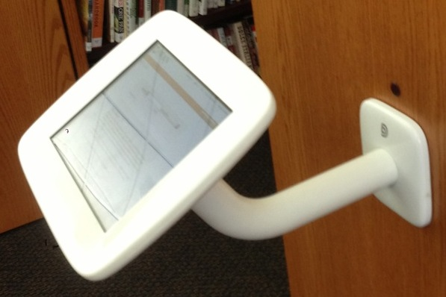
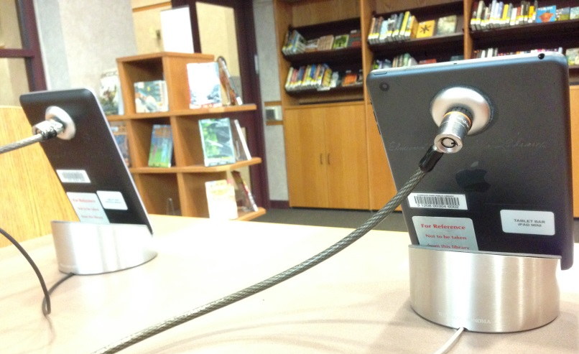
iPACs
Griffin Kiosk
Kensington
Locks
Guided
Access
  http://goo.gl/TcK52S

Slide 32


Set up an OPAC Kiosk
  Old PC
  Free copy of Ubuntu
Step by Step Guide: http://goo.gl/QshMQ

Slide 33


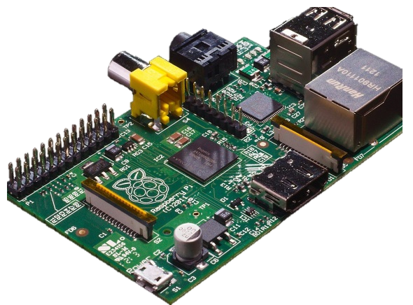
Raspberry Pi
Tiny Computer
  Between $25 and $70
  Perfect amount of power for an OPAC
  ACRL TechConnect article:
    http://goo.gl/SrUzx1

Slide 34
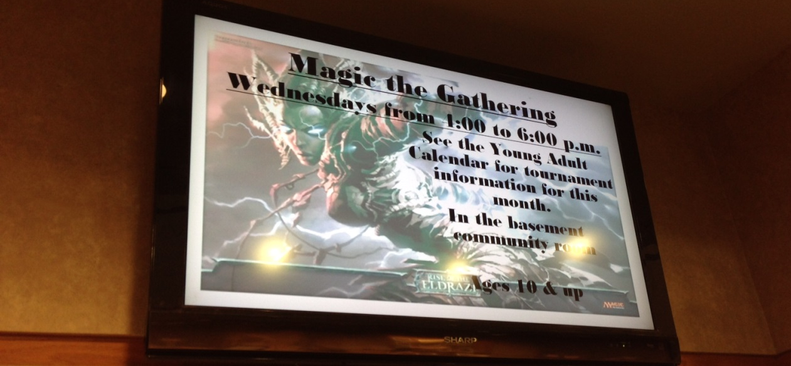
Lobby Display
Digital Signs can be crazy expensive
Use PowerPoint (or a free alternative)
  Setup a shared folder –tell staff to save there
  Use PowerPoint Viewer (free)
  Hook up to any TV

Slide 35

Office Alternatives
If MS Office is not in the budget:
Try
  LibreOffice
  OpenOffice
  KOffice
  Google Docs

Slide 36
Server Virtualization
Windows Server 2012 – HyperV
VM Ware
  If your server has the RAM & Processor speed
  No need to buy another server
  No need to setup a regular computer as a server

Slide 37
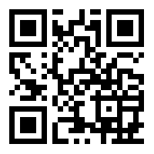
A.B.T.
Always Be Troubleshootin’
Ahren Sievers
Technology Librarian @ Elmwood Park Public Library
asievers@elmwoodparklibrary.org
Google.com/+AhrenSieversEPPL

Slide 38
Infopeople webinars are supported in part by the U.S. Institute of Museum and Library Services under the provisions of the Library Services and Technology Act, administered in California by the State Librarian. This material is licensed under a Creative Commons 3.0 Share & Share-Alike license. Use of this material should credit the author and funding source.

