Slide 1
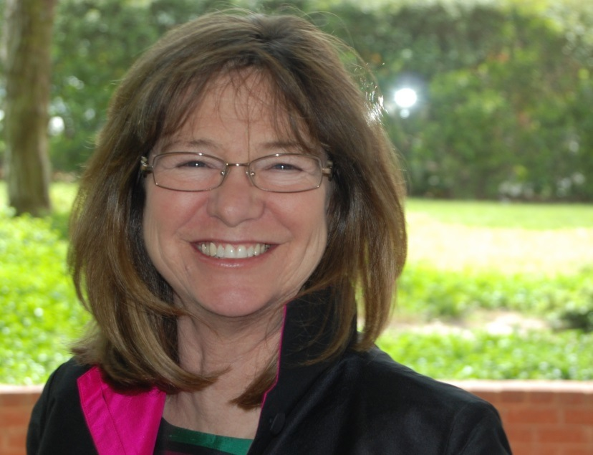
Consistent Communication
Coordinating Marketing Efforts Across Multiple Platforms
An Infopeople Webinar
Tuesday, September 23, 2014
Presenter: Nancy Dowd

Slide 2
What is multichannel marketing
Do you need this strategy to succeed?

Slide 3
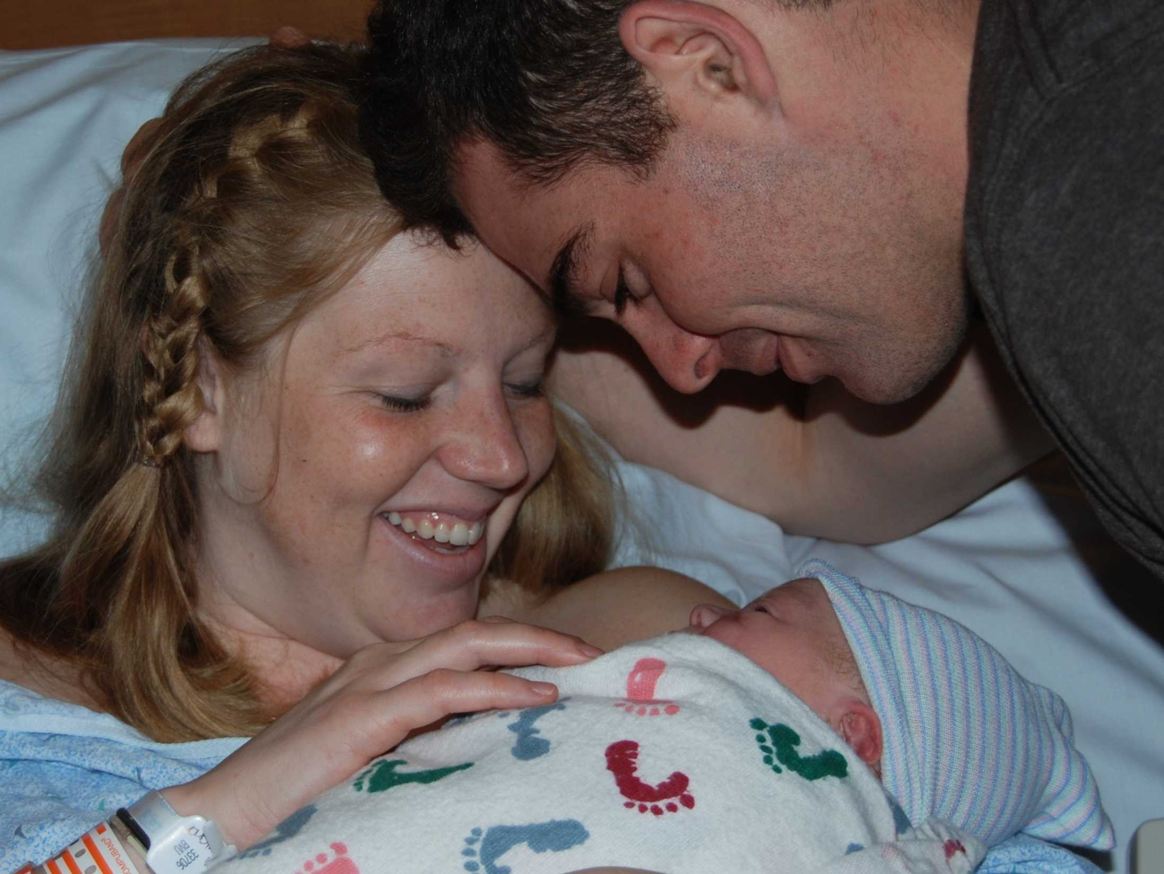
Notes:
What is multi-channel marketing and why do you need to start incorporating these strategies into your planning? Meet Winston….

Slide 4




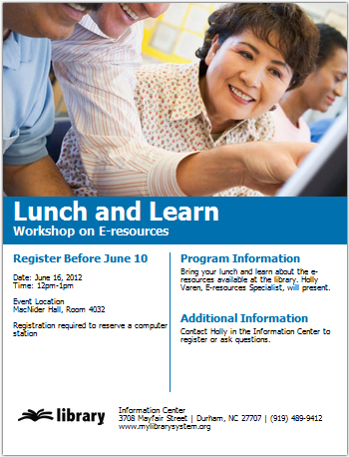


Slide 5
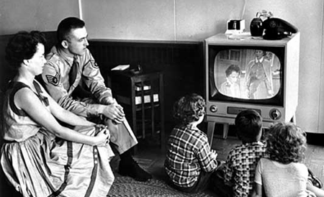
Notes:
There was a time when everyone would watch the same TV shows at the same time, read the same set of newspapers….

Slide 6
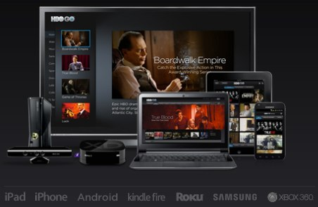
Notes:
Now we demand multiple screens

Slide 7
Marketing strategy

Slide 8
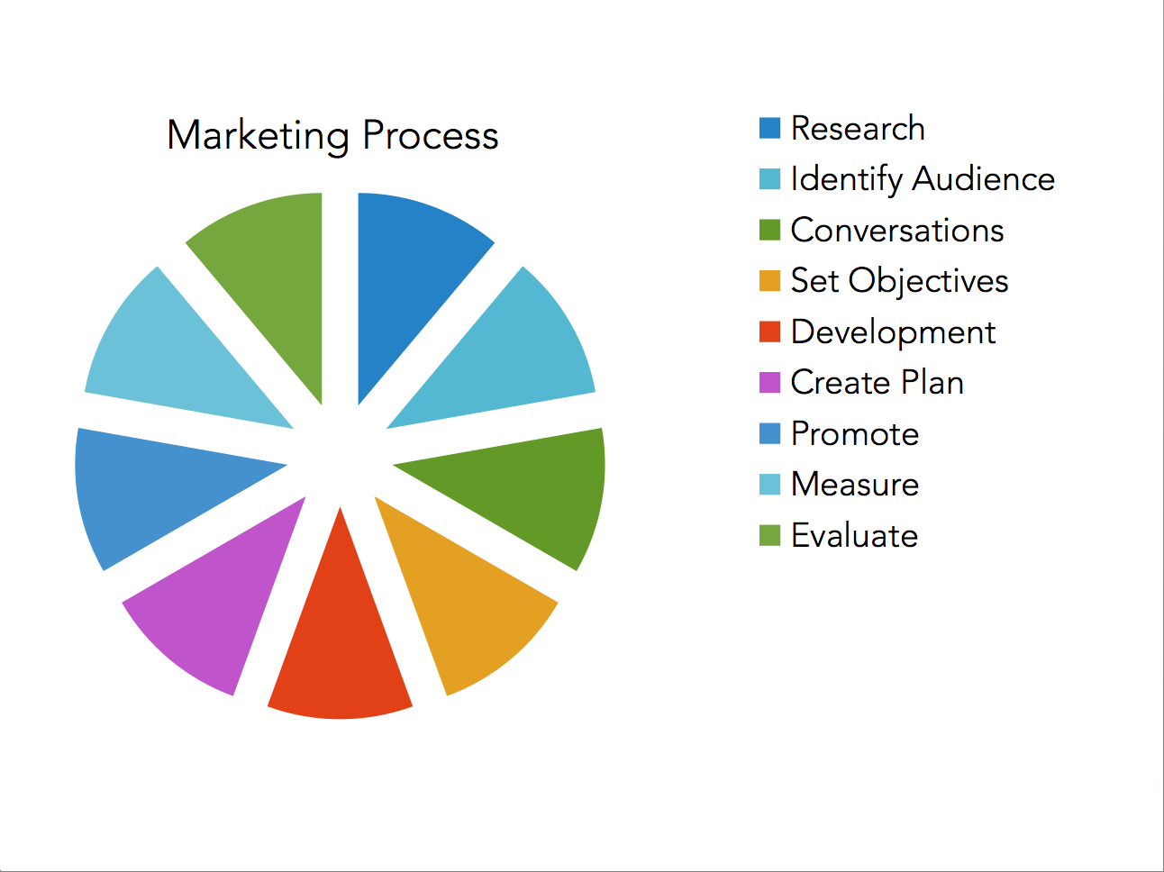
Notes:
The typical marketing process is cyclic and can be overwhelming

Slide 9
simplified
1. Know what your people want and need
2. Create products that help
3. Package, repackage, promote
4. Deliver through the channels they

Slide 10
Align. Engage. inform.

Slide 11
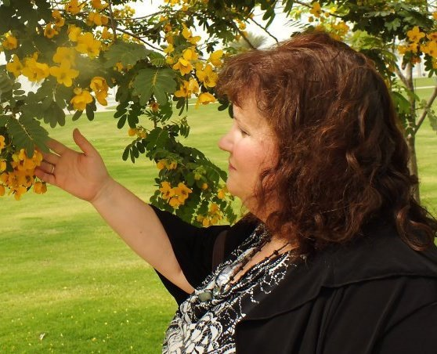

Notes:
Meet Janie Hermann. Janie is what we like to call a natural marketer.

Slide 12
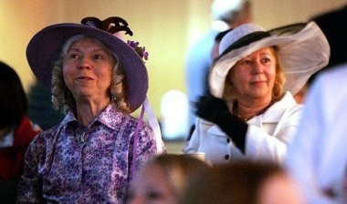
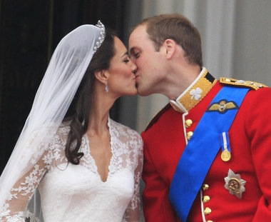
Notes:
When Princeton Public Library wanted to celebrate the Royal Wedding, Janie posted it out on their FB page to see if there was any interest in gathering at the library at 5 am dressed in royal wedding attire. There was.

Slide 13
Align. Engage. inform.

Slide 14
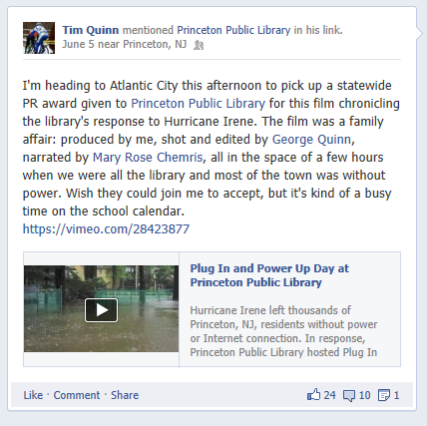
https://vimeo.com/28423877
Notes:
When Hurricane Irene hit NJ the library used social media to let folks know they could come to the library. Because they had so many connections the word spread quickly and over 4500 people filled the library to plug in and power up. Tim’s son created this video but never garnered the same response.

Slide 15
Align. Engage. inform.

Slide 16
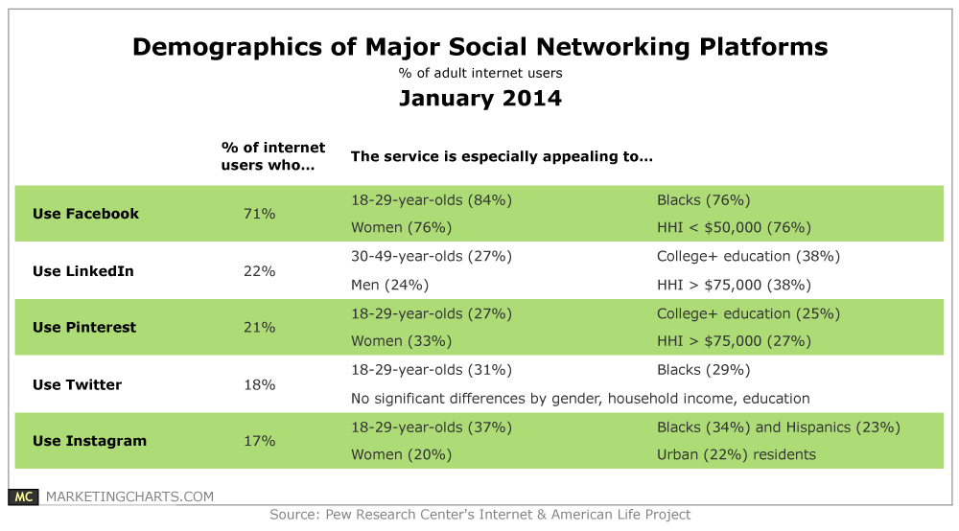
The channels

Slide 17
Social Impact
Connect with People
    Helps keep up with social ties - family and friends
    Online social support
    Political engagement
    Revives dormant relationships
    Connect with people similar hobbies
    Read comments by celebrities, politicians and athletes
    -Pew Institute

Slide 18
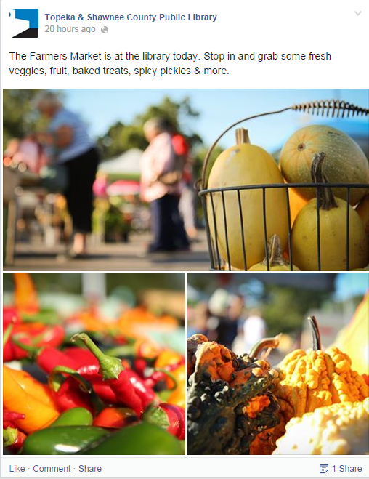

19-29 yr. olds
10 minutes a day
40% more than once
69% income 75k+
College grads
71% of online users
Notes:
Facebook
10 minutes a
day – 40% more than once ad ay
Mostly 19-29 year olds- 84%
69% - Income 75K
45% of people online who are over 65% use it
College grads 68%
Twitter
Forty-six percent of users visit daily and twenty nine percent check their feed multiple times throughout the day
The amount of Twitter users held somewhat steady, with 18 percent of online adults on the site, up from 16 percent in 2012.
Twitter is slightly more popular among women (18 percent) than men (17 percent), and use is highest among people between the ages of 18 and 29.

Slide 19
What works?
What
works?
Images
Fun
Relevancy

Slide 20
What
works?
Questions
Shorten links
Comments and Conversations

Slide 21
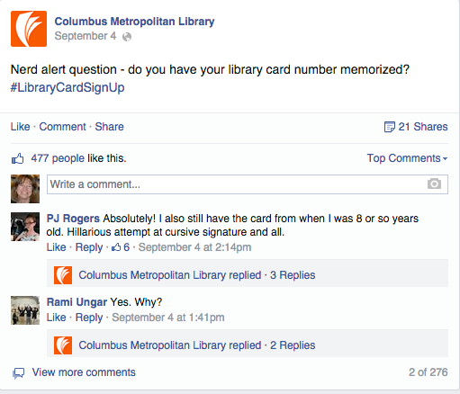
What
works?
Questions
Shorten links
Comments and Conversations

Slide 22
What
works?
Questions
Shorten links
Comments and Conversations
Being there

Slide 23
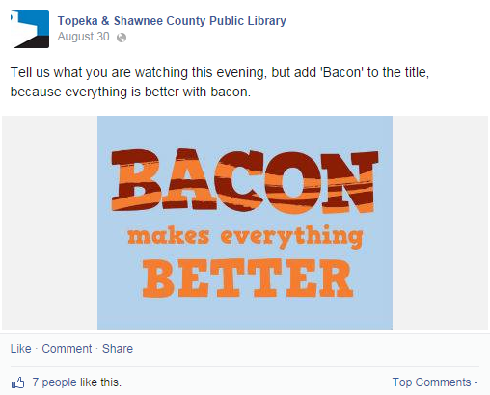
Not all posts are created equal.

Slide 24
Notes:
Plan content
Create special topics and host on specific days

Slide 25

18- 29 year olds
46% use daily - multiple
5 minutes a day
23% under 30K income
Notes:
Twitter
Forty-six percent of users visit daily and twenty nine percent check their feed multiple times throughout the day
11% of social media
The amount of Twitter users held somewhat steady, with 18 percent of online adults on the site
Twitter is slightly more popular among women (18 percent) than men (17 percent), and use is highest among people between the ages of 18 and 29.

Slide 26
What
works?
Reason to click
Short URLS
Retweets
Leave 20 characters to add comments
“Favorites”

Slide 27
What
works?
Images
Fun
Relevancy

Slide 28

18- 29 year olds
46% use daily - multiple
5 minutes a day
23% under 30K income
Notes:
Twitter
Forty-six percent of users visit daily and twenty nine percent check their feed multiple times throughout the day
11% of social media
The amount of Twitter users held somewhat steady, with 18 percent of online adults on the site
Twitter is slightly more popular among women (18 percent) than men (17 percent), and use is highest among people between the ages of 18 and 29.

Slide 29
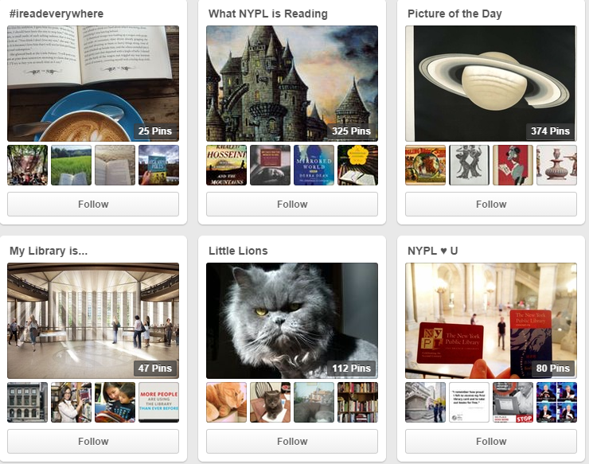
Mostly women
50% have children
15 minutes a day
100K income
Notes:
Content: Repinned images featuring female life style topics
Top - Tutorials, DIY, Recipe pins
Demographics: Mostly women – 50% have kids
More than 75% access through phones and tablets
Spends about 15 minutes on site everyday
Income 100K
People scroll quickly and may not notice a good video
Gifs don’t play
Use images – don’t worry about text

Slide 30
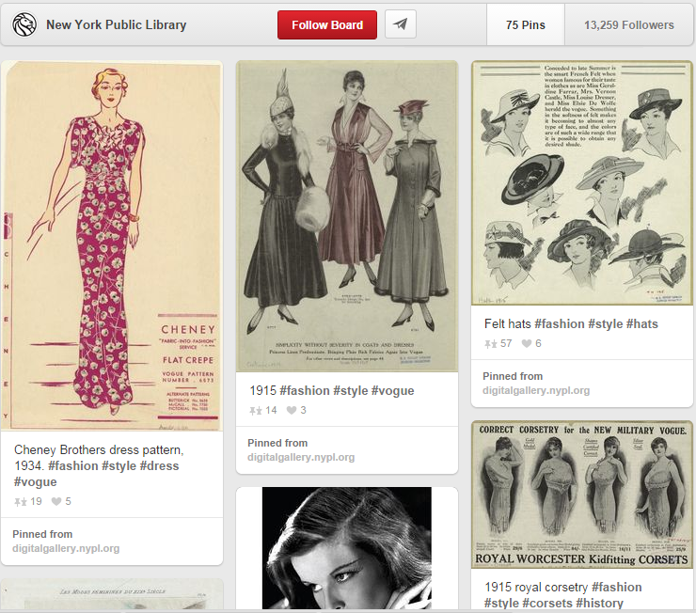
Notes:
NYPL features images from their collections

Slide 31
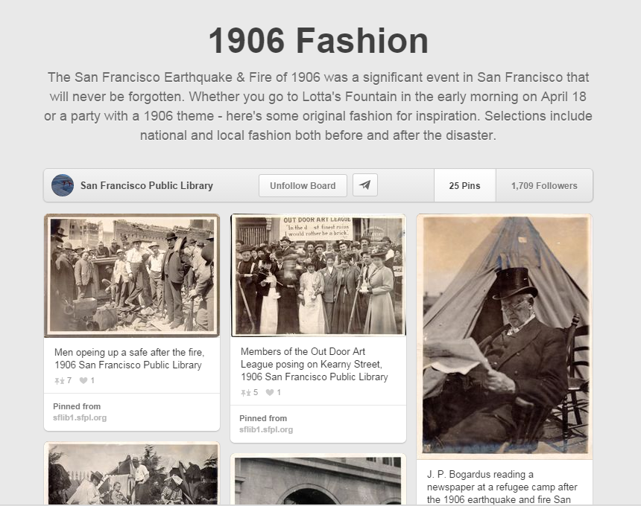
Notes:
SFPL combines visual and context with great results

Slide 32
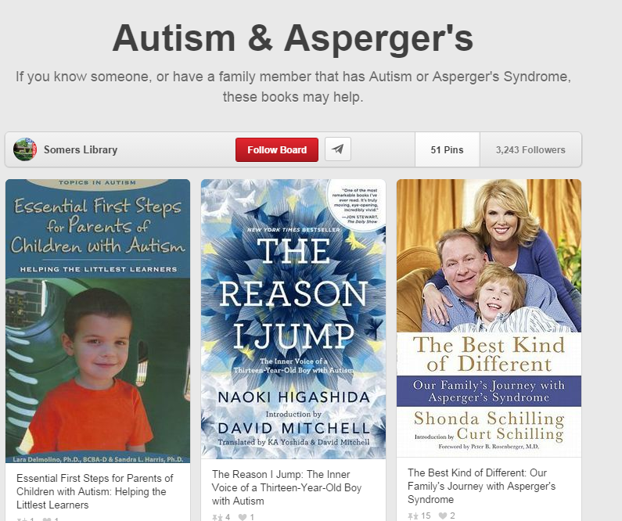
Notes:
Sommer Library has 36,254 followers consider book lists on niche interests.

Slide 33
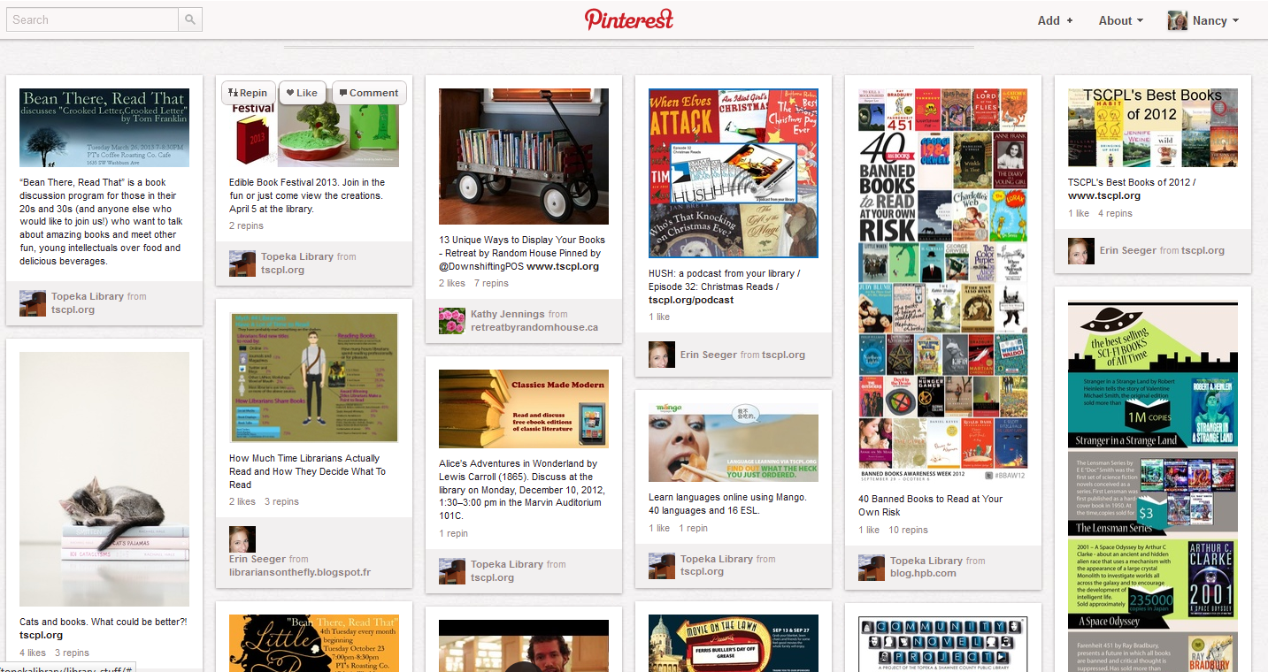

Slide 35

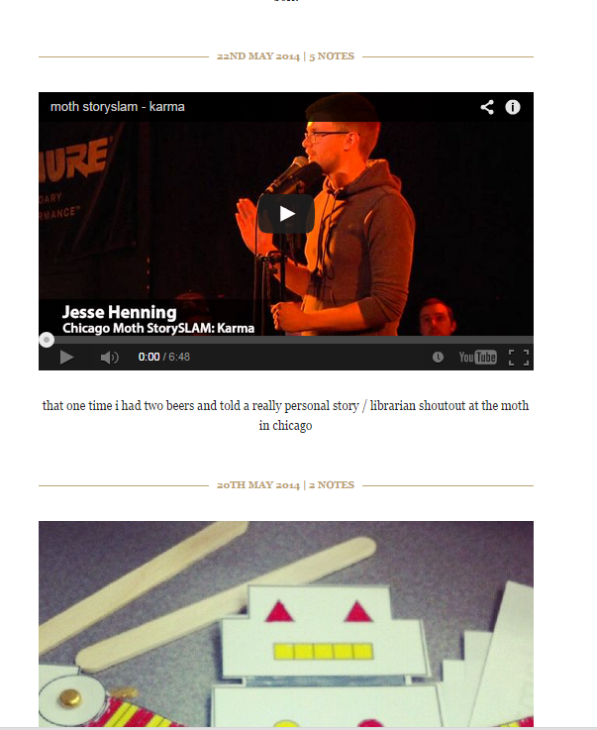
16- 24 year olds
33% have children
35K and less - college/YA
14 minutes a day
Men and women
Videos and Gifs work well
Notes:
Tumblr
Contet: self uploaded images and shared photos- musicians, actors, animated gifs and memes
Age group: 16-24
Man and women
33% have children
Most use computer but 50% use app
Use to blog and post visual content to twitter
On site about 14 minutes a day
Young adults and college students making 35K or less
Videos and GIFs work well

Slide 36

GenX and Millennials
Home of the “Selfie”
35K and less - college/YA
14 minutes a day
All about me, me, me
Teens say it’s “most important SM”
Notes:
Prestige - says its most important Reaches millennials and GenXers- birth place of the selfie
Top 10 mobile app
All about me, me, me… works on fear of missing out on things
Pure social media – enhances images with filters to make them look better – videos gaining traction
Consider setting up photo opportunities for others instagram from your library rather than you trying to post images
All about me- peaks after dinner
Is a great visual brand builder
50% use app
Use to blog and post visual content to twitter
On site about 14 minutes a day
Young adults and college students making 35K or less
Videos and GIFs work well

Slide 37



Slide 38
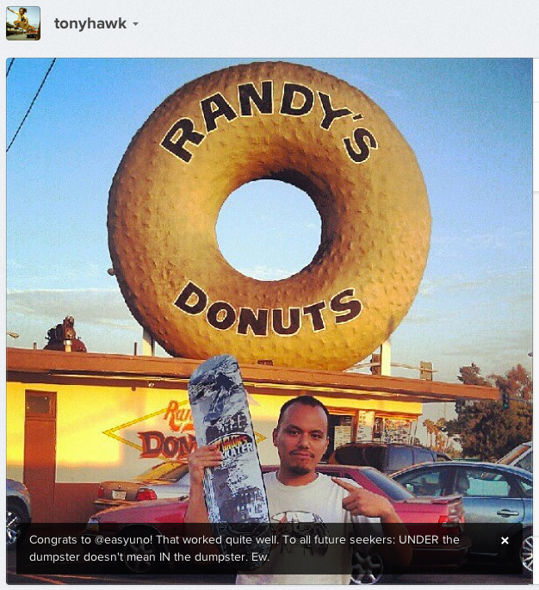
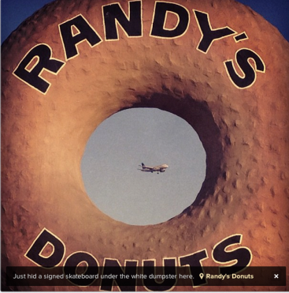

Slide 39

30- 49 year olds
Career minded
College Grads
Income 75K +

Slide 40
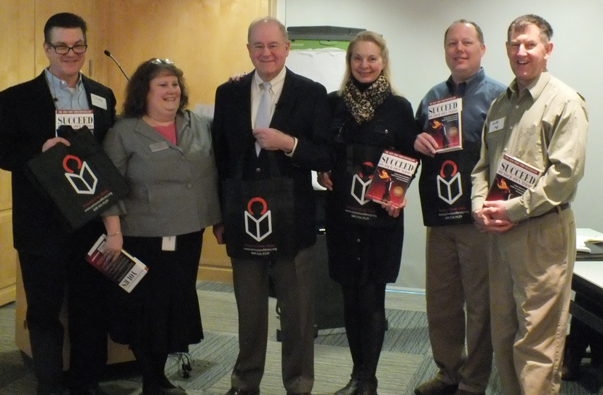
Notes:
Business people
Only channel with larger male population
Networking
Well-known career coach Alex Freund of Landing Expert Career Coaching conducted a 5 week series in Feb. 2012 that included modules on objectives and career plan, resume writing, networking, communications and compensation negotiation. Each module included an hour of interview preparation via mock interviewing.
Based upon the success of this pilot project, a second series has been scheduled for April 2012 and other libraries in NJ are replicating this course.

Slide 41

Teens - early 20’s
Girls
60 Million users
400 Million made per day
12% shared with multiple recipients
5% selfies shared on SM come from Snapchat

Slide 42

40 Million users
18-20 year olds
Shared through Twitter (1in 5)
Weekends are very popular
Musicians love this platform - they get 3 of 5 most retweeted
16 minutes per month watching online commercials

Slide 43

Video
1+ BILLION users
1 Billion views every day
100 hours of video uploaded per minute

Slide 44


Notes:
https://www.youtube.com/watch?v=NsE6l7ILJCM&
YouTube reaches more adults aged 18 to 34 than any single cable TV network. Nearly half of people in this age group visited YouTube between December 2013 and February 2014, according to Nielsen. It was rated by millennials as the top place to watch content, ahead of digital and TV properties like Facebook and ESPN.

Slide 45
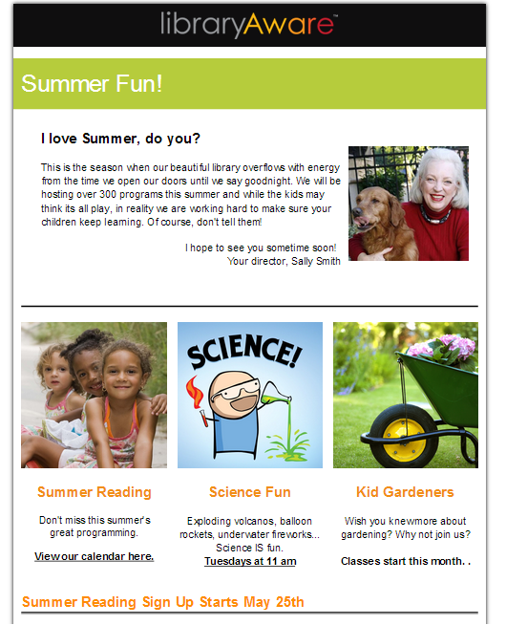
Email
Notes:
Want to drive everyone to email where they can tell you want tthey want from you so you can deliver that information
Short, visual, strong call to action

Slide 46
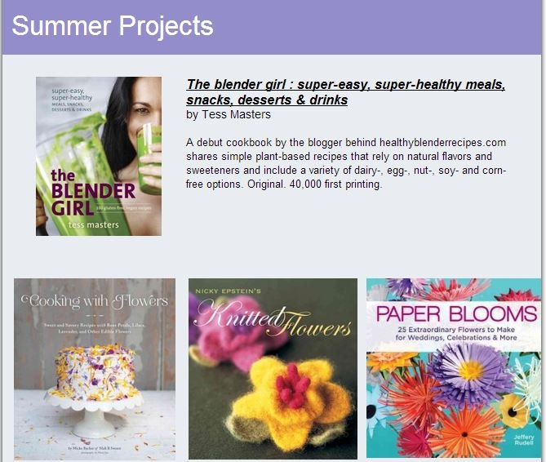
Eblast

Slide 47
Content calendar vs communication blueprint

Slide 48
The Communication Blueprint
Audiences: ,
PRINT | SOCIAL | EMAIL | MEDIA | WEB | Personal
PRE-PROMOTION
POST PROMOTION

Slide 49
The Communication Blueprint
Audiences: University Parents and Elected Officials ,
PRINT | SOCIAL | EMAIL | MEDIA | WEB | Outreach
PRE-PROMOTION
Bookmarks at circulation Flyers at Partner Locations TJ Maxx, Gymboree, Baby Gap, preschools | Facebook Announcement FB Fast Facts FB-Post Photos Links from Mommy bloggers | E-Blast Announce Blast – Picture Link and next session EO Invite EO Invite | Photo-Op Media Advisory | Announcement Calendar Posting | Check Out Centers Book drops Fitness Mobs
POST PROMOTION
Send printed picture to EO Survey at program | FB- Post Survey | Thank You to EO with links to photo and media Include in Monthly Newsletter | Post Release captioned photo | Pictures Include quotes

Slide 50
Putting it together

Slide 51
Small scale

Slide 52


Slide 53
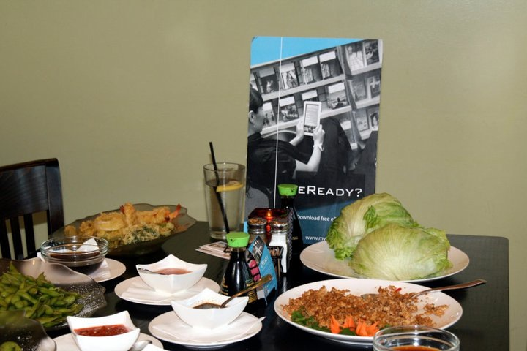

Slide 54
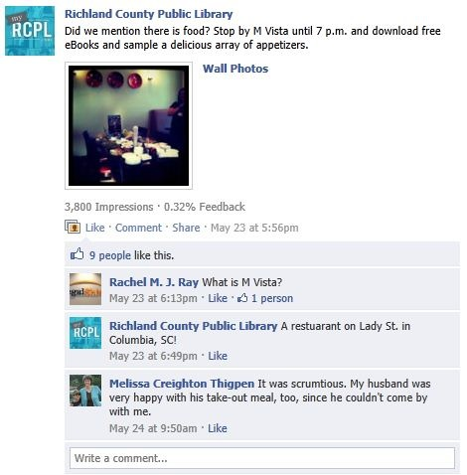
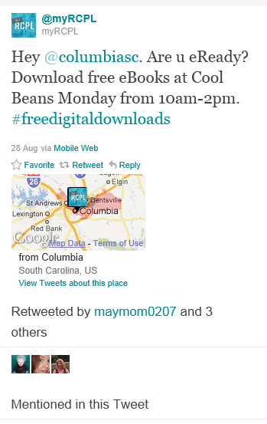

Slide 55
Total Package

Slide 56


Slide 57
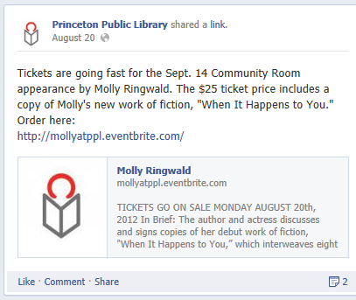
Facebook

Slide 58
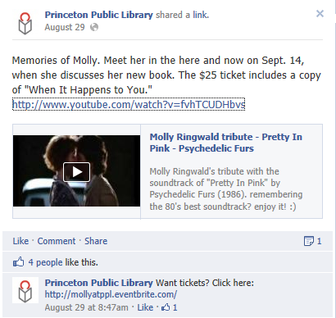

Slide 59
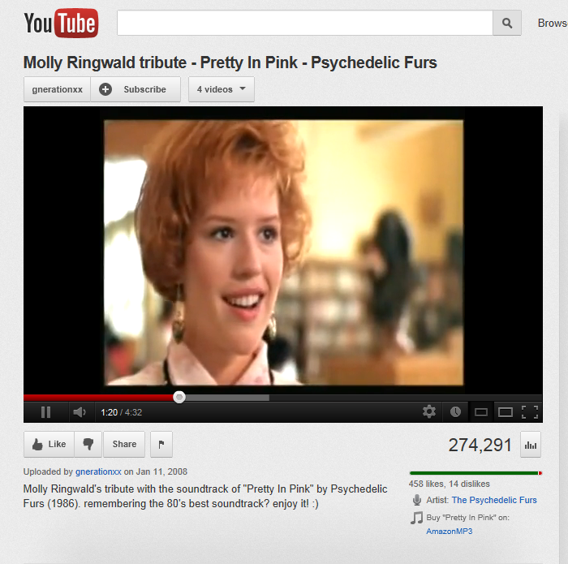

Slide 60
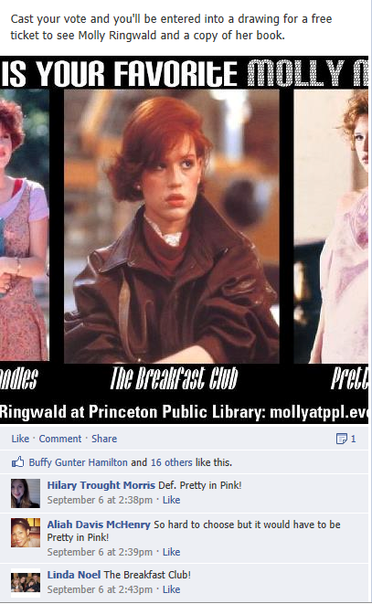
Notes:
Create a board on Pinterest…

Slide 61
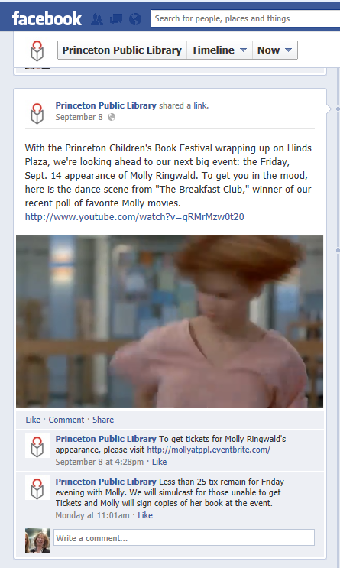
Notes:
They know how to use social media.

Slide 63
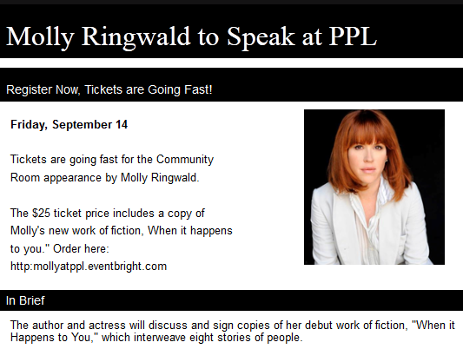
Stakeholders:
Email
Invitation to attend
Invitation to welcome audience
Sponsorship
Opportunity

Slide 64
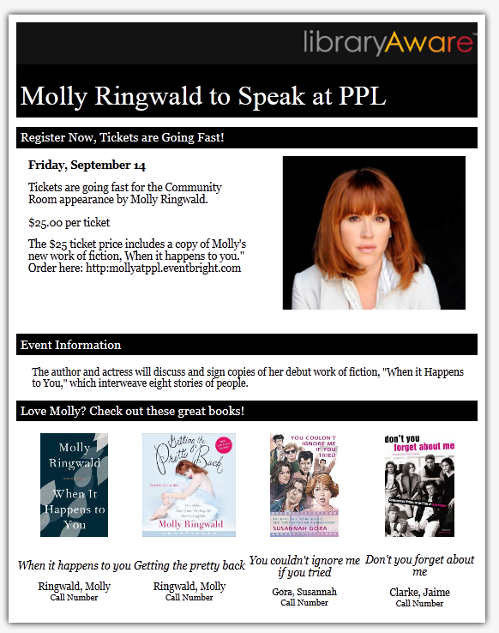
Cross Promote

Slide 65
resources

Slide 66

Targeted

Slide 67
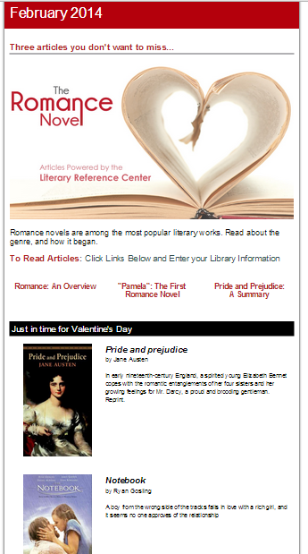
Cross Promote

Slide 68
Movie
and Books

Slide 69

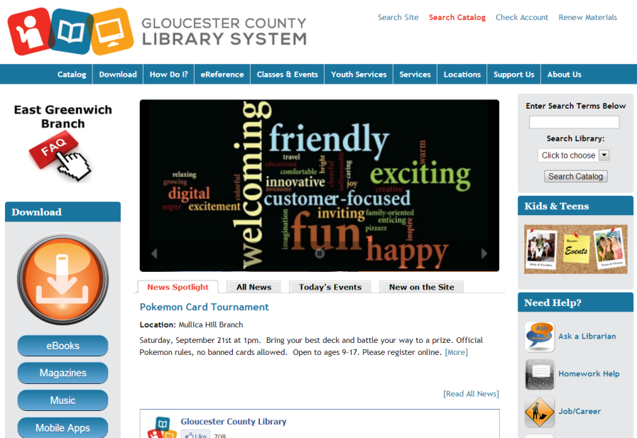
Your Library
Add to your website and facebook too.

Slide 70
if we don’t reach them
they will never hear us.
Thank you.
Nancy Dowd ndowd@me.com

Slide 71
Infopeople webinars are supported by the U.S. Institute of Museum and Library Services under the provisions of the Library Services and Technology Act, administered in California by the State Librarian. This material is licensed under a Creative Commons 3.0 Share & Share-Alike license. Use of this material should credit the author and funding source.

