Slide 1
Programming in a Box
Nuts and Bolts – Literally
Wednesday, October 29, 2014
Daisy Porter-Reynolds
Leslie Tanaka-Loza
Notes:
Actually there was a electricity program involving bolts!
Introduce ourselves….

Slide 2
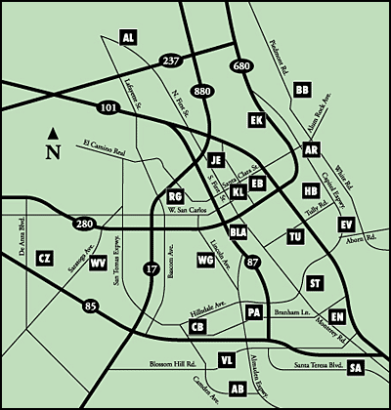
Notes:
DAISY

Slide 3
Plan once;
deliver nineteen times
Notes:
DAISY

Slide 4
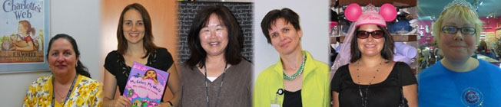
Notes:
DAISY

Slide 5

Notes:
DAISY

Slide 6

Notes:
DAISY

Slide 7

Notes:
DAISY

Slide 8

POLL
What’s the best program
you have done?
Please type your answers into the chat box.

Slide 9
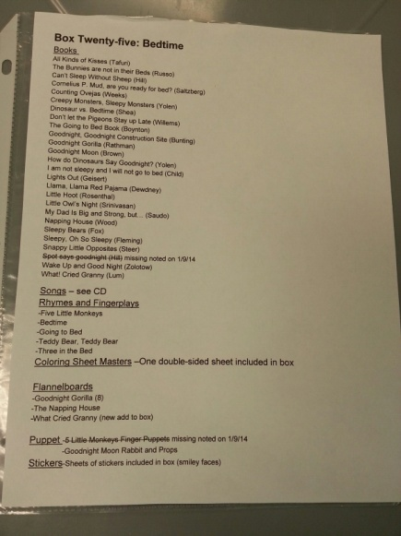
Storytime boxes started it all
Key elements:
  Books
  Flannels
  Finger puppets
  Large puppets
  Songs
  Stickers
Notes:
Storytime is our bread and butter
Keep them moving
Inventories checked at arrival and departure with Main Library check-up halfway down the line

Slide 10
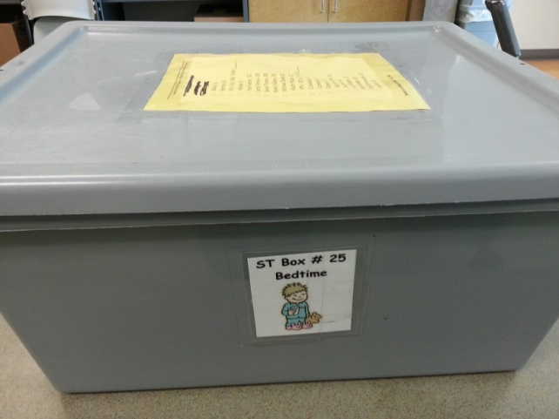

Slide 11
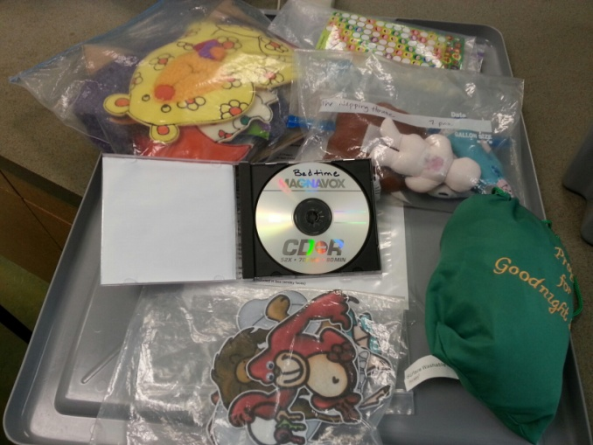

Slide 12
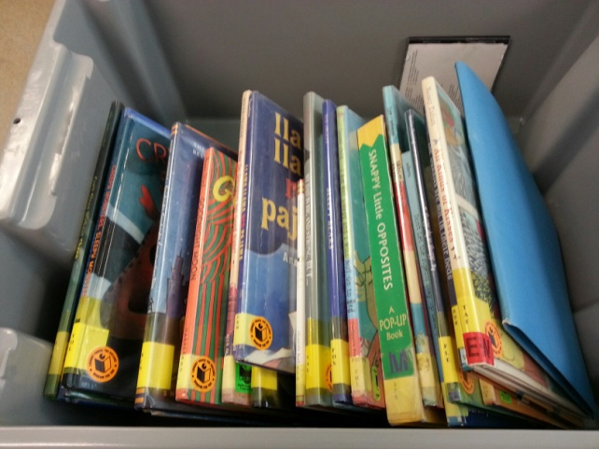

Slide 13
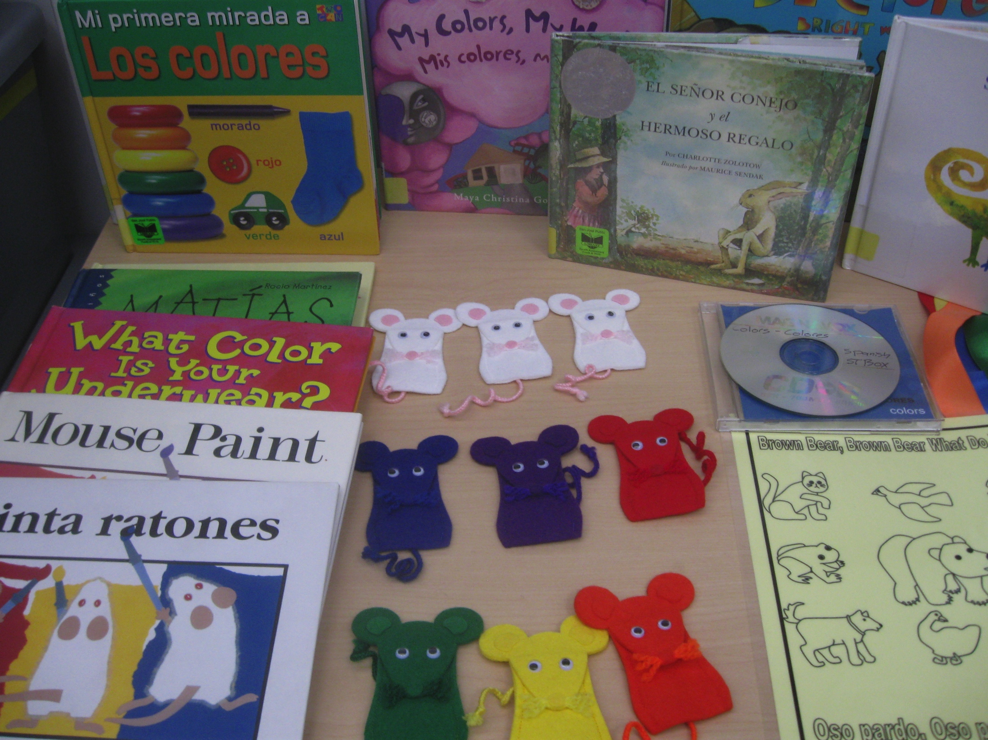

Slide 14
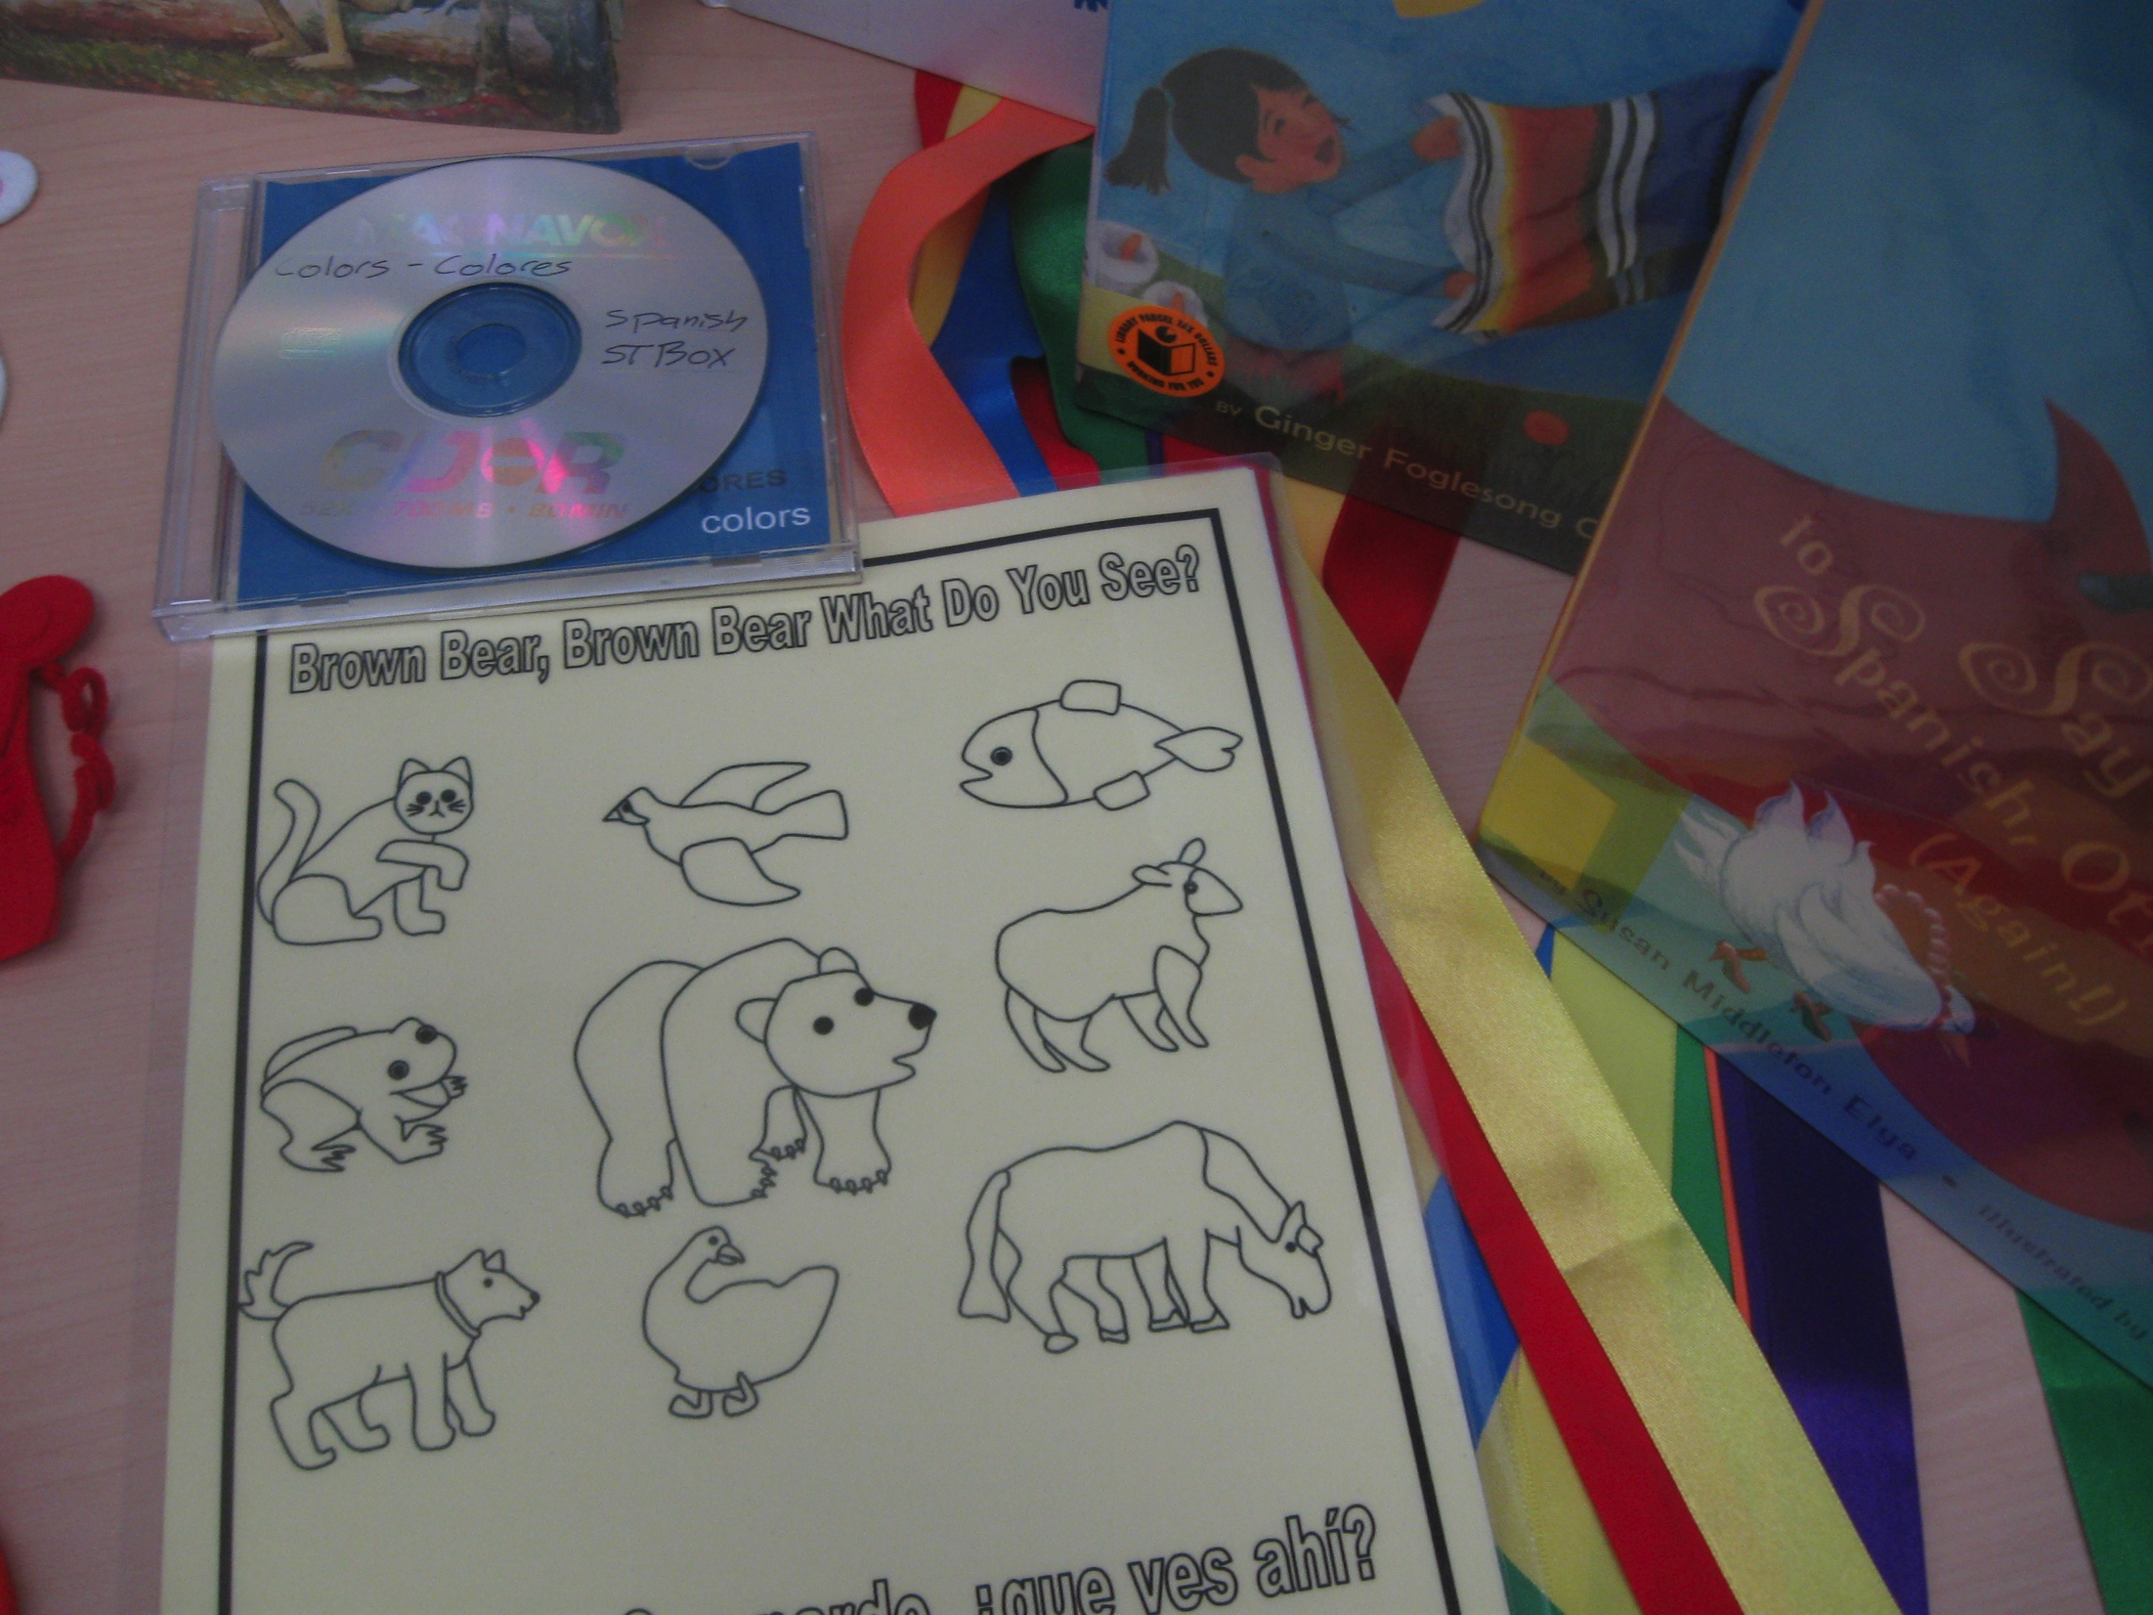

Slide 15
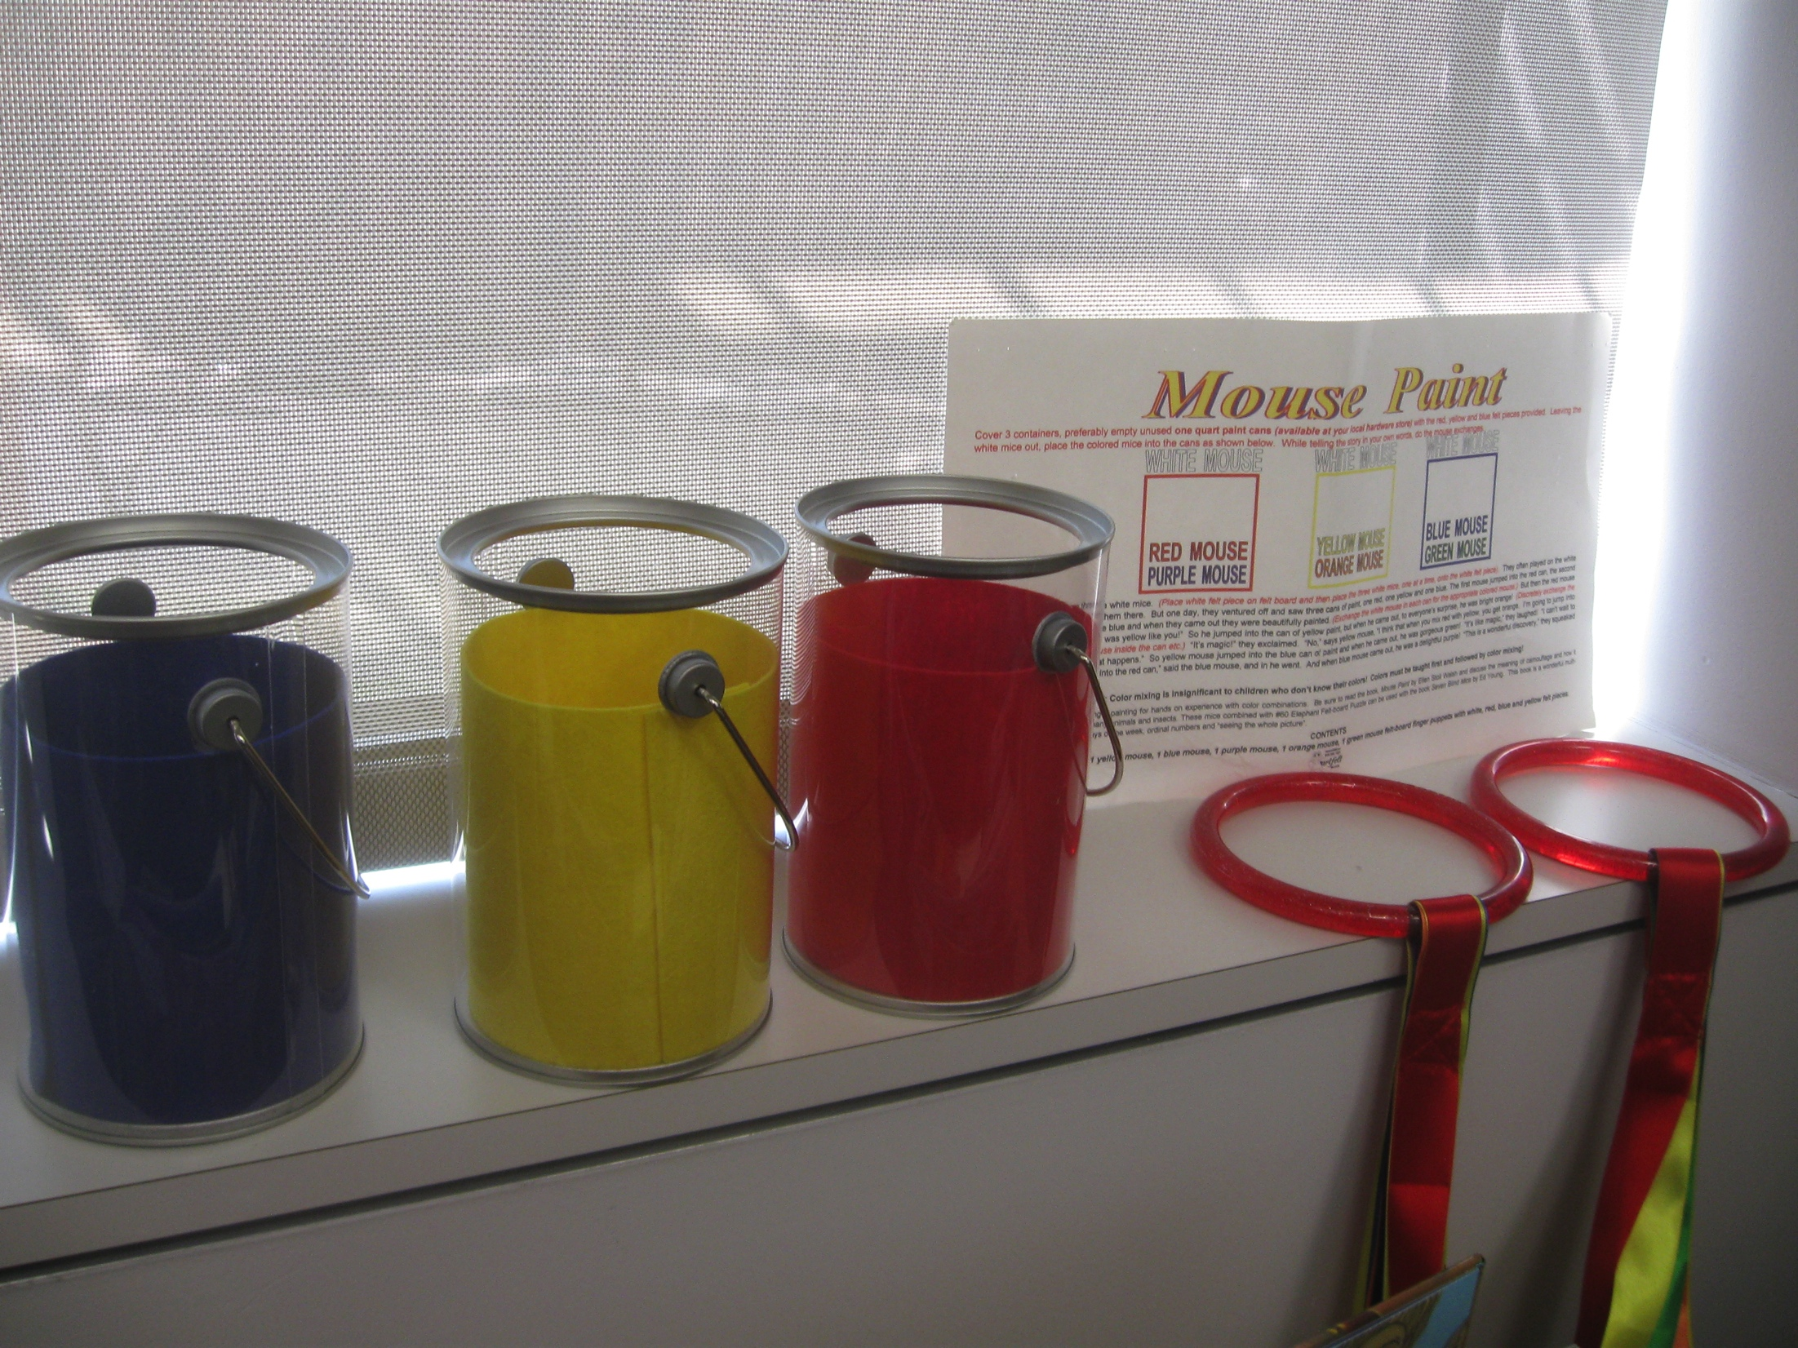

Slide 16
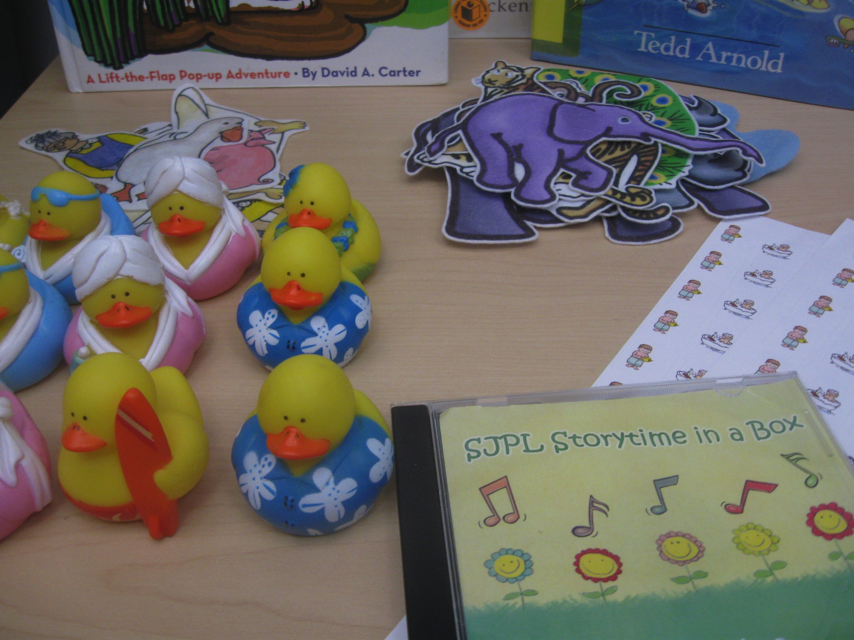

Slide 17
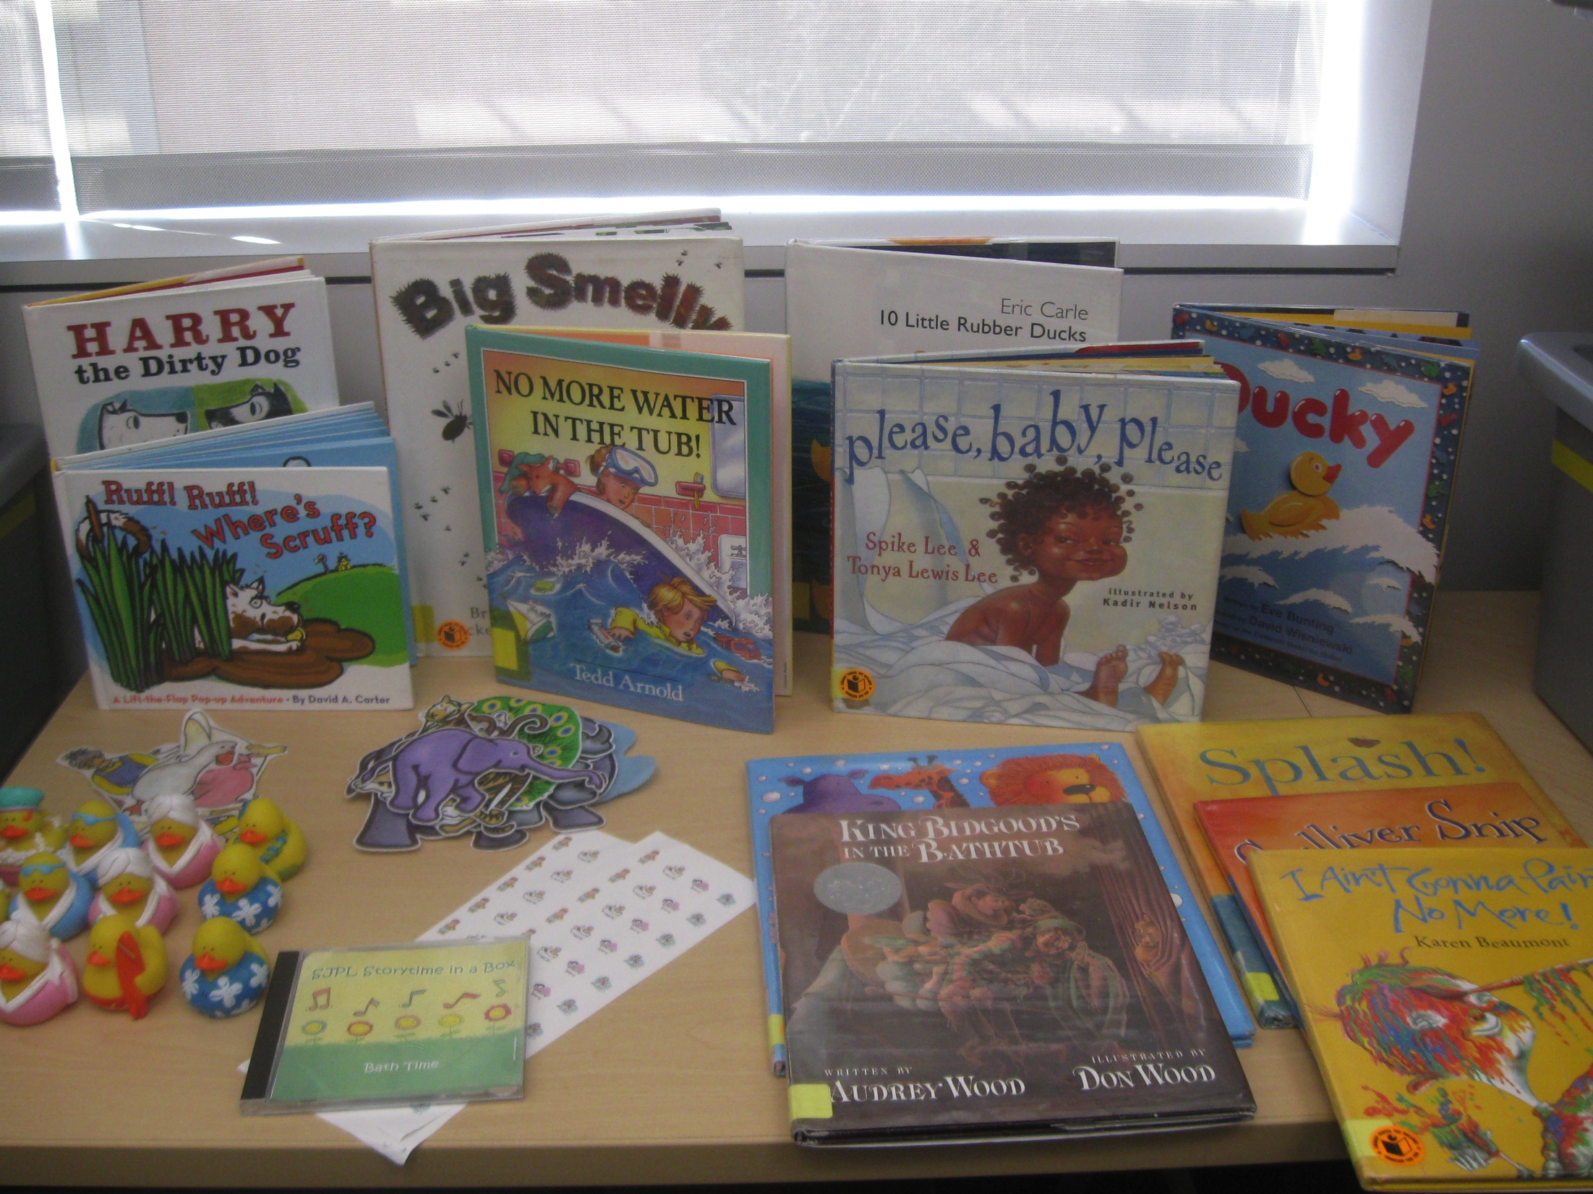

Slide 18
Boxes are not created equal
Boxes can be:
  Virtual
  Physical
  Hybrid
Notes:
Virtual is instructions and all you will need to present a program online
Physical is all inclusive and ready to go in an actual box – retention works well
Hybrid includes part virtual and part physical
Craft boxes very popular

Slide 19
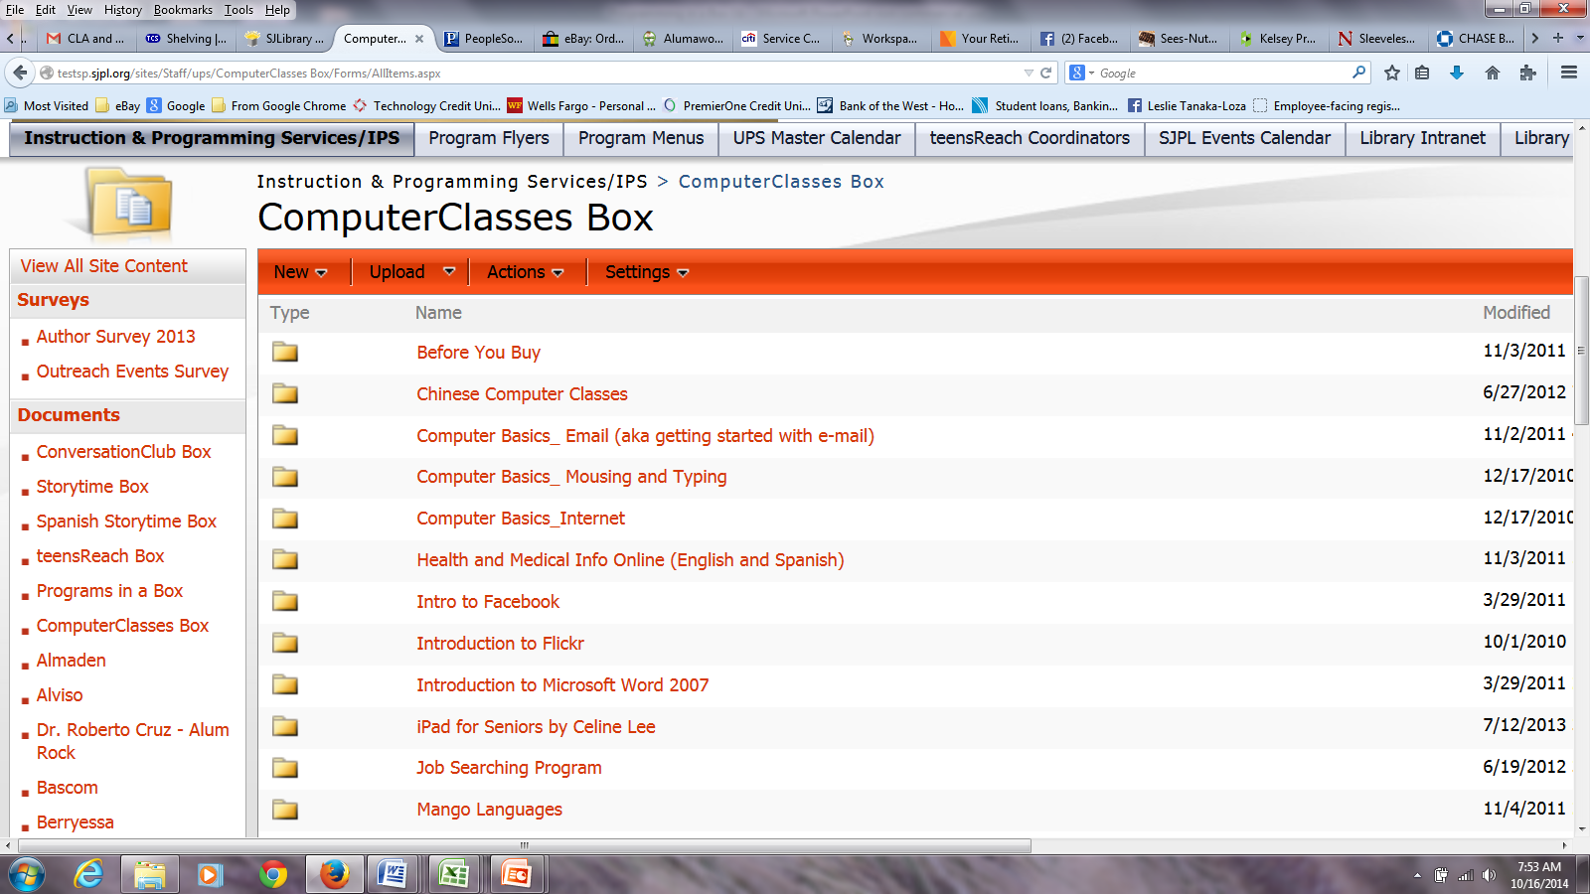
Boxes are not created equal
Notes:
True virtual is the computer box. Virtual is instructions and all you will need to present a program online

Slide 20
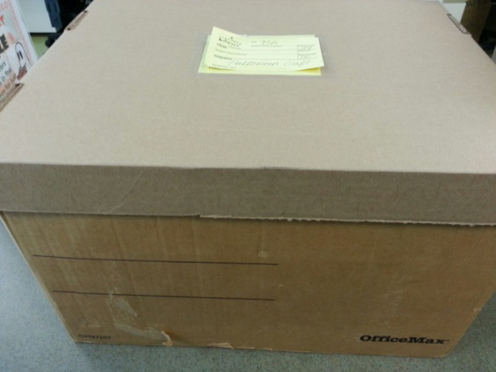
Notes:
Let’s get physical! Drab exterior is deceiving… Physical is all inclusive and ready to go in an actual box – retention works well

Slide 21
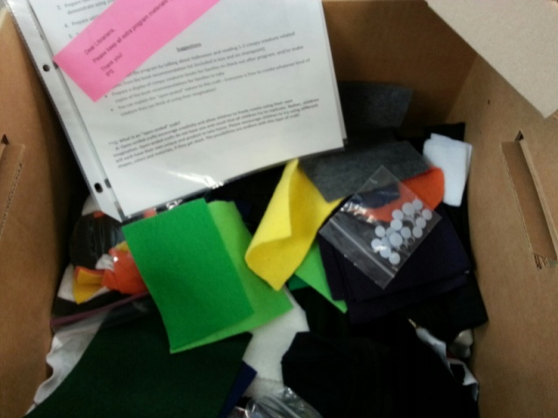
Notes:
There could be loads of goodies inside.

Slide 22
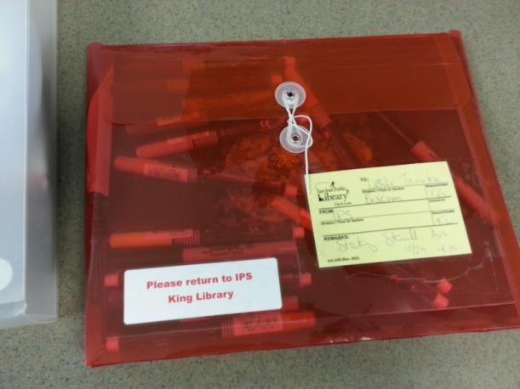
Notes:
Craft boxes very popular – physical envelope

Slide 23
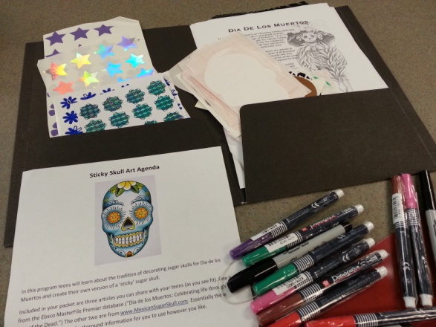
Notes:
Look what is inside!

Slide 24
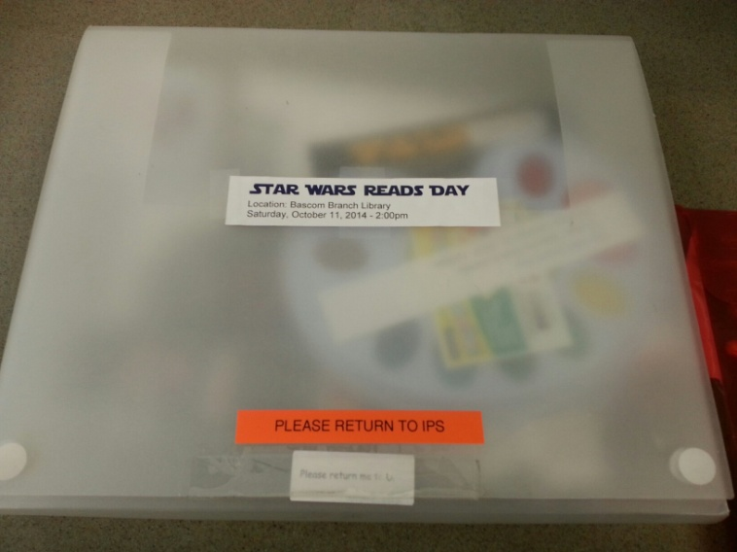
Notes:
Explain part physical and part online - Hybrid includes part virtual and part physical - Containers originally bought for periodicals department came in handy!

Slide 25
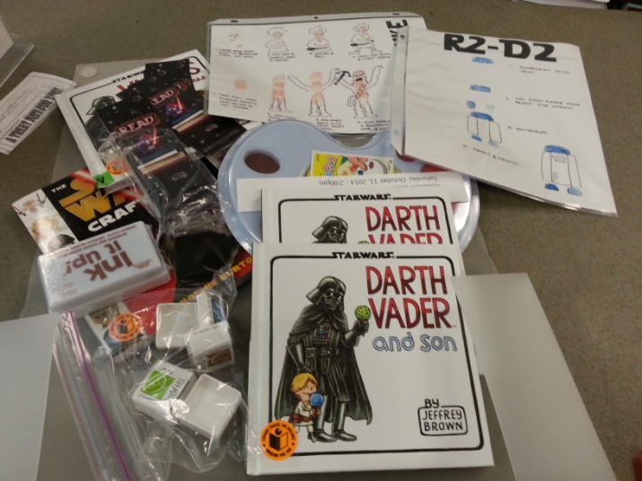
Notes:
Explain part physical and part online: must look at instructions and download or purchase extra materials

Slide 26
How boxes begin - ideas and why
Brainstorming ideas
Surveying Staff Likes
Responding to holiday prompts
Customers are paramount
Notes:
Utilizing stakeholders (librarians) and creative, talented staff

Slide 27
But really, how are they made?
Theme selection – Goldilocks and the three what?
Choosing appropriate content
Ordering supplies
Retention boxes
Staff training
Notes:
Fun to create
Amazon Prime was our friend
Including a sample of a craft
Craft boxes = time saved
Story and craft – hedgehogs with level appropriate craft

Slide 28
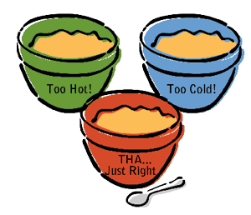
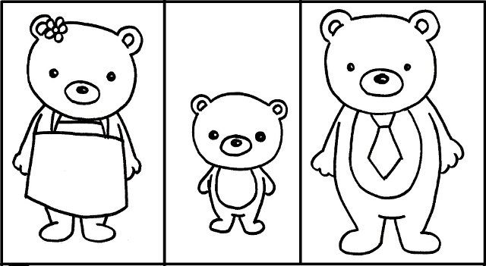
Simple idea becomes great
Notes:
Handout attachment for this box. What was in the box and what was creativity

Slide 29
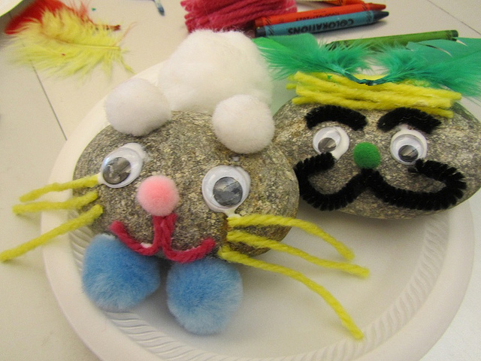
Notes:
Here are some funny stories… And rocks… describe going to get the rocks at the rockery…

Slide 30
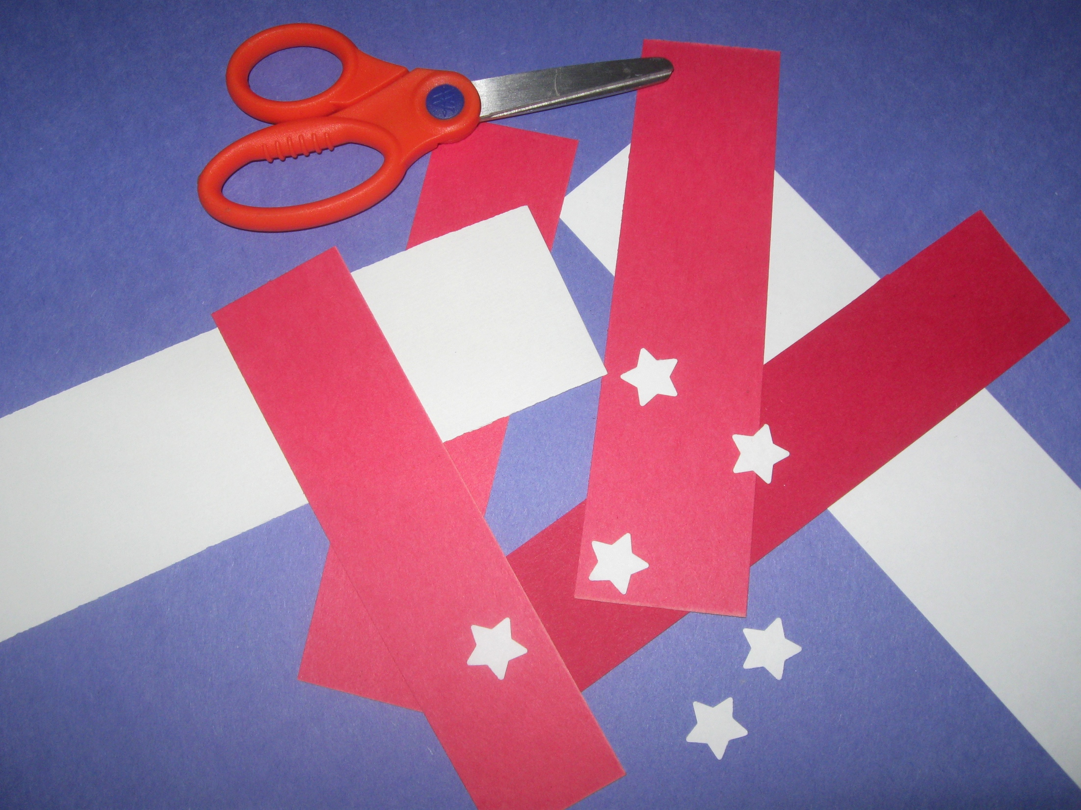
Notes:
Stars and Stripes hat craft

Slide 31
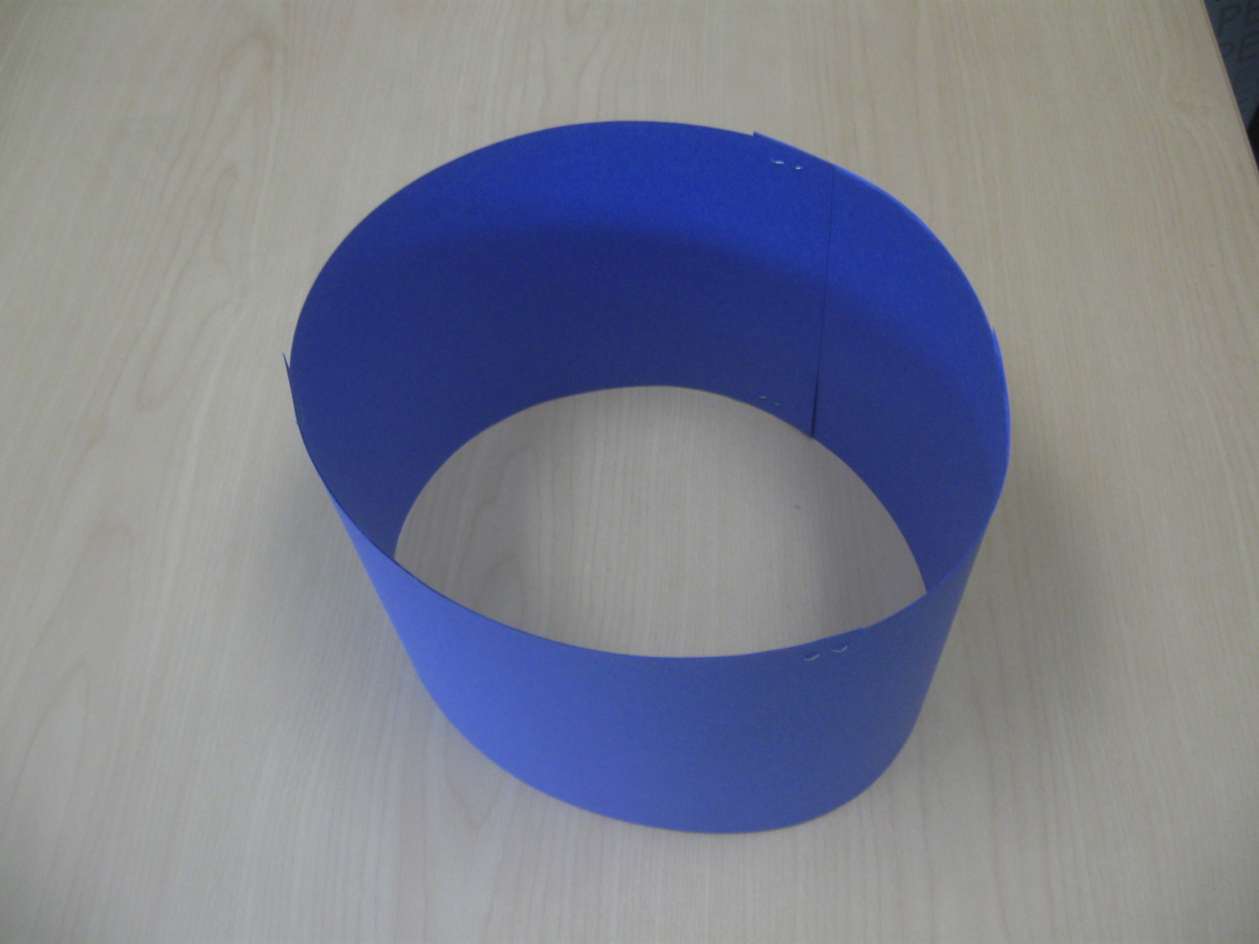
Notes:
Stars and Stripes hat craft – two rectangles make a hat

Slide 32
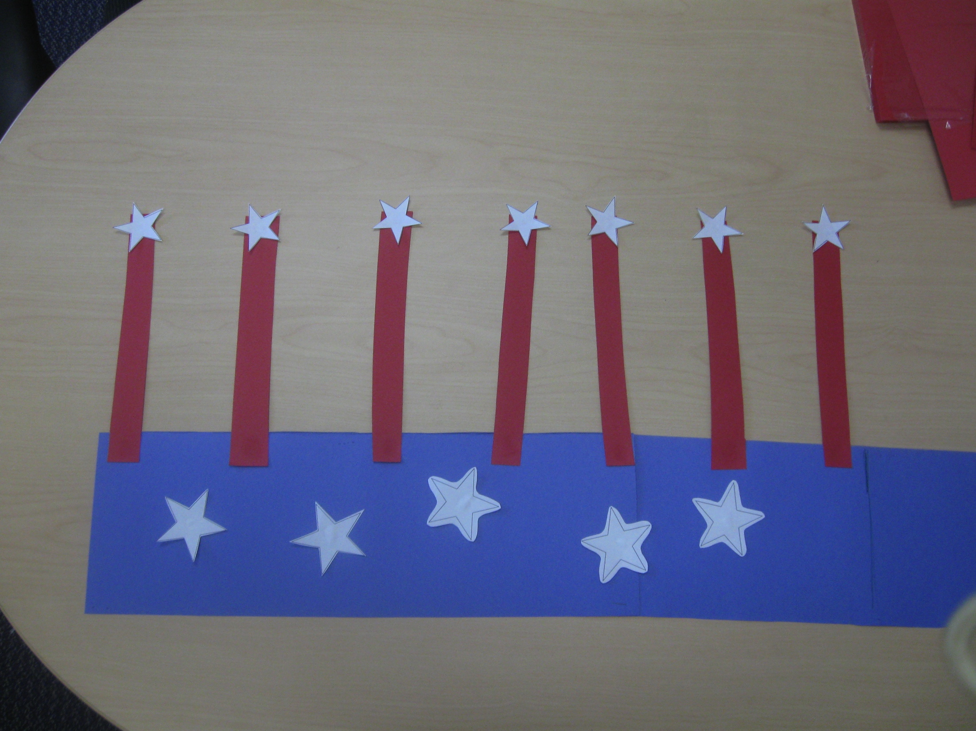
Notes:
Stars and Stripes hat craft

Slide 33
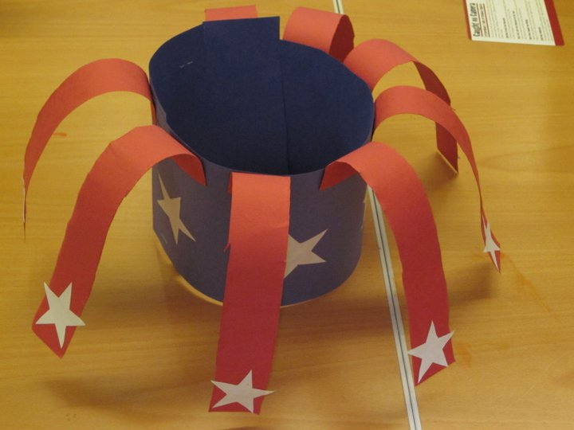
Notes:
Stars and Stripes hat craft – trouble shoot – cardstock? Easy for adult services good picture worth a thousand…

Slide 34
How are they used?
In-house
Branch and Main Library use
Outreach
Notes:
Don’t go out to the public, are used at branches and main library, can be modified for an outreach event

Slide 35
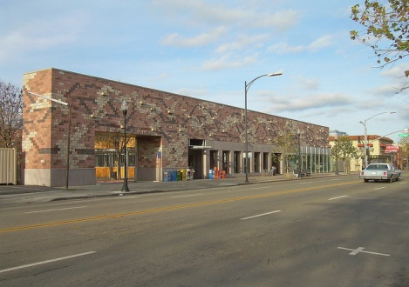
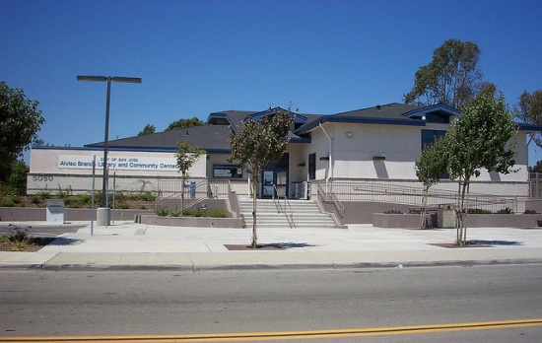
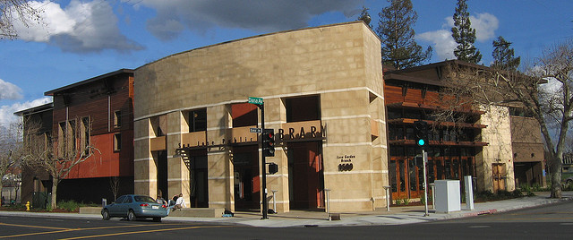
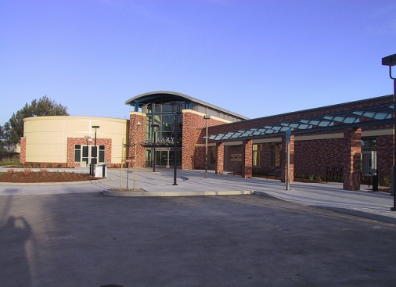
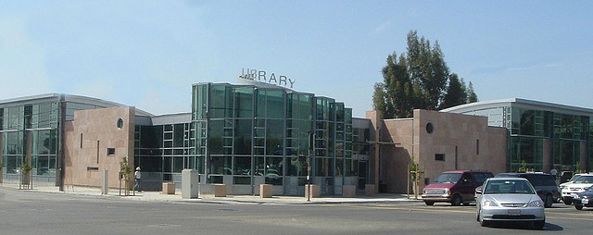
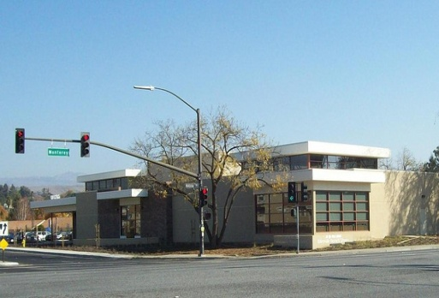
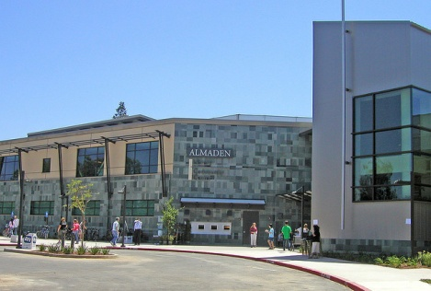
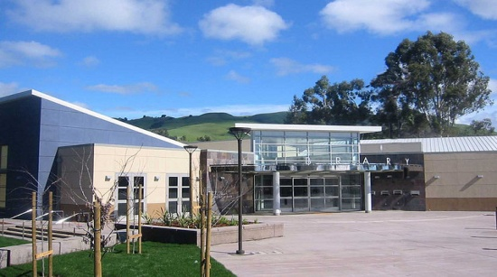
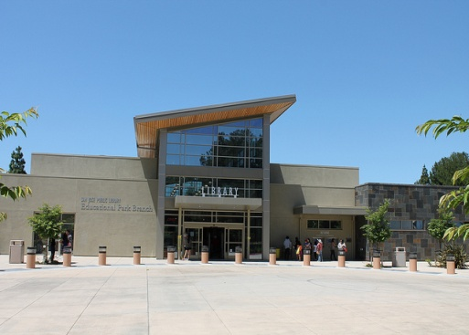
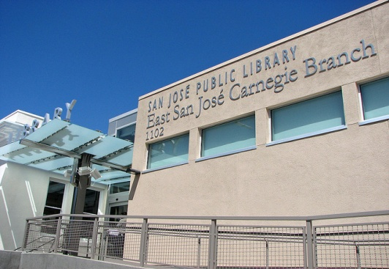
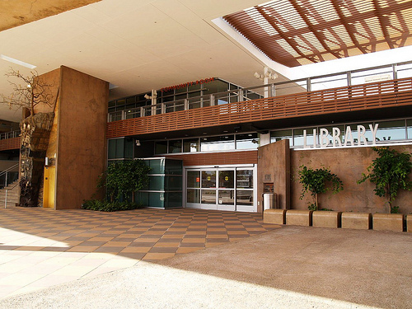
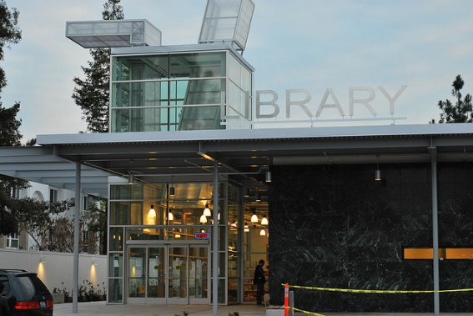
How are they used?
Notes:
Here, there, and all over town.

Slide 36
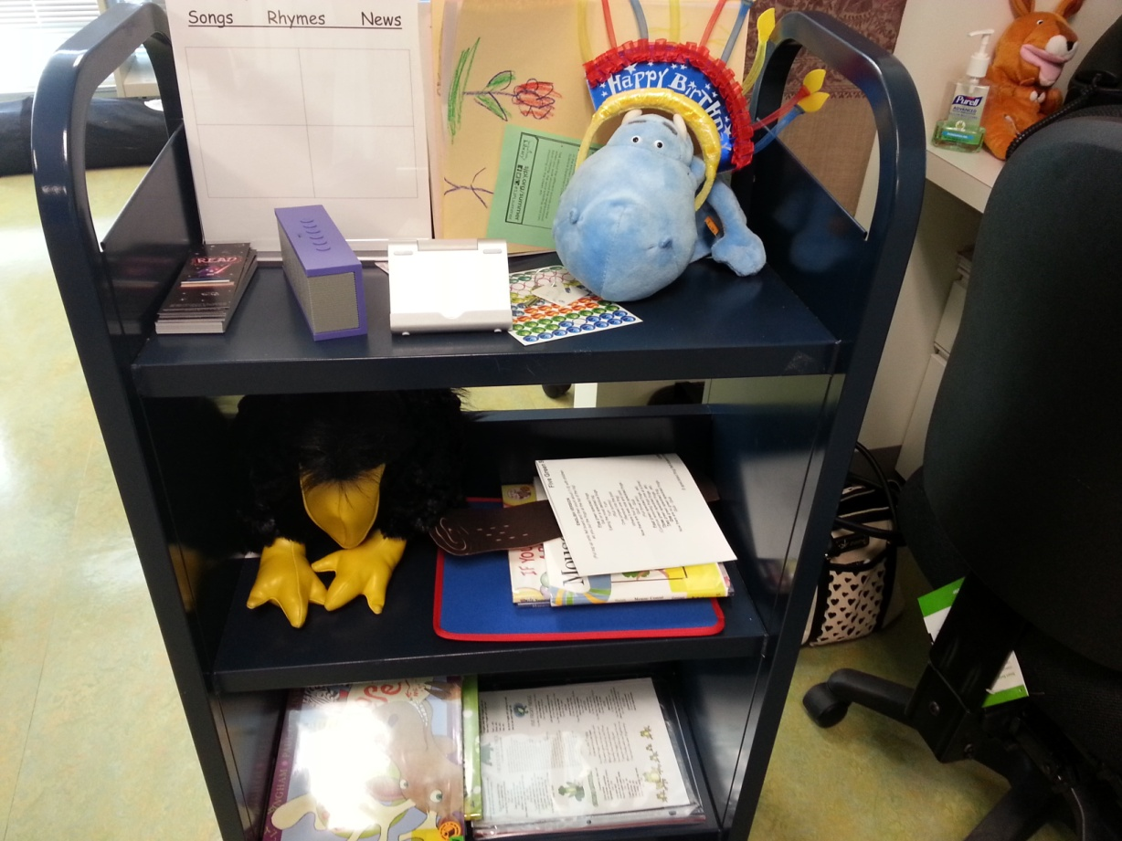
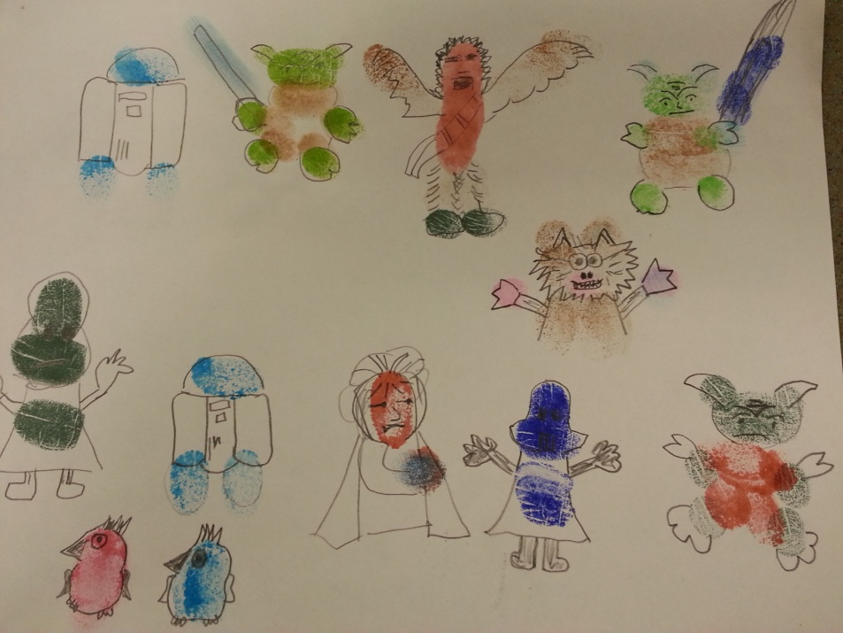
By me and a whole bunch of amazing staff members
Notes:
My booktruck and Star Wars artworks – How are they used?

Slide 37
Now that they are made – where are they stored?
“checked out” – permanently,
sort of
Some are stored as is and ready to go
Broken down and contents stored centrally for later
Craft supplies purchased as needed, no huge warehouse
Notes:
On loading dock, on book trucks, under desks. Wherever they land.

Slide 38
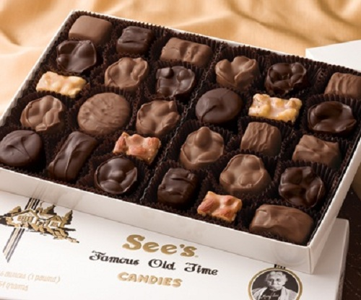
Lessons learned
“The best box is all-inclusive but open for creativity”-Leslie
See’s candy
assortment –
What shall I
choose today?
Notes:
What ages am I expecting?
If I add my favorite songs and fingerplays then it will be easy to fill in with a couple new things
Programming that appeals to all ages and levels - Best laid plans are better with choices and flexibility

Slide 39
Lessons learned
Five senses
ABC’s
Push back
It takes a village
Notes:
Talk about Five senses and abc boxes
All staff on deck
Recently used birthday box to great acclaim!

Slide 40
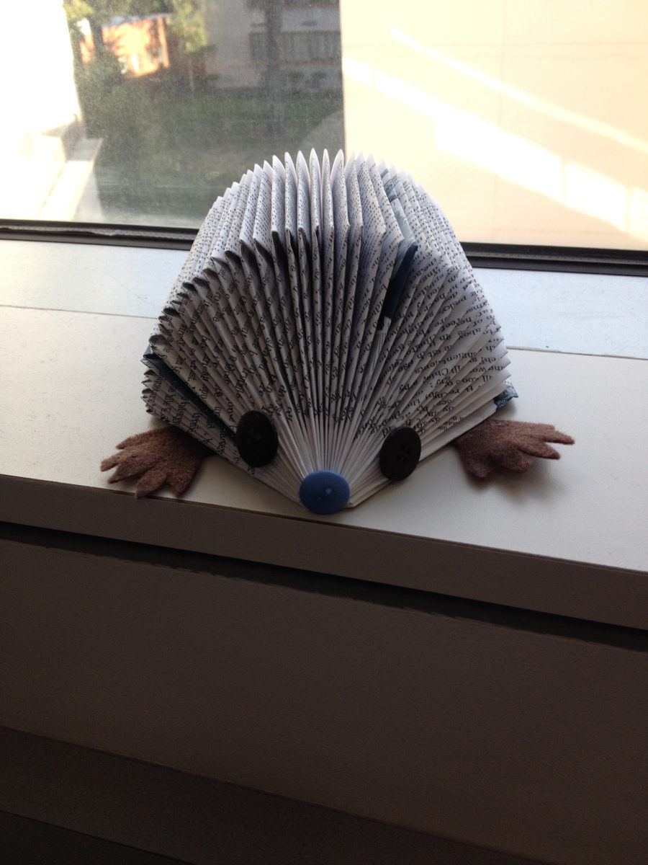
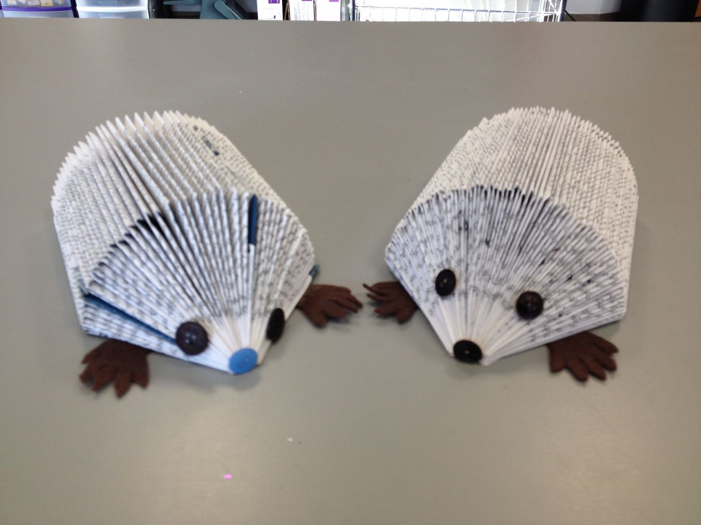
Lessons learned
Hedgehogs
Notes:
This is a time consuming and difficult craft. Mary planned to have several levels of crafts. Maybe even include hedgehog coloring sheets. A box for a variety of ages, skills, and wants

Slide 41
Lessons learned
Roles changed -generalists
Adult librarians were expected to do “children’s” programs
“You’ve taken away our creativity”
Notes:
Push back, crying, outcry, outrage… then.. it takes less time to prep?!? I can still be creative? I don’t have to constantly be thinking of new things?

Slide 42
Questions?
Daisy Porter-Reynolds
Executive Director, Aurora (IL) Public Library
dcport@aurora.lib.il.us
Leslie Tanaka-Loza
Librarian II, San José Public Library
leslie.tanaka@sjlibrary.org

Slide 43
Infopeople webinars are supported in part by the U.S. Institute of Museum and Library Services under the provisions of the Library Services and Technology Act, administered in California by the State Librarian. This material is licensed under a Creative Commons 3.0 Share & Share-Alike license. Use of this material should credit the author and funding source.

