Slide 1

READY TO
TRANSFORM LIFE AFTER 50?
LET’S GET STARTED.
TLA50 WEBINAR
NOVEMBER 19, 2014

Slide 2
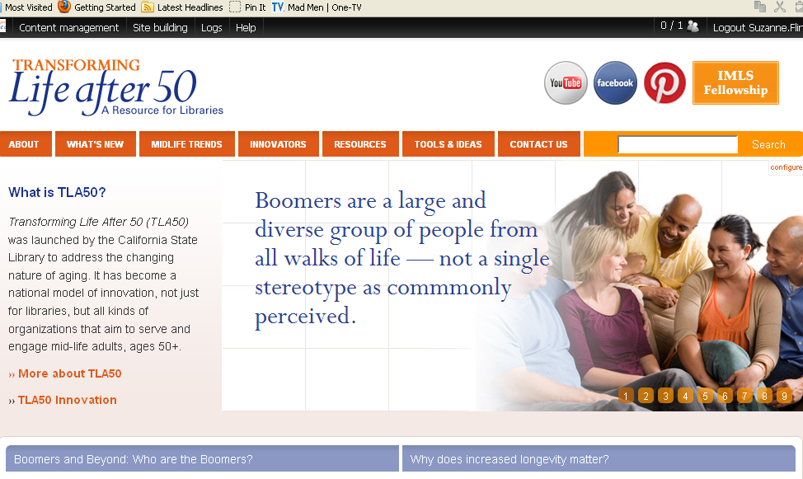
www.transforminglifeafter50.org
Notes:
2

Slide 3
TODAY’S PRESENTERS
Stephen Ristau, TLA50 Project Coordinator
Cindy Mediavilla, Library Programs Consultant, California State Library
Jennifer Baker, Director, St. Helena Public Library

Slide 4
WEBINAR AGENDA
The Big Idea- video
Starting the Conversation - Stephen Ristau
Community Assessment - Cindy Mediavilla
TLA50 Programs & Strategies - Jennifer Baker
Q&A/ AHA’s
Coming Attractions - Stephen Ristau

Slide 5
The Big Idea
http://theagingamericaproject.com
Notes:
Go to website

Slide 6
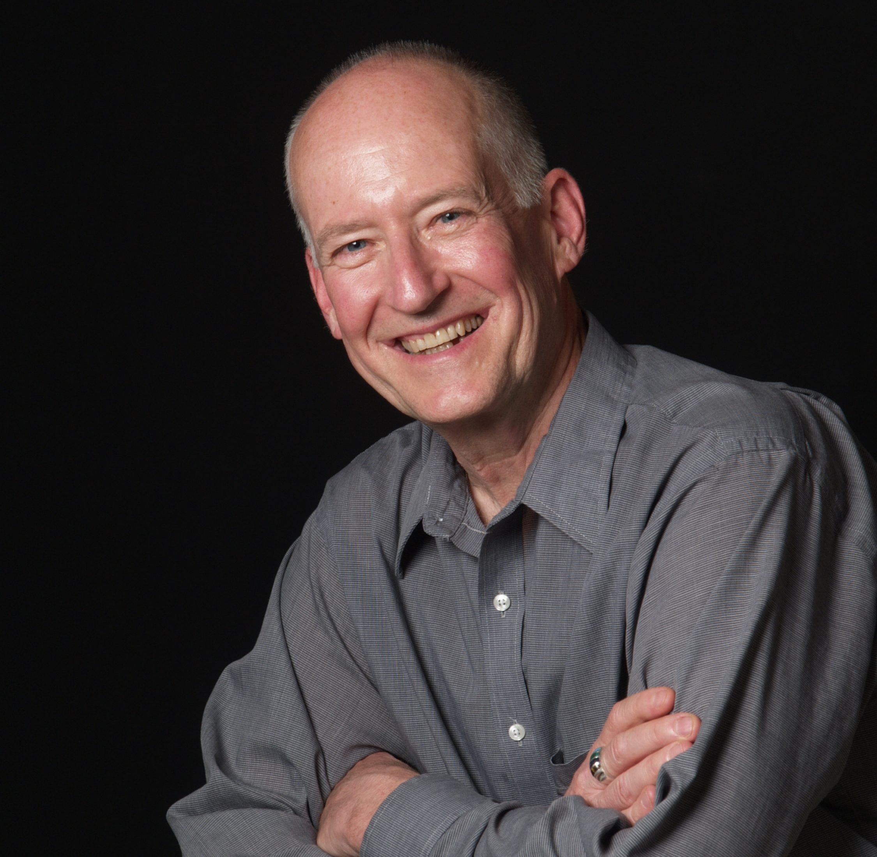
Strategic Facilitation
Starting the Conversation
Stephen Ristau
What is strategic facilitation?
How do I start intentional conversations?
Identifying key stakeholders- internal and external
Powerful questions facilitate engagement
Leveraging early adopters and allies
Engaging an advisory group/ task force
Notes:
There were three parts of the online course: Learning the about the types of facilitation, and how foresight informs strategic facilitation – the philosophy of collaborative dialogue;
reviewing group formation and the tools that you can use to form an advisory group – outreach and group dynamics; and, leadership based on self awareness, commitment and confidence, which inspires others.
Transformation requires that you step out of the box --

Slide 7
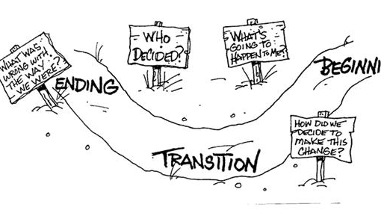
The Path to Transformation
Notes:
Summarizing and Closure
The path to transformation isn’t straight. There may be side-roads, and detours, and there are pauses in the process.
One enters this path by discovering a problem, an opportunity, or a challenge that causes an organization to look at itself. Part of the journey consists of looking back at the library’s changes over time, to mark its effects to its purpose. What has happened in response to those changes?
Is the library the same now as it’s always been?
What’ changes are affecting libraries now?
How will you fulfill its present purpose in response to changes in the context in which the library exists?
Let me ask you one final question. What will happen if the library doesn’t change?
In this project, you have an opportunity to gather a diverse group of people (from the library and the community – newcomers and long timers) to give advice and inform planning.
If you open the door to input on the library’s future, and its role, you give those who will benefit a chance to shape that future. Engagement leads to buy-in and participation beyond giving advice.
Along the transformation path, things can become confused, people may feel displaced and threatened, and resistance and inertia could set in.
Challenges to the status quo are disturbing, and can be perceived as destructive. The transition period occurs when the old forms are gone, and the new form hasn’t matured. It may be long and intense, and may cycle back on itself before a new beginning takes root. That rooting requires leadership…. and a champion for the library and the community.
You have the insight and skill to be that champion… to take the chance, and each small step, to guide your library into its future state.
So, to summarize Strategic Facilitation, What begins as a vision evolves through open, engaging discussion into a plan. This new plan requires collaboration, organization, documentation and leadership.
I am confident that each of you has the ability and capacity for bringing the vision into reality.
Thanks for letting me take part in this exciting work you are doing. I’ve learned from all of you, and hope you have learned a little from me.
Finally, I want to thank Mary Ross, the Wizard of Oz, who led me well along the yellow brick road on online course development and webinars!
Thanks to all…

Slide 8
Take The Online Course
With Your Library Team
http://www.transforminglifeafter50.org/tools-ideas/facilitation/strategic-facilitation-course

Slide 9
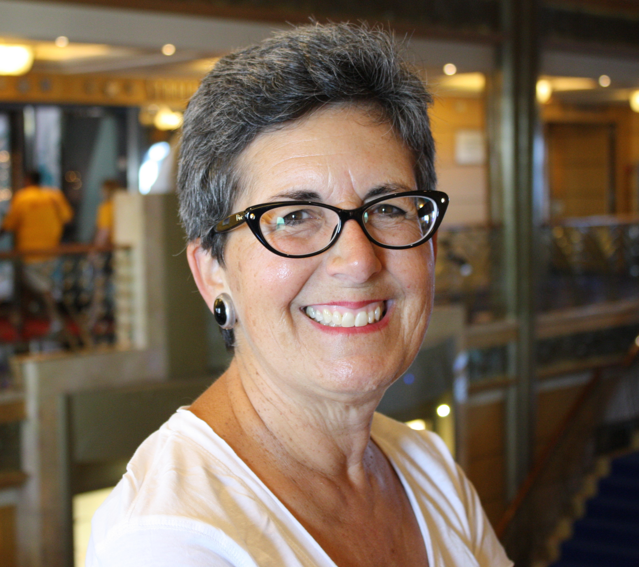
Community Assessment
What is Community Assessment?
Cindy Mediavilla
intentional data collection to identify community assets and target population priorities
critical first step before planning any new library service/program

Slide 10
Community Assessment- Technique #1
External environmental scan of target population’s:
• Demographics
• Setting
• Economic conditions
• Technology levels
• Sociocultural elements

Slide 11
Community Assessment- Technique #2
Key informant/community leader interviews:
Approach from target population’s perspective not from the library’s perspective
May lead to potential partnerships

Slide 12
Community Assessment-
Other Techniques
Focus groups
Surveys
Observations

Slide 13
Take The Online Course
With Your Library Team
http://www.transforminglifeafter50.org/tools-ideas/assessment-evaluation/community-assessment-course

Slide 14
Additional Community
Assessment Resources
Libraries Transforming Communities
http://www.ala.org/transforminglibraries/sites/ala.org.transforminglibraries/files/content/LTC_Binder_FINAL_0.pdf
Community-Led Libraries Toolkit (Working Together Project)
http://www.librariesincommunities.ca/resources/Community-Led_Libraries_Toolkit.pdf

Slide 15
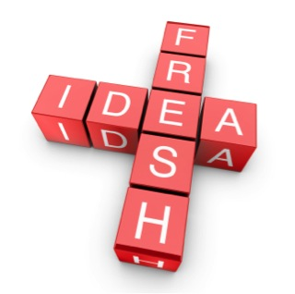
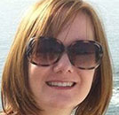
TLA50 Effective
Programs and Strategies
Jennifer Baker

Slide 16
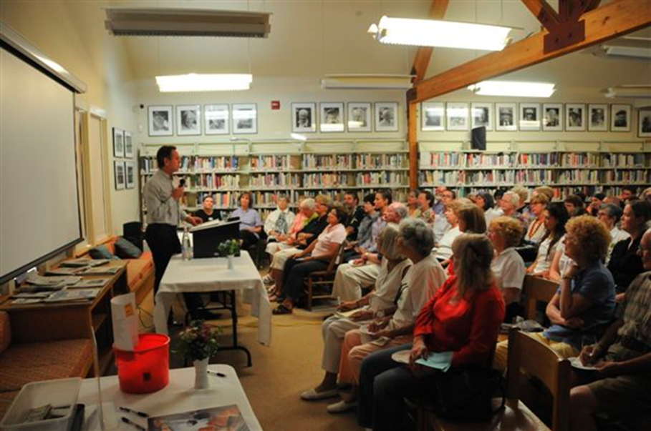
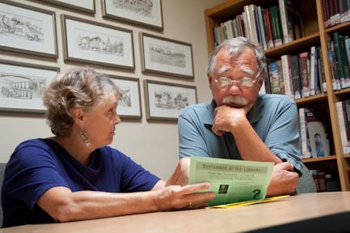
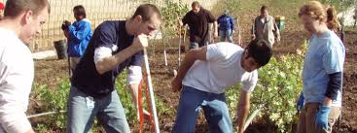
TLA50 Effective
Programs and Strategies
Three basic areas I’ll cover:
Programming
Volunteers
Partnering

Slide 17
TLA50 in Practice
Programming
Just a Few Program Ideas:
book clubs or discussions * academic lectures * author talks & signings * poetry readings * movie/book tie-ins * readers’ theater * plays and theatrical productions * presentations on physical, spiritual, and mental health * forums on community issues or national issues * music concerts * dancing * sing-alongs * writing workshops * food/cooking demonstrations * DIY presentations (like home brewing) * contests—baking/spelling * trivia and games * specialty subject speakers * tributes * history presentations * art receptions * festivals * special holiday related events * films * cultural demonstrations * life coaching * computer classes * how to use your phone * gardening * storytelling * magic * travel talks * crafting & scrapbooking * knitting & crochet clubs * conversation clubs for language learning * yoga * martial arts and self defense demos * animals * life planning * disaster preparedness * political forms & townhalls * parties!

Slide 18
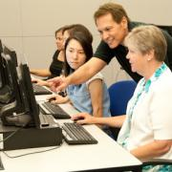
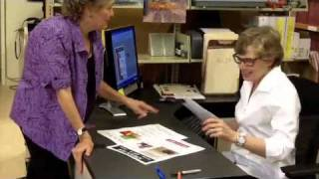
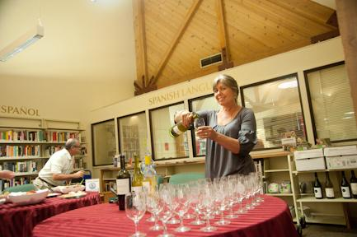

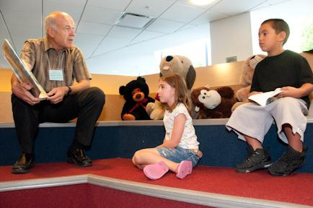
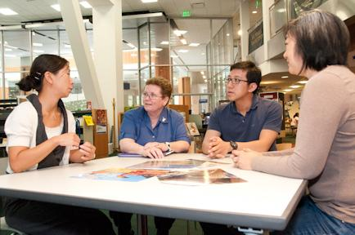
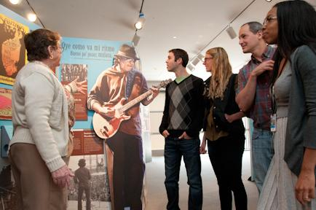
TLA50 in Practice
Volunteers

Slide 19
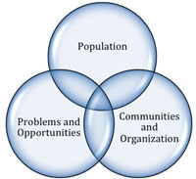
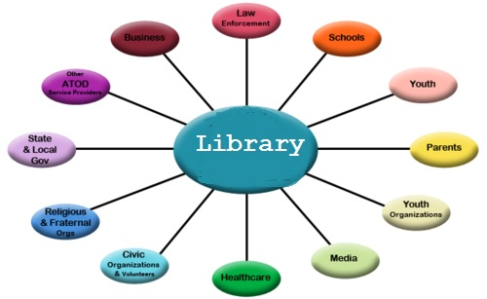
TLA50 in Practice
Community Partnerships

Slide 20
Take The Online Course
With Your Library Team
http://www.transforminglifeafter50.org/tools-ideas/programming/engaging-adults

Slide 21

GET ENGAGED IN TLA50-
COMING ATTRACTIONS
JOIN US ON
SAVE THE DATE
TLA50 Promising Practices Round-up
Wednesday, February 25, 2015, 9:00AM - 3:00pm
Sacramento Public Library Galleria
Details coming soon
GET ON THE TLA50 E-COMMUNICATION LIST
Email Stephen Ristau stephenristau@gmail.com if you would like to be included in future TLA50 communications
www.facebook.com/TLA50

Slide 22
PRESENTERS’ CONTACT INFO
Stephen Ristau, TLA50 Project Coordinator, stephenristau@gmail.com
Cindy Mediavilla, Library Programs Consultant, California State Library, Cindy.Mediavilla@library.ca.gov
Jennifer Baker, Director, St. Helena Public Library, jennifer@shpl.org

Slide 23

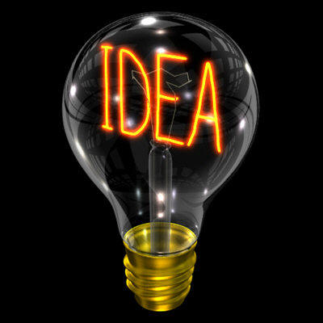
Questions? Aha’s!

