Slide 1

Resource Description and Access Overview:
Making RDA Work
Emily Dust Nimsakont
Cataloging Librarian
Nebraska Library Commission
November 20, 2104
An Infopeople Webinar
Photo Credit: http://www.flickr.com/photos/17295449@N00/2139208615/

Slide 2

What is RDA?
Photo credit: http://www.flickr.com/photos/konradfoerstner/4168966589/

Slide 3

Cataloging code to replace AACR2
Implemented by national libraries on March 31, 2013

Slide 4
RDA is designed…
…with the user in mind.
…to describe all types of resources.
…to make library data work better with other data on the Web.

Slide 5
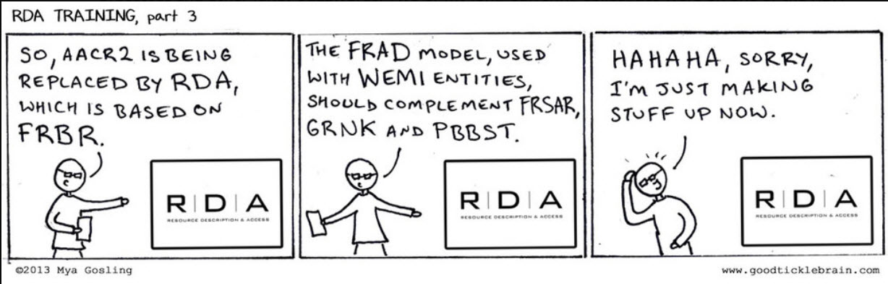
RDA is based on FRBR (Functional Requirements for Bibliographic Records).

Slide 6
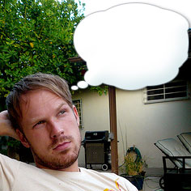


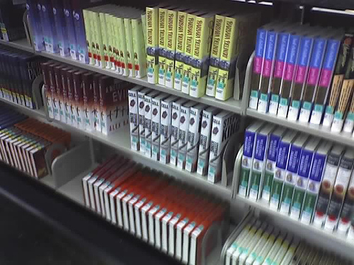
Photo credits: http://www.flickr.com/photos/escapist/730800562/, http://www.flickr.com/photos/dbdbrobot /140068142, http://www.flickr.com/photos/steventong/3556248355, http://www.flickr.com/photos/heidigoseek/115581765

Slide 7
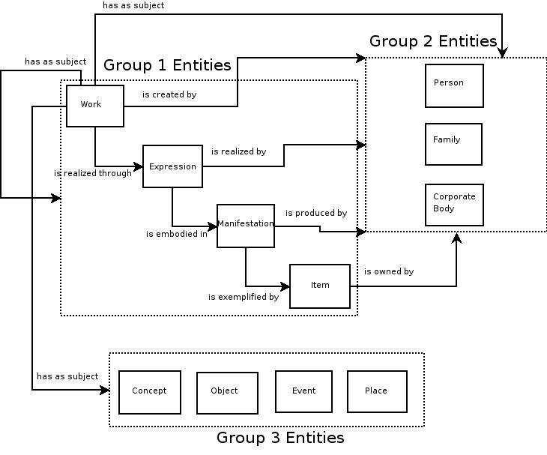
Image credit: http://www.frbr.org/2006/02/25/more-relationships-between-groups

Slide 8
Why RDA?
Photo credit: http://www.flickr.com/photos/konradfoerstner/4168966589/

Slide 9
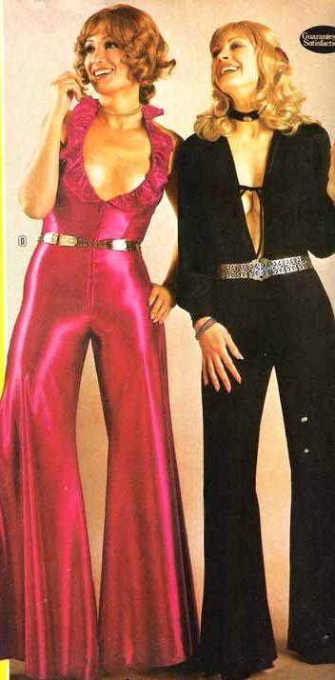
It’s not the 1970s anymore…
Photo credit: http://www.flickr.com/photos/sacheverelle/2659497000/
Notes:
Our catalogs have changed
The things we catalog have changed (and will continue to change)
The bibliographic universe is different
That’s my elevator speech for RDA

Slide 10
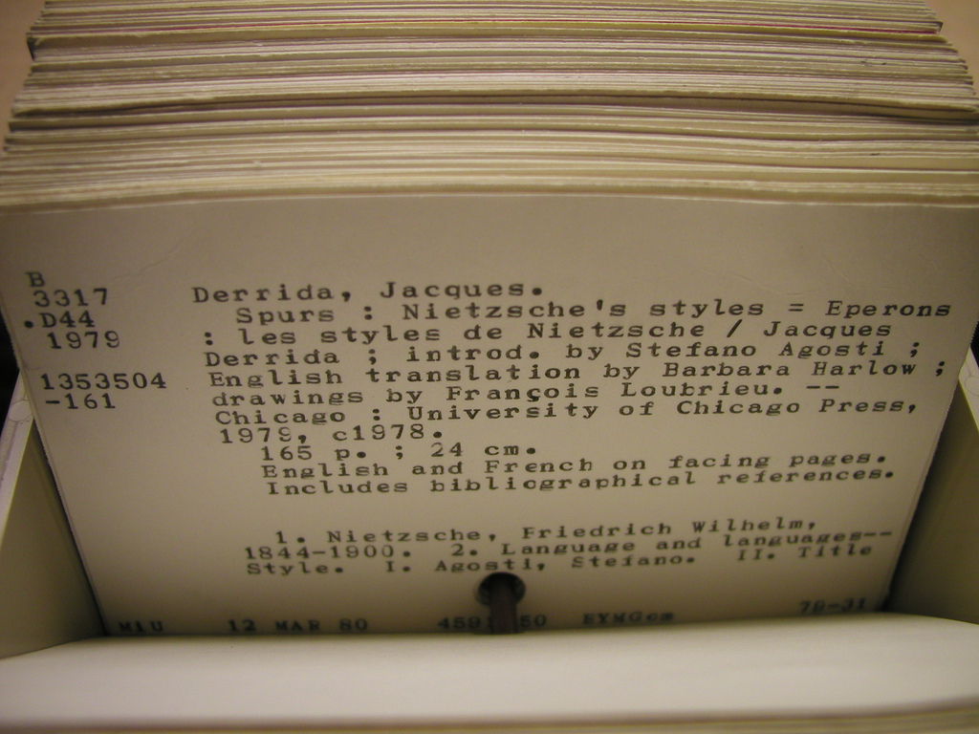
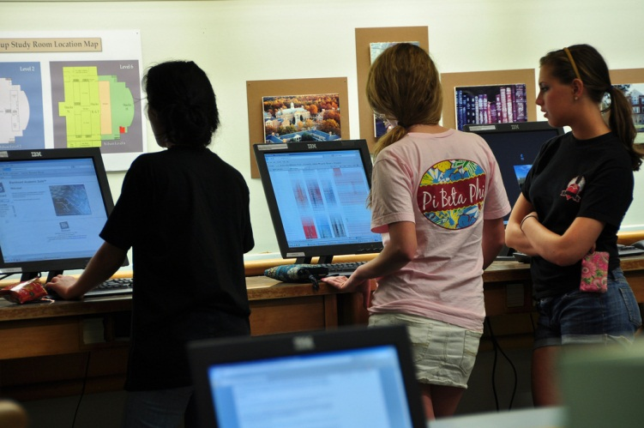
Our catalogs have changed.
Photo credits: http://www.flickr.com/photos/annarbor/4349876203/, http://www.flickr.com/photos/zsrlibrary/4575294736/

Slide 11
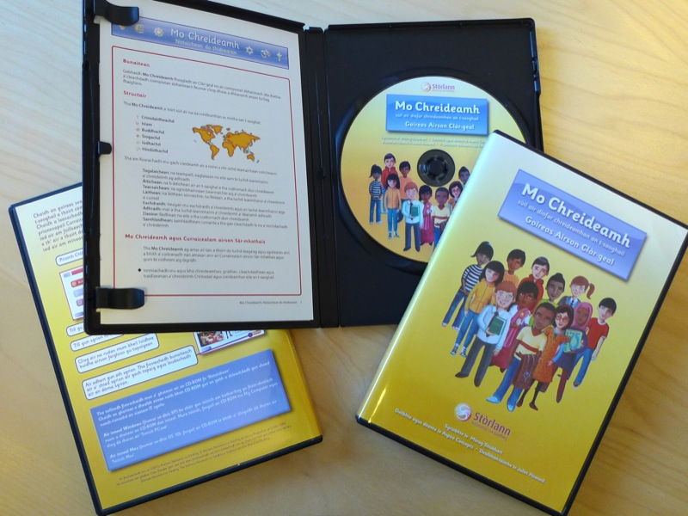
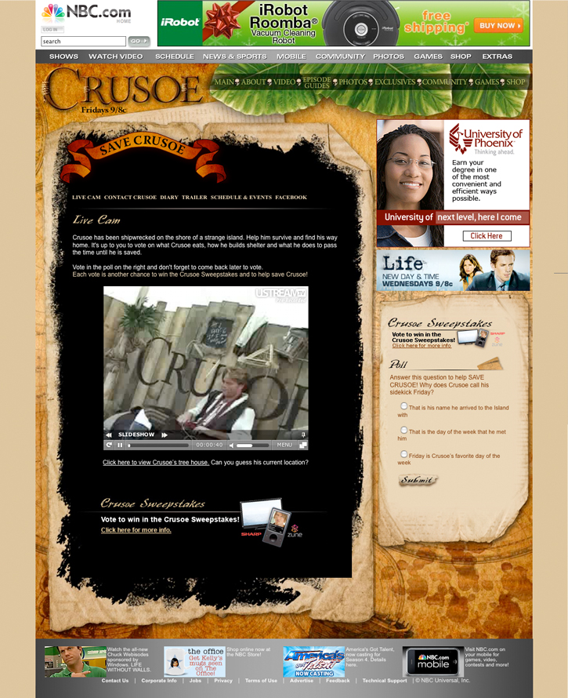
The things we catalog have changed.
And they will continue to change.
Photo credits: http://www.flickr.com/photos/cjc/3494515480/, http://www.flickr.com/photos/mdurwin/3082945477/

Slide 12
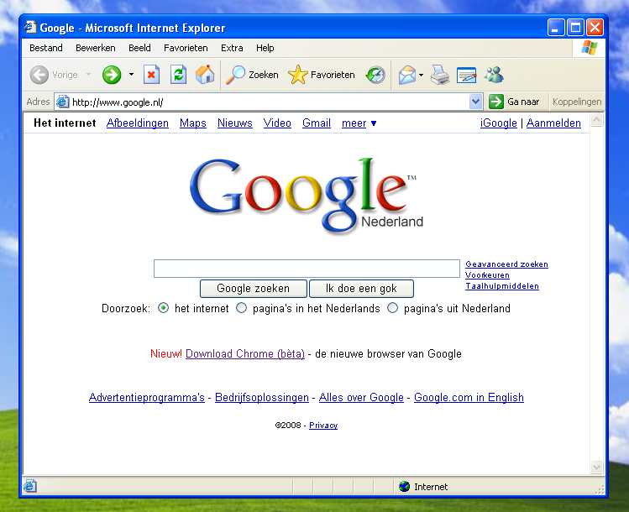
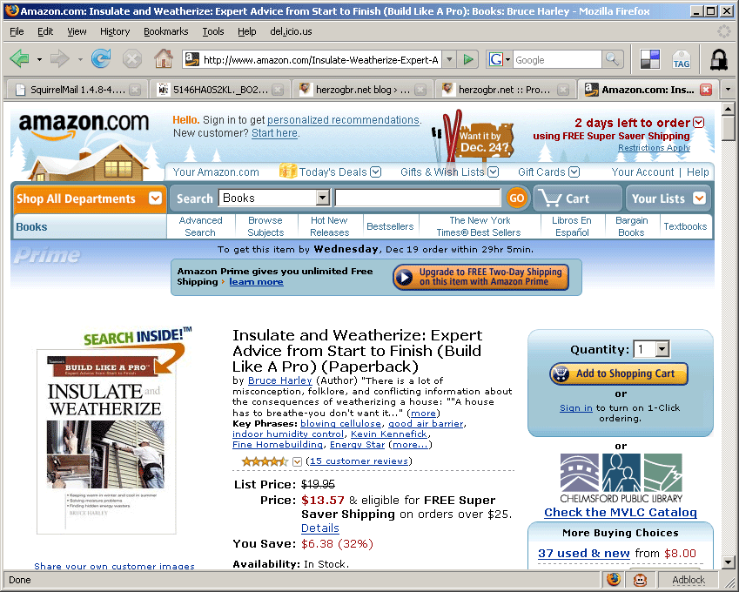
The information universe has changed.
Photo credits: http://www.flickr.com/photos/thms/2821859479/, http://www.flickr.com/photos/herzogbr/2115042793/

Slide 13

Poll

Slide 14

What is different now?
Changes to the public interfaces of library catalogs
Photo credit: http://www.flickr.com/photos/19614198@N00/4661435492//

Slide 15
Fewer Abbreviations
AACR2:
520 p. : col. ill.; 28 cm.
RDA:
520 pages : color illustrations; 28 cm
Notes:
Transcribe a statement of responsibility in the form in which it appears on the source of information. Apply the general guidelines on transcription given under RDA 1.7.
<click>
Cambridge policy is to follow LC-PCC PS 2.4.1.4 which states: “Generally do not abridge a statement of responsibility”.
<click>
So, in general, we now transcribe everything: author affiliations, titles, etc.

Slide 16
Fewer Abbreviations
Source: Third revised edition
AACR2: 250 3rd rev. ed.
RDA: 250 Third revised edition
Source: 2nd enlarged ed., revised
AACR2: 250 2nd enl. ed., rev.
RDA: 250 2nd enlarged ed., revised

Slide 17
Rule of Three is Gone
Source: by Susan Brown, Melanie Carlson, Stephen Lindell, Kevin Ott, and Janet Wilson.
AACR2:
by Susan Brown … [et al.].
RDA:
by Susan Brown, Melanie Carlson, Stephen Lindell, Kevin Ott, and Janet Wilson.
RDA allows:
by Susan Brown [and four others].
Notes:
The AACR2 “Rule of Three” is not part of RDA.
RDA 2.4.1.5 directs us to record the persons, families, or corporate bodies named in the resource. When three or more people etc. are performing the same function, an option is provided to omit all but the first of each group and indicate the omission by summarising (in English) what has been omitted. Under RDA we would never use “... [et al.]”.
<click>
However, Cambridge generally does not apply the option and instead follows the LC-PCC PS which states: “Generally do not omit names in a statement of responsibility.”
<click>
In this example more than three persons are named who all perform the same function or role.
The first version, with “and four others” in square brackets is acceptable under RDA.
However, the second version where all five names are transcribed is preferable, and what would normally be expected in Cambridge.
Both contrast with what we are used to doing under AACR2.
A common reaction to the information in this and the preceding slide tends to be: “Seriously? Do you really mean we have to transcribe all 20 people named on the t.p. of an exhibition catalog or medical textbook (say), along with all their affiliation details?”
Well no, we don’t. The basic idea is simply that we should transcribe everything unless it is “unduly onerous”. The difference between RDA and AACR2 is that there isn’t a fixed numerical cut-off point where we are obliged to abridge things, and instead the decision is left to our judgement as catalogers. For some types of material the rule of three was incredibly unhelpful – I know of readers who have been totally unable to find resources because they can only remember the second author (of four), who of course doesn’t appear on the record.
While the old rule was easy to apply, we had no discretion to include all four authors, even though (say) we knew author 4 was a Cambridge academic who would be looking for his/her publication. What we will have to do much more now is to weigh up the type of material and how valuable (or not) extra access might be and set this against our (inevitably) limited time.

Slide 18
Latin Terms are Gone
AACR2:
[S.l. : s.n.], 2008.
RDA:
[Place of publication not identified] : [Publisher not identified], 2008.

Slide 19
GMD is Gone
GMD (General Material Designation) = bracketed information in the title that conveys the type of material
[electronic resource]
[sound recording]
[videorecording]
Notes:
The General Material Designation, given in MARC AACR2 records in the 245 subfield h, used to be given for all non-print formats. These were an inconsistent set of terms that sometimes referred to content (e.g. cartographic material) and sometimes to carrier (e.g. videorecording).
Instead, three RDA elements have been developed by the Joint Steering Committee, in conjunction with the publishing community (ONIX), to “replace” the GMD. These are the content, media, and carrier types; and three new MARC fields are used to record the data: 336, 337, and 338 respectively.
Content type is really an expression attribute but we will discuss it here, rather than in Module 4, as it makes most sense treated as part of a block with the other 2 new fields.

Slide 20
GMD is replaced by:
–Content type (text, performed music, spoken word, etc.)
–Media type (audio, microform, video, etc.)
–Carrier type (audio disc, online resource, videodisc, etc)

Slide 21
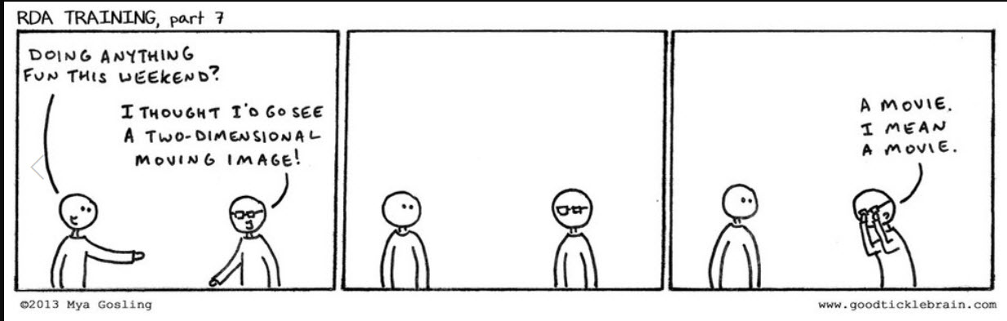
Terminology comes from lists in the RDA guidelines.

Slide 22

Content Type
Photo credits:
http://www.flickr.com/photos/heidigoseek/115581765/
http://www.flickr.com/photos/58571789@N00/5802294925/

Slide 23

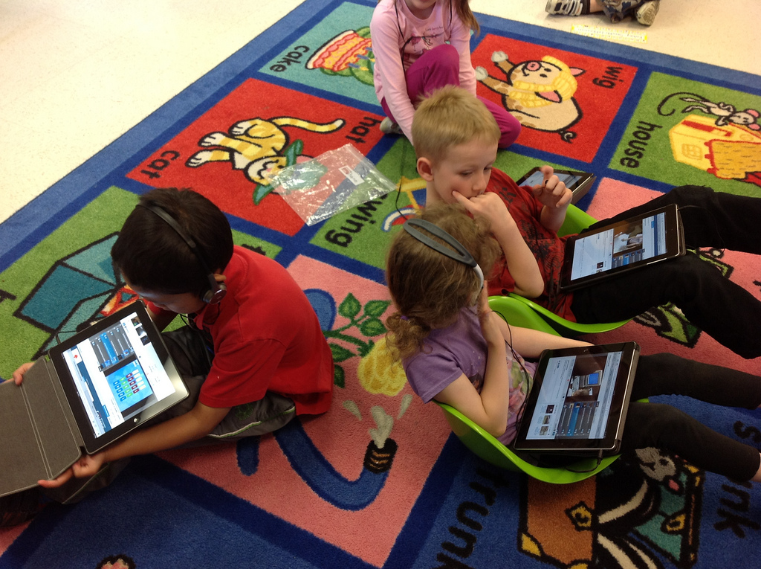
Media Type
Photo Credits: http://www.flickr.com/photos/77961177@N00/275256542/
http://www.flickr.com/photos/57634636@N00/7185647878/

Slide 24
Carrier Type
Photo Credits: http://www.flickr.com/photos/77961177@N00/275256542/
http://www.flickr.com/photos/57634636@N00/7185647878/

Slide 25
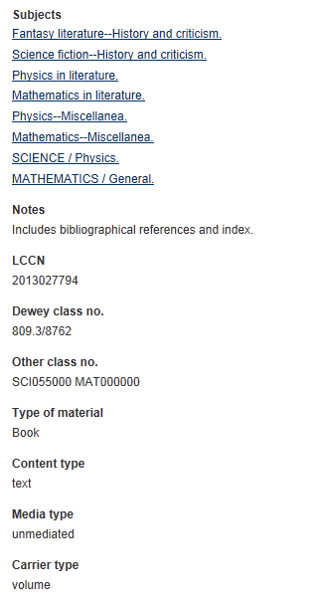
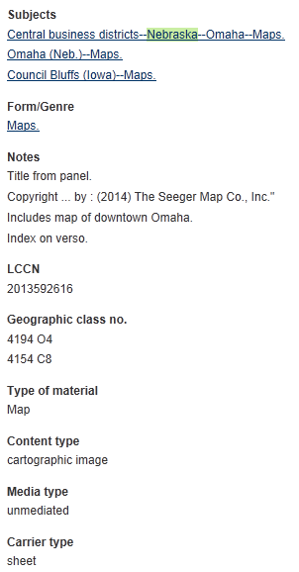

Slide 26
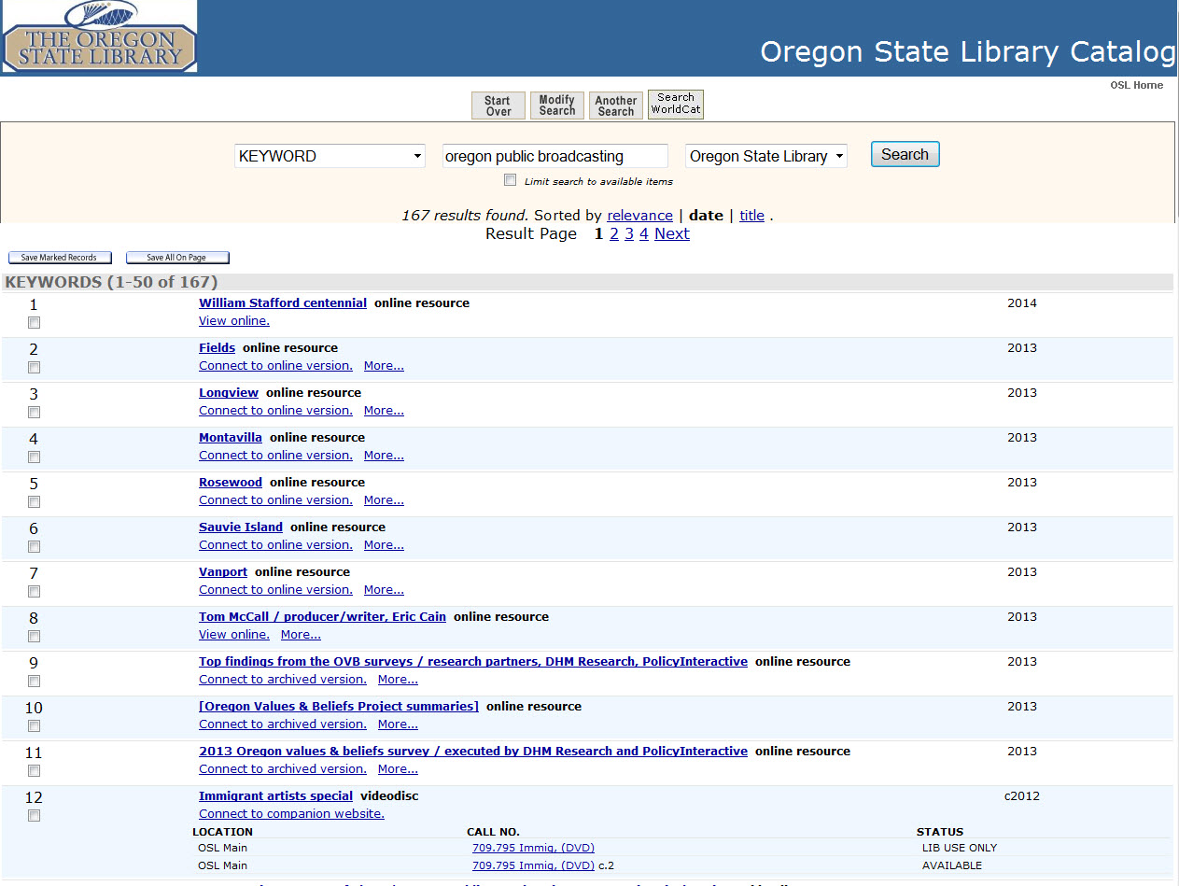

Slide 27
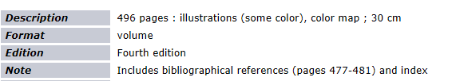


Slide 28
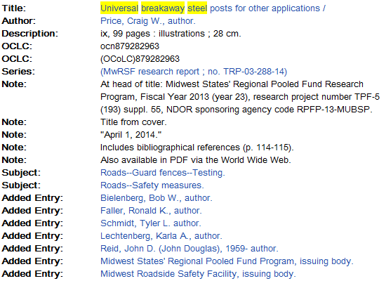
Relationship Designators

Slide 29
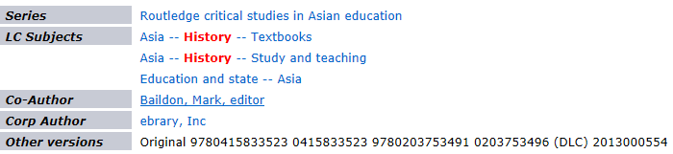
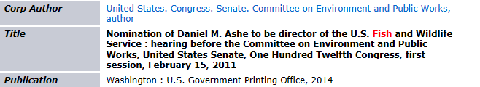
Relationship Designators

Slide 30
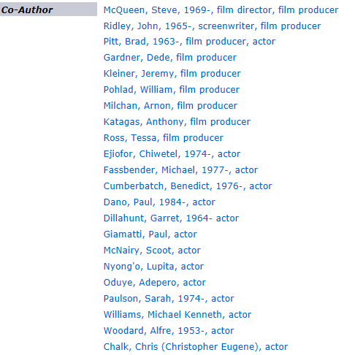
Relationship Designators

Slide 31
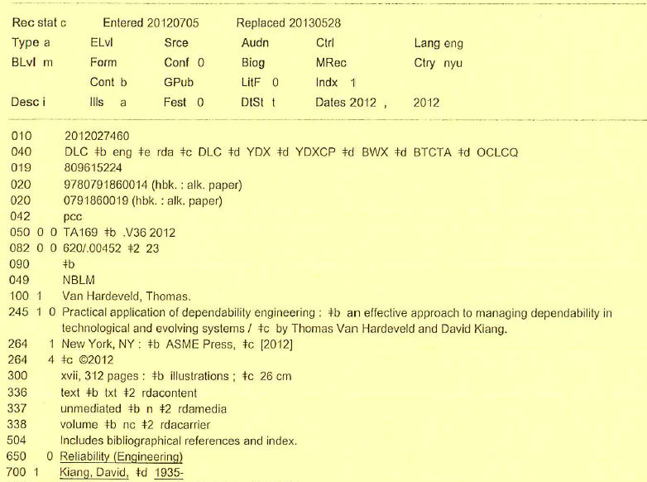
AACR2 or RDA?

Slide 32
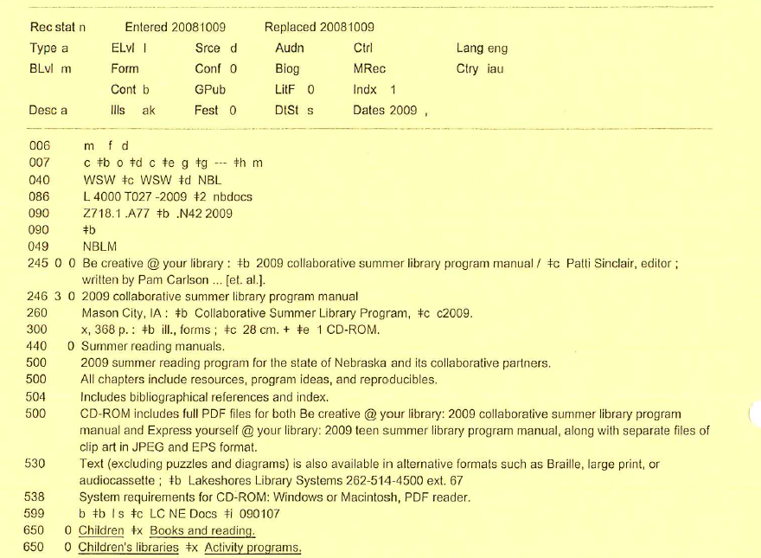

Slide 33
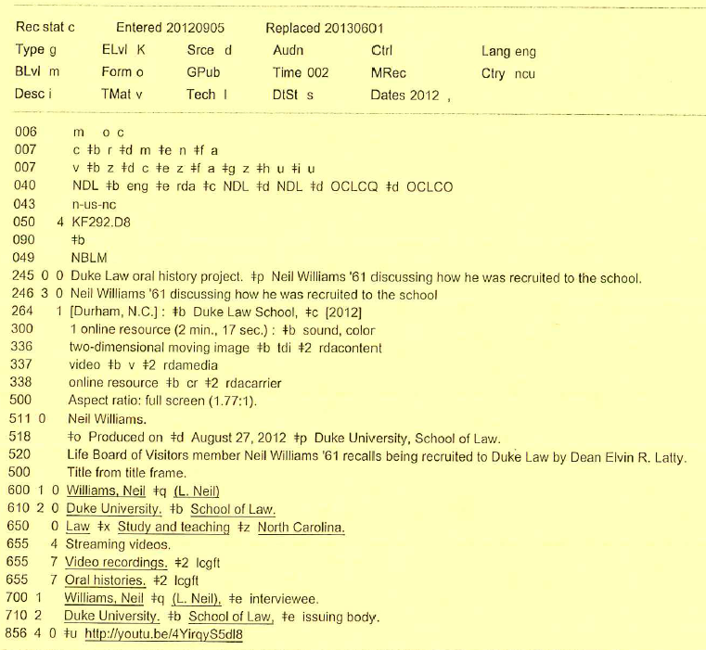

Slide 34
What is different now?
Changes to the creation of catalog records
Photo credit: http://www.flickr.com/photos/19614198@N00/4661435492//

Slide 35
Structure of RDA - General structure
Table of contents
General introduction
Identifying elements (entities and attributes)
  Ch. 1-7: work, expression, manifestation, item
  Ch. 8-11: person, family, corporate body
  Ch. 12-16: concept, object, event, place
Relationships: Ch. 17-22, 24-32
Appendices
Glossary
Index
Notes:
The first thing to note before looking at the RDA Toolkit is that RDA has a clear structure:
<click>
It starts with a table of contents, and a general introduction setting out the principles and fundamental ideas.
Then the primary content of the document is divided into two main chunks:
<click>those about identifying elements covering the Group 1, 2, and 3 entities (you will be learning more about all this RDA terminology in the FRBR workshop so don’t worry too much about that now)
<click>and those about recording relationships between entities
<click>
Another key section is the appendices, which provide information on things like abbreviation, capitalization, mappings to ISBD and MARC, and relationship designators
<click>
Finally, we finish off with a glossary and index.

Slide 36
Structure of RDA – General structure
Unlike AACR2, not organized by class of materials
Instead, arranged around user tasks to help users identify and relate resources
Each section begins with a chapter of general guidelines. Subsequent chapters include instructions that support one of the user tasks
E.g. in Section 1:
  Chapter 1: General guidelines
  Chapter 2: FRBR task = Identify
  Chapter 3: FRBR task = Select
Notes:
Clearly, that is very different from the structure of AACR2.
<click>
Instead of separate chapters for classes of materials, such as books, cartographic materials, printed music, etc., RDA is principle-based and organized around the <click> user tasks to help users identify and relate resources.
<click>
Each section begins with a chapter of general guidelines. Subsequent chapters then include instructions that support one of the user tasks.
<click>
For example, in Section 1 of RDA:
Chapter 1 contains the general guidelines
Chapter 2 focuses on the FRBR user task “Identify”
Chapter 3 focuses on the FRBR user task “Select”
and so on.

Slide 37
Structure of RDA – “Core-ness”
Based on attributes mandatory for a national level record
Defined at the element level
  Always
  “Core if” – situation described
Notes:
Now looking in more detail at some of the recurrent features of RDA:
We have this concept of “core-ness”. Some of the RDA elements are designated as “core” elements. The assignment of core status is based on attributes mandatory for a national level record, as documented in the FRBR/FRAD standards.
<click>
Core-ness is identified at the element level. <click> Some elements are always core (if applicable and the information is available); some are core only in certain situations.
<click>
Core elements can be seen in two ways within RDA:
<click>
They are discussed in general, and listed as a group, in the sub-instructions of RDA 0.6.
They are listed separately, always clearly labelled in light blue, as you progress through the chapters.

Slide 38
Transcription
“Take what you see”
Statement of responsibility
Edition statement
Publication information

Slide 39
Changes to Authority Headings
Families can be creators or contributors in bib records
Persons include fictitious entities and non-human entities
Notes:
Now we will look at what is different in RDA. One big change you might notice is that RDA allows families to be creators or contributors, so you will see AAPs for families in 100 or 700 fields. This will be useful for genealogical publications, archival cataloging and finding aids, though this may not affect very many of you in your daily cataloging.
Until now, AACR2 only allowed families to be included as subjects, using Library of Congress subject headings in 600 fields. The LCSH for families were created to represent all families with the same name.
In RDA, authority records can be established in the LC/NACO authority file for specific families, for use in 100 or 700 fields with 1st indicator 3.

Slide 40
No more abbreviations in authority headings
AACR2 RDA
Abbreviates months Does not abbreviate months
15th cent. 15th century
ca. 1837-ca. 1896 approximately 1837- approximately 1896
fl. 1788-1803 active 1788-1803
b. 1825 1825-
d. 1945 -1945
Dept. Department (unless name uses the form Dept.)
Notes:
We have become used to the idea that RDA does not use abbreviations and AAPs are no exception. This slide lists the most common situations where AACR2 headings included abbreviations, which will all change under RDA.
<click>
So, we do not abbreviate the names of months or words such as “century”.
<click>
We can no longer use Latin abbreviations like “ca.” for “circa”, which is replaced by “approximately” or “fl.” for “floruit”, which is replaced by “active”.
Note that the “b.” and “d.” for birth and death dates have been replaced by a trailing or leading hyphen respectively.
<click>
In corporate body names, the word Department is no longer automatically abbreviated. However, the abbreviated form may still appear in AAPs if that is the form used in the name itself.

Slide 41
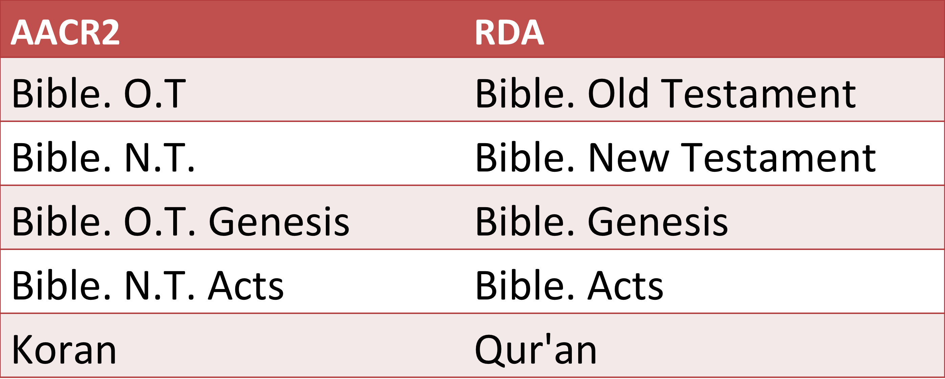
Access Points for Sacred Texts
Notes:
As you can see in the first two rows of this table, the Old and New Testament are no longer abbreviated, as you might expect in RDA.
Also, books of the Bible are no longer grouped under the Old or New Testament but are entered directly after “Bible”. Instructions about expressions of the Bible can be found in RDA 6.30.3.2 if you want more information.
Finally, following the instructions in RDA 6.23.2.5, the authorized access point for the Koran will change form to Qur’an under RDA.
We will talk more about changes to existing authorized forms at the end of this module but the changes to the name authority records will be made automatically in the cambrdgedb database. Those bib records which use authorized forms will also be updated automatically, though any unauthorized form may not be corrected. If you have any concerns about this after the end of this module, do speak to one of the RDA trainers or to staff in Authority Control.

Slide 42
New fields for MARC authority records
046: special coded dates
370: associated place
371: address
372: field of activity
373: affiliation
374: occupation
375: gender
377: associated language
380: form of work
381: other distinguishing characteristics of work or expression
382: medium of performance
383: numeric designation of musical work
384: key
Notes:
A big change between authority records in AACR2 and RDA is that AACR2 was only really concerned with creating the heading and various references. RDA does describe how to construct an authorized access point. However, it also discusses how to record various attributes about the entity, which are not part of the authorized access point but which appear in various new fields in the RDA authority record.
You can see from this slide a selection of the new MARC fields in RDA authority records, covering lots of different types of information about the entity. This information can be very useful when trying to decide which authorized form you should choose as the AAP in a catalog record. For this reason, we are going to spend a bit of time in this module looking at these new fields and some examples of RDA authority records.
We will concentrate today on the left-hand column as these are the most commonly used new MARC fields in authority records. We will not look at those in the right-hand column as they are less common or restricted to certain categories of material, such as music. However, it is worth pointing out their existence and you can look in the MARC21 authority format documentation for more information about their use.

Slide 43
RDA Quiz
Information from title page:
Montgomery County
an illustrated history
Carroll Swanson
Donna Hallquist
Denise Anderson
Ann Peterson
Red Oak -- Montgomery County Historical Society
Des Moines -- Iowa Historical Society
2010
Which is the correct title and statement of responsibility, according to RDA?
245 10 $a Montgomery County : $b an illustrated history / $c Carroll Swanson, Donna Hallquist, Denise Anderson, Ann Peterson.
245 10 $a Montgomery County : $b an illustrated history / $c Carroll Swanson [et al.].

Slide 44
RDA Quiz
Information from title page:
ELEMENTARY AND MIDDLE SCHOOL MATHEMATICS
Third Edition
John A. Van de Walle
Sandra Folk
Karen S. Karp
Jennifer M. Bay-Williams
Pearson Canada
Toronto
Title page verso information: © 2011, 2008, 2005 Pearson Canada Inc., Toronto, Ontario. Original edition published by Pearson…Upper Saddle River, New Jersey, USA.
©2010.
Other information: last introductory page numbered xxiv, last numbered page = 509, includes illustrations; height: 27 cm
Which is the correct physical description, according to RDA?
300 _ _ $a xxiv, 509 p. : $b ill. ; $c 27 cm.
300 _ _ $a xxiv, 509 pages : $b illustrations ; $c 27 cm

Slide 45
RDA Quiz
Information from title page:
ELEMENTARY AND MIDDLE SCHOOL MATHEMATICS
Third Edition
John A. Van de Walle
Sandra Folk
Karen S. Karp
Jennifer M. Bay-Williams
Pearson Canada
Toronto
Title page verso information: © 2011, 2008, 2005 Pearson Canada Inc., Toronto, Ontario. Original edition published by Pearson…Upper Saddle River, New Jersey, USA.
©2010.
Other information: last introductory page numbered xxiv, last numbered page = 509, includes illustrations; height: 27 cm
Which is the correct edition statment, according to RDA?
250 _ _ $a Third edition.
250 _ _ $a 3rd ed.

Slide 46

What could be different in the future?
Photo credit: http://www.flickr.com/photos/rofanator/190667304/

Slide 47
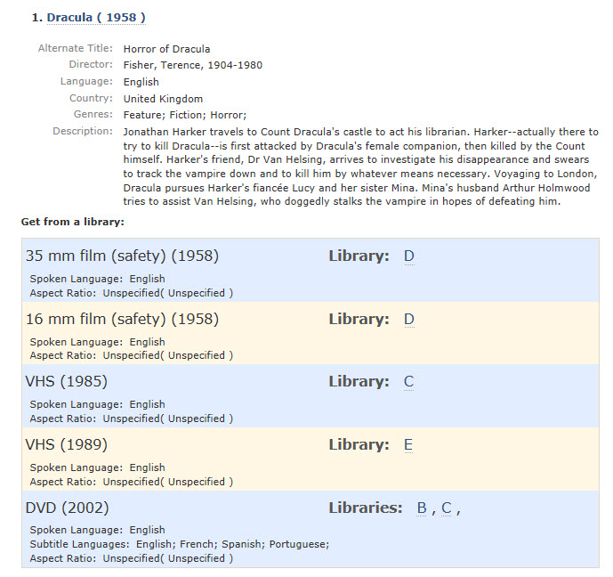
“FRBR-ized” Catalog Interfaces

Slide 48
“FRBR-ized” Catalog Interfaces
OLAC Moving Image Discovery Interface: http://blazing-sunset-24.heroku.com/
Scherzo: http://webapp1.dlib.indiana.edu/scherzo/
AustLit: http://www.austlit.edu.au/subscribe/samples.xml

Slide 49

New Search Options
Photo credit: http://www.flickr.com/photos/zsrlibrary/4575294736/

Slide 50
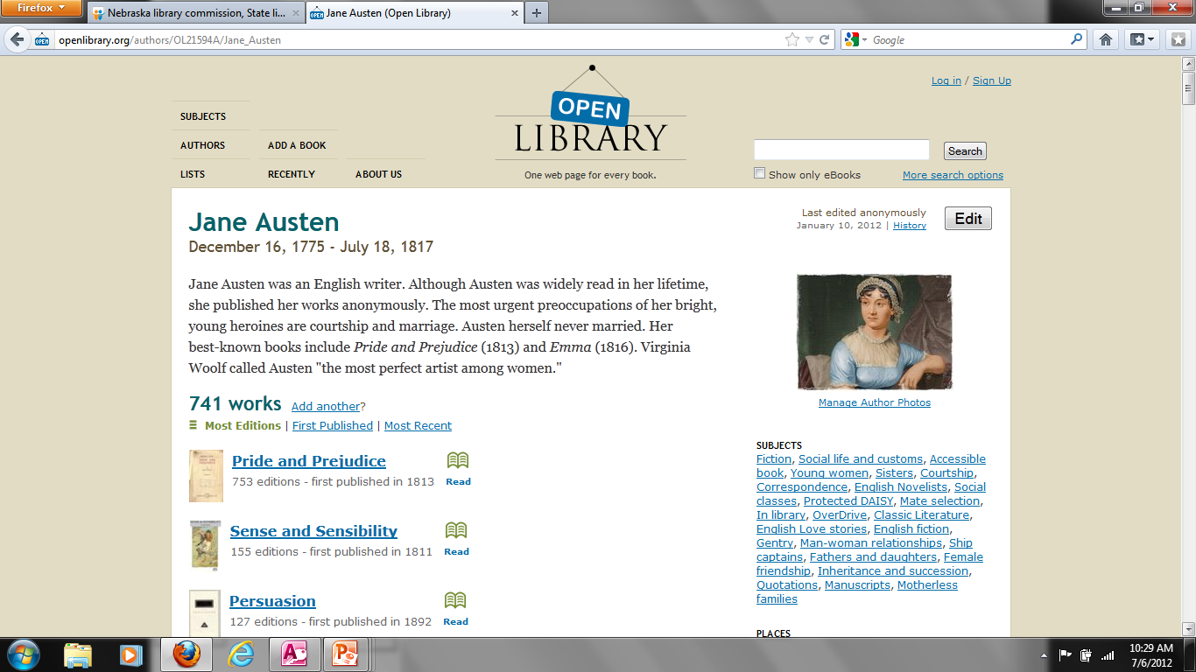
Open Library as an Example
http://www.openlibrary.org
Notes:
Instead of searching for “Jane Austen”, a user could search for women authors from England who wrote in the 1800s.

Slide 51
Richer Authority Records
Jane Austen
Women authors
From England
Wrote in 1800s
Notes:
Richer authority records include things like gender, associated dates, associated place, and field of activity. Instead of searching for “Jane Austen”, a user could search for women authors from England who wrote in the 1800s.

Slide 52
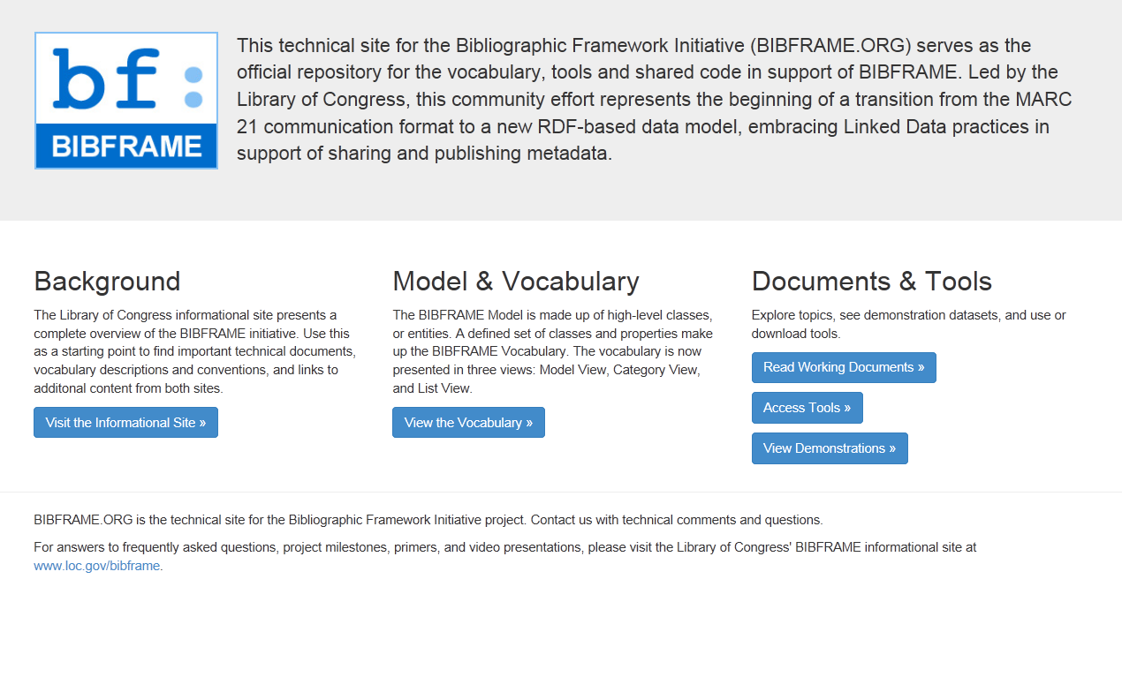
Linked Data/BIBFRAME
http://bibframe.org

Slide 53
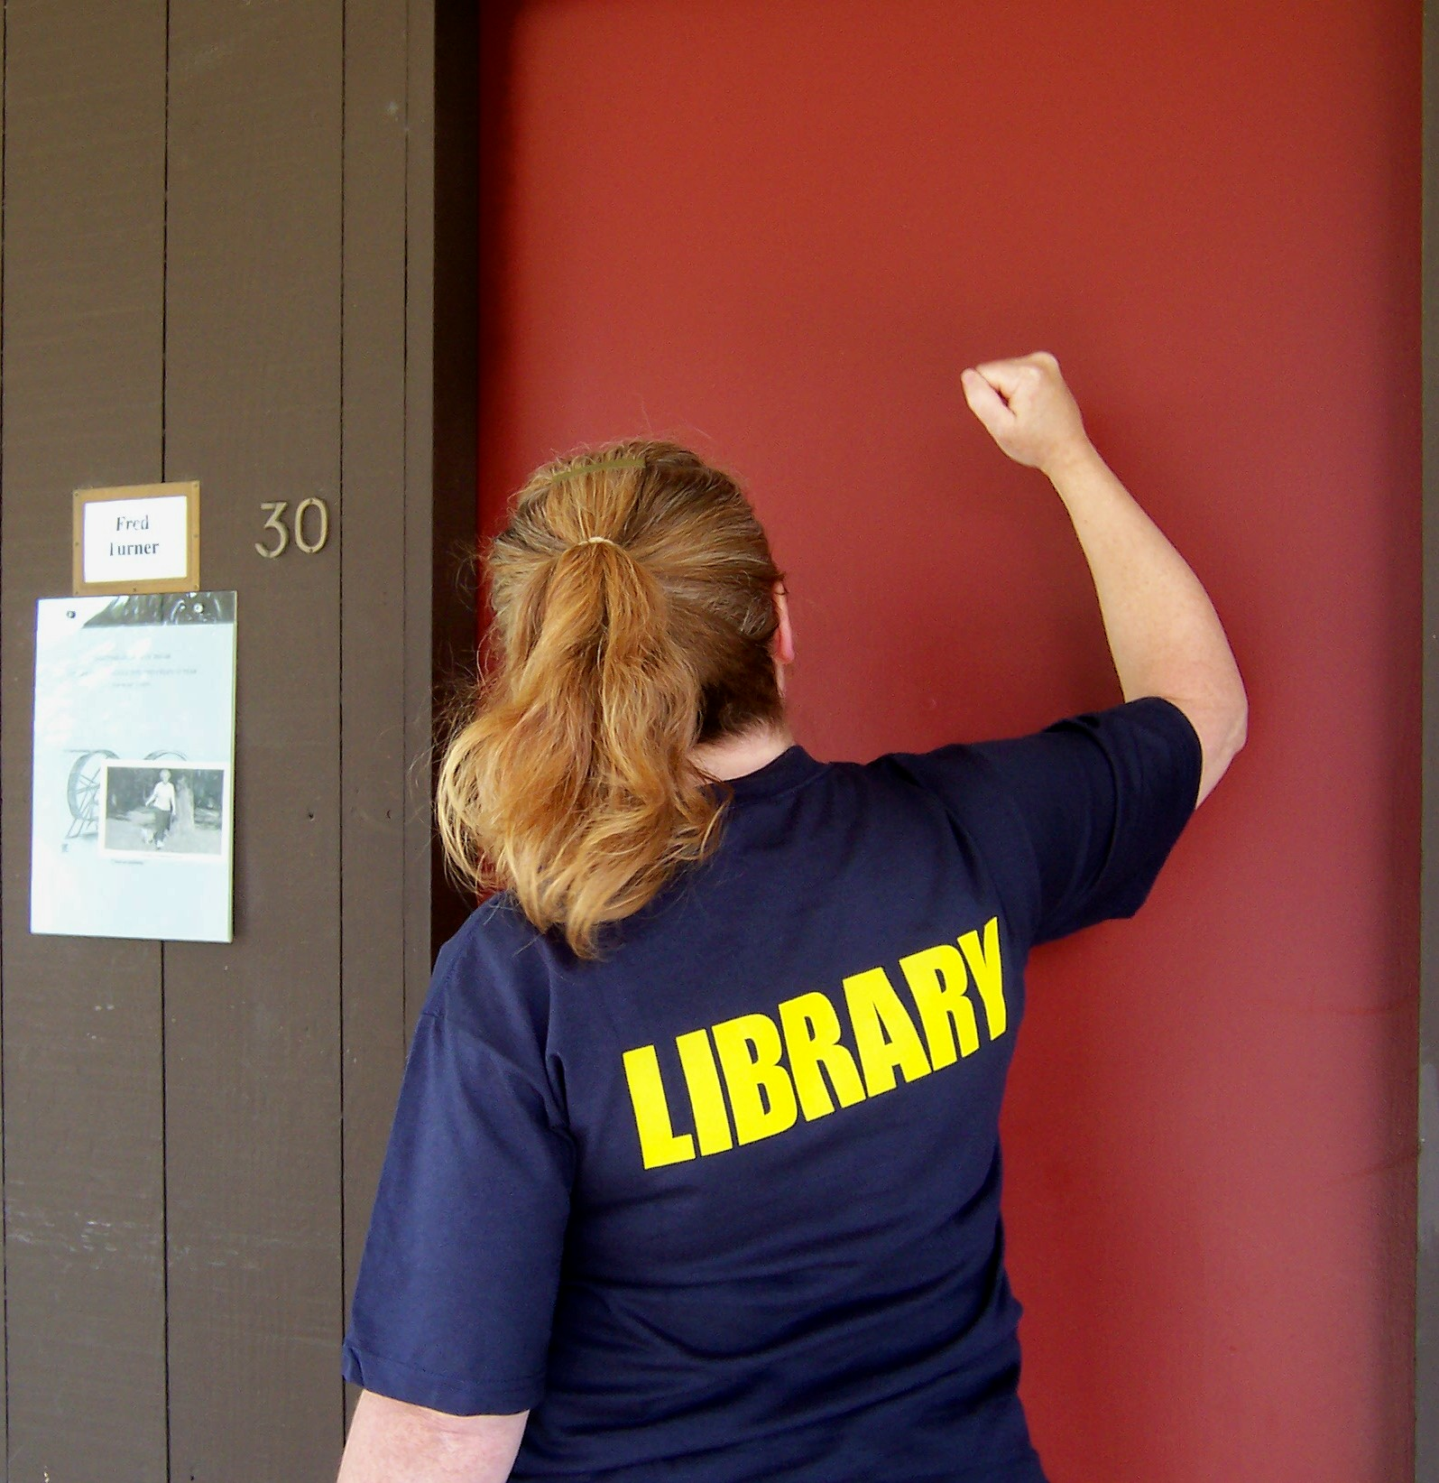
RDA in Your Library
Photo credit: http://www.flickr.com/photos/98372990@N00/2520306406/

Slide 54
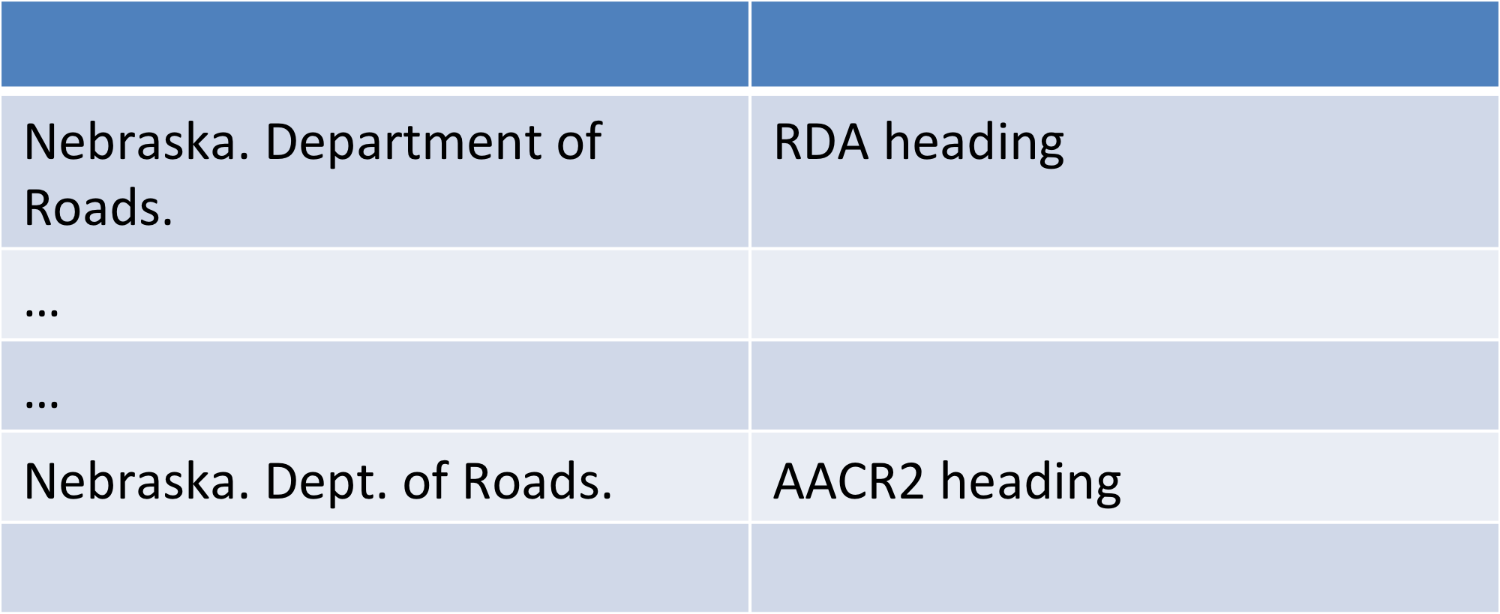
Things you will notice
Split authority files

Slide 55
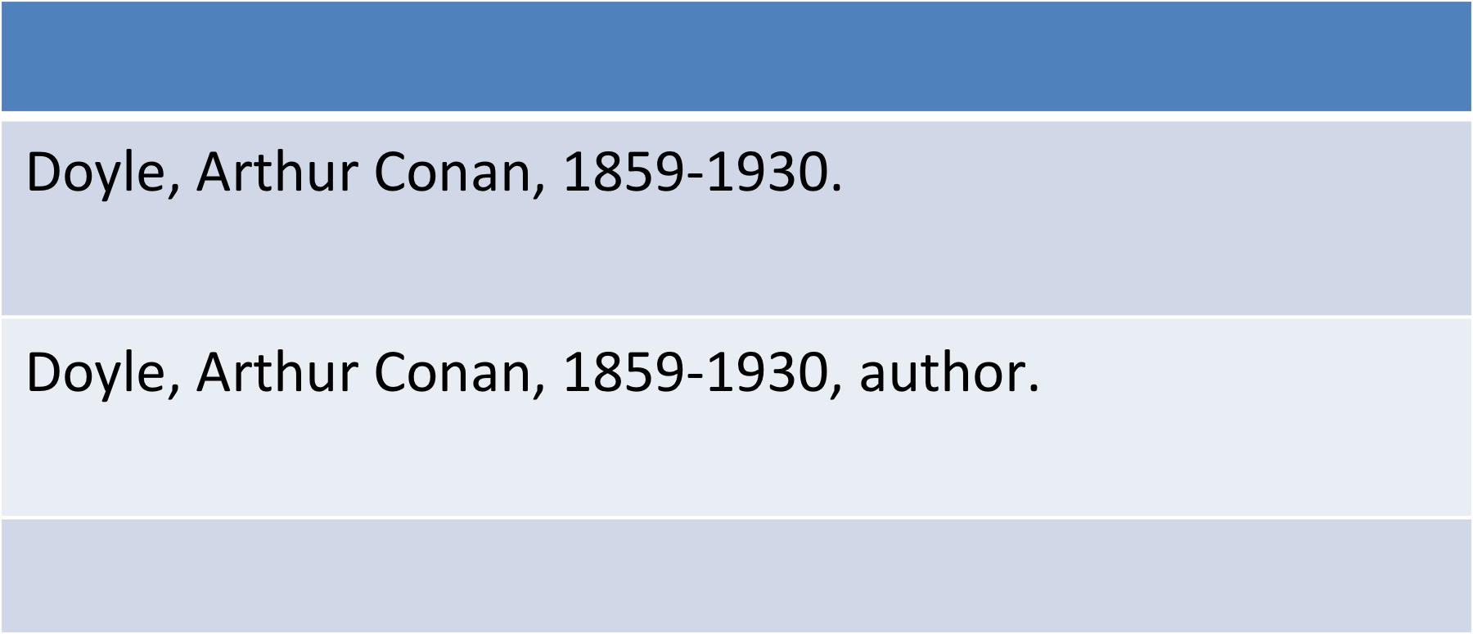
Things you will notice
Split authority files

Slide 56
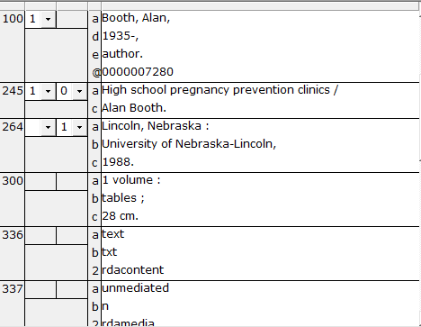
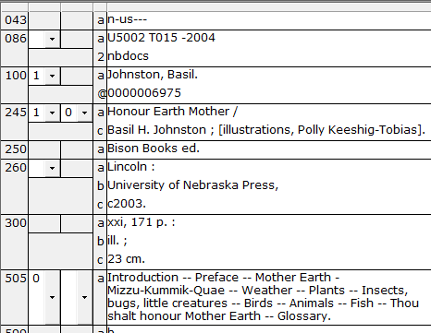
Things you will notice
Need to make sure the catalog is indexing and displaying the correct fields

Slide 57
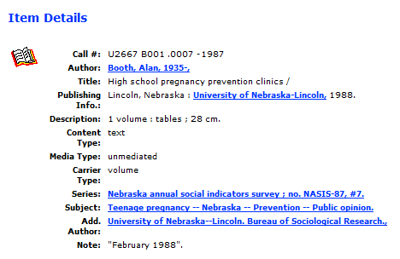
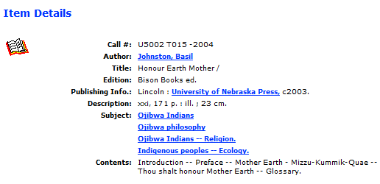
Things you will notice
Need to make sure the catalog is indexing and displaying the correct fields

Slide 58
Convert AACR2 records to RDA?
Marcive http://home.marcive.com/marcive-rda-conversion-service-underway/
Backstage Library Works http://www.bslw.com/faq/rda/
MarcEdit http://marcedit.reeset.net/features

Slide 59

Questions

Slide 60
Thank you!
Emily Dust Nimsakont
Cataloging Librarian
Nebraska Library Commission
enimsakont@gmail.com
http://delicious.com/enimsakont/making_rda_work

Slide 61
Infopeople webinars are supported in part by the U.S. Institute of Museum and Library Services under the provisions of the Library Services and Technology Act, administered in California by the State Librarian. This material is licensed under a Creative Commons 3.0 Share & Share-Alike license. Use of this material should credit the author and funding source.

