Slide 1

An Infopeople Webinar
Wednesday, December 3, 2014
Youth Development in Action
Patty Wong, Yolo County Library

Slide 2
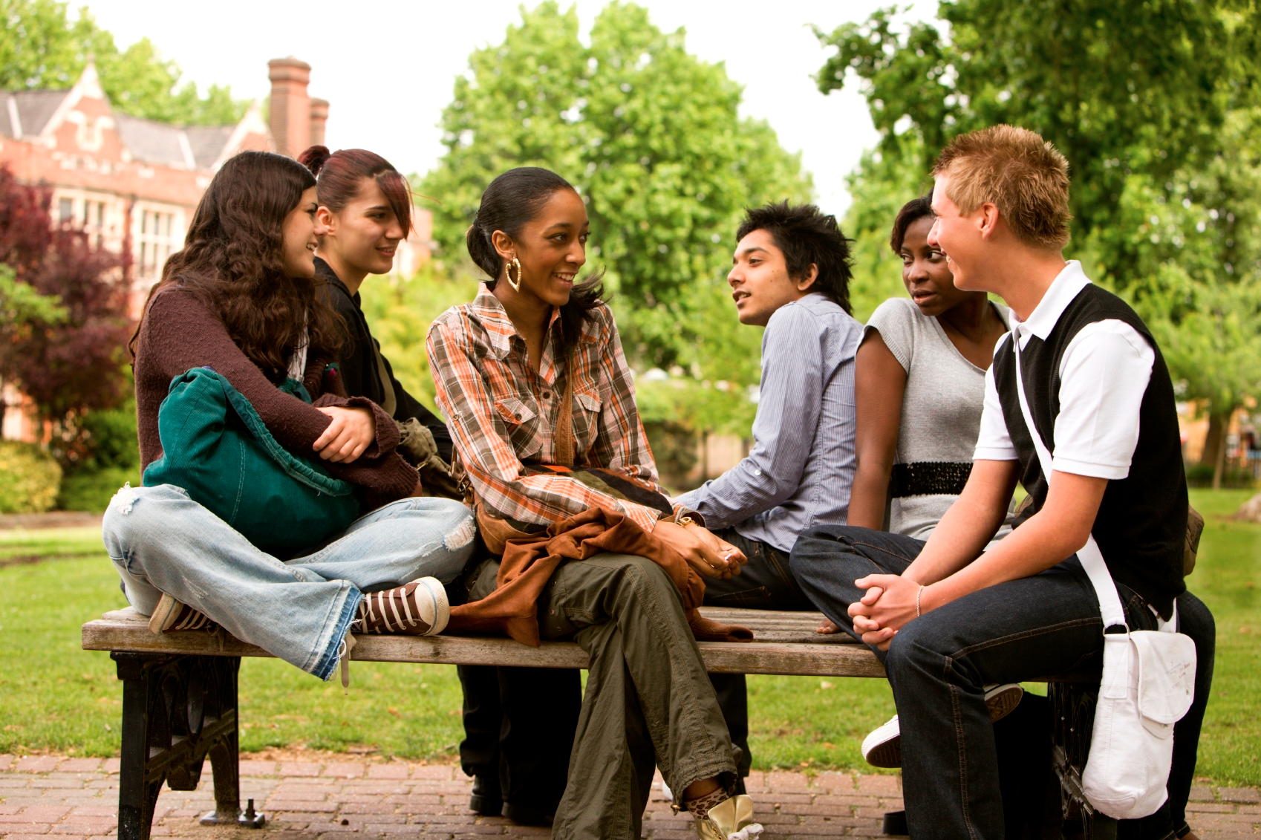
YOUNG ADULTS ARE PART OF OUR COMMUNITY

Slide 3

Staff may not be confident or feel uncomfortable working with young people…WHY?

Slide 4
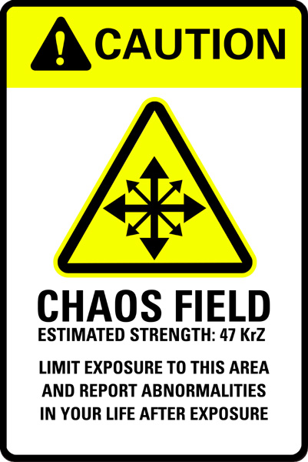
Chaos
Loss of control
Panic
Youth appear:
Uncontrollable
Unpredictable
Unapproachable
They may not look like or behave like us

Slide 5
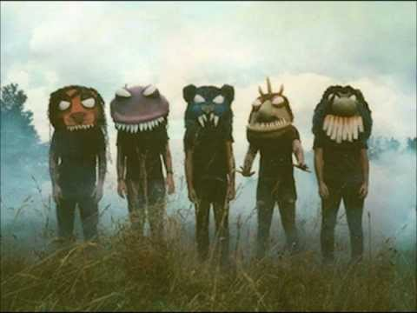

Slide 6
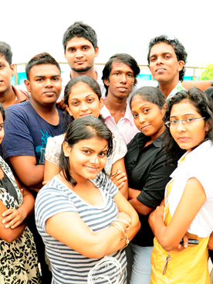
Youth Development
Young Adults
Travel in groups
Experiment
Take risks
Bold
Push boundaries

Slide 7
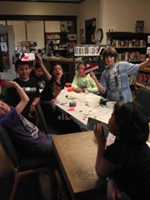
Search Institute
40 Developmental Assets
20 Developmental Relationships
http://www.search-institute.org/

Slide 8
Youth Development Model
Outcomes
Opportunities
Supports

Slide 9
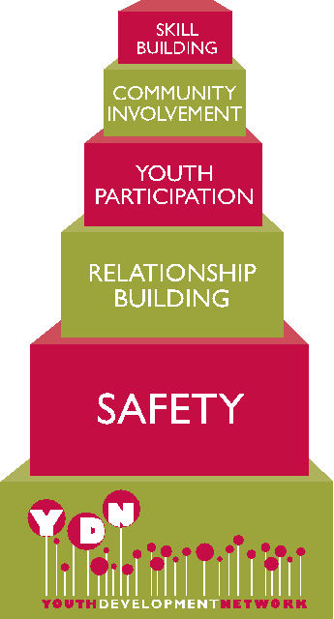
Youth Development:
Based in strengths
Outcomes/solutions focused
A common language
Youth Engagement
Youth Voice/Youth Driven
Leadership
Youth Development Network
www.ydnetwork.org/
Notes:
Solution:
Set the stage for success
Create opportunities to engage staff and youth working together in easy ways to integrate learning through doing

Slide 10
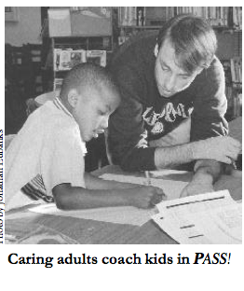
What are you currently doing well for youth?
Oakland Public Library
PASS! Partners for Achieving School Success
Young adults coaching and mentoring younger children under the direction of a caring adult
Youth opportunities:
Employment
Training
Mentoring

Slide 11
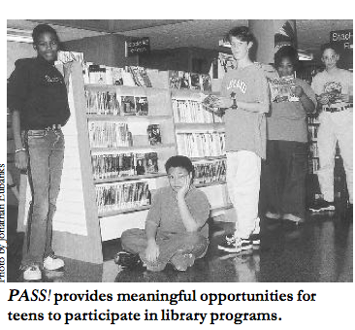
How can I change the program to bring strengths-based supports and opportunities to young people?
Outcomes
Youth Engagement and Voice
Youth Leadership Council
Youth on Library Commission

Slide 12
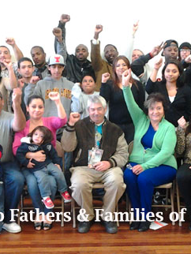
Stockton-San Joaquin County Public Library –
City of Stockton
Youth Development Coalition
Partnerships:
Fathers & Families of San Joaquin
COS Assistant City Manager, Youth in Government Day
Stockton Unified School District
Ripon School District
Afterschool Homework Center Coalition
Stockton Police Department
Downtown Stockton Alliance
Stockton Food Bank
Lao-Khmu Association
Outcomes: 1200 employees throughout Stockton trained by YOUTH in Youth Development principles

Slide 13
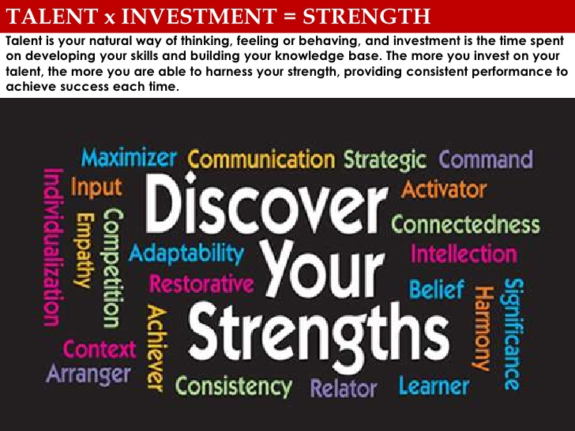
YOLO COUNTY LIBRARY:
Setting the Stage
Gallup Strengthsfinder Assessment
www.gallupstrengthscenter.com
Outcome:
Shift in organizational culture from deficits and gaps to strengths and assets
Use of strengths in vocabulary at work and home
Agreements to work together
Change in performance appraisal
Common understanding of “ambassador role” for Library and County
Library as champion for County Tactic – Collaborate to Maximize Success

Slide 14
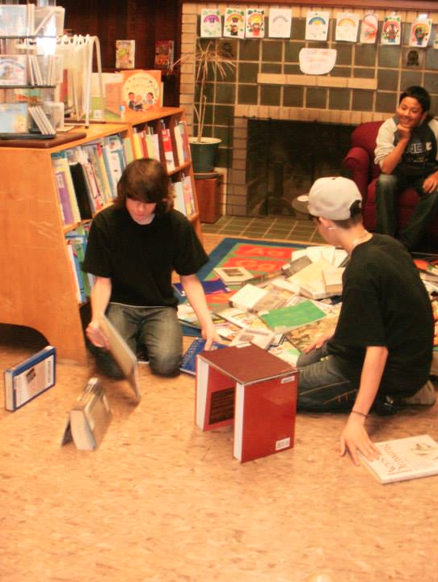
YOLO COUNTY LIBRARY
Outcomes:
Leverage youth development learning to other grant opportunities
Youth centered programming
Youth engagement and leadership at many decision making levels
Youth voice
Stronger relationships with school district leadership
Youth development focus in recruitment and selection of new staff

Slide 15
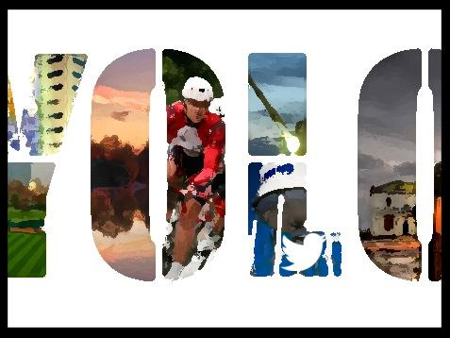
YOLO COUNTY LIBRARY
Youth Development Coalition
Partners:
CA State Library
Youth Development Network
Yolo County Board of Supervisors
Yolo County Office of Education
Yolo County Probation
UC Davis Early Academic Outreach Program
Center for Families
County School Districts
Outcomes:
First countywide Youth Development Institute in early 2015 – 8 teams, 45 participants

Slide 16
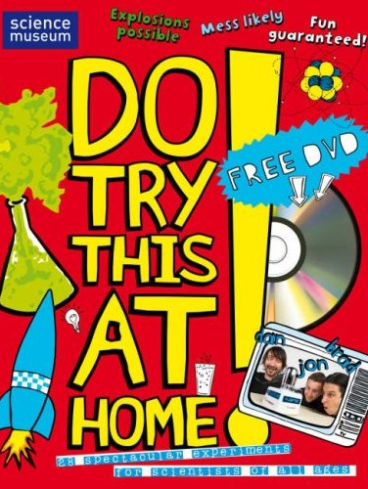
TRY THIS IN YOUR OWN COMMUNITY
Early adopters – who in your community is a youth development organization?
Use and share the research
Use existing programs and services
Introduce terms and concepts

Slide 17

OTHER RESOURCES:
Potential Partners:
County Office of Education
School Districts
Local First 5 Commission
Family Resource Centers
Community Based Organizations
County Housing Authority
City and County leadership
United Way
Funders including Community Foundations
Youth Development Agency

Slide 18

Questions

Slide 19
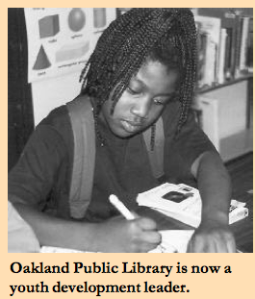
FOR MORE INFORMATION
Patty Wong
patty.wong@yolocounty.org
pattywong61@comcast.net
(530) 848-8768
Strengths: strategic/ideation/
connectedness/
futuristic/individuation

Slide 20
Infopeople webinars are supported in part by the U.S. Institute of Museum and Library Services under the provisions of the Library Services and Technology Act, administered in California by the State Librarian. This material is licensed under a Creative Commons 3.0 Share & Share-Alike license. Use of this material should credit the author and funding source.

