Slide 1

Value-Added Facilitation
Presented by Joan Frye Williams
Wednesday, December 10, 2014

Slide 2
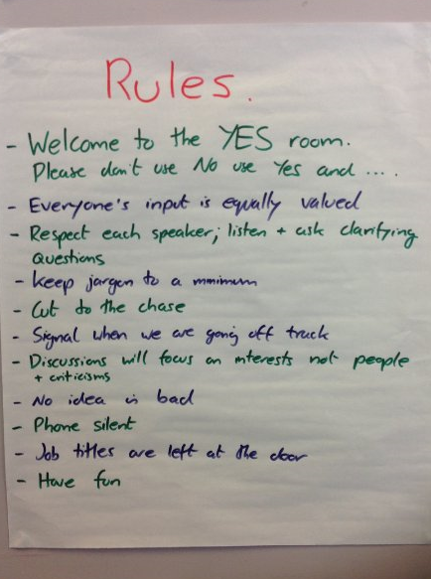
This presentation is not about basic facilitation skills

Slide 3
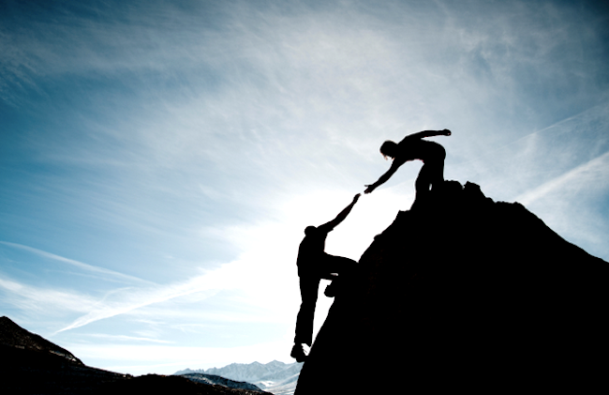
It is possible to serve and lead at the same time

Slide 4

Today’s discussion
Before you start facilitating
Ensuring credibility
Addressing conflicts
Stimulating the group’s best thinking
Consolidating progress

Slide 5

1. Before you start facilitating

Slide 6

Identify the client

Slide 7
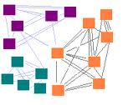
Review the context
Topic(s) for discussion
Perceived problem(s)
Related or larger issue(s)
What happens after this discussion
Time constraints

Slide 8


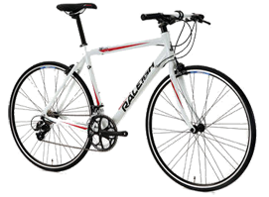
Identify and scope the desired work product

Slide 9

Identify the client’s evaluation criteria

Slide 10

Confirm the group’s level of authority
Comment
Recommend
Decide
  For the group
  Beyond the group

Slide 11

Share all of this with the group

Slide 12

Other things to ask the client up front…

Slide 13

How was the group constituted?
Selection process/criteria
Standing group or this task only?
Participating as individuals or speaking for a specific constituency?
Well acquainted with one other?
Similar levels of authority?

Slide 14

Are there likely points of conflict?
Trigger event(s)
Past attempts to address the same topic
Challenging relationships

Slide 15

Is there any option we should be sure to consider?

Slide 16

Do you have developmental expectations?

Slide 17

How much leeway do I have to challenge or redirect group members?

Slide 18

2. Ensuring credibility

Slide 19

Compare the group’s evaluation criteria with the client’s

Slide 20

Establish baseline facts
What do we know?
How do we know it?
Can we agree on these facts?
Is there anything else we need to know before we can move forward?

Slide 21

Check for assumptions

Slide 22

Always pause to illuminate
Unsupported assertions
Vivid anecdotes
Editorial comments
Attributions of intent

Slide 23
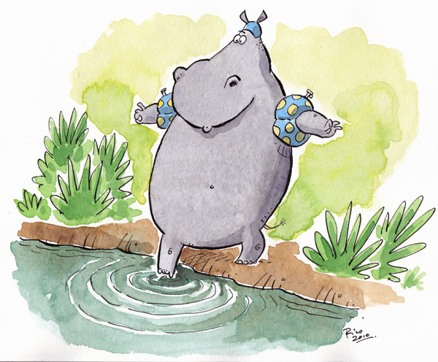
Engage reluctant participants
Eliminate competition
  Round robin
  One-on-one pairs
  Show of hands
Anonymize input
  Write, then hand in
  Write, then post

Slide 24
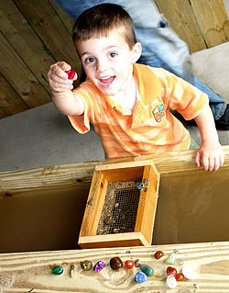
Mine past successes

Slide 25

Speak up for absent stakeholders

Slide 26
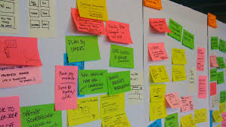
Document your work in progress

Slide 27
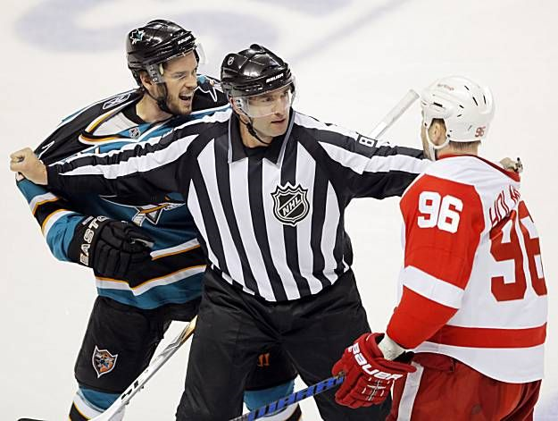
3. Addressing conflicts

Slide 28

Acknowledge the point(s) of disagreement

Slide 29
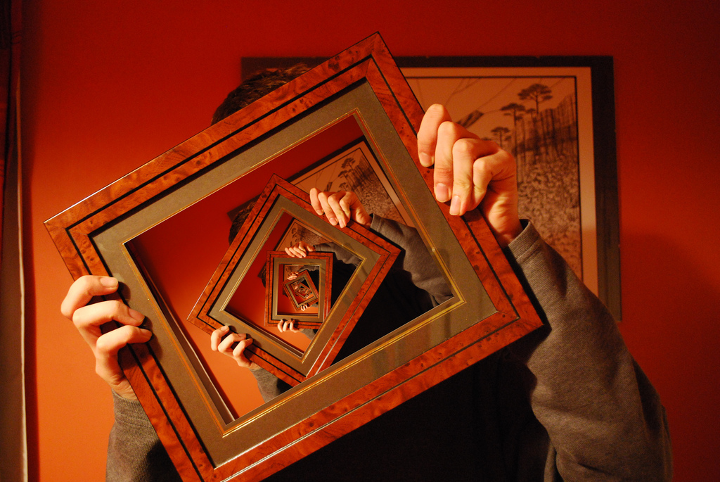
Reframe as a design question

Slide 30

Assess the stakes

Slide 31

Explore a variety of choices

Slide 32

Propose an acceptable solution

Slide 33
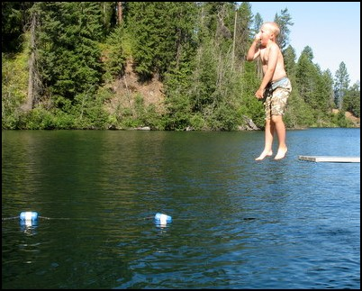
Ask for a commitment to move on

Slide 34
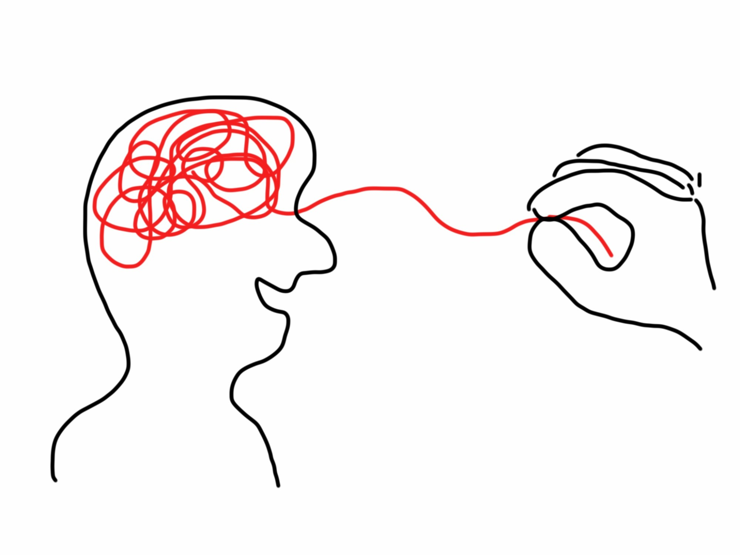
4. Stimulating the group’s best thinking

Slide 35

Look beyond the presenting problem

Slide 36
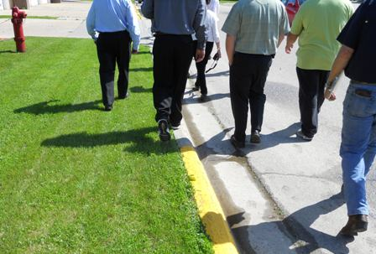
Challenge perceived barriers

Slide 37

Task participants with strengthening each others’ ideas

Slide 38

Point out recurrent themes

Slide 39

Explore the contrarian view

Slide 40

Extend trend lines

Slide 41

Combine the best elements of multiple ideas

Slide 42

5. Consolidating progress

Slide 43

Recap key points separately

Slide 44

Create one or more versions of the work product

Slide 45

Test against the client’s criteria and revise as necessary

Slide 46

Anticipate questions and prepare talking points

Slide 47

Ask each participant to confirm buy-in
The process was fair
I understood the decision criteria
There was an opportunity for my voice to be heard
Even if the result isn’t exactly what I would have chosen, I will support it with positive communications and actions

Slide 48
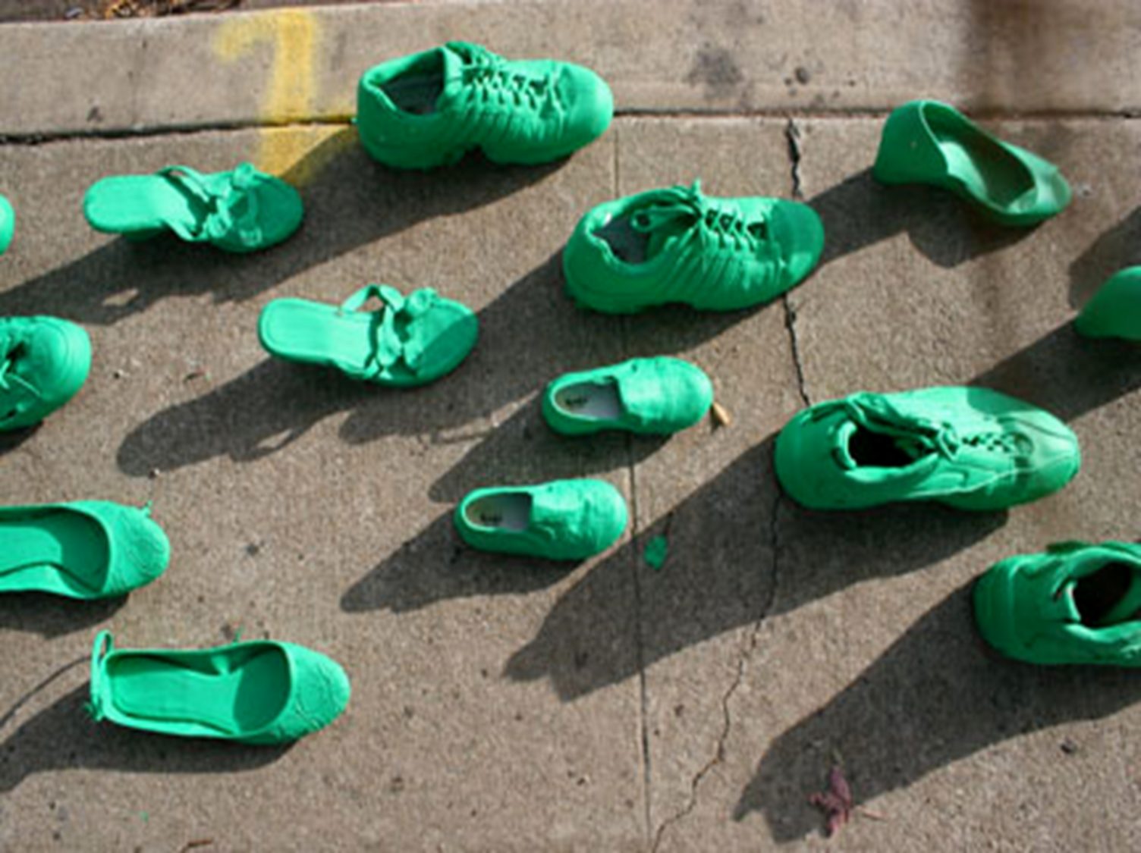
Move forward

Slide 49
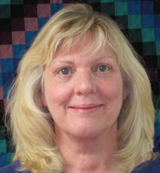
joan@jfwilliams.com
Let’s continue the conversation…
Photo by Martin Helmke

Slide 50

Infopeople webinars are supported in part by the U.S. Institute of Museum and Library Services under the provisions of the Library Services and Technology Act, administered in California by the State Librarian. This material is licensed under a Creative Commons 3.0 Share & Share-Alike license. Use of this material should credit the author and funding source.

