Slide 1
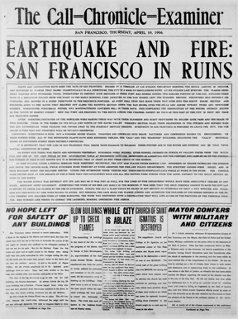
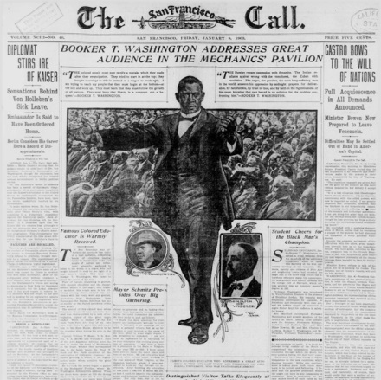
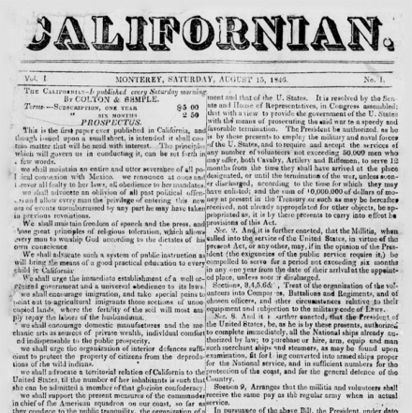
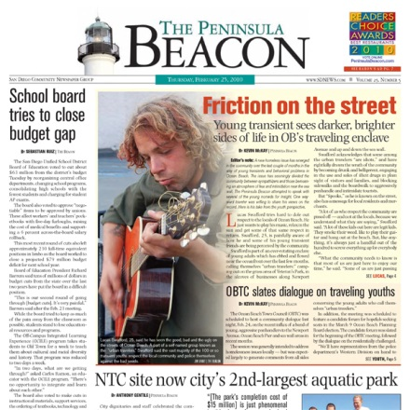
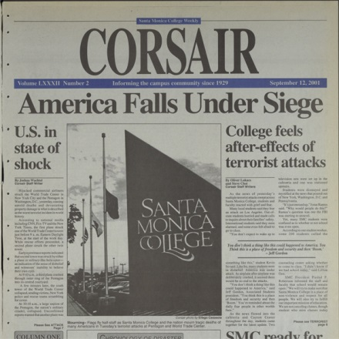
The CDNC: An Introduction
Brian Geiger, Director
Wednesday, December 17, 2014
12 Noon
Notes:
Welcome everyone to this introduction to the CDNC, and thanks for attending. Over the next hour or so we’ll cover what the CDNC is, what we do and how we partner with local CA institutions. Here is a selection of the variety of content in the CDNC.

Slide 2
Poll
Notes:
Over next few minutes I’ll be giving some intro remarks. While I’m giving my schpiel, I’d ask you to please take this poll I created to collect some background info on you, the participants.

Slide 3
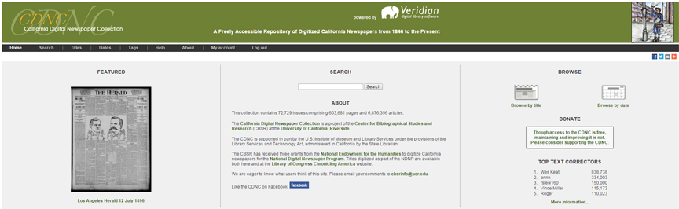
California Digital Newspaper Collection
≈ 1,000,000 pages
≈ 3,000,000 embargoed pages
1846-present
Available to everyone at cdnc.ucr.edu
Partnerships with local, state and national institutions
Notes:
While you do that, here’s a brief intro to the CDNC.

Slide 4
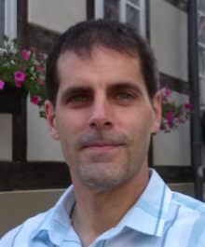
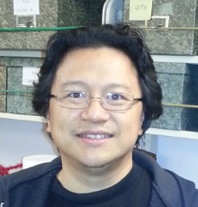




Who We Are
Brian Geiger
Director
Jay Yasul
Admin Assistant
Christine Straitt
Newspaper Cataloger
Ginger Schilling
Data Analyst
Luis Baquera
IT Administrator
Center for Bibliographical Studies and Research
Notes:
CDNC managed by CBSR at UCR. We are not a library nor part of the UCR library. CBSR is humanities research center that manages a number of projects. This is our staff.

Slide 5
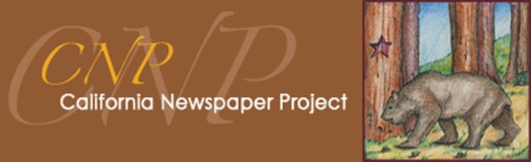
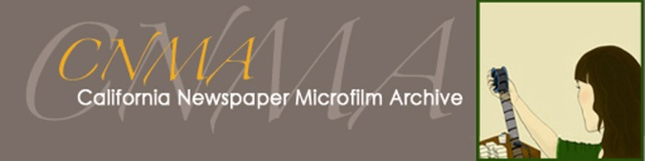
Related Projects
Bibliography and union catalog of
newspapers in CA institutions
Holdings abbreviations:
  “OR” = original newsprint
  “FM” = positive microfilm
  “FMM” = master negative microfilm
“California Newspaper Microfilm Archive”
holdings = CNMA film for digitization
cnp.ucr.edu
Master negative microfilm archive
100,000 reels
Stored at SRLF and NRLF
Available for digitization
cnma.ucr.edu
Notes:
2 related projects you should be aware of are the CNP and CNMA. CNP was a grant-funded project from early 1990s to 2000s to identify and catalog newspapers in institutions around the state. The CNMA grew out of the CNP in the early 2000s. As newspaper microfilmers either went out of business or looked to get rid of film, the CBSR acquired nearly 100,000 reels of master negative newspaper microfilm.

Slide 6
Agenda
History and Background
Standards
CDNC Features
Partnerships
  California State Library/LSTA
  Local Institutions
  Ancestry.com
  Born Digital Project
Notes:
Hopefully you’ve finished the poll. If you have general questions about the CDNC, please type them up and I’ll answer them at the end. If you have specific questions about a slide, please raise your hand so that we can address them as we go along.

Slide 7
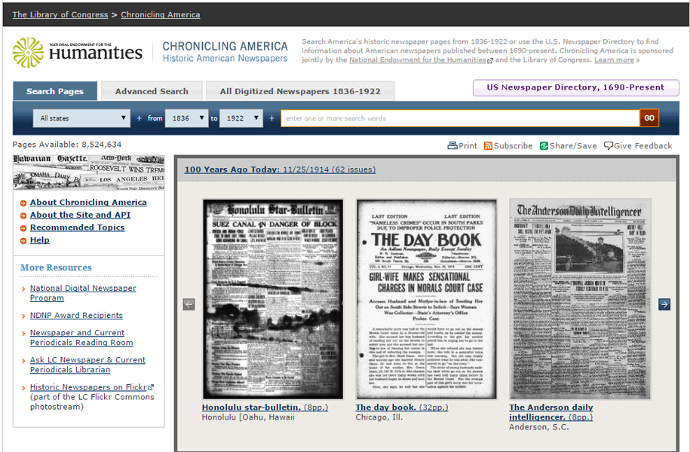
History and Background
2005-2011: National Digital Newspaper Program (NDNP)
Project of the Library of Congress and National Endowment for the Humanities
Participating states send content to LC
Content available at chroniclingamerica.loc.gov
CDNC produced 300,000 pages, available at cdnc.ucr.edu and ChronAm
Notes:
CBSR began digitizing CA newspapers in 2005 as one of the initial 6 participants in the NDNP program. Over 6 years we produced about 300,000 pages now available at CDNC and ChronAm.

Slide 8


History and Background
2007-present: LSTA/CSL
Library Services and Technology Act (LSTA) grants
LSTA administered by the California State Librarian
Produced over 450,000 pages
CDNC officially launched 2007
Notes:
In 2007 the CBSR officially launched the CDNC with the initial 100,000 NDNP pages. That year we also produced an additional 50,000 pages with funding from the State Library through their LSTA grants program. Over the last 7 years we’ve digitized more than 450,000 pages with LSTA funding and initiated other projects I’ll describe in more detail shortly.

Slide 9
History and Background
2008-present: Local Partnerships
Produced over 200,000 pages
Ancestry.com Collaboration
Partnering institutions include
Sausalito Public Library
Coronado Public Library
Santa Monica Community College
Palm Springs Public Library
Tehama Public Library
Occidental College
Healdsburg Museum & Historical Society
San Bernardino County Historical Archives
Port of Los Angeles
Barbro Osher Pro Suecia Foundation
Notes:
Our partnerships with local CA institutions began in 2008, when we digitized about 10,000 pages of the Sausalito News for the Sausalito Public Library. Since then we’ve partnered with more than a dozen libraries and historical societies to digitize more than 200,000 pages. We’ve also established a 3-way partnership with Ancestry.com, us, and local institutions. I’ll describe these various models in more detail shortly. My apologies if your local institution isn’t included on this list. I could only fit so many names, and we’ve worked with many institutions that haven’t actually started to produce content yet.

Slide 10
Standards
Overview
Follow standards set by LC and NEH for NDNP
Used around the world, including Australia, Europe and Asia
Details
Scan from CNMA master negative film, occasionally newsprint or positive film
TIFF archival image for every page
Derivative files provide access
Why
Digital preservation copies of newspaper
Provide superior access than formats like PDF
Usable across platforms
Eliminate need to reprocess in the future
Notes:
That’s a brief history of the CDNC. I want to talk next about what we do, how and why. All of the data we produce follows standards est. by the NDNP project. Standards used around the world. Some of the important details are as follows. Assume this crowd doesn’t need to be convinced of the importance of standards, but just in case these are some of the reasons why we use them. How many use ContentDM?

Slide 11
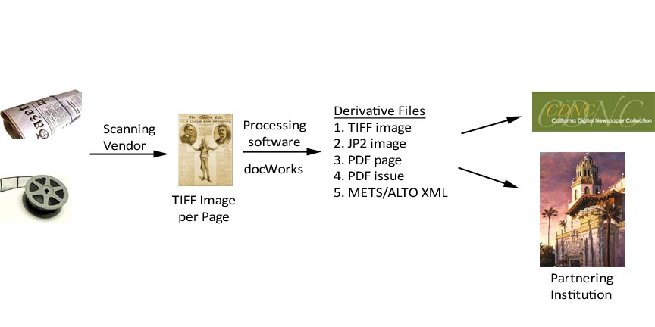
Standards
Notes:
This is our basic workflow. Talk more about derivatives in next slide.

Slide 12
Standards
Derivative Files
TIFF Images
Digital preservation copy of page
Soon downloadable for high-res reproductions
JP2 Images
Used for page display in CDNC
Available for high-res reproduction
PDFs
Downloadable for low-res purposes
METS/ALTO XML
METS defines the physical layout of the issue and pages
ALTO defines page contents and computer-generated text (OCR)
Allows sophisticated access and retrieval of data
Notes:
Might be asking yourself why so many files? Seem quite complicated and it is but for important reasons. Each file does something unique and important. Assume most have at least heard of METS. How many have heard of ALTO?

Slide 13
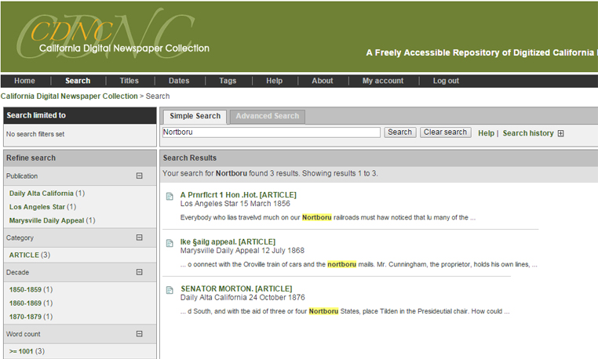
CDNC Features
Notes:
Enough about standards for now. Let’s talk about what all this data means for the end-user. This first slide show some features of a typical search result. I’ve searched for “nortburo” and returned 3 results. Users see their results highlighted and part of the sentence around the term provides some context. They can also refine their search using various facets available on the left-hand side.

Slide 14
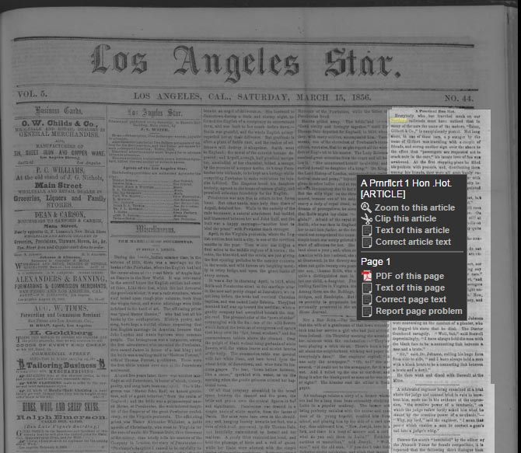
CDNC Features
Notes:
This image shows the first search result. You can see that the researcher sees not only the result highlighted on the page, but also the article in which it appears is contrasted against a darker background. This is especially valuable when a term appears more than once on a page and the user needs to get the specific article they’re interested in. Right-clicking on the article brings up the black action-box displayed. Within that box the user can clip an article to get an image of it or select “text of this article” to copy and paste elsewhere. They can also download a PDF of the page or get the text for the entire page.

Slide 15
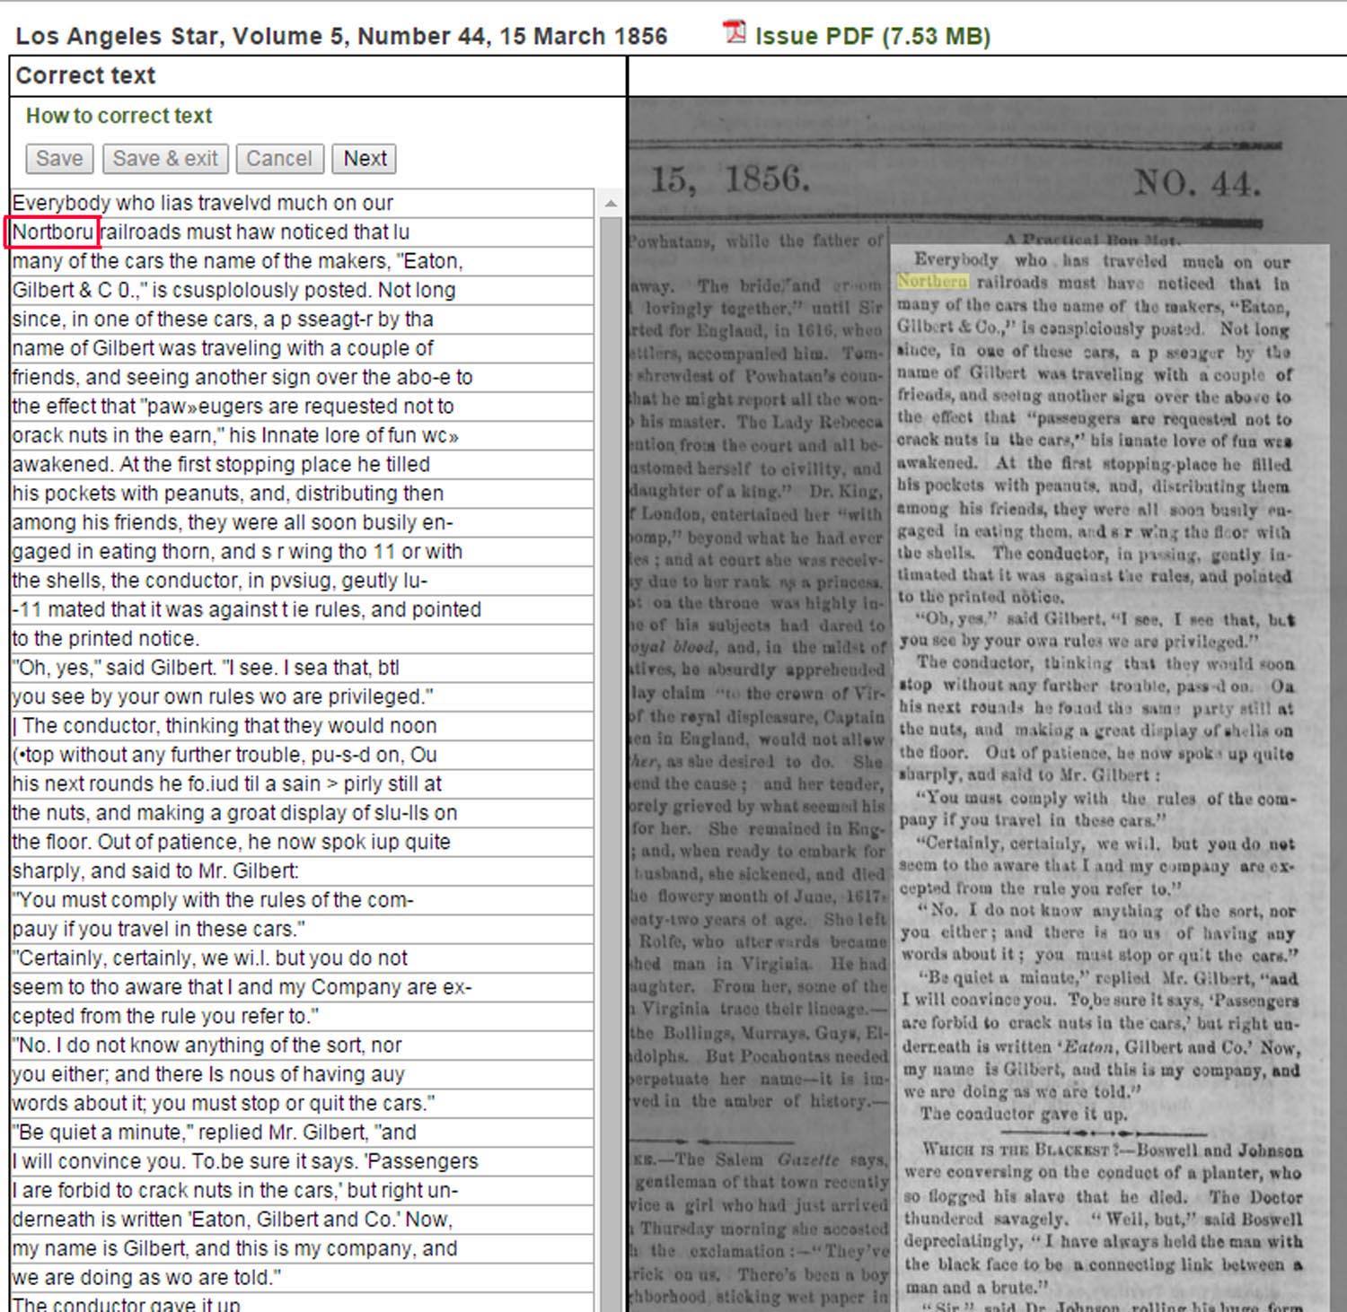
CDNC Features
1. | Wes Keat | 838,881
2. | annh | 334,401
3. | rstew160 | 150,000
4. | Vince Miller | 115,173
5. | Roger | 110,023
6. | RIddings | 99,999
7. | wmartin46 | 97,407
8. | Sharonvdc | 96,792
9. | Conovaloff | 73,186
10. | JFZ | 70,166
11. | Mike Detwiler | 63,786
12. | JeffD-OCRtf | 57,565
13. | Toby | 57,441
14. | mjbarkl | 49,030
15. | Phyllis | 40,855
16. | CathyMK | 36,647
17. | Teresa Nemeth | 35,268
18. | Sheila S | 34,562
19. | Kevin Hopkins | 31,319
20. | DeborahC | 31,039
21. | nrowlett | 30,408
22. | rieck | 27,616
23. | JuneauJim | 26,914
24. | kost | 26,104
25. | stepsix | 25,755
26. | astrayelmgod | 25,152
27. | J Sergneri | 22,691
28. | cferoben | 21,458
29. | daveg | 20,786
30. | Peter H | 20,221
Notes:
This last slide shows the unique and notable User Text Correction feature in the CDNC. On the left I’ve outlined the search result “nortburo” in red. Nortburo is actually a misspelling of “northern” which is highlighted in yellow to the right. The digitizing software transcribed Northern incorrectly as nortburo. Right now if you searched for “northern” in the LA Star you wouldn’t find this instance of it. The user, if he chose, could login and then correct the text within the “Correct text” block on the left side of the screen. That corrected text then becomes searchable by other users. In the image on the right you can see how many lines of text the top 30 correctors have fixed. The top five have each corrected more than 100,000 lines each. Wes Keat alone has corrected almost 1 million.

Slide 16
CDNC Features
Future Additions
Automatically download high res TIFFs and JP2s
Search embargoed content
Robust user accounts
  Save search histories
  Save and organize search results
  Take notes on search results
Tag content with authorized terms like “Illustration,” “Birth/Death Notice,” “Ad”
View titles by county
Notes:
User Text Correction is one of the notable features in the CDNC. Early next year we’ll be adding some additional features.

Slide 17
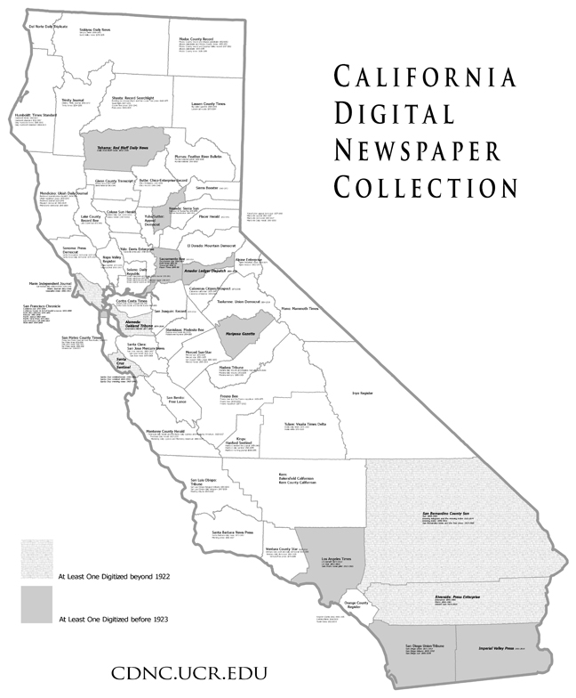
Partnerships
California State Library/LSTA:
5-Year Plan
Notes:
Speaking of counties, this map of CA counties represents our proposed 5-year plan with the State Library and their LSTA program. As I mentioned already, over the last 7 years we’ve focused on digitizing short runs of important historical titles with LSTA funding. Over the next 5 years we’d like to digitize at least one title for each county through at least 1923, when copyright starts. So if you’re with a county library or historical society and you’re considering newspaper digitization, take a closer look at this map after the webinar. The link to a larger version of this map is available in Resources slide at end. The titles listed on this map represent our best efforts to identify the important newspapers. We’d like to hear from you if you think there are more important titles for your county, and to coordinate our efforts with local institutions. At the very least, we will send you copies of the data we produce for your titles.

Slide 18
Partnerships
Local Institutions
Funding
CSL/LSTA 5-Year Plan
CSL/LSTA Pitch an Idea: Local projects that can include newspapers, but…
Local Funding Agencies: foundations, businesses, etc.
Local Resources: fund-raising campaigns, donor, acquisition funds, etc.
How it Works
CNMA master neg microfilm, local positives if necessary, occasionally newsprint
CDNC bundles projects for lower pricing
2015 per page pricing: $0.06 scanning + $0.34 digitization = $0.40 total
CDNC pays vendors and invoices institution for reimbursement
CDNC QCs data then loads into live site and sends copies to institutions
There is no charge to local institution for hosting data in the CDNC, but…
Notes:
What if your local titles aren’t part of the 5-Year Plan, and there will be many publications that aren’t, what are your options? Here’s how we’ve worked with local institutions in the past. I’ll start w/ funding. First, I want to reiterate that you can and should contact me to talk about the 5-Year Plan for your county. Having said that, every spring the State Library runs their Pitch an Idea grant program, and a number of local libraries have received funding to digitize newspapers as part of larger digitization projects. However, with the 5-Year plan in place the CSL plans to reduce these awards for local newspaper projects. A number of institutions have successfully raised money locally from funding agencies, donors, campaigns, etc. In my experience these efforts can take a while and sometimes result in piecemeal projects, that is 10,000 pages one years and another 10,000 another, but they can be successful. Now I must admit that though I’m a trained librarian, I don’t work in a library and don’t have direct experience w/ raising funds in a library setting. Does anyone want to offer ideas or suggestions of approaches that have worked for you? You can use chat it you do.
However you raise the money, this is generally how our projects have worked.

Slide 19
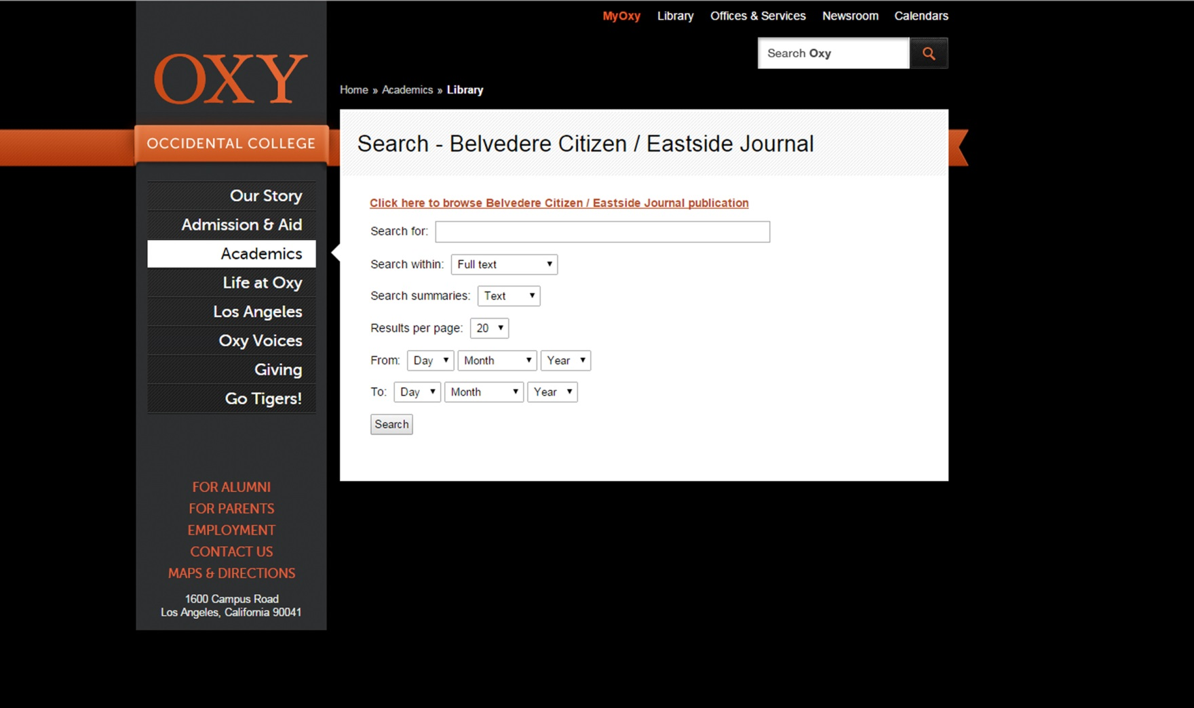
Partnerships
Local Institutions: Branded Website at CDNC
Notes:
Once your data is in the CDNC, one option you might want to know about is local branding. This is a mockup we created for a project we did with Occidental College. We haven’t actually implemented it yet; it’s just a proof of concept. With a local entry page similar to this in the CDNC, users have a url they can visit that is particular to the local institution and searches only their content. Once a user searches, he/she is directed into the CDNC and can expand his search results to include other titles. Clicking the “Home” option in the CDNC would take them back to this branded page. We think the annual cost for a branded page like this would be about $1000, but pricing is still open to negotiation.

Slide 20
Partnerships
Ancestry.com
Overview
Ancestry digitizes film at their cost
Adhere to CDNC digitization standards
Provide copies of all data to CDNC
Available immediately at newspapers.com for a fee
After 3-year embargo available for free to everyone at CDNC
In 2015 hope to make embargoed data searchable but not viewable in CDNC
Interested primarily in long runs, late 19th to early 21st century
To date have digitized San Bernardino Sun, Santa Cruz Sentinel, & Oakland Tribune
Local Institution
Clears copyright by researching or working with copyright holder
Gets free access to titles at newspapers.com during embargo period
Notes:
Another option to consider, particularly if local funding is limited, is the partnership we established with Ancestry.com in 2013. Over the last year and a half we’ve digitized the SB Sun, Santa Cruz Sentinel, and Oakland Tribune from the late 1800s to early 2000s. The terms of the agreement are as follows.

Slide 21
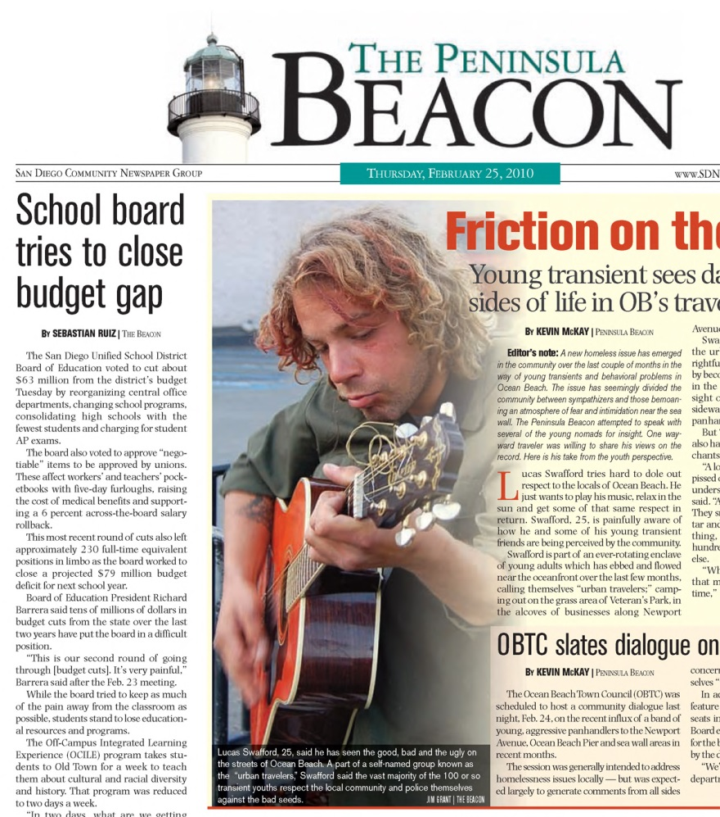
Partnerships
Born Digital Project
Many newspapers no longer microfilmed
PDFs can be preserved instead
CBSR began collecting PDFs in 2010
Publisher uploads PDFs as sending to printer
CBSR developed special uploading software
  cdnc.ucr.edu/pdfuploader
Periodically process PDFs to include in CDNC
How You Can Help
Publishers stop uploading PDFs
Local institution has access to account
Check account and remind publisher to upload
Notes:
Finally, I want to briefly discuss our born digital project, which is an effort to save newspaper PDFs.

Slide 22
Resources
Microfilm
California Newspaper Project, http://cnp.ucr.edu: bibliography and union catalog of CA
newspapers around the state. “FM” holdings are positive reels; “FMM” master negs;
“OR” newsprint. Holdings marked “California Newspaper Microfilm Archive” are FMM
managed by the CDNC and available for digitization or duplication.
California Newspaper Microfilm Archive, http://cnma.ucr.edu: reel-by-reel database
of master neg film available for digitization or duplication. Note not all reels have been
entered, and it is best to double check availability in the CNP above.
Best Practices
METS Standard: maintained by LC at http://www.loc.gov/standards/mets/
ALTO Standard: maintained by LC at http://www.loc.gov/standards/alto/
Historic Newspaper Digitization: a number of documents created by the CDNC,
in part with LSTA funding, available at http://cdnc.ucr.edu/site/related.html

Slide 23
Resources
Documentation
Info on “Born Digital” project and PDF uploader http://cdnc.ucr.edu/site/uploading.html
Copyright http://cdnc.ucr.edu/site/USNewspapersandCopyright.html
California counties 5-year plan http://cdnc.ucr.edu/site/cacounties.html#

Slide 24
Thank You!
Brian Geiger, Director
bgeiger@ucr.edu
951-827-7007
cbsr.ucr.edu

Slide 25
Infopeople webinars are supported in part by the U.S. Institute of Museum and Library Services under the provisions of the Library Services and Technology Act, administered in California by the State Librarian. This material is licensed under a Creative Commons 3.0 Share & Share-Alike license. Use of this material should credit the author and funding source.

