Slide 1
MAKING IT COUNT
California Library Statistics
ONLINE
http://californialibrarystatistics.com

Slide 2
ONLINE!
CSL Digital Data Task Force
Mary Cohen, Palos Verdes Library District
Jeanette Contreras, Placentia Library District
Heather Cousin, Simi Valley Public Library
Lisa Dale, Folsom Public Library
Deborah Janzen, Fresno County Public Library
Mel Lightbody, Butte County Library
Reed Strege, Azusa Public Library
Anne Marie Gold, Municipal Resource Group
Lindsay Thompson, Counting Opinions

Slide 3
ONLINE!
New ways to access YOUR data
  Local Data
  Statewide Data
  Pamphlets

Slide 4
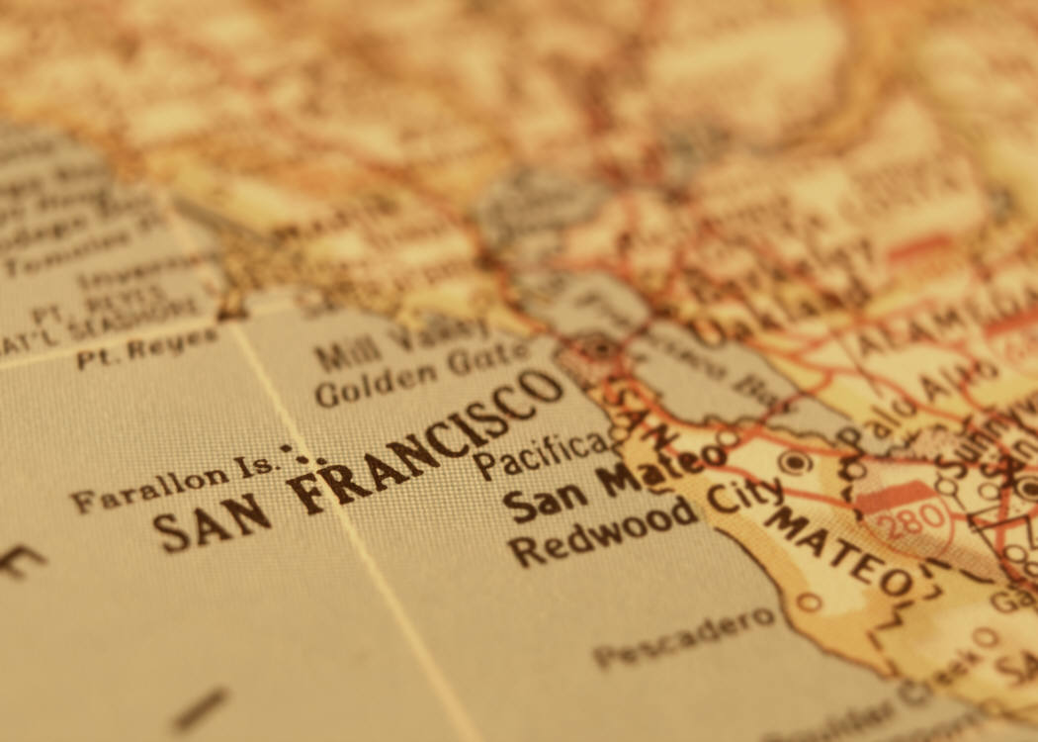
LOCAL REPORTS

Slide 5
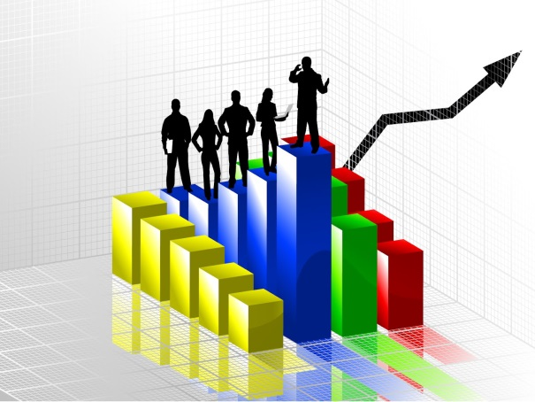
Quick Access to Local Data
Easy-to-use reports for local libraries
Relevant data to share with decision makers
Changes over 5- and 10-year periods
Quick comparisons to similar libraries
Notes:
Based on feedback from Public Library Director’s Forum

Slide 6
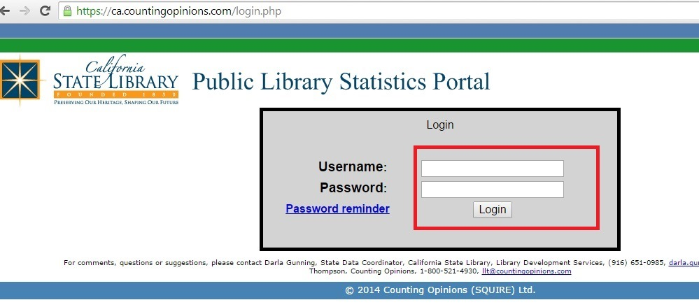
Local Reports Available on the Web
Log in using your Counting Opinions account info
ca.countingopinions.com

Slide 7
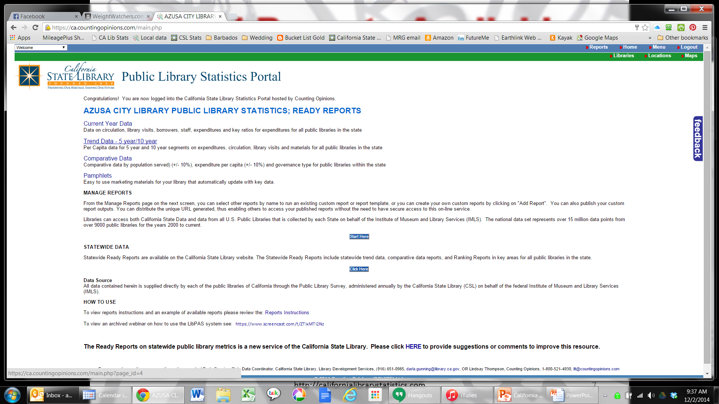
Local Reports Available on the Web
Reports for your local library will appear

Slide 8
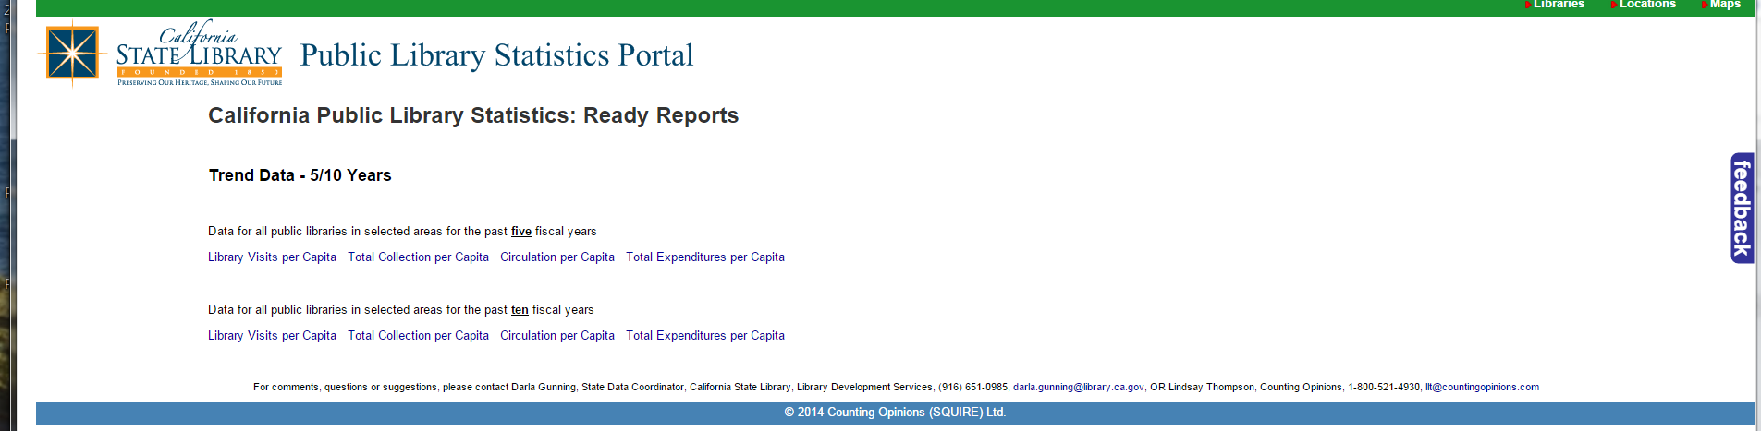
Local Reports Available on the Web
Trend Data Reports reflect change over time

Slide 9
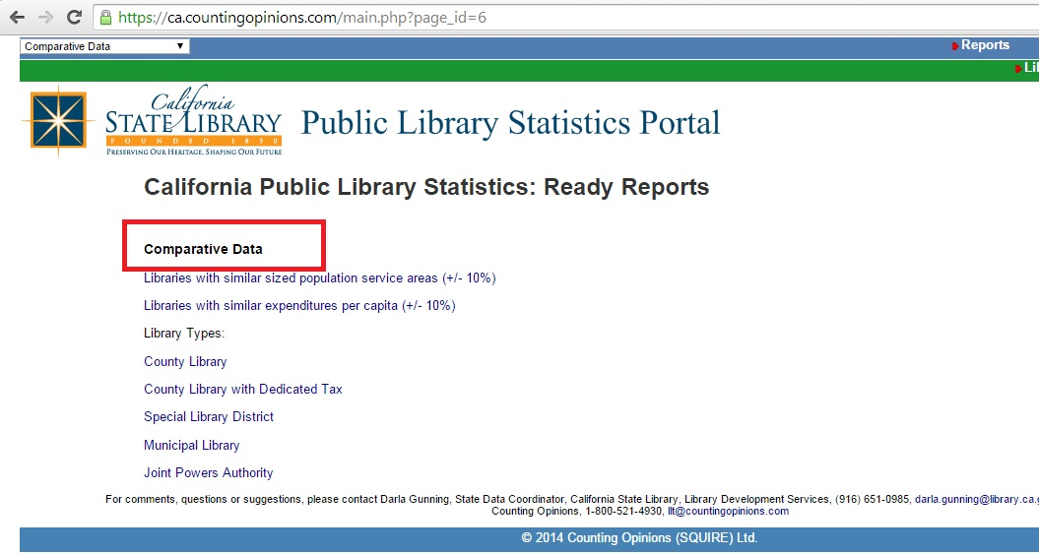
Local Reports Available on the Web
Comparative Data Reports compare similar libraries

Slide 10
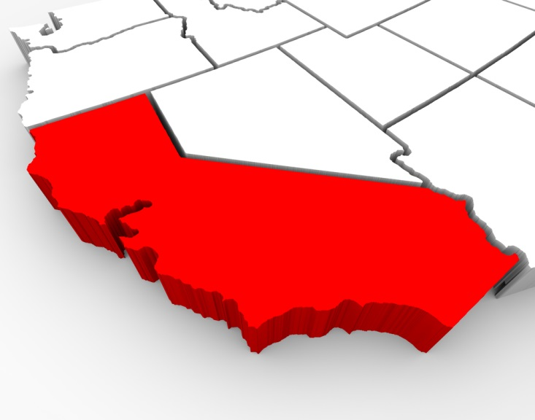
STATEWIDE REPORTS

Slide 11
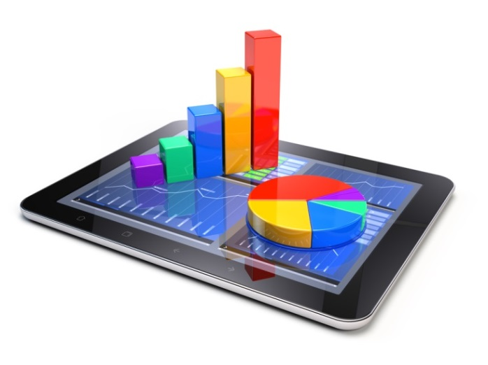
Access to Statewide Data
Useful, user-friendly interface
Easy access to templates and reports
Ability to compare ourselves to other jurisdictions in meaningful way
Includes multi-year data
Notes:
Based on feedback from Public Library Director’s Forum

Slide 12
What’s Included
Summary of service
Specific reports via topic
  Available in Excel and graph formats
Rankings
Comparative Data (totals and averages per data set)
  Population
  Expenditures per capita
  Governance
Notes:
Either here or on the previous/next slide we could mention how the groupings for comparative data were determined as they are different than previous published. Basically, we tried to group so there was a reasonable distribution of data and to keep line item data manageable.

Slide 13
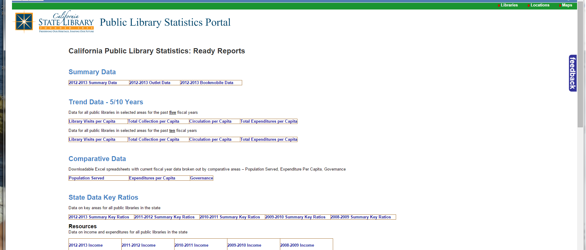
Statewide Ready Reports
Notes:
https://ca.countingopinions.com/index.php?page_id=3

Slide 14
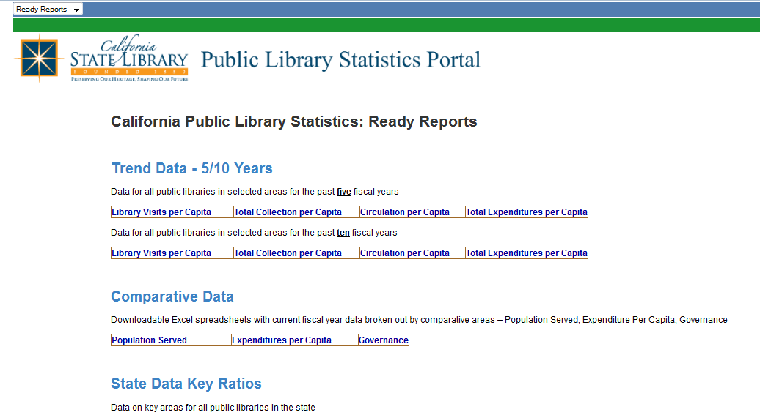
Trend Data

Slide 15
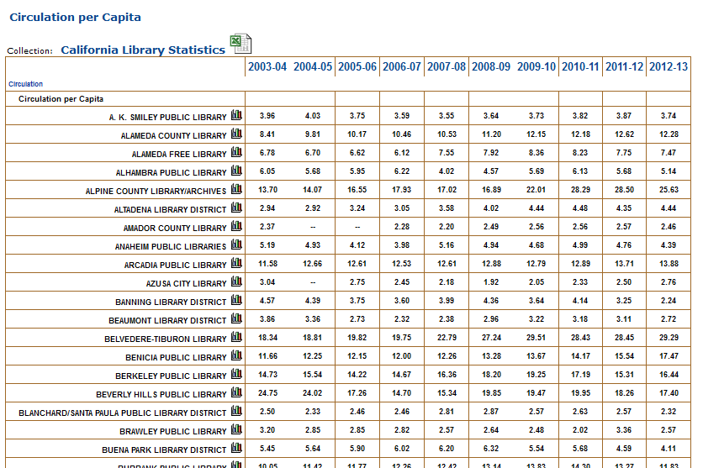
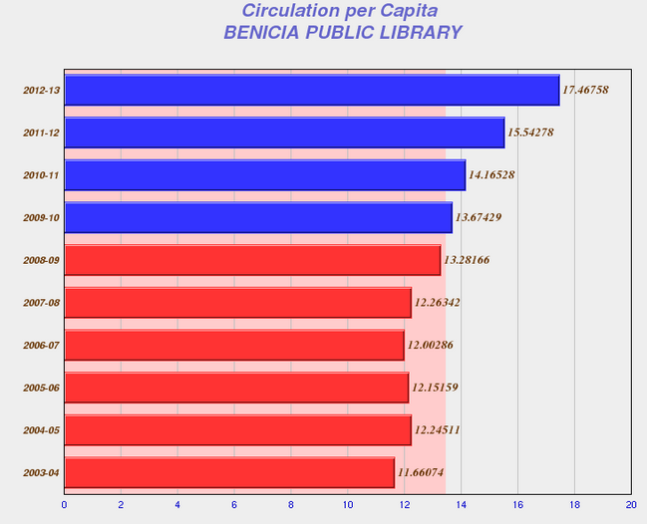
Circ per Capita – 10 yr

Slide 16
Comparative Data

Slide 17
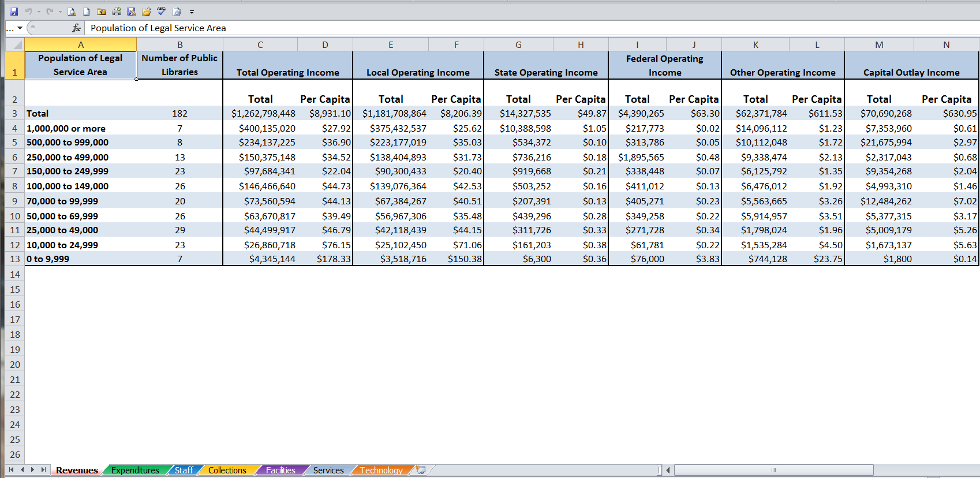
Per Population Served

Slide 18
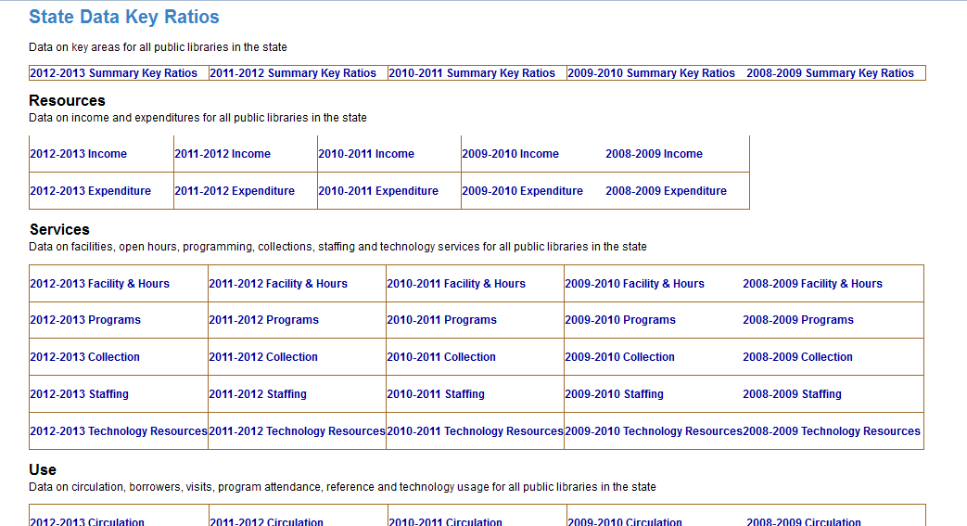
Key Ratios

Slide 19
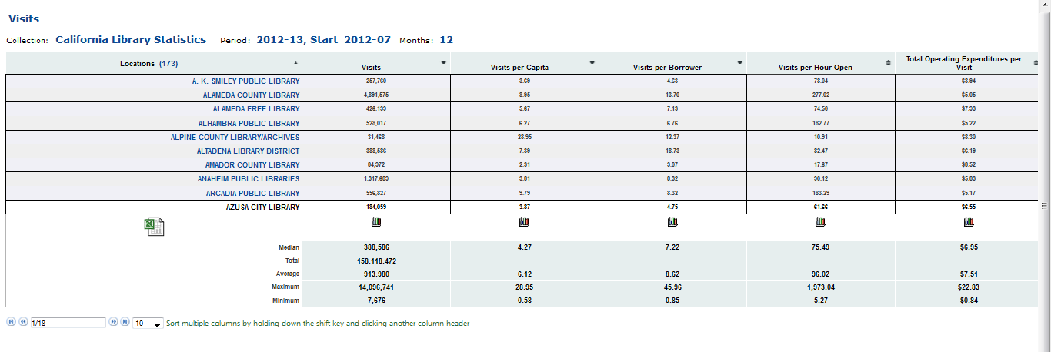
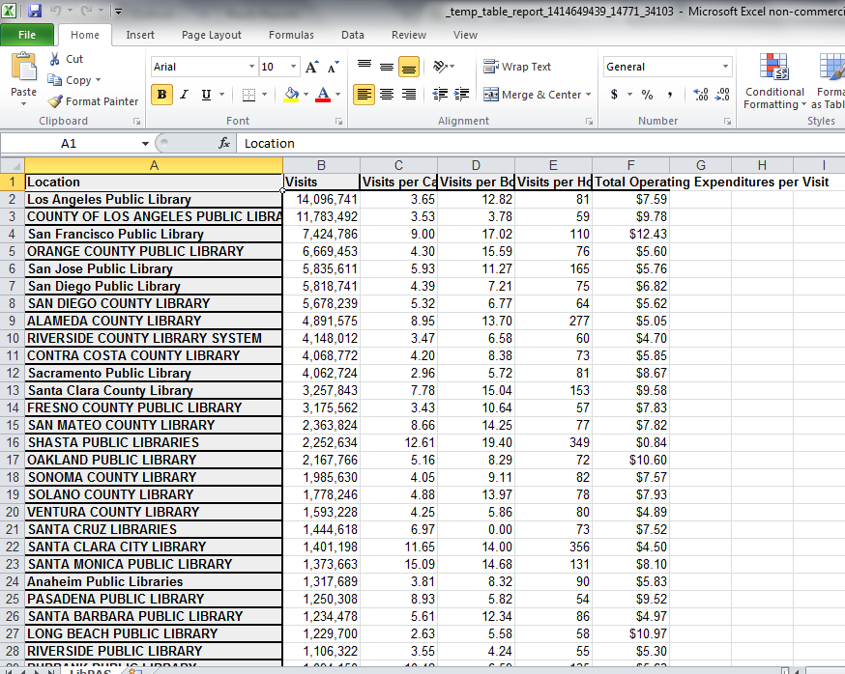
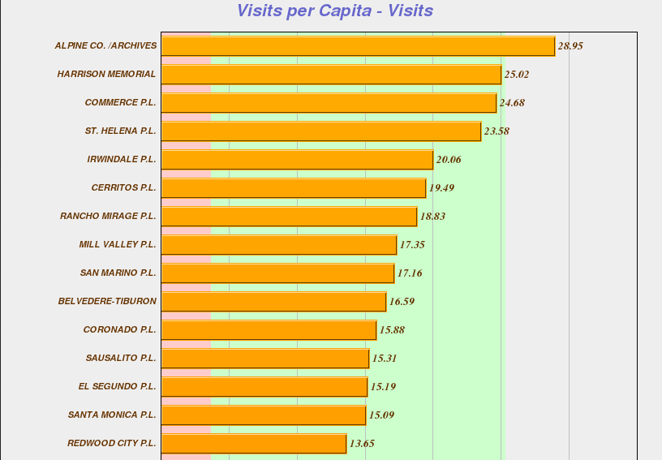
Key Ratios for Visits

Slide 20
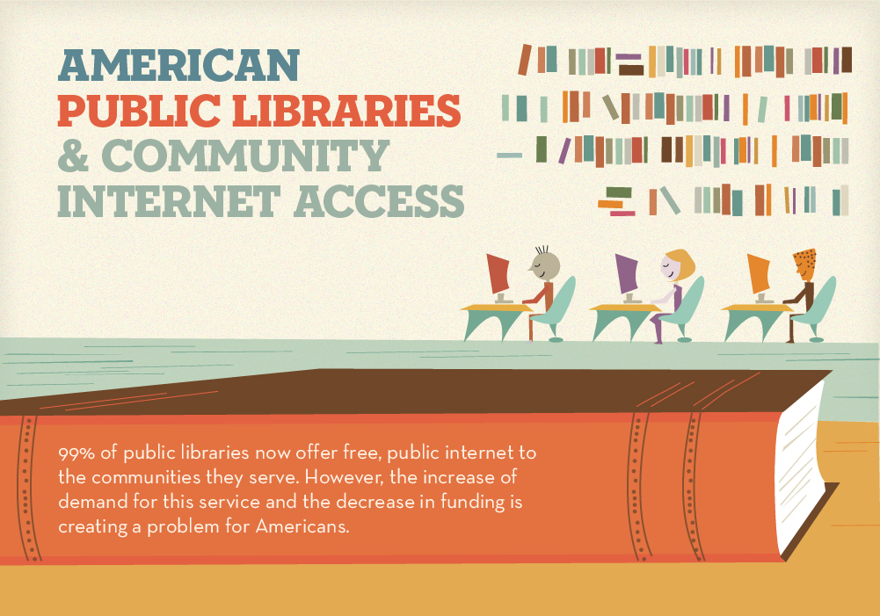
Pamphlets
California State Library Digital Task Force
PAMPHLETS
Jeanette Contreras
Director, Placentia Library District
Mary Cohen
Technical Services Dept. Head,
Palos Verdes Library District

Slide 21
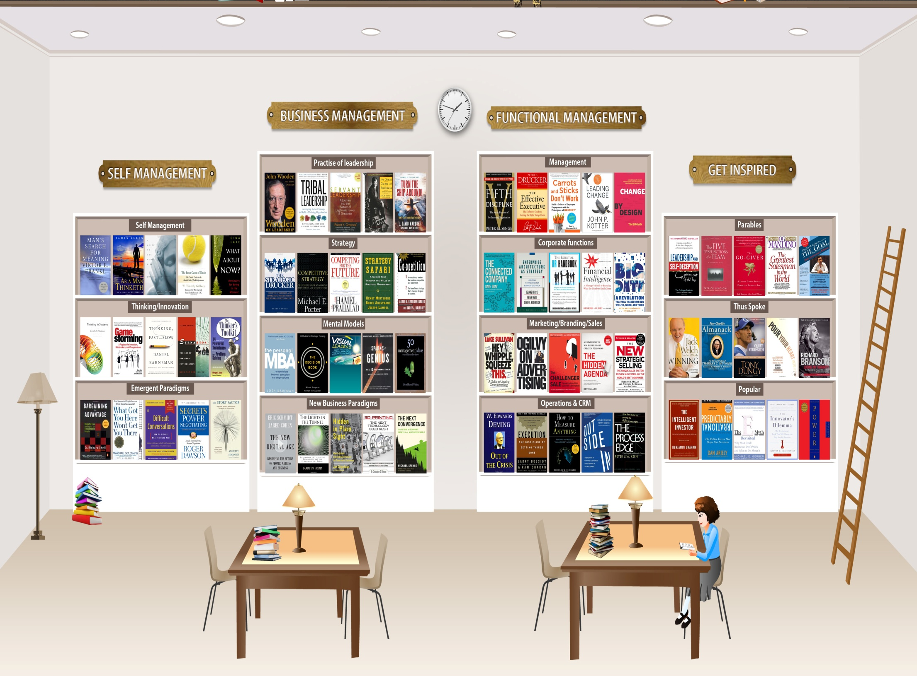
3 Types of Pamphlets Available to Libraries
Bookmark
Tri-Fold
Three
Types of Pamphlets Available to Libraries
Full Page Brochure
Bookmark
Tri-Fold
Full Page Brochure

Slide 22
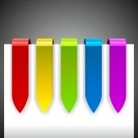
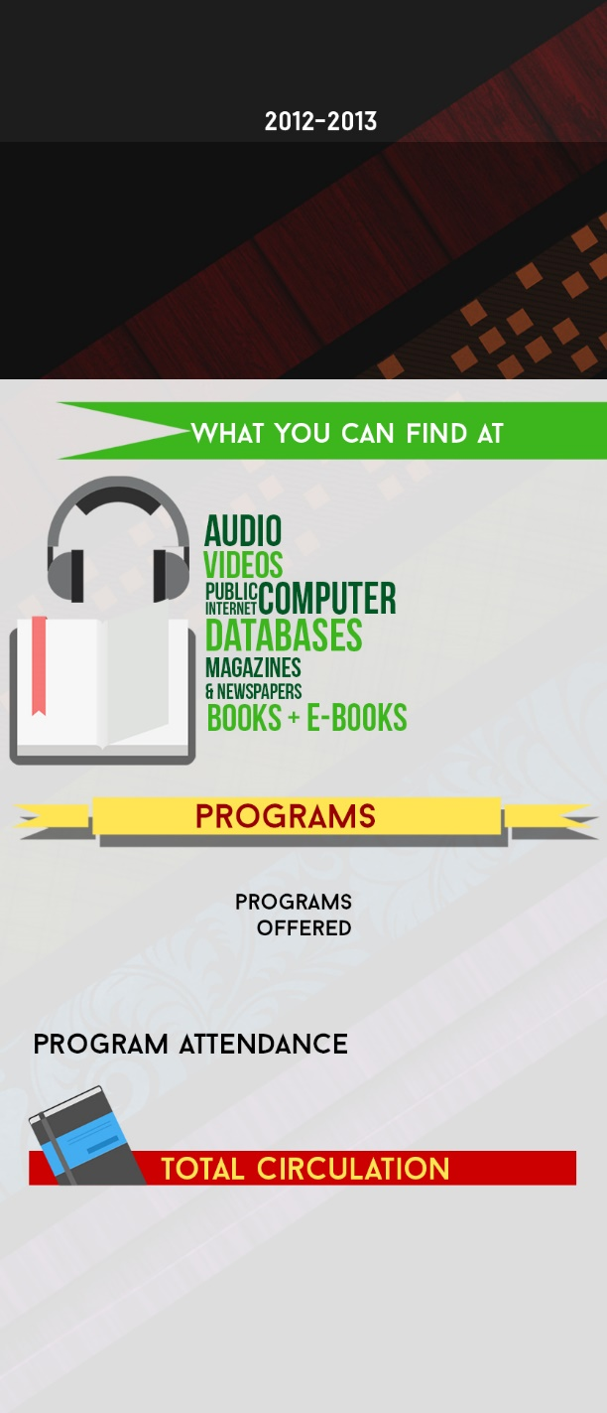
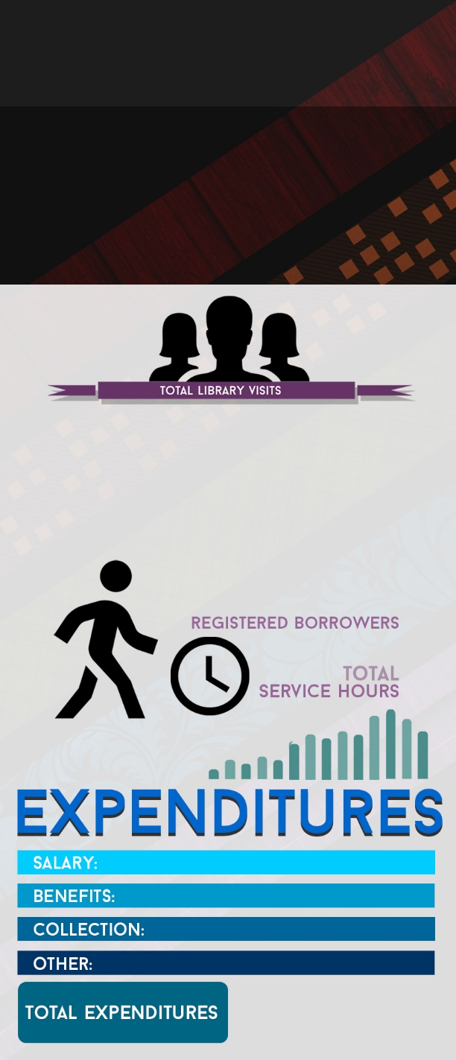
Bookmark
Library Name Here
Library Name Here

Slide 23
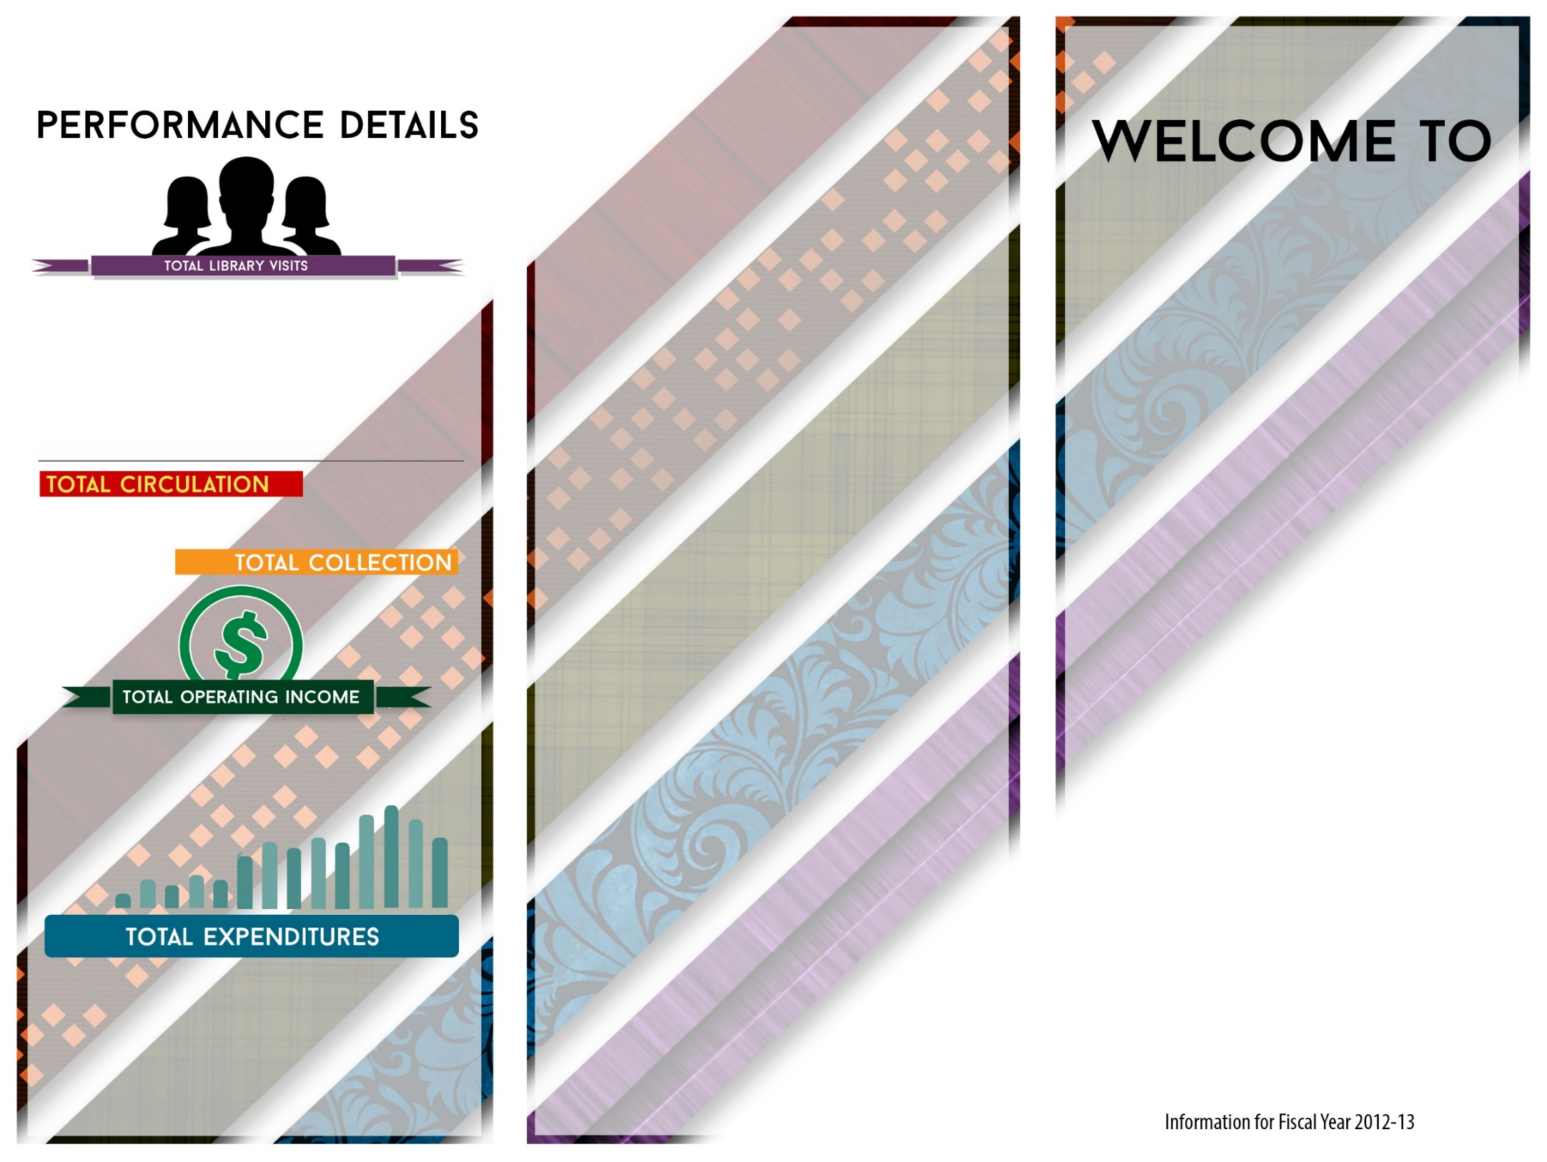
Did You Know?
- There were 158,118,472 annual visitors to California libraries in 2013!
- There are more public libraries than McDonald’s in the U.S. – a total of 16,766 including branches.
- In California, 20% of the population is a frequent moviegoer and 56.5% of the population have a library card!
- There are 1,741,653 electronic materials available in California public libraries!
- Americans go to school, public and academic libraries more than three times more often than they go to the movies.
- A 2012 poll conducted for the American Library Association (ALA) found that 94% of respondents agreed that public libraries play an important role in giving everyone a chance to succeed because they provide free access to materials and resources.
- The 2011-2012 ALA Libraries Connect Communities study reported that 76.3% of libraries reported offering e-books. Public libraries held more than 18.5 million e-books in 2010.
- Almost 89% of public library outlets now offer wireless Internet access.
- More than 92% of public libraries provide services for job seekers.
Come Visit Us Soon!
Library Name Here
Tri-Fold Outside
Library Image Here

Slide 24
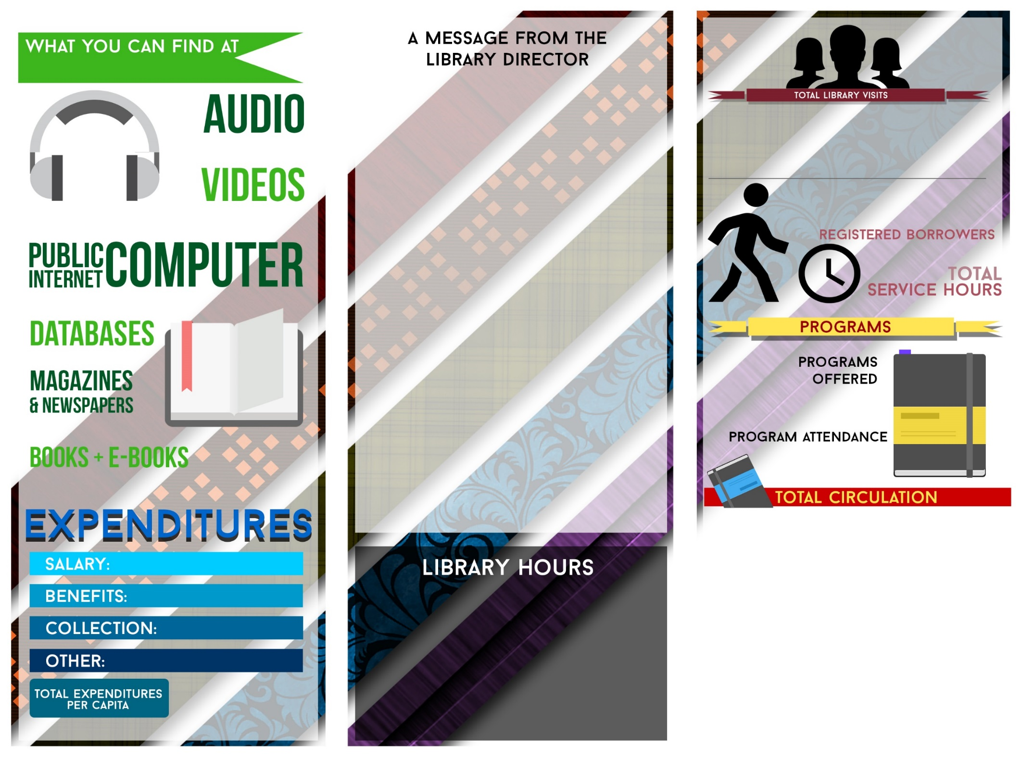
Tri-Fold Inside

Slide 25
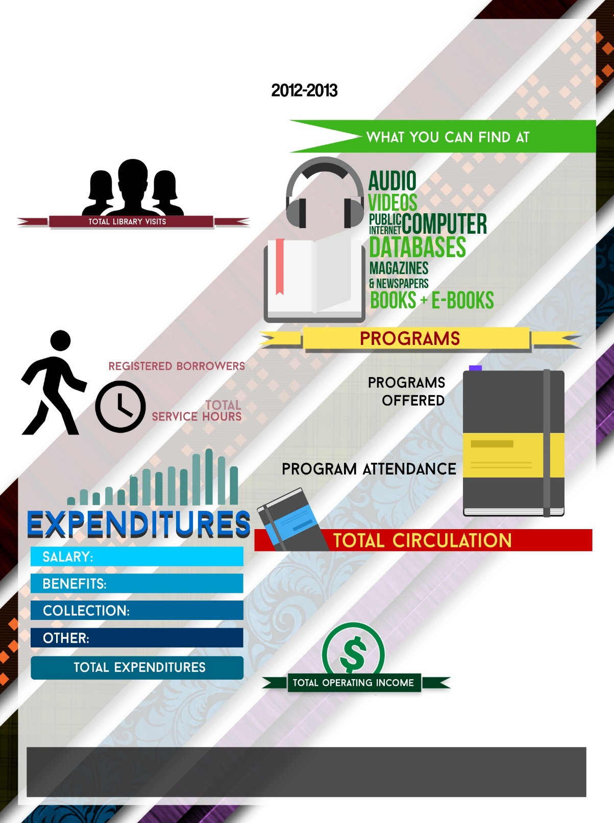
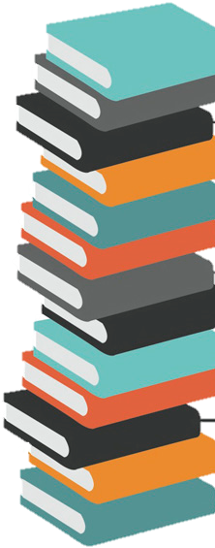
Full Page Brochure
Library Name Here
Library Information

Slide 26
How to Build a Pamphlet
1.
2.
3.
4.
Go to https://ca.countingopinions.com/main.php?page_id=9
Log in to your Counting Opinions account with your ID and password
Click “Pamphlets”
Click one of the three 2012-2013 pamphlets of your choice
VOILA! It’s that simple!
MY LIBRARY
The pamphlet will auto-populate with the data selected. You will have separate text boxes to add your library’s logo, contact information and other general information including a message from the Director.

Slide 27
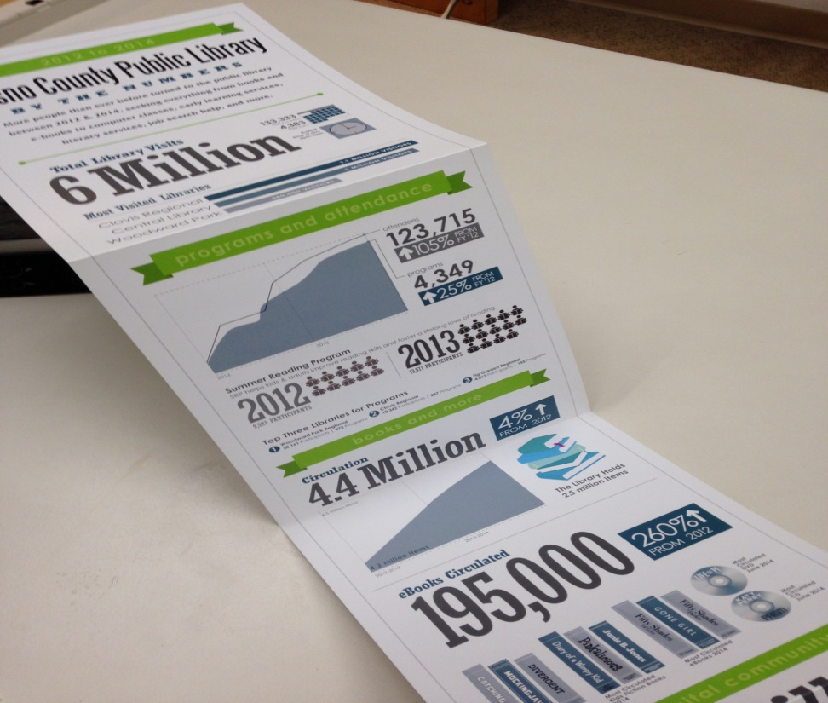
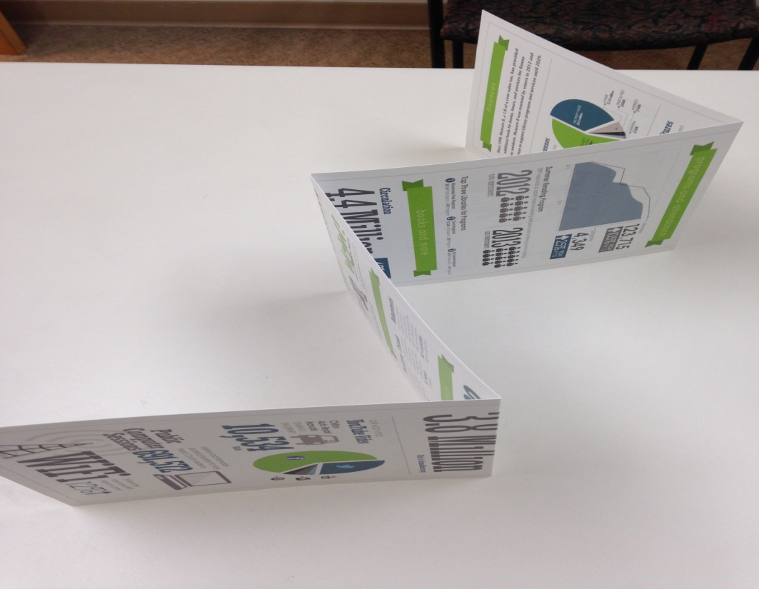
Z-Fold: Another Pamphlet Style
Designed by Fresno County Public Library, this is a
large according style pamphlet with information on
both sides, called a Z-Fold.

Slide 28
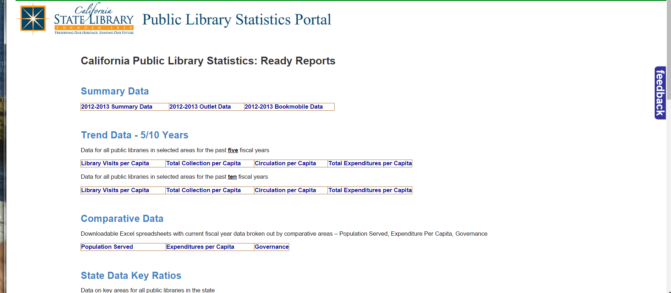
NEED MORE?

Slide 29
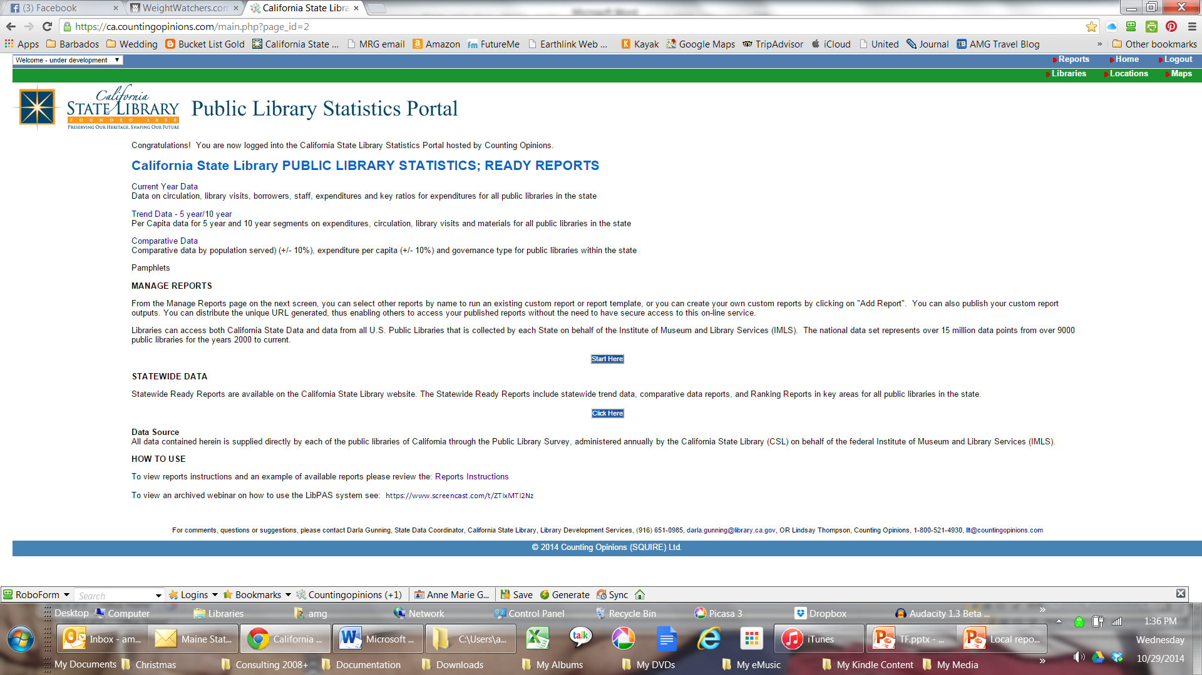
NEED MORE?

Slide 30
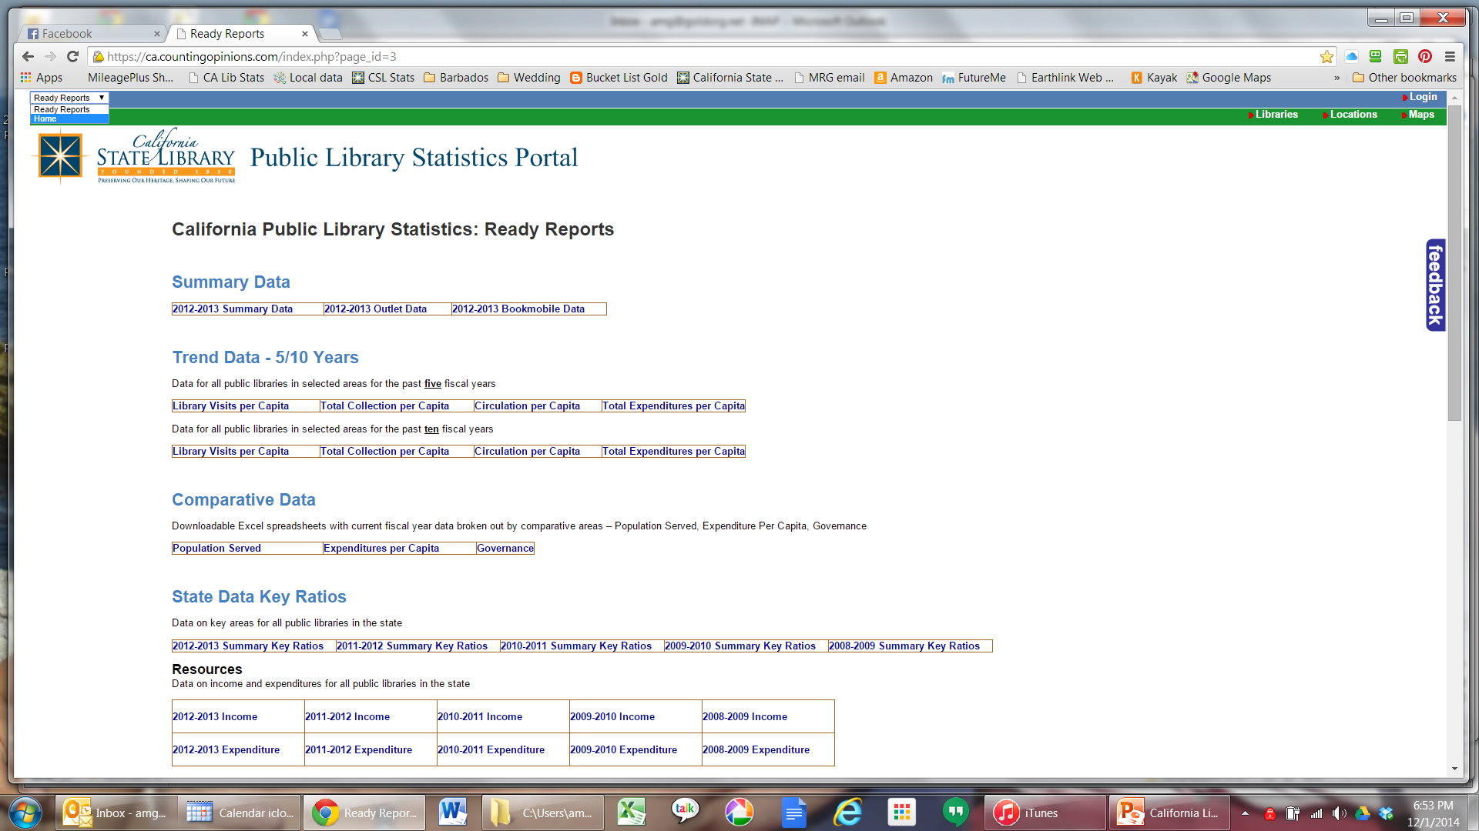
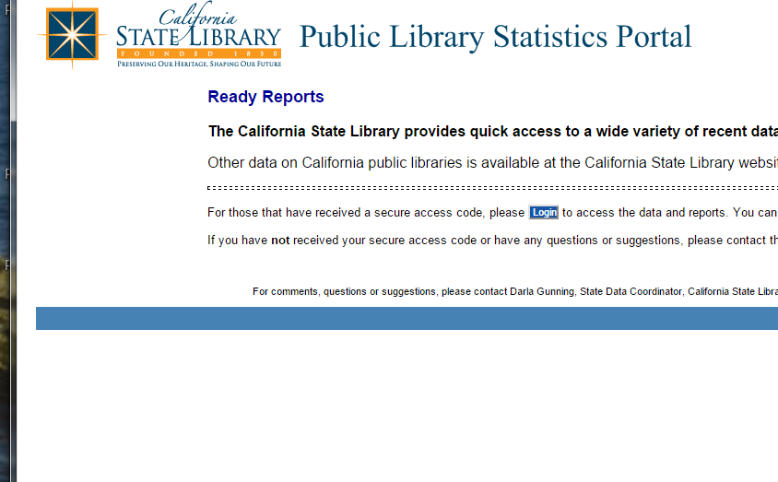
QUICK TRICK
http://californialibrarystatistics.com

Slide 31
NEED MORE?
Infographics
What’s New in Library Measurement

Slide 32
NEED LOGIN?
Your Library Director
Darla Gunning, State Data Coordinator, California State Library, Library Development Services
(916) 651-0985
darla.gunning@library.ca.gov

Slide 33
http://californialibrarystatistics.com
?????????????????????????

Slide 34
Infopeople webinars are supported in part by the U.S. Institute of Museum and Library Services under the provisions of the Library Services and Technology Act, administered in California by the State Librarian. This material is licensed under a Creative Commons 3.0 Share & Share-Alike license. Use of this material should credit the author and funding source.

