Slide 1
Managing Your LSTA Grant FY2014/15
January 15, 2015

Slide 2
AGENDA
Guide and Forms
Grant Period
Important Reporting Dates
Reports
Financial Reports
How to Modify a Grant
Grant Award Budget Modification Form
Mid Project Program Narrative Report
Grant Documents & Record Keeping
Federal Restrictions on Use of LSTA Funds
Final Program Narrative Report
Contact Information
Notes:
Gerry Maginnity

Slide 3
GUIDE AND FORMS
http://www.library.ca.gov/grants/lsta/
Notes:
On the California State Library website at the address here – we’ve put the guides, forms, and how tos.

Slide 4
GUIDE AND FORMS
http://www.library.ca.gov/grants/lsta/manage.html
Notes:
On the California State Library website at the address here – we’ve put the guides, forms, and how tos.

Slide 5
GUIDE AND FORMS
Notes:
On the California State Library website at the address here – we’ve put the guides, forms, and how tos.

Slide 6
GRANT PERIOD
Grant Period* | July 1, 2014 – June 30, 2015
Final Expenditure Date All grant funds be spent or encumbered by this date. | June 30, 2015
Final Liquidation of Encumbrances (if required) | August 15, 2015
Return of Non-Liquidated Funds (All funds that are not spent be returned by this date) | August 31, 2015
* (See your grant LSTA Grant Guide for specific due dates)

Slide 7
IMPORTANT REPORTING DATES (Sample)
Reporting Period | Reports (*See your grant LSTA Grant Guide for specific due dates) | Due Date*
July – September | 1st Quarter Financial Report - WAIVED | Report expenditures on the October-December report
October - December | 2nd Quarter Financial Report and Mid-Project Program Narrative Report | January 31, 2015
January - March | 3rd Quarter Financial Report | April 30, 2015
April - Project End Date | Final Financial Report and Program Narrative Report | July 31, 2015
60 Days from Project End Date (if end date is extended see extension letter for new dates) | Liquidation Report Due (Only required if encumbered funds have not been spent by the final report) | August 31, 2015

Slide 8
REPORTS (FY2014/15)
Waived
July-September
July-December
Final
Program
Narrative
Report
January-March
April-Project End Date
Notes:
1st quarter financial report – waived for FY14/15
2nd quarter financial report and Mid-Project Narrative
3rd quarter financial report
4th quarter financial report and final program report

Slide 9
QUARTERLY FINANCIAL REPORT (Page 1)
Notes:
Emphasize changes are in reaction new IMLS reporting requirements where new details for each project are being requested.

Slide 10
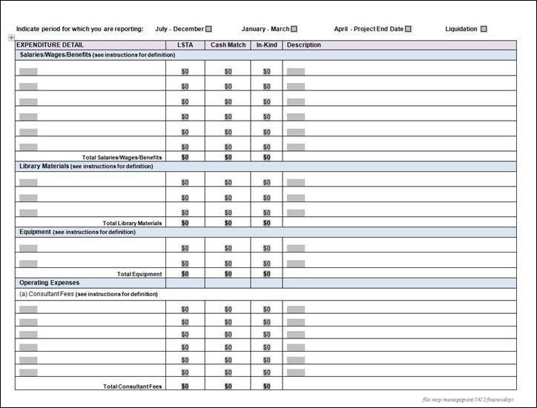
QUARTERLY FINANCIAL REPORT (Page 2)
Notes:
Note that financial report follows closely the budget n original application including details on in-kind and cash match funding for the project.

Slide 11
QUARTERLY FINANCIAL REPORT (Page 3)
Notes:
Note that financial report follows closely the budget n original application including details on in-kind and cash match funding for the project.

Slide 12
HOW TO MODIFY A GRANT
Contact your Grant Monitor to discuss changes and
complete the Grant Award Budget Modification Form (if necessary).
Notes:
Note to presenters: Do we want to bring up actual views of these documents? In ppt these are quite small to see any detail.
Changes may include:
-change in how you are spending the grant funding from your original budget
-requests for additional funding
-request to reduce funding

Slide 13
MID PROJECT PROGRAM NARRATIVE REPORT
Notes:
A few minor changes with more detailed instructions.

Slide 14
GRANT DOCUMENTS & RECORD KEEPING
IMPORTANT AREAS TO CONSIDER
All grant documents will be addressed to the head of the agency responsible for the project, who shall ensure that all documents are given to the proper local people, including fiscal agents.
NOTE: Be sure to know all of the people in your local community and agency that will touch the grant and be in contact with them frequently.
Accounting
Audit – potential for State or Federal audit
Data and Publications Created with Grant Funds
Audio and Video Created with Grant Funds
Publicity
Equipment Inventories
Retention of Records – minimum of 3 years after project closes
Details of all of these areas are located in the LSTA Grant Guide
Notes:
Invite attendees to review page 2-4 of Guide and go over each area.
This is the page to emphasize know all of the people in your community that touch your grant. So that you can get answers locally first before contacting us.

Slide 15
FEDERAL RESTRICTIONS ON USE OF LSTA FUNDS
IMPORTANT AREAS TO CONSIDER
Advertising and public relations
Alcoholic beverages
Construction or remodeling
Contributions, donations
Entertainment
Fund-raising
General government expenses
Honorariums, stipends
Income from project
Lobbying
Memberships, subscriptions, and professional activities
Premiums, prizes, incentives, and souvenirs
Refreshments
Training
Travel Expenses
Details of all of these areas are located in the Federal Restrictions on Use of LSTA Funds
Notes:
Invite attendees to review FEDERAL RESTRICTION ON USE OF LSTA FUNDS – Go over each area.

Slide 16
FINAL PROGRAM NARRATIVE REPORT
TO BE REVISED SPRING 2015
Notes:
Due to new IMLS reporting requirements where details for each project are being requested, especially at the end of the projects this report form is still being revised.

Slide 17
CONTACTS
GRANT MONITOR
Project assistance
Must be communicated with if you would like to make any changes
need more time
change in activities
change in budget
LSTA BUDGET/REPORTING
How to fill out financial reports?
Has the State Library received our reports?
When will we receive our payment?
What if we don’t spend all of our funds? How do we send funds back?
Grant Monitor identified on page 2 of your Grant Award letter. If you cannot locate, contact:
Mickie Potter, LSTA Analyst
(916) 653-4730
mickie.potter@library.ca.gov
Colette Moody, Fiscal Analyst
(916) 651-0977
colette.moody@library.ca.gov

Slide 18
Wrap-up Thank You!

