Slide 1
From STEM to STEAM
STEAM Programming for Teens
Karen Jensen, MLS
www.teenlibrariantoolbox.com
An Infopeople Webinar
Wednesday, January 21, 2015

Slide 2
What is STEM?
Science
Technology
Engineering
Math

Slide 3
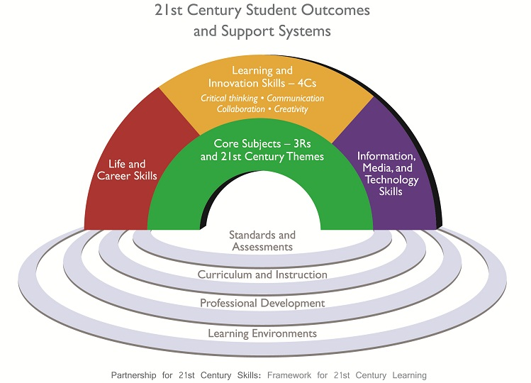
Why STEM?
Current education is very STEM focused
21st Century Literacy Skills

Slide 4
Why STEM?
Benefits for Libraries . . .
Communicate to our communities that we are relevant
Communicate to our communities that we are aware of and able to provide best practices
Demonstrate to our communities that we are proactive
Demonstrate to our communities that we are engaged

Slide 5
Why STEM?
Benefits for Teens . . .
Digital Divide or Digital Gap
Contemporary literacy skills
Better prepared for success in education, work, etc.

Slide 6
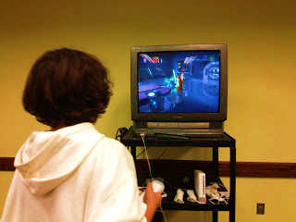
Gaming in the Library
Why?
Computer Literacy
Multiplatform Storytelling (Basic Literacy Skills)
21st Century Education
Lateral Thinking, Creativity, Innovation (STEM Education)
“Lateral thinking is solving problems through an indirect and creative approach, using reasoning that is not immediately obvious and involving ideas that may not be obtainable by using only traditional step-by-step logic.” (Edward de Bono)
Physical Benefits That Impact Learning and Basic Literacy
Hand/eye coordination, for example
Patron (Customer) Satisfaction and Retention
Supporting General Education
Challenges: keeping up with popular systems/games, game ratings

Slide 7
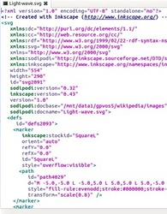
Coding @ the Library
Coding Tools:
Code Academy
Scratch
Code.org
Resources:
Article at Librarified
Lego: We Do ($200.00) – YouTube
Beyond Legos: Coding for Kids
7 Apps for Teaching Coding Skills
Teaching Teens about Digital Literacy Through Coding
Camp for Code: Library program teaches teens basics of programming, robotics
The Basics: Binary Code (YouTube tutorial)
Teach binary code with fun pony bead, fuse bead, Rainbow Loom crafts, for example

Slide 8
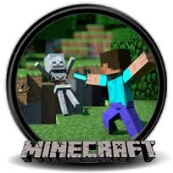
Minecraft
Minecraft is a game that was designed to help teach kids coding in a fun, game like environment.
See also, Why Everyone Should Learn to Code: http://www.slate.com/blogs/future_tense/2013/03/29/codecademy_hacker_school_why_everyone_should_learn_to_code.html
See also these References from YALSA: http://yalsa.ala.org/blog/2013/04/04/connect-create-collaboratecraft-a-teen-tech-week-post-mortem-minecraft-in-the-library/, http://www.questia.com/library/1G1-317588244/minecraft-programs-in-the-library-if-you-build-it

Slide 9
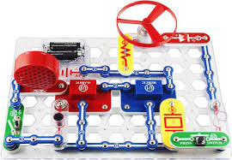
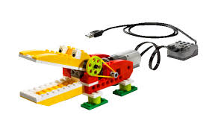
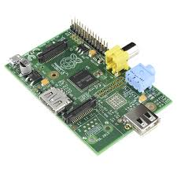
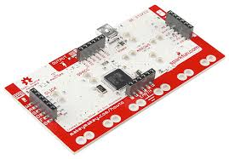
STEM Kits
Snapcircuits
Lego We Do
Makey Makey
Raspberry Pi

Slide 10
Not just STEM, STEAM
Add the A for ART
Balance of creative thinking, problem solving and self expression added into the science.

Slide 11
Why STEAM?
Combines the benefits of STEM programming with
Creative Outlet + Tech Skills
Self discovery and expression
Creative thinking
Problem solving
Stimulates imagination
Develops a sense of craftsmanship
Multiple disciplines

Slide 12
STEAM
Programming
With
Visual Arts

Slide 13
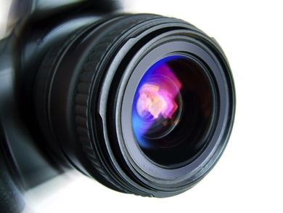
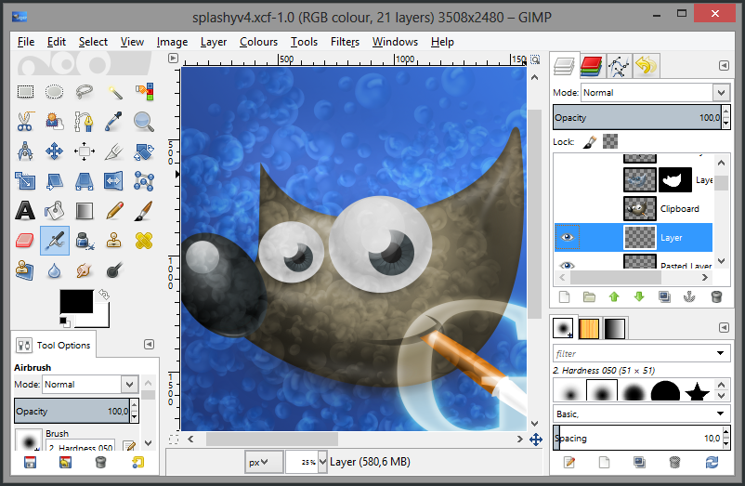
Digital Photography &
Photo Manipulation
Have someone come in and do a digital photography workshop and discuss things like lighting, setting up a shot, etc.
Then, you can have a GIMP workshop. GIMP is a free, online equivalent to Photoshop. You can download it online and a variety of free brushes. It is not easy to use at first, so classes are good.
Picmonkey.com is an online photoediting program.

Slide 14
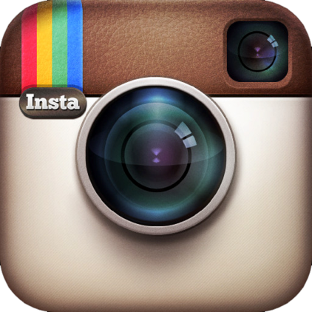
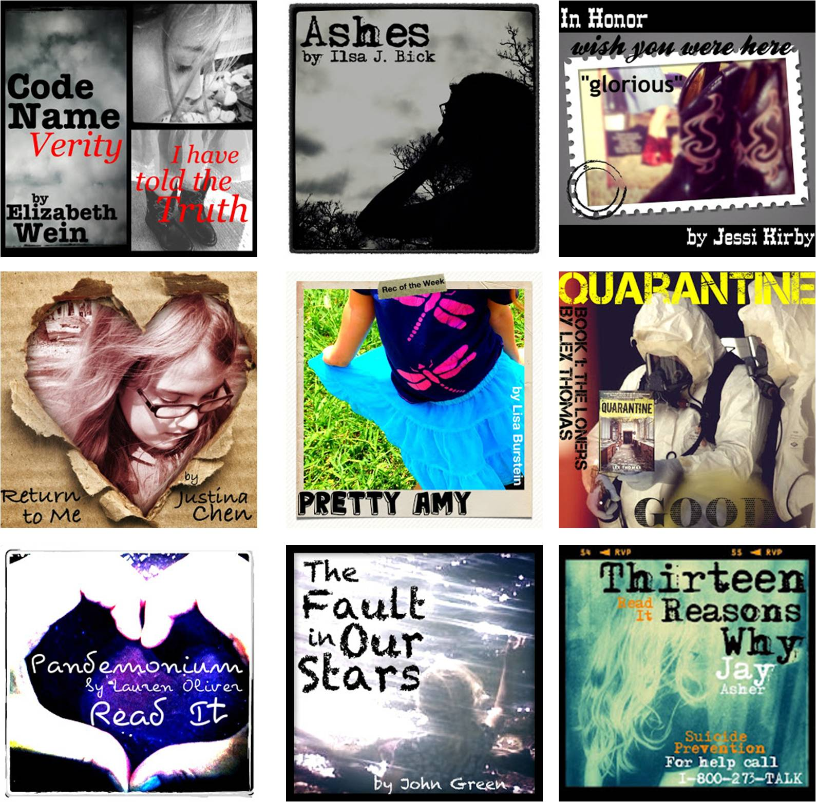
  Instagram – very popular with tweens and teens, visual in nature, quick & easy interface
  Top Instagram Tags & Instagrammers
  How to Be a Pro on Instagram
Creative Ways to Use Instagram:
Book Face
Book Quotes/Covers
Book Spine Poetry
Get Caught Reading
@ My Library

Slide 15

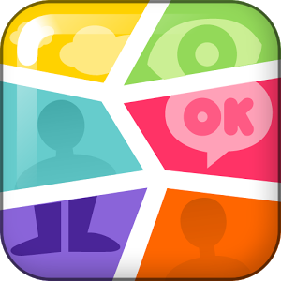

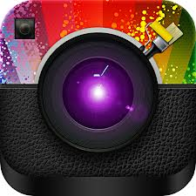
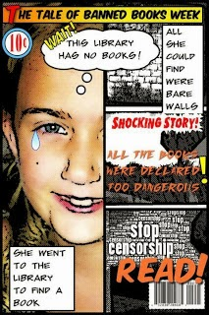
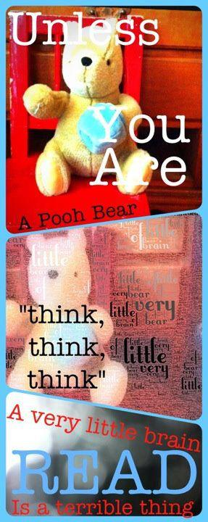
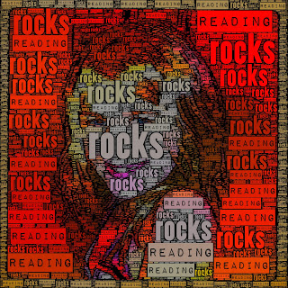
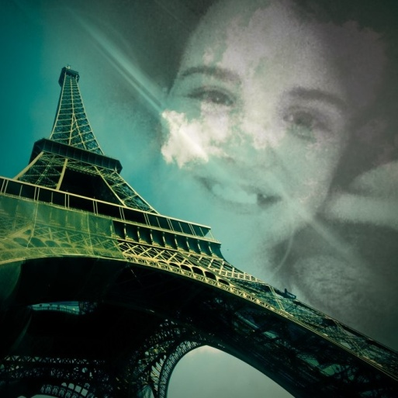
Photo Apps
Comic Book Photo Shake Word Foto Filter Mania
5 Best Photo Editor Apps

Slide 16
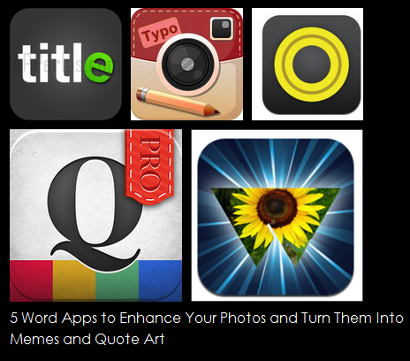
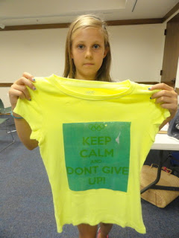

Memes!
Basically: An idea that spreads.
See Urban Dictionary
Have Meme contests. See also: Meme the shirts
Word App Review and Breakdown
Know Your Meme

Slide 17
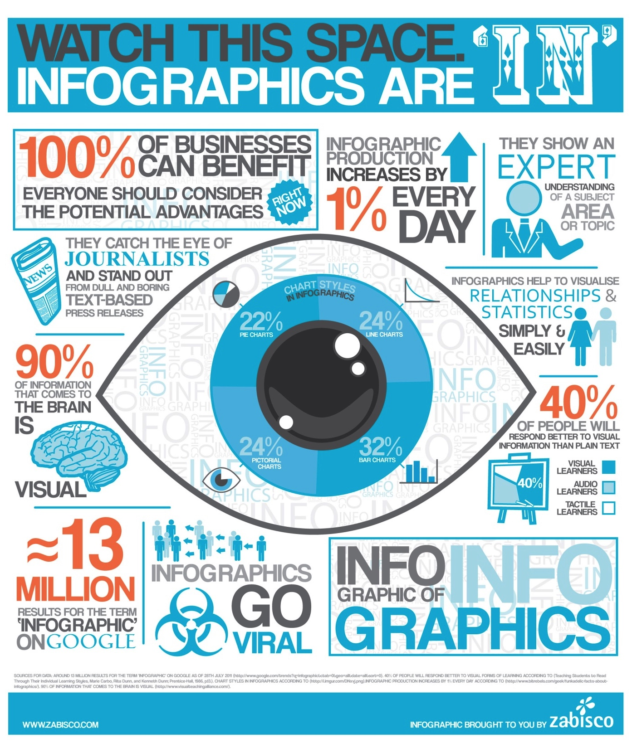
Infographics
Infographics is a visual way to represent data. It combines visual arts with computer skills to create the Infographic
Ways to use it with teens:
Nick Felton: Infographic Biographies
Have teens tell their life story, or HS story, or senior year story in infographics
20 Tools for Creating Your Own Infographics

Slide 18
STEAM
Programming
With
Motion Picture
Arts

Slide 19

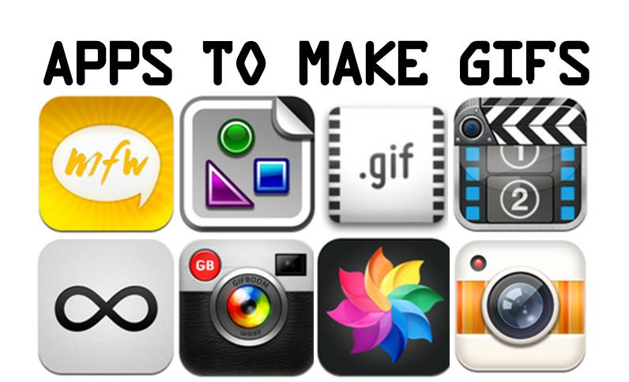
It stands for Graphics Interchange Format. They are those moving picture thingies that you see around the web.
GifBoom (app!)
Cinemagram (also an app!)
Gizmodo: How to Make a GIF in 5 Easy Steps
Free Online GIFmaker
Make a GIF
Mashable: Make Reaction GIFs with These 7 Tools
Mashable: How to Make GIFs
8 Free GIF Maker Apps

Slide 20

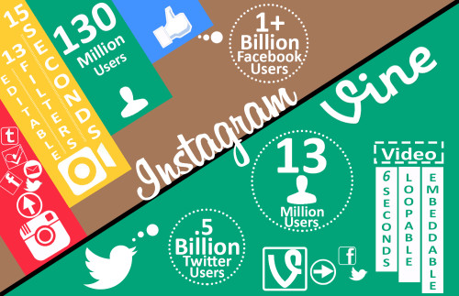

Vine
  6 second videos
  Popular with teens
  Example: What is Teen Advocacy?
  6 Second Booktalks
  Resources: How to Vine ; How to Add Special Effects to Vine ; Ultimate Guide to Vine ; 6 Tips for Making an Awesome Vine Video ; 6 Ways Your Brand Can Use Vine
  Examples: Buzzfeeds 10 People You Should Follow on Vine
YouTube
  More popular than FB
  Arranged by channels
  First online awards show
  Resources:
  Video App: iMovie
  6 Biggest Mistakes Brands Make on YouTube ;
  How to YouTube with Success
  10 Essential YouTube Tips and Tricks

Slide 21
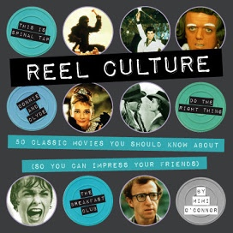
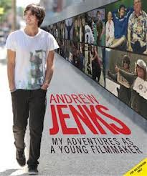
Teen Film Festival
Teens can create short films using a variety of tools, like iMovie, Movie Maker, Vine, Instagram Video and more.
You can make it a theme: Say, make a video about why the library is important to you. Or do a booktrailer festival. Or you can keep it open ended.
Resources
Want to make a movie? There's an app for that of course. Here's more on iMovie.
Here's some information on making book trailers.
Here's a YouTube clip on making a Short Film
Clipcanvas on How to Make a Short Movie
Top 5 Online Tools to Make a Online for Free
How to Use Windwos Movie Maker
See also: Lights, Camera, Action: 5 YA Titles about teen filmmakers

Slide 22
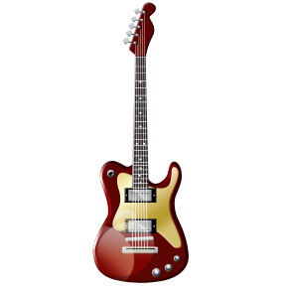
STEAM
Programming
With
Music

Slide 23
Why music?
Music has positive effects on literacy.
There are numerous studies that show this connection:
http://ecrp.uiuc.edu/v10n1/bolduc.html
http://www.abcmusicandme.com/documents/impact_of_music_on_literacy.pdf
http://educationcloset.com/2012/07/17/integrating-music-and-literacy/
Music and Literacy
There is just something about the teenage years and music.
Some say there is something about the age 14 and music: http://learning.blogs.nytimes.com/2011/05/25/is-14-a-magic-age-for-forming-cultural-tastes/
“Fourteen is a sort of magic age for the development of musical tastes. Pubertal growth hormones make everything we’re experiencing, including music, seem very important. We’re just reaching a point in our cognitive development when we’re developing our own tastes. And musical tastes become a badge of identity.” – Daniel J. Levitin, a professor of psychology and the director of the Laboratory for Music Perception, Cognition and Expertise at McGill University. (http://blog.clickitticket.com/post/What-Kind-Of-Music-Were-You-Listening-To-At-Age-14.aspx )
Slate: Musical Nostalgia

Slide 24
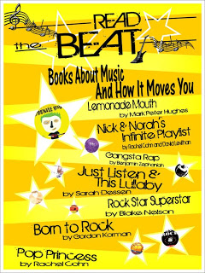
The Book Playlist?
Playlist: “a list of recorded songs or pieces of music chosen to be broadcast on a radio show or by a particular radio station.”
(Dictionary.com)
A playlist is a modern day mixtape!
Book Playlists Can Be Many Things:
The list of songs an author listens to while writing
a book that helped set the mood or helps define
a character.
The list of songs talked about within the book
itself (see The Perks of Being a Wallflower,
for example)
The list of songs that comes to the mind of a
reader as they read a book or think of the
characters.

Slide 25
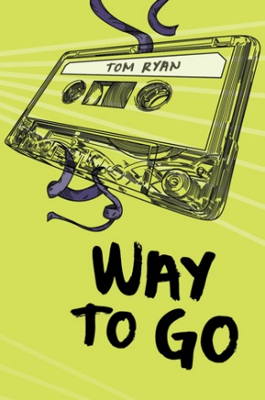
Where can you find Book Playlists?
Many authors will share their book playlists on Tumblr or in Blog Posts
See: Sarah Dessen discussing the playlist for Just Listen
Many readers will create book playlists and share them in the same way.
See: Reading 2.0
Book playlists can be simple – from just a list of song titles – to an actual playlist that embed the audio or video so you can quickly and easily hear the song being mentioned. For example, this Buzzfeed playlist for The Perks of Being a Wallflower has the video embedded for easy viewing/listening: http://www.buzzfeed.com/kaylayandoli/the-perks-of-being-a-wallflower-playlist-you-nee-cqn5)
There are many tools for creating playlists:
Spotify
Mashable: 10 iPhone Apps for Music Lovers
Soundcloud: What are playlists? How do I make them?
www.playlist.com
www.take40.com

Slide 26
Video Killed the Radio Star . . .
Music programming can also be about video
Teens can create lip sync videos to their favorite songs. How many different versions of Let it Go from Frozen have you seen?
These videos can even be library promotions. You have seen the It’s All About the Books take on All About the Bass, right? https://www.youtube.com/watch?v=Pduszh4ADTU
You can do it simple: Use Animoto (which has free, already cleared songs you can use) to create a slide show of teens in the library/at library programs. Share it online or upload it to a screen that repeats behind your circulation desk or in your teen area.
Or use something like MovieMaker to make “Book Trailers”
Music copyright info here

Slide 27

Let’s Make Beautiful Music Together @ the Library
A number of public libraries have digital media labs and recording studios.
They include:
Arlington Heights Memorial Library: The Studio
Cleveland Public Library
Cuyahoga CPL Recording Studio
Stoke Public Library
And more . . . .

Slide 28
Unconventional
Using technology to take your library’s book discussion groups outside the four walls of your library!
Book Discussion Groups

Slide 29
Why Tech?
People can participate from any location
Depending what tech you use, people can participate on their own time
A way of taking your programming outside the building and creating outreach opportunities
You can build an archive of discussions for new people to go back and read

Slide 30
What are the disadvantages?
Requires an access to technology, so there are economic barriers as well as some other barriers to access
For some, it will lack the social interaction and intimacy that they are looking for
While it can increase numbers, it doesn’t necessarily get people into the building

Slide 31

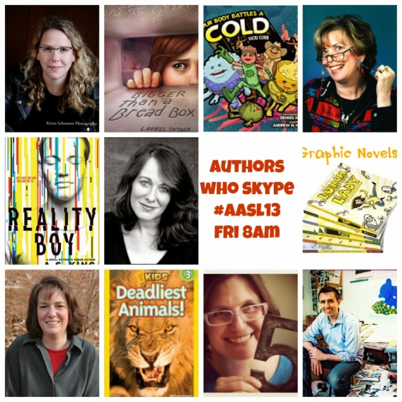
Skype Book Discussion Club
Skype is an online video chat program that you can download for free. Combine this tech with a traditional book discussion group to bring tech into literacy. Many authors will Skype for free (see link below) and love to meet with readers.
You could also do a sort of sister city/pen pal book discussion with another library and meet their teens. For example, have a Divergent discussion in March when the movie is released.
Skype in the Classroom
Authors who Skype (for free!)

Slide 32



Let’s Talk Social Media & Book Discussions
  Facebook – ongoing changing in policies are causing some users to defect, less popular now, teens are defecting, can now use Hashtags. Groups feature allows for great online book clubs.
  Twitter – very popular, large book/reading community, easy to share, #hashtags rule (see The Beginners Guide to the Hashtag)
  Pinterest – results in the most actual purchases and traffic, easily organized, some copyright concerns to be aware of (Mashable: Pinterest Drives More Traffic to Publishers Than Twitter, LinkedIn, Reddit Combined) (20 Ways Libraries are Using Pinterest)

Slide 33



Let’s Talk Social Media & Book Discussions
  Tumblr – Very popular with teens, allows for a variety of different kinds of posts, has an ask feature, reblogging allows for addition of comments
  Google Hangouts – Can be closed or open, similar to Skype, Hangouts can be recorded and shared
  Goodreads – Designed as a reading community, great for making lists and sharing reviews, a very tumultuous community at times, now owned by Amazon

Slide 34
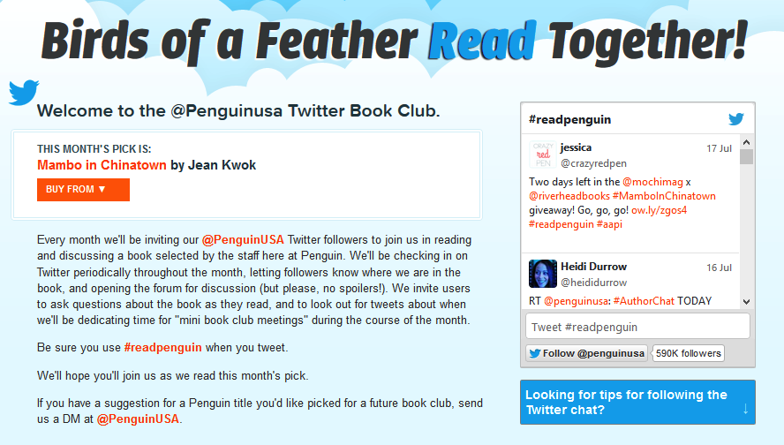
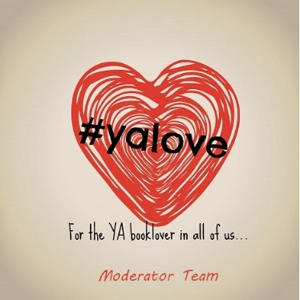
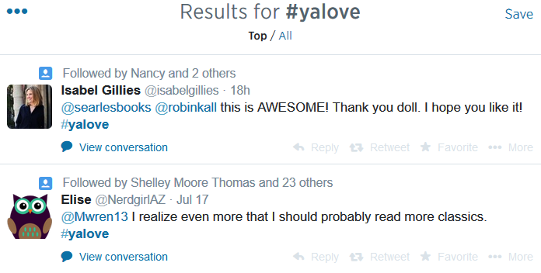
Twitter Chats
Put together a schedule, create a hashtag, promote, discuss, archive
Examples:
#yalove
#ewyagc
#svyalit

Slide 35

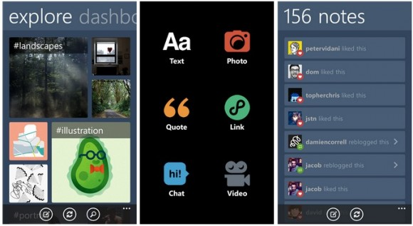
  Tumblr – everyone who works with teens should be using this; easy to use, very visual and easy to organize
Don’t Blog,
Tumbl
  5 Things You Can Do with Tumblr
  Craft Tutorials: Example, Tardis Costume
  Booklists: Example, 10 Things I Learned About Surviving the Apocalypse from YA Books
  New Books: Share the covers & reviews
  Program Pics
  Book Quotes

Slide 36
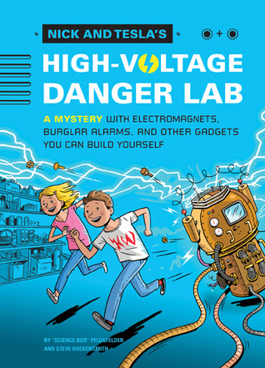
STEM Themed Books
Nick and Tesla has built in projects. They also have projects on their website.
Do a reading club with a STEM themed book and find projects that you can easily do from the Science Fair books. STEM Girls Booklist.
Do a Sci Fi book club and have someone come in and talk about telescopes and observatories. #YALIT that takes place in space.
Do a mystery book club and have a forensic scientist come in and talk about crime solving procedures. Or watch How Sherlock Changes the World on PBS.
CSI Program outline.

Slide 37
Resources and Further Reading
Reaching Teens Subversively through Passive Programming: http://www.programminglibrarian.org/library/planning/reaching-teens-passive-programming.html#.UtP2ZLRjs_s (Book Facing)
21st century teens & 21st century libraries http://www.districtdispatch.org/2014/01/21st-century-teens-21st-century-library-services-call-action/
Today’s Teens, Tomorrow Techie http://www.bklynpubliclibrary.org/support/volunteer/t4
Libraries Connect Teens To Technology with Video Games: http://library.austintexas.gov/press-release/library-connects-teens-technology-through-video-games-47499
Recharge Your Library with Pop Culture and Technology: http://www.amazon.com/Recharge-Library-Programs-Culture-Technology/dp/1610693698
Teaching Teens about Digital Literacy through Programming: http://www.alsc.ala.org/blog/2012/03/beyond-legos-coding-for-kids/
http://www.ala.org/news/press-releases/2013/10/diy-your-library-teen-tech-week-materials-national-library-week-among-gems
Teen Tech Camp http://www.memphislibrary.org/teens/techcamp
Pew: Teens and Technology http://libraries.pewinternet.org/2013/08/22/our-latest-research-on-teens-and-technology/
Using Technology to Connect Teens and Public Libraries http://scholarworks.sjsu.edu/slissrj/vol2/iss2/7/
Retired Teachers Teach Community Art and Science: http://auburnpub.com/lifestyles/it-s-alive-retired-moravia-educators-teach-community-art-and/article_c9a94f03-e932-5b61-ae88-38b3f117411c.html
On TLT: Tech with Nick and Tesla, Teen Tech 12, Check In @ Your Library,

Slide 38
Infopeople webinars are supported in part by the U.S. Institute of Museum and Library Services under the provisions of the Library Services and Technology Act, administered in California by the State Librarian. This material is licensed under a Creative Commons 3.0 Share & Share-Alike license. Use of this material should credit the author and funding source.

