Slide 1
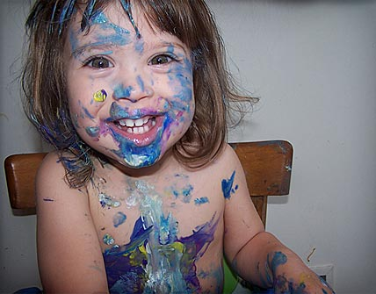
Creating Baby Spaces
Designing for Success
Presented by: Bridget Alexander
An Infopeople webinar
Tuesday, January 27, 2015

Slide 2
Poll

Slide 3
The Benefits of a Connected Parenting Community
Why do we want to offer programs that build a community of families?
Dr. Brazelton’s Touchpoints work indicates that normalizing the challenges of parenting makes for healthier, less stressed parents and children.

Slide 4
Evolution Favors Community
Evolutionarily people evolved to share the work of raising children.
Experienced parents support new parents
Many adults engage with a child so parents can replenish reservoirs of patience and engagement
A higher ratio of adults to children ensured each child had support in facing the challenges of growing and learning

Slide 5
Connected Families Benefit Us All
When families are connected, they invest in their neighborhoods, school, and libraries.
Lens shifts from what is good for our family to what is good for our community
Child experiences diversity of parenting styles and family cultures
Institutions benefit from engagement

Slide 6
If we want to connect with families, we need to design programs for babies.
and they need to be more than
a story time with a song.

Slide 7
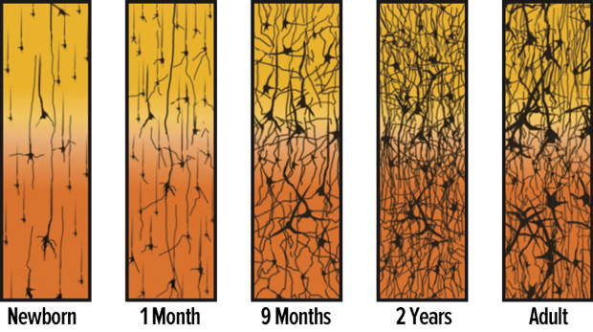
The First Year of Life is a Neuron Building Party- and You Want to Be Invited

Slide 8
The Development of Visual, Auditory, Tactile, Motor, and Vestibular Centers
In endless studies, development of these sensory centers directly correlates to IQ and future learning success.
Windows of developmental opportunities in these centers open and close throughout infancy and early childhood.
Developing these centers requires active engagement that looks different from what we conceive of as educational.

Slide 9



If we don’t offer opportunities and show families the value of play and engagement, there are plenty of corporations that will happily step in and do the job- badly.

Slide 10
Advocating for Play
Libraries are an accessible institution that can model the power of play and arts engagement.
Educate parents that play is an evolutionary, child directed impulse to pursue activities that develop the sensory centers on the timeline that works best for that individual child

Slide 11
Play is Learning!
Adults forget that nurturing the motor and sensory centers behind reading, writing, and calculating is the true work of early childhood.
Children naturally work these systems in play.
Libraries can set up environments that invite play and the sensory development that promotes literacy and future learning.

Slide 12
Letter Recognition Can Wait!
In infancy and toddlerhood, we want to automate the motor, auditory, and visual skills that lead to fluid reading and writing.
This includes:
Tracking Interactive Language Games
Grasping Vowel/Consonant Sounds
Pinching Rhyme Recognition
Focusing Line and Shape Recognition

Slide 13

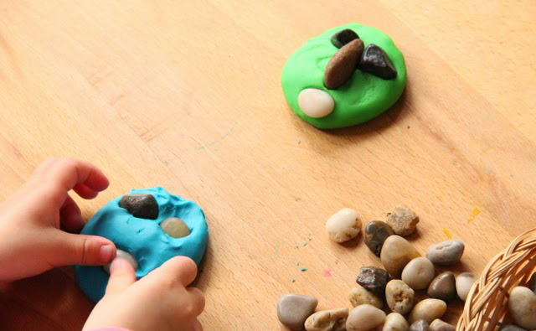
This means developing literacy looks like this
Tracking Bubbles and Developing Finger Strength

Slide 14
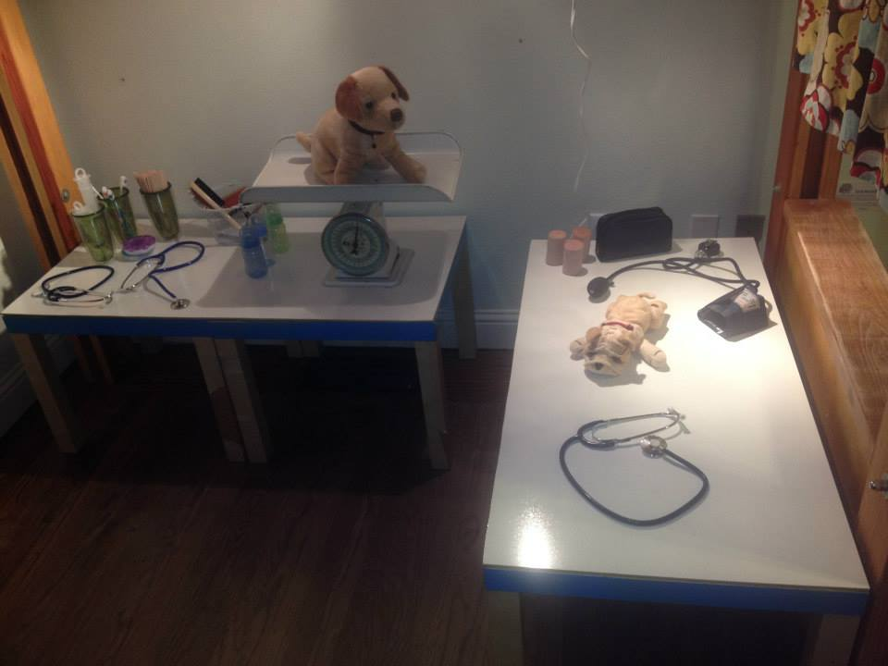
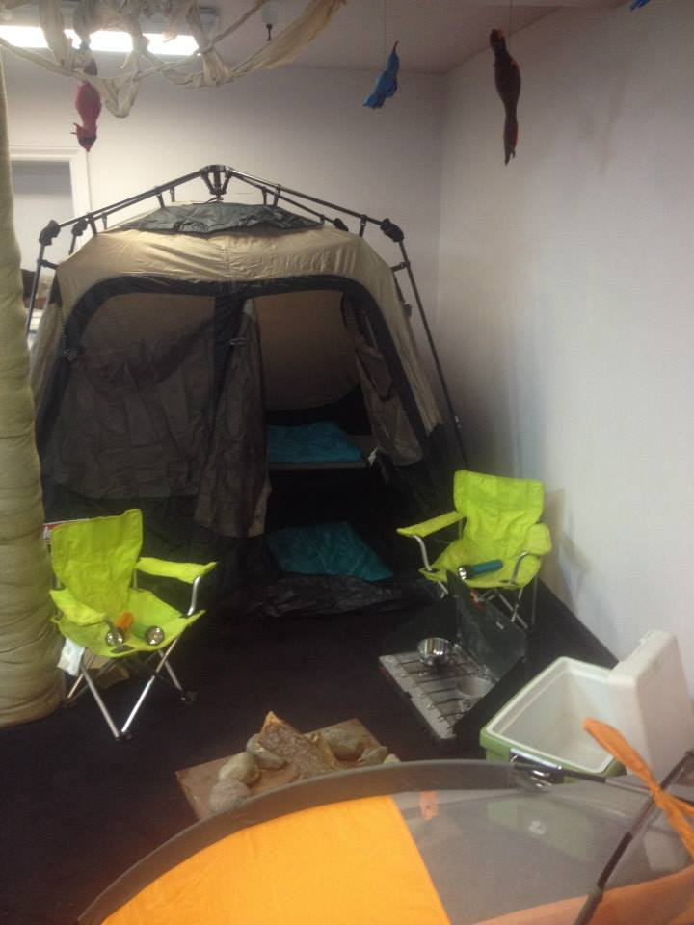
Developing Vocabulary
through Dramatic Play

Slide 15
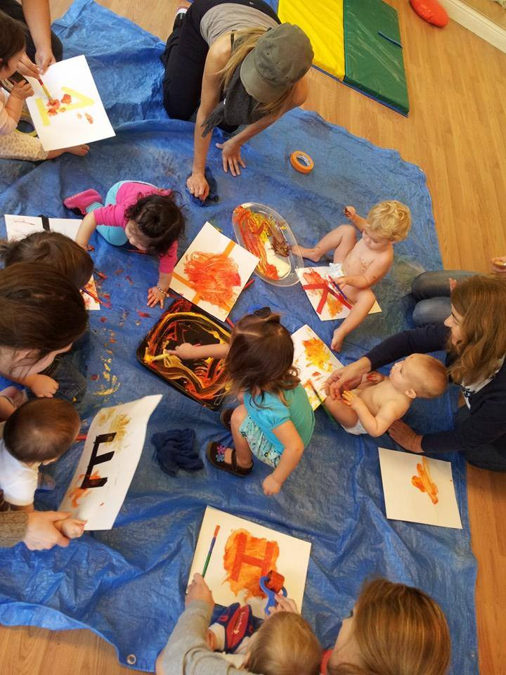
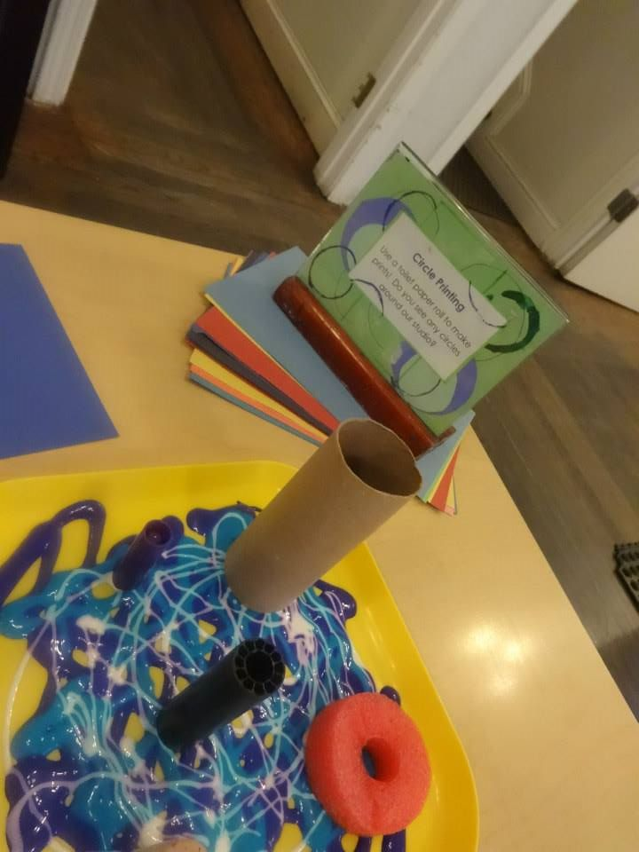
Developing focus, grasp, letter recognition,
shape recognition, and color recognition.

Slide 16
What are the Challenges of Programming for Infants?
They can’t do much and they eat the play dough.
They barely follow the plot lines.
They want us to sing to them. We don’t sing.
They rarely come without highly energetic siblings attached.
They always come with grown ups attached.
Nearly everything in the environment can be either fallen off of or used to hit someone.
All of the above

Slide 17
The Solution:
PROCESSED BASED ART

Slide 18
Process Art
Allows each child to define how they want to engage
Ensures every child can find a developmentally meaningful way to engage
Invites experimentation rather than mastery of specific steps or skills
Inspires focus and allows for layers of complexity.

Slide 19
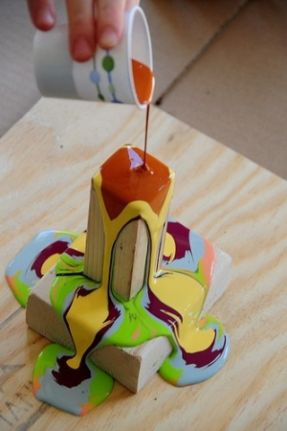
Art experiences should not invite sameness.

Slide 20
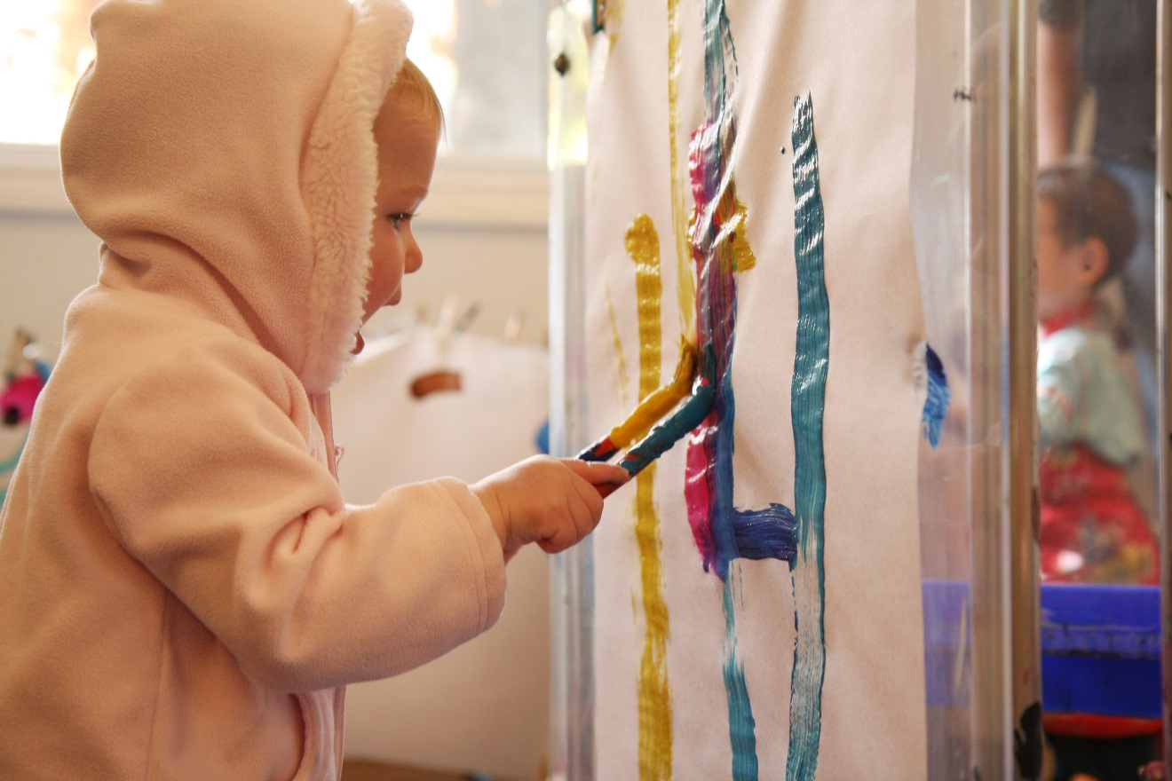

Art should not require an instruction sheet.

Slide 21
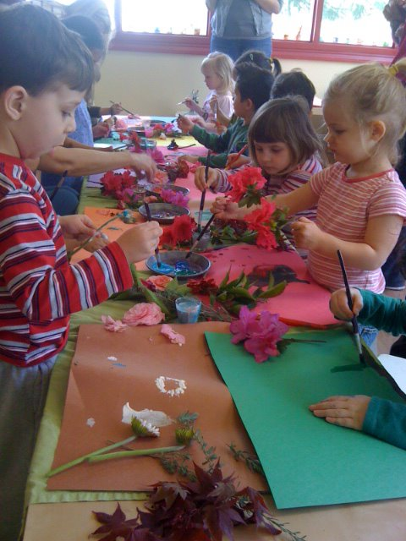
Art should not have a deadline.

Slide 22
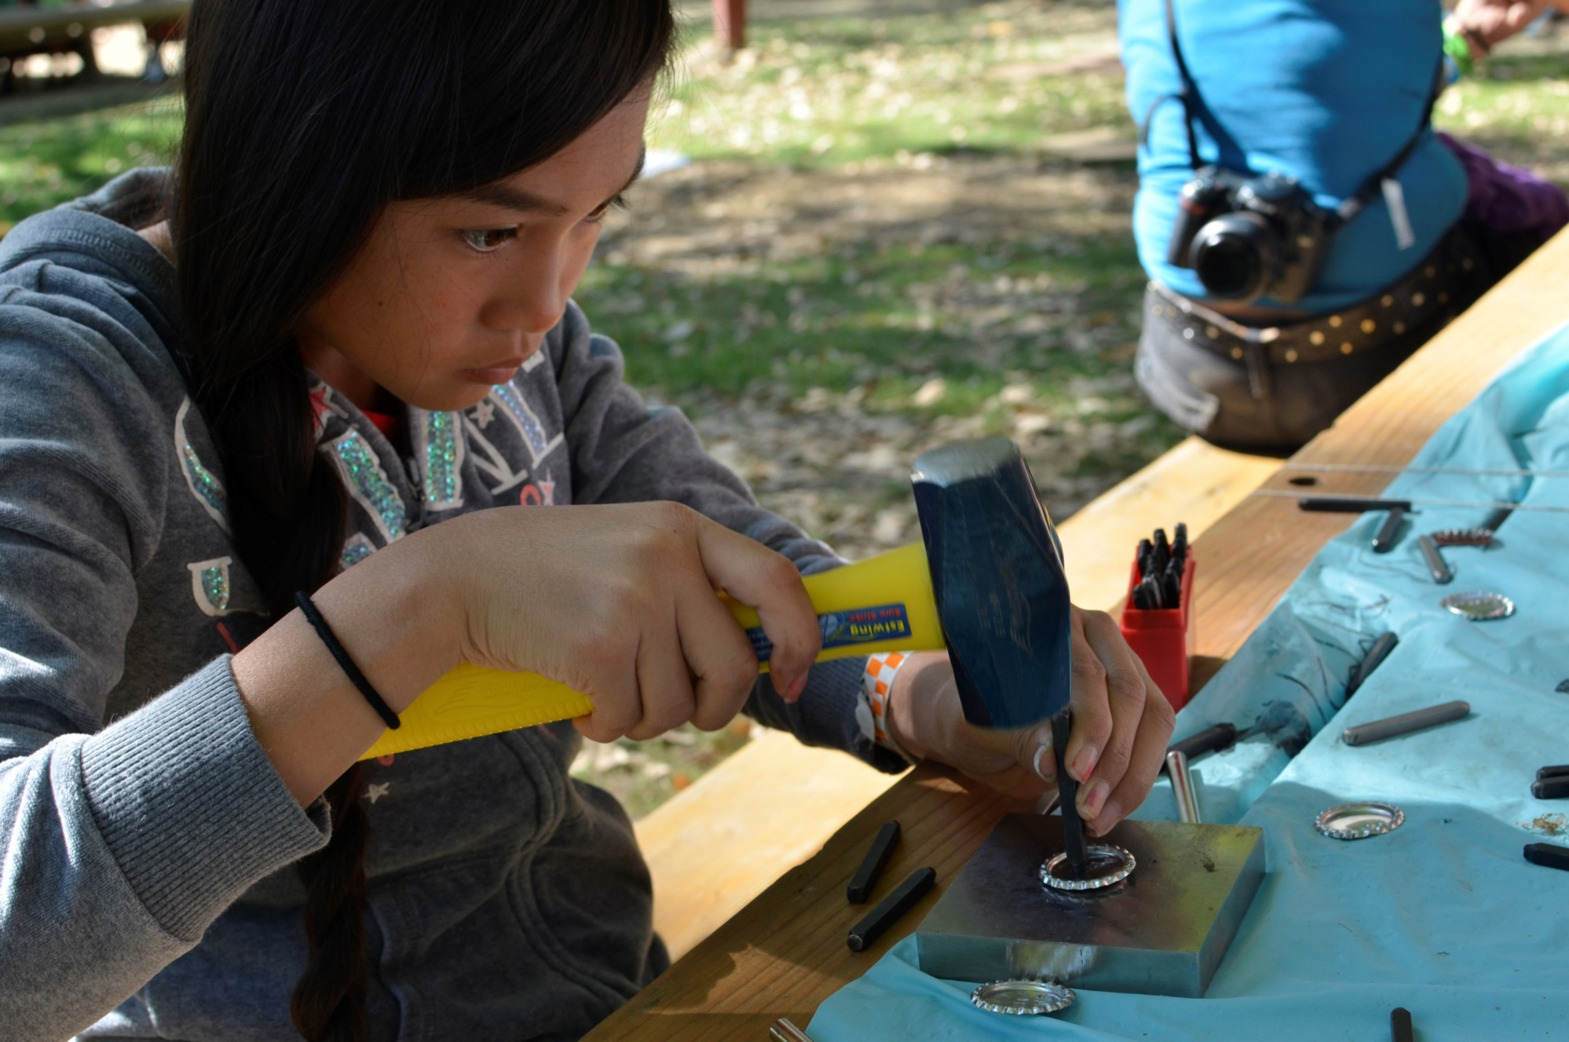
Art should encourage creativity not conformity.

Slide 23
Think of setting up an art experience in the same way you would think of setting up a science experiment.
Encourage tinkering.
Invite inventiveness.

Slide 24
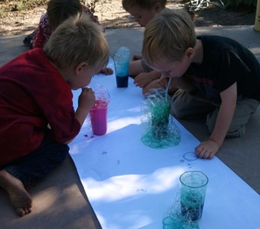
Spend lots of time in the space where science meets art- and resist the urge to explain everything!

Slide 25
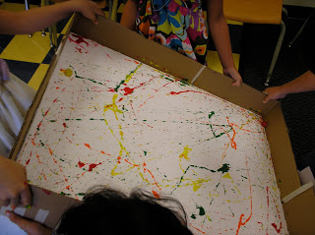
Introduce new ways of manipulating mediums.

Slide 26
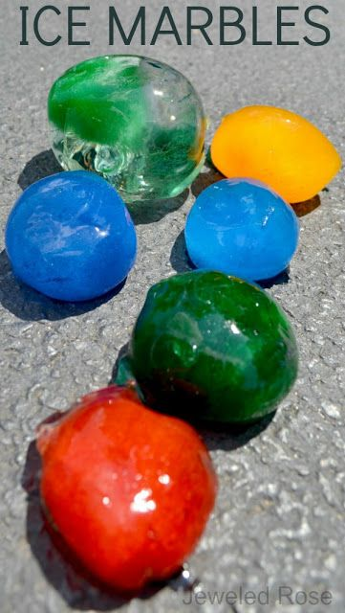
Don’t overthink what the kids need to do.
Present the offering and step back.
Paint squeezed into a balloon. Balloon filled with water and frozen overnight.

Slide 27
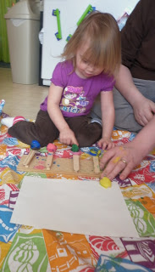
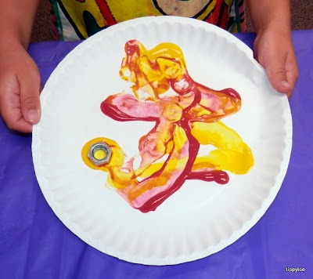
With great process art, the adults will naturally engage, but still allow the children to lead and extend the possibilities.
Left: Popsicle stick catapults shooting clay/paint.
Top: Painting with magnets.

Slide 28
It is not process art.
It is probably not art at all.
If there’s a wrong way to do it-

Slide 29
Great Process Based Art with Infants
Adaptable projects that accommodate the huge range of development within the first 12 months.
Active learning rather than passive receiving.
Baby gets to drive engagement.
Works WITH the babies’ development impulses rather than against them.
Allows engagement of any length of time.

Slide 30
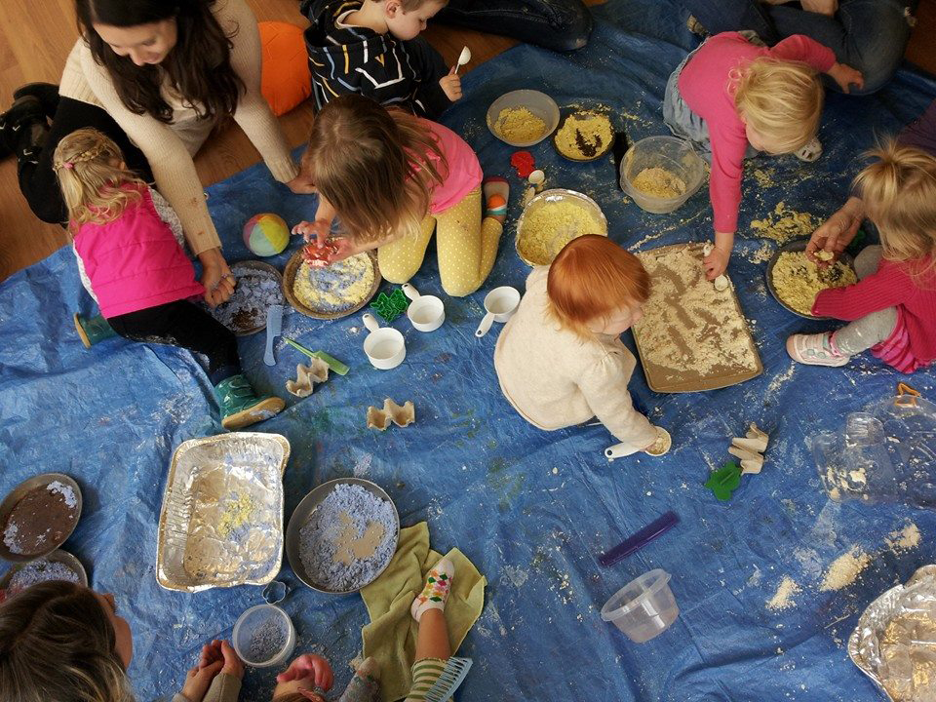
Making Cloud Dough

Slide 31
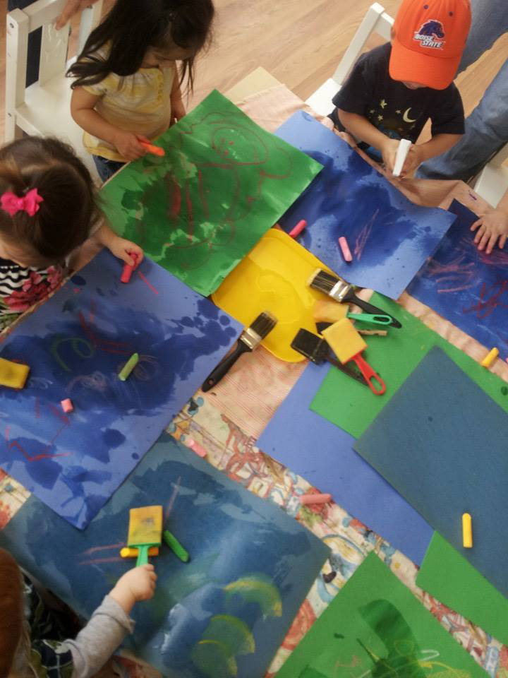
Water and Chalk on Construction Paper

Slide 32
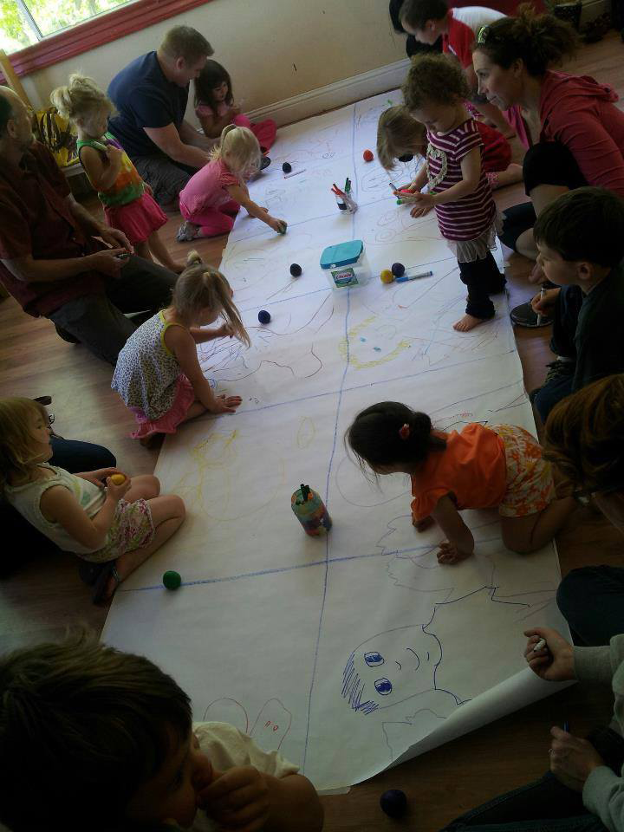
Tracing and Decorating Baby

Slide 33
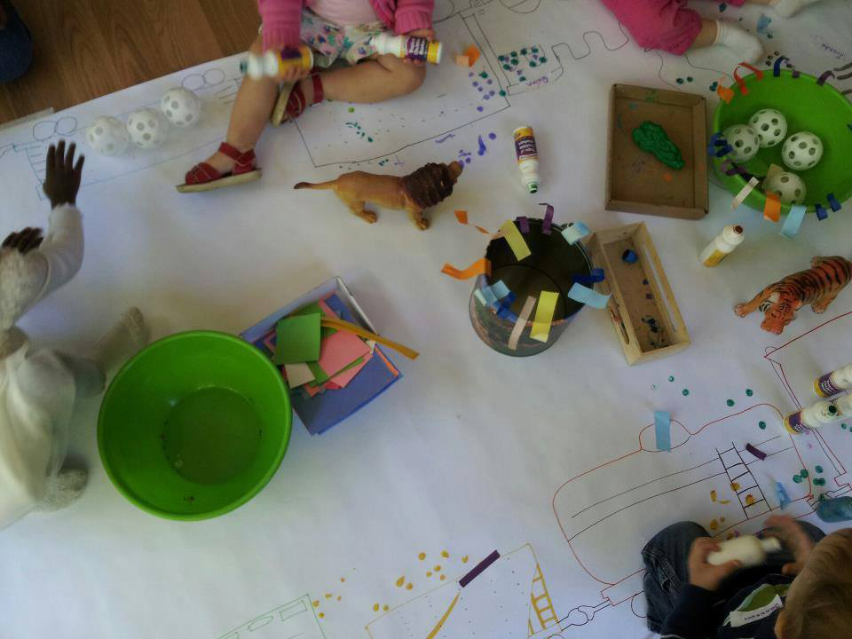
Classic Invitation to Create with Buffet of Supplies

Slide 34
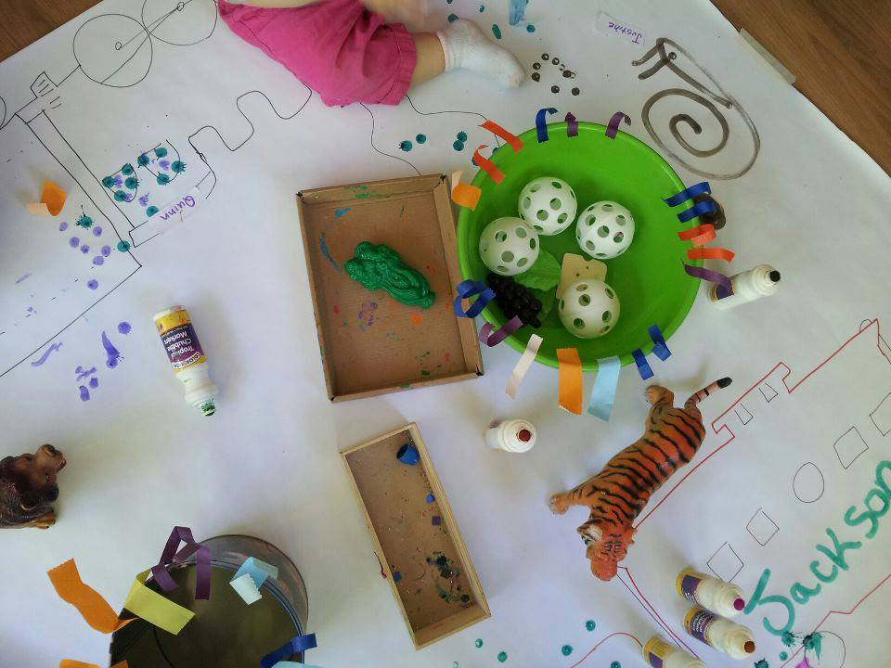

Slide 35
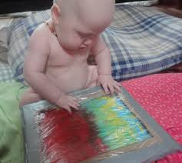
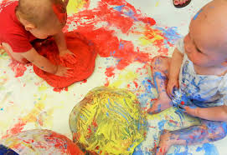
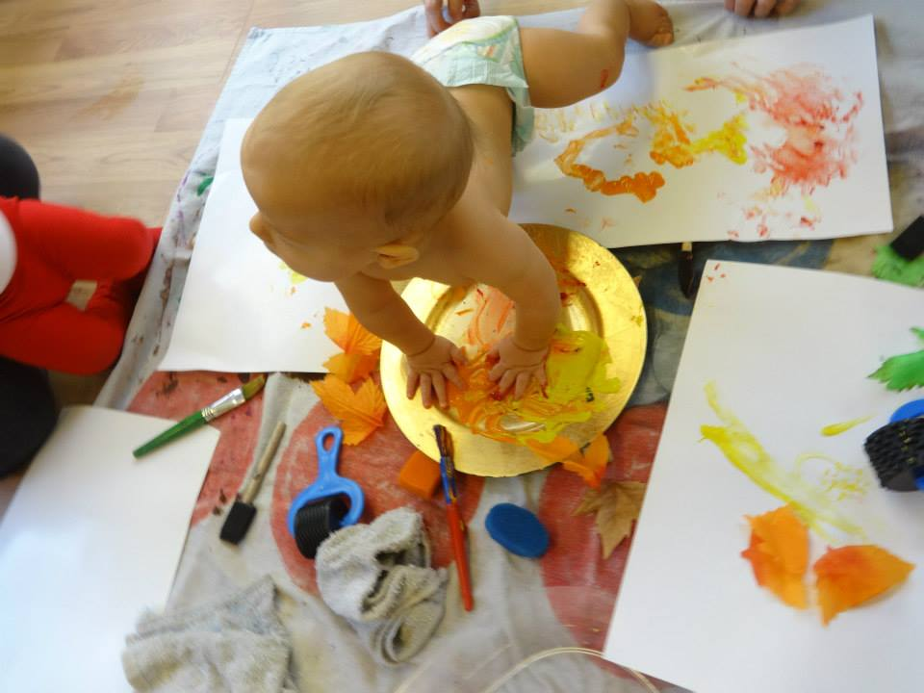
Work with the babies natural drives to explore mediums and possibilities.
You may be offering a rare Yes! to the baby to indulge in wonder.
You may also be modeling for parents the magic of saying yes.

Slide 36
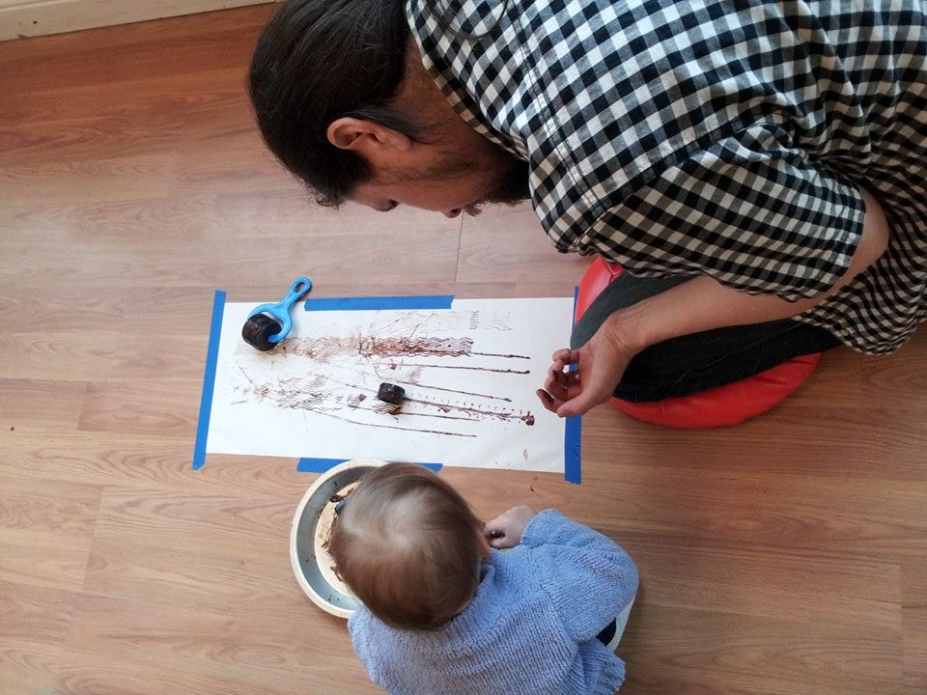
Let the babies lead. When you take away instruction and set up an invitation, parents can relax
and follow their babies leads rather than trying to help them do something right.

Slide 37
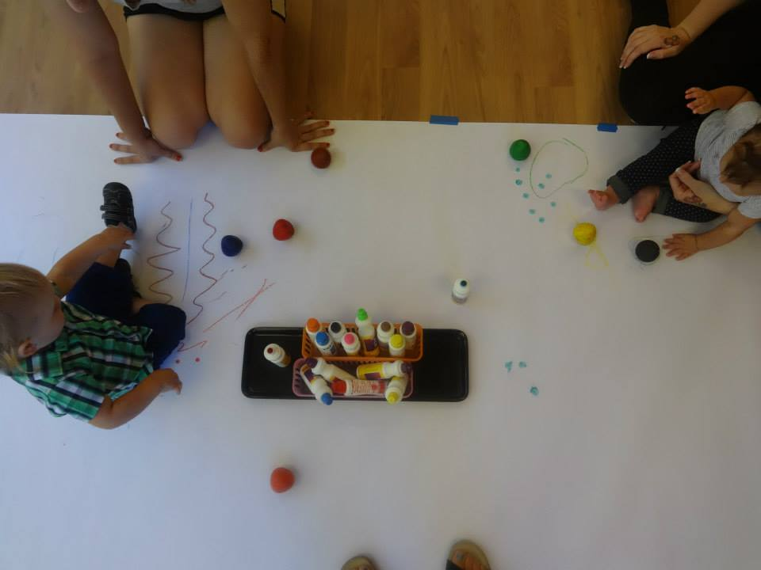

Slide 38
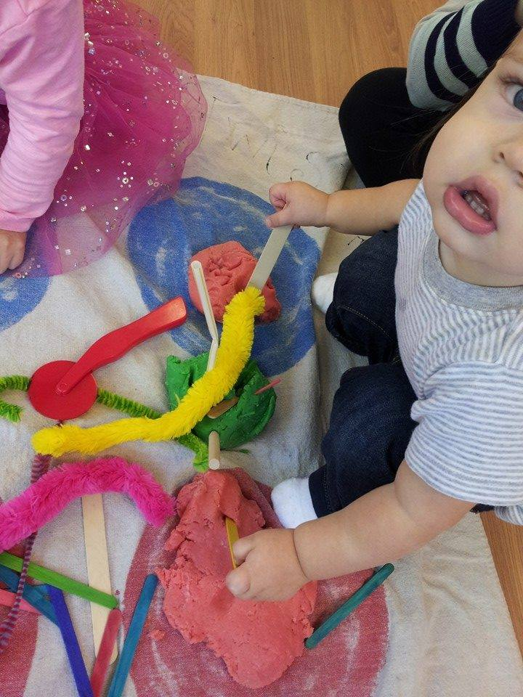
What looks to an adult as random and confusing is not so for a baby.
EVERYTHING is an invitation to explore, invent, create, and test.
Babies are scientists on a constant quest to discern the possibilities of things.
How does this work?
What can this do?
What happens when you drop it, pull it, taste it, squish it, stomp it, throw it…?

Slide 39
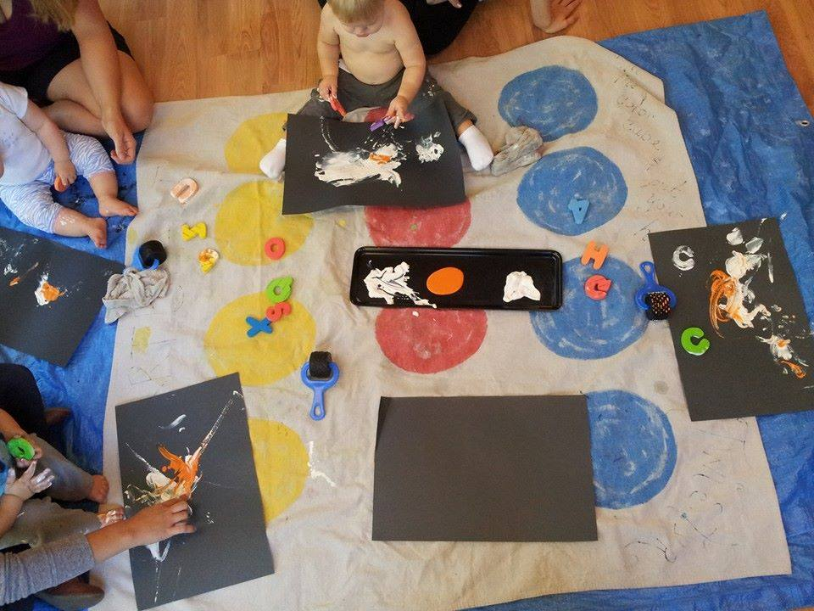

Slide 40
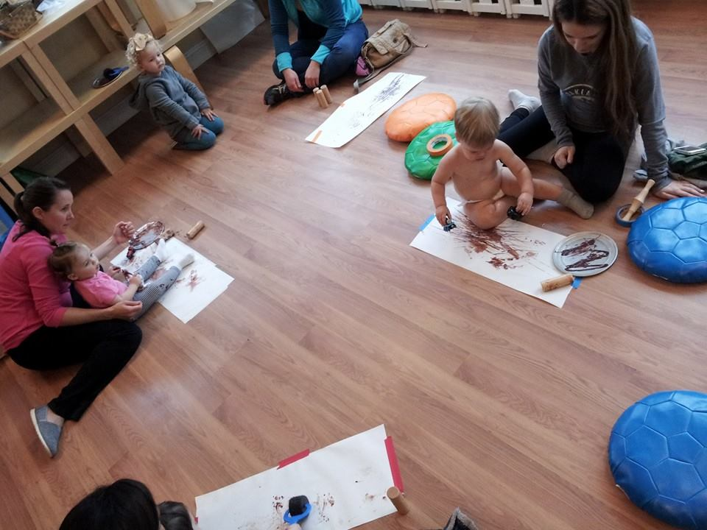
Ideally, the leader empowers the caregivers rather than directing the activity. The leader does most of her work in planning and set up.

Slide 41
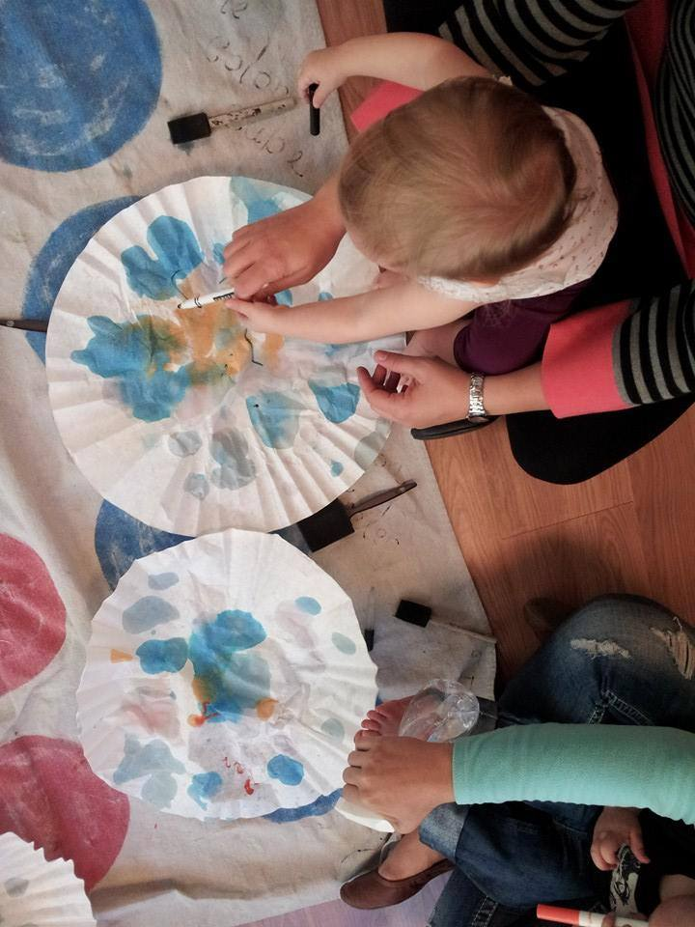
Supply buffets allow children to work right in their developmental zone.
Example Activity:
Coffee Filter Art
Buffet Items:
Liquid Watercolors
Eye Droppers
Foam Brushes
Bristles Brushes
Sponge Pieces
Markers
Coffee Filters

Slide 42
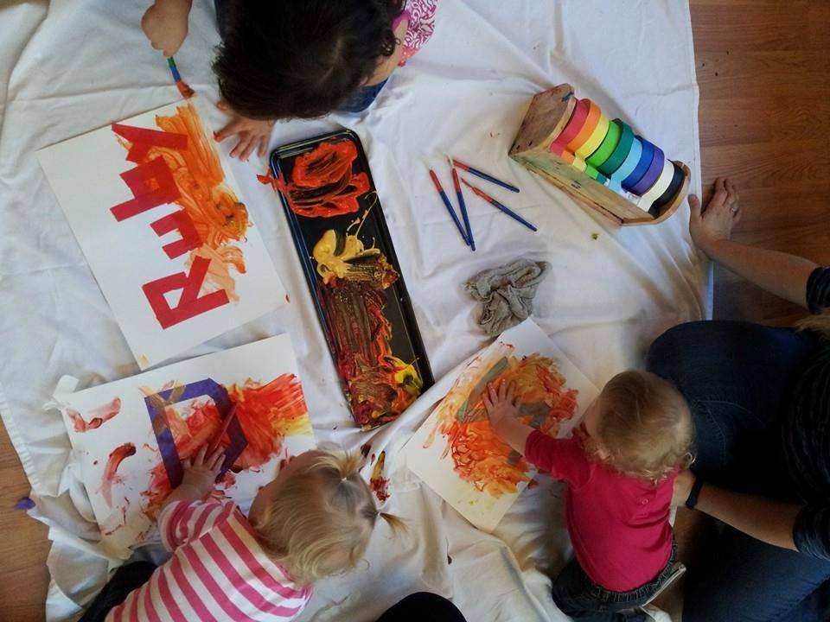
Some activities may have an extra job for caregivers- assisting with tape or tracing.

Slide 43
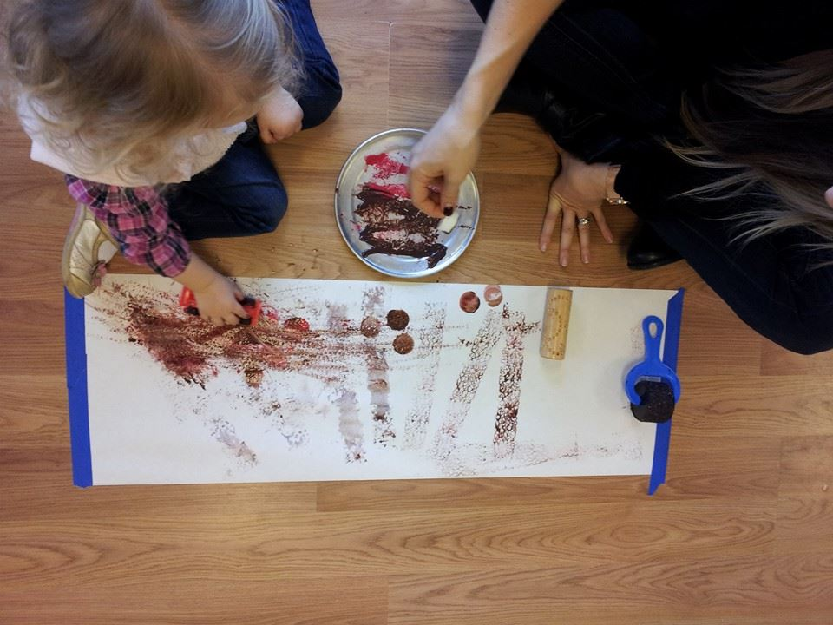
A simple invitation is to define individual space by taping paper to the floor and offering supplies at each space rather than expecting a
sharing of supplies and space.

Slide 44
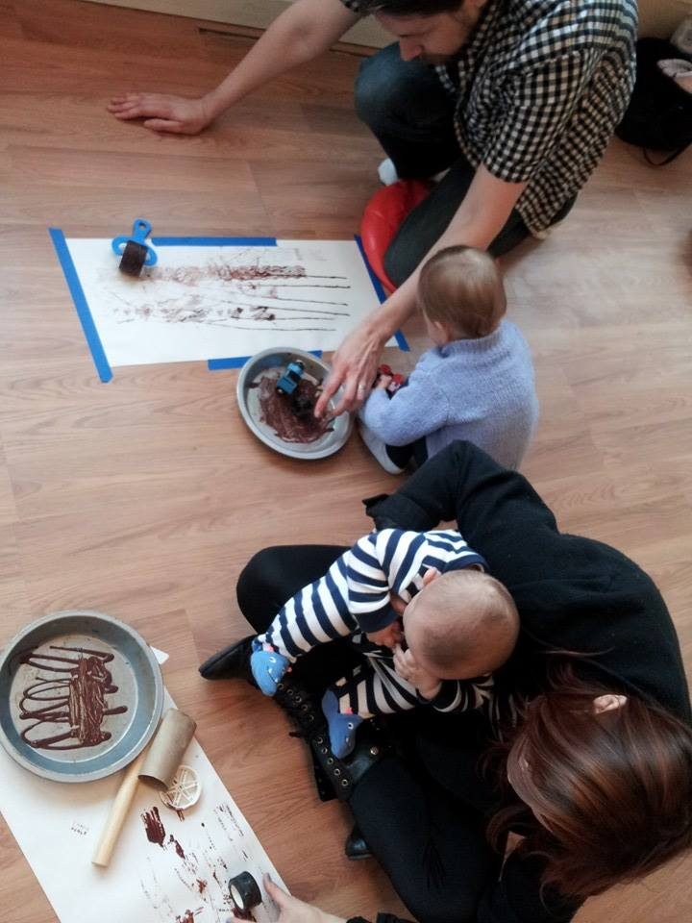
You can also take care of your caregivers by making the environment feet safe for introverts and extroverts.
Many introverted caregivers dread the sing-along circles and highly interactive sessions.
Easy fix:
Have some individual stations, some stations for two, and a central station for multiple children.
This will allow you to get to know your caregiving community.

Slide 45
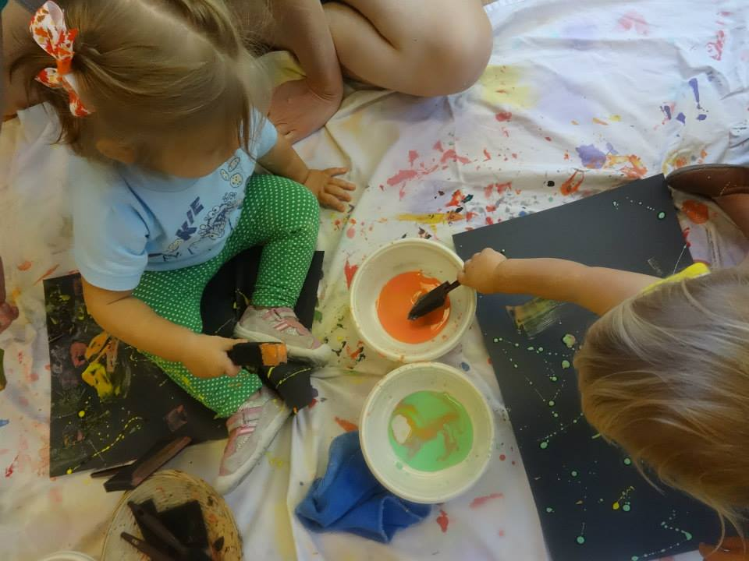

Slide 46
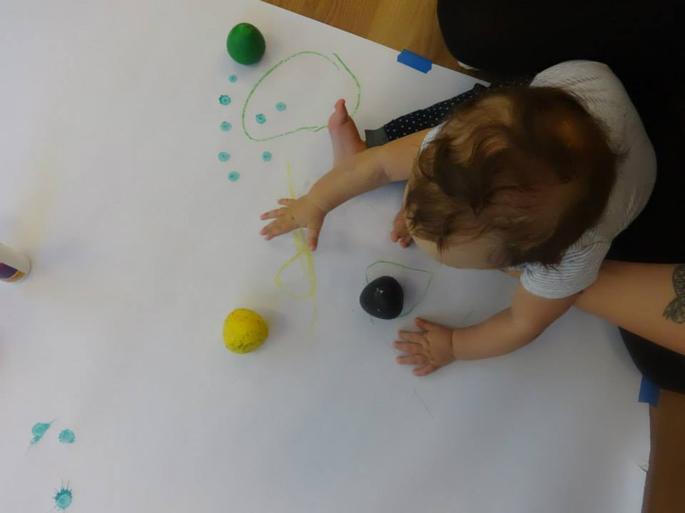

Slide 47
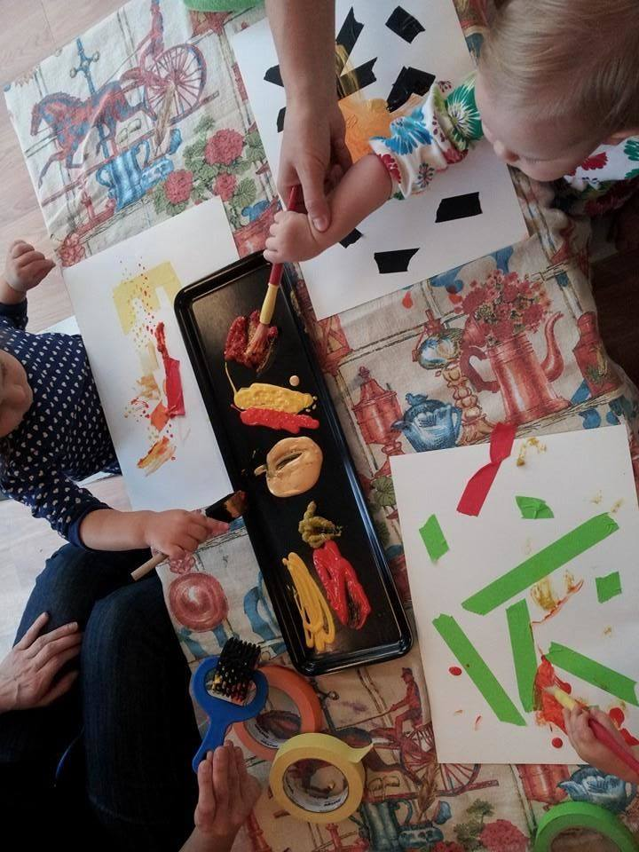
Parents and caregivers grow as they witness the range of ways caregivers engage and guide the children.
Some layer in academics.
Some sit way back and allow the children to lead.
Some do a project of their own right next to the baby.
Some let their babies taste the paint.
Some douse their babies in hand sanitizer ever 5 minutes.
Some cloak in aprons.
Some strip down to diapers.

Slide 48
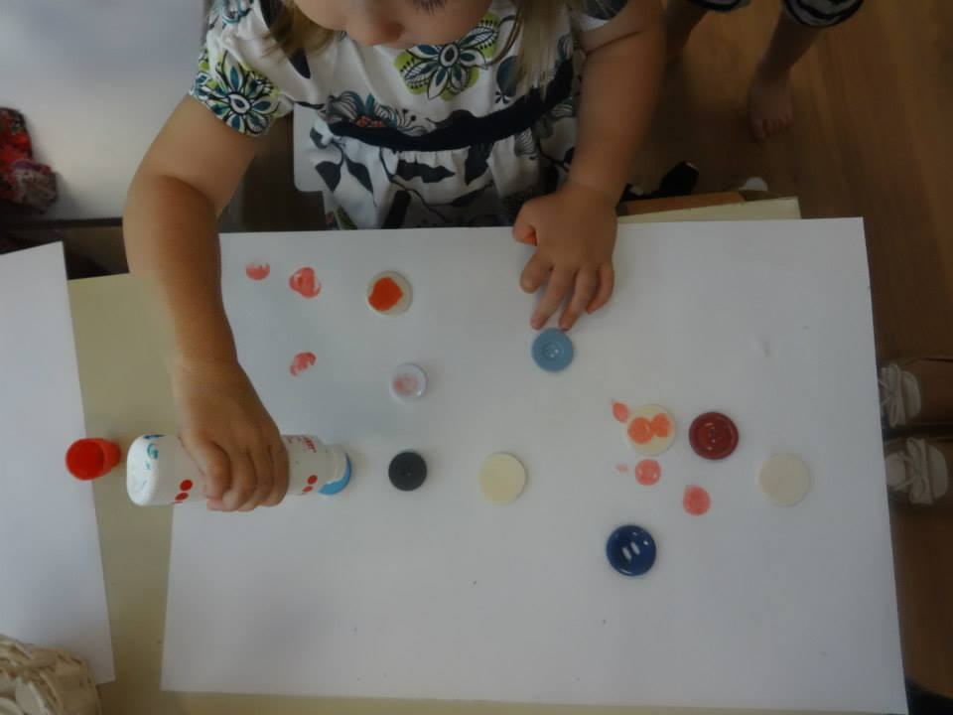

Slide 49
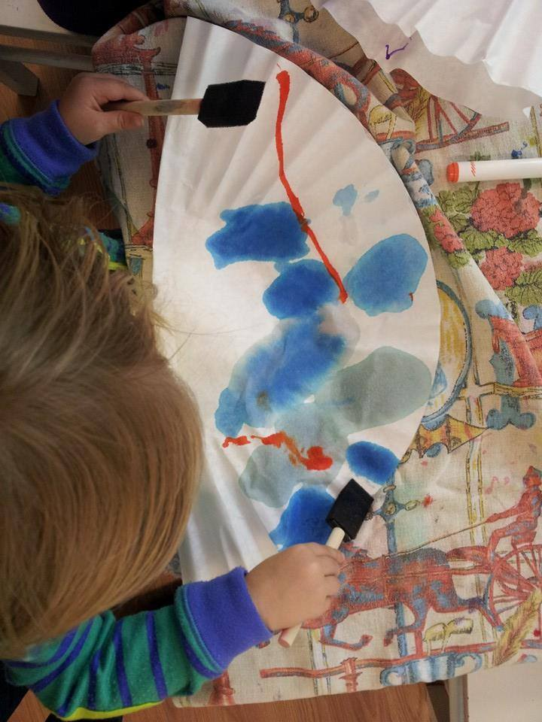
Use supplies that offer spectacular effect with little physical exertion.
Crayons need to be pressed hard.
Markers require a developed grasp.
Great supplies:
Liquid Watercolors
Dot Markers
Foam Brushes
Coffee Filters
Tissue Paper
Tempera Paint
Cars and Balls to Roll Paint
Colored Masking Tape
Doughs
Charcoal
Clay
Round Crayons

Slide 50
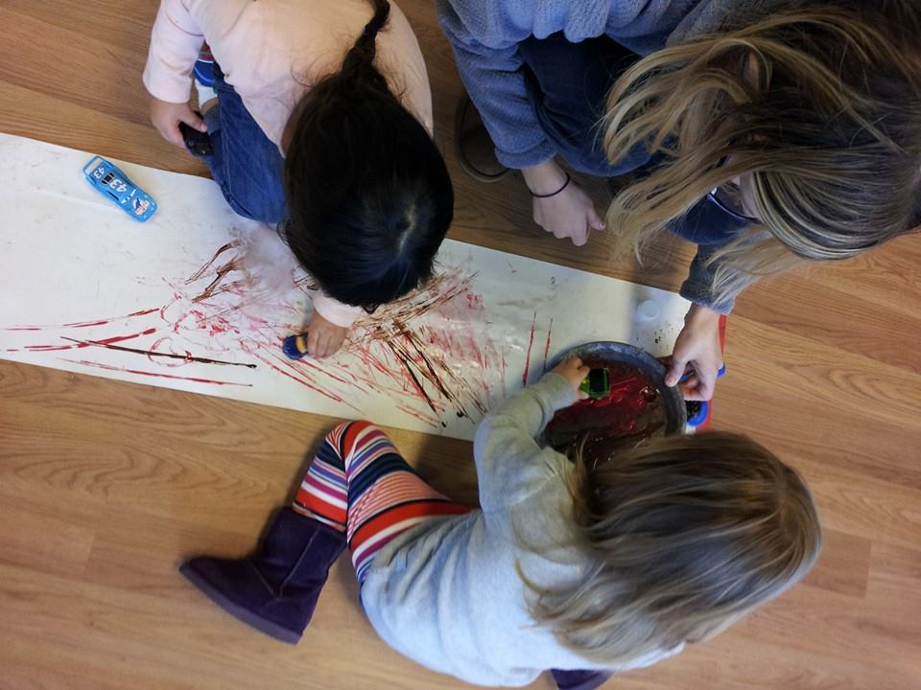

Slide 51
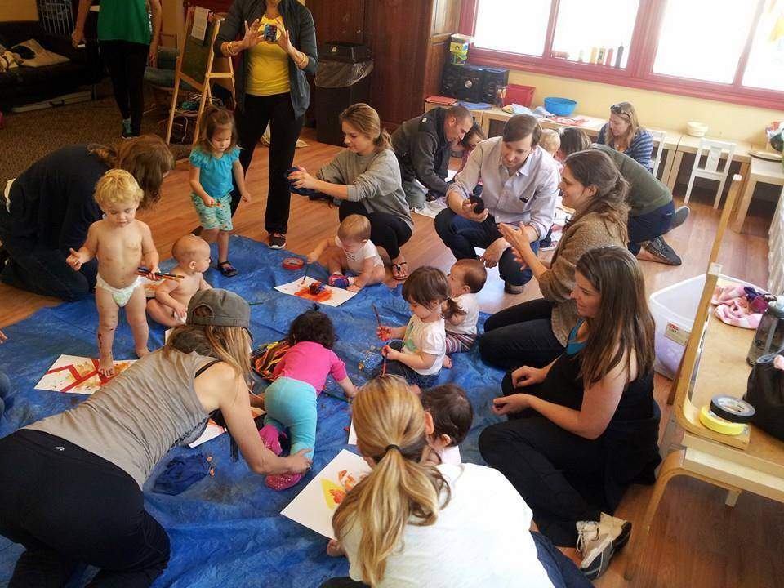
Community is Inevitable

Slide 52
Sensory Tables
Scientific exploration stations
only with glitter and feathers

Slide 53
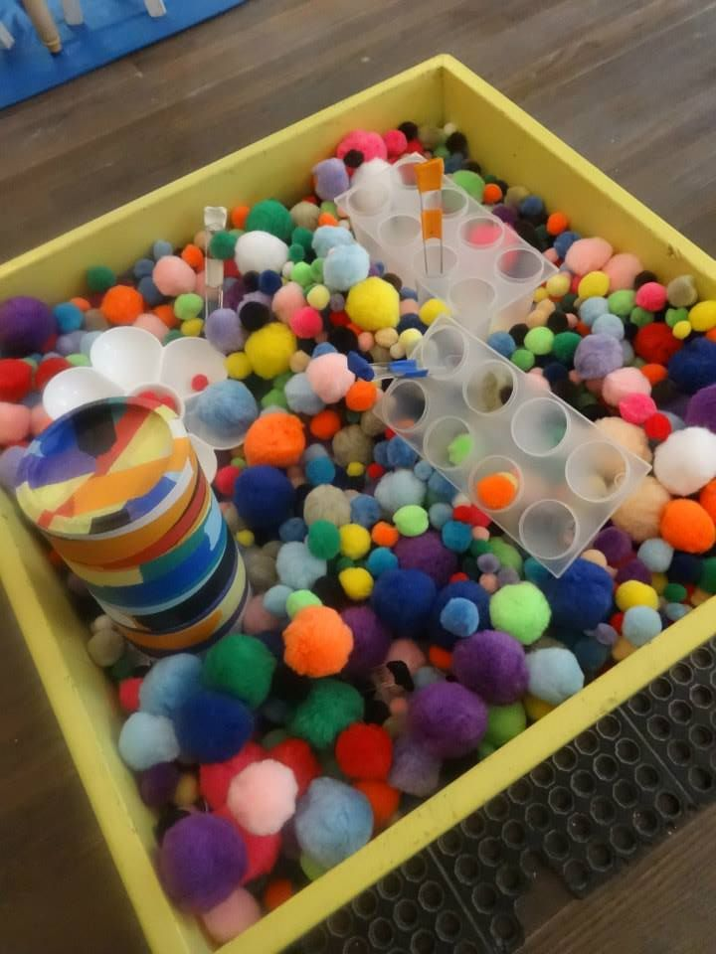

Slide 54
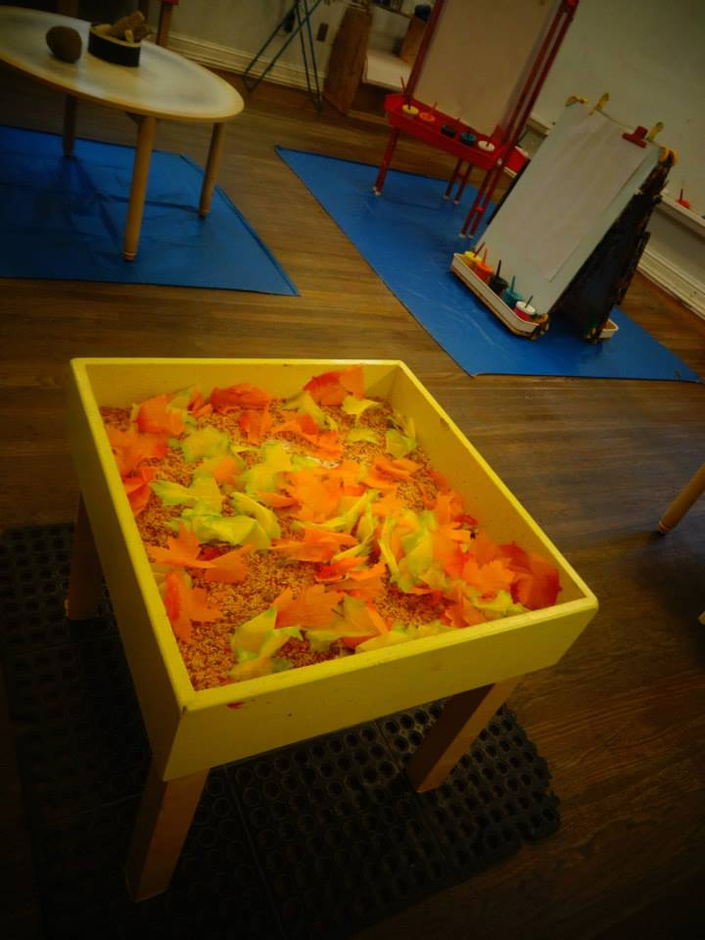

Slide 55
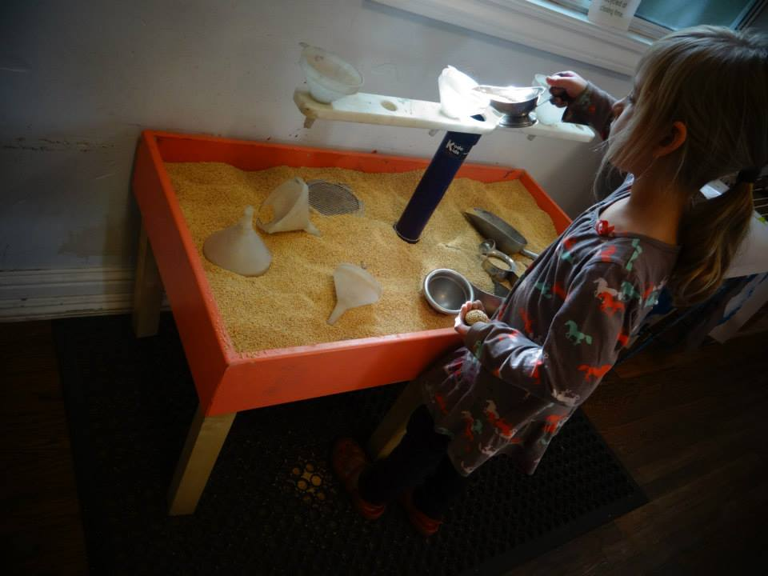

Slide 56
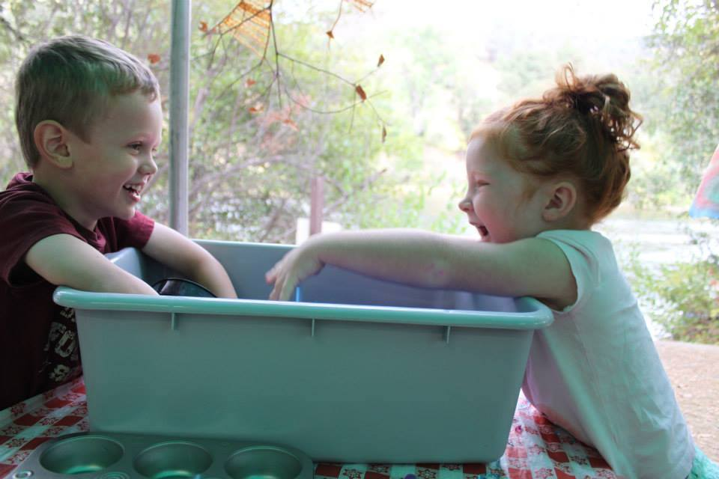

Slide 57
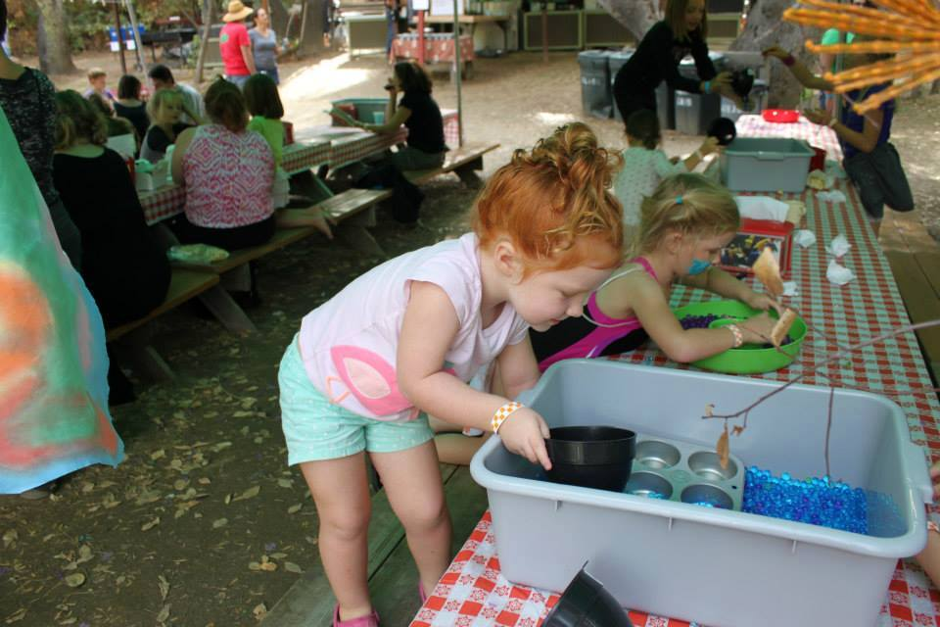

Slide 58
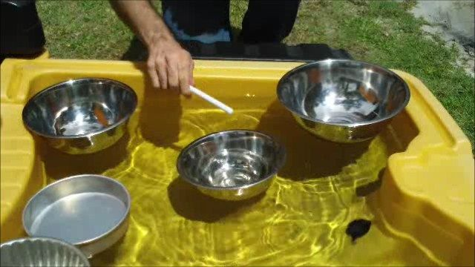

Slide 59
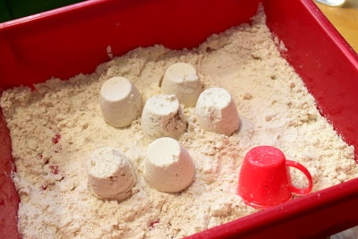
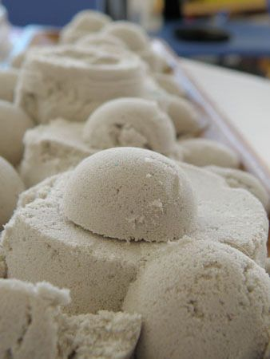
Cloud Dough
8 cups flour
1 cup oil
Moon Sand
4 cups sand
2 cups cornstarch
1 cup water

Slide 60
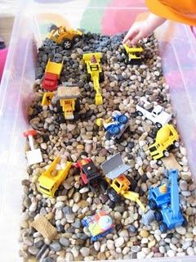
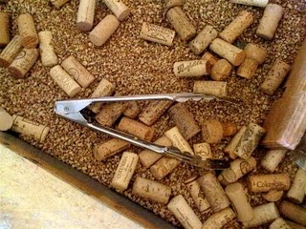




Slide 61




Slide 62


Slide 63


Slide 64
Movement

Slide 65

Devote time to both gross and fine
motor activities.

Slide 66

Develop a repertoire of movement games that promote interaction between child
and caregiver. Use classics: Peekaboo, mirroring games, wrapping tightly,
and animal imitation games are all fun and easy to play at home.

Slide 67



Your library can make accessible and inclusive activities that are too often reserved for children of privilege.
Offer the latest enrichments that EVERY parent wants to give their child:
Yoga Martial Arts Infant Massage
Dance Tumbling Art and Music
The intro level on ALL these can be lead by staff that have completed simple trainings.

Slide 68

Most of all, continue to think of the invitation. It’s challenging to LEAD movement activities. It’s easy to set up invitations and step back.
Examples of Inviting Movement:
Drum Circles
Obstacles Courses
Masking Tape Courses
Crawling Courses
Bubble Machines
Disco Balls Light Play
Chalk Course
Parachute Play
Dance Party/Freeze Dance
Silk Scarves and Ribbon Play

Slide 69


Fine Motor activities allow children’s curiosity to drive development of the fine motor pinch and grasping skills needed for future writing and tracking.

Slide 70




Slide 71


Elementary teachers are bemoaning the number of children who can’t manage scissors or shoe tying by age 7. This is because preschools and kindergarten are skipping the play and art that develops the motor skills that lie underneath reading and writing.

Slide 72




Clear Contact Paper Collage

Slide 73




Embrace Low Tech Equipment
Messages caregivers that fancy equipment is not needed.
No storage issues on single use items.
Children can recreate when older.
Ensures accessibility.
Money used for staff and supplies rather than equipment.

Slide 74

Give parents ideas on how to scaffold exploration and tinkering in their infants.

Slide 75



Small additions to classic mediums adds a whole new layer of exploration and development: Play dough is a great stabilizer for building as well as for making impressions and molds.
You can even pour melted crayon plaster into play dough molds. Jello be filled with dinosaurs, plastic letters, grains of rice and excavated.

Slide 76



Creative Challenge Drives Development

Slide 77






Art can move

Slide 78



Slide 79
Challenges of siblings, parents, and infancy
The right project- and good set up- eliminates the greatest challenges.

Slide 80
The Cardinal Rule:
Set up an invitation
Focus on mediums
Pick good supplies
Step out of leadership
Set up defined space for each pair
Set up community space

Slide 81
What Space Do You Have for Programs?
A) We have a separate community room.
B) We can create space within the library.
C) We have an outdoor space.
D) We can travel to other sites to deliver programs.
E) We have absolutely no space whatsoever for programs.

Slide 82
Keys to Launching a Successful Library Program for Infants
Rule 1: Develop existing staff. Don’t waste a dime on “experts and artists.”
Identify the staff person who is great at building relationships.
Play to strengths.
Offer training to develop a workshop leader: Music Together, ECE Classes, and Conferences.
Allot staff time to develop workshops and get supplies. Curriculum developer may be different than workshop leader.

Slide 83
Rule 2: Pick a regular time and stick to it.
10 am is our most successful time.
Avoid nap and meal times.
Allow lots of time for it to develop momentum. Word of mouth will drive its success.
Run the program with the same teacher so that relationships develop.

Slide 84
Rule 3: Promote Wisely
Title it: Baby and Me to indicate age bracket.
Profile with photos on your Facebook, Instagram, and Twitter page of the babies engaged in activities. Parents will share photos and spread word.
Parent groups on social media can work wonders.
Promote by highlighting that week’s medium.
Book titles and teacher photos do not bring people in!
List separately on free community calendars.

Slide 85
Rule 4: Stick with Process Art
Spend 2 minutes at opening highlighting how the activity ties into development.
Spend 2 minutes empowering caregivers to facilitate the process.
Process art will allow you to accommodate crowd swells as well as low turn out. Supplies are easily reused.
Process art allow will accommodate older siblings.
Process art will accommodate a range of attention levels.

Slide 86
Rule 5: Get ahead
Start a Pinterest Board and pin 30 activities right away. Consider making it public.
Stock up on standard process art supplies: paint, brushes, paper, sensory items, tarps…
Pick 1 or 2 more ambitious play elements to create each year.

Slide 87
Examples of Library Programs
Art Beast in the Libraries throughout Sacramento: Weekly art for all programs as well as one time workshops
Catch ‘em in the Cradle: Empowering parents as first teachers
Lisle Library outside Chicago: Process based art pinterest board and programs.

Slide 88
Chat:
What Amazing Library Programs for Infants Have You Seen?

Slide 89
Excellent Internet Resources for Art Inspiration:
Pinterest: Search Process Art
Teacher Tom
Red Ted Art
Play at Home Mom
Magic Onions
Artful Parent
Tinkerlab
Make Zine and the Makers Movement
Child’s Play Music
Bev Bos
Ooey Gooey
Explorations Early Learning
Reggio Children Inspired Facebook Page
Let the Children Play Facebook Page
Rebecca and Andrew Facebook Page

Slide 90
Sources for Supplies
Discount School Supply: Enter the word museum in discount code line for 15% off
Nasco Educational Supplies
RAFT: Resource Area for Teaching
Explorations Early Learning
KODO Kids: Overpriced good ideas
Ebay

Slide 91
Thank You
Contact Information:
Bridget Alexander
Executive Director of Waking the Village
bridget@wakingthevillage.org
www.artbeaststudio.com
www.littlehousesfestival.com
www.wakingthevillage.org
www.arteniabeast.com

Slide 92
Infopeople webinars are supported in part by the U.S. Institute of Museum and Library Services under the provisions of the Library Services and Technology Act, administered in California by the State Librarian. This material is licensed under a Creative Commons 3.0 Share & Share-Alike license. Use of this material should credit the author and funding source.

