Slide 1
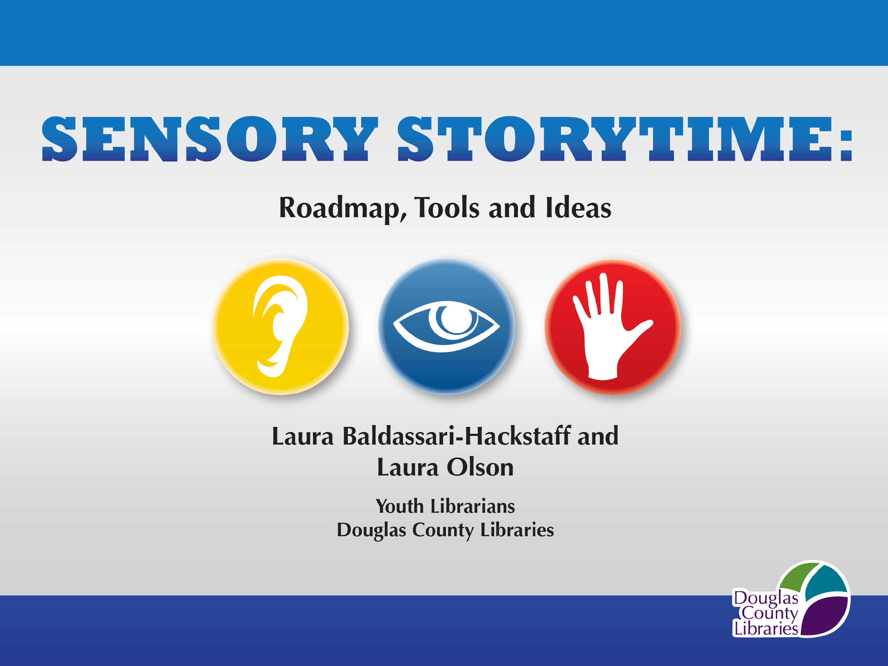
An Infopeople Webinar
Wednesday, February 11, 2015
Notes:
Social Story http://douglascountylibraries.org/storytime/sensorystorytime
YouTube videos:
http://www.youtube.com/watch?v=ehJoVM-SG3k&feature=c4-overview&list=UUr3WN_8IqM6b_l36Z0VabHA
http://www.youtube.com/watch?v=PSLJaETbNU8&feature=c4-overview&list=UUr3WN_8IqM6b_l36Z0VabHA

Slide 2
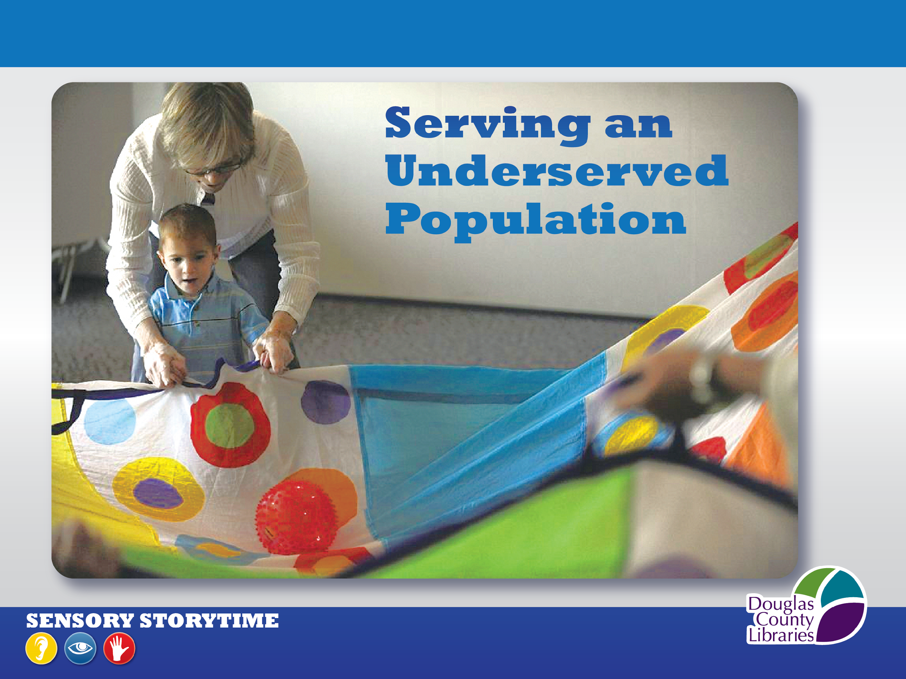
National Center for Education Statistics
Notes:
In its most recent report on special education, the National Center for Education Statistics reports that almost 6.5 million public school students between the ages of 3 and 21 received special education services, 454,000 of those students were diagnosed with autism, and the incidence of autism among those students increased almost 500% between 2000 & 20012.
The link to that information is at the bottom of this slide for you.
http://nces.ed.gov/programs/digest/d13/tables/dt13_204.30.asp
Table 204.30.Children 3 to 21 years old served under Individuals with Disabilities Education Act (IDEA), Part B, by type of disability: Selected years, 1976-77 through 2011-12
This is the reality that made our library district realize that we were not adequately serving the families of these kids.
We believed that they would come to the library IF OFFERED THE APPROPRIATE PROGRAM, and that led to our sensory storytime.
Since beginning our sensory storytime, we know that many who attend have come to our library for the first time. After our storytime, they get their new library cards, and come into the Children’s Dept. to play, socialize, and checkout materials. This tells us that this storytime is a very important addition to our weekly programs.
Introduce ourselves
Show of hands, who is actively considering or already doing sensory storytime?
(Pause)
Great—we’ll ask to hear from you at the end of our presentation. We have shared ideas with librarians in Pennsylvania, Arizona, Iowa, and Colorado who are planning or offering their own sensory storytime, and hopefully some of them are listening today!
When you leave today, we hope you’ll have the roadmap, tools, and ideas to develop and offer your own sensory storytime.

Slide 3
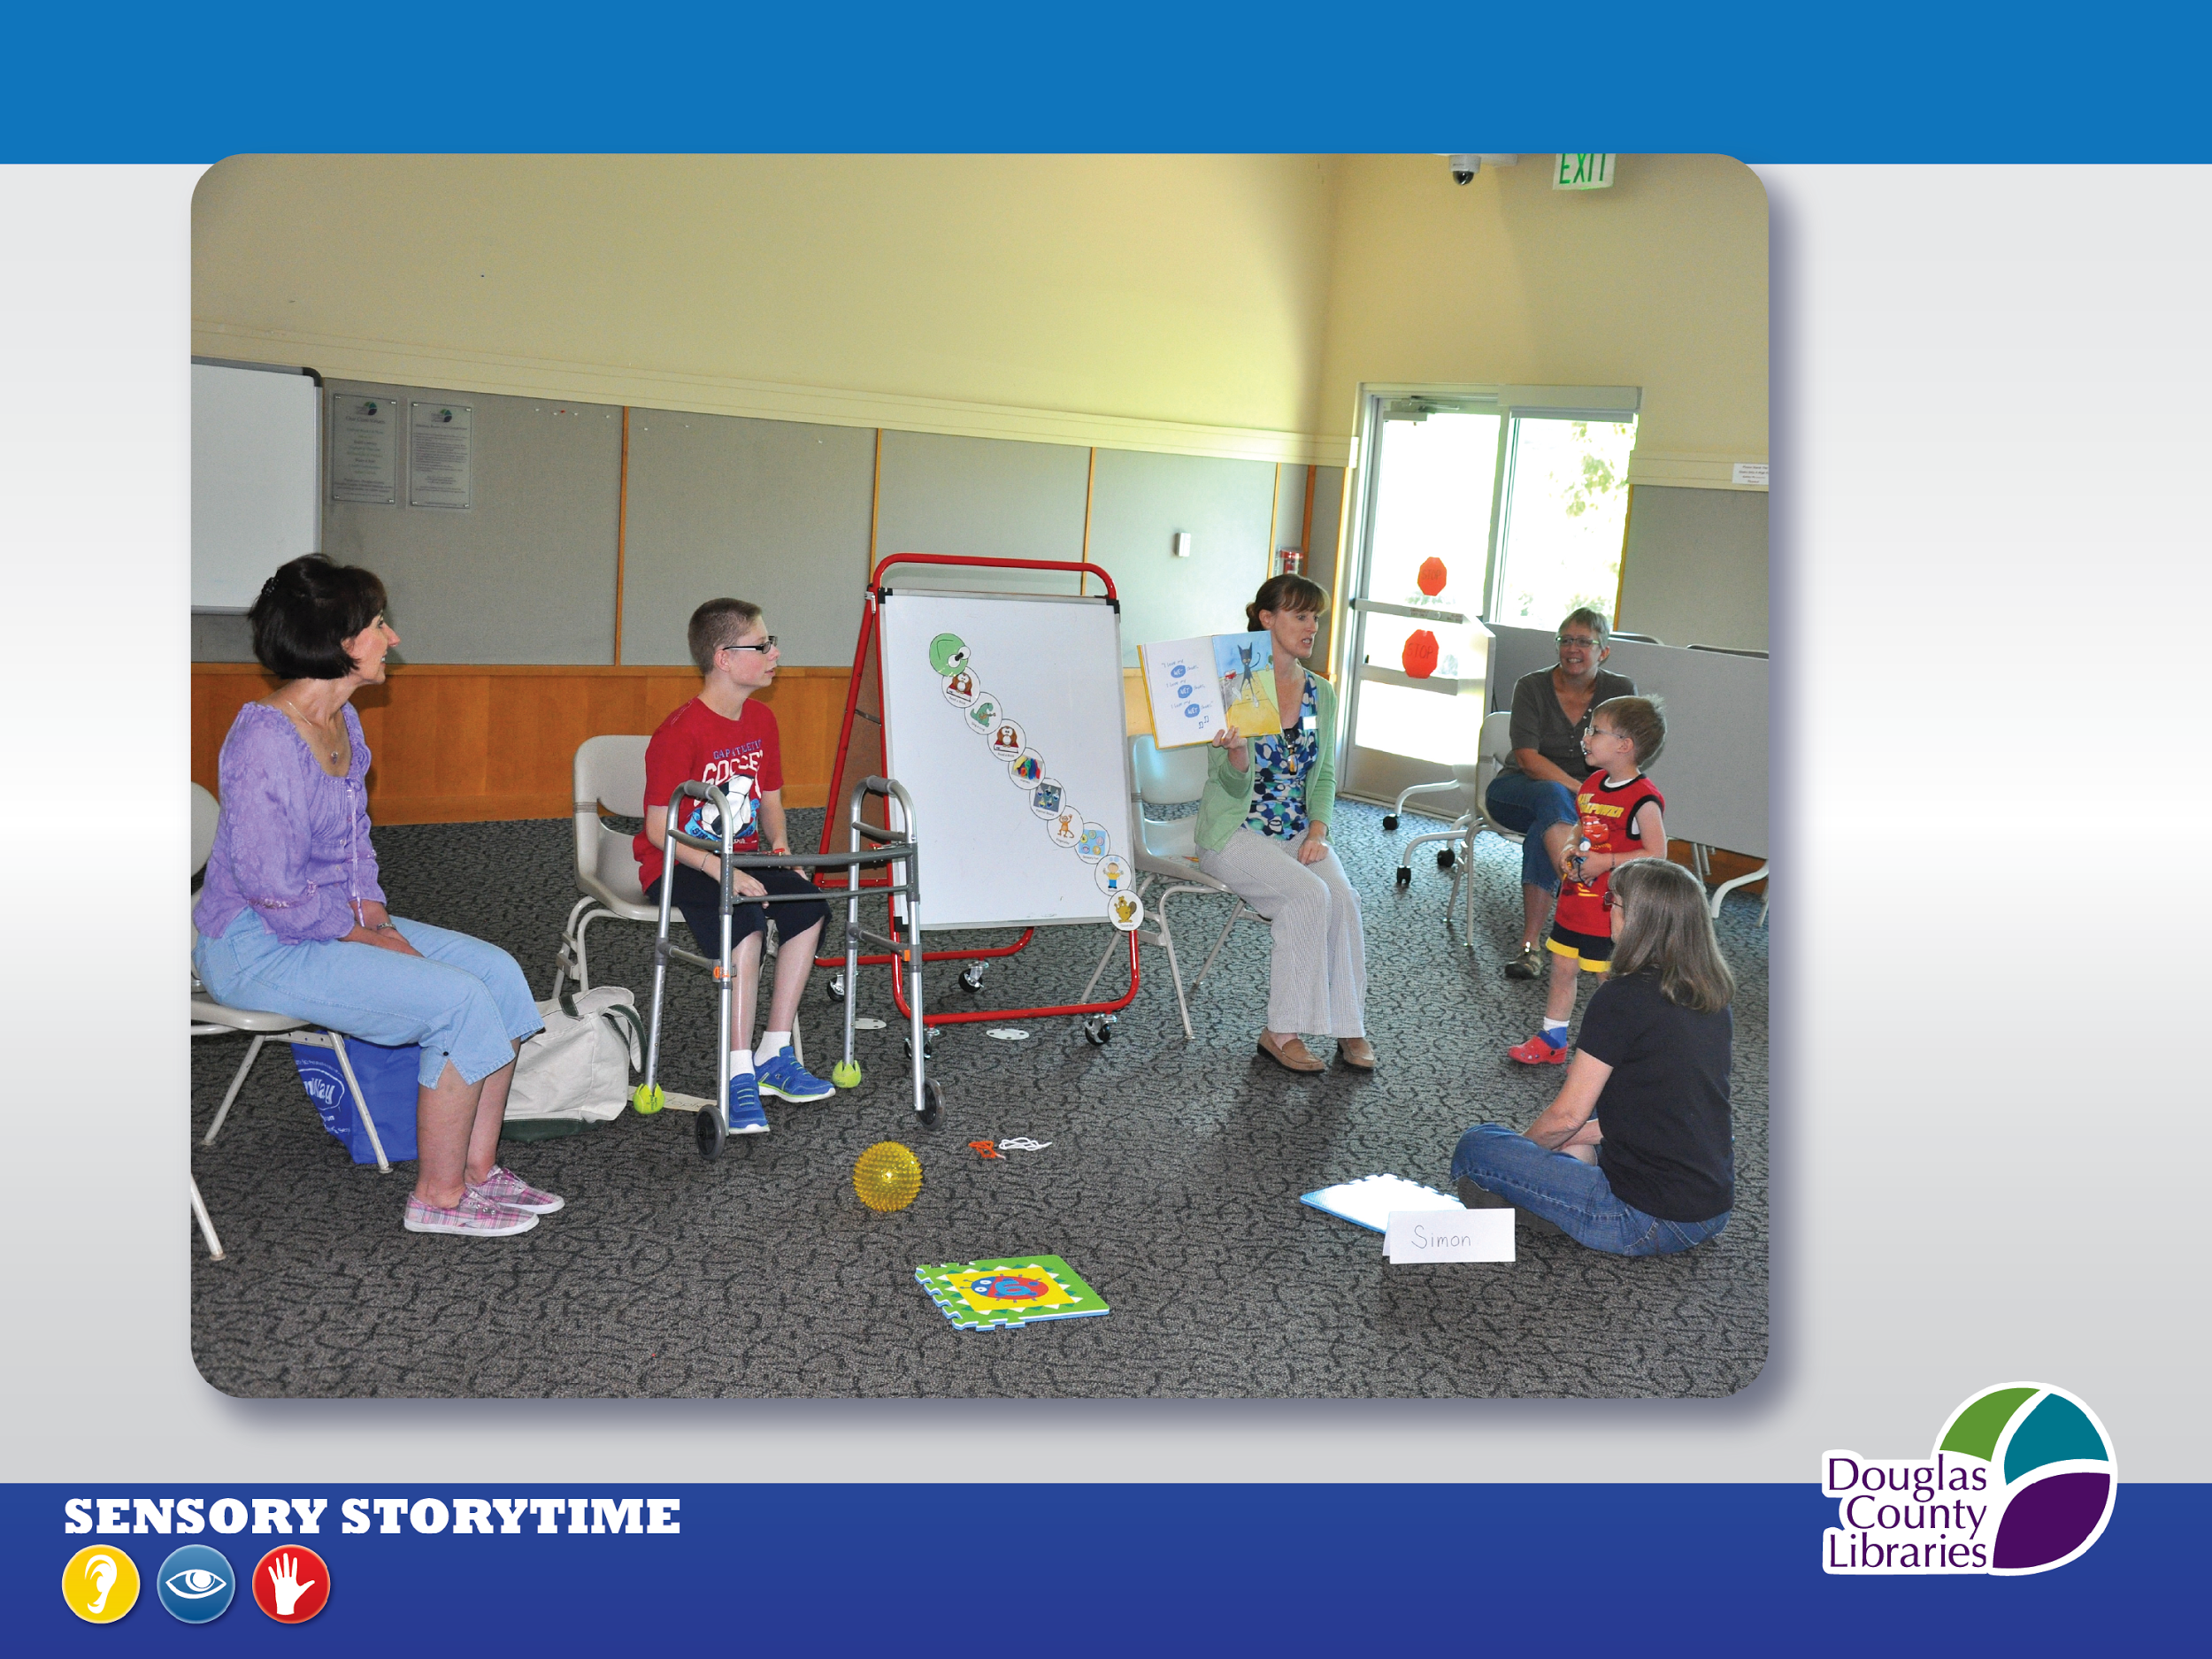
Notes:
Our Sensory-enhanced Storytime is a traditional storytime in many ways, but with sensory enhancements, such as fidgets for the children to hold, sensory balls, dual presentations of a story where we read from the storybook while the volunteer presents the flannel version, scent jars to pass around, and additional opportunities to vocalize and move.
We have photos of our sensory-enhanced resources coming up.
Our storytime is designed to be at a Toddler or Preschool level of development, while being for all ages of youth on the autism spectrum, differently-abled, and typically developing.
Our audiences range from infants and toddlers to young adults.
We offer this storytime twice weekly, with a morning and afternoon session.
Each session is 20-30 minutes in length. We cap registration at 15 children and require that participants have a parent or caregiver attend, but a one-to-one ratio is not necessary. Siblings are welcome, but do not require registration.
Medical therapists are welcome too.
This storytime is held in a meeting room and we close the doors, allowing children to fully participate in the best way to meet their needs. A closed room is very important for a sensory storytime program for this reason.

Slide 4
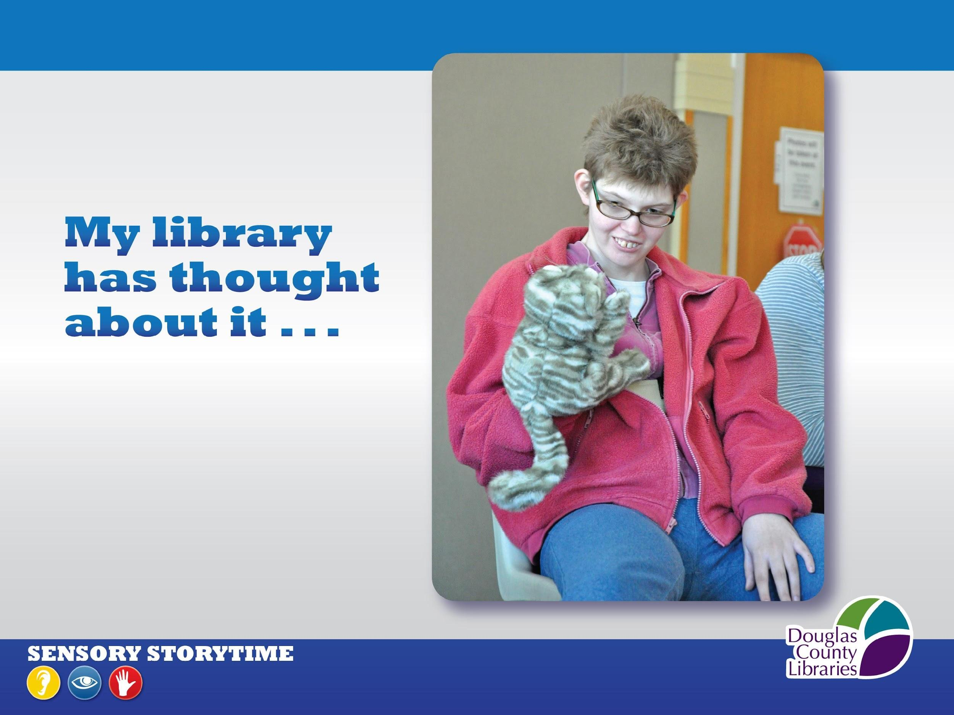
Notes:
The foundation we began with is very familiar to you if you provide traditional storytimes at your library:
IT’S A STORYTIME that provides a SAFE ENVIRONMENT, is FUN,
And WELCOMING TO ALL
The skills you need ARE CHILDREN’S LIBRARIANS SKILLS- YOU HAVE THEM!
You are Flexible / Confident / Relaxed / Friendly / Calm / Informed / Collaborative
We want to emphasize that Laura and I had no prior knowledge or training in autism or special education. So please don’t feel you have to be a specialist.
One small note regarding the Budget: we didn’t spend more than $100 to begin this program,
for supplies such as felt, pipe cleaners, etc. (for fidgets and flannelboard stories).
So if you are thinking about implementing your own sensory storytime we encourage you to do so!
Let’s look at how we developed our sensory storytime program.

Slide 5
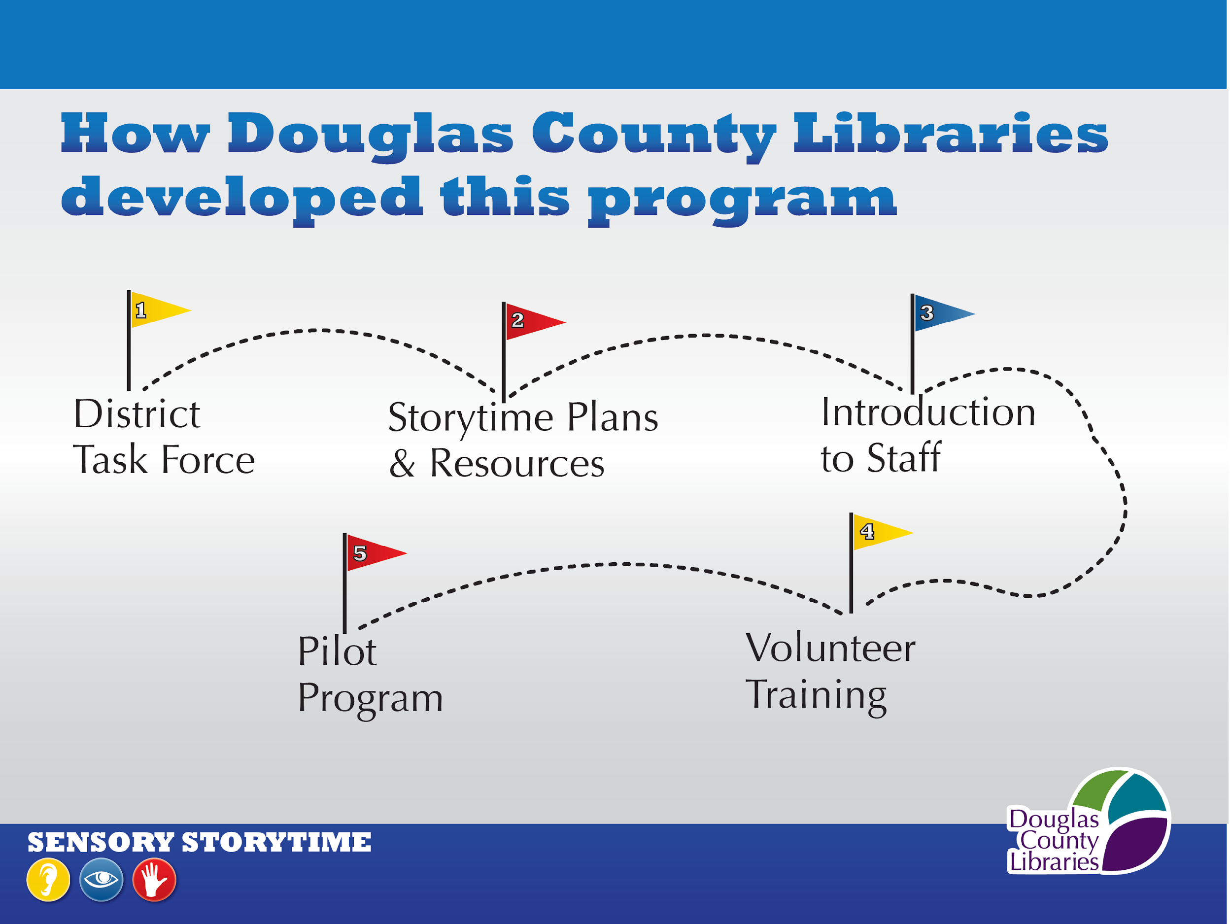
Notes:
Here are the 5 steps we followed to develop and begin our storytime.
We formed a Task Force, developed the needed resources, introduced the storytime to staff, trained our volunteers, and launched a Pilot.
We’ll talk in-depth about these now, beginning with the formation of a Task Force.

Slide 6

Notes:
We created this program with a Task Force that included:
Assoc. Directors, our Branch Manager, Youth Department Heads, Volunteer Dept. Head, our Branch Volunteer Coordinator, Youth Librarians, and staff from our Community Relations and Training departments.
Working on this with people from throughout our District kept folks in the loop as we developed it.
The Task force worked together for 10 months and got crucial input from the Autism Society of Colorado, an ALSC Blog by Tricia Twaragowski, and our local public school district.
-- The Autism Society of Colorado was invaluable to us. We learned about autism from their classes, Introduction to Autism and Autism 101, They had a Q&A session specifically to address our questions and needs, observed our traditional storytime for insight into how we present a storytime, and visited our sensory room and suggested adaptations to it that would provide our audience with a safe environment.
We cannot overemphasize how SUPPORTIVE the Autism Society of Colorado has been since we began developing this storytime. Contact your local branch as you develop your program.
-- We also learned a great deal from Tricia Twaragowski’s 5-part ALSC blog, Programming for Children with Special Needs, an in-depth description of her development of a sensory storytime for the Public Library of Charlotte & Mecklenburg County in No. Carolina.
It is worth your time to check this out, because Tricia explains her reasons for offering the storytime, its unique elements, stime plans, community partnerships, and her future plans for the program. We adopted many of her practices into our sensory storytime, and we are very grateful that she shared her experiences.
-- Finally, we collaborated extensively with our local public school district. An occupational therapist from their inclusive preschool program attended our task force meetings and shared her knowledge about sensory storytime. They let us observe an inclusive preschool session, which was very helpful as we moved to our second step, the development of our weekly storytime plans and resources that we’ll talk about now.

Slide 7
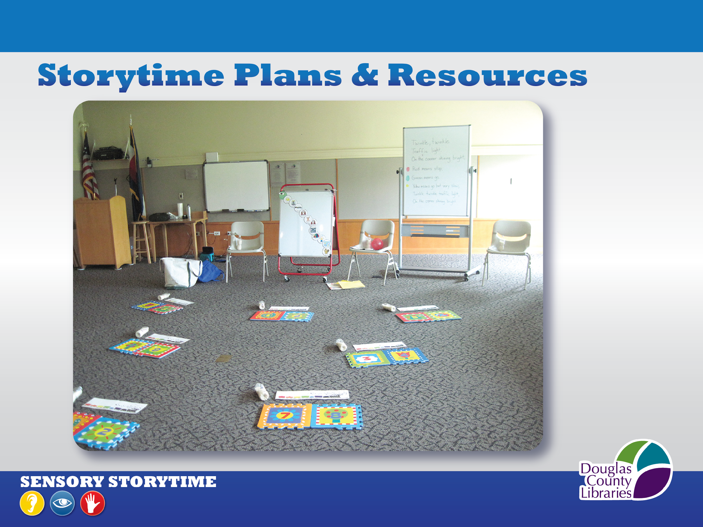
Notes:
Storytime Plans: Laura and I along with 2 colleagues from around the district adapted traditional storytime plans to include multi-sensory elements: simultaneous story and flannelboard, scents, textures, sounds, movements, and interactive elements. Volunteers helped us create adapted books, storybook images on craft sticks, feltboard stories. (Show examples of adapted book, craft stick image and flannelboard.)
We adapted the Space according to the Autism Society’s recommendations:
No push pins, pencils, paper clips, etc. on floor or any surfaces
No fluorescent lights—can be distracting so we use mostly natural light
No ceiling fans running
Block or remove climbing hazards—such as stacks of chairs.
We have an alarmed exit door so they suggested we have a volunteer whose main job is to keep eye on door.

Slide 8
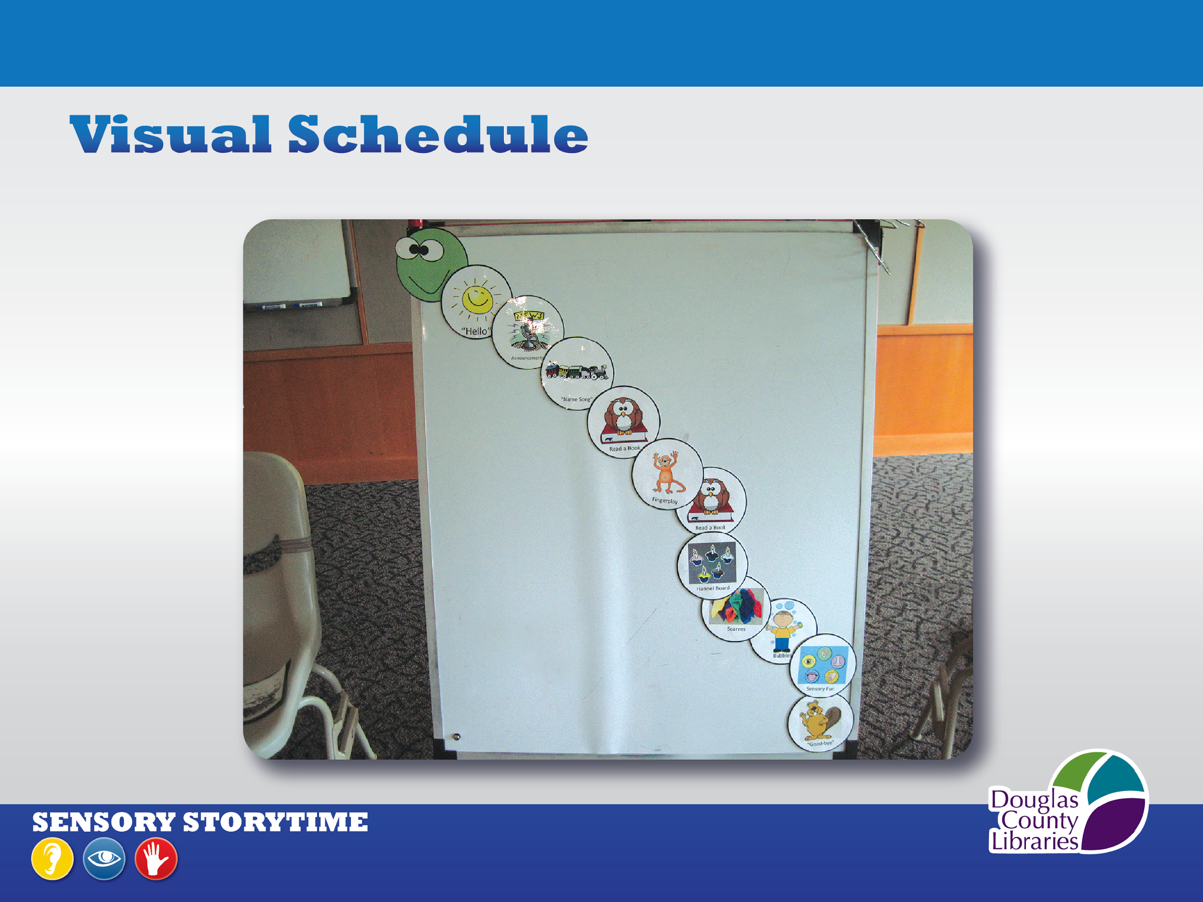
Notes:
We made a Visual Schedule: Friendly caterpillar face and clip-art images for storytime activities- Read a Book, Sing a Song, Fingerplay, Flannelboard story, Bubbles, Parachute. This schedule really helps everyone in the room know exactly what comes next. For example a parent or caregiver knows thy have time for a potty break before we bring out the parachute. You can google “Visual Schedule” and find many ideas and resources

Slide 9
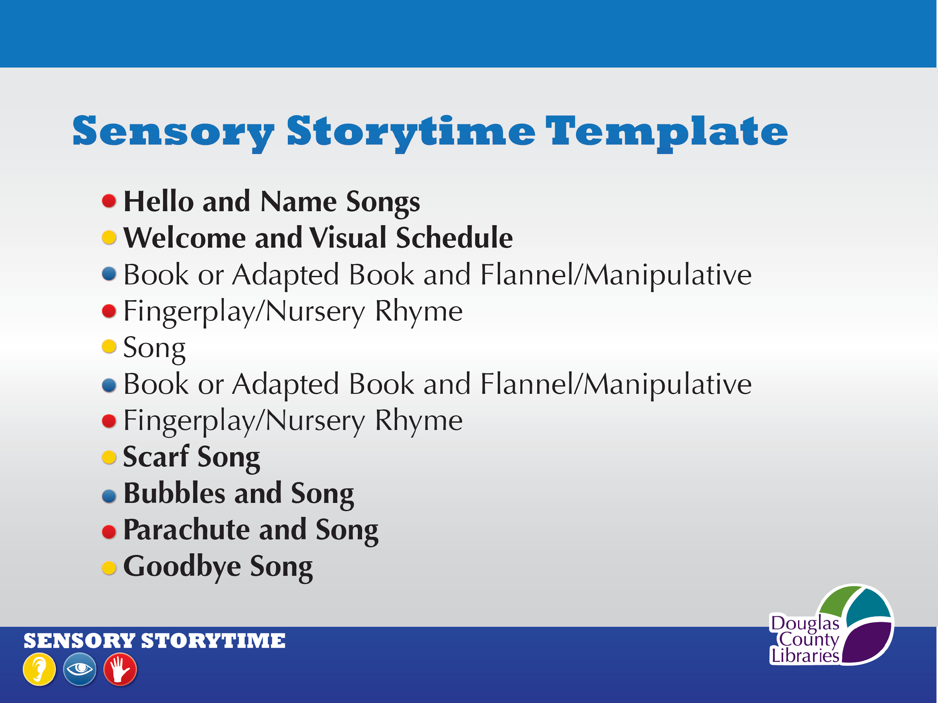
Notes:
Here is the sensory storytime model that we follow each week.
The parts that we repeat at each session are in bold.
Repetition is an important thing to do in sensory storytime.
Its importance may not be immediately apparent, but over time, we know that kids who, after attending storytime for months and not actively participating, begin to suddenly sing our regular songs, or mimic our movements, or begin to participate in the Bubbles and Parachute activities.
Repetition is important for all kids as they learn, and seeing our kids learning thru what we repeat at sensory storytime keeps us singing the same songs even when we are tired of them, because the kids benefit so much.

Slide 10
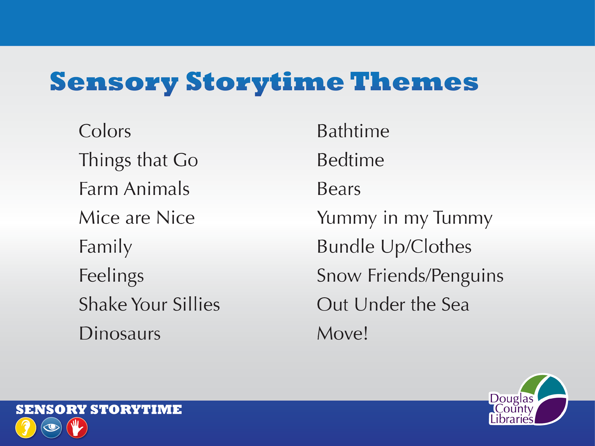
Notes:
Here are the weekly themes that we started with.
They probably look familiar to you, and the good news is that they adapt
beautifully when sensory experiences are added for a sensory storytime .
We have found that books you can sing, and pop-up and lift-the-flap books, help our kids stay engaged.
They help because as they sing or lift a flap, they use multiple areas of their brains and that helps them use their strengths to stay involved and learn.
Based on this experience, we encourage you to include them in your sensory storytimes.
And here are just a few examples of storytime books to sing. (next slide)

Slide 11
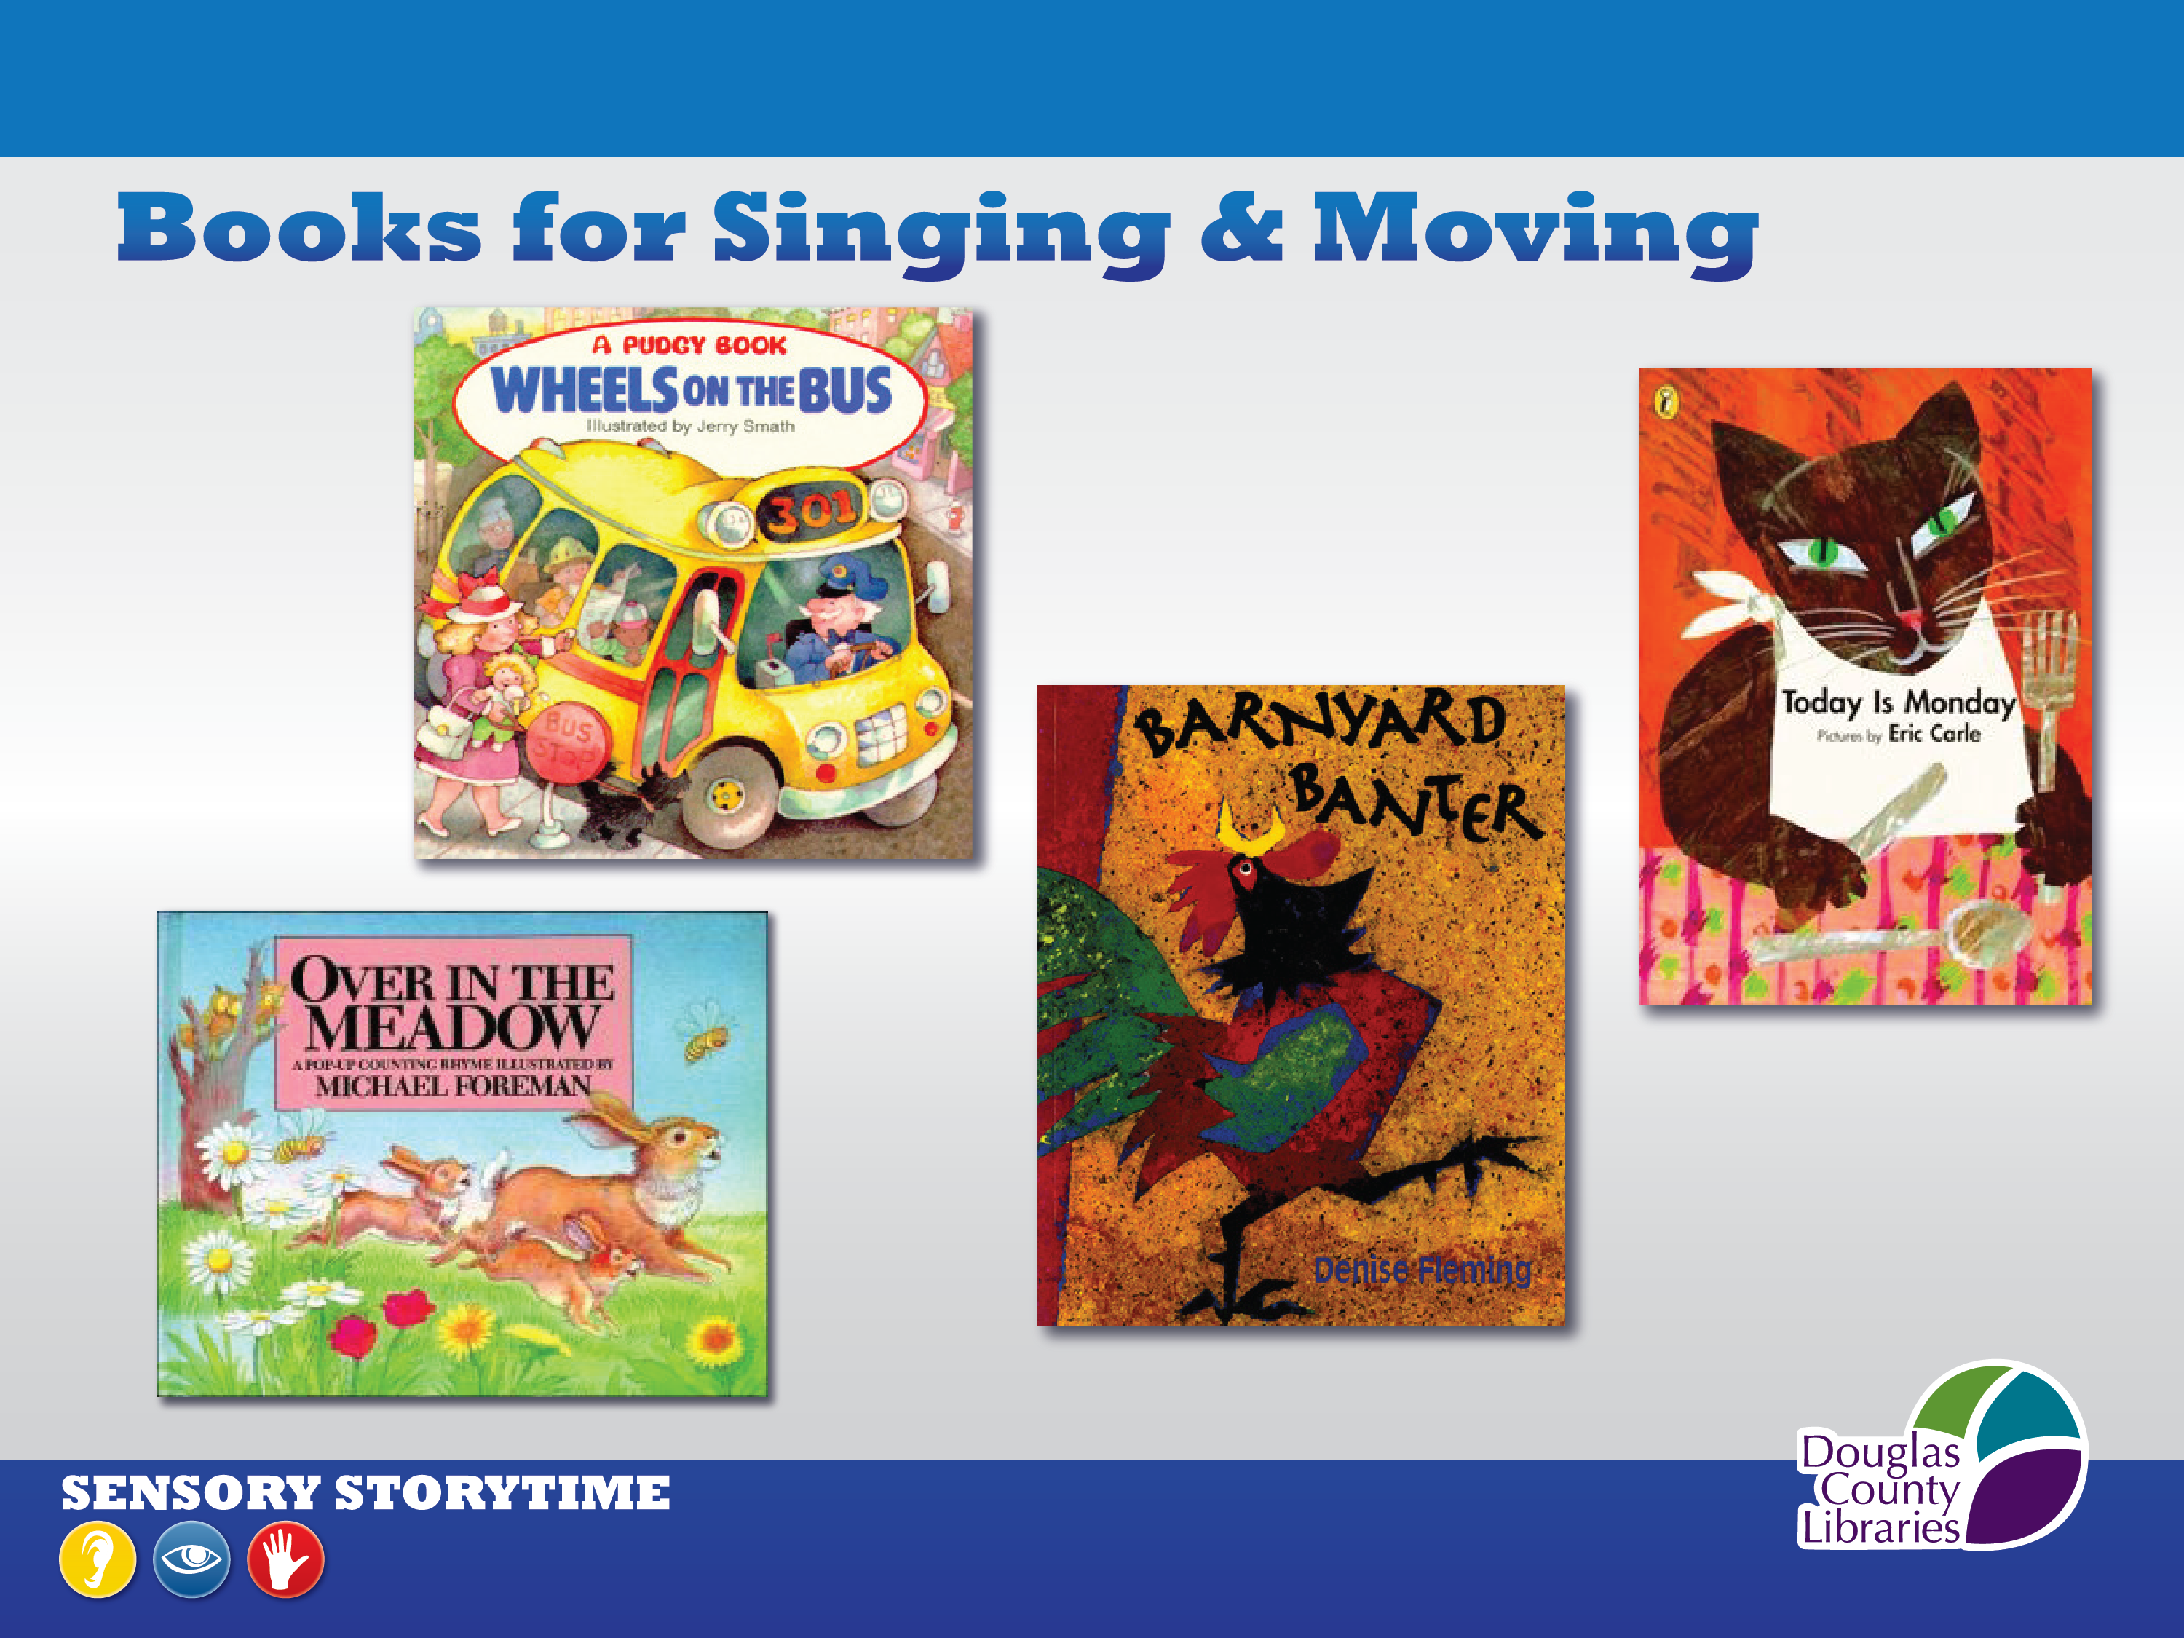
Notes:
Here are just four of the books that are great for singing and getting the kids to move.
There are many others, by authors such as Iza Trapani, Jane Cabrera, Lindsey Craig, and more.
Which books &/or music do you like to include in storytimes to encourage movement and participation?

Slide 12
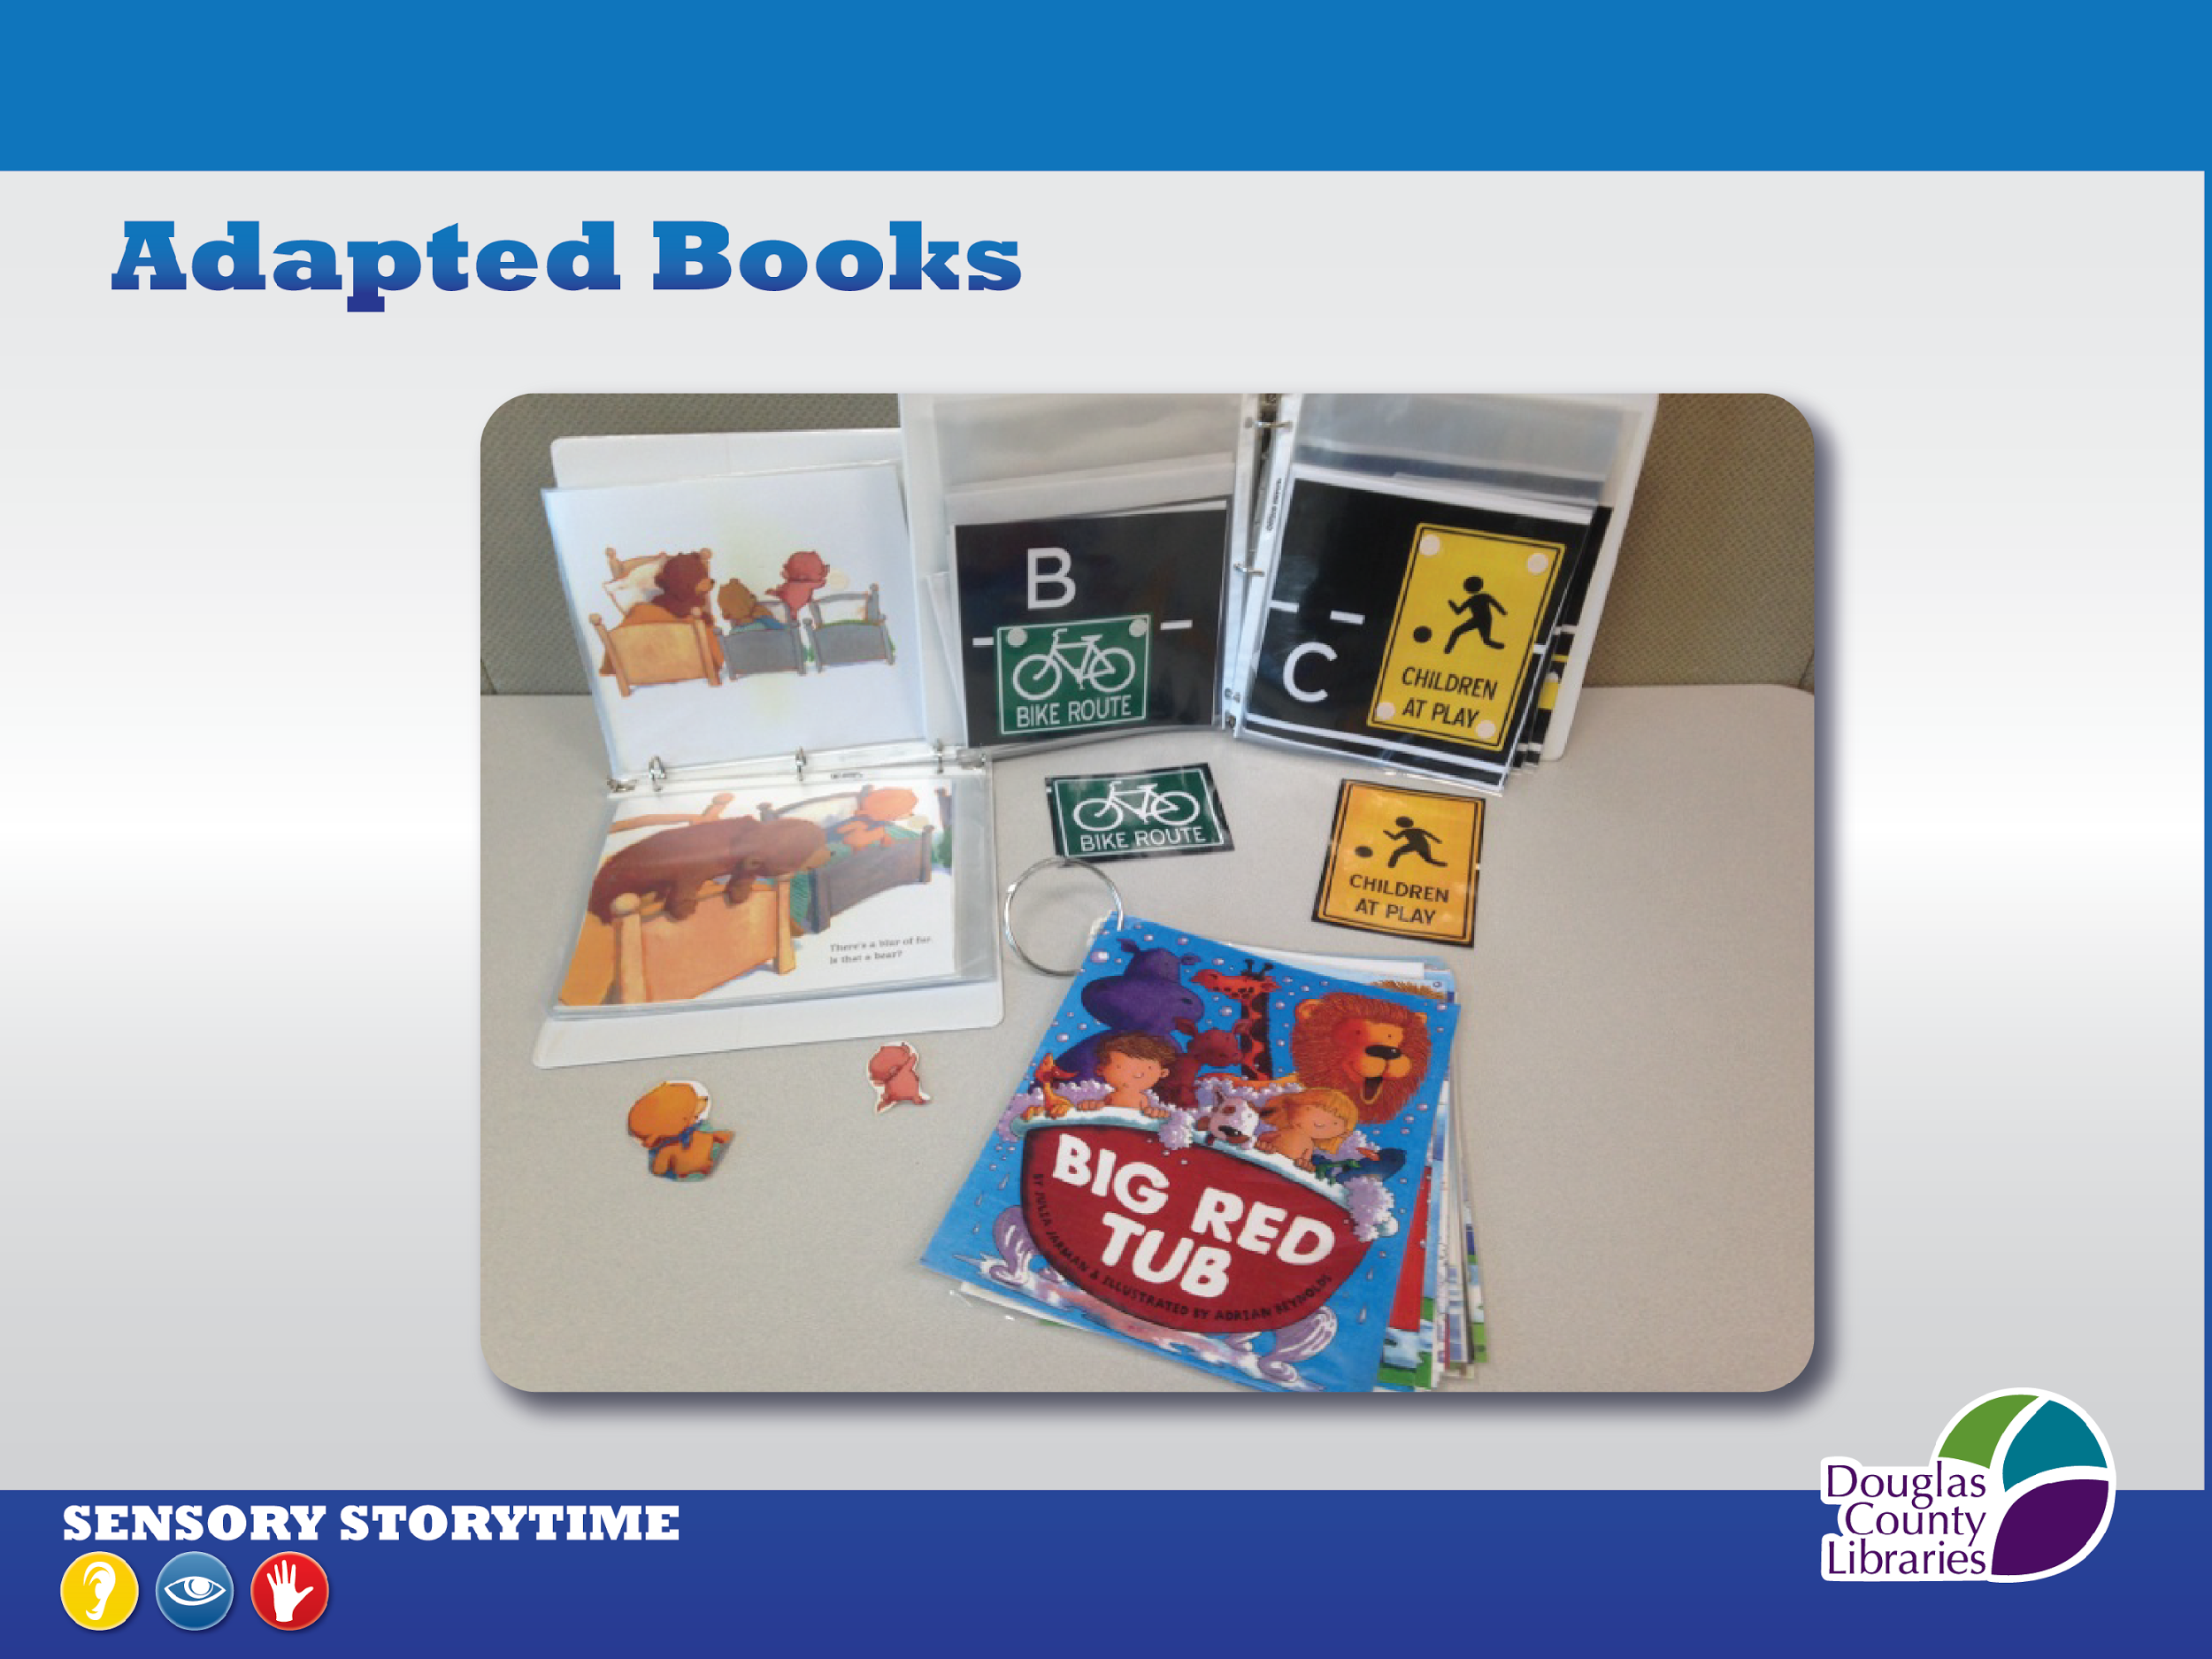
Notes:
We call these our adapted books.
We make them by copying the pages of a picture storybook, inserting each page into a protective sleeve, and binding them into a 3-ring binder.
Next we make copies of selected images from the book, laminate them, and velcro them onto the protective sleeve on top of the same image on the page in the sleeve.
At storytime, we remove these velcroed images from the adapted book and put them onto a flannelboard.
As we read the adapted book, the kids can find the image on the flannelboard that matches the image on the page and move it from the flannelboard to on top of the original image in the sleeve.
They love it and it is another way to keep them engaged.

Slide 13
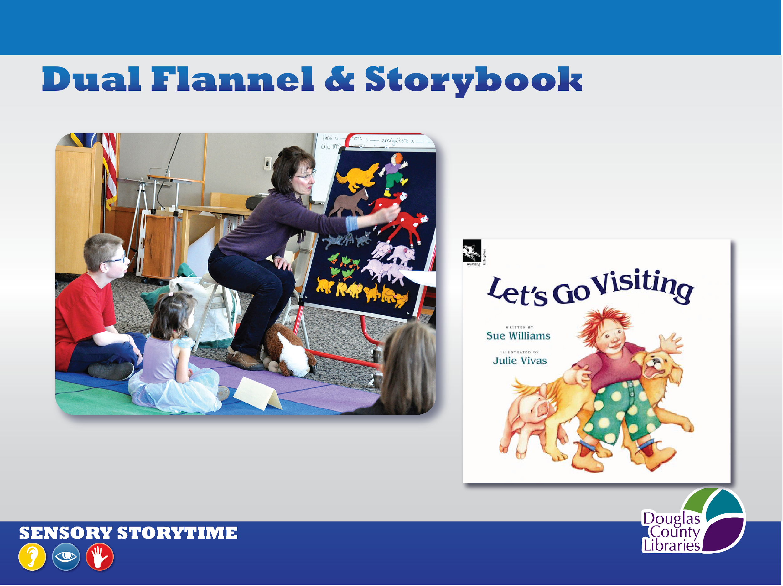
Notes:
Another way to engage the kids’ multiple senses and increase their involvement in the story is to read the story and have our volunteer create the flannel story at the same time.
Like with the adapted books, we can also place the flannel pieces on a separate flannelboard and have the kids find the correct flannel piece and put it on the volunteer’s big flannelboard as the story progresses.

Slide 14
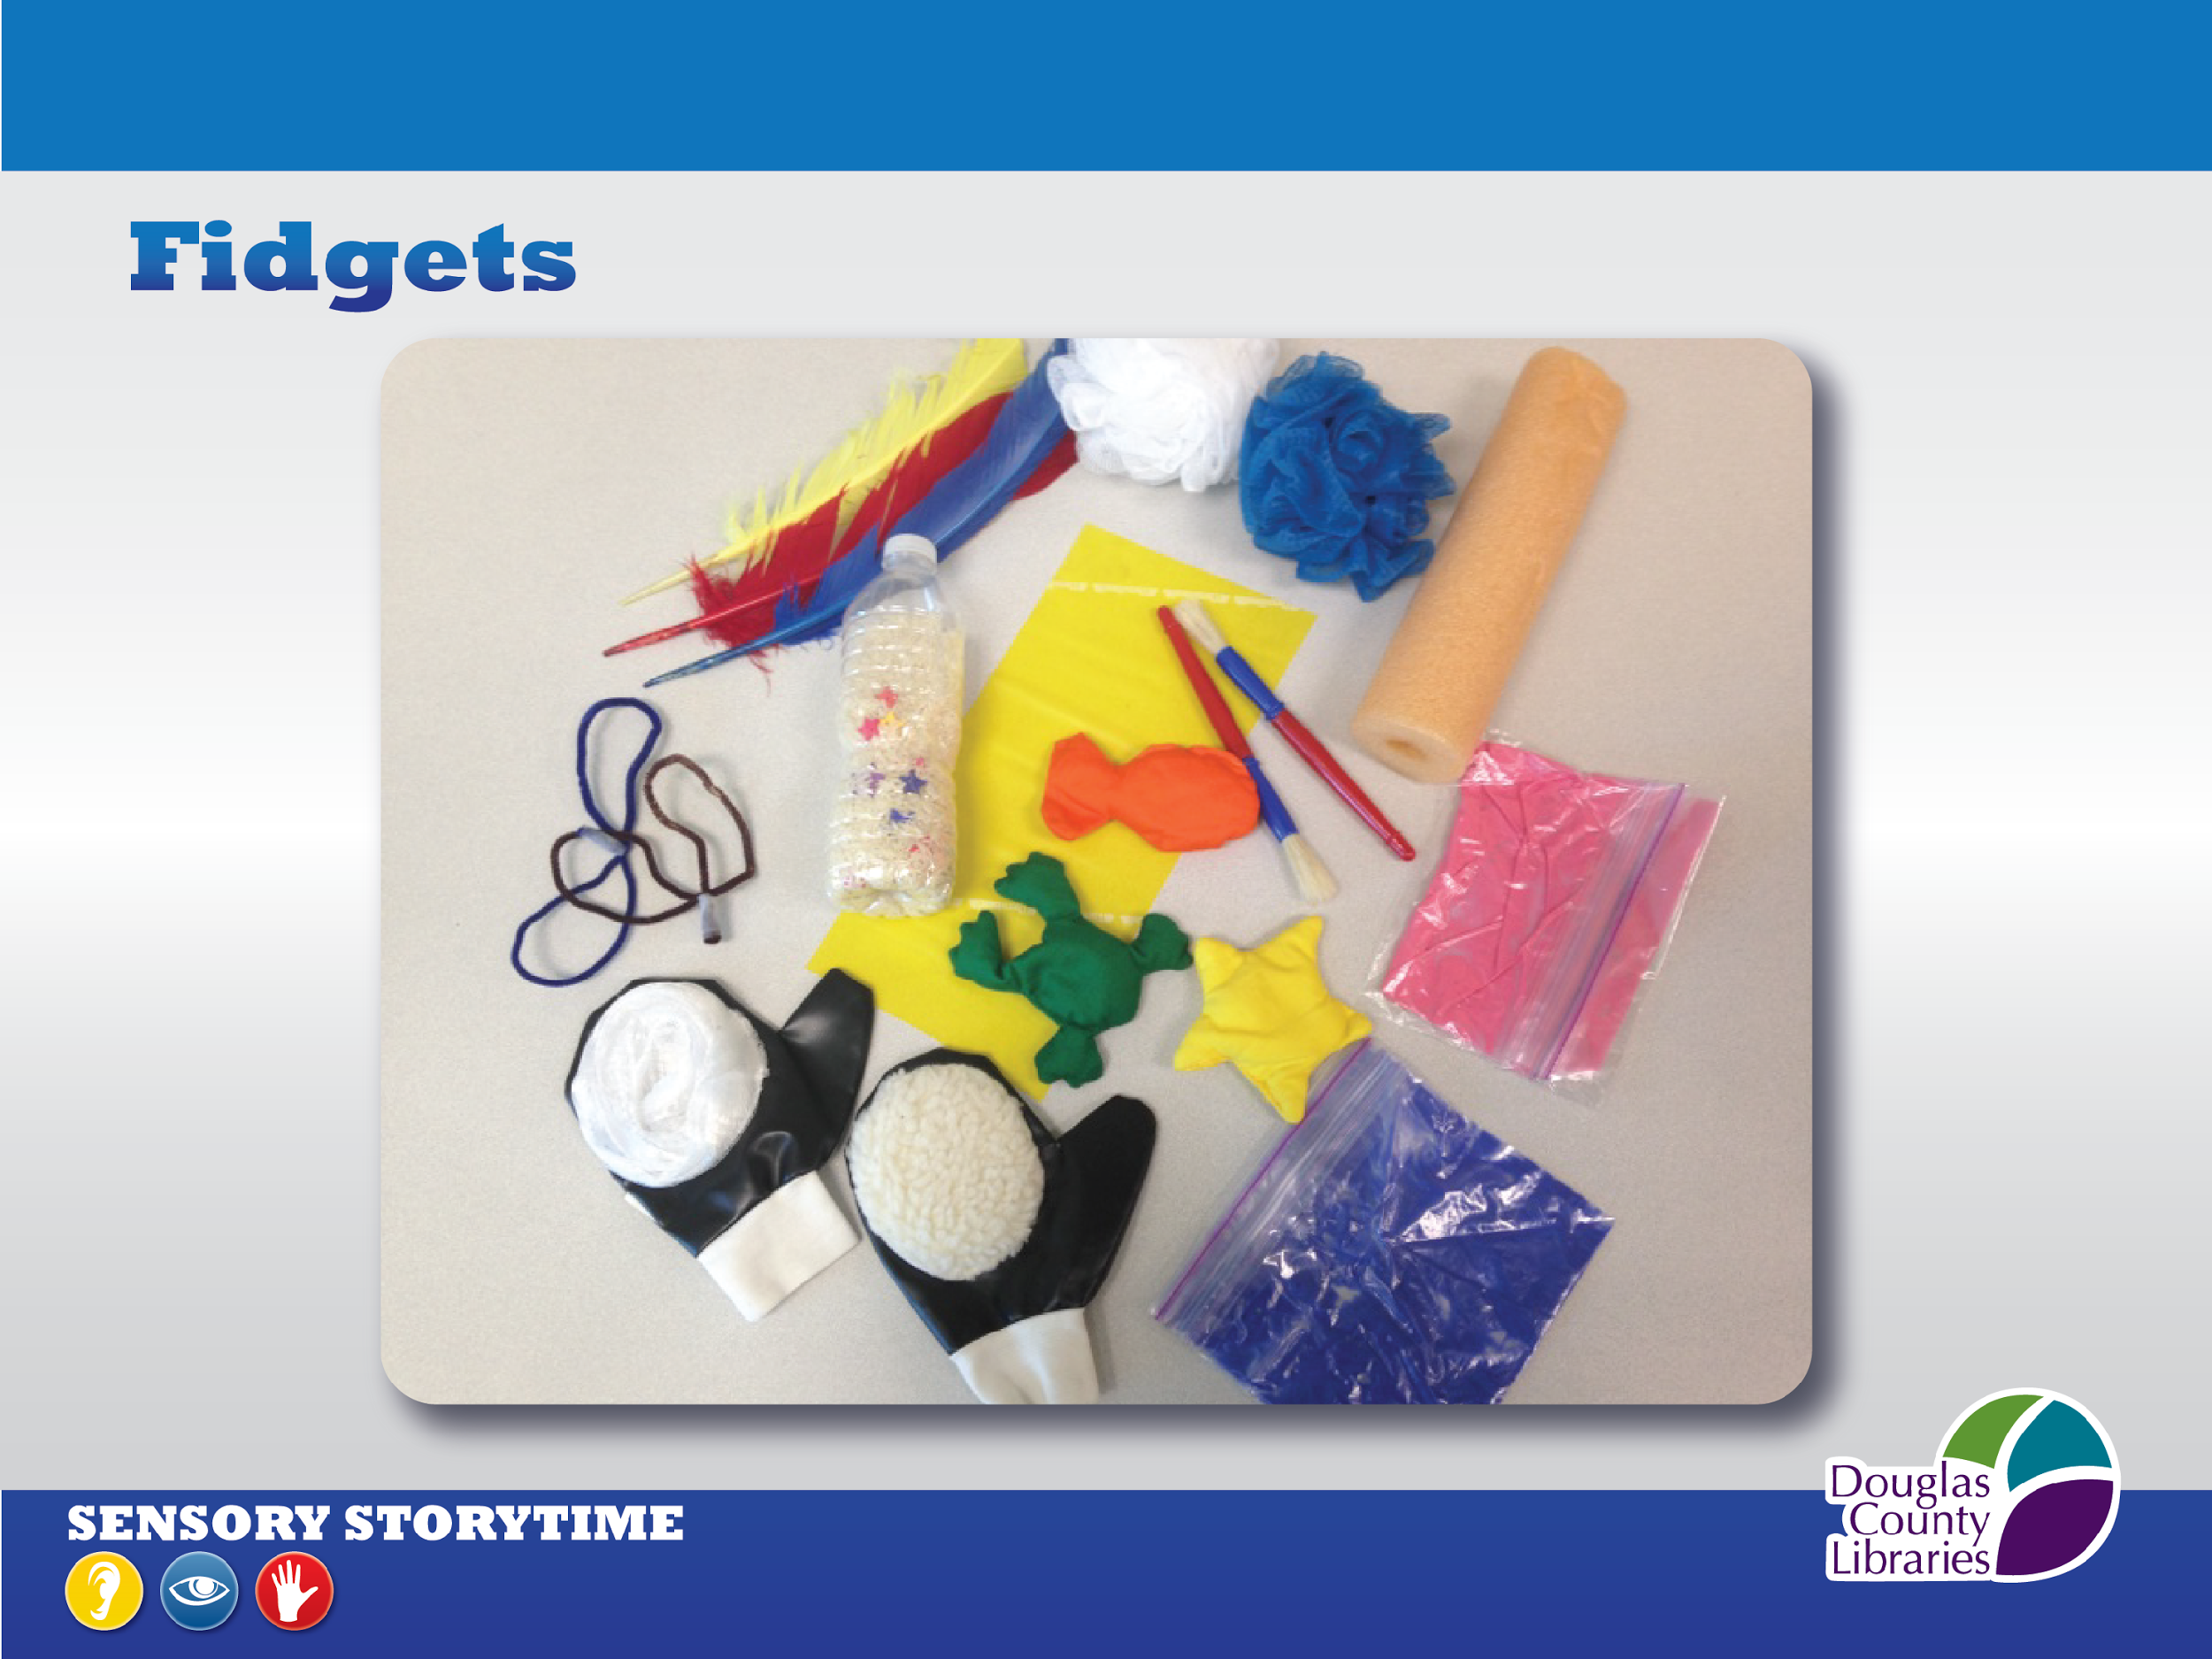
Notes:
Fidgets:
Bean bags, Thera-Bands, Shower scrubbies, Tempera paint in ziploc bags,
Chubby Paint brushes, Swim noodles, Feathers, Pipe cleaners, and more.
Lakeshore, Discount School Supply, Target

Slide 15
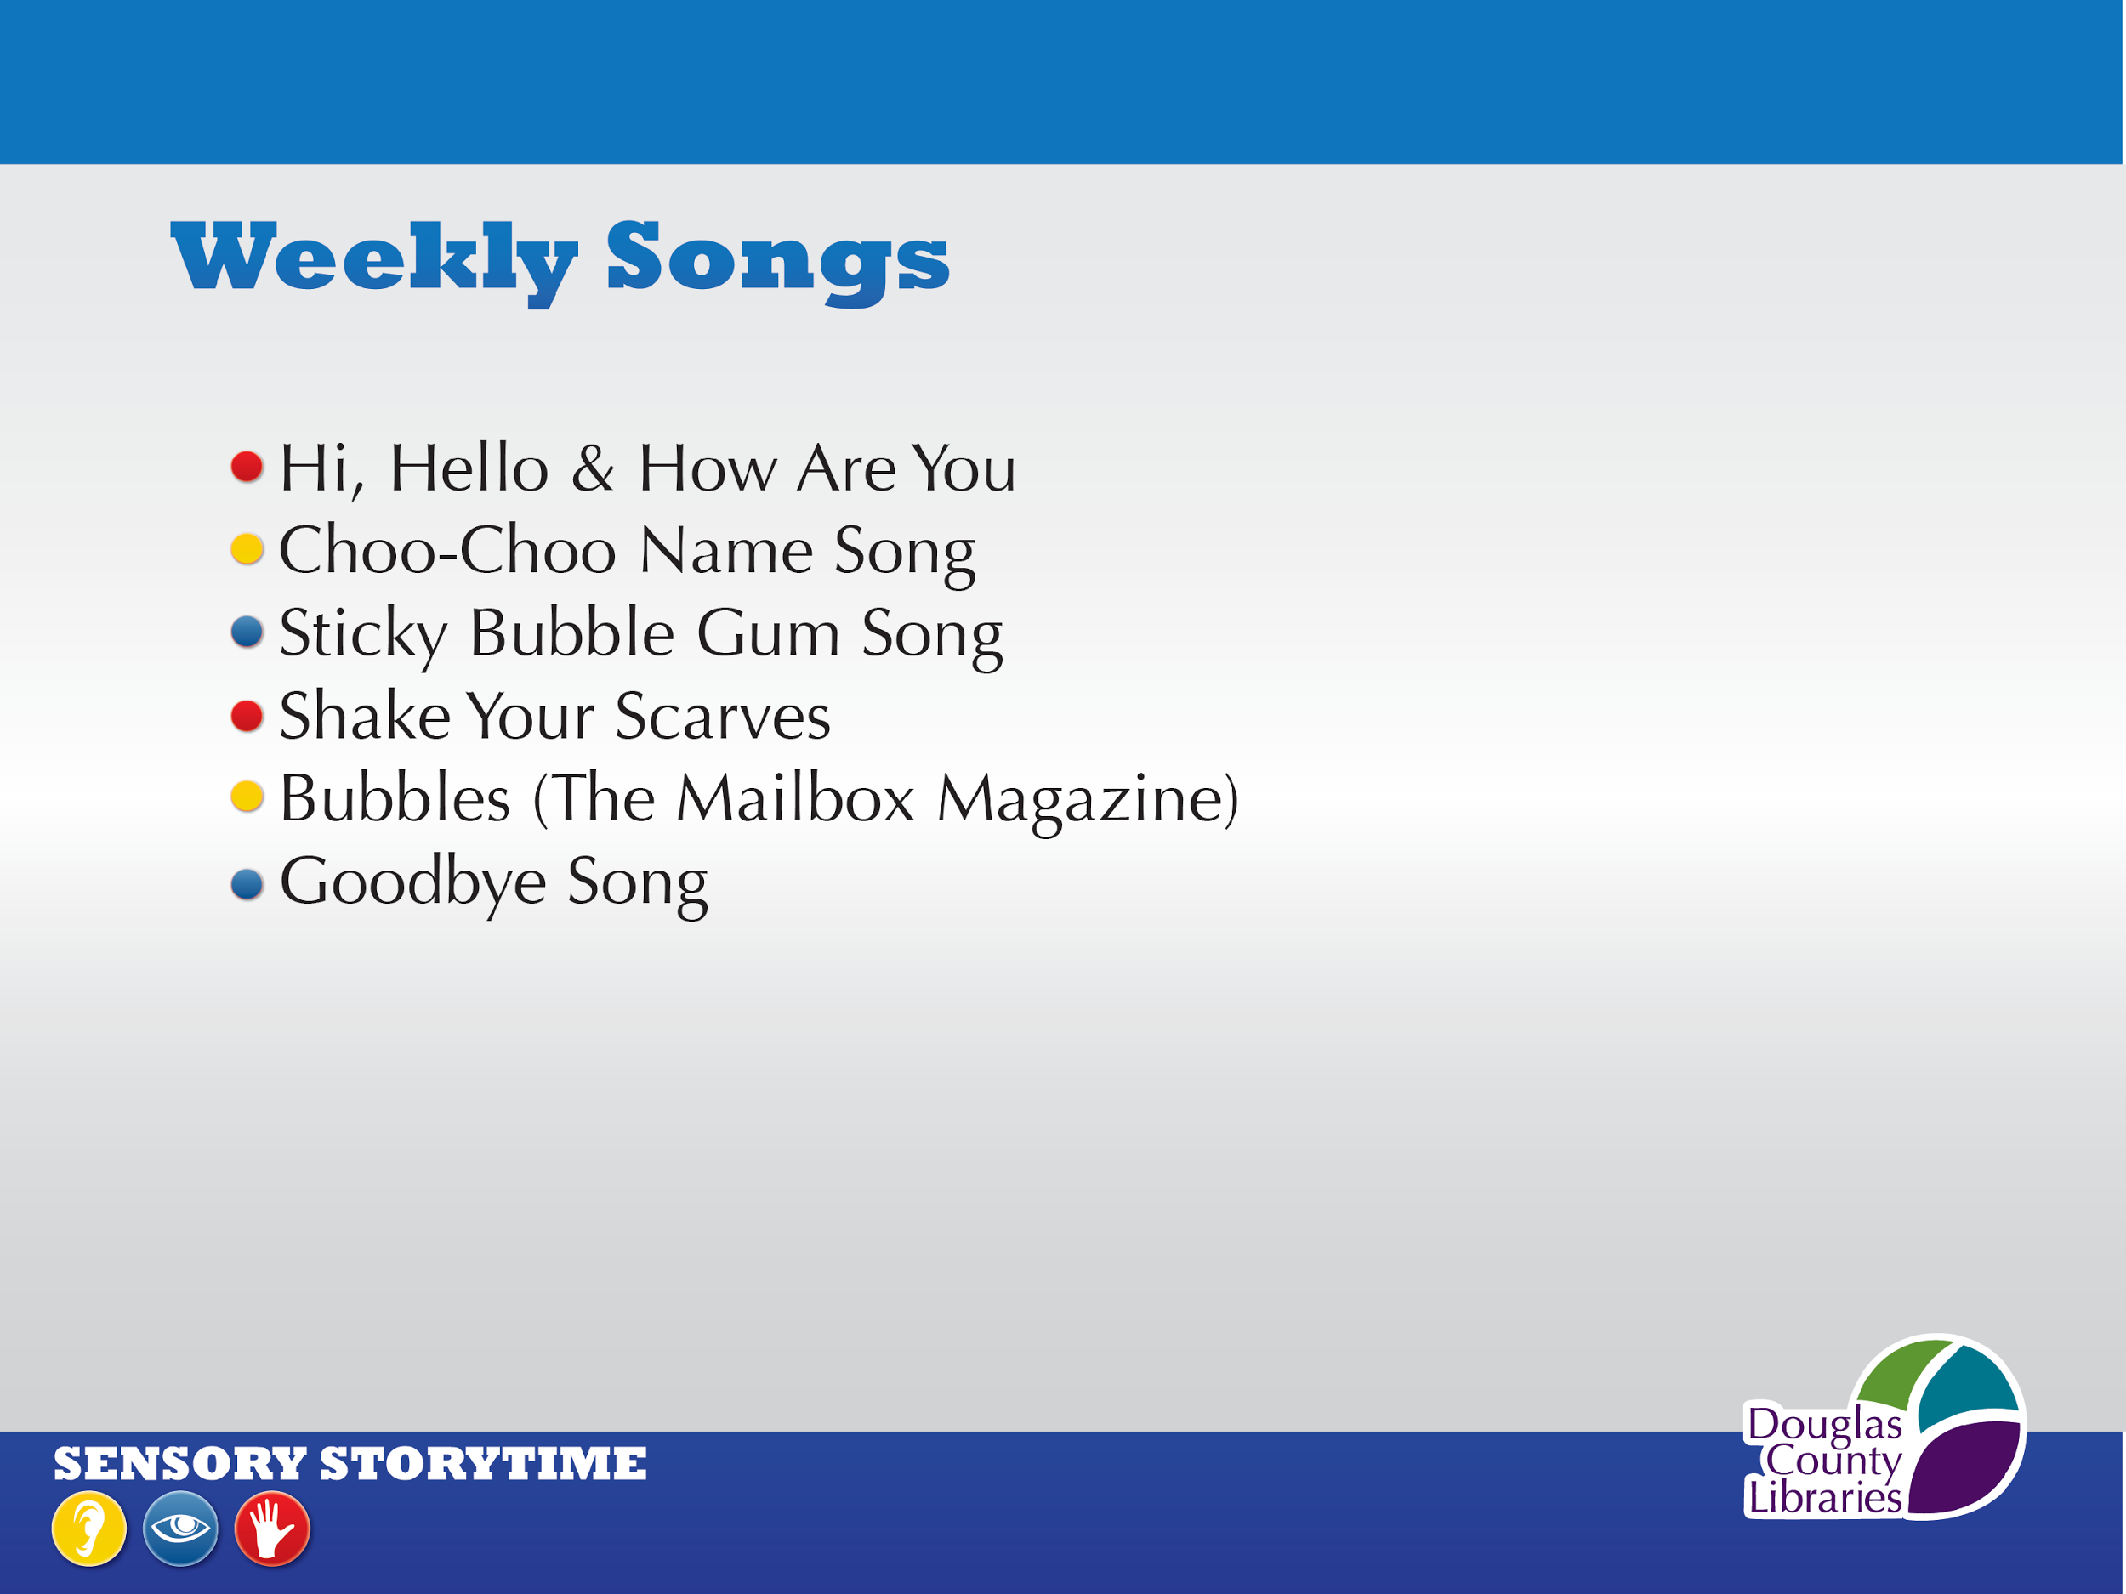
Notes:
We sing these songs weekly, and they are usually 6 of the 7 songs that we sing at a storytime, which again shows the importance that we place on repetition in sensory storytime.
Words to the songs are in our handout.
Let’s look at some of our favorite music cds on the next slide.

Slide 16
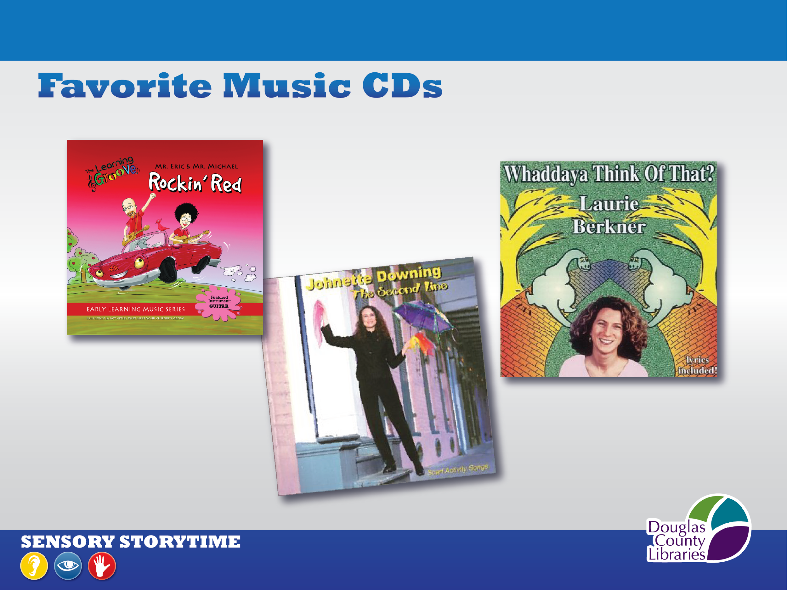
Notes:
Eric Litwin, Johnette Downing’s The Second Line (Shake Your Scarves), Laurie Berkner, Hap Palmer, Raffi, The Wiggles’ Yummy Yummy (Shaky Shaky song for parachute time) The Wiggleworms, and Jim Gill, are some of our favorite musical artists.
You for sure have others, and if you love them, the kids pick up on your enthusiasm as you sing together, so they work!

Slide 17
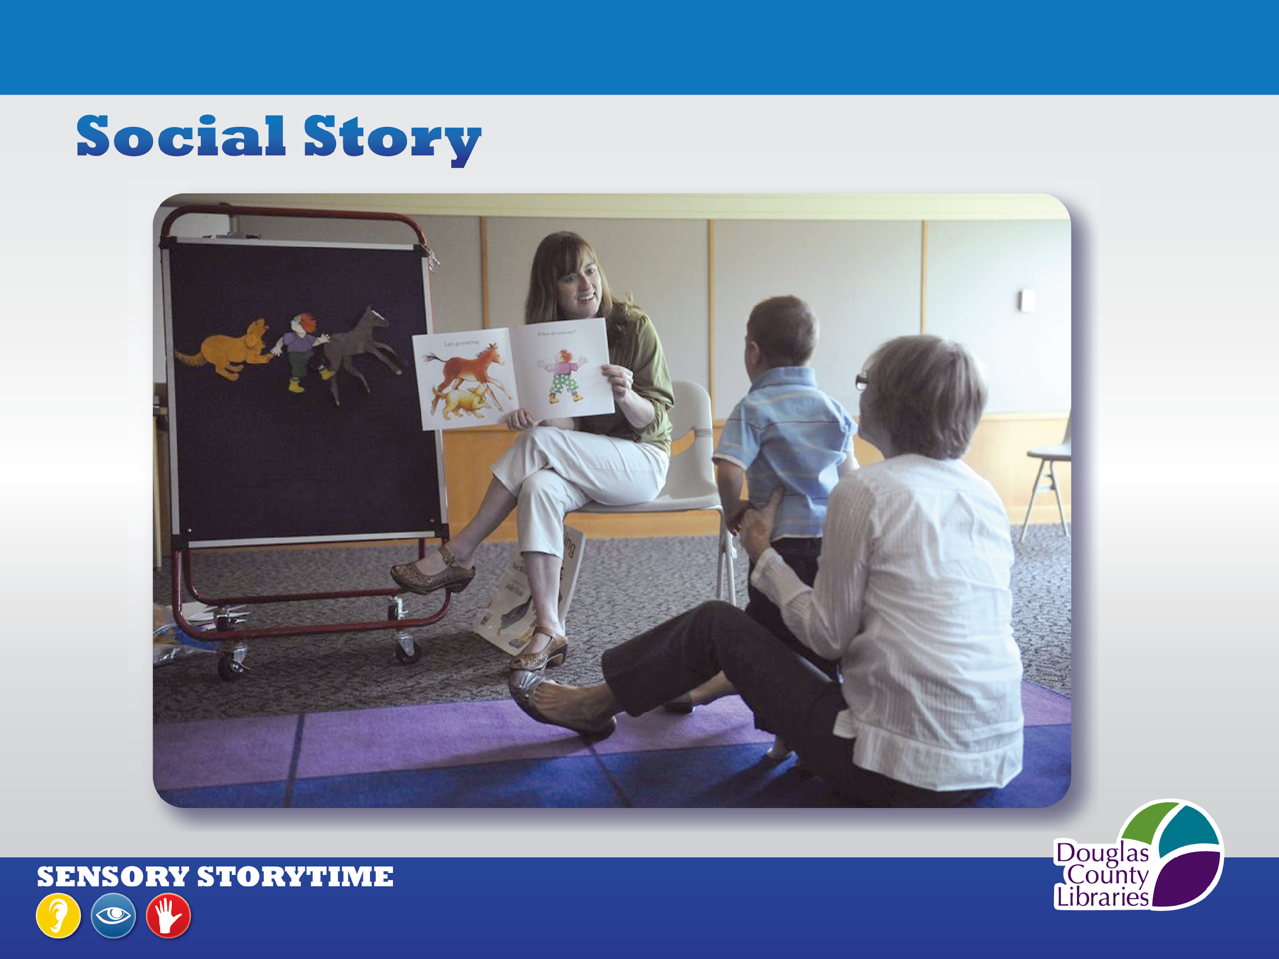
Social Story
Notes:
Social Story http://douglascountylibraries.org/storytime/sensorystorytime
WE POSTED OUR SOCIAL STORY ON OUR SENSORY ST WEB PAGE: We based our Social Story (http://DouglasCountyLibraries.org/storytime/sensorystorytime ) on the example we received from the Inclusion Collaborative of the Santa Clara County Office of Education, and we referred all registrants to it in the pre-survey we sent to them.
WE’LL PLAY OUR SOCIAL STORY NOW. The link to it is in your handout.

Slide 18
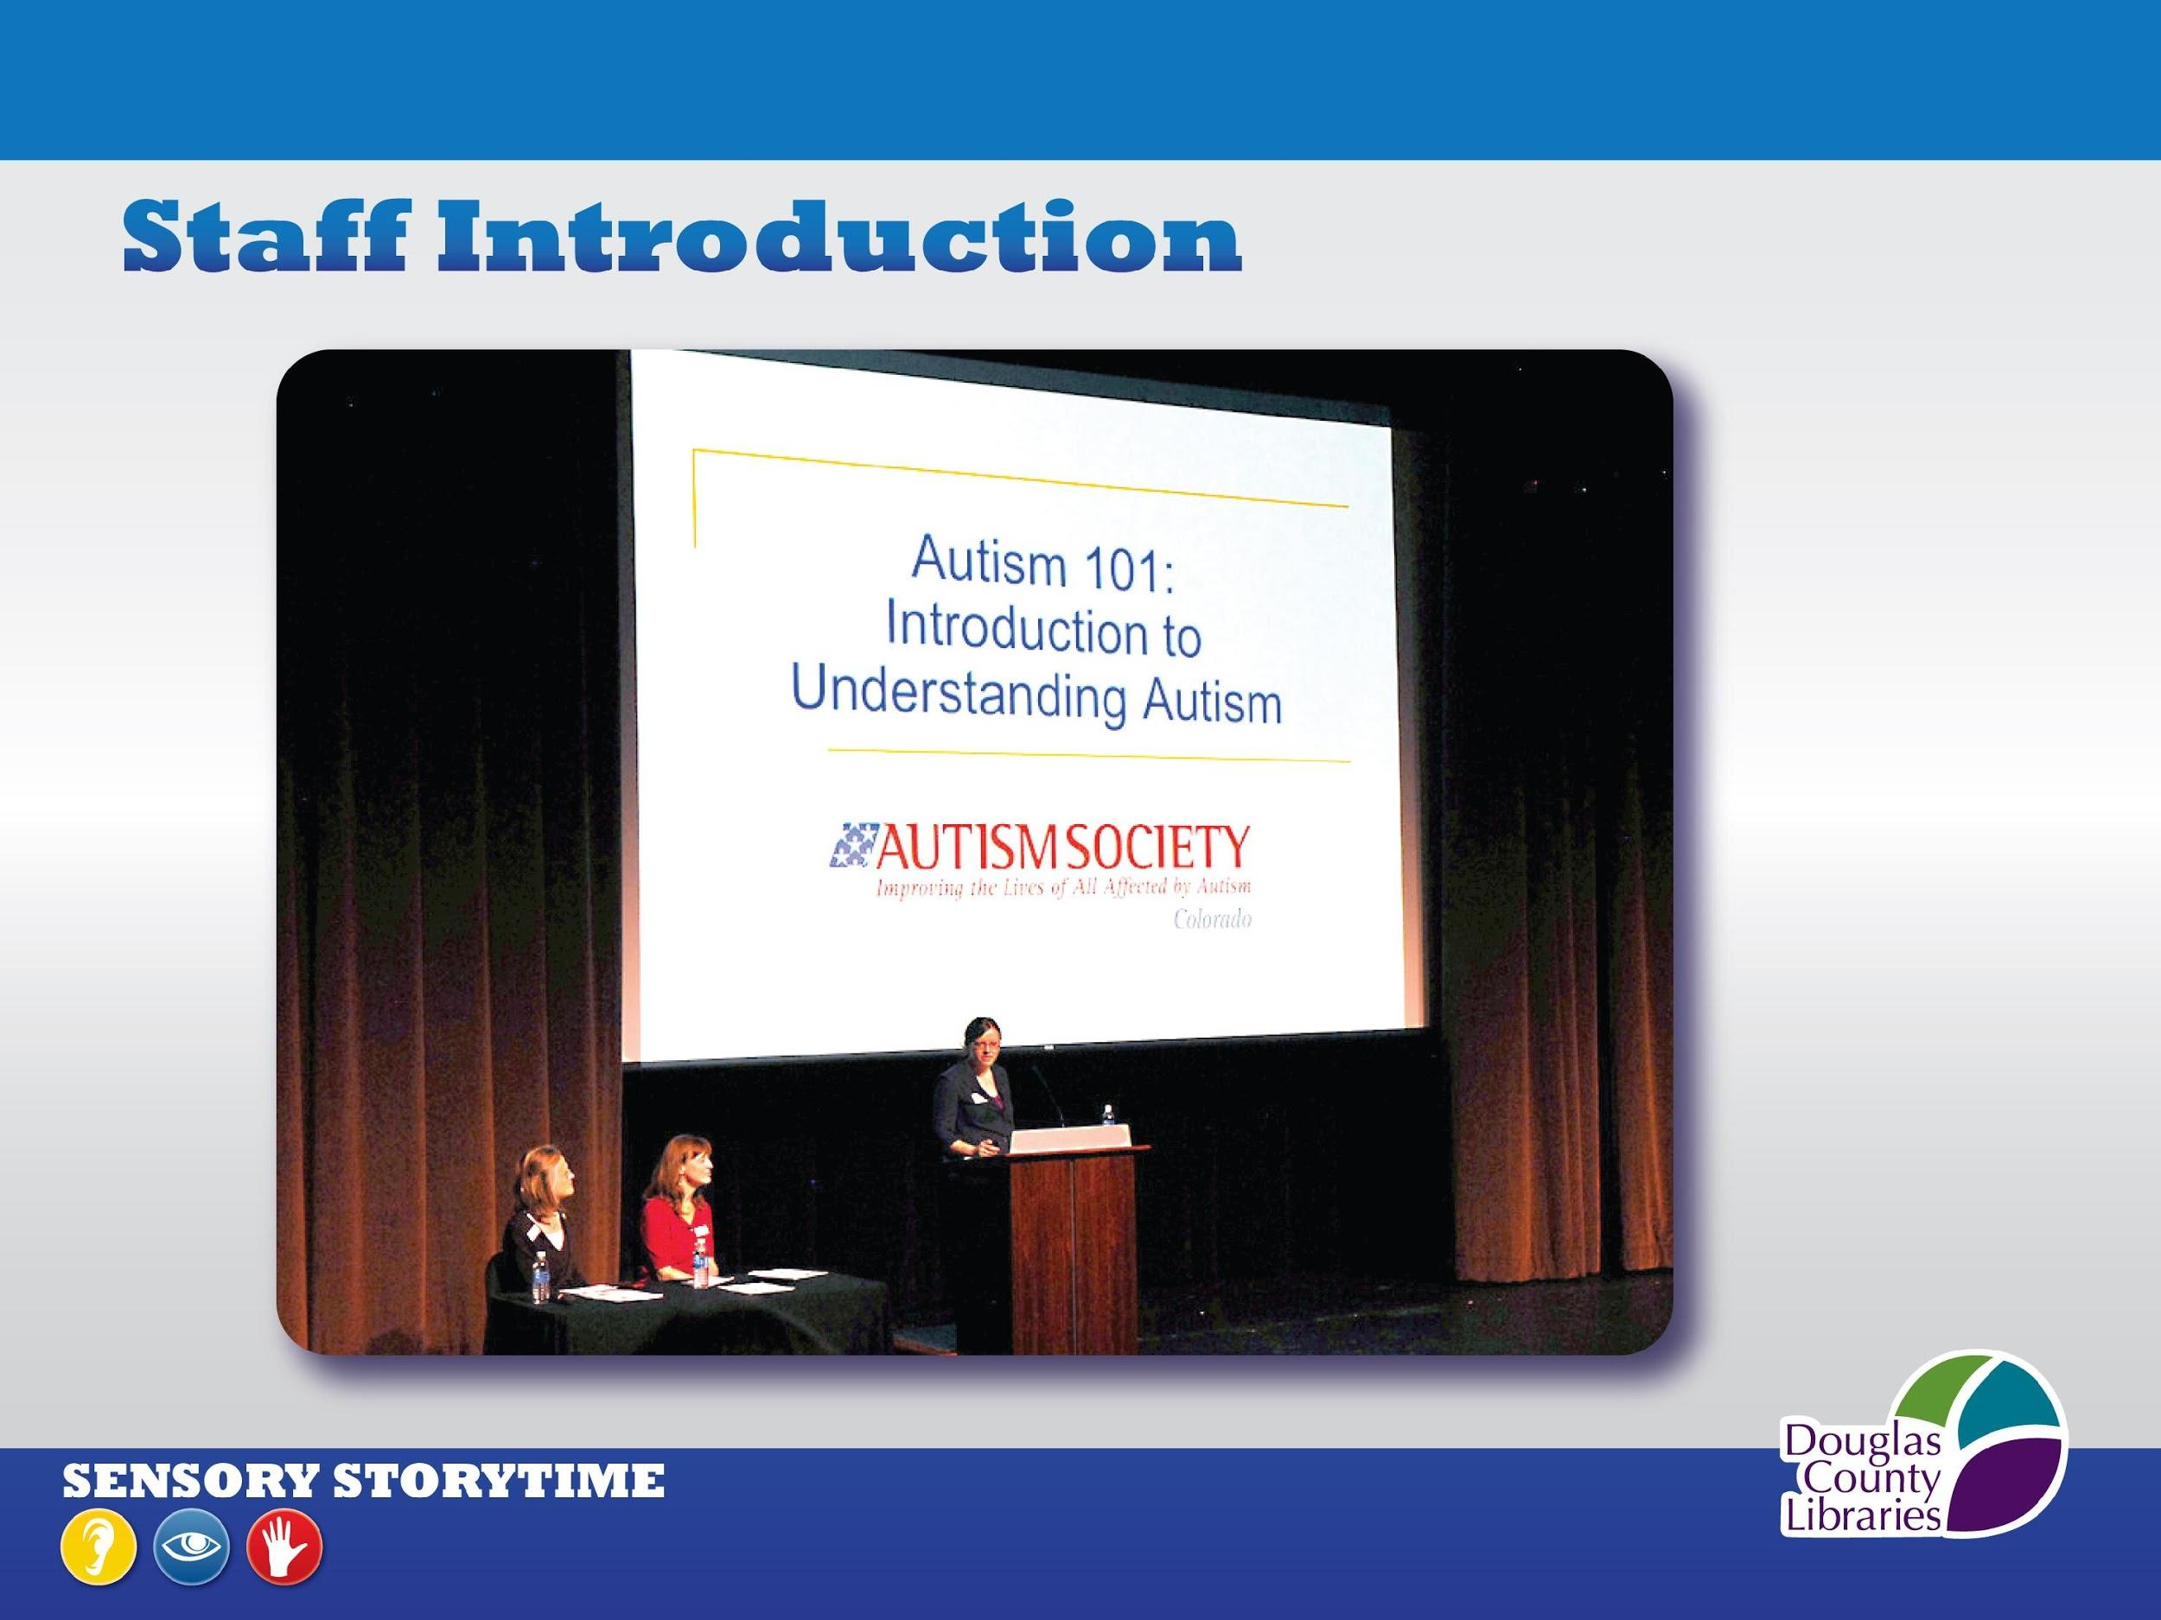
Notes:
After developing these resources, our next step was to introduce it to our all of the staff at our libraries.
This is a photo from our district’s annual Staff Day. We invited the Autism Society to present their Autism 101 slideshow, and then Laura and I and demonstrated a part of a Sensory-enhanced Storytime for everyone.
The Autism Society’s presentation gave everyone a greater understanding of autism, and we want to share some of this with you now. It is a disorder that affects the brain’s normal development, especially with social and communication skills. It is referred to as AUTISM SPECTRUM DISORDER (or ASD) because it has a wide range of symptoms, mild to severe.
It can be a co-diagnosis with other special needs, and is diagnosed four times more often in boys than girls. (And we do tend to see more boys in our storytime than girls.)
It was important to roll out this program to the entire staff for 3 reasons:
It helps all of us serve our patrons with special needs
It got them talking about it, and they helped spread the word about this new program.
The result was we all had increased confidence when serving this population.
Here is just some of what we learned from the Autism Society. (next slide)

Slide 19
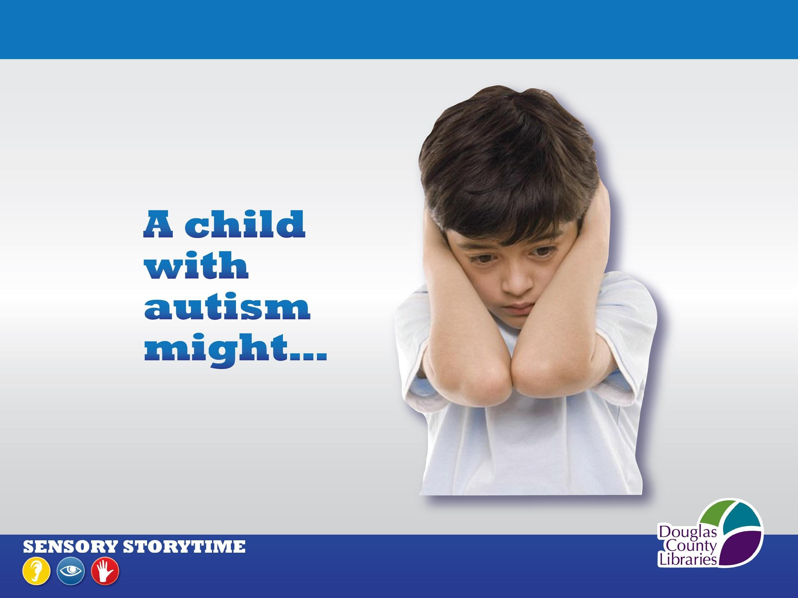
Notes:
Now we want to share with you the very useful info on the Signs of Autism that the
Autism 101 presentation taught us:
The Autism Society has identified recognizable signs of ASD that you may observe in a storytime, so we want to share them with you now:
A person with autism-
May avoid eye contact & being touched
May stare at lights, ceiling fans, hands, or other objects
May have repetitive behaviors such as hand flapping, body rocking, spinning
May have unusual vocalizations such as echolalia, or may be completely non-verbal
May not smile back at you
May be socially awkward & not pick up on social cues
May not respond to his/her name and can appear to be deaf
A person with autism-
May have strong responses to sound, light, smell, temperature or touch, signs of a Sensory Processing Disorder. This is why we keep lights low and ceiling fans off
Thinks literally, uses literal language, and may not understand jokes/sarcasm. This is why we avoid stories with metaphors
May insist on routines & have great difficulty with transitions. This is why we include the Visual Schedule and repeat specific storytime activities each week.
This knowledge greatly increased our understanding of our participants and helped us to relax and enjoy the experience with them. It helped us to begin offering sensory storytime with confidence.

Slide 20
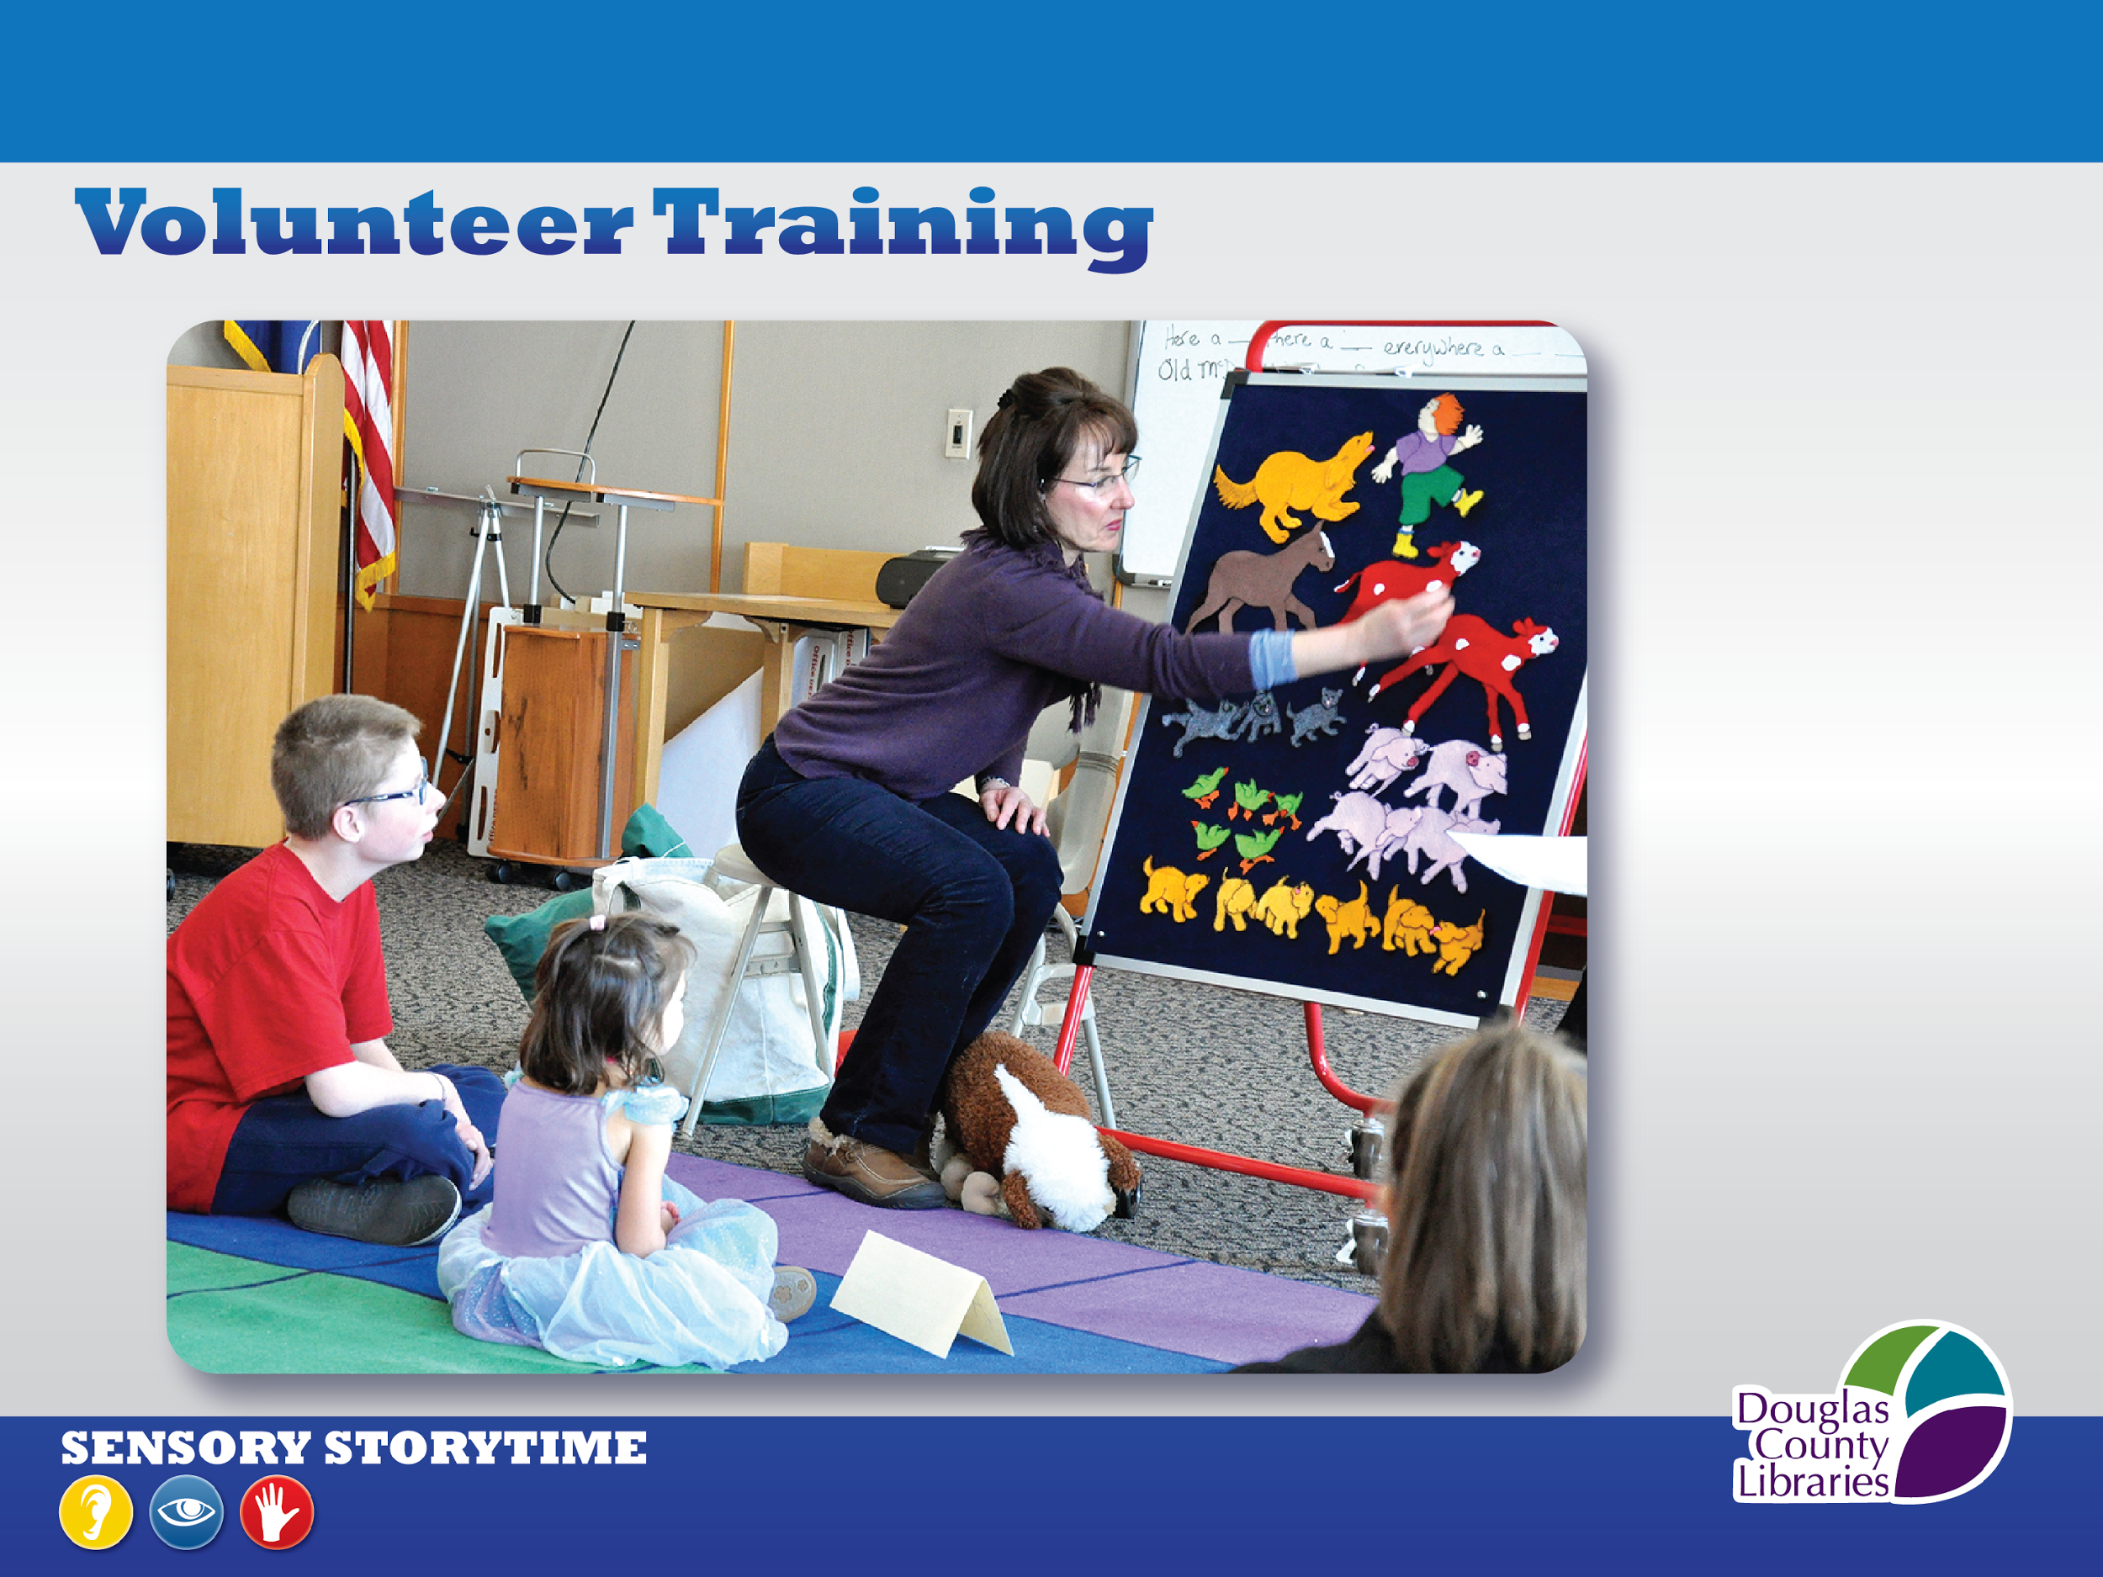
Notes:
We couldn’t do this program without our regular volunteers. Including them is the biggest difference from our traditional storytimes.
Why use volunteers? The bring experiences, knowledge, resources, ideas you would not otherwise get/ additional hands, eyes and hearts/ recommended by Autism Society to have minimum 2 vols. due to size of room, two doors, size of audience.
We look for volunteers who are calm, friendly, compassionate, flexible, multigenerational, committed, self-aware.
Retired teachers, therapists, or people with other experiences with the special needs population are superb sensory storytime volunteers but not necessary.
Our branch has a volunteer coordinator so she recruited, screened with a background check, and helped train our core volunteers.
Describe volunteer training:
Showed part of Autism 101 slideshow with Autism Society’s permission / Explain expectations (6-month commitment, Roles, Not disciplinarians) and demonstrated a sensory-enhanced storytime.
An unexpected positive result of including volunteers has been the relationships developed between our volunteers & participants. For example, Christopher here loves Shannon the volunteer. I’m pretty much chopped liver—he’s way more excited to see Shannon than me. Many hugs and even small gifts have been exchanged between our volunteers and participants.

Slide 21

Notes:
We began offering our sensory storytime with a Pilot Program to help us:
Determine the best days and times to offer it / determine our likely audience / understand the effectiveness of each part of the storytime / adjust it based on our pilot experiences and parent recommendations / and to develop additional sensory-rich fidgets and activities
OUR PILOT ran for 3 months on differing days of the week each month.
From our first session we had siblings, extended family, and medical therapists attend with the children.
WE GAVE ALL PARTICIPANTS DURING THE PILOT OUR PRE- & POST-SURVEYS that provided us with recommendations that we adopted, such as:
To email storytime plan prior to the storytime to familiarize the children with it ahead of the session / and to not make changes in the storytime for their children because storytime helps them learn to follow directions and participate in group activities
WE OFFERED A RESOURCE TABLE at each sensory storytime during the pilot, with information on Library programs, local special needs resources, and community events
One of our realizations during the pilot was that our focus during the development stage had been on young children with autism, but that youth of all ages and with varied diagnoses, were attending. Importantly, we do not ask for a child’s diagnosis- our storytime is inclusive to everyone.
At the conclusion of the Pilot, we had a better understanding of our audience, their preferred days and times, and what worked in the storytime, so we set our regular schedule for the next year.

Slide 22
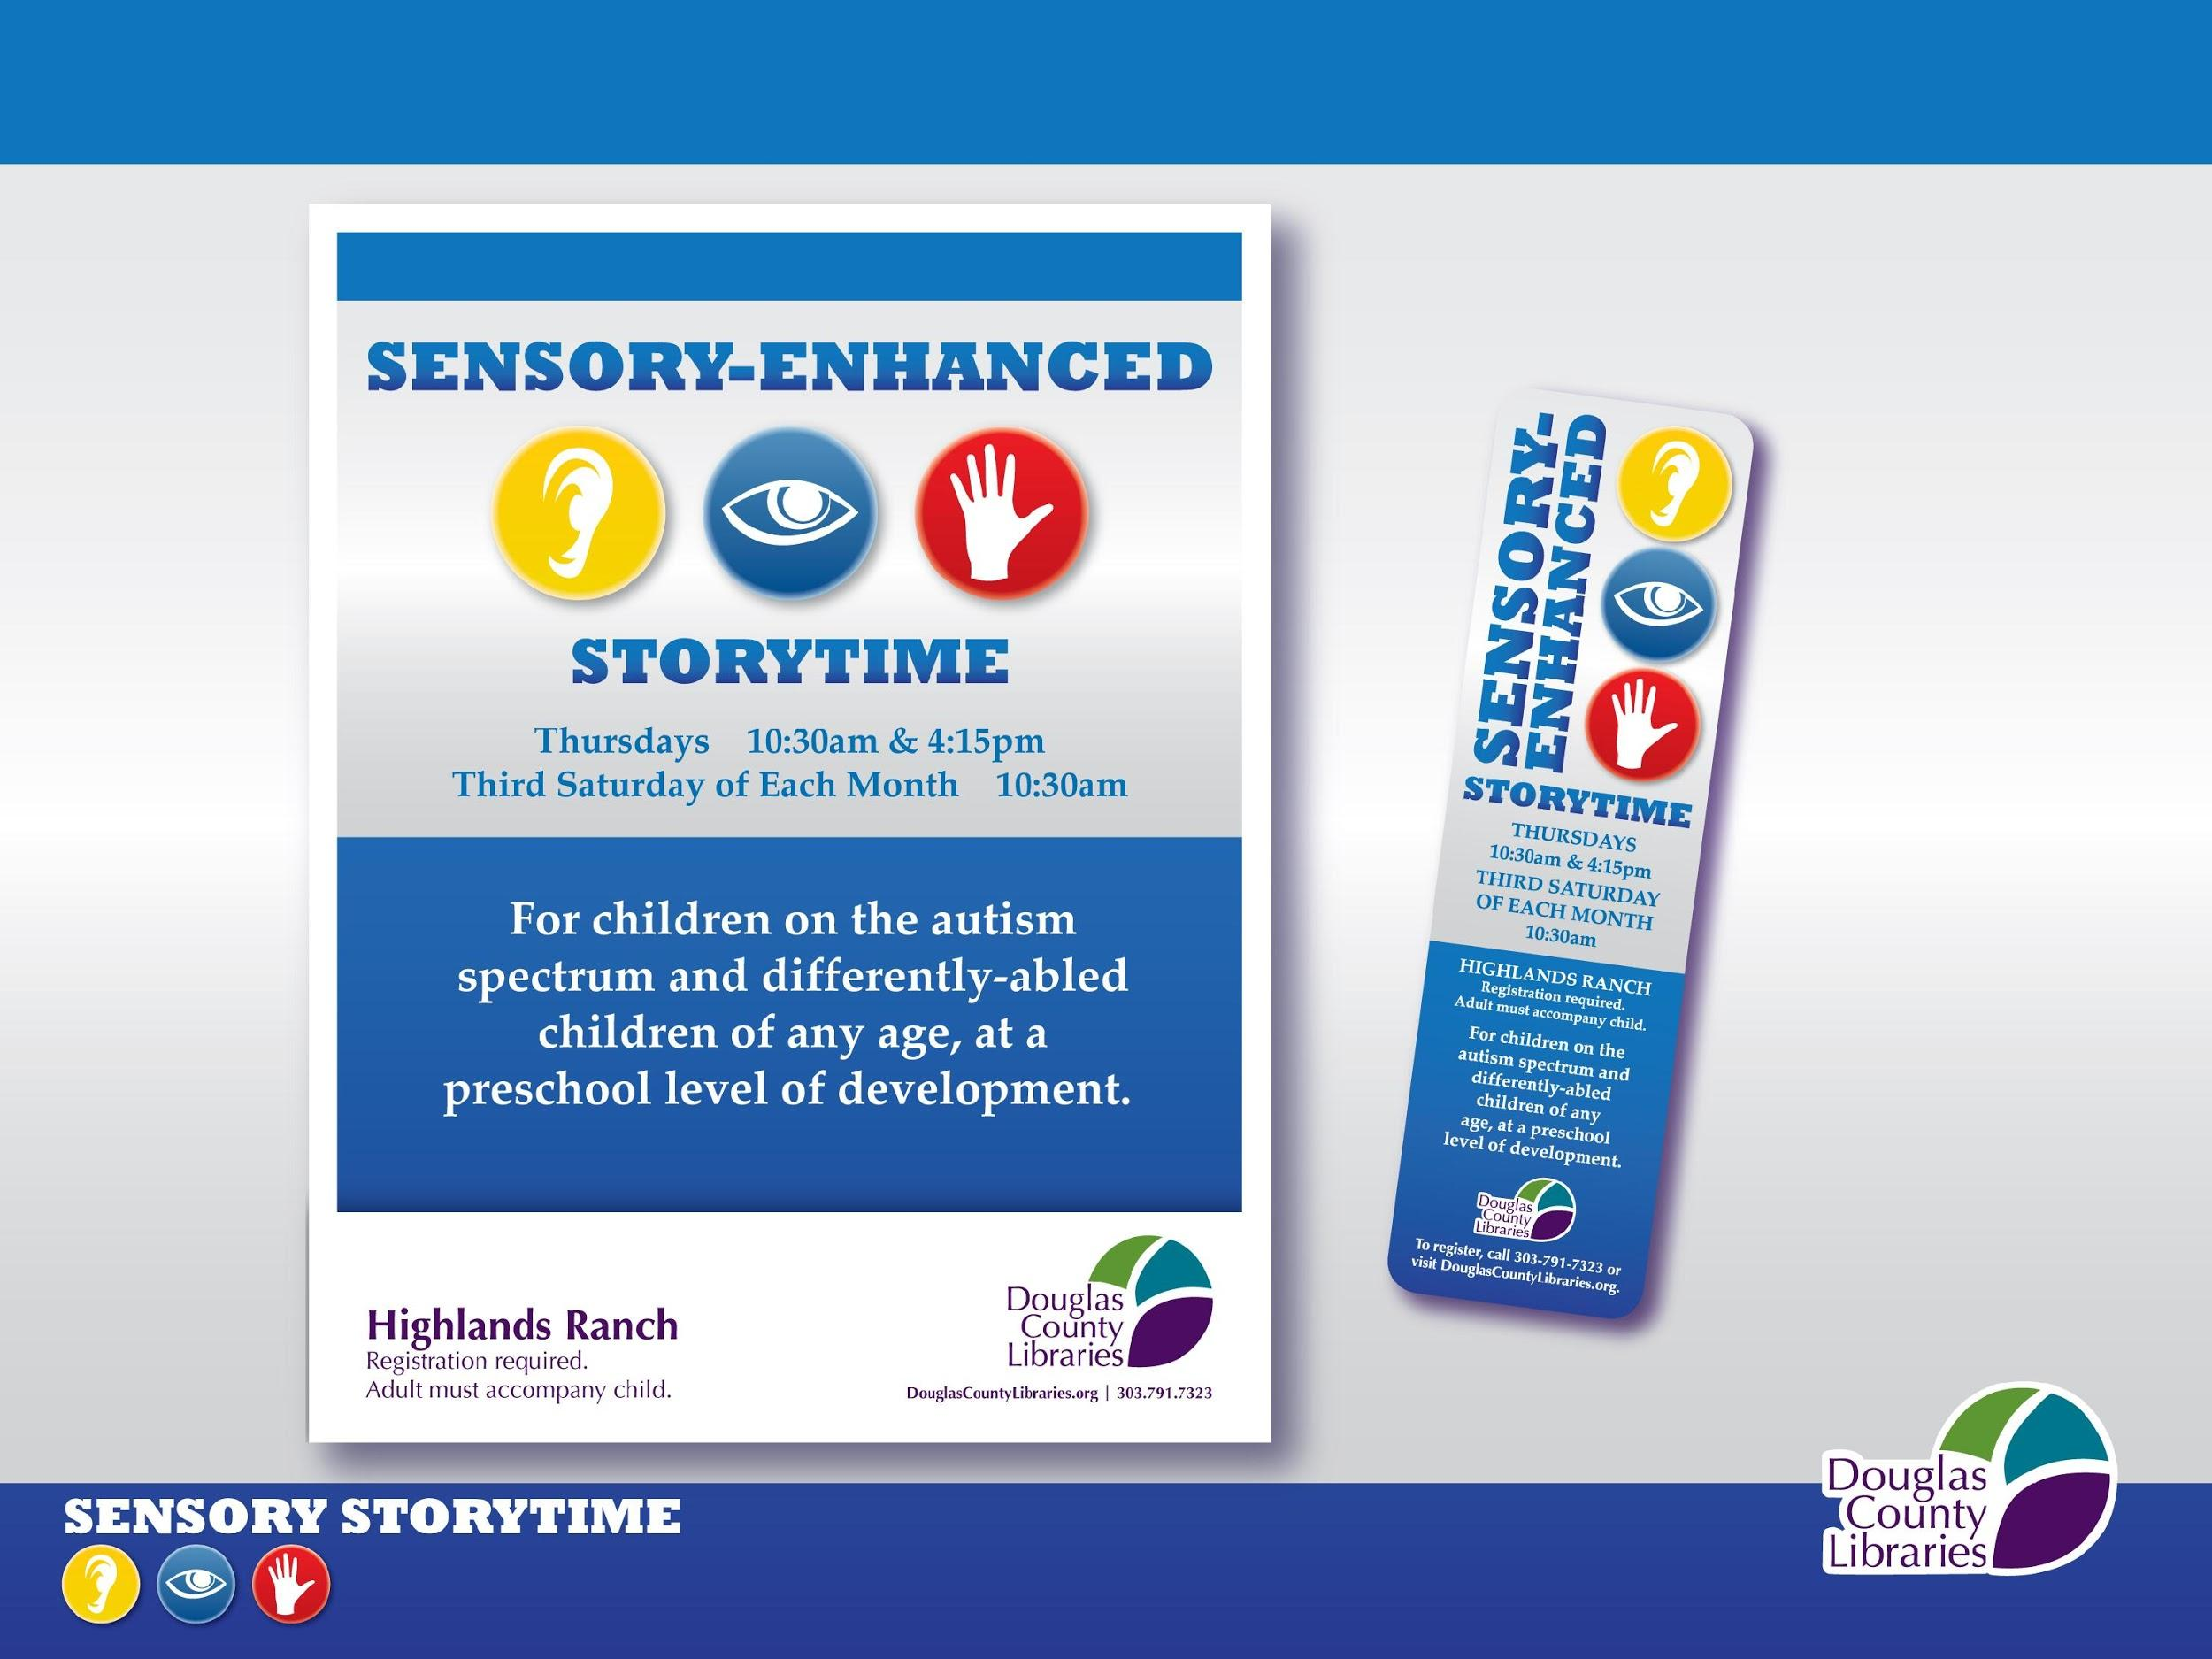
Notes:
Here’s some of our marketing collateral.
How to spread the word?
Our storytime is listed on the Autism Society’s online calendar.
We’ve developed relationships with other community service providers so we can share each other’s information.
We know that our public school district and Child Find, Colorado’s early intervention service to evaluate children at no cost recommends our st.
We have our information in family publications, such as Colorado Parents magazine
We see therapists who join their clients in storytime and recommend to their other clients.
We’ve had articles published in the local community newspaper.
And we’ve heard from participants who’ve heard about our program through social media.
We’re still working to promote this storytime and increase attendance.

Slide 23
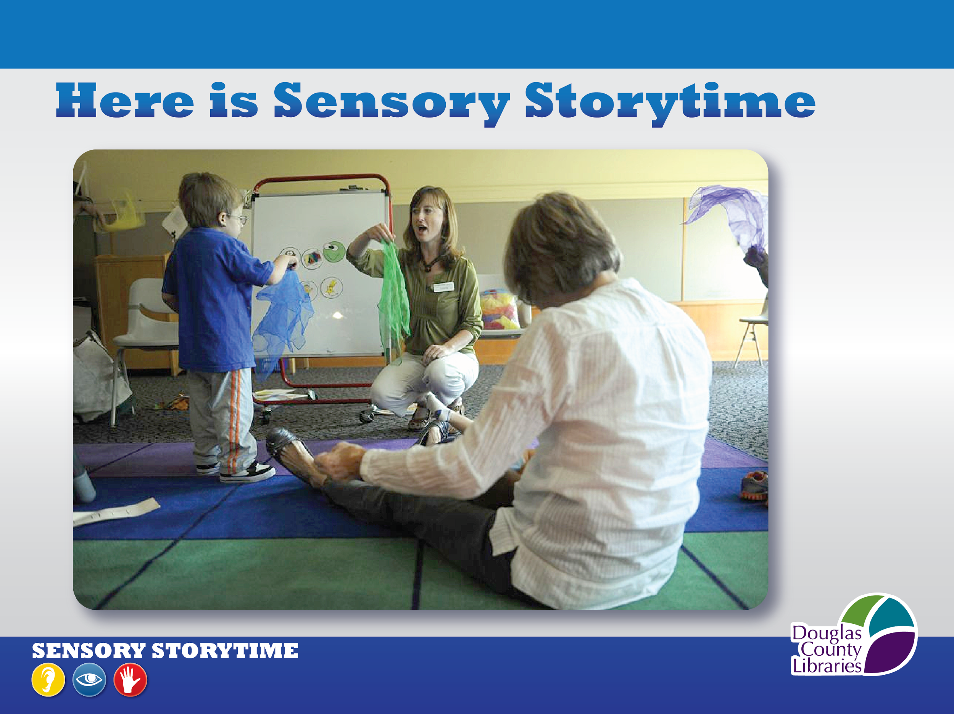
Video 1
Video 2
Notes:
YouTube videos:
http://www.youtube.com/watch?v=PSLJaETbNU8&feature=c4-overview&list=UUr3WN_8IqM6b_l36Z0VabHA
http://www.youtube.com/watch?v=ehJoVM-SG3k&feature=c4-overview&list=UUr3WN_8IqM6b_l36Z0VabHA
We will play 2 short clips of our storytime now.
In the first clip you will see us singing the Name Song and reading the beginning of a story.
In the second clip, we sing the Scarf Song.
Both the Name Song and Scarf Song are done at every sensory storytime.
PLAY FIRST CLIP THRU TO END OF FIRST ‘FROGGY!’ RESOLUTION
PLAY SECOND CLIP IN ENTIRETY

Slide 24
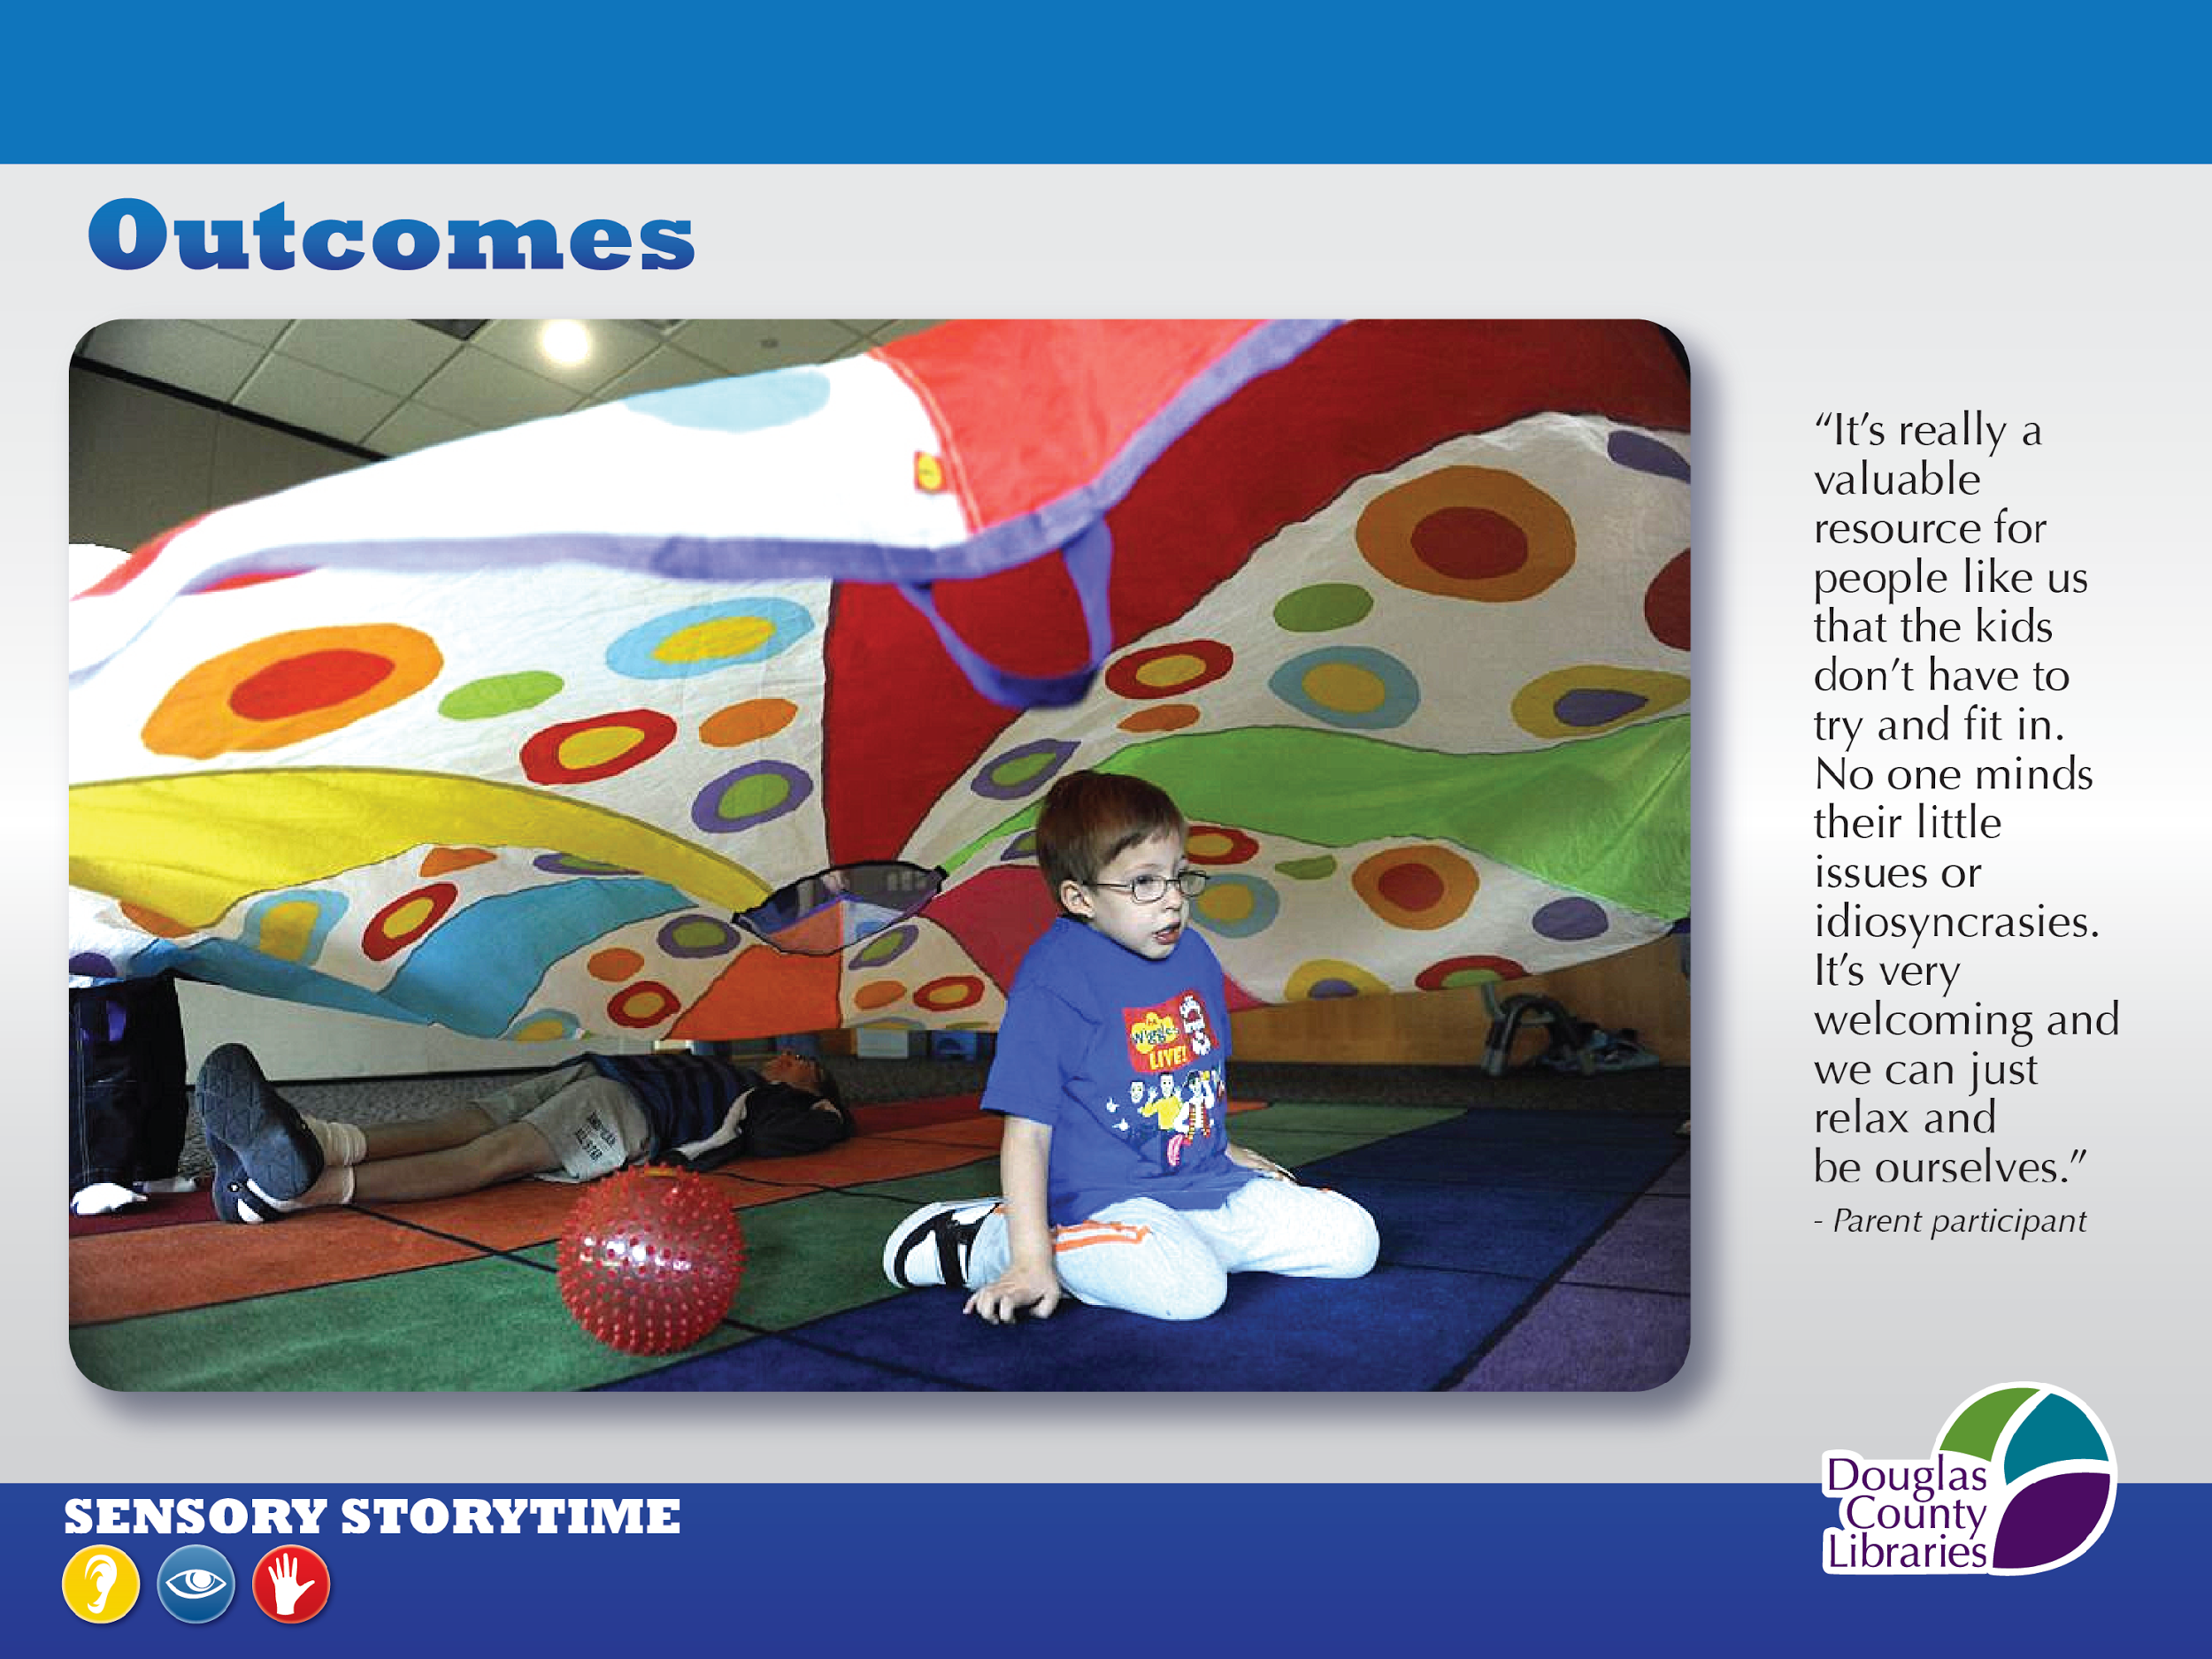
Notes:
Here’s one of our regular families who’s been coming to this storytime for a year now.
We love this quote from their mom.
HERE ARE ADDITIONAL QUOTES FROM PARENTS, MORE POSITIVE RESULTS OF THIS PROGRAM:
Thank you for allowing my son to be who he is at your storytime.
My special needs child is accommodated and not ostracized for needing to get up or touch everything.
I just wanted to thank you for the sensory storytime. It has been a huge stepping stone for us, especially in preparing for preschool.
We are enjoying the variety of activities at this storytime and also the consistency within each activity to help build confidence in the memory of each one.
You did not put your hands over your ears once during the storytime!
Thank you for offering storytime during school breaks. The continuity helps my child cope with the less-structured vacation time.
ADD QUOTES FROM FALL ‘14 SURVEY
I wish more libraries were doing this!
We have more of these positive reactions from parents and caregivers.
Have you surveyed your storytime participants?
Did you get helpful info?

Slide 25
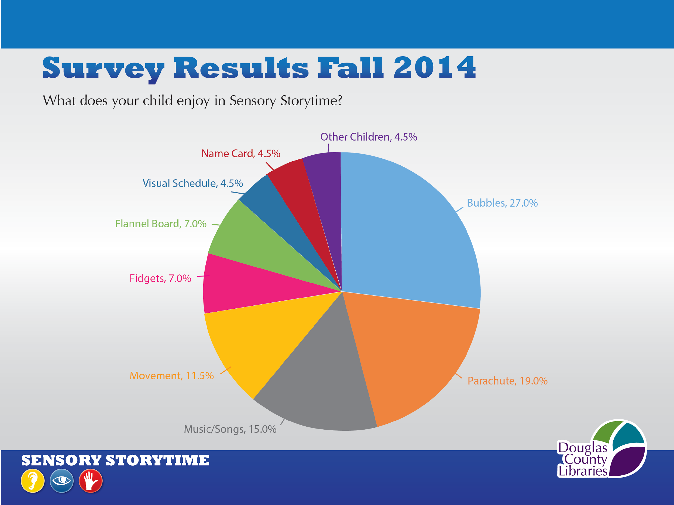
Notes:
We had been doing our storytime for 3 years and decided to survey our families.
We received some very interesting and heartening results!

Slide 26
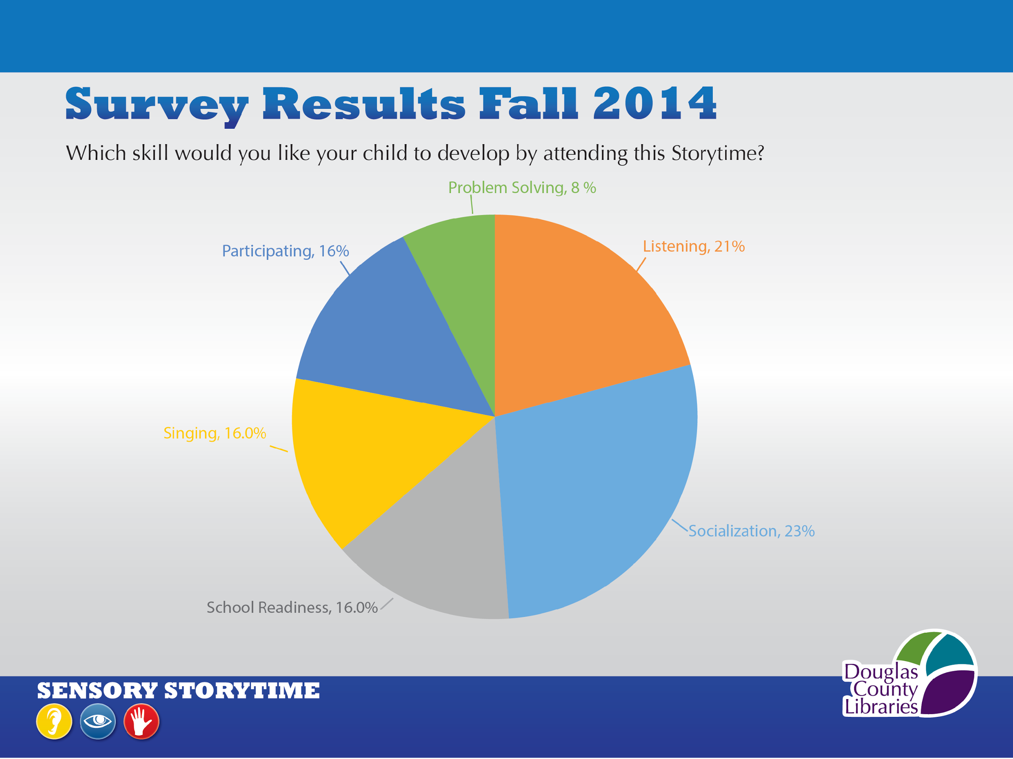
Notes:
As youth librarians and storytime presenters, we all know that the activities that we do at storytime (first chart) can help children develop these 6 early literacy and school readiness skills that were mentioned by parents in survey.
Next we asked them if they saw actual skill development as a result of coming to sensory storytime. (next slide)

Slide 27
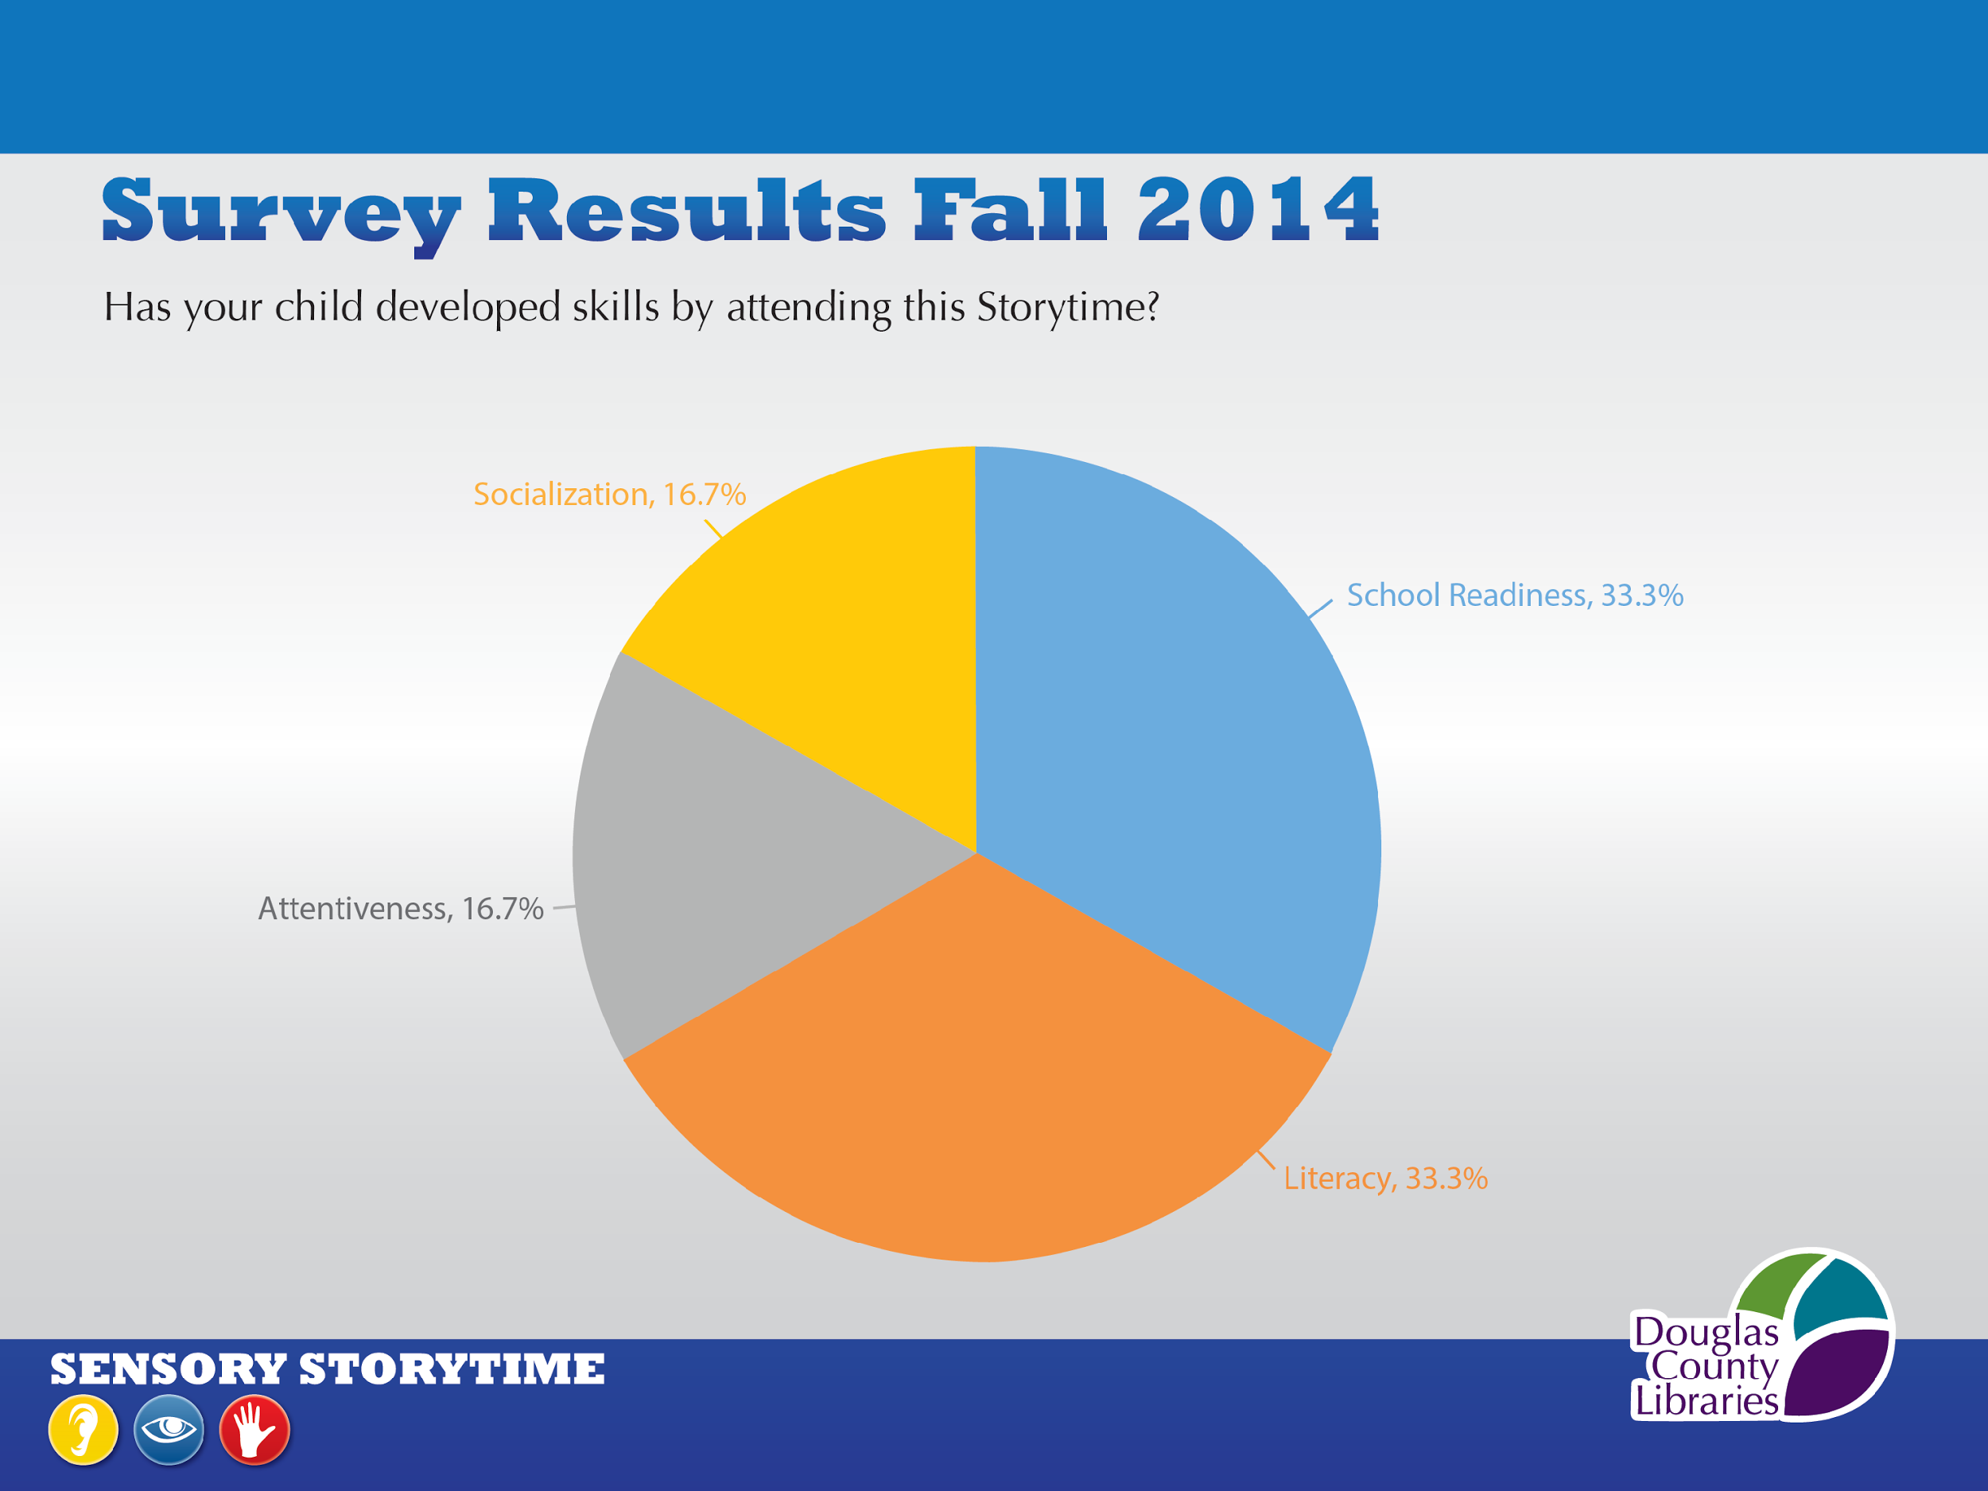
Notes:
The activities that the children enjoy in SE ST (first chart), like the Bubbles, Parachute, Singing & Moving, Flannel stories, & Visual Schedule,
are developing skills that the parents see in their children, and they are skills that the parents want their children to learn by attending (second chart).
This feedback from parents shows us the importance of the program for their children. It also shows the importance of surveying the parents, because until we began talking to them, and then surveying them, we did not realize the extent of the skill-building.

Slide 28
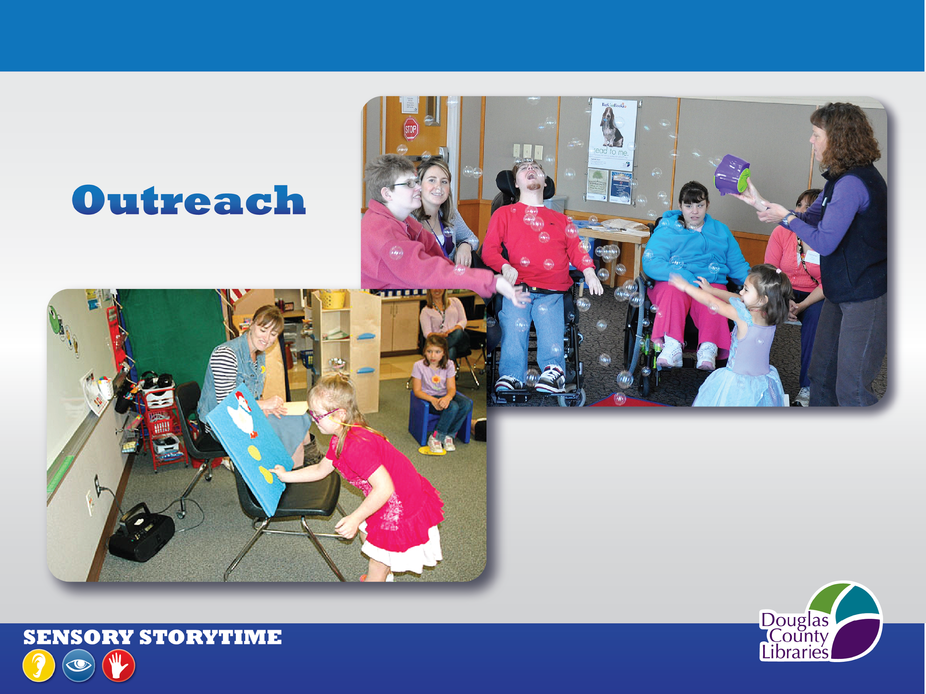
Notes:
We have begun to get invited to local elementary schools to bring our storytime to specials needs’ classrooms. And we’ve developed a partnership with a young adult facility—they bring a small group to our weekly storytimes at the library and once a month Laura and I take turns bringing our storytime to them.
We’ve noticed other unexpected positive results from our storytime:
We see many different families—not just those with children on the spectrum.
Parents use the ST to prepare for preschool and kindergarten.
Just like traditional storytimes parents use as an opportunity for socialization, participating in a group, learning concepts such as colors, numbers , & shapes.
Parents appreciate the safe environment where there’s no judgement
Participants may see they are inattentive but we’ll see progress even if it’s simply shaking a scarf or singing along
Children with special needs benefit when ST is shared with siblings, cousins and friends
Friendships developed by our younger participants with the young adults—we certainly didn’t expect to serve young adults but it works!
You will have other unexpected positive results because sensory storytime can benefit the differently-abled and their families in many ways, as we have shared with you today.
We hope you’ll share your experiences with us so that we can learn from you as well.

Slide 29
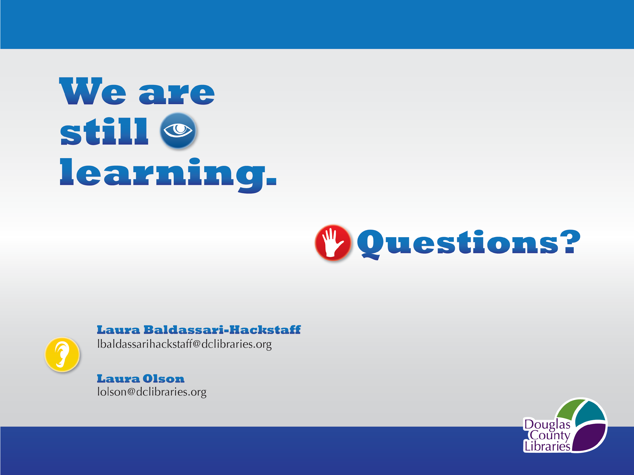
Notes:
We are now in our 4th year of sensory storytime, and we are
still learning from our participants, adapting our activities accordingly, and expanding our marketing.
To conclude, we want to share a quote from a book that is listed in your handouts today- Including Families of Children With Special Needs, the 2014 edition revised by Carrie Scott Banks.
It describes the Universal Design for Learning, a model of learning that gives children multiple opportunities to get involved with the storytime. We did not come across this until we were well into offering the program, but it does summarize why an inclusive storytime like this is effective. It is effective, in part, because it is based on the
“‘Universal Design for Learning.’ The precepts [of this concept] are simple: multiple means of representation, engagement, expression, and assessment...By providing children with more than one way to interact with the material, we allow more children to become engaged and provide them with a comfortable point of access...Multiple means of engagement means using their strengths and interests to make a connection between them and the material.” p. 66
Including Families of Children With Special Needs. Rev. ed. Carrie Scott Banks. 2014.
We encourage you to begin a sensory storytime at your library. The benefits it offers to our patrons, and the enjoyment it provides, are worth the effort. It has been one of the most rewarding experiences of our careers. Our email addresses are on the screen, and in your handout, and we would like to hear from you.
Now we want to open it up to your questions, and if you are offering your own sensory storytime, please share some of your experiences.
THANK YOU!

Slide 30
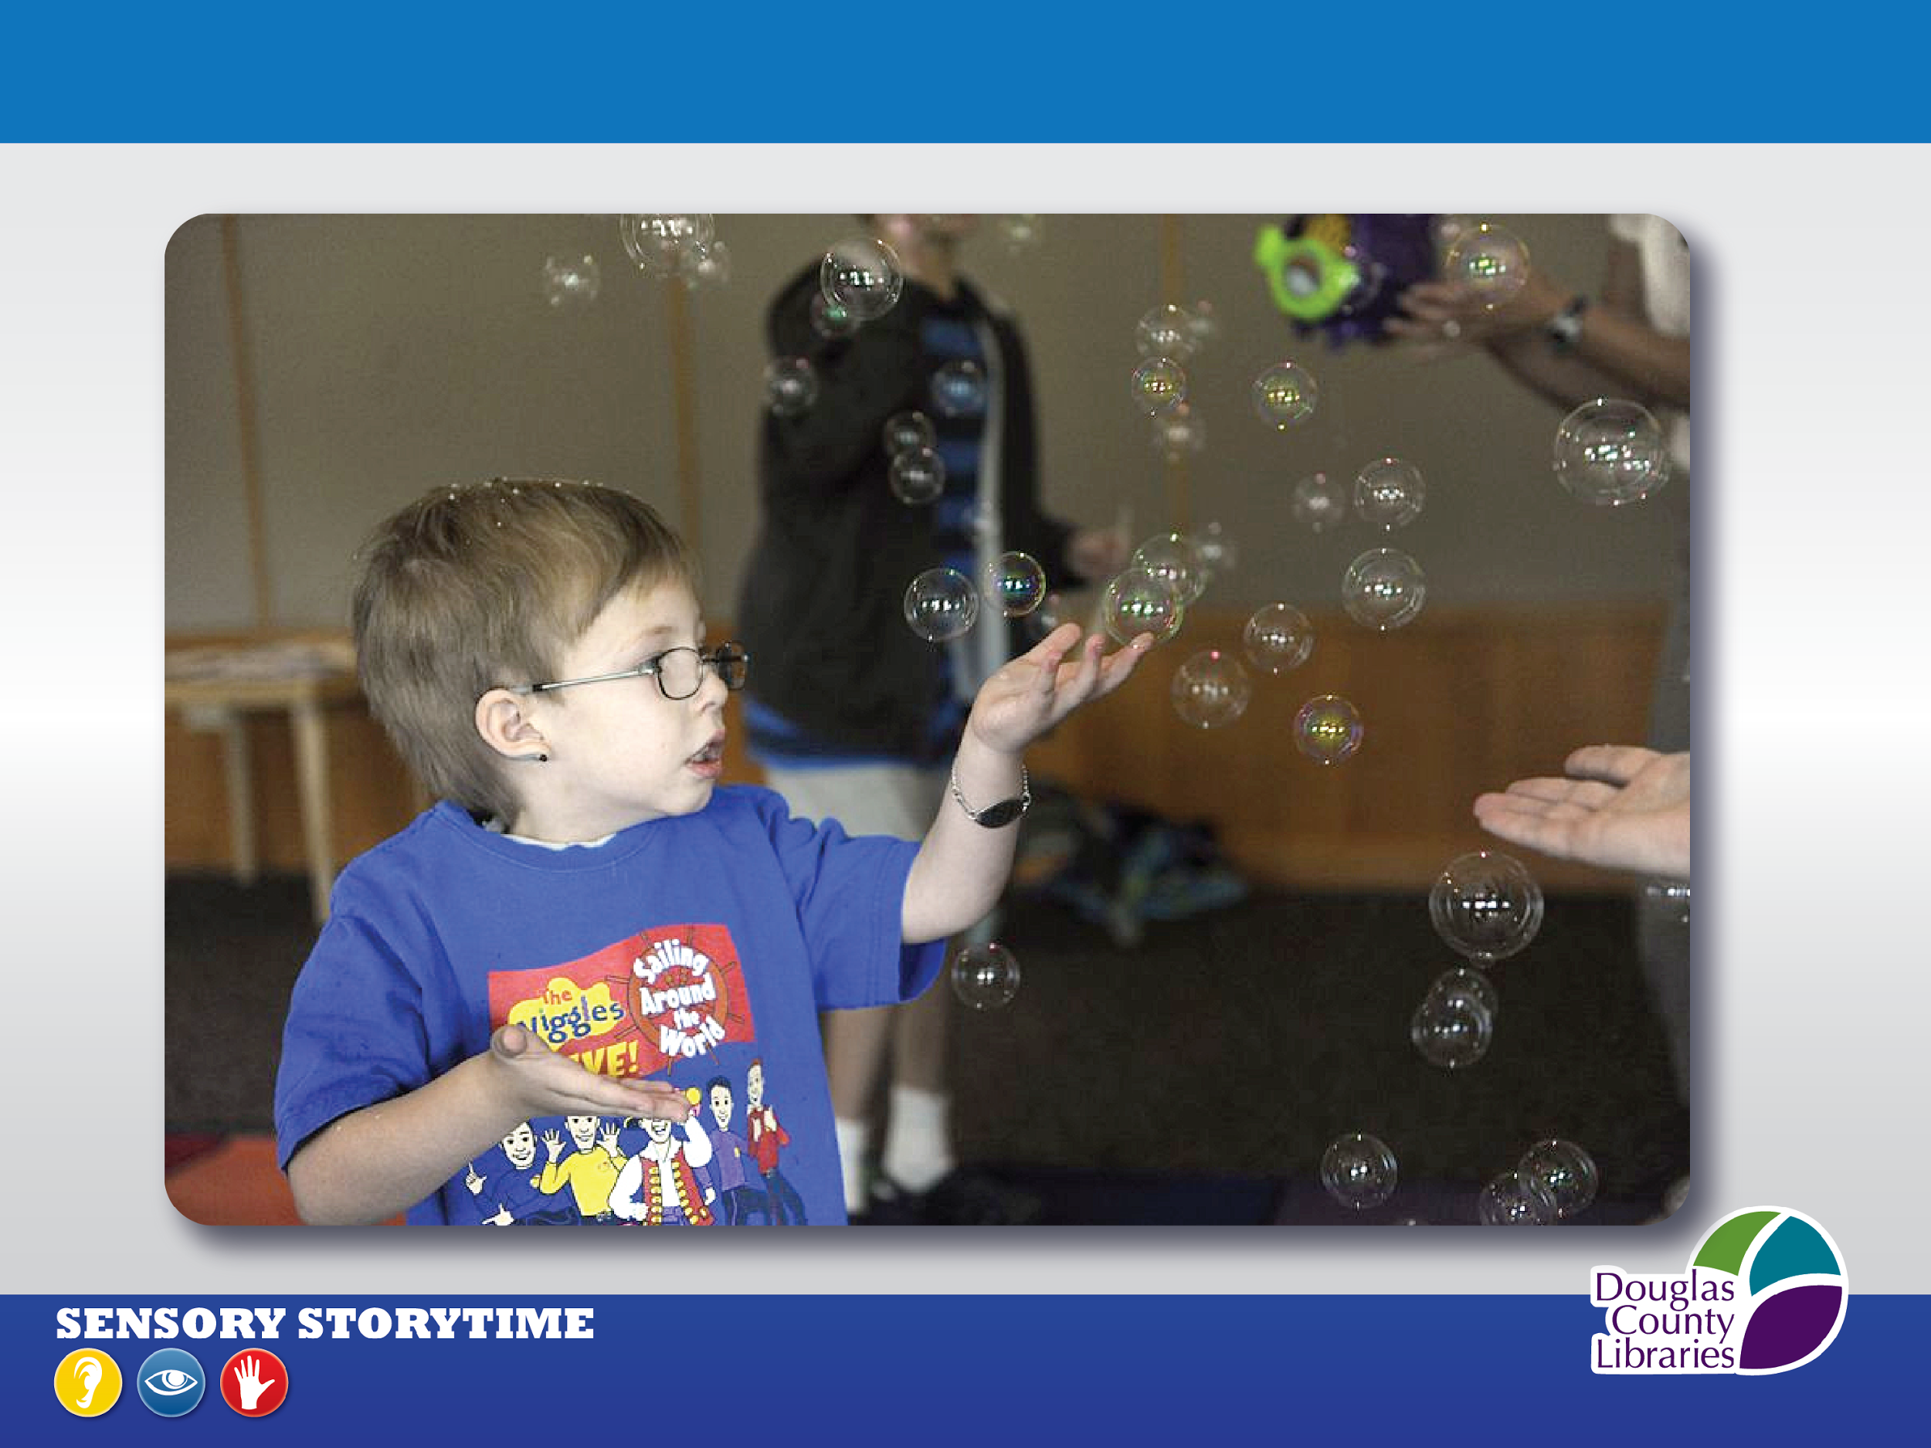

Slide 31
Infopeople webinars are supported in part by the U.S. Institute of Museum and Library Services under the provisions of the Library Services and Technology Act, administered in California by the State Librarian. This material is licensed under a Creative Commons 3.0 Share & Share-Alike license. Use of this material should credit the author and funding source.

