Slide 1

Introduction to Intellectual Freedom for Libraries
2015 Update
Presented by Mary Minow
J.D., A.M.L.S
Tuesday, February 17, 2015

Slide 2
Library shelves
– Books (schools and public libraries)
- Internet
Responding to challenges
- American Library Association
Social Media update
- Public and staff postings
Legal information, not legal advice

Slide 3

Books and physical materials
A parent asks you to remove a book from the shelf because she feels it could harm her children.

Slide 4
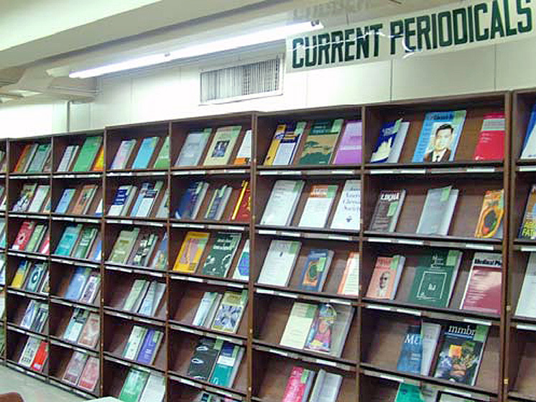
Who decides?
Your library has too many liberal magazines and not enough conservative ones!
Notes:
http://en.wikipedia.org/wiki/File:DLSU-Lib_Periodicals.jpg

Slide 5

Selection v. Removal
Librarian doesn’t buy book or magazine
No judicial review
Notes:
Let’s start with the librarian. Now here’s a really interesting legal phenomenon. Selection v. Removal. Let’s say you, the librarian, decide not to buy a book. …. You can’t buy every book, there isn’t enough money or space. The court’s don’t look at the purchases you don’t make! It would be impossible.
http://sspp.gsfc.nasa.gov/sem/img/developing.gif
http://www.smith.edu/libraries/images/fyi/tips/58.jpg

Slide 6
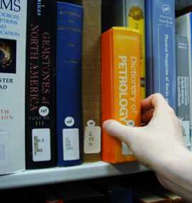
Selection v. Removal
Removal by the government may invite judicial review
Notes:
On the other hand, when the Government removes a book, (CD, DVD etc.), and someone files a free speech or First Amendment claim that the government is restricting access to information, ….
http://sspp.gsfc.nasa.gov/sem/img/developing.gif
http://www.smith.edu/libraries/images/fyi/tips/58.jpg

Slide 7

Selection v. Removal
Removal by the government may invite judicial review
Notes:
that might end up in court … that could invite judicial review … and in fact that’s just what happened in the …
http://sspp.gsfc.nasa.gov/sem/img/developing.gif
http://www.smith.edu/libraries/images/fyi/tips/58.jpg

Slide 8

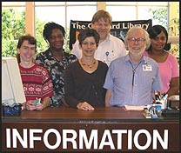
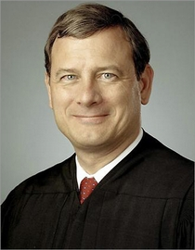
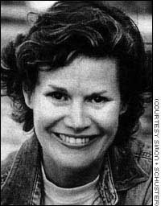
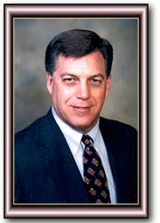
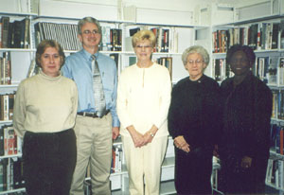
Who Decides What
Goes in Library Collection?
Librarians
Judge
Author
Legislator
Library Board
Notes:
http://library.gsfc.nasa.gov/AskALib/askalib.jpg
http://www.contentedits.com/clientimages/1092/revised2a.jpg
Luverne Public Library, 148 E. Third Street
Luverne, AL
Now this may come as a surprise to you if you get to select materials for your library. You may find yourself reading reviews at work, at home, in relative peace. But there’s a large web of interested parties out there, who can or do get involved in deciding what’s at the library.
First and foremost there’s the author … do you recognize this author, the author who’s racked up the most challenges, according to the American Library Association? That’s Judy Blume, and she’s an eloquent spokesperson on behalf of intellectual freedom. She says “But it's not just the books under fire now that worry me. It is the books that will never be written. The books that will never be read. And all due to the fear of censorship. As always, young readers will be the real losers. “
Authors and publishers are at the start of the chain, but who’s next? It’s the librarians who get to select the books, CDs, DVDs for the library, based on the library’s collection development policy, a policy that should be set and approved by the library board.
What about the public? For example, one group, Parents Against Bad Books in Schools has become a resource for other local groups who want to challenge books in libraries.
The next picture on this slide is a state legislator. How do state legislators get involved, when libraries are run by local government, cities, counties, and the like. ?
This picture is of a state legislator in Alabama, Gerry Allen, who introduced a bill last session that read “No public funds shall be used for the purchase of library materials that recognize or promote homosexuality as an acceptable lifestyle.”
… does the legislator have the legal right to make such a restriction? Would the librarian have that right?
THAT’S WHERE THE COURTS COME IN. The picture that says JUDGE on this slide is of our new Chief Justice of the Supreme Court, John Roberts. It’s the courts that determine whether restrictions on library books and materials are CONSTITUTIONAL, that is whether they comport with the free speech guarantees in the First Amendment.

Slide 9

Law, Cases
Question is Always
Will Library Win in Court?
Library Restriction
on Speech

Slide 10
Or will Patron win?

Slide 11
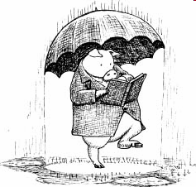
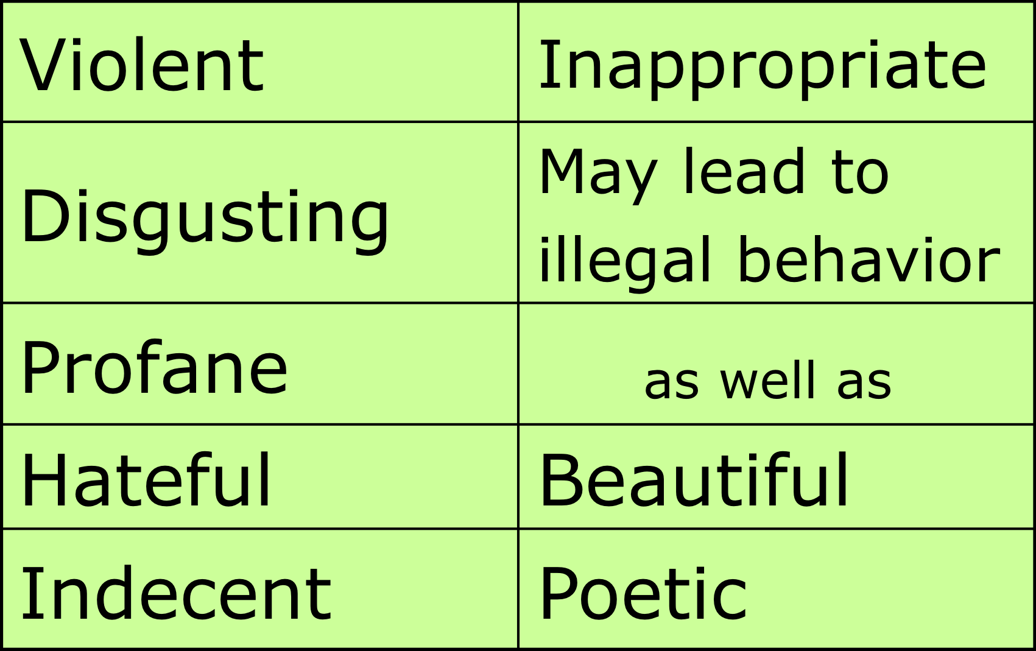

Legal Definitions
Speech protected under umbrella of First Amendment:
Notes:
As a past Supreme Court Justice, Justice Harlan once wrote: - one man’s vulgarity is another’s lyric
It's impossible to define words like offensive.
As Supreme Court Justice Antonin Scalia wrote back in 1987:
De Gustibus non est disputandum. Just as there is no arguing about taste, there is no use litigating about it
===========
www.ed.gov/Family/RWN/ Activ97/begin.html

Slide 12

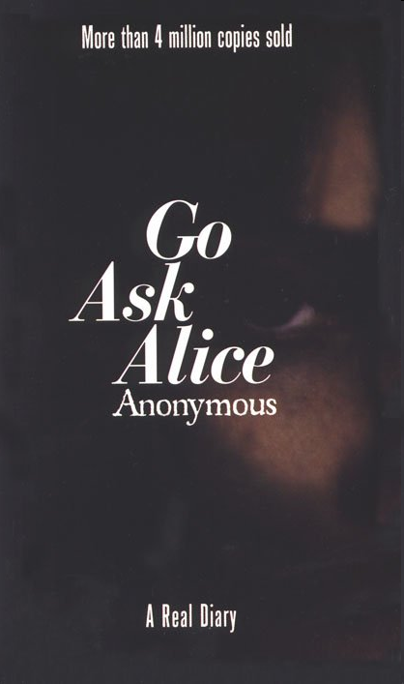
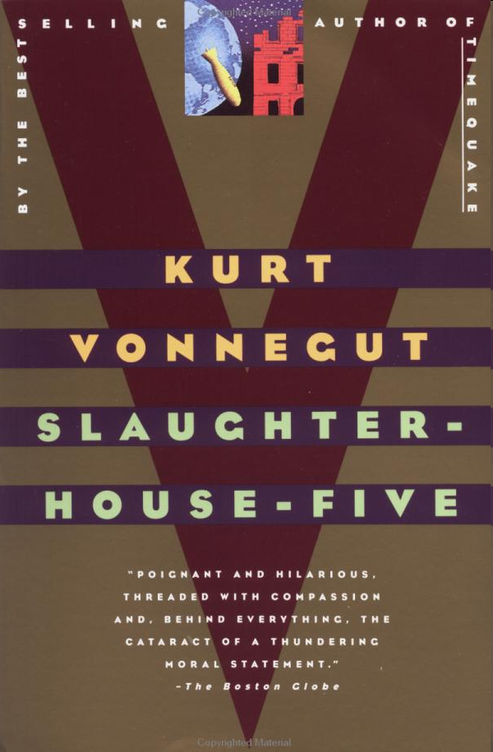

Court Case: Can a library legally remove books based on viewpoint?
Student sued when school board removed books as
“anti-American,
anti-Christian,
anti-Semitic, and
just plain filthy”
Bd. of Ed. v. Pico, 457 U.S. 853 (1982)

Slide 13
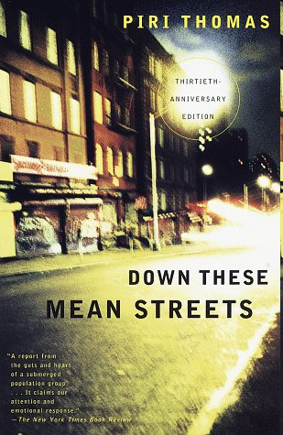

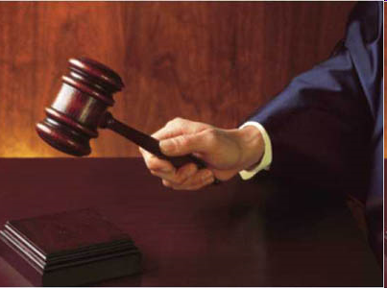
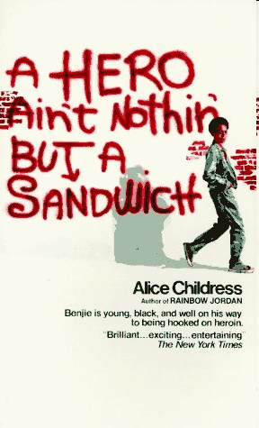
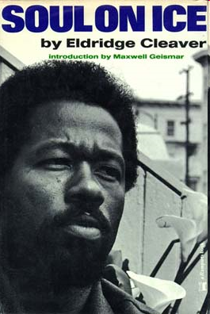
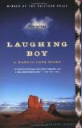
No. U.S. Supreme Court
Schools in loco parentis and set curriculum, but cannot remove books unless educationally unsuitable or pervasively vulgar.
Settlement: Books returned to shelves.
Bd. of Ed. v. Pico, 457 U.S. 853 (1982)is cited for this proposition. The decision was a plurality, not a majority.
Lower court decisions citing it are controlling.
Notes:
http://www.fbi.gov/publications/leb/2004/sept2004/sept04lebx27x1.jpg

Slide 14
No. U.S. Supreme Court
Schools in loco parentis and set curriculum, but cannot remove books unless educationally unsuitable or pervasively vulgar.
Settlement: Books returned to shelves.
Public library, place of free-wheeling inquiry, put the books on display
Bd. of Ed. v. Pico, 457 U.S. 853 (1982)is cited for this proposition. The decision was a plurality, not a majority.
Lower court decisions citing it are controlling.
Notes:
http://www.fbi.gov/publications/leb/2004/sept2004/sept04lebx27x1.jpg

Slide 15
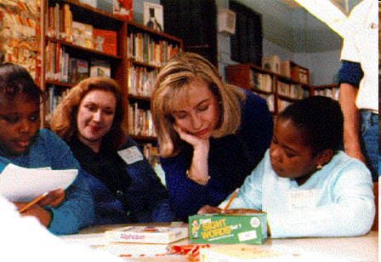
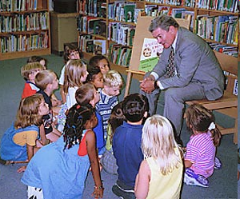
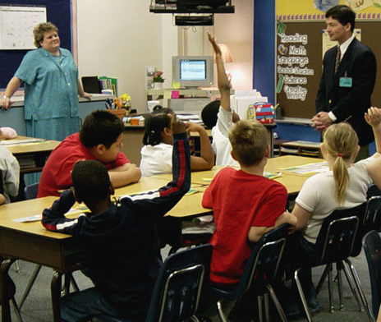
School Boards do NOT have unrestricted authority
May consider vulgarity and educational suitability, but not merely the unorthodox ideas represented
Classrooms School Libraries Public Libraries
educationally freewheeling
suitable
School libraries
in between
Bd. of Ed. v. Pico, 457 U.S. 853 (1982)
Notes:
Despite the fact that it was a plurality decision, the Pico case has come to stand for the proposition that school boards do NOT have unrestricted authority to pull books off the library shelves. The school board has the authority to determine classroom curricula, and can determine what is and is not educationally suitable there. The Pico case noted that the challenged books compared the school library to public libraries, noting that the not only did the local public library own all of the titles, but had put them on display.
Legally, the PICO case has come to stand for the proposition that school libraries are somewhere in between the classroom – where the school board can decide what’s taught, and the public library, the locus of freewheeling public inquiry.
Today’s cases show that school boards do not have unrestricted authority to take books off library shelves. They may consider whether the books are vulgar or eduationally unsuitable, but they may not remove books merely based on the unorthodox ideas represented.
School Boards do NOT have unrestricted authority
May consider vulgarity and educational suitability, but not merely the unorthodox ideas represented
http://www.house.gov/hensarling/images/classroom.jpg CLASSROOM
http://clinton3.nara.gov/WH/EOP/First_Lady/images/public_school_library.jpg SCHOOL LIBRARY
http://bond.senate.gov/images/library.jpg PUBLIC LIBRARY

Slide 16
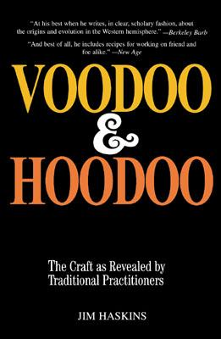
School Libraries Book Removal
Scholarly and practical look
West African religions in U.S.
Spells to do ill
Love Spells
Court: Deny access to ideas?
If so, return to shelves
Campbell v. St. Tammany Parish School Board, 64 F.3d 184 (5th Cir. 1995)
Notes:
So let’s look at the more recent cases. A school board in Louisiana voted 12 to 2 to remove VOODOO & HOODOO, a book about West African religions in the U.S. Along with scholarly analysis, the book had a practical side -- love spells, and spells to do ill.
An important point here is that the school level committee voted unanimously to retain it, based on professional criteria and yet the school board still removed it from the shelves.
The Fifth Circuit federal court said the question to determine is why the board removed the books. Was it because the book had ideas that it didn’t like, and was it trying to deny access to those ideas? If so, said the court, the school would have to return the book to the shelves.
[In light of the special role of the school library as a place where students may freely and voluntarily explore diverse topics, the School Board's noncurricular decision to remove a book well after it had been placed in the public school libraries evokes the question whether that action might not be an unconstitutional attempt to "strangle the free mind at its source." ]

Slide 17
Court Looks at Board’s Motivation
Scholarly and practical look
West African religions in U.S.
Spells to do ill
Love Spells
Court: Deny access to ideas?
If so, return to shelves
Campbell v. St. Tammany Parish School Board, 64 F.3d 184 (5th Cir. 1995)
Notes:
So let’s look at the more recent cases. A school board in Louisiana voted 12 to 2 to remove VOODOO & HOODOO, a book about West African religions in the U.S. Along with scholarly analysis, the book had a practical side -- love spells, and spells to do ill.
An important point here is that the school level committee voted unanimously to retain it, based on professional criteria and yet the school board still removed it from the shelves.
The Fifth Circuit federal court said the question to determine is why the board removed the books. Was it because the book had ideas that it didn’t like, and was it trying to deny access to those ideas? If so, said the court, the school would have to return the book to the shelves.
[In light of the special role of the school library as a place where students may freely and voluntarily explore diverse topics, the School Board's noncurricular decision to remove a book well after it had been placed in the public school libraries evokes the question whether that action might not be an unconstitutional attempt to "strangle the free mind at its source." ]

Slide 18
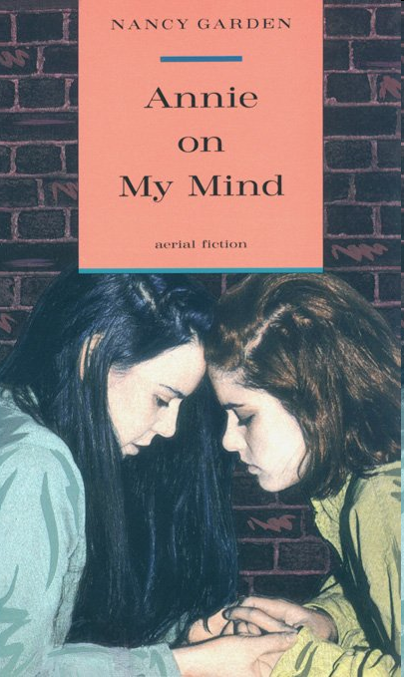
School Board removes Annie
novel about teenage lesbian relationship
Case v. Unified School District No. 233, 908 F. Supp. 864 (D. Kan. 1995)
Notes:
In 1993, an advocacy group Project 21 donated copies of Annie on My Mind, a book about two lesbian teenagers, and copies of All American Boys about two gay teenagers to the Olathe School District.
The donation got extensive media coverage, and the school started getting complaints about the books, even though copies of Annie had been on the District's library shelves since the mid-1980s.
The libraries did not have All American Boys.
The assistant superintendent asked the librarian and other media specialists to advise her as to the suitability of the book for the collection. The librarians found reviews that were generally favorable, “sensitive and realistic” and in fact the book was ALA award winning book. The librarian did not recommend All American Boys, which she described as “shallow and incomplete.”
The school district’s policy incorporated the American Library Association's School Library Bill of Rights, which states that it is the responsibility of the school library media center to provide materials that: support the curriculum; encourage students' "growth in knowledge" and "development of literary, cultural and aesthetic appreciation and ethical standards"; and "reflect the ideas and beliefs of religious, social, political, historical, and ethnic groups and their contribution to the American and world heritage and culture, thereby enabling students to develop an intellectual integrity in forming judgment.“
The school district reconsideration policy set forth a 13-step written procedure to address concerns about library materials. The process begins when a patron challenges the appropriateness of the materials and notifies the school. If the school is unable to resolve the complaint informally without the removal of the item, the complaint is referred to the appropriate library media coordinator, who appoints a committee to review the complaint. The committee is charged with reading the challenged material and evaluating it according to the District's established criteria for the selection of library materials. The committee issues a report, which is furnished to the building principal, who is responsible for implementing the committee's decision. The complainant is notified of the District's disposition of the complaint. If dissatisfied, the complainant may appeal to the superintendent.
The District failed to follow its adopted procedures for the reconsideration of library materials. The District neither awaited a formal complaint, nor appointed a committee to consider the removal (as opposed to the donation) of Annie on My Mind. If the media specialists committee that was established to consider the donations also acted as a review committee for materials already on the shelves, its recommendation was ignored. The District's written guidelines forbid a reversal of the Review Committee's decision without an appeal to the superintendent by a complainant. No appeal was made. The District also ignored its own incorporation of the American Library Association's Library Bill of Rights, which affirms the importance of having a diversity of ideas available in the library "thereby enabling students to develop an intellectual integrity in forming judgment."
After the media specialists had concluded that the donation of Annie on My Mind should be accepted and that the books should be added to the existing copies on the shelves, Dr. Wimmer overrode that decision by promulgating new "book donation guidelines." In doing so, he disregarded the recommendation of the media specialists as well as the District's established criteria for the reevaluation of library resources.
There was no discussion by the Board concerning the literary or educational merit of the book. The Board of Education ignored its own guidelines and criteria established for the reconsideration of library materials.

Slide 19
Court:
Violation of First Amendment
Removal not based on “educational suitability”
but on ideology
Case v. Unified School District No. 233, 908 F. Supp. 864 (D. Kan. 1995)
Notes:
In 1993, an advocacy group Project 21 donated copies of Annie on My Mind, a book about two lesbian teenagers, and copies of All American Boys about two gay teenagers to the Olathe School District.
The donation got extensive media coverage, and the school started getting complaints about the books, even though copies of Annie had been on the District's library shelves since the mid-1980s.
The libraries did not have All American Boys.
The assistant superintendent asked the librarian and other media specialists to advise her as to the suitability of the book for the collection. The librarians found reviews that were generally favorable, “sensitive and realistic” and in fact the book was ALA award winning book. The librarian did not recommend All American Boys, which she described as “shallow and incomplete.”
The school district’s policy incorporated the American Library Association's School Library Bill of Rights, which states that it is the responsibility of the school library media center to provide materials that: support the curriculum; encourage students' "growth in knowledge" and "development of literary, cultural and aesthetic appreciation and ethical standards"; and "reflect the ideas and beliefs of religious, social, political, historical, and ethnic groups and their contribution to the American and world heritage and culture, thereby enabling students to develop an intellectual integrity in forming judgment.“
The school district reconsideration policy set forth a 13-step written procedure to address concerns about library materials. The process begins when a patron challenges the appropriateness of the materials and notifies the school. If the school is unable to resolve the complaint informally without the removal of the item, the complaint is referred to the appropriate library media coordinator, who appoints a committee to review the complaint. The committee is charged with reading the challenged material and evaluating it according to the District's established criteria for the selection of library materials. The committee issues a report, which is furnished to the building principal, who is responsible for implementing the committee's decision. The complainant is notified of the District's disposition of the complaint. If dissatisfied, the complainant may appeal to the superintendent.
The District failed to follow its adopted procedures for the reconsideration of library materials. The District neither awaited a formal complaint, nor appointed a committee to consider the removal (as opposed to the donation) of Annie on My Mind. If the media specialists committee that was established to consider the donations also acted as a review committee for materials already on the shelves, its recommendation was ignored. The District's written guidelines forbid a reversal of the Review Committee's decision without an appeal to the superintendent by a complainant. No appeal was made. The District also ignored its own incorporation of the American Library Association's Library Bill of Rights, which affirms the importance of having a diversity of ideas available in the library "thereby enabling students to develop an intellectual integrity in forming judgment."
After the media specialists had concluded that the donation of Annie on My Mind should be accepted and that the books should be added to the existing copies on the shelves, Dr. Wimmer overrode that decision by promulgating new "book donation guidelines." In doing so, he disregarded the recommendation of the media specialists as well as the District's established criteria for the reevaluation of library resources.
There was no discussion by the Board concerning the literary or educational merit of the book. The Board of Education ignored its own guidelines and criteria established for the reconsideration of library materials.

Slide 20
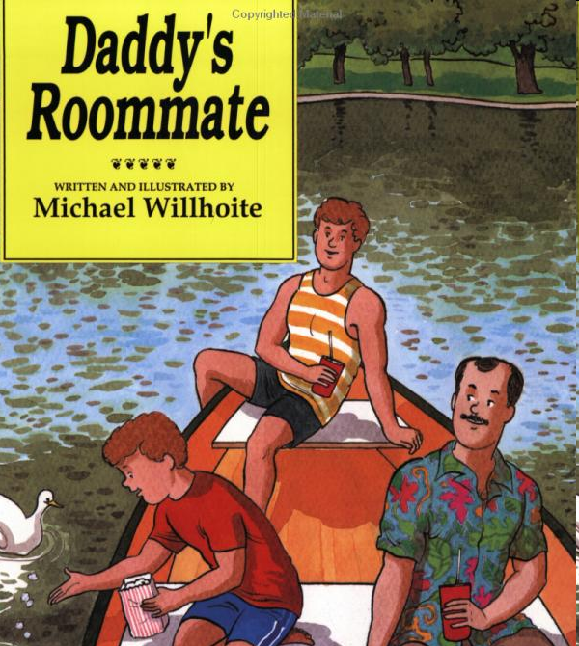
Public Library:
Move books to adult shelves?
City council:
300 petitioners may demand children’s books go to adult area
Court:
Sund v. City of Wichita Falls, 121 F. Supp. 2d 530, (N.D. Tex. 2000)
Notes:
Now here’s an important court case that looked at a public library. The library that did not actually remove books, but merely moved children’s books with gay themes to an adult area.
It’s especially interesting because it took a good look at who makes the decisions. In this case, the city council of Wichita Falls, TX, passed an ordinance that allowed 300 library card holders to petition for the removal of any children's book in the Wichita Falls public library children's section to be relocated to the adult section.
The library relocated Daddy's Roommate and Heather Has Two Mommies, after getting petitions [spearheaded by members of the First Baptist Church of Wichita Falls who initially wanted to remove "any literature that promotes or sanctions a homosexual lifestyle." ]

Slide 21
Court: No. Patron’s don’t decide this.
Children and parents sued library.
Court:
Books returned to children’s area.
Next group may want to move children’s bibles away from kids.
Sund v. City of Wichita Falls, 121 F. Supp. 2d 530, (N.D. Tex. 2000)

Slide 22

Can library require parent’s permission to read Harry Potter?
School board required parent’s permission to read Harry.
Student sued.
Counts v. Cedarville Sch. Dist. 295 F. Supp. 2d 996 (2003)
Notes:
What if a library requires parent permission before checking out a particular book to a child? A school district in Arkansas had copies of Harry Potter and the Sorcerers Stone in the library, but kept it behind the desk, checking it out to children only if they had parental permission.
Dakota Counts and her parents sued the school, claiming that even though Dakota had her own copy at home, and even though her parents were willing to let her read the book, it was a burden for her to have to ask for parental permission, and there would be a stigma for her to borrow a book known as a “bad book”
How did the court rule in this case?

Slide 23
Can library require parent’s permission to read Harry Potter?
School board required parent’s permission to read Harry.
Student sued.
Court: No. Return to open shelves.
Otherwise, too much burden, stigma for children
Counts v. Cedarville Sch. Dist. (Ark.) 295 F. Supp. 2d 996 (2003)

Slide 24

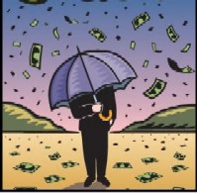
Who Decides What
Goes in Library Collection?
Library Board
Vote to remove book
Librarians Select and Weed
Chief Justice John Roberts
First Amendment
Schools – may remove if educationally unsuitable
Public Libraries – may remove if unprotected by First Amendment
Legislator
Ties funding to policies
Notes:
So let’s review – who gets to decide what goes into a library collection? First stop, the librarians who select books, with no judicial oversight. Librarians also week books, and when they do, it should be based on professional criteria, and not the viewpoint of the book (or cd, dvd etc.).. .
The public, either as individuals or as an organized group may approach the library or the library bd to remove the book. If it’s a school board, the board has the authority to remove books that are educationally unsuitable, but even then not if it merely doesn’t agree with the ideas or viewpoint of the book.
If it’s a public library, the books have even greater protection … and it’s not likely that the library board would be able to overrule professional criteria and remove books based on their viewpoint.
Finally, can a legislator tied state or federal funds to a requirement to remove material? Although they can pass such laws, it’s likely the courts will strike down such laws as unconstitutional, unless the material falls outside the protection of the First Amendment.
A
http://library.gsfc.nasa.gov/AskALib/askalib.jpg
http://www.contentedits.com/clientimages/1092/revised2a.jpg
Luverne Public Library, 148 E. Third Street
Luverne, AL
http://www.pnl.gov/edo/images/money_rain.jpg

Slide 25
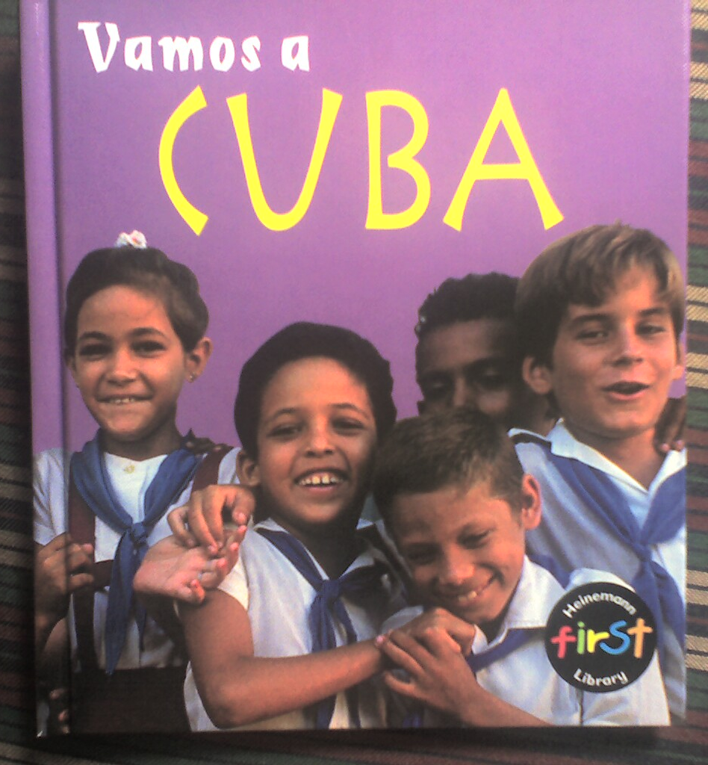
Ages 4 - 8
Parents wanted removal from school library
ACLU v. Miami-Dade County Sch. Bd., 557 F.3d 1177, 1200 (11th Cir.), cert. denied, 130 S. Ct. 659 (2009).
Notes:
That School Board member, Frank J. Bolanos, added the following item to the School Board's April 18, 2006 agenda: PROTECTING OUR CHILDREN FROM THE HURTFUL & INSULTING DISTORTIONS OF THE BOOK "VAMOS A CUBA" BY REMOVING THESE BOOKS FROM ALL OF OUR PUBLIC SCHOOL LIBRARIES. Mr. Bolanos described !Vamos a Cuba! as "hurtful and insulting to both our Cuban-American community and those Cubans still living on the island under oppressive conditions." (Plaintiffs' Exhibit 19, Memo to School Board Members dated April 18, 2006). Mr. Bolanos then described a number of the book's passages as "distortions," followed by his comments, labeled "reality." (Id.). The following is a list of those [*14] passages and his comments:
. Book's distortion: "The people of Cuba eat, work and study like you," page 5.
Reality: Nothing could be further from the truth. The people of Cuba survive without civil liberties and due process under the law and receive 10 to 20 year prison sentences for simply writing a document or voicing an opinion contrary to the party line. People are told where to work. They lose their job if they do not follow the dictates of the communist party. Children are indoctrinated and forced to chant Castro's greatness in class.
. Book's distortion: "White rice is the most common food in Cuba. Black beans are eaten. Arroz con Pollo is another favorite dish," page 12.
Reality: Food is rationed; people stand in line for hours to ask for their measly ration only to be told they ran out. Children stop receiving their milk ration at age six.
. Book's distortion: "The major celebration in Cuba is 'Carnival.' It is celebrated on July 26th," page 26.
Reality: The annual commemoration of July 26th is the symbolic observation of the rise to power of Castro's communist, totalitarian regime. It is a day of mourning [*15] for most Cubans. Cubans celebrate the 20th of May and the 28th of January, to celebrate their independence from Spain and the birth of Jose Marti, Cuba's greatest national hero.
. Book's distortion: "The celebrations in Cuba are a mix of African and Catholic roots," page 27.
Reality: Historically, Castro's regime has prohibited or chastised those that engage in religious practices, including the Catholic Church and other organized forms of religion. Religious leaders, including Jehovah's Witnesses have been imprisoned. A famous cry while facing Castro's firing squad was "Viva Cristo el Rey" (long live Christ the King).

Slide 26
Ages 4 - 8
"The people of Cuba eat, work and study like you"
Complaint: Nothing could be further from the truth. People of Cuba survive without civil liberties and due process.
ACLU v. Miami-Dade County Sch. Bd., 557 F.3d 1177, 1200 (11th Cir.), cert. denied, 130 S. Ct. 659 (2009).
Notes:
That School Board member, Frank J. Bolanos, added the following item to the School Board's April 18, 2006 agenda: PROTECTING OUR CHILDREN FROM THE HURTFUL & INSULTING DISTORTIONS OF THE BOOK "VAMOS A CUBA" BY REMOVING THESE BOOKS FROM ALL OF OUR PUBLIC SCHOOL LIBRARIES. Mr. Bolanos described !Vamos a Cuba! as "hurtful and insulting to both our Cuban-American community and those Cubans still living on the island under oppressive conditions." (Plaintiffs' Exhibit 19, Memo to School Board Members dated April 18, 2006). Mr. Bolanos then described a number of the book's passages as "distortions," followed by his comments, labeled "reality." (Id.). The following is a list of those [*14] passages and his comments:
. Book's distortion: "The people of Cuba eat, work and study like you," page 5.
Reality: Nothing could be further from the truth. The people of Cuba survive without civil liberties and due process under the law and receive 10 to 20 year prison sentences for simply writing a document or voicing an opinion contrary to the party line. People are told where to work. They lose their job if they do not follow the dictates of the communist party. Children are indoctrinated and forced to chant Castro's greatness in class.
. Book's distortion: "White rice is the most common food in Cuba. Black beans are eaten. Arroz con Pollo is another favorite dish," page 12.
Reality: Food is rationed; people stand in line for hours to ask for their measly ration only to be told they ran out. Children stop receiving their milk ration at age six.
. Book's distortion: "The major celebration in Cuba is 'Carnival.' It is celebrated on July 26th," page 26.
Reality: The annual commemoration of July 26th is the symbolic observation of the rise to power of Castro's communist, totalitarian regime. It is a day of mourning [*15] for most Cubans. Cubans celebrate the 20th of May and the 28th of January, to celebrate their independence from Spain and the birth of Jose Marti, Cuba's greatest national hero.
. Book's distortion: "The celebrations in Cuba are a mix of African and Catholic roots," page 27.
Reality: Historically, Castro's regime has prohibited or chastised those that engage in religious practices, including the Catholic Church and other organized forms of religion. Religious leaders, including Jehovah's Witnesses have been imprisoned. A famous cry while facing Castro's firing squad was "Viva Cristo el Rey" (long live Christ the King).

Slide 27
School Library Book (Miami, FL)
Ages 4 - 8
COURT:
School board may remove book based on inaccuracies.
ACLU v. Miami-Dade County Sch. Bd., 557 F.3d 1177 (11th Cir.), cert. denied, 130 S. Ct. 659 (2009).
Notes:
Vamos a Cuba and Let’s Visit Cuba is an easy reader that became an explosive issue in the Miami Cade County School district over the past few years.
Here’s an update on the case, and since the Supreme Court has denied a plea to hear the case, this is likely the final word.
A parent, who had been a political prisoner in Cuba, saw that his child’s school library had a book that showed happy smiling faces of children and said things like these children go to school, just like you do,… they eat just like you do.
The book was challenged at the school and went to two different materials reconsideration committees, both of which recommended keeping the book on the shelf. The superintendent kept the book on the shelf, but the school board overruled him and took it off (along with others in the same series)
The ACLU filed suit, won at the lower court, but the final word is tha the appellate court ruled in 2009 that the school board has the right to remove the book because the book has many factual inaccuracies.
If you’ve studies library book censorship, you’re familiar with the Supreme Court dec. Island Trees School District v Pico. Most library censorship cases cite that decision, but in this Vamos a Cuba case, the federal appellate court in the 11th circuit explictly said it did not need to follow Pico, because it was, in fact, a 4 to 4 decision, and did not establish clear precedent.
Nevertheless, the court did discuss the Pico standard – that a school board may not remove a book based on political ideology or disagreement with the ideas in a book, but may only remove based on pervasive vulgarity or educational unsuitability.
The Court observed that “everyone, including both sides’ experts, agreed that the book contained factual inaccuracies,” including omissions of Cuba’s food rationing system, of its forced government work and of the obligatory ideological indoctrination that takes place in its schools. Therefore, the evidence supported the board’s contention that it was motivated by a legitimate goal of not having misleading books on its shelves rather than an improper desire for political orthodoxy.
What is unique is that the court found most of the inaccuracies in what the Book DID NOT SAY, rather than what it did say… in that it leaves out the hardships of living in Cuba, that in fact the people of cuba do not, as the book states, “eat, work and go to school like you do”
In American Civil Liberties Union of Florida, Inc. v. Miami-Dade County School Board, 557 F.3d 1177 (11th Cir. 2009), a school board’s decision to remove the book Vamos a Cuba from its shelves did not violate students’ First Amendment rights because the removal was based upon its factual inaccuracies rather than its political message.
That School Board member, Frank J. Bolanos, added the following item to the School Board's April 18, 2006 agenda: PROTECTING OUR CHILDREN FROM THE HURTFUL & INSULTING DISTORTIONS OF THE BOOK "VAMOS A CUBA" BY REMOVING THESE BOOKS FROM ALL OF OUR PUBLIC SCHOOL LIBRARIES. Mr. Bolanos described !Vamos a Cuba! as "hurtful and insulting to both our Cuban-American community and those Cubans still living on the island under oppressive conditions." (Plaintiffs' Exhibit 19, Memo to School Board Members dated April 18, 2006). Mr. Bolanos then described a number of the book's passages as "distortions," followed by his comments, labeled "reality." (Id.). The following is a list of those [*14] passages and his comments:
. Book's distortion: "The people of Cuba eat, work and study like you," page 5.
Reality: Nothing could be further from the truth. The people of Cuba survive without civil liberties and due process under the law and receive 10 to 20 year prison sentences for simply writing a document or voicing an opinion contrary to the party line. People are told where to work. They lose their job if they do not follow the dictates of the communist party. Children are indoctrinated and forced to chant Castro's greatness in class.
. Book's distortion: "White rice is the most common food in Cuba. Black beans are eaten. Arroz con Pollo is another favorite dish," page 12.
Reality: Food is rationed; people stand in line for hours to ask for their measly ration only to be told they ran out. Children stop receiving their milk ration at age six.
. Book's distortion: "The major celebration in Cuba is 'Carnival.' It is celebrated on July 26th," page 26.
Reality: The annual commemoration of July 26th is the symbolic observation of the rise to power of Castro's communist, totalitarian regime. It is a day of mourning [*15] for most Cubans. Cubans celebrate the 20th of May and the 28th of January, to celebrate their independence from Spain and the birth of Jose Marti, Cuba's greatest national hero.
. Book's distortion: "The celebrations in Cuba are a mix of African and Catholic roots," page 27.
Reality: Historically, Castro's regime has prohibited or chastised those that engage in religious practices, including the Catholic Church and other organized forms of religion. Religious leaders, including Jehovah's Witnesses have been imprisoned. A famous cry while facing Castro's firing squad was "Viva Cristo el Rey" (long live Christ the King).

Slide 28
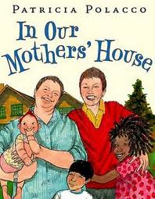
Picture book
Parents complained book “normalizes a lifestyle we don’t agree with”
^{School district behind counter}
^{Said} “advocacy of homosexuality,” violated Utah sex education laws
AW v Davis School Dist. filed Nov. 13, 2012
Notes:
On November 13, 2012, a mother filed a lawsuit against the Davis County Schools in the U.S. District Court for the District of Utah, on behalf of her two children, A.W. and C.W. The Plaintiffs, represented by the ACLU and bringing suit under 42 U.S.C § 1983, sought injunctive and declaratory relief, as well as nominal damages, alleging that the school district violated their First and Fourteenth Amendment rights by removing a children’s book, In Our Mothers’ House, from the library shelves to a restricted access section. The book depicts a same-sex couple and their three adopted children. Specifically, the Plaintiffs alleged that the book should be returned to the regular collection and that similar books should not be restricted from student access. Plaintiffs also sought to class certification.Defendant argued that the book violated Utah’s sex education law, U.C.A. 1953 §53A-13-101, which prohibits sex-education curricula from using instructional materials that advocate homosexuality. Defendant also claimed that because elementary school students have structured time in the library, such time should be treated as part of the curriculum. The matter was referred to alternative dispute resolution on December 11, 2012. It then settled. Defendants agreed to return the book to regular circulation, to not remove the book from libraries for any reason based on its content, and not to rely on Utah Code §53A-13-101 as a basis for content discrimination. Plaintiffs agreed that the book may be restricted on a per-student basis, just as any other book may, at the request of a parent or guardian. As part of the agreement, both parties filed motions to dismiss. The case closed on February 4, 2013.

Slide 29
Picture book
Settled 2013.
School District agreed to return to regular circulation.
Book may be restricted per-student at the request of parent (like any book)
AW v Davis School Dist. settled and dismissed Feb. 4, 2013 1:2012cv00242
http://dockets.justia.com/docket/utah/utdce/1:2012cv00242/86877
Notes:
On November 13, 2012, a mother filed a lawsuit against the Davis County Schools in the U.S. District Court for the District of Utah, on behalf of her two children, A.W. and C.W. The Plaintiffs, represented by the ACLU and bringing suit under 42 U.S.C § 1983, sought injunctive and declaratory relief, as well as nominal damages, alleging that the school district violated their First and Fourteenth Amendment rights by removing a children’s book, In Our Mothers’ House, from the library shelves to a restricted access section. The book depicts a same-sex couple and their three adopted children. Specifically, the Plaintiffs alleged that the book should be returned to the regular collection and that similar books should not be restricted from student access. Plaintiffs also sought to class certification.Defendant argued that the book violated Utah’s sex education law, U.C.A. 1953 §53A-13-101, which prohibits sex-education curricula from using instructional materials that advocate homosexuality. Defendant also claimed that because elementary school students have structured time in the library, such time should be treated as part of the curriculum. The matter was referred to alternative dispute resolution on December 11, 2012. It then settled. Defendants agreed to return the book to regular circulation, to not remove the book from libraries for any reason based on its content, and not to rely on Utah Code §53A-13-101 as a basis for content discrimination. Plaintiffs agreed that the book may be restricted on a per-student basis, just as any other book may, at the request of a parent or guardian. As part of the agreement, both parties filed motions to dismiss. The case closed on February 4, 2013.

Slide 30

Internet
Man looks at porn on the computer.
Another patron complains.
Notes:
http://www.erh.noaa.gov/pbz/images/computer_man.jpg

Slide 31
Legal Definitions
Speech protected under umbrella of First Amendment:
Notes:
As a past Supreme Court Justice, Justice Harlan once wrote: - one man’s vulgarity is another’s lyric
It's impossible to define words like offensive.
As Supreme Court Justice Antonin Scalia wrote back in 1987:
De Gustibus non est disputandum. Just as there is no arguing about taste, there is no use litigating about it
===========
www.ed.gov/Family/RWN/ Activ97/begin.html

Slide 32
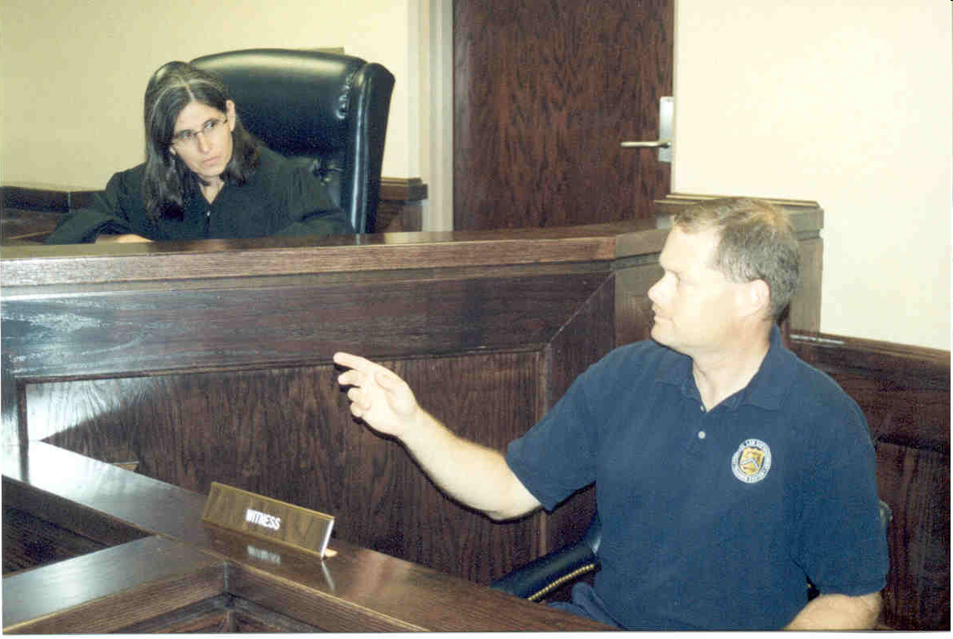
Early lawsuit: Parent sues Livermore
Premises liability
Public nuisance
Public funds waste
… and Constitutional Duty
to Protect child
Parent, Kathleen R. sued Livermore
son downloaded pornography at the library

Slide 33
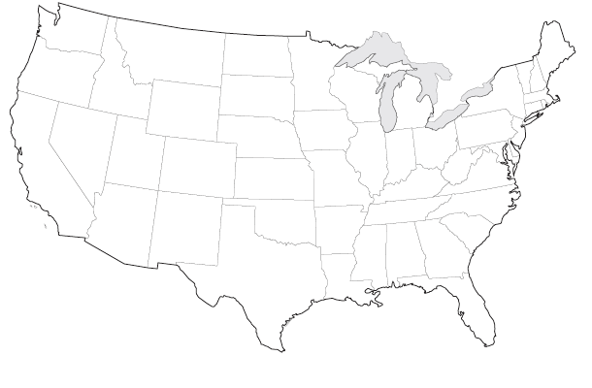
Library Won
Possible state lawsuits:
Premises liability
Public nuisance
Public funds waste
Possible federal lawsuit:
Protect child – constitutional duty
Library immune from suit
No duty to protect child
(federal grounds)
California: Kathleen R. v. City of Livermore,
87 Cal. App. 4th 684 (2001)

Slide 34
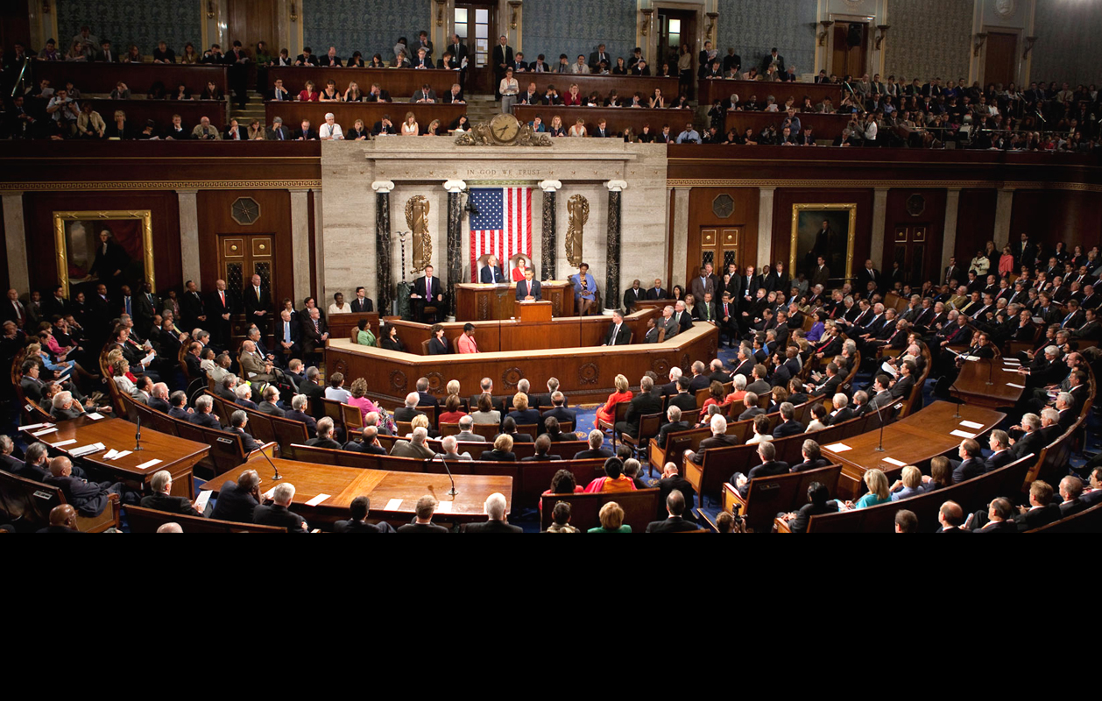
Children’s Internet Protection Act (CIPA)
…requires schools and libraries with specific federal funds* to block
child pornography
obscenity
harmful to minors
*erate discounts and LSTA funds for internet access
Notes:
http://burgess.house.gov/news/email/show.aspx?ID=N63ZXX2VH5OERIAZNH5THWCPRM

Slide 35

U.S. Supreme Court
NOT PROTECTED under
Umbrella of First Amendment
C
O
H
Notes:
=========
www.crh.noaa.gov/ dlh/question.htm

Slide 36

First Amendment does not protect
Child Pornography
Obscenity
Harmful to Minors
Notes:
=========
www.crh.noaa.gov/ dlh/question.htm

Slide 37

Child Pornography
Image of minor "sexually explicit conduct”
None at home
No research purpose
DO NOT UNBLOCK!
Call Police
Cybertipline.com or call 1-800-843-5678 (1-800-THE-LOST)
CIPA cites 18 U.S.C. Sec. 2256;
PROTECT ACT Signed into law April 30, 2003; See 18 U.S.C. §2256(B);
Notes:
CIPA refers to other sections of the federal code to give definitions of C-O-H, and in the handout, I wrote an article pulling out these definitions in full, because I didn't see that anyone else had done it.
I think everyone just figured they know it when they see it... and that's not the legal definition.
Child pornography, according to federal law that the Children's Internet Protection Act references,
refers to Visual depiction of minor (under 18) engaged in
"sexually explicit conduct."
Sexually explicit conduct is actual or simulated:
(A) sexual intercourse, including genital-genital, oral-genital, anal-genital, or oral-anal, whether between persons of the same or opposite sex;
(B) bestiality;
(C) masturbation;
(D) sadistic or masochistic abuse; or
(E) lascivious exhibition of the genitals or pubic area of any person
None at home
No bonafide research purpose
... so don't unblock these sites for a patron...who says they are doing research ..
People who say they were journalists, researchers are IN JAIL NOW because child pornography was on their hard drives.
[U.S. v Matthews, 209 F.3d 338 (4th Cir. 2000) NPR journalist wrote series on CP - claimed newsgathering solely - imprisoned - no defense no jury allowed - disseminates harm to children][must have scienter - knowingly transport, but need not be bad motive-Matthews failed to inform FBI of his research]
========
jail:
www.attorneygeneral.gov/team_up/ slides/slide2.cfm

Slide 38
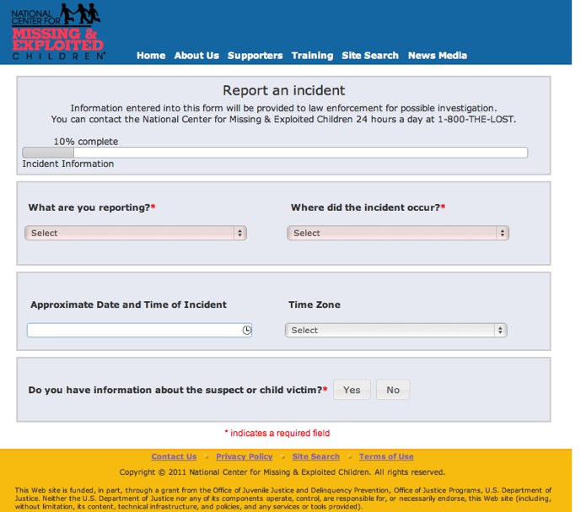
Cybertipline.com

Slide 39

What about man with his own laptop or mobile device?
United States v. Talley, 392 Fed. Appx. 129, 2010 U.S. App. LEXIS 17058 (4th Cir. Va. 2010); cert. den. 131 S. Ct. 84 (2010)
Notes:
http://nihseniorhealth.gov/olderdrivers/whendrivingskillschange/man_on_computer_popup.html

Slide 40
What about man with his own laptop or mobile device?
Child Pornography is ILLEGAL
Any device
United States v. Talley, 392 Fed. Appx. 129, 2010 U.S. App. LEXIS 17058 (4th Cir. Va. 2010); cert. den. 131 S. Ct. 84 (2010)
Notes:
http://nihseniorhealth.gov/olderdrivers/whendrivingskillschange/man_on_computer_popup.html

Slide 41

Key Point
It’s not censorship to report child pornography.
Child pornography is against the law.

Slide 42
Obscenity
Community standards find prurient interest
Patently offensive sexual conduct defined by state law … and
Taken as a whole lacks serious literary, artistic, political, or scientific value.
CIPA cites 18 U.S.C. § 1460; Courts likely to apply Miller v. California, 413 U.S. 15, 24 (1973). See also "Judicial Erosion of Protection for Defendants in Obscenity Prosecutions?: When Courts Say, Literally, Enough is Enough and When Internet Availability Does Not Mean Acceptance.” Harvard Journal of Sports & Entertainment Law, (Spring 2010) http://tinyurl.com/obscenityprosecutions
Notes:
By now you've probably heard of the Miller test - the legal definition of obscenity brought to us by the Supreme Court.
To illuminate a little, it is MUCH narrower than most people think. To be legally obscene, an item must satisfy three multipart conditions
First, “the average person, applying contemporary community standards” must find that the work, taken as a whole, appeals to the prurient interest,
community standards is determined by a jury selected from the community ...
it must appeal to the PRURIENT interest - it must turn you on...
the court has gone on to refine that definition further - it must not only be prurient, but it must appeal to a shameful morbid lust, not a healthy normal sexual reaction
second, the work must depict sexual conduct in a patently offensive way ... as my Stanford law school professor, Kathleen Sullivan explained it in laymans language,
that means it must gross you out
... In fact, she is famous for saying:
it must turn you on and gross you out at the same time...
it must be obscene by STATE LAW. Where I'm from in California is obviously going to be different from other states, but NO STATE can go further than the Miller definition
Finally, the work must lack serious literary artistic political or scientific value.
This is a national standard, so even if you're in a state with the strictest obscenity laws like Tennessee, if there is some serious value to the work, it is not obscene.
Legal advice to cyberporn producers is to be sure to put links to safe sex sites etc to add to the taken as a whole serious criteria.
Jeffrey Douglas an adult industry lawyer who's tracked obscenity convictions nationwide, has said that as for ADULTS, just about anything is permissible, with possible exceptions of bestiality, necrophilia, incest, rape...and even then if you can show it was a dream, you may be okay
--------
"a work may be subjected to state regulation if (a) whether 'the average person, applying contemporary, community standards' would find that the work, taken as a whole, appeals to the prurient interest; (b) whether the work depicts or describes, in a patently offensive way, sexual conduct specifically defined by the applicable state law; and (c) whether the work, taken as a whole, lacks serious literary, artistic, political or scientific value
Miller v. California, 413 U.S. 15, 24 (1973). In Miller, the Court reviewed a criminal conviction against a commercial vendor who mailed brochures containing pictures of sexually explicit activities to individuals who had not requested such materials.
57. Miller, 413 U.S. at 24. The decision offers some further clarification: "Under the holdings announced today, no one will be subject to prosecution for the sale or exposure of obscene materials unless these materials depict or describe patently offensive "hard core" sexual conduct specifically defined by the regulating state law, as written or construed." Id. 413 U.S. at 27. Later, in Jenkins v. Georgia, 418 U.S. 153 (1974), the Supreme Court reversed the conviction of a movie theater owner for showing the film, Carnal Knowledge. The Court held that the First Amendment would not allow the materials to be labeled obscene unless they "depict or describe patently offensive `hard-core' sexual conduct."

Slide 43
Harmful to Minors
“harmful to minors” means any picture, image, graphic image file, or other visual depiction that–
taken as a whole and with respect to minors, appeals to a prurient interest in nudity, sex, or excretion;
(B) depicts, describes, or represents, in a patently offensive way with respect to what is suitable for minors, an actual or simulated sexual act or sexual contact, actual or simulated normal or perverted sexual acts, or a lewd exhibition of the genitals; and
(C) taken as a whole, lacks serious literary, artistic, political, or scientific value as to minors.
Children’s Internet Protection Act (Pub. L. 106-554)
Notes:
Now, to the heart of the matter:
Harmful to Minors material
this is where the real concern is ... material that is considered harmful to children
Until CIPA, was relegated to state law, and I listed the NC law on the handout on the last page. NC law, by the way, offers librarians a defense to librarians carrying out legitimate functions
... some other states have similar provisions, written before the Net, to ensure that libraries could let kids check out art books on Michelangelo and the like without any second guessing themselves
So what is the definition of HM that CIPA uses?
It's the first federal definition for HM, and as you know, applies only to libraries and schools that take specified federal monies are concerned.
It's modeled on the obscenity definition for adults, but uses a standard ...
"with respect to minors"
which in practice (at least from what we've seen from state courts using similar definitions)
means soft core pornography.
Playboy, thus could be found harmful to minors, but never obscene for adults.
--------
NC ST § 14-190.15 (2003) Disseminating harmful material to minors; exhibiting harmful performances to minors
(a) Disseminating Harmful Material. -- A person commits the offense of disseminating harmful material to minors if, with or without consideration and knowing the character or content of the material, he: (1) Sells, furnishes, presents, or distributes to a minor material that is harmful to minors; or (2) Allows a minor to review or peruse material that is harmful to minors.
…
(c)(2) [affirmative defense when...] The defendant was a school, church, museum, public library, governmental agency, medical clinic, or hospital carrying out its legitimate function; or an employee or agent of such an organization acting in that capacity and carrying out a legitimate duty of his employment.
…

Slide 44
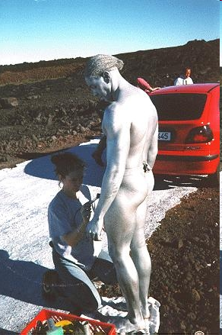
Harmful to Minors (part of CIPA)
NEW to federal law
The term “harmful to minors” means any picture, image, graphic image file, or other visual depiction that--
(A) taken as a whole and with respect to minors, appeals to a prurient interest in nudity, sex, or excretion;
(B) depicts, describes, or represents, in a patently offensive way with respect to what is suitable for minors, an actual or simulated sexual act or sexual contact, actual or simulated normal or perverted sexual acts, or a lewd exhibition of the genitals; and
(C) taken as a whole, lacks serious literary, artistic, political, or scientific value as to minors.
SEXUAL
Children’s Internet Protection Act (Pub. L. 106-554)
Notes:
A point I want to really emphasize is that the definition is based wholly on sex.
Wholly on sex, even the excretion portion refers to prurient interests.
Even the use of Excretion in the definition refers to a PRURIENT interest in excretion ... there must be a sexual interest in it
Thus... hate sites, violent sites, disgusting sites, are NOT considered harmful to minors... according to the courts
=====
http://www.mlo.noaa.gov/Tours/ROAD/silver3.jpg

Slide 45
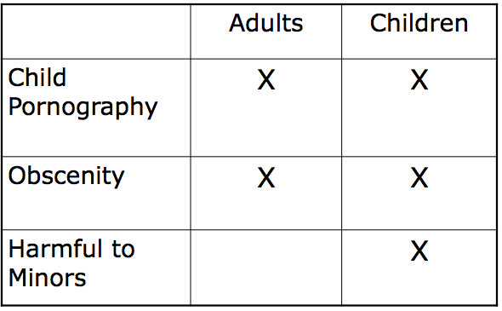
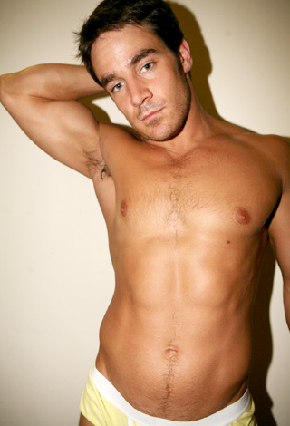
Libraries with E-Rate discounts and certain LSTA funds *
Required to block or filter “visual depictions”
CIPA images to block
SEXUAL
Not merely nudity
*for Internet serivce or internal connections. Also applies to libraries with LSTA grants for computers and direct costs to access the Internet
CIPA cites 18 U.S.C. § 1460; Courts likely to apply Miller v. California, 413 U.S. 15, 24 (1973). See also "Judicial Erosion of Protection for Defendants in Obscenity Prosecutions?: When Courts Say, Literally, Enough is Enough and When Internet Availability Does Not Mean Acceptance.” Harvard Journal of Sports & Entertainment Law, (Spring 2010) http://tinyurl.com/obscenityprosecutions
Notes:
By now you've probably heard of the Miller test - the legal definition of obscenity brought to us by the Supreme Court.
To illuminate a little, it is MUCH narrower than most people think. To be legally obscene, an item must satisfy three multipart conditions
First, “the average person, applying contemporary community standards” must find that the work, taken as a whole, appeals to the prurient interest,
community standards is determined by a jury selected from the community ...
it must appeal to the PRURIENT interest - it must turn you on...
the court has gone on to refine that definition further - it must not only be prurient, but it must appeal to a shameful morbid lust, not a healthy normal sexual reaction
second, the work must depict sexual conduct in a patently offensive way ... as my Stanford law school professor, Kathleen Sullivan explained it in laymans language,
that means it must gross you out
... In fact, she is famous for saying:
it must turn you on and gross you out at the same time...
it must be obscene by STATE LAW. Where I'm from in California is obviously going to be different from other states, but NO STATE can go further than the Miller definition
Finally, the work must lack serious literary artistic political or scientific value.
This is a national standard, so even if you're in a state with the strictest obscenity laws like Tennessee, if there is some serious value to the work, it is not obscene.
Legal advice to cyberporn producers is to be sure to put links to safe sex sites etc to add to the taken as a whole serious criteria.
Jeffrey Douglas an adult industry lawyer who's tracked obscenity convictions nationwide, has said that as for ADULTS, just about anything is permissible, with possible exceptions of bestiality, necrophilia, incest, rape...and even then if you can show it was a dream, you may be okay
--------
"a work may be subjected to state regulation if (a) whether 'the average person, applying contemporary, community standards' would find that the work, taken as a whole, appeals to the prurient interest; (b) whether the work depicts or describes, in a patently offensive way, sexual conduct specifically defined by the applicable state law; and (c) whether the work, taken as a whole, lacks serious literary, artistic, political or scientific value
Miller v. California, 413 U.S. 15, 24 (1973). In Miller, the Court reviewed a criminal conviction against a commercial vendor who mailed brochures containing pictures of sexually explicit activities to individuals who had not requested such materials.
57. Miller, 413 U.S. at 24. The decision offers some further clarification: "Under the holdings announced today, no one will be subject to prosecution for the sale or exposure of obscene materials unless these materials depict or describe patently offensive "hard core" sexual conduct specifically defined by the regulating state law, as written or construed." Id. 413 U.S. at 27. Later, in Jenkins v. Georgia, 418 U.S. 153 (1974), the Supreme Court reversed the conviction of a movie theater owner for showing the film, Carnal Knowledge. The Court held that the First Amendment would not allow the materials to be labeled obscene unless they "depict or describe patently offensive `hard-core' sexual conduct."

Slide 46
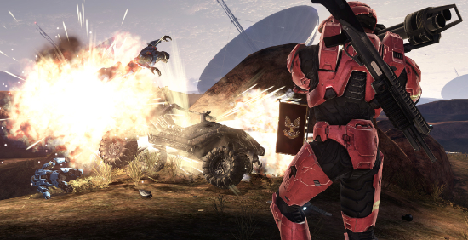
Is Graphic Violence
Harmful to Minors?
Supreme Court:
No
Brown v. Entertainment Merchants Assn., 131 S. Ct. 2729 (2011)
Notes:
http://thisismynext.com/2011/06/27/supreme-court-video-games-protected-free-speech-analysis/

Slide 47
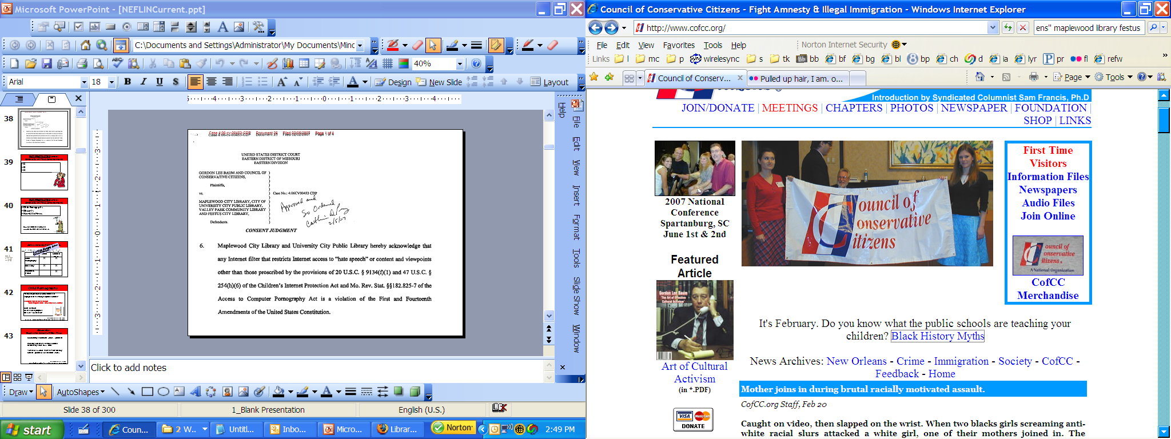
May Library Filter Hate Sites?
Not recommended.
CONSENT JUDGMENT: LIBRARY REMOVES HATE FILTERS
Libraries sued for blocking hate sites
www.cofcc.org/
Baum v Maplewood City Library et al – Consent Judgment Feb. 5, 2007 (libraries acknowledge filters restricting hate speech or content other than that proscribed by CIPA is a violation of First and Fourteenth http://tinyurl.com/hatefilters

Slide 48

May a School Filter LGBT Sites?
Missouri school uses URL Blacklist (free).
Blocks categories “pornography” “sexuality”
PFLAG claimed it blocks sites expressing a positive viewpoint towards LGBT
Students could request unblocking, but not completely anonymously
Parents, Families, and Friends of Lesbians and Gays v. Camdenton R-III School District, 2:11-cv-04212
Notes:
http://en.wikipedia.org/wiki/File:Nuvola_LGBT_flag_borderless.svg

Slide 49
No. Viewpoint Discrimination.
School district must stop
blocking LGBT websites,
submit to monitoring of its filtering practices for 18 months
and pay the ACLU’s $125,000 attorney fees
Parents, Families, and Friends of Lesbians and Gays v. Camdenton R-III School District, 2:11-cv-04212
Notes:
http://en.wikipedia.org/wiki/File:Nuvola_LGBT_flag_borderless.svg
Reports from legal counsel Theresa Chmara focused on the Sarah Bradburn et. al. v. North Central Regional Library District (Washington state) filtering decision in a public library and the two filtering lawsuits in Missouri filed by the ACLU. The PFLAG v. Camdenton R-ILL School District (Missouri) decision resulted in the judge requiring that the school’s filter stop its viewpoint discrimination of pro-GLBT websites while at the same time allowing anti-GLBT websites to be accessible. Barbara Stripling was an expert witness in this case, and it is felt that her testimony was very influential in the judge’s decision. The court’s judgment is: the school district must stop blocking LGBT websites, submit to monitoring of its filtering practices for 18 months, and pay the ACLU’s $125,000 attorney fees. Although narrow in scope, this is a second win in the battle over filtering in schools, the first being another ACLU lawsuit in Tennessee in 2009. As a result of the Sarah Bradburn et. al. v. North Central Regional Library District decision, the FTRF will be focusing its future efforts on educating about filtering in public and school libraries.

Slide 50

Is Filtering Internet a removal of library content?
It’s complicated.
WA Supreme Court (6-3): Internet sites are part of collection development.
No need to disable filters.
Law: Library may disable "to enable access for bona fide research or other lawful purposes”
U.S. Supreme Court (2003): Concerns dispelled by the ease with which patrons may have filtering disabled.
47 U.S.C. § 254(h)(6)(D) (E-rate: disabling permitted for adults); 20 U.S.C. § 9134(f)(3) (disabling permitted without mention of age); Anten, Todd. (Fall, 2005). Note: "Please Disable the Entire Filter": Why Non-Removable Filters on Public Library Computers Violate the First Amendment, 11 Texas Journal on Civil Liberties & Civil Rights 65; Mary Minow. (April 5, 2004). Lawfully Surfing the Net: Disabling Public Library Internet Filters to Avoid More Lawsuits in the United States First Monday, firstmonday.org/issues/issue9_4/minow/; Bradburn v. North Central Regional Library District (WA Supreme Court upholds library policy of no disabling)(now pending in federal court http://tinyurl.com/filterdisabling
Notes:
http://www.state.gov/cms_images/12Des_KidsChairs600.jpg
http://www.dnr.sc.gov/hunting/archery/images/archerypic.jpg
Washington – disabling versus unblocking sites

Slide 51
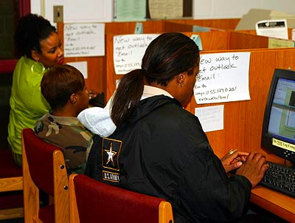
Joint school / public library
Library worthy mission of facilitating learning, research, and recreational pursuits.
Not required to provide “universal coverage” and enjoys “broad discretion to decide what material to provide to [its] patrons.”
Bradburn v North Central Regional Library District, 2012 U.S. Dist. LEXIS 50360 (April 10, 2012);See also U.S. v. American Library Association, 539 U.S. 194 (2003)(upheld filters, noting that librarians can disable on request)

Slide 52
Responding to Challenges
Constitution
Federal Law
State Laws
Local laws
Library Policies
Where does ALA Code of Ethics fit in?

Slide 53

Responding to Challenges
Code of Ethics
equitable access, unbiased, and courteous responses to all …
Library Bill of Rights
right to use library not denied or abridged because
origin, age, background, or views
Notes:
ALA amends the Library Bill of Rights to support “the rights of an individual to the use of a library should not be denied or abridged because of his race, religion, national origins, or political views.”
http://www.ofmdfmni.gov.uk/image6-2.gif
http://www.flickr.com/photos/12392252@N03/2730564719/

Slide 54

Personal v. Professional
Code of Ethics
We do not allow
our personal beliefs to interfere with access to information.
Vegetarian librarian opposed to cookbooks with hamburgers

Slide 55
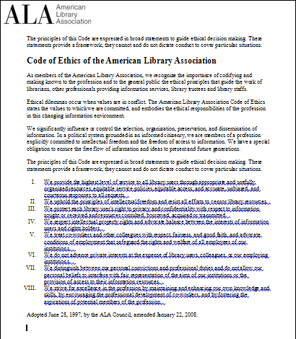
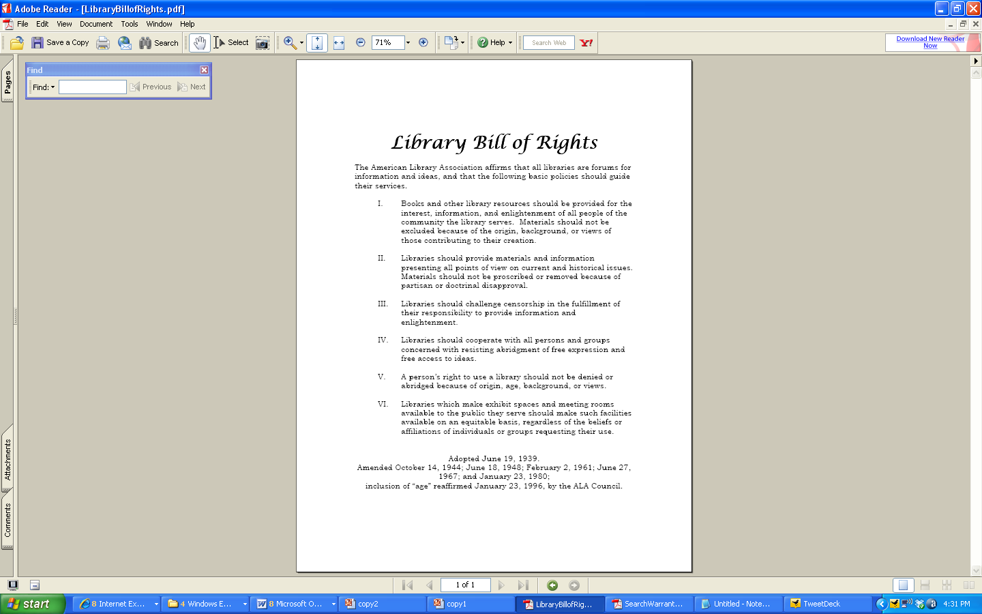
TODAY: American Library Association Code of Ethics & Bill of Rights
Notes:
Every professional group has a code of ethics
Anthropology – american assn code of ethics and society for applied anthropology code of ethics
Engineering code of ethics
APA

Slide 56
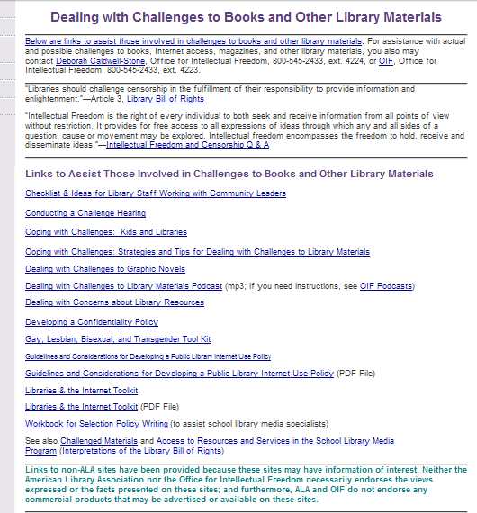
Key point:
Use library policy
REMOVAL DECISIONS MADE BY DIRECTOR AND BOARD
Resources:
ALA Office for Intellectual Freedom
800-545-2433, ext. 4223
http://tinyurl.com/ydtbwp3
Notes:
HINGHAM - A high-risk sex offender from Norwell will be charged with possession of child pornography after he was caught printing photos of naked children off the Internet at the Hingham Public Library.
Mark R. Sullivan, 40, of 125 Forest St., a registered Level 3 sex offender, is being held at Plymouth County Jail until his next court appearance on March 22.
Hingham Police Lt. Michael Peraino said that on the afternoon of Feb. 14, an unidentified library employee went to check on a computer on which he had just installed new software, and saw Sullivan printing something from that computer.
The employee asked Sullivan how the computer was working; after Sullivan said, ‘‘Fine,’’ the employee saw he was printing a nude picture of a girl about 10 years old.
The employee took the picture out of printer, saying the library didn’t allow such images to be printed. Sullivan grabbed it, saying it was an accident and that it had popped up on his screen.
When asked why he was printing a popup, Sullivan mumbled that it wouldn’t happen again, Peraino said.
The library employee alerted director Dennis Corcoran, who confronted the man and told him library computers are not to be used to view such images. This morning, Corcoran said he called police within 30 minutes after the staffer saw the image Sullivan had downloaded. He said police called the library back a little after 12:30 p.m. that day, and spoke with him and other staff members later that afternoon.
Corcoran said a staff member found Sullivan’s Massachusetts Sex Offender Registry listing about 7:30 that night.
A police search of criminal records showed that Sullivan had been found guilty of possession of child pornography three times in the past, and was currently on probation through Plymouth County Superior Court.
Corcoran said Sullivan stayed at the library ‘‘for a while’’ after he was confronted, then left on his own.
‘‘We obviously didn’t know he was a Level 3 sex offender when this happened,’’ the director said.
After Sullivan left, the staff didn’t allow anyone else to use the computer, and when the library closed, a staff member checked the computer’s Internet browser history to see which Web sites Sullivan had visited.
The employee found a number of Russian Web sites showing nude children, and Web sites where someone could purchase police badges and uniforms.
The computers in the children’s section of the library have security filters on them, but the other computers in the library don’t.
The employee also saw that Sullivan had visited various South Shore police department Web sites, to see how each town displayed its sex offender registry. He also visited the state Sex Offender Registry, and searched for his own name.
When the employee did a search for Sullivan’s name, a picture of him came up, showing he was a Level 3 sex offender, registered in Norwell.
This morning Corcoran said Sullivan was a ‘‘quasi-known, quirky person’’ who had visited the library a number of times over the past six months. He said he observed Sullivan for about an hour late last summer, after a female patron complained about Sullivan’s distracting behavior.
The patron told Corcoran she thought Sullivan was looking at child images on one of the computers.
On Friday, Sullivan was called into court by his probation officer, and was put into police custody.
Sullivan will be arraigned in Hingham District Court on March 22 on a charges of a third and subsequent offense of possession of child pornography along with a probation violation hearing scheduled for that day.
Sullivan was convicted on March 12, 2001, on seven counts of possession of child pornography and three counts of posing or exhibiting a child in a state of nudity or sexual conduct.
He spent 60 days of a 2½ -year sentence in prison, and was currently on probation.
If convicted, Sullivan could face 10 years in prison and a fine of not less than $10,000 but not more than $30,000.
Norwell Police Sgt. John Suurhans said that police there had not received any complaints about Sullivan since he moved to town. As a Level 3 sex offender, Sullivan’s photo is on posters at all the schools in Norwell as well as day care centers, grocery stores, gyms, town hall, the post office and the library.
A neighbor of Sullivan’s who asked not to be named said that he’d seen Sullivan walking through the neighborhood regularly and had seen his photo at the post office but had never met him.
Reporter Diana Schoberg contributed to this article.
Kristen Walsh may be reached at KRWalsh@ledger.com
Police said that Sullivan, on Feb. 14, used a computer at the Hingham library to peruse Web sites containing pictures of nude children, and that he printed out a photo of a naked girl who appeared to be about 10.
A library employee said he saw Sullivan print the picture. The employee was able to keep a portion of the picture, which tore when he tried to pull it from Sullivan’s hand. The library worker reported the incident to Library Director Dennis Corcoran, who confronted Sullivan and called police.

Slide 57
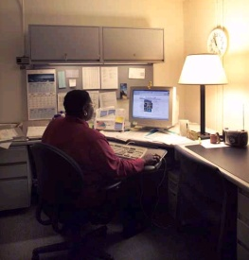



First Amendment and Public Forums
purpose
Nonpublic
Forum
Public Forum
Limited Public Forums
Cultural
Notices
Govt office
Nonprofit
Flyers
Public
meeting
room
street

Slide 58
Public Comments in
Limited Public Forum
Define purpose of the space
    Broad: Library services
    Narrow: Reading game
Ask for civility (but don’t enforce)
Remove OFF TOPIC
    Cialis
    Personal attacks that are off topic
Bury offensive posts
OFF TOPIC!

Slide 59

Want More Control?
Treat online space as a newsletter with letters to the editor
“Government speech”
Content is determined
by library

Slide 60
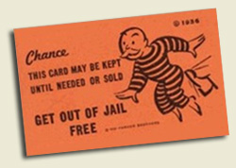
But isn’t the library responsible for libel?
No.
Matchmaker.com not liable when user posted false profile for Star Trek actress
Carafano v. Metrosplash.com, Inc., 339 F.3d 1119 (9th Cir. 2003)
Sect. 230 broad protection – from false information, negligence, sexually explicit content, discrimination
No provider or user of an interactive computer service shall be treated as the publisher or speaker of any information provided by another information content provider. 47 USC§ 230(c)
Notes:
for false information negligence, sexually explicit content, discrimination etc. BUT don’t ASK for illegal content

Slide 61

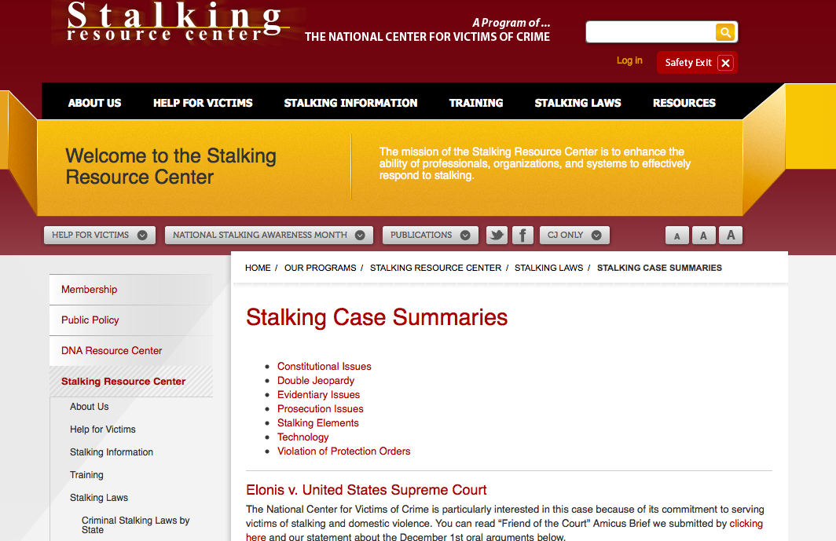
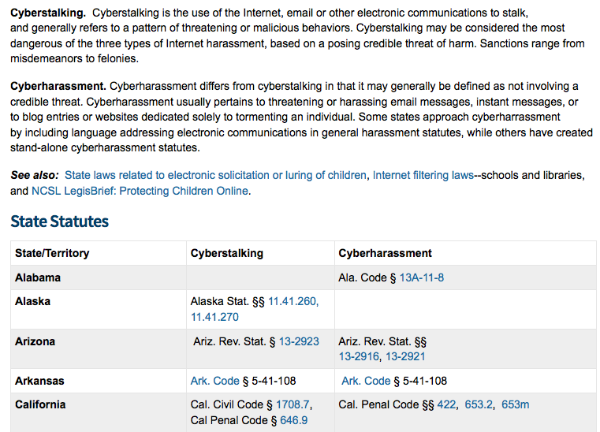
Very tough to show threats, stalking
Pending case before Supreme Court: Elonis v. United States
Notes:
U.S. Supreme Court hears case on social media speechFrost Brown Todd LLCUSAJanuary 30 2015 In December, the Supreme Court of the United States heard oral arguments in Elonis v. United States. This case concerns holding individuals criminally liable for comments made on social media that are considered “true threats.” Elonis made multiple posts on Facebook concerning his desire to kill his ex-wife, law enforcement officials, and school students. He was convicted of threatening another person over the interstate lines (the internet) in violation of 18 U.S.C. § 875(C). At issue is whether a conviction under the statute requires proof of the defendant’s subjective intent to threaten, or whether it is enough to show that a “reasonable person” would regard the statement as threatening.This is the Supreme Court’s first case involving the limits of speech on social media. Elonis argued that the government must prove that he specifically intended his speech to be taken as a threat. Alternatively, the federal government requests the Court to apply a “reasonable person” standard, and hold that if a “reasonable person” would interpret an internet rant as a “true threat,” then that should be enough to hold the speaker as criminally responsible.

Slide 62


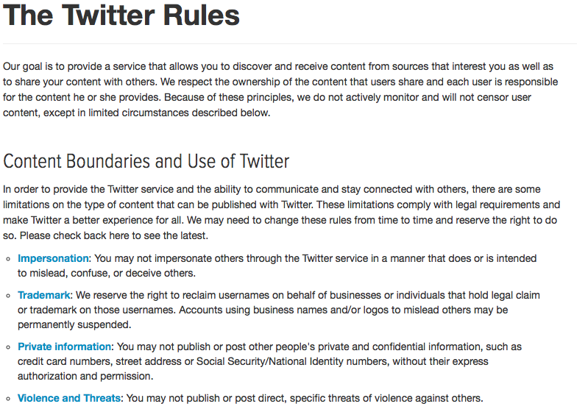

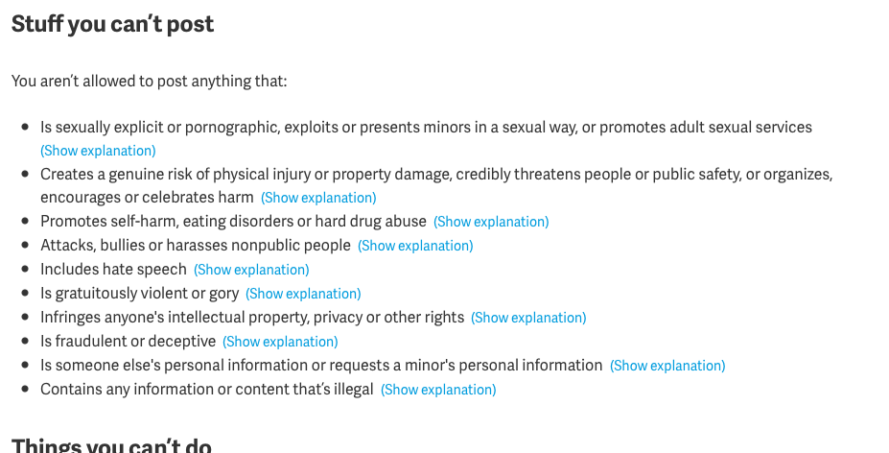
Terms of Service
https://www.facebook.com/legal/terms
https://about.pinterest.com/en/acceptable-use-policy
https://support.twitter.com/articles/18311-the-twitter-rules

Slide 63
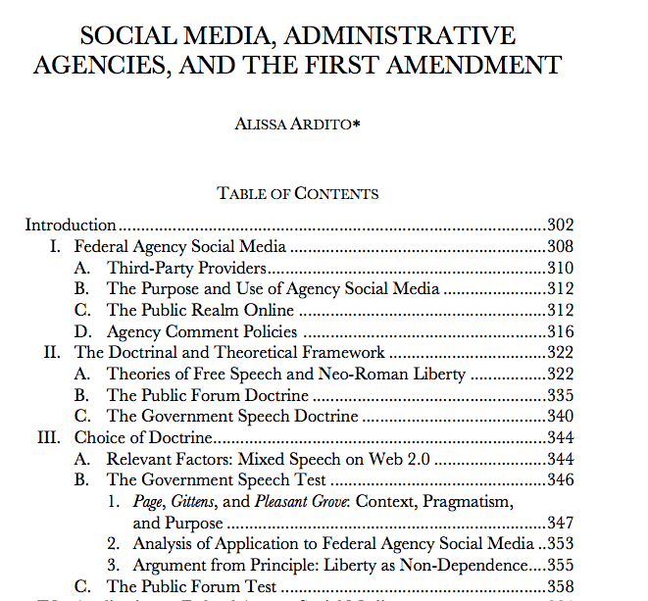
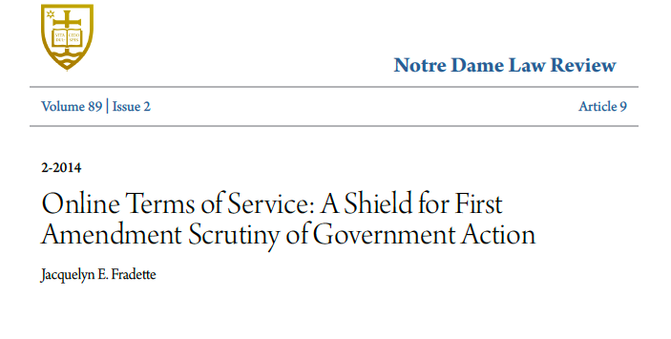
Further Reading
http://politicalscience.yale.edu/sites/default/files/ardito_alissa_socmediaadminagenciesandfirstamend.pdf

Slide 64
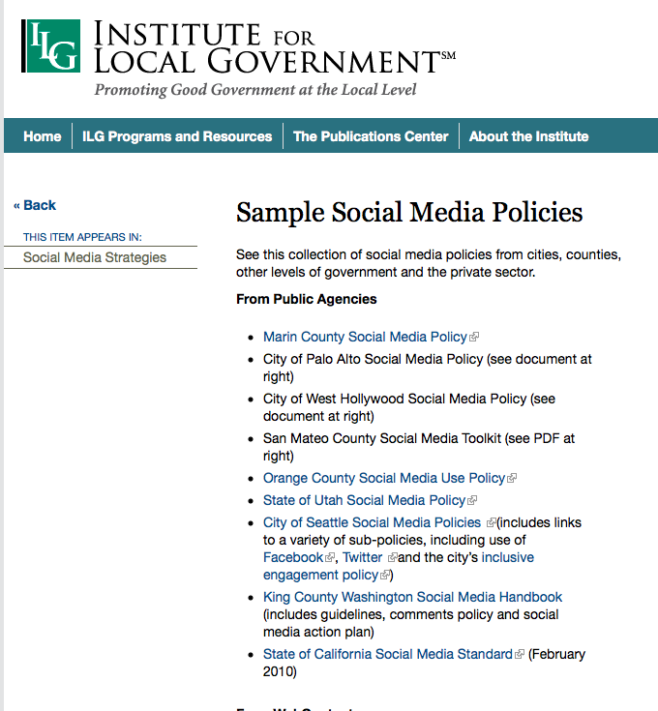
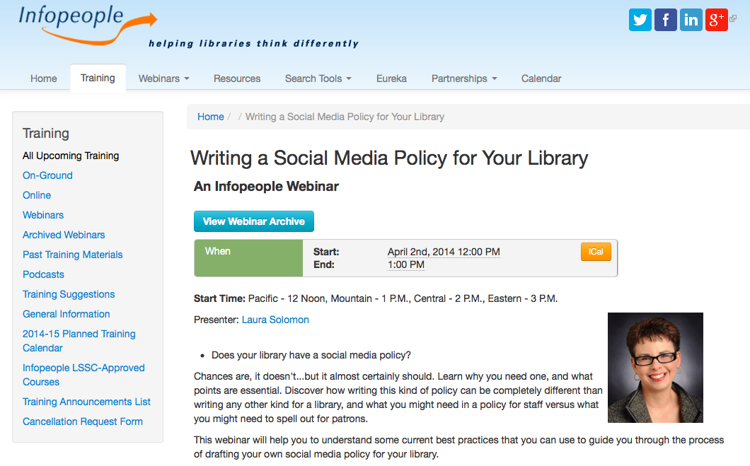
Employees and Social Media
You heard that a library worker in the next county was reprimanded for a post she put on the library's social media site. Now you wonder about writing your next posts for your library.
Library determines official speech
http://www.ca-ilg.org/post/sample-social-media-policies
Graziosi v. City of Greenville, No. 13-60900 (5th Cir. Jan. 9, 2015)
Notes:
http://blog.ericgoldman.org/archives/2015/01/police-officers-facebook-post-criticizing-chiefs-budget-decision-justified-termination-graziosi-v-greenville.htm
Employees have the right to
speak as private citi
zens on matters of
public concern, but that right must be weighed against the legitimate interest, as an employer, in ma
intaining an effective workforce.

Slide 65

Social Media Speech as Private Citizen
Public employees, (unlike private) do have some limited First Amendment rights to speak out on matters of public concern.
Court must find YES to all three … or
1) Private (not workplace) speech?
2) Public concern? Corruption?
(mere gripes don’t qualify)
3) Does public interest outweigh employer’s interest in maintaining order?
employee loses
e.g. off duty police officer terminated after criticizing chief on Facebook. Loses case.
Graziosi v. Greenville, No. 13-60900 (5th Cir. Jan. 9, 2015)
But note: Speech protected for some “concerted activity” e.g. union organizing http://www.nlrb.gov/news-outreach/fact-sheets/nlrb-and-social-media
Notes:
http://blog.ericgoldman.org/archives/2015/01/police-officers-facebook-post-criticizing-chiefs-budget-decision-justified-termination-graziosi-v-greenville.htm
Employees have the right to
speak as private citi
zens on matters of
public concern, but that right must be weighed against the legitimate interest, as an employer, in ma
intaining an effective workforce.

Slide 66
Recap
Library shelves
– Books (schools and public libraries)
- Internet
Responding to challenges
- American Library Association
Social Media update
- Public and staff posts
Legal information, not legal advice

Slide 67
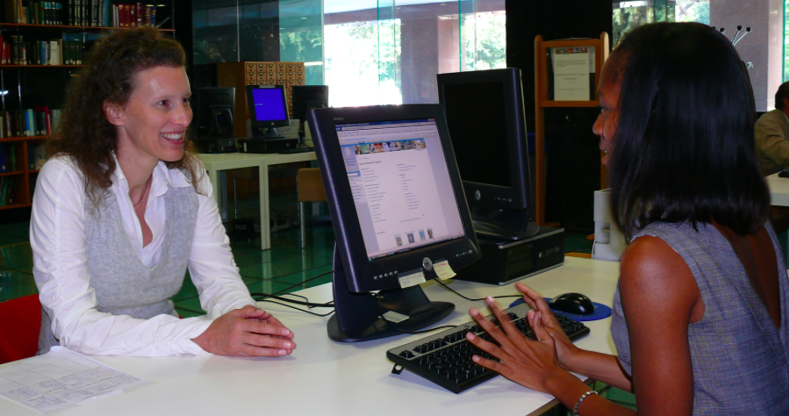
Social Media
Public comments
One public comment on the library's social media site seems like a slur and another seems like a threat. Should you remove them?
Notes:
http://upload.wikimedia.org/wikipedia/en/6/63/DLML_reference_desk.jpg

Slide 68

Questions

Slide 69
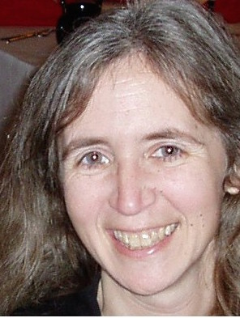
Thank you
minow@librarylaw.com

Slide 70
Infopeople webinars are supported in part by the U.S. Institute of Museum and Library Services under the provisions of the Library Services and Technology Act, administered in California by the State Librarian. This material is licensed under a Creative Commons 3.0 Share & Share-Alike license. Use of this material should credit the author and funding source.

