Slide 1



Teen Learning Labs
Presented by Corey Wittig
Digital Learning Librarian
Tuesday, February 24, 2015
an Infopeople webinar
Notes:
Introduction

Slide 2
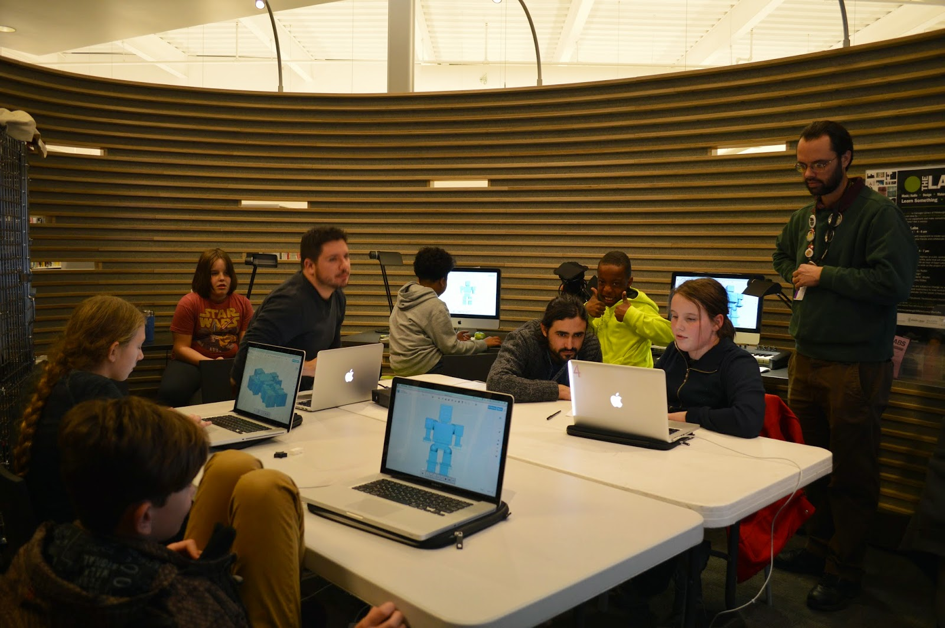
Key Concepts of
Informal Learning in Libraries
Mentor Led
Interest-based
Youth-centered
Collaborative learning
Traditional and Digital Media
Notes:
Youth-Centered (not resource-centered)

Slide 3
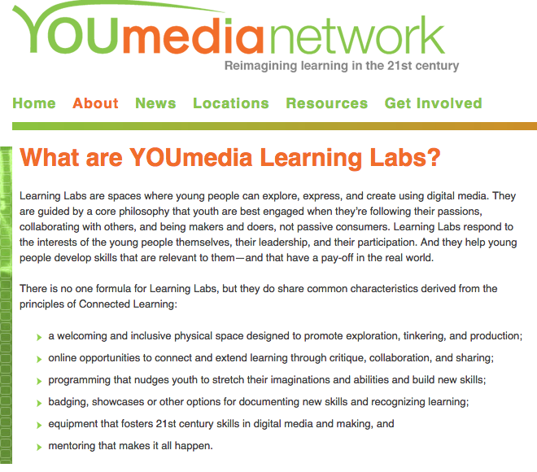
Youmedia.org
Notes:
YOUmedia – the first “Learning Lab”

Slide 4

History of Teen Learning Labs in Libraries
YOUmediaChicago.org

Slide 5
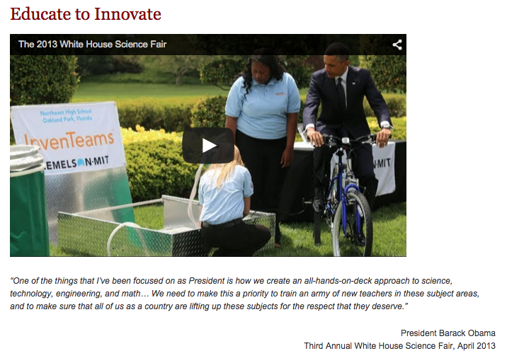
President Obama’s “Educate to Innovate” program
Whitehouse.gov
Notes:
That’s why in November 2009, The President launched the Educate to Innovate initiative to move American students from the middle of the pack in science and math to the top over the next decade (whitehouse.gov). President asked for public/private partnerships to support the initiative and MacArthur/IMLS partnered for IMLS LL grants (LL report)

Slide 6
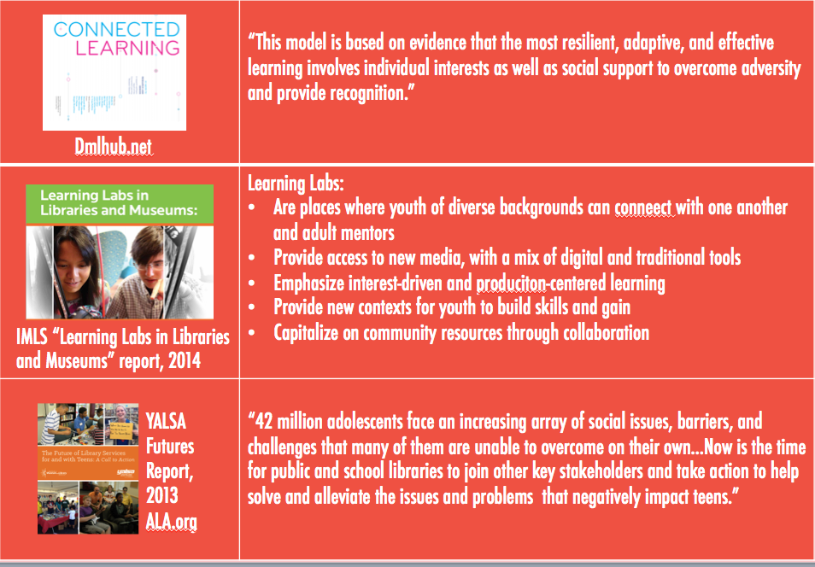
Research/Reports
& Takeaways

Slide 7
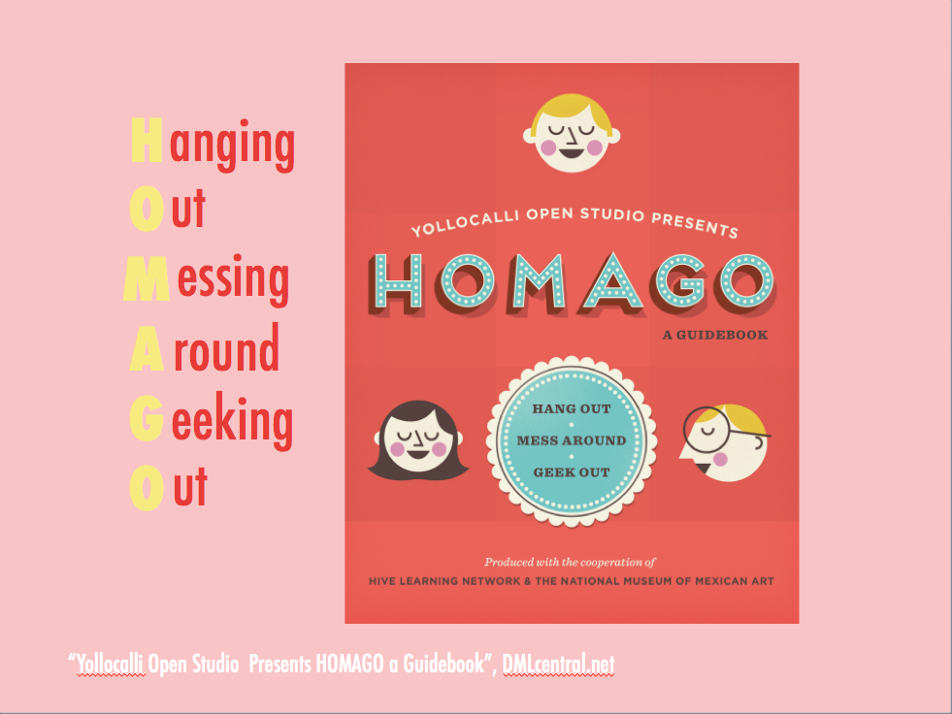
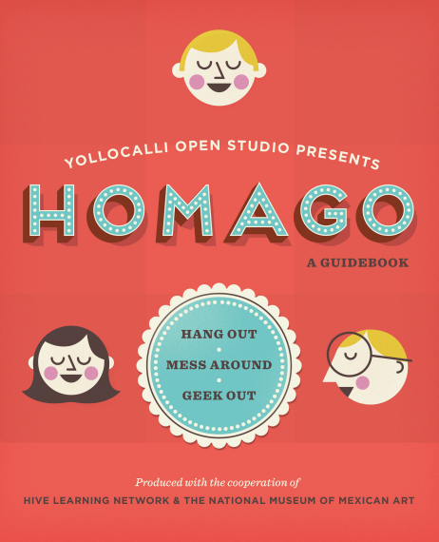
H
O
M
A
G
O
anging
ut
essing
round
eeking
ut
“Yollocalli Open Studio Presents HOMAGO a Guidebook”, DMLcentral.net

Slide 8

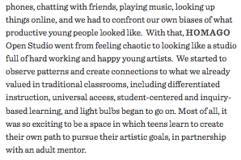
H
O
M
A
G
O
“Yollocalli Open Studio Presents HOMAGO a Guidebook”, DMLcentral.net

Slide 9
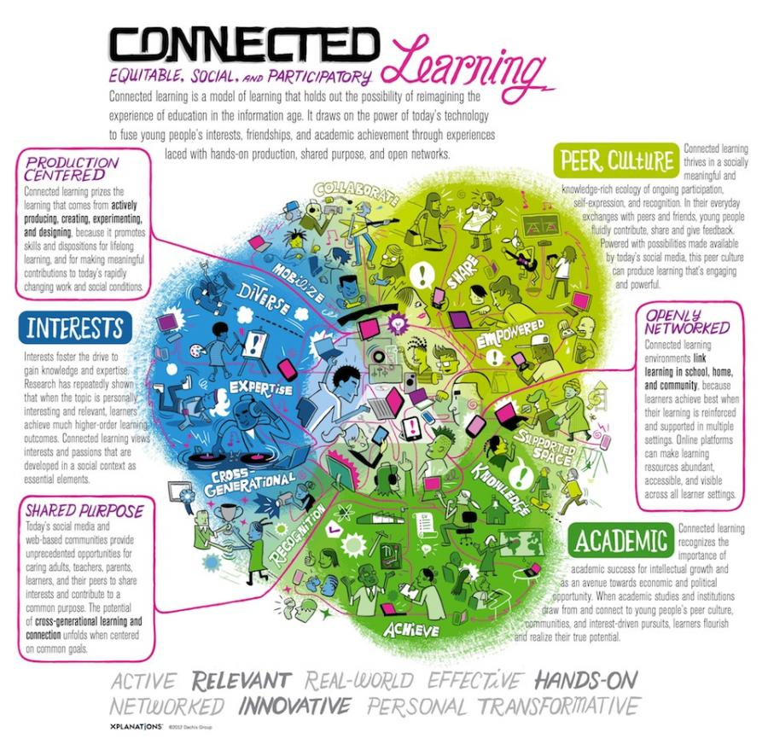
Connected Learning Theory
Connected Learning Research Network and Digital Media & Learning Research Hub

Slide 10
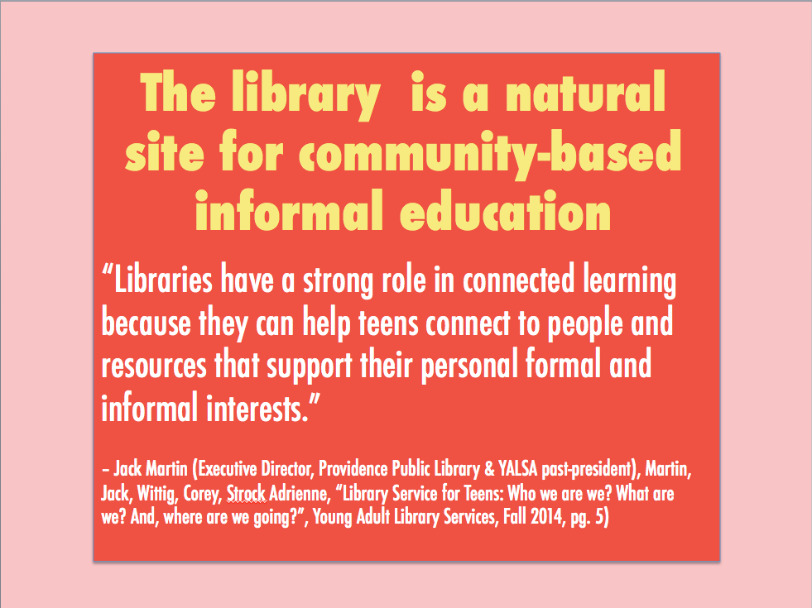
The library is a natural site for community-based informal education
“Libraries have a strong role in connected learning because they can help teens connect to people and resources that support their personal formal and informal interests.”
– Jack Martin (Executive Director, Providence Public Library & YALSA past-president), Martin, Jack, Wittig, Corey, Strock Adrienne, “Library Service for Teens: Who we are we? What are we? And, where are we going?”, Young Adult Library Services, Fall 2014, pg. 5)

Slide 11
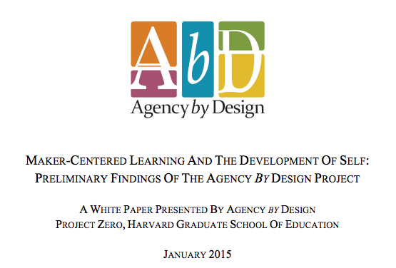
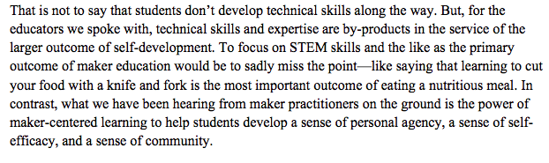

Slide 12
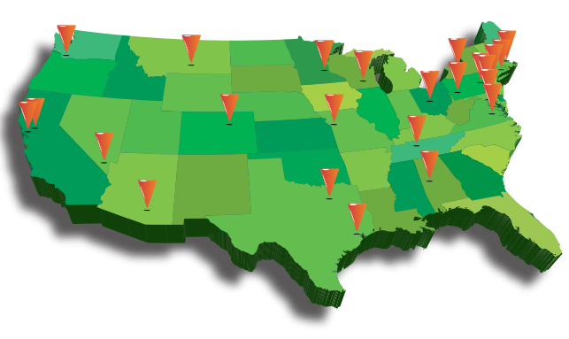
Successful Learning Labs
Teen Learning Labs are in libraries of all sizes!
Learning Labs in Libraries and Museums: Transformative Spaces for Teens, IMLS.gov
Here are some early standouts:
YOUmedia (Chicago Public LIbrary)
The Bubbler (Madison Public Library)
The Studio
(Anythink, Rangeview Library District)
Information Commons (Brooklyn Public Library)
Maker Jawn
(Free Library of Philadelphia)
Studio NPL (Nashville Public Library)
Teen Central and IMAGINEYOU
(Rochester Public Library)

Slide 13

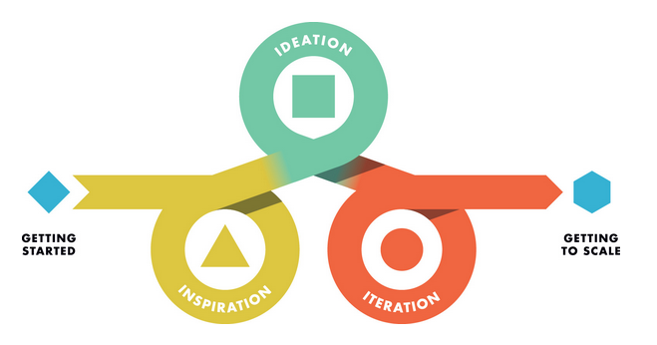
Translating Research into
User-Centered Programming
Connect the research to
your community
Strategic Plan
Program Design
Your vision of the future
of your library
designthinkingforlibraries.com

Slide 14
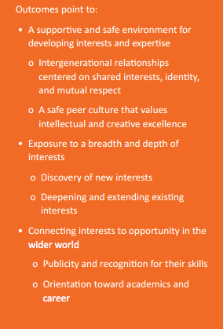
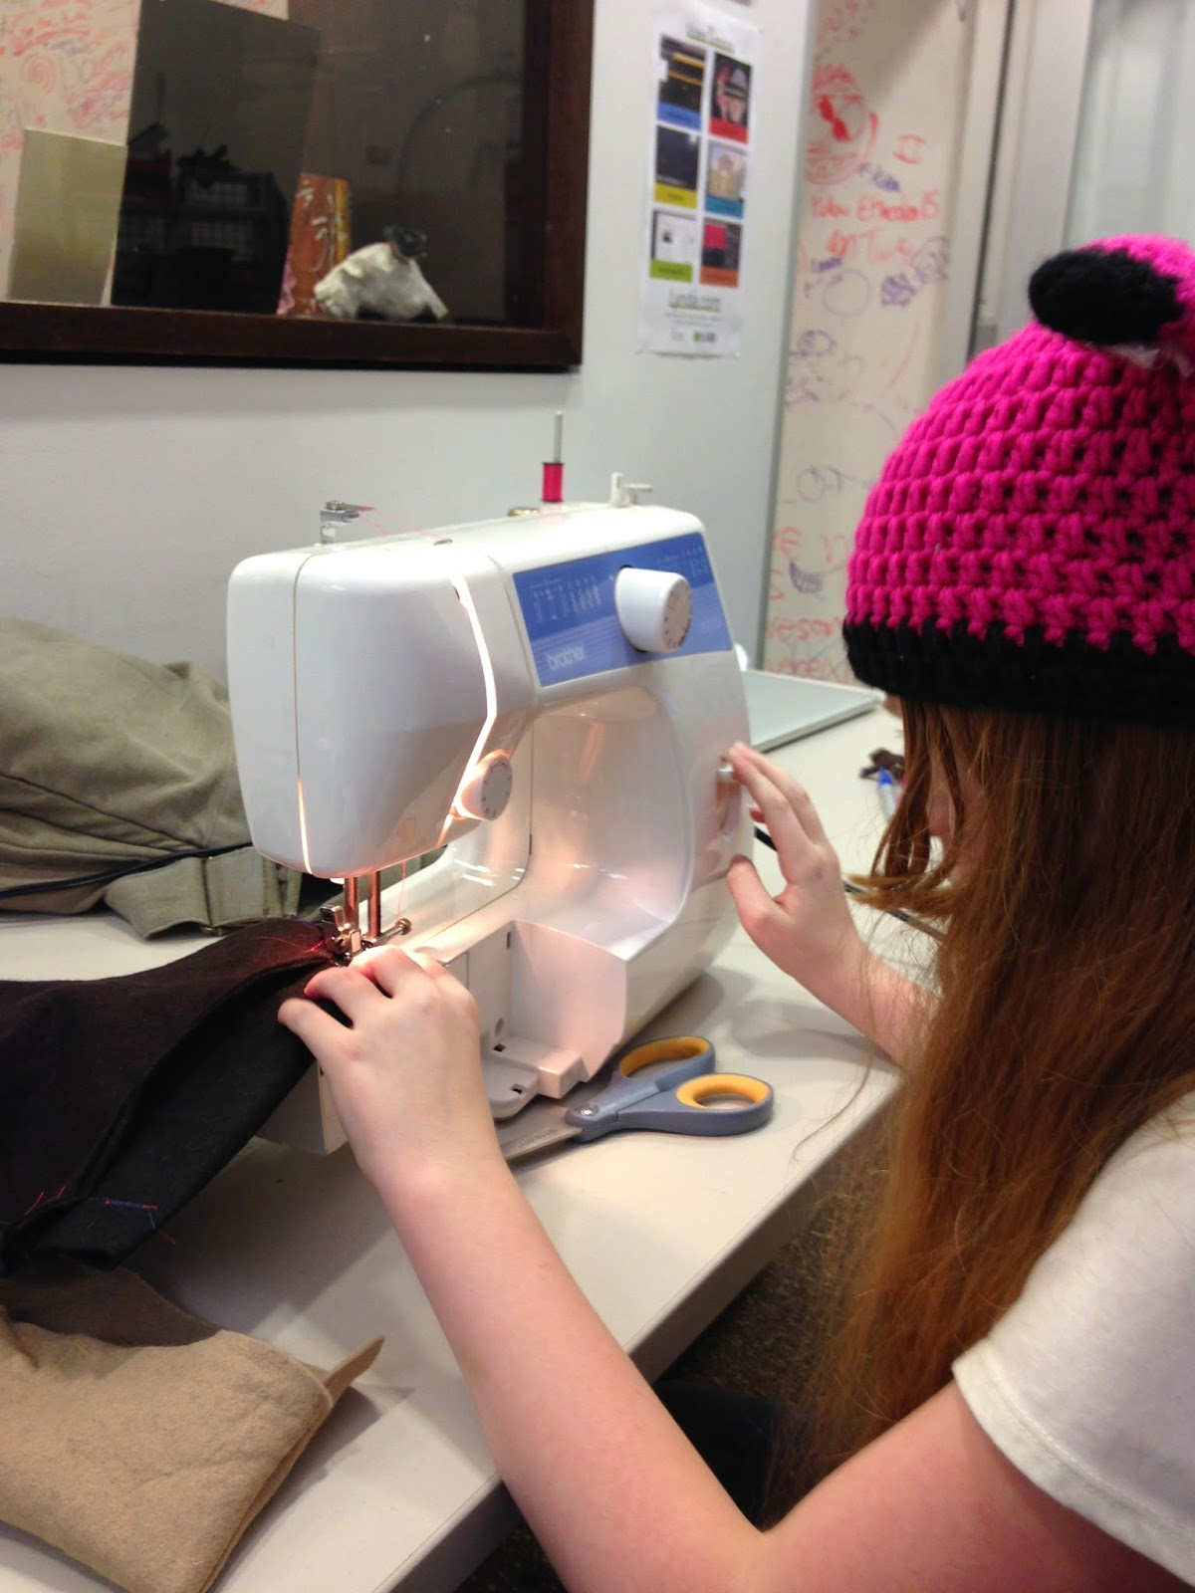
Outcomes of Successful
Learning Labs
Outcomes should be collective and personal
Learning Labs in Libraries and Museums: Transformative Spaces for Teens, imls.gov

Slide 15
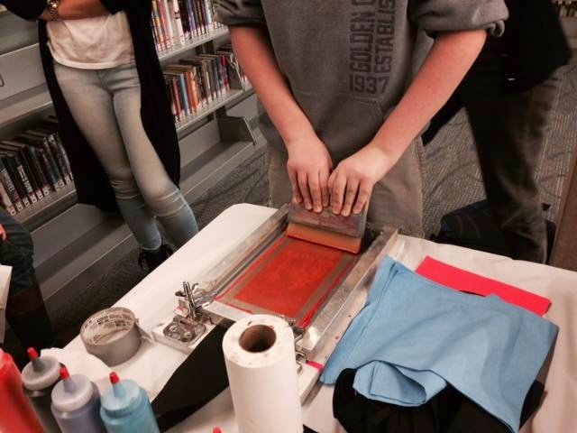
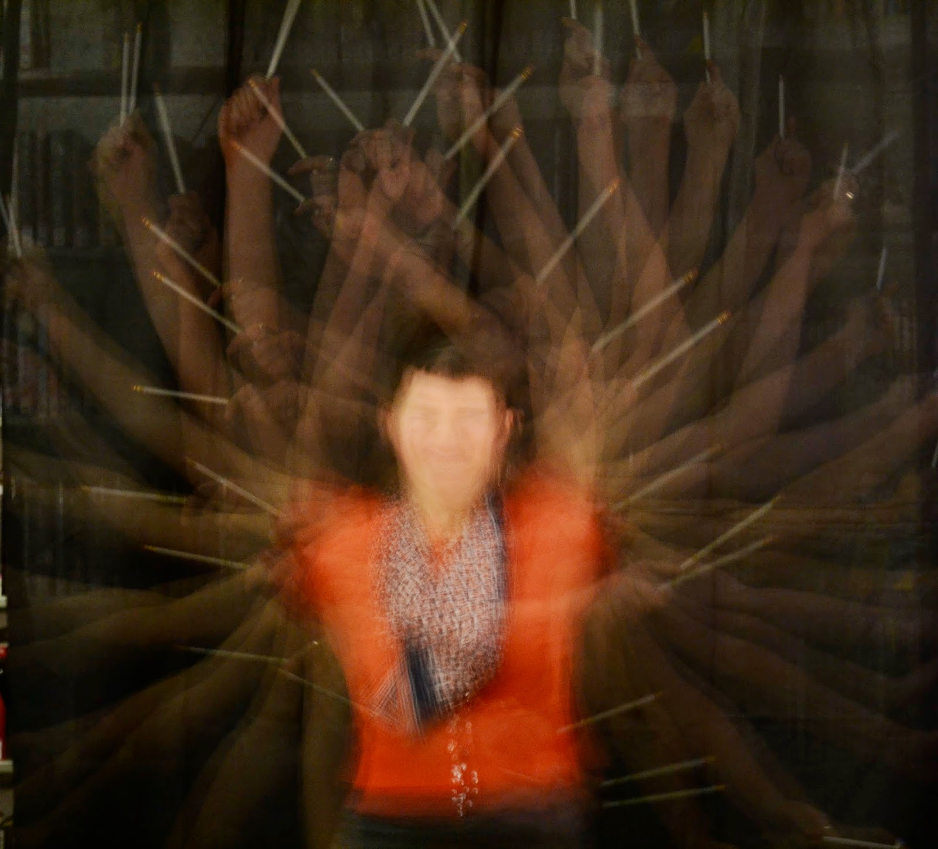
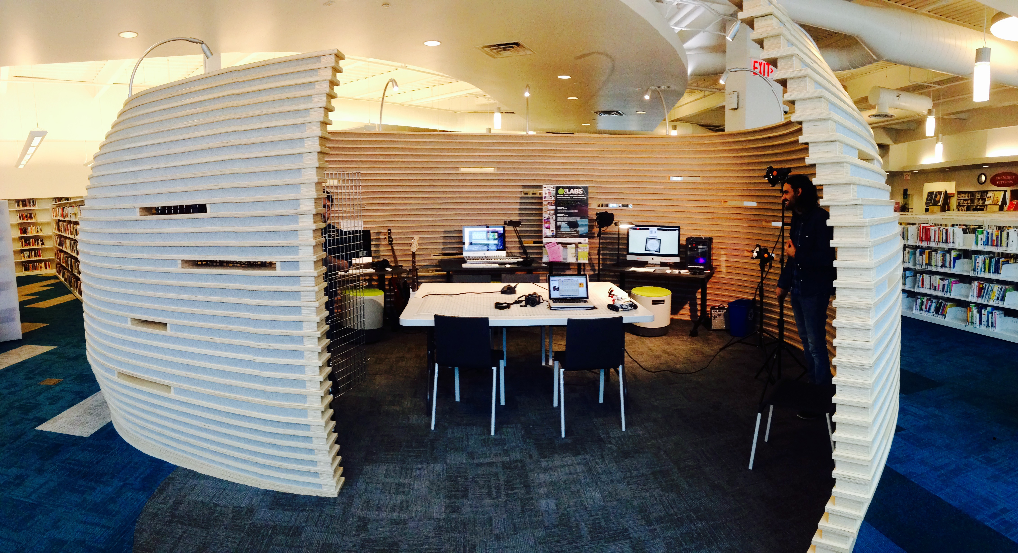
There is no
“one-size fits all” teen learning lab
Learning Labs don’t have to be large MakerSpaces or fablabs to create the desired learning outcomes

Slide 16
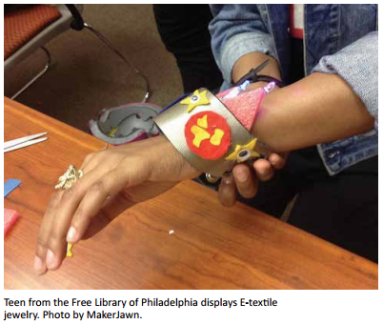
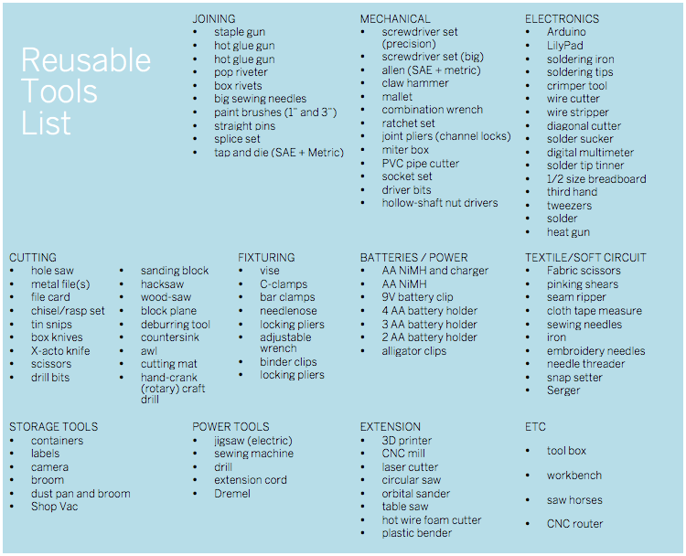
Common Equipment in Learning Labs
IMLS Report
“Before you go on a shopping spree and max out your credit card assess what your Makerspace will actually require.”
Makerspace Playbook, School Edition

Slide 17







Popular Software

Slide 18
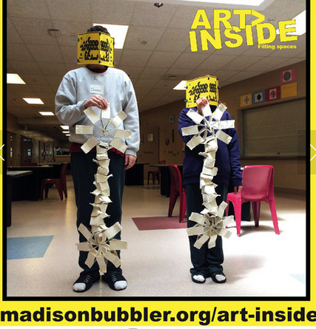
The popularity of
Learning Labs
There is need.
A way to track the learning that happens in our libraries
A way of engaging teens
A way to spread “transliteracy”
A necessary public service for disempowered, underprivileged teenagers

Slide 19
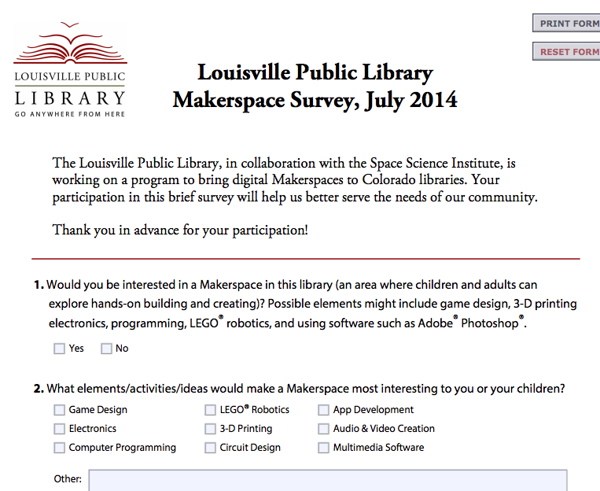
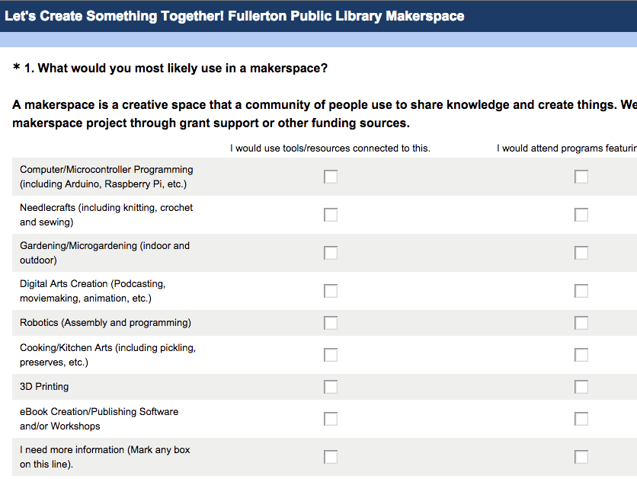
Choosing the right tools and programs for your space
Louisville Public Library Makerspace Survey, 2014
Craft a survey for your teen space and your teen staff in order to find what teens want and need
Engage local schools to find where teenagers need the most support academically

Slide 20
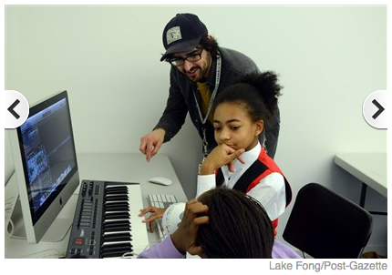
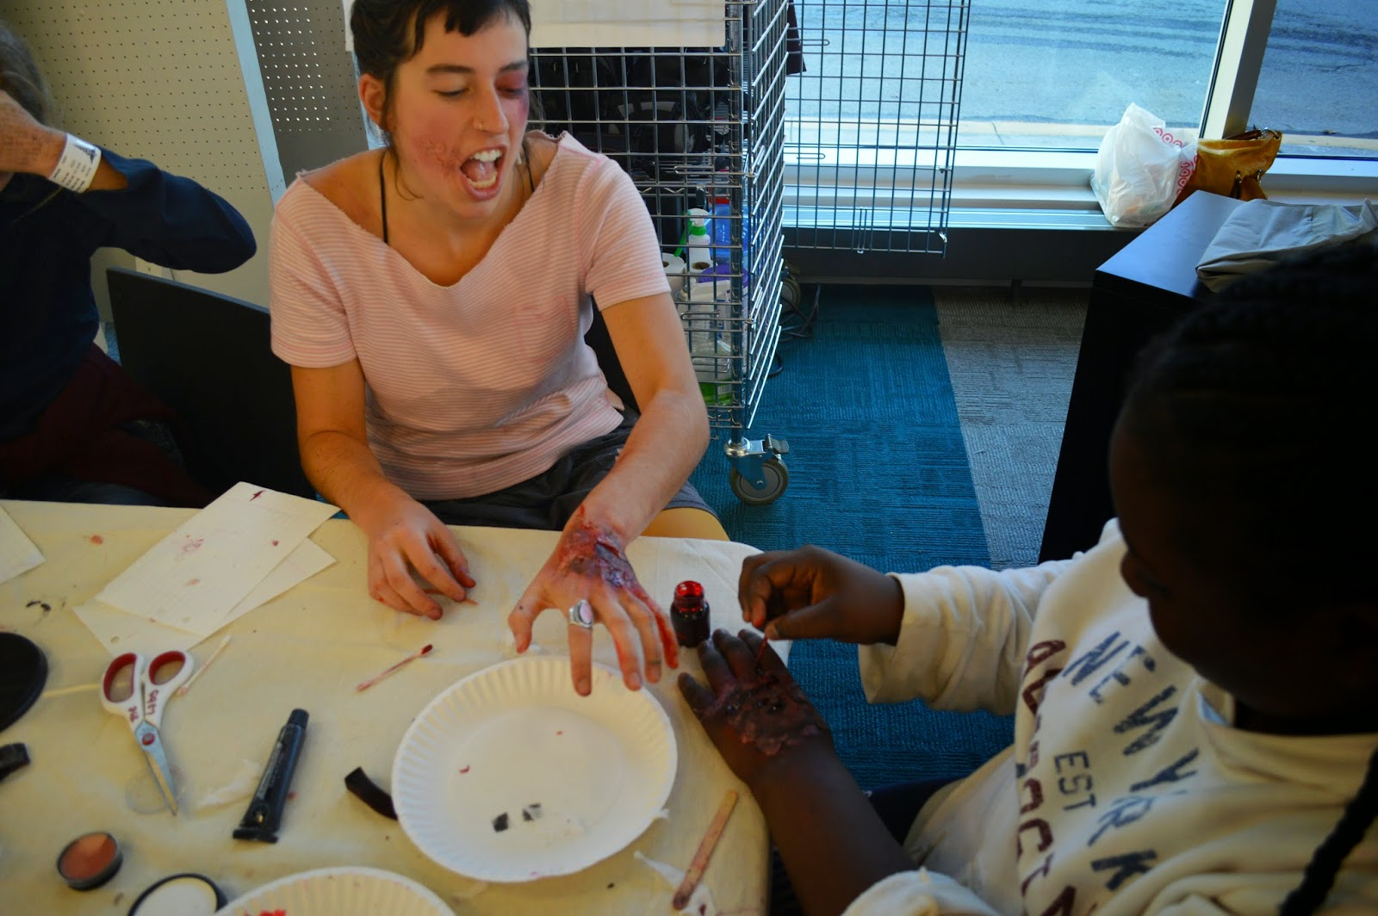
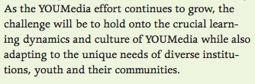
Staffing a Learning Lab
Mentors are:
role-models
subject-matter experts
instructors,
Youth advocates
Connected Learning Report, dmlhub.net

Slide 21
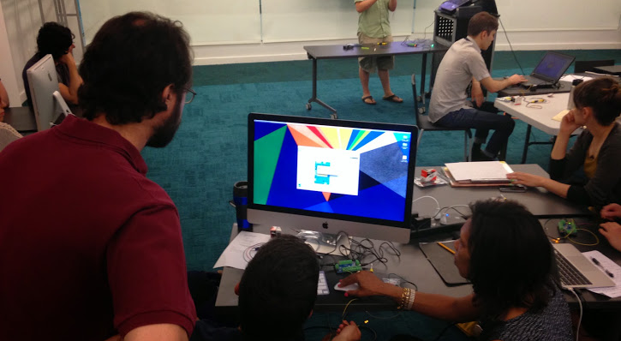
Strategies for alternate staffing models
Training existing staff through one-on-one and group professional development
Put out a call for volunteer makers
  Community experts, etc.
Advocate to trustees and other stakeholders for the importance of staff for learning labs
  Ask them to “Support library staffing plans that acknowledge the role that all staff have in providing service for and with teens.”

Slide 22
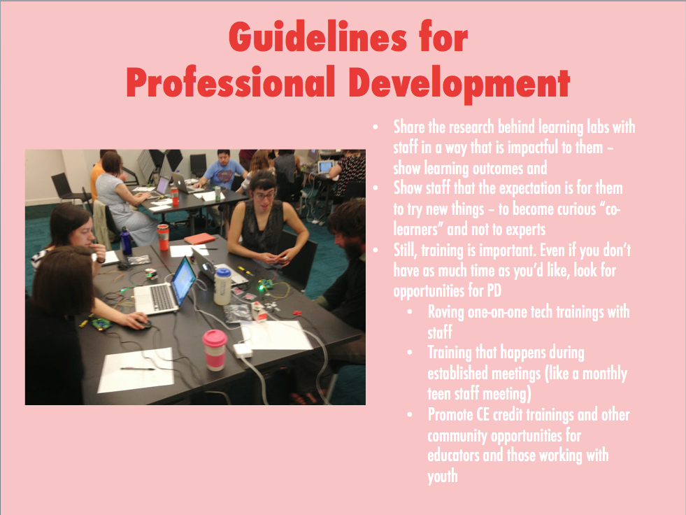
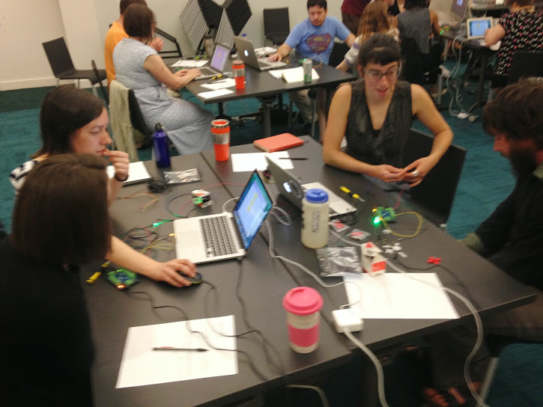
Guidelines for
Professional Development
Share the research behind learning labs with staff in a way that is impactful to them – show learning outcomes and
Show staff that the expectation is for them to try new things – to become curious “co-learners” and not to experts
Still, training is important. Even if you don’t have as much time as you’d like, look for opportunities for PD
  Roving one-on-one tech trainings with staff
  Training that happens during established meetings (like a monthly teen staff meeting)
  Promote CE credit trainings and other community opportunities for educators and those working with youth

Slide 23
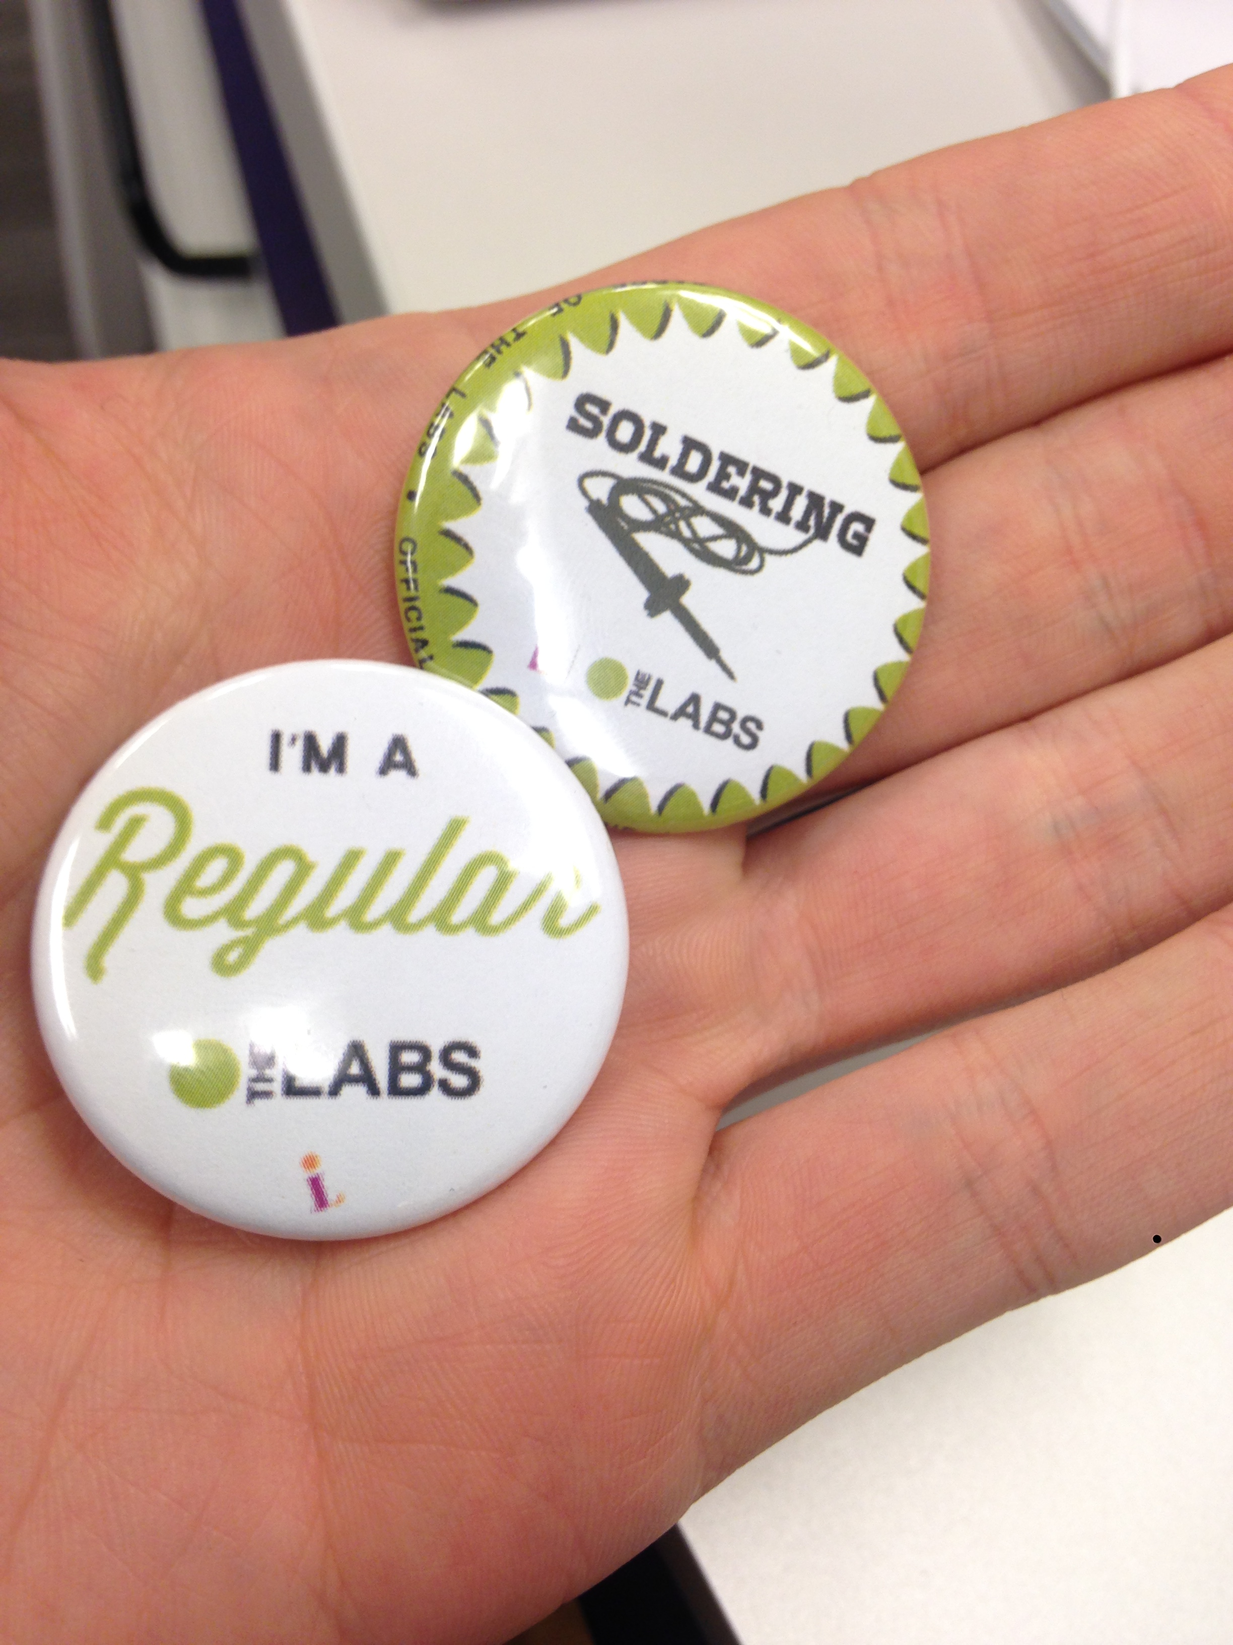
Using Qualitative Evaluations
Evaluation is ongoing
Action research through programming
Post-program surveys for teens
Interviews with youth as they progress through programming
Was there a change in disposition? (how the user thinks or feels)
Connect to outcomes (skills and knowledge gained through programming)

Slide 24
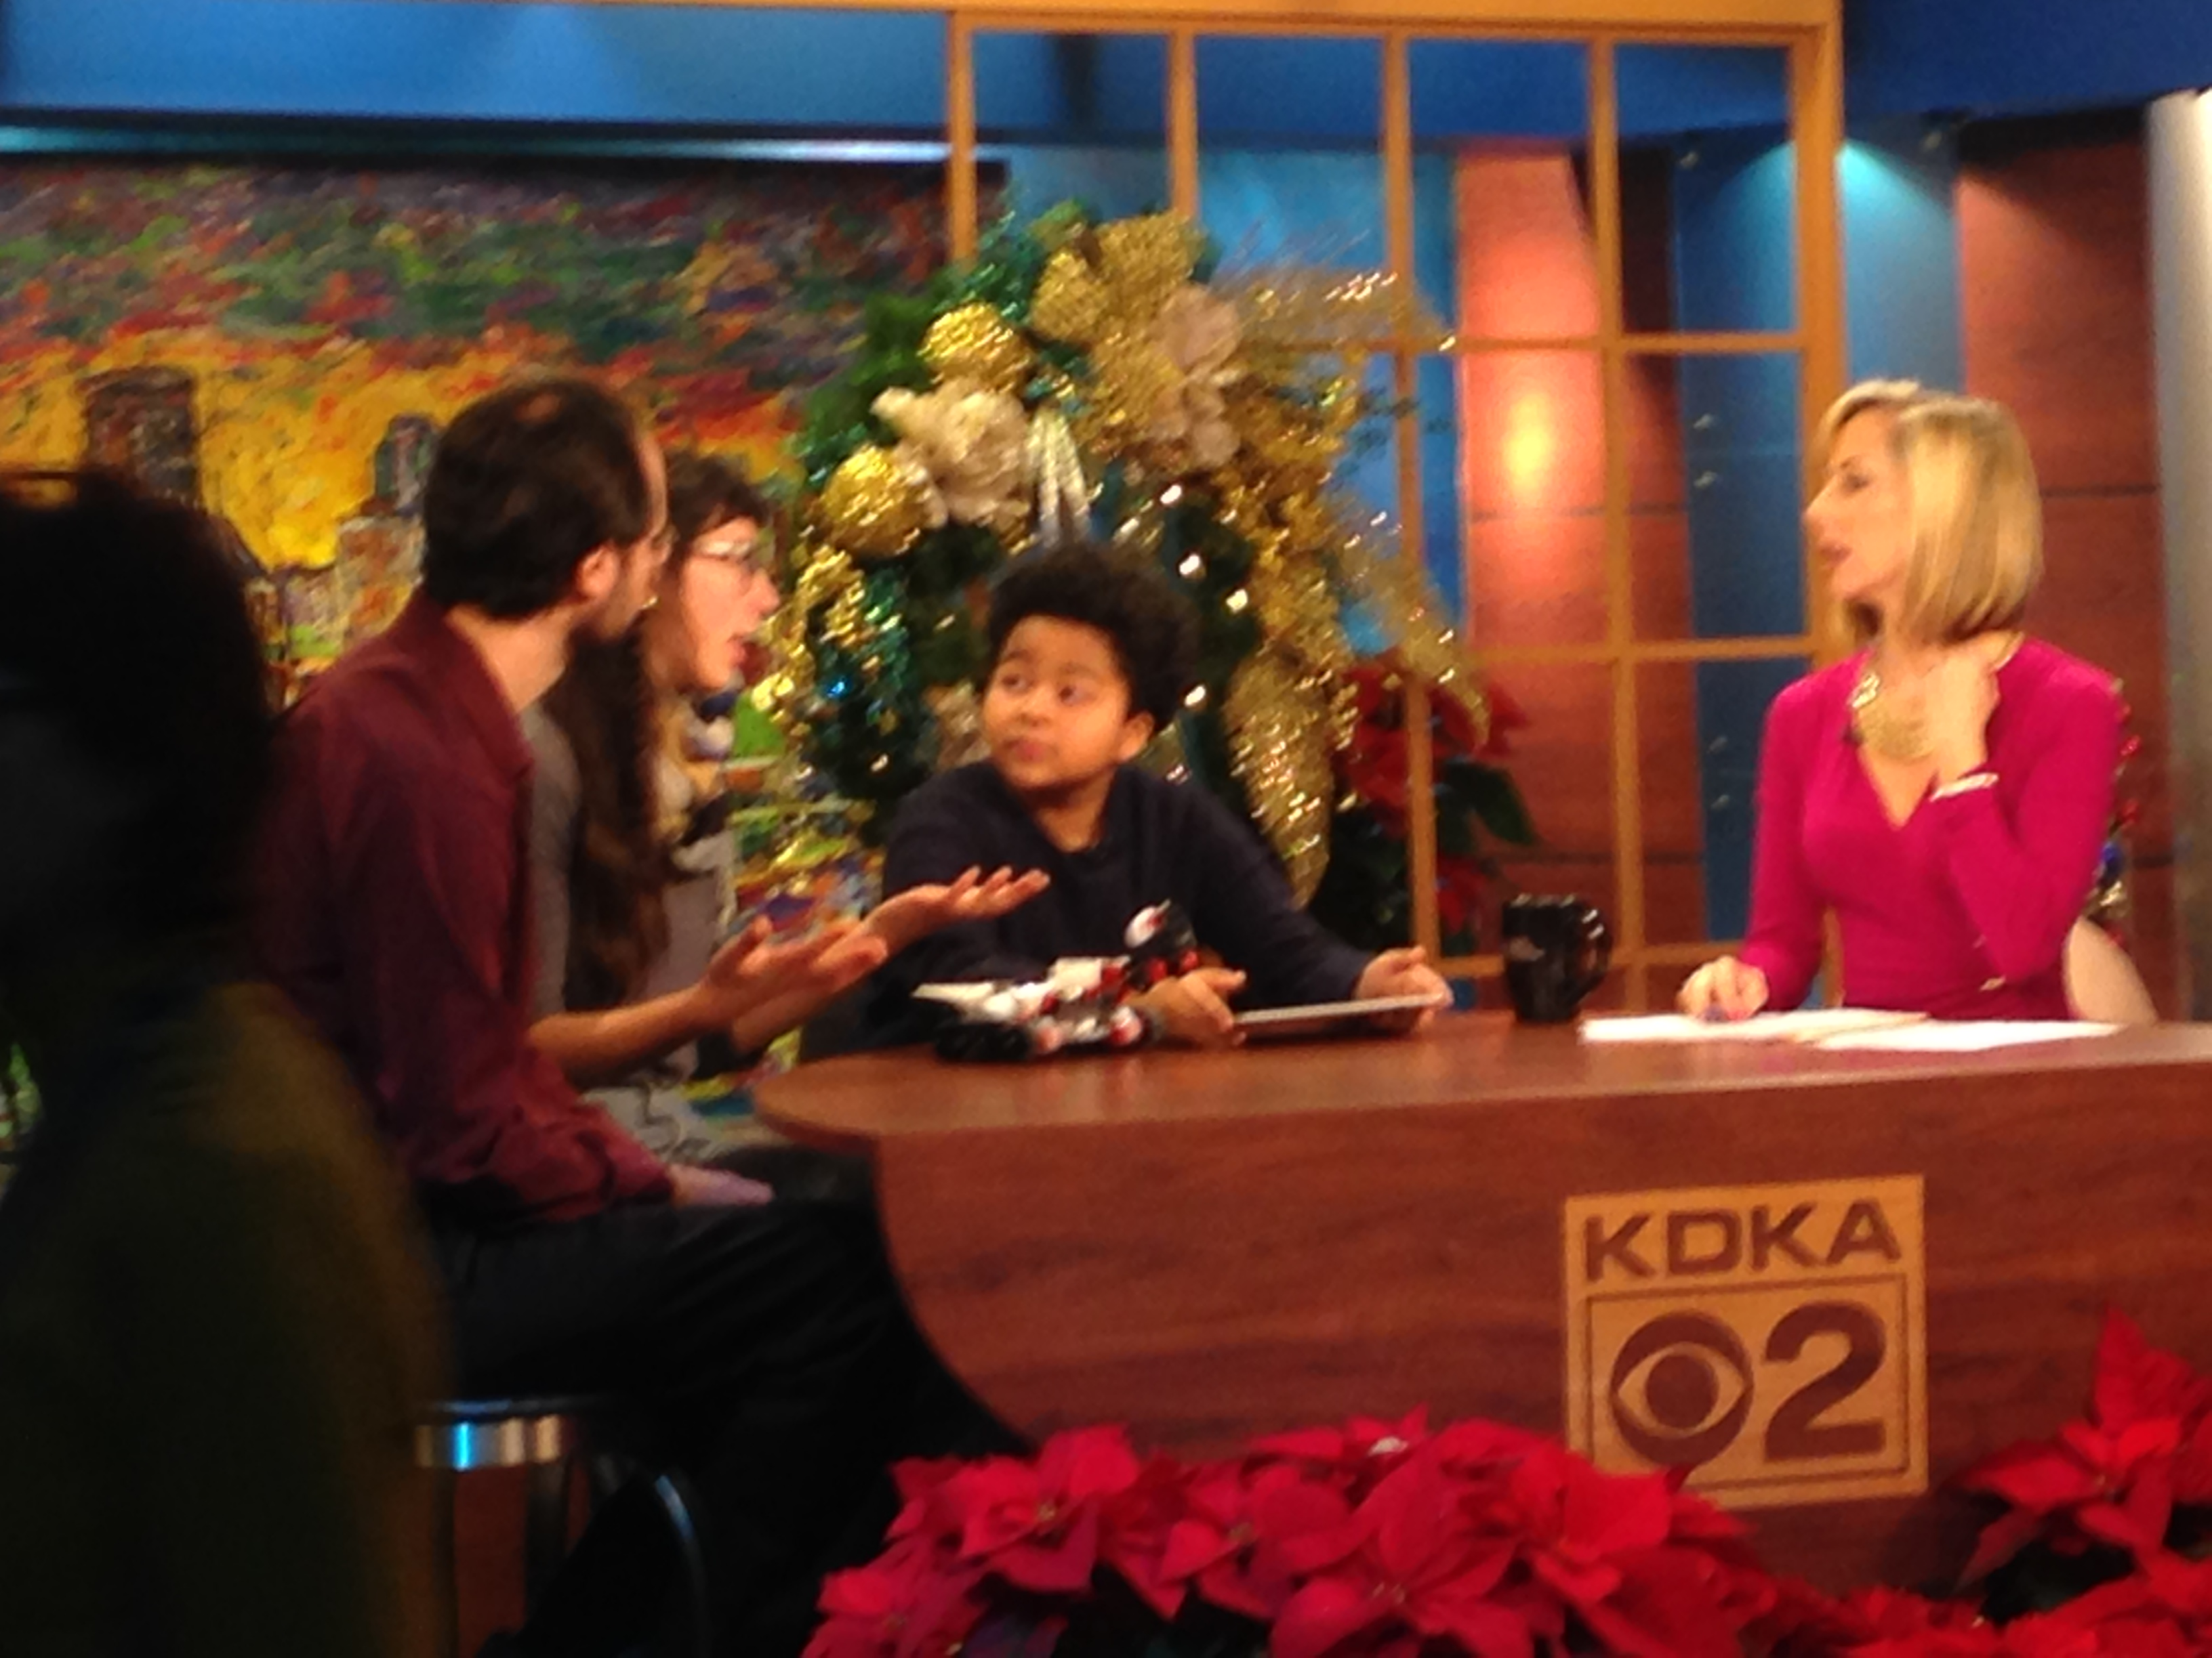
Using Data to create action plans
Show your colleagues the need by sharing this data
Use YALSA talking points
Share stories from programming
Promote youth work to the community to draw attention and demonstrate the purpose of learning lab programming
Involve staff and stakeholders in developing informal education practices so your work doesn’t happen in a bubble.

Slide 25

Questions

Slide 26

Thank you
coreymwittig@gmail.com

Slide 27
Infopeople webinars are supported in part by the U.S. Institute of Museum and Library Services under the provisions of the Library Services and Technology Act, administered in California by the State Librarian. This material is licensed under a Creative Commons 3.0 Share & Share-Alike license. Use of this material should credit the author and funding source.

