Slide 1

Presented by
Rita Gavelis
Wednesday, March 11, 2015
An Infopeople Webinar
Photo by starmanseries - Creative Commons Attribution License https://www.flickr.com/photos/69125796@N00
Created with Haiku Deck

Slide 2

Photo by MarcelaPalma - Creative Commons Attribution-NonCommercial-ShareAlike License https://www.flickr.com/photos/53114928@N02
Created with Haiku Deck

Slide 3

Photo by evil_mel - Creative Commons Attribution-NonCommercial License https://www.flickr.com/photos/76886703@N00
Created with Haiku Deck

Slide 4

Photo by WarzauWynn - Creative Commons Attribution-NonCommercial License https://www.flickr.com/photos/94246031@N00
Created with Haiku Deck

Slide 5

Photo by evil_mel - Creative Commons Attribution-NonCommercial License https://www.flickr.com/photos/76886703@N00
Created with Haiku Deck

Slide 6
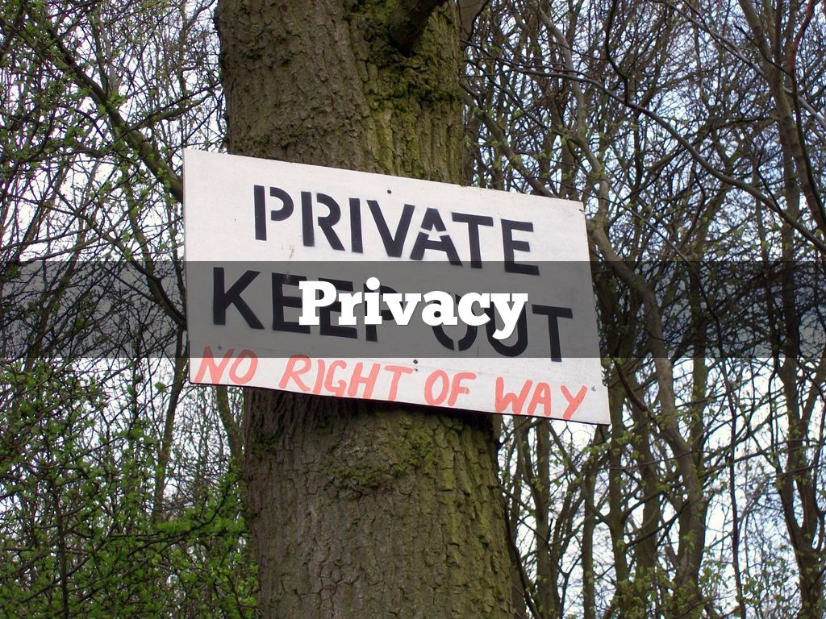
Photo by Peter aka anemoneprojectors - Creative Commons Attribution-ShareAlike License https://www.flickr.com/photos/58414938@N00
Created with Haiku Deck

Slide 7

Photo by purpleslog - Creative Commons Attribution License https://www.flickr.com/photos/93453114@N00
Created with Haiku Deck

Slide 8
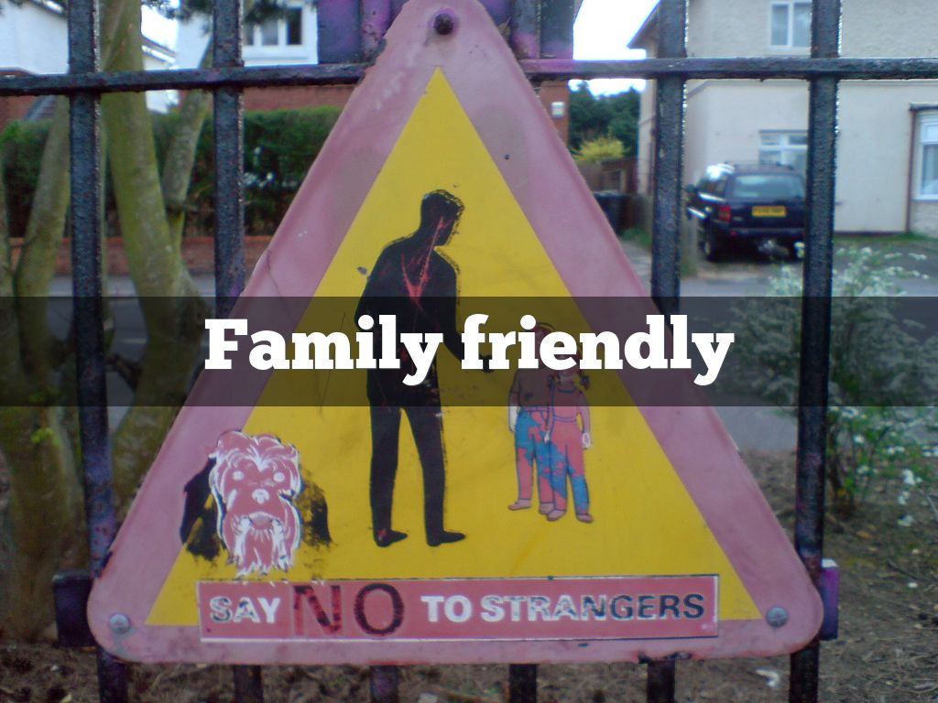
Photo by privatenobby - Creative Commons Attribution-NonCommercial-ShareAlike License https://www.flickr.com/photos/73674114@N00
Created with Haiku Deck

Slide 9
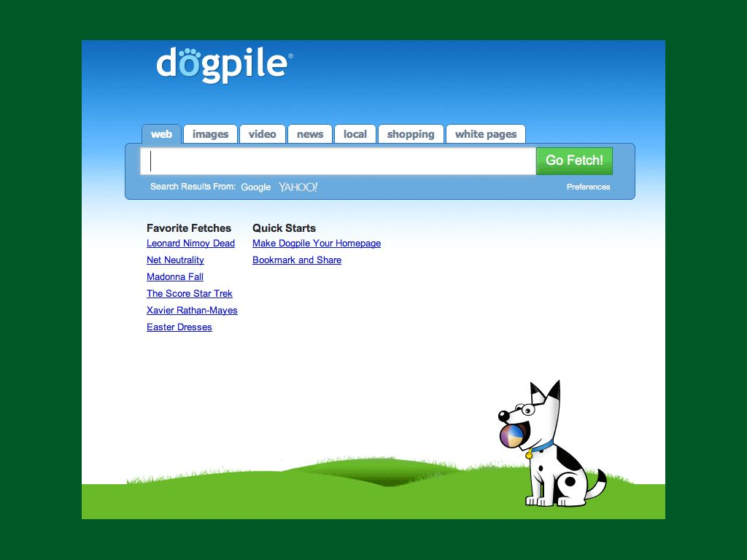

Slide 10
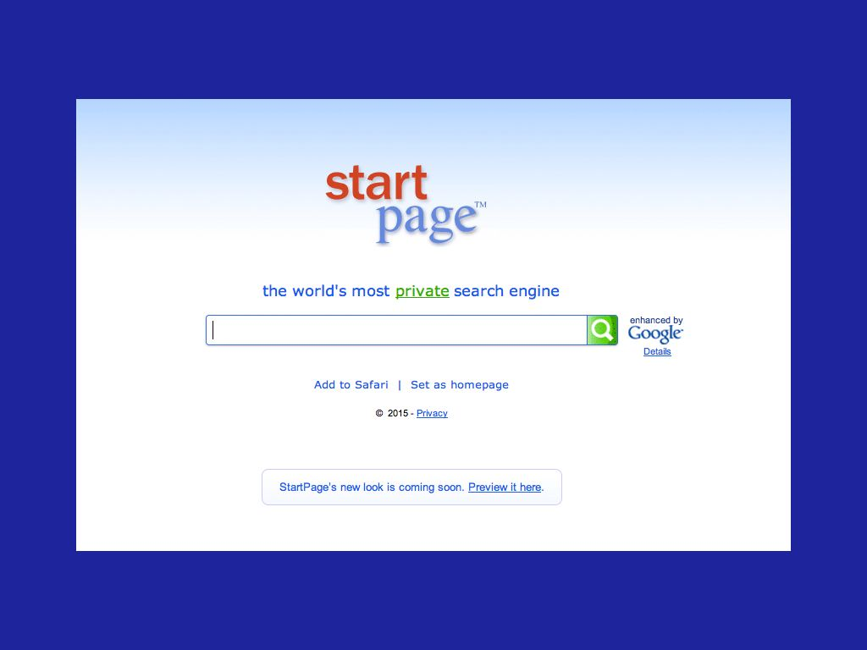

Slide 11
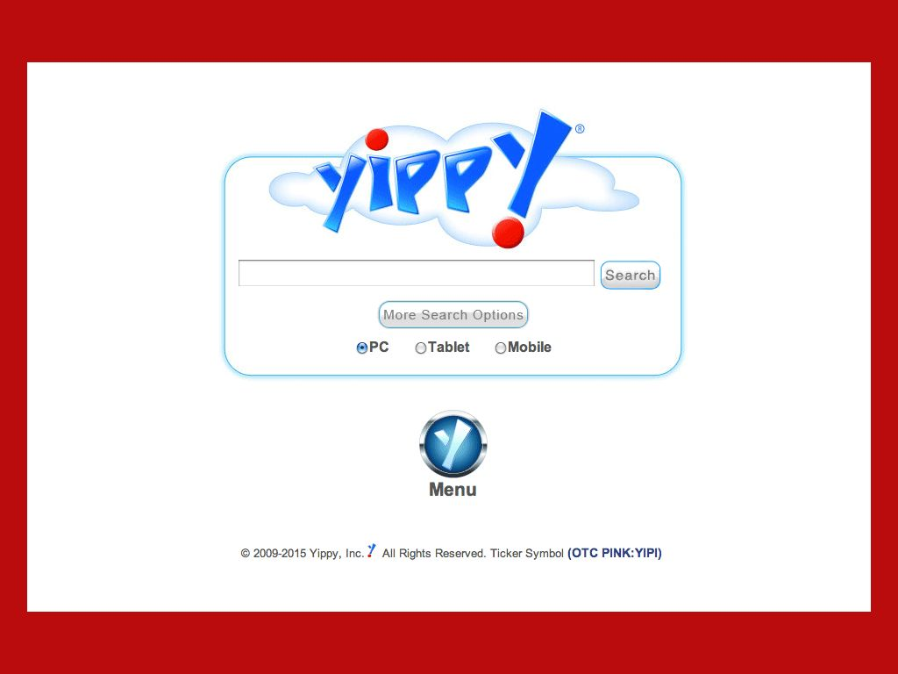

Slide 12
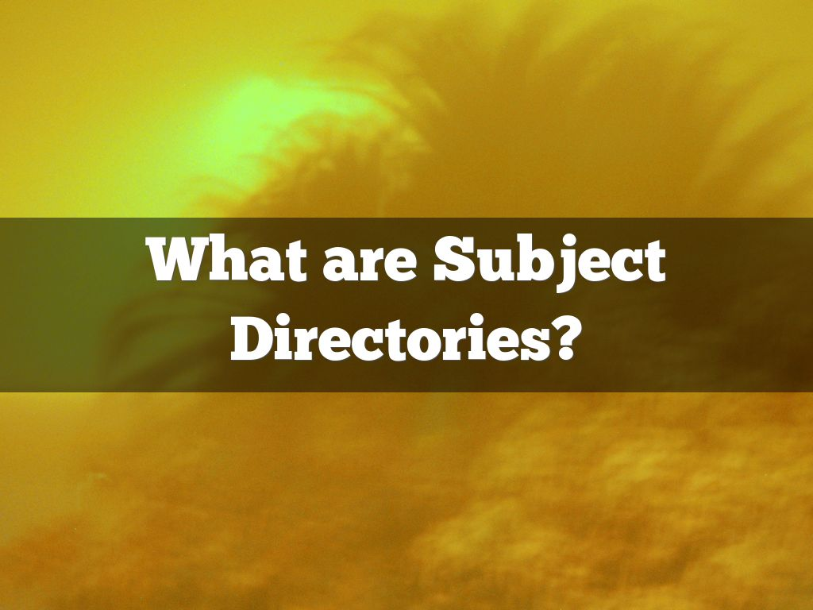
Photo by Keoni Cabral - Creative Commons Attribution License https://www.flickr.com/photos/52193570@N04
Created with Haiku Deck

Slide 13
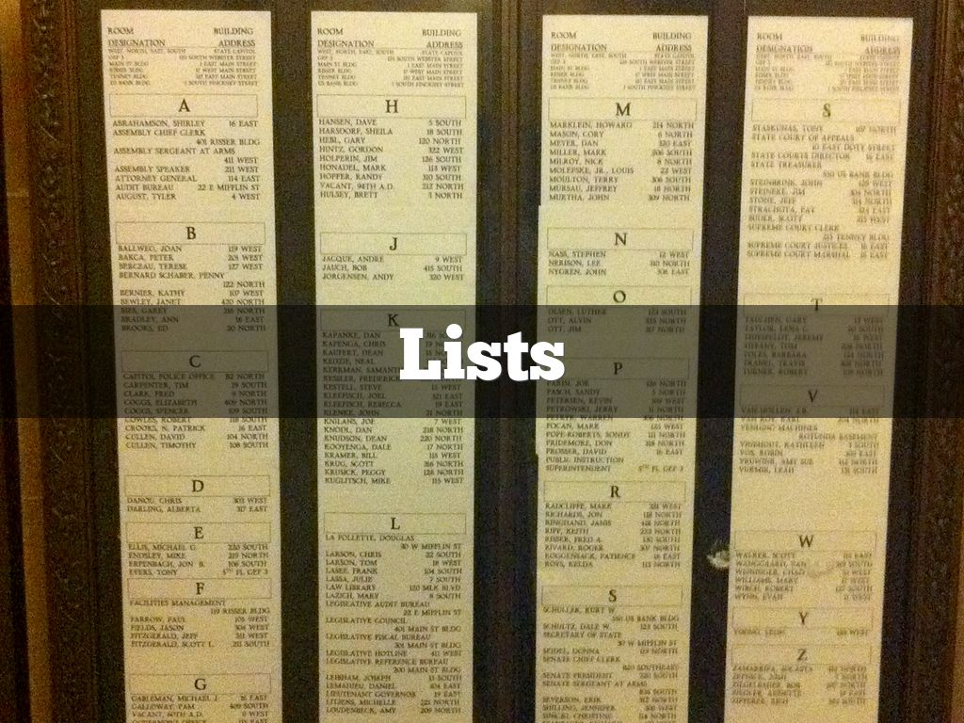
Photo by OnTask - Creative Commons Attribution-ShareAlike License https://www.flickr.com/photos/22434330@N00
Created with Haiku Deck

Slide 14
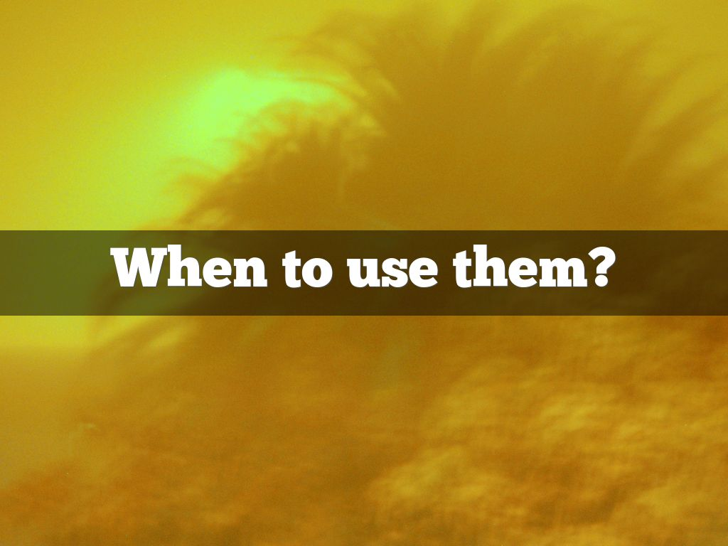
Photo by Keoni Cabral - Creative Commons Attribution License https://www.flickr.com/photos/52193570@N04
Created with Haiku Deck

Slide 15

Photo by jimmiehomeschoolmom - Creative Commons Attribution License https://www.flickr.com/photos/94168846@N00
Created with Haiku Deck

Slide 16

Photo by jbcurio - Creative Commons Attribution License https://www.flickr.com/photos/69131582@N00
Created with Haiku Deck

Slide 17

Photo by toridawnrector - Creative Commons Attribution-ShareAlike License https://www.flickr.com/photos/124387535@N03
Created with Haiku Deck

Slide 18

Photo by menegue - Creative Commons Attribution License https://www.flickr.com/photos/93751689@N04
Created with Haiku Deck

Slide 19


Slide 20
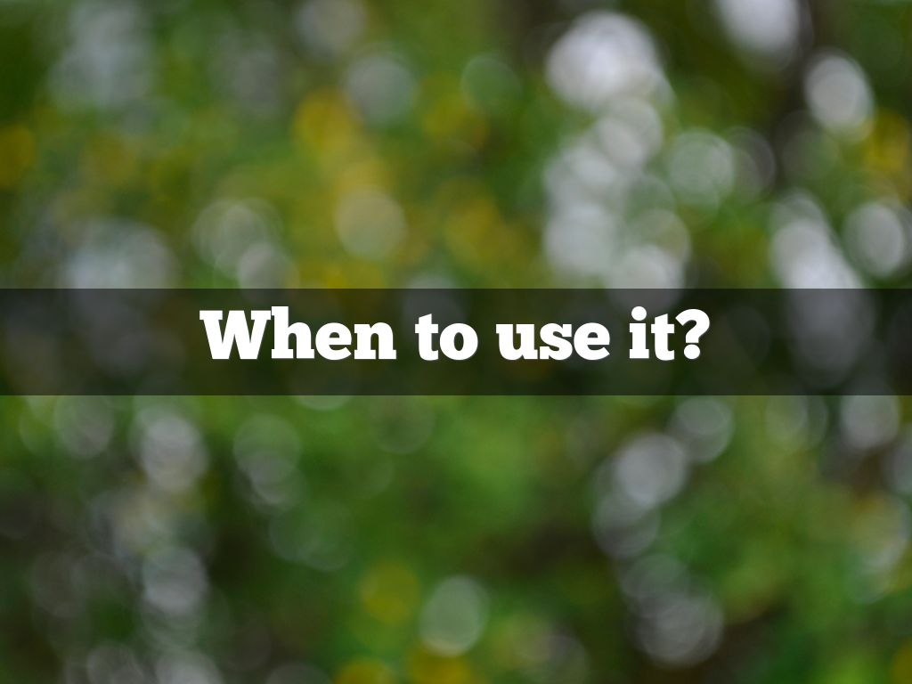
Photo by menegue - Creative Commons Attribution License https://www.flickr.com/photos/93751689@N04
Created with Haiku Deck

Slide 21

Photo by GRwitters - Creative Commons Attribution License https://www.flickr.com/photos/34646442@N06
Created with Haiku Deck

Slide 22
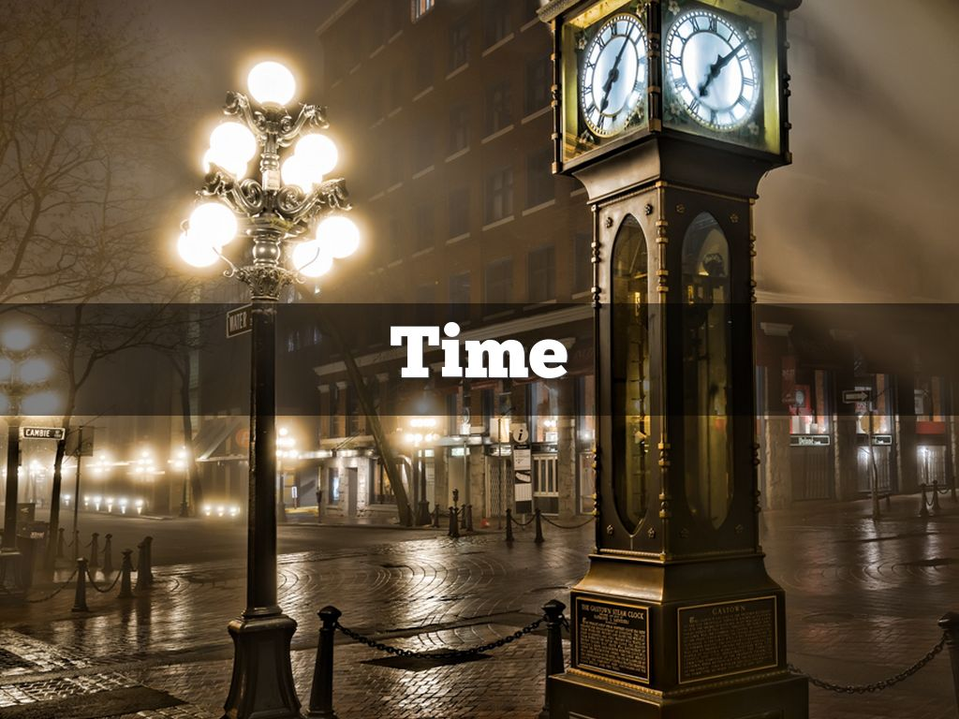
Photo by `James Wheeler - Creative Commons Attribution-NonCommercial-ShareAlike License https://www.flickr.com/photos/24128704@N08
Created with Haiku Deck

Slide 23

Photo by Kris Olin - Creative Commons Attribution-NonCommercial-ShareAlike License https://www.flickr.com/photos/32512570@N06
Created with Haiku Deck

Slide 24

Photo by holisticmonkey - Creative Commons Attribution License https://www.flickr.com/photos/15376240@N00
Created with Haiku Deck

Slide 25
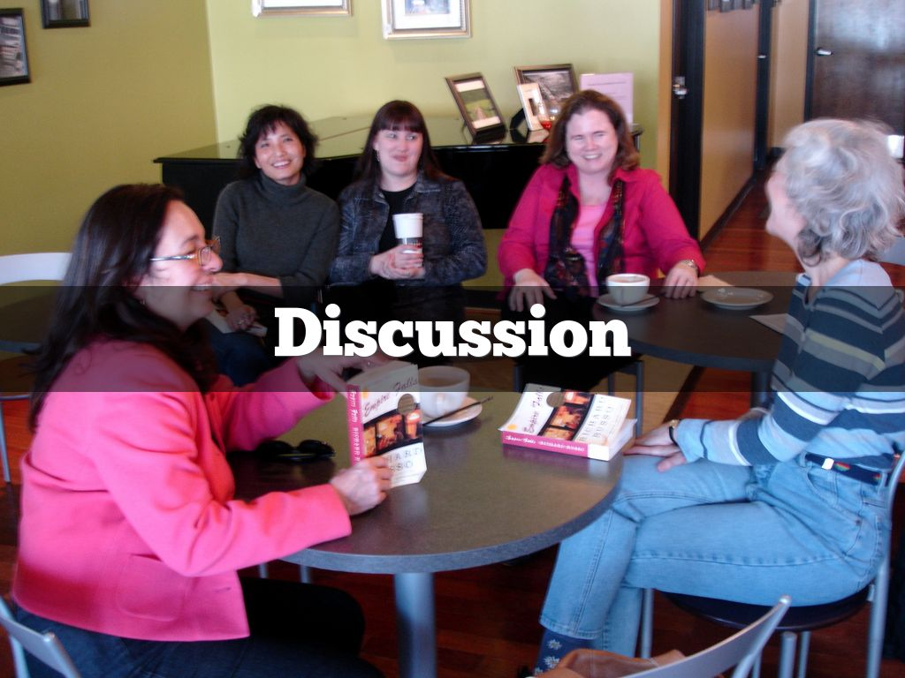
Photo by chelmsfordpubliclibrary - Creative Commons Attribution-NonCommercial-ShareAlike License https://www.flickr.com/photos/7281942@N03
Created with Haiku Deck

Slide 26
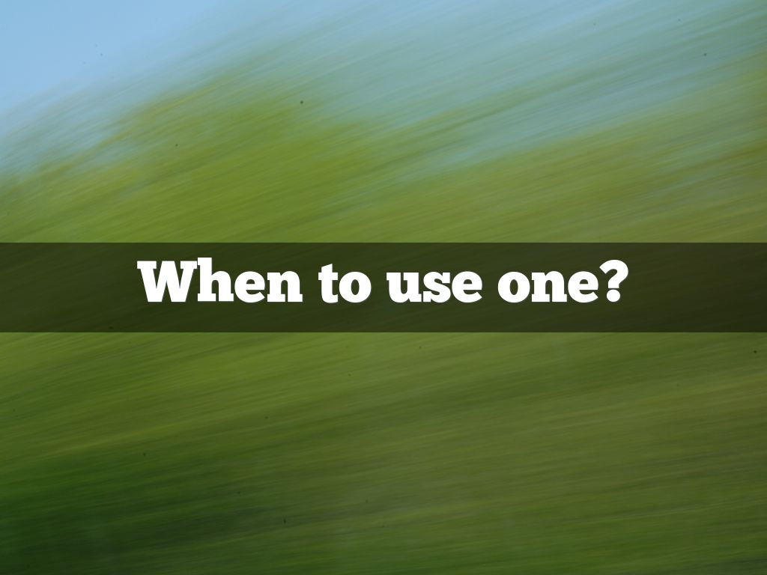
Photo by holisticmonkey - Creative Commons Attribution License https://www.flickr.com/photos/15376240@N00
Created with Haiku Deck

Slide 27
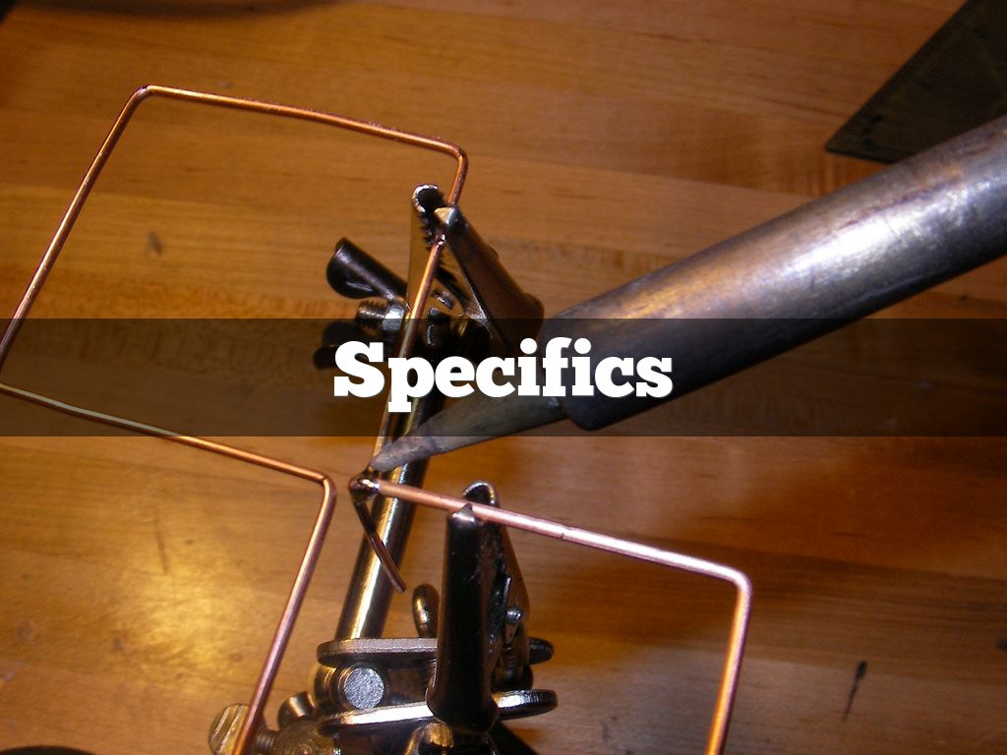
Photo by purecanesugar - Creative Commons Attribution-ShareAlike License https://www.flickr.com/photos/39799424@N00
Created with Haiku Deck

Slide 28
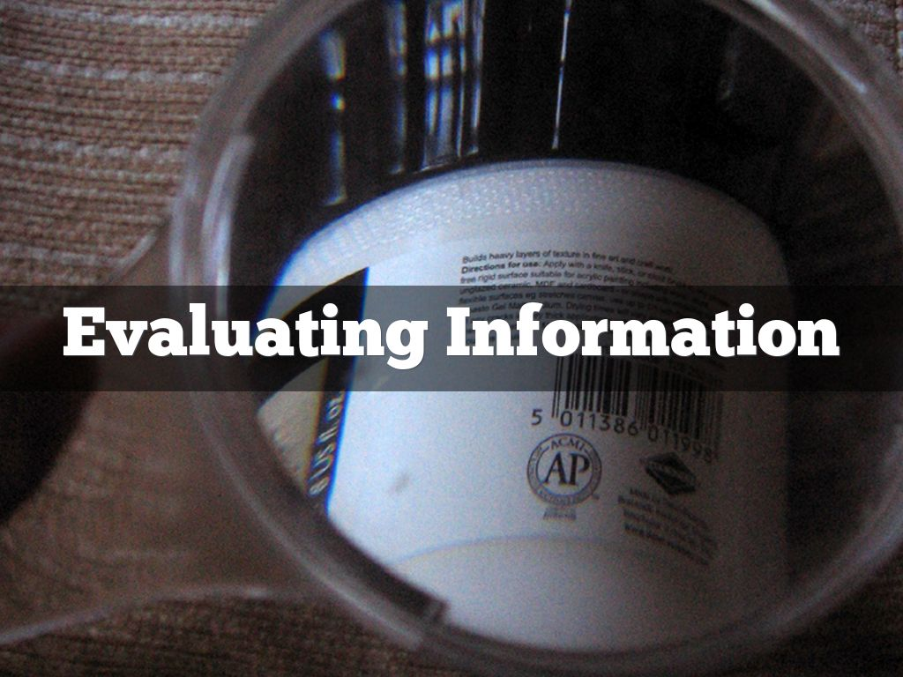
Photo by crabchick - Creative Commons Attribution License https://www.flickr.com/photos/62327186@N00
Created with Haiku Deck

Slide 29

Photo by vestman - Creative Commons Attribution License https://www.flickr.com/photos/61417318@N00
Created with Haiku Deck

Slide 30

Photo by Kevin N. Murphy - Creative Commons Attribution-NonCommercial License https://www.flickr.com/photos/14404175@N00
Created with Haiku Deck

Slide 31



Slide 32
Thank You
Rita Gavelis
rita@libassist.com
Part 1: View the archive at https://infopeople.org/civicrm/event/info?reset=1&id=452
  Power Searching: alternative search engines, social media, and subject indices
Part 3: Wednesday, May 13, 2015 @ 12 Noon Pacific
  Power Searching: databases and the hidden web

Slide 33
Infopeople webinars are supported in part by the U.S. Institute of Museum and Library Services under the provisions of the Library Services and Technology Act, administered in California by the State Librarian. This material is licensed under a Creative Commons 3.0 Share & Share-Alike license. Use of this material should credit the author and funding source.

