Slide 1
WHAT’S NEW IN YOUNG ADULT LITERATURE
2015
MICHAEL CART
Tuesday, April 21, 2015

Slide 2

TRENDS

Slide 3
A Renaissance of realistic fiction
A surfeit of series
A brace of Brobdingnagian novels
An increase in market share
The adult purchase of Yas
The continued clutch of crossover titles (including New Adult)
The sheer number of YA titles

Slide 4
REALISTIC FICTION

Slide 5



Slide 6
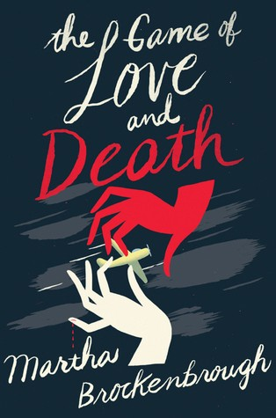


Slide 7


She', on on epic rood lrlp
in seor<h of the lrulh.

Slide 8


G A Y L E
New York Times be:.uelllngau,hor of If i Stlly
F O R M A N

Slide 9



Slide 10



Slide 11
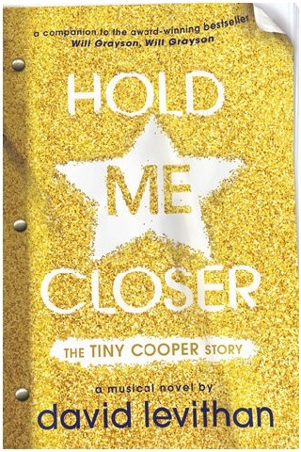


Slide 12



Slide 13

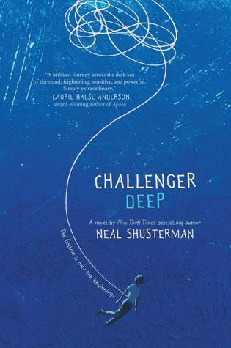

Slide 14

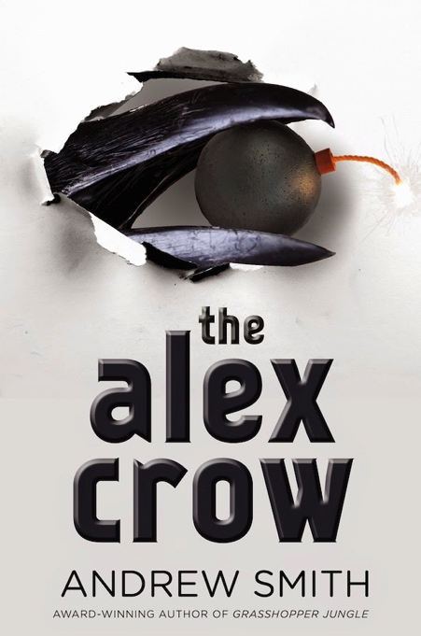


Slide 15
GENRE FICTION

Slide 16
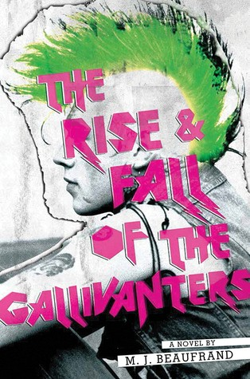

Slide 17



Slide 18
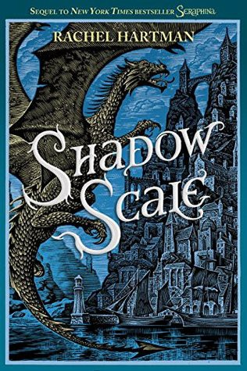
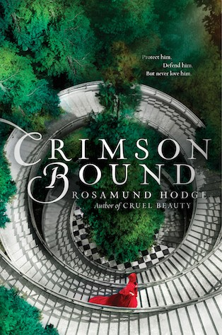

Slide 19



Slide 20



Slide 21
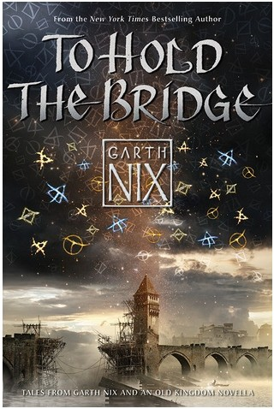


Slide 22




Slide 23
NONFICTION AND GRAPHIC NOVELS

Slide 24
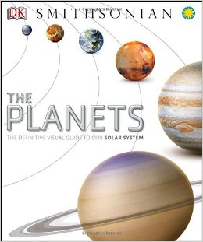
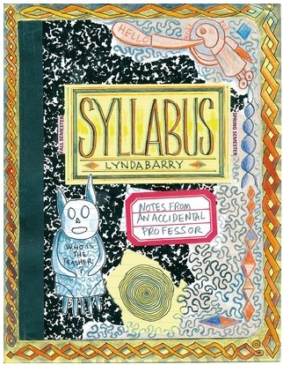

Slide 25



Slide 26
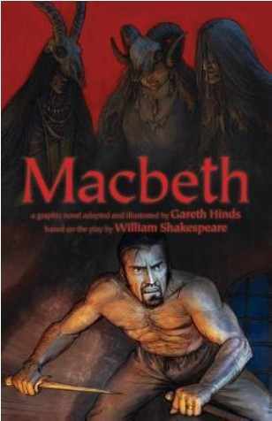

DEBUNK IT!
HOW TO STAY SANEIN A WORLD OF MISINFORMATION 0
JOHN GRANT

Slide 27

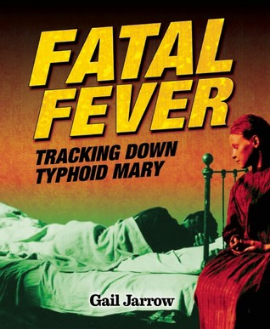

Slide 28



Slide 29

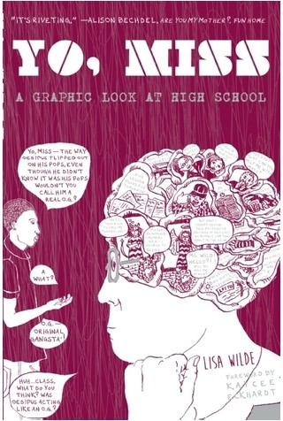

Slide 30
ADULT BOOKS FOR YOUNG ADULTS

Slide 31



Slide 32



Slide 33



Slide 34
Thank You! Michael Cart mrmcart@aol.com

Slide 35
Infopeople webinars are supported in part by the U.S. Institute of Museum and Library Services under the provisions of the Library Services and Technology Act, administered in California by the State Librarian. This material is licensed under a Creative Commons 3.0 Share & Share-Alike license. Use of this material should credit the author and funding source.

