Slide 1


April 22, 2015

Slide 2
Presenters:
Consultants Amy Gleason & Courtney Saldana
Kari Johnson, Fresno County Library
Janet Coles, California State Library
Notes:
COURTNEY – WELCOME
AMY AND KARI – INTRO YOURSELVES

Slide 3
In this webinar:
Learn about STeP and why it is important
Learn how STeP is working in California libraries
Find out how YOUR library can apply to be part of the STeP team in 2015/16
Notes:
COURTNEY

Slide 4
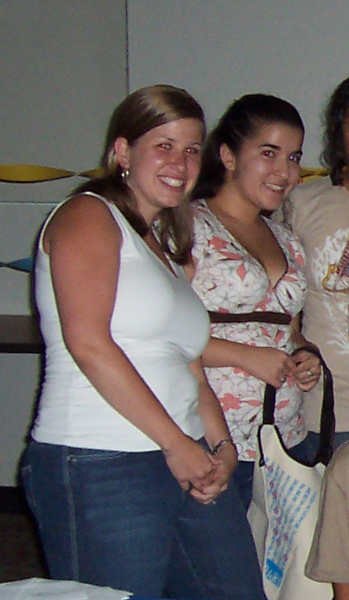
Evolution of the step project:
2007
Notes:
COURTNEY

Slide 5

Evolution of the step project:
2012 Eureka! Leadership Institute
Life Skills for Teen Moms
Notes:
COURTNEY

Slide 6
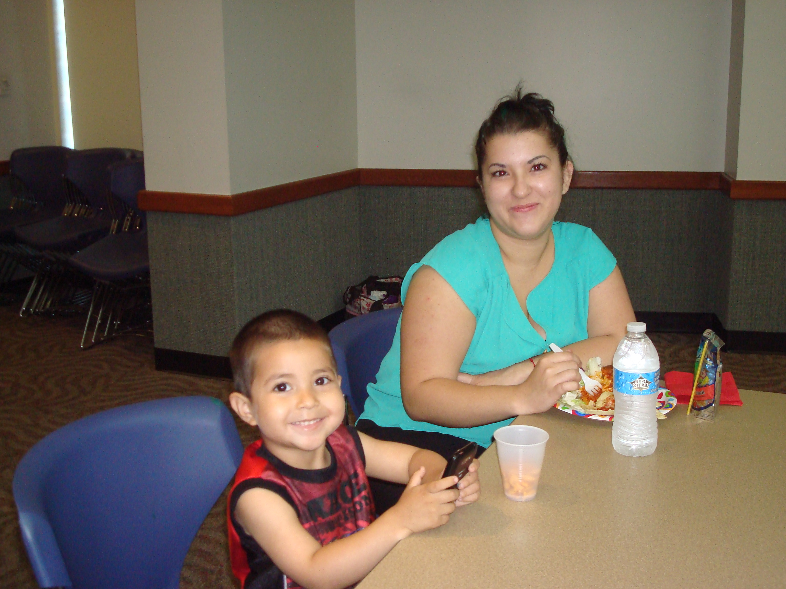
Evolution of the step project:
2007
2013
Notes:
COURTNEY

Slide 7
Why is step important?
In California, the teen birth rate was reduced by 45% between 2000 and 2012. Nonetheless, the number of teen mothers in California remains significant, with nearly 35,000 children born to mothers aged 19 or under in 2012 (latest year for which data are available).
In that year, California ranked 19th in the nation in teen birth rates, at 23.6 per 1000. 21 California counties had birth rates significantly higher than the national average.
Notes:
AMY

Slide 8
Why is step important?
Teen mothers face multiple, difficult challenges in their lives. Child care, education, employment, housing, health care, nutrition, and physical/emotional safety.
Many teen mothers have limited or even no support system to teach and guide them on their parenting journey as they themselves try to navigate adolescence.
Most high schools have cut funding for support services for pregnant and parenting students.
Nearly 70% of California teen moms drop out of high school, according to the CA Department of Education.
Notes:
AMY

Slide 9
What is step?
The STeP project seeks to bridge the gap, by piloting a model for library services for pregnant/parenting teen moms in selected public libraries.
Each library will work with community partners to recruit participants and implement a series of informational/ instructional workshops.
Selected libraries will receive training, resources and funding to successfully plan and implement this project.
Notes:
AMY
The model will follow practices for services to teen parents recommended by the US Office of Adolescent Health (http://tinyurl.com/mg9vq4m).
aimed at providing these teens with the knowledge, skills and tools to succeed as adults and parents.

Slide 10
Step in 2015
STeP was implemented in 5 CA libraries:
  Berkeley Public
  Fresno County
  Los Angeles Public
  San Diego Public
  San Mateo County
Notes:
COURTNEY

Slide 11
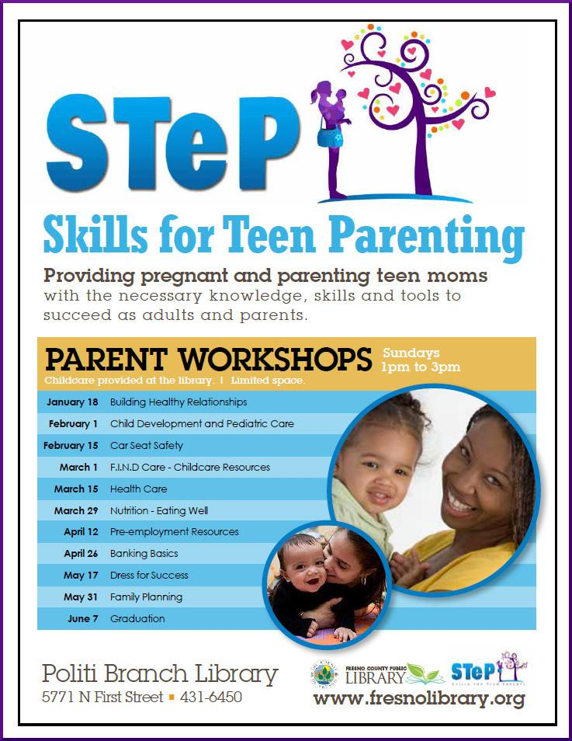
Step at the Fresno library:
Notes:
When started program, days, some of the workshops

Slide 12
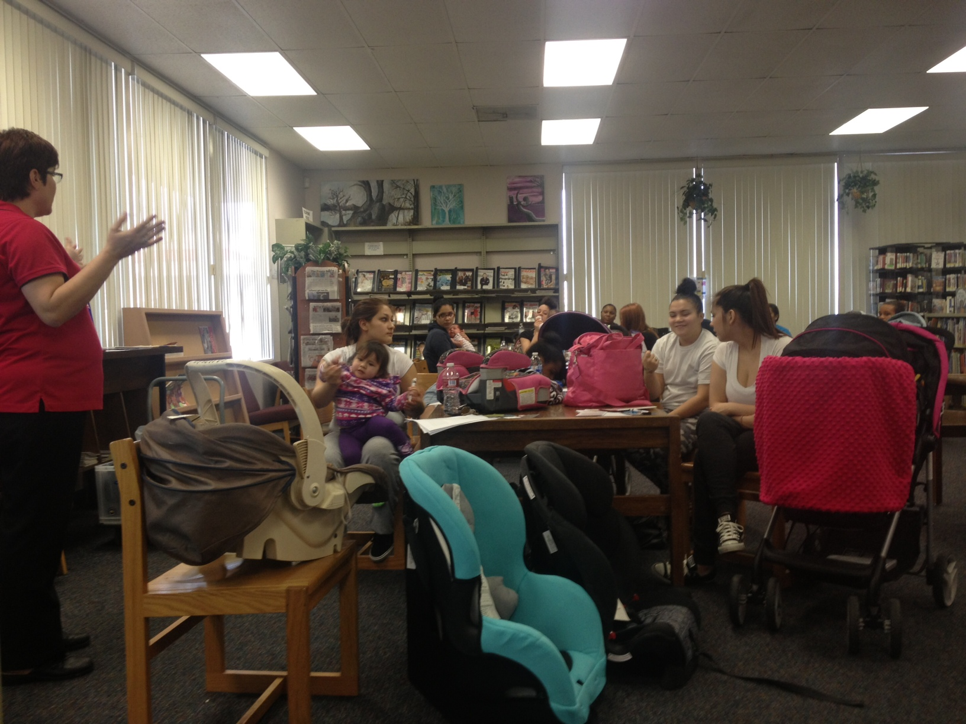
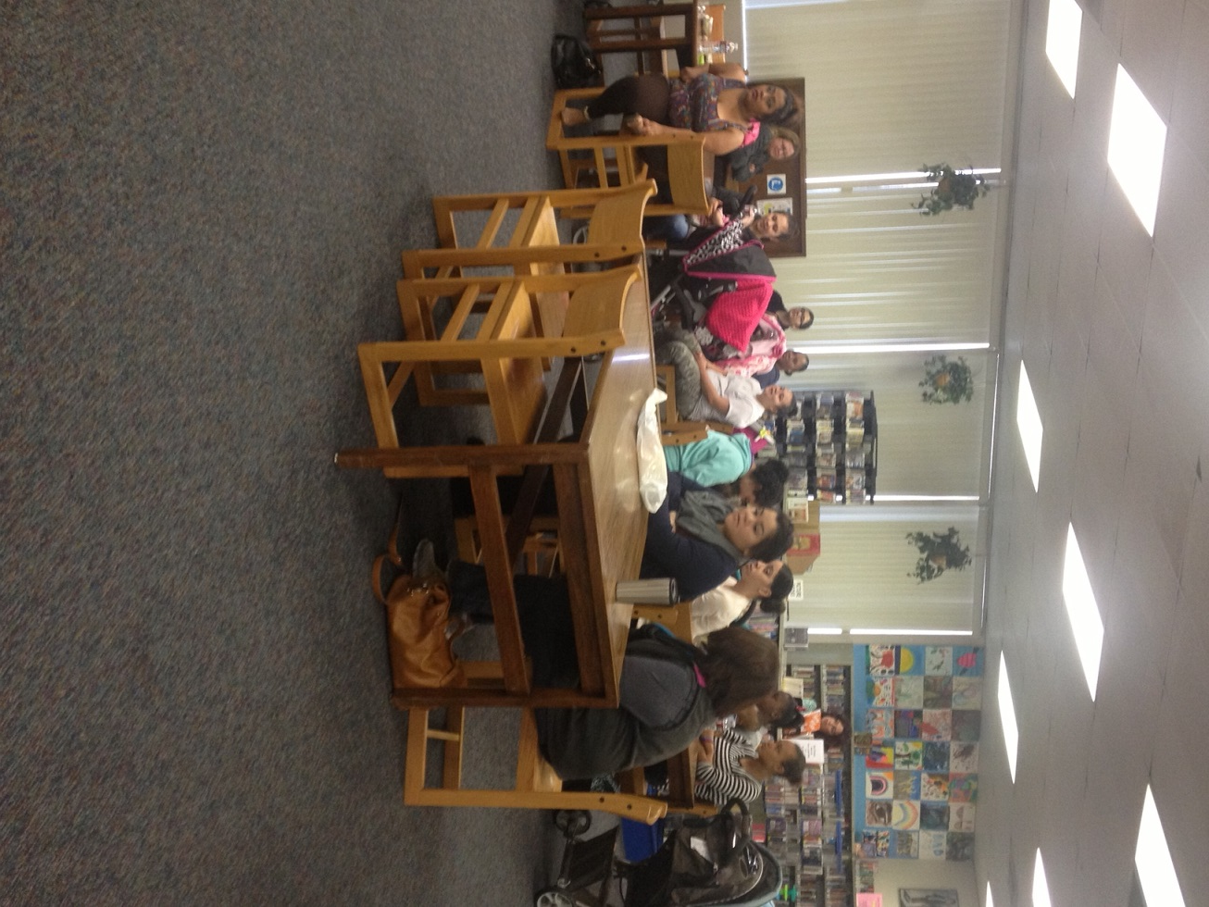
Step at the Fresno library:
Challenges
  Scheduling
  Childcare
  Teen Involvement
Rewards
  Partnerships
  Impact
  Knowledge
  Empowerment
  Skills
  Outcomes
  Library users
Notes:
Challenges
Rewards
Teens gaining many skills, how programs have impacted teen lives,

Slide 13
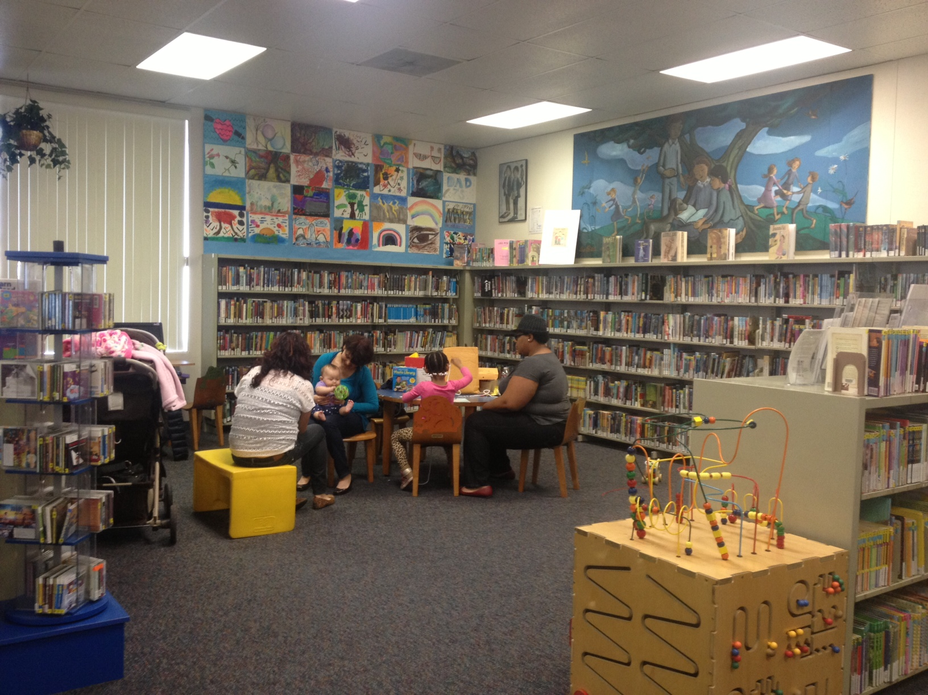
Step at the Fresno library:
Expansions
  Summer 2015
  Fall 2015
Notes:
Future in Fresno

Slide 14
Is step for you?
The right person for this project is:
Someone who likes teenagers
Someone who likes teen moms and their babies
  Committed to serving this population
  Looking for a challenge
  Focused on the community
  Has the capacity to run the program (The Four C’s)
  Proficient in Organizational Skills
  Willing to reach out to community partners
Notes:
COURTNEY

Slide 15
Project Requirements:
Recruit 20 or more teen moms
Hold 10 workshops (or 5 workshops twice)
Collaborate with one SOLID community partner
Be available for monthly chats
Attend one 6 hour training session prior to project implementation
Notes:
AMY

Slide 16
Each Project library receives:
$5000 to implement the project at one location within the library’s jurisdiction
A core library collection to support the project at the selected location
Intensive staff training and ongoing technical assistance
Notes:
AMY

Slide 17
Application process:
Application period is April 23-May 22, 2015.
Application information and materials are available at http://www.library.ca.gov/grants/lsta/apply.html
Applications will be reviewed starting the last week of May. Online interviews will be conducted as part of the application process. Libraries will be notified by early July.
Notes:
JANET

Slide 18
Thank you!
Janet Coles Kari Johnson
California State Library Fresno County Library
janet.coles@library.ca.gov kari.Johnson@fresnolibrary.org
Amy Gleason Courtney Saldana
Social Services Consultant Library Services Consultant
Former Supervisor, AFLP & Ontario City Library
Cal-Learn Programs in Sacramento County Youth Services Supervisor
amy@eslsacramento.com csaldana@ci.ontario.ca.us
Notes:
Questions?

Slide 19
A California State Library Webinar
Hosted by Infopeople
Infopeople webinars are supported in part by the U.S. Institute of Museum and Library Services under the provisions of the Library Services and Technology Act, administered in California by the State Librarian. This material is licensed under a Creative Commons 3.0 Share & Share-Alike license.
Use of this material should credit the author and funding source.

