Slide 1

Seeing the Big Picture
Presented by Joan Frye Williams
Wednesday, May 20, 2015

Slide 2


Both views are useful

Slide 3
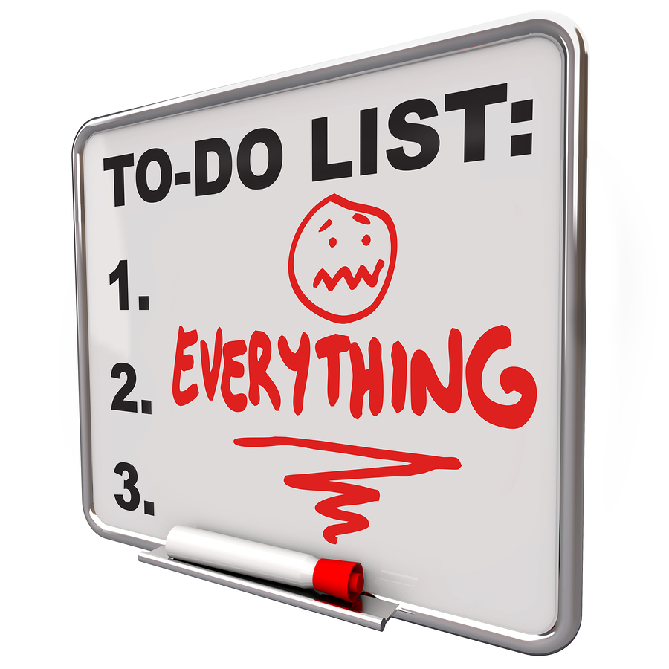
Why add this task when you’re already so busy?
More “yes” answers
Clearer priorities
Fewer surprises
Less work in the long run
Greater sense of connection
Improved chances for promotion

Slide 4

Today’s discussion
Six important big picture perspectives
Things to consider before you act
Barriers to big picture thinking
Inspiring big picture thinking in others
What you can do when people get bogged down in the details

Slide 5

1. Look beyond library processes to community results
Notes:
Which are you doing?
Making a living
Being the best stone carver I can be
Building a cathedral

Slide 6

Observe and learn
Patterns of library use over time
What people do after they come in contact with your services
How specific services connect to the library’s stated mission

Slide 7

Visualize before you act
What difference you want to make to the people you serve – the “big why”
How this action moves you in that direction
How you will evaluate progress
What else you can try if this doesn’t get you there
Don’t stop at “If we’re happy, they’ll benefit.”

Slide 8

Don’t overlook the need for a shared vision

Slide 9

2. Look beyond your immediate team to your stakeholders

Slide 10

Internal stakeholders
Other library departments
Union
Board, friends, foundation
Library users

Slide 11
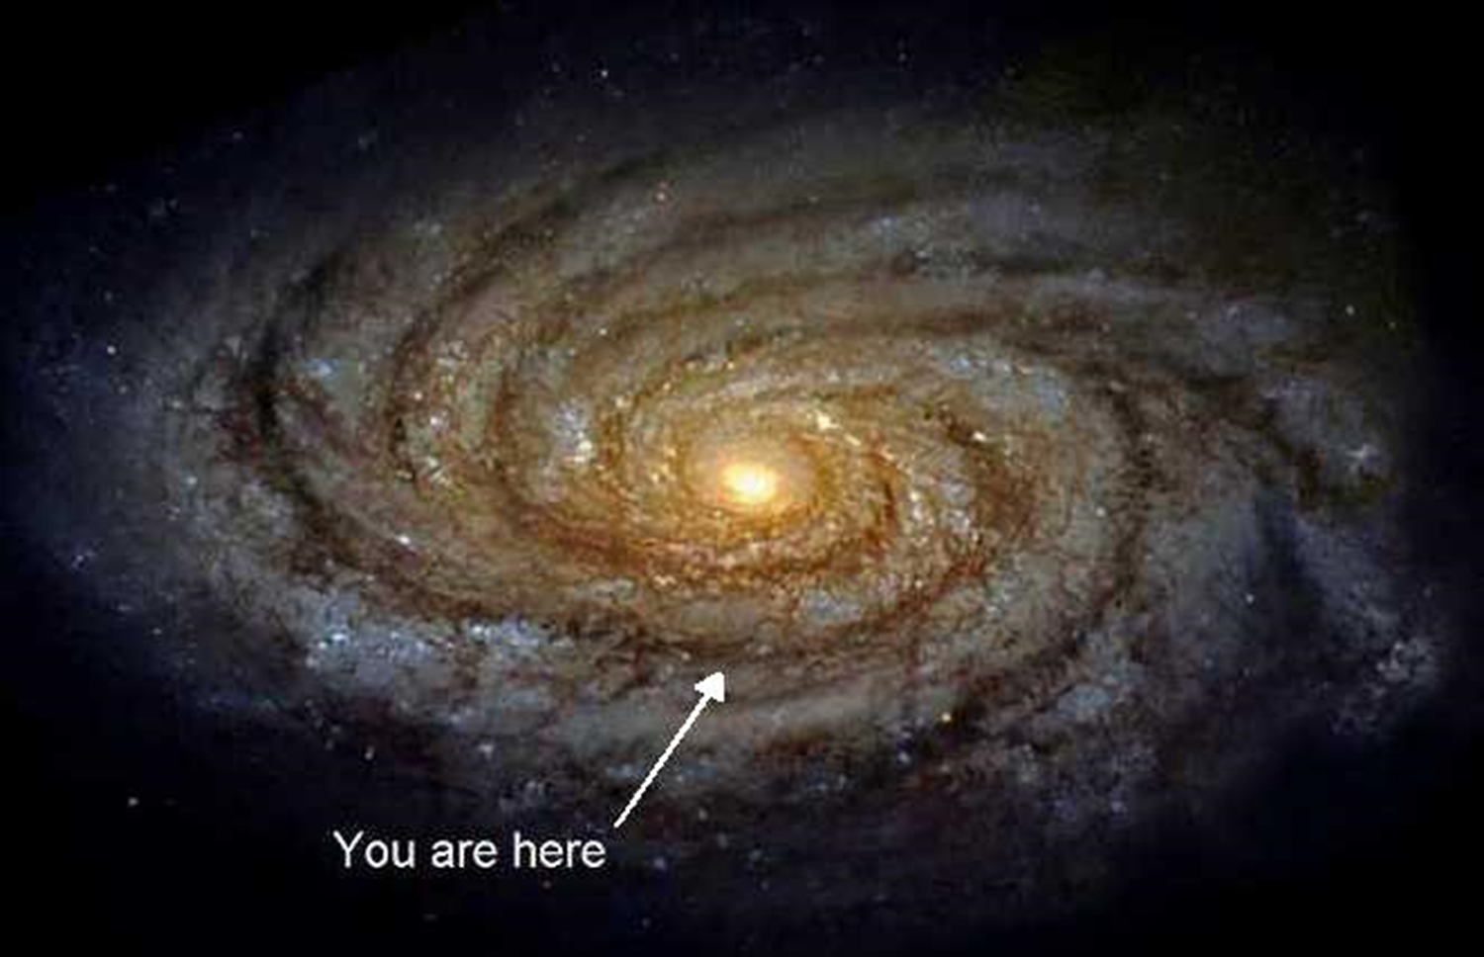
External stakeholders
Elected officials
Other city/county/campus departments
Partner agencies (current and potential)
Vendors
Neighbors
Non-users
Media

Slide 12

Observe and learn
Different groups’ stated priorities
Their patterns of action
Their preferred vocabulary
What gets them excited
What they do well
Where their authority begins and ends

Slide 13

Visualize before you act
Who will be affected by your action
How your work aligns with their interests
How your path might be smoothed by bringing them into the process
Questions they’ll have, and how you’ll answer
Don’t stop at “They don’t get it.”

Slide 14

Don’t overlook the people you don’t usually see

Slide 15

3. Look beyond situations to causes and consequences

Slide 16
Observe and learn
How workload, information, and decisions move through your organization
Who’s responsible for what
How failures happened, and what was learned
Triggers for conflict or resistance
Notes:
Process mapping can help

Slide 17
Visualize before you act
What problem you’re trying to solve
Who else is having the same or a related problem
How your action will eliminate the problem, not just move it elsewhere
Don’t stop at “They need to change.”

Slide 18
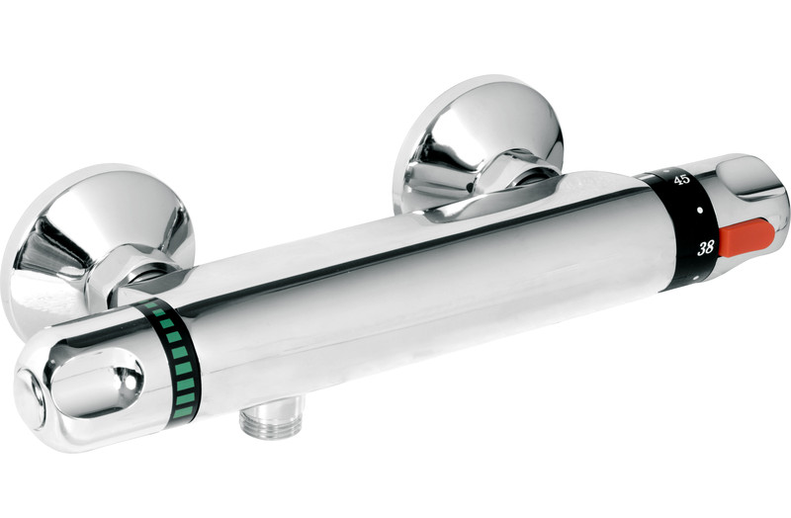
Don’t overlook preventive measures

Slide 19
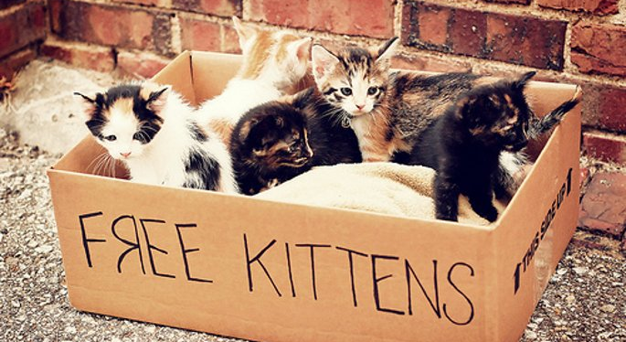
4. Look beyond out-of-pocket expenses to actual costs and benefits

Slide 20
Observe and learn
Which tasks take the most staff time
Which projects take the most calendar time
Which specialized resources are already stretched too thin
Steps and deadlines in annual budget and grant cycles

Slide 21
Visualize before you act
The service payoff for taking this action
The strategic payoff for taking this action
How important this is, compared to what you’re already doing
What it would cost to take a new approach instead of struggling to fix the one you have
Don’t stop at “Without new resources
we can’t do anything.”

Slide 22

Don’t overlook what won’t get done while you’re working on this

Slide 23

5. Look beyond your immediate needs to the library’s broader commitments

Slide 24
Observe and learn
The basics of relevant laws
The basics of relevant contracts
Library policies
City/county/campus policies
Long standing arrangements and traditions
Go-to resource people on these topics

Slide 25
Visualize before you act
What this action says about the library and its priorities
How this action aligns with the library’s existing commitments
Where higher level permissions or negotiations might be required
Don’t stop at “It’s management’s job
to worry about that.”

Slide 26
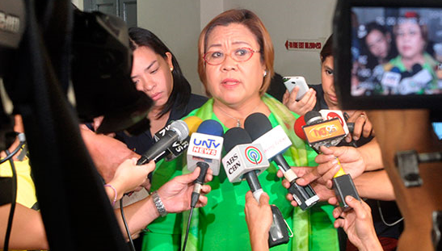
Don’t overlook the need to prep your boss

Slide 27

6. Look beyond today to the future
Notes:
The bad news is time flies. The good news is you can be the pilot.

Slide 28
Observe and learn
How the community you serve is changing
Where demand is increasing, and whether you have the capacity to respond
Where demand is decreasing, and how you might scale back to make room for new priorities
Trends and fresh practices in customer service, technology, and collection development

Slide 29
Visualize before you act
Likelihood that the library will be dealing with this (or a similar) situation again in 10 minutes, 10 days, 10 months, or 10 years
How you’ll cope if your action is a roaring success and you don’t get any new resources
How you can package this work for others to use
Don’t stop at “I just need to get
(person or group) off my back.”

Slide 30

Don’t overlook the power of precedent

Slide 31
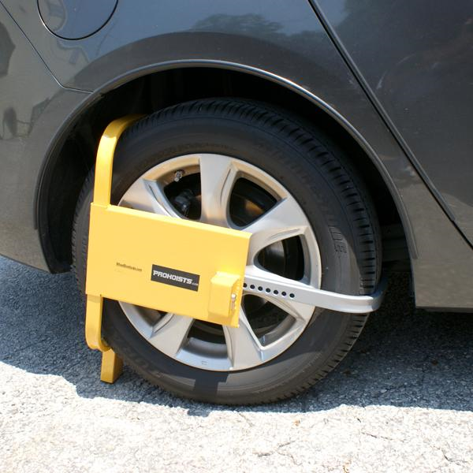
Barriers to big picture thinking
Perfectionism
Procrastination
Pessimism
Fear of conflict
Complacency

Slide 32
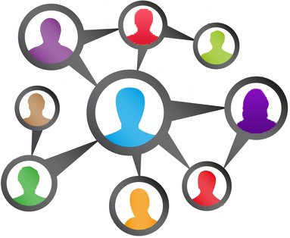
To inspire big picture thinking in others, communicate
Fit
Trust
Caring
Openness
Development
Ownership
Notes:
Don’t just tell, show
Fit. Am I a fit with the organization and its culture? Is the purpose of the organization meaningful to me? Are the values of the company in harmony with my values? Am I a fit with my job? Is my work significant, challenging and the best use of my abilities?
Trust. Do I have a trusting workplace where leaders have integrity and are honest, respected and fair?
Caring. Do I have a caring workplace where my peers and managers feel like family, and they encourage collaboration and teamwork? Do I have friends at work?
Openness. Am I informed, and does my manager listen?
Development. Does the company support individual development? Am I developing and growing in ways that nurture achievement and mastery?
Ownership. Do I feel like an owner? Do I have autonomy where I participate in decision-making, have responsibilities and have flexibility in how I achieve my goals?

Slide 33

If you get bogged down in the details
Acknowledge – “Good point”
Step back – “I’d like to look at that in context for a minute”
Visualize (start with one of the points outlined in previous slides)
Reframe – “In light of what we just discussed, how can we…”
Repeat as necessary

Slide 34

It’s wise to see the task you’re doing in its larger context

Slide 35
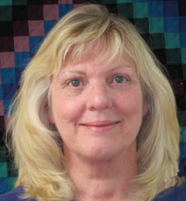
joan@jfwilliams.com
Let’s continue the conversation…
Photo by Martin Helmke

Slide 36

Debuting this summer:
Joan Frye Williams’ new Infopeople podcast series
The Practical Iconoclast

Slide 37

Infopeople webinars are supported in part by the U.S. Institute of Museum and Library Services under the provisions of the Library Services and Technology Act, administered in California by the State Librarian. This material is licensed under a Creative Commons 3.0 Share & Share-Alike license. Use of this material should credit the author and funding source.

