Slide 1


Jennifer Bennett
CVA, Senior Manager, Education & Training
jbennett@volunteermatch.org
@JenBennettCVA

Slide 2
What are we talking about?
Moving beyond “Volunteers Needed”
How do volunteers find you? How can you find them?
Creating the work
Finding the right volunteers
Evaluating your success
What’s next?

Slide 3
“Volunteers Needed”
What does your volunteer program look like to a volunteer? Volunteers have a choice!
Are your opportunities task based or collaborative?
  One size does not fit all volunteers
Do you have clear roles and expectations?
  Volunteers want to know the impact and make good use of their time.
Can you identify the “right” volunteer for the role or your organization?
  It’s as important to know when to say yes as it is to learn to say no.

Slide 4
This is not your mother’s volunteering
Shifts in generations create a new model
  Volunteers hope to make an impact
  Volunteer task lists replaced by meaningful, targeted work, skills based
  Meaningful to the volunteer, important to the organization
Volunteers need flexibility
  Does not imply that they can’t be dependable, reliable, accountable
Volunteers want to understand
  Answer the question “Why?”

Slide 5
How do volunteers find you?
80% of Volunteer Coordinators tell us the “Word of Mouth” is their #1 recruitment method
What are your volunteers saying about your organization? What can you do about it?

Slide 6
Pros and Cons of “WoM”
You can create a positive experience
  Meaningful and important
  The right volunteer in the right job
  Saying no politely and professionally
Make it easier for volunteers to share
  Arm them with information
  Engage through social media
  Don’t keep them in a silo

Slide 7
Pros and Cons of “WoM”
Passive
  You can’t make your volunteers tell their friends, but you can encourage them
Depends on earned marketing/media
  Easier now than ever – but it’s just as easy to share a negative experience
Doesn’t bring in volunteers who don’t have a connection or know who you are

Slide 8
How can you find volunteers?
VolunteerMatch by the numbers:
95,507 Active opportunities nationwide
9,496,042 Connections since 1998
3,500 Average referrals a day
  Around 300 during peak hours
2-3 Referrals for each visitor
Lots of volunteers don’t have a strong idea about where or how they want to volunteer.
They are looking for a opportunity to make an impact and find a cause they care about. (79% and 82% Hart 2010)

Slide 9
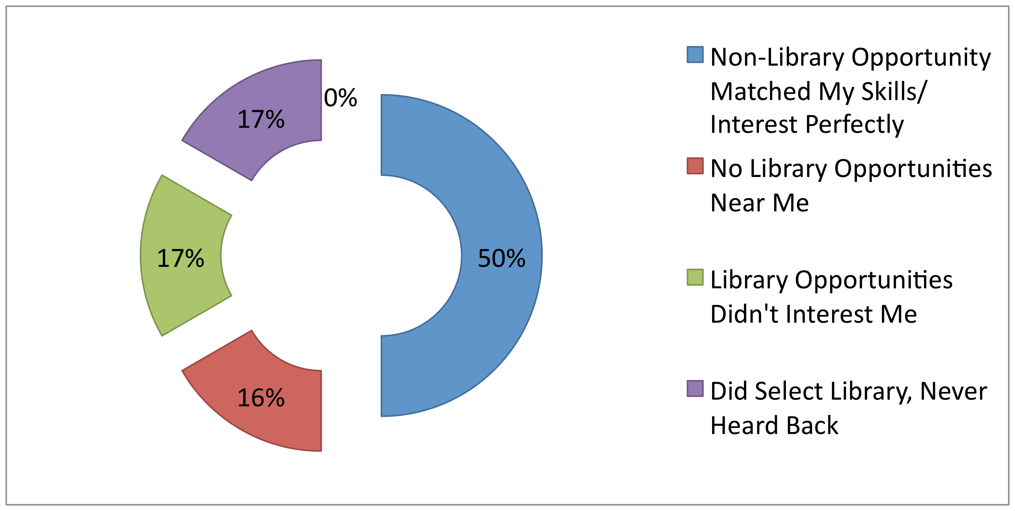
Why Didn’t You Take a Library Opportunity?
2013/2014 Library Survey Results, Carla Lehn

Slide 10
Did Your Library Volunteer Opportunity Lead to Other Forms of Support?
60% told friends about what the library has to offer
30% introduced friends to volunteer opportunities at the library
10% gave money to support the library
5% asked friends to give money to support the library
5% attended a rally or other meeting in support of the library
2013/2014 Library Survey Results, Carla Lehn
Notes:
The project is documenting that volunteers recruited through our VolunteerMatch hub are not only sharing their skills, but are also naturally developing into strong library supporters. The survey asks them if and how their library volunteer experience led to other forms of library support, with the following results:· libraryData from an initial survey of library volunteers recruited through the Get Involved “hub” site shows that for 72.9% of them, this was their first experience volunteering for a library.

Slide 11
Where are you looking now?
Consider each recruitment channel
  Who would you expect to recruit there?
  What opportunity or message would be right for this channel?
  How successful has this channel been in the past?
Which opportunities or roles are harder to fill?
  Who would be/is successful at this role?
  What makes them the “right” volunteer
  Think about where you might find others with
Think about community partnerships
  Are there channels or communities that you’re overlooking now?

Slide 12
Create a Recruitment Plan
Introduce your program and your work!
  Set the stage – tell your story
Have a “virtual” conversation
  Answer the question “what do volunteers do at your organization?”
Prioritize the information you share
  What does a volunteer need to know to decide if they’re the right volunteer for your program?

Slide 13
Find the right volunteers!
When inviting volunteers to participate in your
organization finding the right fit becomes even
more important
Know who you want
  Comprehensive position descriptions: skills, experience, traits or characteristics
Create a strong foundation and manage expectations
  No bait and switch
  Policies and procedures manual, NDA, Letter of agreement

Slide 14
Find the right volunteers!
Screen volunteers
  For skills, but also for characteristics and fit
Understand why no is not necessarily a negative outcome
  Meaningful work
  Right fit for the position and the organization
  Focus your time on supporting the right volunteers.

Slide 15
Keys to Creating Volunteer Engagement
Develop work that is meaningful to the volunteer and important to the organization.
Create a connection between volunteers, clients and your mission
Establish the foundation necessary to support a diverse program of volunteer engagement
Know and share the impact of the work volunteers do

Slide 16
Create the right opportunities
Ask why?
  Why does this work matter, why would someone want to volunteer for this opportunity?
Incorporate responsibility and accountability
  Set and manage expectations for all stakeholders
  Be clear about decisions that can be made, made with consultation, and must be brought to supervisors
Think creatively
  What could you accomplish if you weren’t limited to the time and talent of paid staff?

Slide 17
Think about different opportunities
Just because someone can’t make it to your office doesn’t mean they can’t contribute.
Portable opportunities
  Project based, skills based, possibly virtual
Virtual opportunities
  Done from anywhere, maybe skilled based, but not necessarily
Peripheral opportunities with follow up
  Involvement on any level can lead to more impactful engagement

Slide 18
Start with a plan
What will your volunteer corps look like in 5 years?
What do you envision your program looking like?
What will it look like if you just maintain it?
Who are your stakeholders, and how are they involved now? Who/how would you like them to be?
Start with evaluation and build evaluation points into your plan.

Slide 19
Evaluate!
What’s working now, and what’s not?
  Surveys – volunteers, paid staff, clients
  Informal conversations, interviews, town halls
Solicit feedback on the program, process.
  Brainstorm opportunities for meaningful engagement
Don’t abandon volunteers or paid staff
  Create an ongoing plan to support, evaluate, problem solve as roles/programs change
Follow up on surveys and interviews – year over year or as programs evolve

Slide 20
Evaluate!
What’s working now, and what’s not?
  Surveys – volunteers, paid staff, clients
  Informal conversations, interviews, town halls
Solicit feedback on the program, process.
  Brainstorm opportunities for meaningful engagement
Don’t abandon volunteers or paid staff
  Create an ongoing plan to support, evaluate, problem solve as roles/programs change
Follow up on surveys and interviews – year over year or as programs evolve

Slide 21
Things to Think About
You don’t have to change everything right now
  Identify the priorities or critical positions
  Start with small changes or clarify the foundations
Invite volunteers to take on leadership roles
  Volunteers want to tell you what they like (and don’t like) about your program
  Invite your superstar volunteers to take the lead
Share your milestones and successes with the organization
  Manager, leadership, co-workers and, of course, the volunteers!

Slide 22
Resources
Learning Center
Find upcoming webinar dates, how-to videos and more
http://learn.volunteermatch.org
Volunteer Engagement Blog
Visit Engaging Volunteers, our nonprofit blog
blogs.volunteermatch.org/engagingvolunteers/
Upcoming Related Webinar Topics:
Where do I go from here? Engage Volunteers in New Ways
Developing a Strategic Plan for Volunteer Engagement
Build Staff Buy-In for Volunteer Engagement

Slide 23


Thanks for attending!
Join us online:
Like us on Facebook: www.Facebook.com/VolunteerMatch
Follow us on Twitter: @VolunteerMatch
For any questions contact:
Jennifer Bennett
(415) 321-3639
@JenBennettCVA
jbennett@volunteermatch.org

