Slide 1
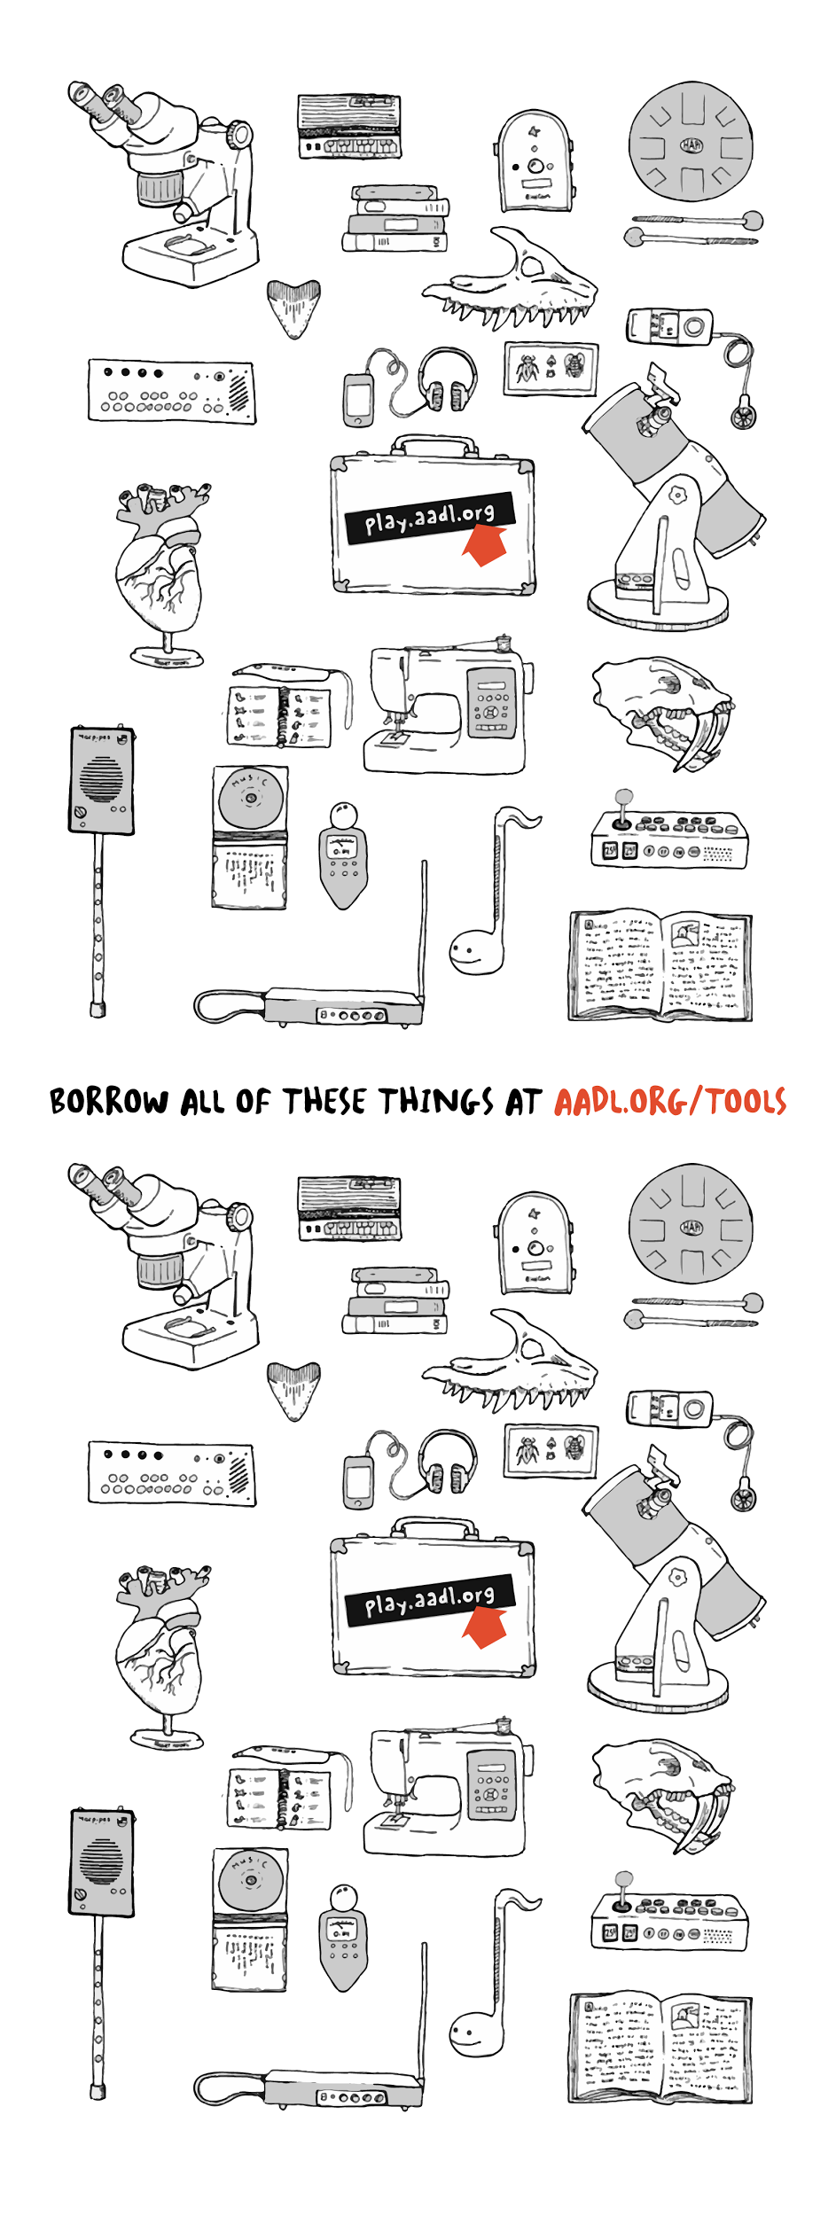
Libraries That Lend Things
An Infopeople Webinar
Wednesday, July 22, 2015
Steve Teeri teeris@aadl.org
Anne Drozd drozda@aadl.org

Slide 2
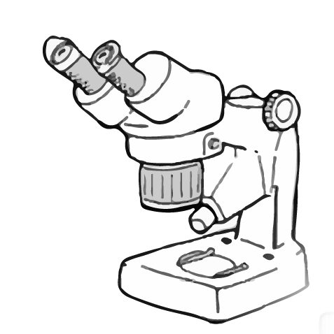
What we’ll cover:
Where to start
AADL’s current collections
Audience
Collaboration with community organizations
How to start an unusual collection at your library

Slide 3
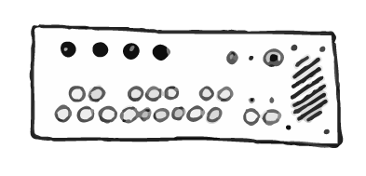
Where to start.

Slide 4

But we’re already lending things!

Slide 5
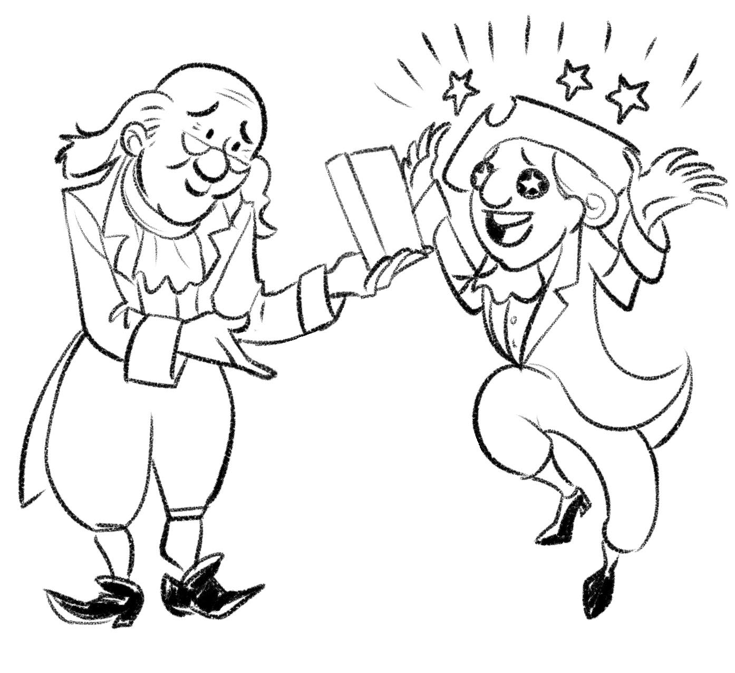
Books were once unusual objects.

Slide 6
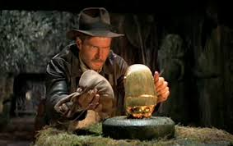
Why lend other things?
A natural extension of the core
mission of libraries:
reduce barriers to access
increase access to rare and hard-to-find objects

Slide 7
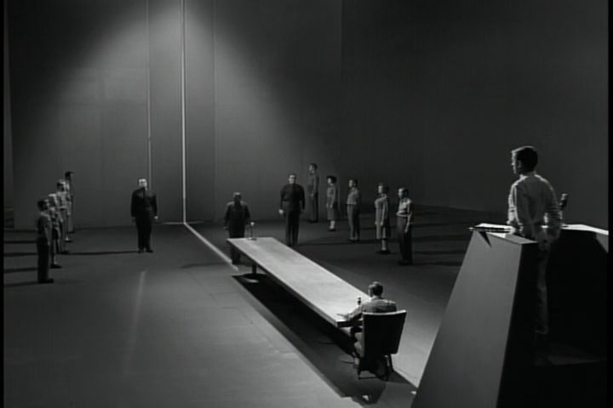

Slide 8
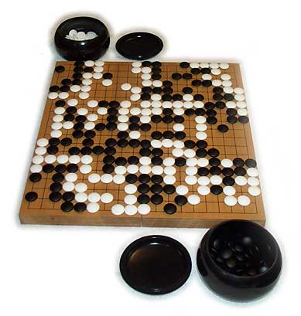
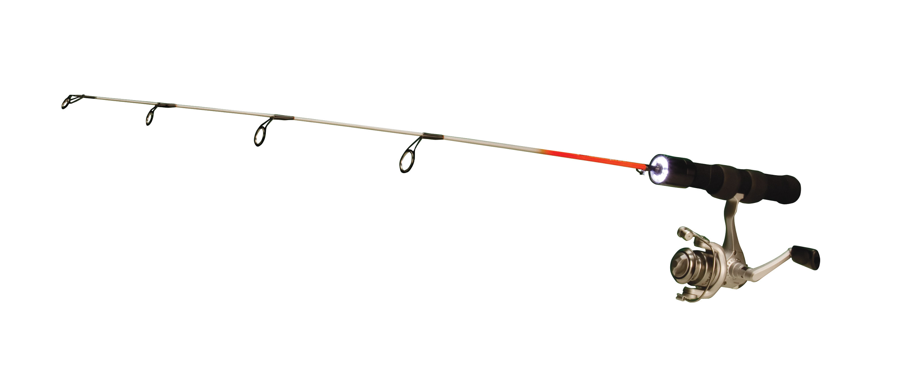
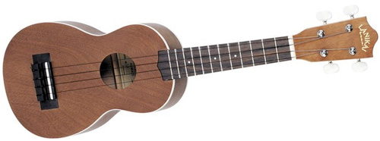
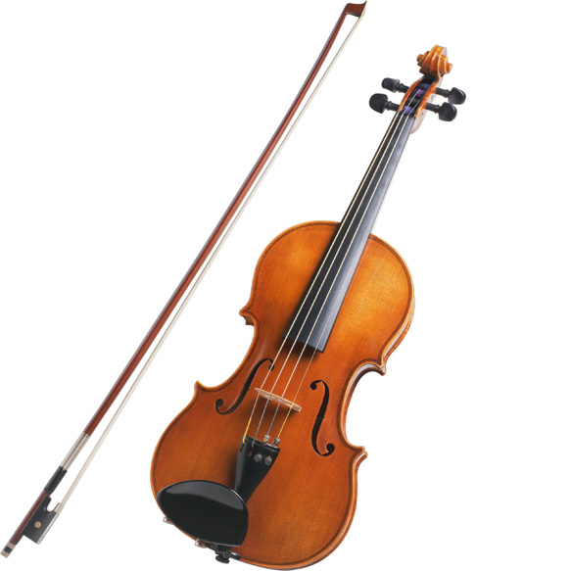
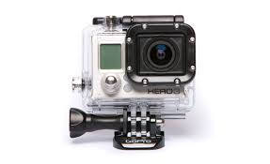
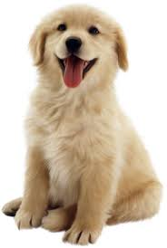
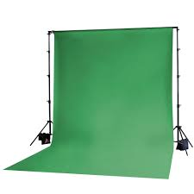
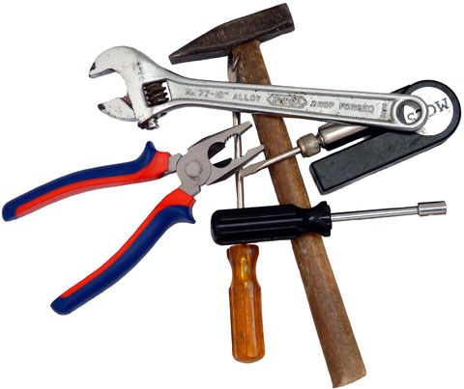
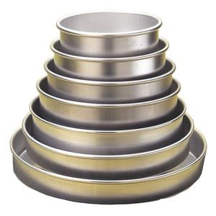
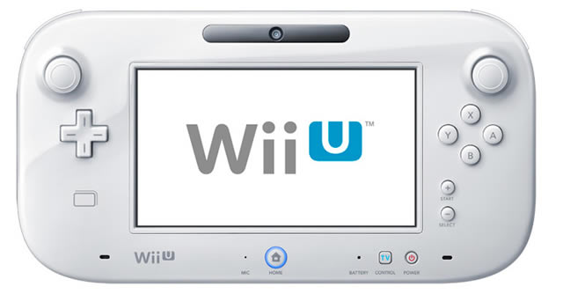
What are other
libraries lending?

Slide 9
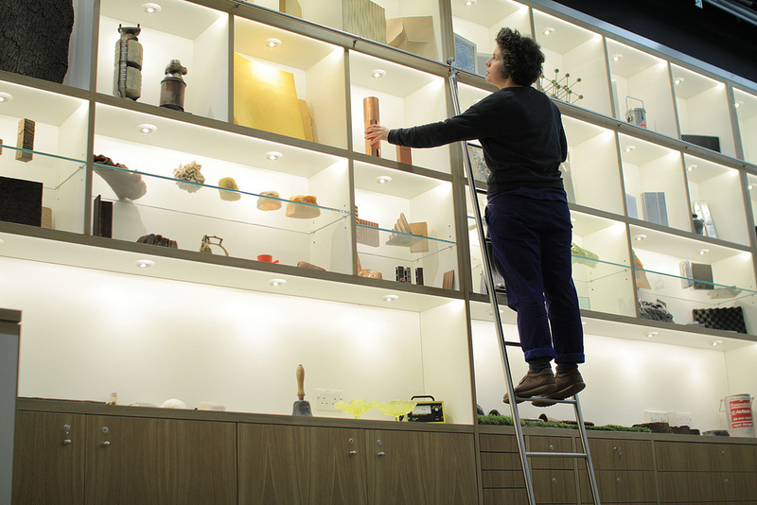
Institute of Making at University College London
the Materials Library — that contains over 1,500 of the most extraordinary materials on earth.

Slide 10
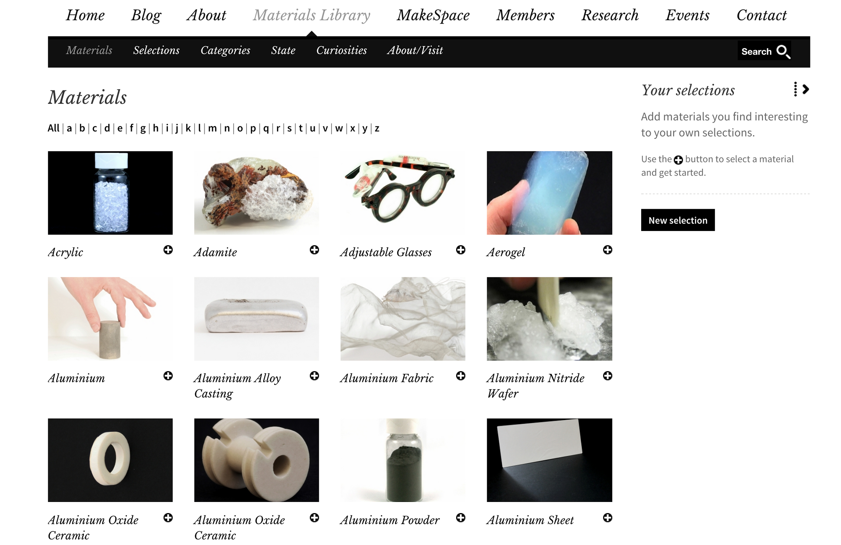

Slide 11
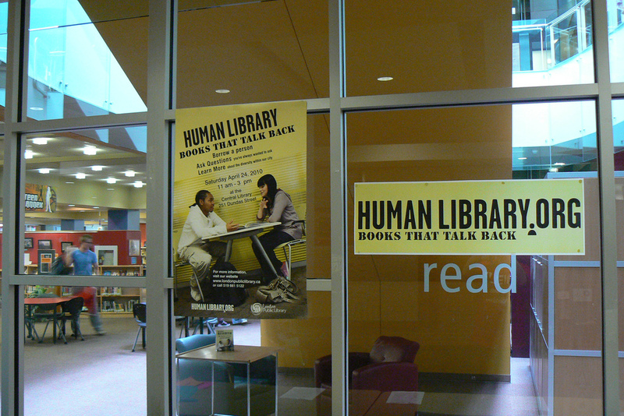
Human Library in Copenhagen, Denmark

Slide 12
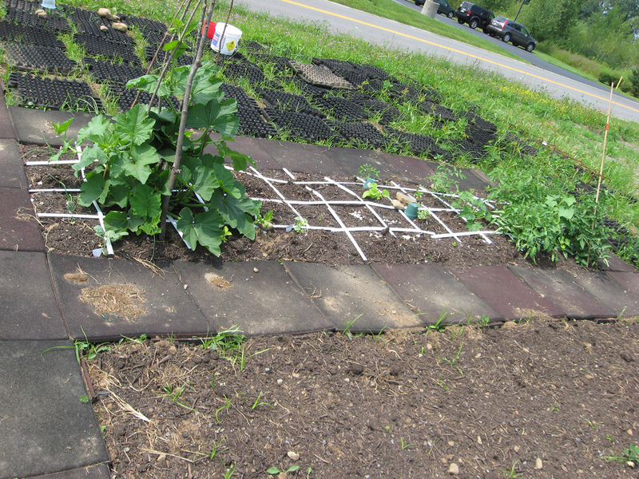
Libraryfarm
Cicero, New York

Slide 13
you can start small.

Slide 14
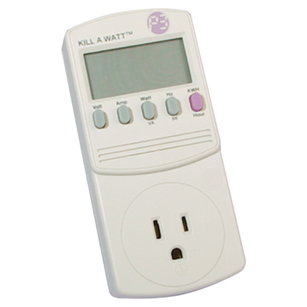
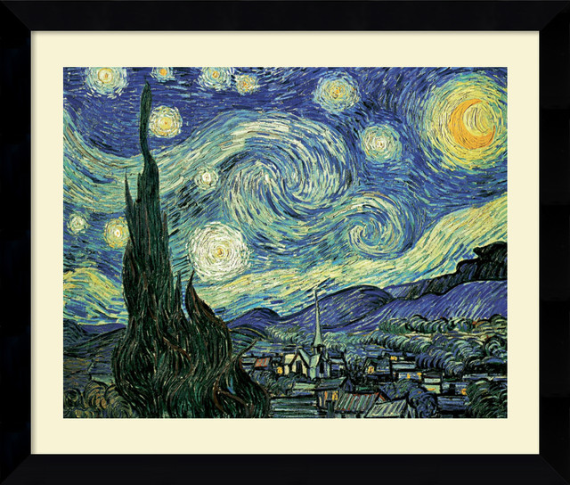
Where we started:
Energy Meters (2005)
aadl.org/hometools
Art Prints (40+ years)
aadl.org/artprints

Slide 15
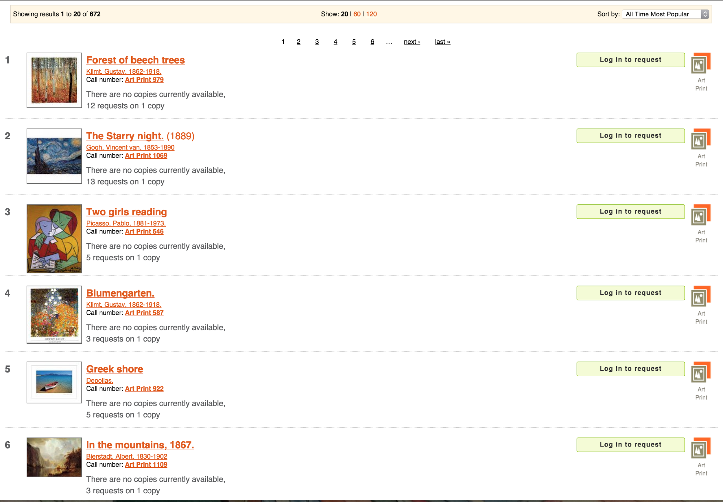
Art Prints

Slide 16
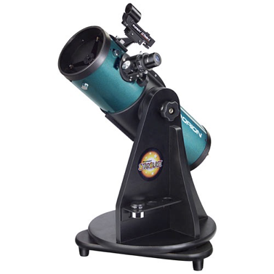


Telescopes
+
Started in 2009 with 7. Now circulating 30.

Slide 17
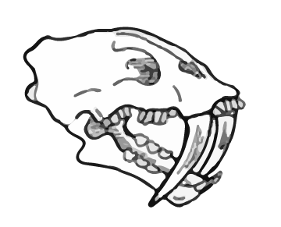
aadl’s current collections

Slide 18
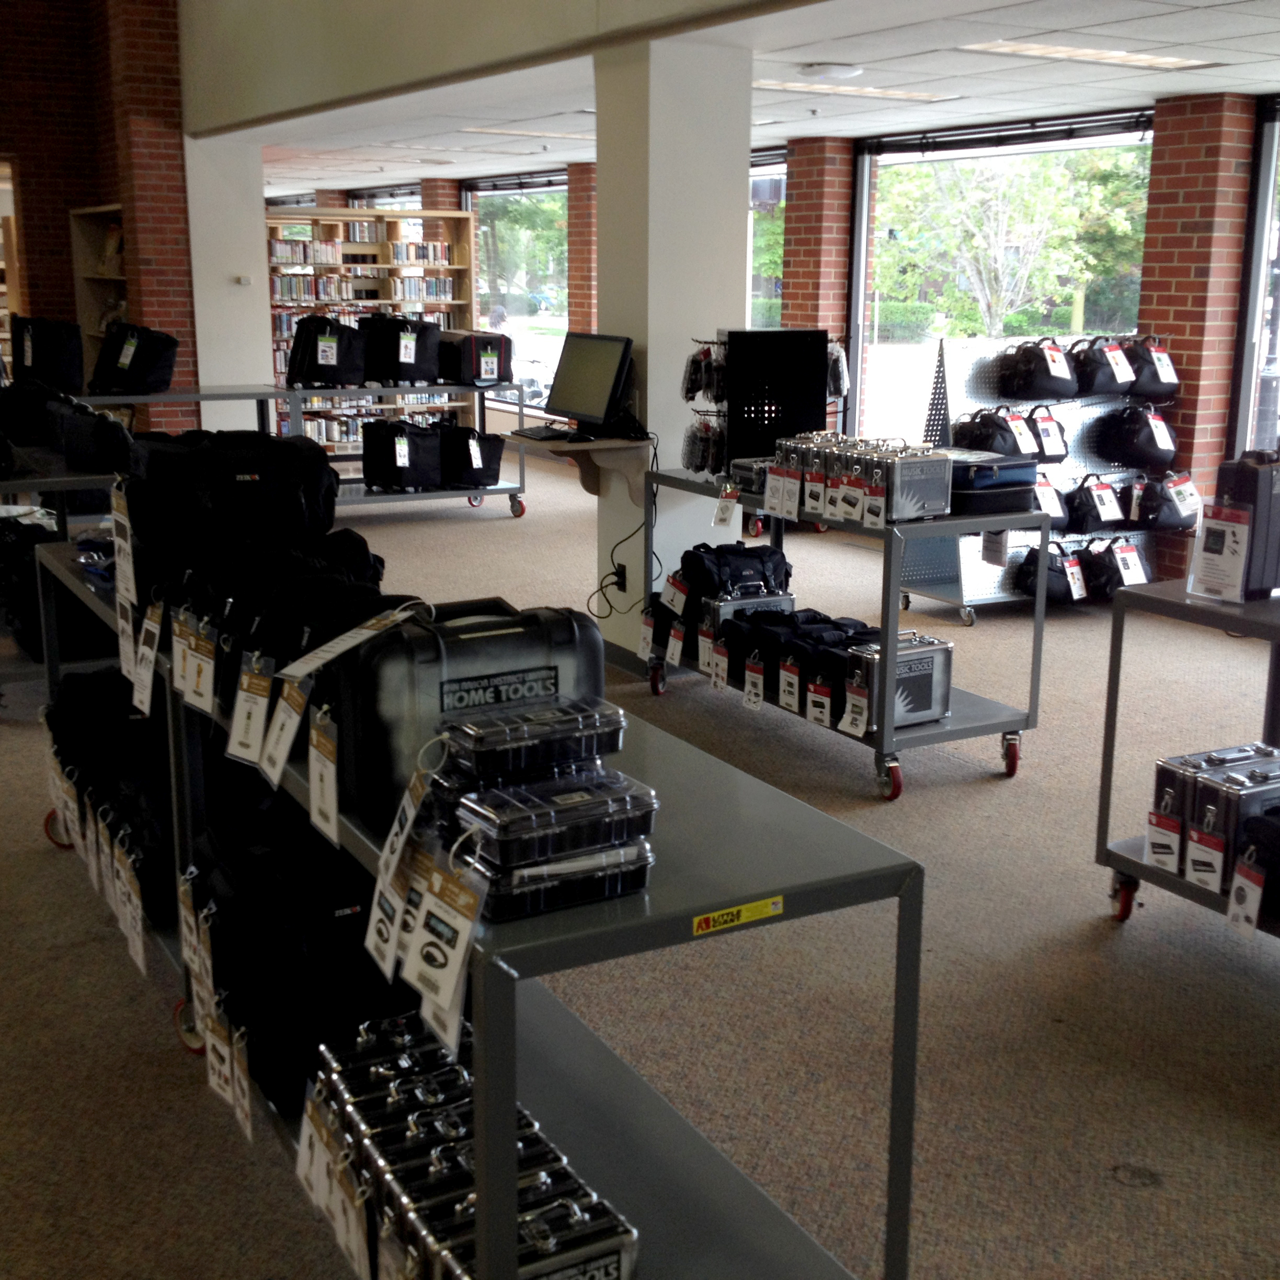

Slide 19
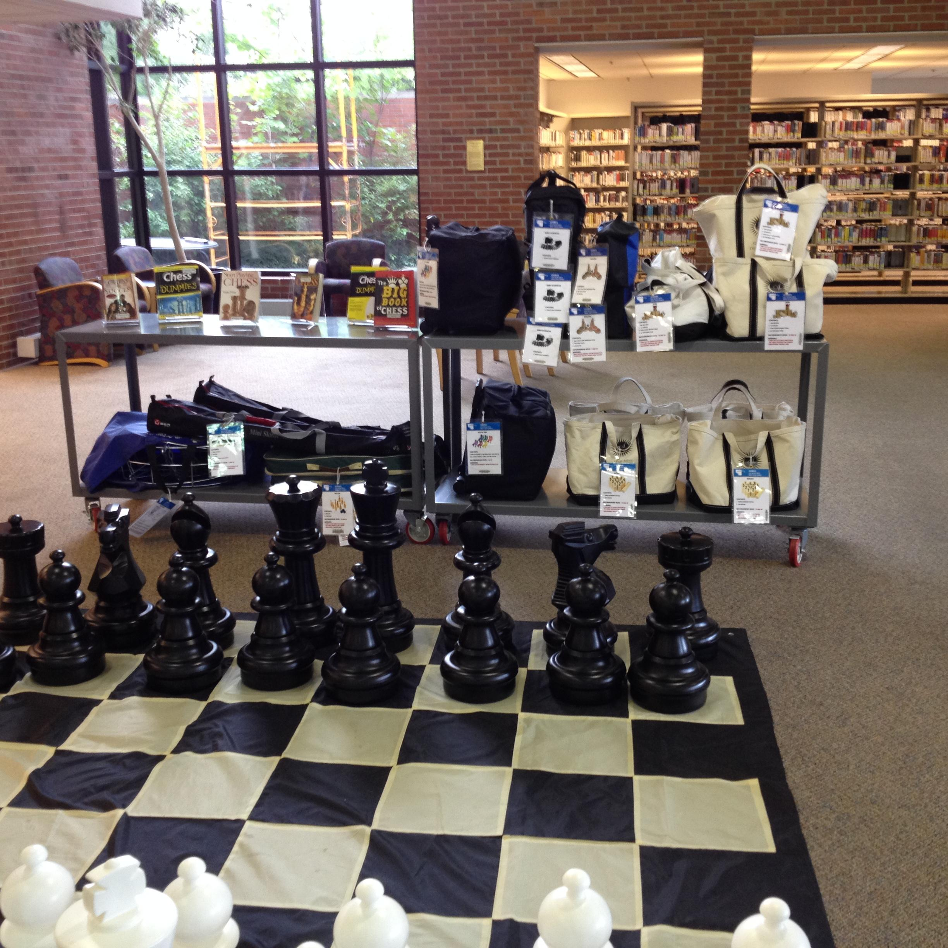

Slide 20
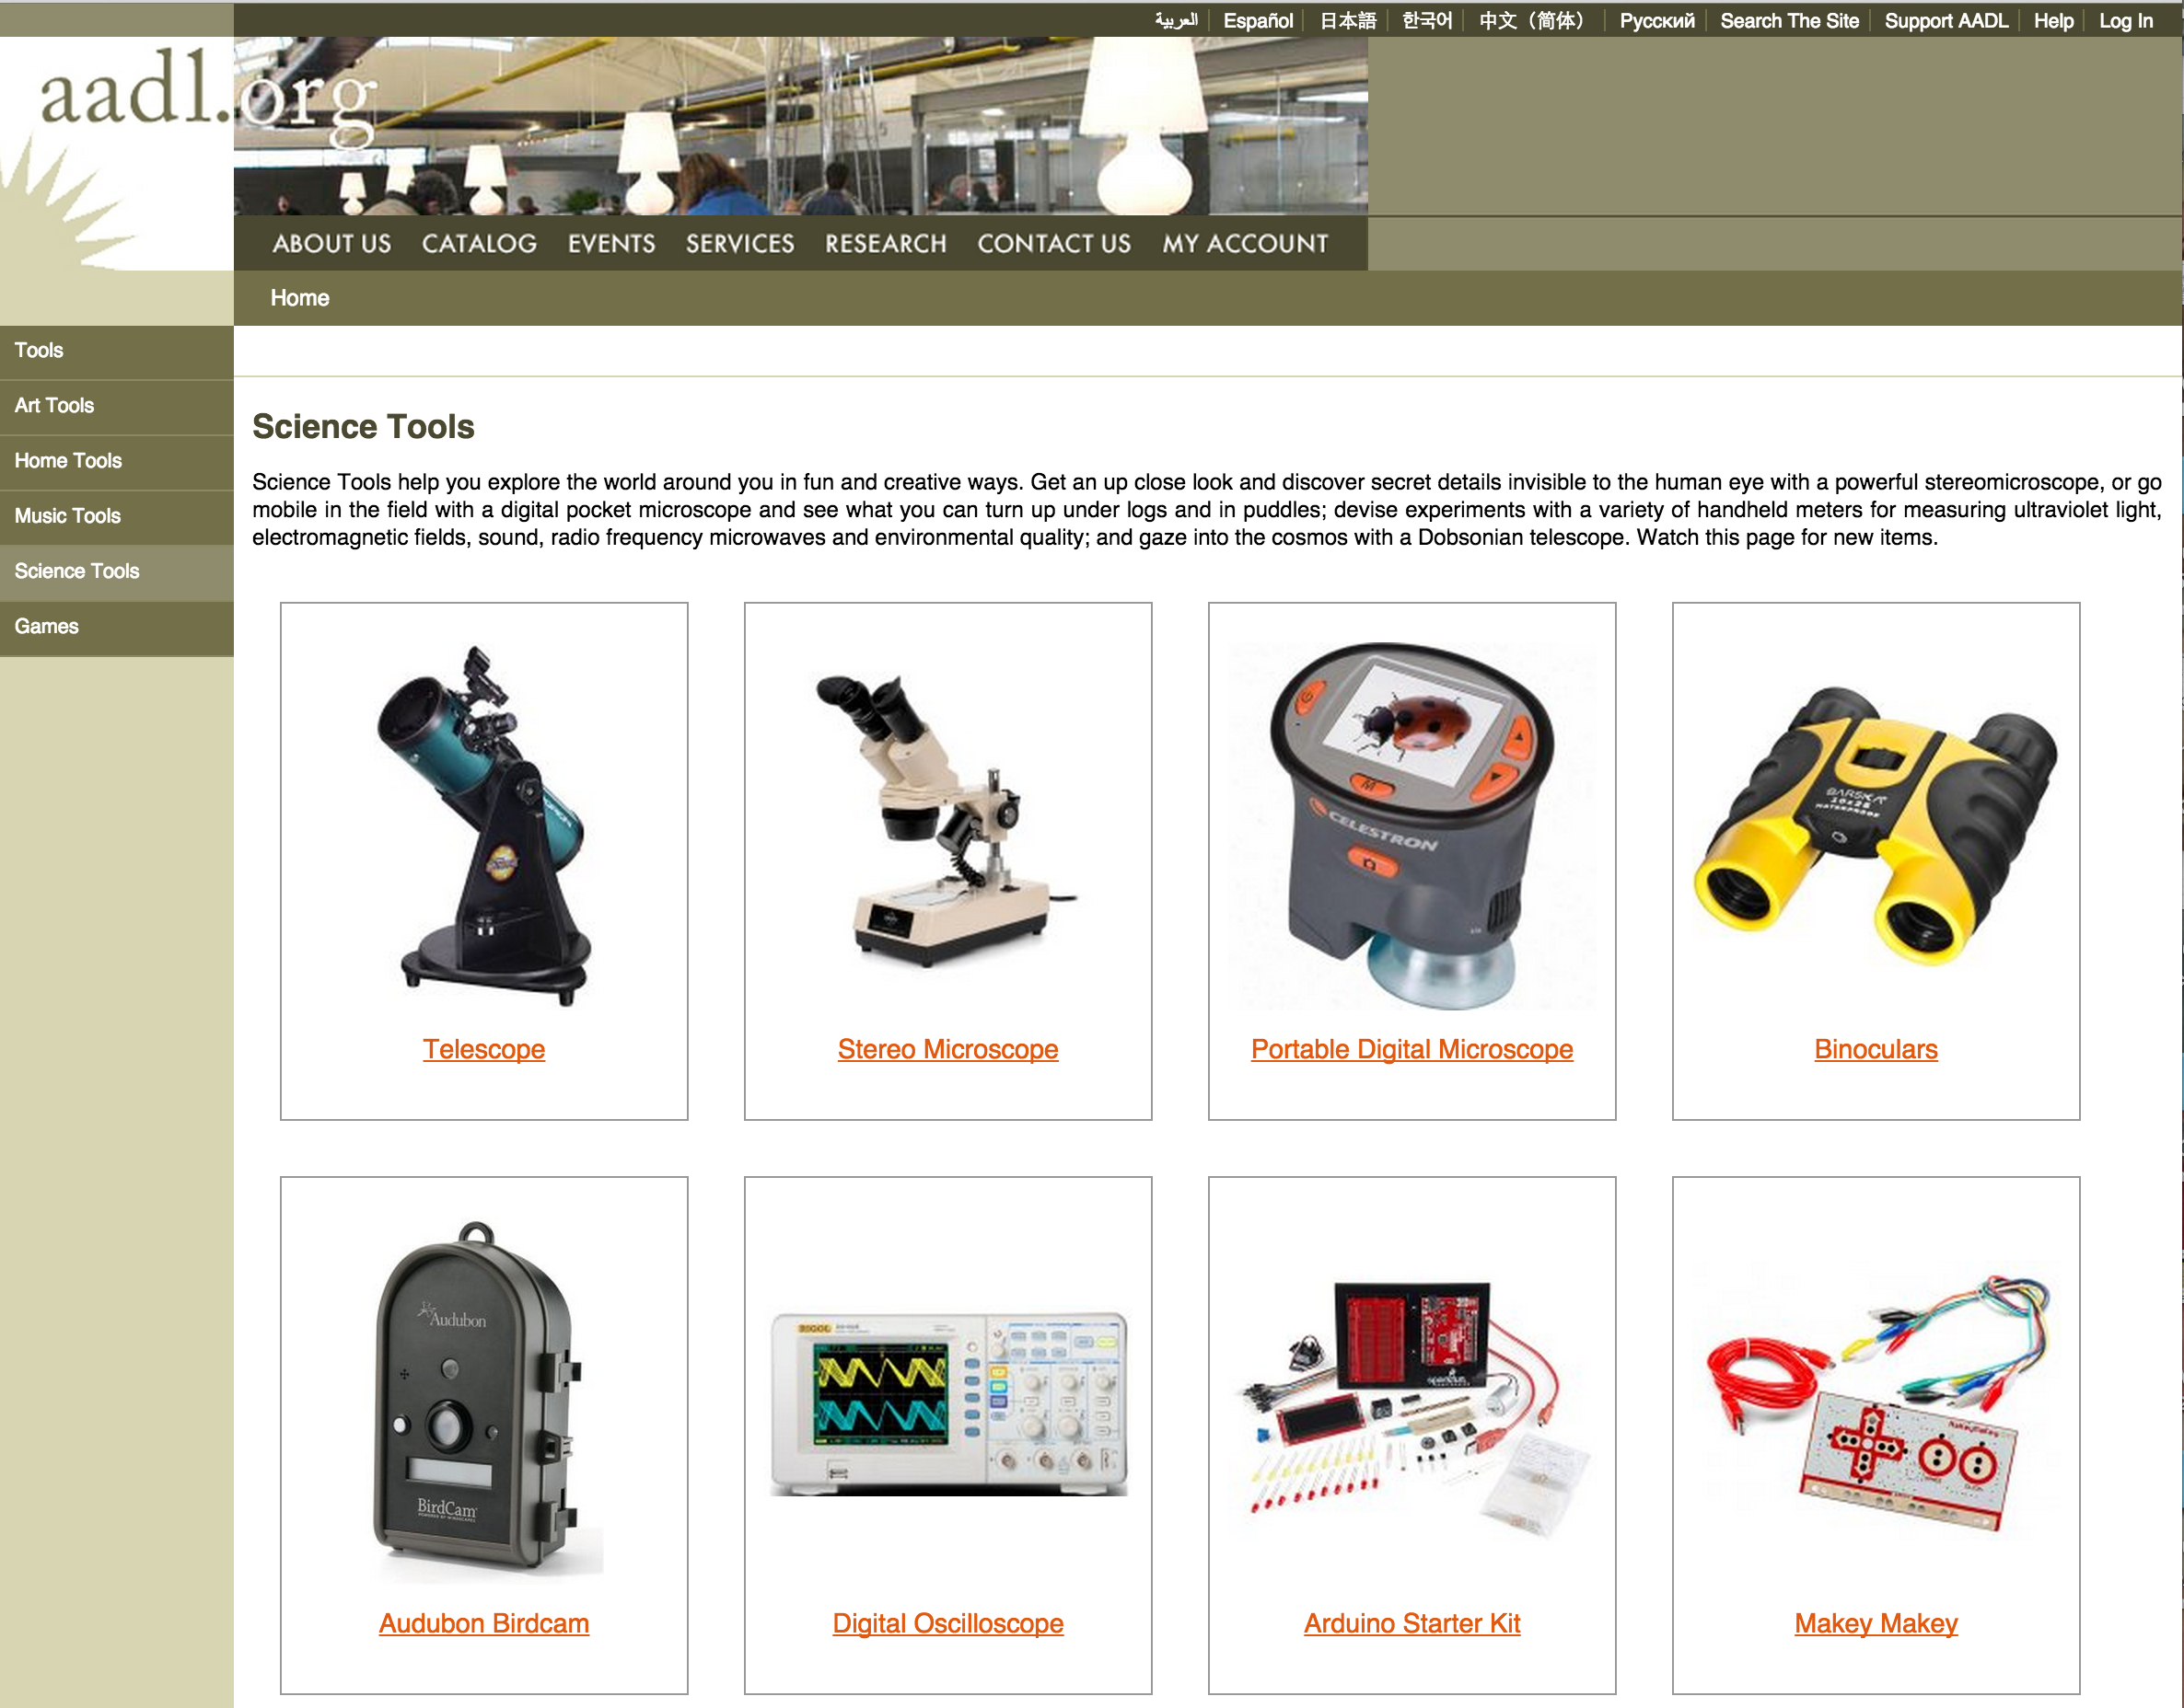
aadl.org/sciencetools

Slide 21
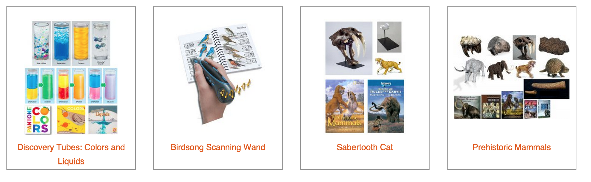
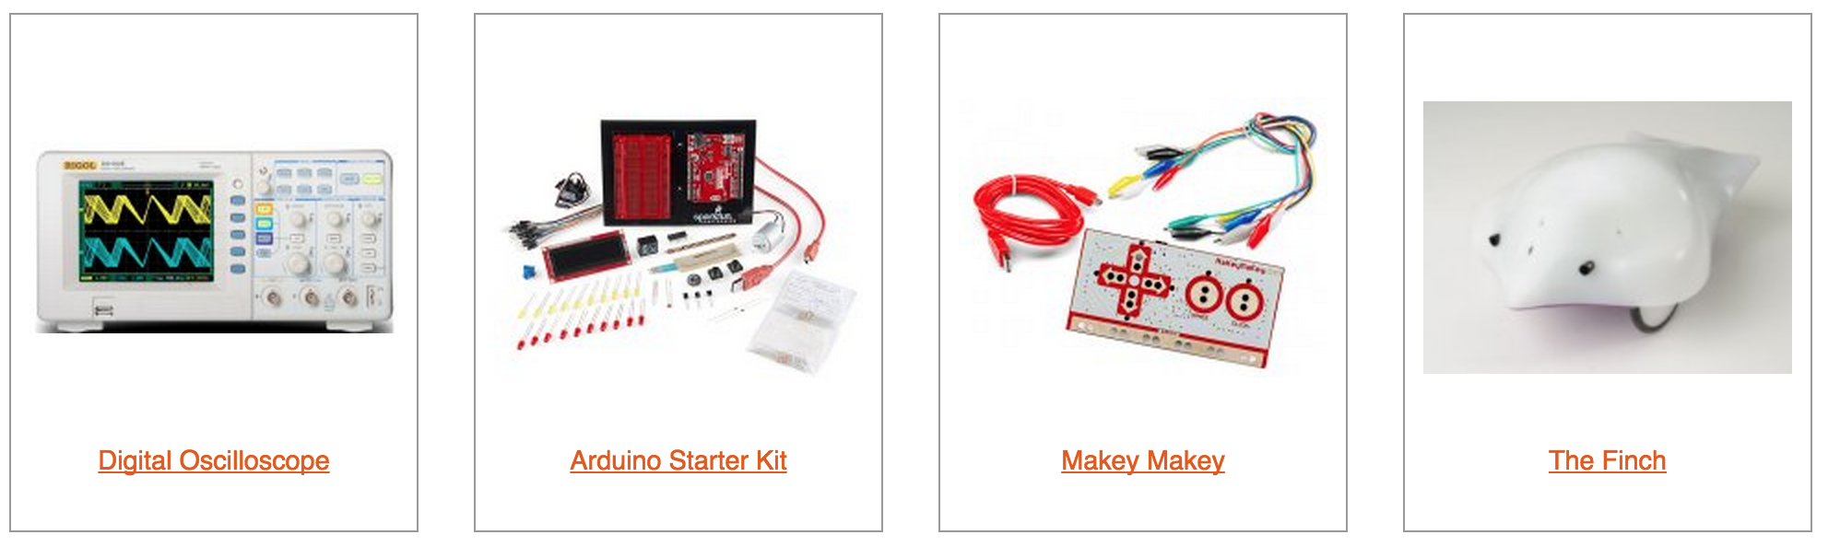
Science Tools
aadl.org/sciencetools

Slide 22
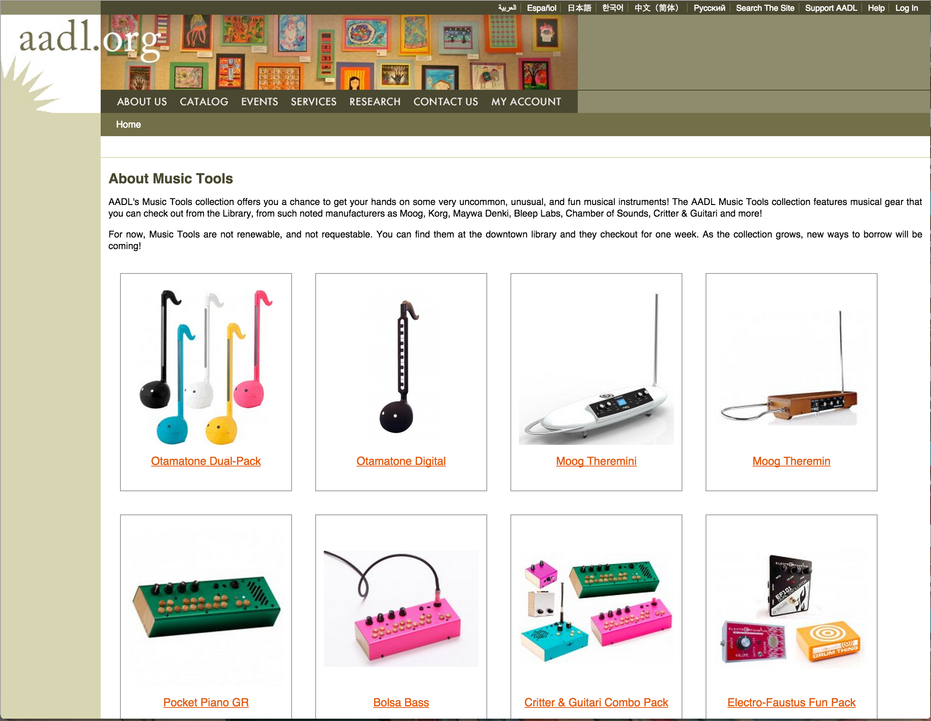
aadl.org/musictools

Slide 23
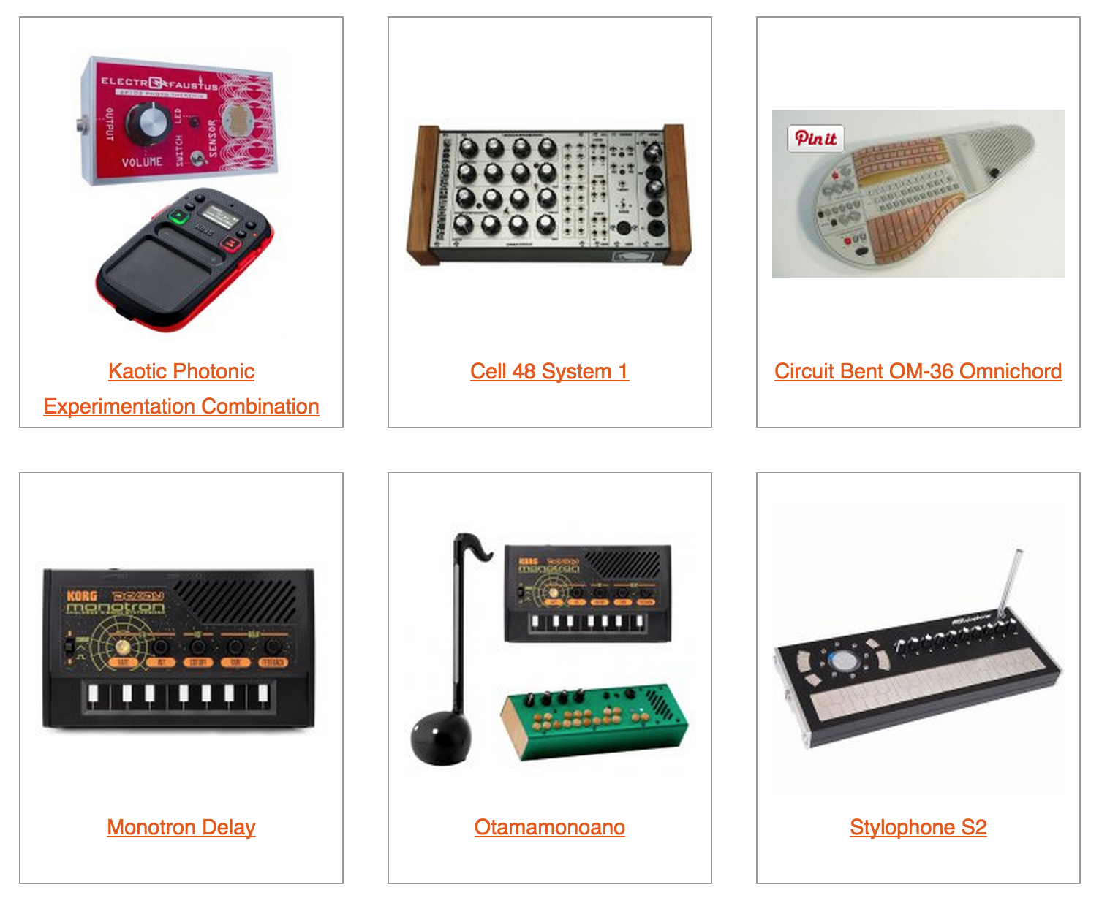
Music Tools
aadl.org/musictools

Slide 24
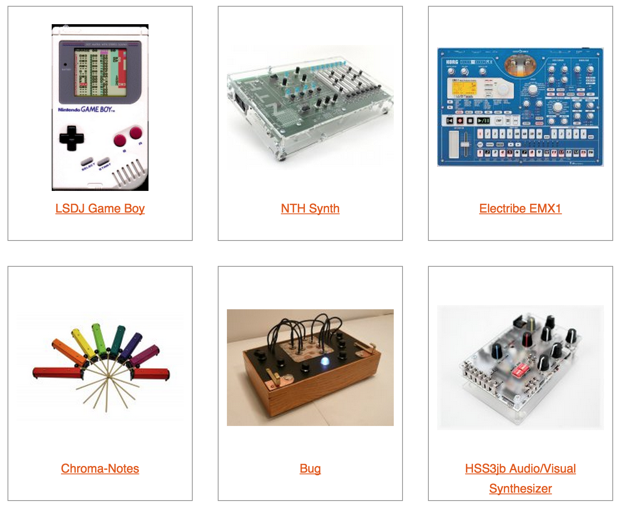
Music Tools
aadl.org/musictools

Slide 25
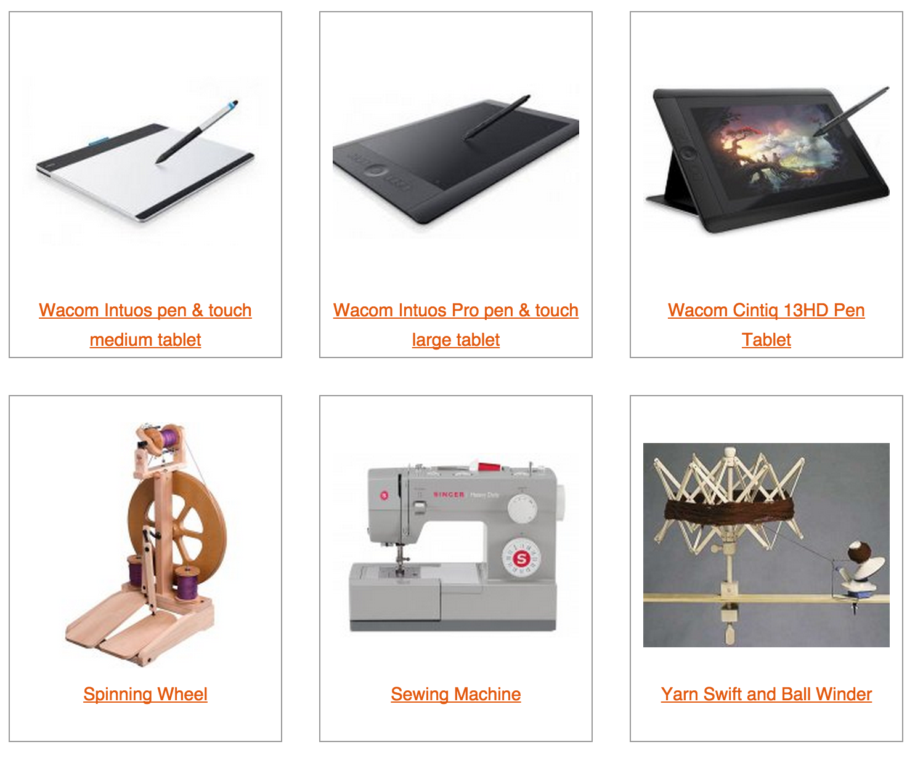
Art Tools
aadl.org/arttools

Slide 26
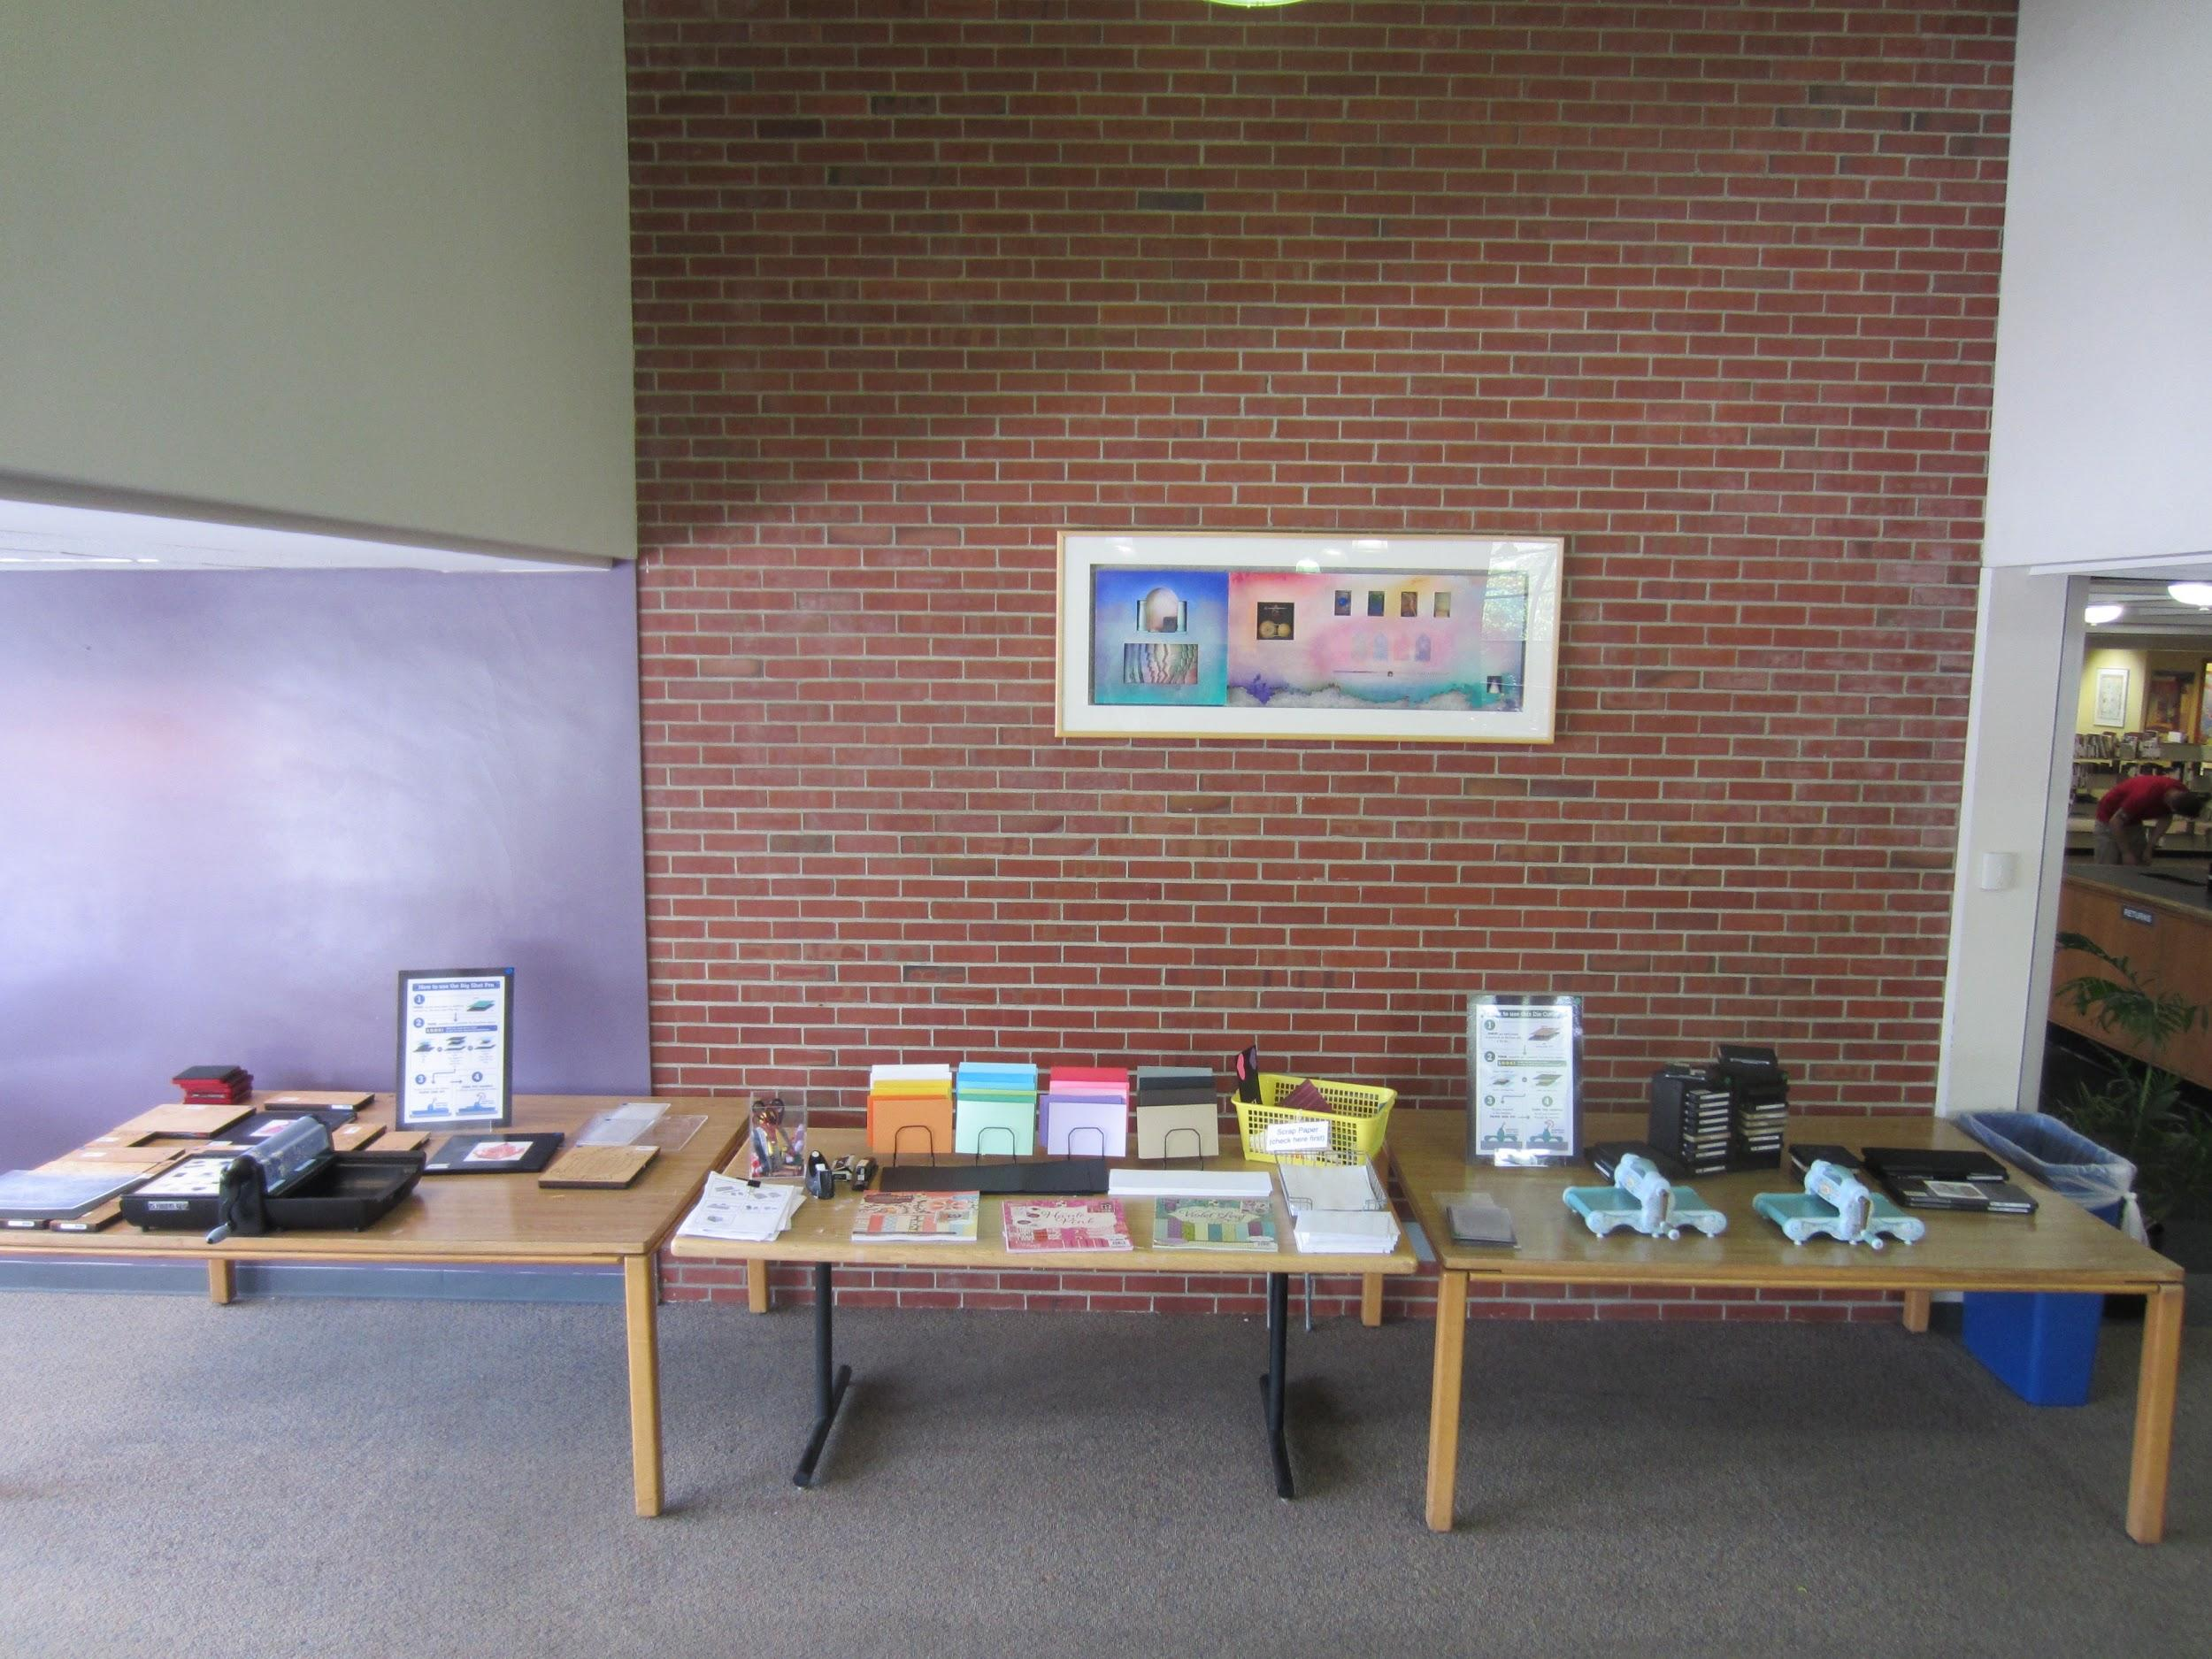

Slide 27
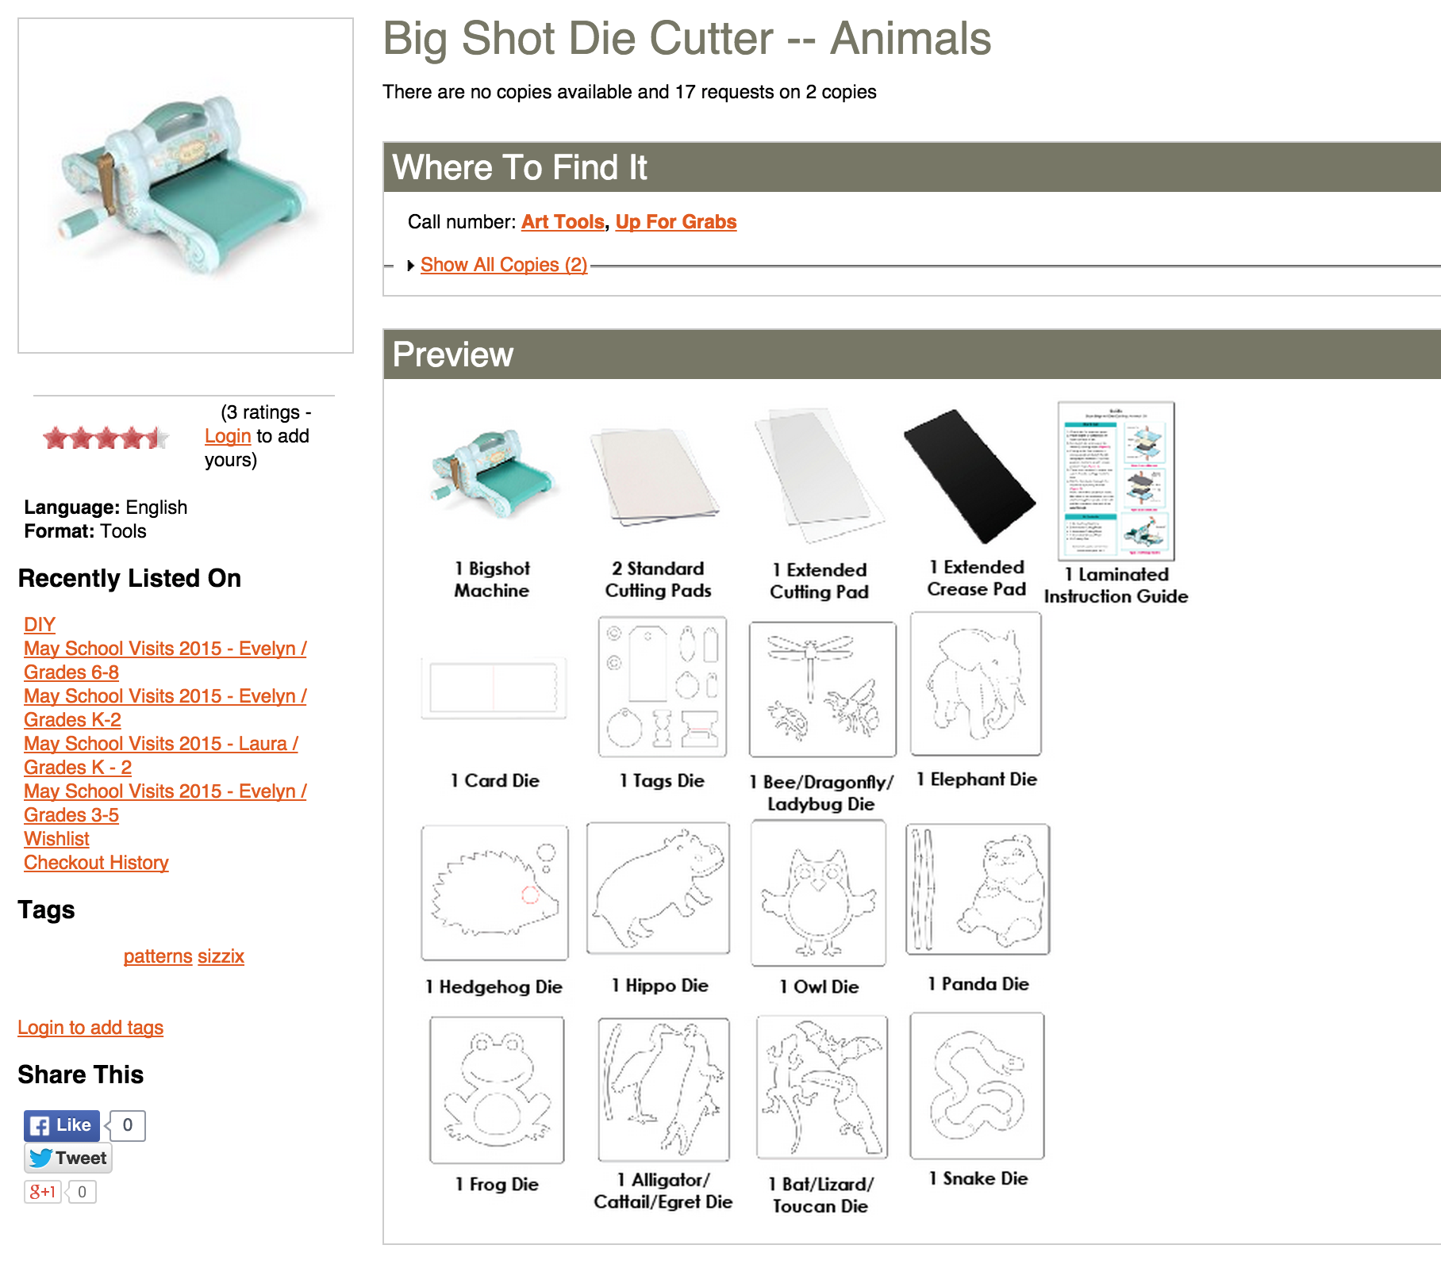

Slide 28
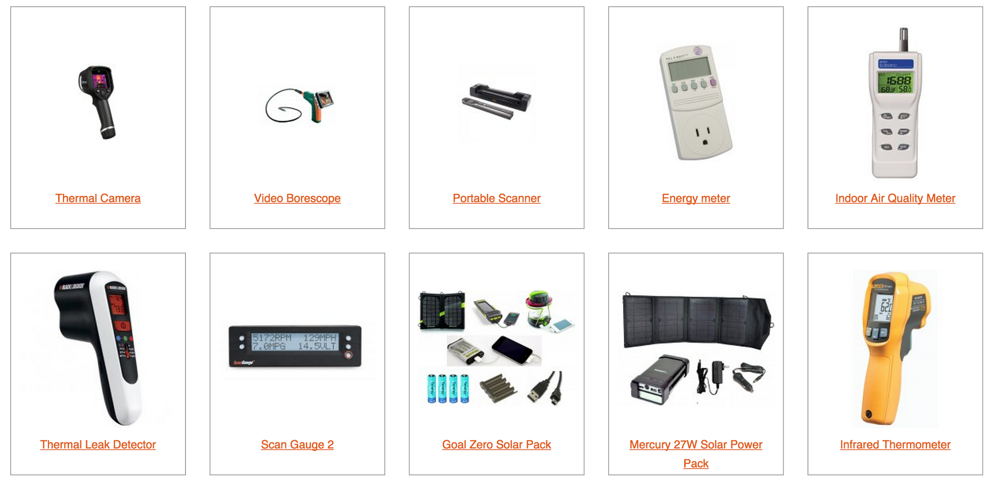
Home Tools
aadl.org/hometools

Slide 29
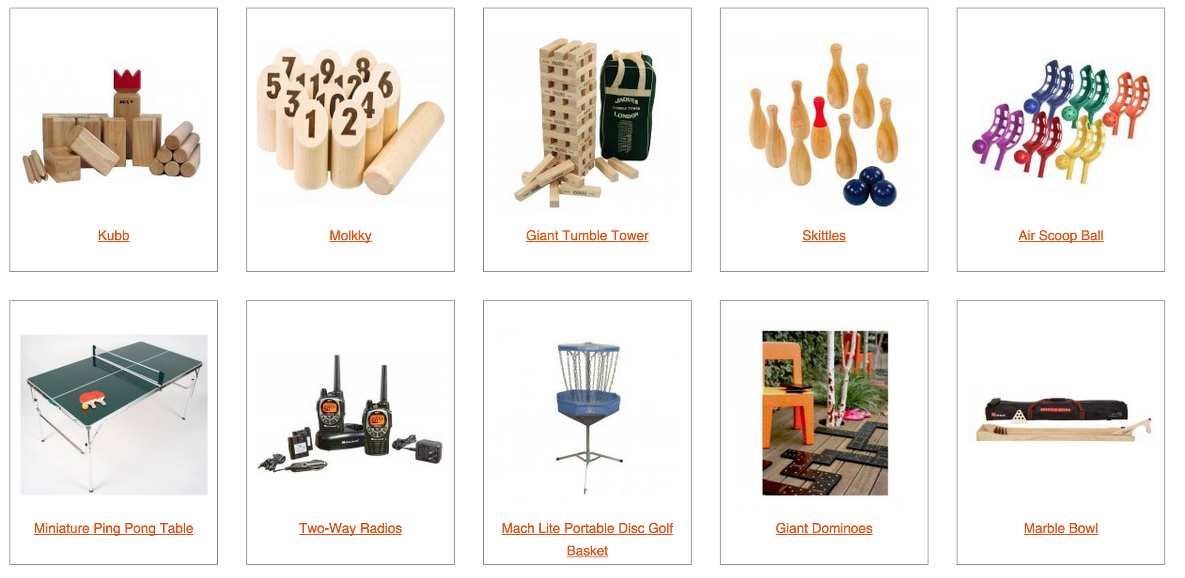
Games
aadl.org/games

Slide 30
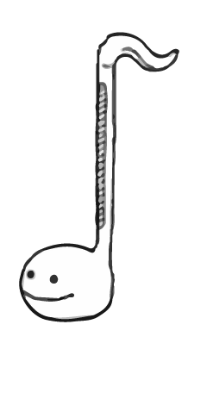
Audience

Slide 31
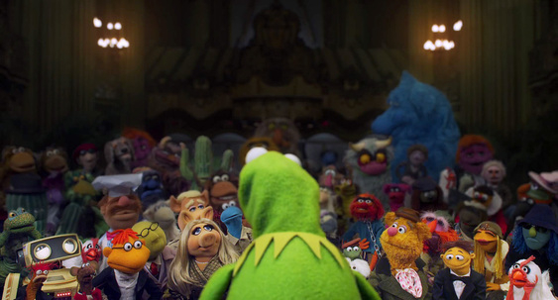
Your audience is your community.

Slide 32
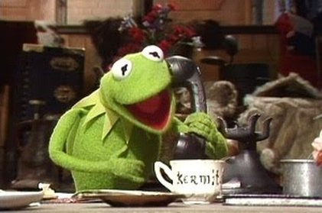

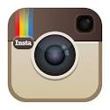


Start a conversation.
email
social media
contact us forms
at the reference desk
at events
contact organizations in your community with similar interests

Slide 33
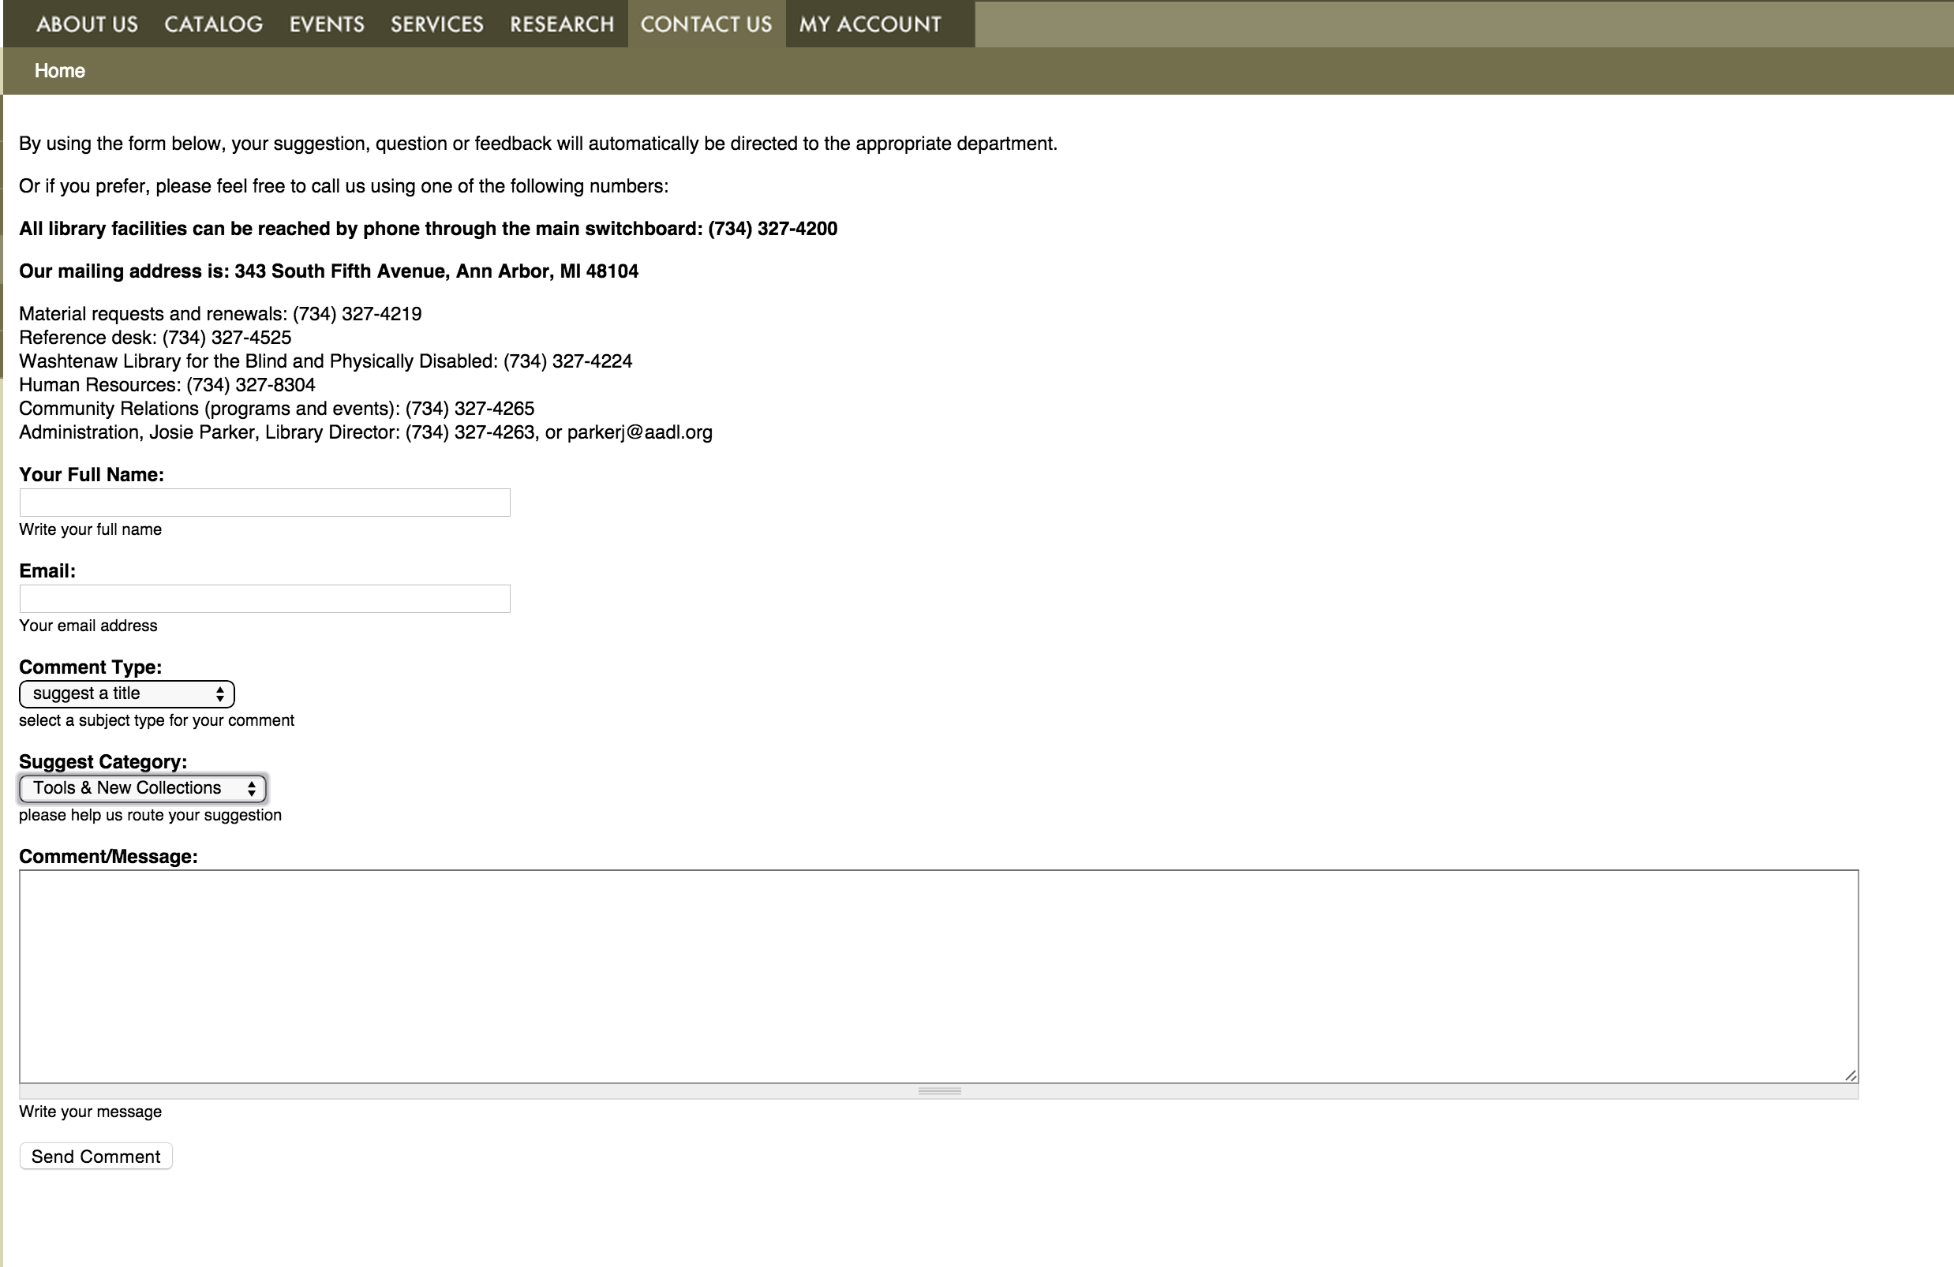

Slide 34
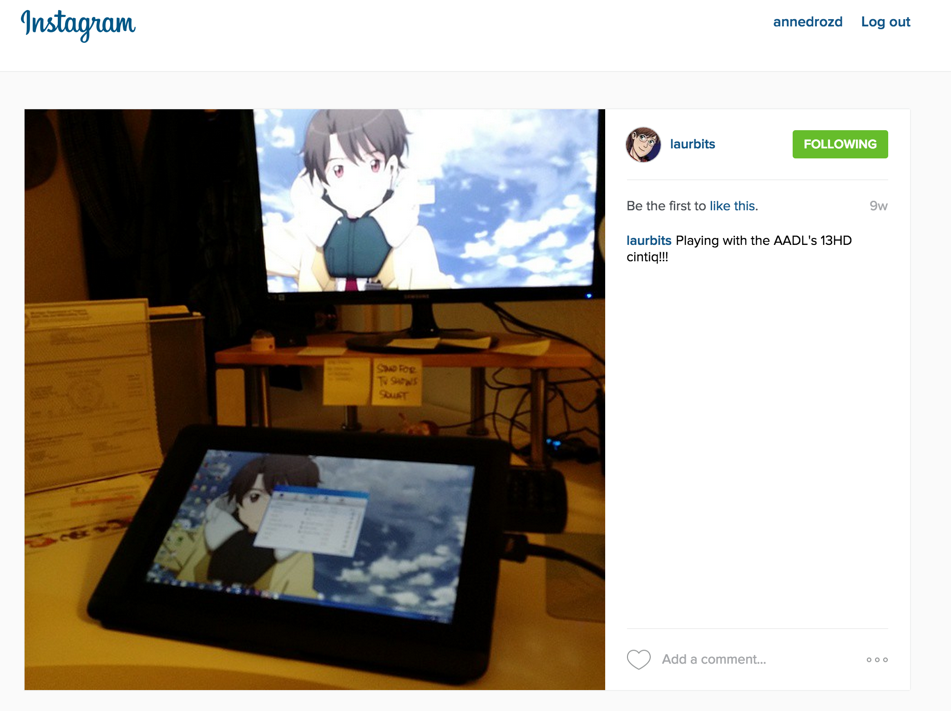

Slide 35
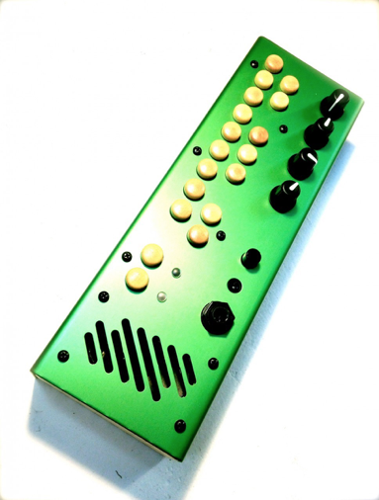

Start small to test the audience interest.

Slide 36
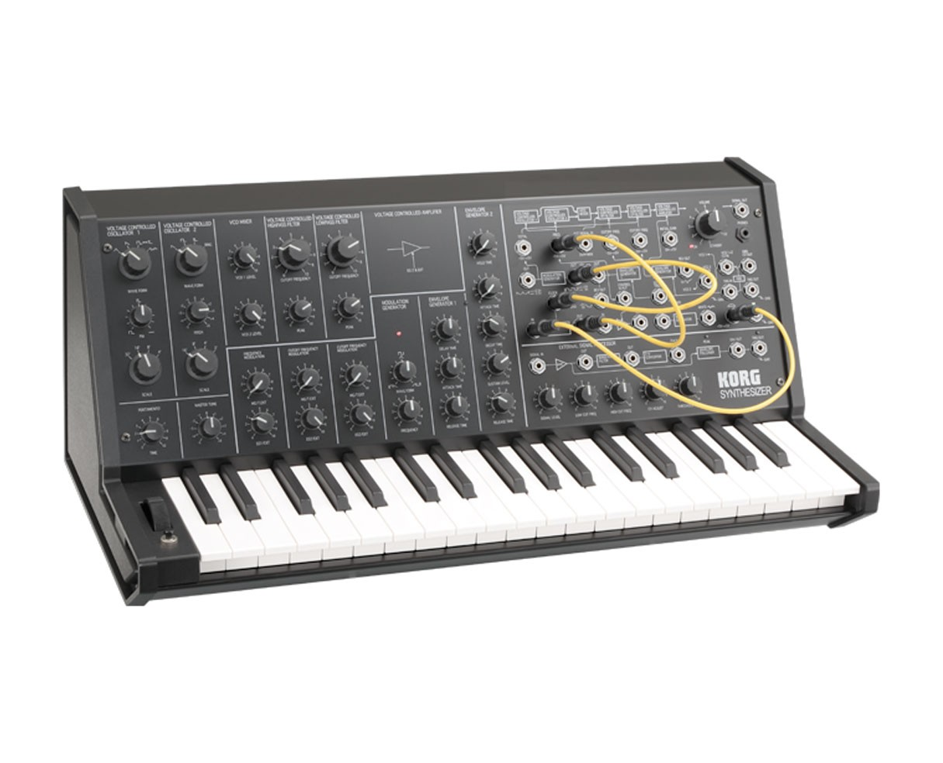
Progression from general collections (accessible to all) to tools requiring specialized knowledge.

Slide 37
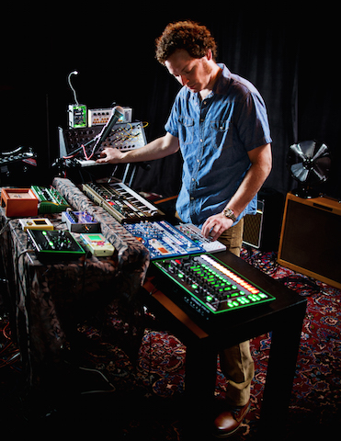
Patron Uses:
Dave Menzo
Musician Dave Menzo explored an exciting concept for his new album “Shhh...”. Every instrument played on the album came from AADL’s Music Tools collection! This unusual collection allows Library cardholders to check out drum machines, synthesizers, guitar pedals, and other instruments.

Slide 38
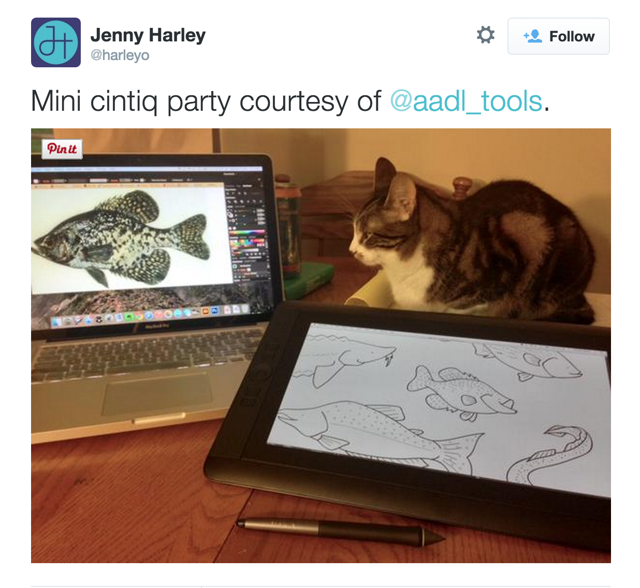

Slide 39
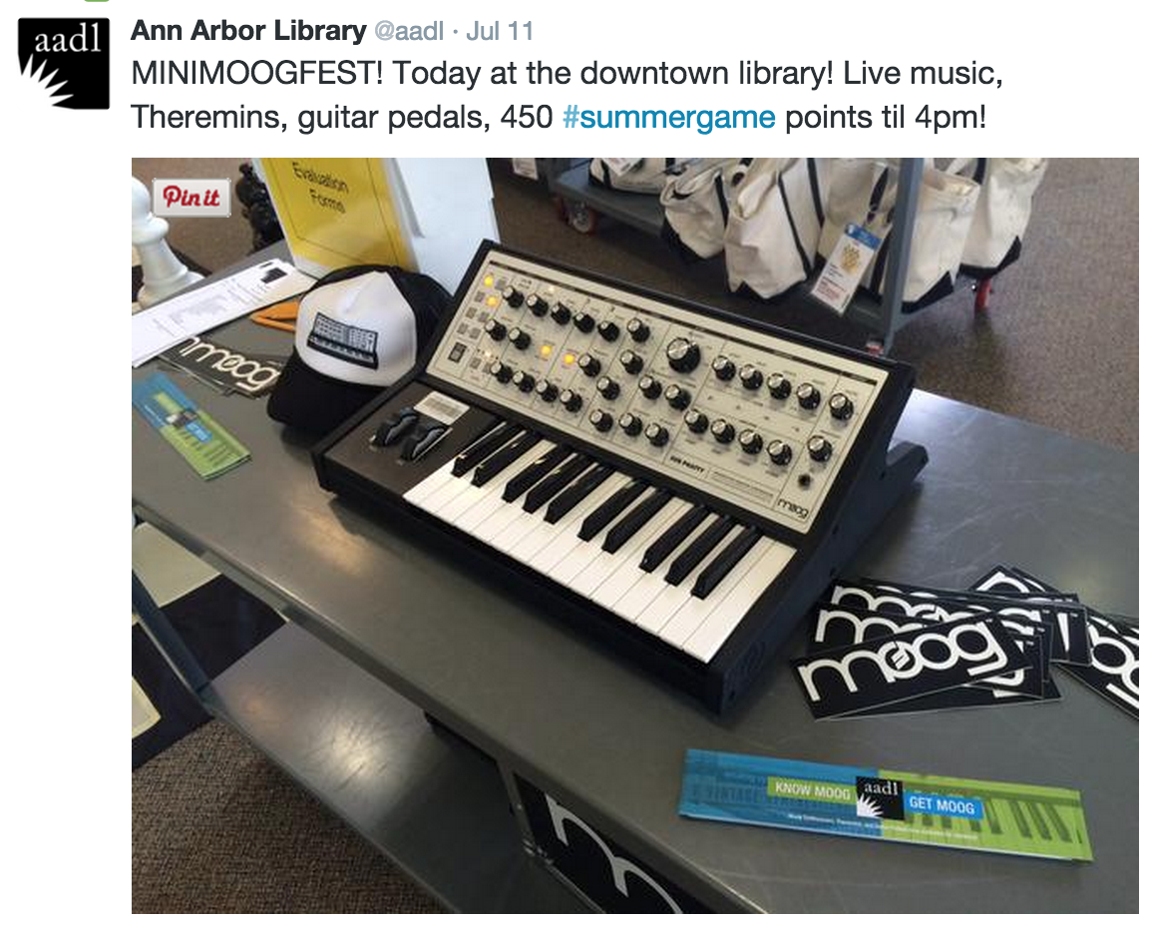
Events:

Slide 40
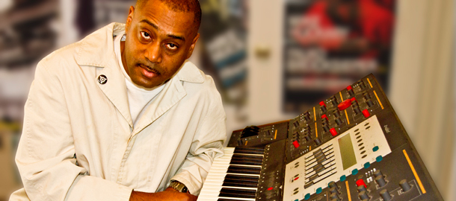
Electronic Music Production with Mike Huckaby
(weekly workshops at aadl)

Slide 41

Telescope Modifications Event

Slide 42


Telescope Launch Event

Slide 43


Mini Maker Faire

Slide 44

Collaborations with community organizations

Slide 45
Telescopes
+
Started in 2009 with a dozen. Now circulating 30.

Slide 46

Music tools in the classroom
Collaboration with Tappan Middle School’s music program and orchestra teacher Joe DeMarsh

Slide 47







Summer Day Camp Kits
+

Slide 48



Ann Arbor Film Festival’s Expanding Frames
+

Slide 49

How to start a collection at your library?

Slide 50
Planning
Selection?
Policy?
Budget?
Where will the collection live?
Cataloging?
How to handle circulation?
Maintenance?
Repairs?
Staff time?

Slide 51

Nontraditional Selection Trifecta:
Short-Term Use
Infrequent Need
Relatively Expensive

Slide 52


Slide 53

Budget
=

Slide 54
Shelving

Slide 55

Cataloging

Slide 56

Circulation / Maintenance / Repairs

Slide 57

Thank You!
Have more questions? Please feel free to contact us.
Steve Teeri teeris@aadl.org
Anne Drozd drozda@aadl.org

Slide 58
Infopeople webinars are supported in part by the U.S. Institute of Museum and Library Services under the provisions of the Library Services and Technology Act, administered in California by the State Librarian. This material is licensed under a Creative Commons 3.0 Share & Share-Alike license. Use of this material should credit the author and funding source.

