Slide 1
Successful Programming for Babies & Toddlers
Brooke Newberry and Kendra Jones
Tuesday, September 22, 12 noon Pacific
An Infopeople Webinar

Slide 2
Poll Time!
Why do you think we should program for babies and toddlers?
Notes:
Social-emotional growth, safe, free, and welcoming environment for caregivers and their children, One of our reasons is on the next slide.

Slide 3
Why Program for Babies and Toddlers?
Community!
Language acquisition!
Literacy skills!
Sensory skills!
Notes:
Describe five skills. Define EL

Slide 4
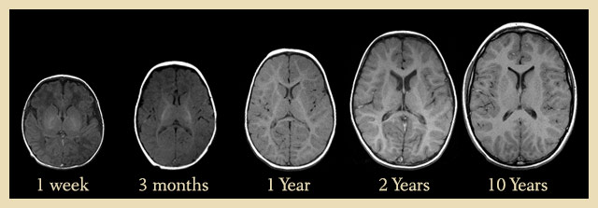
All About
the Brain
www.humanjourney.us
Notes:
In the first year of life, a baby’s brain grows to 60% of it’s adult size. 85% of brain growth happens in the first 3 years of life. We need to take advantage of this growth!

Slide 5

30 million word gap
www.zerotothree.com
“A child from a high-income family will experience 30 million more words within the first four years of life than a child from a low-income family.” Hart and Risley, 1995
Notes:
Talk about community and language acquisition. Baby storytime bridges gaps between SES’s. Families from every income, etc. attend. Babies hear new words because other families speak differently than theirs.

Slide 6
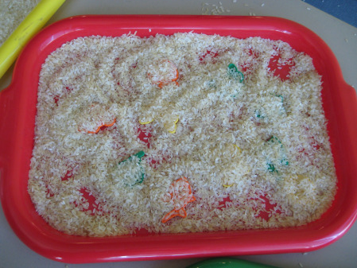
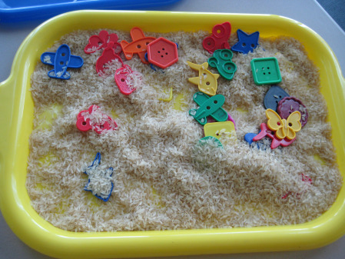
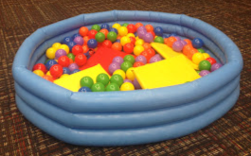
Sensory
Experiences!
Notes:
Great after storytime activity, or one off program ideas. What babies and toddlers learn about the way things feel, smell, and look like will shape their understanding of the world as they grow. Exposing children to a variety of sensory experience when they are very young helps them what they like and dislike, as well as how things work! Sensory experiences also help develop motor skills. Babies develop language during sensory experiences when caregivers talk about what they are seeing and feeling and ask lots of questions. You’ll notice that we include a lot of sensory elements in our programs and this is why!

Slide 7
Poll Time!
What is a limitation you face in programming?
- Lack of space?
- Funding?
- Staff?
- Other
Notes:
Now we know offering programs are important for brain development, encouraging play, establishing a sense of community. But actually making them happen can be a challenge. What are yours?

Slide 8
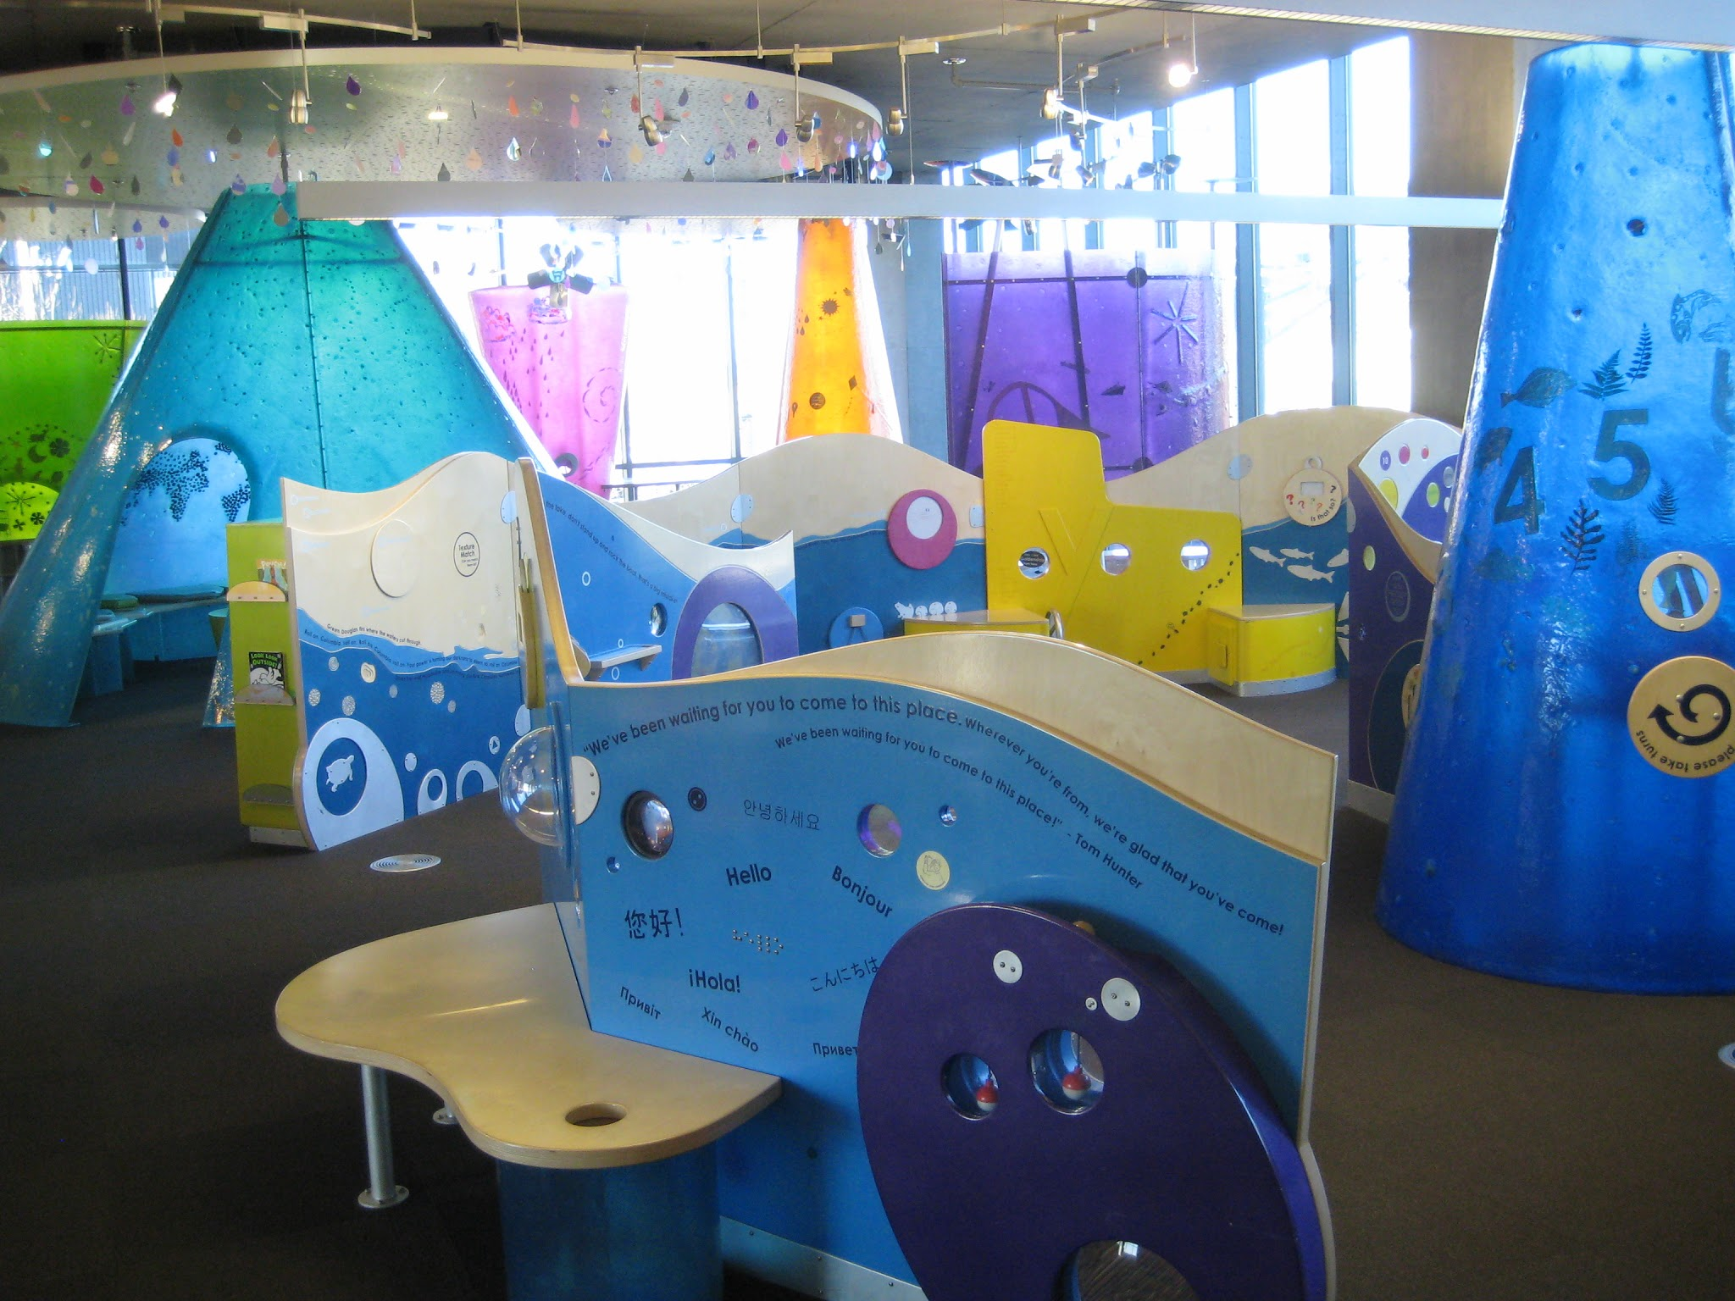
This isn’t real life.
Vancouver Community Library’s Early Learning Center
Notes:
You’re looking at probably a million dollars of worth of play items, if not more. Very few of us are lucky enough to get this. Even if you do have this, you know it comes with its own set of problems.

Slide 9
Focus on Play!
Be Brave!
Have fun!
Include other early literacy elements!

Slide 10
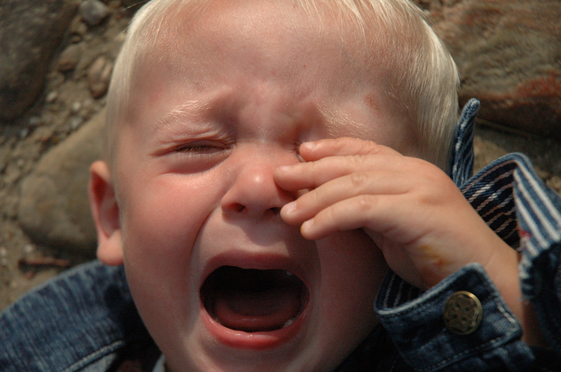
“...while experts continue to expound a powerful argument for the importance of play in children’s lives, the actual time children spend playing continues to decrease. Today, children play eight hours less each week than their counterparts did two decades ago (Elkind,2008).”
FreeImages.com/T. Rolf.
Notes:
Pretty much how we feel about this information. No time to cry, let’s do something about it! You will notice throughout our presentation that the majority of our activities focus on play. This is why.

Slide 11
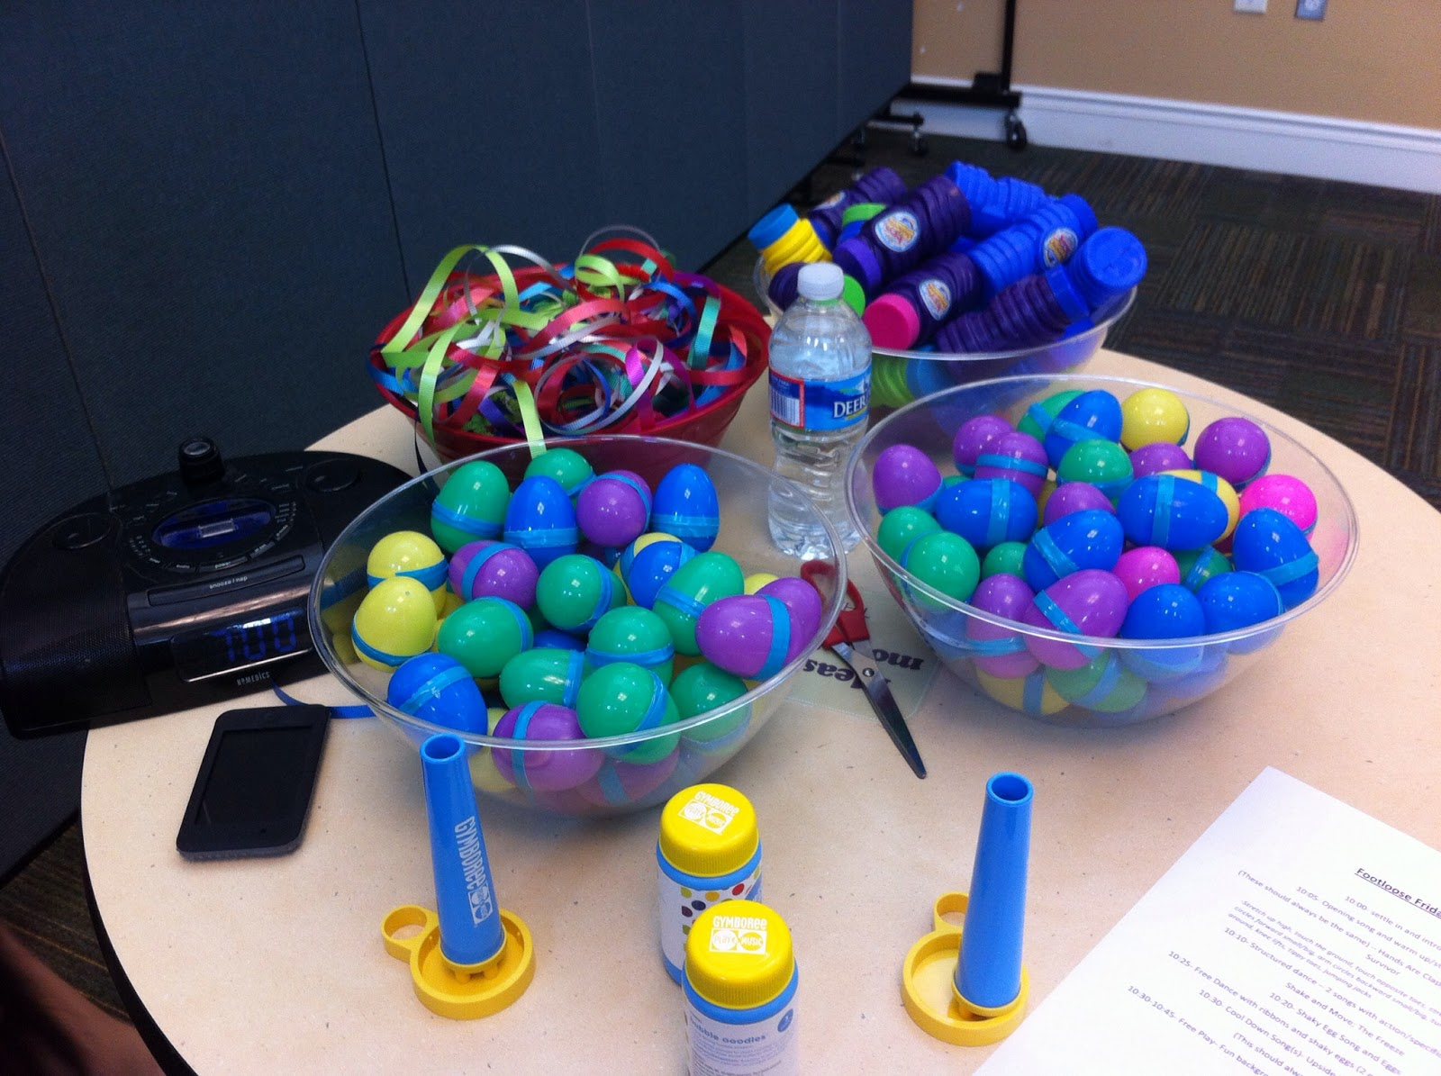
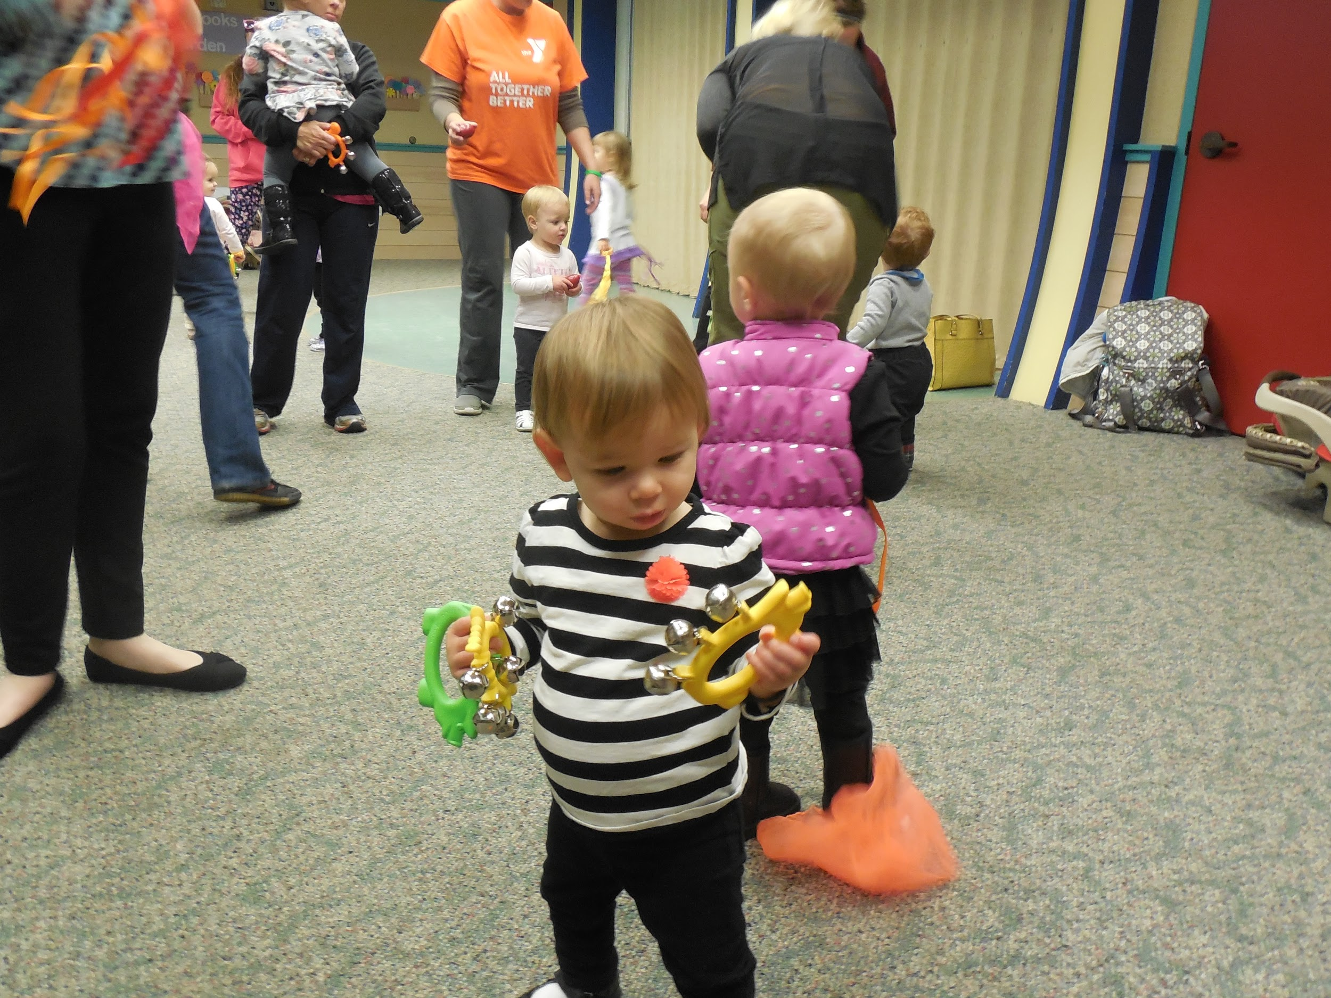
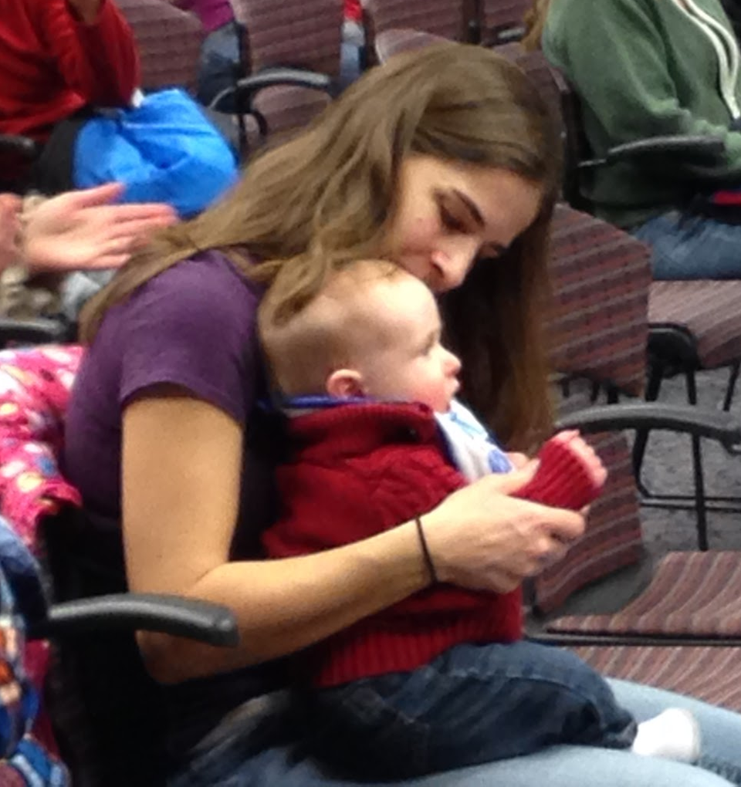
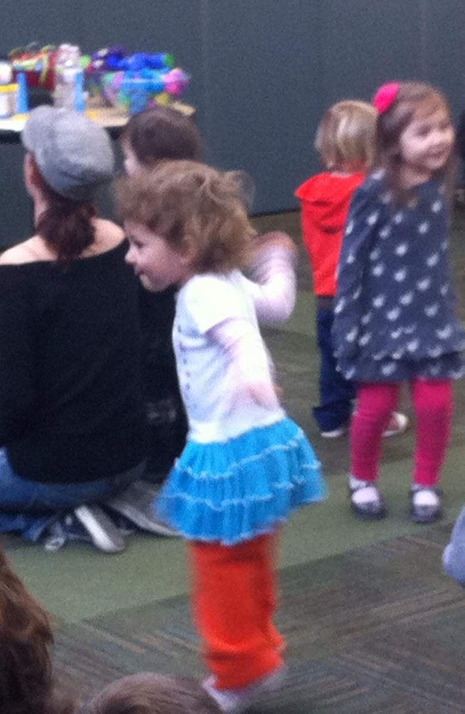
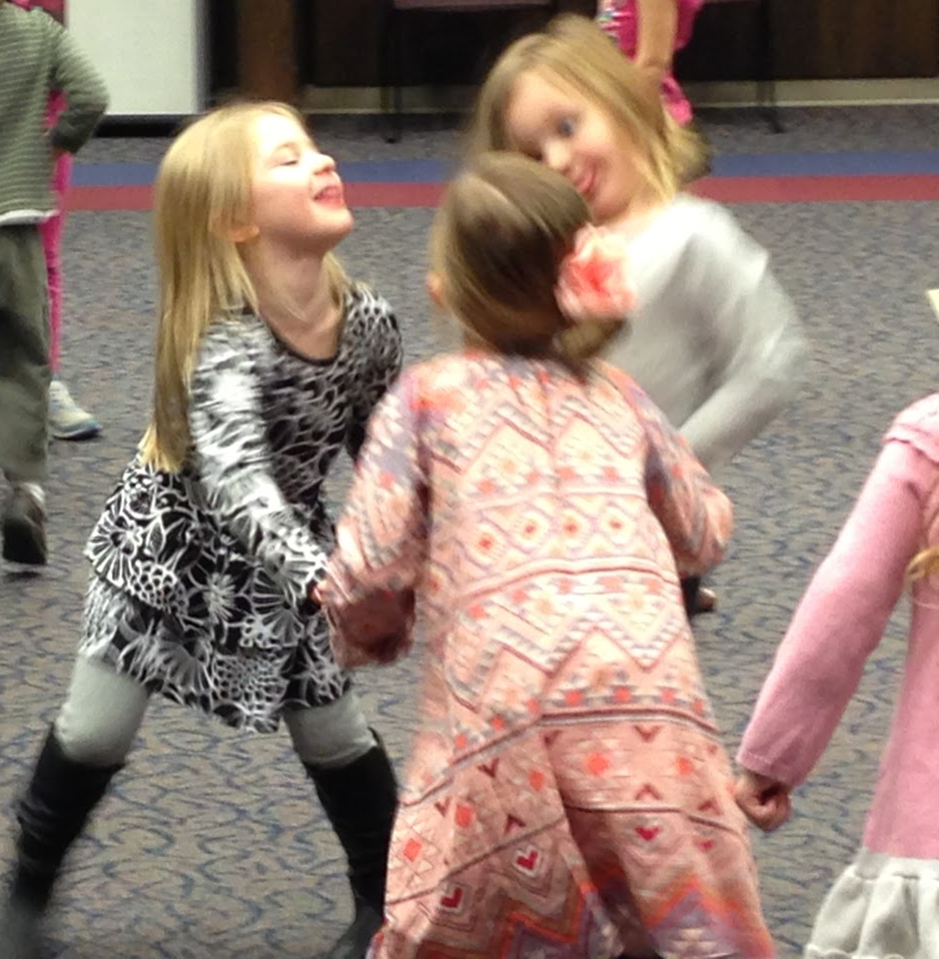
Dance!
Notes:
Dancing makes you feel good, is great exercise, and helps develop self regulation skills in toddlers. SO MUCH FUN!

Slide 12
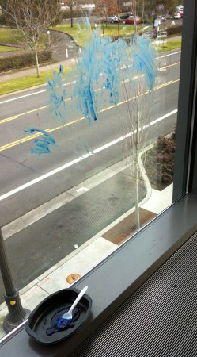
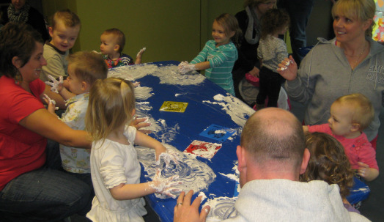
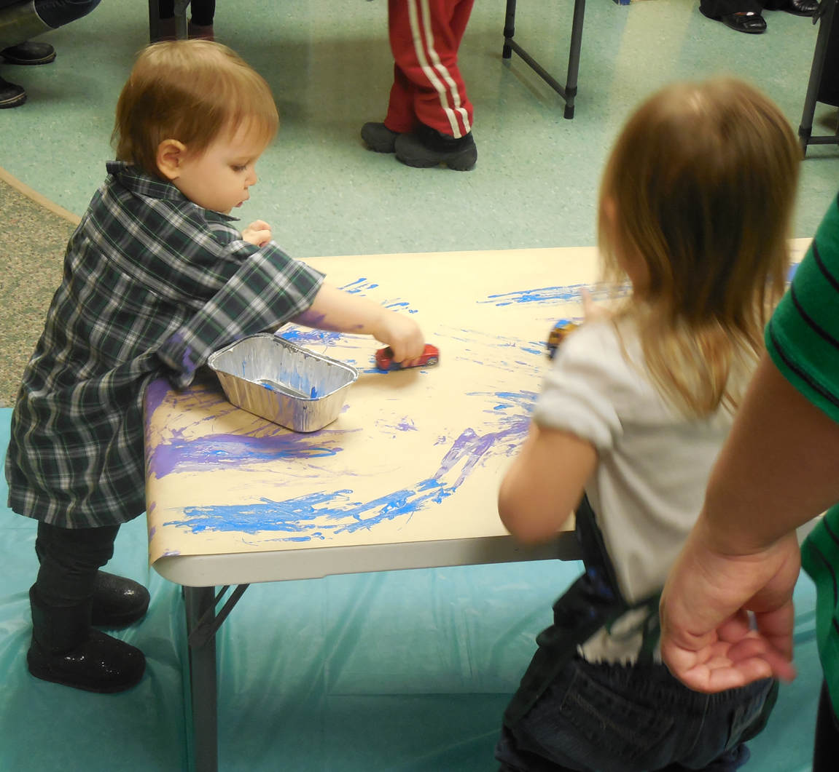
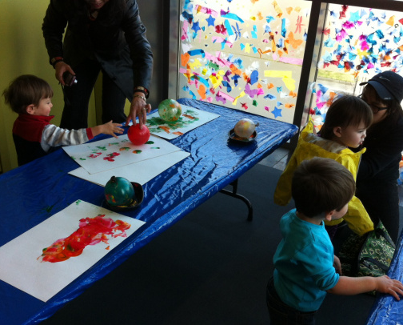
Be Brave!
Notes:
Don’t be afraid to get messy. Everything for kids comes in a washable format. Invest in smocks for the kids and tarps and table covers if you’re worried, but don’t skip the mess! Kids need to explore EVERYTHING. We’ll share more details about these kinds of programs in just a bit.

Slide 13
Programming in Action
No Mess!
Storytime activities!
Special programs!

Slide 14
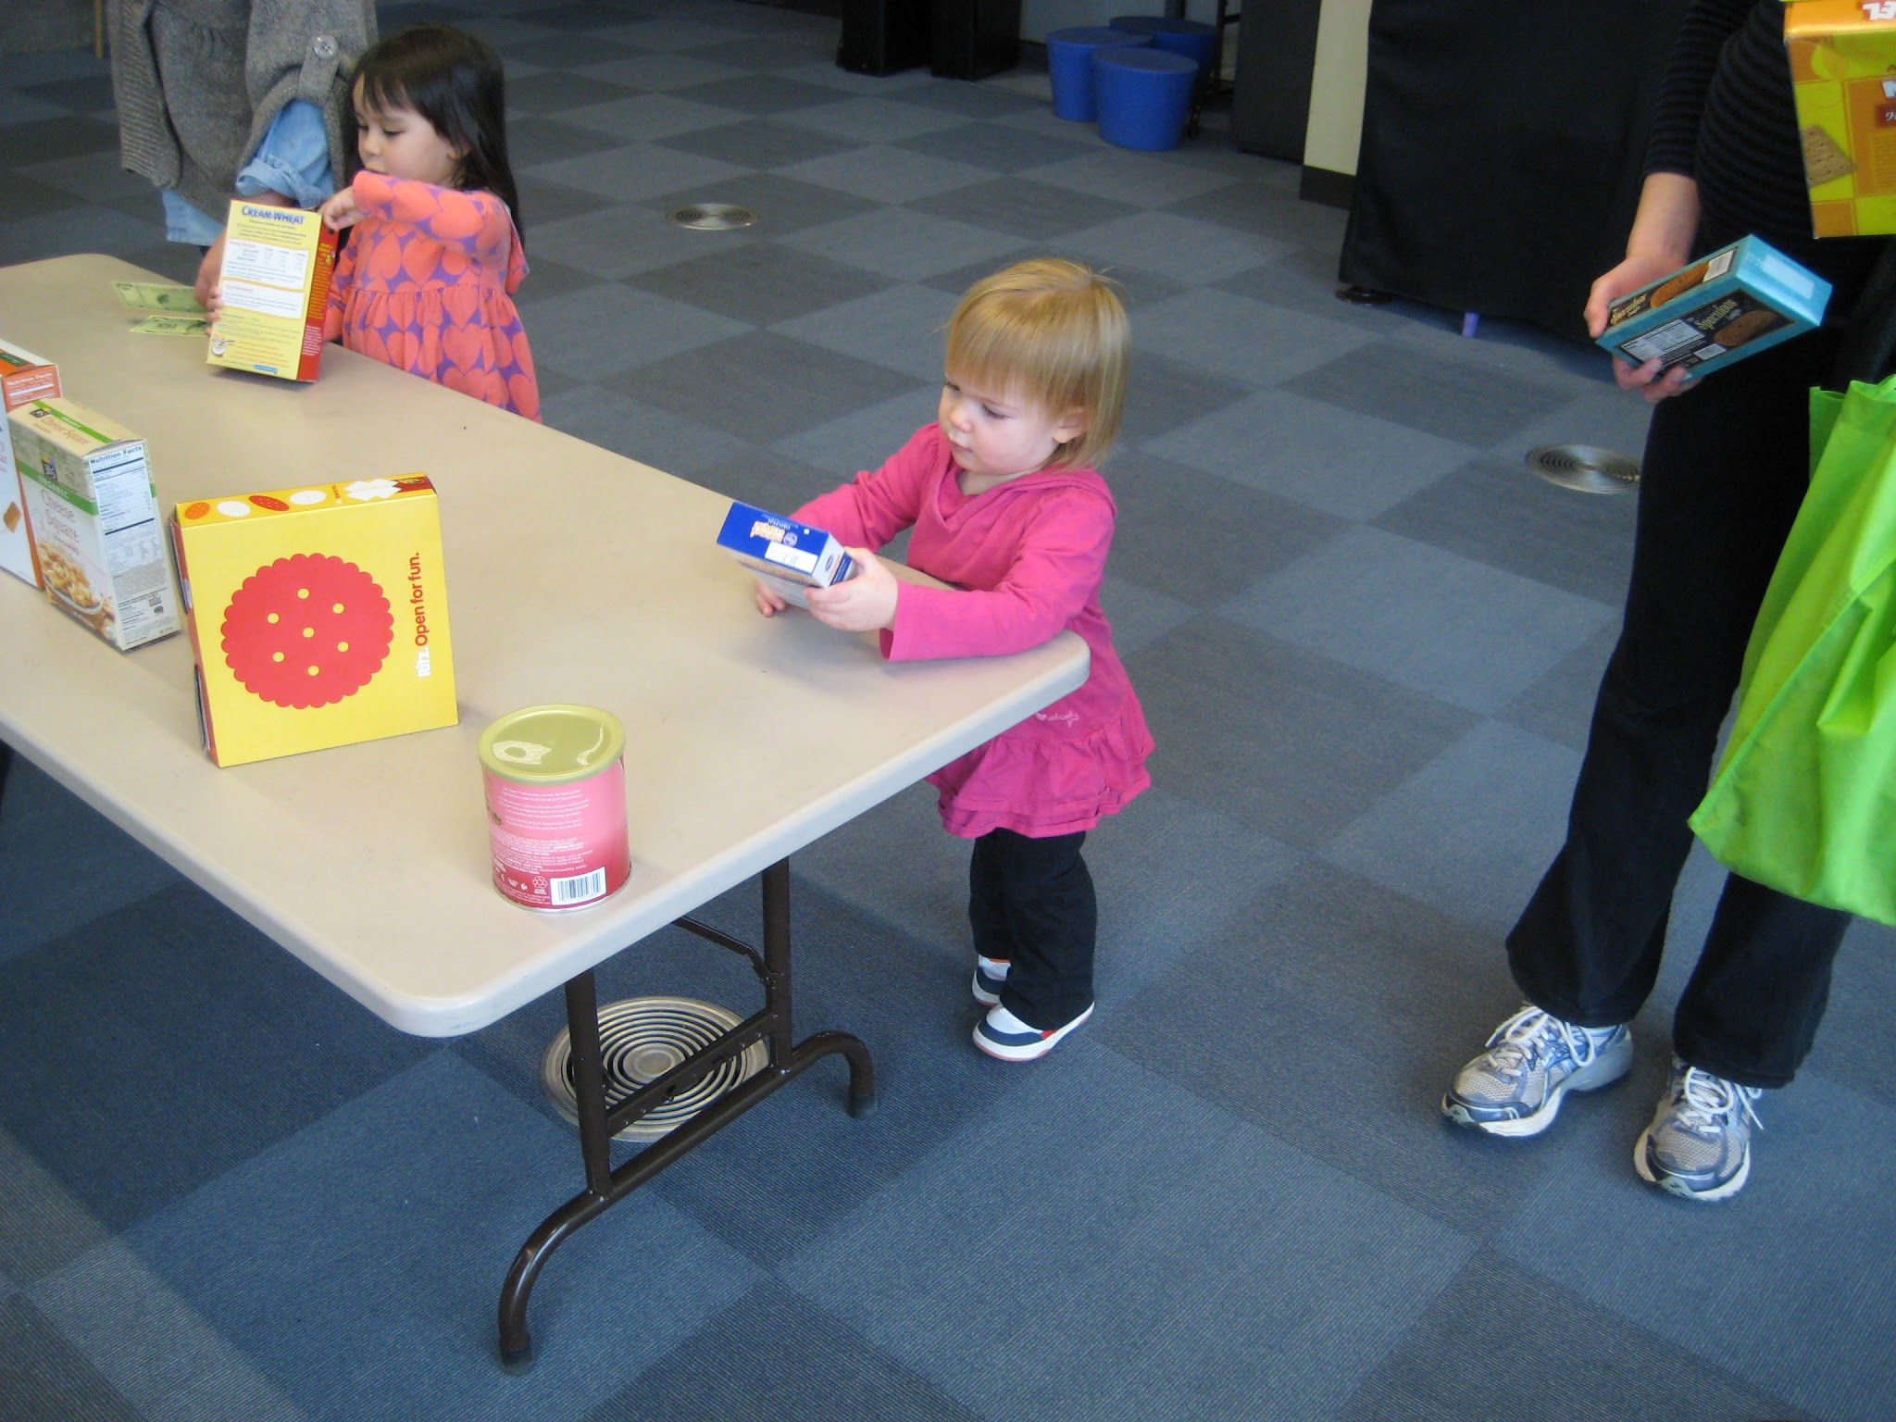
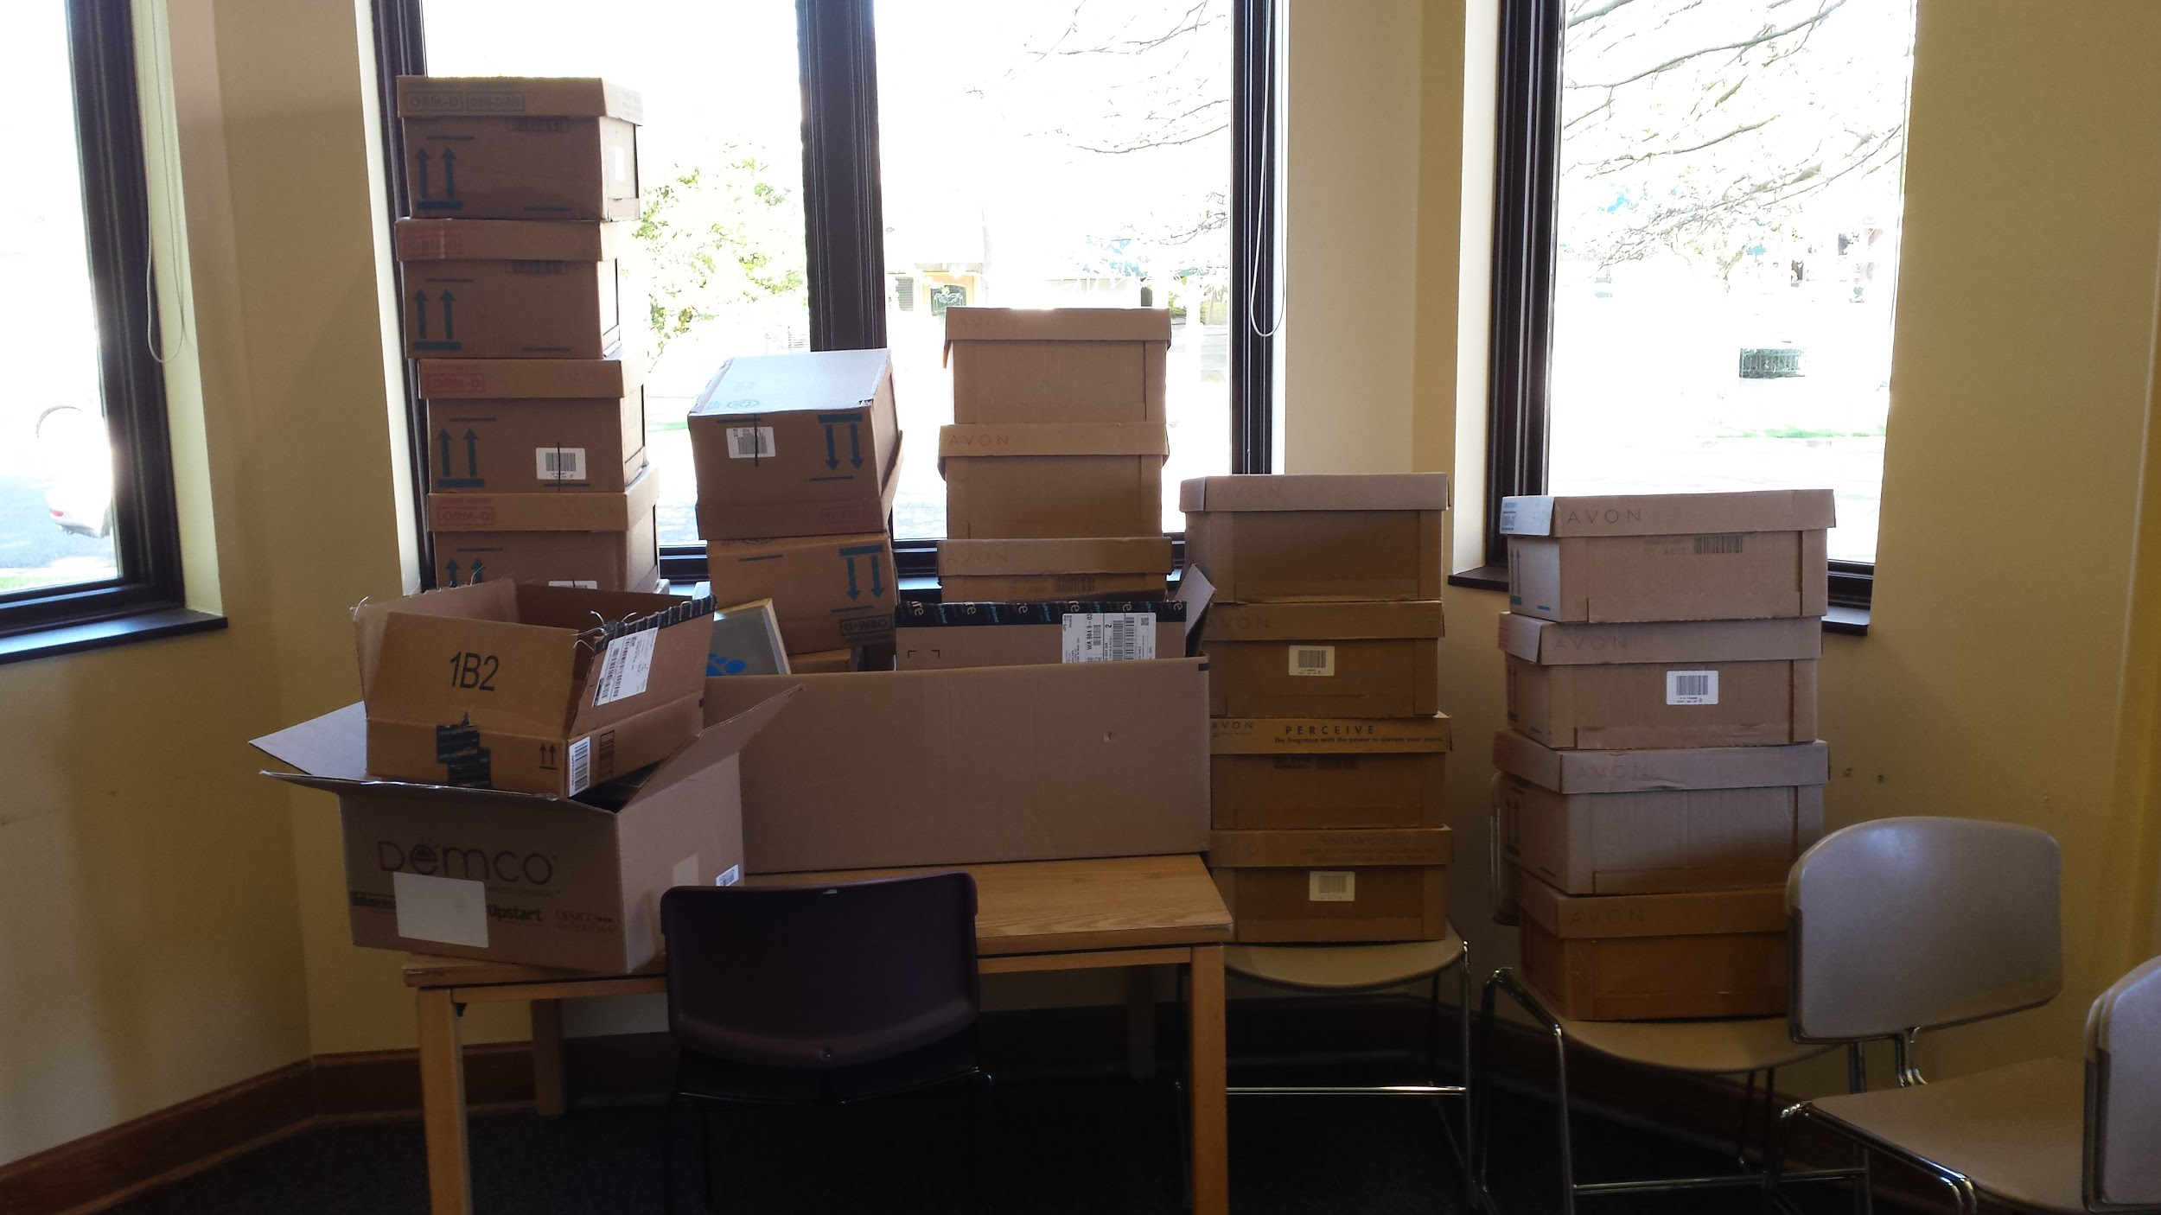
Use What You Have!
Notes:
· Use what you have! Do you have a spare table?. Have a big open space? Make a grocery store! Bring in all the stuff that’s been in your cabinet for months!

Slide 15
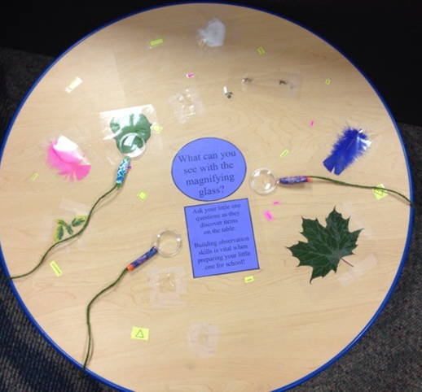
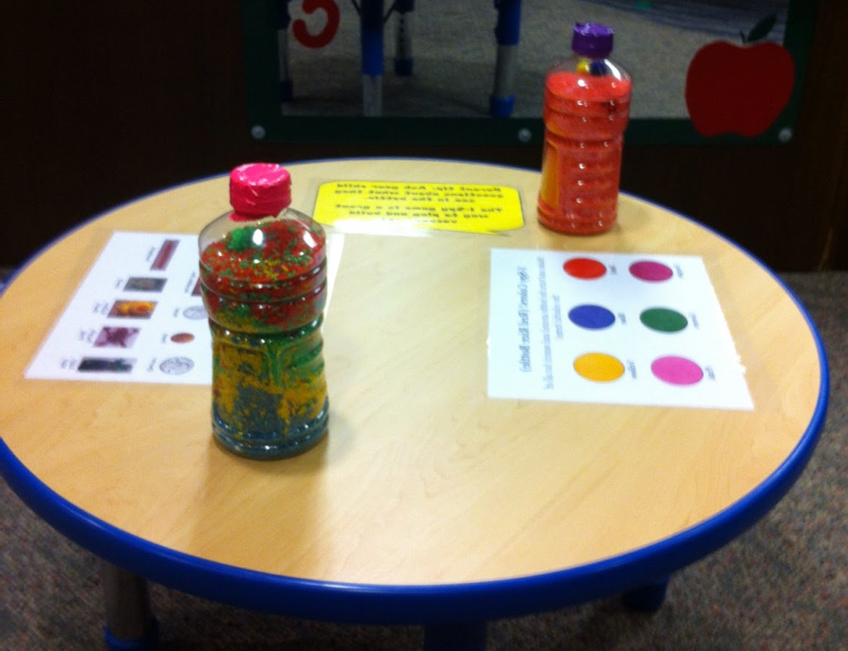
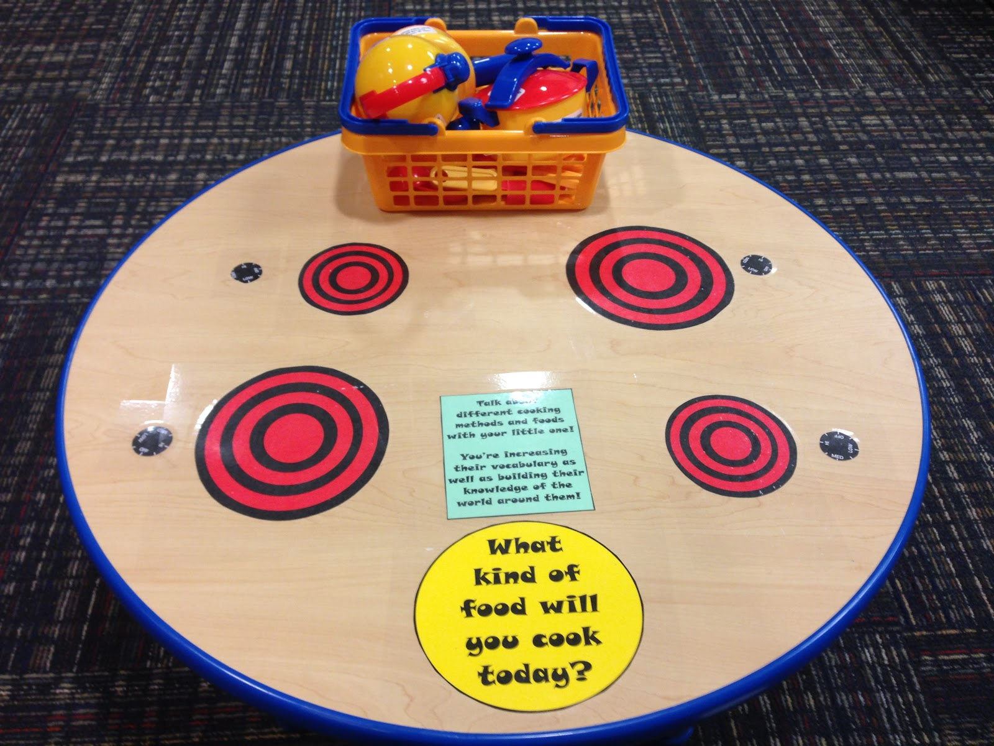
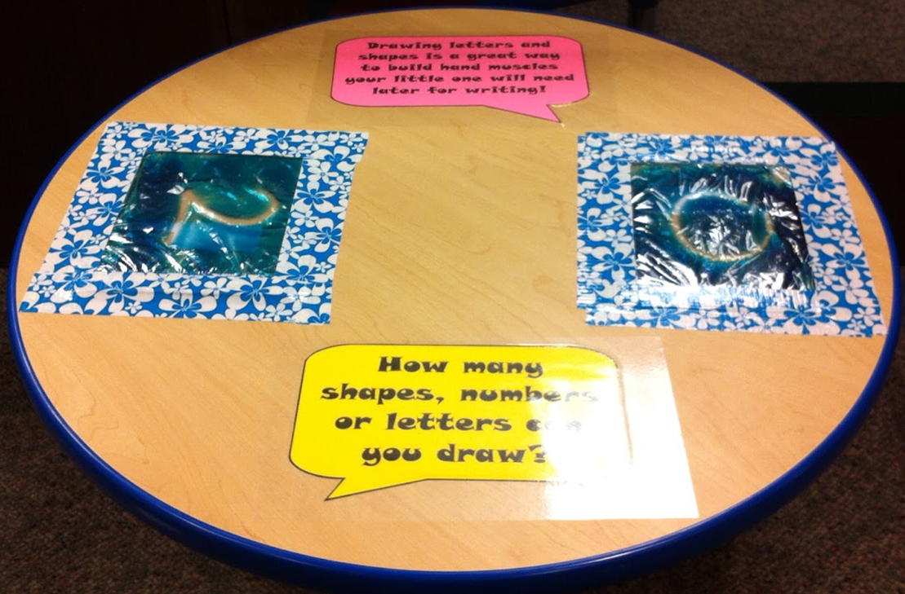
Table Activities
Notes:
All of these projects were under $10. Describe each table and the activity on them.

Slide 16
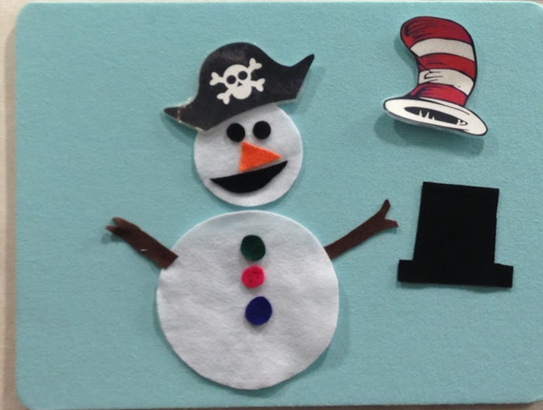
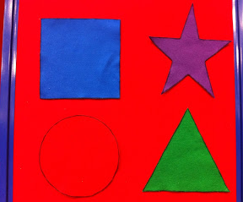
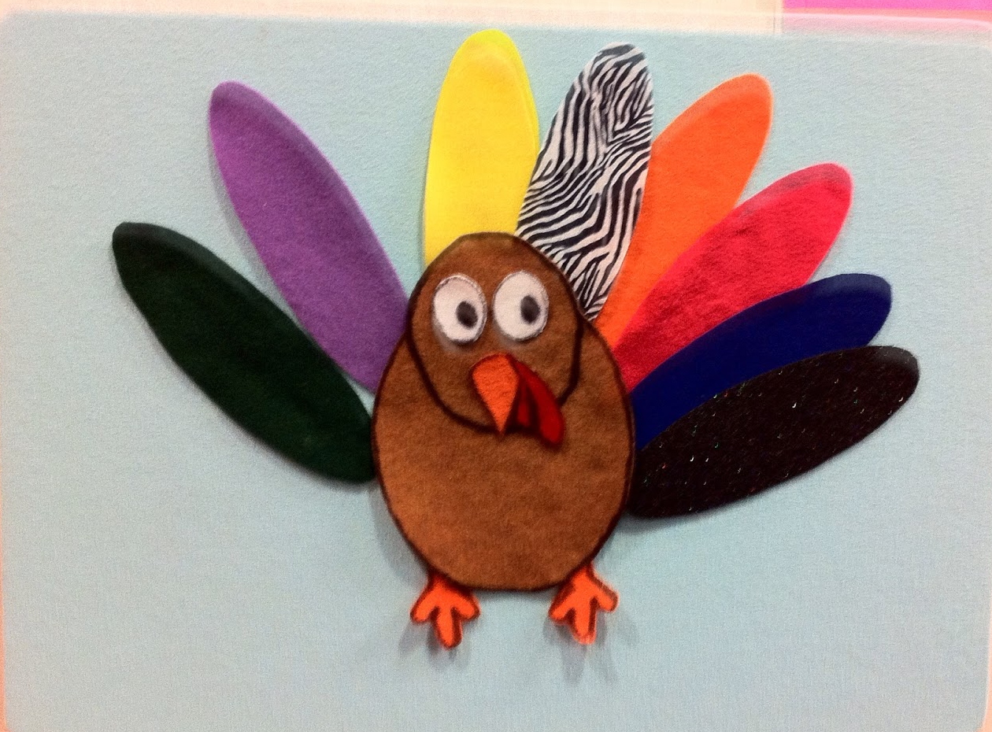
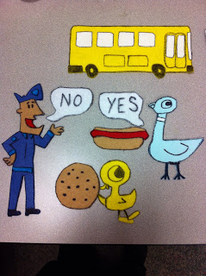
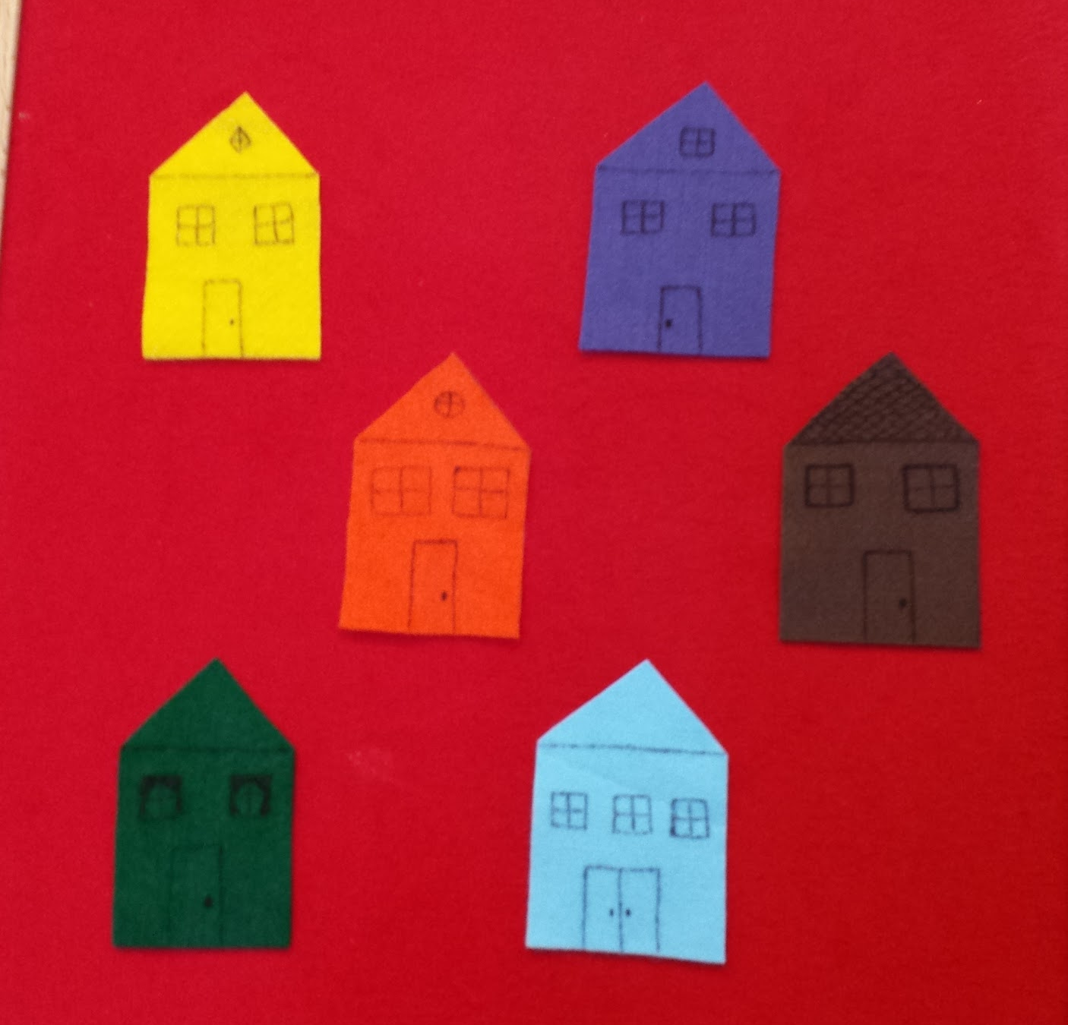
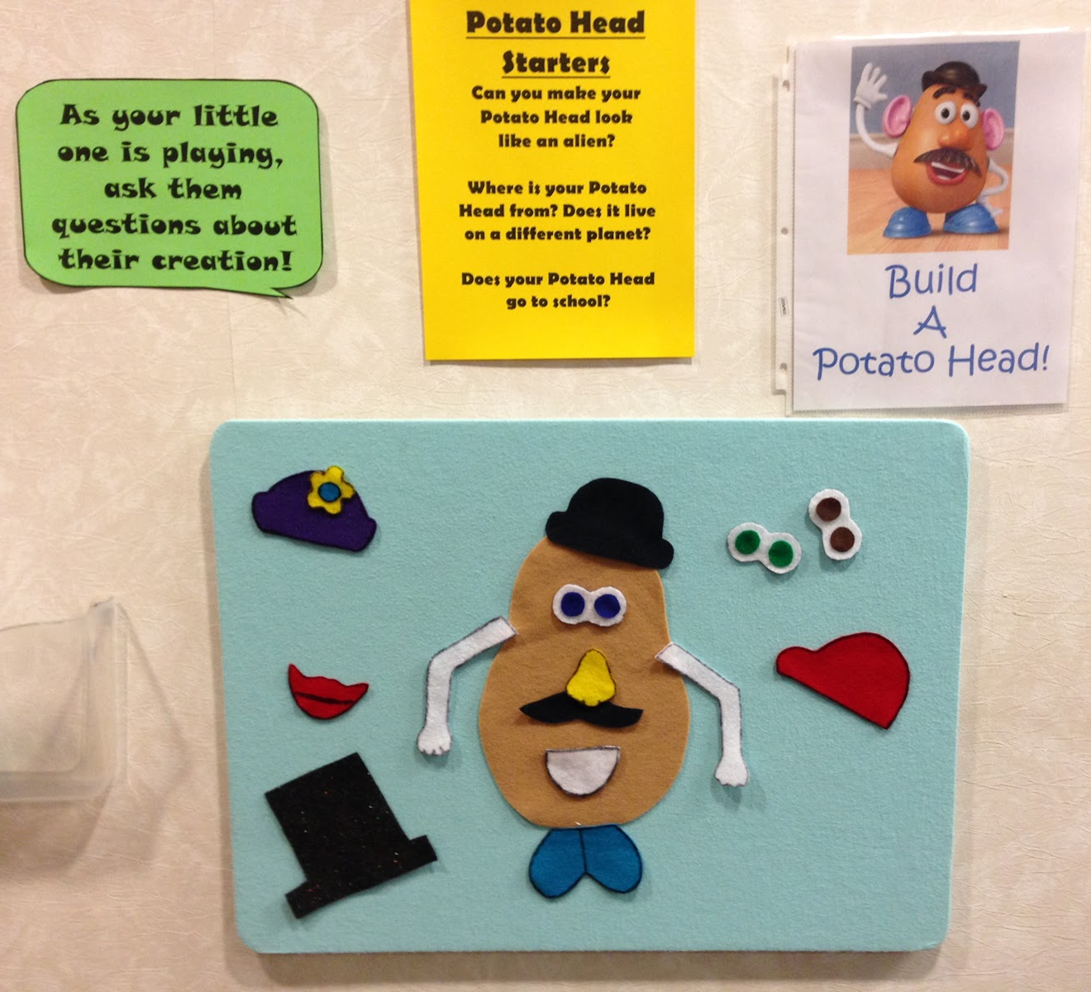
Flannel Games
Notes:
Passive

Slide 17
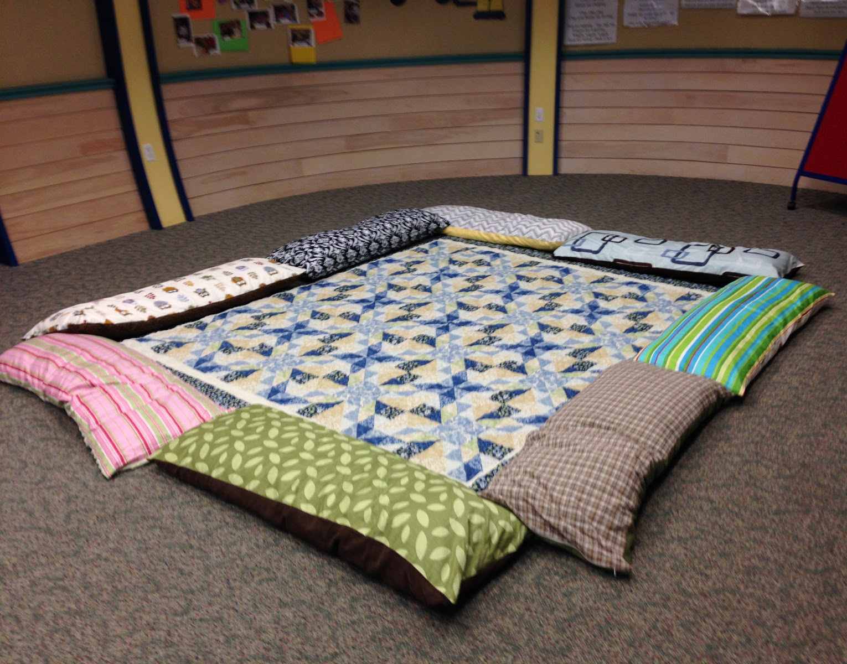
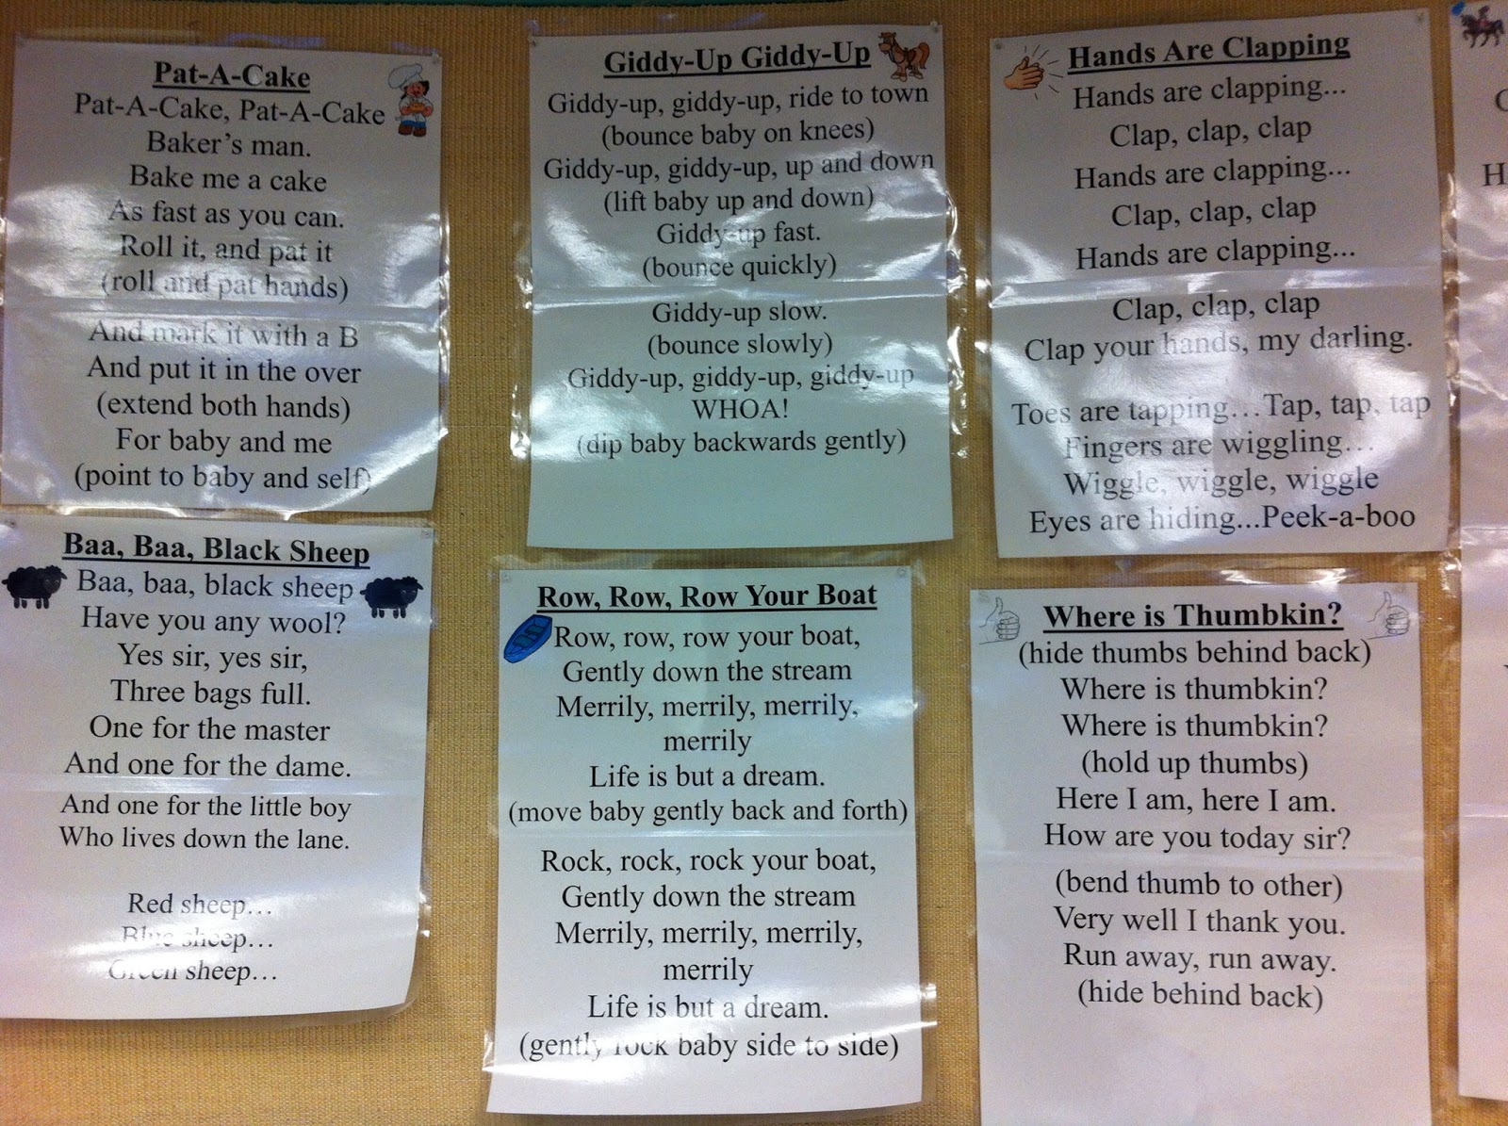
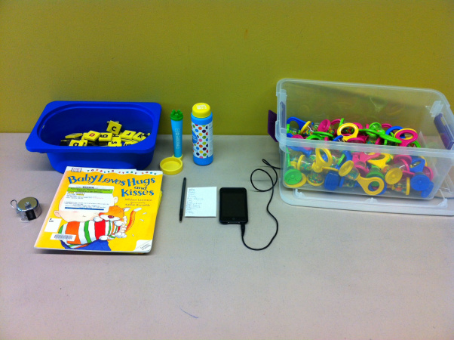
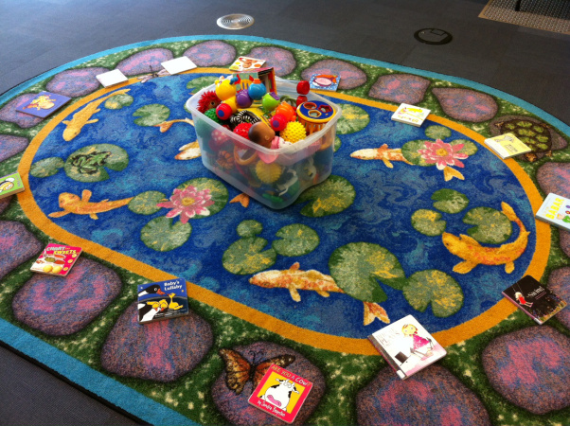
Storytime Set-up
Notes:
Storytime is the original library play space. Make them as fun as possible and include lots of play elements.

Slide 18
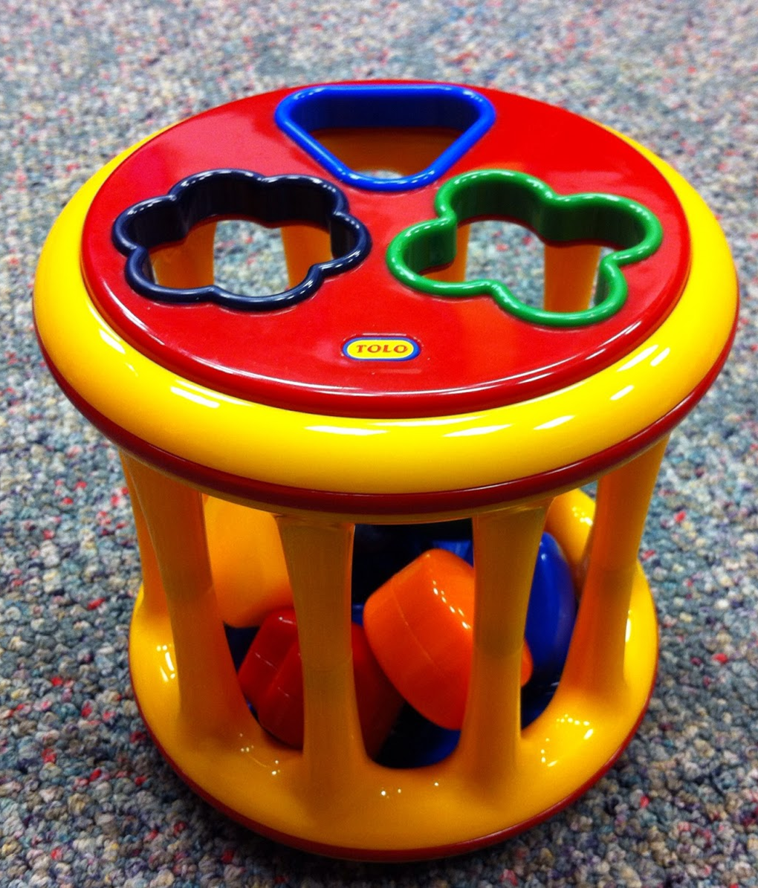
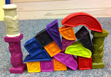
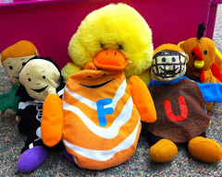
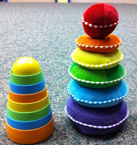
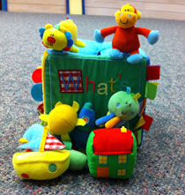
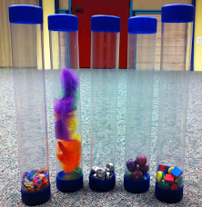
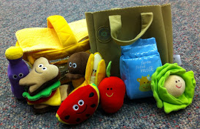
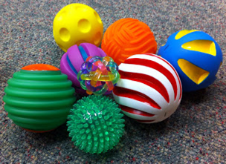
Storytime Toys
Notes:
· One of the easiest ways to incorporate play is to buy some toys for your storytime. Blocks are awesome, so are stackers, balls, stackers, and shape sorters. Shape sorters are the holy grail of toys. There are actual fights over it every week.

Slide 19
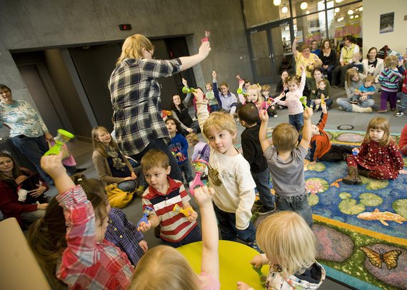
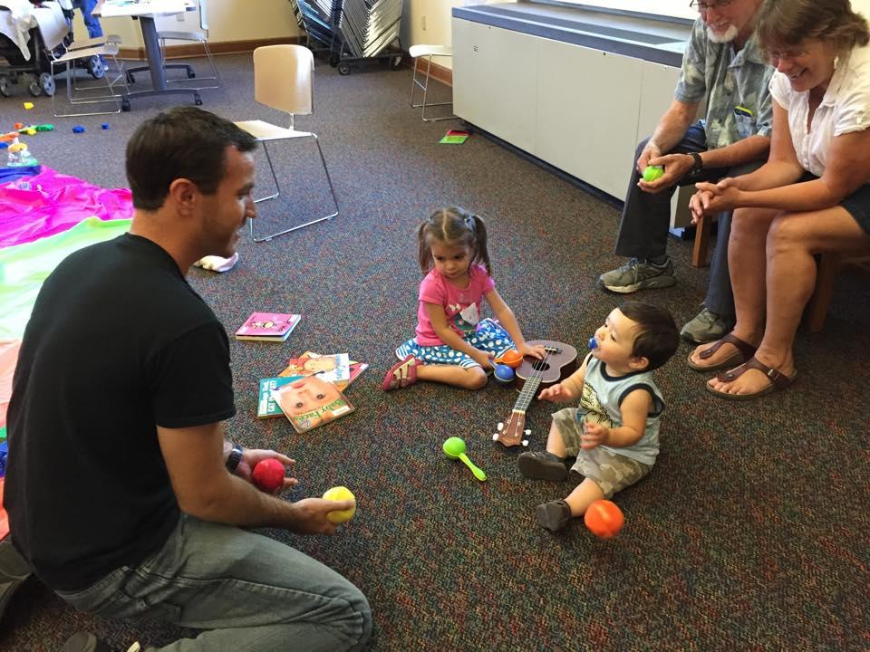
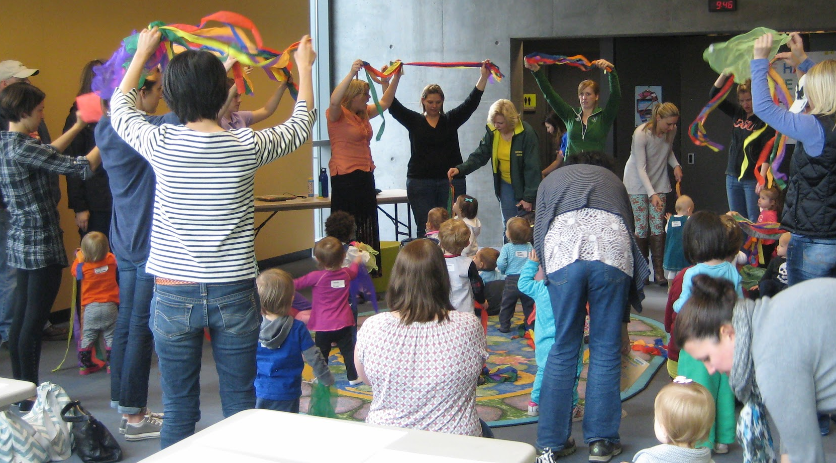
Storytime
In Action
Notes:
Get up and move in storytime. Use dancing ribbons, scarves, and bells for fun gross motor movement.

Slide 20
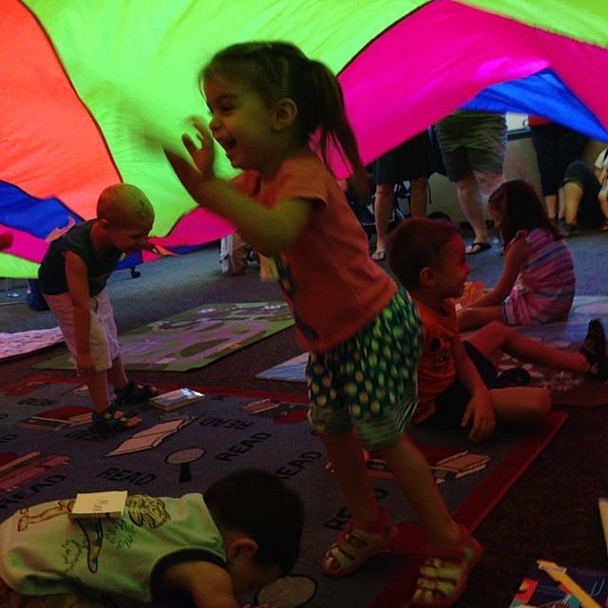
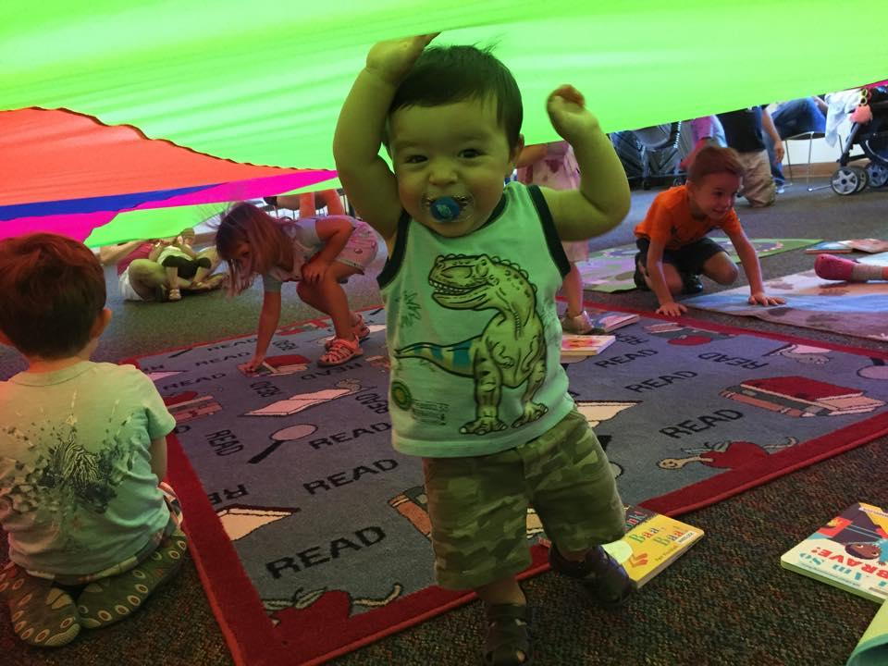
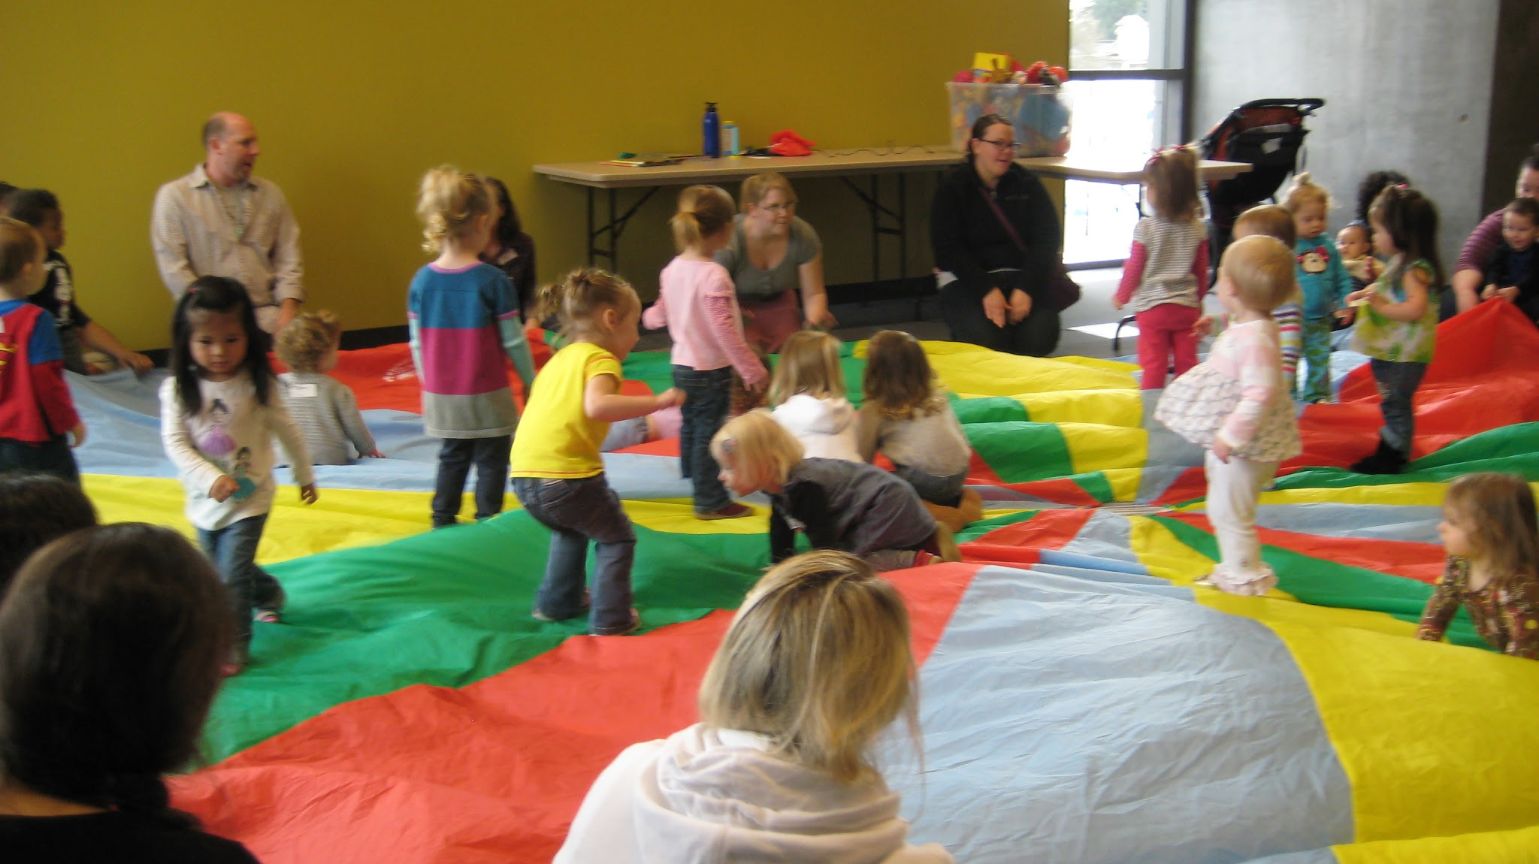
Parachute
Notes:
The parachute is pure magic in storytime. There are so many ways to use it with any size of group and it’s always a hit. Plus, chutes are pretty cheap. Check Kendra’s blog for lots of ideas for using the parachute with the very young, including how to set it up and make sure the grown ups in the room are helping.

Slide 21
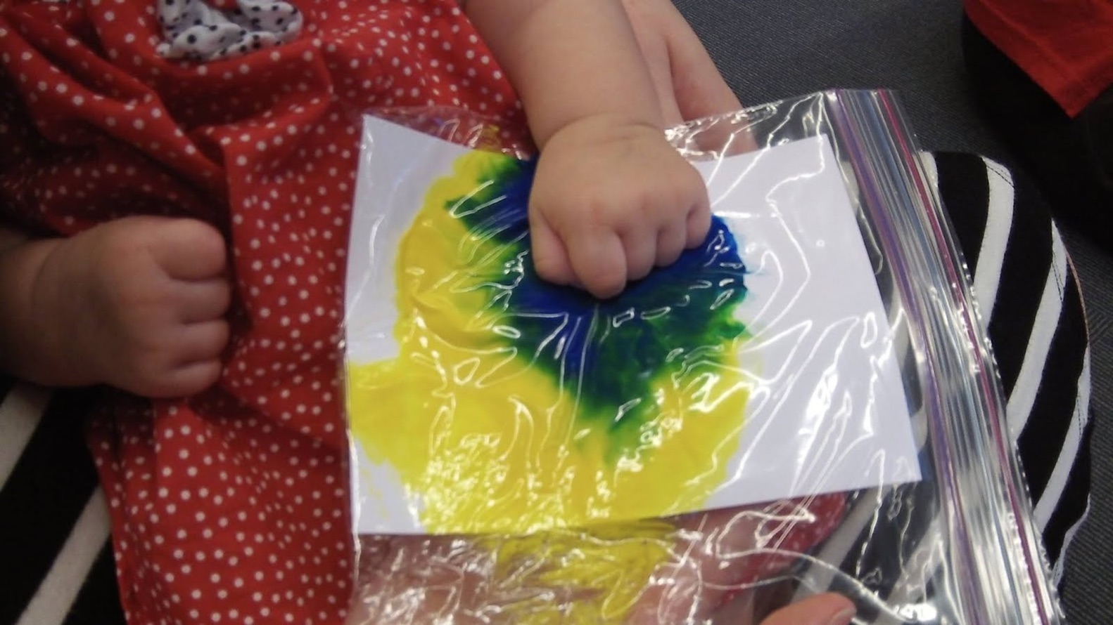
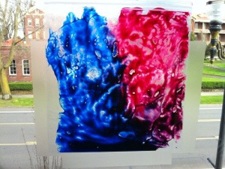
squish paint in bags with paper
No Mess Painting
tape paint bags to windows or tables

Slide 22
Poll Time!
What is one concern you have about programming for babies & toddlers?

Slide 23
Programming in Action Messy!
Materials?
Storytime activities!
Special programs!
Clean up?

Slide 24
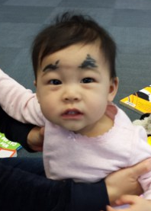
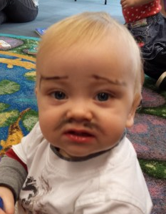
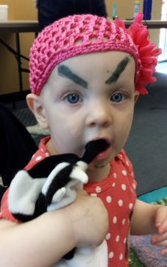





Eyebrows
Mustache
Notes:
Yeah, the pictures speak for themselves. Just do this. You won’t be sorry. Washable markers or face paint crayons, or maybe tub crayons.

Slide 25





Play Around!
Notes:
Describe different activities at play group. Talk about fine motor development with tissues, gross motor with crawling under table, etc

Slide 26



Washable Stamp Pads
Handprints and Toy Car Painting
Notes:
invest in smocks, or use mens’ shirts

Slide 27


Shredded Paper
on a Tarp or Parachute
Notes:
Does your library shred library card applications? Do you have a volunteer who could shred old newspapers? This is the project for you. It is messy, but worth it.

Slide 28



Science!
Notes:
Science activities are so much fun for littles! Most projects can be done for low cost and also replicated at home. Using items like medicine droppers (that WalMart will donate to you), is great for fine motor development and strenthening hand muscles. Its also great for introducing new vocabulatry words like dissolving, precipitation, density.

Slide 29



Water Play!

Slide 30


Paint with
- balloons
- shaving cream
Notes:
Finger painting is a classic activity. Change it up by using shaving cream instead. Partially blow up balloons and dip them in finger paint for even more sensory play fun.

Slide 31



Paint with
- veggies
- fingers

Slide 32
Poll Time!
Share one idea you can use right away and one you can work towards.

Slide 33
Success
Confidence!
Enthusiasm!
How can you measure it?

Slide 34


Be Silly!
Be Confident!
Notes:
Confidence & Enthusiasm

Slide 35

Success?
Notes:
Talk about successful passive program. # and little $$ spent. Attendance, evaluation, etc. Feedback from community. Ways to tell if passive stations are being used.

Slide 36


Does it work?
Notes:
Yes! We are pretty much the only place for people with kids this age to enjoy programs for FREE. They get to socialize, etc. But it still has to be engaging and valuable or no one will come.

Slide 37





Resources
Notes:
If we have time, talk about the amazing PLN online community. We’ll include links on the handouts to our favorite blogs, resources, etc. Yes! Also: look at your handout.

Slide 38
Your turn
What are your questions?
Notes:
10 minutes for questions

Slide 39


How do
you play?
Kendra Jones
peaceluvbks@gmail
klmpeace.wordpress.com
Brooke Newberry
berasche@gmail
readingwithred.blogspot.com
Notes:
· We’d love to hear from you! Maybe you have a question about something we flashed on the screen, or maybe you want to tell us about something awesome you’re doing. Tell us! Here’s our email and blogs.

Slide 40
Infopeople webinars are supported in part by the U.S. Institute of Museum and Library Services under the provisions of the Library Services and Technology Act, administered in California by the State Librarian. This material is licensed under a Creative Commons 3.0 Share & Share-Alike license. Use of this material should credit the author and funding source.

