Slide 1
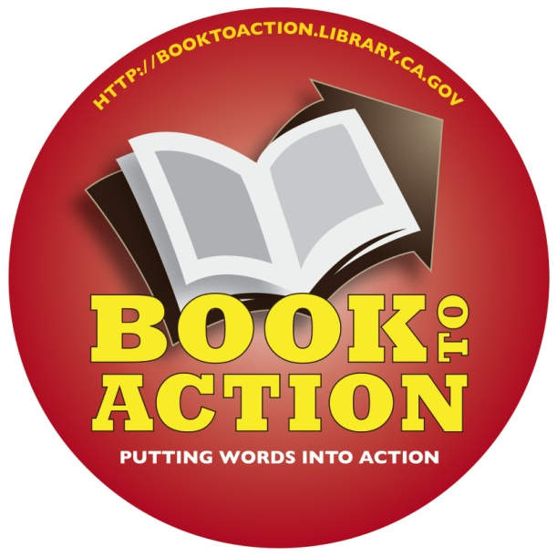
Book-to-Action:
Expanding the Library’s Role in Promoting Civic Engagement
http://booktoaction.library.ca.gov
Presenter: Mary Menzel, California Center for the Book
PowerPoint prepared by Sally Thomas, Hayward Public Library
Notes:
2014 PLA presentation with Allison McKee from Contra Costa County and Lori Easterwood of Sacramento Public.
Civic engagement and community-building

Slide 2
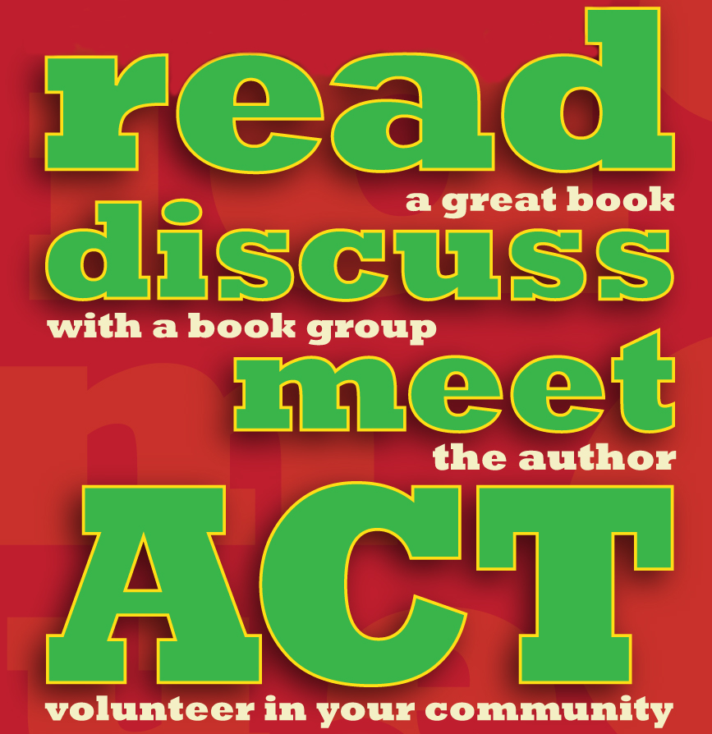
Book-to-Action
Engage community members in collectively reading and discussing a book and putting their new-found knowledge into action by participating in a community service project related to the book's topic.
Collaborate with local organizations doing vital work in your community
Expand your library’s role by mobilizing volunteers in work that enhances civic engagement.
Notes:
Pick a book, often nonfiction, on topic of interest to community.
Have a book discussion and invite the author to speak. You may find a local author who won’t have to travel far to speak at your library.
Work with a local nonprofit or another city or county agency to develop a volunteer opportunity for the community, tied in with the book’s topic.
Benefits:
Expands the public’s idea of what libraries can do and is a great way to demonstrate to the community that the library is more than just books
Emphasizes the Library’s role as the center of the community
Gets you out into the community connecting people to each other and like-minded groups to each other
Connects generational groups and people with varying abilities and backgrounds
Opens up the possibilities of alternative funding partners
Great example to use when talking to local officials about the value of the library

Slide 3
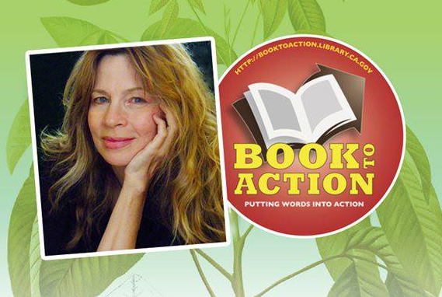
Sacramento - 2013
Spring Warren, author of The Quarter-Acre Farm
Notes:
Maybe your community is interested in sustainable agriculture and supporting local farmers. Sacramento read The Quarter-Acre Farm: How I kept the patio, lost the lawn, and fed my family for a year by Spring Warren, and partnered with a host of local organizations you can see on the next slide.

Slide 4







Slide 5
Ocean Park Branch, Santa Monica Library, 2013
Adult book: You Had Me at Woof by Julie Klam
YA book: Finding Danny by Linzi Glass
Partners included Santa Monica Animal Shelter Education Program and Forte Animal Rescue
Community Event: Animal Rescue Group Information Fair, July
Notes:
Maybe your community is interested in the local animal rescue situation. A branch of Santa Monica Library read a YA book, Finding Danny, and an Adult book, You Had Me at Woof, and worked with the local animal shelter and rescue groups.

Slide 6

San Diego Public, 2012
Two partners:
  Tecolote Nature Ctr
  San Diego Natural History Museum
Service Projects:
  6 canyon clean-up days
  3 guided hikes & 6 nature storytimes with related crafts
On-going Family Nature Club Formed
Notes:
San Diego readers turned out for clean-up days inspired by this book, and young readers were encouraged to take part by reading another book, I LOVE DIRT! 52 Activities to Help You and Your Kids Discover the Wonders of Nature.

Slide 7
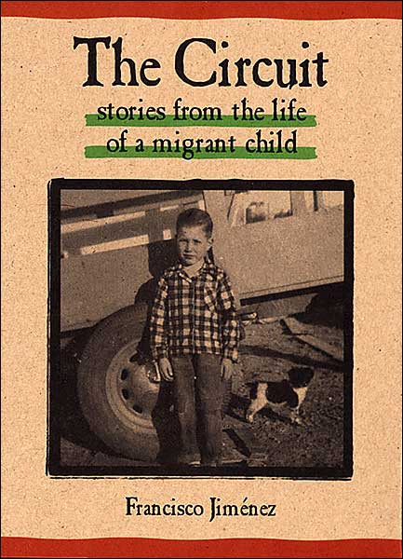
Santa Clara City Library, 2012
Partner:
Santa Clara School District’s Migrant Education Program
Notes:
Maybe, like Santa Clara City Library, you’re concerned about the educational opportunities for migrant children in your school system.

Slide 8

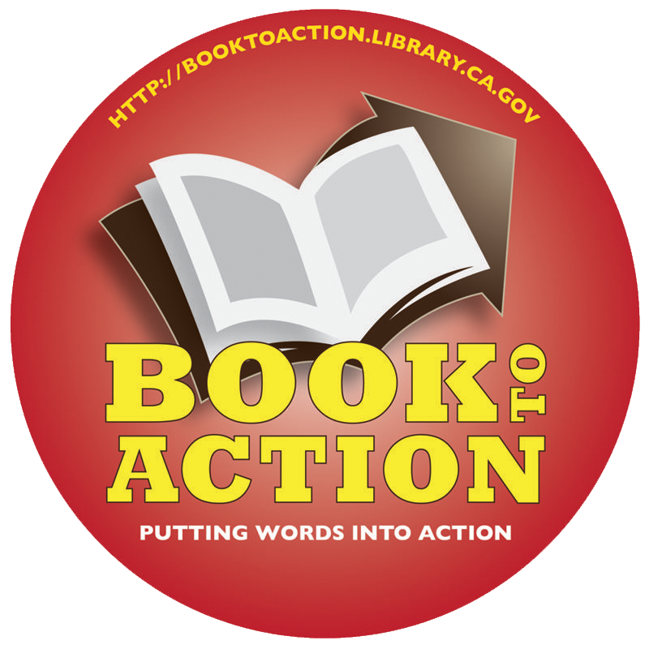

Notes:
Several libraries have used ecologically-oriented titles such as Plastic Free and a wonderful book by Edward Humes, Garbology: our Dirty Love Affair with Trash, and they have partnered with local environmental groups and agencies.

Slide 9
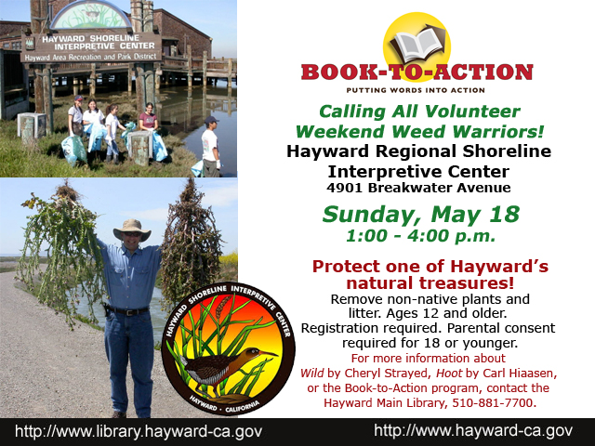
Notes:
Books like Wild by Cheryl Strayed and Hoot by Carl Hiaasen are natural lead-ins to clean-up days and other ecology-oriented activities.

Slide 10
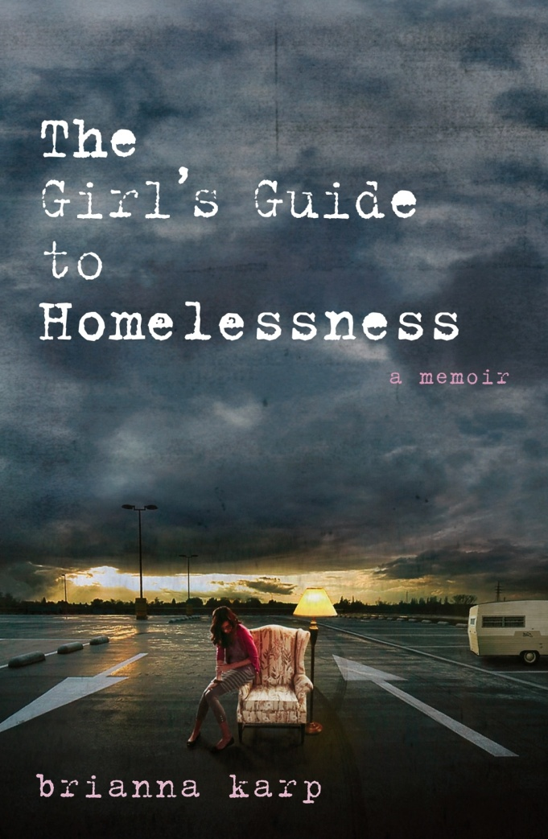
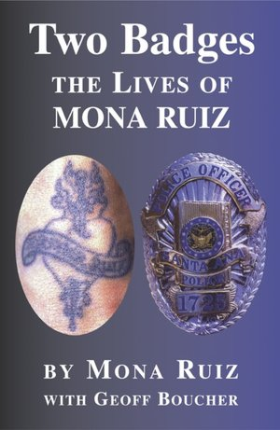
Notes:
Some libraries have found local authors with inspiring stories that lead to conversations and volunteer activities about gangs, homelessness and the problems of runaway teens.

Slide 11
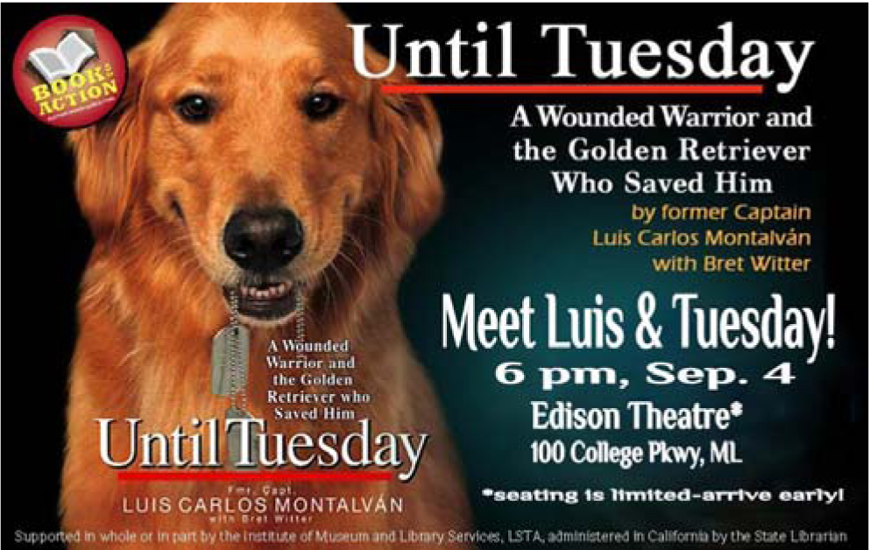
Mono County Free Library, September 2013
Notes:
Maybe your community is concerned about services for injured veterans and would like to learn more about them and their service animals like Tuesday.

Slide 12
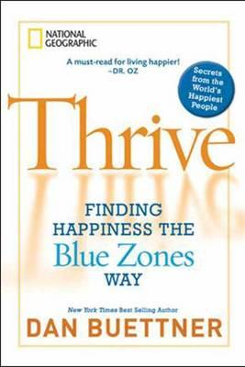

Book-to-Action: A Great Idea
Multonomah County Library Launches
Books-to-Action, November 2008
Volunteer Project at the National Conference on Positive Aging
IMLS Western Regional Fellowship:
Transforming Life After 50 - 2010
Notes:
In 2008, The Multnomah County Library launched the HANDS ON BOOMER INITIATIVE. Their first book selection was Thrive: Finding Happiness the Blue Zones Way by Dan Buettner. In addition to book discussions, the Library organized volunteers to help at the National Conference on Positive Aging.
Then in 2010 librarians who had organized programs that appealed to baby boomers presented about these programs at the IMLS Western Regional Fellowship program for the Transforming Life After 50 initiative. Sally Thomas was there, thought that Book to Action sounded perfect for her community, and got LSTA grants for two intergenerational Book-to-Action programs at Hayward Public Library.

Slide 13

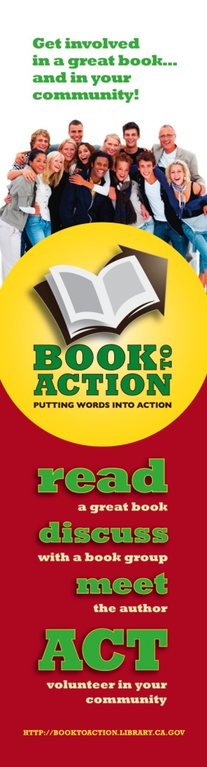
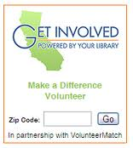
California State Library Promotes Civic Engagement
Notes:
When Hayward Library had such a success with Book-to-Action, the California State Library recognized the statewide potential of the program model. The California State Library has actively promoted civic engagement and community-building for many years, with the Transforming Life after 50 initiative and “Get Involved: Powered By Your Library” which aims to expand the visibility and contributions of skilled volunteers in public libraries. Book to Action was a natural complement to these initiatives, so in 2012 the State Library offered $3,000 grants to 10 libraries to pilot Book to Action as a statewide program.

Slide 14
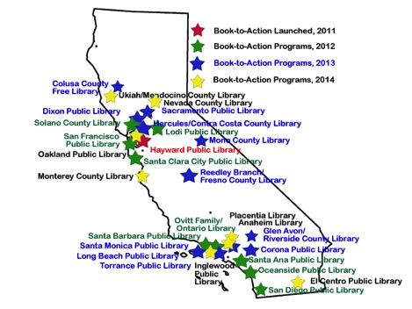
Book-to-Action: Ongoing Success Throughout California!
Notes:
This hasn’t been updated with the 2015 participating libraries, but it shows the nice reach of Book to Action and how it has been used in large, small, rural, urban, and suburban. libraries

Slide 15
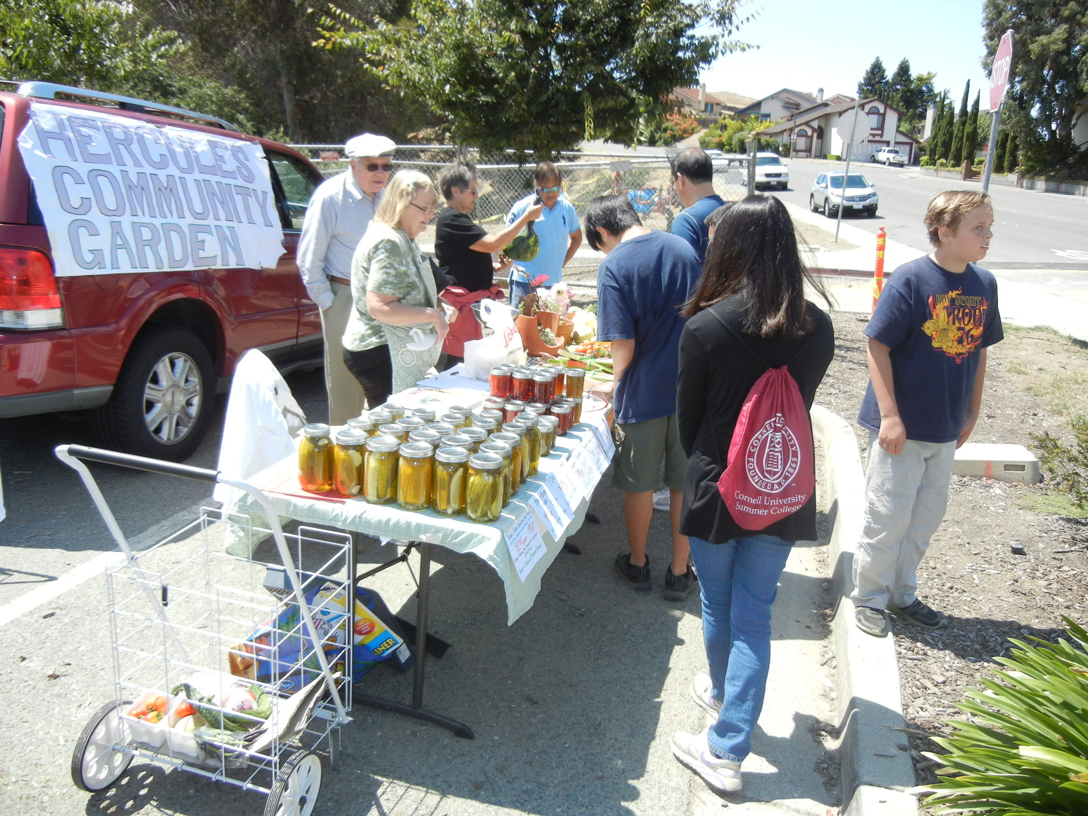
“The City needs more of this!”

Slide 16
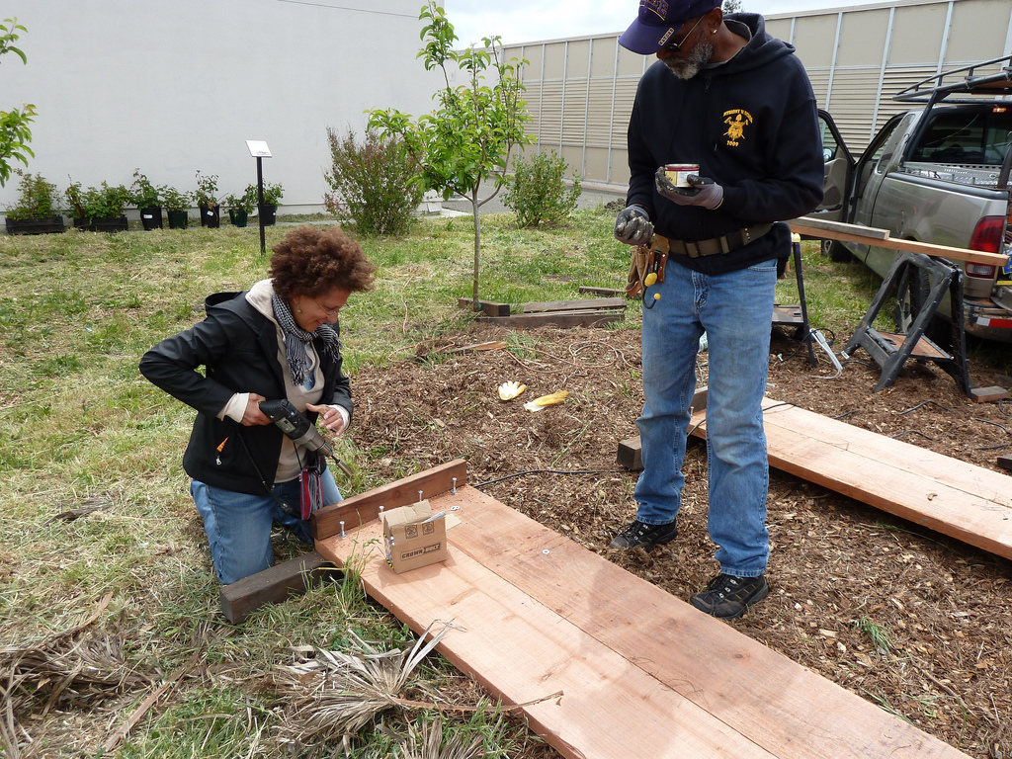
“I can make a difference.”
Notes:
One of the most important outcomes of this project was community members saying that they could make a difference.

Slide 17
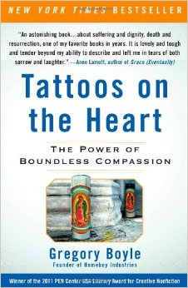
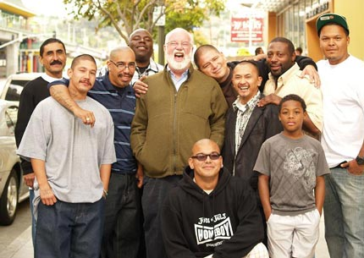
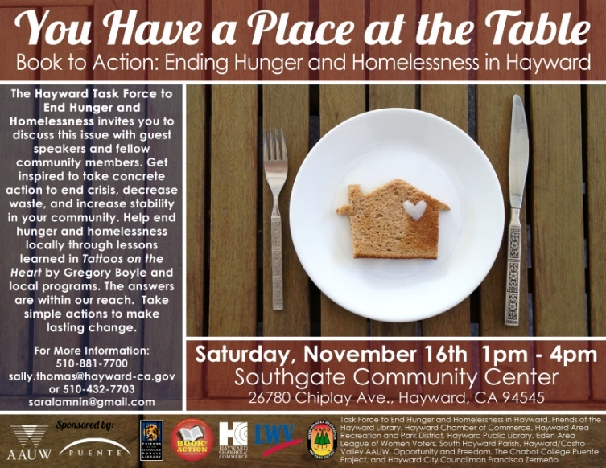
Hayward
Notes:
Hayward is one of the communities where Book to Action has taken on a life beyond the State Library’s funding cycle, and the community and partner agencies come forward with ideas for programs. Other agencies even take the lead in organizing the activities. Since the California Center for the Book started administering the program, I’ve heard many stories like this, that the program model is so attractive and meaningful for people, that it takes on a life of its own and inspired organizations and individuals to come forward.

Slide 18
Questions?
http://booktoaction.library.ca.gov
Notes:
questions

Slide 19
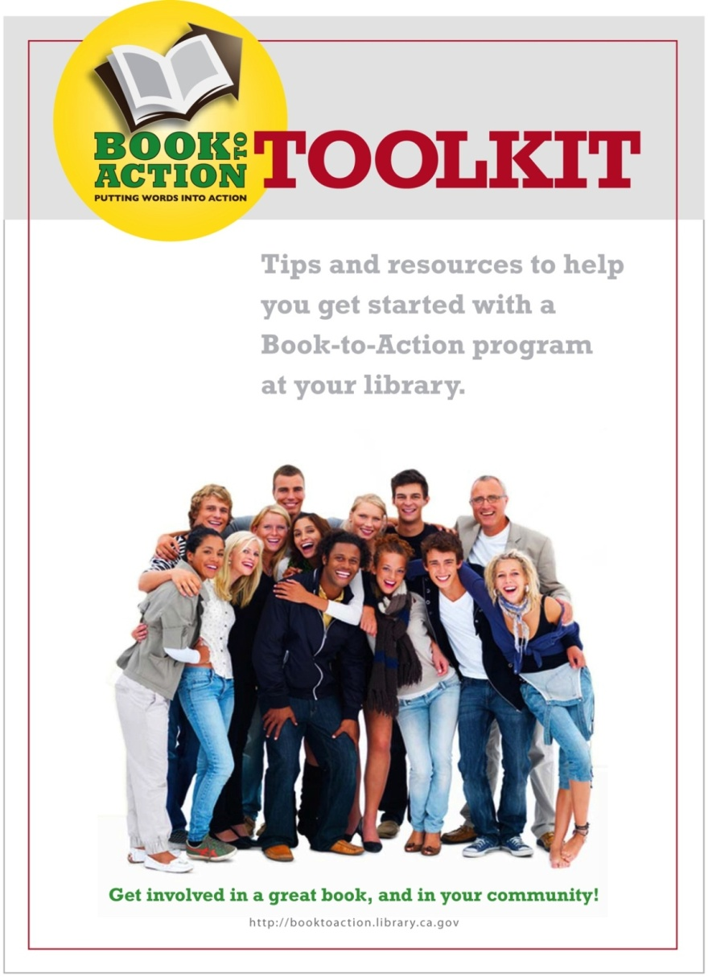
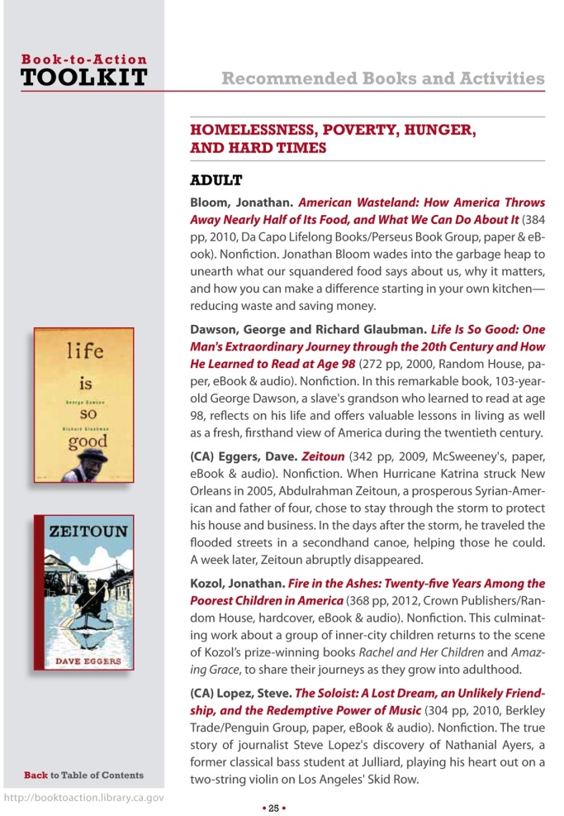
http://booktoaction.library.ca.gov
Notes:
In 2012, the California State Library asked Sally Thomas to develop a Toolkit, to provide resources to help other libraries organize successful Book-to-Action programs. The Toolkit is available on the California State Library website, and is available for use by any library, regardless of location. It was designed to be accessed online and features active links to help you navigate the publication. But you can also opt to download a high-resolution copy that can be printed.

Slide 20
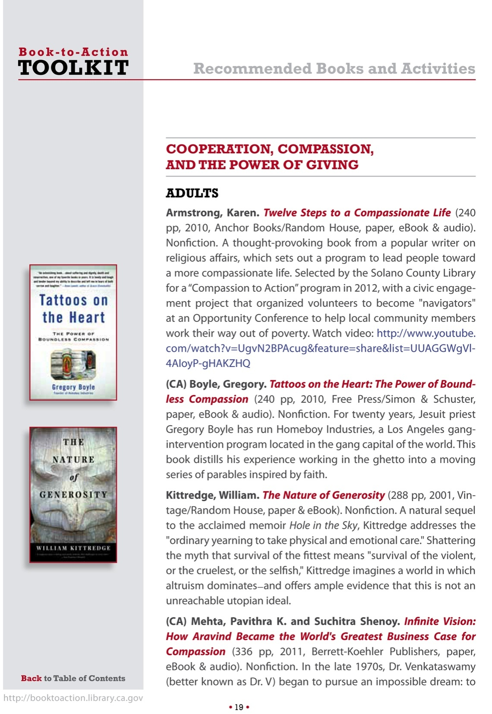
Notes:
The Tool kit has an extensive book list of titles that can readily linked to a civic engagement or community-building volunteerism activity.
Most of the books are geared towards adults, but there are some youth titles also.
CCFB will post an update on its website with more book and partnership suggestions.

Slide 21
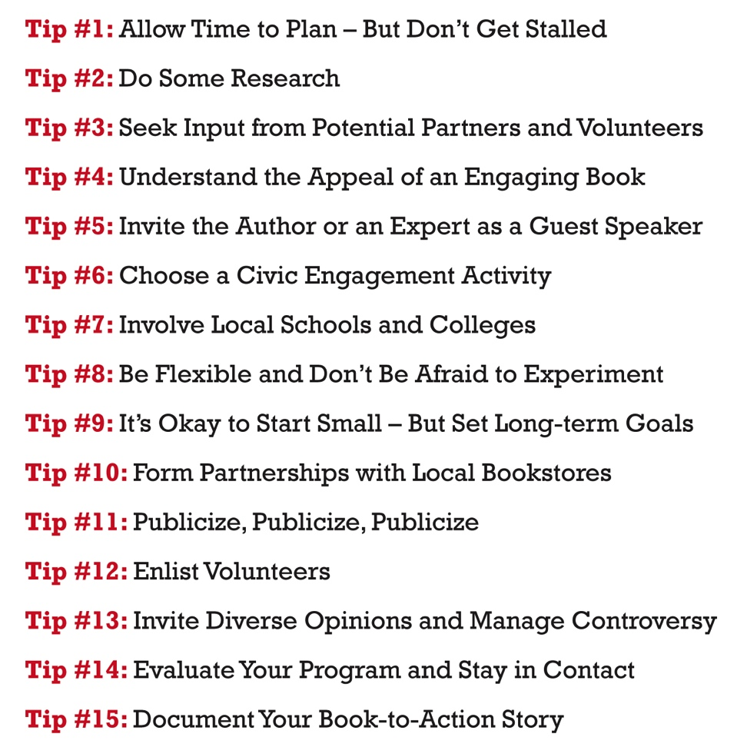
Notes:
The Toolkit can be read from cover-to-cover, or you can jump to the area that interests you the most. The main message is that the Book-to-Action program is FLEXIBLE!! It can be done on a very small scale, or on a large scale. And the Toolkit was not intended to overwhelm you, but to give you a good head start on organizing a successful program.

Slide 22
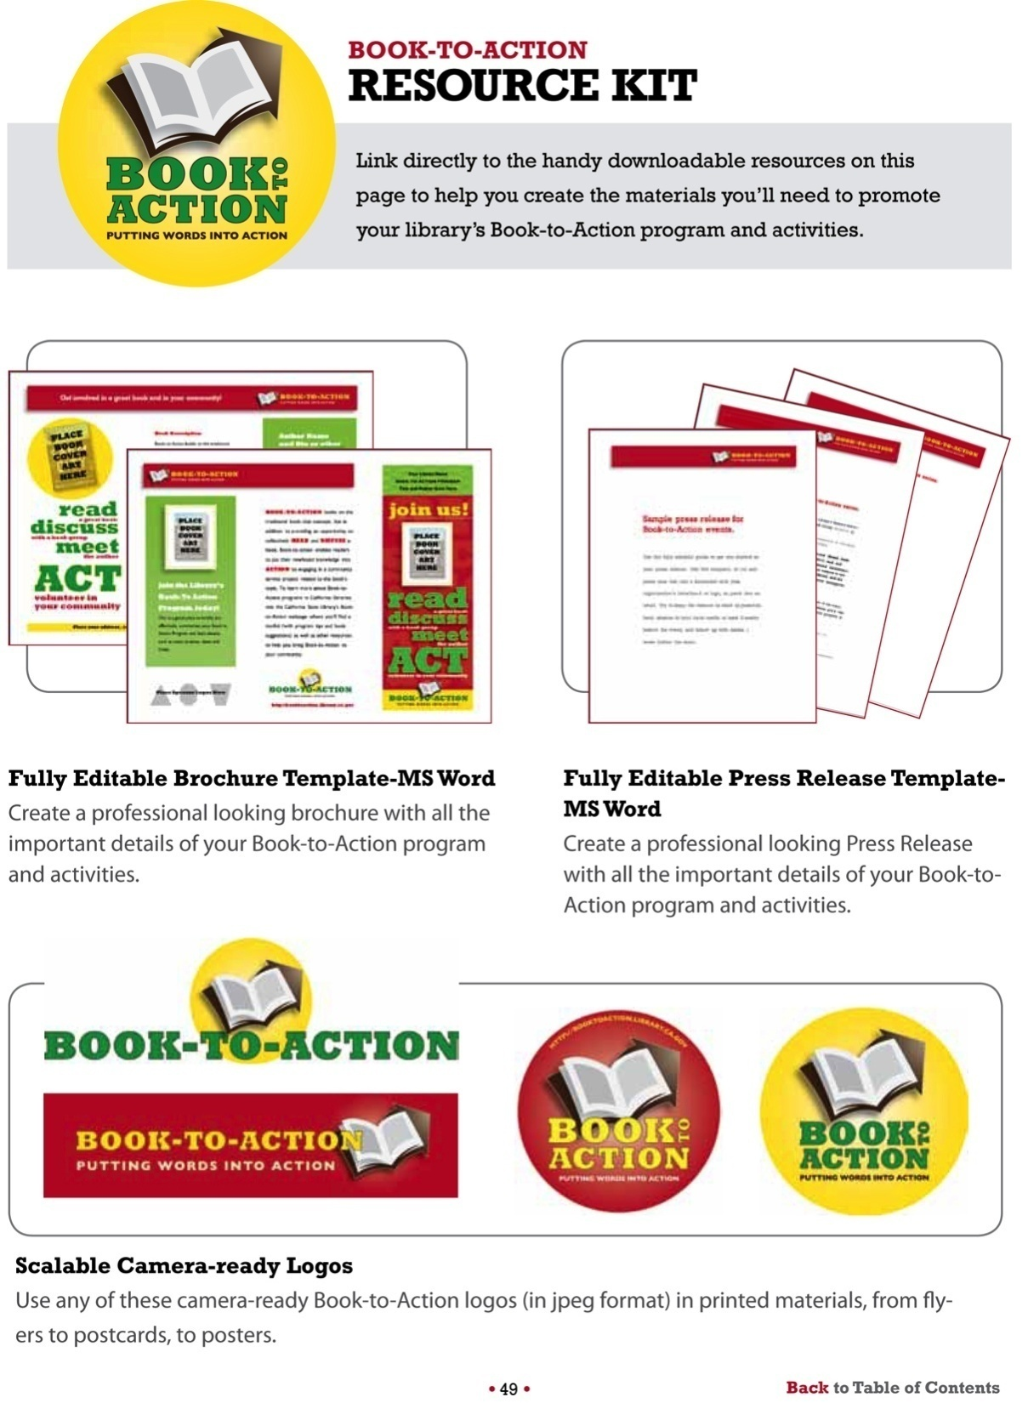
Notes:
The toolkit includes links to downloadable logos, a press release template, and…on the next slide…

Slide 23
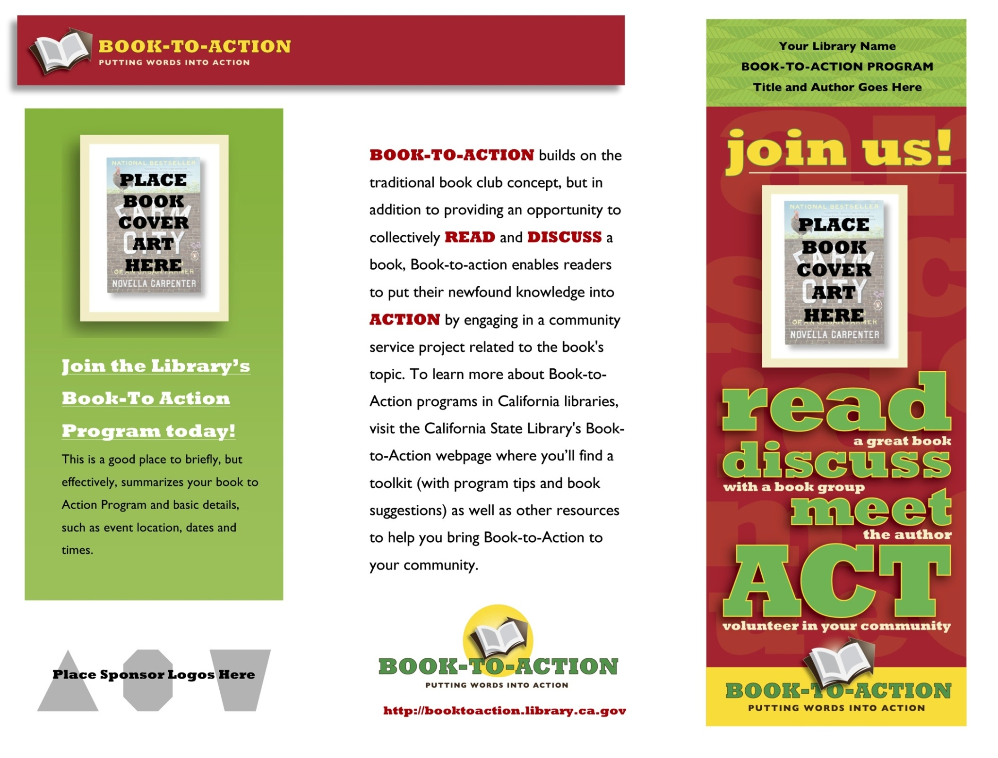
Notes:
A Word document template for a brochure that you can adapt to describe your program.

Slide 24
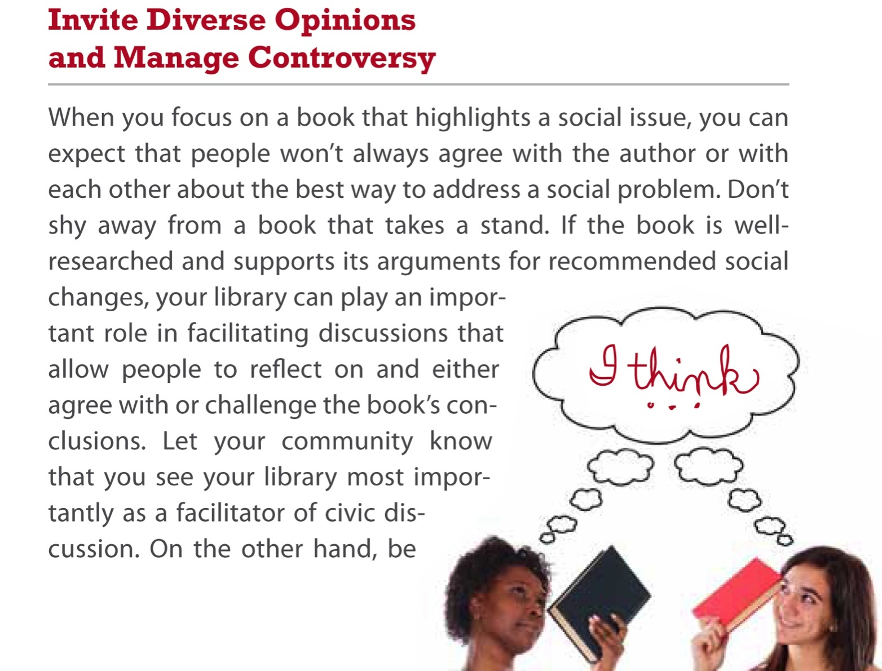
Managing Controversy
Notes:
The Toolkit addresses one of the questions that we often get about Book to Action – that issues of concern to the community are often politically charged or controversial. It is up to you to choose books and issues that you’re comfortable exploring, and certainly the library is an appropriate place to have a civil discussion of an important community concern.
The Toolkit also offers lots of helpful advice about finding and working with partners, which is a crucial part of Book to Action.

Slide 25
Before we go over the application and deadlines…any questions?
Notes:
Questions?

Slide 26
Book to Action
is not a grant.
is not a reimbursement program.
CA Center for the Book will pay these invoices
for you (up to $3,000):
Books to give to community members
Author fees
Author travel
Notes:
Each library can request up to $3000 in Book to Action funds.
LSTA funds that can be used for giveaway books, author speaking fees, and author travel.
You get invoices from your book vendor and/or from the author, send them to me, and I submit them to SCLC for payment.
We’ll choose between 13 and 20 libraries to participate, based on how many libraries ask for the maximum.
We don’t use the word honorarium or stipend. “Speaker Fee” !!
If $600 or more goes to one person, we need an SSN or W-9.

Slide 27
2016 Request to Participate
Elements will include:
Amount requested ($3,000 maximum)
Title of selected book(s)
Description of program(s), speaker(s), topic, and community service activity. (200 words maximum)
Community service partner(s)
Intended audience (e.g. adults, school-aged children, specific target populations)
How many people are expected to participate
Anticipated outcomes of the program,.
Notes:
Request to participate under revision right now. Will require library name, contact person or people, phone and email, director signature.
Title of selected book(s)
Description of the program(s) to be conducted, including information on speaker(s), topic, and community service activity. (200 words maximum)
Intended audience (e.g. adults, school-aged children, specific target populations) and how many people are expected to participate
Proposed community service partner(s) and their anticipated role in the project
Anticipated outcomes of the program, i.e. what positive changes are expected in the audience’s skills, knowledge, behavior, attitude, status, or life condition?

Slide 28
Outcomes
learned something new and valuable about a current topic by reading and discussing the selected book.
learned something new and valuable about a service need in their community.
found their participation in the Book-to-Action project to be a meaningful experience.
interested in engaging in community service again.
interested in another Book- to-Action Project.
Notes:
We are revising the proposal form and the final narrative report, but outcomes are important and we are working on surveys to help you capture outcomes information.
Very high proportions of respondents report these important outcomes.
84% of respondents said they learned something new and valuable about a current topic by reading and discussing the selected book.
87% said they learned something new and valuable about a service need in their community.
100% said they found their participation in the Book to Action project to be a meaningful experience.
90% said they would be interested in engaging in a community service project again.
90% said they would be interested in participating in another Book to Action Project.

Slide 29
2016 Request to Participate
should also include:
A brief outline of expected program expenses and funding sources.
No minimum cash match or
in-kind requirement.
Remember:
CA Center for the Book will pay invoices for
Books to be given to community members
Author fees
Author travel
Notes:
Also:
a brief rundown of the program expenses you expect – e.g. materials for the volunteer activity, prizes or incentives, refreshments, staff time
and what additional funding sources you’ll use.
There is no minimum cash match or in-kind requirement

Slide 30

Book to Action 2016
Deadline for request to participate:
December 1, 2015 – 5 pm
Notification will be made by:
December 15, 2015
All programming must be complete
and invoices submitted to CCFB by:
Friday, May 13, 2016
Final narrative report due by:
Tuesday, May 31, 2016
Notes:
Deadline for request to participate: December 1, 2015 – 5 pm
Notification will be made by: December 15, 2015
We’ll choose 13 to 20 libraries depending on the amount of money requested. $40,000 total available.
End of my grant period for FY 15-16 is June 30, 2016.
All programming must be complete and invoices submitted to me by: Friday, May 13, 2016
Final narrative report form is also under revision and may be an online form. It will be due by: Tuesday, May 31, 2016

Slide 31
Questions?
Book to Action is supported by the U.S. Institute of Museum and Library Services under the provisions of the Library Services and Technology Act, administered in California by the State Librarian.
Notes:
Questions?

Slide 32
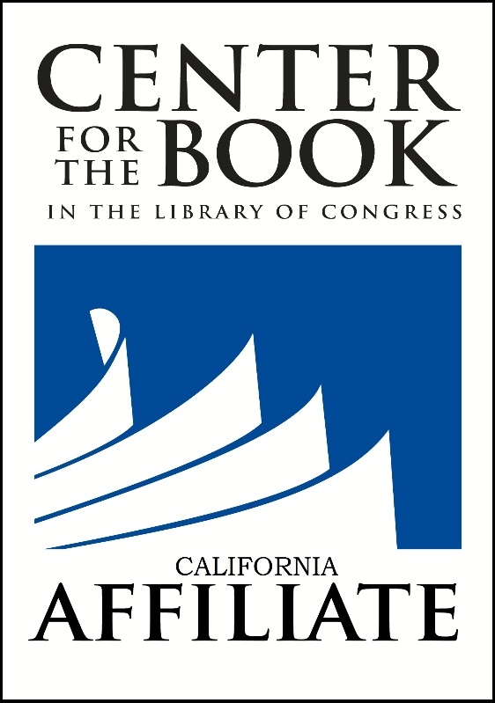
Thank You
Mary Menzel
California Center for the Book
mmenzel@calbook.org

