Slide 1

Getting Started with Usability Testing
with
Amanda L. Goodman
An Infopeople Webinar
Wednesday, October 7, 2015

Slide 2
POLL
Which kind of library do you work at?

Slide 3





Overview
UX for Special Groups
Physical Space
Websites
Who are your users?
What is meant by UX?
Notes:
A word on the choice of saying user instead of patron, member, etc. in this presentation:
It is the preferred term of Infopeople who are hosting this webinar today!

Slide 4

What is meant by UX?
Notes:
The definition of user experience depends on who you ask. Some will say that UX is just about:
-- web or
-- statistics or
-- how people feel interacting with your product or service or
-- product development or
-- visual design or… the list goes on
So which is it?

Slide 5
“User experience” encompasses all aspects of the end-user’s
Interaction with the company, its service, and its products.
Nielsen Norman Group
http://www.nngroup.com/articles/definition-user-experience/
Notes:
The Nielsen Norman Group is a leader in the UX field. Go check out their website for hundreds of articles. Everyone references them at some point.

Slide 6
Everything is Interconnected
In-Person + Web + Emails + Phone Calls + Word of Mouth
Total experience of your library
Notes:
I agree with Nielsen Norman: UX a holistic system where everything is interconnected.
-- Every touch point a user has with your library is a moment of experience.
-- What can they learn about your library from the web?
-- Who answers the phone when they call? Is it a machine or person? Is that person friendly and helpful?
-- When they visit, can they find a place to park?
-- And so on to what their neighbors have to say about the library. Is it a must-visit place in town?
The ultimate goal is to make people’s lives better so they can get their work done.
Your goal may be different and your objectives may change depending on the project.

Slide 7

How users feel
Users that are happy will support the library.
What does that support look like?
-- Financial contributions
-- Voting in the library’s favor
-- Advocating for the library in local politics
Notes:
Why is it important that users have great interactions with the library?
[read slide]
There are of course, other ways that users can support the library. In turn, the library has to support their community.
What the library provides for the community depends on your mission.
How can tell if your library is helping?

Slide 8
Measuring usage and interaction
What do people need?
Define success
Track and analyze data
Notes:
To find out if your library is making users happy and removing obstacles that get in the way of their goals,
You need to keep track of what you’re doing and how it impacts users.
First, what do people need?
-- Access to information for work or play
-- Literacy
-- Computer familiarity to get jobs or just function in today’s society
-- To feel part of a community such as parents and seniors who need to know they’re not alone
-- and so on
What is success:
-- You need to know where you start at so you can make goals to see if interaction or usage increases.
e.g. program attendance
e.g. database usage
e.g. more library card signups
Track that usage to see how you’re doing. The rest of this webinar will introduce things to track and how to do it.
Also simple things you can do to improve the user experience of the library.

Slide 9
Useful, useable, desirable: like three legs of a stool,
if your library is missing the mark
on any one of these it’s bound to wobble.
Every decision you make affects how
people experience your library.
Aaron Schmidt and Amanda Etches
Useful, Usable, Desirable: Applying User Experience Design to Your Library
Notes:
This quote from Aaron Schmidt and Amanda Etches gives you a grounding as to what you’re looking to do. Check out their book for some foundational tips on UX in libraries.

Slide 10

Who are your users?
Notes:
Before you can define what users want, you need to figure out who are your users.

Slide 11

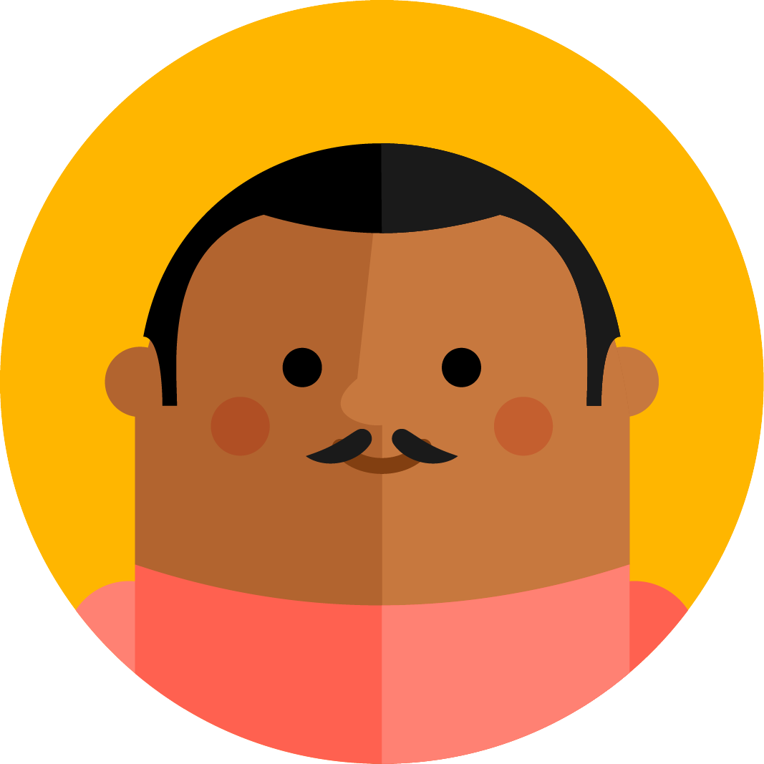

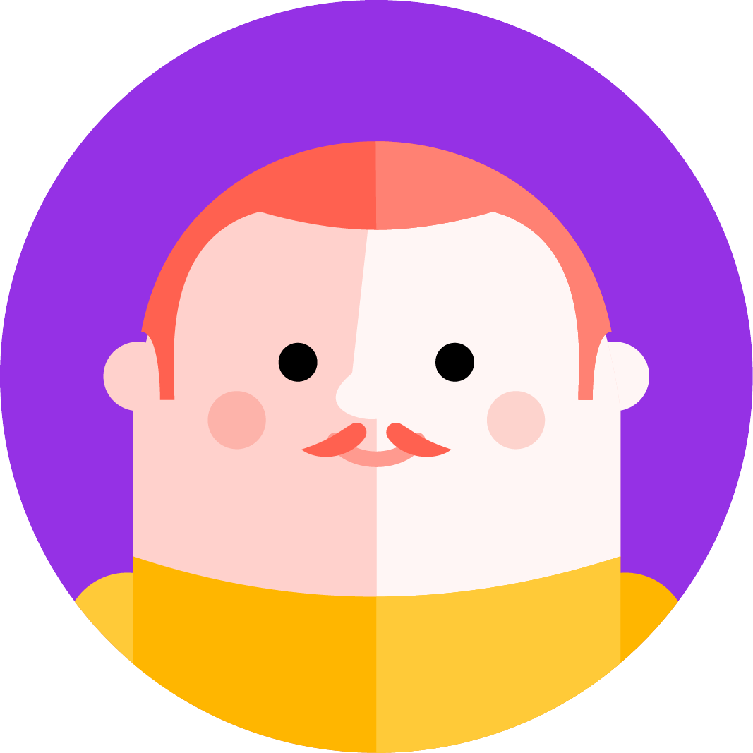





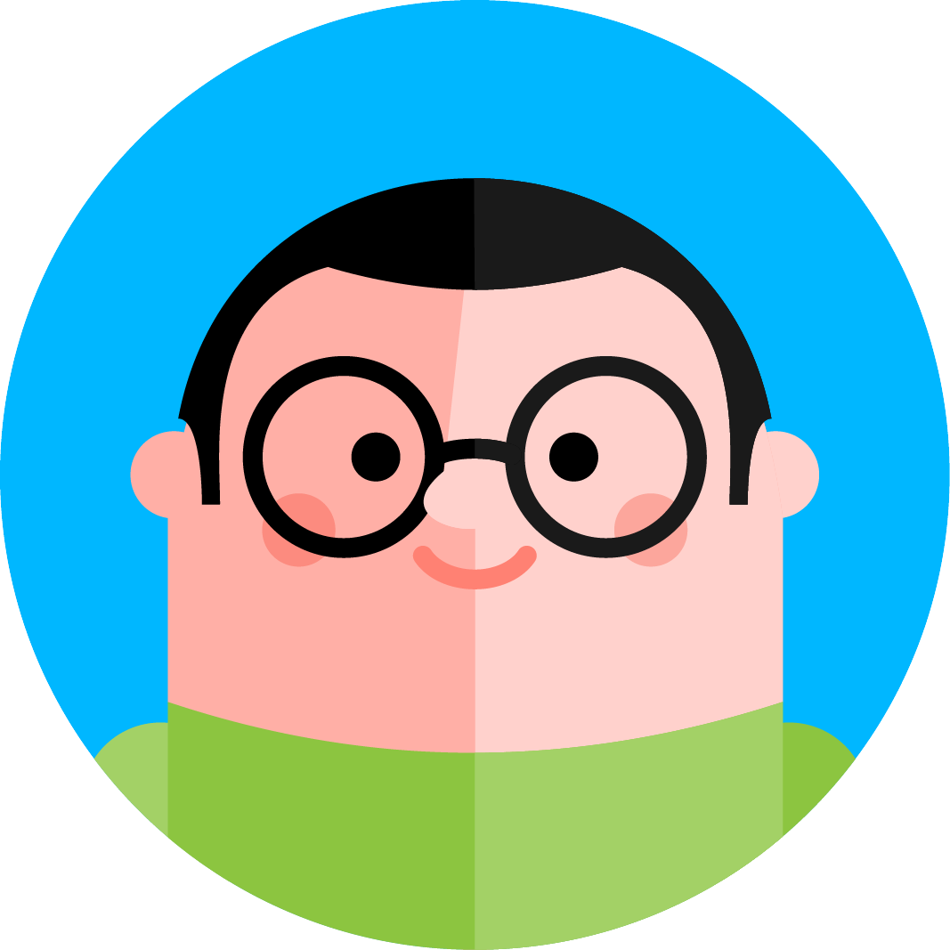
Who are your users?
Notes:
This may come as a surprise, but not everyone is your user.
This is especially true when you’re trying to develop new services and get people in the door.

Slide 12

Targeting Your Audience
Define your user groups.
Stick to broad categories.
Look for common traits.
Notes:
Common traits for user groups:
-- Academic library: faculty, staff, students, scholars, alumni
-- Public library: caregivers, children, teens, young adults, adults, seniors,
-- School library: caregivers, children, teachers, staff, and concerned community members
You can also define your user groups by different criteria. In an academic library for instance, you may instead have:
-- Grads, Undergrads, Distance Learners, Non-traditional students
Your user groups may change based on the context of the project.
Common traits are ones that represent what they need from the library.
-- students for example may need access to resources that they can’t access elsewhere but are required to by their teacher

Slide 13
Interviewing your users
Recruit target users.
Ask:
What are their needs?
What do they want to do?
What is stopping them?
Notes:
First up, you are not testing your users. You are testing your product or ideas about them. Never a person.
Now that you defined the groups you are looking to talk to, you need to recruit users.
How many people do you need to talk to? Nielsen Norman’s research shows that five will catch most of your usability issues when you are testing for a very specific thing.
Make sure to talk to the right users.
-- It’s a waste of time to talk with someone who is not affected in any way or have zero interest in what you’re doing.
----- e.g. Don’t ask my dad about your website. He doesn’t care. He’ll never visit your website. He’ll just skew your results with his complete lack of knowledge.
Recruitment methods include:
-- talk to staff to find potential users
----- Beware of the bias to just choose just favorite patrons. A favorite is likely to be a big supporter of the library already and familiar with it.
----- You want a mix of people from beginners to advanced for most big projects.
-- Post signs, advertise, or physically be present to invite people to participate.
----- Bribes in the form of coffee of food does wonders.
-- Guerilla testing is my favorite.
----- Take a clipboard, a few targeted questions, and hit the streets (or a busy place in your library)
----- If you can get a second person to accompany you to take notes, even better.
----- You may want to record audio and video – with the user’s person – as a reference.
-----I did this with our touch screen kiosk. I only filmed their hands.
You may notice that this slide text of questions is very broad with “What is stopping them” for example.
Later when you are testing a service, product, or idea, you will learn what is stopping someone:
-- Can’t find information on the website
-- Don’t hear about programs
-- Can‘t find parking

Slide 14
Building personas for focus
A persona is a fictional person whose traits are gathered from talking about the needs of real users.
This persona gives you a user to keep in mind when you are evaluating your projects and ideas.
Notes:
Now that you have talked to your target users, create a persona.
A persona is a fictional person whose traits are gathered from the needs of talking to real users. This persona will give you a focal point to keep in mind when you are evaluating your projects.
In my community for instance, we have many moms who took a break from the workforce to raise their children. They’re now attempting to get back in the saddle.

Slide 15
Who am I?
Maria is a former executive who wants to return
to the workforce after raising her children.
Wants:
To freshen up her skills.
To learn the newest things in her field.
To update her resume.
Traits:
Tech savvy.
Well-educated.
Has own transportation.
How to get in contact:
She checks her email on her phone
while waiting at storytime, the grocery
store, the doctor’s office.
Limitations:
Busy with the kids.
Limited hours she can study.
Expectations of the library:
Wide range of materials in her field.
Easy access to resources.
Use those resources on her own time.
Quick response time to queries.
Notes:
This is a sample persona. A real persona would include a photograph, not an illustration.
What traits you have on your persona depends on your projects.

Slide 16
POLL
How well do you know your users?

Slide 17

Websites
Notes:
Now we are going to move into how to test these aspects of your library and improve them.
First up: the website.
Three of these methods are more passive where you observe patterns of data gathered over time.
Two are more active where you can help direct the conversation.

Slide 18

Google Analytics
analytics.google.com
Ask:
How are people finding your site?
What paths do they take through it?
Where are the weak points?
Notes:
A word: I know that not everyone is crazy about using Google for your web analytics. If you have a different service you like to use, post it in the chat box.
Analytics like this is passive gathering. You are just studying data and looking for patterns instead of asking people directly.
Add your Google Analytics code to every web property the library has access to.
-- Main website
-- Vendor sites like eBooks, databases
-- Seasonal websites like summer reading
-- Social media like Tumblr
Paths:
-- When they land on the front page, what do they click on first? At my library it is the catalog or logging in.
-- Keep in mind that every page on your site is now a landing page.
-- Search engines don’t necessarily link to the front of the site. They send people to the exact page with the information they are looking for.
Weak Points:
-- Are people hitting your front page and then leaving without clicking on anything?
-- What links on your site do people click on a resource page?
Warning:
-- It can be difficult to track clicks from your website which lead to another site.
-- Databases, digital content vendors
-- In that case, view the stats from that site

Slide 19
Heatmaps
crazyegg.com
Ask:
What are people looking at?
How far are people scrolling down?
Where are people clicking?
Notes:
Crazyegg.com is just the one that I have experience with. It is more visual than Google Analytics. If possible, use together.
Crazyegg gives you a 30 day trial before you have to pay for it.
Heatmap:
-- Great for you visual types out there.
-- The more popular a link is, the redder the color will be when you view your site on crazyegg.
-- Google Analytics gives you a basic heatmap, but it isn’t nearly as detailed.
Scrolling:
-- Helps you prioritize content. If no one scrolls all the way down, you better put the important bit at the top of the page.
-- This means using an inverted triangle writing style like journalists do.
-- Put the important bit at the top and then elaborate from there down to just the fluffy details at the bottom of the page.
Clicking:
-- Crazyegg tracks more than just clicks on links.
-- Where are people clicking on the page in general?
-- You’d be surprised at the seemingly odd places people click. It may be a hint that people are confused about what is clickable.

Slide 20
Card Sorting
measuringux.com/CardSorting
Ask:
What pages go together?
What would you call this page?
Does any page go in two+ locations?
Notes:
Helps you figure out your navigation, how to organize content, and what words to use.
That link is a comparative list of online card sorting tools.
Basic description:
-- Write down the main pages of your website which includes the top level ones (e.g. Events) as well as the next level down (e.g. databases)
-- Ask the user to talk aloud about their thought process.
-- Ask users to group the cards together in piles that make sense to them.
-- If the user thinks another term would better, ask them to write that down (either on the card or on a sticky note attached to the card)
----- e.g. Research or Reference or Information Services or…
-- Do you think any pages should go in more than one group?
Tips:
-- Don’t put too many cards out at once.
----- I’ve tried to complete two online card sorts for other organizations. Each had 100+ cards so I just gave up halfway through.
-- Run a card sort on one person or a group up to three.
-- Do card sorts a few times to see if everyone is on the same page.
-- Once you have a “master” version which matches most people’s selections, test this out on a new group of users to see if they can follow along/agree.

Slide 21
A/B Testing
vwo.com/ab-testing/
Ask:
Which terms do people click on?
Which layout do people prefer?
Where is this content more successful?
Notes:
This is pretty much guaranteed to cost you money if you are doing this on the web. That link goes to a great overview of A/B Testing
You can test email campaign designs (e.g. MailChimp and Constant Contact).
-- Test subject line, content, what gets clicked on more
For websites
-- Nearly everything can be tested
-- e.g. does your call-to-action (AKA what you’re trying to get people to do on that page) get more clicks in the sidebar, top of the page, or somewhere else?
-- In the notes for these slides is a write-up from Mashable on different options: http://mashable.com/2010/11/04/a-b-testing-resources/#Bb8MoEPqMSqR
You can also do this in real life:
-- Which sign designs or displays catch people’s attention?
-- Does the events flyer placed in location A get picked up more often than in location B?

Slide 22
General Web Design Tips
Notes:
-- Do not use “click here”. Be descriptive like “View the map” where that phrase is a link.
-- Make the text bigger.
-- High contrast text to background
-- Be mobile-friendly

Slide 23

STYLE GUIDES ARE KING
Notes:
To make your life easier, use style guides.
-- Helps you figure out the voice of your website (i.e. corporate or friendly casual like Trader Joe’s site).
-- Observe the same writing style choices e.g. Oxford comma, how do you write eBooks
-- Keeps you on brand with consistency. Your library will look more professional
-- Can be difficult to enforce if you don’t get administrative support
Helpful sites:
-- voiceandtone.com
-- styleguides.io

Slide 24

Physical Space
Notes:
While the web can be intimidating to get a handle on, we’re going to do some quick pick-ups on how to improve your physical space.
It doesn’t have to cost money.

Slide 25

Observations
What are your pre-conceptions?
Take notes of what you see.
Analyze and try small changes. Observe reactions to that alteration.
Notes:
Observe what people:
-- do
-- go
-- move
-- ask
Take notes
-- Use tally marks as it is quicker
-- Do multiple observations of the same area in different time periods (e.g. morning, after school)
Analyze
-- Learn about the pre-conceptions that your coworkers or yourself already have about how people act or behave or ask
-- Does what you observe match what staff think?
-- Here is where you can do a little of that in-person A/B testing that we spoke of earlier.

Slide 26
Signage
Do a sign inventory.
Make it consistent with templates.
Enforce the template system.
Notes:
Inventory:
-- take photos of every sign
-- make note of which ones need to be removed
-- what is redundant?
-- who is responsible for that area?
-- are people really asking about that?
Consistency can be hard:
-- someone is going to think that this sign should be red with green text on it for Christmas. Just say no.
Goal:
What can you do to make signage unnecessary?

Slide 27
Appearance
Cleanliness
Building maintenance
People’s attitudes
Notes:
Cleanliness:
-- This is obvious, but you’d be surprised how often it is overlooked.
-- Is trash can emptied in a timely fashion?
-- Is gum scrapped off the bottom of tables?
-- Are chairs clean and non-stained?
Building maintenance
-- How does the paint look? Chipped, scuffed, or dirty?
-- Are parking spots well-defined or does the paint need to be touched up?
-- Any lights out, flickering, or is there an area where it’s too dark?
-- How often is the bathroom checked and stocked?
-- Do you have changing tables in all your bathrooms? Men have kids too.
-- Are chairs pushed in when not in use?
-- Are books clean, organized (watch for DVDs and CDs), and the stack appearances look good?
People:
-- This can seem odd to put under appearances. But people’s attitudes and behaviors are observed by users.
-- Provide great customer at every single touch point from the web to phone to in-person.
-- Give specific examples of expected behaviors. Don’t say vague things like great customer service to your employees.
-- Be polite and courteous. Take the high road in disagreements.
-- Watch what you’re saying (e.g. talking about others, curse words) and doing (e.g. looking at your cellphone) wherever a user can see it

Slide 28
THE LAST POLL
Notes:
Post your answer in the chat box.

Slide 29

UX for Special Groups
Notes:
This is an overview of how to make the library a more friendly place for kids, seniors, and those with disabilities.

Slide 30

Kids
Furniture is appropriate height
Worn materials replaced
Child-friendly equipment
Notes:
If you’ve ever baby or puppy-proofed a house, you know the importance of getting down to their eye-level and seeing the dangers from their point of view.
-- Wall outlets, sharp corners on furniture, heavy items which can be easily pulled down on a kid’s head
Worn materials:
-- At my library, we have a mounted iPad which causes trouble because kids get so entranced that they forget to pay attention to their bladder.
-- They switched to a vinyl covered stool before removing it completely
-- Likewise, kids and their caregivers care about appearances.
-- Be clean, mindful of tidiness, and regular wipe downs with bleach on surfaces
Child-friendly equipment
-- Appropriate scissors for their age group AND ones available for left or right handed kids
-- Coat racks the right size
-- Step stools
-- Make sure rug edges stay down
-- Cover or avoid sharp corners
-- Kid-friendly computer and video games
-- Watch keyboards and mice
-- Employee staff who like children
You’re trying to avoid the child becoming fearful of the library because they keep tripping
or bumped their heads or they sense a staff member doesn’t really like kids.

Slide 31
Seniors and Those with Disabilities
Compassion
Check for obstacles
Large text + high contrast
Technology
Notes:
Nearly everyone will be disabled at some in their life.
This could happen through breaking a bone, carpal tunnel syndrome, or just old age.
Obstacles:
-- Americans with Disabilities Act will catch most of these such as the width of aisles, elevators, bathroom stalls, and cut curbs for wheelchair access
-- Use state daycare guidelines if you want to be top-notch. A five-star daycare in NC has to pass rigorous tests for accessibility and safety for example
-- Can people in wheelchairs get their chair under counters at computers, tables, check-out, sinks?
-- For that matter, do you know if your library has a wheelchair to loan? If so, do you know where it is?
Large text + high contrast:
-- If possible, have a computer which can be used for those who are visually impaired
-- Signage should be high contrast in person as well as on your site
-- If you can, invest in other assistance technology like screen-readers, braille books, etc.
Technology:
-- iPads are not very accessible
-- Use gamer mice with rollerball
-- Large-lettered keyboards
-- If you have digital kiosks, you should have an audio port available and design a kiosk where sound can be used for navigation
-- Perhaps have special equipment which is not for the general public
----- My library lent out a portable CD player for a senior resident who could not use computers and the buttons on MP3 players are too small.

Slide 32
Be Mindful
Notes:
Pay attention to the difficulties others encounter with your library.

Slide 33

Resources

Slide 34

Books
Rosenfeldmedia.com/books
The UX Book
Don’t Make Me Think, Revisited
Smashing UX Design

Slide 35
Web
User Experience Design at sliderule.com
UIE Podcasts
Uxmag.com
A List Apart → alistapart.com

Slide 36
UXers in Libraries
LibUX.co ← me + Michael Schofield
WeaveUX.org
Design & UX in Libraries Facebook group
#litaUX Twitter chats

Slide 37
Just Ask Your Users
Notes:
If nothing else, just ask someone what they think.
-- Even just a quick back-and-forth with your coworkers. Does this make sentence? How does this look?
----- But use your own judgment too. Your coworker may not have an eye for design or care about consistency

Slide 38

Thanks for attending. Questions?
Amanda@godaisies.com
@godaisies

Slide 39
User Experience Design for Libraries
with
Amanda L. Goodman
An Infopeople Online Learning Course
Tuesday, November 10 – Monday, December 7, 2015

Slide 40
Infopeople webinars are supported in part by the U.S. Institute of Museum and Library Services under the provisions of the Library Services and Technology Act, administered in California by the State Librarian. This material is licensed under a Creative Commons 3.0 Share & Share-Alike license. Use of this material should credit the author and funding source.

