Slide 1
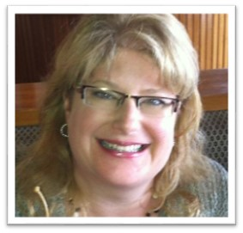


Beyond the Survey:
a practical approach to
INTERVIEWS and FOCUS GROUPS
Stephanie Gerding
Brenda Hough
November 17, 2015

Slide 2


Slide 3
Problem Solving
Brainstorming
with experts
Staff Input
Advocacy
Strategic Planning
Evaluation
Needs Assessment
Reaction
and Use

Slide 4
Beyond the Survey:
a practical approach to
INTERVIEWS and FOCUS GROUPS
“Why don’t you like surveys?”

Slide 5

Surveys

Slide 6
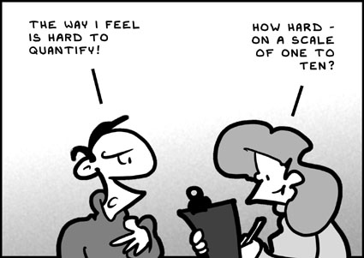

Slide 7


Slide 8

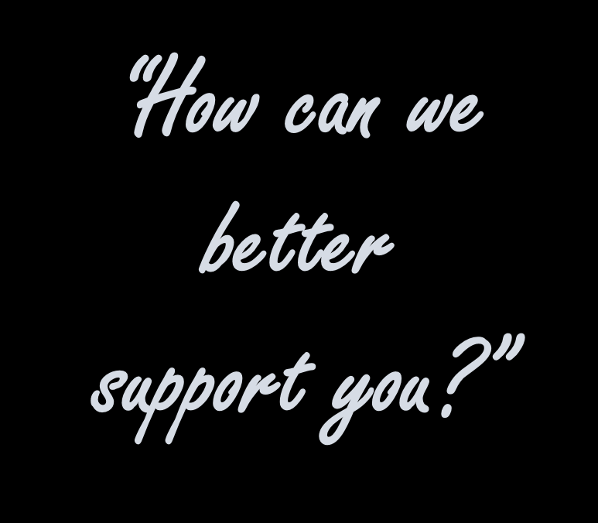
25 people

Slide 9
the final question:
“Share any additional thoughts or comments”

Slide 10
three multiple choice questions:
What are we doing that’s useful?
What are the barriers you encounter?
What additional support would help you?

Slide 11
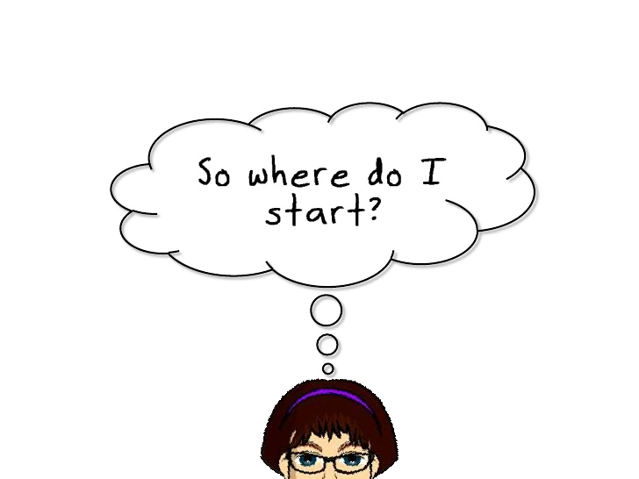

Slide 12

Follow these steps for success:
  Goal/Purpose
  Collect
  Analyze/Synthesize
  Package and Deliver

Slide 13
Follow these steps for success:
  Goal/Purpose
  Collect
  Analyze/Synthesize
  Package and Deliver

Slide 14
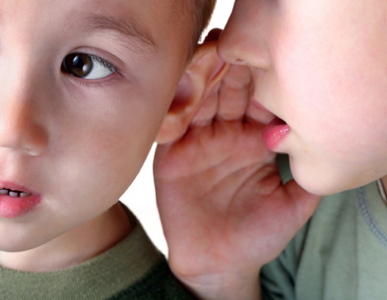

qualitative vs quantitative research
numbers
words

Slide 15
qualitative vs quantitative research
words
numbers
why?
how many?
what do you
think about…?
how much?
how do you
feel about…?

Slide 16
Which question is best answered by a qualitative research method?
A. Which library programs were most popular last year?
B. What types of library programs would the community like us to offer?
C. How great is the interest in local history programming?

Slide 17
Which question is best answered by a qualitative research method?
A. Which library programs were most popular last year?
B. What types of library programs would the community like us to offer?
C. How great is the interest in local history programming?

Slide 18
Follow these steps for success:
    Goal/Purpose
    What will be done with this information?
    2) Collect
    3) Analyze/Synthesize
    4) Package and Deliver

Slide 19

focus groups

Slide 20

focus groups
8 – 12 participants

Slide 21
focus groups
8 – 12 participants
3 – 5 groups

Slide 22
focus groups
8 – 12 participants
3 – 5 groups
Organizational Needs Assessment
  Directors
  Staff > 10 years experience
  Staff < 10 years experience
  Advisory board

Slide 23

focus groups
8 – 12 participants
3 – 5 groups
Organizational Needs Assessment
  Directors
  Staff > 10 years experience
  Staff < 10 years experience
  Advisory board

Slide 24
focus groups
8 – 12 participants
3 – 5 groups
saturation

Slide 25
focus group
moderator

Slide 26
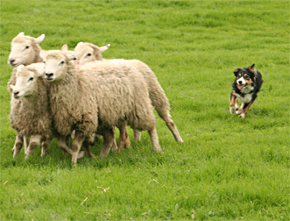
focus group
moderator
skills and characteristics?

Slide 27
focus group
moderator
assistant moderator

Slide 28
focus group
moderator
assistant moderator
questions

Slide 29
focus group
moderator
icebreaker
assistant moderator
questions

Slide 30
focus group
moderator
icebreaker
open ended
assistant moderator
questions

Slide 31
focus group
moderator
icebreaker
open ended
short
assistant moderator
questions

Slide 32
focus group
moderator
icebreaker
open ended
short
avoid bias
assistant moderator
questions

Slide 33
focus group
moderator
icebreaker
open ended
short
avoid bias
probing
assistant moderator
questions

Slide 34
focus group
moderator
icebreaker
open ended
short
avoid bias
probing
follow-up
assistant moderator
questions

Slide 35
focus group
moderator
icebreaker
open ended
short
avoid bias
probing
follow-up
summarize
assistant moderator
questions

Slide 36
questions
Seniors Focus Group:
What are some issues facing you in this period of your life?
Community Leader Interview:
What services should the library offer?
Student Focus Group:
Do you know how to submit ILL requests through OCLC?
School Principal Interview:
What is the best time to offer programs for children?

Slide 37


Slide 38

focus group
moderator
debrief
assistant moderator
questions

Slide 39
focus group
moderator
debrief
assistant moderator
patterns and themes
questions

Slide 40
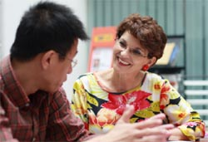
interviews

Slide 41
interviews
phone
face to face
Skype

Slide 42
interviews
interviewer
skills and characteristics?

Slide 43

interviews
interviewer

Slide 44
interviews
interviewer
debrief
questions
patterns and themes

Slide 45

interviews
or
focus groups
??

Slide 46
Follow these steps for success:
  Goal/Purpose
    What will be done with this information?
  2) Collect
  3) Analyze/Synthesize
  4) Package and Deliver

Slide 47
analyzing the data

Slide 48

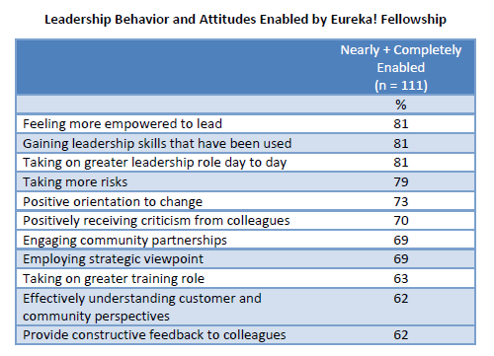
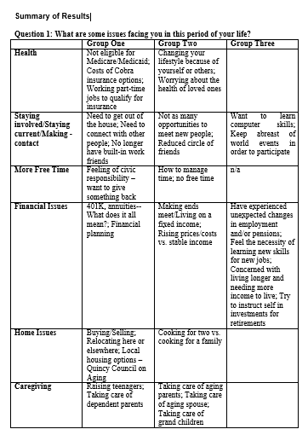
analyzing the data

Slide 49


analyzing the data

Slide 50
Follow these steps for success:
  Goal/Purpose
    What will be done with this information?
  2) Collect
  3) Analyze/Synthesize
  4) Package and Deliver

Slide 51


Slide 52
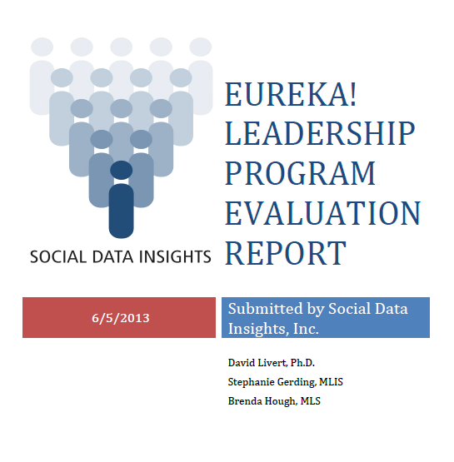
reporting the data
Major themes
Key findings
Recommendations
“Quotes…”

Slide 53
reporting the data
Share it!
“Quotes…”
Key findings
Recommendations
Major themes

Slide 54
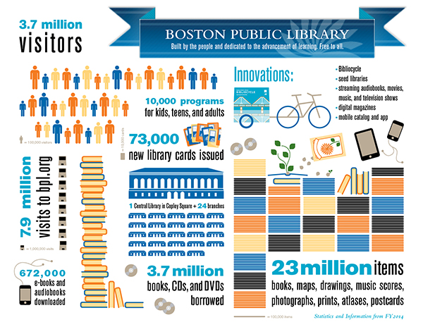

Slide 55


ADAPT
GRANTS

Slide 56

what will you
do NEXT?

Slide 57
Thank You
Stephanie Gerding
Brenda Hough
stephaniegerding@gmail.com
bckhough@gmail.com

Slide 58
Infopeople webinars are supported in part by the U.S. Institute of Museum and Library Services under the provisions of the Library Services and Technology Act, administered in California by the State Librarian. This material is licensed under a Creative Commons 3.0 Share & Share-Alike license. Use of this material should credit the author and funding source.

