Slide 1

DIGITAL BADGING IN THE
LIBRARY COMMUNITY
An InfoPeople Webinar
November 19, 2015
Catherine Hakala-Ausperk
chakalaausperk@gmail.com

Slide 2
In This Webinar….
1
2
3
The Value of Badges
What You Need
How to Create Badges
4
5
How to Send Badges
Sharing Badges

Slide 3
1
Record Professional Growth
Personal Sense of Reward
Create/Spread Your Brand
Recruiting/Job Hunting
Engage Learners
The Value of Badges
“A badge is a symbol or indicator of an accomplishment, skill, quality or interest”.
Badge Alliance

Slide 4

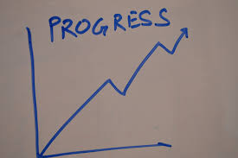
RECORD PROFESSIONAL GROWTH
WHAT’S THE VALUE TO THE RECEIVER?

Slide 5
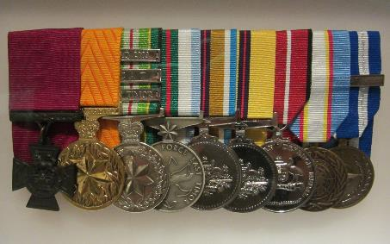
PERSONAL SENSE OF REWARD
Annual Evaluations
Conference Attendance
Professional Involvement
Awards & Honors
Community Involvement
Professional Achievement
Commons.Wikimedia.org

Slide 6
CREATE/SPREAD YOUR BRAND
WHAT’S THE VALUE TO YOUR LIBRARY?

Slide 7
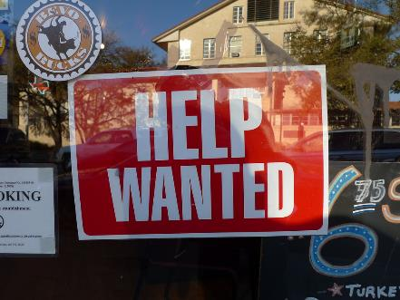
RECRUITING/JOB HUNTING
DEMONSTRATE:
Initiative
Technical Skills
The Big Picture
flickr.com

Slide 8

ENGAGE LEARNERS
EMPHASIZE:
Content
Growth
Competitiveness
Fun
Commons.Wikimedia.org

Slide 9


Question:
Answer in Text Box
How Do You Currently Track, Record and Use Your Professional Development History?

Slide 10
2
A Badge
Email Addresses of Attendees
A Badge “System” or Program
What You Need
“Badges are the new professional currency”.
Mary Ann Nestor, Kent State University

Slide 11

TO CREATE YOUR BADGE
THE BASICS:
A recognizable shape/template
Big enough to say something
Bright!
Pixabay.com

Slide 12

(COPYRIGHT FREE) ARTWORK
REMEMBER:
Create it yourself
Google Images (check usage rights)
Always cite
Flickr
Do some research
Have fun with it
Commons.Wikimedia.org

Slide 13
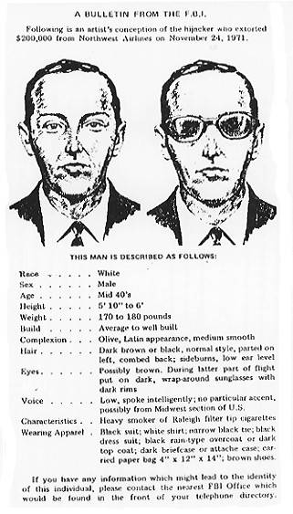
DESCRIPTIONS
DATA:
Title
Date/Time/Hours
Outcome (What Was Learned or Accomplished?
En.wikipedia.org

Slide 14
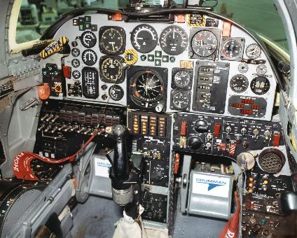
WHAT’S A “BADGE SYSTEM?”
Credly, Mozilla, Open Badge Factory
Pick an easy one
Pick something YOU can manage
Ask for help
En.wikipedia.org

Slide 15

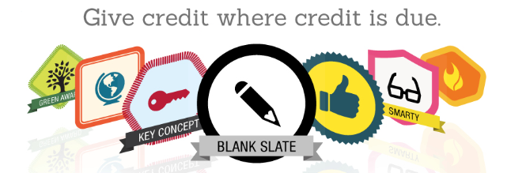
INTRODUCTION TO CREDLY

Slide 16
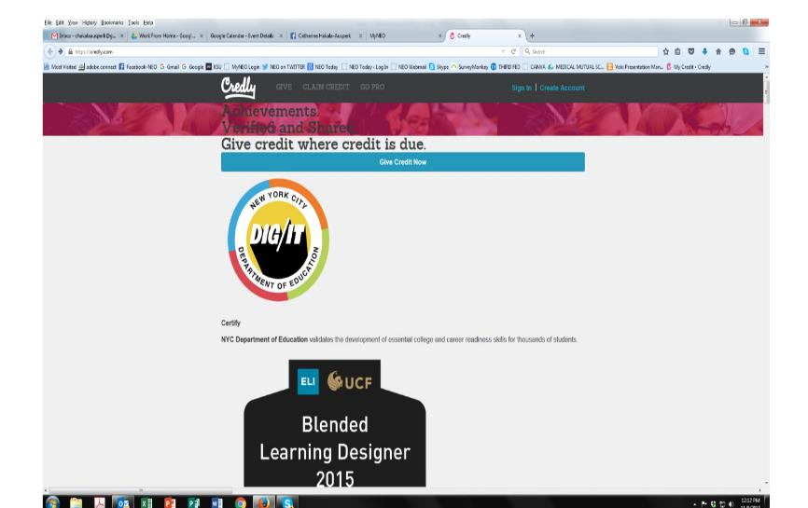

Slide 17
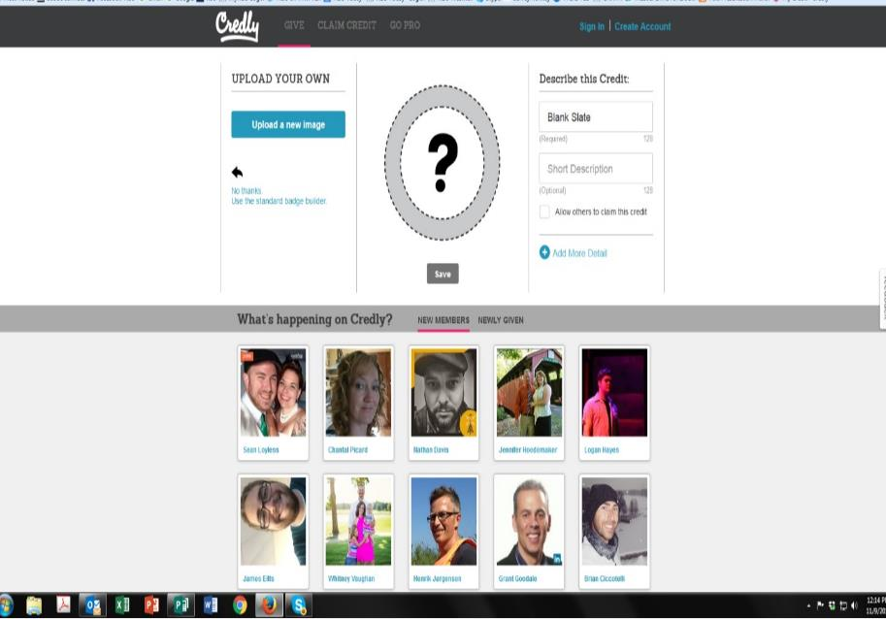

Slide 18
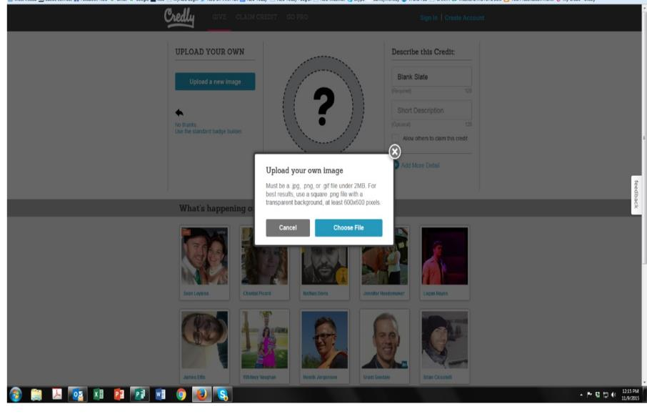

Slide 19
Next, add your description!

Slide 20
Question:
Answer in Text Box
How Many Different People at Your Library Might Be Involved in Issuing Badges?
(Here’s how you can share the job!)

Slide 21
3
Badge Template
Image of Topic
Title and Text
JPEG
How to Create Badges
Badges help “people of all ages gain and display 21st century skills and unlock new career and educational opportunities.
https://wiki.mozilla.org/Badges

Slide 22

BADGE TEMPLATE
GOLDENS 101

Slide 23
BRAND
YOUR
TEMPLATE
GOLDENS 101

Slide 24
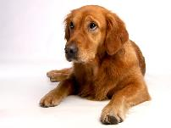
IMAGE OF TOPIC
GOLDENS 101

Slide 25
TITLE AND TEXT
GOLDENS 101
GOLDENS 101

Slide 26
SAVE
(IN FOLDERS!)
GOLDENS 101
GOLDENS 101

Slide 27
Question:
Answer in Text Box
How Might You Get Artwork for Your Badges?

Slide 28
4
Start with an Introductory Letter
Double Check Your Description
Cite Competencies!
Email CSV files
How to Send Badges
“With the right technology, you can make your idea for a badging program for your association a reality.”
www.webcourseworks.com

Slide 29

YOUR INTRODUCTORY LETTER
Writersincharge.com

Slide 30

DOUBLE CHECK EVERYTHING BEFORE SENDING
www.pixabay.com

Slide 31

CITE COMPETENCIES
calicospanish.com

Slide 32

USE CSV FILES FOR LARGER CLASSES
www.enwikipedia.org

Slide 33
Question:
Answer in Text Box
What Competencies Might You Use?

Slide 34
5
Virtual Portfolios
Social Media
Marketing
Sharing Badges
“Instead of gathering, printing and scanning…you can simply link to your badges.”
Mary Ann Nestor, Kent State University

Slide 35

mswordresume.com
WHAT ARE VIRTUAL RESUMES AND PORTFOLIOS?

Slide 36
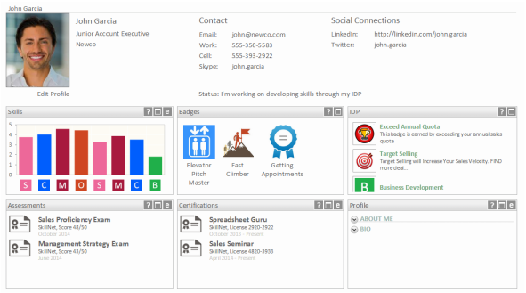
skillnet.net
HOW CAN YOU USE SOCIAL MEDIA TO SHARE BADGES?

Slide 37

Blog.coerll.utexas.edu
WHAT & TO WHOM ARE YOU MARKETING?

Slide 38
Question:
Answer in Text Box
How Will You Share Your Digital Badges?

Slide 39

QUESTIONS?
COMMENTS?
IDEAS?
Thank you!
Catherine Hakala-Ausperk
chakalaausperk@gmail.com

Slide 40
Infopeople webinars are supported in part by the U.S. Institute of Museum and Library Services under the provisions of the Library Services and Technology Act, administered in California by the State Librarian. This material is licensed under a Creative Commons 3.0 Share & Share-Alike license. Use of this material should credit the author and funding source.

