Slide 1
Using Social Media for Readers’ Advisory
Kaite Stover
Director of Readers’ Services
The Kansas City Public Library
An Infopeople Webinar
Thursday, December 3, 2015

Slide 2
Digitally-based Reader’s Advisory
In the most recent Novelist/LJ poll of librarians
93% said their libraries were pursuing digital
RA in these areas:
  Website resources: 79%
  Book recs via social media: 49%
  Readalike recs in catalog: 41%

Slide 3
Digitally-based RA (cont)
  Librarian blogs: 32%
  Patron book ratings: 31%
  Form-based RA: 19%
  Librarian chat on website: 19%
Source: http://lj.libraryjournal.com/2014/02/library-services/the-state-of-readers-advisory/

Slide 4
Adult Social Media Users
71% of internet-using adults are using Facebook,
more women, 31% seniors
52% use multiple platforms
42% use Pinterest, majority women
26% use Instagram, recent increase in young adults 18-29
23% use Twitter, daily use decreasing among adults
Source: 1/9/15--Sept 2014 Pew Survey: http://www.pewinternet.org/2015/01/09/social-media-update-2014/

Slide 5
Readers’ Advisory:
In-person vs. online
The Reader
The Reading
The Conversation
Which is better? Which is your preference?
What is your patrons’ preference? Which one
fits in your workday better?

Slide 6
Golden Rules of Social Media
Communicate and connect
Listen, respond, and observe
Contribute value
Share, thank, credit, & collaborate
Be real, be nice, be honest
Words vs. numbers
Time and patience
Sources: http://www.lifehack.org/articles/work/5-golden-rules-of-social-media-marketing.html
https://gigaom.com/2009/05/26/10-golden-rules-of-social-media/

Slide 7
Different Platforms,
Different RA uses
  Facebook
  Twitter
  Goodreads
  Pinterest, Tumblr, Instagram, and all the others we will likely run out of time for

Slide 8
How Do We Get Patrons to Interact?
Phrasing the perfect post
Vote: early & often
Recognition
Crowdsourcing
Start conversations with patrons

Slide 9
Social Media Policies
Library’s social media mission
Privacy & patrons
Content & copyright
Social media and staff

Slide 10

Readers’ Advisory on

Slide 11
What is Facebook?
Free social networking website
Users register to create profiles
Send messages,
Create events, groups, fan/business pages
Available in 37 languages
Presence technology
Created in 2004
For additional information watch The Social Network (PG-13)

Slide 12
Facebook User/Reader Friendly
71% of internet-using adults
31% of those are seniors
Conversation/connections/community

Slide 13
Reader’s Advisory on Facebook
Ask a question
Offer a “bookmatch”
Civic engagement & reading
Event (and reading) promotion
Engagement and algorithms

Slide 14
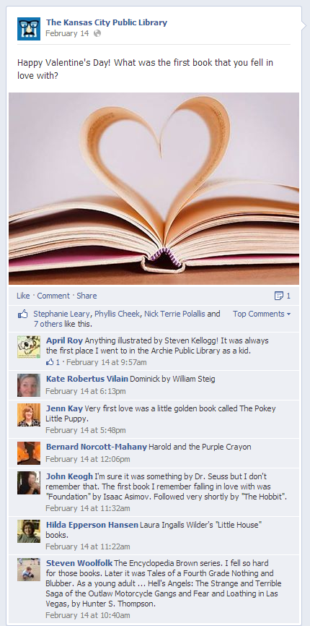
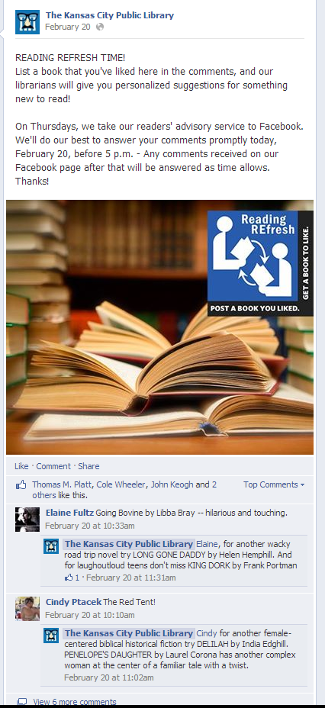
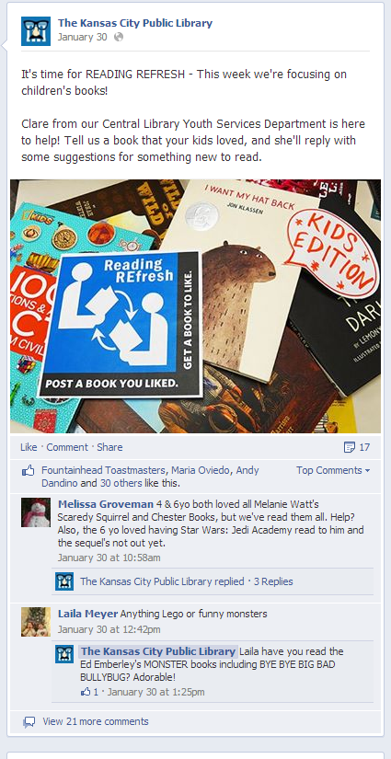

Slide 15
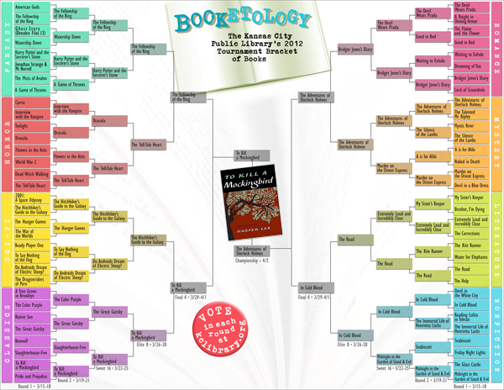
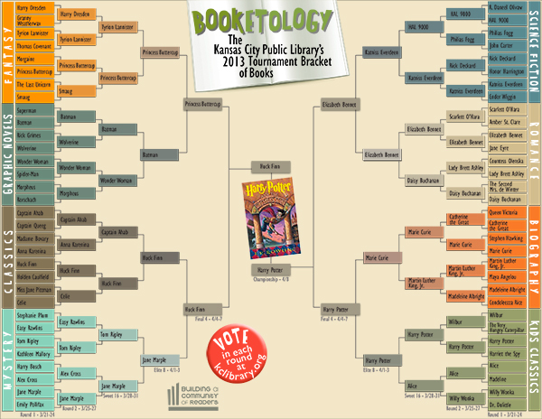
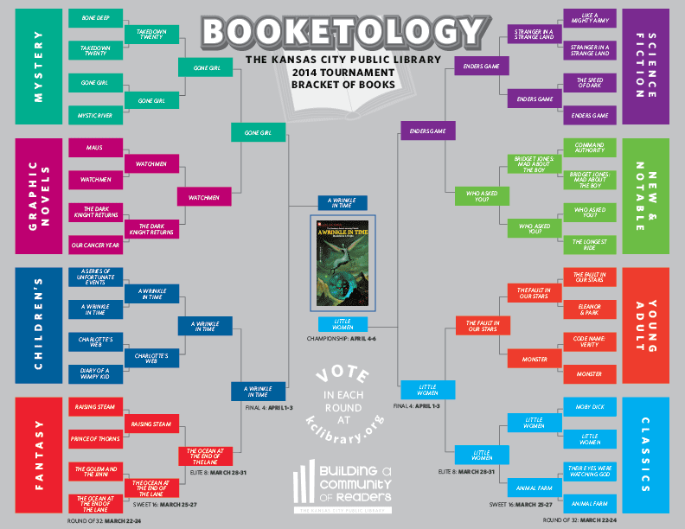

Slide 16
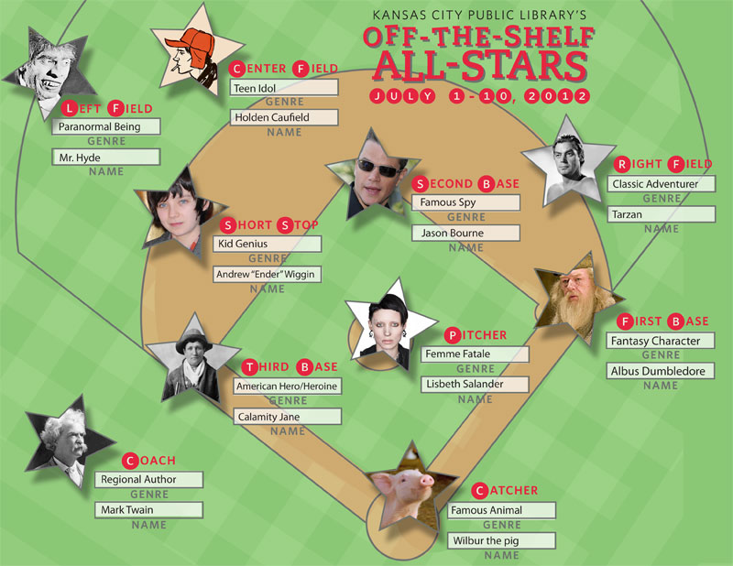


Slide 17
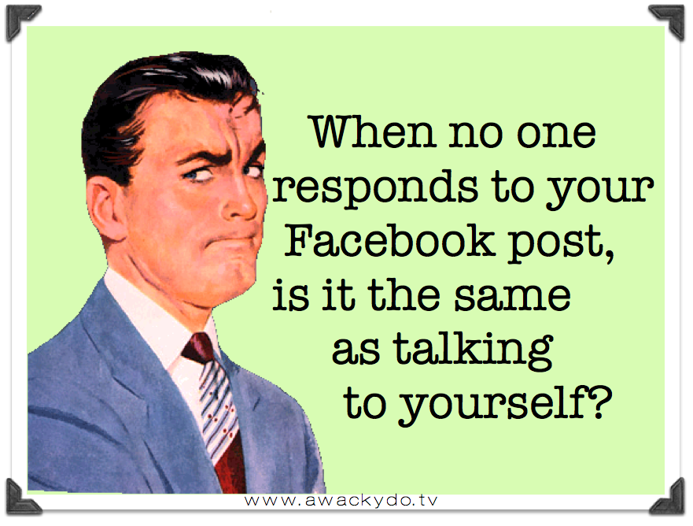

Slide 18
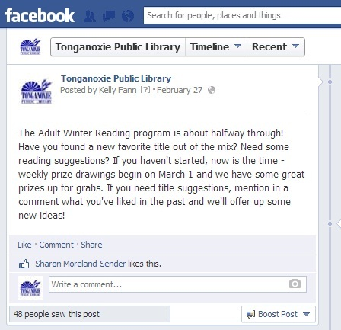

Slide 19
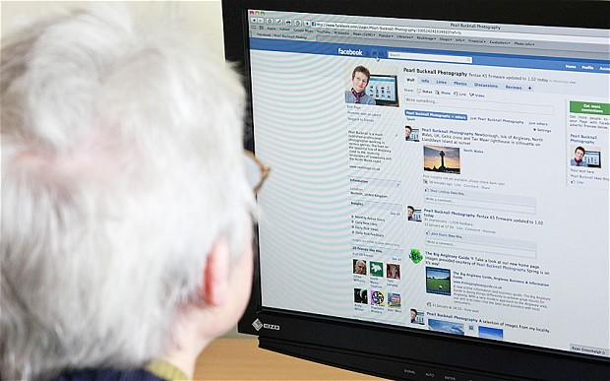
http://i.telegraph.co.uk/multimedia/archive/02489/facebook-keeps-pen_2489492b.jpg

Slide 20
Who’s doing it right?
Seattle Public Library
  RA Librarian Party
  Fun questions
Darien Library
  All sorts of cool stuff (steal these ideas)
Cuyahoga Public Library
  Night Owls

Slide 21
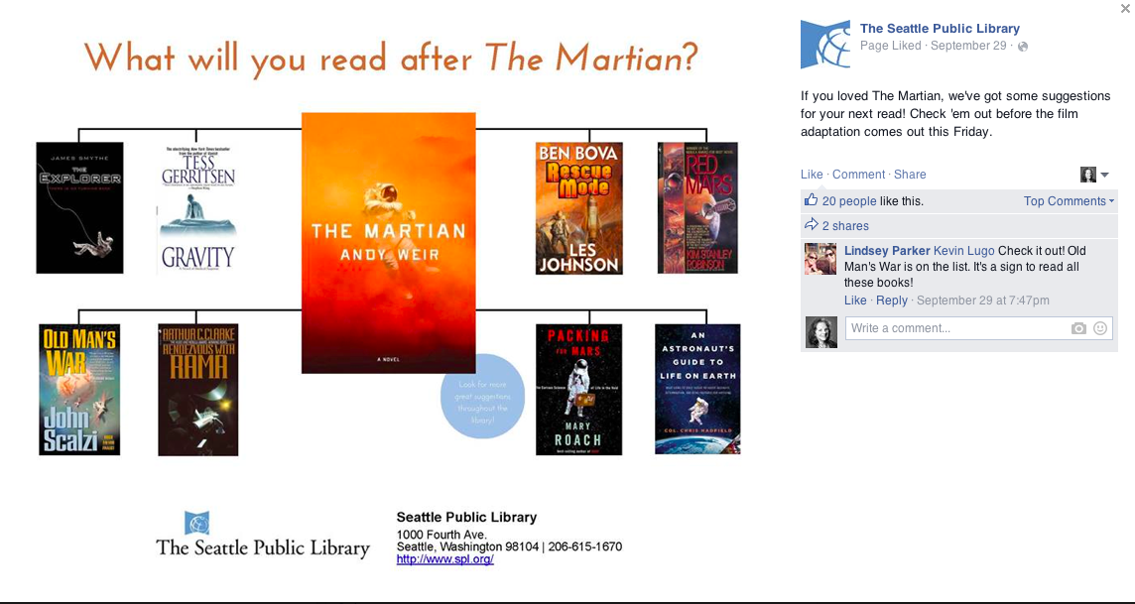

Slide 22
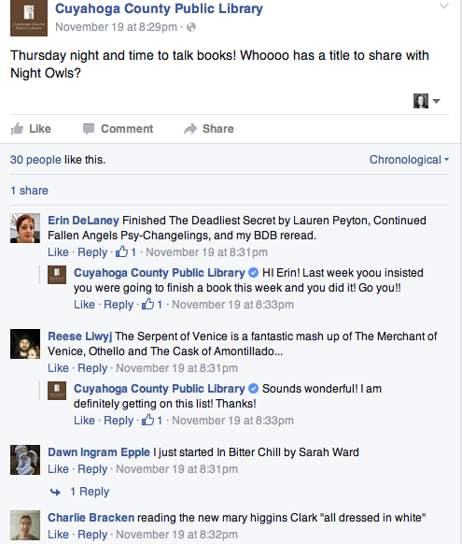
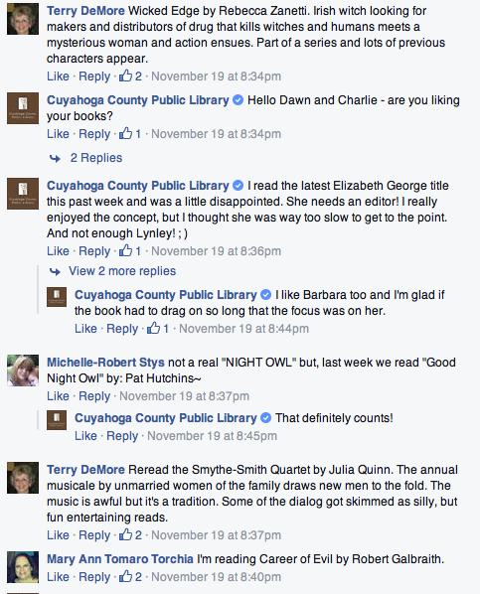

Slide 23

Readers’ Advisory on

Slide 24
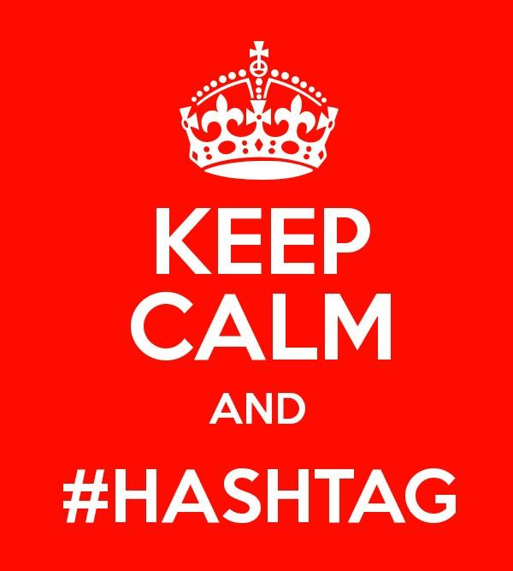
What is Twitter?
Short 140-character messages
People who like the same stuff sharing short conversations & breaking news
Especially younger adults, people in cities, non-whites
And authors, publishers, journalists, bloggers
@mentions, ReTweets, #hashtags…

Slide 25
Twitter User/Reader Friendly
52% of online adults are using multiple platforms (Twitter is probably one of those platforms)
Short, sweet, high concept
Funny, timely, aware

Slide 26
Reader’s Advisory on Twitter
Network of librarians for real-time discussion and suggestions.
Live chats: #readadv, #ewgc, #titletalk
#fridayreads
#BoD: bookoftheday
Integrate with Facebook, Instagram, Tumblr, Pinterest

Slide 27
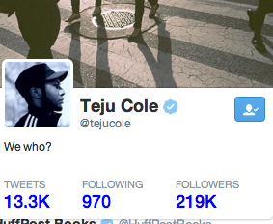
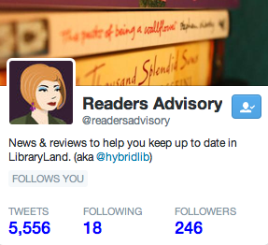

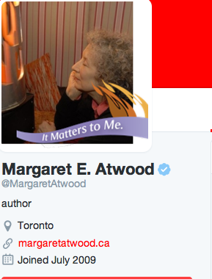
More Bookish People to Follow:
authors
publishers
editors
associations
bookshops
bloggers
reviewers
readers
librarians
your local author community

Slide 28
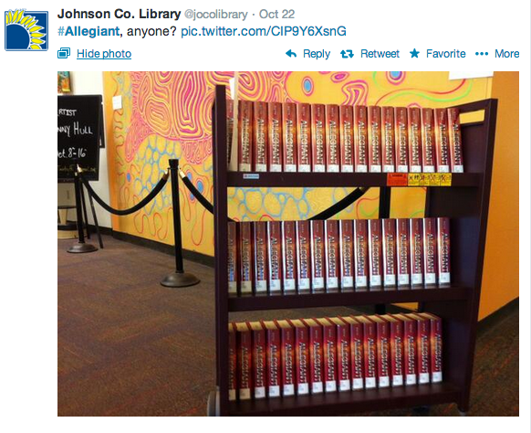
Starting slow and small:
New releases / book news / reviews
Book-to-Movie trailers
“Just ordered” / “Just arrived”
#FollowFriday, #FridayReads, #ThrowbackThursday
Ideas where to find stuff:
The Millions
The Early Word
Entertainment Weekly’s Shelf Life
Publisher’s Weekly
NPR Books
Huffington Post Books
Buzzfeed Books
Book Riot
Bookish
bookish people you follow on Twitter)

Slide 29
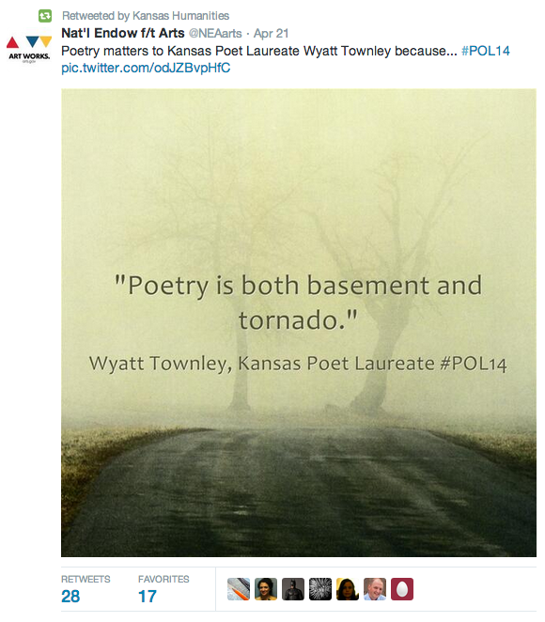
Keep it simple and lively:
Hidden treasures from the catalog
Bookish quotes
Staff Picks
Open ended questions:
  “What’s the first book that made you love books?”
  “Give a shoutout to your favorite bookish canine.”
  “Versus”
  “What if… ?”
Answer bookish questions from your feed

Slide 30
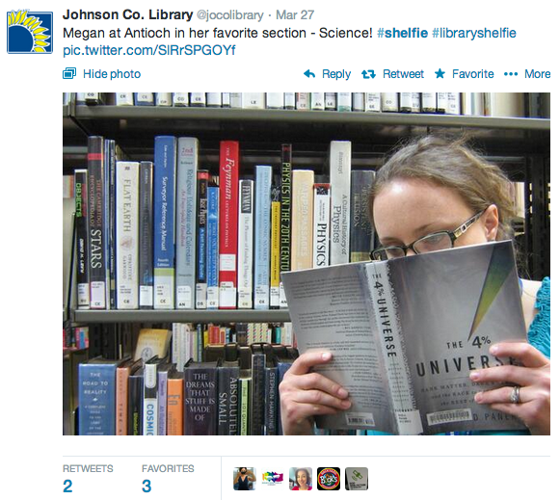
Up Your Game:
“Tweet us 3 titles and we’ll tweet 3 back”
  (Or offer to recommend books based just on their twitter bio!)
#Shelfies
“My Ideal Bookshelf” & other staff lists
Book Math

Slide 31
Who’s doing it right?
Seattle Public Library (they do everything right)
  @SPLBuzz
Lawrence (KS) Public Library
  @lawrencelibrary
The New York Public Library (of course)
  @nypl
Homewood (AL) Public Library
  @WeKnowBooksETC

Slide 32
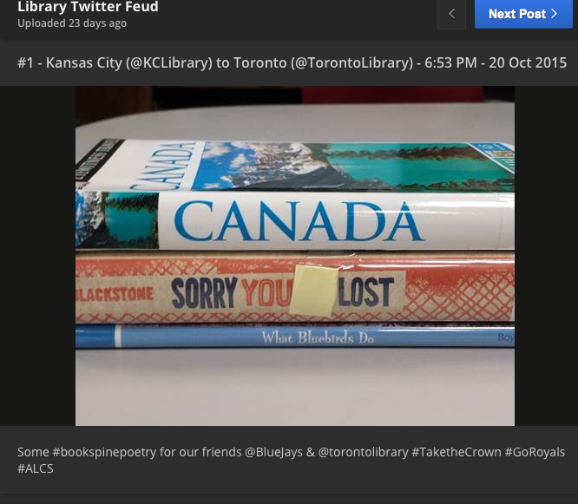

Slide 33
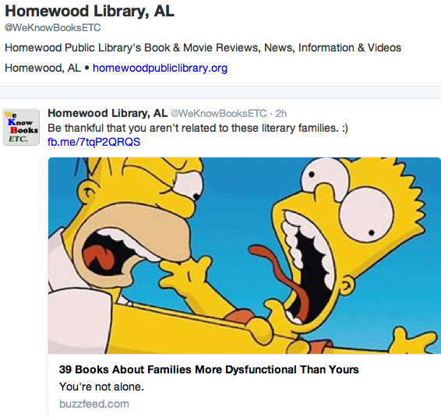

Slide 34

Readers’ Advisory on

Slide 35
What is Goodreads?
Goodreads is the world’s largest site for readers and book recommendations. Our mission is to help people find and share books they love. Goodreads launched in January 2007.

Slide 36
Goodreads User/Reader Friendly
Serious reader seeks books for not-so-serious reading. Format agnostic
Crowd sourced tagging

Slide 37
Reader’s Advisory on Goodreads
Feature:
Best books and staff picks
Readalikes and reading lists
Books recommended by patrons
New acquisitions
Archived lists for book groups
Polls

Slide 38
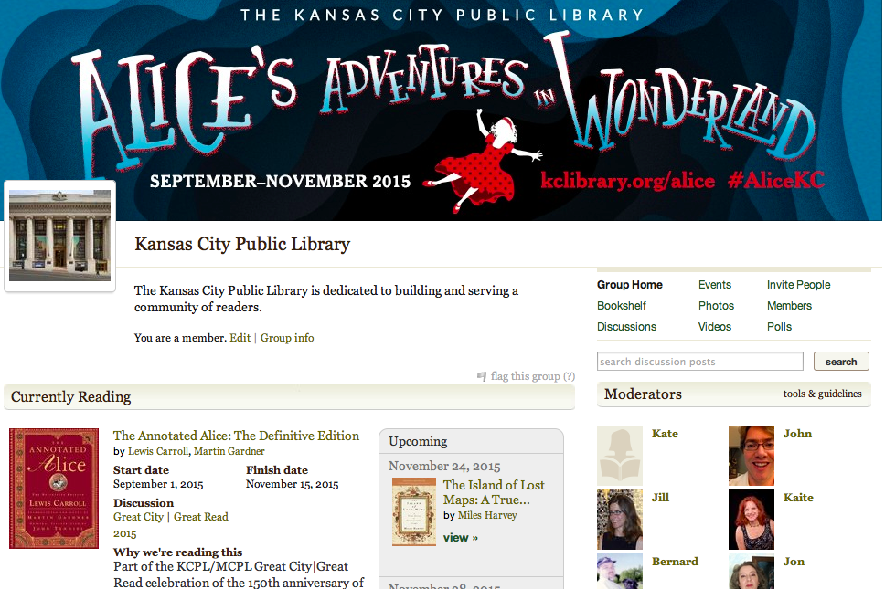

Slide 39
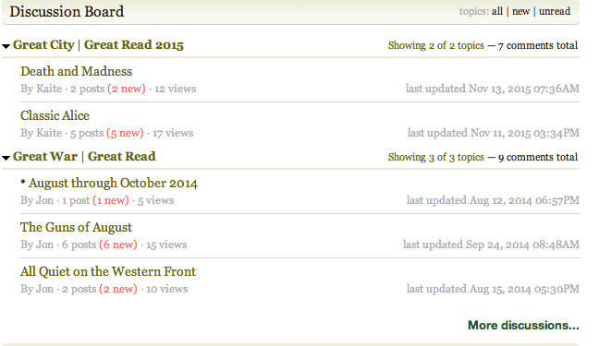
Discussion Boards

Slide 40
Who’s doing it right?
Huntsville-Madison County (AL) Public Library
Mid-Continent (MO) Public Library
Salt Lake County (UT) Library Services
Anne Arundel County (MD) Public Library

Slide 41
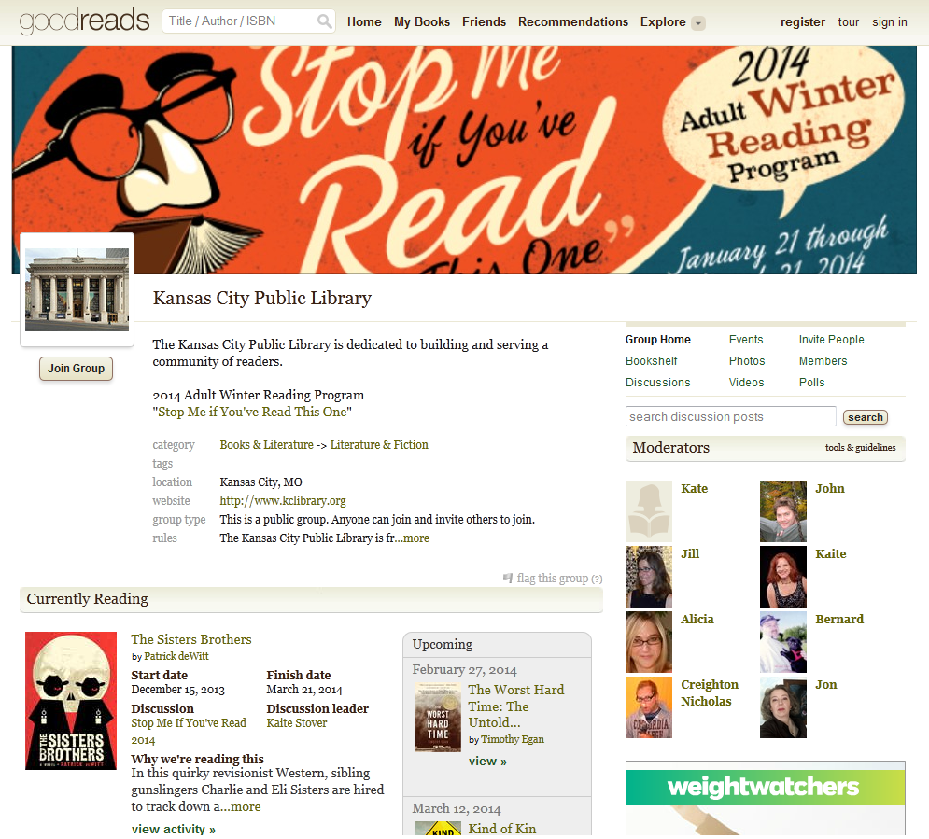

Slide 42
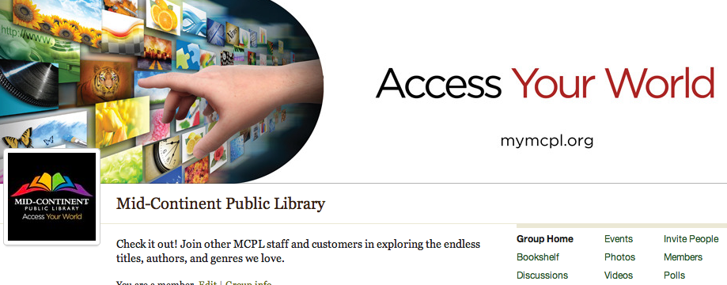
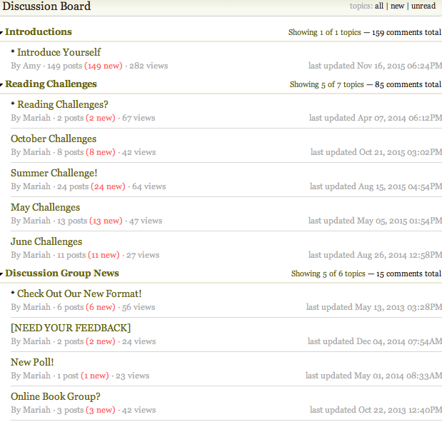

Slide 43

Readers’ Advisory on

Slide 44
What is Pinterest?
Visual bookmarking tool/image collecting site for your interests, projects, hobbies, “good intentions,”etc. Pinterest launched in 2010.
Pinterest is the Internet’s most glamorous wormhole.

Slide 45
Pinterest User/Reader Friendly
WOMEN who read/craft/cook/bake/sew/travel/garden/party/get married (better than you—kidding)
Promote books that speak to those interests

Slide 46
Reader’s Advisory on Pinterest
Feature:
Best books and staff picks
Readalikes and reading lists
Books recommended by patrons
New acquisitions
Collaborate on boards with patrons and other libraries

Slide 47
Who’s doing it right?
New York Public Library
Cedar City (UT) Public Library
Allen County (IN) Public Library
Manhattan (KS) Public Library
Park Ridge (IL) Public Library

Slide 48
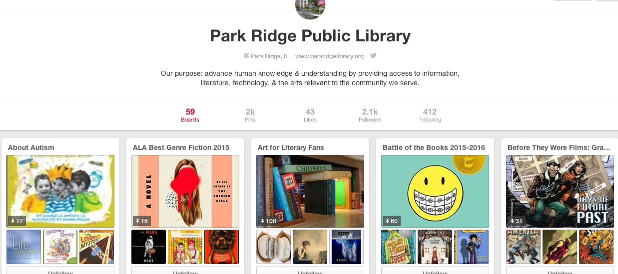

Slide 49
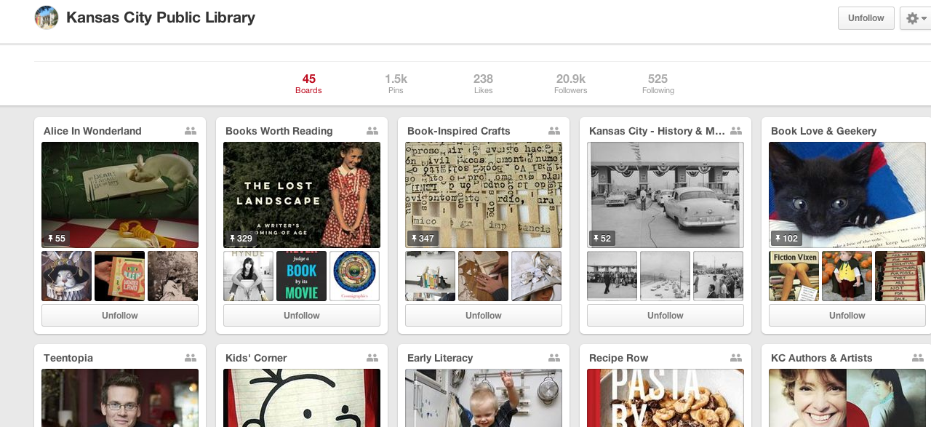

Slide 50
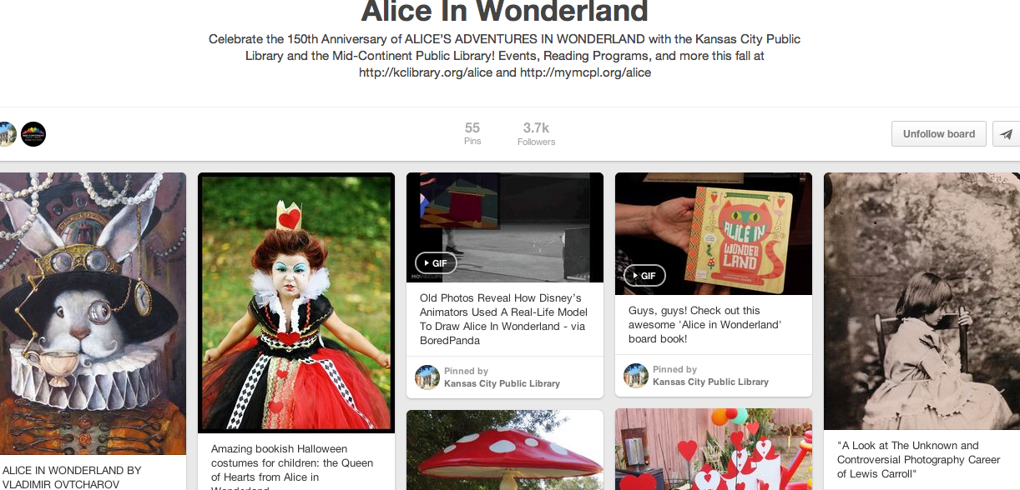

Slide 51
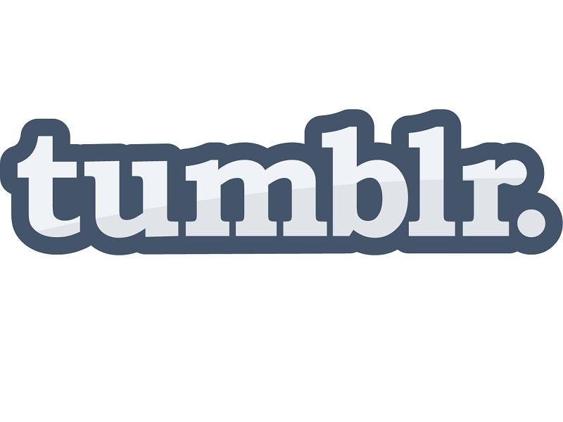
Readers’ Advisory on

Slide 52
What is Tumblr?
the boring answer:
a microblogging platform and social media site that supports multimedia options.
But what is tumblr *really*?

Slide 53
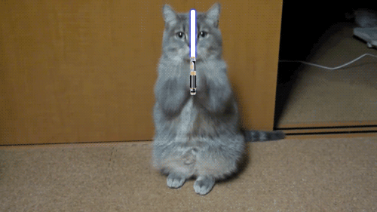
But really, Tumblr is…
#CAT GIFS

Slide 54
Tumblr User/Reader Friendly
About half of regular Tumblr users are 16-24;
users spend more total time on the site than
other social networks*
Visual format great for reader’s advisory
Flowcharts
Stephanie Anderson’s Tumblr for Reader’s Advisory
Libraries and Librarians on Tumblr
Library Journal’s Tumblarian 101
Display ideas at libdisplays.tumblr.com
*Source: http://www.businessinsider.com/tumblr-and-social-media-demographics-2013-12

Slide 55
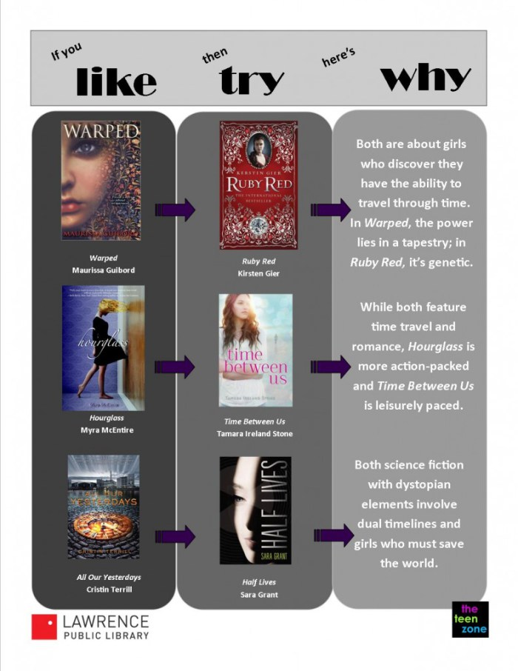
If You Like > Try > Why
via Molly Wetta of Wrapped up in Books

Slide 56
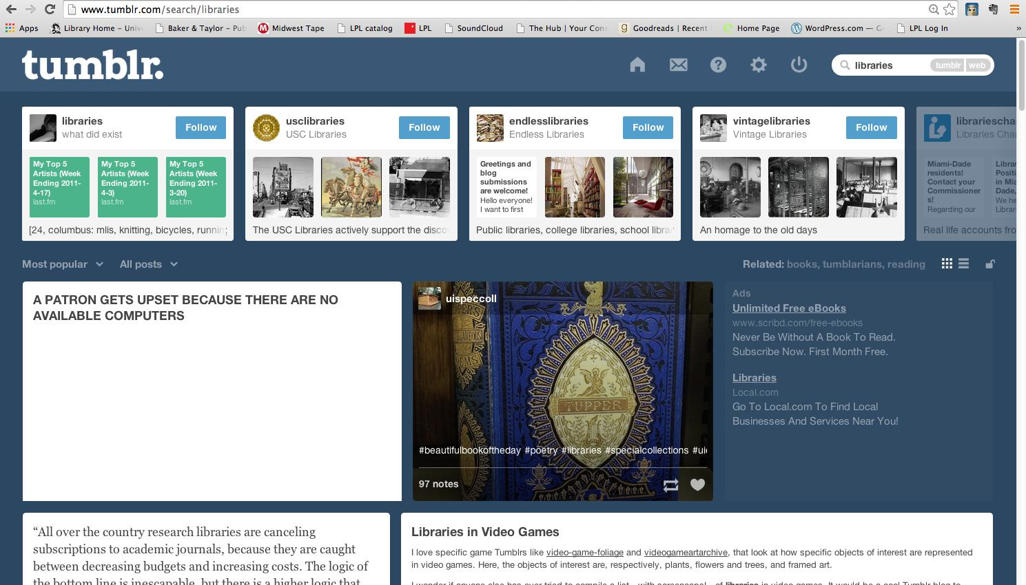
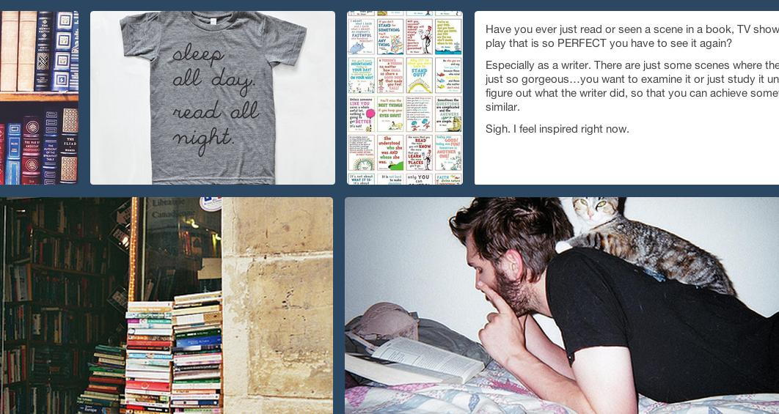
Tumblr is…
#READING
#BOOKS
#LIBRARIES

Slide 57
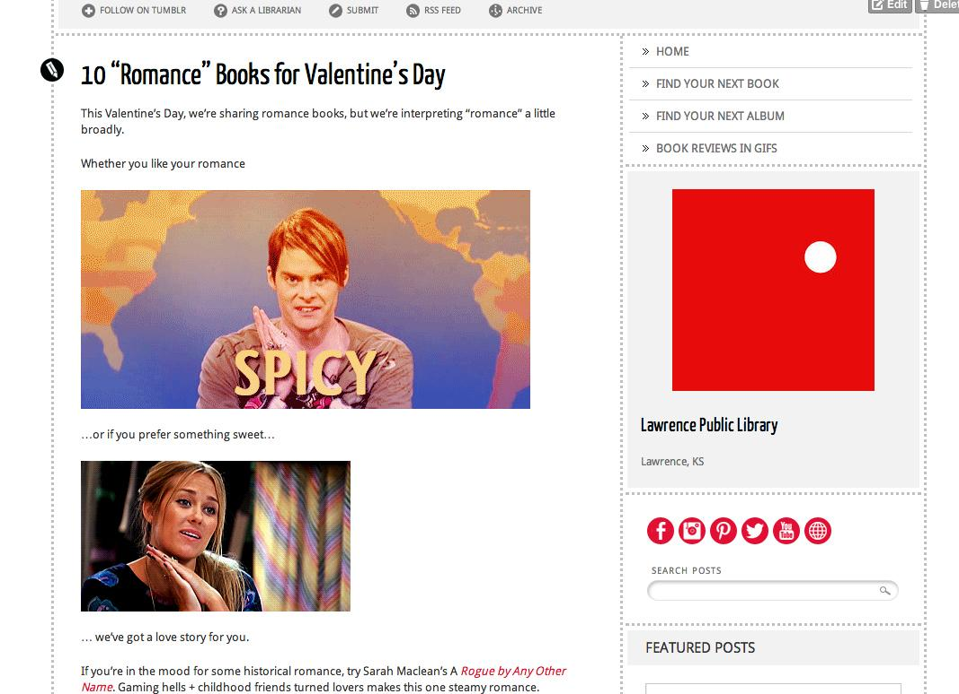
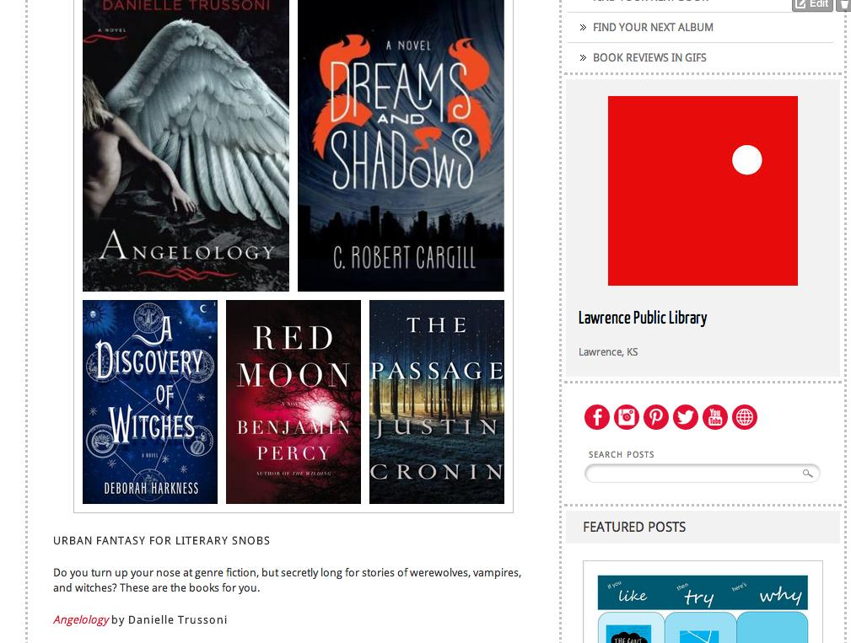
Booklists

Slide 58
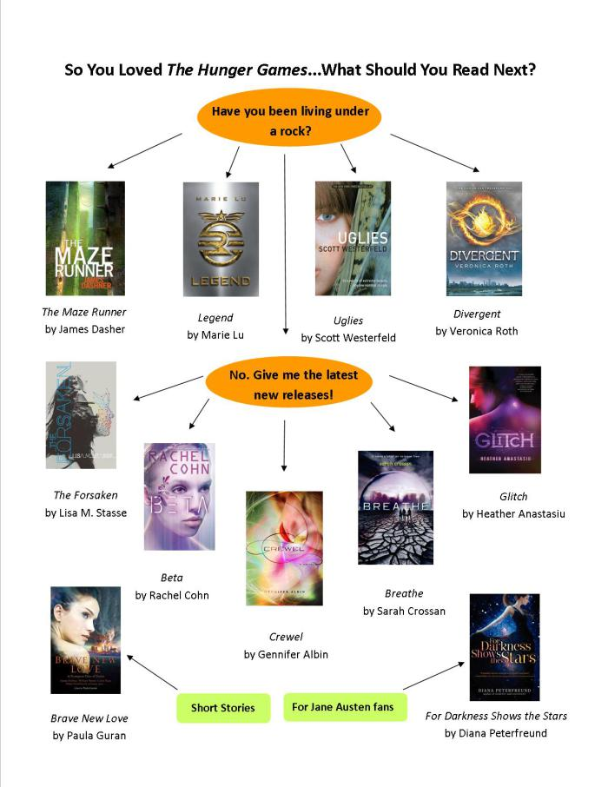
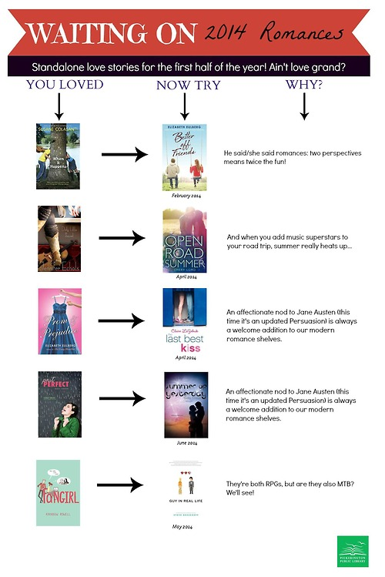
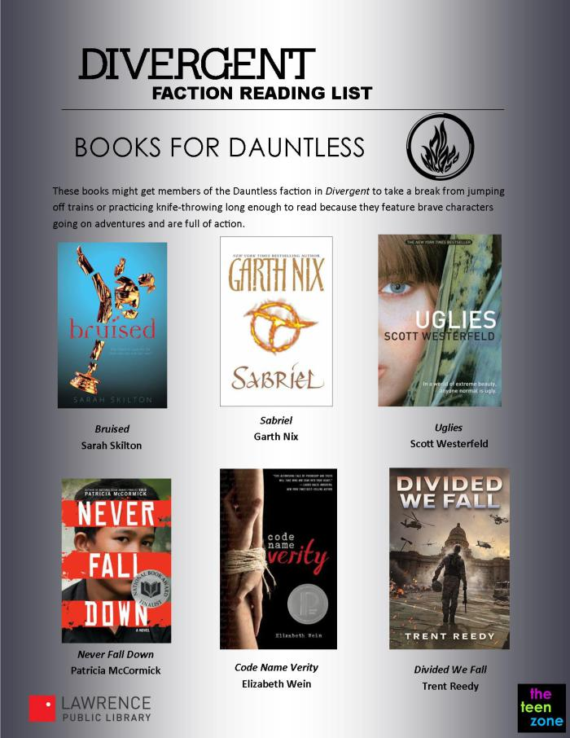
Flowcharts

Slide 59
Who’s doing it right?
Darien (CT) Library
Lawrence (KS) Public Library
Queens (NY) Library
Toronto Public Library

Slide 60

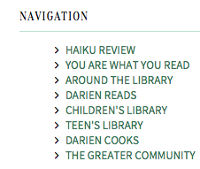
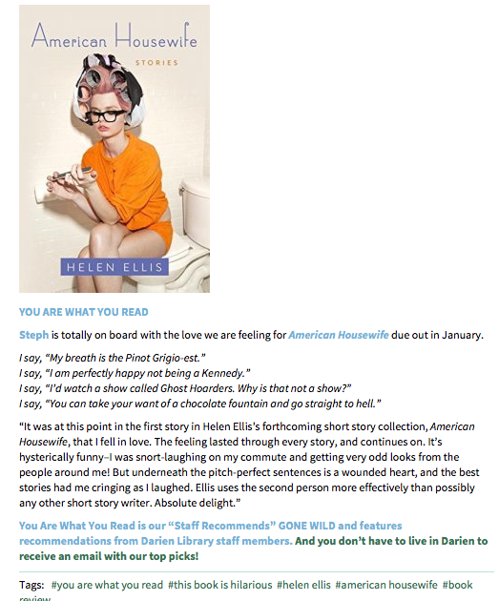

Slide 61
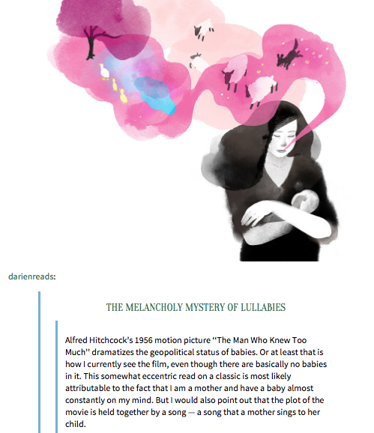

Slide 62
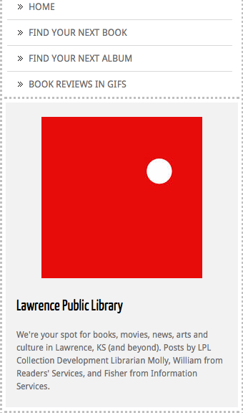
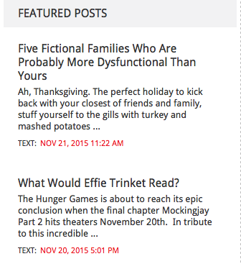

Slide 63
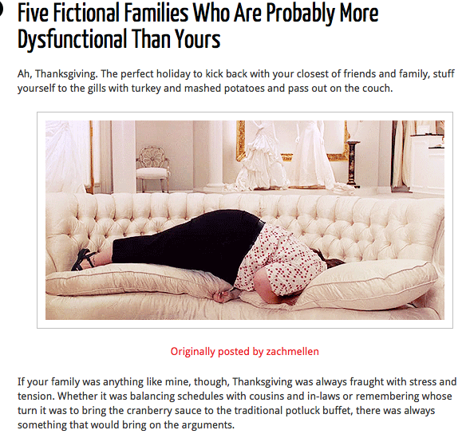

Slide 64
What is Instagram?
Online mobile photo-sharing app. Works best on mobile devices.
Visual tweeting

Slide 65
Instagram User/Reader Friendly
Instagram users are the youngest of all social media users and this platform is growing the quickest*
Highly visual with snappy captions & quirky hashtags
*baddiewinkle

Slide 66
Reader’s Advisory on Instagram
Feature:
Best books and staff picks
Readalikes and reading lists
Books recommended by patrons
New acquisitions
Archived lists for book groups
Polls

Slide 67
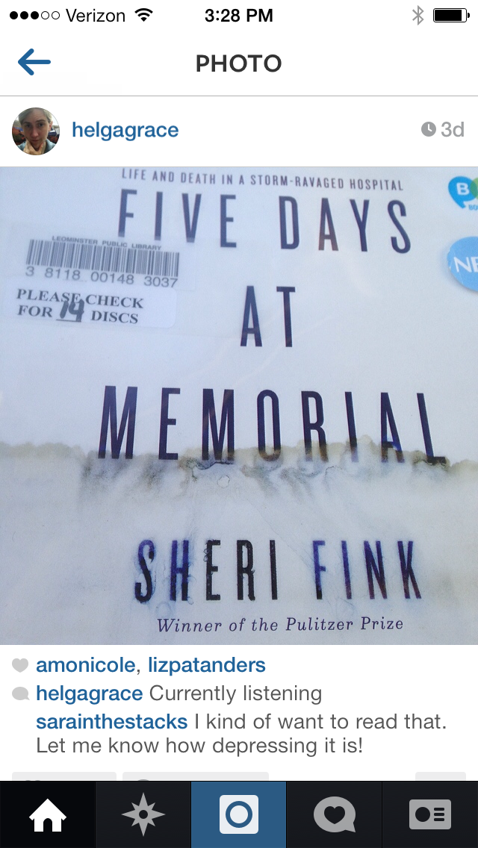
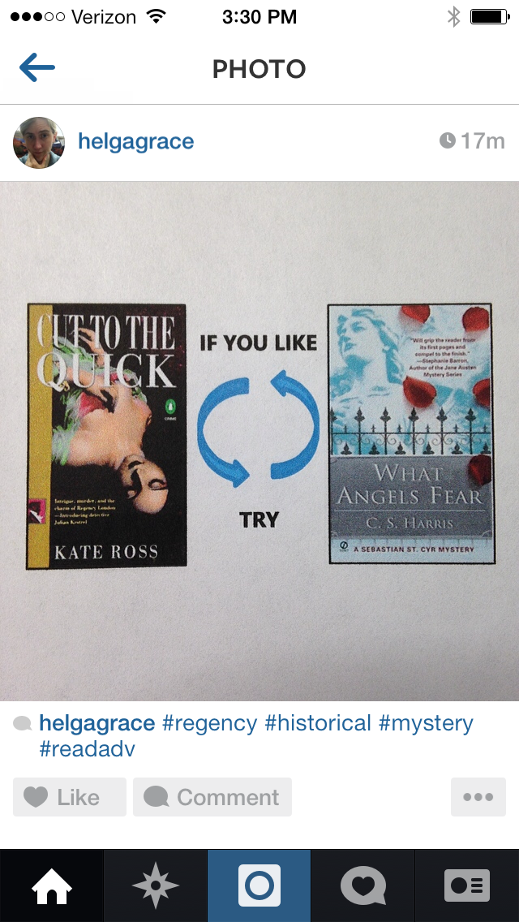
More pictures, less typing
Reading now/listening now
Book of the Day
Picture of library copy, can include link to catalog
Readalike recommendations

Slide 68
Who’s doing it right? Publishers
Penguin Random House Library Marketing
Touchstone Books
Viking Books
Picador Books
Chronicle Books
Akashic Books
Harper Perennial
St Martins Press
Riverhead Books

Slide 69
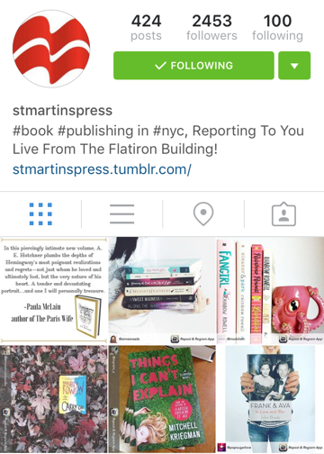
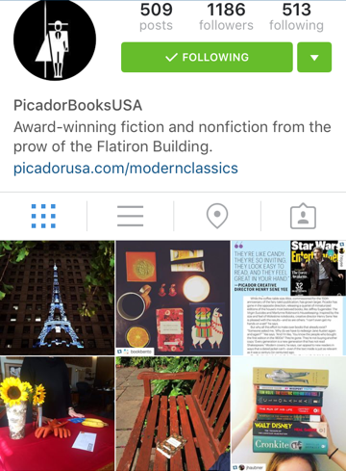

Slide 70


Slide 71
Content, Training, & Staff
Platform and Best Fit
Creating Content
Staff: Training & Engagement

Slide 72
Want a handout? Go here:
kaitestover.pbworks.com/
Professional Presentations →2015 InfoPeople Webinar: Using Social Media for Readers’ Advisory

Slide 73
Kudos, salaams, & highest of 5s:
Kelly Fann, Lawrence (KS) Public Library
Naphtali Faris, Kansas City Public Library
Amy Fisher, Mid-Continent (MO) Public Library
Mariah Hone, Mid-Continent (MO) Public Library
Anna Mickelson, Springfield, MA
Rachel Smalter-Hall, Book Riot
Molly Wetta, Lawrence (KS) Public Library
Thank you.
Kaite Stover: kaitestover@gmail.com

Slide 74
Infopeople webinars are supported in part by the U.S. Institute of Museum and Library Services under the provisions of the Library Services and Technology Act, administered in California by the State Librarian. This material is licensed under a Creative Commons 3.0 Share & Share-Alike license. Use of this material should credit the author and funding source.

