Slide 1
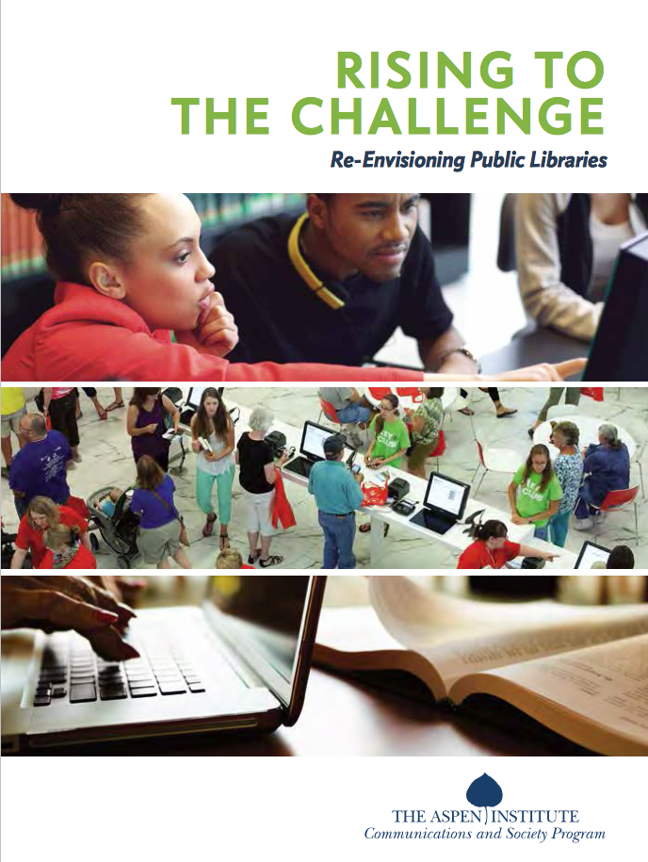
Aspen Institute’s Rising to the Challenge:
Re-envisioning Public Libraries
An Infopeople Webinar
with
Susan Hildreth, Aspen Fellow
January 26, 2016
Notes:
Does this look familiar? Some of you have seen this report.
For others, it’s your first peek at a groundbreaking initiative to change the public’s perception of public libraries.
It’s a national effort to position libraries as essential to their communities and to the well-being of our democracy in the 21st century.
It’s getting a lot of attention and one of the reasons is because it was produced by the Aspen Institute, which has an international reputation as an educational and policy organization – funded by Gates.
If you get the Aspen Institute’s attention, it signals that you have an important role to play in making a better society and a better world.
And what’s more important than public libraries? We know we can change the world.

Slide 2
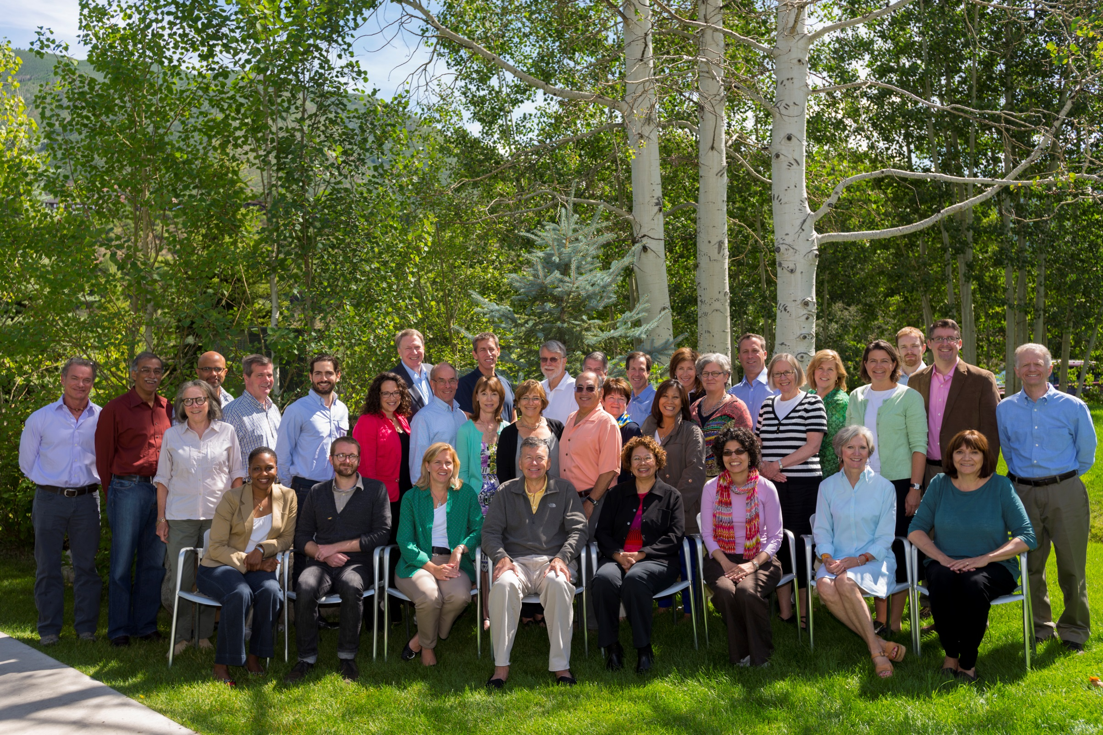
With support from the Bill & Melinda Gates Foundation, the Aspen Institute Dialogue on Public Libraries working group came together to craft and articulate a shared vision for the future of public libraries.
The working group included:
leaders from the library field,
executives from businesses,
officials from various levels of government,
community development organizations,
and education experts.
Notes:
Talk about my personal participation, became an Aspen Fellow for Communications and Society program to work on deployment of report
The Dialogue’s work was informed by the 35-member working group that met twice in the project’s first year to examine the evolving societal role of the public library, and to shape and advance a perspective that re-envisions U.S. public libraries for the future. The Dialogue working group also convened roundtable focus group and preview sessions with board members and other thought leaders from the Public Library Association (PLA), Association for Rural and Small Libraries (ARSL), the Chief Officers of State Library Agencies (COSLA), the American Library Association (ALA) and the International City/ County Management Association (ICMA). Participants in these gatherings provided illuminating insights into opportunities and challenges inherent in the vision.

Slide 3

A networked world
Notes:
When public libraries got their start, we were seeking to fill a void in our communities – of literacy, culture and education.
Today’s networked world is one where information is in the palm of your hand. The spread of powerful digital information and communication technologies has touched every aspect of daily life.
The Internet has changed the game. What’s needed now is digital literacy -- the ability to find, evaluate and use information.
Access to digital networks and digital literacy skills are essential to modern life.
In fact, public libraries are already at the forefront of tackling the critical need for these skills by providing access to
online information and supporting digital literacy.
To meet the needs of individuals, the community and the nation in this new knowledge society, public libraries
must be re-invented for a networked world.

Slide 4
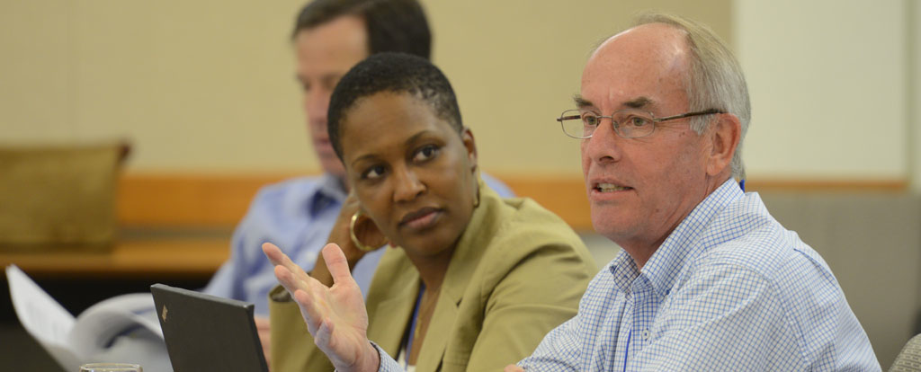
Gateway to lifelong learning
“Persistent education and learning are the reality …
the library as people, place and platform is the new knowledge institution that can serve all those needs.”
-LEE RAINIE
Notes:
This is Lee Rainie – Director, Pew Research Center Internet Project, member of the Aspen working group
He says, “No longer a nice-to-have amenity, the public library is a key partner in sustaining the educational,
economic and civic health of the community during a time of dramatic change.”
Public libraries inspire Learning and empower people of all ages.
Now is the time to focus on how important libraries are to education and the difference we make in our communities.

Slide 5
People
Place
Platform
Notes:
Going to do a tour of this important report – main sections include library assets, strategies for success, actions steps for a variety of stakeholders and an action guide
What are our strengths, the things of value that are unique to us? They are: People, Place and Platform.
So, what does that mean? So let’s break that down a bit.

Slide 6

LIBRARY AS PEOPLE
“Take away my people, but leave my factories, and soon grass will grow on the factory floors. Take away my factories, but leave my people, and soon we will have a new and better factory.”
Andrew Carnegie
Notes:
The public library is a gathering place for civic engagement, fostering new relationships and strengthening the social capital of the community.
Librarians and library staff must be actively engaged in the community.
They connect individuals to a vast array of local and national resources and serve as neutral conveners to facilitate community conversations and consensus.
They facilitate learning and creation for children and adults alike.
We’re high-tech and high touch representing the best combination of technology and skilled, educated people.

Slide 7

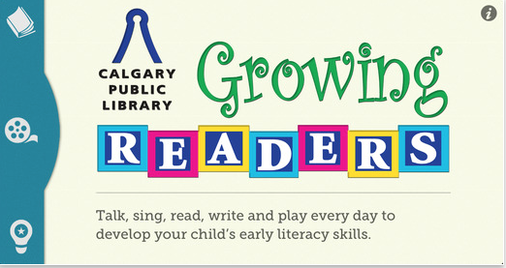

Notes:
The library as people focuses on the library’s role in building human capital as well as building relationships and knowledge networks in the community.
People are at the center of the library’s mission.
The library is a facilitator of human connection and understanding. Library staff are making sure that
community members are reaching their goals as well as connecting community members with similar interests and concerns.
Think of it as match.com for libraries and the people we serve.
Here’s an example. Grow a Reader Early Literacy App Calgary Public Library CA takes fun, interactive contents from popular early childhood literacy programs and delivers it to parents via their mobile devices.
Its goal is to encourage parents to interact with their children and focus on the 5 building blocks for language and reading development. What are they? Talking, singing, reading, writing, playing. My challenge to you is to identify Humboldt County Library examples!

Slide 8
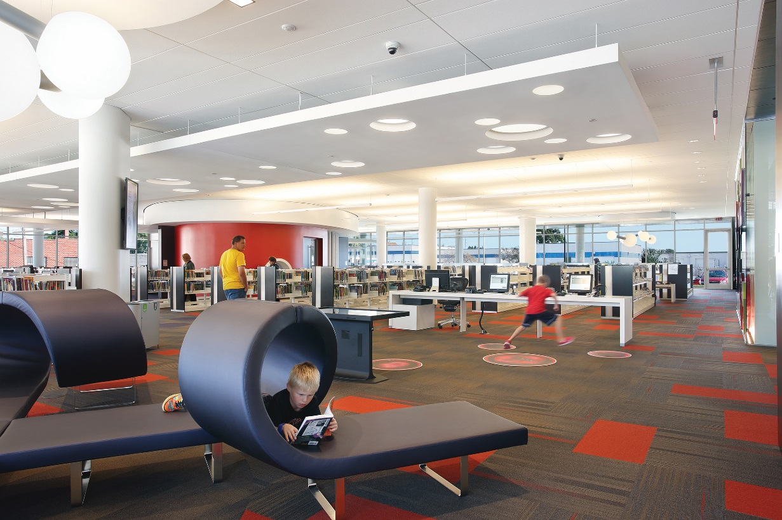
LIBRARY AS PLACE
“The public library is first and foremost a place…that promotes development in society. It is the family room of a community.”
Akhtar Badshah
Cedar Rapids Public Library
Notes:
The public library is a welcoming space for a wide range of purposes—reading, communicating, learning, playing, meeting and getting business done.
Its design recognizes that people aren’t just consumers of content but creators as well.
Its physical presence provides an anchor for economic development and neighborhood revitalization, and helps to strengthen social bonds, community identity and civic pride. In our rural communities the bookmobile often represents the library as the mobile hot spot!
The library is also a virtual space where individuals can gain access to information, resources and all the rich experiences the library offers.
In the creative design of its physical and virtual spaces the public library defines what makes a great public space.

Slide 9
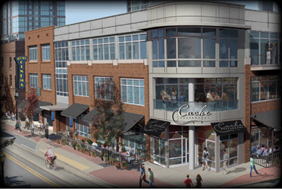
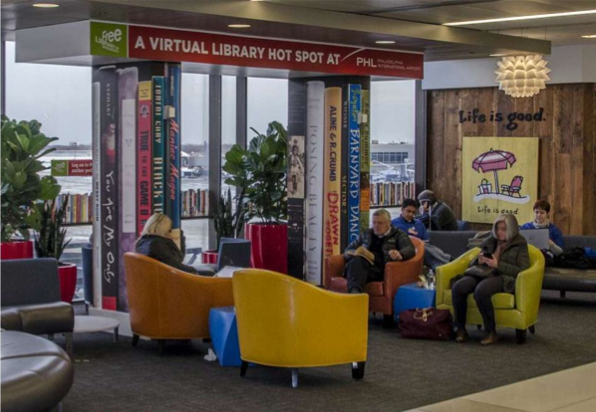
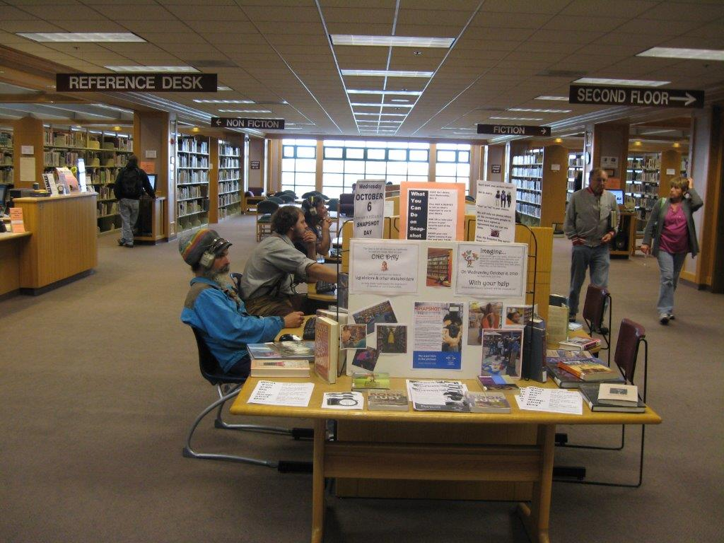
Philadelphia Free Library Virtual Branch at Airport
Ron Robinson Theater,
Central Arkansas Library System
Humboldt County Main Library
Notes:
Library = Community Hub
Today’s library is both a physical and virtual place, but it continues to be the physical presence of the library that anchors it most firmly in the community.
Here’s some examples
Ron Robinson Theater, part of Central Arkansas Library System’s main library – 315 seat multi use venue with state of the art technology offering films, live theater and concerts.
Philadelphia Free Library partnered with Airport Authority to open a virtual library at the International airport.
Ron Robinson Theater, Central Arkansas Library System
Philadelphia Free Library Virtual Branch at Airport
There is lots of activity going on at the Main Library – celebrating its 20th anniversary – and I am sure this is just a sample of all the activities here and in the branches.

Slide 10
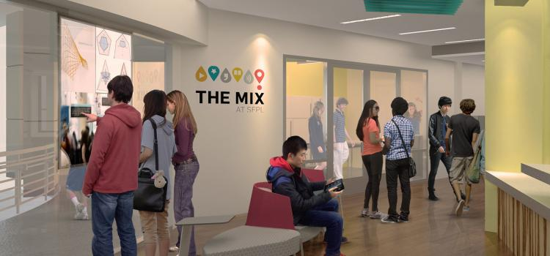
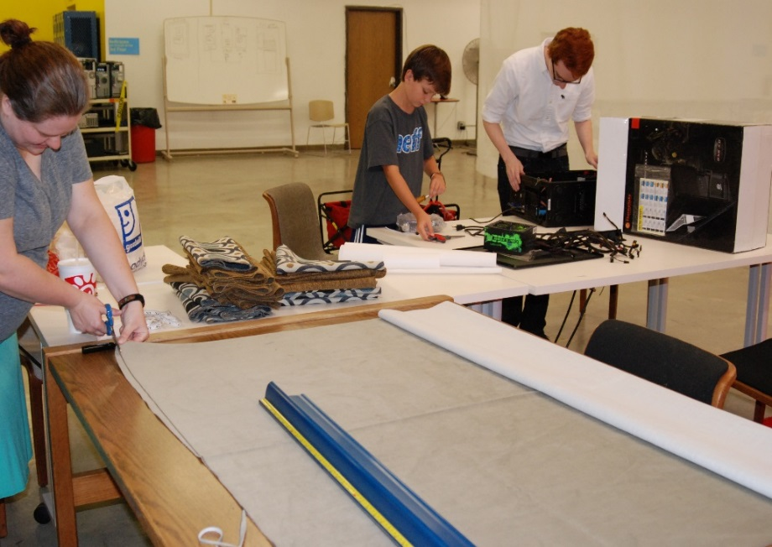
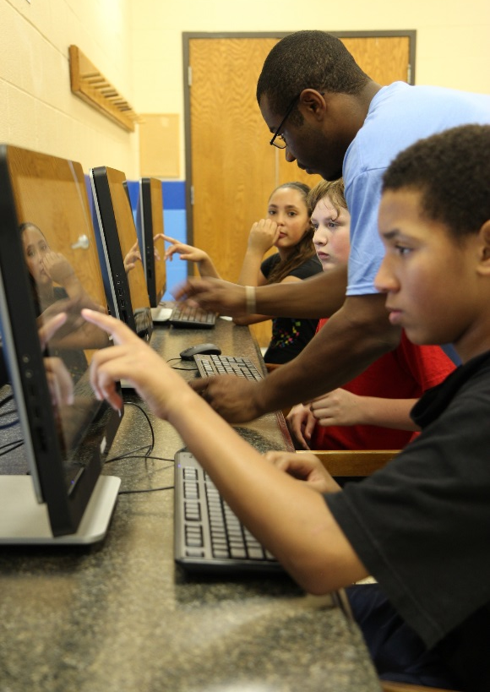
LIBRARY AS PLATFORM
THE MIX at San Francisco Public Library
Nashville Public Library Makerspace
Library computers at community centers
Notes:
Now let’s talk about library as platform. That concept is a little bit harder to grasp at first. The library as platform sees itself as “library as a service.” It’s a physical or virtual space that people can use as a base to create new content, connect people to ideas and each other and promote community learning and relationships.
Within the building itself, it starts with the biggest, fattest, most secure Internet connection possible, robust Wi-Fi, and
support for mobile devices for borrowing books, film and music. Humboldt County Library is fortunate to be one of the first public libraries to join CalREN – the California Research and Education network to get robust connectivity to support all kinds of digital content and services. Although our student at the Kim Yerton Branch is using paper and pen I am sure he also depends on online resources from the library as well.
Outside the physical library, these high quality experiences are delivered on-demand to users wherever they may be and through whatever device they want and for whatever purpose they choose.
Content may come from within the library’s own collections, from a national content platform or anywhere in the cloud. So we’re talking Overdrive, Hoopla, Zinio.

Slide 11

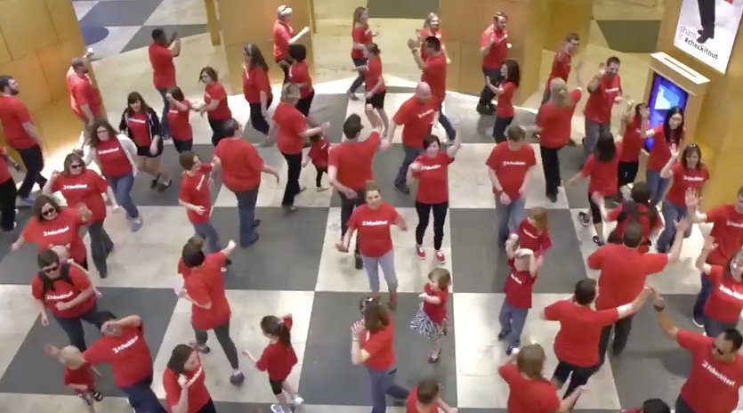
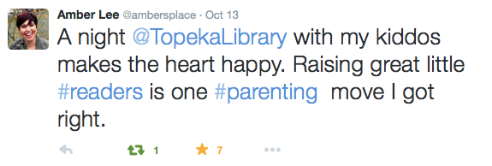
In the teen room, where kids come daily after school.
Friends gather to play Majong at the Broadmoor Library in New Orleans.
A lot of community supporters
stepped forward for a video shoot.
Notes:
A great library platform is a “third place” that supports the learning and civic needs of the community.
When we talk about our community, a sociologist named Ray Oldenburg argued for the importance a third place separate from home ("first place") and the workplace ("second place”) where people can gather, socialize and learn together.
Wouldn’t it be great if the library were that third place for most folks?

Slide 12
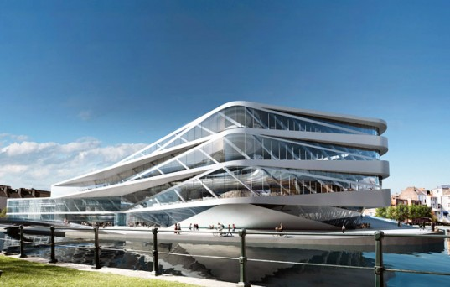
Notes:
This is architectural firm UNStudio’s design for the Urban Library of the Future and Centre for New Media in Gent , Belgium.
Doesn’t this image look like an attempt to interpret the notion of library as platform in physical space?
Or perhaps a futuristic version of the Love Boat?

Slide 13


Slide 14
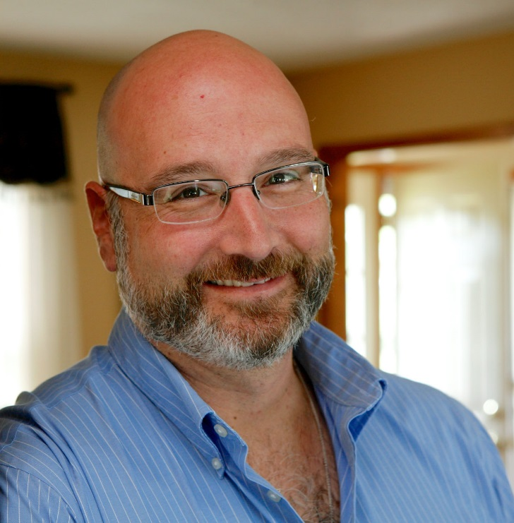
Library as platform
R. David Lankes
Notes:
David Lankes, a professor of library and information science at Syracuse University, describes it this way.
“The new view of the library is not as place, or as collection, but as community platform for knowledge creation and sharing.”
He further states that: “The Mission Of Librarians Is To Improve Society Through Facilitating Knowledge Creation In Their Communities.”
He suggests that our library catalogs should be a platform to connect people to content, events, people and other information.
In other words, it’s not just about our stuff.

Slide 15
Notes:
Here’s my reading recommendation for this evening.
Check out this brand new book -- BiblioTech – Why Libraries Matter More than Ever in the Age of Google by John Palfrey.
John is the founding chairman of the Digital Public Library of America. Remember that –
His book presents a compelling argument for re-envisioning libraries as platforms to help our institutions, our communities
and our democracy grow and thrive in the 21st century.
So, how do we get there?

Slide 16
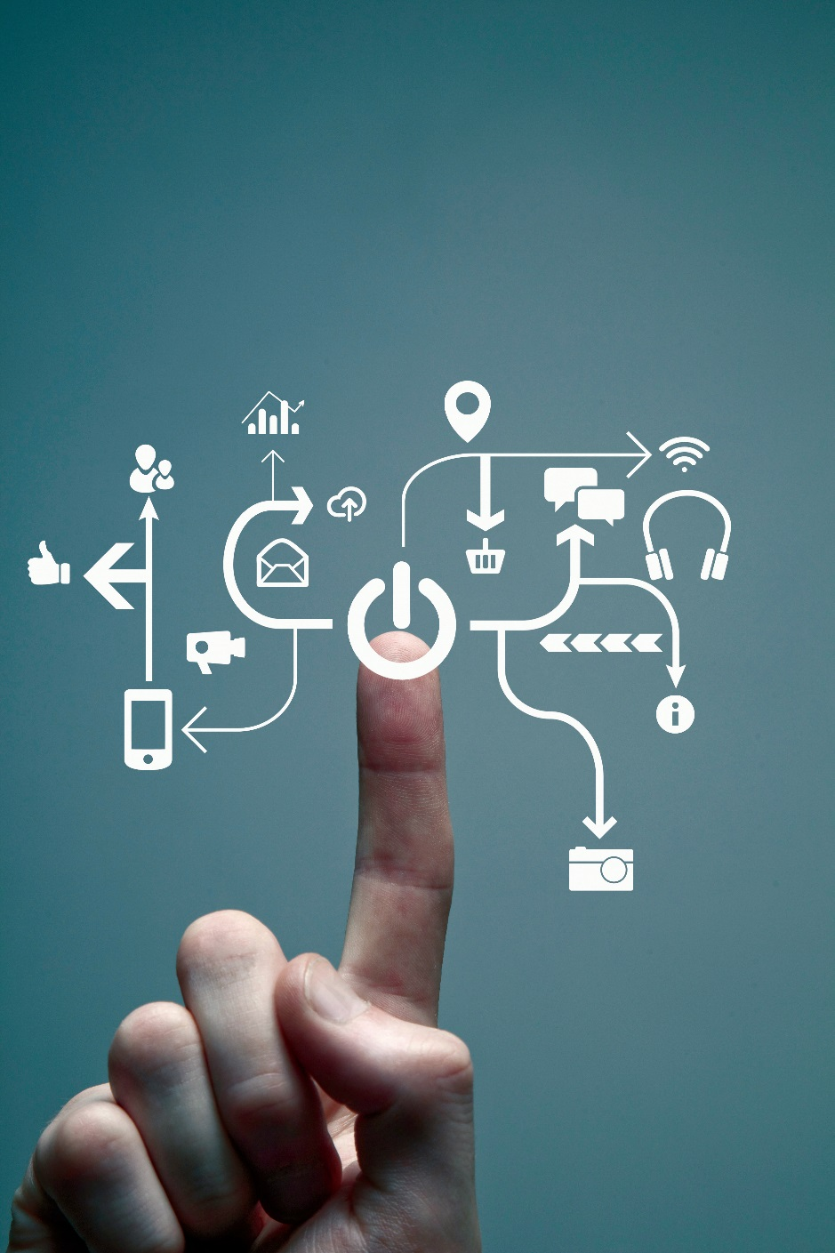
STRATEGIES
FOR
SUCCESS
Notes:
Connecting people to the world in a different way is the challenge of the 21st century for public libraries in communities of all sizes.
Libraries long ago established their place in the hearts of their communities.
Sustaining and broadening that position requires new thinking about what a library is and how it drives opportunity and success in today’s world.
Here’s are four strategies that Rising to the Challenge identifies as essential to libraries’ long term survival.

Slide 17
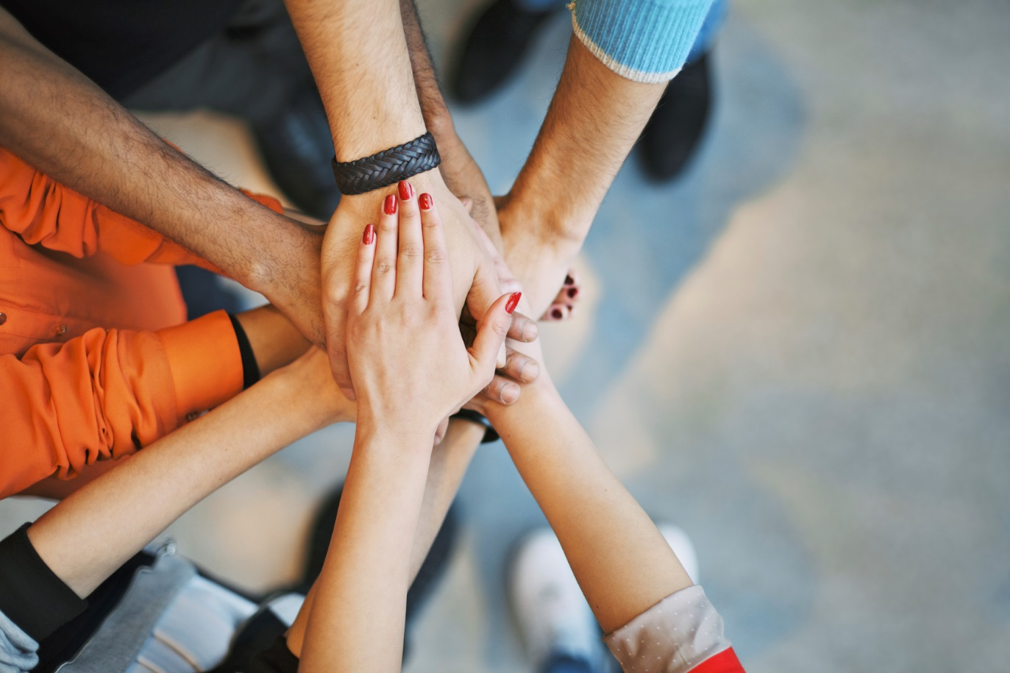
1. Aligning with community goals
STRATEGIES
Notes:
To be successful, public libraries need to align their people, place and platform assets and create services that support local community goals.
That means we know what’s going on in our communities. We know and participate in goal setting with other organizations like our local governments, United Way and other organizations that seek to have a significant impact on the community.

Slide 18
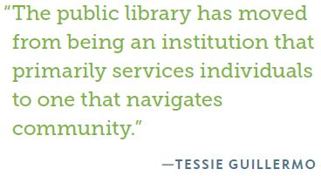

Notes:
Here’s a perspective from someone outside the library world.
This is Tessie Guillermo – President and CEO of ZeroDivide – this is an organization that helps organizations
and institutions use technology to facilitate social change in underserved communities.
They focus their efforts on closing the digital divide.
Does that sound familiar? Do libraries care about the digital divide?
You bet we do! We’re all about equal access, right?

Slide 19
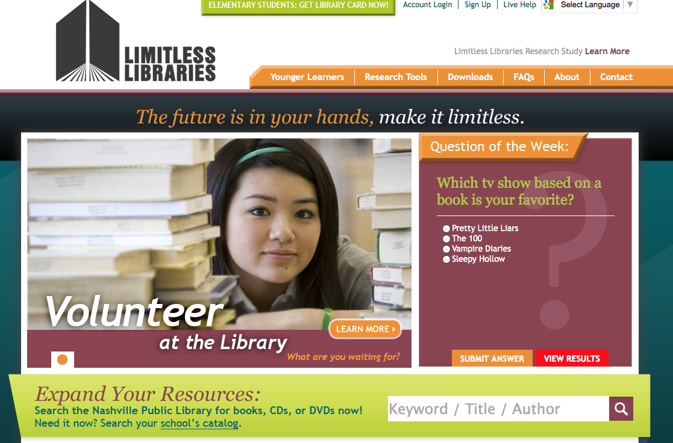
Notes:
Here’s an example from the library world. LIMITLESS LIBRARIES is a project serving more than 80,000 Nashville public school students and 7,000 educators giving them access to a wealth of resources.
This is a cooperative program between the Nashville Public Library and Metro Nashville Public Schools designed to encourage resource sharing and improve student access to learning materials.
Since its launch, circulation of school library resources has increased 79 percent; 28,000 middle and high school students are registered Limitless Libraries users; and bulk purchasing
and negotiated discounts have achieved an estimated $271,000 in savings while vastly expanding resources.
Limitless Libraries, Nashville, TN

Slide 20
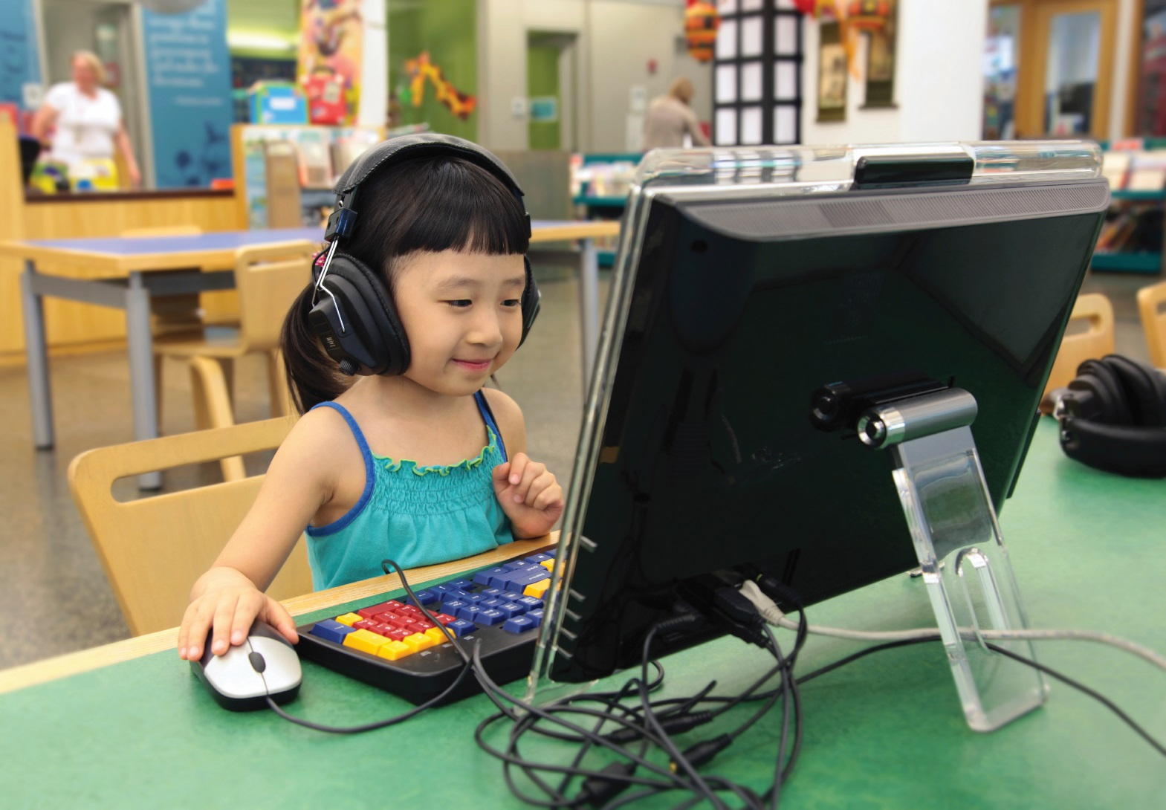
2. Provide access to content in all formats
STRATEGIES
Notes:
As we continue to our shift our role from warehouse to platform, we’re investing in content in many formats.
Libraries face a couple of major challenges:
1. Being able to obtain and share e-books and other digital content on a similar basis as we do physical books and other stuff
2. Having affordable, universal broadband technologies that deliver and help facilitate the creation of content. - Humboldt had made great progress with current access.
Advocacy (there’s that word again) for changes in the business model for ebooks and for more accessible and affordable broadband are critical.

Slide 21
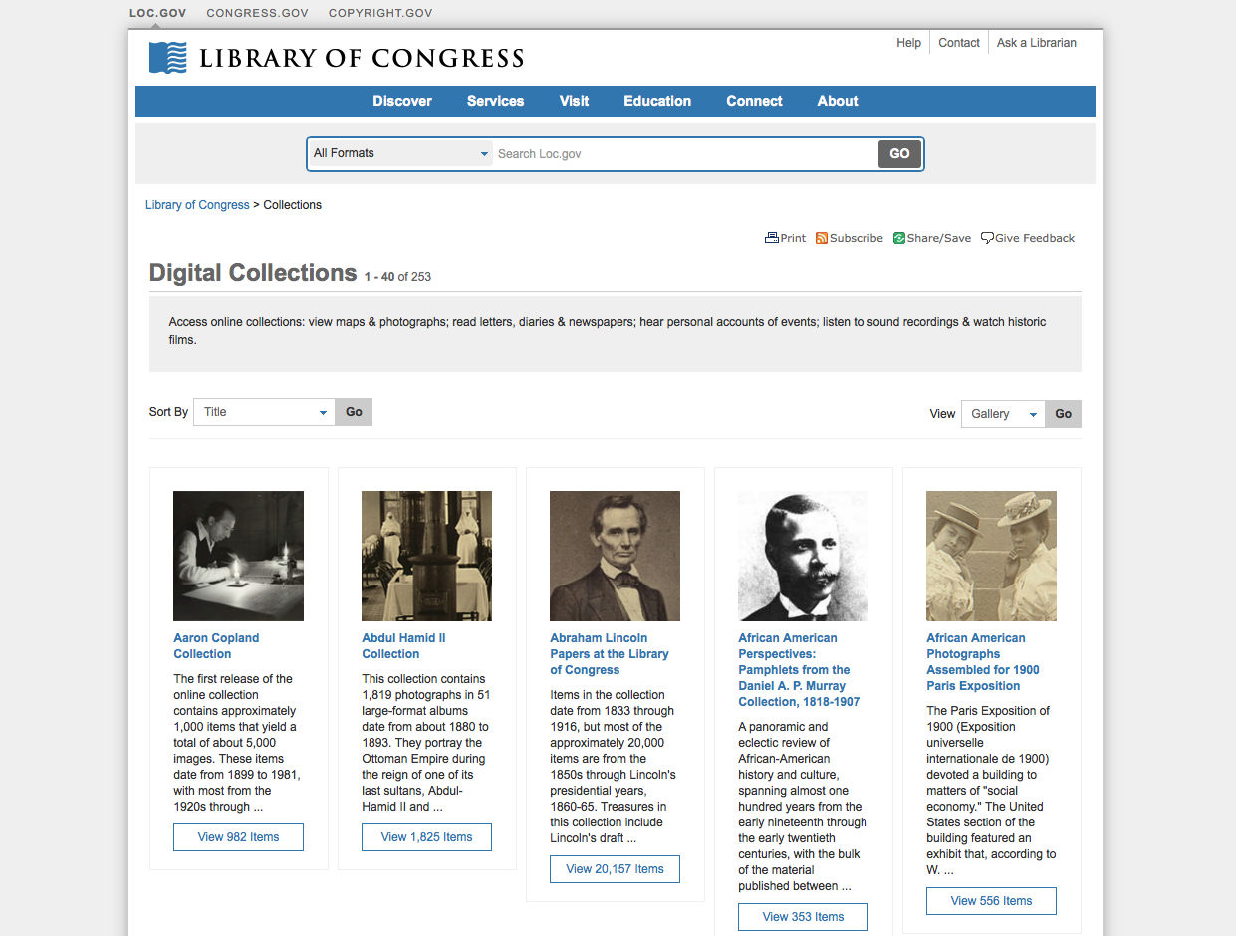
Notes:
The Library of Congress has made digitized versions of collection materials available online since 1994.
They’re providing a gateway to a growing treasury of photos, manuscripts, maps, sound recordings, movies, and books, as well as native digital content like Web sites.
LC provides one of the largest bodies of noncommercial high-quality content on the Internet. So we all have access to the treasures of our national library.
But that’s just a start.

Slide 22
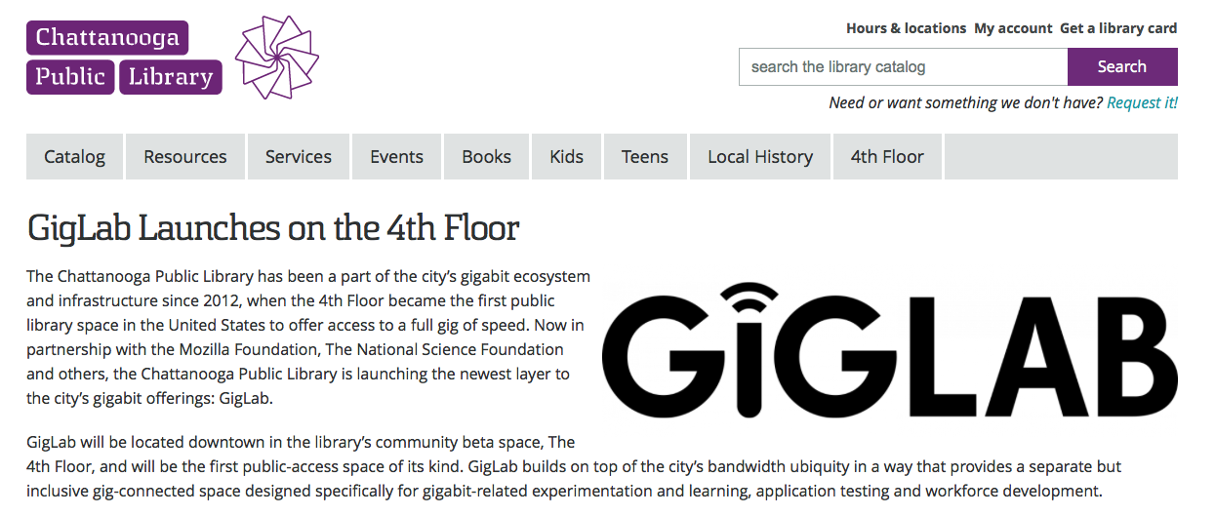
ACCESS IS NOT ENOUGH!
Notes:
And access by itself isn’t enough. Here’s an example of what the Chattanooga Public Library is doing with it’s Gigabit broadband access.
Chattanooga PL doesn’t just have a gigabit connection. Its GigLab provides a separate gig-connected space designed specifically for gigabit-related experimentation and learning, application testing and workforce development. So it’s not just access – it’s a maker space using gigabit technology for hand-on learning and entrepreneurship.

Slide 23
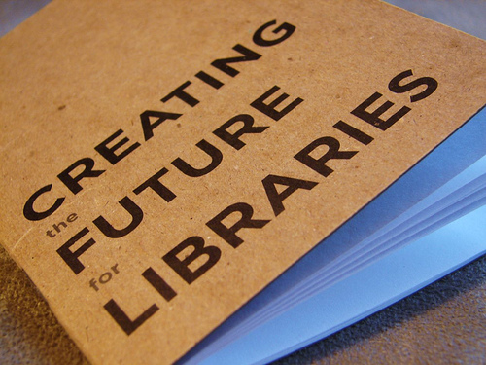
3. Ensuring long-term sustainability
STRATEGIES
Notes:
What all this means is that things are changing – and along with drastic change comes the need for a new models for library budgets, governance and how we measure the difference we make to meet the demands of our society
and our communities.
We all know that funding is dependent on how we’re governed and who makes the decisions about library funding. We know that some funding models are more effective than others in providing sustained and predictable financial resources.
Pam Sandlian-Smith of Anythink Libraries in Colorado says, “Special taxing districts are effective for longer-term planning and transformation. The provide certainty and are less open to political changes.

Slide 24
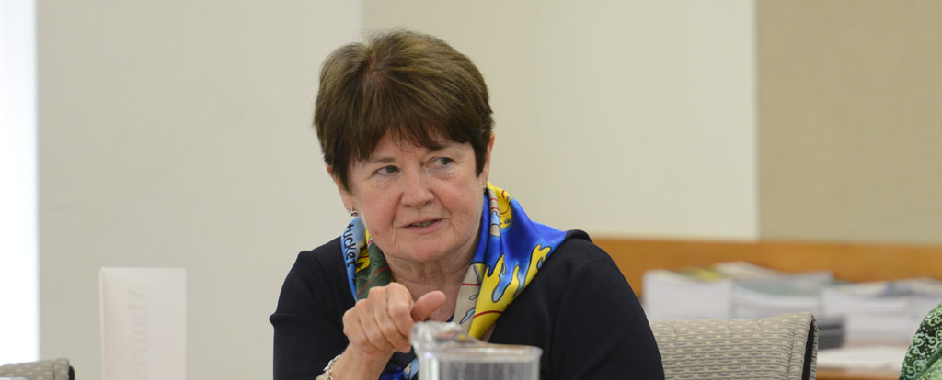
Toward a national digital platform
“With a nationally networked platform, library and other leaders will also have more capacity to think about the work they can do at the national level that so many libraries have been so effective doing at the state and local levels.”
-MAUREEN SULLIVAN
Notes:
An essential part of our future as individual libraries is becoming part of larger library platforms.
Having a great website and digital presence for our individual libraries is just the start. Becoming part of a national digital platform will level the playing field and help bridge the digital divide by ensuring that
whether your library services a population of 300 or 3 million, you have access to the world’s information at your fingertips.

Slide 25
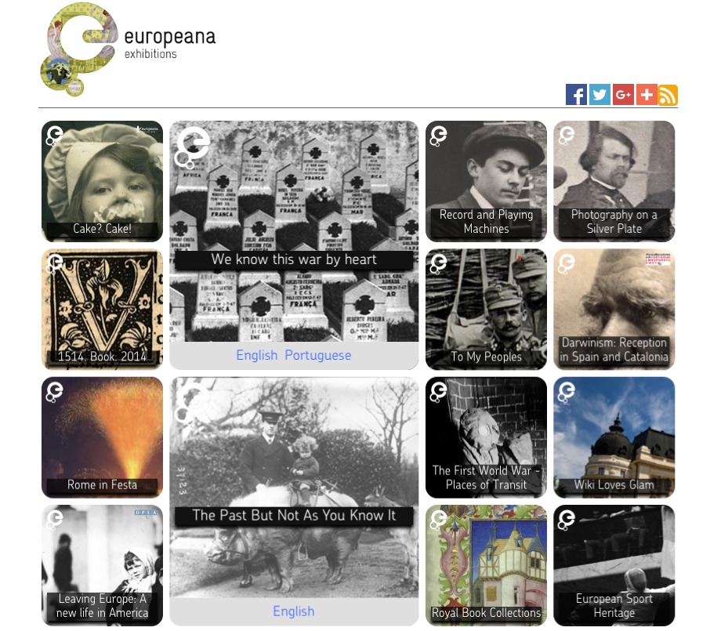
Europeana
Notes:
Europe is already working on this. It was originally called the European Digital Library Network and began in 2005 with a letter from the president of France and the premiers of several other
countries to the European Commission. They recommended the creation of a virtual European library to make Europe’s cultural heritage accessible for all.

Slide 26
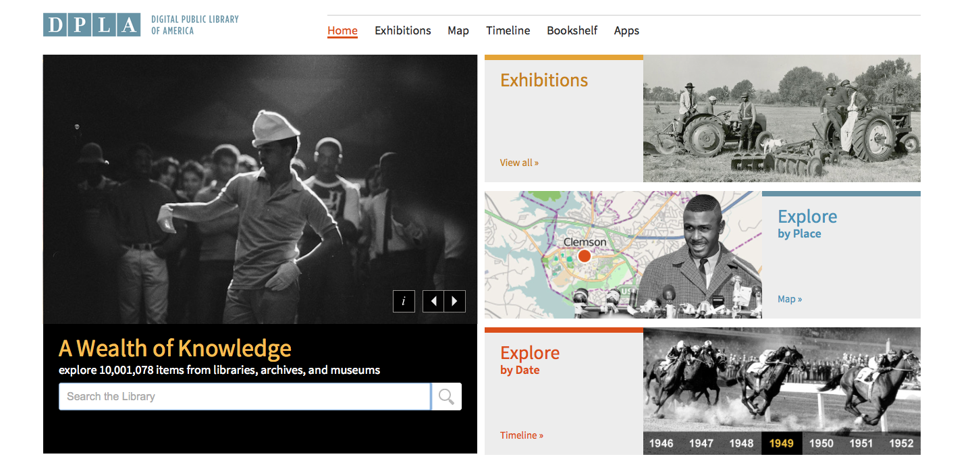
Digital Public Library of America
Notes:
So, how do we go about doing that here in the United States? Are you familiar with the Digital Public Library of America? http://dp.la/
The Digital Public Library of America brings together the riches of America’s libraries, archives, and museums, and makes them freely available to the world.
It’s:
A portal that delivers students, teachers, scholars, and the public to incredible resources, wherever they may be in America.
A platform that enables new and transformative uses of our digitized cultural heritage.
An advocate for a strong public option in the twenty-first century.
All libraries should be represented and provide access to the DPLA. It has the potential to be a, let’s call it, a fourth place for libraries and the communities they serve.

Slide 27
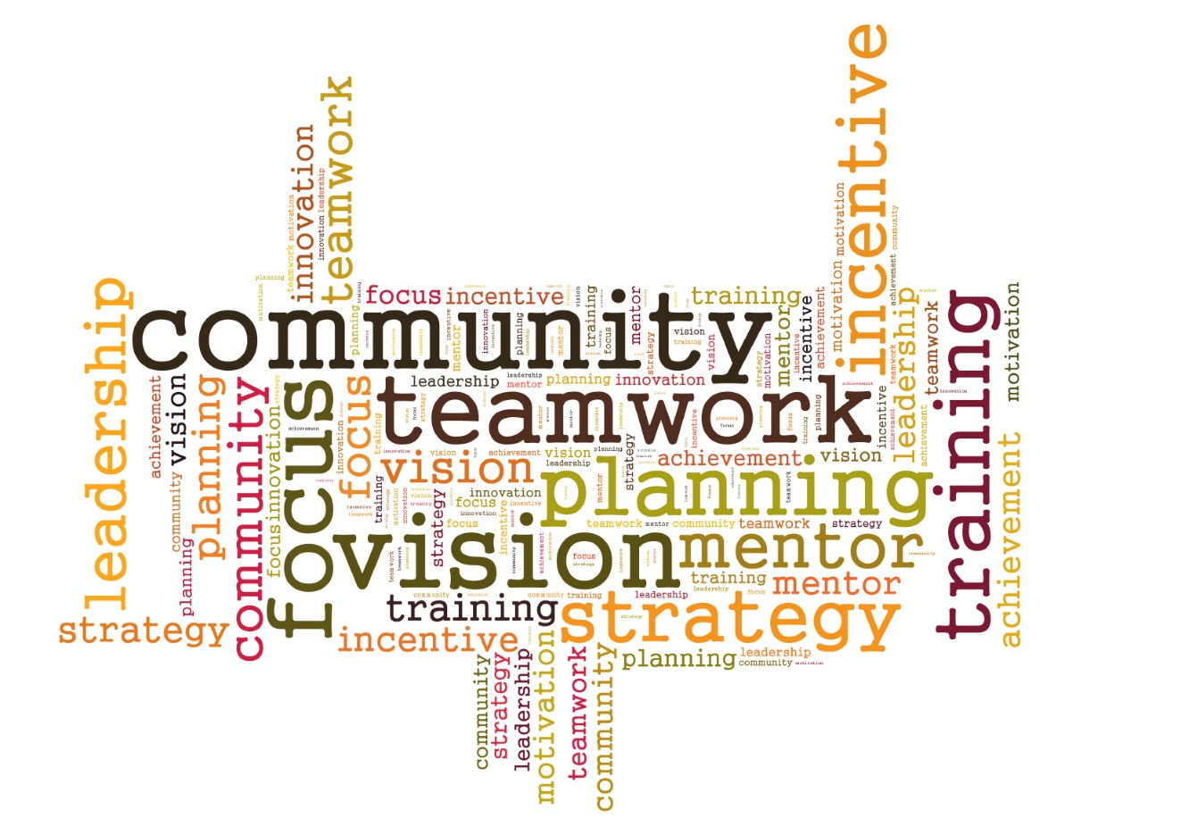
4. Cultivating leadership
Notes:
The fourth strategy for success is leadership. Leadership is essential throughout the community; and especially in libraries.
Leaders will build communities and public libraries that thrive and succeed together. And it has to be leadership with VISION.
Every community needs a vision and a strategic plan. Every public library needs a plan that directly aligns the library and its work with the community’s educational, economic and other key goals.
And it must have input from all stakeholders in the community.

Slide 28
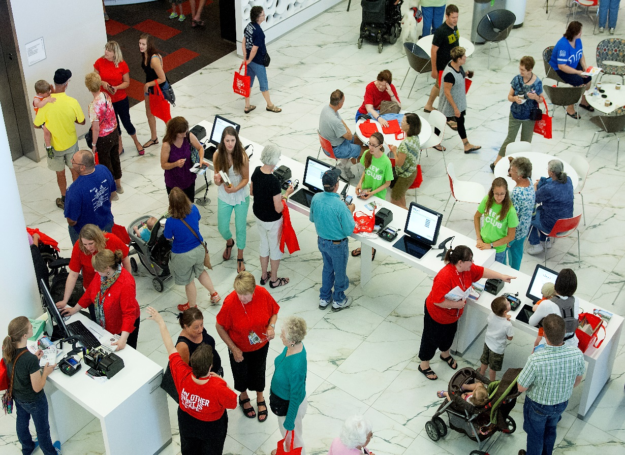
GETTING STARTED
Action Steps For
Library Leaders,
Policymakers &
The Community
Notes:
To advance progress toward the vision, and with these four strategic opportunities in mind, the Dialogue offers a series of action steps for getting started. There are 15 action steps addressed to
each stakeholder group: library leaders, policymakers and the community. These are not intended to be comprehensive lists, and the steps are not organized in any sequential order. Rather, they
are recommendations for actions that have surfaced throughout the Dialogue’s deliberations and consultations and offer a starting point for change. They are necessarily general, as the unique
people, needs, resources, environments and character of each community will have to guide specific community goals and action plans. This report itself is offered as a beginning—not an end—to a
Broader national dialogue on the future of the public library.

Slide 29
Library Leaders
Define the scope of the library’s programs, services and offerings around community priorities
Develop partnerships and collaborations
Measure outcomes and impacts to communicate the library’s value to the community
Engage the community in planning and decision making
Notes:
All critical - first is most important. Show impact of what we provide. Also changing long-held rules that impede progress; brand the library as platform for community learning and development

Slide 30
Policymakers
Define libraries as part of the community’s priority infrastructure
Develop strategic alliances and partnerships with local library leaders to advance educational, economic and social goals
Leverage the economic development potential of the public library as a community platform
Support and accelerate deployment of high-speed broadband & wi-fi to all libraries
Notes:
Economic and workforce development – critical in rural communities

Slide 31
Community Partners
Connect the community’s knowledge resources to the library’s networks & platform
Volunteer organizational and technical expertise to mentor and support learning that takes place in library spaces and on its platform
Develop strategic partnerships and alliances with public libraries
Notes:
Advocacy and connections great to have community group as key stakeholders in library planning

Slide 32


Slide 33

TABLE OF CONTENTS
Acknowledgements and Photo Credits
Background
Introduction
Instructions
People
Place
Platform
Jobs and Economic Development
The Library as Civic Resource
The Library as Literacy Champion
SOAR Assessment
Strategies for Success
Action Steps for Library Leaders
Engaging Community Leaders
Convening Your Public Dialogue
Taking Action: Next Steps
Appendix
www.LibraryVision.org
#LibraryVision

Slide 34
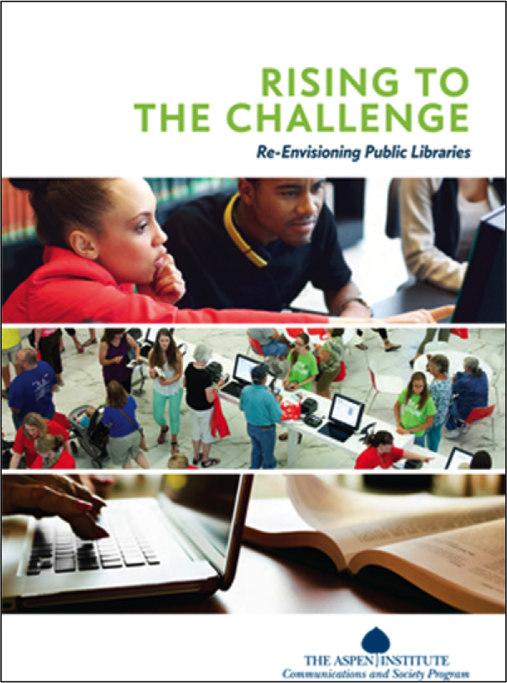
To learn more:
http://as.pn/libraries
www.LibraryVision.org
Susan Hildreth, Aspen Fellow
hildreth@plsinfo.org
or
Amy Garmer, Director
amy.garmer@aspeninstitute.org

Slide 35
Infopeople webinars are supported in part by the U.S. Institute of Museum and Library Services under the provisions of the Library Services and Technology Act, administered in California by the State Librarian. This material is licensed under a Creative Commons 3.0 Share & Share-Alike license. Use of this material should credit the author and funding source.

