Slide 1
Emerging Tech Trends in Libraries
Tuesday, February 2, 2016
An Infopeople Webinar
david lee king | topeka & shawnee county public library | davidleeking.com
Notes:
goal - talk about tech trends and how they affect libraries! 10 trends, how libs should respond, trends vs fads, and how to prepare.
Ton of time for questions, discussion, etc.
Also - emerging trends and tipping points

Slide 2
flickr.com/photos/lgb06/4390432853/
Notes:
for me - phone, tv.
The new stuff was VCRs, walkman, cassette tapes, computers and modems hooked to telephone lines. Wild stuff :-)

Slide 3
Notes:
another truth. It’s not going away. It’s now integrated into what we do. You have a pretty fancy computer on your desk, and you’re expected to use it. Customers expect their devices to work with your stuff.

Slide 4
flickr.com/photos/wwworks/5063710551/
10 year cycles
Notes:
Technology has developed in ten-year cycles: 1960s: mainframe computing, 1970s: mini-computing, 1980s: personal computing, 1990s: desktop internet computing, 2000s: mobile internet computing.

Slide 5
flickr.com/photos/gumption/5318386773/
Notes:
and - it’s always changing! Anyone own some old, dead tech? I have 2 PCs and one TV I need to get rid of ...
Who has dead tech at home? What? Anything interesting? Pressure cooker, anyone?

Slide 6
What’s NEW
for you?
Notes:
another way to look at it - what’s new for you?
DSLR cameras. Mac to PC virtual desktop - Parallels. 3D printers in 2014.
ask…
OK - now, on to 10 emerging tech trends!

Slide 7
1
The Internet
of Things

Slide 8
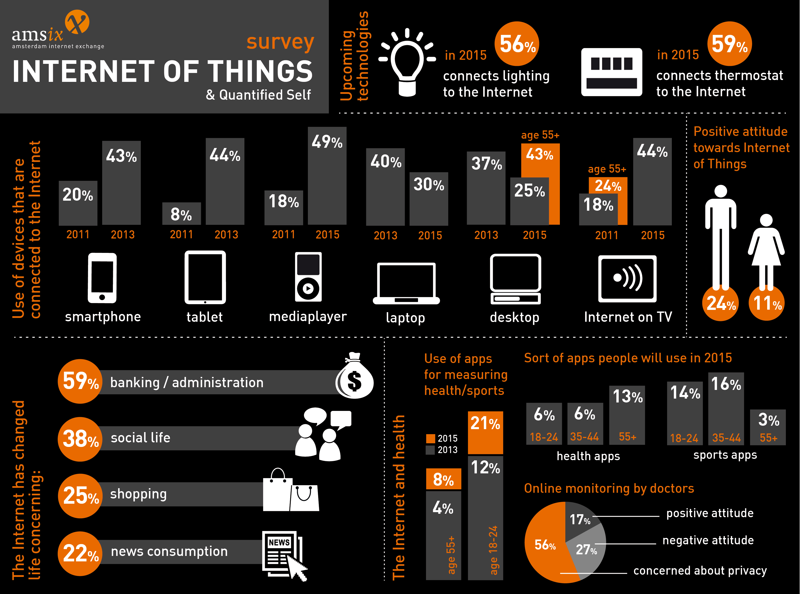
ams-ix.net/newsitems/87
Notes:
or, IoT.
The Internet of Things (IoT) is the network of physical objects or "things" embedded with electronics, software, sensors, and network connectivity, which enables these objects to collect and exchange data.
the “Internet of Things” is beginning to take off, with a staggering array of devices, appliances and vehicles just waiting to have their own IP addresses.
Gartner forecasts that over the next two decades, there will be a “proliferation of contextually-aware, intelligent personal assistants, smart advisors (such as IBM Watson), advanced global industrial systems and public availability of early examples of autonomous vehicles.”
According to the firm, this will be the most disruptive in the history of IT.
Different types:
internal state - health, diagnostics, battery level, CPU utiliation, up-time, etc. diagnostics. ping-like broadcasts of health.
physical attributes - monitoring the world surrounding device, like altitude, orientation, temp, humidity, radiation, air quality, noise, and vibration
actuation services - ability to remotely trigger, change, or stop physical properties or actions on the device.
Location - GPS. Proximity.

Slide 9
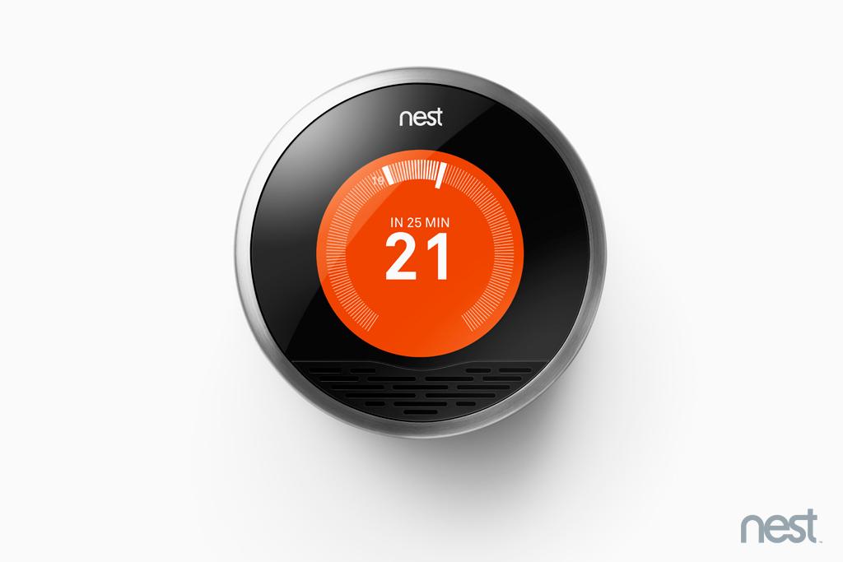
Notes:
Your thermostat. Finding your keys. Starting your car. Lightbulbs. Your health. Etc.

Slide 10
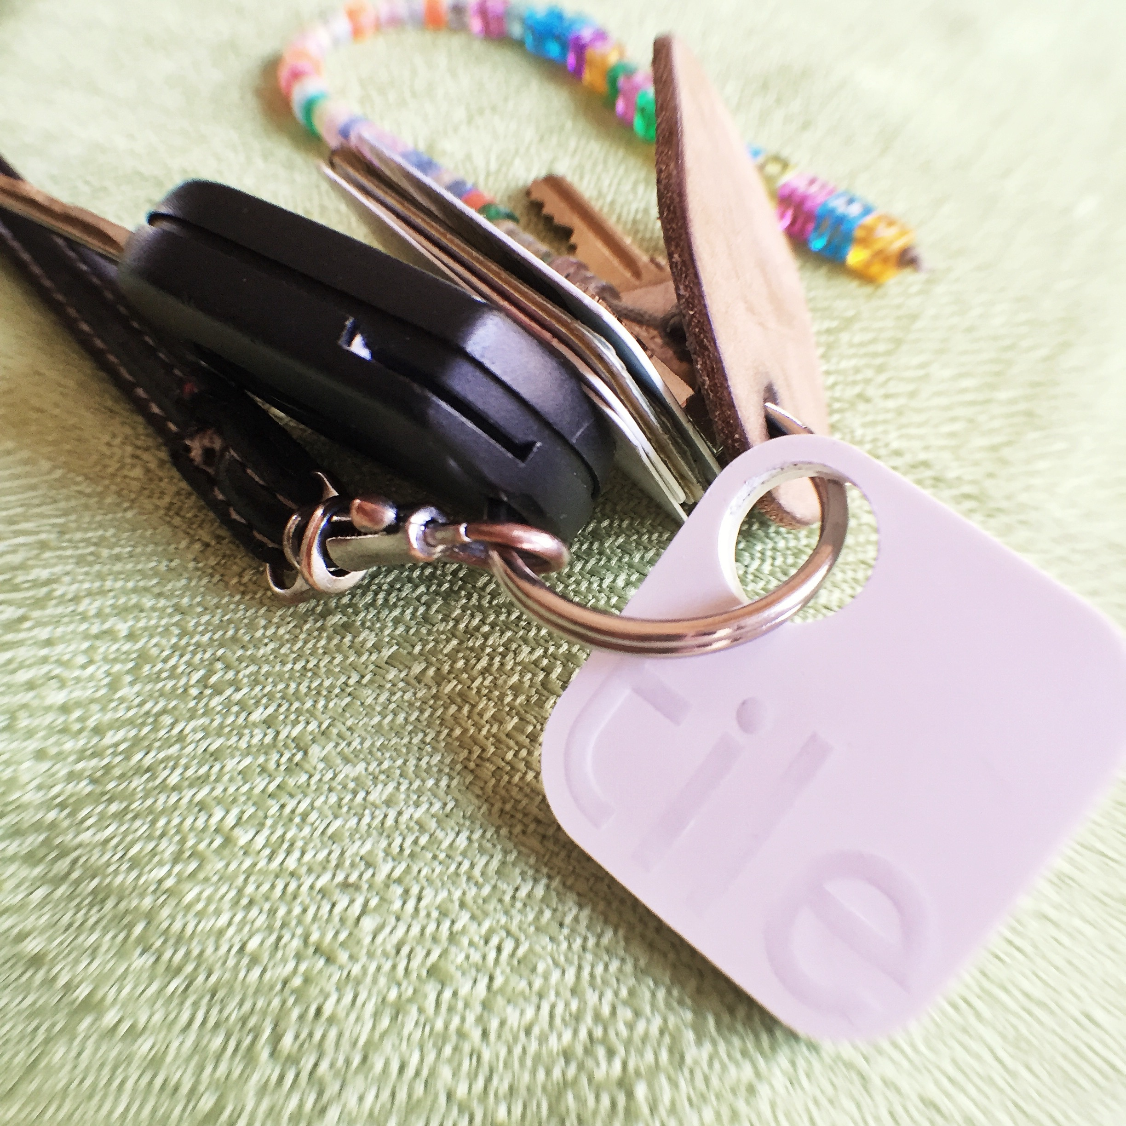
Notes:
Finding your keys. Starting your car. Lightbulbs. Your health. Etc.

Slide 11
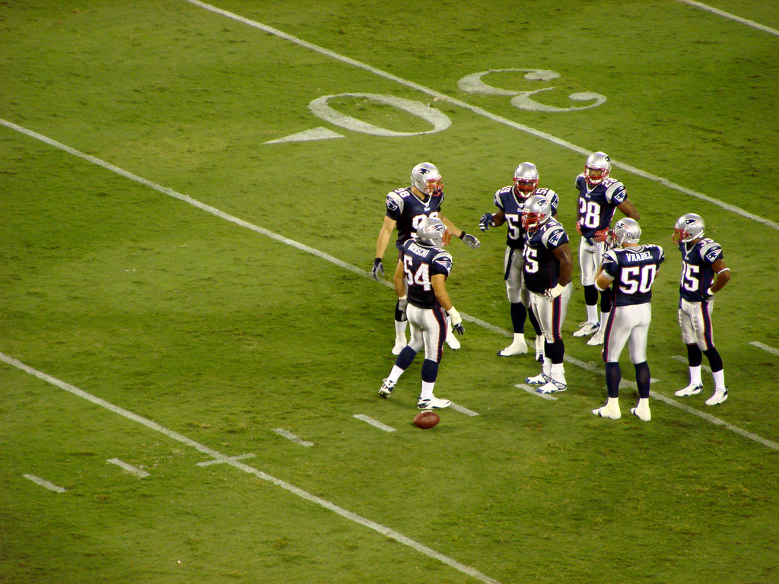
flic.kr/p/2SRhrT
Notes:
http://www.cio.com/article/2980853/wearable-technology/the-internet-of-things-comes-to-the-nfl.html
Every NFL player and stadium will be equipped with RFID sensors and receivers, respectively, this football season, allowing the league to track fine-grained location data for every play.
each player will be equipped with a set of RFID sensors about the size of a quarter embedded in his shoulder pads, each emitting unique radio frequencies. Gillette Stadium (and every other stadium used by the NFL) has been equipped with 20 receivers to pick up those radio frequencies and pinpoint every player's field position, speed, distance traveled and acceleration in real time.
By using two sensors for each player — one embedded in the left shoulder pad and one on the right — the system will also be able to identify the facing of each player.
The NFL plans to use the data generated to power the NFL 2015 app for Xbox One and Windows 10, allowing for things like "Next Gen Replay" that will allow fans to call up stats for each player tied into highlight clips posted on the app. But that's just the beginning. The data will be fed to broadcasters, leveraged for in-stadium displays and provided to coaching staff and players.

Slide 12
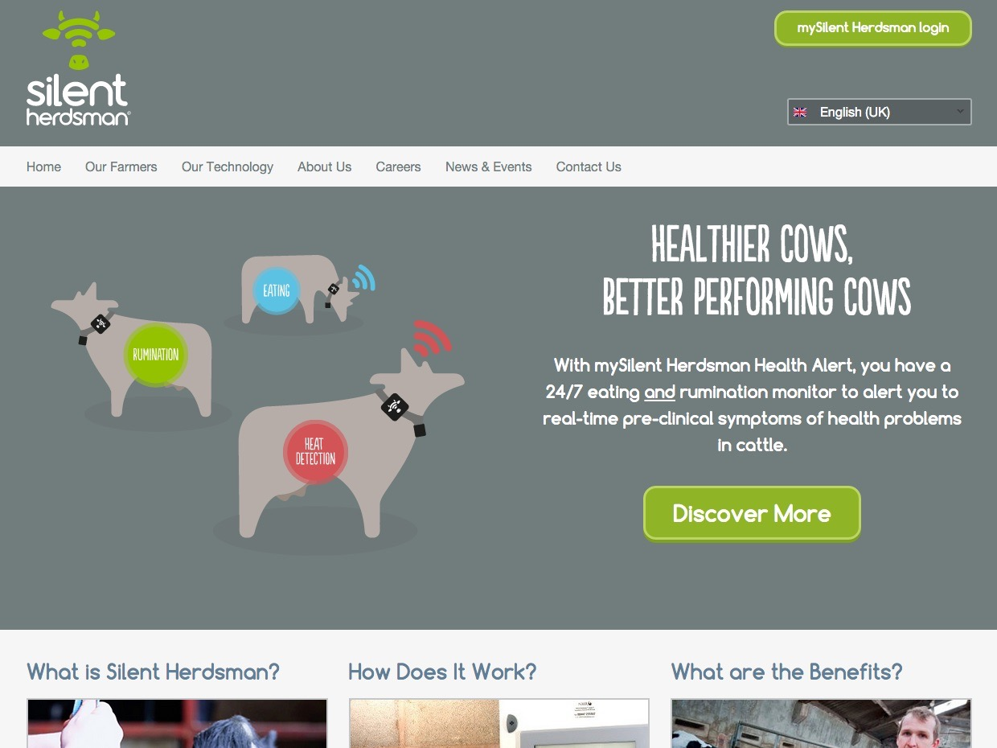
Notes:
Silent Herdsman continually monitors a cow’s activity and automatically detects changes in normal behaviour, indicating patterns related to oestrus, eating and rumination.
Silent Herdsman identifies the cow’s cycle, eliminating the need for costly human observations or the use of labour intensive alternatives. The result is a substantial increase in the successful identification of cows in oestrus, and those with the early onset of illness. To prolong the collar’s battery life, Silent Herdsman flags an alert only when cows enter their critical states. Fertility, milk yield and operational efficiency are therefore maximised.

Slide 13
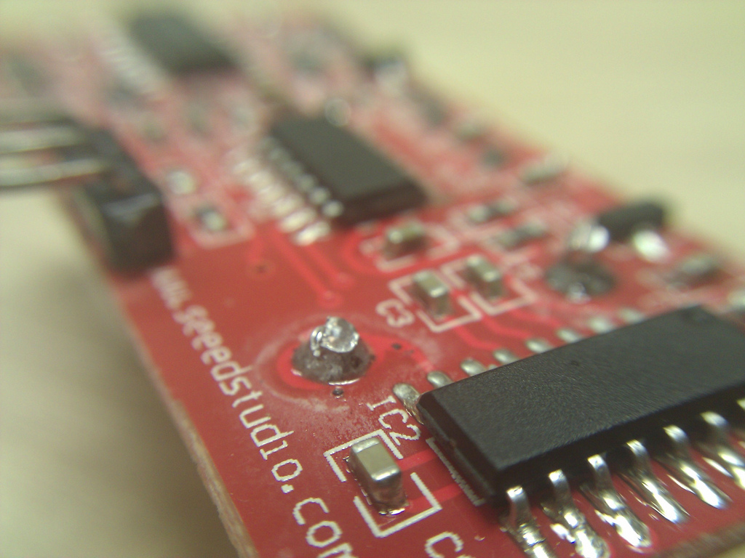
flic.kr/p/akrhbx
Notes:
A sensor … measures, it evaluates; in short, it gathers data. The Internet of Things really comes together with the connection of sensors and machines. That is to say, the real value that the Internet of Things creates is at the intersection of gathering data and leveraging it. All the information gathered by all the sensors in the world isn’t worth very much if there isn’t an infrastructure in place to analyze it in real time.
Let’s look at one example. In 2007, a bridge collapsed in Minnesota, killing many people, because of steel plates that were inadequate to handle the bridge’s load. When we rebuild bridges, we can use smart cement: cement equipped with sensors to monitor stresses, cracks, and warpages. This is cement that alerts us to fix problems before they cause a catastrophe. And these technologies aren’t limited to the bridge’s structure.
If there’s ice on the bridge, the same sensors in the concrete will detect it and communicate the information via the wireless internet to your car. Once your car knows there’s a hazard ahead, it will instruct the driver to slow down, and if the driver doesn’t, then the car will slow down for him. This is just one of the ways that sensor-to-machine and machine-to-machine communication can take place. Sensors on the bridge connect to machines in the car: we turn information into action.
You might start to see the implications here. What can you achieve when a smart car and a smart city grid start talking to each other? We’re going to have traffic flow optimization, because instead of just having stoplights on fixed timers, we’ll have smart stoplights that can respond to changes in traffic flow. Traffic and street conditions will be communicated to drivers, rerouting them around areas that are congested, snowed-in, or tied up in construction.
from http://www.wired.com/insights/2014/11/the-internet-of-things-bigger/

Slide 14
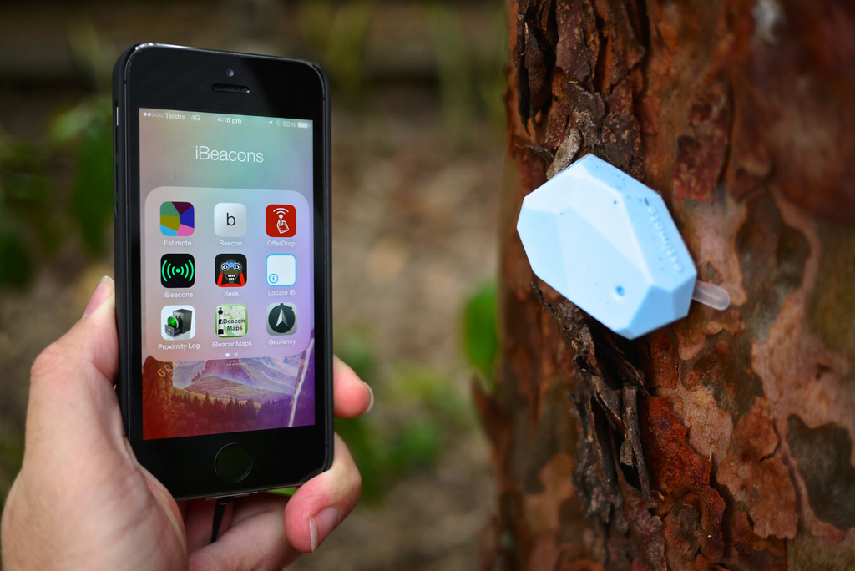
flic.kr/p/mFcVCt
Notes:
High-Precision Location Sensing - Knowing an individual's location to within a few meters is a key enabler of the delivery of highly relevant contextual information and services. Apps exploiting precise indoor location currently use technologies such as Wi-Fi, imaging, ultrasonic beacons and geomagnetics. In 2014, Gartner expects growth in the use of wireless beacons using the new Bluetooth Smart standard. In the longer term, technologies such as smart lighting will also become important. Precise indoor location sensing, combined with mobile apps, will enable a new generation of extremely personalized services and information.

Slide 15
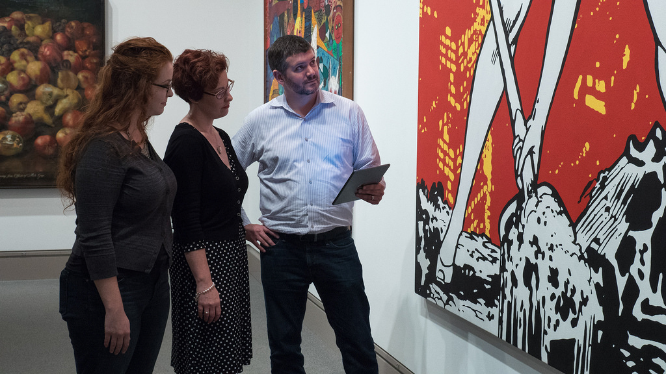
flic.kr/p/pMY9RB
Notes:
museums, apple stores, etc.

Slide 16
What’s this mean for the library?
flic.kr/p/akrhbx
Notes:
Wow - hard to say!
RFID = sensors in books
Capira Technologies, Bluubeam = beacon tech for libraries.
newer libraries = web-based HVAC, lighting, monitoring, etc.
iBeacons in libraries??
GPS - track bookmobiles? Marauder’s Map?
Better stats for libraries, for strategic planning, meeting community needs
money savings (smart HVAC controls)
Other thoughts?

Slide 17
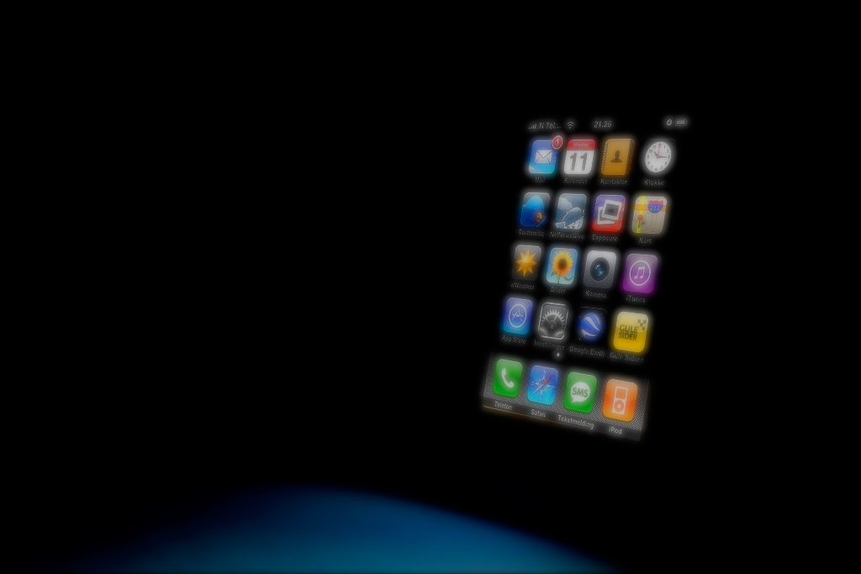
2
mobile
flickr.com/photos/ramyoga/3025034131/
Notes:
Mobile technology is here to stay. People have moved from cellphones that only made phone calls to smartphones that offer a wide range of web-based services. This means customers can now access your library’s website on-the-go.

Slide 18

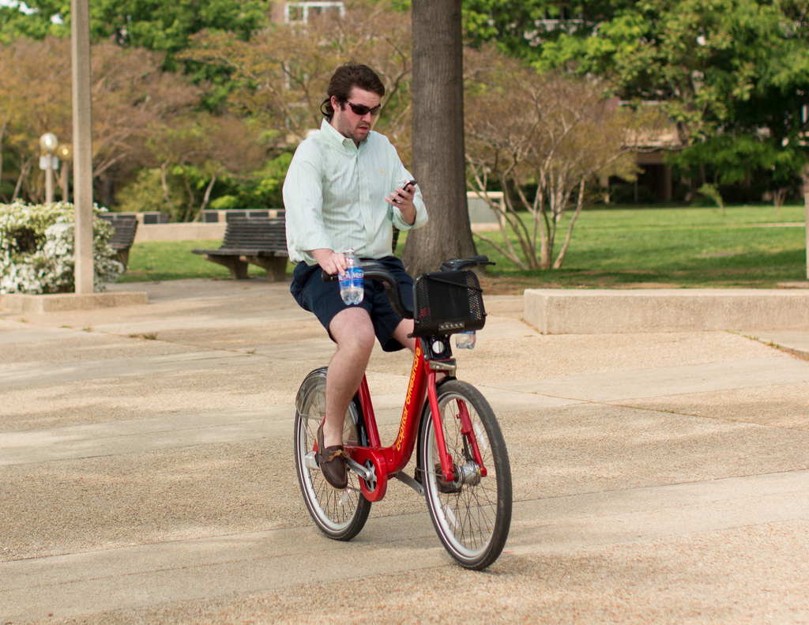
flickr.com/photos/mr_t_in_dc/6937521074/
not a
good idea
Notes:
ok - some people go a bit far with the whole mobile, always on thing...
just because you have it, doesn’t mean you have to use it. It’s still an obsession.
silliness and stupidity aside, there’s a reason our smartphones are so popular and we want to use them on our bikes. It’s because of the amazing connectivity we get to each other

Slide 19
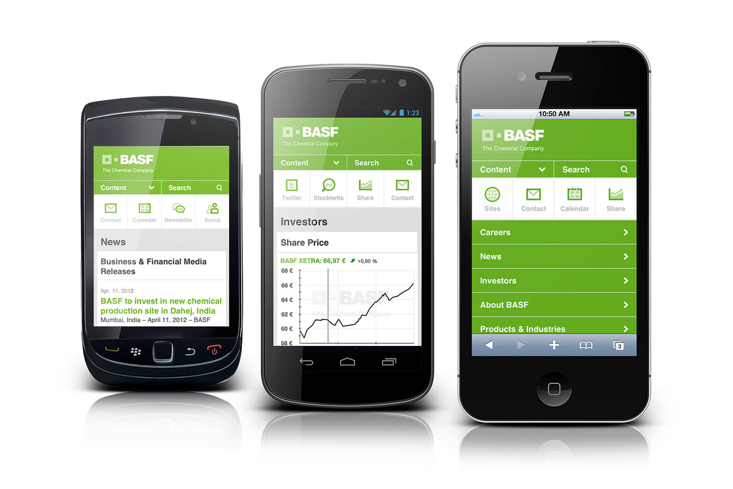
flickr.com/photos/73295603@N00/7195432918/
Notes:
needs to work on a variety of mobile devices. Why so focused on mobile-first approach?

Slide 20
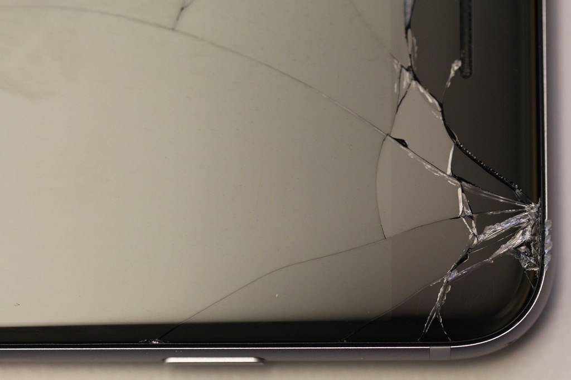
Notes:
Scary image! This is now a major deal for a growing number of us!
Costly, too - $120 or so for me.
We do a LOT more than just talk, huh?

Slide 21
68%
of US Adults own smartphones
Notes:
Pew Internet says that 64% of American adults own smartphones. 85% of younger adults (18-29), 79% - 30-49, 54% - 50-64, 27% 65+. All of those have web access. Think about your use for a sec. How many of you visited a website on your smartphone today? In the last week?
Most likely.
And mobile is leading the way. U.S. homes now have 1.4 tablets per household, compared to 1.2 a year ago. We spend 130 minutes a day with smartphones and tablets, compared to 170 minutes a day watching TV

Slide 22
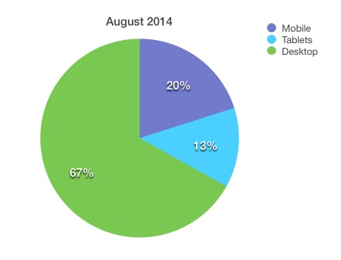
Notes:
Google Analytics stats for August 2014. 33% of my library website users are using it via some type of mobile device. Growing slowly - under 30% about a year ago.
this is HUGE for the library.

Slide 23
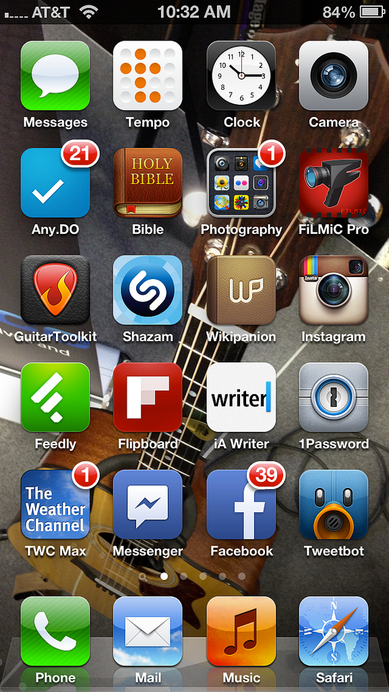
Notes:
mobile apps - there’s an app for that! How many apps does your library have?
Count them …
ILS, boopsie, hoopla, zinio, overdrive - other databases? Other services?

Slide 24
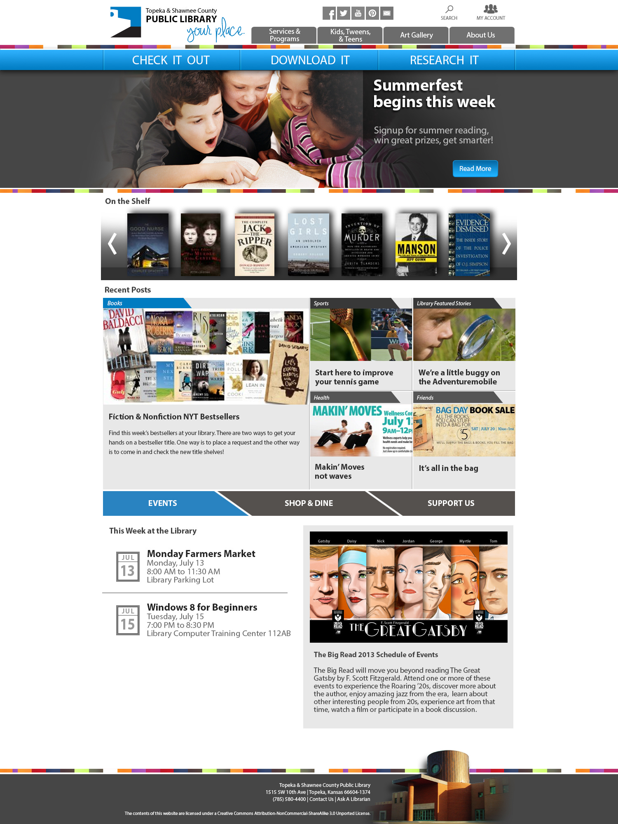
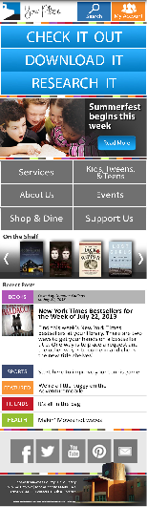
design for mobile
Notes:
design for mobile, responsive design. get staff writing for mobile.
Libraries need to make sure their websites work great on mobile devices. That might mean building a specialized mobile website or app. It might also mean designing a Responsive website. Responsive design is an emerging web design trend that uses one set of back-end code that automatically adjusts to different screen sizes. The same website, if designed using Responsive design techniques, works on a desktop, a smaller tablet, and an even smaller smartphone.

Slide 25
Notes:
For those of you not yet familiar with responsive design ... here’s my library’s new website, not live yet...
It’s responsive. It “adapts” to different screens and devices. Same content, different (yet similar) visual look.

Slide 26

teens…
Notes:
78% of teens have a cell phone
37% of all teens have smartphones
72% of kids 0-8 have used a mobile device (watching videos, playing games, etc).
What do they do on their phones?
Text and use apps. A typical teen boy sends about 50 texts per day. 100 for a girl.
1-5 calls per day.
31% of teens who take their phones to school send text messages every day during class time.

Slide 27
cell
mostly
Notes:
Low income - get the smartphone, not internet at home, laptops, etc.
That’s the ONLY connection they have
10% of Americans own a smartphone but do not have broadband at home, and 15% own a smartphone but say that they have a limited number of options for going online other than their cell phone. Those with relatively low income and educational attainment levels, younger adults, and non-whites are especially likely to be “smartphone-dependent.”

Slide 28
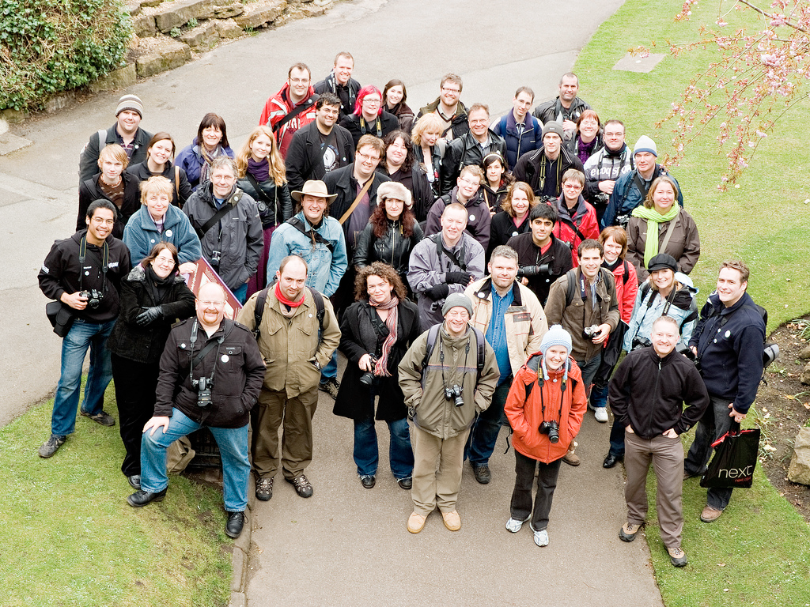
what do your mobile users need?
flickr.com/photos/beavis/2425374221/
Notes:
ask this - wifi and power.
ILS/catalog.
databases
reference - ask us.
basically, your library services - all of them - represented online and accessible via a mobile device. They want more than hours and location and a catalog!

Slide 29
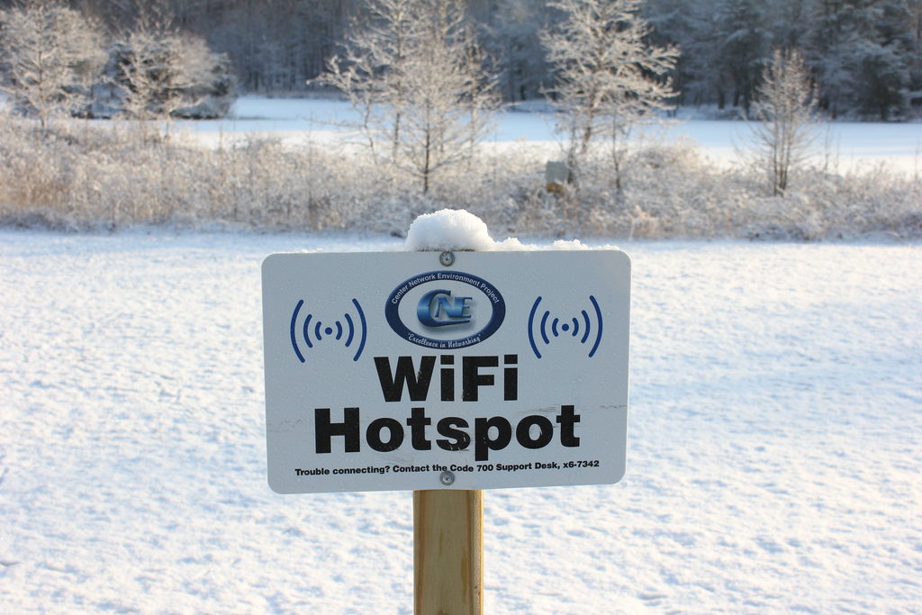
flic.kr/p/99GGKN
Notes:
Mobile + wifi = very important! Connection Everywhere…
where can you NOT get wifi - not quite there yet, but it’s readily available.
In homes, at the mall. At the auto repair place. In parks, in cities.
Changes coming:
new wifi standards - 802.11ac and the second development of the 802.11ax standard. Wi-Fi hotspots are expected to be faster and more reliable. Wi-Fi alliance predicts that products based on a draft of the standard will likely reach markets by early 2016.
they enable Wi-Fi to provide new services. Over the next three years, demands on Wi-Fi infrastructure will increase as more Wi-Fi-enabled devices appear in organizations, as cellular offloading becomes more popular, and as applications such as location sensing demand denser access-point placement.
LTE and LTE-A - Long Term Evolution (LTE) and its successor LTE Advanced (LTE-A) are cellular technologies that improve spectral efficiency and will push cellular networks to theoretical peak downlink speeds of up to 1 Gbps, while reducing latency. All mobile users will benefit from improved bandwidth, and superior performance combined with new features such as LTE Broadcast will enable network operators to offer new services.

Slide 30
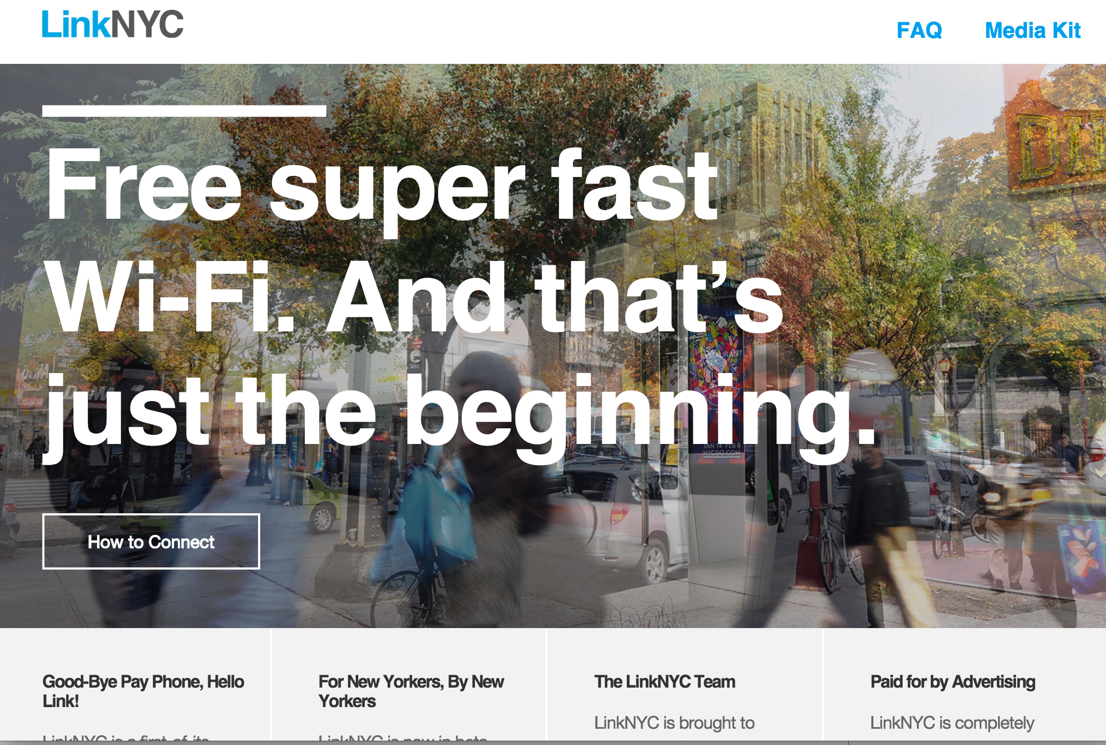
Notes:
LinkNYC is a new communications network that is replacing New York City pay phones with state-of-the-art kiosks called Links. Each Link is equipped with free services like high-speed Wi-Fi, phone calls, a tablet for web browsing, and device charging for anyone living in or visiting New York City to enjoy. In addition to Link’s features being free to the public, they also come at no cost to taxpayers. Over the next several years, over 7,500 Links will be installed across the five boroughs.
The launch of LinkNYC is beginning with a beta phase, giving New Yorkers an early opportunity to try out Link's features and provide feedback. Additional apps and services will be rolled out over the next few months and on an ongoing basis over the next several years.
Q. What do Links do?
Links provide high-speed Wi-Fi, phone calls to anywhere in the U.S., device charging, a touch screen tablet for Internet browsing, access to city services, maps and directions, and a 911 Emergency Call button. All of these services are free to use. Links also have two have two 55” high-definition digital screens used for public service announcements and advertising.
for free.

Slide 31
BYOD
flickr.com/photos/fishbraintexas/7263316350/
Notes:
According to a biannual survey of SMB IT intentions by Spiceworks, Inc., almost 59% of small-midsize businesses already support the BYOD trend, with the trend even more popular in companies with less than 20 employees.
OK - your staff are already bringing in their smartphones and checking Facebook at work. Do you have a policy for that? My suggestion - let em play. But also make sure they get their work done. Don’t write a no facebook or no mobile policy, instead, it’s a personnel/behavior thing that you probably already have.

Slide 32
What’s this mean for the library?
Notes:
get a mobile site, get wifi.
Bandwidth & wifi pipe - do you have enough? Probably not.
Make an apps page on your site.
mobile version of the catalog - first order of business.
more power! Charging stations!
What else - thoughts?

Slide 33
3
Consumer Technology
flickr.com/photos/personalspokesman/105737843/
Notes:
This is the stuff we buy.
phones, laptops, tablets, storage, batteries, cameras, watches, wifi, kitchen appliances, TVs, automobiles, etc., etc.
driving the tech market. Because we have money to spend.

Slide 34
stuff we use
flickr.com/photos/personalspokesman/105737843/
Notes:
it’s consumer tech because it’s stuff we use in our daily lives. For entertainment, to stay connected, to stay healthy, “just because”
So - 3D printer? Not really consumer tech yet.

Slide 35
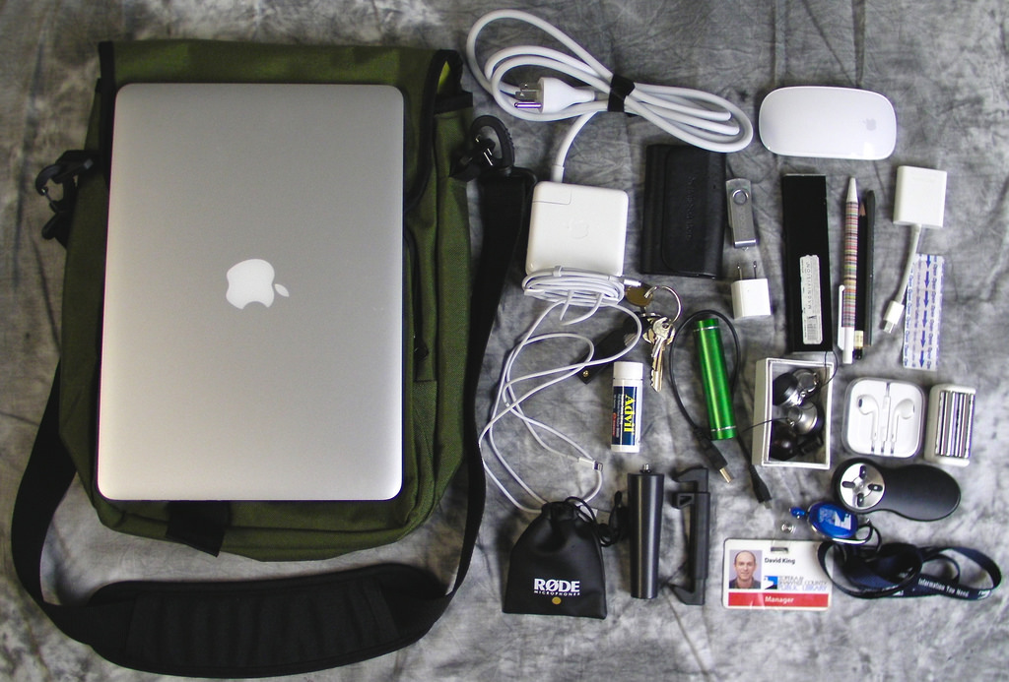
Notes:
What’s in my bag? what did you bring to this conference?

Slide 36
flickr.com/photos/sarabeephoto/8563344780/
Notes:
What’s in my bag? what did you bring to this conference?

Slide 37
smartphones, tablets, laptops
Notes:
smartphones and tablets - no need for cameras, mp3 players, gaming devices - laptops even

Slide 38
gaming - HUGE changes
flickr.com/photos/ian_d/30859899/
Notes:
gaming - still hot. But not console games as much. tablet and smartphone games.

Slide 39

flic.kr/p/bzYBiM
Notes:
minecraft
someone made a server … inside of minecraft! It’s a game-changer.

Slide 40
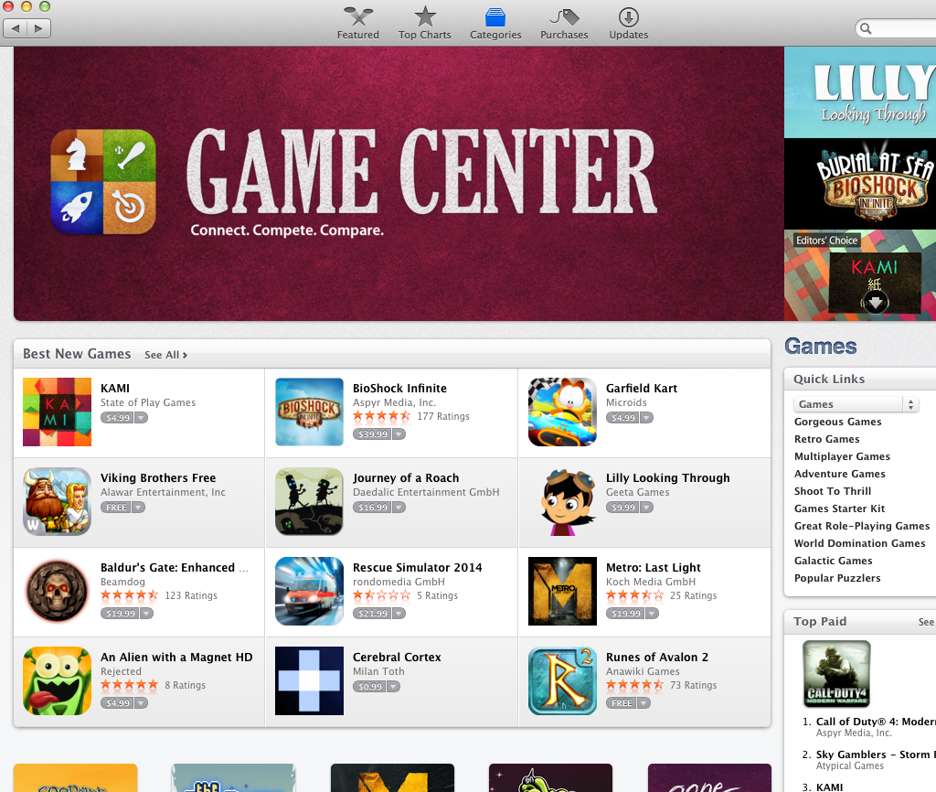
Notes:
because of the app store! Angry birds, right? Candy Crush?

Slide 41
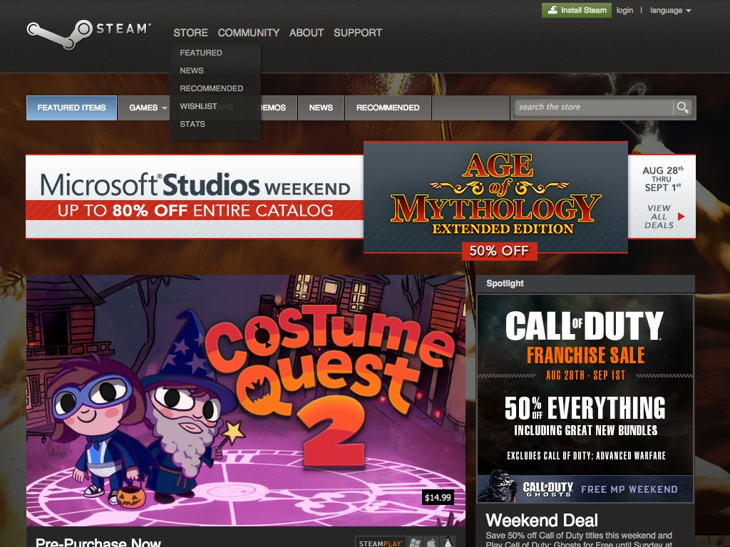
Notes:
Steam - another version of the move from console-based games to online games.

Slide 42
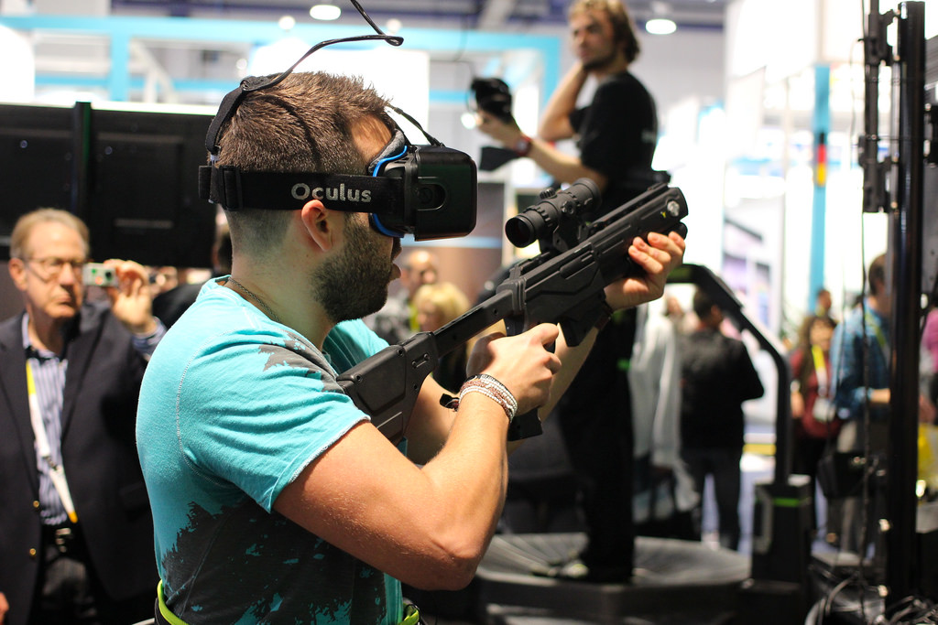
https://flic.kr/p/rpB1bd
Notes:
virtual reality gaming at CES16

Slide 43
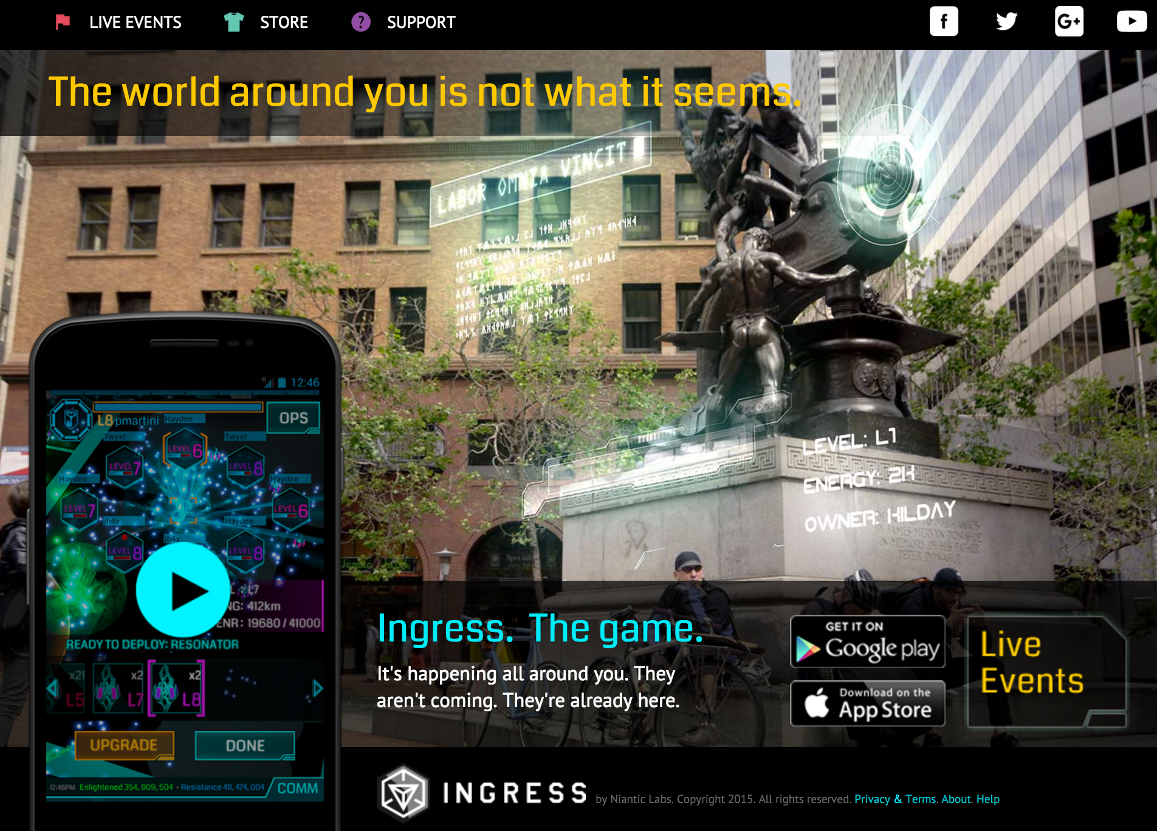
Notes:
Ingress is an augmented-reality massively multiplayer online location-based game[4] created by Niantic Labs. The game was first released exclusively for Android devices on November 15, 2012,[2][5] and was made available for Apple's iOS on July 14, 2014.[3][6] The game has a complex science fiction back story with a continuous open narrative,[7][8] which however is not necessary for playing and enjoying the game. Ingress has also been considered to be a location-based exergame.[9]
The gameplay consists of capturing "portals" at places of cultural significance, such as public art, landmarks, monuments, etc., and linking them to create virtual triangular "control fields" over geographical areas. Progress in the game is measured by the number of "mind units" (MUs) captured via such control fields, i.e. people nominally controlled by each faction (as illustrated on the Intel Map).[10][11] The necessary links between portals may range in length from meters to kilometers or hundreds of kilometers, created in operations of considerable logistical complexity.[12] International links and fields are not uncommon, as Ingress has attracted an enthusiastic following in cities worldwide[13] amongst both young and old,[14] to the extent that the gameplay is itself a lifestyle for some, including tattoos.[2] Gameplay relies heavily on the player physically moving about the community in order to interact with portals. Playing in a vehicle is possible, but increases in speed disable some features of the game, both for safety reasons and in order to encourage physical activity.

Slide 44
                Television
flickr.com/photos/75012107@N05/9183539215/
Notes:
TVs - connecting our internet do hickeys to it to watch cat videos on youtube. My tv has wifi capabilities. I use an AppleTV to watch Netflix. DVRs? Other stuff? Ask...
4K monitors and movies - right around the corner.

Slide 45
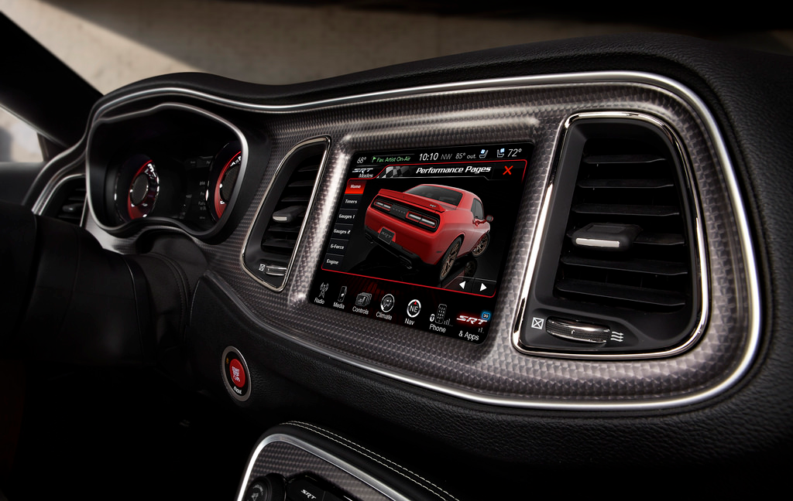
flic.kr/p/nHqun2
connected cars
Notes:
Anyone have this and use it? hybrids, in-cab computers (sync, etc), smartphone connectivity, self-driving cars.
We set an on-car reminder for our next oil change. Weird!

Slide 46
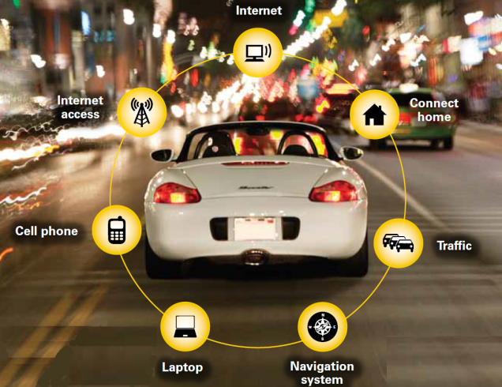
http://www.startupbootcamp.org
Notes:
read slide … then - think about the bookmobiles of the future!

Slide 47
http://widgetlove.com/media/catalog/product/cache/1/image/d1eb4c9f6ec46dda73e75238af223687/s/k/sku_60646_1.jpg
Batteries!
Notes:
boring but really necessary! Share mine… cheap but useful.
Also extra cables to plug in when I need to. In the car, at work, etc.
nanowire lithium-ion batteries. faster charge, holds 30-40% more electricity. Great for automobiles!

Slide 48
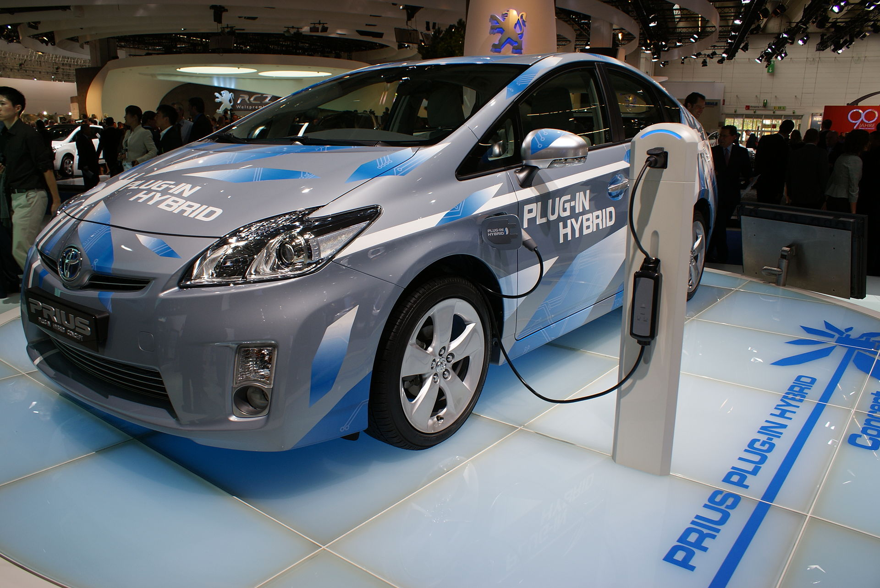
https://en.wikipedia.org/wiki/Toyota_Prius_Plug-in_Hybrid

Slide 49
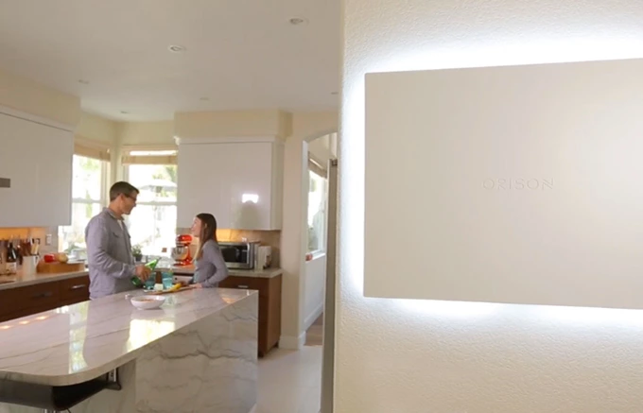
https://www.kickstarter.com/projects/ericclifton/orison-rethink-the-power-of-energy
Notes:
Orison gives you power over energy like never before. Whether you get your energy from the grid, a solar array, or some other source, you can now control when to store it and when to use it. Orison will automatically store energy when utility rates are low, and then use that energy to power your home or business when rates are high. During a power outage, it will automatically power your home or business and make sure none of your stored energy is sent back to the grid. By localizing your energy distribution, you save money and reduce peak demand on the grid.

Slide 50
What’s this mean for the library?
Notes:
People will be bringing in weird stuff
they will want to pug it in to your public PCs
they will want to charge it up
Gaming - might mean consoles, might mean some tablets.
try before you buy
And they will want to download it to watch/listen.

Slide 51
4
flickr.com/photos/keoni101/7069578953/
wearable
tech-
nology
Notes:
Wearable/ultra-portable computing will begin to work its way into events
This decade may turn out to be the decade of wearable/everywhere computing. Computers are popping up in our cars, our home appliances, and soon on our bodies.
wearable tech is to smartphone as smartphone is to laptop.

Slide 52
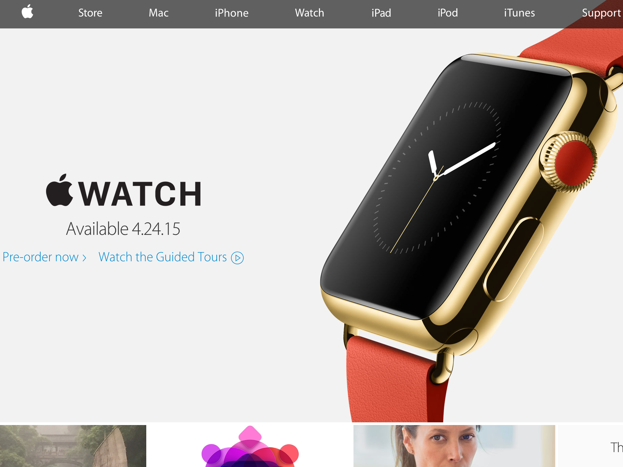
Notes:
Apple Watch! tells time. vibrates for messages. You talk to it. Messages, calls, and email. will transfer seamlessly to an iphone or a computer. Glances - weather, calendar, etc. Fitness tracker that syncs to iphone - actually learns your activity and fitness levels, then suggests activity goals. Apple Pay - uses NFC technology and your credit card info so you can pay with your watch. Apps have an add-on called Glances, so you get relevant updates on your watch.
$349, I think. Pretty pricey watch! But it does a whole lot, too.

Slide 53
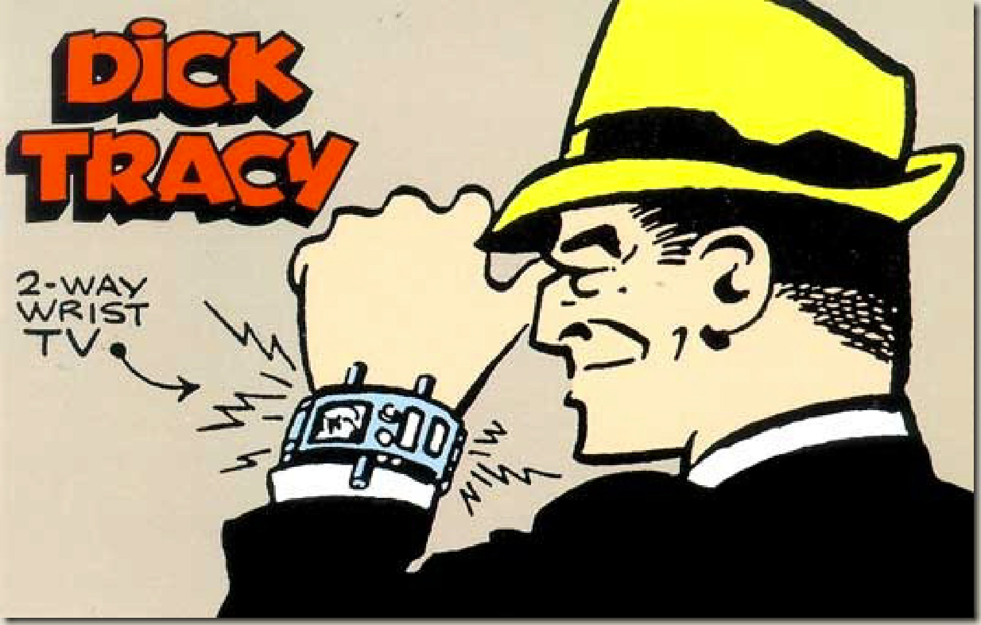
pearlsofprofundity.files.wordpress.com/2013/08/dick-tracy-5.jpg

Slide 54
flickr.com/photos/blazenhoff/10075402254/
Google Glass
Notes:
google.com/glass - uses: record your work in classroom. Teacher takes class on a tour of a manufacturing plant. access teacher notes, syllabus, reference tool, etc during class.
Firefighter example - access floorplans, maps, cameras, etc to aid in saving lives.
$1500, different styles. Very experimental still.

Slide 55
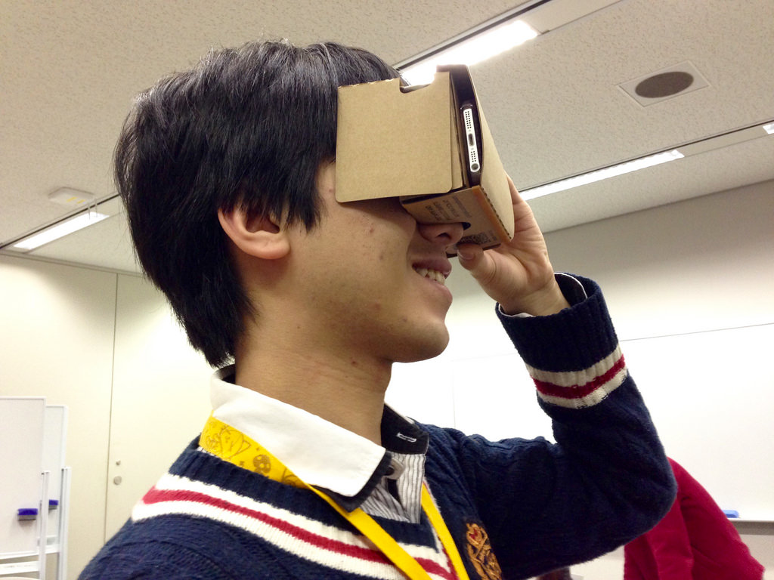
https://flic.kr/p/BrmcwQ

Slide 56
flickr.com/photos/piatkowski/8558437789/
smart watches
Notes:
wikipedia.org/wiki/Smartwatch
Pebble, Martian, Sony, Samsung, etc.
check sports scores, send texts, health monitor (sleep patterns, calories burned, walk and run step counter, etc). Home controls like thermostats or music, get directions (maps, GPS). notifications that you don’t want on your phone. You can peek like you peek at your watch.

Slide 57
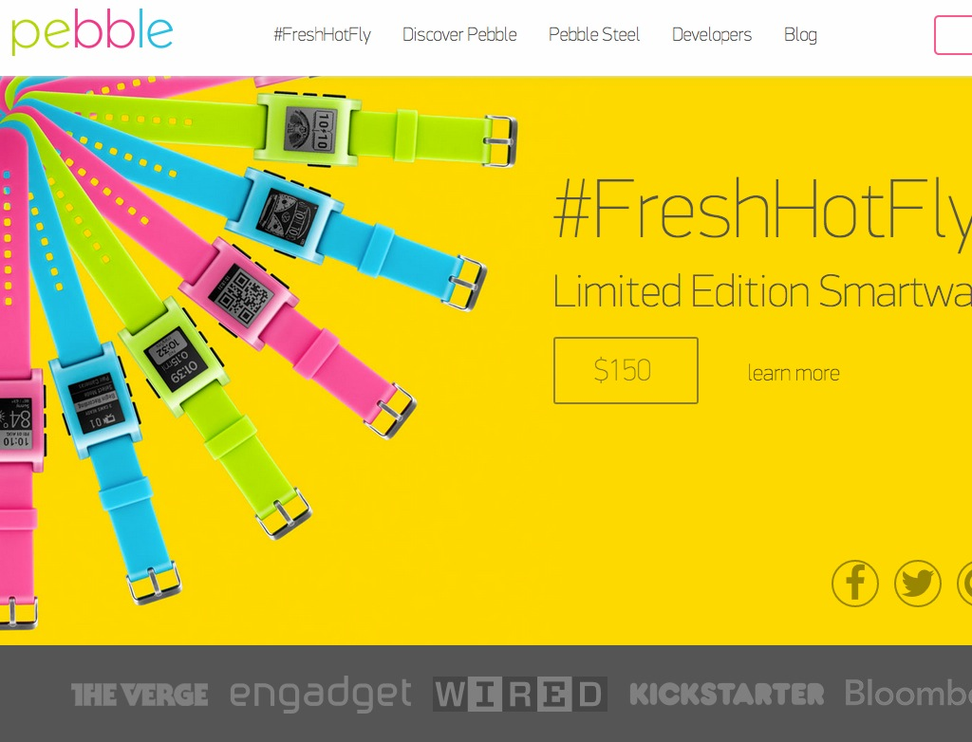

Slide 58
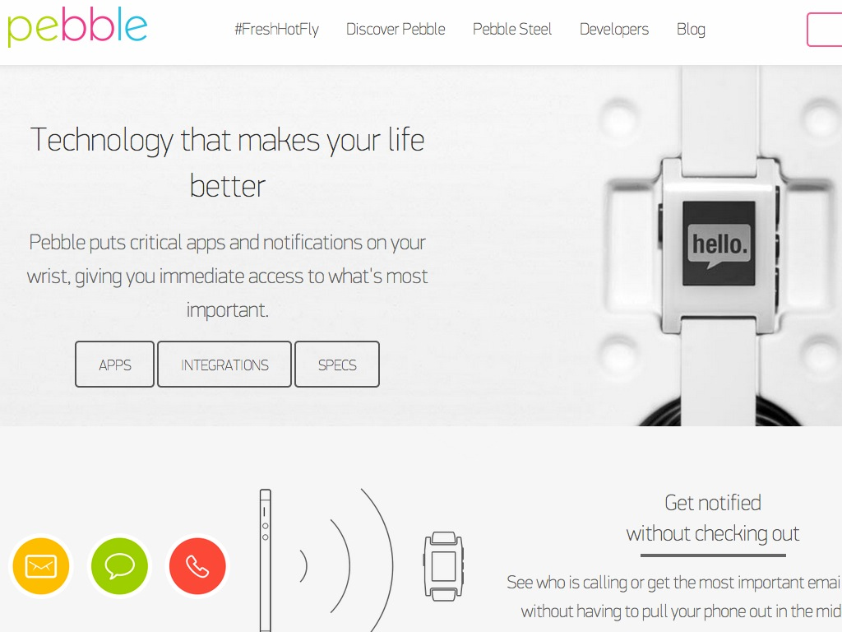

Slide 59
health monitor
bracelets
flickr.com/photos/intelfreepress/9690003914/
Notes:
Nike’s FuelBand, Jawbone’s UP, Fitbit, Misfit’s Shine and others, all of which can be used as part of a personal health-monitoring system. iHealth has a digitally-connected glucose testing kit, and the company’s digital blood pressure cuff uses the iPhone for controlling the cuff and delivering data to the user.
connect to apps. count steps.

Slide 60
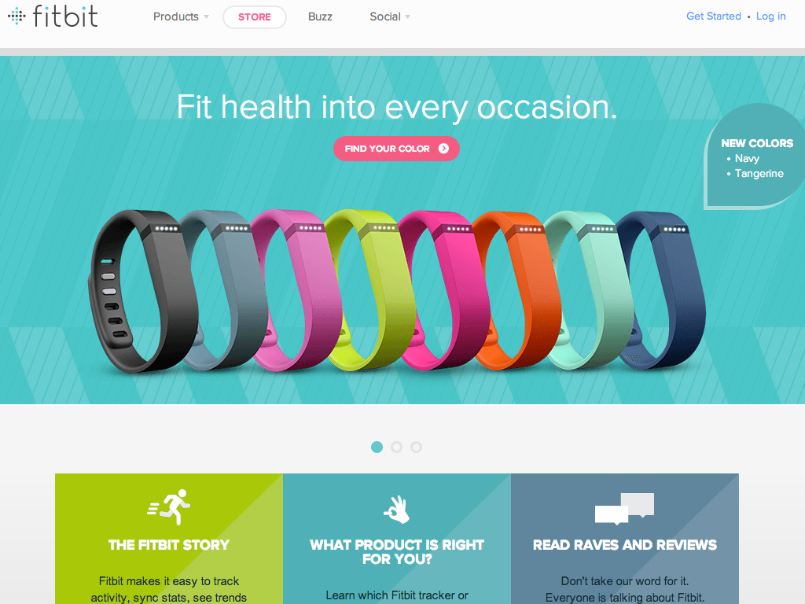
Notes:
fitbit flex. $99.
tracks steps, distance, and calories burned. Sleep quality and wakes you silently in the morning. Stats are synced to an app/website.
Goal - be healthy, more active.

Slide 61
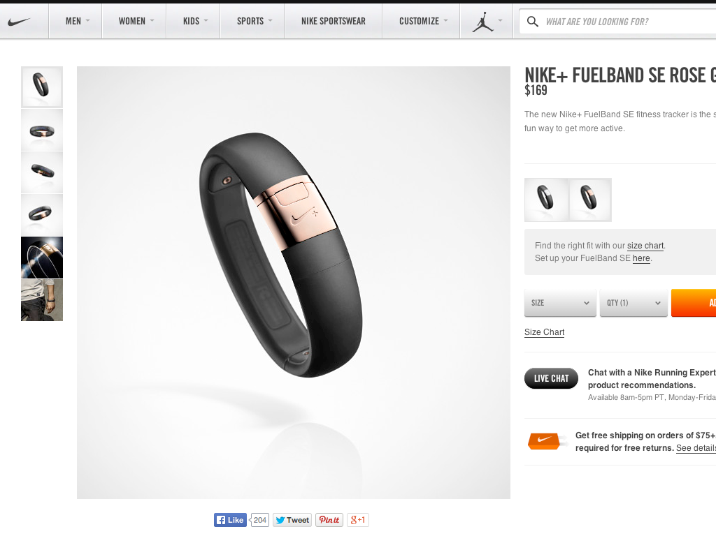
Notes:
Nike Fuelband - $150-170. Earn “Nikefuel.” Tracks workout intensity, sleep tracking, Nike Groups - social network for them. “win the hour” - reminders that give you an extra push to get you moving.

Slide 62
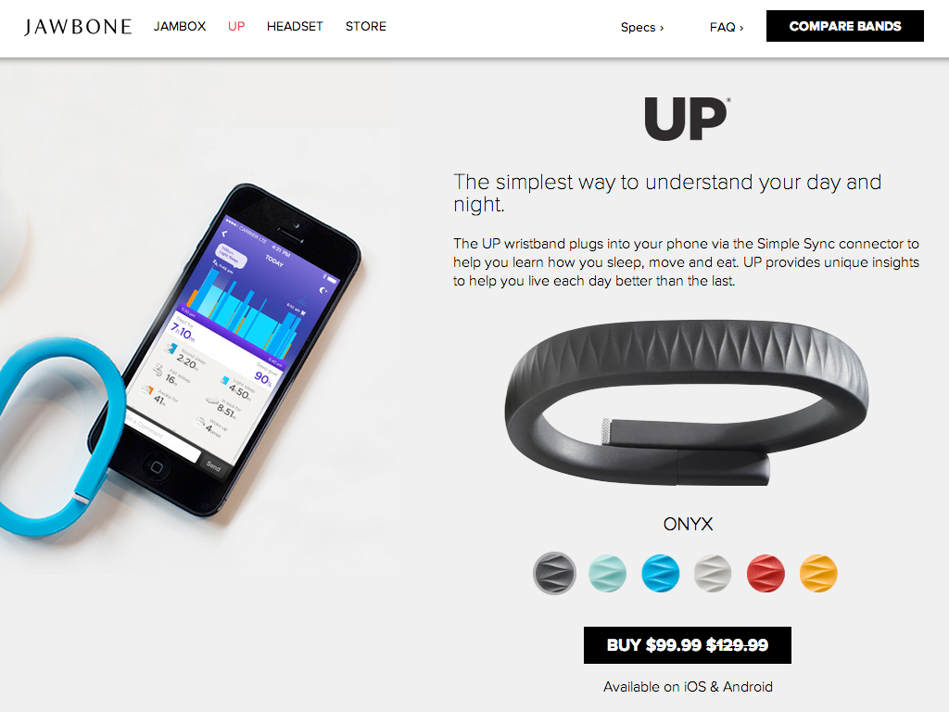
Notes:
Jawbone UP - “insight engine.” logs workouts, calories burned, intensity. Food and drink tracking, sleep tracking, smart alarm (vibrates to wake you up at the optimal moment in your sleep cycle so you feel refreshed). customizable idle alert,, mood tracking!

Slide 63
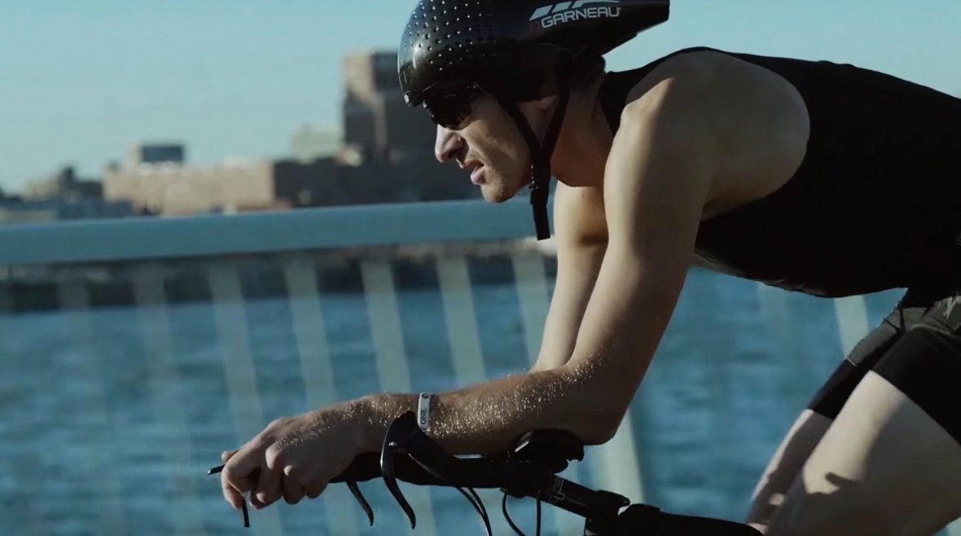
hexoskin.com
Notes:
Hexoskin, the first company to launch a sensor-packed smart shirt back in 2013, is looking to address that app issue with its brand new Smart shirt. Like the first version, the Smart can record movement, heart rate and respiration when you're awake or asleep. All of that data can be reviewed in real time on a smartphone or tablet with your entire workout history stored in the cloud.
Now thanks to the inclusion of a Bluetooth Smart sensor the shirt can connect to a whole host of fitness apps, which includes Runkeeper, Strava, Endomondo, Runtastic, MapMyRun and Polar Beat.

Slide 64
what’s this mean for the library?
flickr.com/photos/intelfreepress/9690003914/
Notes:
Power. Connecting it to the internet, to a website.
Eventually, probably us incorporating it into work. Cleaning it, sharing them. Ick.
If your business supplies iPhones, will it supply the Watch too?
classes on what they are/how to use? Fitbit at the library group? Walking book discussion group?

Slide 65

5
smart
machines
flic.kr/p/cTn6M9
Notes:
a smart machine is an intelligent device that uses machine-to-machine (M2M) technology.
Smart machines include robots, self-driving cars and other cognitive computing systems that are able to make decisions and solve problems without human intervention.
Smart machines will be digital disruptors because of the effects -- both positive and negative -- they will have on society. In business, the competitive advantages these technologies are capable of providing may bring higher profit margins and lead to more efficient manufacturing processes.

Slide 66
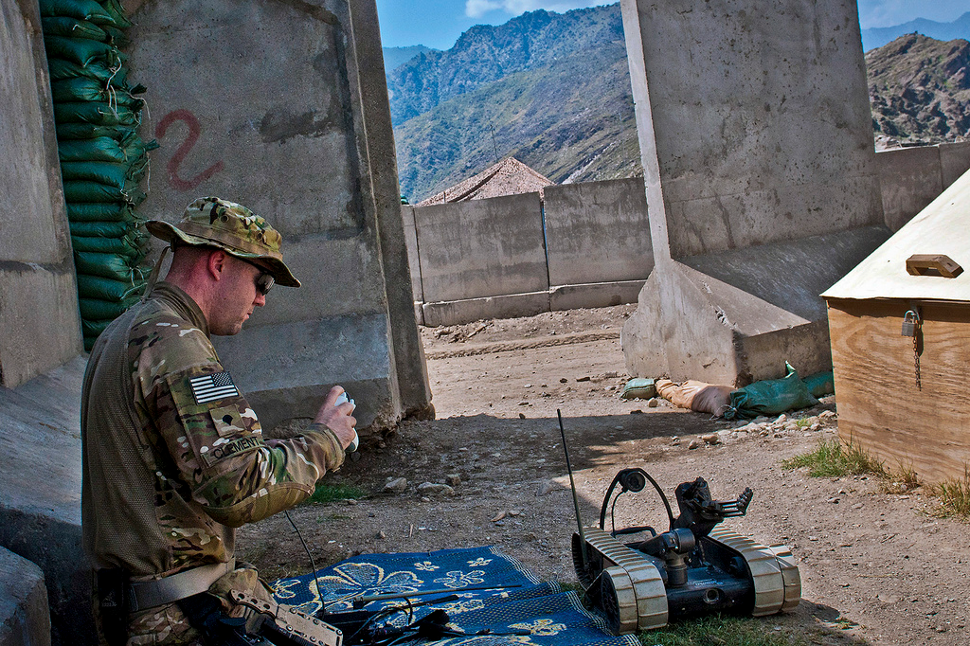
robotics
flic.kr/p/a9HrBK
Notes:
U.S. Army Spc. gets a refresher course on an EOD robot in eastern Afghanistan EOD = explosive ordnance disposal
Robotics is HUGE. Mars rovers, military. Service industry! Arduinos help make simple ones.
Just the beginning.

Slide 67
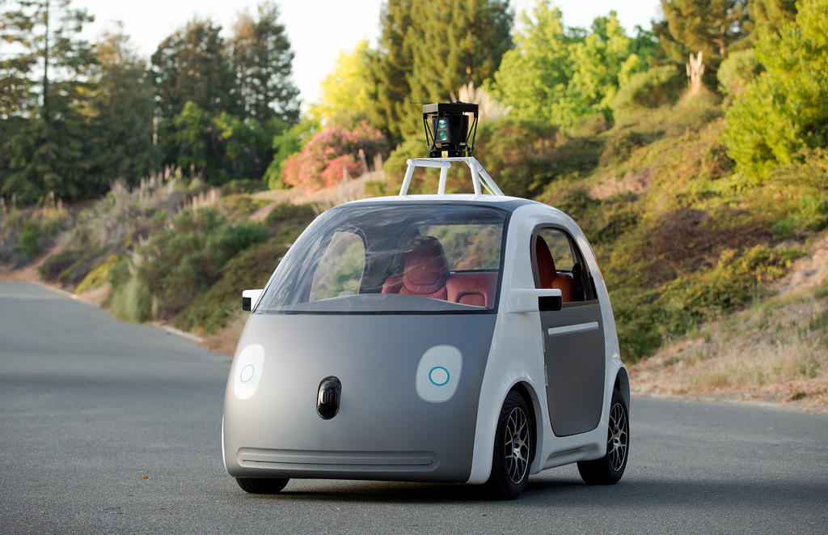
flic.kr/p/p1FYTd
Notes:
Self driving cars. Google’s version here.

Slide 68
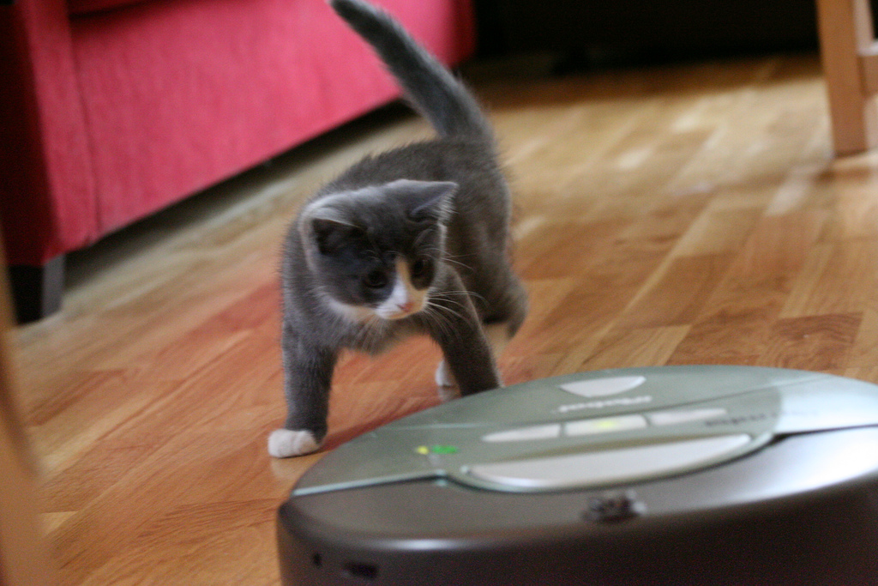
flic.kr/p/qWDEP
Notes:
Roomba vacuum cleaner!
Replacing human work. Some good, some bad.
automated call centers. Manufacturing, assembly lines.

Slide 69
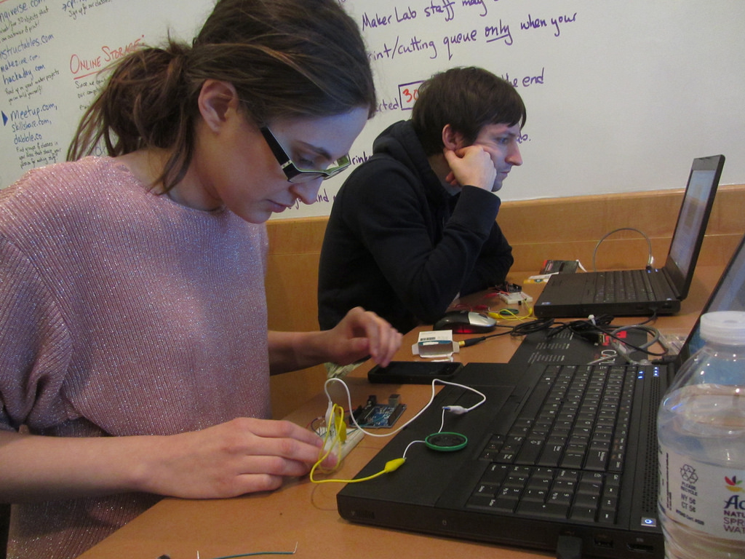
flic.kr/p/k6bnoy
what’s this mean for the library?
Notes:
Chicago Public Library makerspace.
Arduino stuff
Teach. Classes, makerspaces. Arduino, Raspberry Pi, sensors. Electronics.
Your collections…
As smart devices get more mainstream, think about adding them to library.
Automated Handling Systems as early example …
What else?

Slide 70
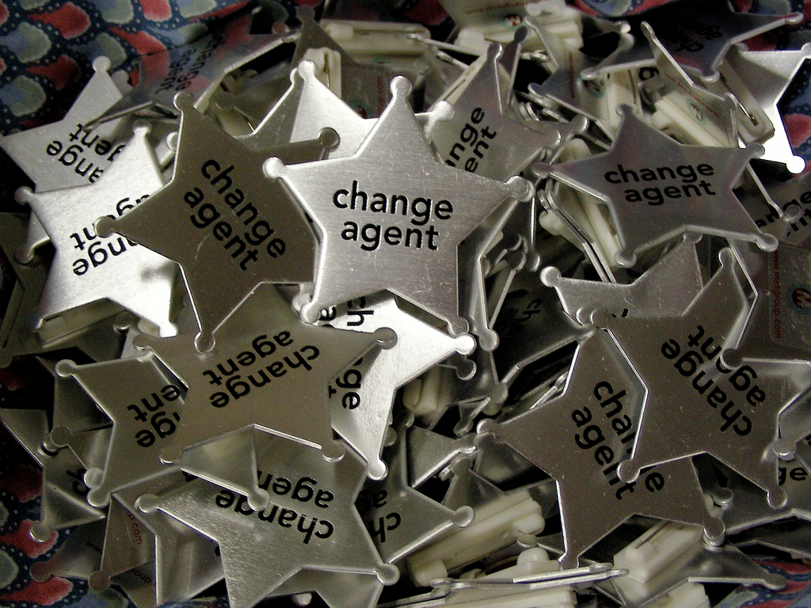
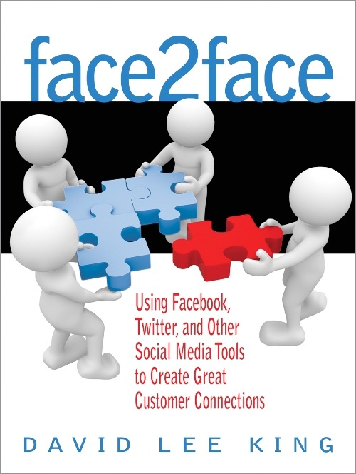
to be continued …
davidleeking.com
Notes:
Thanks! Part 2 is next month!

Slide 71
Emerging Tech Trends
The Series Continues
Part 3: Tuesday, March 2, 2016
David Lee King
Part 4: Wednesday, June 15, 2016
Laura Solomon

Slide 72
Infopeople webinars are supported in part by the U.S. Institute of Museum and Library Services under the provisions of the Library Services and Technology Act, administered in California by the State Librarian. This material is licensed under a Creative Commons 3.0 Share & Share-Alike license. Use of this material should credit the author and funding source.

