Slide 1
Building An E-book Collection
An Infopeople Webinar
Amanda Jacobs Foust
Consultant
February 9, 2016
Notes:
Hi everyone. I am Amanda Jacobs Foust, former Electronic Services Librarian for Marin County Free Library and former Library Collection Development Coordinator for Califa’s enki ebook platform. During my tenure with Marin County, I initiated or assisted in the launch of key e-Book collections; including Overdrive (not once, but three times), 3M Cloud, Baker & Taylor’s Axis 360, enki Library and Hoopla for both our 10-branch county system and our consortia.

Slide 2
The Value Of
E-books
Notes:
So, let’s dive into our first topic for today’s webinar, the value of e-books and get into the nitty, gritty of why we should collect and provide e-books at all.

Slide 3

Why Collect E-books?
https://briannaejackson.wordpress.com
Notes:
Why collect e-books at all? It’s a refrain you’ve probably all have heard from staff and patrons alike. Perhaps it’s even something you yourself question. The simplest answer is because patrons read them. Ever since the rise of e-readers with the launch and success of Amazon’s Kindle starting in 2007, e-books have been, until recently, in increasing demand by readers. Library staff, particularly those who work in traditional reference and circulation desks, deal most frequently with traditional library users who come into the library regularly and check out physical books. However, American readers, on the whole, are hybrid readers, even as e-book reading slows and print reading remains strong (Pew, see resources handout) And some patrons don’t read print at all any more and never enter a physical library building, instead, they (primarily) self-serve without any interaction with staff or coming into the building. E-book readers are avid and devoted readers who look beyond format for the content they want to read and the availability of material (88% of readers read both formats). Additionally, publishers the divide between what is published in traditional book form and in e-book means that even those that have strong preferences for one format or another must occasional dip into both formats. For example, review books or Advanced Reader’s Copy are increasingly available in e-book format. Plug for e-readers course in April

Slide 4

What Kind Of Patron Reads E-books?
http://www.fieldglass.com/resources/ebooks
Notes:
According to the Pew Research Center: Overall, 36% of our sample of readers in both formats prefer e-books for a majority of the circumstances we queried, 24% prefer printed books, and 40% have no preference. Additionally: Those who read both e-books and printed books prefer reading in the different formats under different circumstances. One of the reasons many book lovers read in both printed and e-book formats is that they feel each format has its own virtues. In a head-to-head competition, people prefer e-books to printed books when they want speedy access and portability, but print wins out when people are reading to children and sharing books with others. When asked about reading books in bed, the verdict is split: 45% prefer reading e-books in bed, while 43% prefer print.

Slide 5
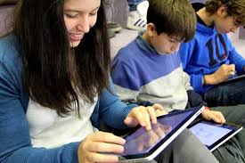
What Community Needs Do
E-books Fill?
http://childrensliteracylab.org/story/_1805
Notes:
All of which is to say that your community is better served and informed by having access to library e-books and your statistics will be reflective of this with increased circulations and by reaching patrons who previously rarely used the library and dedicated users.

Slide 6

CHAT:
Other Reasons To Offer
E-books To Your Patrons?
https://www.istorybooks.co/blog/childrens-stories-online/reading-kids-ebooks-good-printed-books
Notes:
I know for my family a huge part of why we are library users and e-book readers is space. We just can’t afford the physical space to store everything we read. Another consideration is time; we just can’t spend the time we’d like physically visiting local libraries or bookstores. Being able to jump online and download ebooks 24/7 makes our lives easier and simplier.

Slide 7
E-book Publishers & Vendors
Notes:
So now that we discussed some of the philosophy of why libraries should provide e-books, let’s start delving into some of the unique complications of providing them. As many of you know, printed books can be purchased by libraries and loaned to the public under the first sale doctrine. According to ALA: without the the first-sale doctrine, which allows the owner of any particular lawful copy of a copyrighted work to resell, rent, lend, or give away that copy without the copyright owner's permission… the shift to digital dissemination may give copyright owners more complete control over access to copyrighted works and in particular may eliminate the preservation benefits of widespread distribution of copies that are legally and practically transferable under the first-sale doctrine. Which is why and how publishers are able to currently license or lease content rather than allowing us to outright purchase and own e-books.

Slide 8





The Big Five
No checkout cap, but initial pricing is 3X that of retail.
Limits to 26 checkouts
Titles expire after two years or 52 checkouts.
No checkout caps, but pricing can be as much as 300% higher than retail.
Titles expire after one year.
Notes:
So, the Big Five. None of these are great options, particularly in regards to building and maintaining your e-book collection. It certainly requires a whole new way of thinking and considering how to spend your money while serving your community. You definitely can’t apply the same tried and true collection development principals you use for your physical collections. All are one copy, one user. For example, do you have a hold ratio for your physical books? It’s really hard to mimic your hold ratio for ebooks if they cost 3x as much as a physical copy.

Slide 9

Other Publishers and Free E-books
http://teste.tinegociosse.com.br/2014/02/13/efeitos-da-tecnologia-intelectual-em-nossos-cerebros-web
Notes:
Outside the Big Five, publishers are more flexible, but within the confines of ebook vendors for libraries, it is difficult for libraries to self-manage the content they could own and manage. The Open e-Books initiative (The Open eBooks initiative will make over $250 million in popular e-books from major publishers available, for free, to children from low-income families via an app. The Open eBooks app is being developed by the New York Public Library, which is partnering with the Digital Public Library of America and First Book to curate and deliver the e-books to students from low-income families.), the Digital Public Library of America, the Library Simplified app ( It is intended to work and integrate with technologies and systems common to libraries such as an Integrated Library System/Library Management Systems (ILS/LMS), Online Public Access Catalogue (OPAC) or Single Sign On (SSO) credential management system or commercial eBook hosting and distribution service such as Overdrive, Baker & Taylor's Access 360, or 3M Cloud Library.), Unglue.it (Unglue.it is a place for individuals and institutions to join together to make ebooks free to the world. We work together to support authors, publishers, or other rights holders who want their ebooks to be free. We support Creative Commons licensing as an enabling tool to "unglue" the ebooks) and Internet Archive are all resources that try and address these issues. Free eBooks can be found and linked from your library’s website and catalog. For free (and legal) e-book collections, try Baen Free Library, Feedbooks, Project Gutenberg, Bartelby and Open Library. Links for all of these are available in the resource sheet.

Slide 10
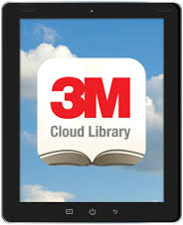
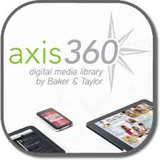
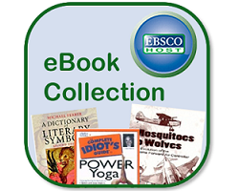
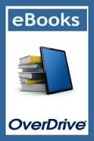
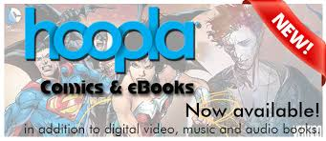
E-book Vendors For Libraries
Notes:
Current best practice when determining a vendor is to determine what content you want. OverDrive, the largest and most-well-known of library e-book vendors provides the largest collection of titles. Baker & Taylor’s Axis 360 is typically the most affordable in regards of upfront, starting costs and 3M is historically the most flexible in terms of owning content and transferring content. EBSCo eBooks has a strong non-fiction collection that was formerly the NetLibrary collection and hoopla is making a big splash in libraries as a content provider. They use a pay per use model, which intimidates many libraries out of free of spending too much budgeted money. Additionally, they provide something the other vendors have been unable to secure; which is comics.

Slide 11
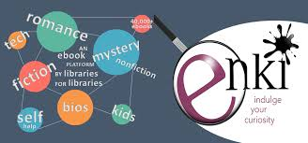
Califa’s Enki Library
Notes:
We’d be remiss not to spend a few minutes on Califa’s enki project. Califa, which is a CA non-profit multi-type library consortium which negotiates discounted rates for group purchases on behalf of it’s members, and pioneers new technological projects; such as the enki library, which began in 2012 in partnership with Contra Costa County Library. The enki Library is different from traditional library vendors in that it: is an eBook platform built on open source code, Califa owns all the titles, they only purchase content directly from publishers and they never pay retail and it’s a shared collection.

Slide 12
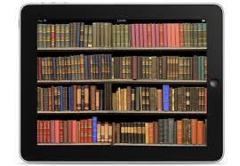
CHAT:
Other Vendors Your Library Offers?
http://www.likesbooks.com/blog/?p=11195
Notes:
I know that there are other vendors out there that are less popular, such as the Gale Virtual Reference Library or can sometimes be overlooked, such as the Safari Tech Collection, which can be easily accessed and used; but ten

Slide 13
Policies & Procedures
Notes:
So now, let’s talk about some policies and procedures…

Slide 14

How To Determine Which
E-books To Buy
http://www.tylershores.com/2015/05/11/president-obamas-250-million-ebook-program-the-good-the-bad-and-the-maybe
Notes:
For libraries, when publishing e-books, we have to consider not just the content (and it’s availability per the publisher), but also our vendor choice and how the interface as provided by the vendor enhances or detracts from the user’s experience. This proves to be an enormous challenge because of the wide array of technical challenges that can be present. A great vendor interface can change overnight due to a system update, a revised app or be drastically diminished (or improved upon) if the company is acquired or merged with a new vendor. It is a constantly changing and challenging environment for both the public and staff at all levels of technical comfort. Recommended budget allocation’s for ebooks is 12.7% by 2017. Your budget will also help you determine how much you can invest in expensive titles, what kind of holds ratio policy you will maintain, how you handle purchase requests and if you will be able to repurchase books on a one or two year cycle. For e-books that expire after a certain amount of time or check-outs, some librarians consider those to be self-weeding titles that don’t need to be repurchased; but, as it is a constantly changing and challenging landscape, it is something you need to carefully consider and review on an annual basis and when big changes happen (such as the recent change implemented by Penguin Random House). A recommended best practice is to form a committee or task force to discuss and consider e-book (and e-content) related issues.

Slide 15
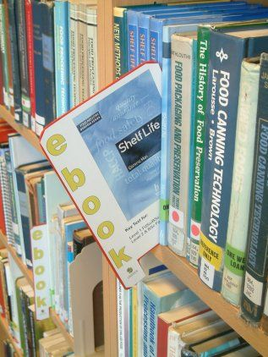
Collection Development &
Challenge Policies For E-books
librarynews.blogs.lincoln.ac.uk
Notes:
It is also important to revisit and adapt both your collection development and challenge policies so that they specifically include e-books and e-content. Patrons will want to know why some content is purchased as ebooks, but not as physical and vice versa and they will also challenge books in your e-book collection and you will need to consider how a challenged book process will be handled.

Slide 16
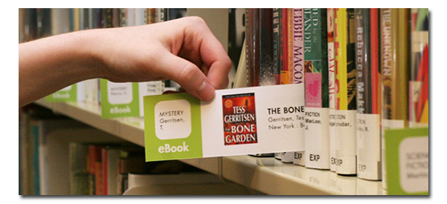
Weeding E-books
http://blogs.overdrive.com/promotional-ideas/2013/01/03/give-your-ebooks-a-physical-presence-sacramento-public-library-shares-marketing-ideas
Notes:
It’s also time for us to implement routine weeding for our e-book collections. Some titles are timely, such as travel guides, and can be outdated and need to be removed. Some non-fiction has become inaccurate and needs to be removed. And don’t forget your expired content. It often needs to be removed when it expires. Just because the collection doesn’t take up the same physical space doesn’t mean that the collection shouldn’t have the some collection maintenance considerations.

Slide 17
Best Practices

Slide 18
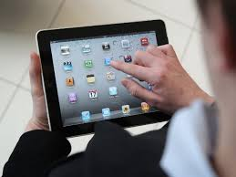
Staff Training On E-books
http://www.techtimes.com/articles/73797/20150803/brain-training-ipad-game-helps-improve-life-of-schizophrenia-patients.htm
Notes:
One of the things I did in my capacity as Electronic Services Librarian at Marin County was assist in the creation and development of ‘eBook Academy,’ which is four two-hour sessions on our downloadable and streaming e-content for staff at all levels. Each staffer also received an iPad Mini for personal use prior to the class and is allowed to retain the iPad mini for the duration of their employment.

Slide 19
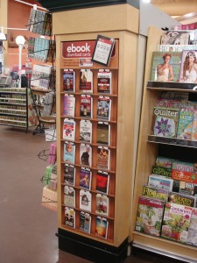
E-book Purchase Suggestions
http://publishingperspectives.com/2013/10/enthrill-reimagines-the-original-discovery-engine-for-ebooks/#.VqaTSvkrK00
Notes:
If possible, encourage your staff and your patrons to suggest e-book titles and purchase them whenever possible. And provide them with the how and why if you cannot purchase said titles.

Slide 20
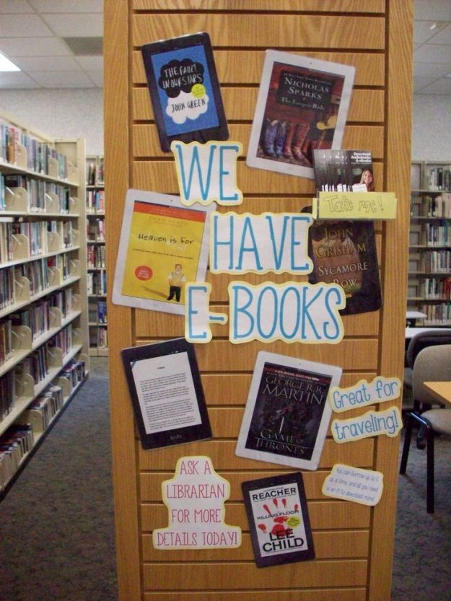
Patron Support of E-books
http://whatareyoureadingblog.com/tag/display-ideas
Notes:
It’s challenging, but necessary to have a hierarchy of support for patrons. At MCFL we would encourage frontline staff to spend no more than 5-10 minutes assisting patrons with ereaders and ebooks before referring them either to book a personalized one-on-one appointment or to put them in touch via email to the Electronic Service department.

Slide 21
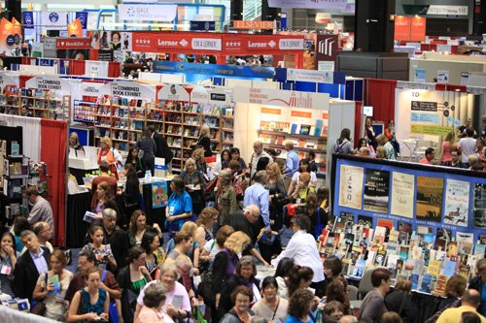
E-books And Conferences
http://thefreightdude.com/blog/2015/05/29/ala-freight-shipping-to-san-francisco-ca
Notes:
One thing that has become clear since the surge of ebooks is that publishers and libraries don’t have a great understanding about how their respective industries work. A lot of staff attend conferences such as ALA Annual and Book Expo and engage and talk with publishers at these events. I would like to encourage all staff to start broaching the subject of e-books and the challenges they face in libraries and with patrons as part of our routine vendor interactions.

Slide 22
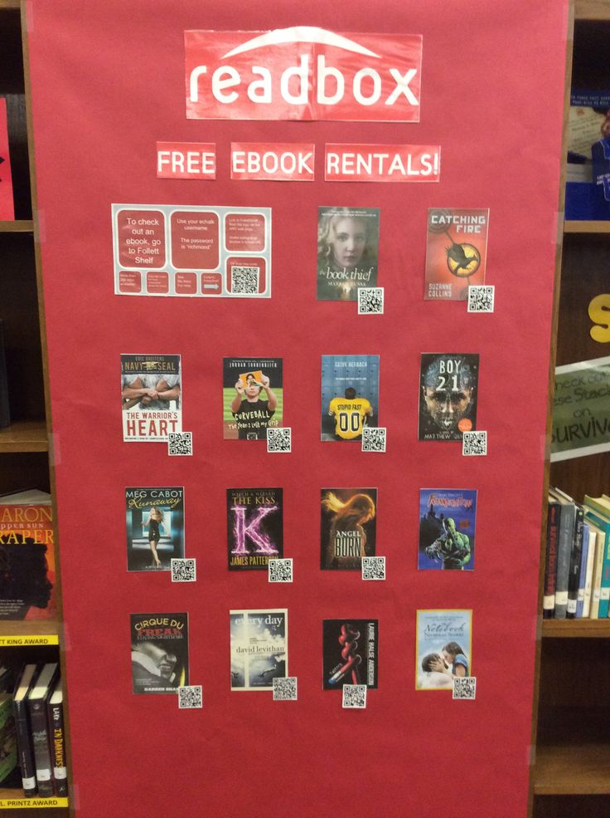
CHAT:
Other Best Practices For E-books?
New Richmond Public Library NRPL
Notes:
Id love to hear from you your success from your libraries.

Slide 23
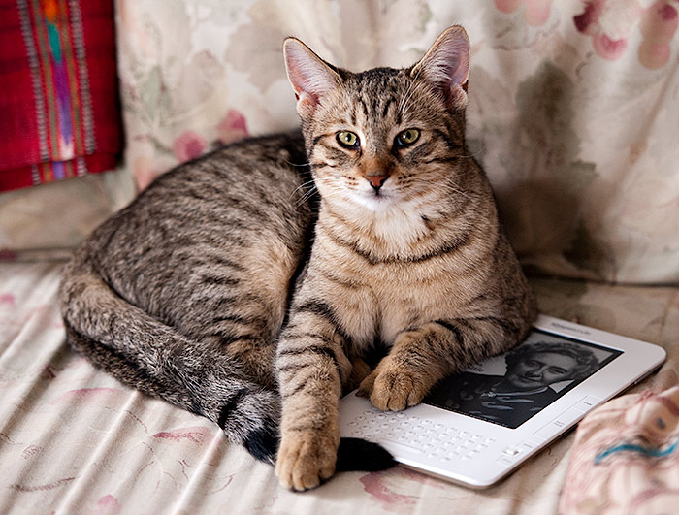
Questions?
http://raeganhuston.com/doggy-did-you-know-edition-21

Slide 24
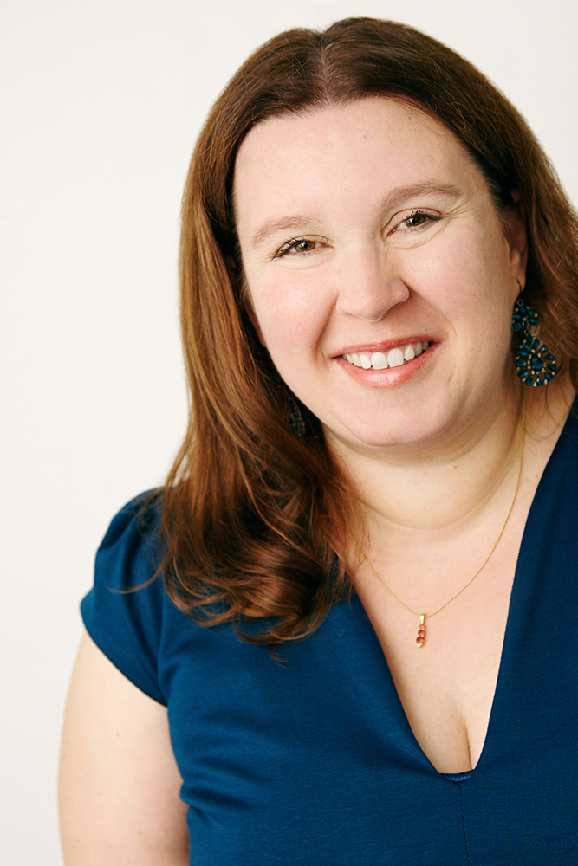
Thank You!
Amanda Jacobs Foust
Consultant
amanda@amandajacobsfoust.com
www.amandajacobsfoust.com

Slide 25
Infopeople webinars are supported in part by the U.S. Institute of Museum and Library Services under the provisions of the Library Services and Technology Act, administered in California by the State Librarian. This material is licensed under a Creative Commons 3.0 Share & Share-Alike license. Use of this material should credit the author and funding source.

