Slide 1
Emerging Tech Trends in Libraries
Part 3
Tuesday, February 2, 2016
An Infopeople Webinar
david lee king | topeka & shawnee county public library | davidleeking.com
Notes:
goal - talk about tech trends and how they affect libraries! 10 trends, how libs should respond, trends vs fads, and how to prepare.
Ton of time for questions, discussion, etc.
Also - emerging trends and tipping points

Slide 2
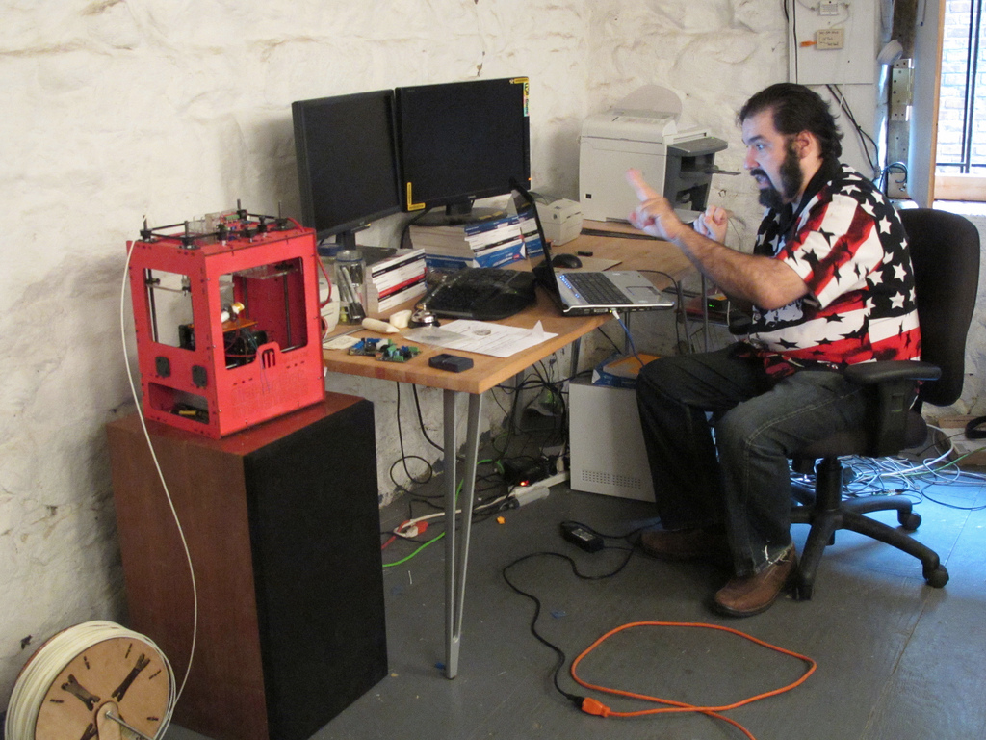
6
Grassroots Tech
flickr.com/photos/laughingsquid/4169808020/
Notes:
Grassroots technology is hard to define, but easily recognizable. This trend includes emerging Do-It-Yourself (DIY) ideas and services like hackerspaces, makerspaces, 3D printing, and digital media labs.
There’s a national “Maker/DIY” trend that’s been steadily growing in recent years, and includes a technology element. Here’s what Makerfaire.com has to say about this trend:
“As the movement has gathered increasing momentum, makers have created their own market ecosystem, developing new products and services. The combination of ingenious makers and innovative technologies such as the Arduino microcontroller and personal 3D printing are driving innovation in manufacturing, engineering, industrial design, hardware technology and education …

Slide 3
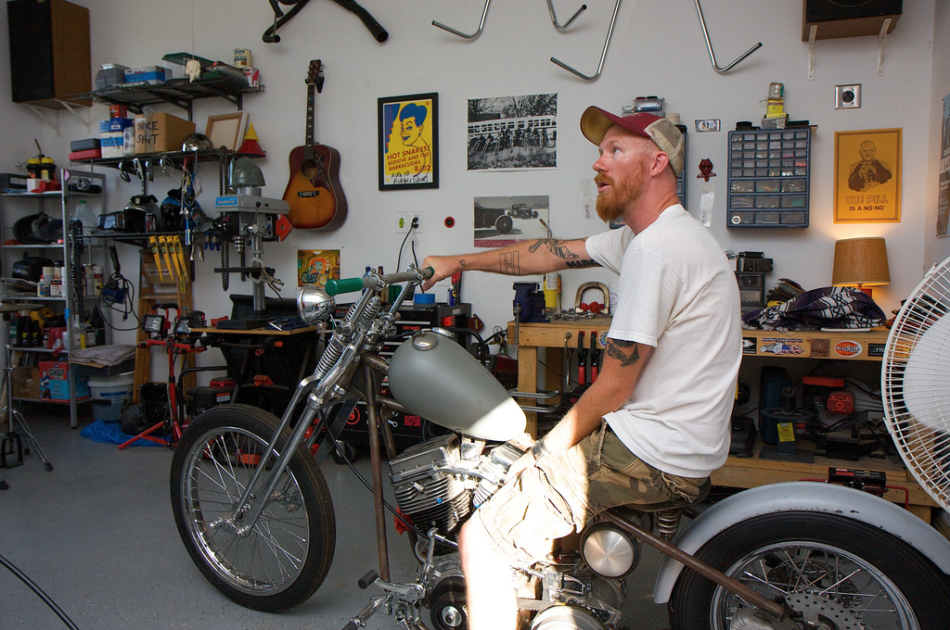
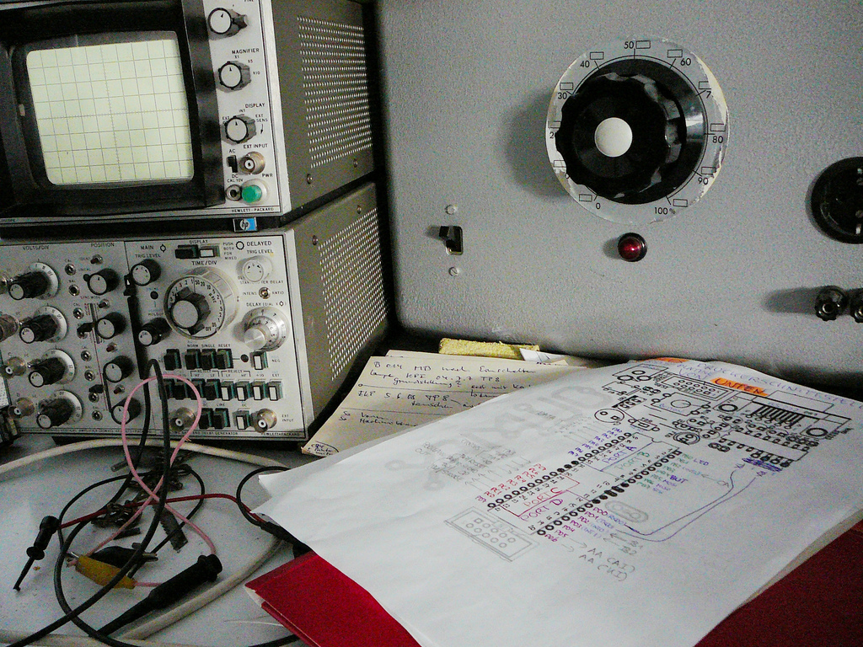
flickr.com/photos/tbisaacs/2641052226/
flickr.com/photos/flickrsven/4788472500/
Notes:
Many makers are hobbyists, enthusiasts or students (amateurs!) – but they are also a wellspring of innovation, creating new products and producing value in the community. Some makers do become entrepreneurs and start companies.”

Slide 4
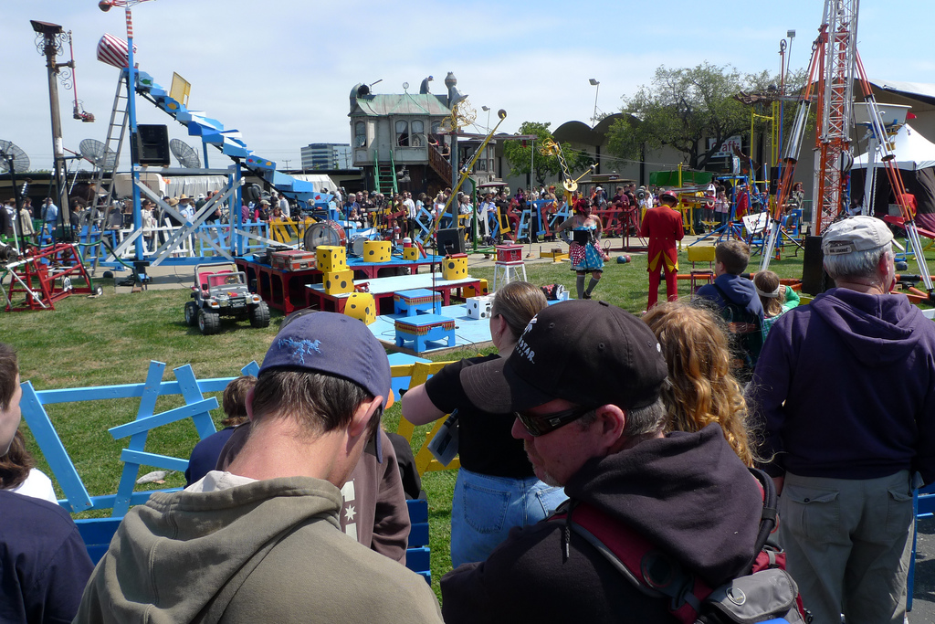
what’s going on here?
flickr.com/photos/jandrick/3586246946/
Notes:
simple - people like making stuff. Always have, always will. They are organizing makerfaires, organizing makerspaces of all types.
Having fun making stuff in a more social environment instead of their basement or garage.

Slide 5
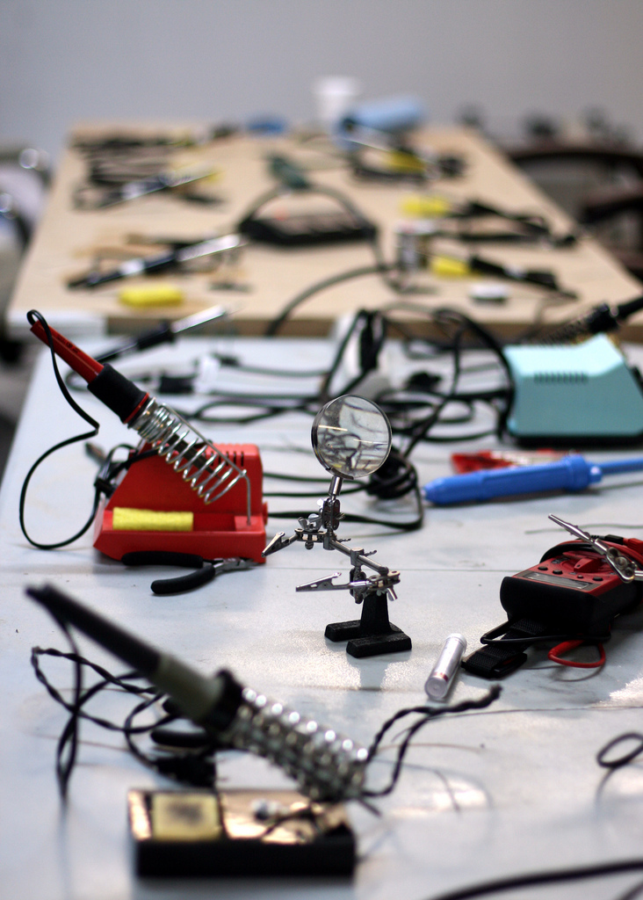
3D printers & makerspaces
flickr.com/photos/opacity/3531963245/
Notes:
Hackerspaces can be viewed as open community labs incorporating elements of machine shops, workshops and/or studios where hackers can come together to share resources and knowledge to build and make things
These are popping up all over the place. People want to make stuff, and they want to collaborate on things. Many of them don’t have a good space - apartments aren’t conducive to this stuff!
tools are expensive, but by coming together and by paying dues, these groups can buy pricey tools.
Not connected to universities or traditional labs. And they combine machine shop, technology, electrical, etc. Think Thomas Edison in the 21st century here.
innovators who want to fabricate, prototype, and learn.

Slide 6
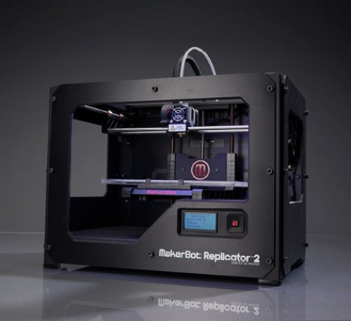
makerbot.com
Notes:
Many of them have this. makerbot. 3d printer. hook it up to CAD software, design something print it out using hot plastic.
This isn’t the end-all. But it is a HUGE game-changer.

Slide 7
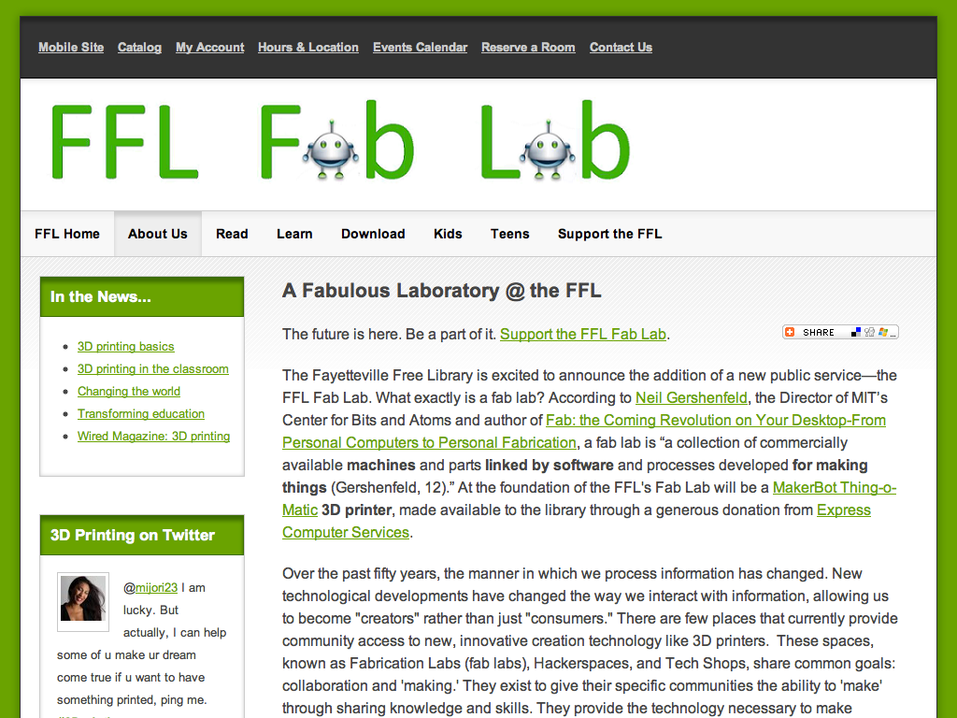
Notes:
Fayetteville Free Library
From FFL - There is no place in the state of New York that provides free and open access to 3D printing technology, which has the power to revolutionize society. The public library will provide a safe and accessible space where anyone in the community can interact, understand and develop through use of this technology.
So far, the Fab Lab is equipped with: a MakerBot, a 3D printer that lets you “print” plastic pieces of your own design
plans on adding other equipment as well, including a CNC router and a laser cutter.

Slide 8
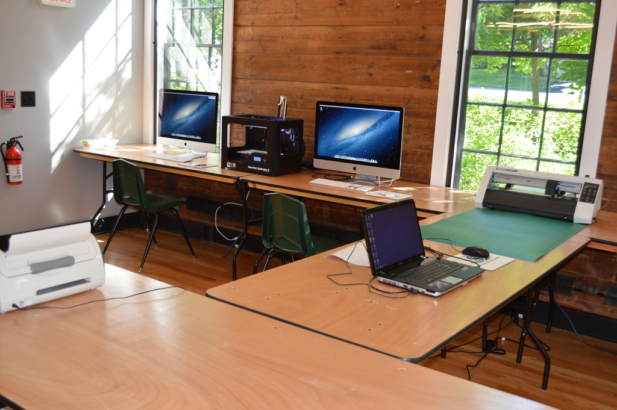
flickr.com/photos/fayfreelibrary/9674422713/
Notes:
Fayetteville Free Library
From FFL - There is no place in the state of New York that provides free and open access to 3D printing technology, which has the power to revolutionize society. The public library will provide a safe and accessible space where anyone in the community can interact, understand and develop through use of this technology.
So far, the Fab Lab is equipped with: a MakerBot, a 3D printer that lets you “print” plastic pieces of your own design
plans on adding other equipment as well, including a CNC router and a laser cutter.

Slide 9
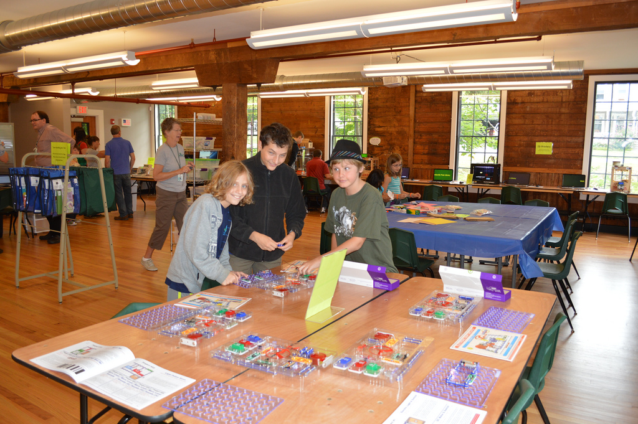
flickr.com/photos/fayfreelibrary/9711109328/

Slide 10
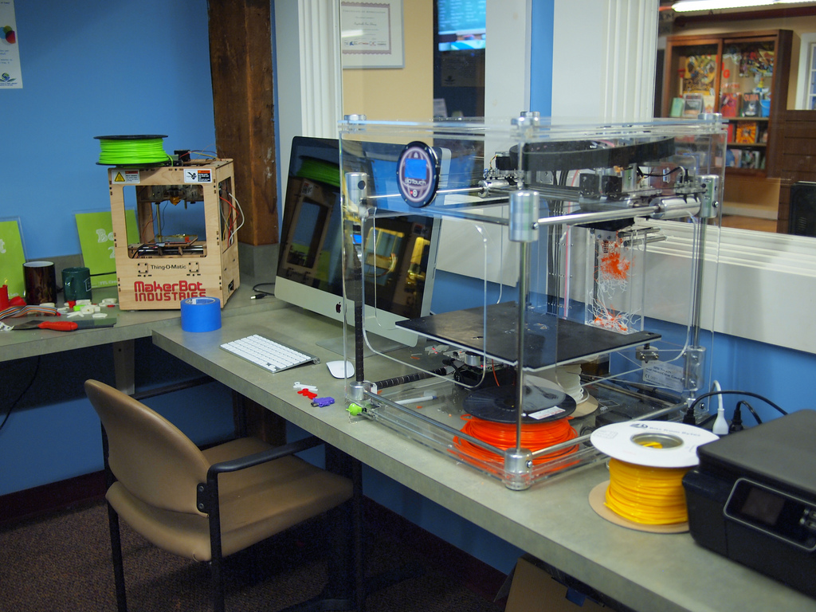
flickr.com/photos/mempix/9657224972/

Slide 11
Notes:
Allen County Public Library and Tekventure, a non-profita

Slide 12
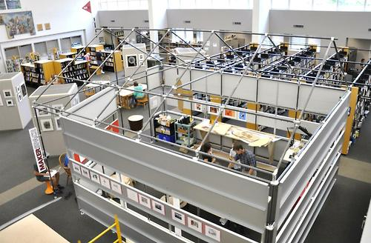
http://25.media.tumblr.com/tumblr_mbybs0MLqq1rhd130o1_500.jpg
Notes:
westport public library - built it inside the library.

Slide 13
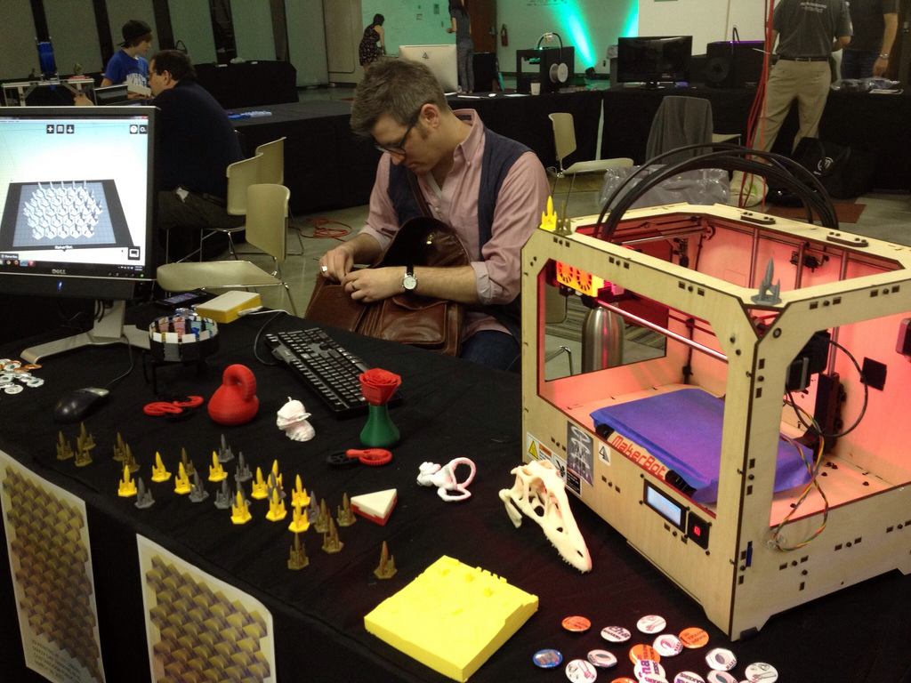
flickr.com/photos/griffey/8562525683/
Notes:
chattanooga public library - the 4th floor of the library. Turning it into a really cool makerspace. More on that as it develops! Just started.

Slide 14
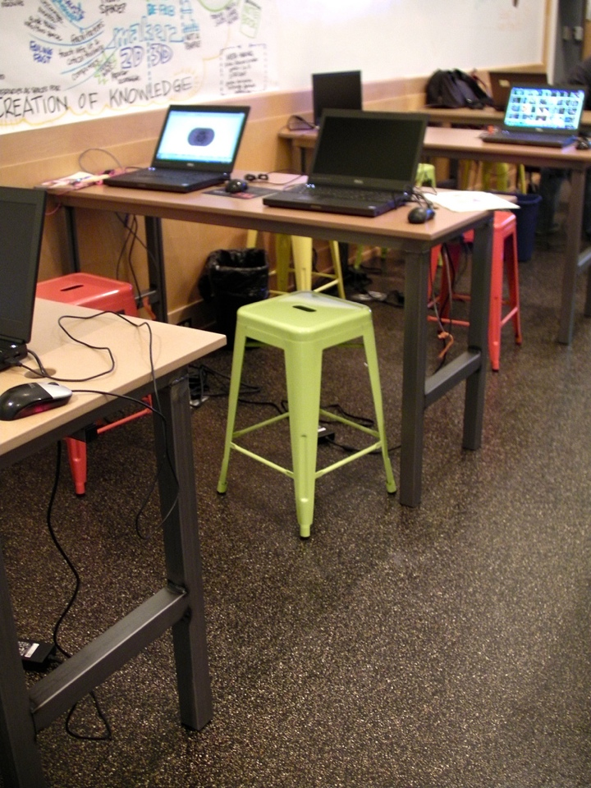

Slide 15
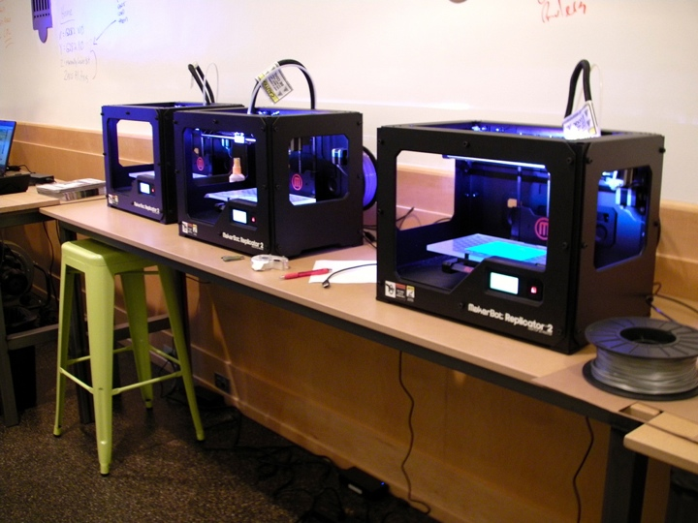

Slide 16
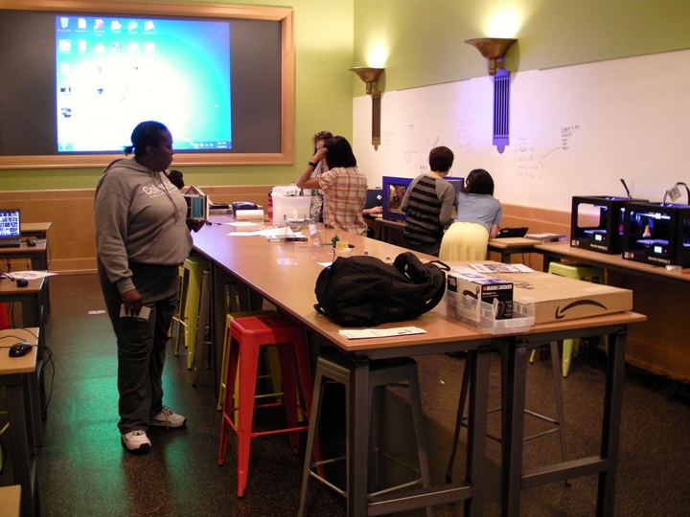

Slide 17
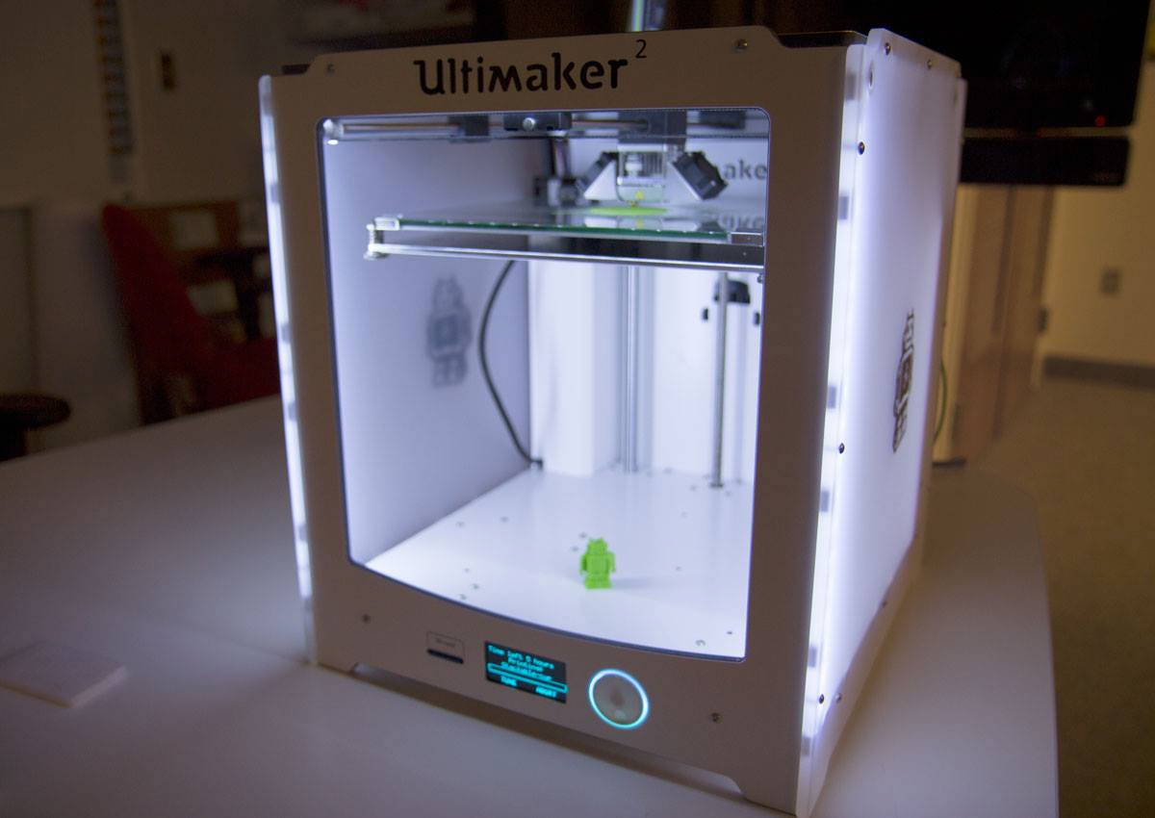
Notes:
Many of them have this. makerbot. 3d printer. hook it up to CAD software, design something print it out using hot plastic.
This isn’t the end-all. But it is a HUGE game-changer.

Slide 18
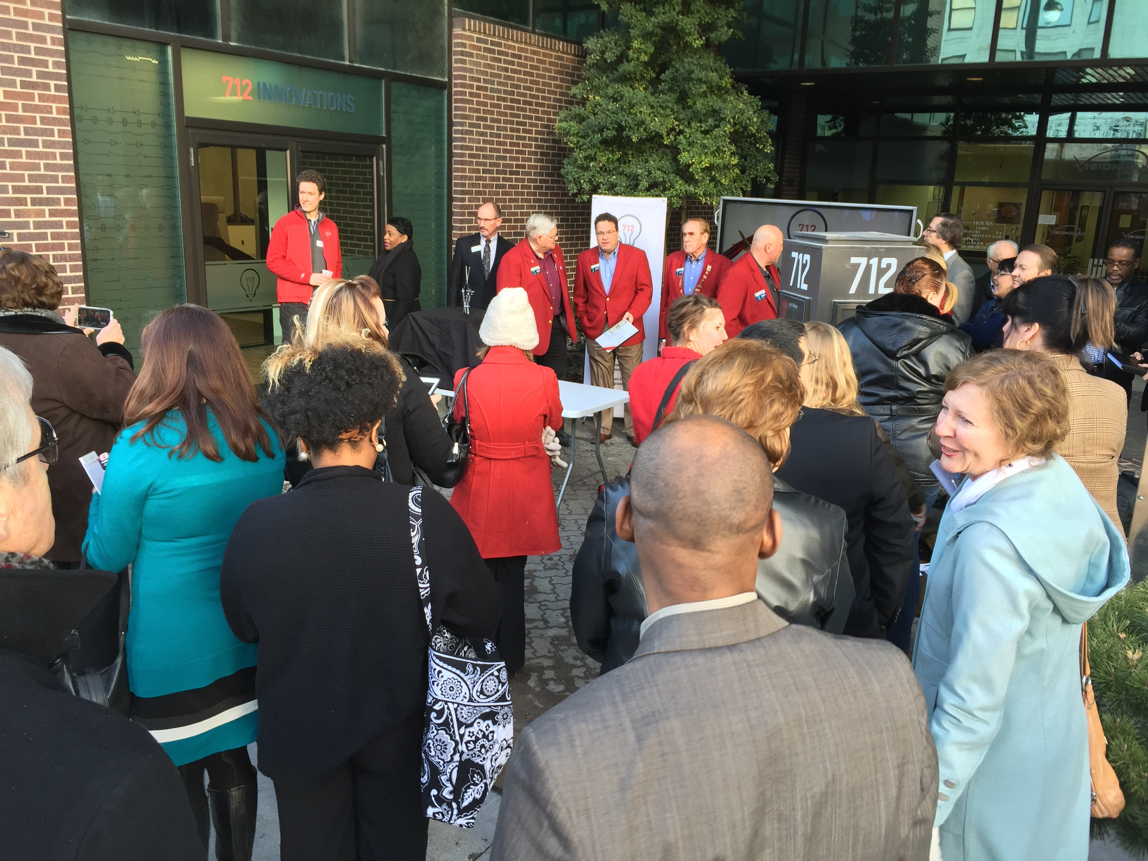
Notes:
Many of them have this. makerbot. 3d printer. hook it up to CAD software, design something print it out using hot plastic.
This isn’t the end-all. But it is a HUGE game-changer.

Slide 19
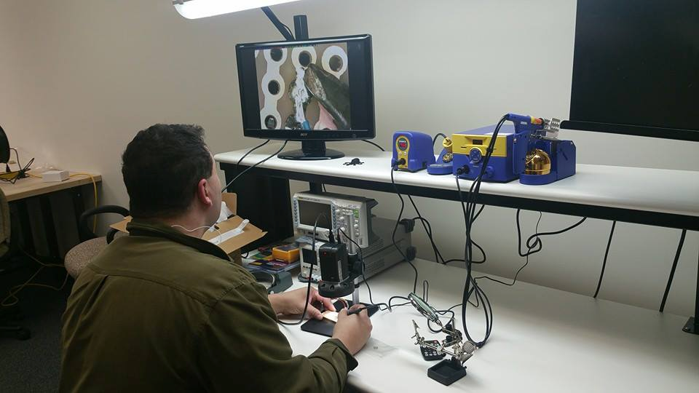
Notes:
Many of them have this. makerbot. 3d printer. hook it up to CAD software, design something print it out using hot plastic.
This isn’t the end-all. But it is a HUGE game-changer.

Slide 20
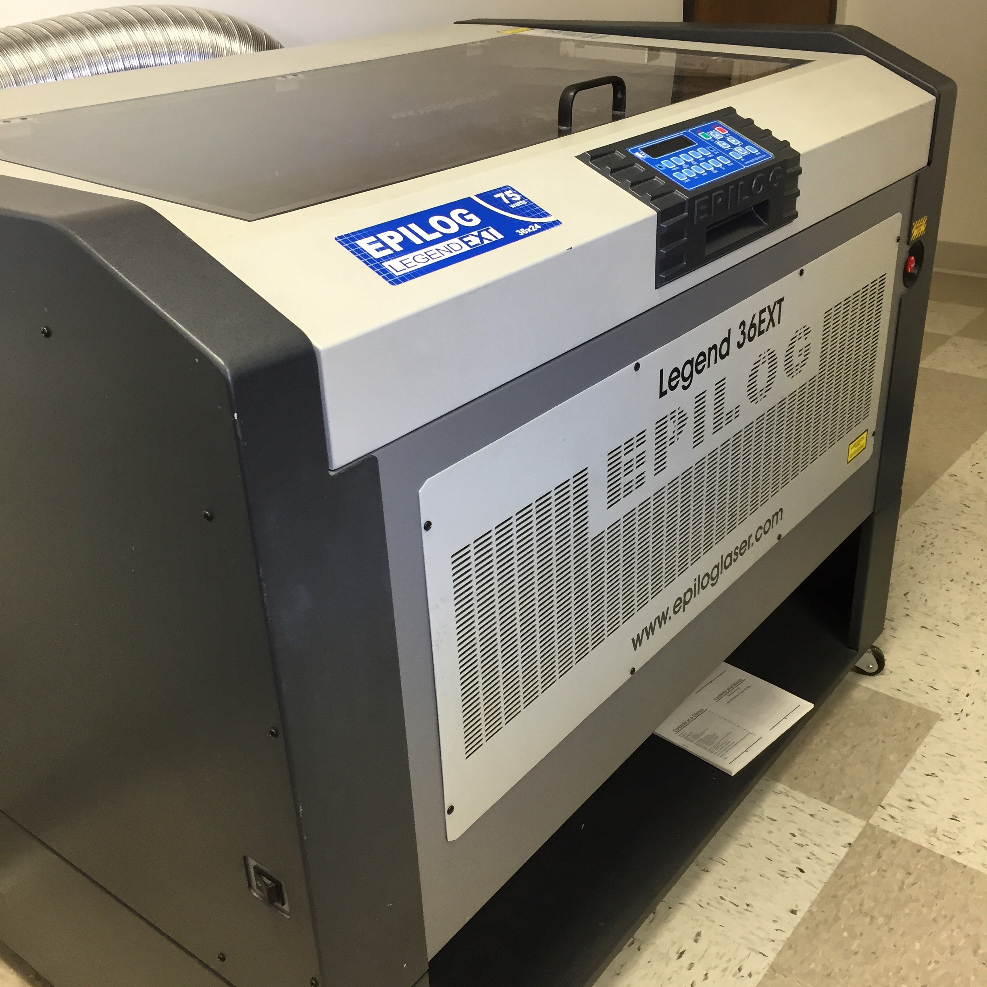
Notes:
Many of them have this. makerbot. 3d printer. hook it up to CAD software, design something print it out using hot plastic.
This isn’t the end-all. But it is a HUGE game-changer.

Slide 21
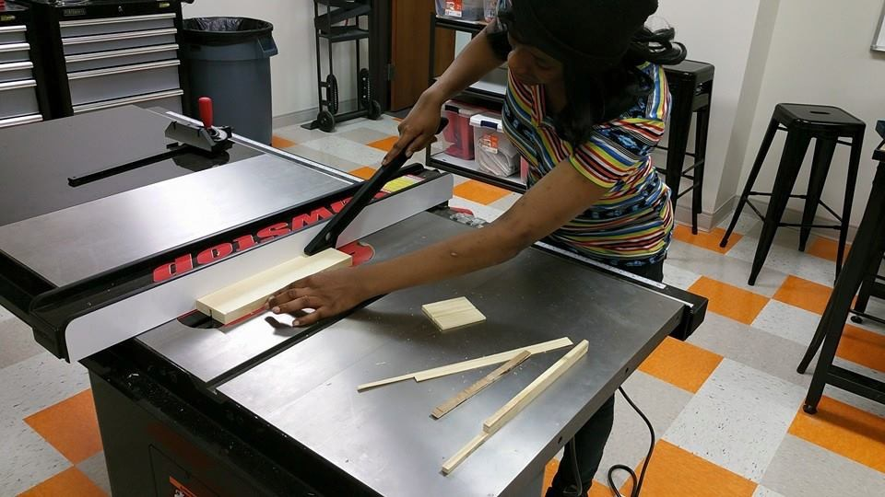
Notes:
Many of them have this. makerbot. 3d printer. hook it up to CAD software, design something print it out using hot plastic.
This isn’t the end-all. But it is a HUGE game-changer.

Slide 22
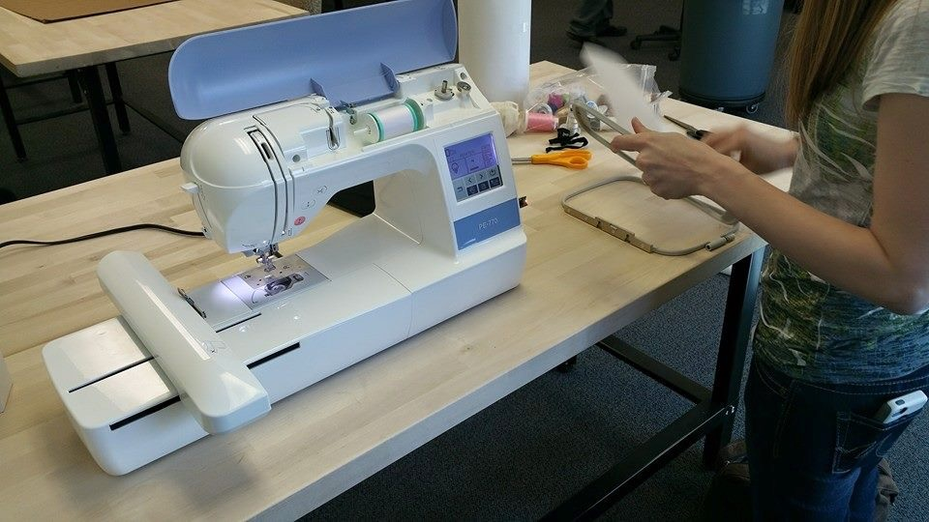
CNC router
normal shop tools
drill presses
vacuum cleaner
CAD/CAM software
computers
more than
3D printers
scroll saws
laser cutters
power tools
Notes:
lots more tools than just a 3d printer!

Slide 23
Digital Media Labs
flickr.com/photos/skokiepl/4058219993/
Notes:
What happens here?
Similar to hackerspaces, but for media making. People who want to create videos, music, graphic design, podcasts.
Again, not always great to do where you live, and you can spend thousands to create a home studio. Good mics, keyboards, computers, etc.
And space for recording.

Slide 24
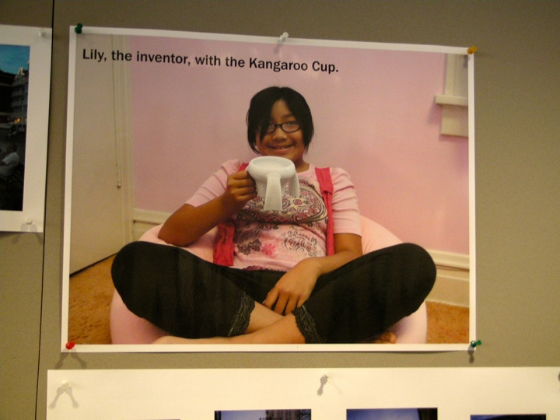
Notes:
10-year-old Lily Born set out to design a cup that her grandfather (who has Parkinson’s disease) could use without spilling. After working with her dad (entrepreneur Joe Born) on a design, and creating many prototypes at local art space Bughouse Studio, she came up with the Kangaroo Cup, a stackable, easy-to-grab coffee mug.
Made a video for Indiegogo (crowdsourced fundraising site like Kickstarter), raised over $12,000.
Made the video at the digital media lab.

Slide 25
flickr.com/photos/skokiepl/4058219993/
Notes:
What happens here?
Similar to hackerspaces, but for media making. People who want to create videos, music, graphic design, podcasts.
Again, not always great to do where you live, and you can spend thousands to create a home studio. Good mics, keyboards, computers, etc.
And space for recording.

Slide 26
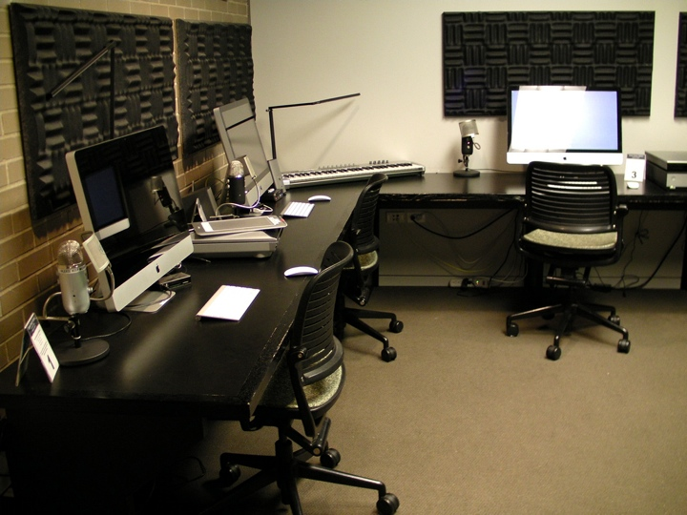

Slide 27
flickr.com/photos/skokiepl/5552496451/
Notes:
skokie public library - here’s their dml. with staff, ready to assist.

Slide 28
flickr.com/photos/skokiepl/3882340882/
Notes:
greenscreen

Slide 29
flickr.com/photos/skokiepl/3890021232/
Notes:
media boxes you can check out.

Slide 30
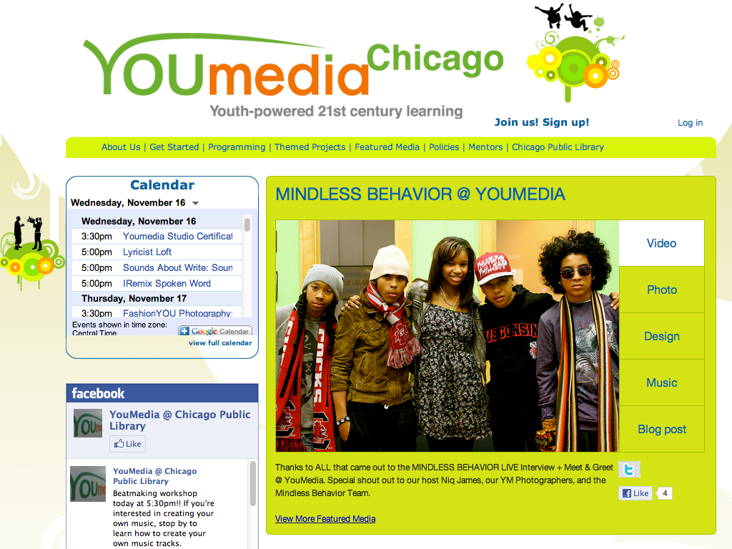
Notes:
High school - access thousands of books, over 100 laptop and desktop computers, and a variety of media creation tools and software...
Similar to Skokie, but just for teens with a valid Chicago Public Library card.

Slide 31
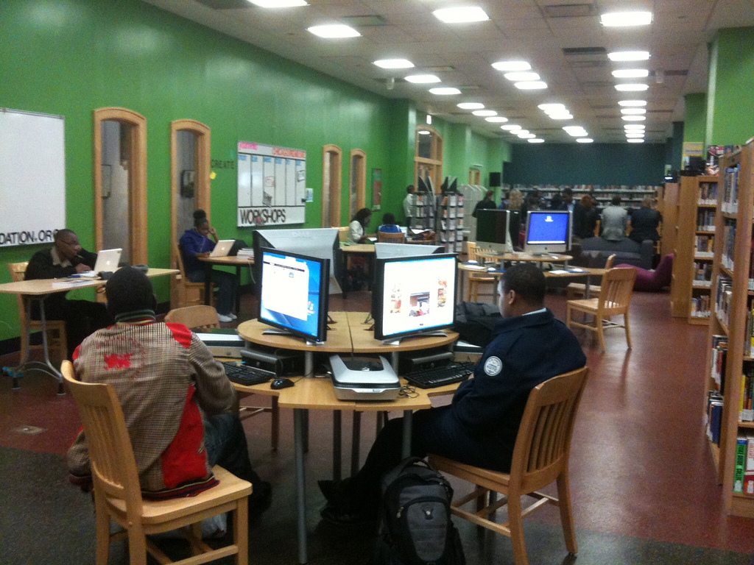
flickr.com/photos/vvvamobile/7237665204/
Notes:
66 mac and pc laptops
cameras, video cameras, software
gaming
music equipment, mics
small recording studio

Slide 32
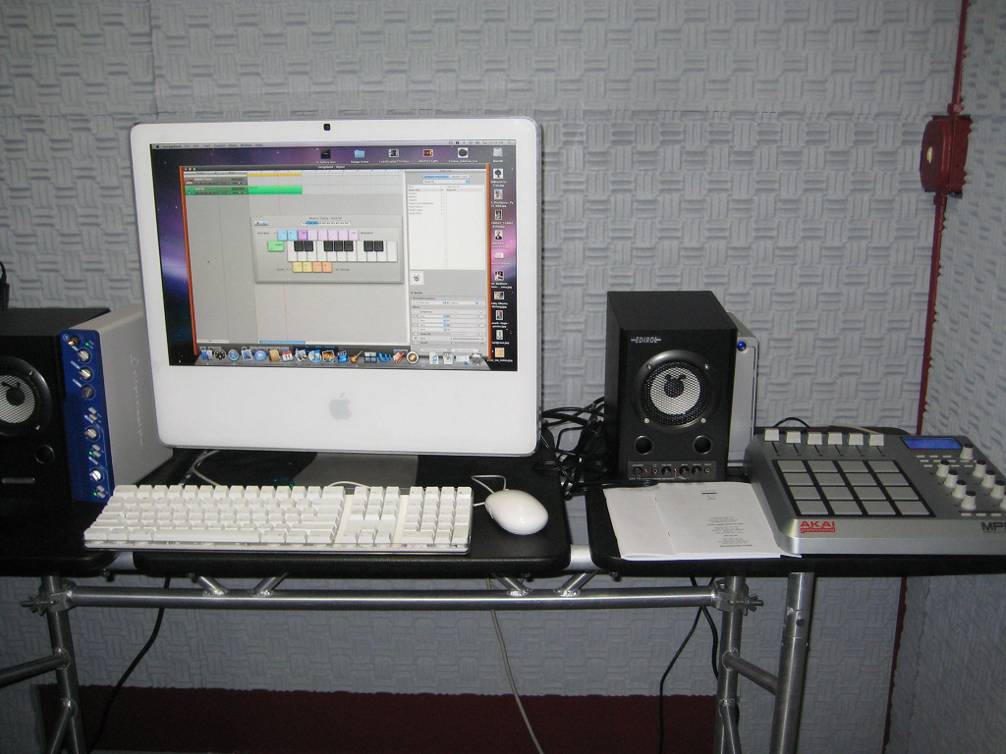
flickr.com/photos/kongtemplation/3717885164/
Notes:
someone creating some cool music!

Slide 33
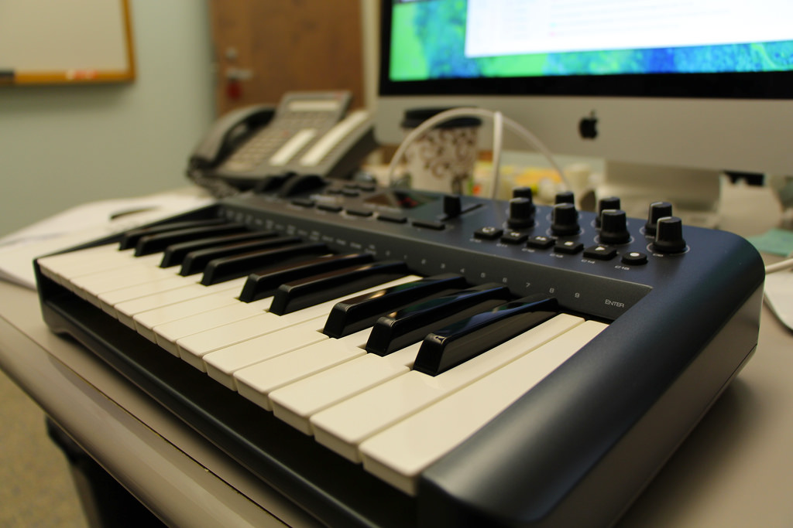
Notes:
Testing equipment for my library’s upcoming makerspace/media lab. Opening in December!

Slide 34
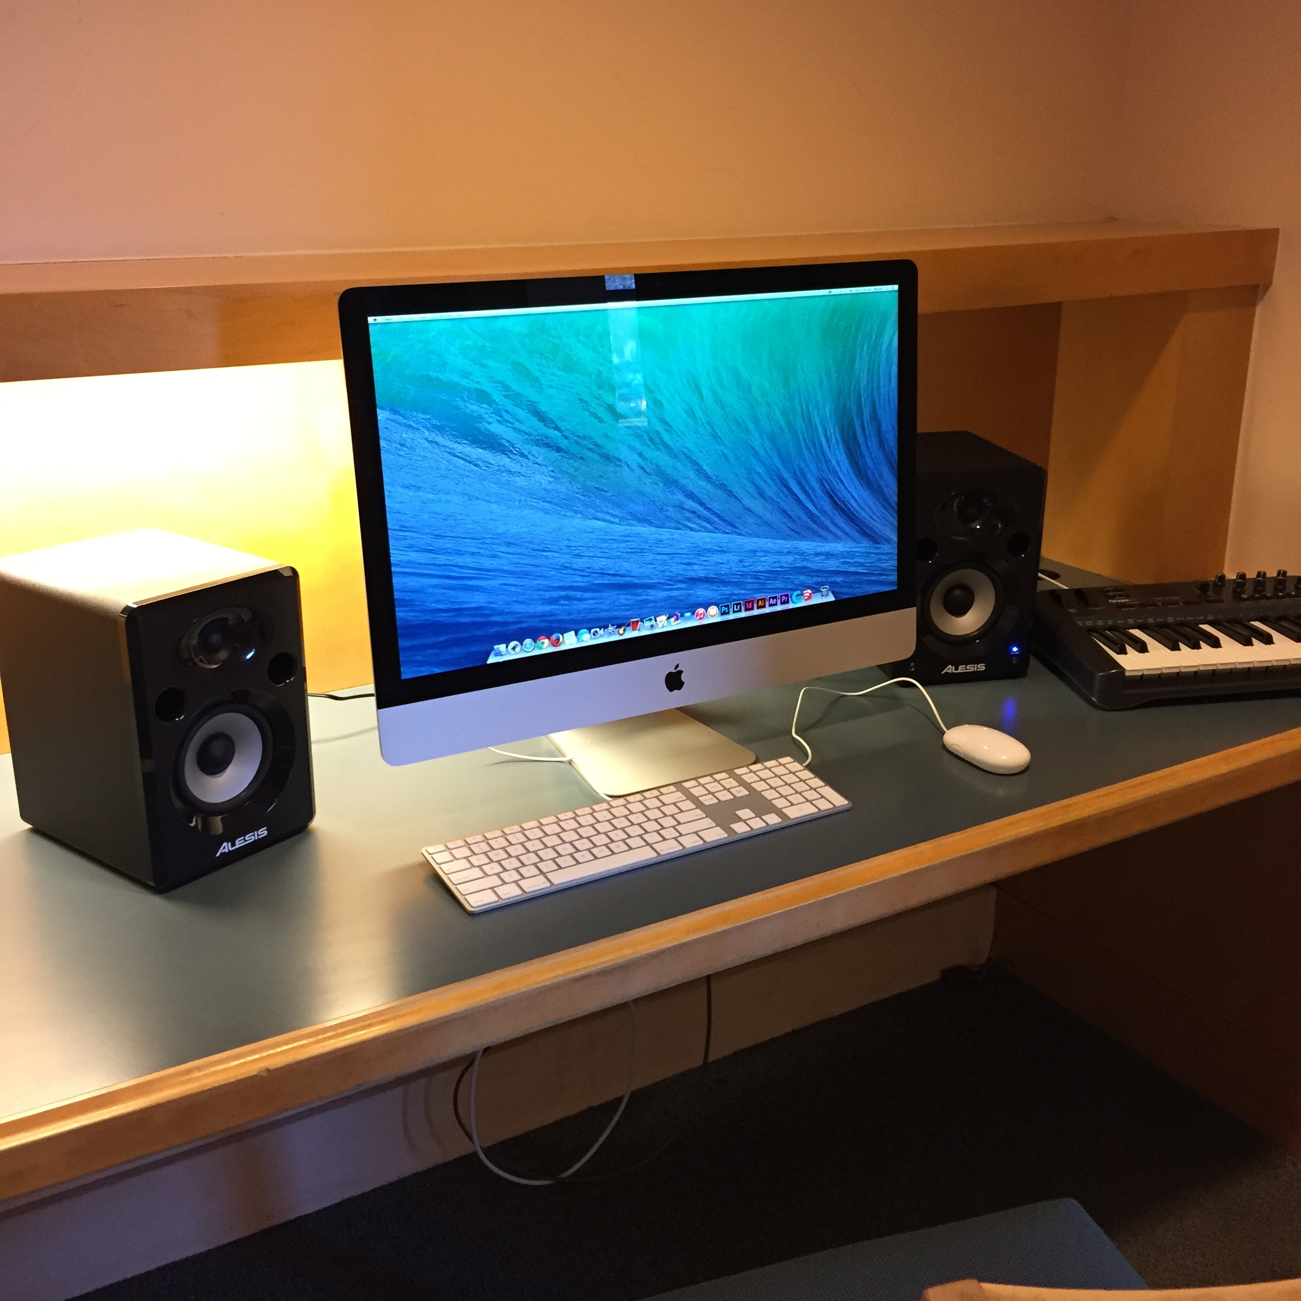
Notes:
Testing equipment for my library’s upcoming makerspace/media lab. Opening in December!

Slide 35
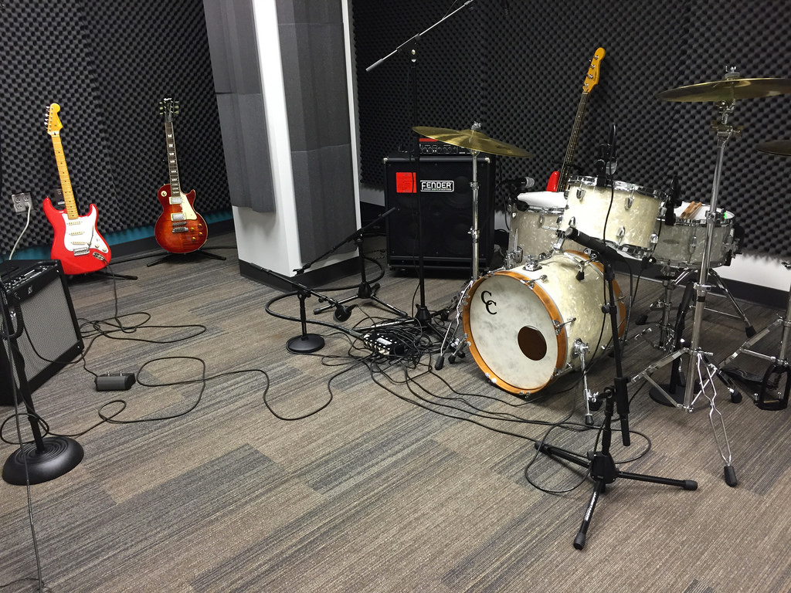
Notes:
Lawrence Public Library - full recording studio, complete with recording engineer.

Slide 36
Co-Working spaces
flickr.com/photos/madrideducacion-es/6850575857/
Notes:
Co Working spaces - independent workers, small businesses, corporate workgroups can gather to share ideas, team up on projects, and get some work done in a more social setting. Alternative to meeting at home or local coffee shop
Meetingpoint - This Helsinki City Library location is across the street from Library 10 in a building full of stores and cafes.
There are no materials to browse or check out.
People bring in their computers to the Laptop Doctor for repair and for lessons. Most of the interactions are one-on-one but there’s a Laptop Club during which many people gather for instruction.

Slide 37
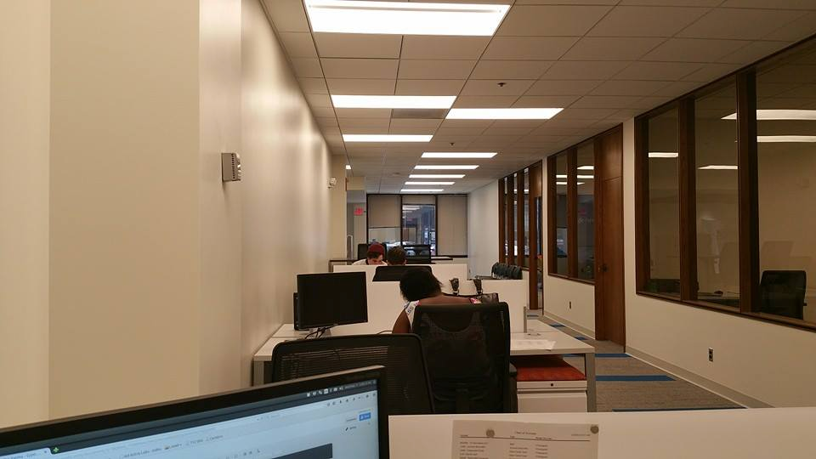
Notes:
Co Working spaces - independent workers, small businesses, corporate workgroups can gather to share ideas, team up on projects, and get some work done in a more social setting. Alternative to meeting at home or local coffee shop
Meetingpoint - This Helsinki City Library location is across the street from Library 10 in a building full of stores and cafes.
There are no materials to browse or check out.
People bring in their computers to the Laptop Doctor for repair and for lessons. Most of the interactions are one-on-one but there’s a Laptop Club during which many people gather for instruction.

Slide 38
other
cool
stuff
Notes:
makerspaces, digital media labs, coworking spaces. Those are the big things that lots of libraries are getting interested in doing.
Libraries are doing a lot of other creation-based stuff! Some very unique things. Here are some of them:

Slide 39
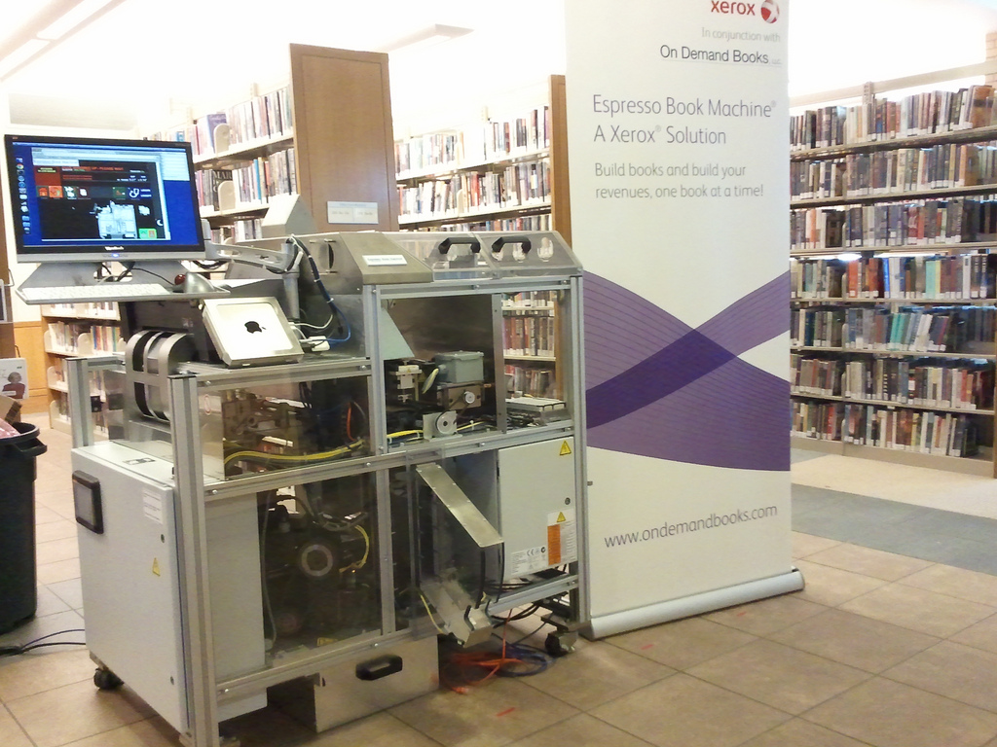
flickr.com/photos/darienlibrary/6280965372/
Notes:
espresso book machine at Darien Library. Prints a book in about 10 minutes. The library doesn’t have it?
The machine takes as input a PDF file and prints, binds, and trims the reader’s selection as a paperback book.
Why not print it out and take it home? Cool concept.

Slide 40
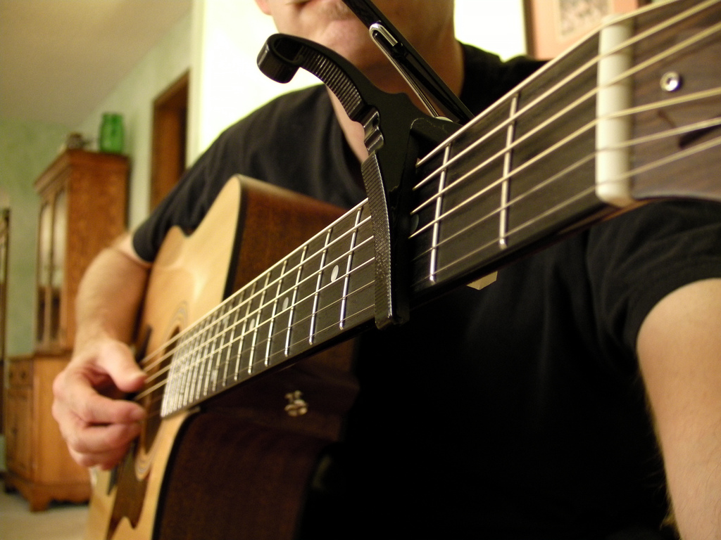
check out guitars!
Notes:
checking out musical instruments! Some libraries are checking out instruments like guitars. Pretty cool idea.
Lots you could do around that - partnerships, classes, content creation...

Slide 41
Notes:
Ann Arbor - checking out electronic music stuff, like this Korg Monotron. It makes weird noises that people might use in EDM.
Right in their catalog!

Slide 42
Notes:
Seeds! Why not?

Slide 43
Notes:
What to do with those seeds? How about checking out some land?

Slide 44
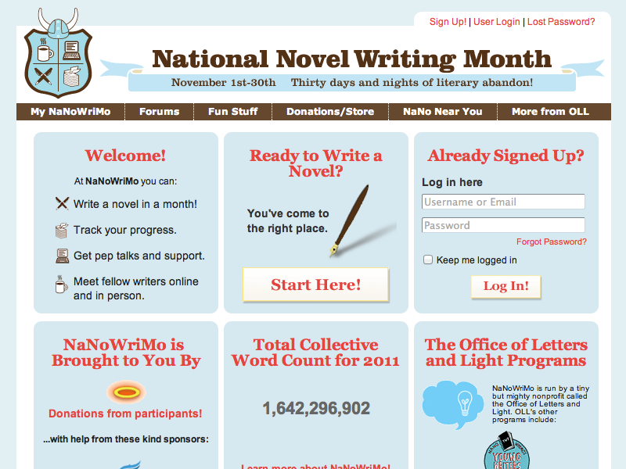
Notes:
other types of content creation - something we do! Mentioned already...
write 40,000 words in a month
365 - take a photo a day (they get creative)
normal blogs, photos, videos dumped to youtube
libraries participate in this type of thing, too.
This is all forms of content creation by customers.

Slide 45
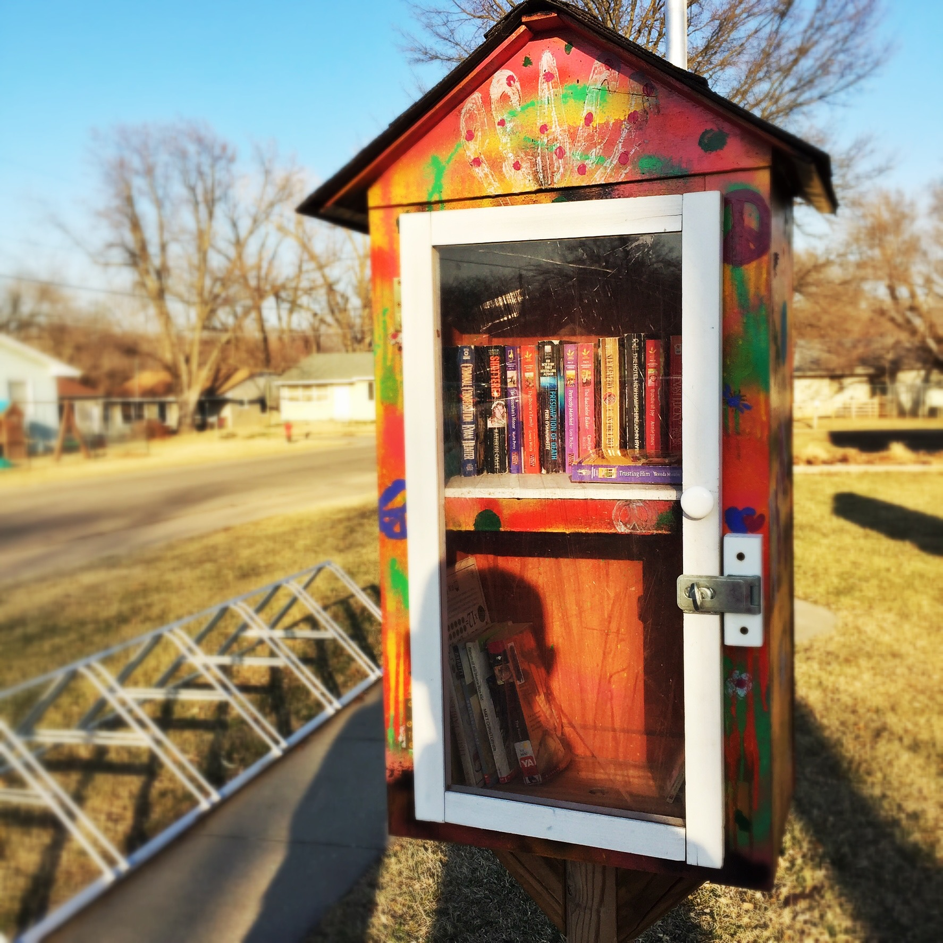
Notes:
other types of content creation - something we do! Mentioned already...
write 40,000 words in a month
365 - take a photo a day (they get creative)
normal blogs, photos, videos dumped to youtube
libraries participate in this type of thing, too.
This is all forms of content creation by customers.

Slide 46
What’s this mean for the library?
Notes:
How does grassroots technology affect libraries? In order to directly incorporate these trends into your library building, you might need to carve out physical space. A great example of this is the Chattanooga Public Library’s 4th floor. It was a storage area, but is now being turned into an interactive space. The library describes their vision as: “a public laboratory and educational facility with a focus on information, design, technology, and the applied arts. The 14,000 sq foot space hosts equipment, expertise, programs, events, and meetings that work within this scope. While traditional library spaces support the consumption of knowledge by offering access to media, the 4th floor is unique because it supports the production, connection, and sharing of knowledge by offering access to tools and instruction” (from http://4thfloor.chattlibrary.org/about).
How can your library respond to grassroots technology? Ask patrons what new things they would like to do in the library. Find out if your library customers want technology like 3D printers, digital media labs, or podcasting equipment.
Your library could also start buying some of these grassroots technology tools for staff to use. If your budget doesn’t allow for this, you can ask staff to bring in personal devices for a “show and tell” day.

Slide 47
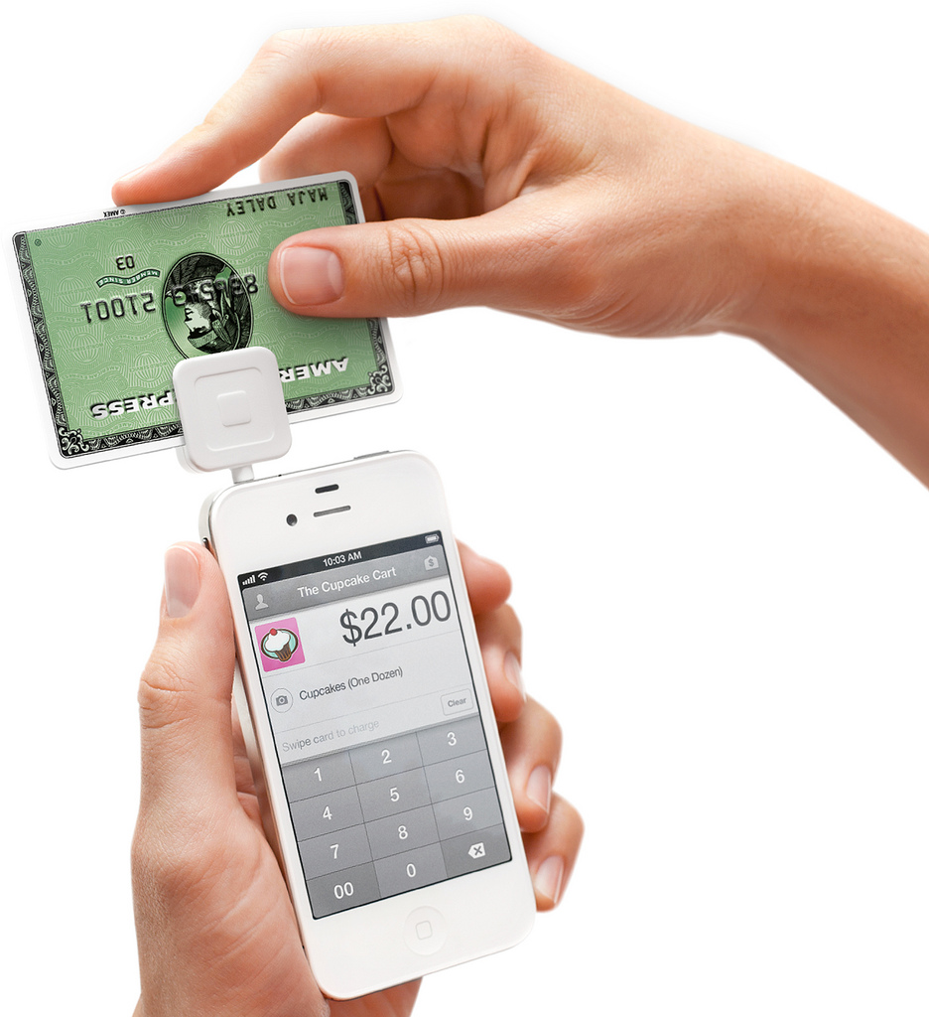
7
Payment
Systems
flic.kr/p/bm7FGx
Notes:
Huge changes here!
What have you seen?
Pay using Paypal account at a Dollar Store.
Apple Pay anyone?

Slide 48
flic.kr/p/bm7FGx
Notes:
mobile devices for payment. Friends sales, coffee shops, Apple stores. My son’s hairstylist! Vendors this week at the weekly farmers market thing…

Slide 49
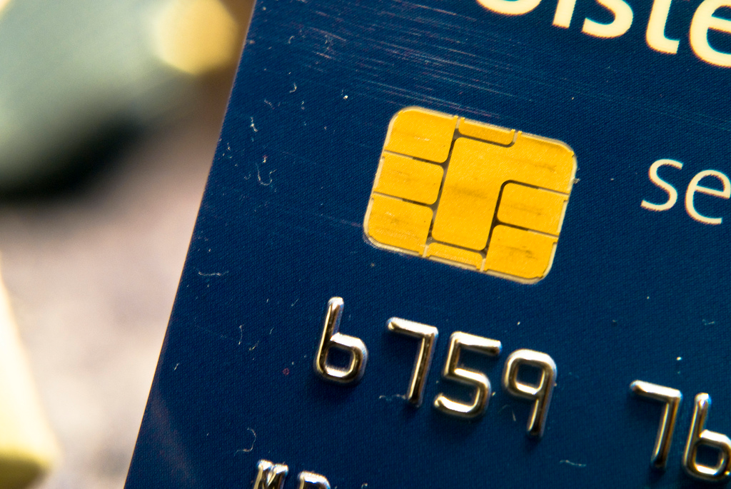
flic.kr/p/64Fobe
Notes:
Something you’ve dealt with -
Chip - changing the way we pay everything.

Slide 50
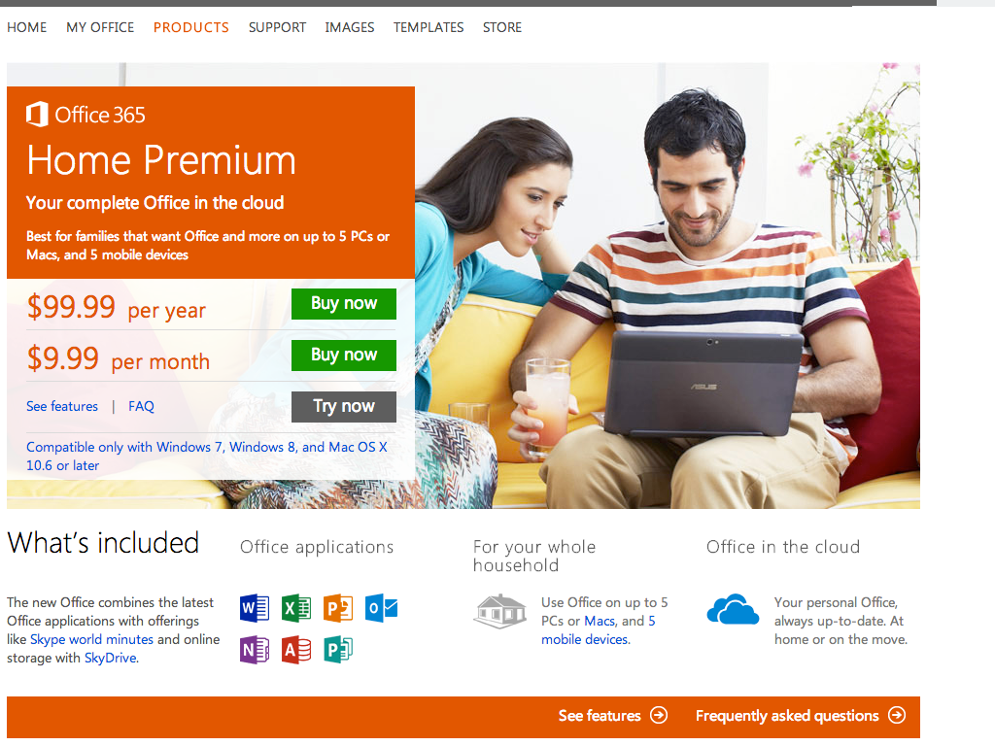
Notes:
Microsoft Office or Adobe Creative Cloud?
Spotify - subscribing to music instead of buying.
subscription model - MS! Adobe! Apple! - no more skipping upgrades. No more large upfront outlay of cash.

Slide 51
What’s this mean for the library?
flic.kr/p/bm7FGx
Notes:
Taking payment is changing.
You CAN take credit cards - it’s easy.
Cos and chips - have you converted yet? Have to.
What else?

Slide 52
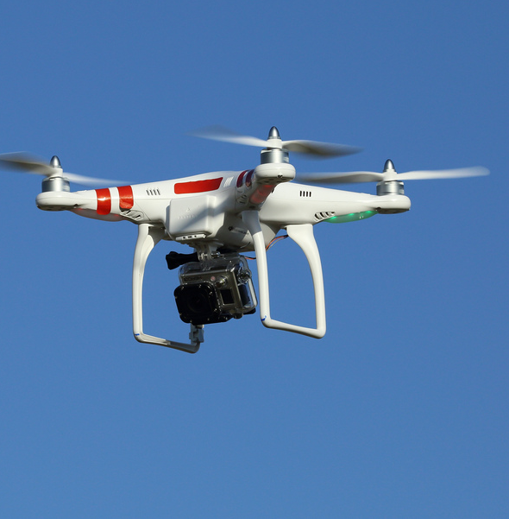
8
Drones!
flic.kr/p/ei1iWe
Notes:
Drones - remote controlled flying thing with a camera
military - obvious uses
aerial photos and videos
Amazon and other companies - delivery
park rangers - help catch poachers
crop monitoring
3d mapping
search and rescue - can check hard-to-reach places

Slide 53
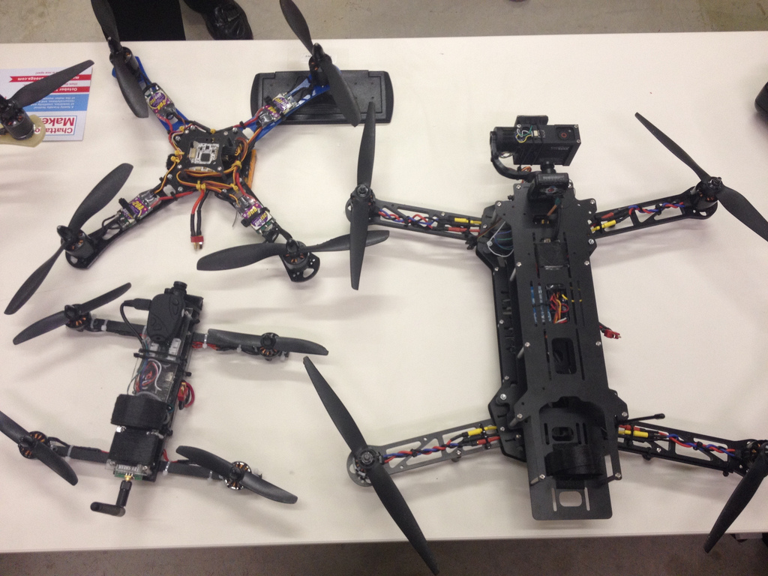
flic.kr/p/nJCn8s
Notes:
National Day of Making @4thfloorchatt
In celebration of President Obama's National Day of Making on June 18, the Mayor's office, the public library and a selection of community makers hosted the Mayor's Maker Challenge on the 4th Floor, open to the public for demos and hands-on learning and making all morning. The event included photography drones, a banana piano, quad copters, 3D printing, art bikes, fruit-controlled Tetris, vinyl sticker making, a maker debris field, the history of making in Chattanooga, yarn bombs, LED helium balloons and maze building.
"NOW, THEREFORE, I, BARACK OBAMA, President of the United States of America, by virtue of the authority vested in me by the Constitution and the laws of the United States, do hereby proclaim June 18, 2014, as National Day of Making. I call upon all Americans to observe this day with programs, ceremonies, and activities that encourage a new generation of makers and manufacturers to share their talents and hone their skills."

Slide 54
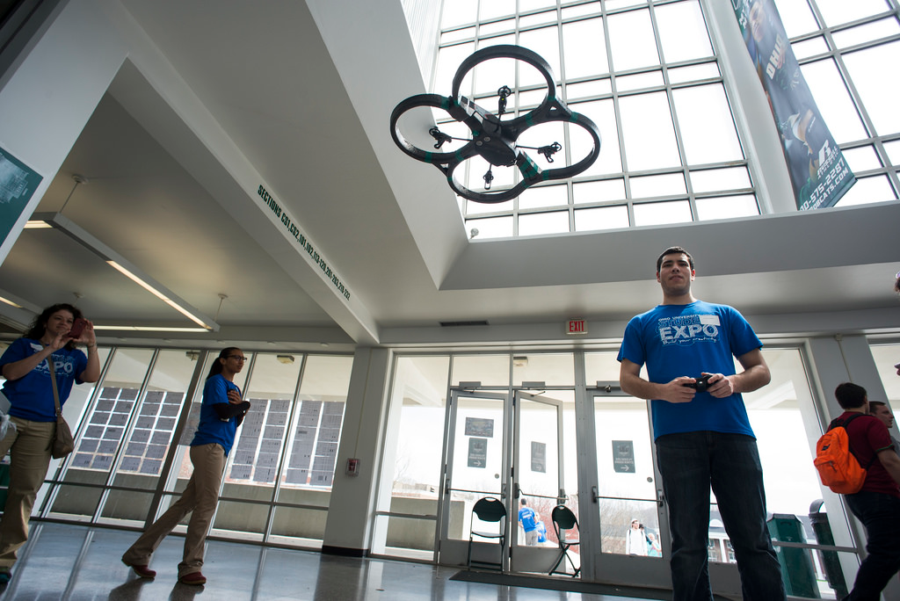
flic.kr/p/rQVsa9
Notes:
Russell Gilabert, a senir in electrical engineering, flys a modified parrot AR Drone during the 2015 Student Expo at the Ohio University Convocation Center on Thursday, April 9, 2015. (Tyler Stabile/ Ohio University Libraries)

Slide 55
flic.kr/p/rQVsa9
What’s this mean for the library?
Notes:
Uses - photos and videos.
check your roof!
fun for teens
making, coming alongside science students
check them out to patrons
what else?

Slide 56
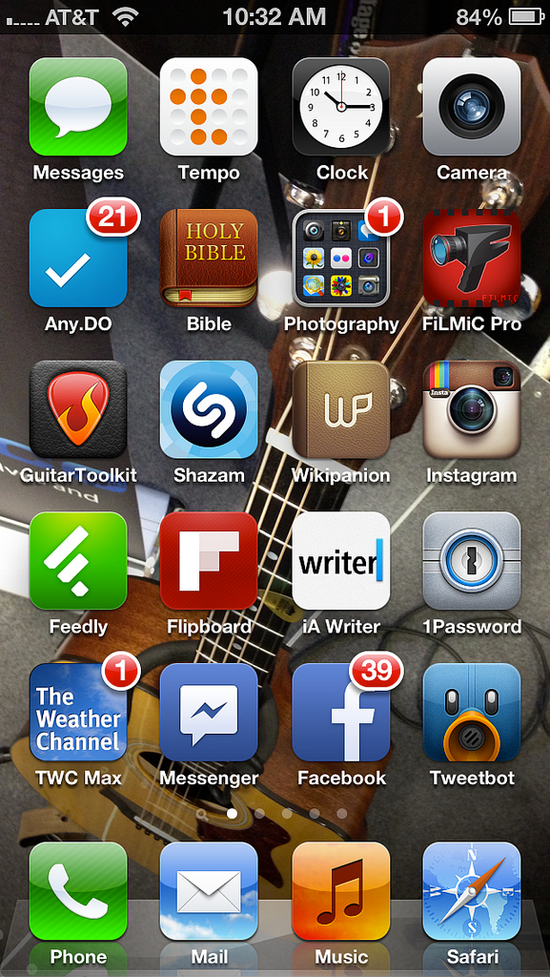
9
Rise of the
App Store
Notes:
Rise of the App Store
Software changes - multiplatform/multiarchitecture applications
android/ios/windows | windows, mac, web | web
mobile and desktop
Polaris LEAP.

Slide 57
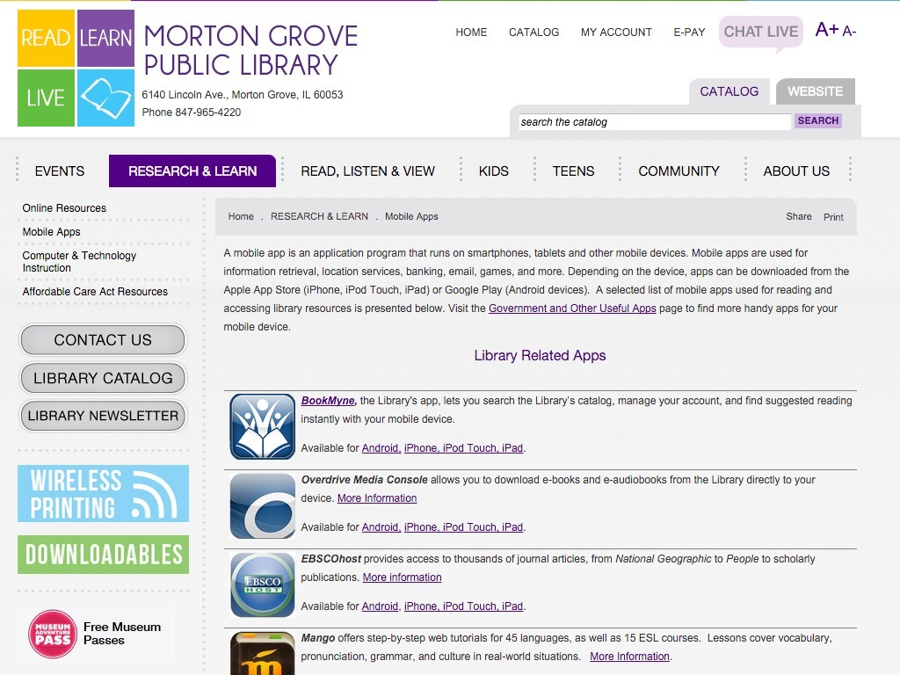
Notes:
Library apps - have a page for those?
You have more than you think!
Apps
plus a couple of app stores
plus instructions on use.

Slide 58
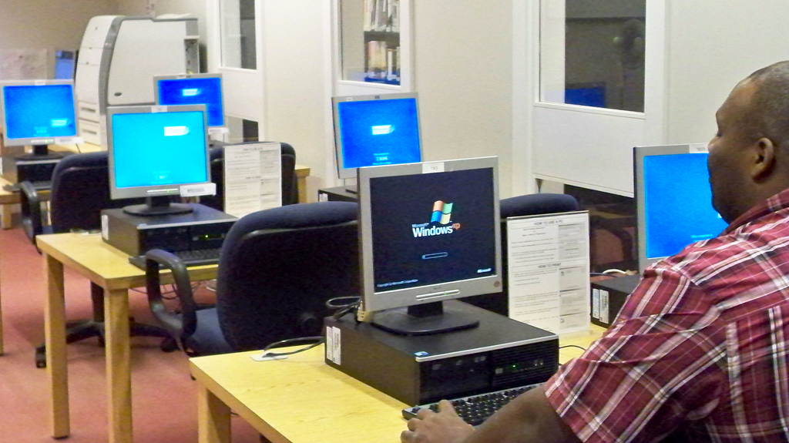
What’s this mean for the library?
flic.kr/p/8C1pWN
Notes:
Training. Lots of it.
For staff! Have to know how our stuff works on a variety of devices, both PC based and mobile.
A ton of mobile platforms. How to navigate the app stores to find library apps.
Always changing! Those are yesterday’s PCs in the pic, for example… I hope so, anyway!

Slide 59
10
Web Changes!

Slide 60

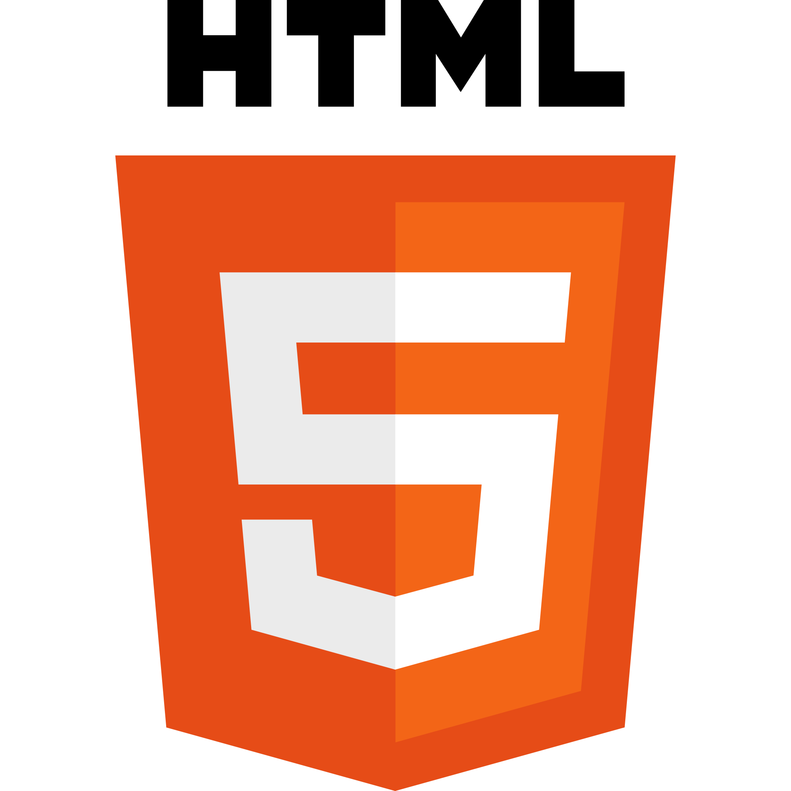
from Wikimedia
Notes:
Adobe Flash - served it’s purpose. Closed, proprietary system on a web that’s increasingly built on open standards.
Apple and Youtube stepped away from flash. Google has been, too.
It’s a plug-in for a web browser. Browser plug-ins are on their way out. Apple’s iOS has never supported plug-ins, Flash is long-discontinued for Android, and the new version of IE for Windows 8 doesn’t support most plug-ins. Chrome will soon be blocking traditional NPAPI browser plug-ins.
HTML5 - major update to HTML that brings a lot of flash-like functionality to the web:
The following is an incomplete list of things that are part of HTML5:
Video: playing video on a website without needing things like Flash.
Audio: playing audio on a website without the need for plugins.
Canvas: using code to automatically draw stuff on a website.
Drag & Drop: dragging and dropping stuff on a website.
Application Cache: storing website content, such as images, on a device, making the site run faster.

Slide 61
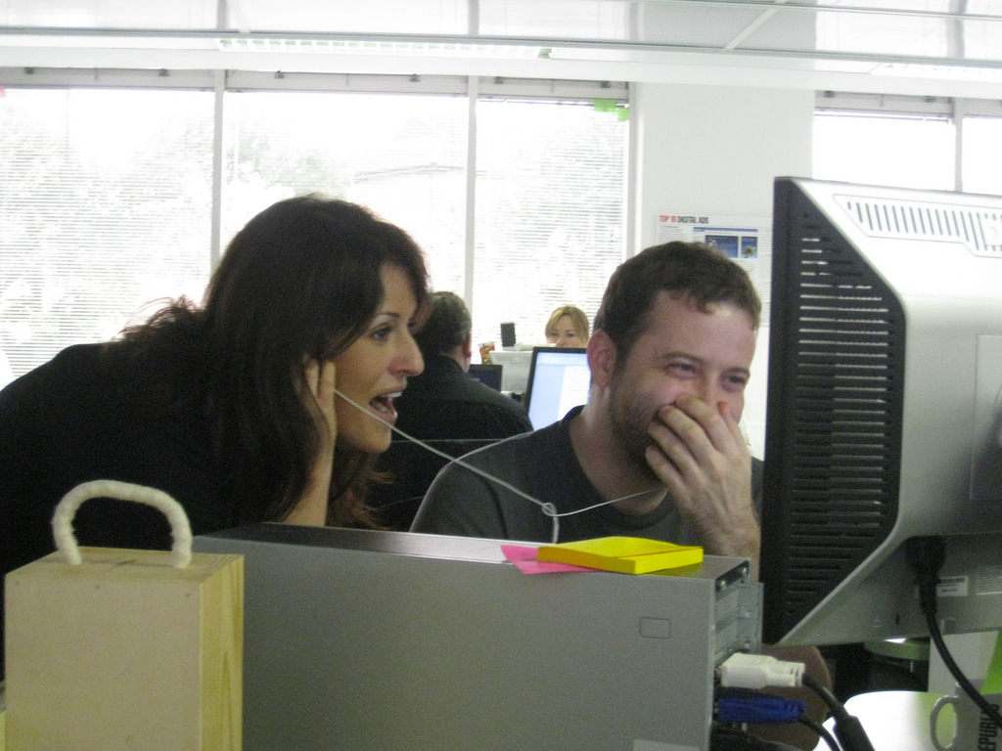
watching video
flic.kr/p/5kovZt
Notes:
itunes, netflix, youtube - DVDs, blu ray - will disappear

Slide 62
listening to music
Notes:
same thing - CDs in libraries ... itunes, pandora, youtube. smartphone players. or streaming from cloud - itunes, google play
listen to band’s new music is easy. Try before you buy. Remember those headphones and CDs at a record store?
The hard thing - checking out a CD at the library. That part’s hard, but how do you listen to it? Might have to download it to iTunes, load it onto your player of choice.
Will we teach that to customers?

Slide 63
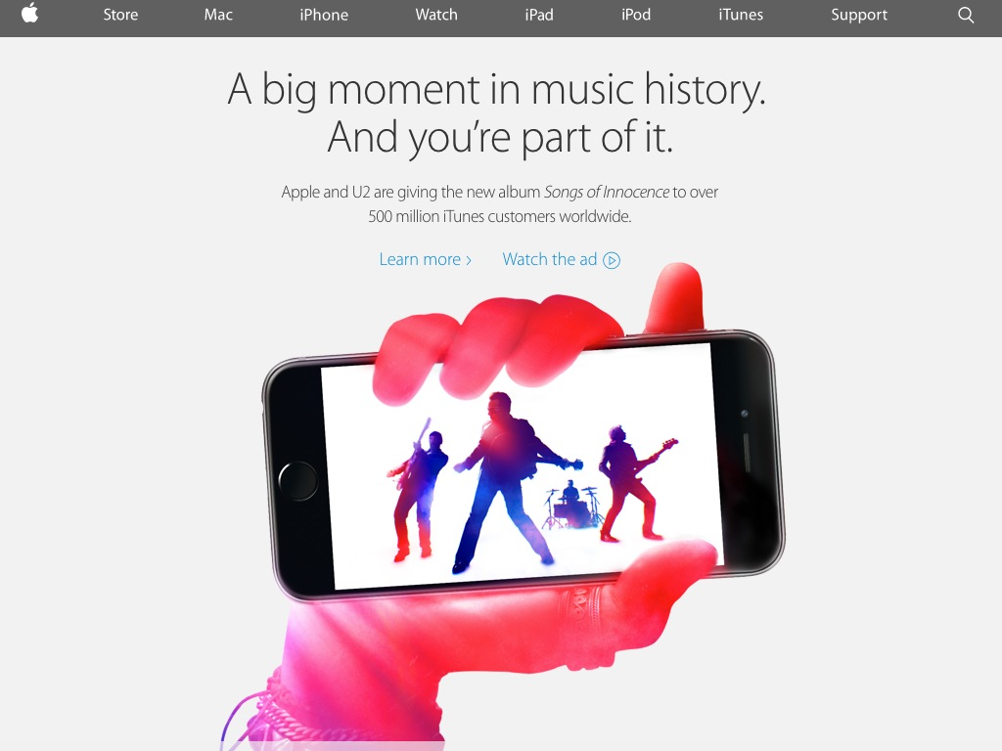
Notes:
boggles my mind. U2 has been working on their new album for a good 2 years. They just gave it away to all Apple iTunes customers! Anyone with an iTunes account just got the album for free (until mid October).
New business model here. I’m sure U2 cut a deal with Apple. And they’ll make money on their tour and with publishing, too. Just very different, and very online.

Slide 64
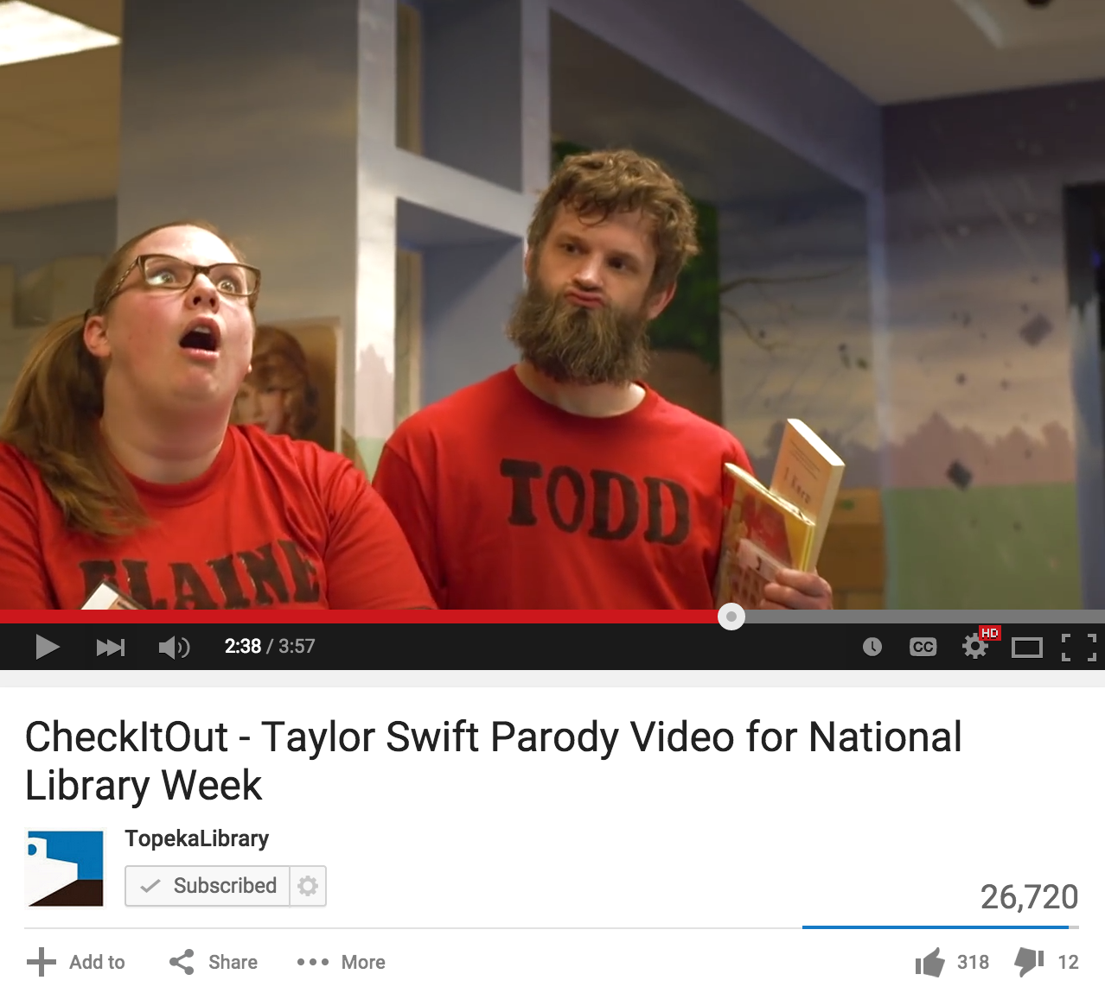
Notes:
Video on the web and on mobile devices - my library :-)
Entertainment - youtube, vine, etc represent a new hollywood. Vine stars!

Slide 65
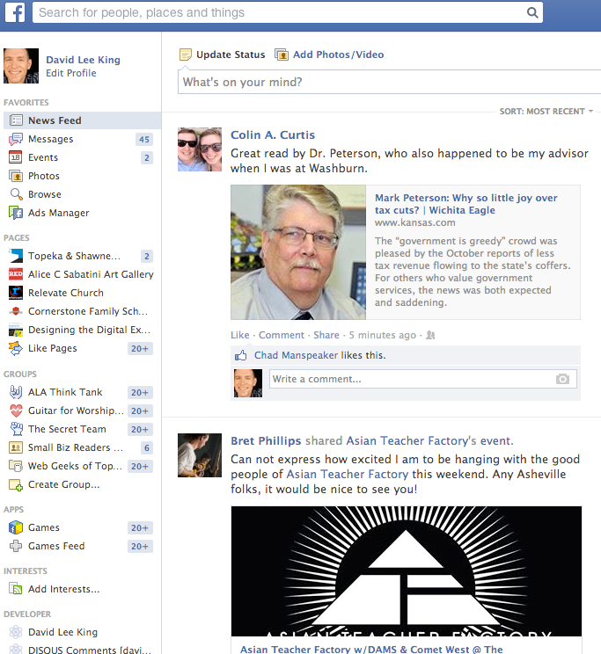
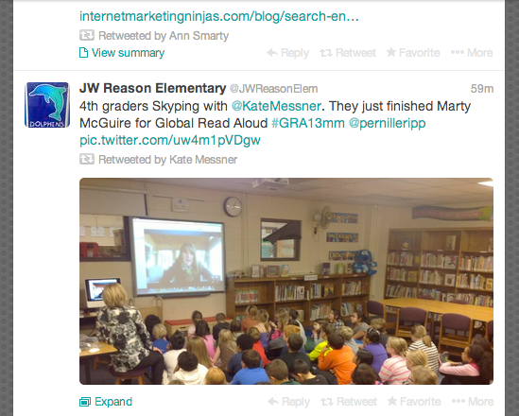
Notes:
Here’s what I mean. Facebook & Twitter as examples. Youtube, flickr, instagram, pinterest, vine... all visual.

Slide 66
78%
of US Adults watch online videos
Notes:
The percent of online adults who watch or download videos has also grown over the past four years, from 69% of adult internet users in 2009 to 78% today.
54% of internet users have posted original photos or videos to websites and 47% share photos or videos they found elsewhere online.
Some 9% of cell phone owners use Snapchat and 18% use Instagram.

Slide 67
every
company
is a media company
Notes:
white house correspondents dinner. we are the same in some ways… Tom Foremski (a journalist) said this first in 2005.
in today’s world, how do you get the news out about your library?
Video, articles, news stories, press releases. going on the news. making videos.

Slide 68
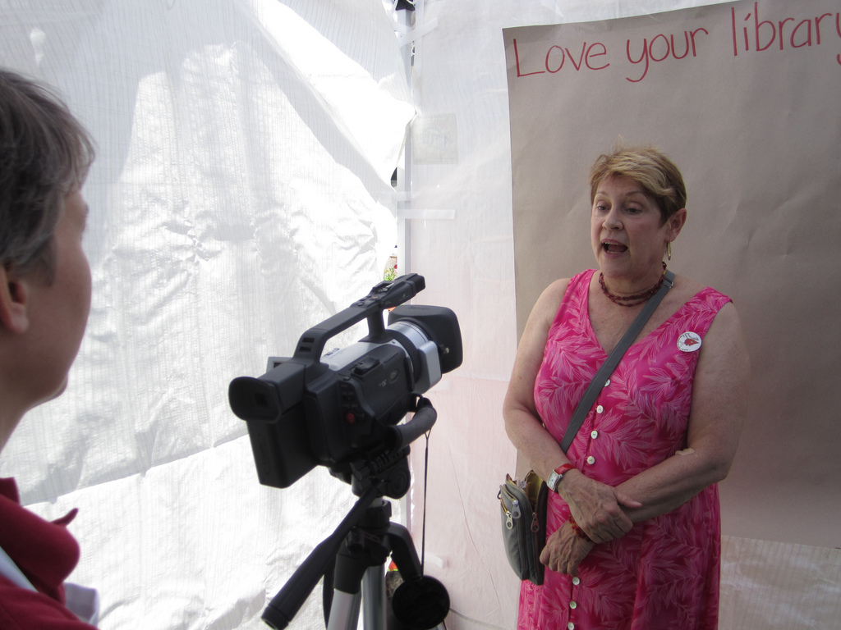
What’s this mean for the library?
flickr.com/photos/oppl/5867907324/
Notes:
Make videos!
Update your website for use. etc…

Slide 69

Trends vs. Fads
flickr.com/photos/tonythemisfit/2592267101/
Notes:
Finally, let’s talk about trends vs. fads. How can we know if something is emerging or submerging?

Slide 70

Fad
flickr.com/photos/slworking/5738159839/
Notes:
here for a short time, then disappears fast. Fun, but no enduring value!
Foursquare, perhaps.
There are also some strong warning signs that an emerging technology tool is more of a fad than a trend:
If a service stops being updated, that’s a strong indicator the service might disappear soon. For example, Google Reader wasn’t significantly updated for years. A few months ago, Google announced that the service is being discontinued this summer.
If no one is using the service, that’s always a good indicator. Myspace is a great example. As newer social media tools appeared, people actively deleted their Myspace accounts or let them go dormant.
The technology might be too difficult to use. For instance, Second Life and Minecraft are both virtual worlds, and both include building things as a major activity. Second Life was difficult to use, and never really became very popular. Minecraft, however, includes similar activities to Second Life, but it’s easy to use, and kids love it. If you work in a public library, I’ll guess that you have customers using Minecraft right now.

Slide 71

Trend
flickr.com/photos/yourdon/3405811164/
Notes:
There are some telltale signs when a trend is emerging. You will definitely hear about the trend in online and traditional media. You might see stickers for the trend on a restaurant door or on the backs of cars. The morning radio DJ or TV personality might mention it. You will also notice library customers start to use and ask about the trend.
A true trend takes time to emerge. As I said earlier, social media is a definite trend. It didn’t appear yesterday. Social media is a good 10 years old, and has changed drastically every couple of years. But the key trend behind ever-changing services - easily communicating online - remains the same.

Slide 72

how to prepare

Slide 73
don’t be held back by tech!
Notes:
don’t be held back by tech!
Do what you can tomorrow
plan for next year
budget
one thing at a time
train staff
hold on for dear life! It’s not slowing down any time soon :-)

Slide 74

thank you!
davidleeking.com
Notes:
Thanks!

Slide 75
Infopeople, a grant project of the Califa Group, is supported in part by the U.S. Institute of Museum and Library Services under the provisions of the Library Services and Technology Act, administered in California by the State Librarian.

